Slide 1
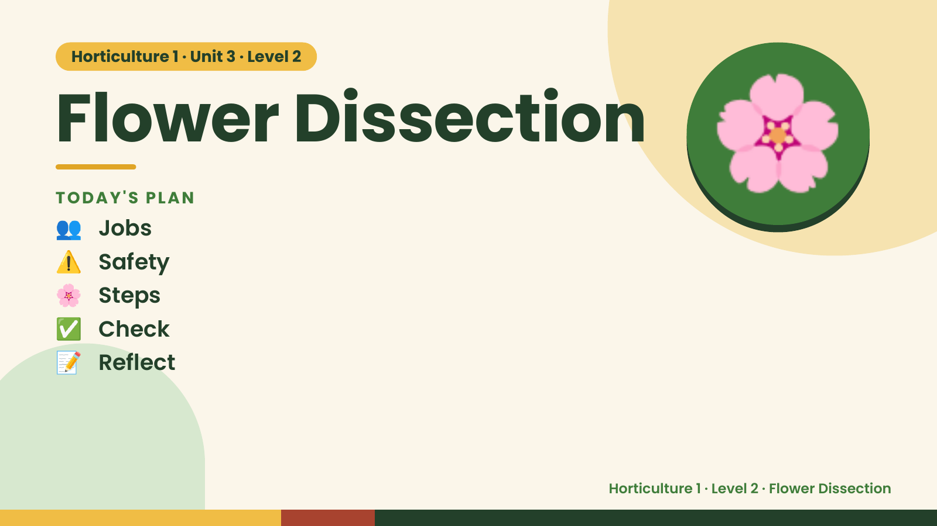
Notes:
Horticulture 1 · Unit 3 · Level 2
Flower Dissection
👥 Jobs
TODAY'S PLAN
⚠️ Safety
🌸 Steps
🌸
✅ Check
📝 Reflect
Horticulture 1 · Level 2 · Flower Dissection

Slide 2

Notes:
Get ready
Jobs
🧑‍🌾 Grower
Does the main plant job
with the tools
🧺 Supply helper
Gets and returns supplies
and tools to staff
📸 Recorder
Takes photos and fills in
the chart
🧽 Clean-up captain
Sweeps, wipes tables,
checks hands are
washed
Horticulture 1 · Level 2 · Flower Dissection

Slide 3
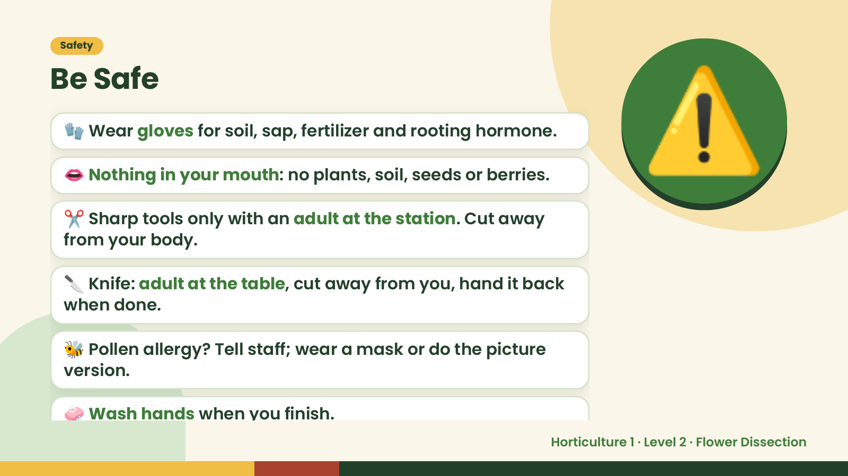
Notes:
Safety
Be Safe
🧤 Wear gloves for soil, sap, fertilizer and rooting hormone.
👄 Nothing in your mouth: no plants, soil, seeds or berries.
✂️ Sharp tools only with an adult at the station. Cut away
from your body.
⚠️
🔪 Knife: adult at the table, cut away from you, hand it back
when done.
🐝 Pollen allergy? Tell staff; wear a mask or do the picture
version.
🧼 Wash hands when you finish.
Horticulture 1 · Level 2 · Flower Dissection

Slide 4
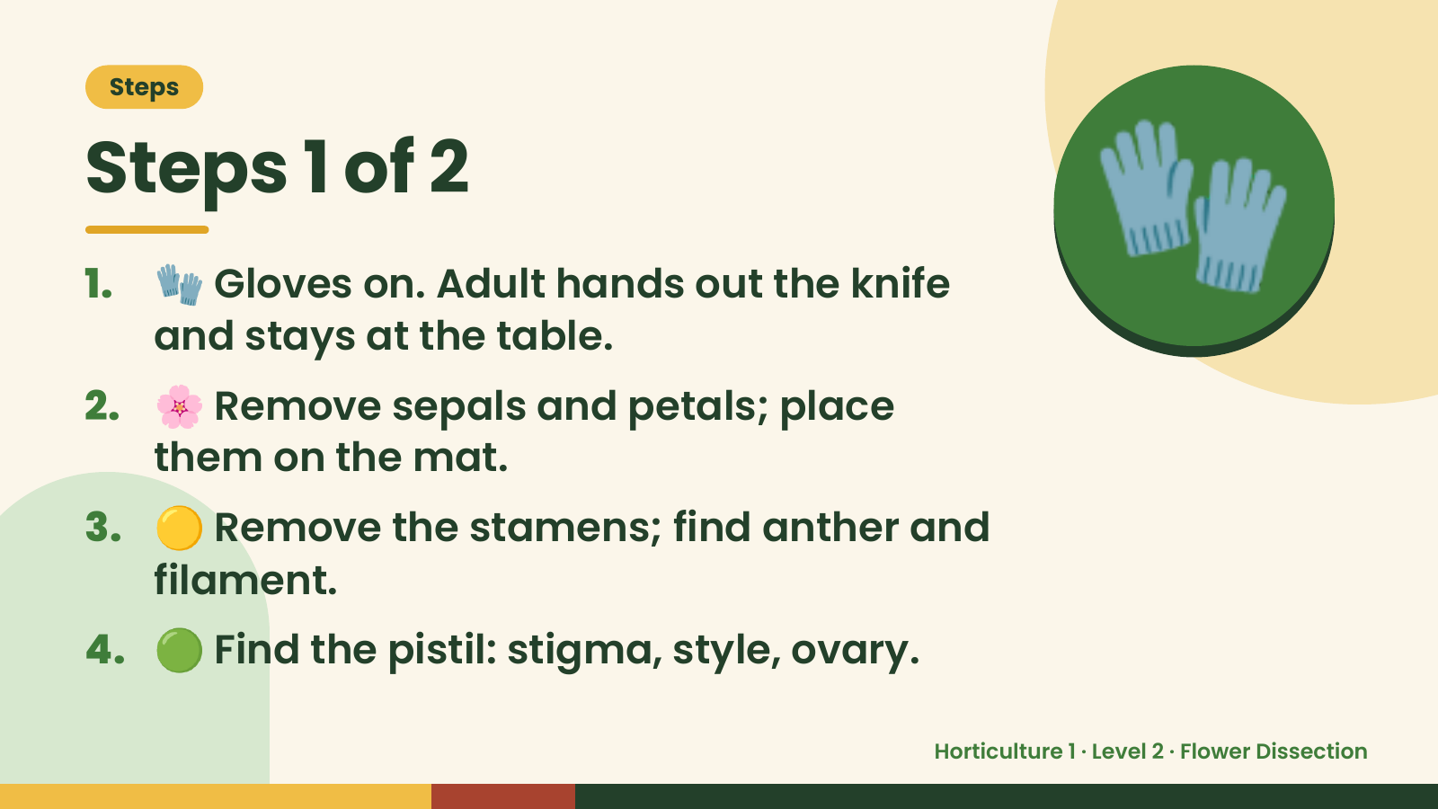
Notes:
Steps
Steps 1 of 2
1. 🧤 Gloves on. Adult hands out the knife
and stays at the table.
2. 🌸 Remove sepals and petals; place
them on the mat.
🧤
3. 🟡 Remove the stamens; find anther and
filament.
4. 🟢 Find the pistil: stigma, style, ovary.
Horticulture 1 · Level 2 · Flower Dissection

Slide 5
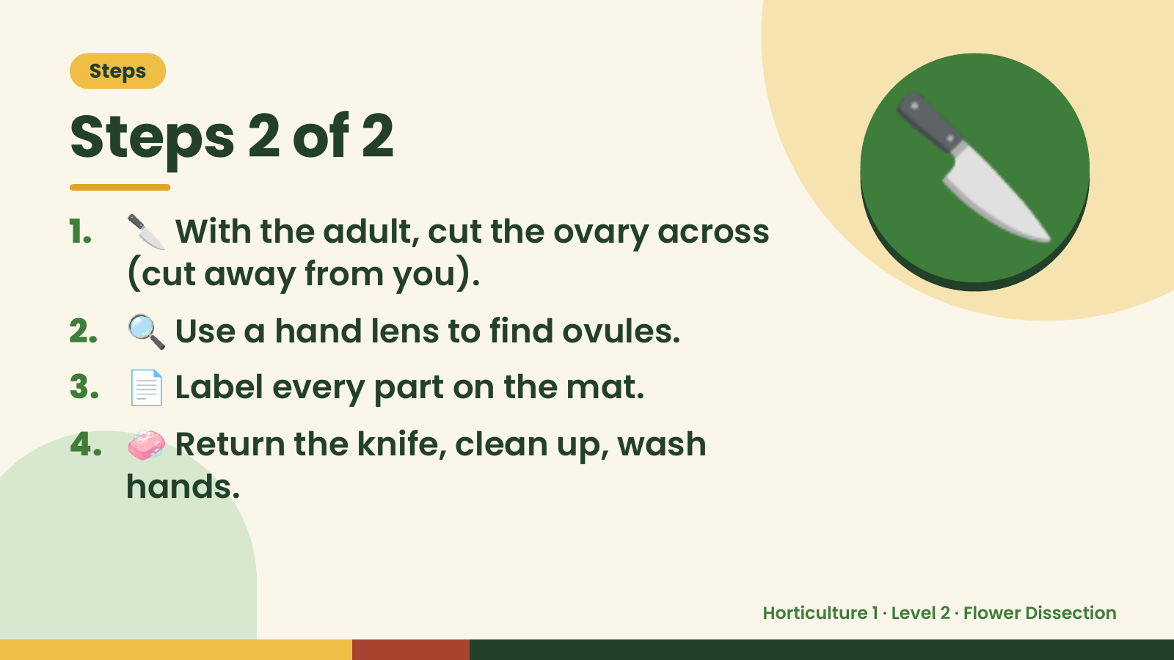
Notes:
Steps
Steps 2 of 2
1. 🔪 With the adult, cut the ovary across
(cut away from you).
2. 🔍 Use a hand lens to find ovules.
🔪
3. 📄 Label every part on the mat.
4. 🧼 Return the knife, clean up, wash
hands.
Horticulture 1 · Level 2 · Flower Dissection

Slide 6
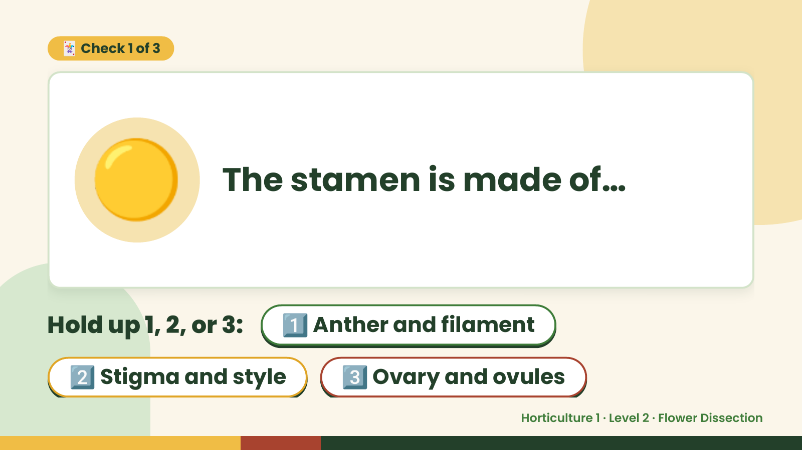
Notes:
🃏 Check 1 of 3
🟡 The stamen is made of…
Hold up 1, 2, or 3: 1️⃣ Anther and filament
2️⃣ Stigma and style 3️⃣ Ovary and ovules
Horticulture 1 · Level 2 · Flower Dissection

Slide 7
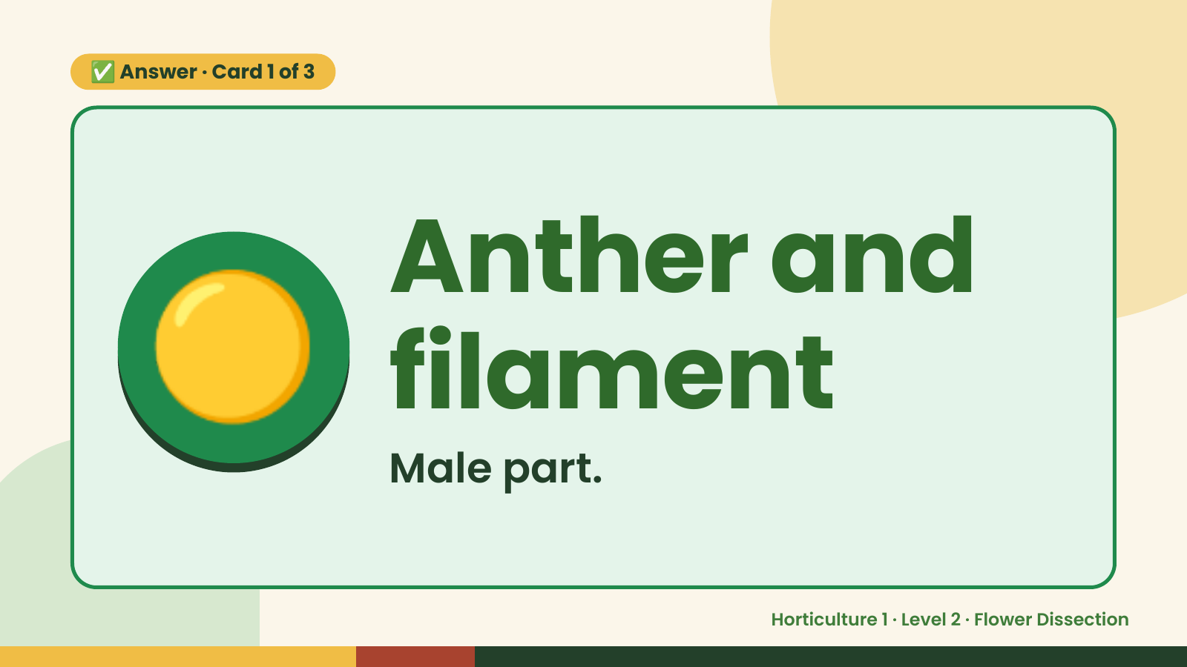
Notes:
✅ Answer · Card 1 of 3
🟡 Anther and
filament
Male part.
Horticulture 1 · Level 2 · Flower Dissection

Slide 8
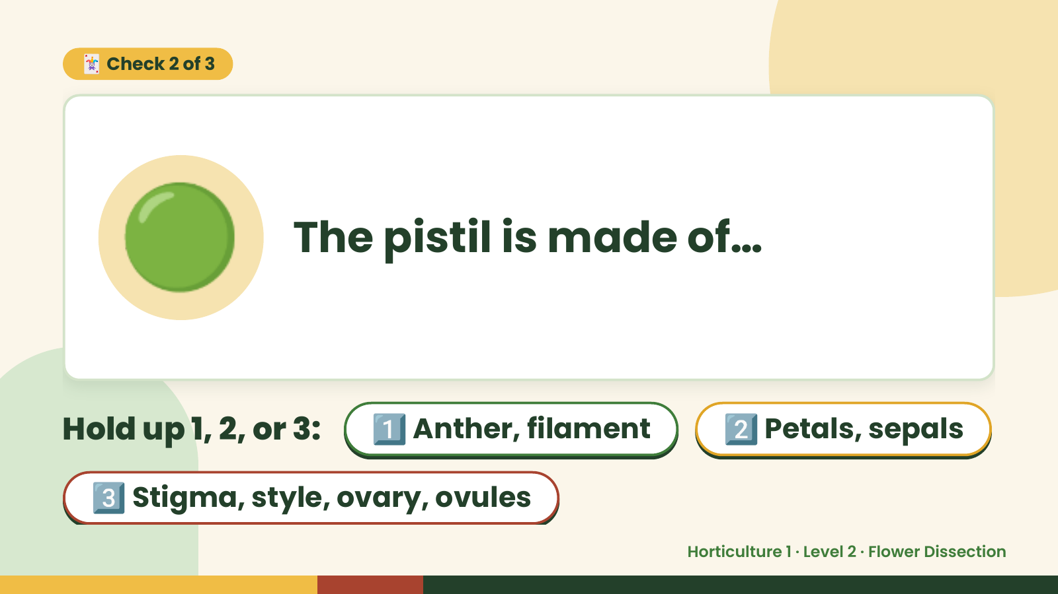
Notes:
🃏 Check 2 of 3
🟢 The pistil is made of…
Hold up 1, 2, or 3: 1️⃣ Anther, filament 2️⃣ Petals, sepals
3️⃣ Stigma, style, ovary, ovules
Horticulture 1 · Level 2 · Flower Dissection

Slide 9
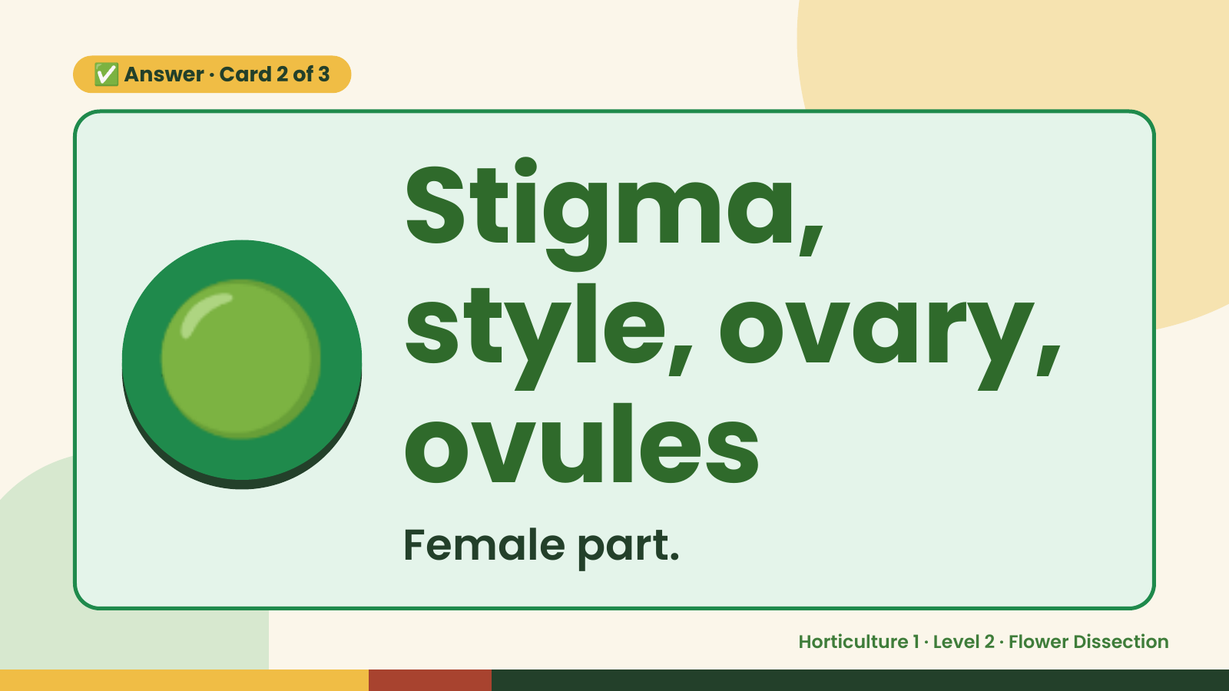
Notes:
✅ Answer · Card 2 of 3
🟢 Stigma,
style, ovary,
ovules
Female part.
Horticulture 1 · Level 2 · Flower Dissection

Slide 10
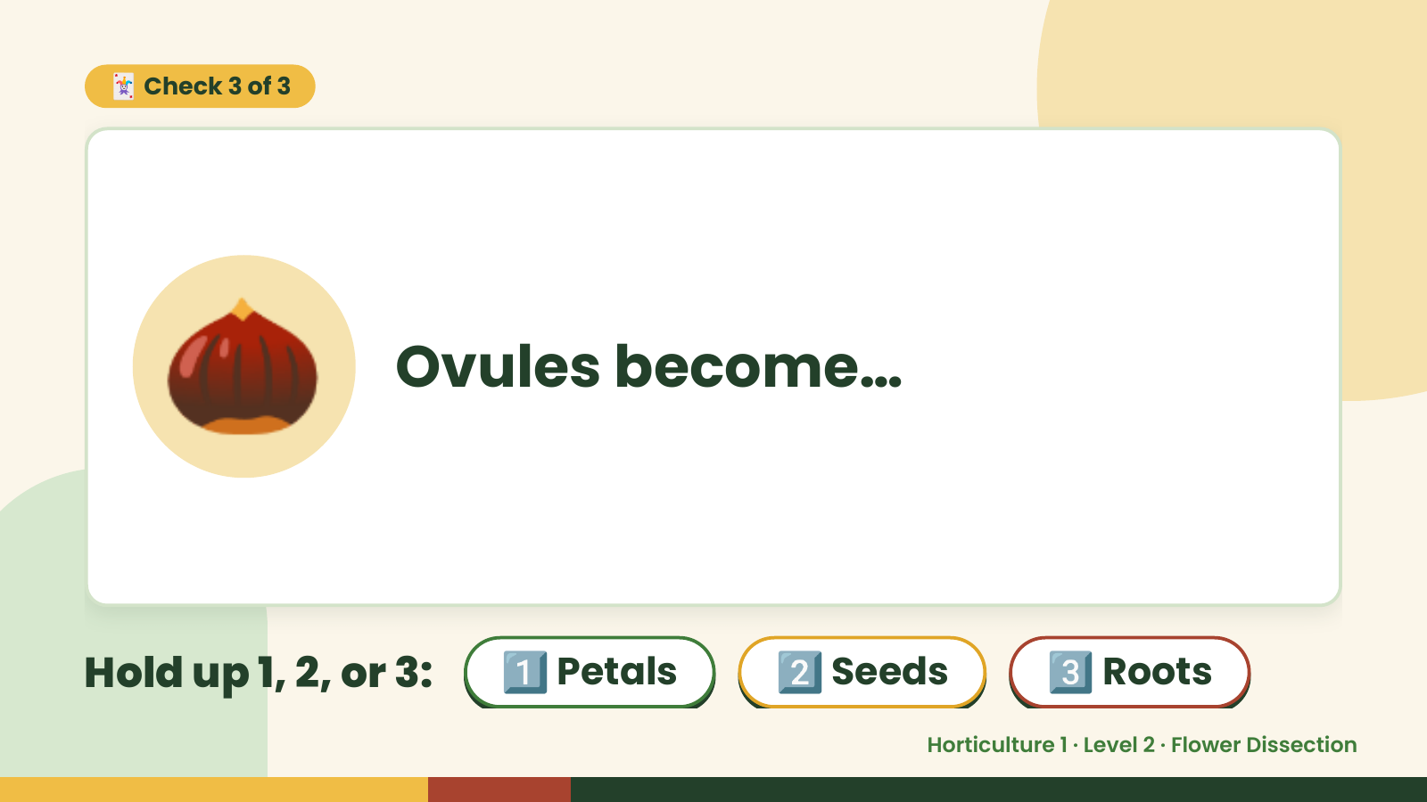
Notes:
🃏 Check 3 of 3
🌰 Ovules become…
Hold up 1, 2, or 3: 1️⃣ Petals 2️⃣ Seeds 3️⃣ Roots
Horticulture 1 · Level 2 · Flower Dissection

Slide 11
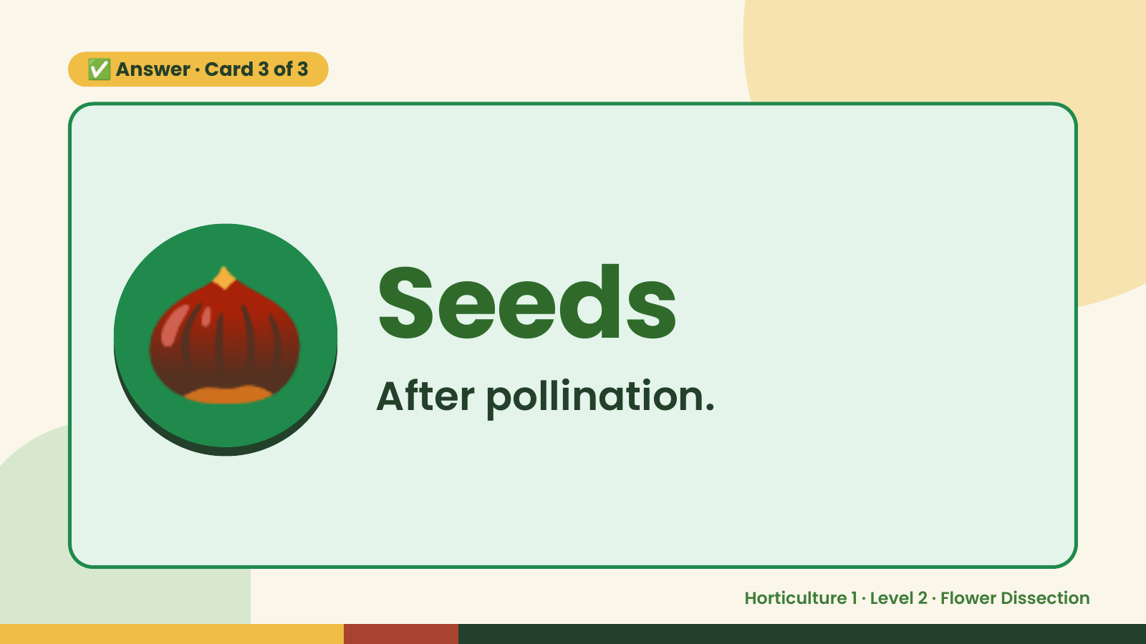
Notes:
✅ Answer · Card 3 of 3
🌰 Seeds
After pollination.
Horticulture 1 · Level 2 · Flower Dissection

Slide 12

Notes:
Wrap-Up
Clean Up +
Reflect
🧽
Return and count tools.
Sweep and wipe your area.
Wash hands, then do the reflection.
Horticulture 1 · Level 2 · Flower Dissection

