Slide 1
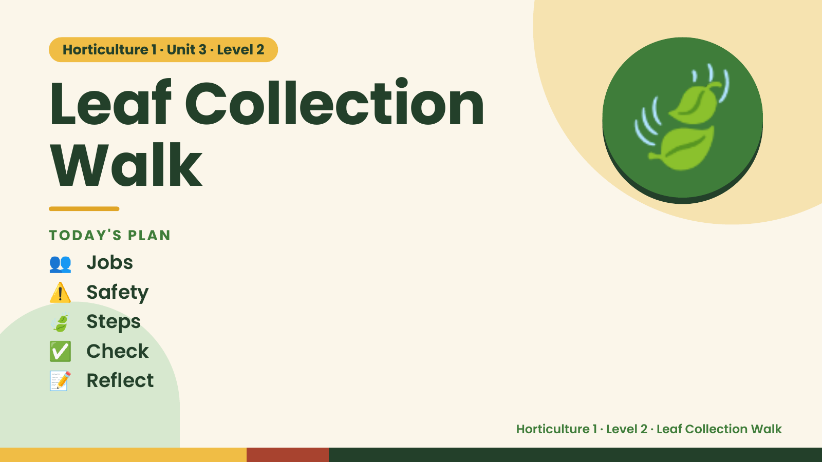
Notes:
Horticulture 1 · Unit 3 · Level 2
Leaf Collection
Walk
👥 Jobs
TODAY'S PLAN
🍃
⚠️ Safety
🍃 Steps
✅ Check
📝 Reflect
Horticulture 1 · Level 2 · Leaf Collection Walk

Slide 2

Notes:
Get ready
Jobs
🧑‍🌾 Grower
Does the main plant job
with the tools
🧺 Supply helper
Gets and returns supplies
and tools to staff
📸 Recorder
Takes photos and fills in
the chart
🧽 Clean-up captain
Sweeps, wipes tables,
checks hands are
washed
Horticulture 1 · Level 2 · Leaf Collection Walk

Slide 3
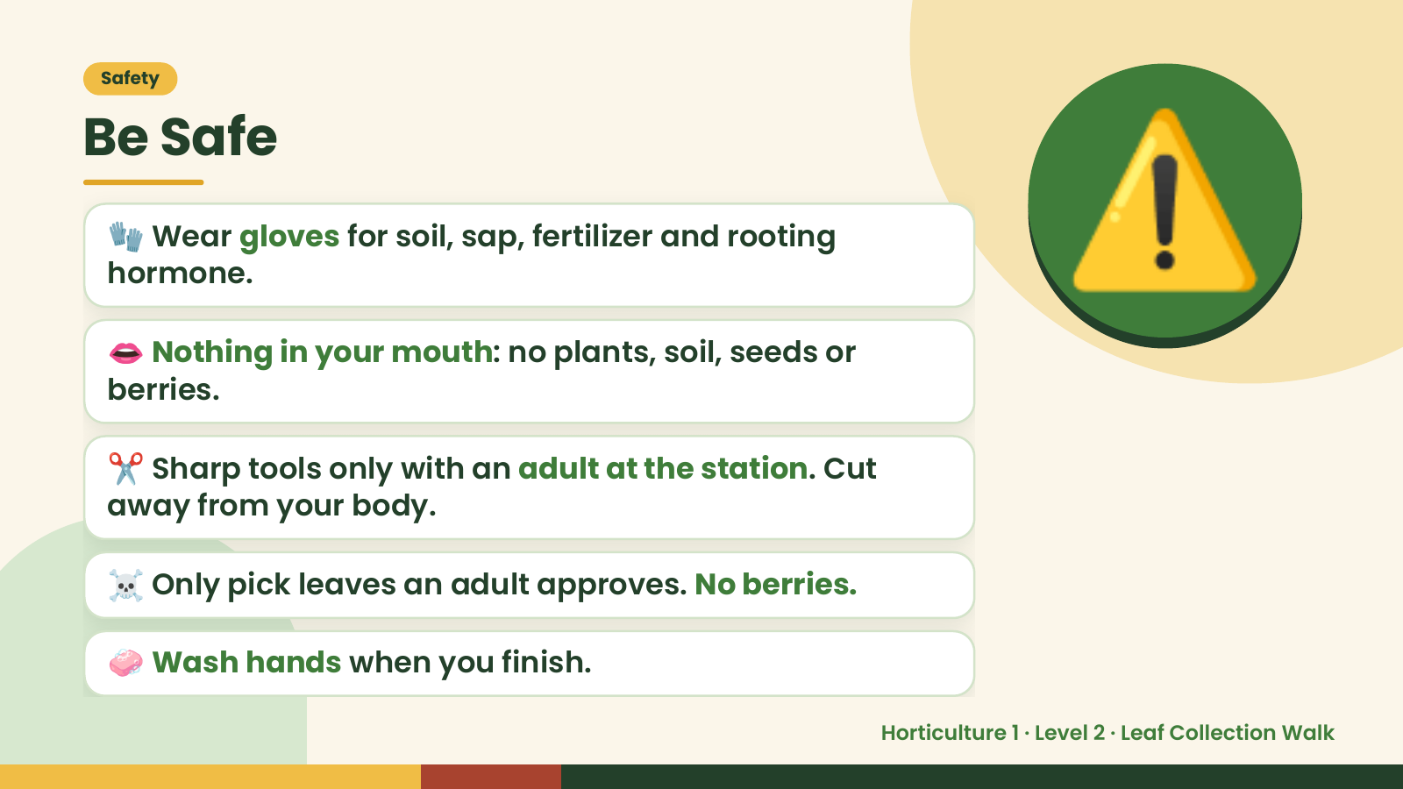
Notes:
Safety
Be Safe
🧤 Wear gloves for soil, sap, fertilizer and rooting
hormone.
👄 Nothing in your mouth: no plants, soil, seeds or
berries.
⚠️
✂️ Sharp tools only with an adult at the station. Cut
away from your body.
☠️ Only pick leaves an adult approves. No berries.
🧼 Wash hands when you finish.
Horticulture 1 · Level 2 · Leaf Collection Walk

Slide 4
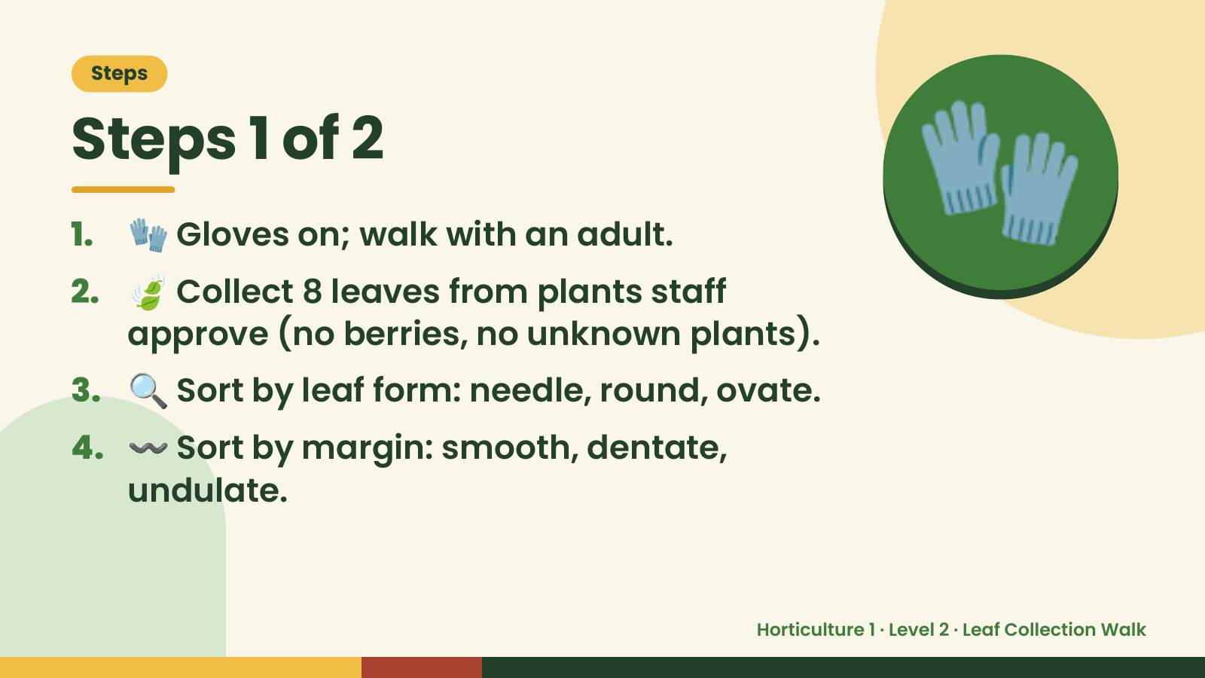
Notes:
Steps
Steps 1 of 2
1. 🧤 Gloves on; walk with an adult.
2. 🍃 Collect 8 leaves from plants staff
approve (no berries, no unknown plants).
🧤
3. 🔍 Sort by leaf form: needle, round, ovate.
4. 〰️ Sort by margin: smooth, dentate,
undulate.
Horticulture 1 · Level 2 · Leaf Collection Walk

Slide 5
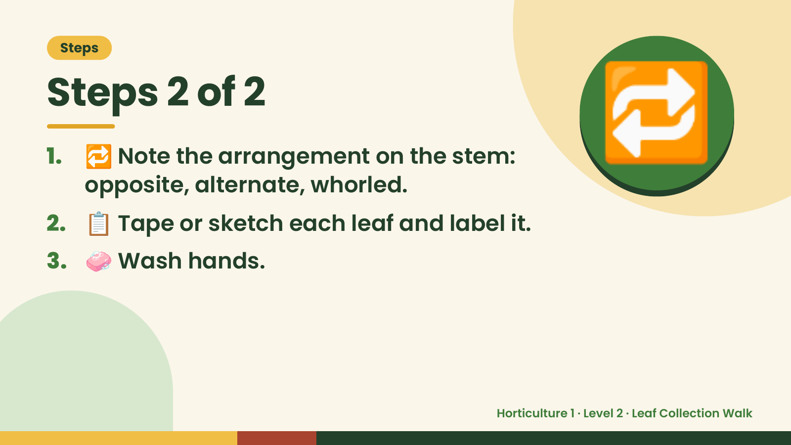
Notes:
Steps
Steps 2 of 2
1. 🔁 Note the arrangement on the stem:
opposite, alternate, whorled.
2. 📋 Tape or sketch each leaf and label it.
🔁
3. 🧼 Wash hands.
Horticulture 1 · Level 2 · Leaf Collection Walk

Slide 6
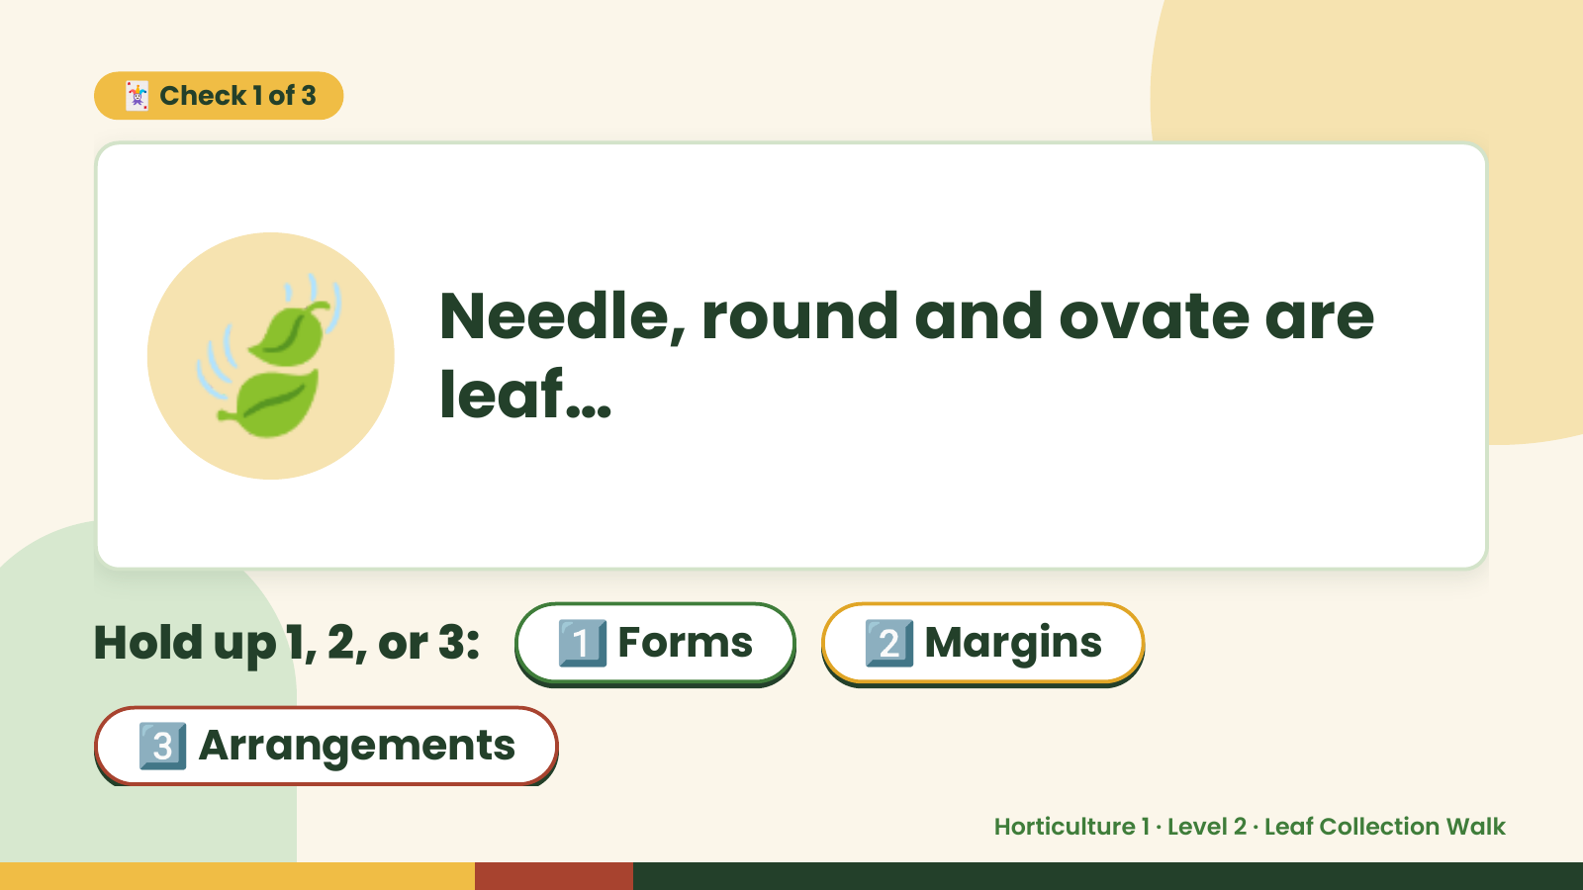
Notes:
🃏 Check 1 of 3
🍃 Needle, round and ovate are
leaf…
Hold up 1, 2, or 3: 1️⃣ Forms 2️⃣ Margins
3️⃣ Arrangements
Horticulture 1 · Level 2 · Leaf Collection Walk

Slide 7
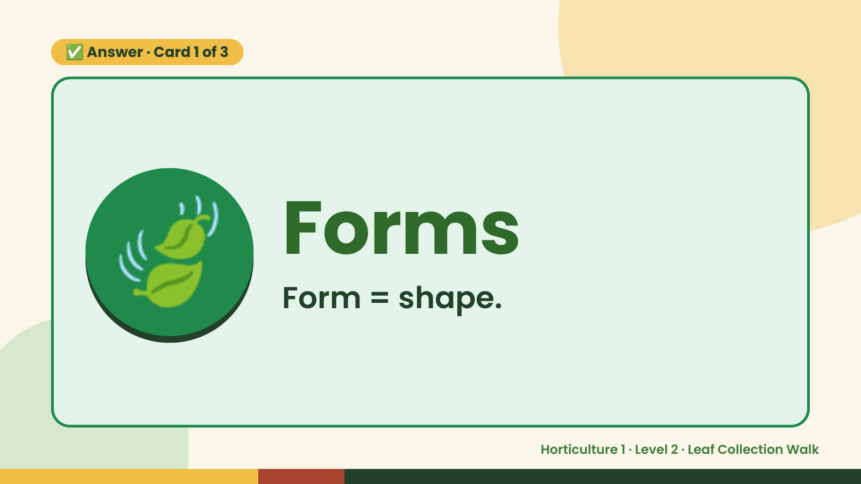
Notes:
✅ Answer · Card 1 of 3
🍃 Forms
Form = shape.
Horticulture 1 · Level 2 · Leaf Collection Walk

Slide 8
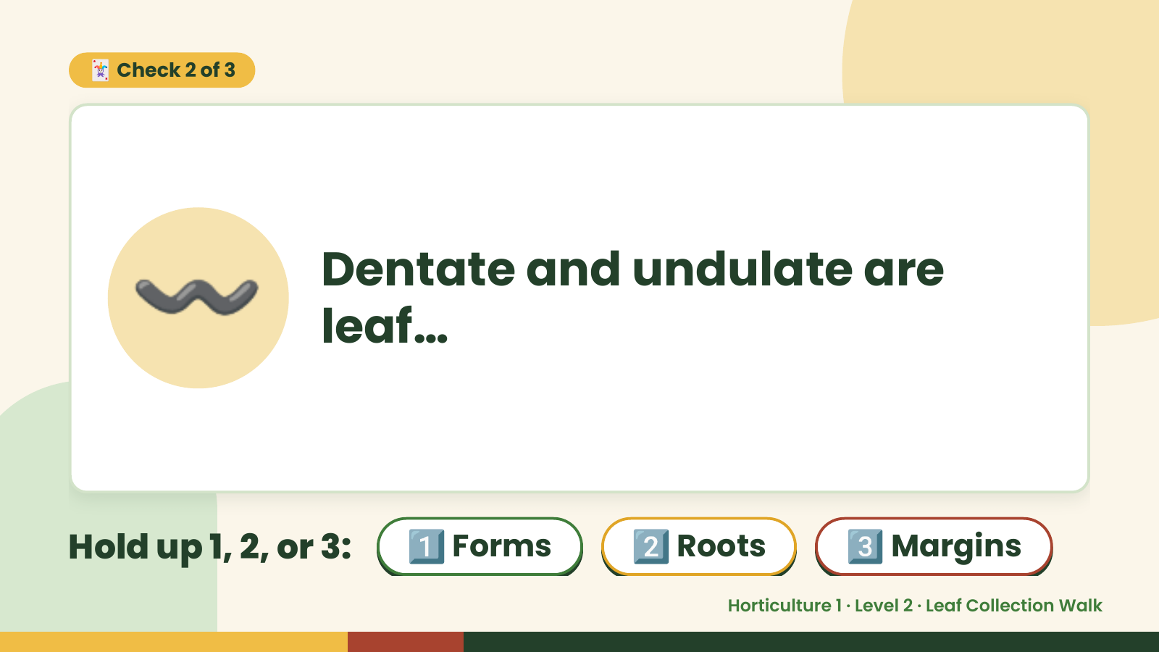
Notes:
🃏 Check 2 of 3
〰️ Dentate and undulate are
leaf…
Hold up 1, 2, or 3: 1️⃣ Forms 2️⃣ Roots 3️⃣ Margins
Horticulture 1 · Level 2 · Leaf Collection Walk

Slide 9
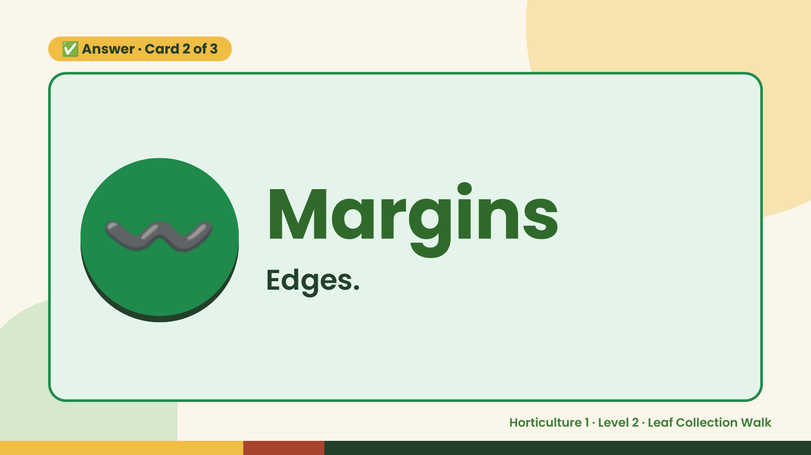
Notes:
✅ Answer · Card 2 of 3
〰️ Margins
Edges.
Horticulture 1 · Level 2 · Leaf Collection Walk

Slide 10
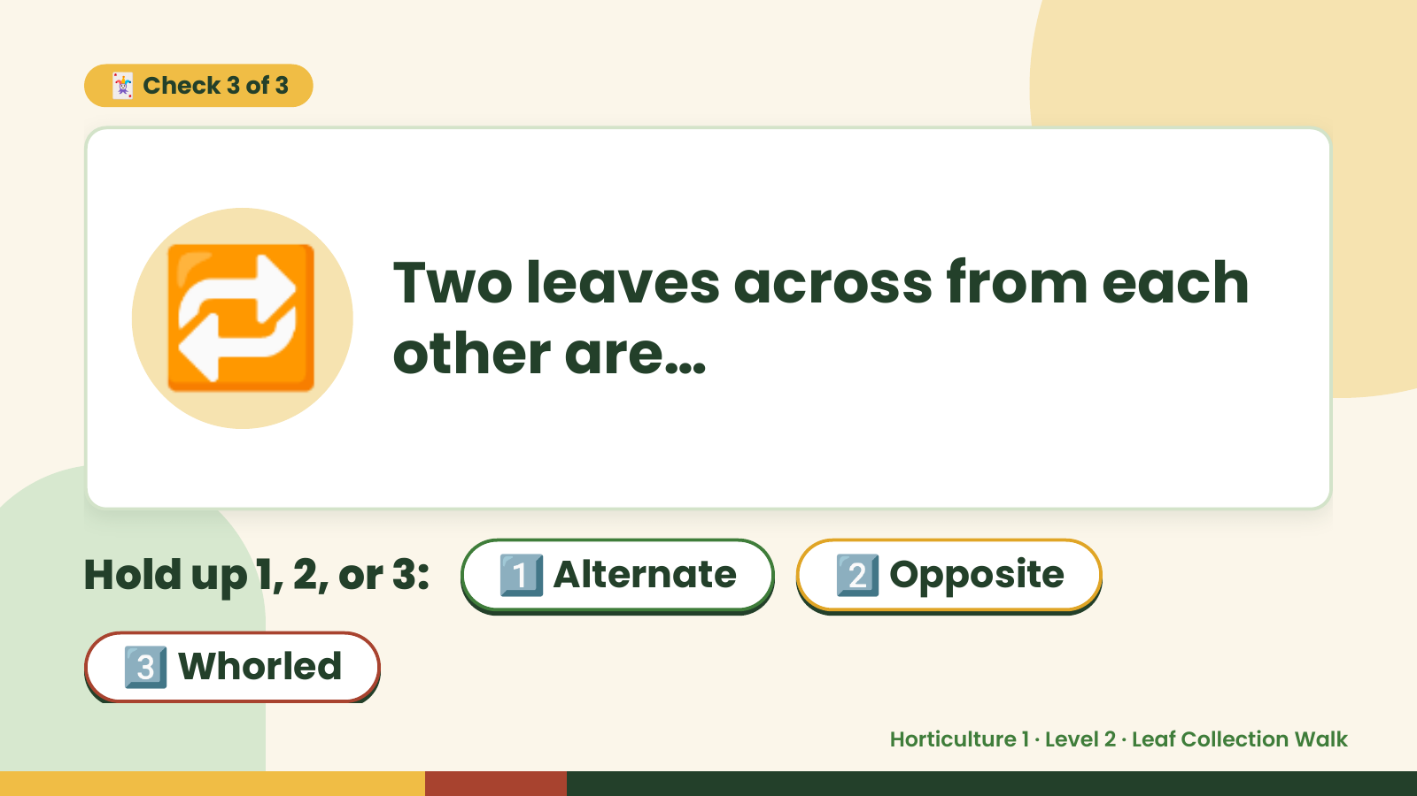
Notes:
🃏 Check 3 of 3
🔁 Two leaves across from each
other are…
Hold up 1, 2, or 3: 1️⃣ Alternate 2️⃣ Opposite
3️⃣ Whorled
Horticulture 1 · Level 2 · Leaf Collection Walk

Slide 11
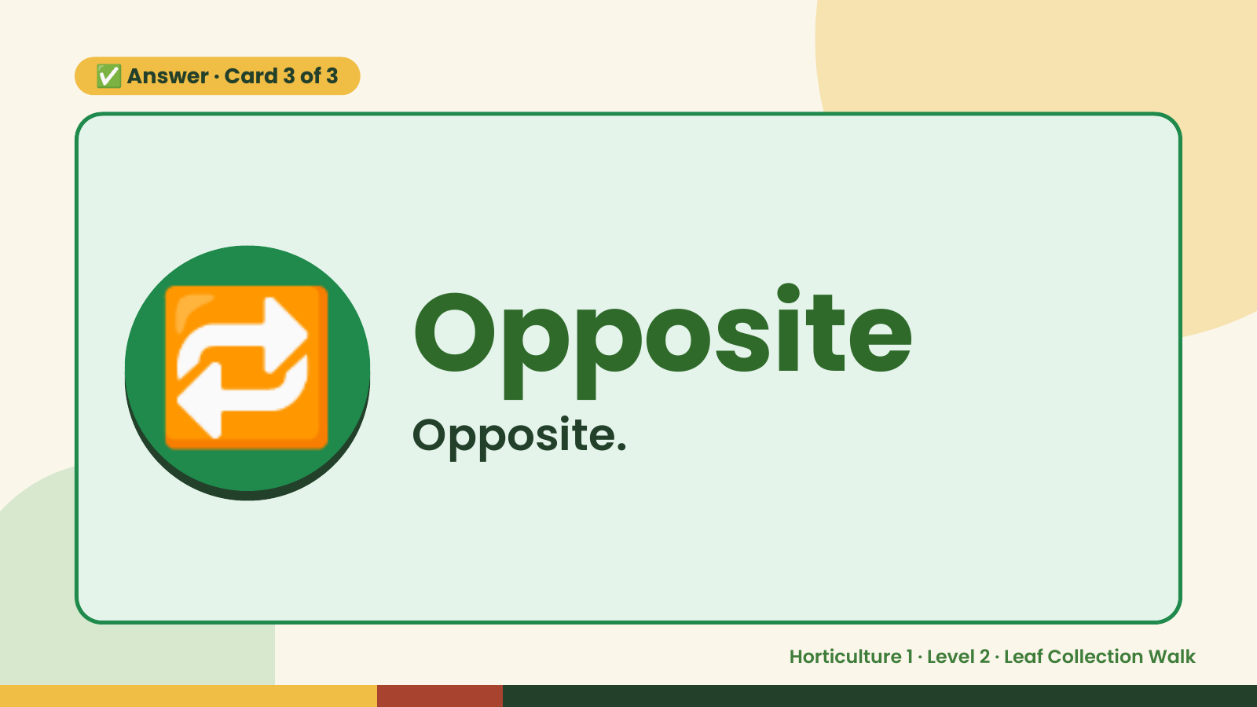
Notes:
✅ Answer · Card 3 of 3
🔁 Opposite
Opposite.
Horticulture 1 · Level 2 · Leaf Collection Walk

Slide 12

Notes:
Wrap-Up
Clean Up +
Reflect
🧽
Return and count tools.
Sweep and wipe your area.
Wash hands, then do the reflection.
Horticulture 1 · Level 2 · Leaf Collection Walk

