Slide 1
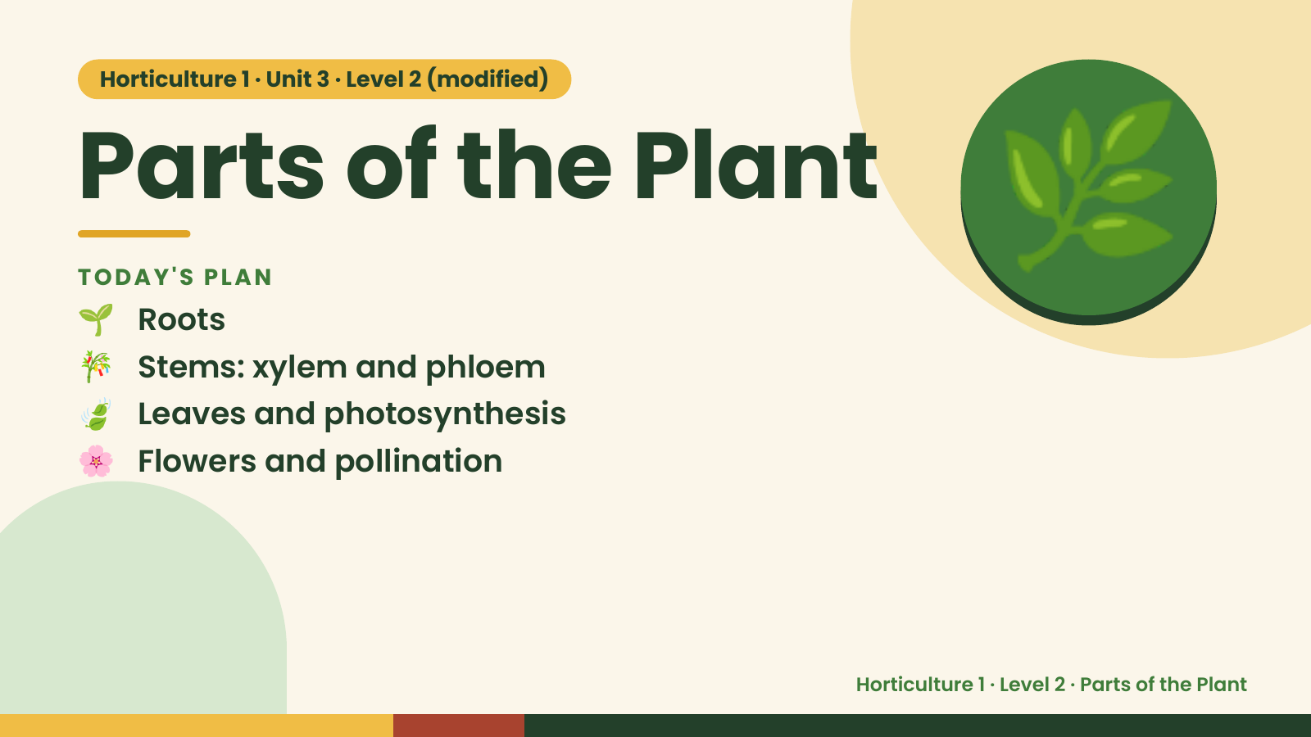
Notes:
Horticulture 1 · Unit 3 · Level 2 (modified)
Parts of the Plant
🌱 Roots
TODAY'S PLAN
🎋 Stems: xylem and phloem
🍃 Leaves and photosynthesis
🌿
🌸 Flowers and pollination
Horticulture 1 · Level 2 · Parts of the Plant

Slide 2
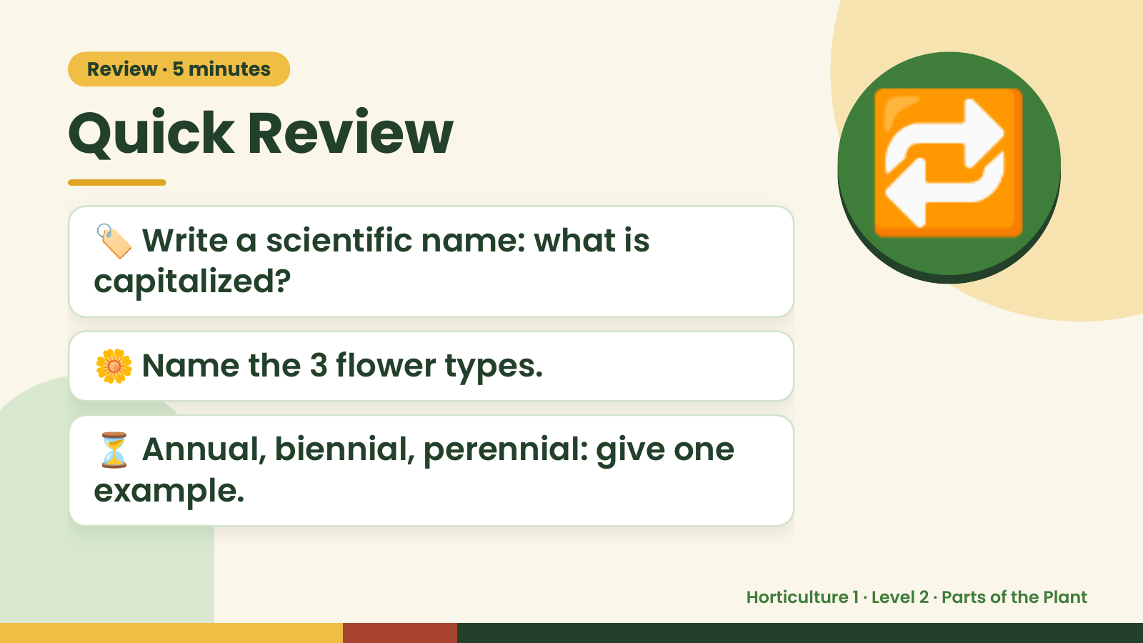
Notes:
Review · 5 minutes
Quick Review
🏷️ Write a scientific name: what is
capitalized?
🔁
🌼 Name the 3 flower types.
⏳ Annual, biennial, perennial: give one
example.
Horticulture 1 · Level 2 · Parts of the Plant

Slide 3
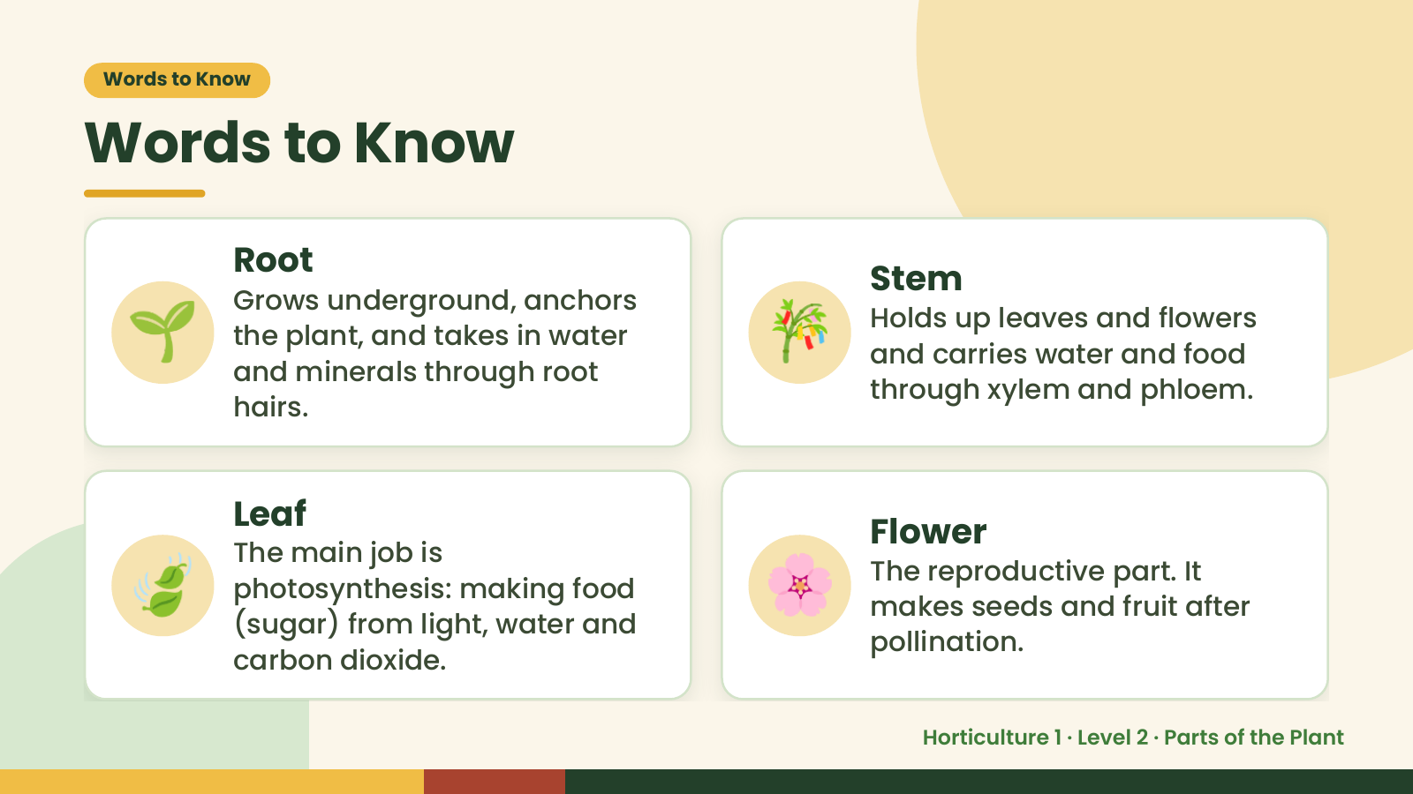
Notes:
Words to Know
Words to Know
🌱 🎋
Root
Stem
Grows underground, anchors
Holds up leaves and flowers
the plant, and takes in water
and carries water and food
and minerals through root
through xylem and phloem.
hairs.
🍃 🌸
Leaf
Flower
The main job is
The reproductive part. It
photosynthesis: making food
makes seeds and fruit after
(sugar) from light, water and
pollination.
carbon dioxide.
Horticulture 1 · Level 2 · Parts of the Plant

Slide 4
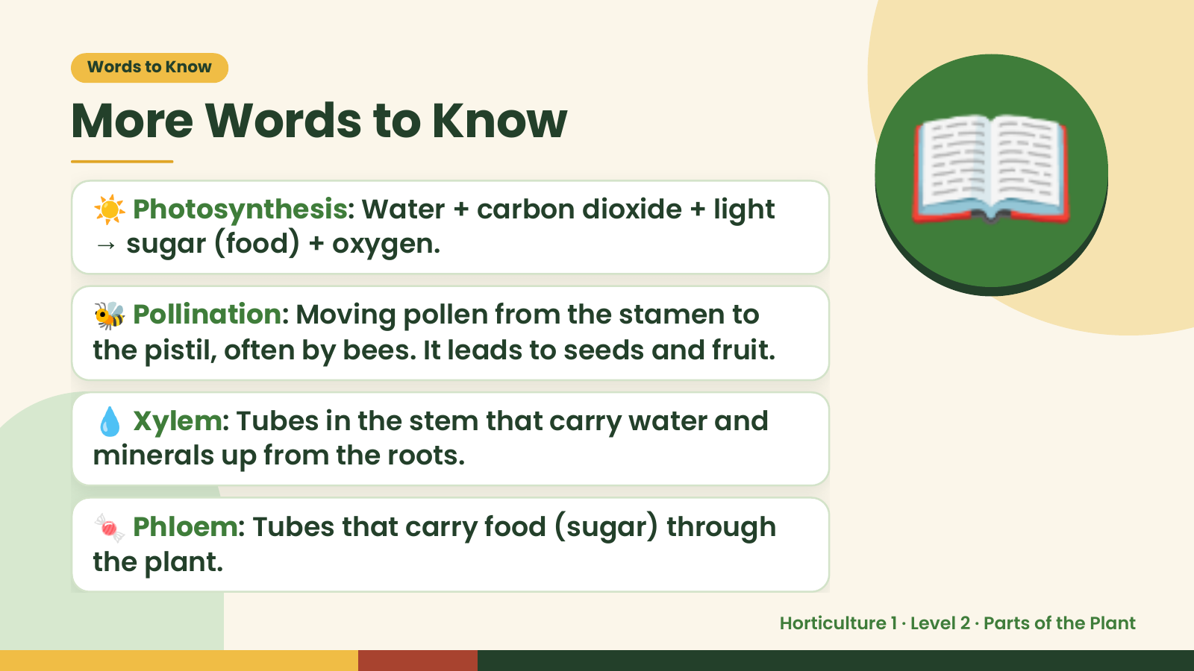
Notes:
Words to Know
More Words to Know
☀️ Photosynthesis: Water + carbon dioxide + light
→ sugar (food) + oxygen.
🐝 Pollination: Moving pollen from the stamen to
the pistil, often by bees. It leads to seeds and fruit.
📖
💧 Xylem: Tubes in the stem that carry water and
minerals up from the roots.
🍬 Phloem: Tubes that carry food (sugar) through
the plant.
Horticulture 1 · Level 2 · Parts of the Plant

Slide 5
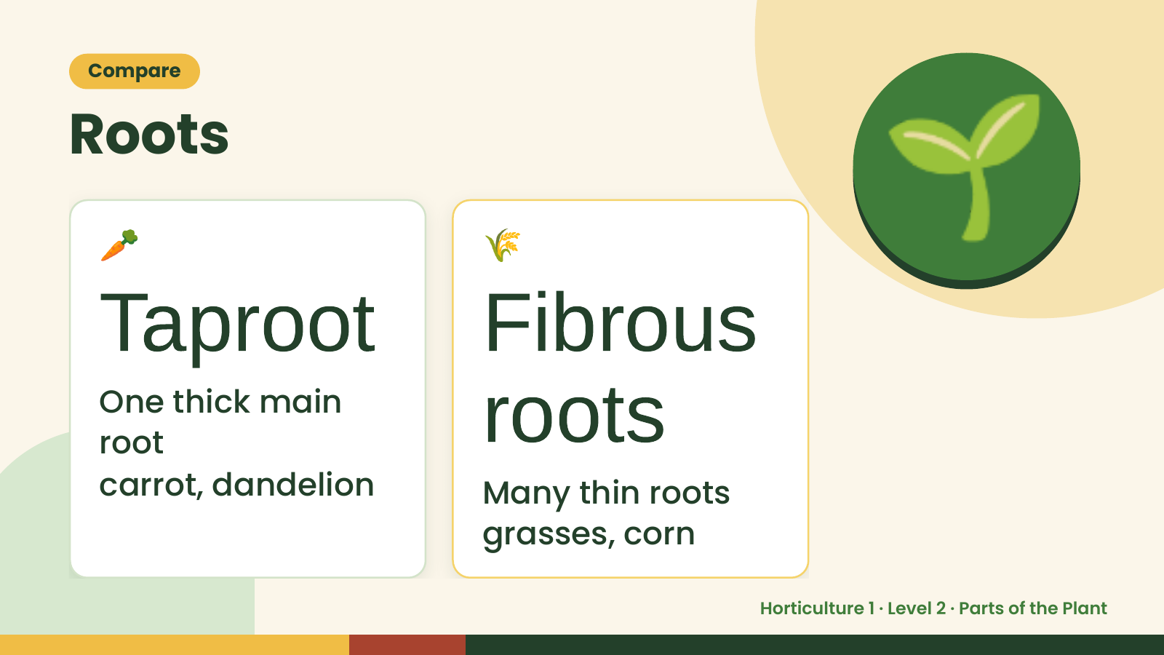
Notes:
Compare
Roots
🥕
Taproot Fibrous
🌾
🌱
root roots
One thick main
carrot, dandelion Many thin roots
grasses, corn
Horticulture 1 · Level 2 · Parts of the Plant

Slide 6
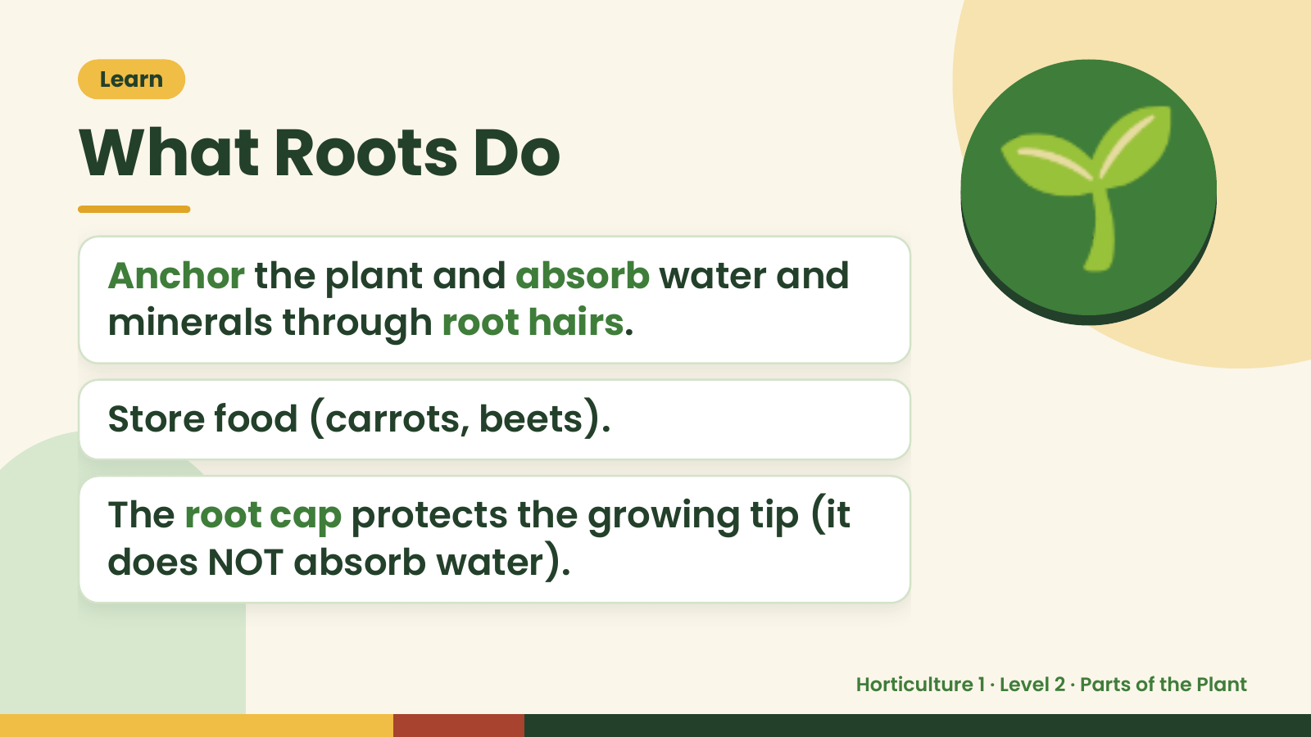
Notes:
Learn
What Roots Do
Anchor the plant and absorb water and
minerals through root hairs.
🌱
Store food (carrots, beets).
The root cap protects the growing tip (it
does NOT absorb water).
Horticulture 1 · Level 2 · Parts of the Plant

Slide 7
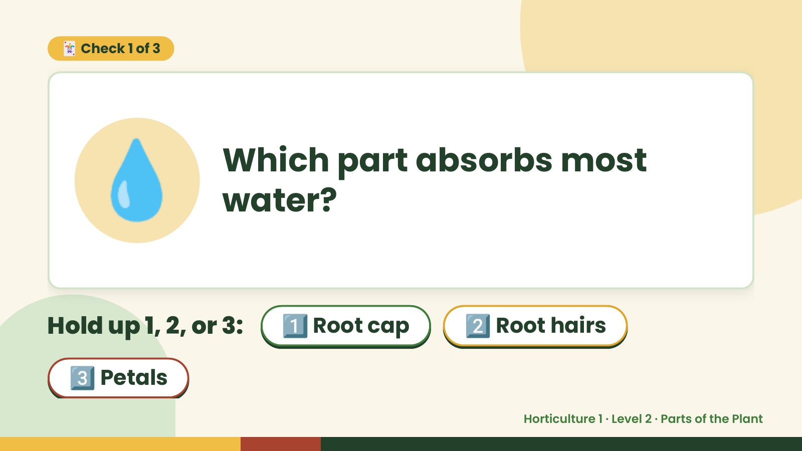
Notes:
🃏 Check 1 of 3
💧 Which part absorbs most
water?
Hold up 1, 2, or 3: 1️⃣ Root cap 2️⃣ Root hairs
3️⃣ Petals
Horticulture 1 · Level 2 · Parts of the Plant

Slide 8
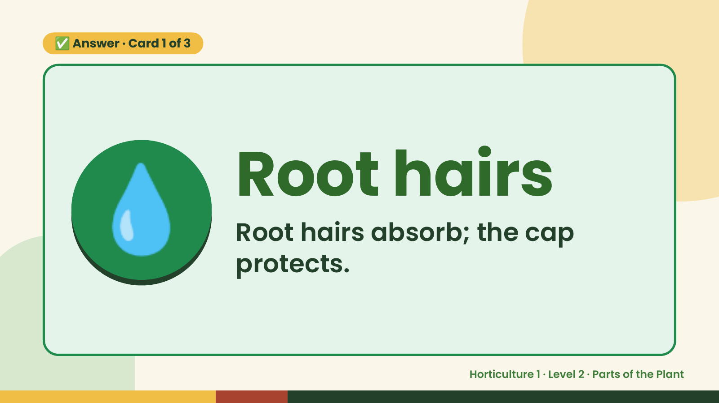
Notes:
✅ Answer · Card 1 of 3
💧 Root hairs
Root hairs absorb; the cap
protects.
Horticulture 1 · Level 2 · Parts of the Plant

Slide 9
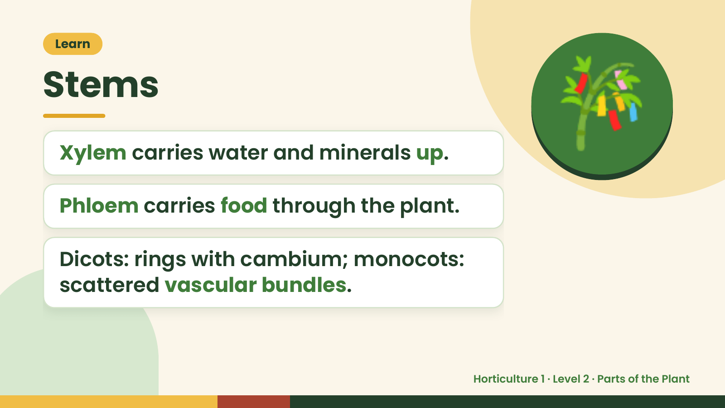
Notes:
Learn
Stems
Xylem carries water and minerals up.
Phloem carries food through the plant.
🎋
Dicots: rings with cambium; monocots:
scattered vascular bundles.
Horticulture 1 · Level 2 · Parts of the Plant

Slide 10
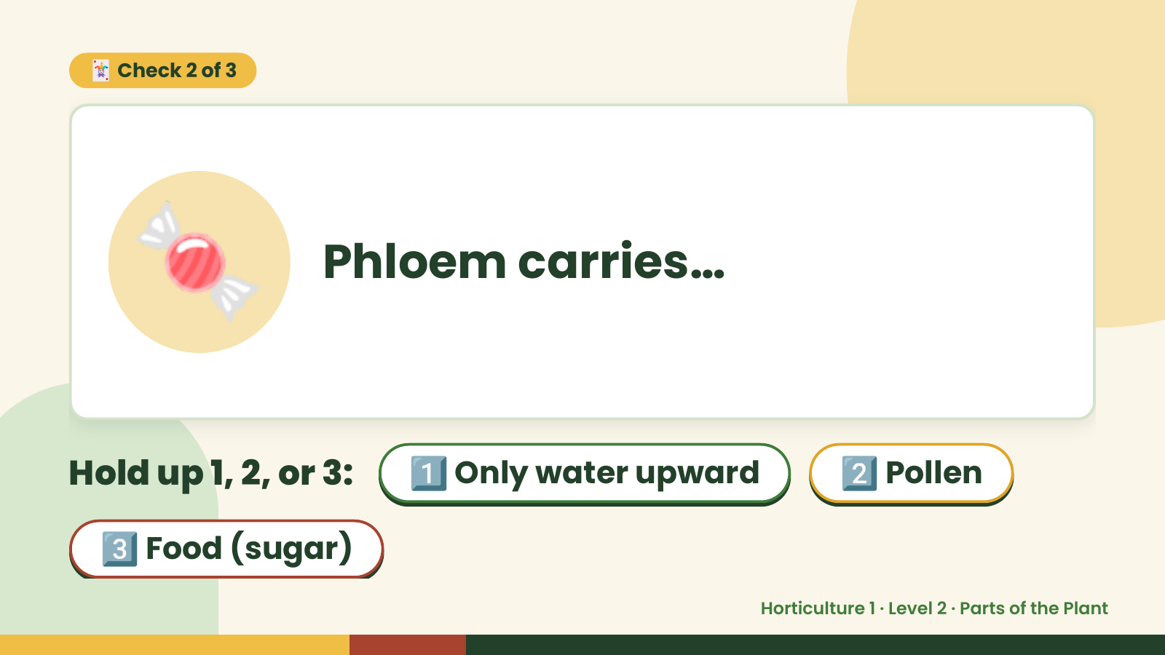
Notes:
🃏 Check 2 of 3
🍬 Phloem carries…
Hold up 1, 2, or 3: 1️⃣ Only water upward 2️⃣ Pollen
3️⃣ Food (sugar)
Horticulture 1 · Level 2 · Parts of the Plant

Slide 11
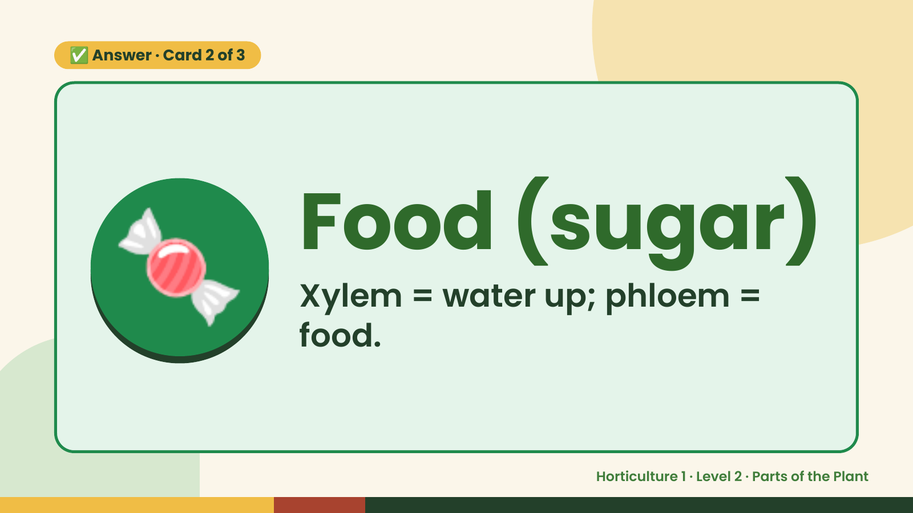
Notes:
✅ Answer · Card 2 of 3
🍬 Food (sugar)
Xylem = water up; phloem =
food.
Horticulture 1 · Level 2 · Parts of the Plant

Slide 12
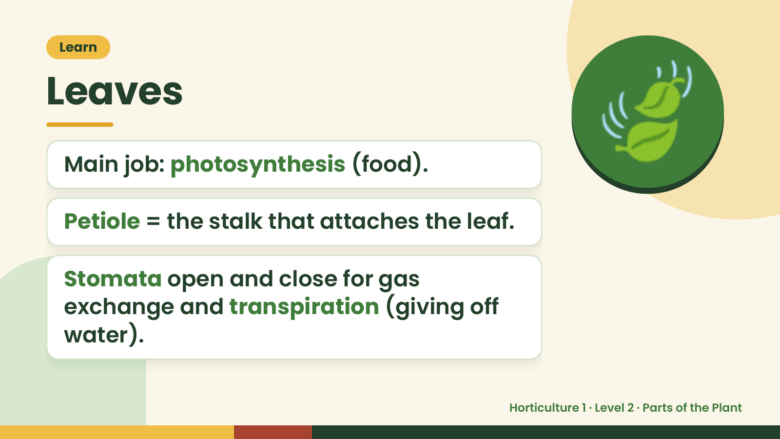
Notes:
Learn
Leaves
Main job: photosynthesis (food).
Petiole = the stalk that attaches the leaf.
🍃
Stomata open and close for gas
exchange and transpiration (giving off
water).
Horticulture 1 · Level 2 · Parts of the Plant

Slide 13
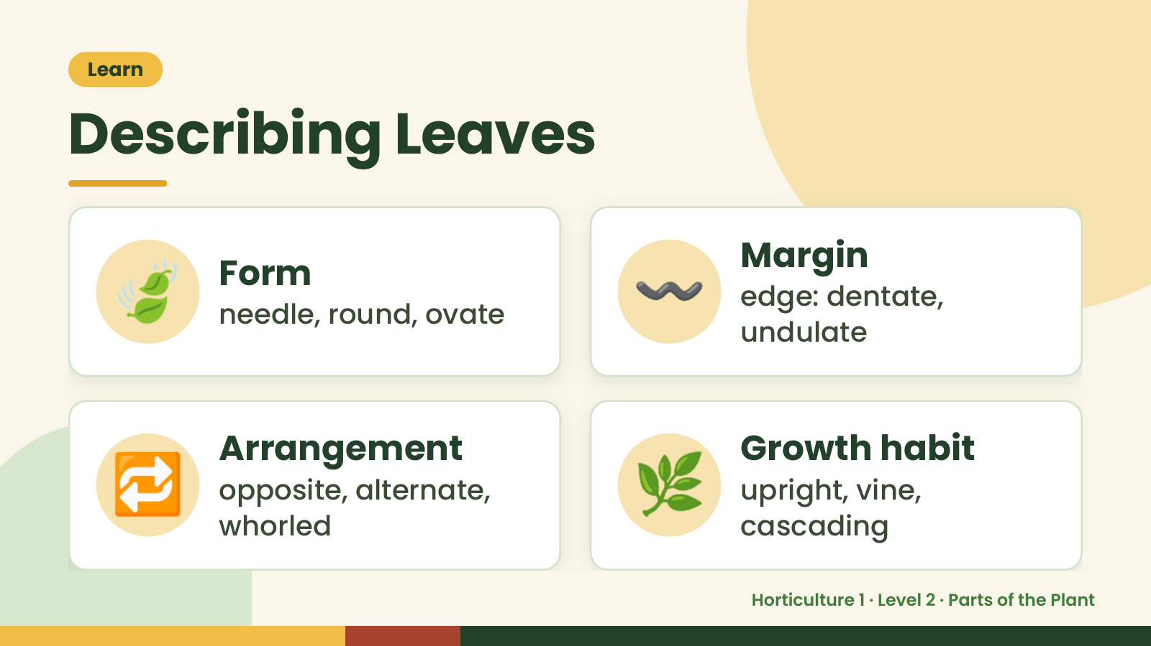
Notes:
Learn
Describing Leaves
🍃 Form
needle, round, ovate 〰️ Margin
edge: dentate,
undulate
🔁 Arrangement
opposite, alternate,
whorled
🌿 Growth habit
upright, vine,
cascading
Horticulture 1 · Level 2 · Parts of the Plant

Slide 14
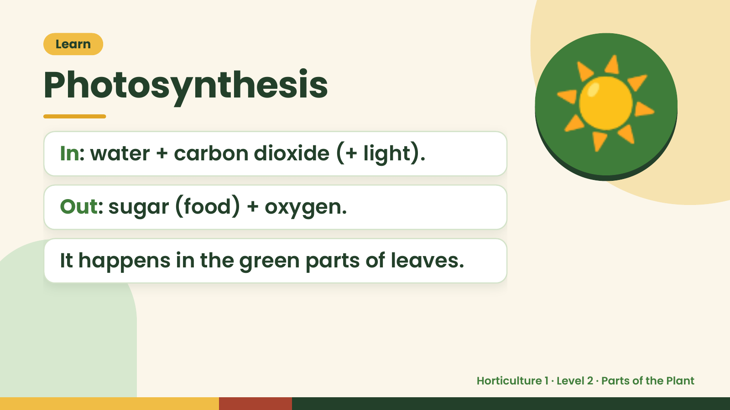
Notes:
Learn
Photosynthesis
In: water + carbon dioxide (+ light).
Out: sugar (food) + oxygen.
☀️
It happens in the green parts of leaves.
Horticulture 1 · Level 2 · Parts of the Plant

Slide 15
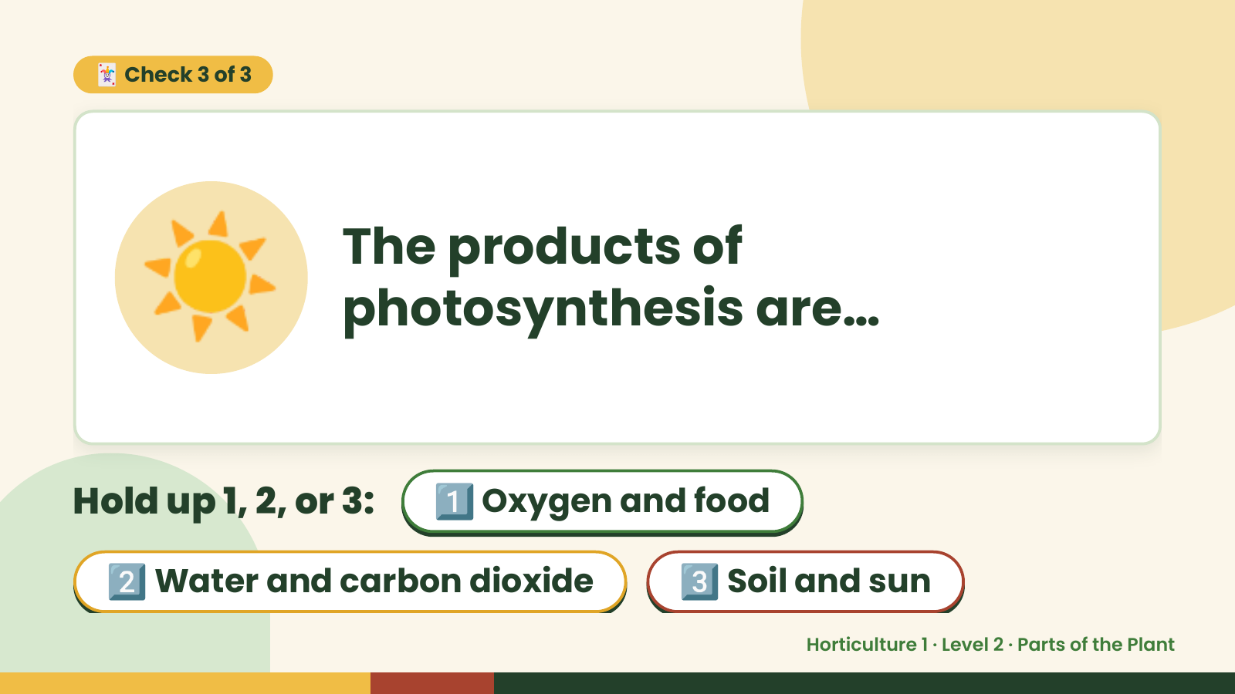
Notes:
🃏 Check 3 of 3
☀️ The products of
photosynthesis are…
Hold up 1, 2, or 3: 1️⃣ Oxygen and food
2️⃣ Water and carbon dioxide 3️⃣ Soil and sun
Horticulture 1 · Level 2 · Parts of the Plant

Slide 16
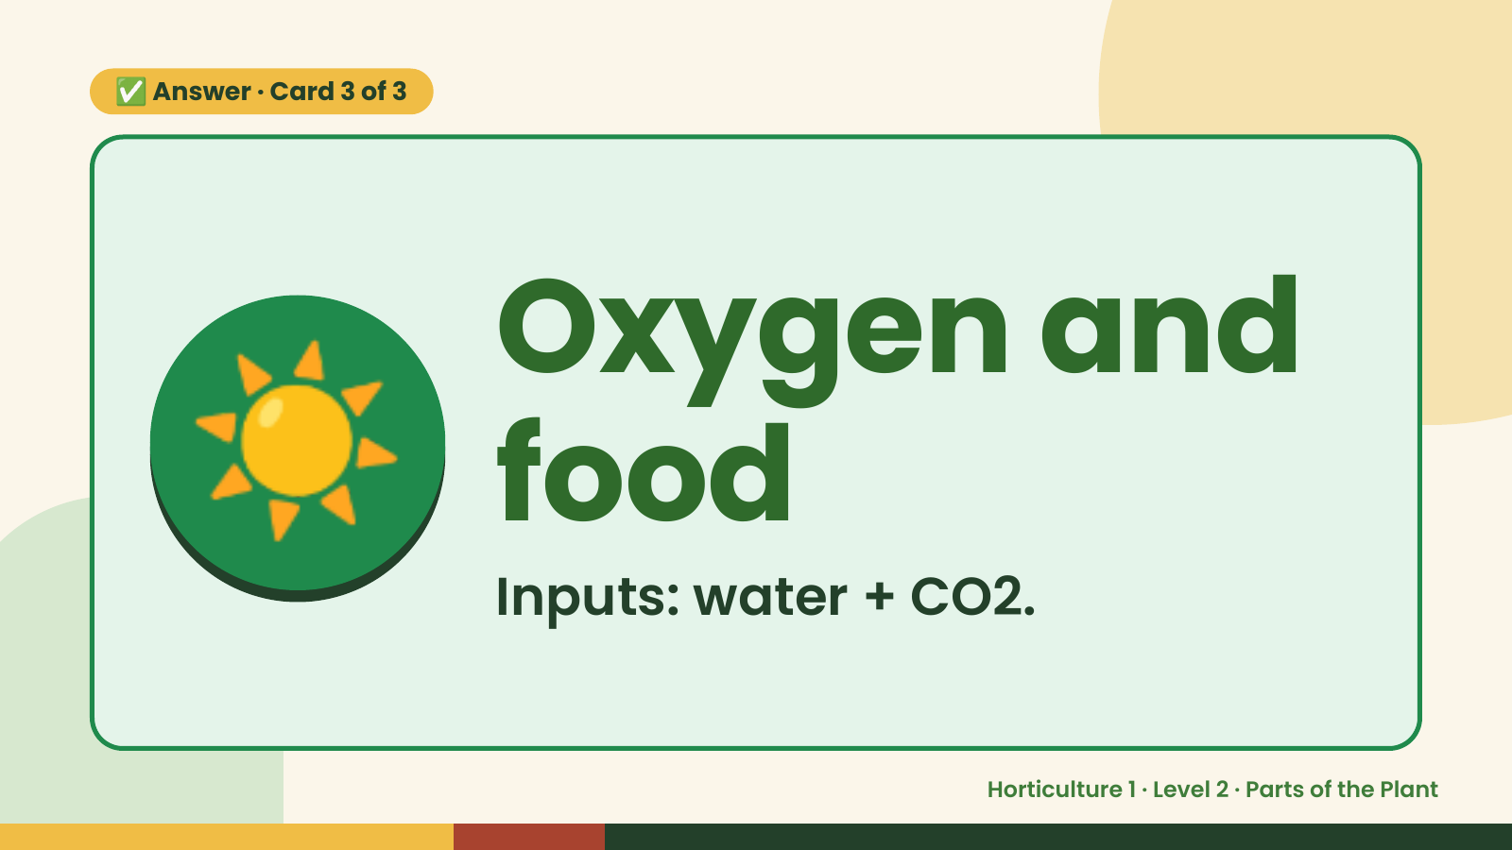
Notes:
✅ Answer · Card 3 of 3
☀️ Oxygen and
food
Inputs: water + CO2.
Horticulture 1 · Level 2 · Parts of the Plant

Slide 17
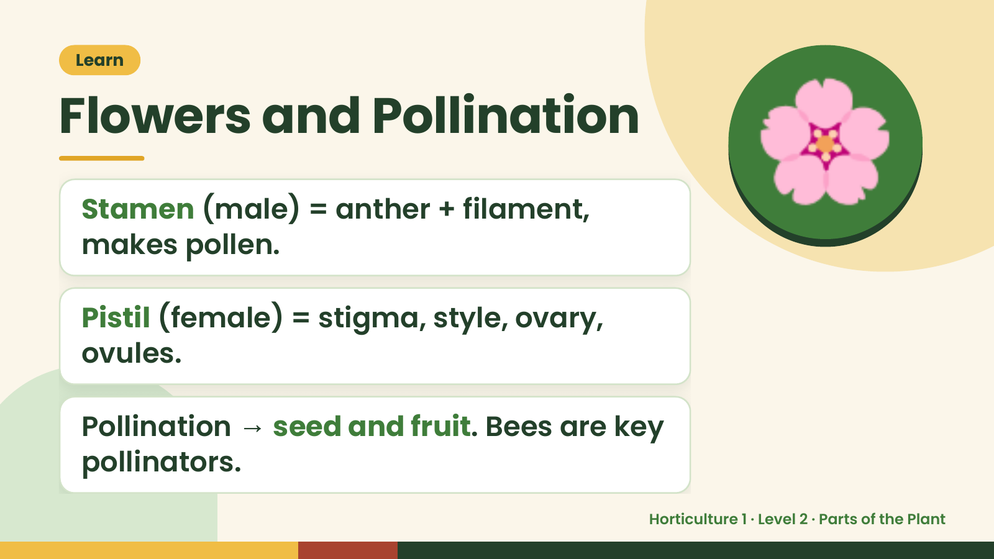
Notes:
Learn
Flowers and Pollination
Stamen (male) = anther + filament,
makes pollen.
🌸
Pistil (female) = stigma, style, ovary,
ovules.
Pollination → seed and fruit. Bees are key
pollinators.
Horticulture 1 · Level 2 · Parts of the Plant

Slide 18
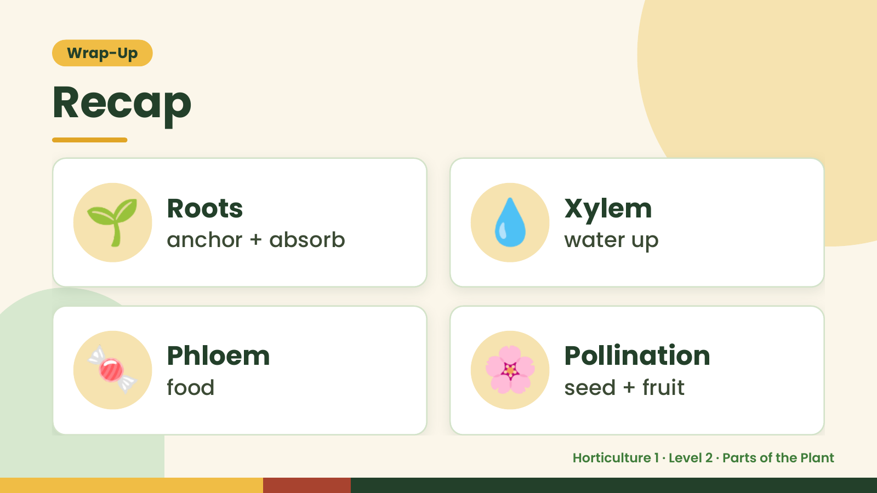
Notes:
Wrap-Up
Recap
🌱 Roots
anchor + absorb 💧 Xylem
water up
🍬 Phloem
food 🌸 Pollination
seed + fruit
Horticulture 1 · Level 2 · Parts of the Plant

Slide 19
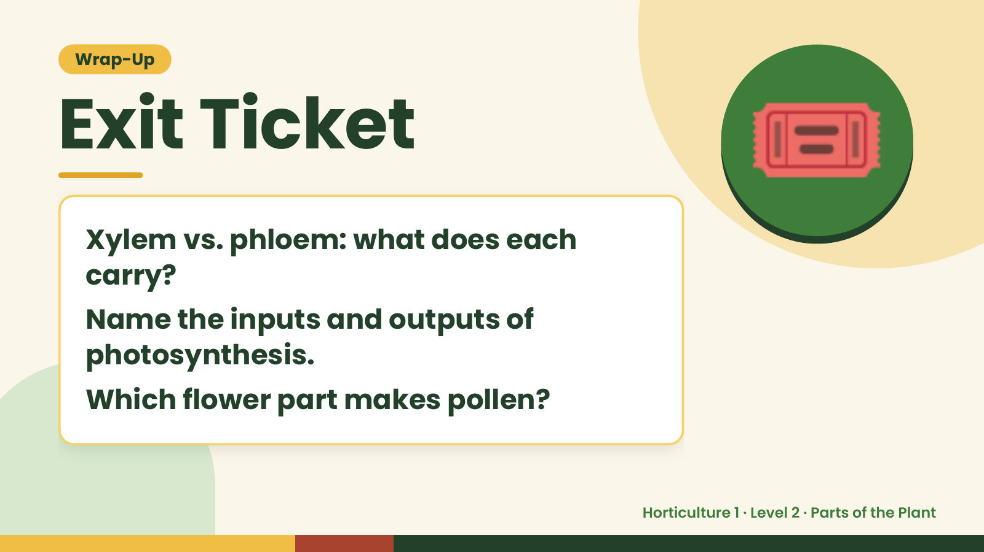
Notes:
Wrap-Up
Exit Ticket
Xylem vs. phloem: what does each
carry?
🎟️
Name the inputs and outputs of
photosynthesis.
Which flower part makes pollen?
Horticulture 1 · Level 2 · Parts of the Plant

