Slide 1
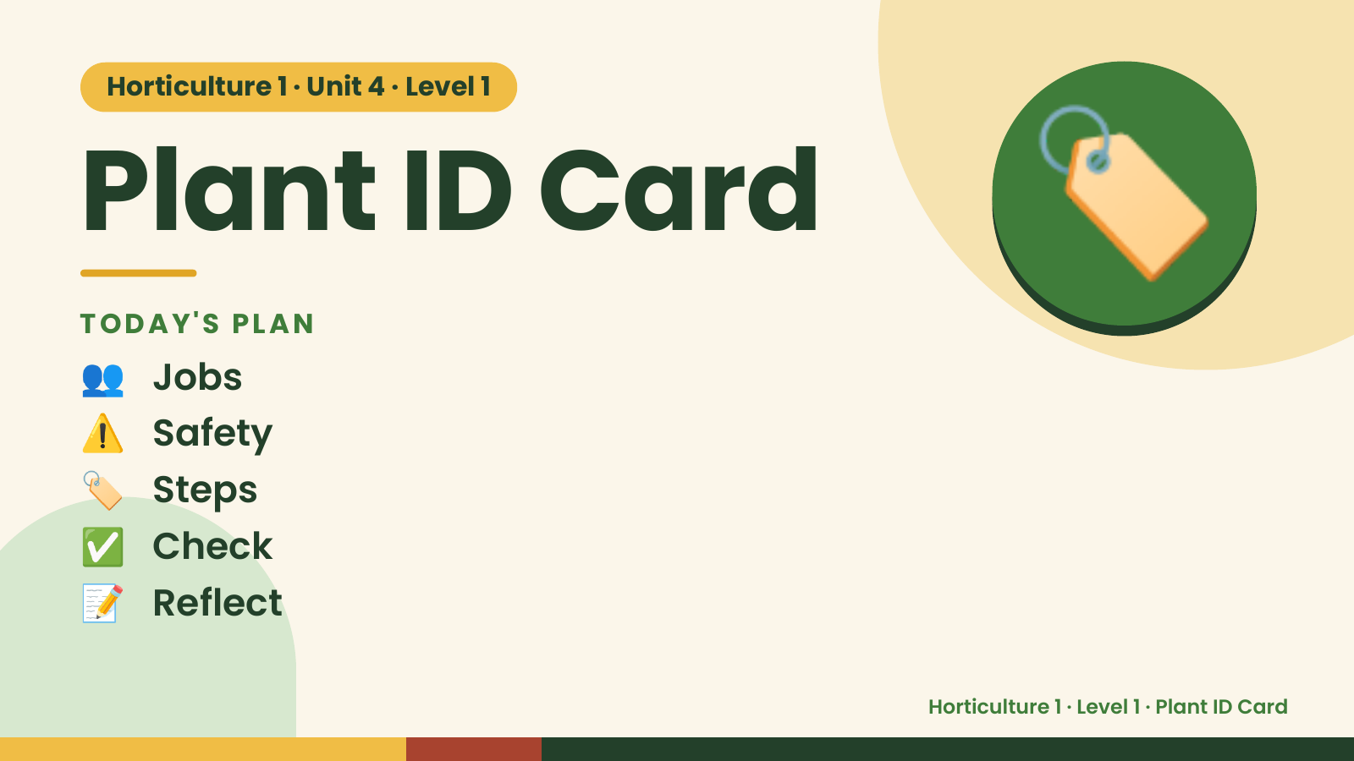
Notes:
Horticulture 1 · Unit 4 · Level 1
Plant ID Card
TODAY'S PLAN
👥 Jobs
🏷️
⚠️ Safety
🏷️ Steps
✅ Check
📝 Reflect
Horticulture 1 · Level 1 · Plant ID Card

Slide 2

Notes:
Get ready
Jobs
🧑‍🌾 Grower
plants 🧺 Supply helper
gets tools
📸 Recorder
photos 🧽 Clean-up
captain
cleans
Horticulture 1 · Level 1 · Plant ID Card

Slide 3
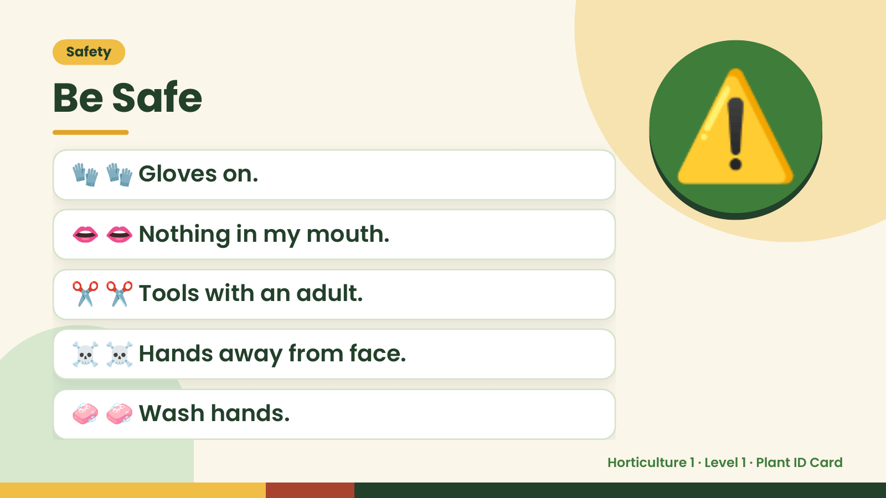
Notes:
Safety
Be Safe
🧤 🧤 Gloves on.
👄 👄 Nothing in my mouth.
⚠️
✂️ ✂️ Tools with an adult.
☠️ ☠️ Hands away from face.
🧼 🧼 Wash hands.
Horticulture 1 · Level 1 · Plant ID Card

Slide 4
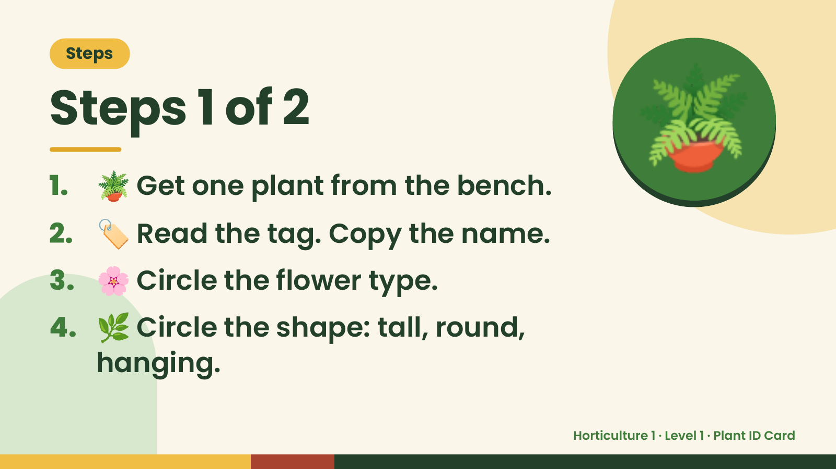
Notes:
Steps
Steps 1 of 2
1. 🪴 Get one plant from the bench.
2. 🏷️ Read the tag. Copy the name.
🪴
3. 🌸 Circle the flower type.
4. 🌿 Circle the shape: tall, round,
hanging.
Horticulture 1 · Level 1 · Plant ID Card

Slide 5
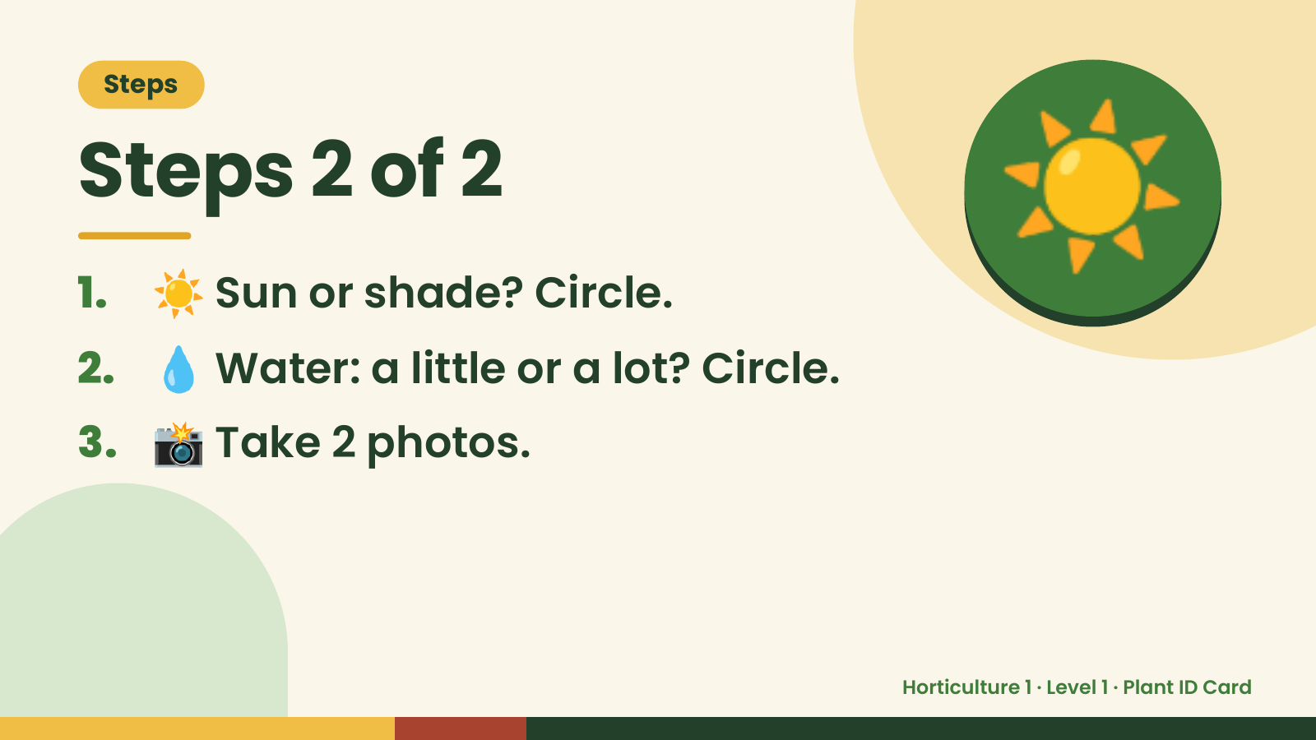
Notes:
Steps
Steps 2 of 2
1. ☀️ Sun or shade? Circle.
2. 💧 Water: a little or a lot? Circle.
☀️
3. 📸 Take 2 photos.
Horticulture 1 · Level 1 · Plant ID Card

Slide 6
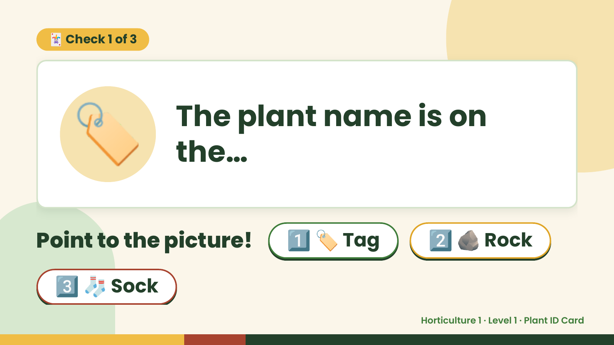
Notes:
🃏 Check 1 of 3
🏷️ The plant name is on
the…
Point to the picture! 1️⃣ 🏷️ Tag 2️⃣ 🪨 Rock
3️⃣ 🧦 Sock
Horticulture 1 · Level 1 · Plant ID Card

Slide 7
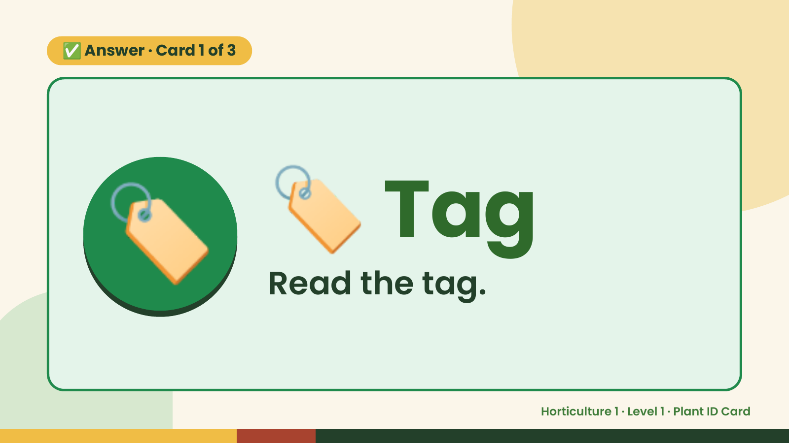
Notes:
✅ Answer · Card 1 of 3
🏷️ 🏷️ Tag
Read the tag.
Horticulture 1 · Level 1 · Plant ID Card

Slide 8
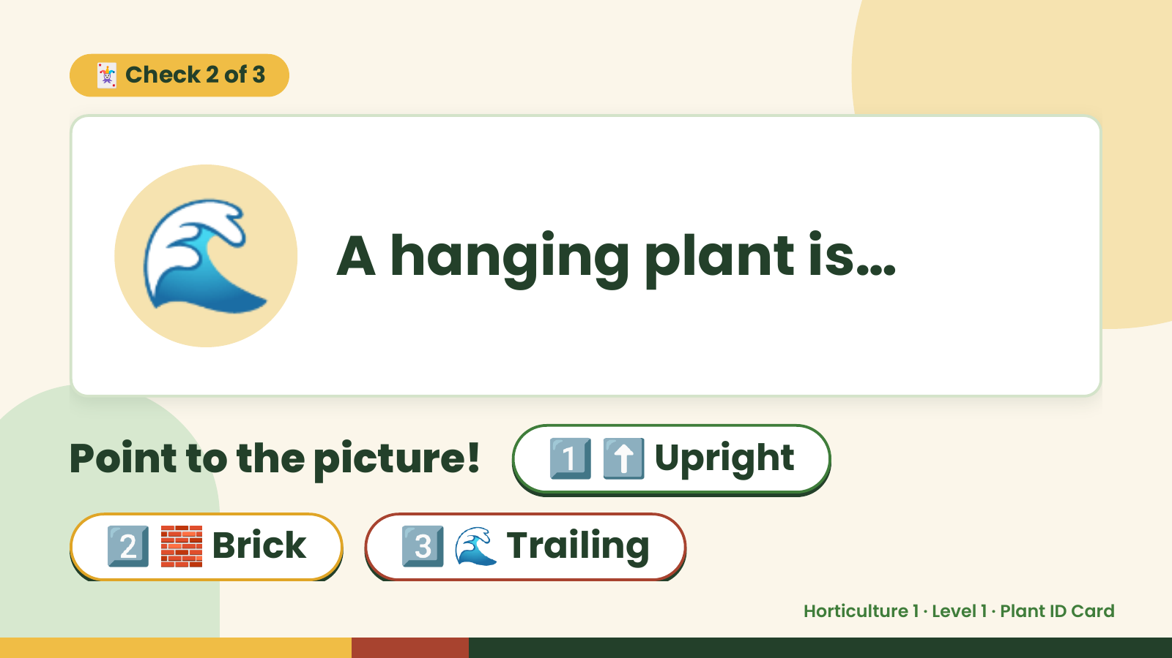
Notes:
🃏 Check 2 of 3
🌊 A hanging plant is…
Point to the picture! 1️⃣ ⬆️ Upright
2️⃣ 🧱 Brick 3️⃣ 🌊 Trailing
Horticulture 1 · Level 1 · Plant ID Card

Slide 9
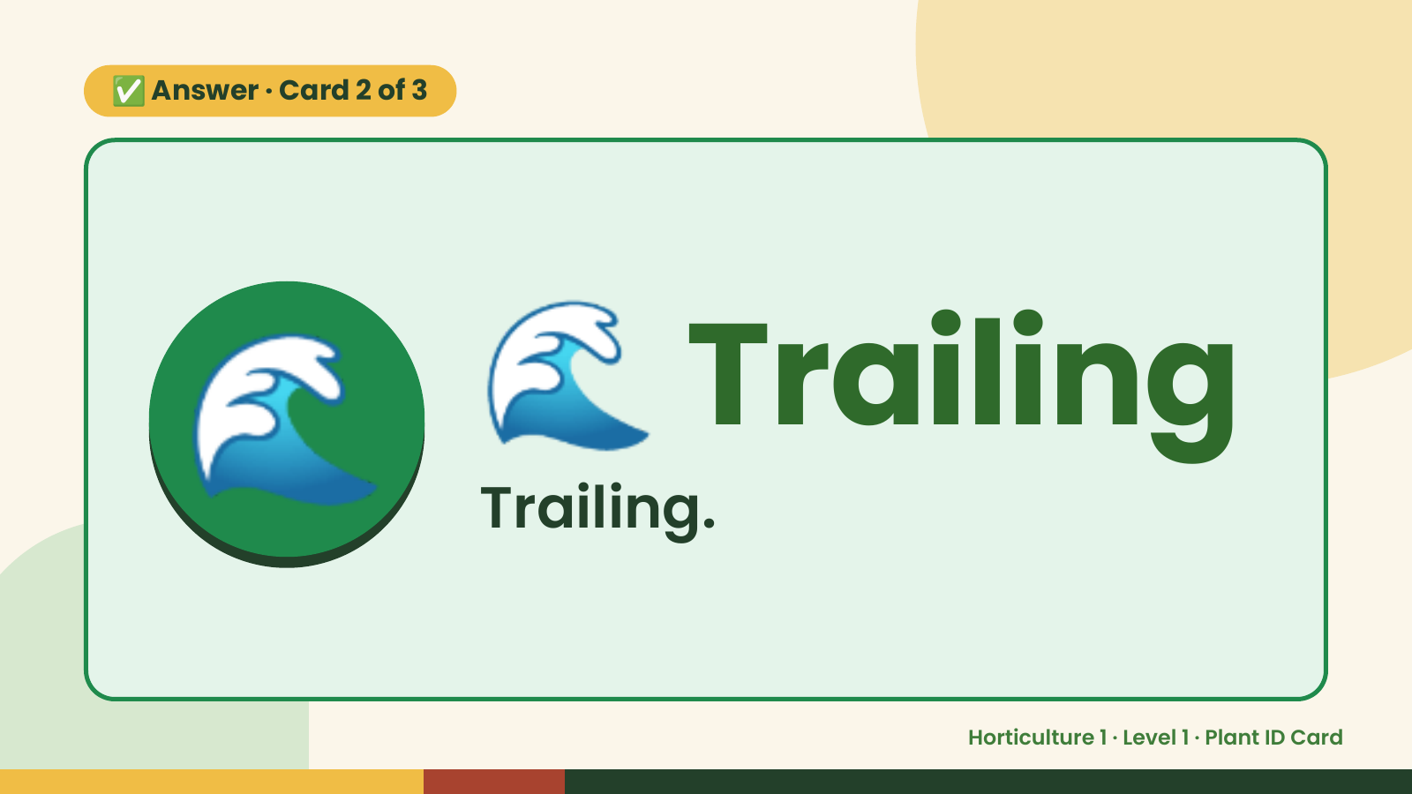
Notes:
✅ Answer · Card 2 of 3
🌊 🌊 Trailing
Trailing.
Horticulture 1 · Level 1 · Plant ID Card

Slide 10
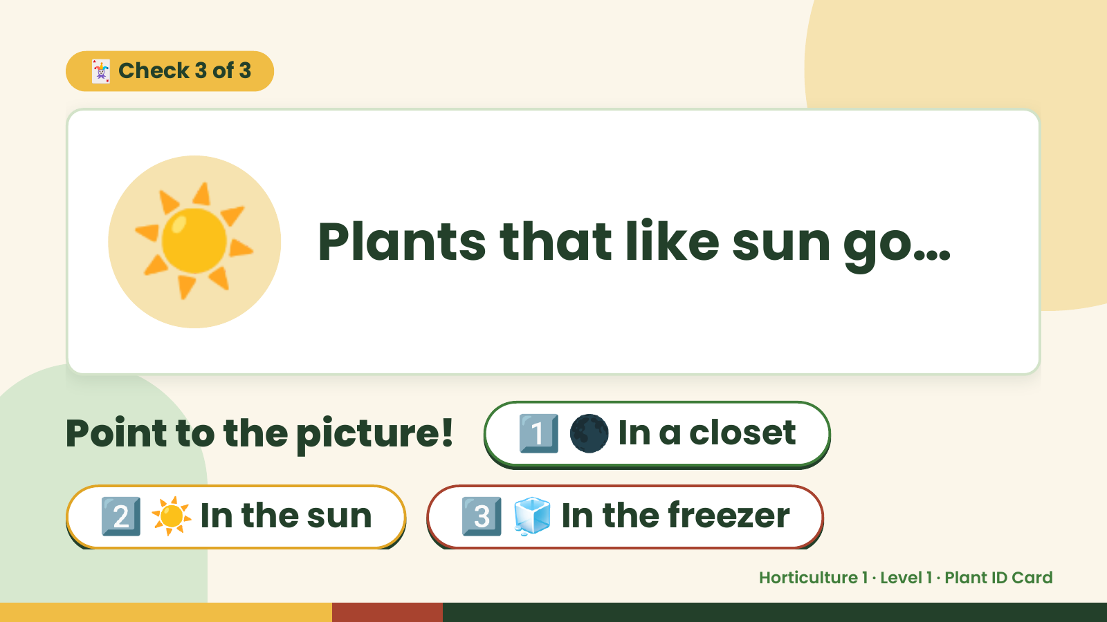
Notes:
🃏 Check 3 of 3
☀️ Plants that like sun go…
Point to the picture! 1️⃣ 🌑 In a closet
2️⃣ ☀️ In the sun 3️⃣ 🧊 In the freezer
Horticulture 1 · Level 1 · Plant ID Card

Slide 11
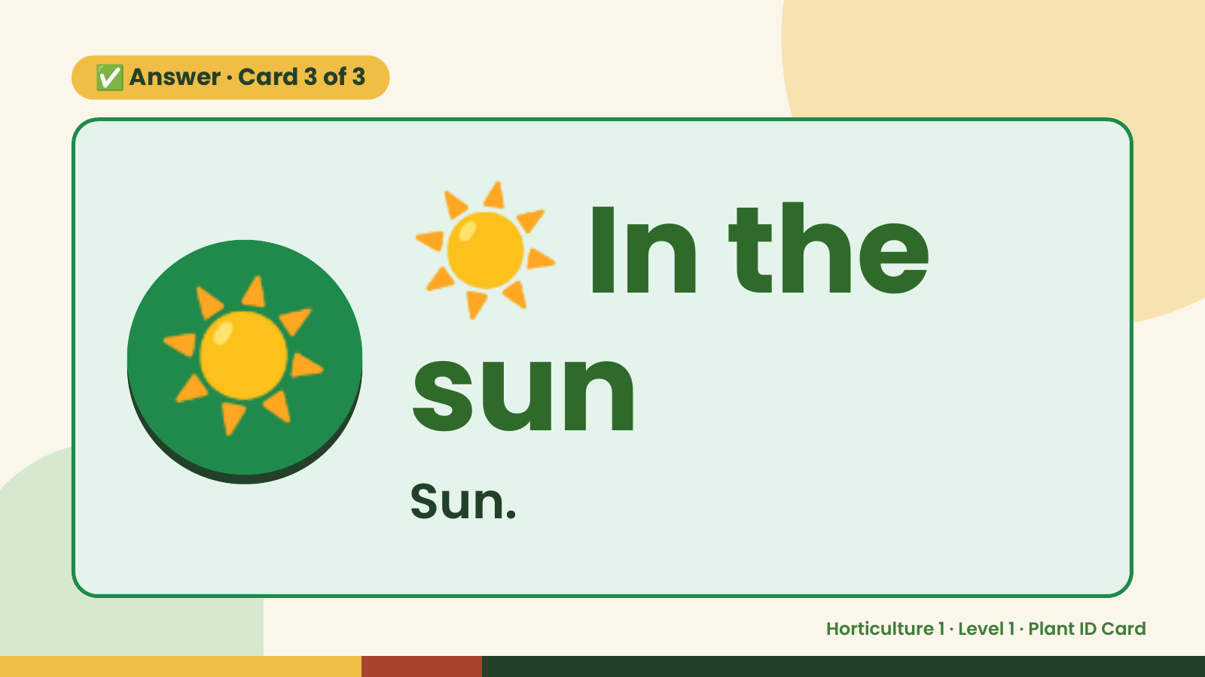
Notes:
☀️
✅ Answer · Card 3 of 3
☀️ sunIn the
Sun.
Horticulture 1 · Level 1 · Plant ID Card

Slide 12

Notes:
Wrap-Up
Clean Up +
Reflect
🧽
🧽 Clean the table.
🧰 Give tools back.
🧼 Wash hands.
Horticulture 1 · Level 1 · Plant ID Card

