Slide 1
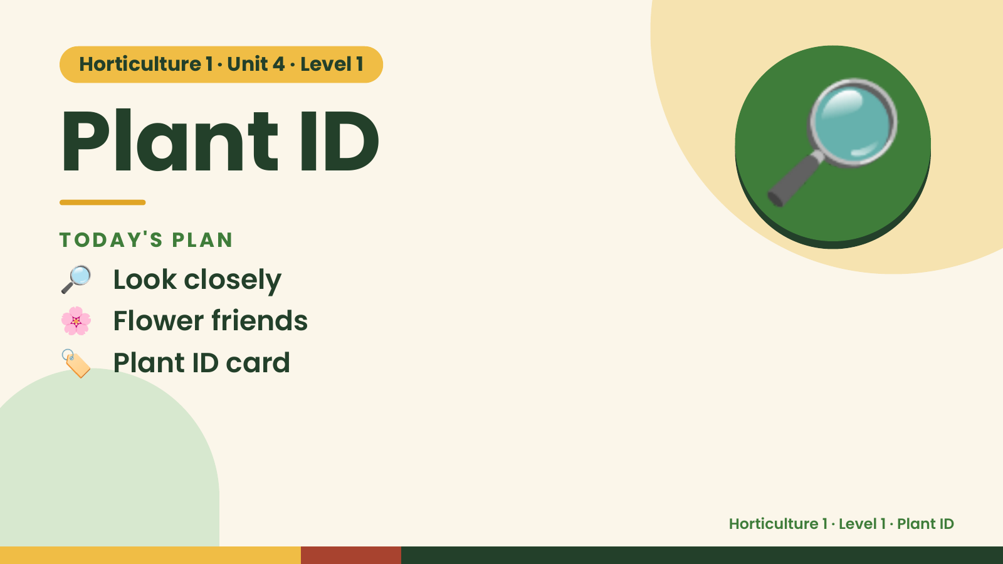
Notes:
Horticulture 1 · Unit 4 · Level 1
Plant ID
TODAY'S PLAN
🔎 Look closely
🔎
🌸 Flower friends
🏷️ Plant ID card
Horticulture 1 · Level 1 · Plant ID

Slide 2
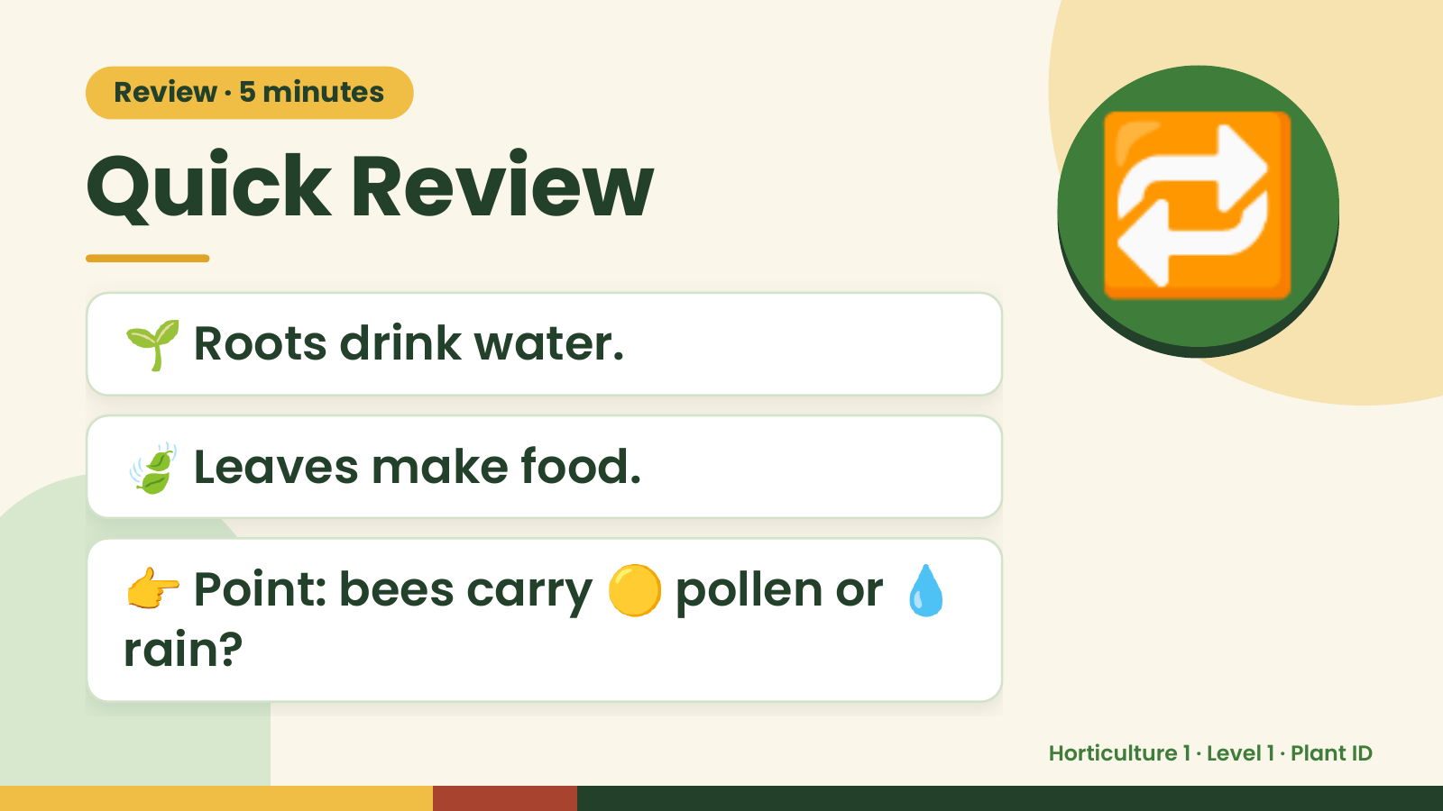
Notes:
Review · 5 minutes
Quick Review
🌱 Roots drink water.
🔁
🍃 Leaves make food.
👉 Point: bees carry 🟡 pollen or 💧
rain?
Horticulture 1 · Level 1 · Plant ID

Slide 3
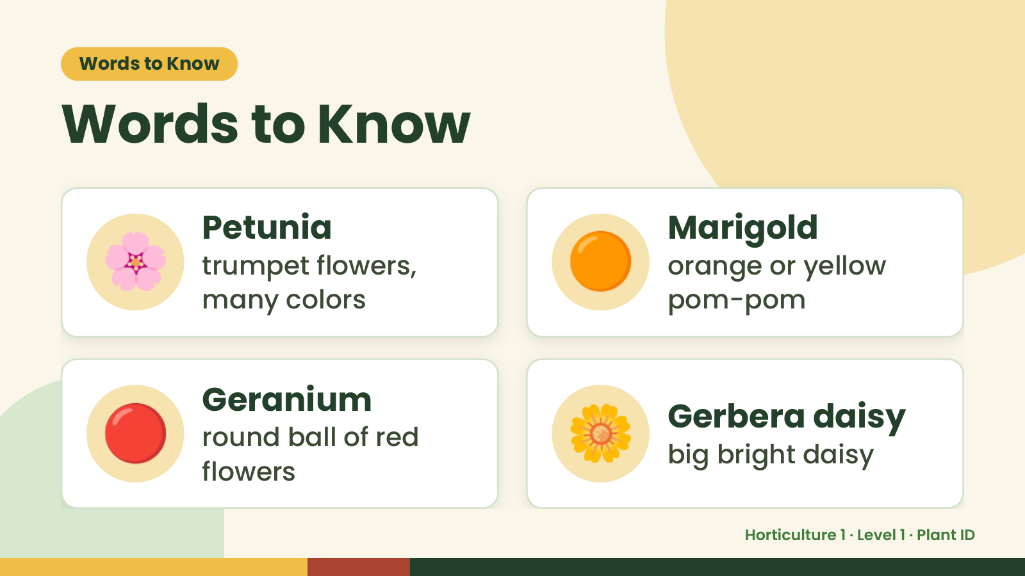
Notes:
Words to Know
Words to Know
🌸 Petunia
trumpet flowers,
many colors
🟠 Marigold
orange or yellow
pom-pom
🔴 Geranium
round ball of red
flowers
🌼 Gerbera daisy
big bright daisy
Horticulture 1 · Level 1 · Plant ID

Slide 4
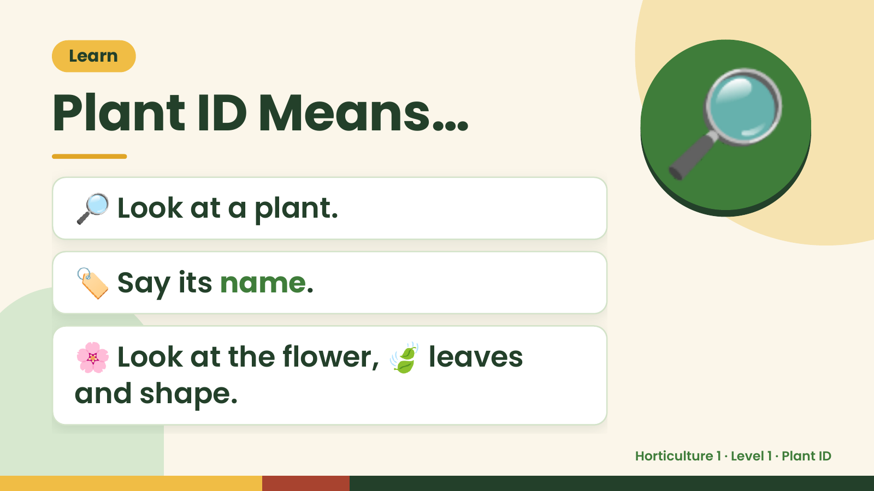
Notes:
Learn
Plant ID Means…
🔎 Look at a plant.
🔎
🏷️ Say its name.
🌸 Look at the flower, 🍃 leaves
and shape.
Horticulture 1 · Level 1 · Plant ID

Slide 5
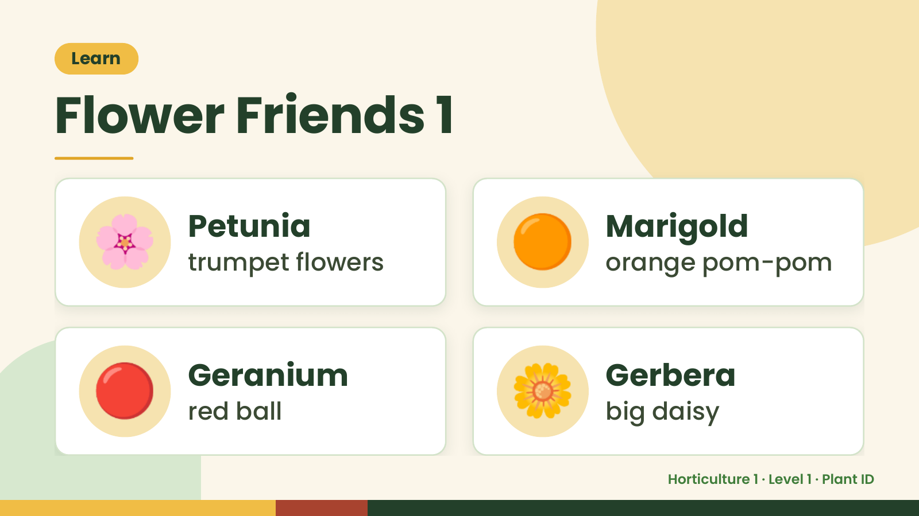
Notes:
Learn
Flower Friends 1
🌸 Petunia
trumpet flowers 🟠 Marigold
orange pom-pom
🔴 Geranium
red ball 🌼 Gerbera
big daisy
Horticulture 1 · Level 1 · Plant ID

Slide 6
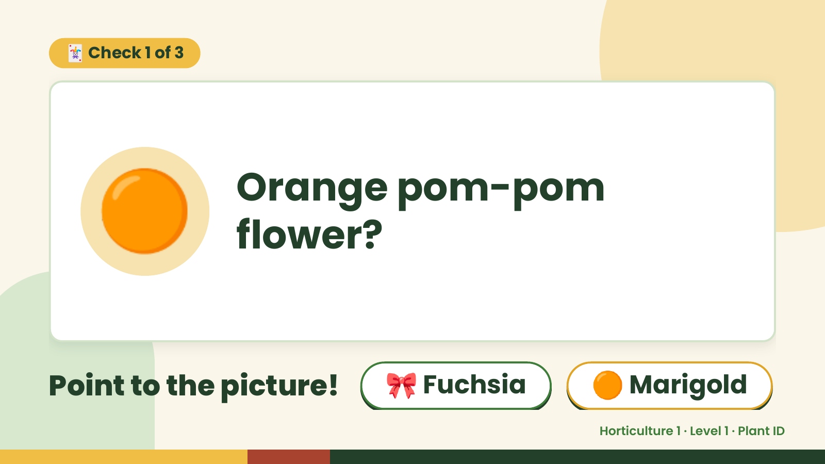
Notes:
🃏 Check 1 of 3
🟠 Orange pom-pom
flower?
Point to the picture! 🎀 Fuchsia 🟠 Marigold
Horticulture 1 · Level 1 · Plant ID

Slide 7
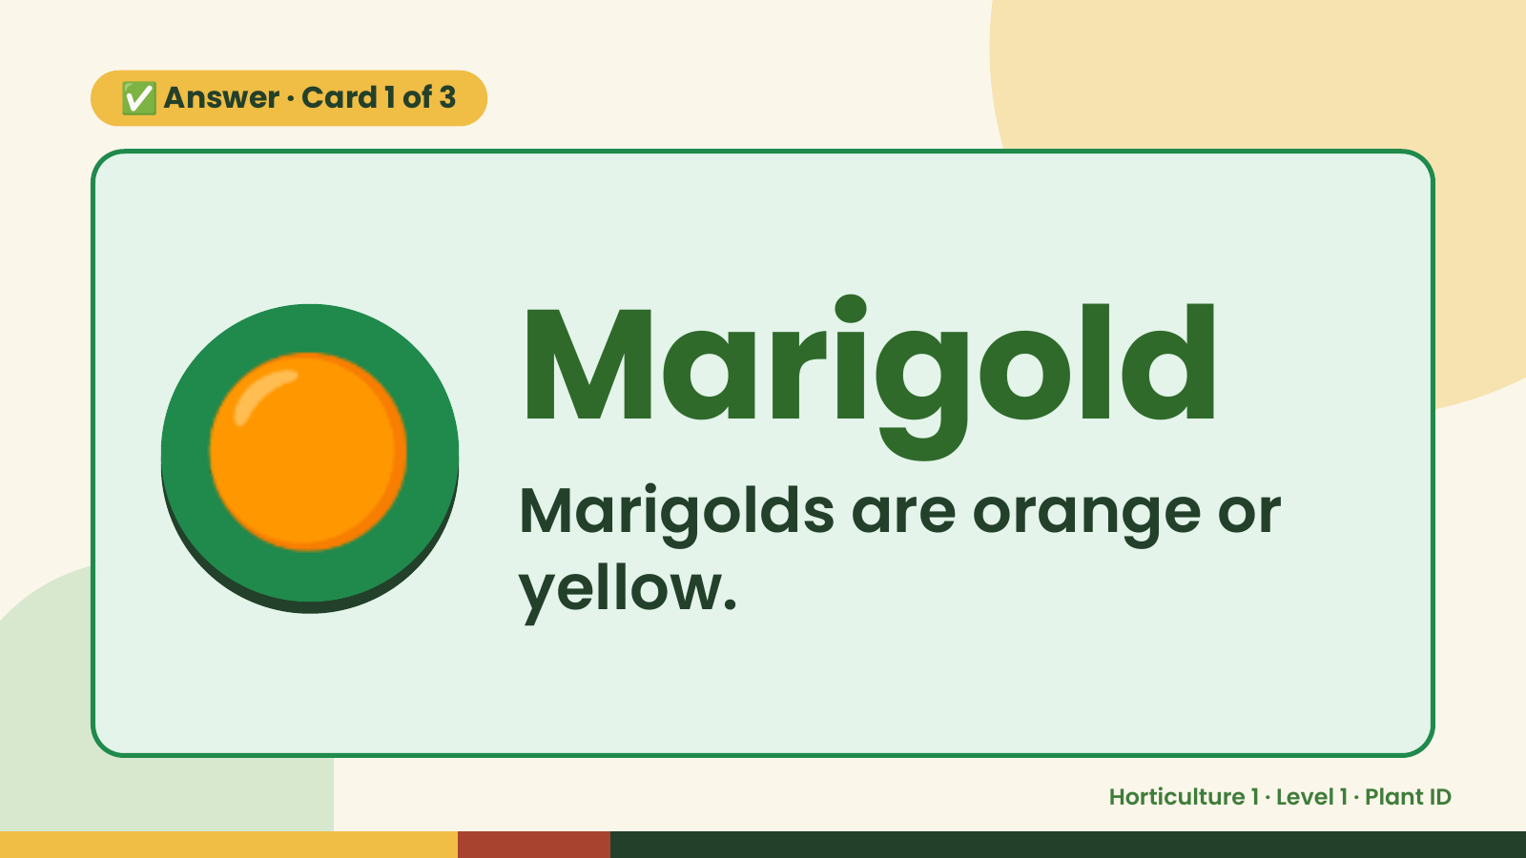
Notes:
✅ Answer · Card 1 of 3
🟠 Marigold
Marigolds are orange or
yellow.
Horticulture 1 · Level 1 · Plant ID

Slide 8
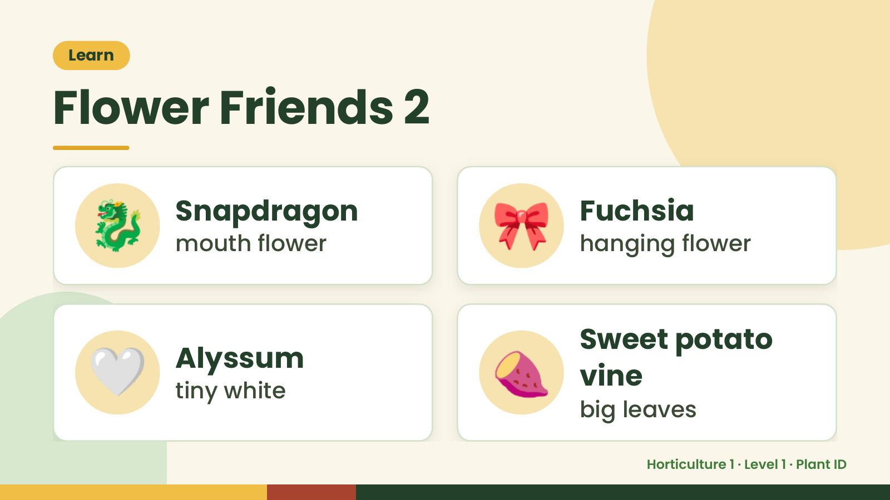
Notes:
Learn
Flower Friends 2
🐉 Snapdragon
mouth flower 🎀 Fuchsia
hanging flower
🤍 Alyssum
tiny white 🍠 Sweet potato
vine
big leaves
Horticulture 1 · Level 1 · Plant ID

Slide 9
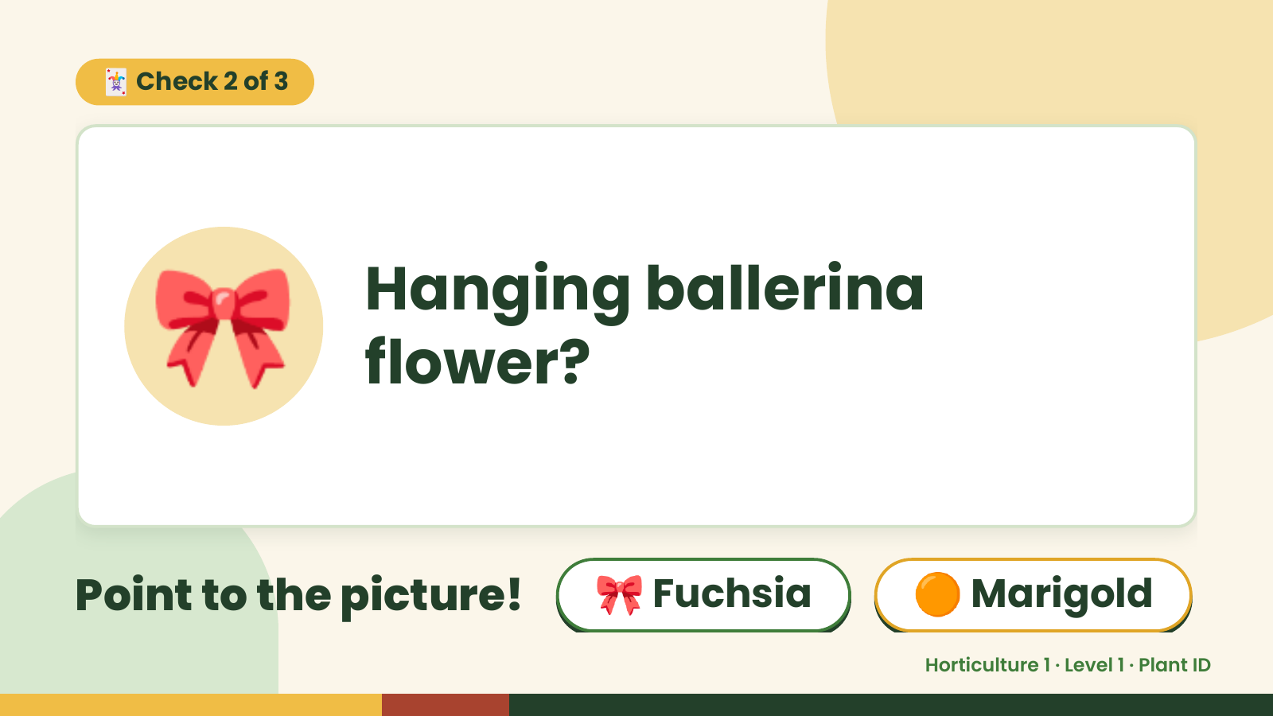
Notes:
🃏 Check 2 of 3
🎀 Hanging ballerina
flower?
Point to the picture! 🎀 Fuchsia 🟠 Marigold
Horticulture 1 · Level 1 · Plant ID

Slide 10
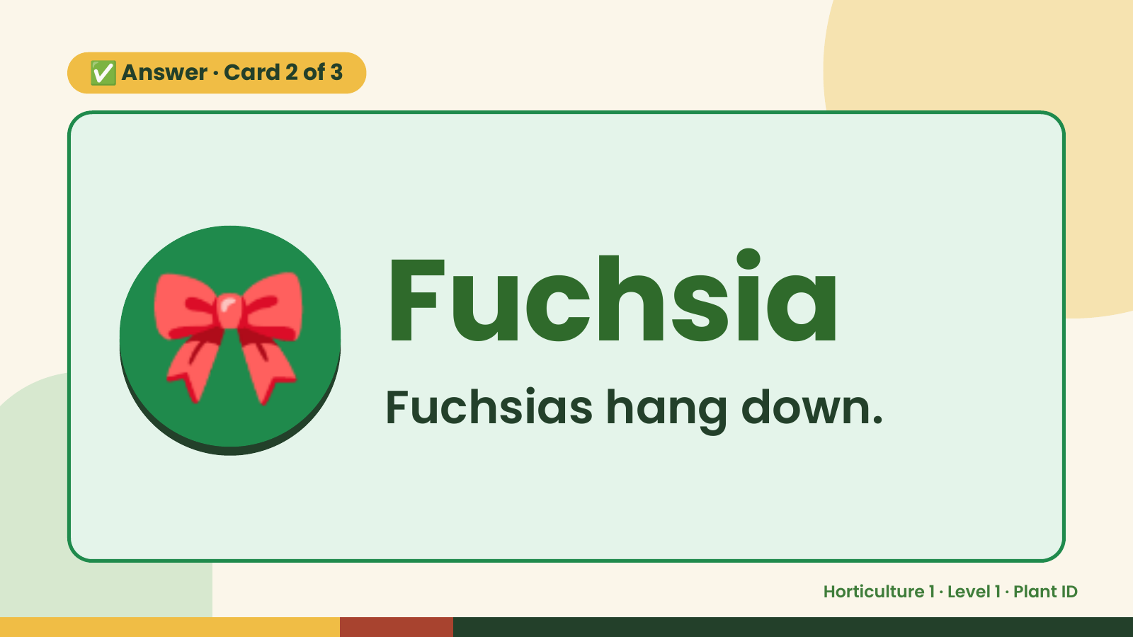
Notes:
✅ Answer · Card 2 of 3
🎀 Fuchsia
Fuchsias hang down.
Horticulture 1 · Level 1 · Plant ID

Slide 11
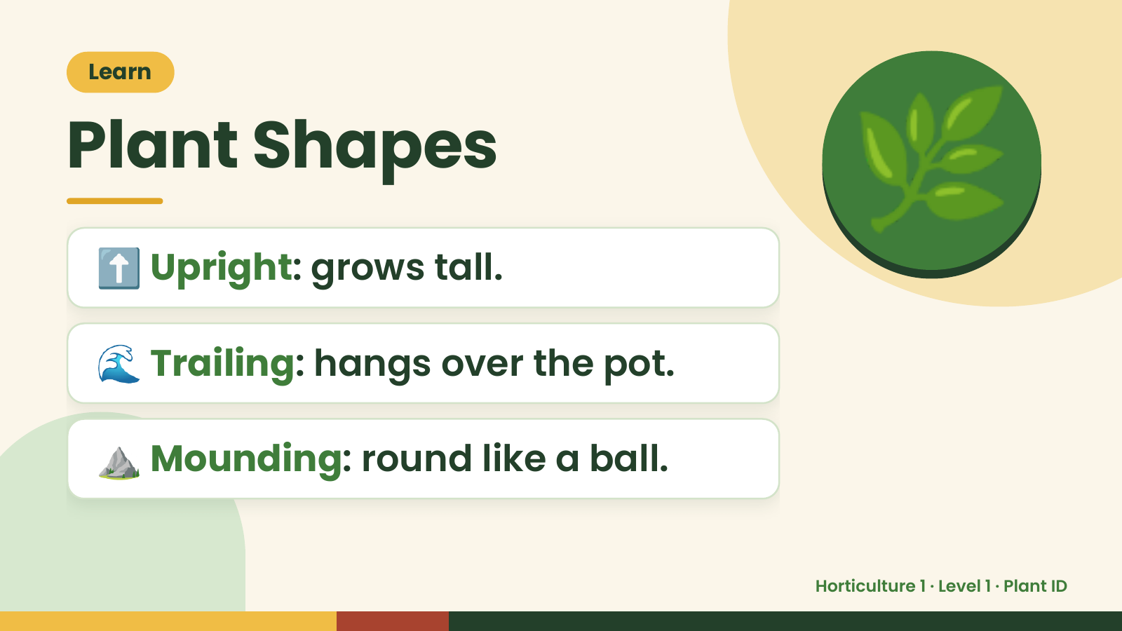
Notes:
Learn
Plant Shapes
⬆️ Upright: grows tall.
🌿
🌊 Trailing: hangs over the pot.
⛰️ Mounding: round like a ball.
Horticulture 1 · Level 1 · Plant ID

Slide 12
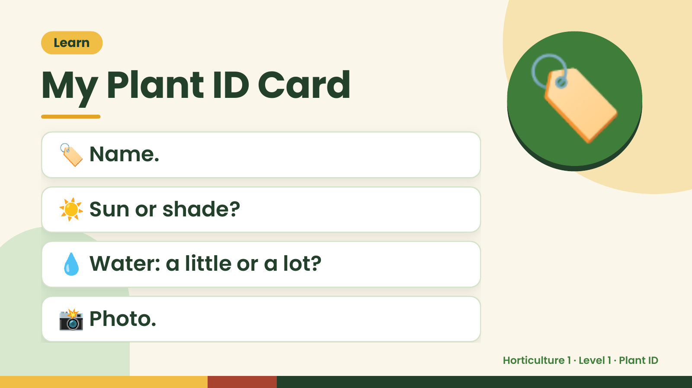
Notes:
Learn
My Plant ID Card
🏷️ Name.
☀️ Sun or shade?
🏷️
💧 Water: a little or a lot?
📸 Photo.
Horticulture 1 · Level 1 · Plant ID

Slide 13
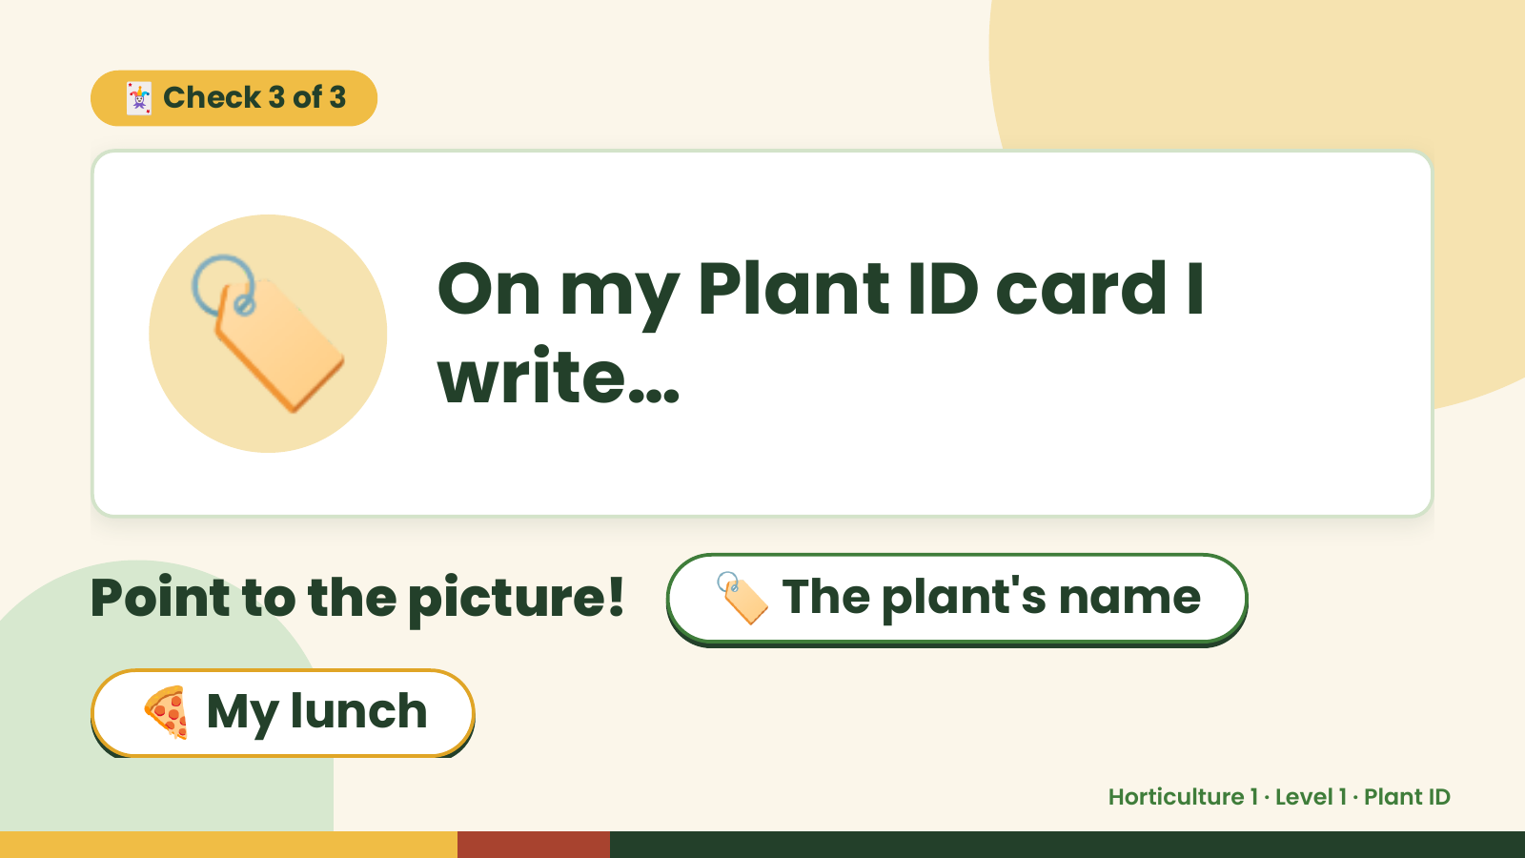
Notes:
🃏 Check 3 of 3
🏷️ On my Plant ID card I
write…
Point to the picture! 🏷️ The plant's name
🍕 My lunch
Horticulture 1 · Level 1 · Plant ID

Slide 14
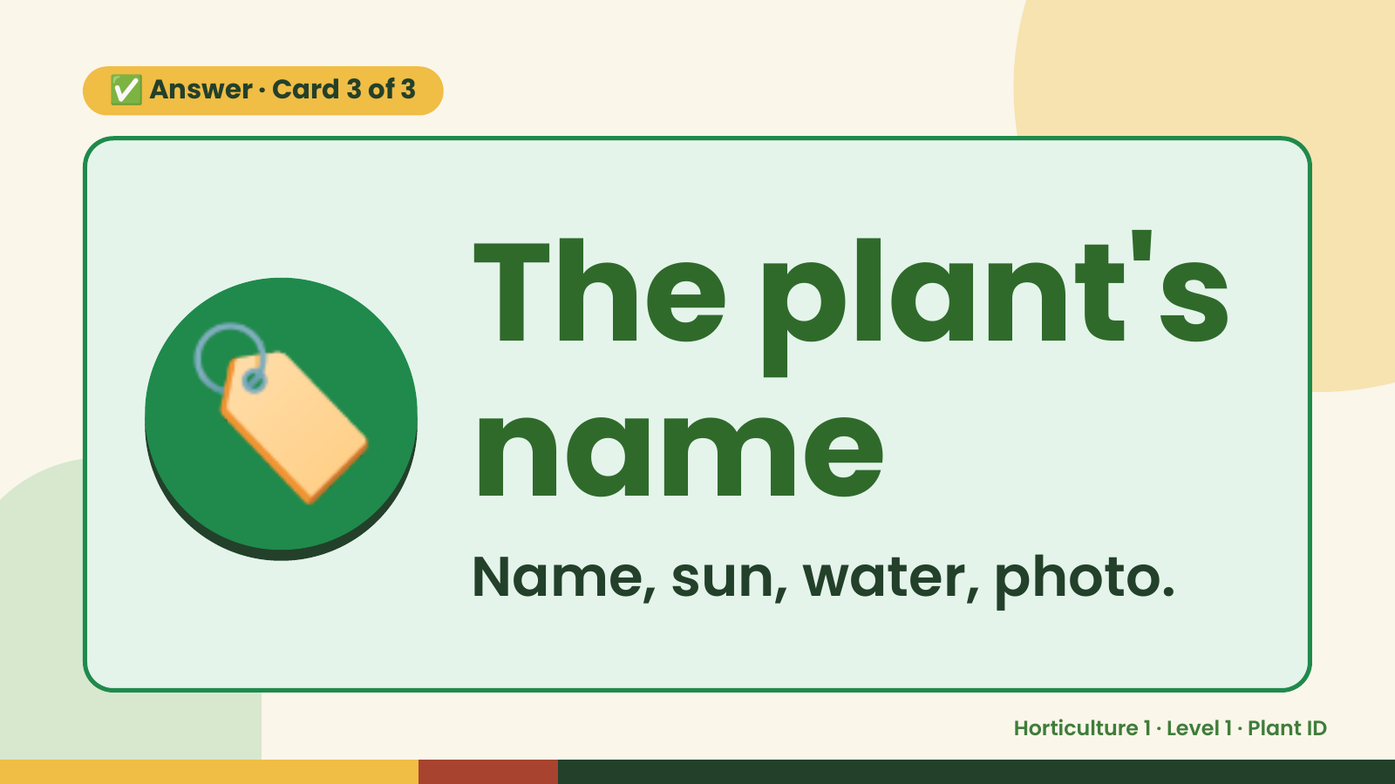
Notes:
✅ Answer · Card 3 of 3
🏷️ The plant's
name
Name, sun, water, photo.
Horticulture 1 · Level 1 · Plant ID

Slide 15
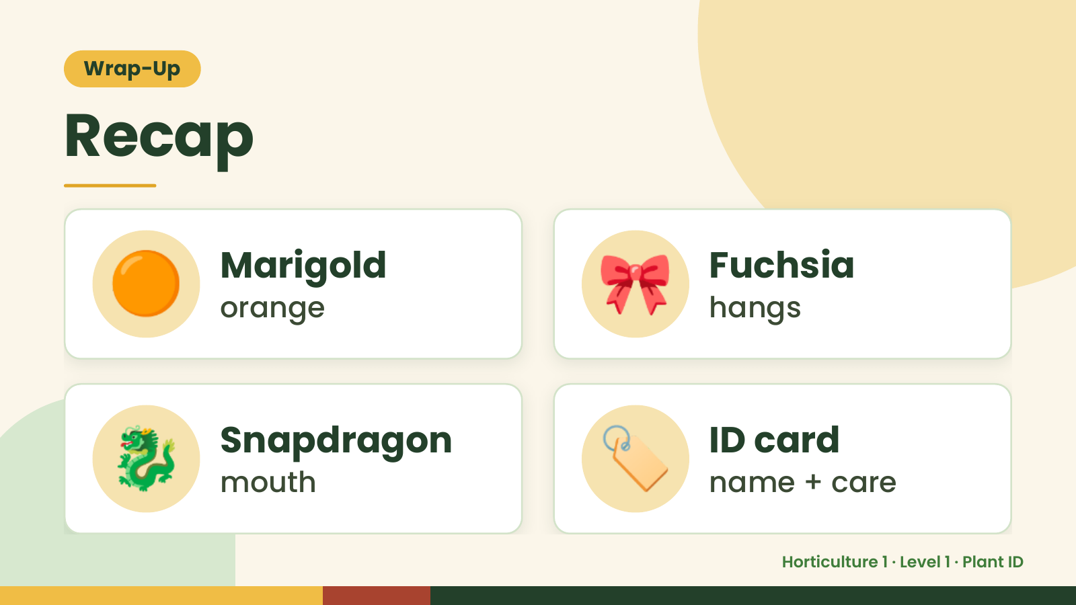
Notes:
Wrap-Up
Recap
🟠 Marigold
orange 🎀 Fuchsia
hangs
🐉 Snapdragon
mouth 🏷️ ID card
name + care
Horticulture 1 · Level 1 · Plant ID

Slide 16
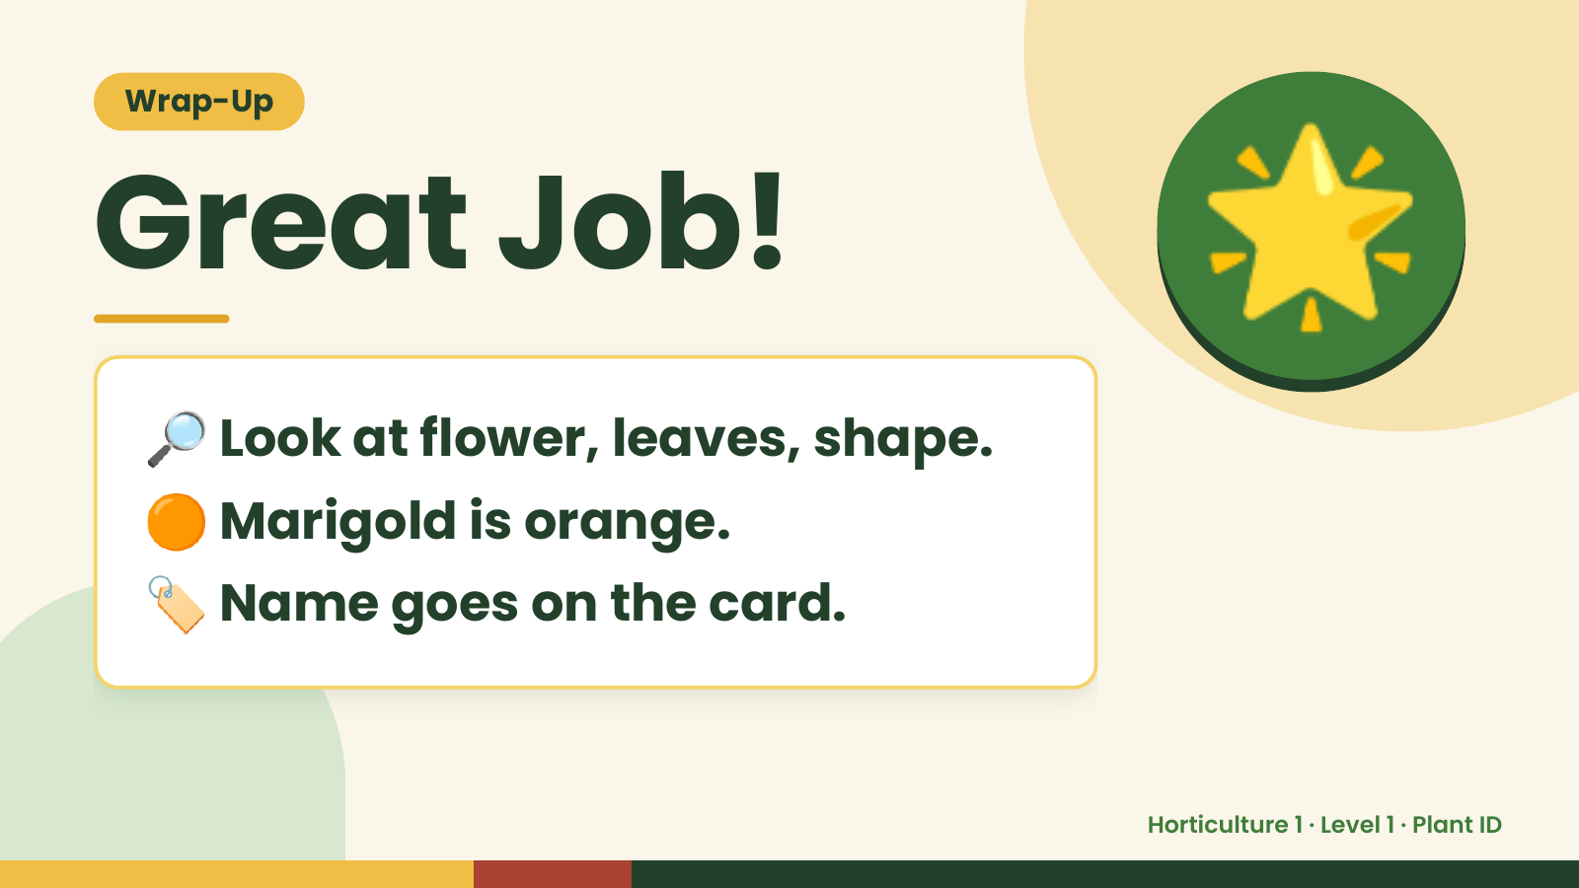
Notes:
Wrap-Up
Great Job!
🔎 Look at flower, leaves, shape.
🌟
🟠 Marigold is orange.
🏷️ Name goes on the card.
Horticulture 1 · Level 1 · Plant ID

