Slide 1
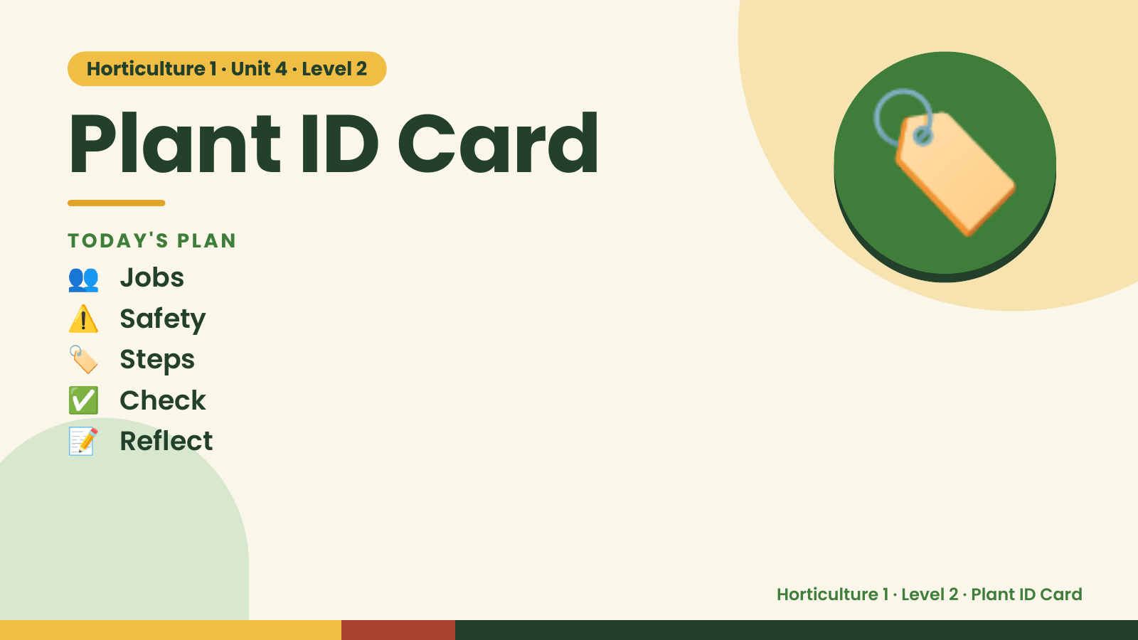
Notes:
Horticulture 1 · Unit 4 · Level 2
Plant ID Card
👥 Jobs
TODAY'S PLAN
⚠️ Safety
🏷️ Steps
🏷️
✅ Check
📝 Reflect
Horticulture 1 · Level 2 · Plant ID Card

Slide 2

Notes:
Get ready
Jobs
🧑‍🌾 Grower
Does the main plant job
with the tools
🧺 Supply helper
Gets and returns supplies
and tools to staff
📸 Recorder
Takes photos and fills in
the chart
🧽 Clean-up captain
Sweeps, wipes tables,
checks hands are
washed
Horticulture 1 · Level 2 · Plant ID Card

Slide 3
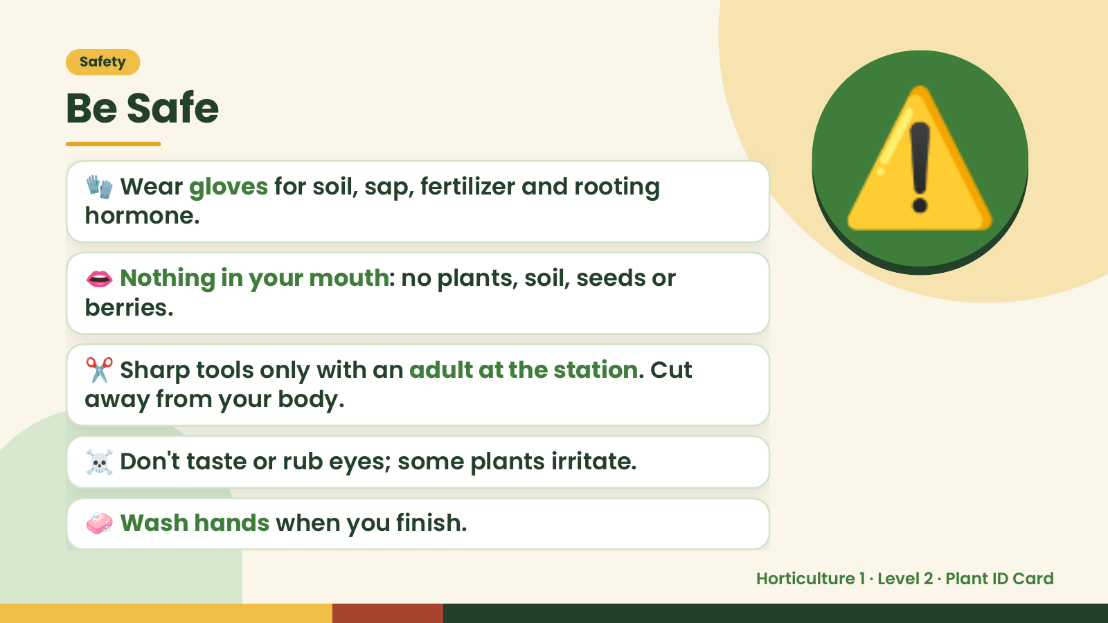
Notes:
Safety
Be Safe
🧤 Wear gloves for soil, sap, fertilizer and rooting
hormone.
👄 Nothing in your mouth: no plants, soil, seeds or
berries.
⚠️
✂️ Sharp tools only with an adult at the station. Cut
away from your body.
☠️ Don't taste or rub eyes; some plants irritate.
🧼 Wash hands when you finish.
Horticulture 1 · Level 2 · Plant ID Card

Slide 4
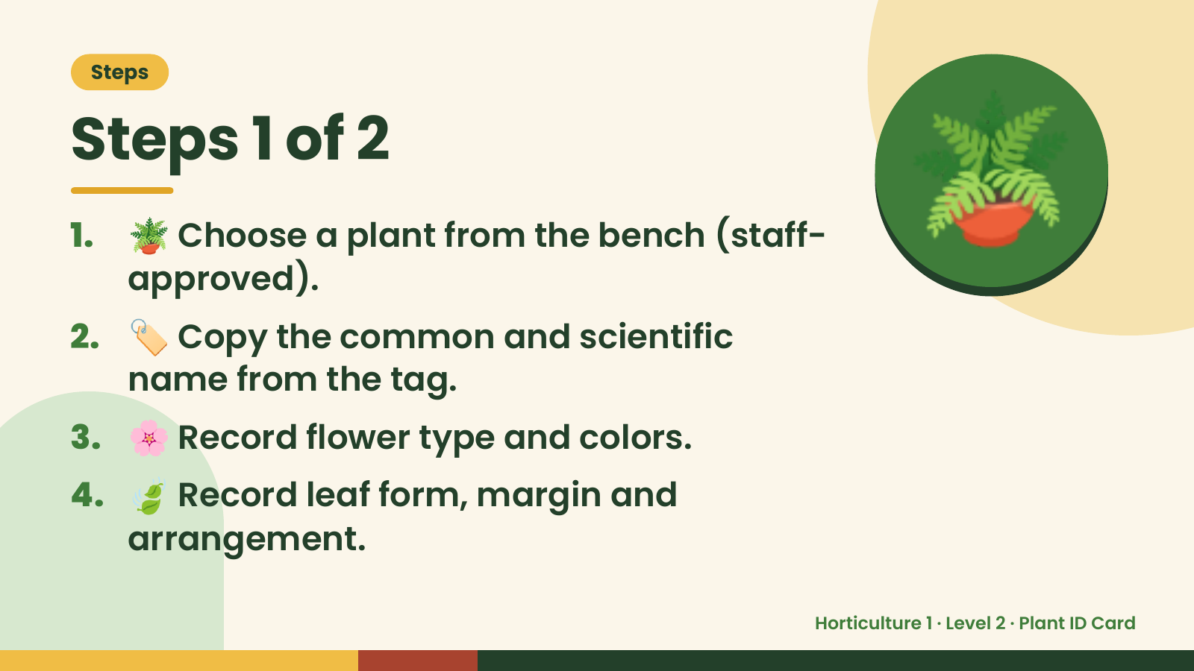
Notes:
Steps
Steps 1 of 2
1. 🪴 Choose a plant from the bench (staff-
approved).
2. 🏷️ Copy the common and scientific
name from the tag.
🪴
3. 🌸 Record flower type and colors.
4. 🍃 Record leaf form, margin and
arrangement.
Horticulture 1 · Level 2 · Plant ID Card

Slide 5
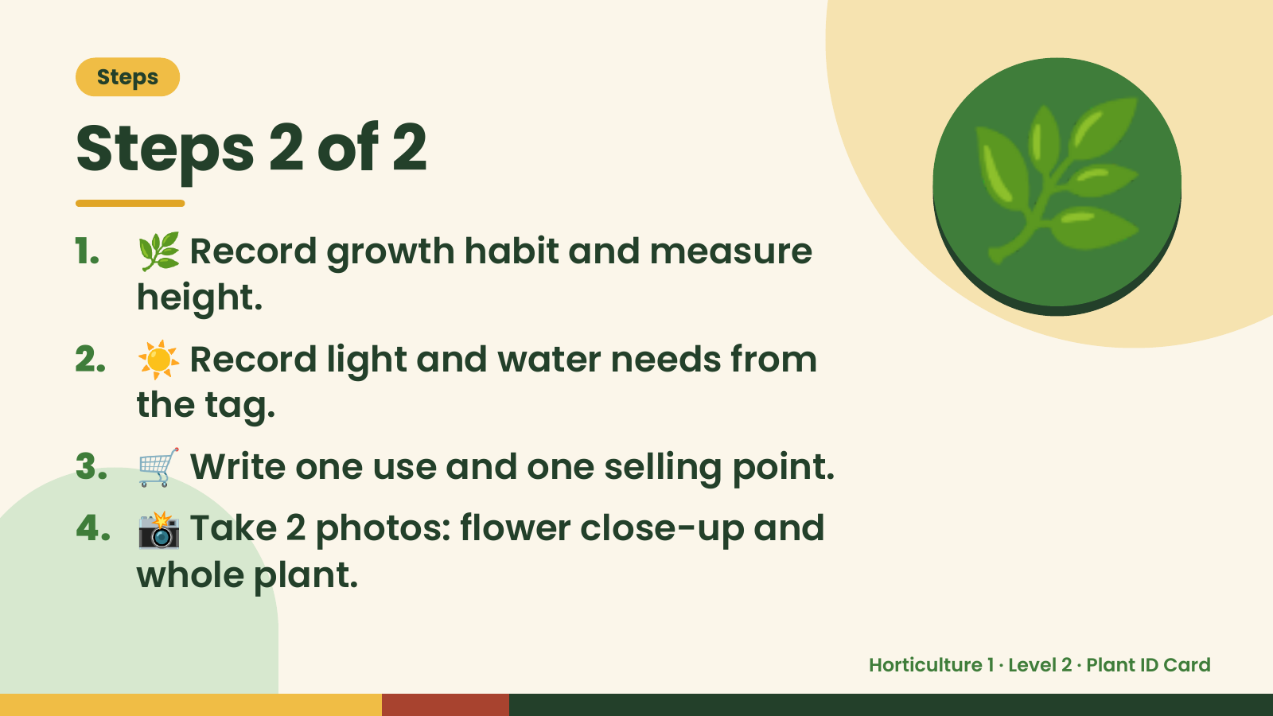
Notes:
Steps
Steps 2 of 2
1. 🌿 Record growth habit and measure
height.
2. ☀️ Record light and water needs from
the tag.
🌿
3. 🛒 Write one use and one selling point.
4. 📸 Take 2 photos: flower close-up and
whole plant.
Horticulture 1 · Level 2 · Plant ID Card

Slide 6
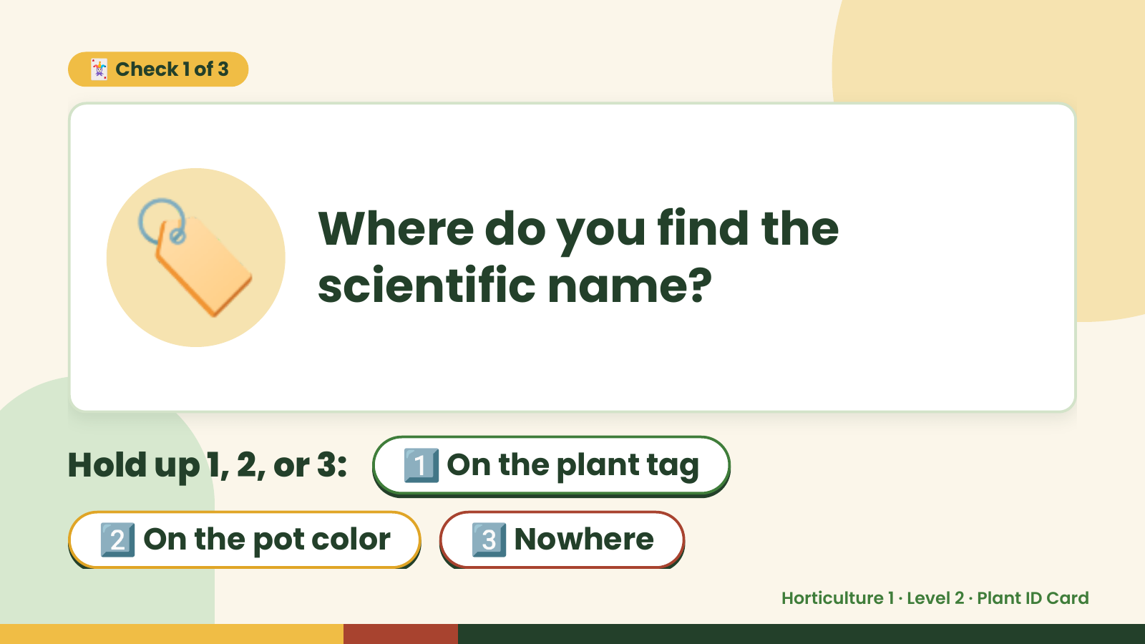
Notes:
🃏 Check 1 of 3
🏷️ Where do you find the
scientific name?
Hold up 1, 2, or 3: 1️⃣ On the plant tag
2️⃣ On the pot color 3️⃣ Nowhere
Horticulture 1 · Level 2 · Plant ID Card

Slide 7
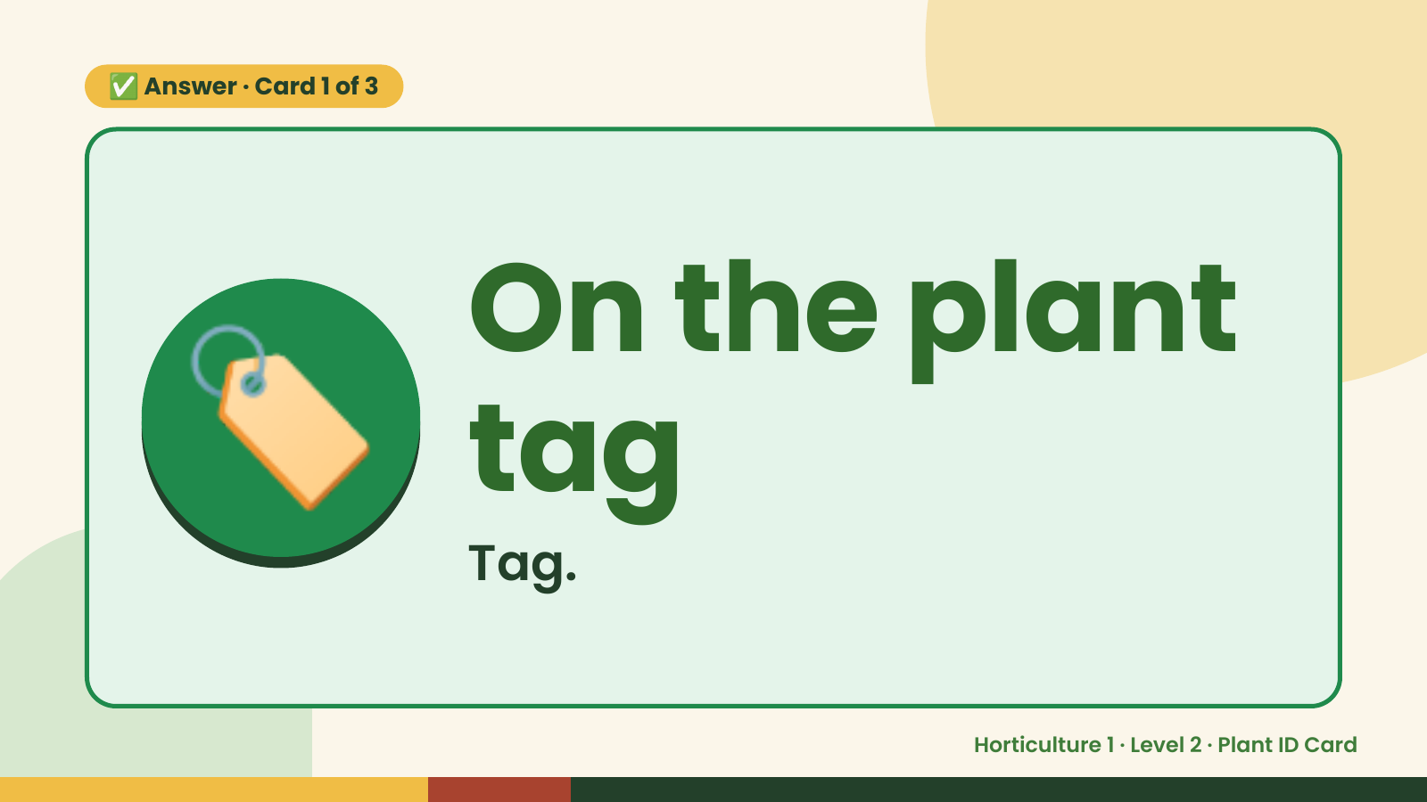
Notes:
✅ Answer · Card 1 of 3
🏷️ On the plant
tag
Tag.
Horticulture 1 · Level 2 · Plant ID Card

Slide 8
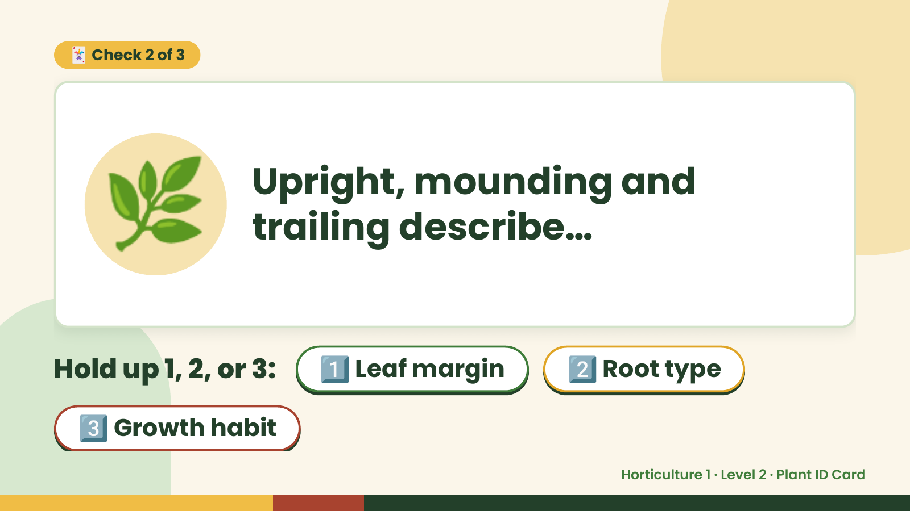
Notes:
🃏 Check 2 of 3
🌿 Upright, mounding and
trailing describe…
Hold up 1, 2, or 3: 1️⃣ Leaf margin 2️⃣ Root type
3️⃣ Growth habit
Horticulture 1 · Level 2 · Plant ID Card

Slide 9
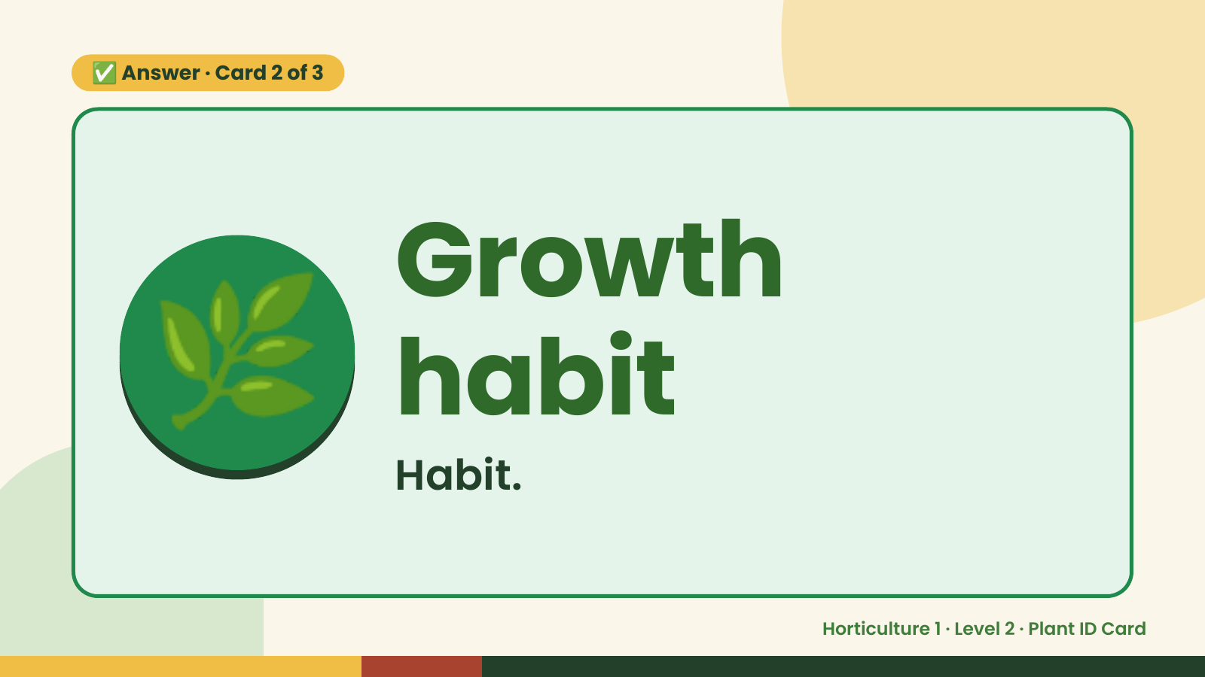
Notes:
✅ Answer · Card 2 of 3
🌿 Growth
habit
Habit.
Horticulture 1 · Level 2 · Plant ID Card

Slide 10
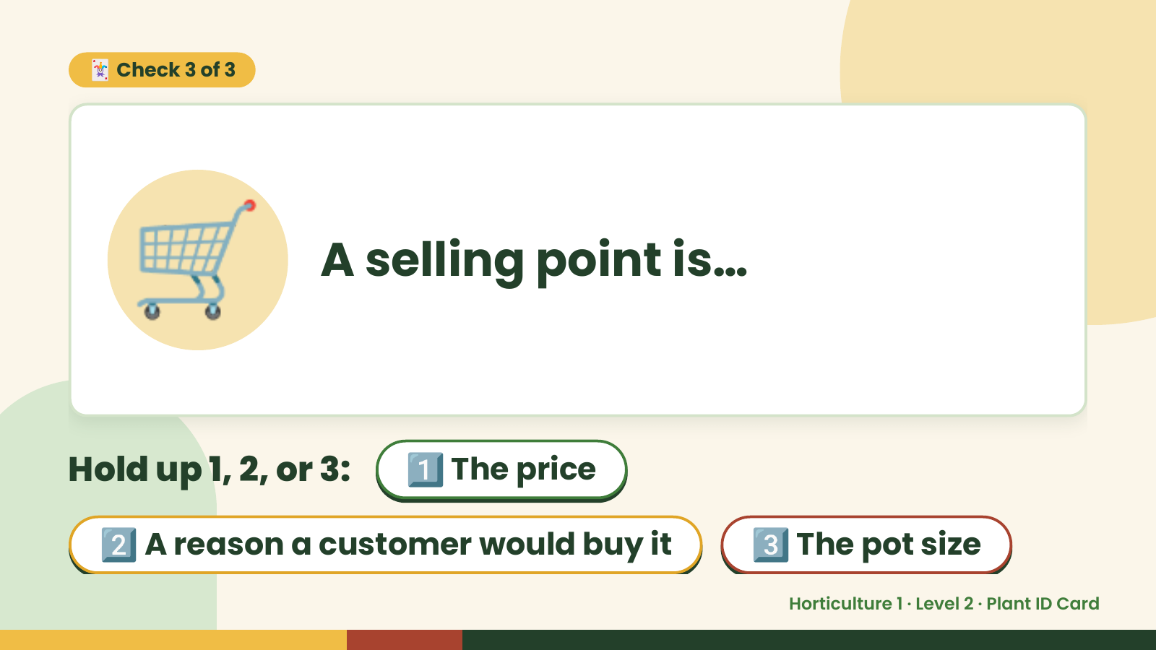
Notes:
🃏 Check 3 of 3
🛒 A selling point is…
Hold up 1, 2, or 3: 1️⃣ The price
2️⃣ A reason a customer would buy it 3️⃣ The pot size
Horticulture 1 · Level 2 · Plant ID Card

Slide 11
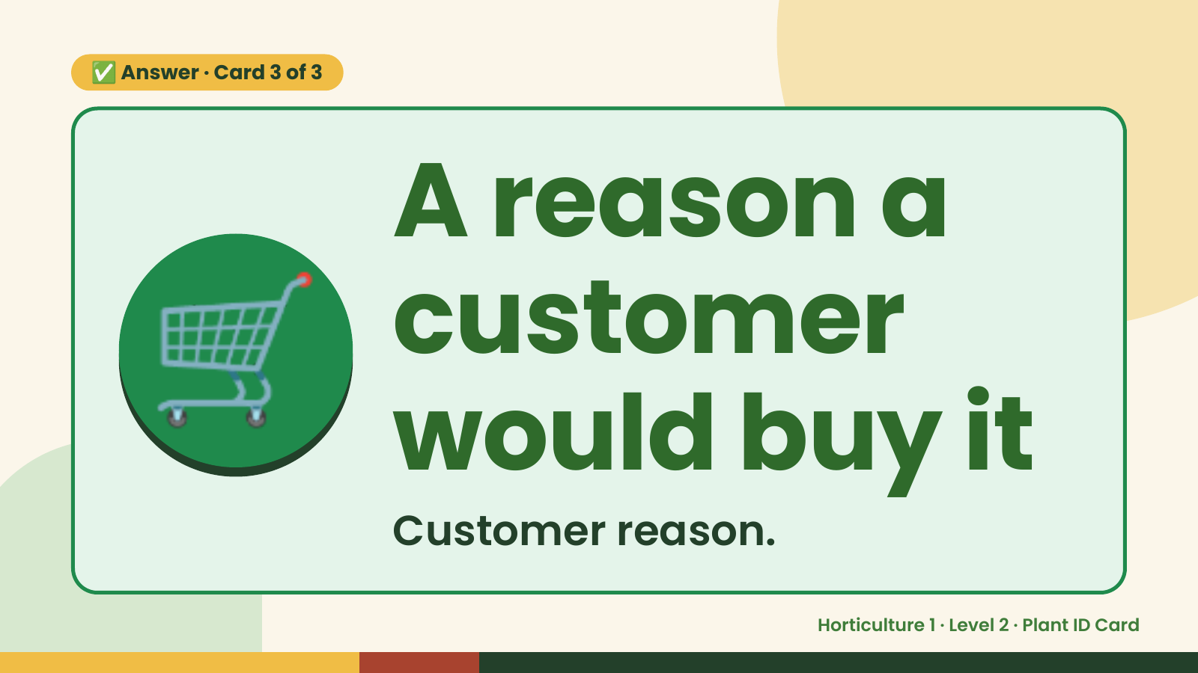
Notes:
✅ Answer · Card 3 of 3
🛒 A reason a
customer
would buy it
Customer reason.
Horticulture 1 · Level 2 · Plant ID Card

Slide 12

Notes:
Wrap-Up
Clean Up +
Reflect
🧽
Return and count tools.
Sweep and wipe your area.
Wash hands, then do the reflection.
Horticulture 1 · Level 2 · Plant ID Card

