Slide 1
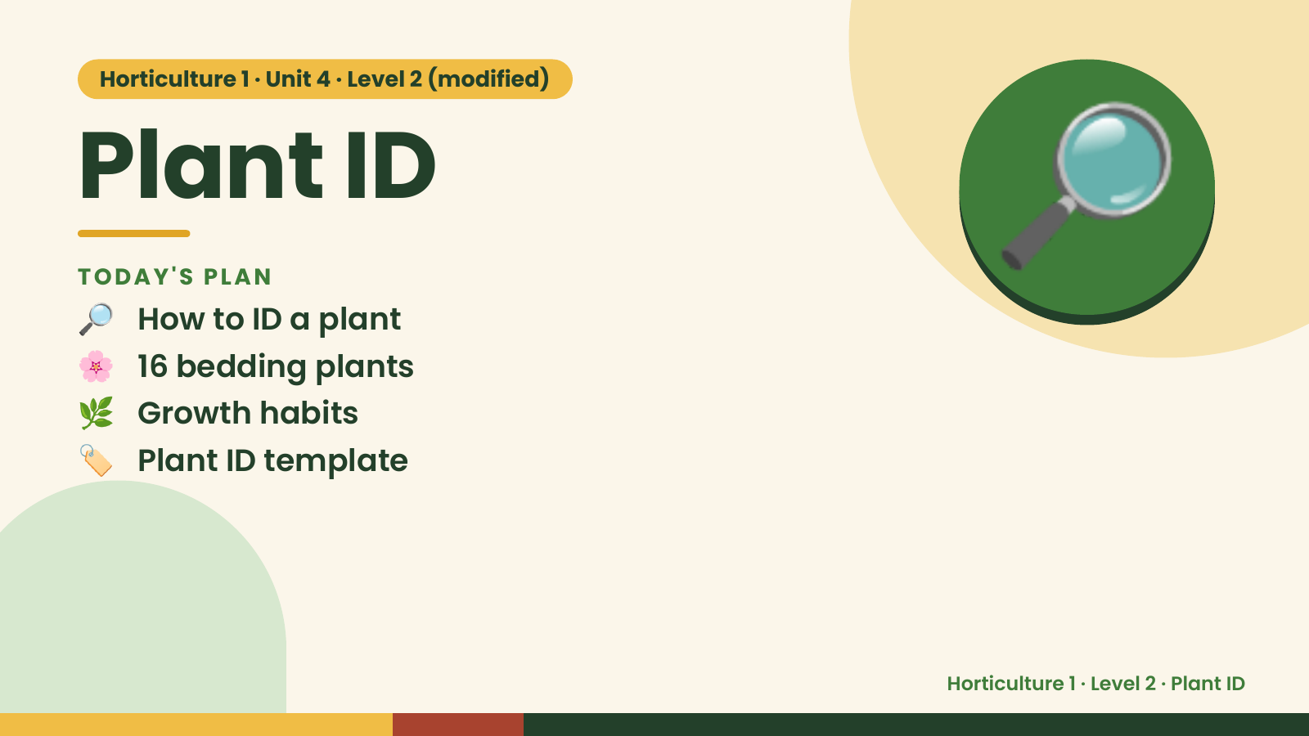
Notes:
Horticulture 1 · Unit 4 · Level 2 (modified)
Plant ID
🔎 How to ID a plant
TODAY'S PLAN
🌸 16 bedding plants
🌿 Growth habits
🔎
🏷️ Plant ID template
Horticulture 1 · Level 2 · Plant ID

Slide 2
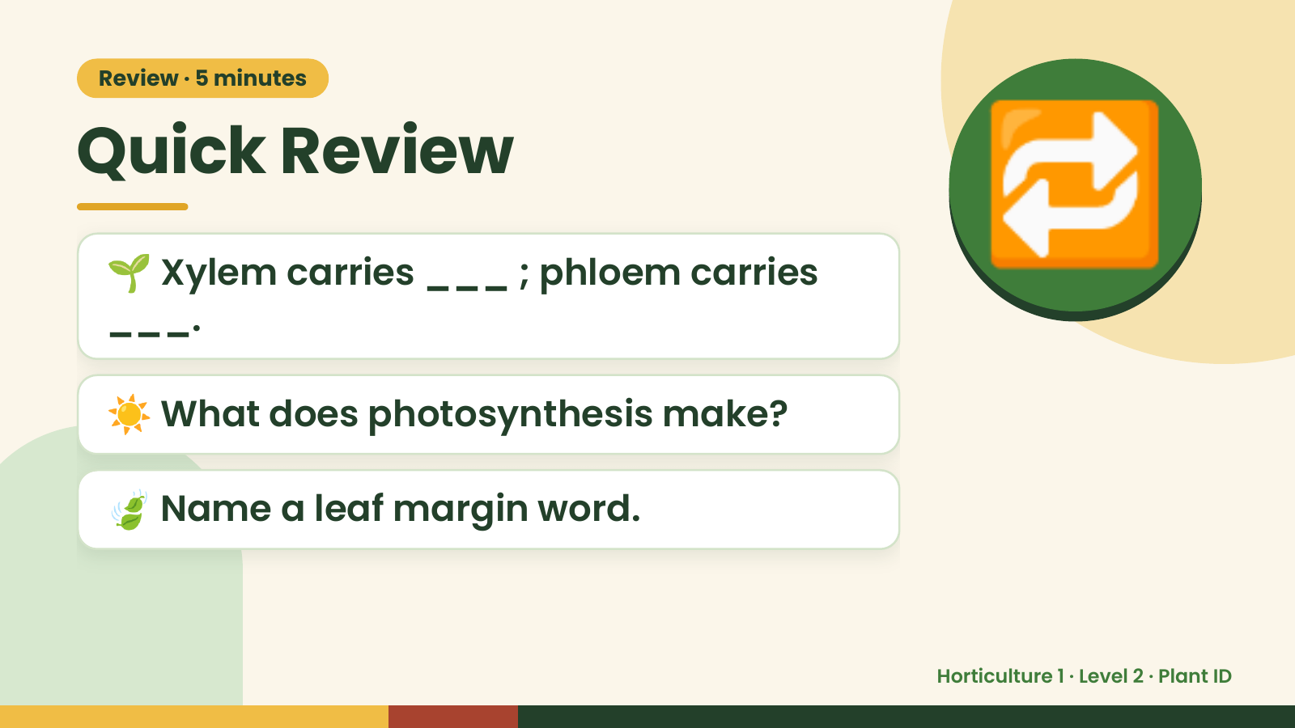
Notes:
Review · 5 minutes
Quick Review
🌱 Xylem carries ___ ; phloem carries
___.
🔁
☀️ What does photosynthesis make?
🍃 Name a leaf margin word.
Horticulture 1 · Level 2 · Plant ID

Slide 3
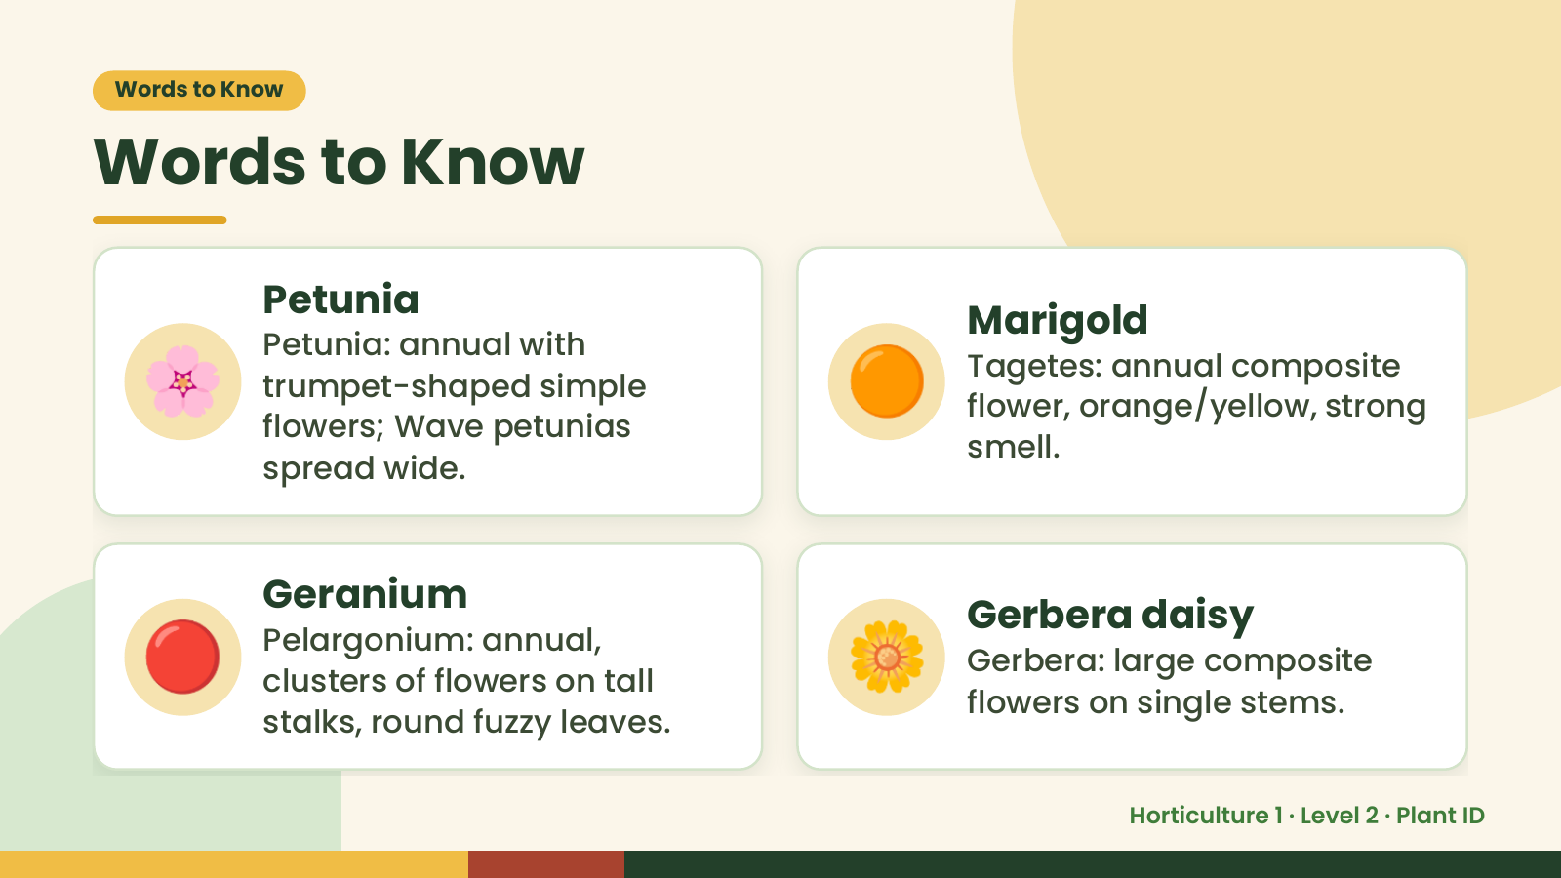
Notes:
Words to Know
Words to Know
🌸 🟠
Petunia
Marigold
Petunia: annual with
Tagetes: annual composite
trumpet-shaped simple
flower, orange/yellow, strong
flowers; Wave petunias
smell.
spread wide.
🔴 Geranium
Pelargonium: annual,
clusters of flowers on tall
stalks, round fuzzy leaves.
🌼 Gerbera daisy
Gerbera: large composite
flowers on single stems.
Horticulture 1 · Level 2 · Plant ID

Slide 4
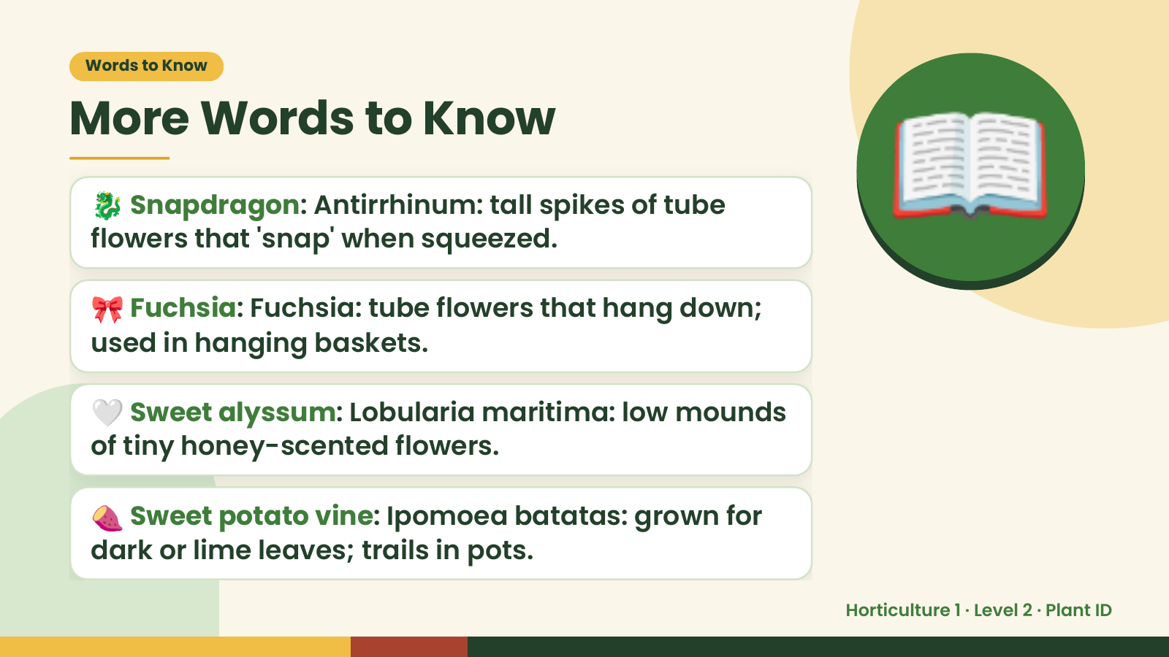
Notes:
Words to Know
More Words to Know
🐉 Snapdragon: Antirrhinum: tall spikes of tube
flowers that 'snap' when squeezed.
🎀 Fuchsia: Fuchsia: tube flowers that hang down;
used in hanging baskets.
📖
🤍 Sweet alyssum: Lobularia maritima: low mounds
of tiny honey-scented flowers.
🍠 Sweet potato vine: Ipomoea batatas: grown for
dark or lime leaves; trails in pots.
Horticulture 1 · Level 2 · Plant ID

Slide 5
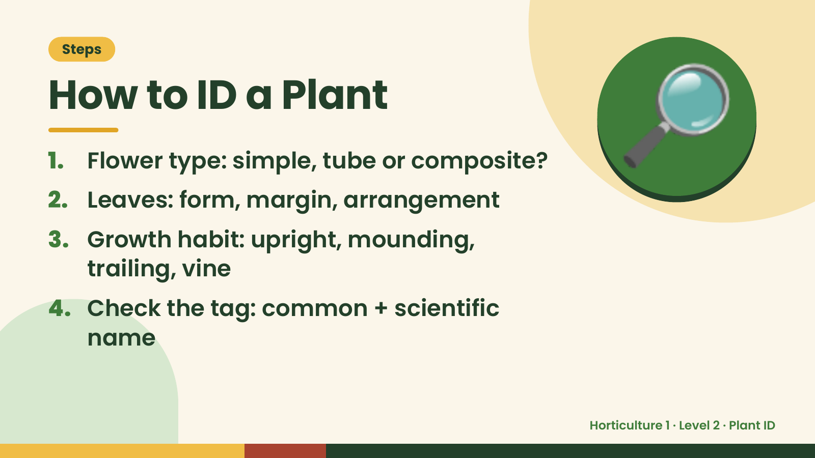
Notes:
Steps
How to ID a Plant
1. Flower type: simple, tube or composite?
2. Leaves: form, margin, arrangement
3. Growth habit: upright, mounding,
🔎
trailing, vine
4. Check the tag: common + scientific
name
Horticulture 1 · Level 2 · Plant ID

Slide 6
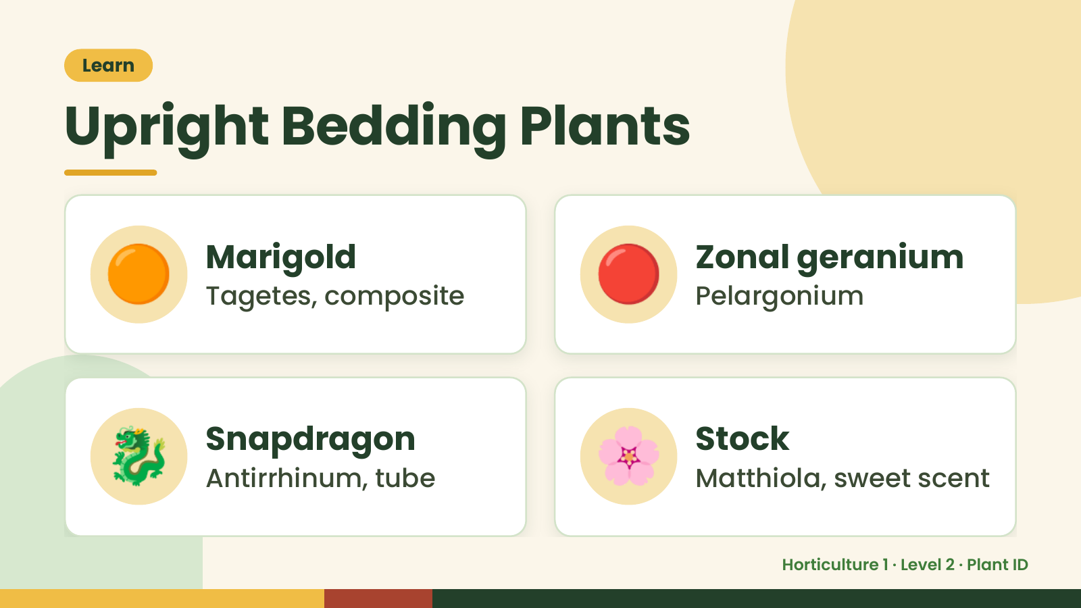
Notes:
Learn
Upright Bedding Plants
🟠 Marigold
Tagetes, composite 🔴 Zonal geranium
Pelargonium
🐉 Snapdragon
Antirrhinum, tube 🌸 Stock
Matthiola, sweet scent
Horticulture 1 · Level 2 · Plant ID

Slide 7
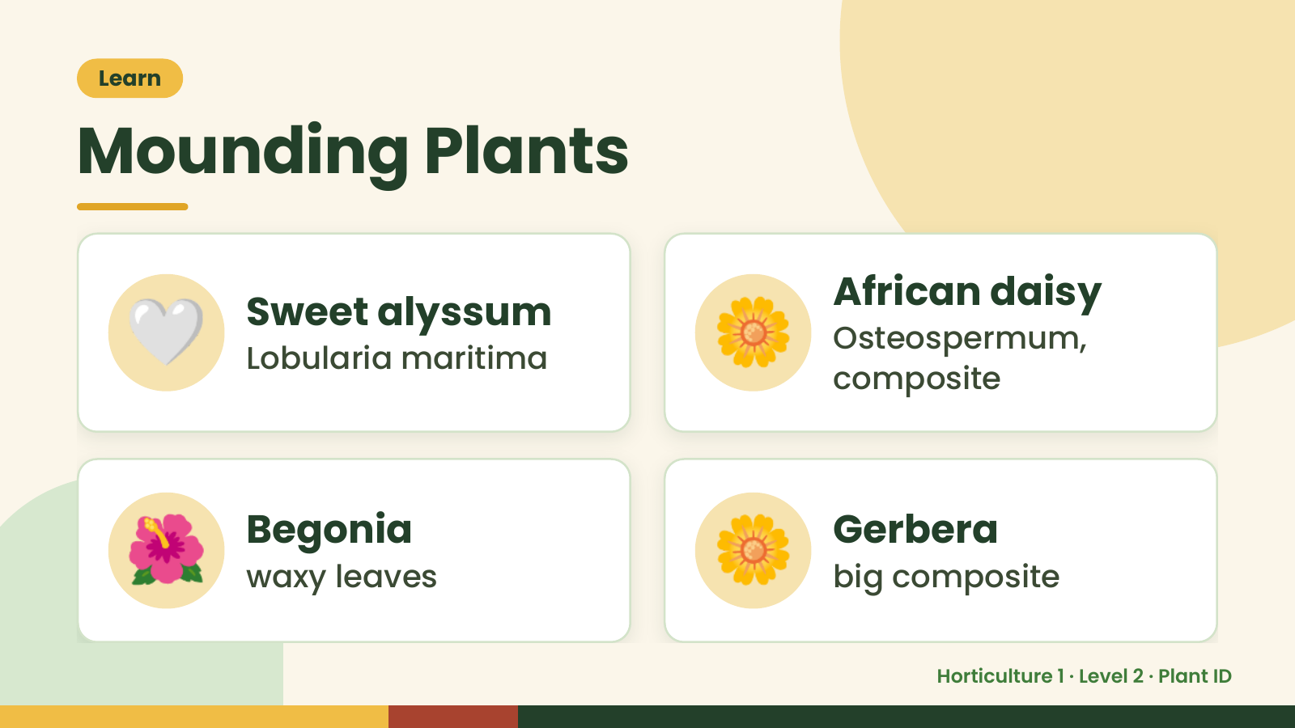
Notes:
Learn
Mounding Plants
🤍 Sweet alyssum
Lobularia maritima 🌼 African daisy
Osteospermum,
composite
🌺 Begonia
waxy leaves 🌼 Gerbera
big composite
Horticulture 1 · Level 2 · Plant ID

Slide 8
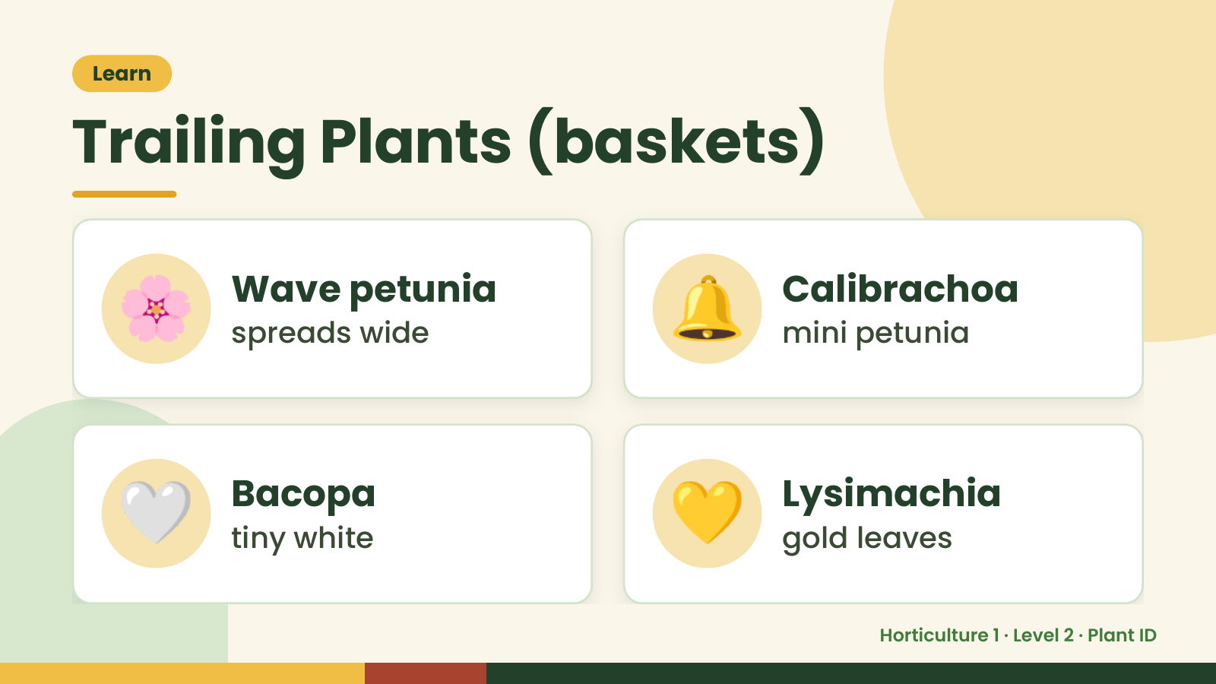
Notes:
Learn
Trailing Plants (baskets)
🌸 Wave petunia
spreads wide 🔔 Calibrachoa
mini petunia
🤍 Bacopa
tiny white 💛 Lysimachia
gold leaves
Horticulture 1 · Level 2 · Plant ID

Slide 9
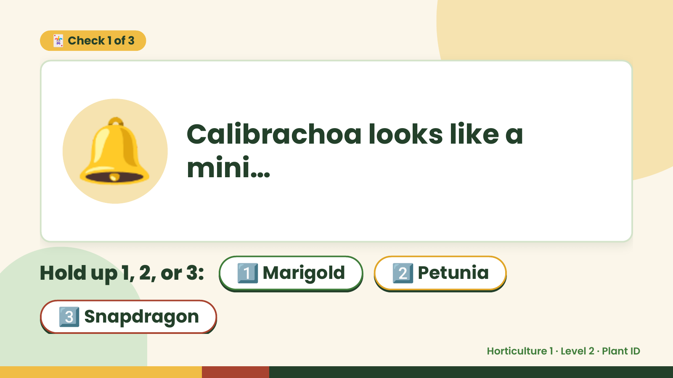
Notes:
🃏 Check 1 of 3
🔔 Calibrachoa looks like a
mini…
Hold up 1, 2, or 3: 1️⃣ Marigold 2️⃣ Petunia
3️⃣ Snapdragon
Horticulture 1 · Level 2 · Plant ID

Slide 10
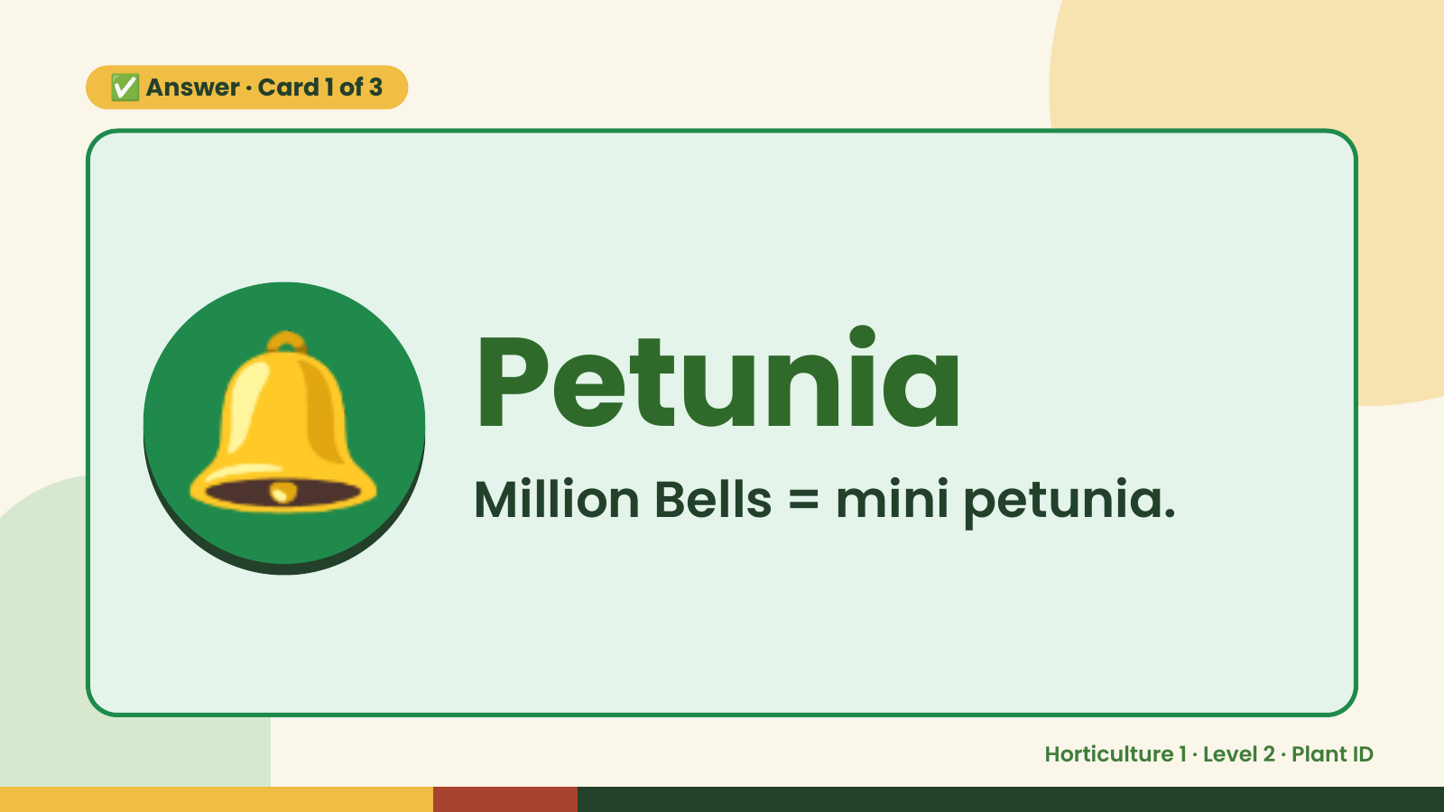
Notes:
✅ Answer · Card 1 of 3
🔔 Petunia
Million Bells = mini petunia.
Horticulture 1 · Level 2 · Plant ID

Slide 11
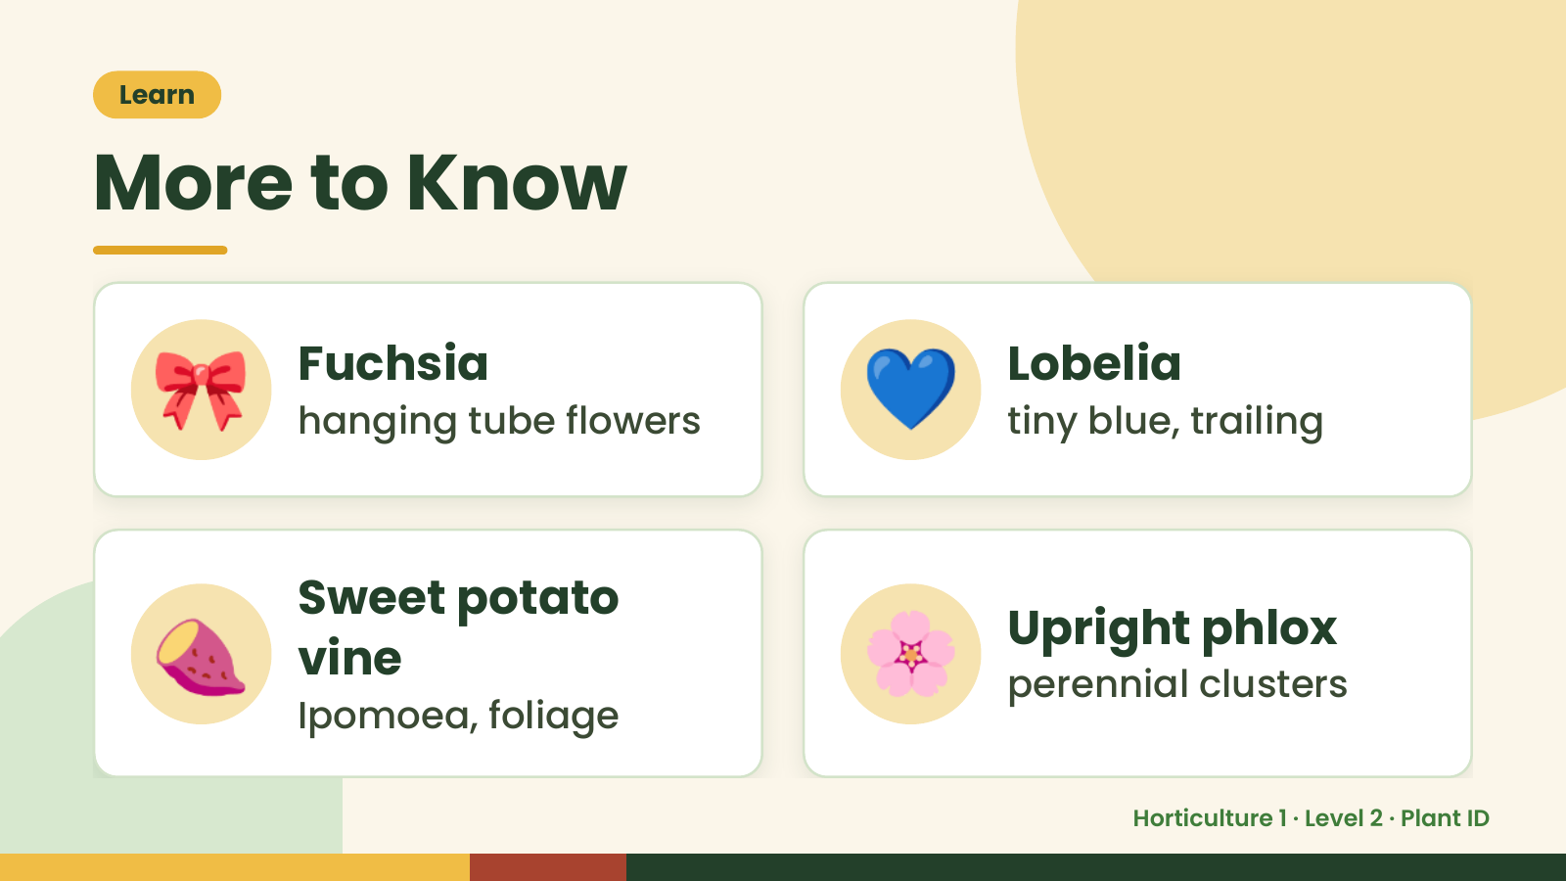
Notes:
Learn
More to Know
🎀 Fuchsia
hanging tube flowers 💙 Lobelia
tiny blue, trailing
🍠 Sweet potato
vine
Ipomoea, foliage
🌸 Upright phlox
perennial clusters
Horticulture 1 · Level 2 · Plant ID

Slide 12
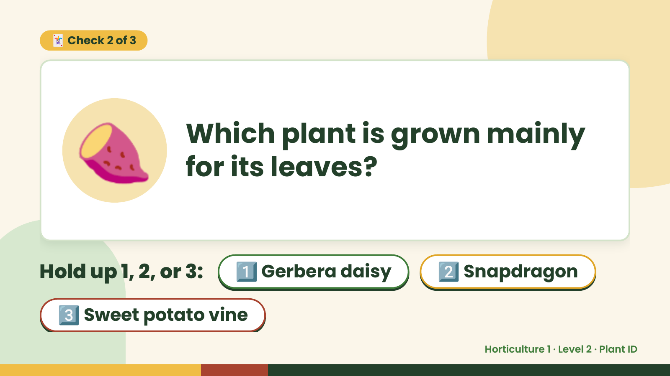
Notes:
🃏 Check 2 of 3
🍠 Which plant is grown mainly
for its leaves?
Hold up 1, 2, or 3: 1️⃣ Gerbera daisy 2️⃣ Snapdragon
3️⃣ Sweet potato vine
Horticulture 1 · Level 2 · Plant ID

Slide 13
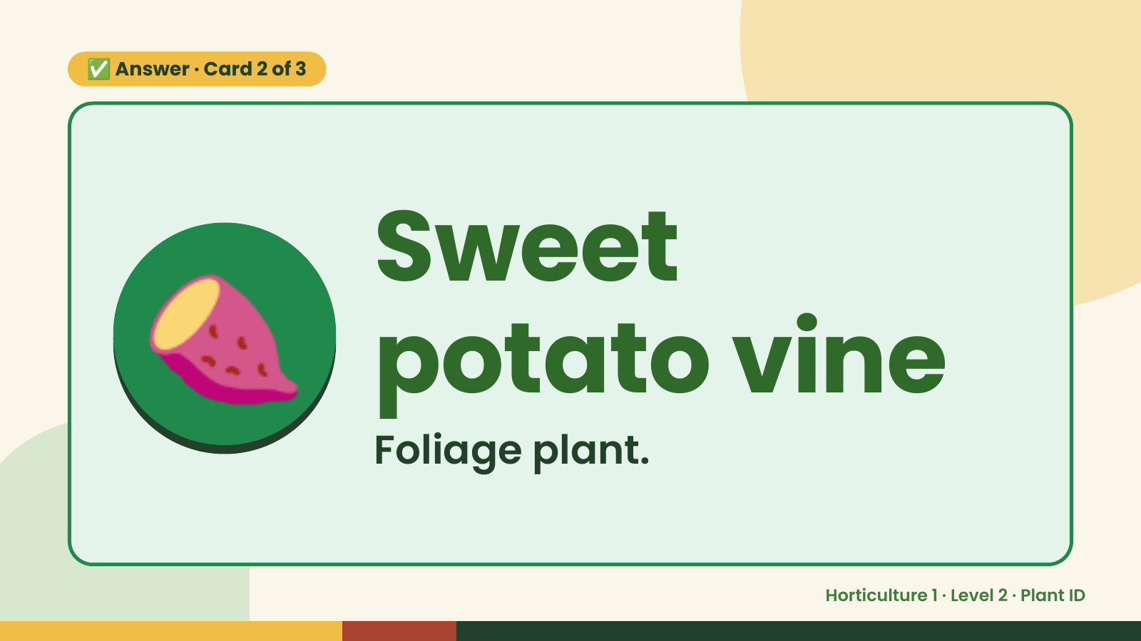
Notes:
✅ Answer · Card 2 of 3
🍠 Sweet
potato vine
Foliage plant.
Horticulture 1 · Level 2 · Plant ID

Slide 14
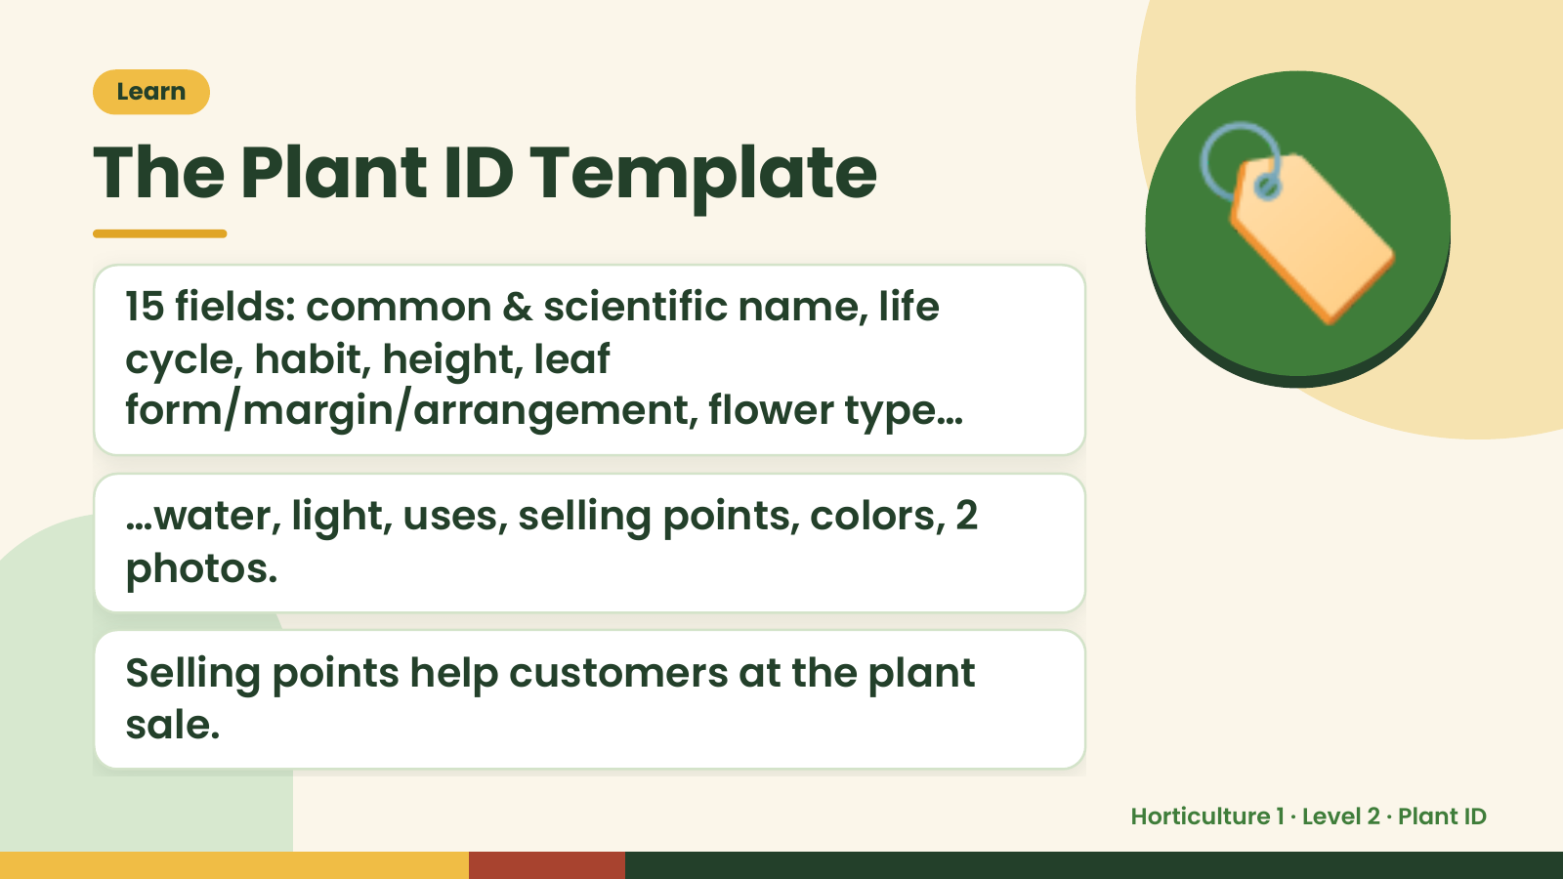
Notes:
Learn
The Plant ID Template
15 fields: common & scientific name, life
cycle, habit, height, leaf
form/margin/arrangement, flower type…
🏷️
…water, light, uses, selling points, colors, 2
photos.
Selling points help customers at the plant
sale.
Horticulture 1 · Level 2 · Plant ID

Slide 15
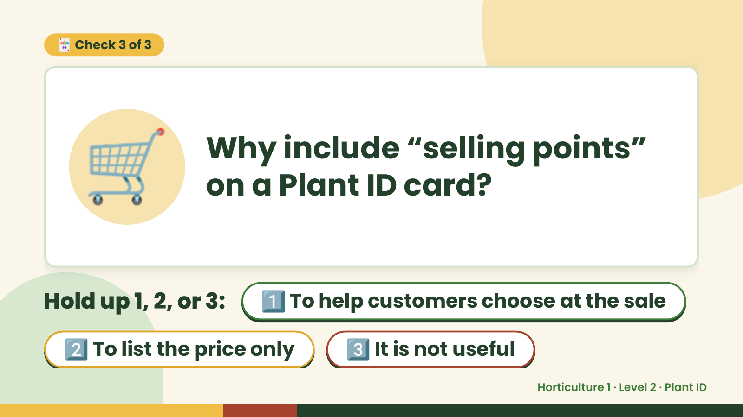
Notes:
🃏 Check 3 of 3
🛒 Why include “selling points”
on a Plant ID card?
Hold up 1, 2, or 3: 1️⃣ To help customers choose at the sale
2️⃣ To list the price only 3️⃣ It is not useful
Horticulture 1 · Level 2 · Plant ID

Slide 16

Notes:
✅ Answer · Card 3 of 3
🛒
To help
customers
choose at the
sale
Customer advice.
Horticulture 1 · Level 2 · Plant ID

Slide 17
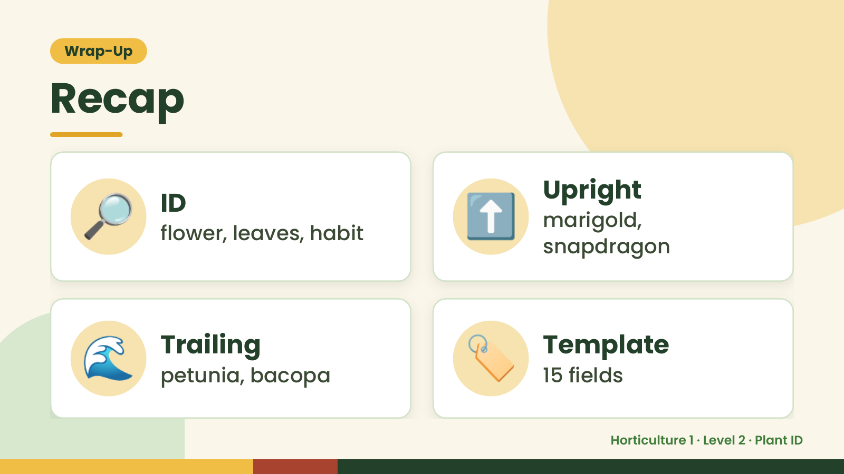
Notes:
Wrap-Up
Recap
🔎 ID
flower, leaves, habit ⬆️ Upright
marigold,
snapdragon
🌊 Trailing
petunia, bacopa 🏷️ Template
15 fields
Horticulture 1 · Level 2 · Plant ID

Slide 18
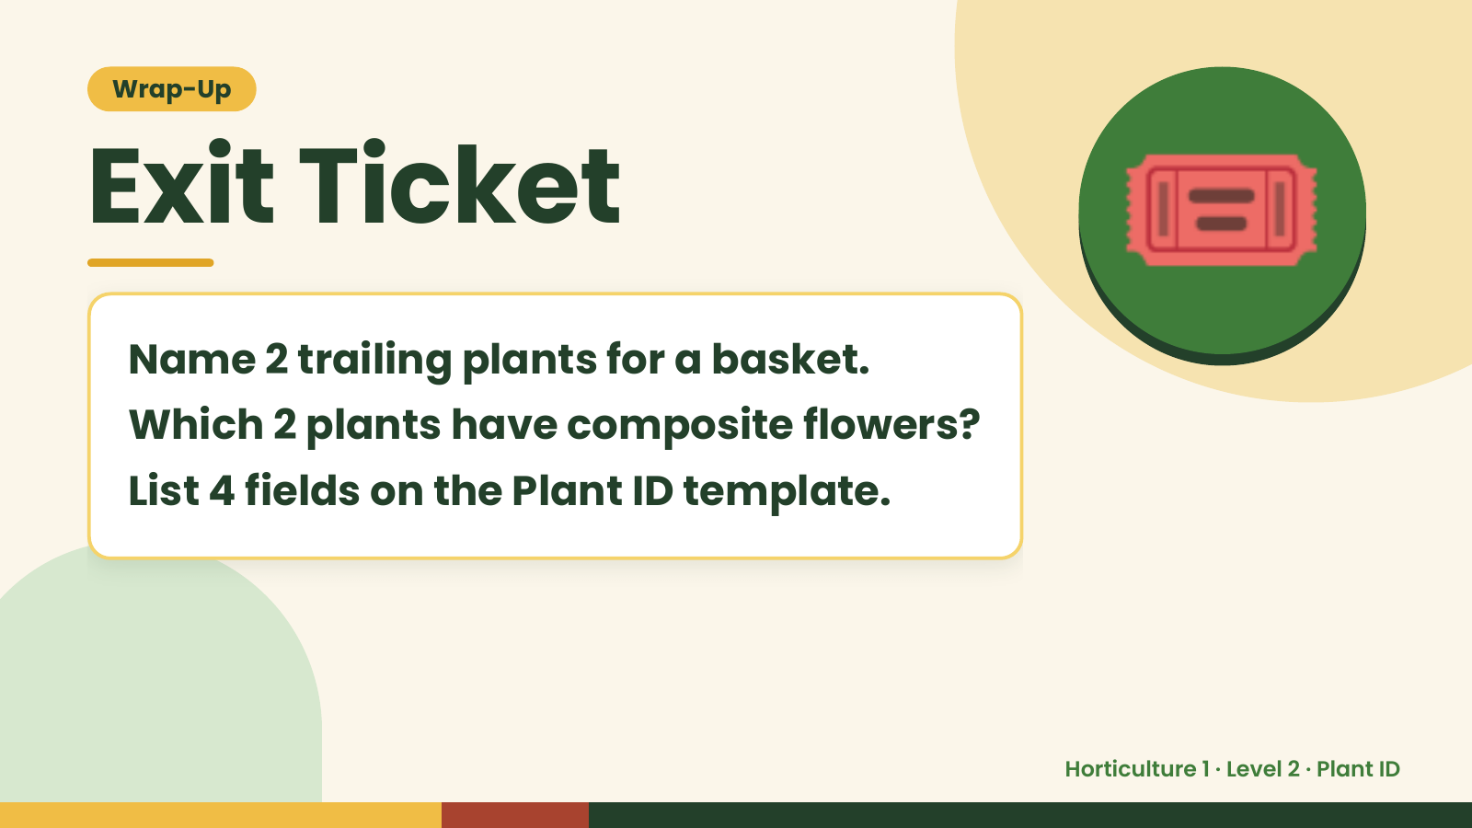
Notes:
Wrap-Up
Exit Ticket
Name 2 trailing plants for a basket.
Which 2 plants have composite flowers?
🎟️
List 4 fields on the Plant ID template.
Horticulture 1 · Level 2 · Plant ID

