Slide 1
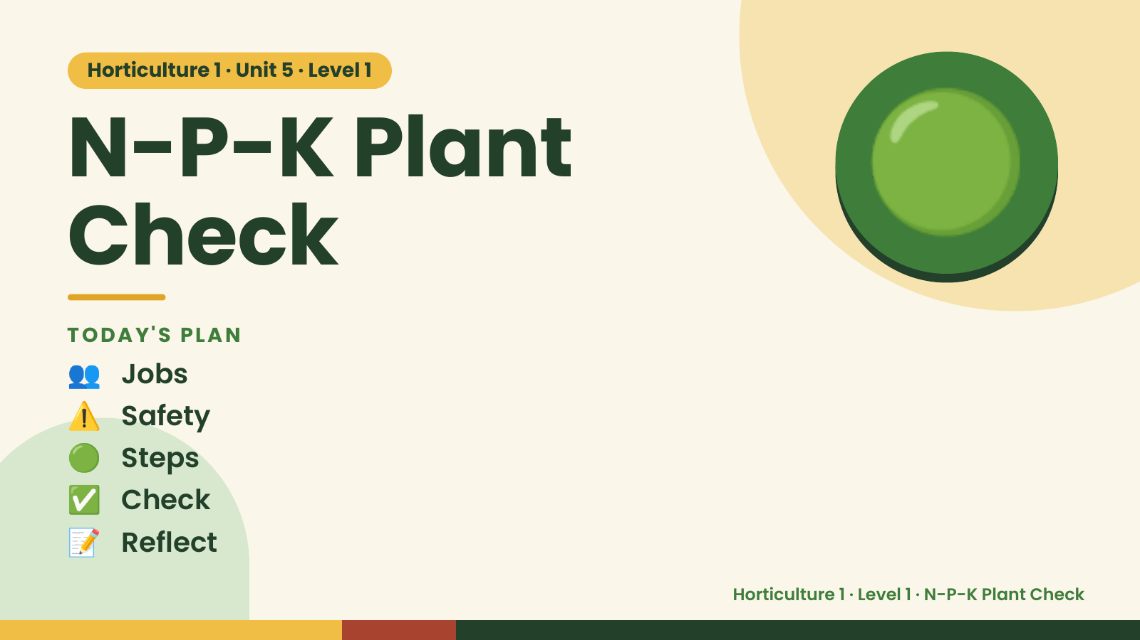
Notes:
Horticulture 1 · Unit 5 · Level 1
N-P-K Plant
Check
TODAY'S PLAN
🟢
👥 Jobs
⚠️ Safety
🟢 Steps
✅ Check
📝 Reflect
Horticulture 1 · Level 1 · N-P-K Plant Check

Slide 2

Notes:
Get ready
Jobs
🧑‍🌾 Grower
plants 🧺 Supply helper
gets tools
📸 Recorder
photos 🧽 Clean-up
captain
cleans
Horticulture 1 · Level 1 · N-P-K Plant Check

Slide 3
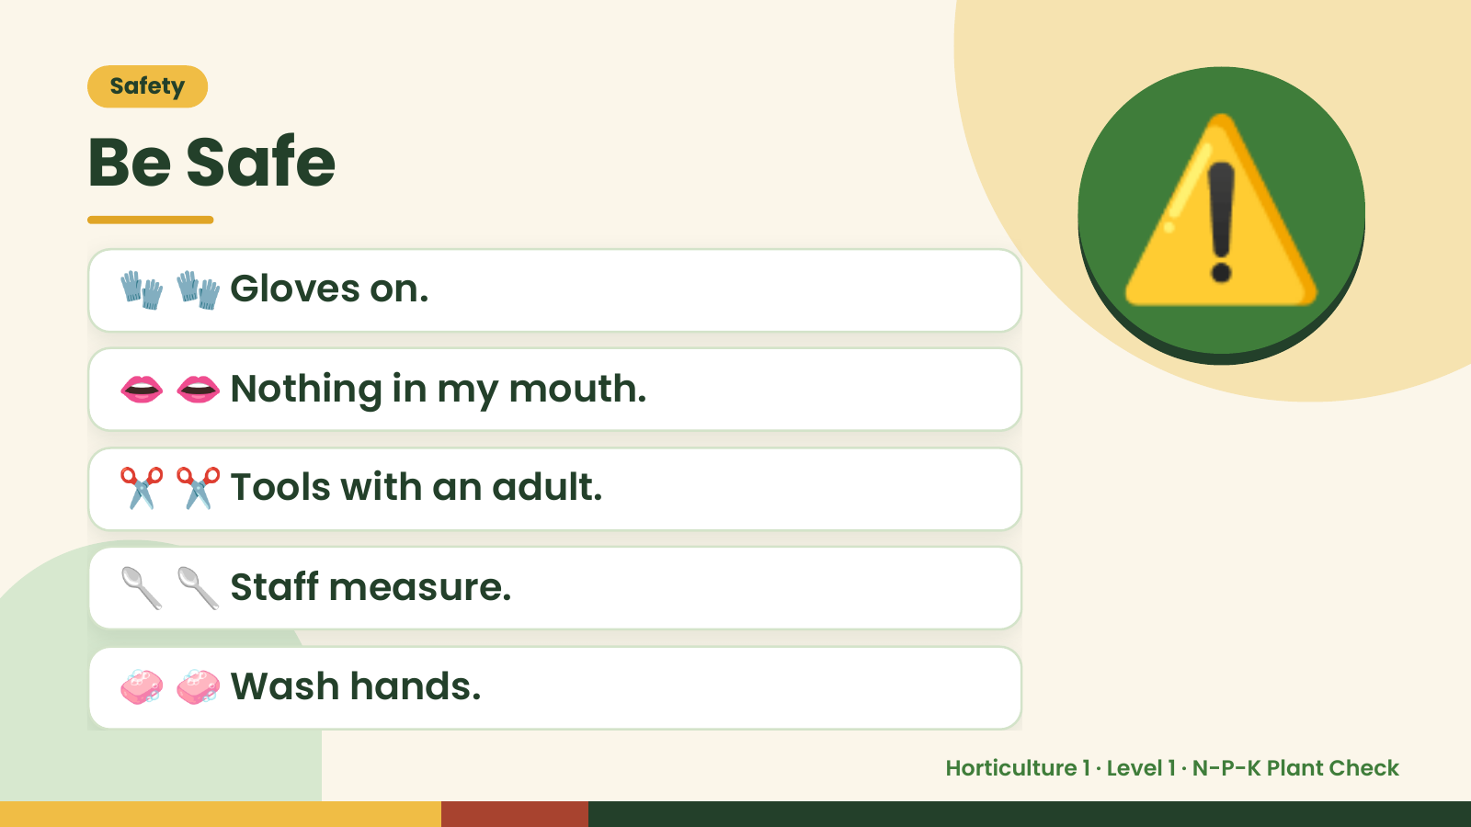
Notes:
Safety
Be Safe
🧤 🧤 Gloves on.
👄 👄 Nothing in my mouth.
⚠️
✂️ ✂️ Tools with an adult.
🥄 🥄 Staff measure.
🧼 🧼 Wash hands.
Horticulture 1 · Level 1 · N-P-K Plant Check

Slide 4
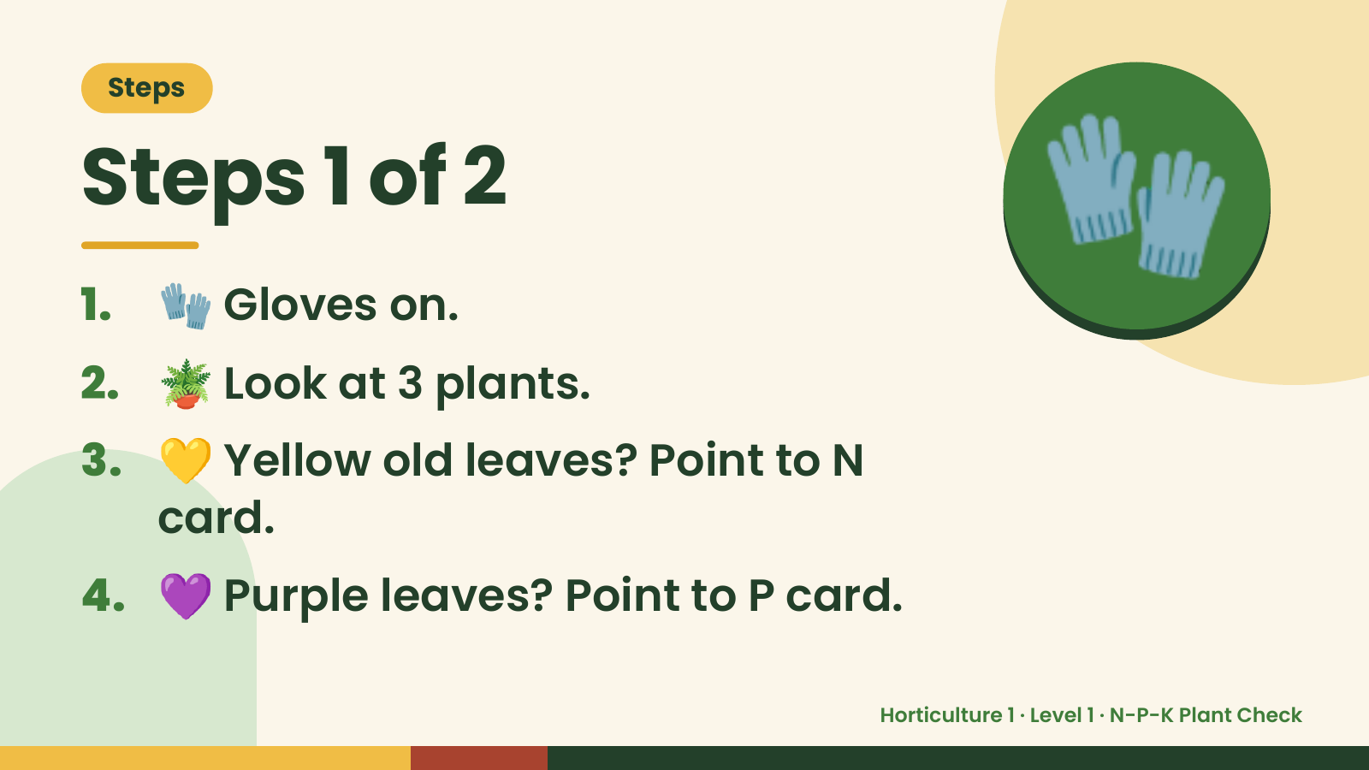
Notes:
Steps
Steps 1 of 2
1. 🧤 Gloves on.
2. 🪴 Look at 3 plants.
🧤
3. 💛 Yellow old leaves? Point to N
card.
4. 💜 Purple leaves? Point to P card.
Horticulture 1 · Level 1 · N-P-K Plant Check

Slide 5
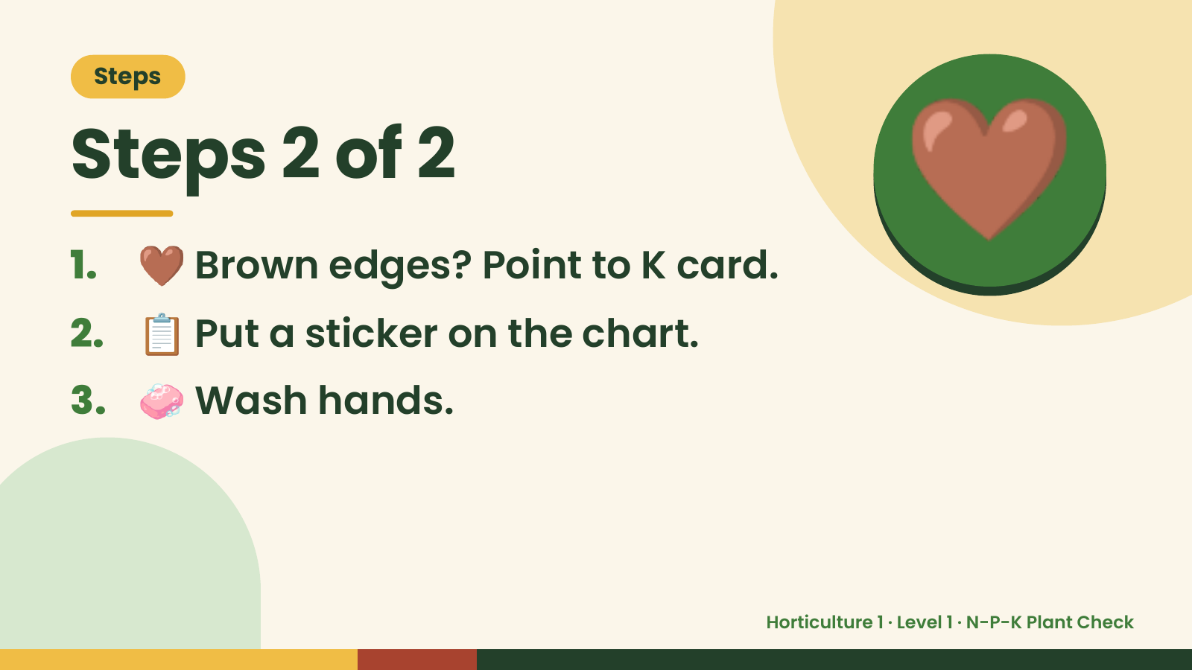
Notes:
Steps
Steps 2 of 2
1. 🤎 Brown edges? Point to K card.
2. 📋 Put a sticker on the chart.
🤎
3. 🧼 Wash hands.
Horticulture 1 · Level 1 · N-P-K Plant Check

Slide 6
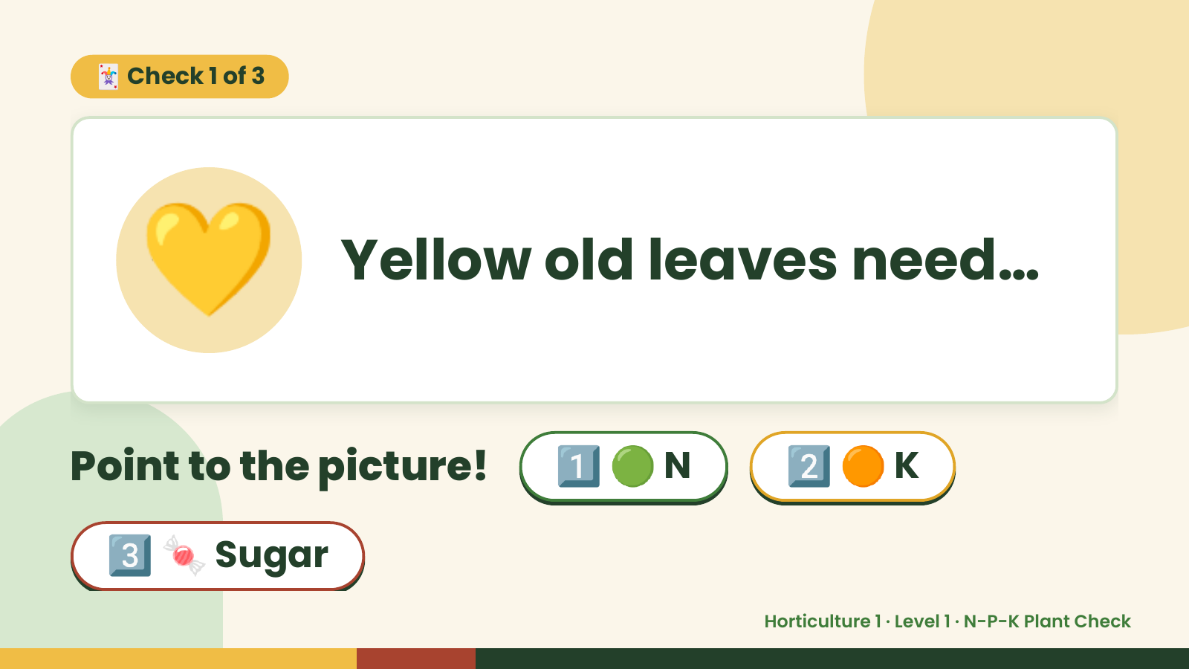
Notes:
🃏 Check 1 of 3
💛 Yellow old leaves need…
Point to the picture! 1️⃣ 🟢 N 2️⃣ 🟠 K
3️⃣ 🍬 Sugar
Horticulture 1 · Level 1 · N-P-K Plant Check

Slide 7
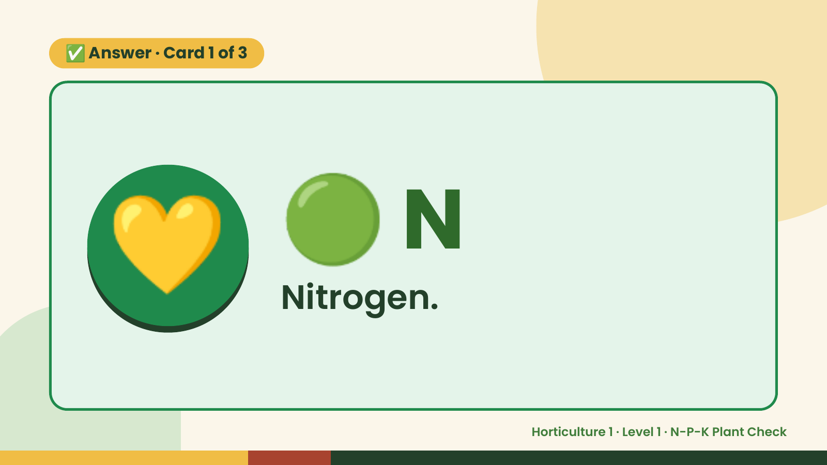
Notes:
✅ Answer · Card 1 of 3
💛 🟢 N
Nitrogen.
Horticulture 1 · Level 1 · N-P-K Plant Check

Slide 8
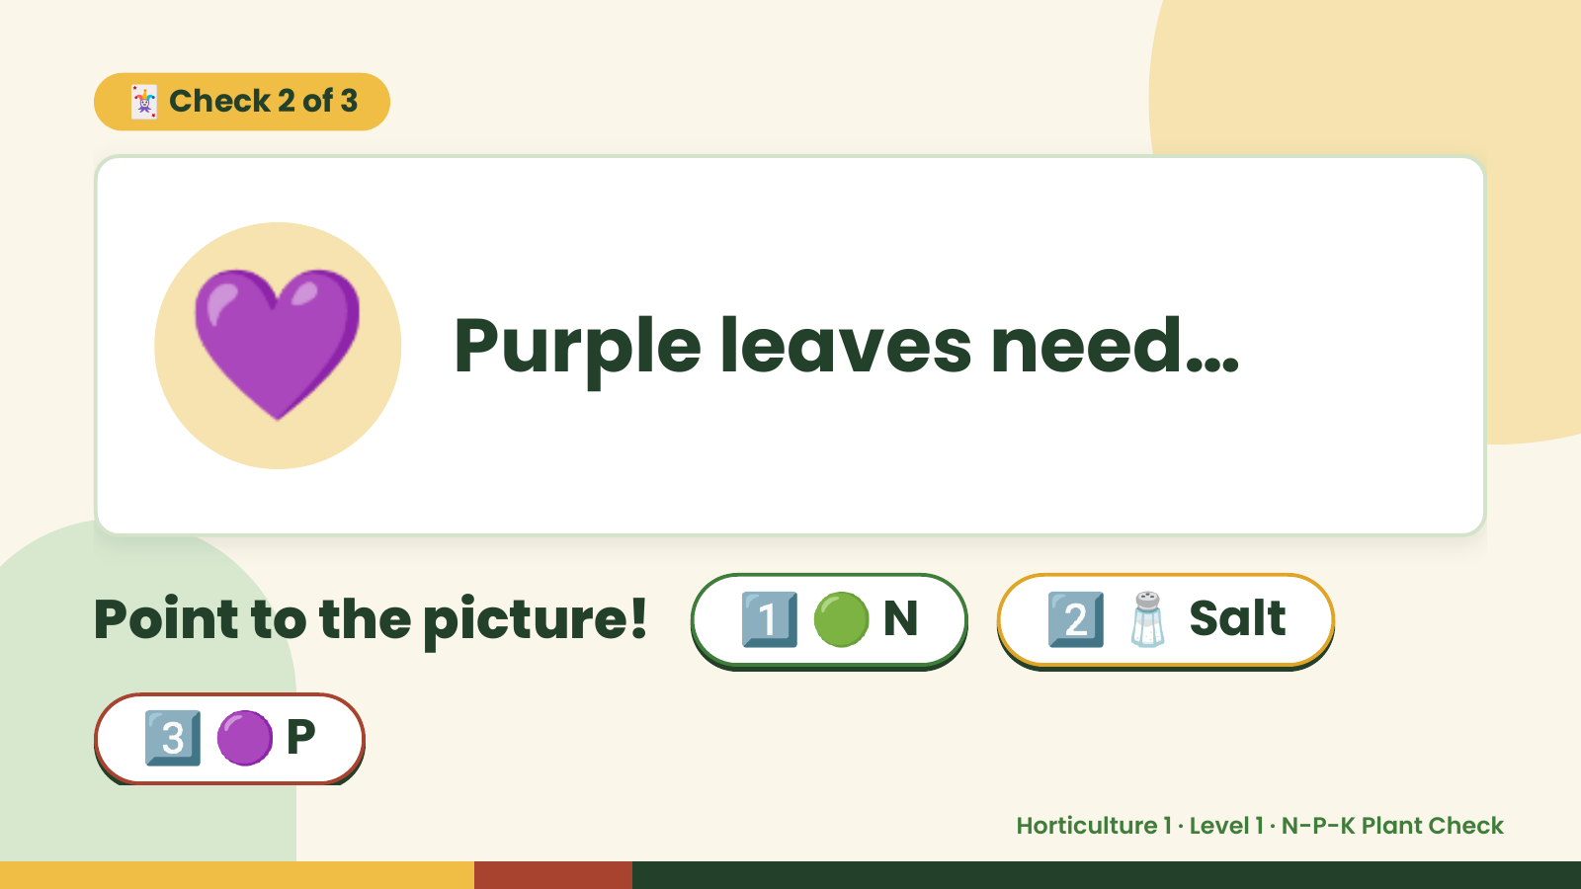
Notes:
🃏 Check 2 of 3
💜 Purple leaves need…
Point to the picture! 1️⃣ 🟢 N 2️⃣ 🧂 Salt
3️⃣ 🟣 P
Horticulture 1 · Level 1 · N-P-K Plant Check

Slide 9
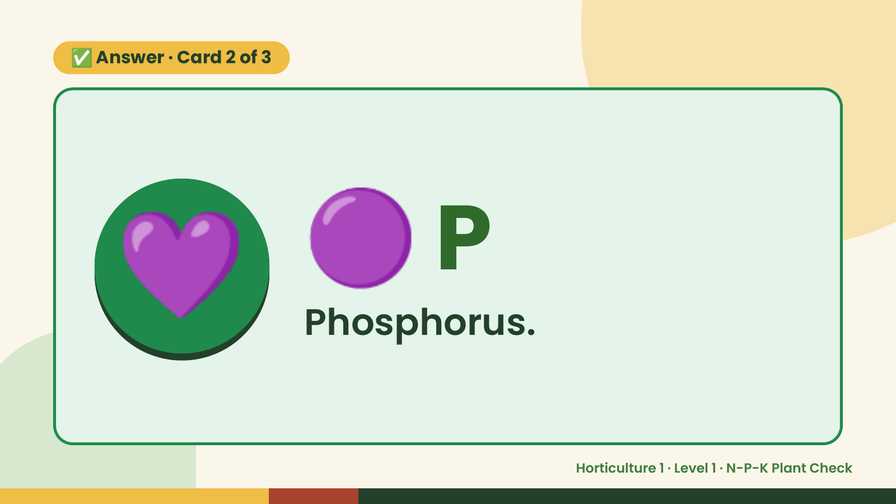
Notes:
✅ Answer · Card 2 of 3
💜 🟣 P
Phosphorus.
Horticulture 1 · Level 1 · N-P-K Plant Check

Slide 10
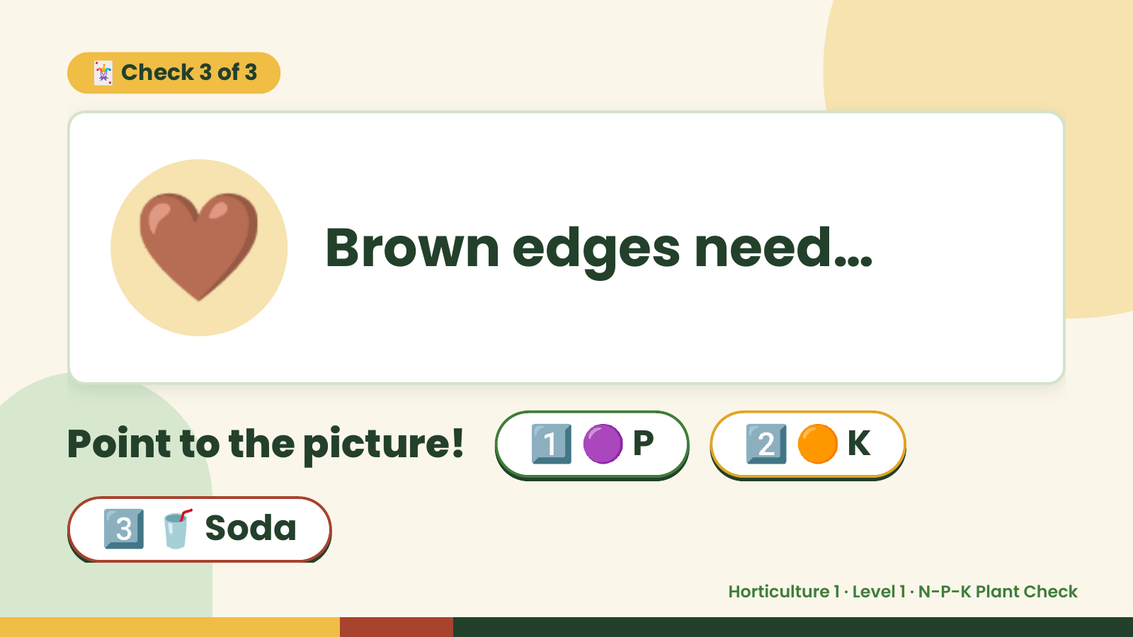
Notes:
🃏 Check 3 of 3
🤎 Brown edges need…
Point to the picture! 1️⃣ 🟣 P 2️⃣ 🟠 K
3️⃣ 🥤 Soda
Horticulture 1 · Level 1 · N-P-K Plant Check

Slide 11
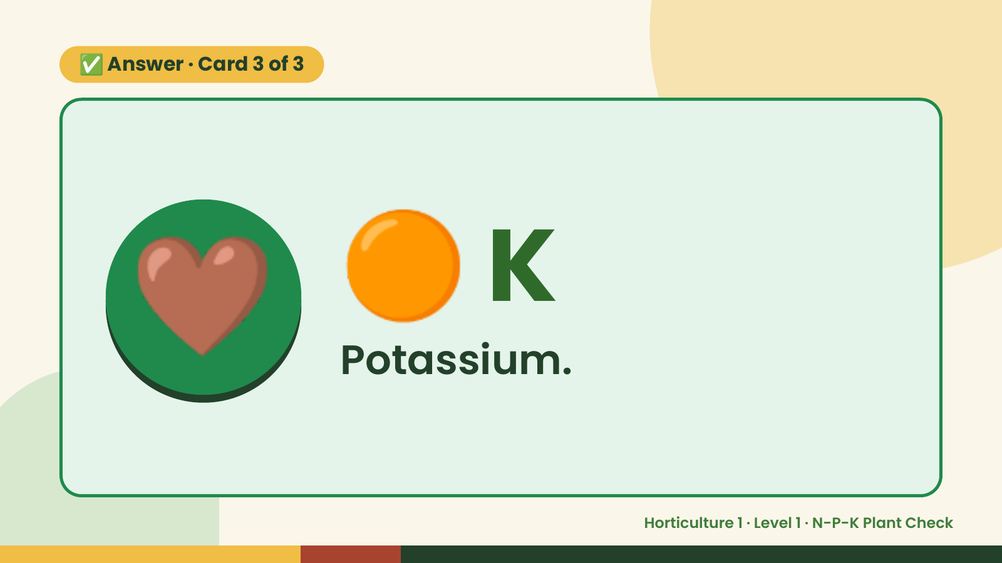
Notes:
✅ Answer · Card 3 of 3
🤎 🟠 K
Potassium.
Horticulture 1 · Level 1 · N-P-K Plant Check

Slide 12

Notes:
Wrap-Up
Clean Up +
Reflect
🧽
🧽 Clean the table.
🧰 Give tools back.
🧼 Wash hands.
Horticulture 1 · Level 1 · N-P-K Plant Check

