Slide 1
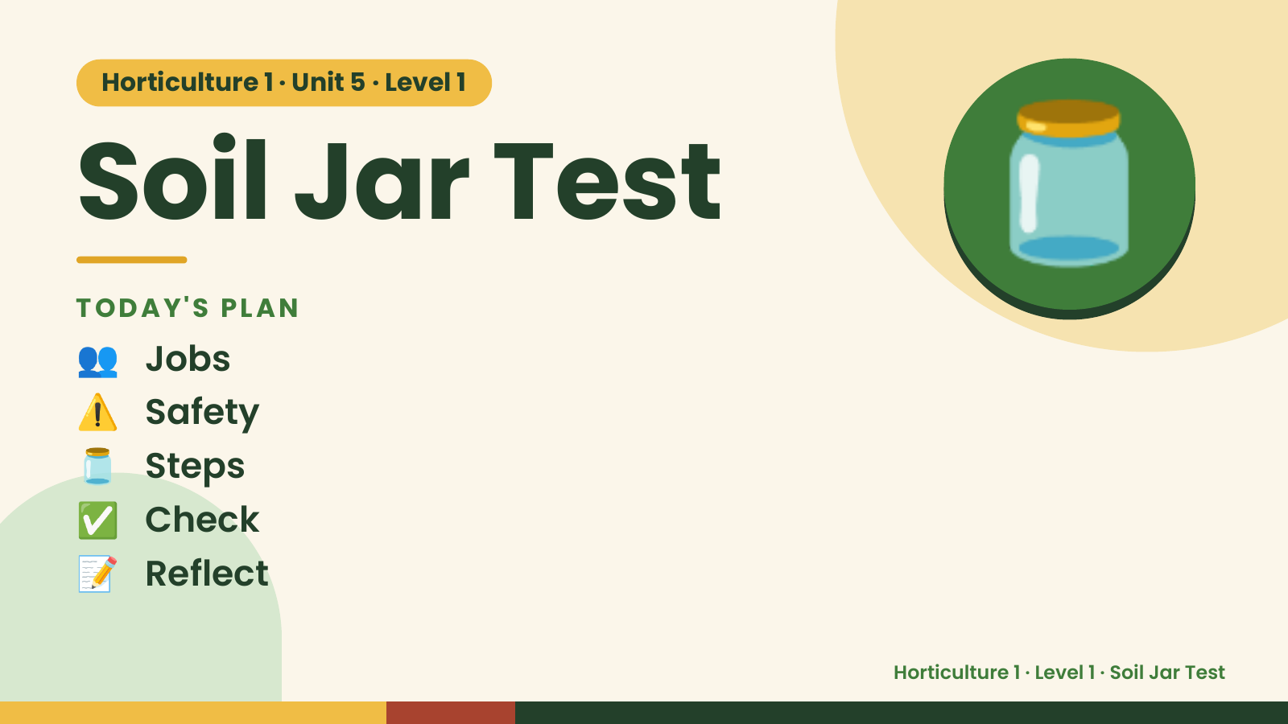
Notes:
Horticulture 1 · Unit 5 · Level 1
Soil Jar Test
TODAY'S PLAN
👥 Jobs
🫙
⚠️ Safety
🫙 Steps
✅ Check
📝 Reflect
Horticulture 1 · Level 1 · Soil Jar Test

Slide 2

Notes:
Get ready
Jobs
🧑‍🌾 Grower
plants 🧺 Supply helper
gets tools
📸 Recorder
photos 🧽 Clean-up
captain
cleans
Horticulture 1 · Level 1 · Soil Jar Test

Slide 3
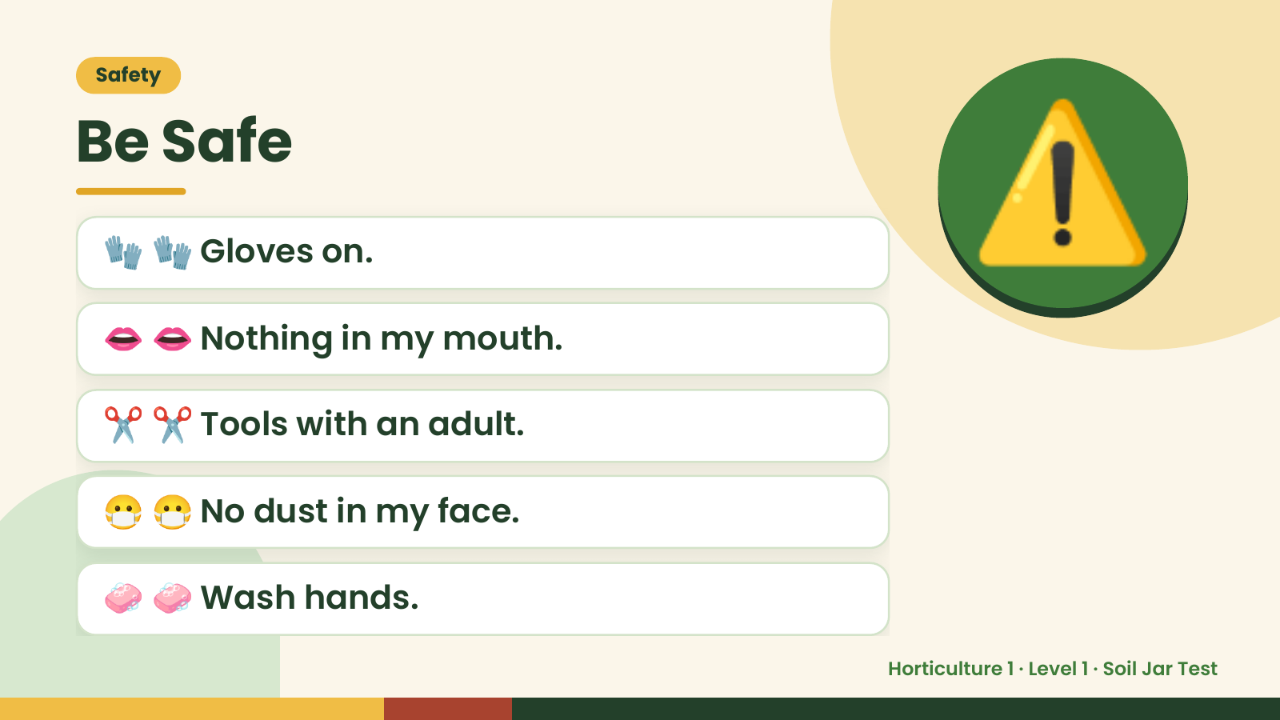
Notes:
Safety
Be Safe
🧤 🧤 Gloves on.
👄 👄 Nothing in my mouth.
⚠️
✂️ ✂️ Tools with an adult.
😷 😷 No dust in my face.
🧼 🧼 Wash hands.
Horticulture 1 · Level 1 · Soil Jar Test

Slide 4
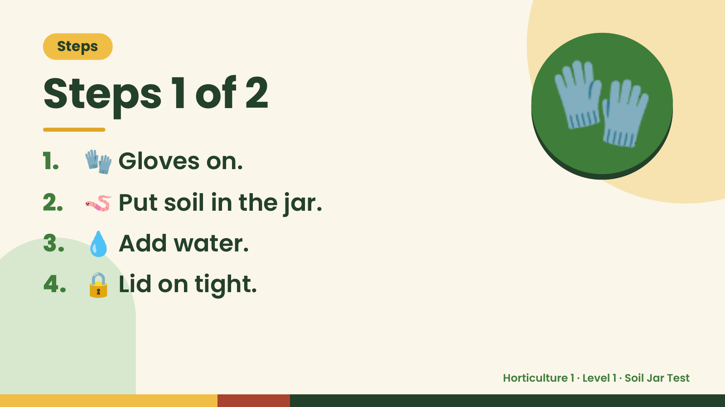
Notes:
Steps
Steps 1 of 2
1. 🧤 Gloves on.
2. 🪱 Put soil in the jar.
🧤
3. 💧 Add water.
4. 🔒 Lid on tight.
Horticulture 1 · Level 1 · Soil Jar Test

Slide 5
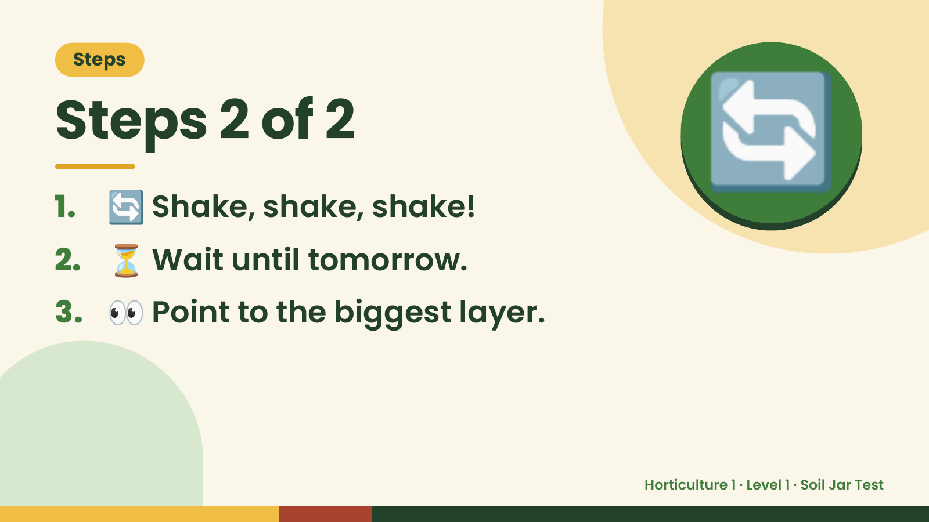
Notes:
Steps
Steps 2 of 2
1. 🔄 Shake, shake, shake!
2. ⏳ Wait until tomorrow.
🔄
3. 👀 Point to the biggest layer.
Horticulture 1 · Level 1 · Soil Jar Test

Slide 6
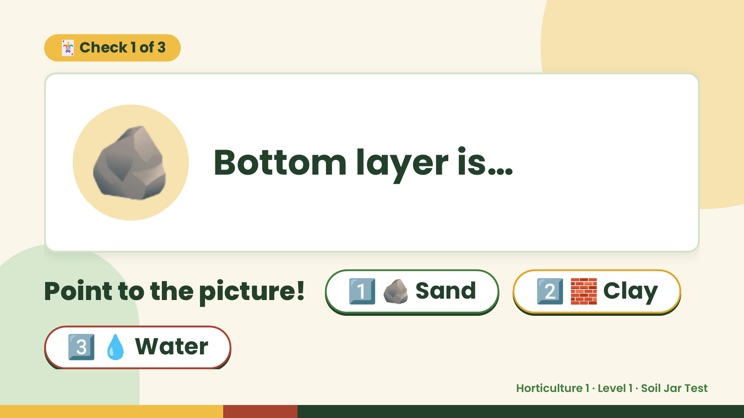
Notes:
🃏 Check 1 of 3
🪨 Bottom layer is…
Point to the picture! 1️⃣ 🪨 Sand 2️⃣ 🧱 Clay
3️⃣ 💧 Water
Horticulture 1 · Level 1 · Soil Jar Test

Slide 7
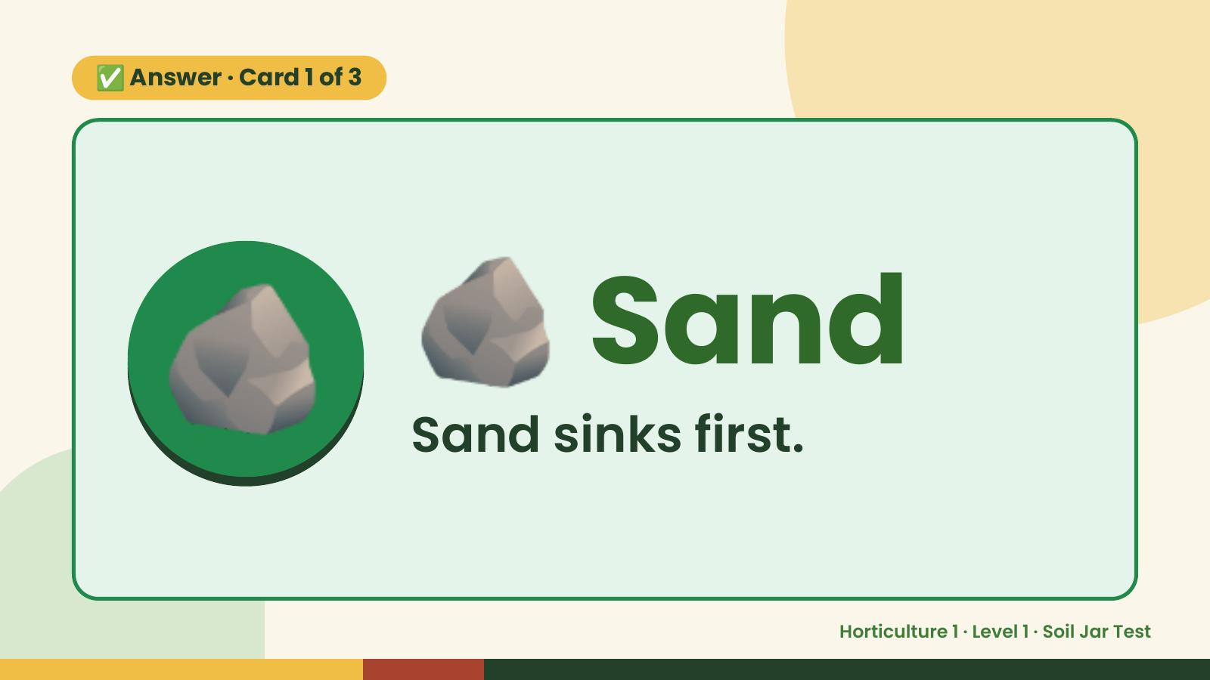
Notes:
✅ Answer · Card 1 of 3
🪨 🪨 Sand
Sand sinks first.
Horticulture 1 · Level 1 · Soil Jar Test

Slide 8
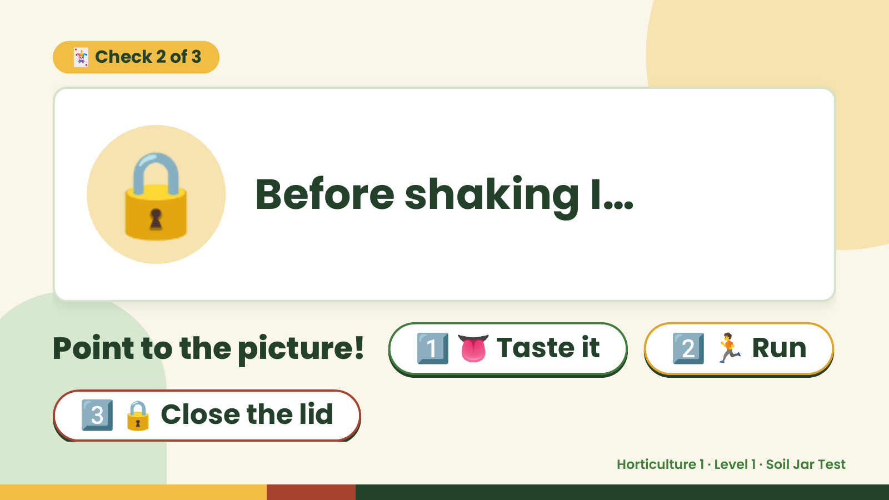
Notes:
🃏 Check 2 of 3
🔒 Before shaking I…
Point to the picture! 1️⃣ 👅 Taste it 2️⃣ 🏃 Run
3️⃣ 🔒 Close the lid
Horticulture 1 · Level 1 · Soil Jar Test

Slide 9
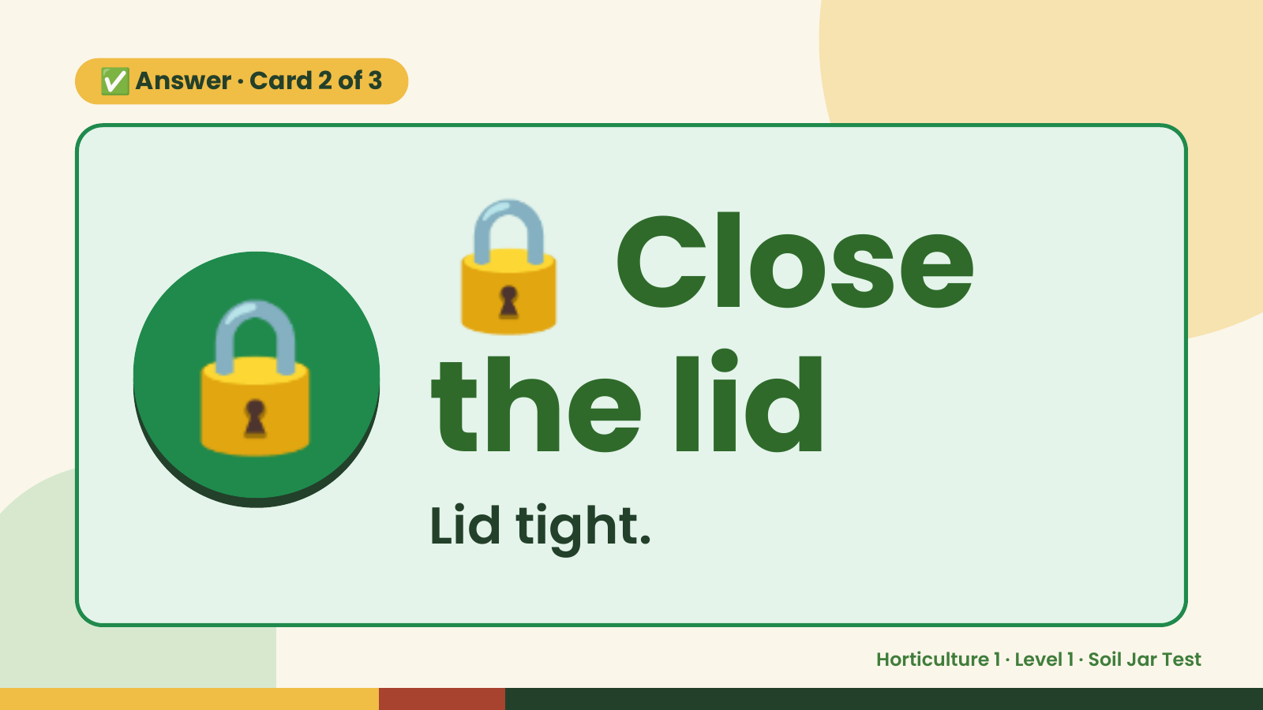
Notes:
🔒
✅ Answer · Card 2 of 3
🔒 the lid
Close
Lid tight.
Horticulture 1 · Level 1 · Soil Jar Test

Slide 10
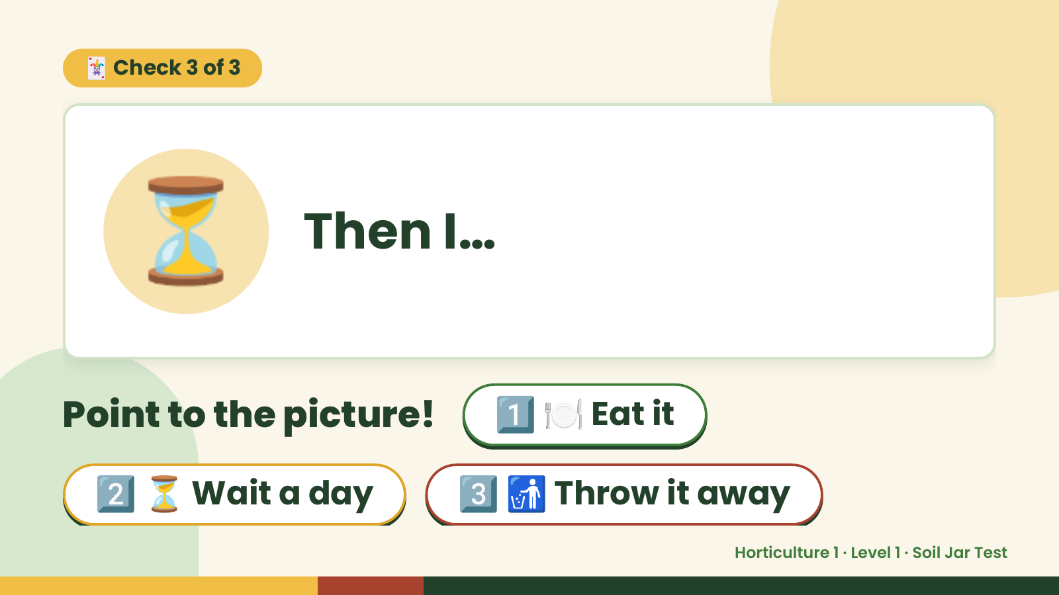
Notes:
🃏 Check 3 of 3
⏳ Then I…
Point to the picture! 1️⃣ 🍽️ Eat it
2️⃣ ⏳ Wait a day 3️⃣ 🚮 Throw it away
Horticulture 1 · Level 1 · Soil Jar Test

Slide 11
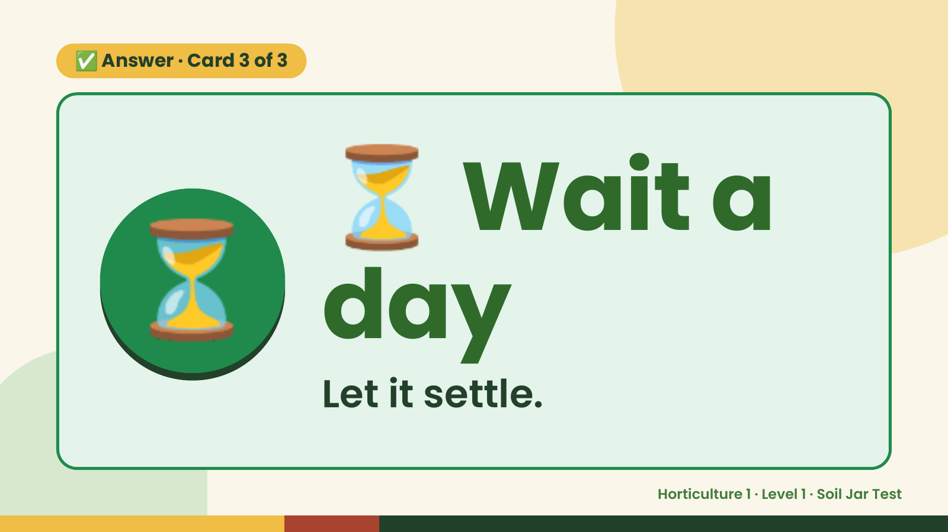
Notes:
⏳
✅ Answer · Card 3 of 3
⏳ day
Wait a
Let it settle.
Horticulture 1 · Level 1 · Soil Jar Test

Slide 12

Notes:
Wrap-Up
Clean Up +
Reflect
🧽
🧽 Clean the table.
🧰 Give tools back.
🧼 Wash hands.
Horticulture 1 · Level 1 · Soil Jar Test

