Slide 1
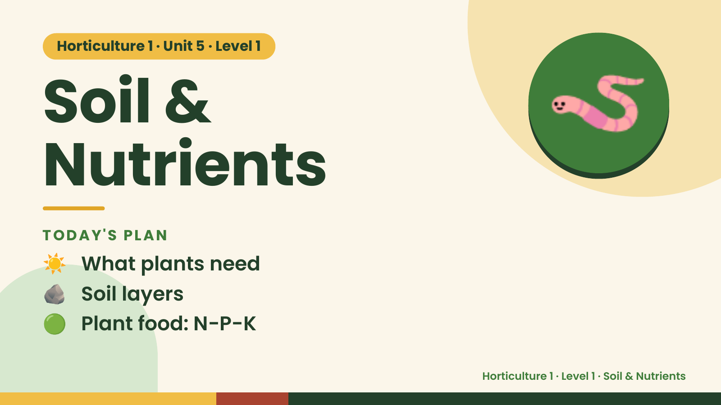
Notes:
Horticulture 1 · Unit 5 · Level 1
Soil &
Nutrients
🪱
TODAY'S PLAN
☀️ What plants need
🪨 Soil layers
🟢 Plant food: N-P-K
Horticulture 1 · Level 1 · Soil & Nutrients

Slide 2
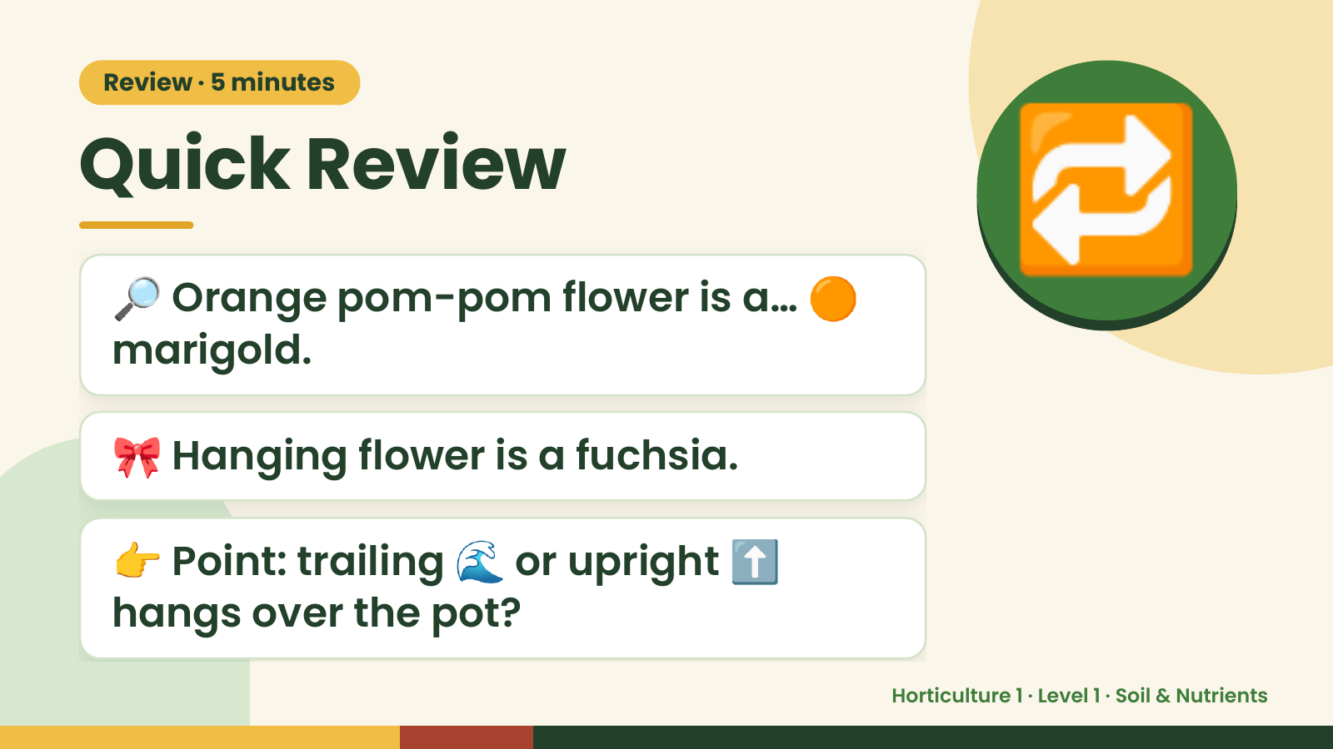
Notes:
Review · 5 minutes
Quick Review
🔎 Orange pom-pom flower is a… 🟠
marigold.
🔁
🎀 Hanging flower is a fuchsia.
👉 Point: trailing 🌊 or upright ⬆️
hangs over the pot?
Horticulture 1 · Level 1 · Soil & Nutrients

Slide 3
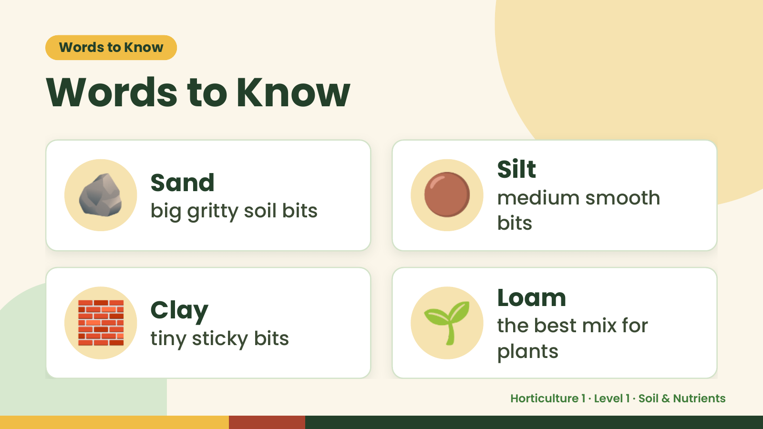
Notes:
Words to Know
Words to Know
🪨 Sand
big gritty soil bits 🟤 Silt
medium smooth
bits
🧱 Clay
tiny sticky bits 🌱 Loam
the best mix for
plants
Horticulture 1 · Level 1 · Soil & Nutrients

Slide 4
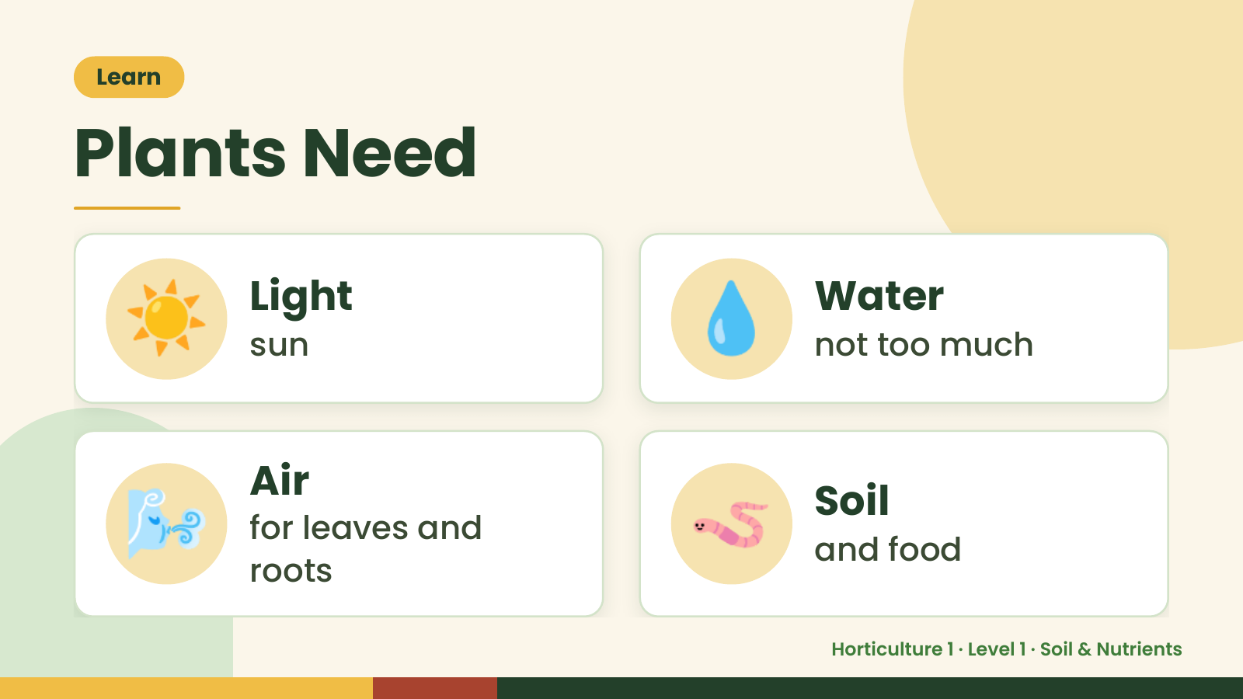
Notes:
Learn
Plants Need
☀️ Light
sun 💧 Water
not too much
🌬️ Air
for leaves and
roots
🪱 Soil
and food
Horticulture 1 · Level 1 · Soil & Nutrients

Slide 5
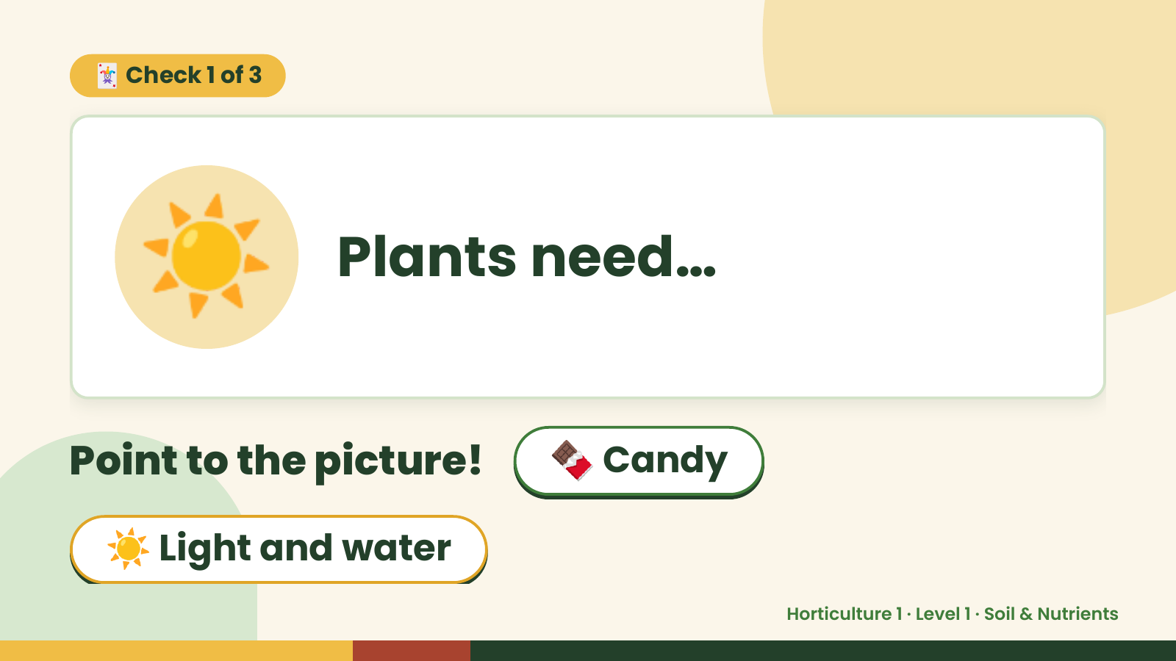
Notes:
🃏 Check 1 of 3
☀️ Plants need…
Point to the picture! 🍫 Candy
☀️ Light and water
Horticulture 1 · Level 1 · Soil & Nutrients

Slide 6
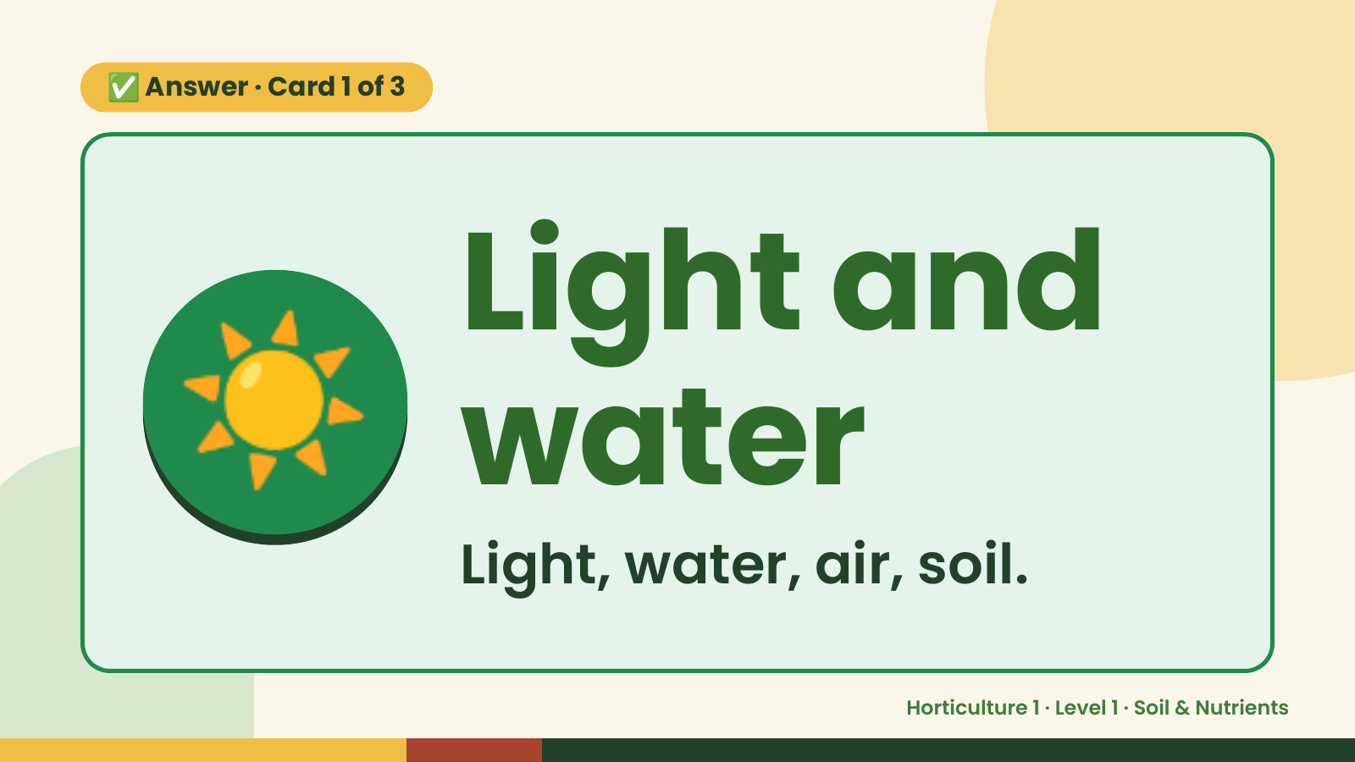
Notes:
✅ Answer · Card 1 of 3
☀️ Light and
water
Light, water, air, soil.
Horticulture 1 · Level 1 · Soil & Nutrients

Slide 7
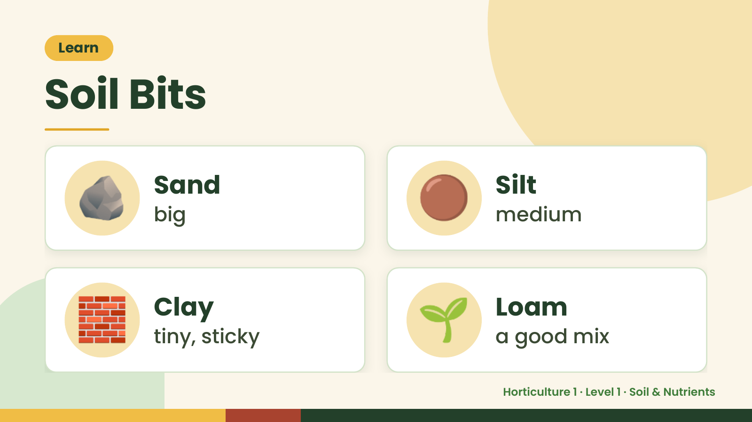
Notes:
Learn
Soil Bits
🪨 Sand
big 🟤 Silt
medium
🧱 Clay
tiny, sticky 🌱 Loam
a good mix
Horticulture 1 · Level 1 · Soil & Nutrients

Slide 8
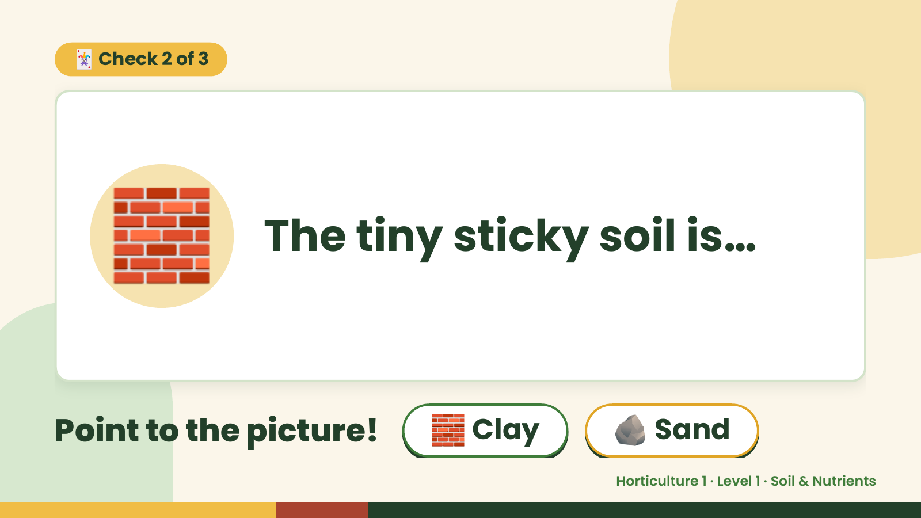
Notes:
🃏 Check 2 of 3
🧱 The tiny sticky soil is…
Point to the picture! 🧱 Clay 🪨 Sand
Horticulture 1 · Level 1 · Soil & Nutrients

Slide 9
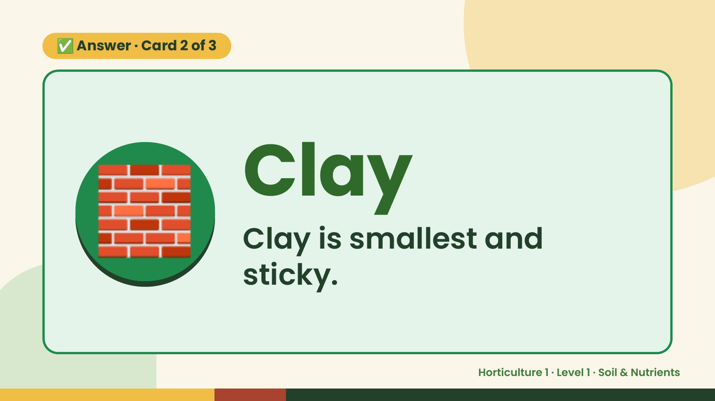
Notes:
✅ Answer · Card 2 of 3
🧱 Clay
Clay is smallest and
sticky.
Horticulture 1 · Level 1 · Soil & Nutrients

Slide 10
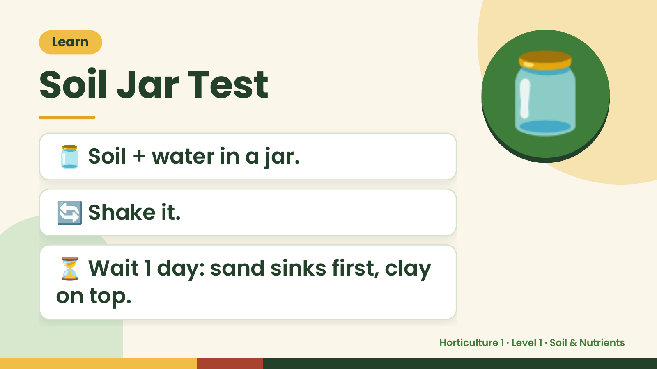
Notes:
Learn
Soil Jar Test
🫙 Soil + water in a jar.
🫙
🔄 Shake it.
⏳ Wait 1 day: sand sinks first, clay
on top.
Horticulture 1 · Level 1 · Soil & Nutrients

Slide 11
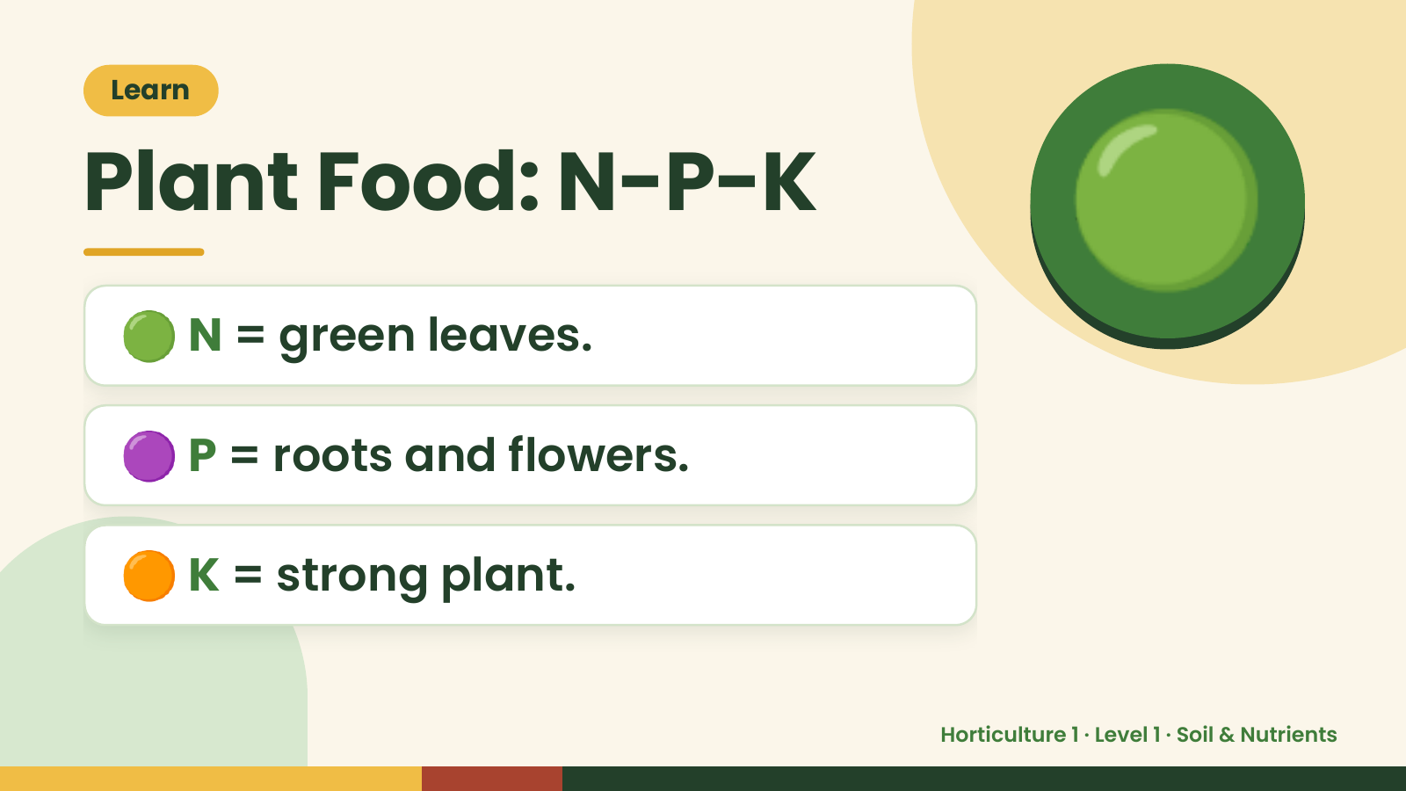
Notes:
Learn
Plant Food: N-P-K
🟢 N = green leaves.
🟢
🟣 P = roots and flowers.
🟠 K = strong plant.
Horticulture 1 · Level 1 · Soil & Nutrients

Slide 12
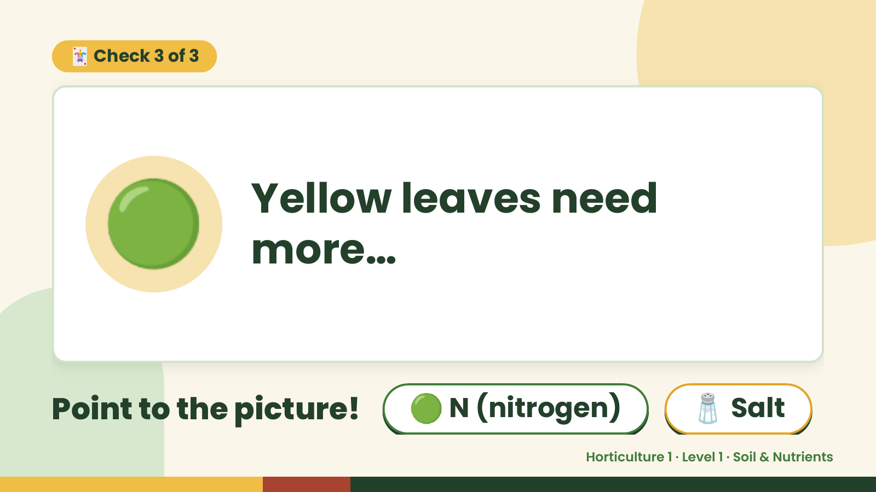
Notes:
🃏 Check 3 of 3
🟢 Yellow leaves need
more…
Point to the picture! 🟢 N (nitrogen) 🧂 Salt
Horticulture 1 · Level 1 · Soil & Nutrients

Slide 13
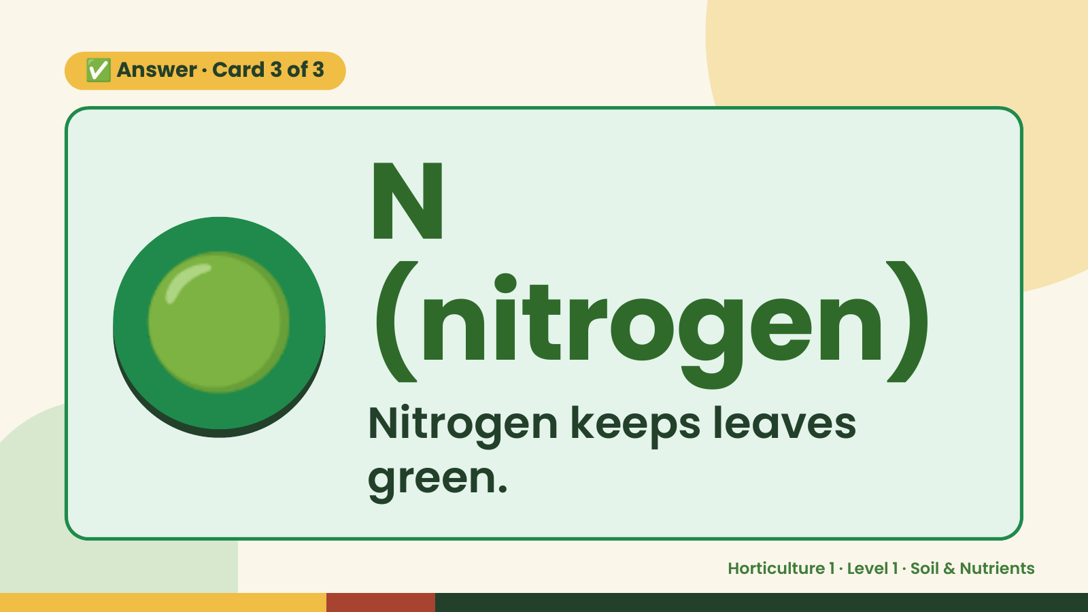
Notes:
✅ Answer · Card 3 of 3
🟢 N
(nitrogen)
Nitrogen keeps leaves
green.
Horticulture 1 · Level 1 · Soil & Nutrients

Slide 14
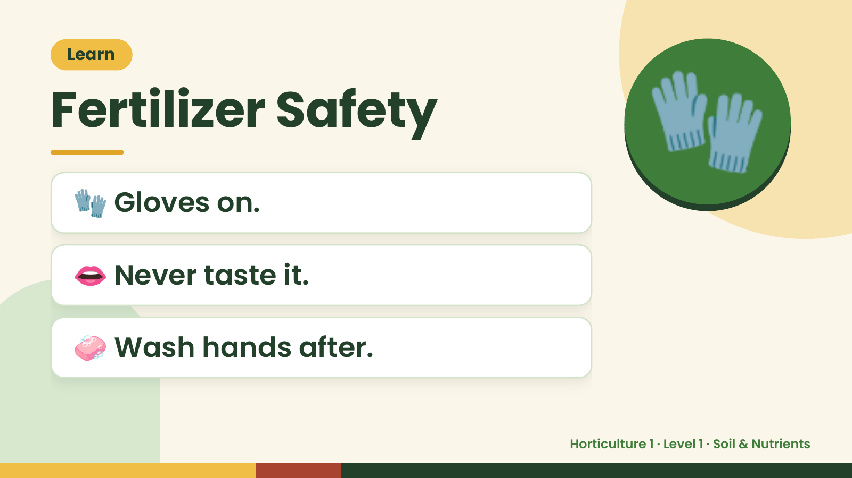
Notes:
Learn
Fertilizer Safety
🧤 Gloves on.
🧤
👄 Never taste it.
🧼 Wash hands after.
Horticulture 1 · Level 1 · Soil & Nutrients

Slide 15
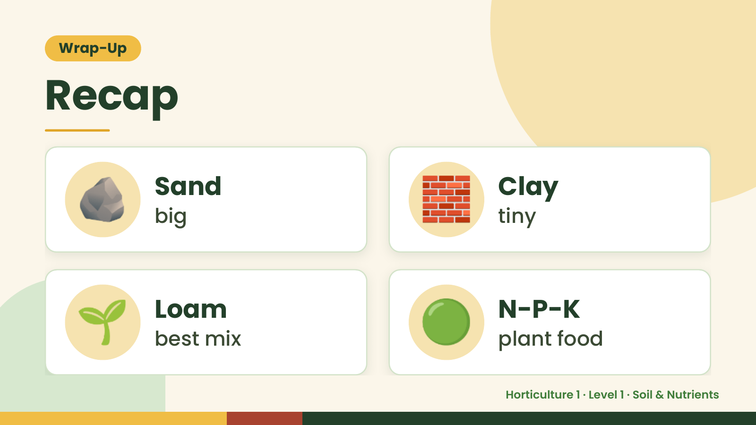
Notes:
Wrap-Up
Recap
🪨 Sand
big 🧱 Clay
tiny
🌱 Loam
best mix 🟢 N-P-K
plant food
Horticulture 1 · Level 1 · Soil & Nutrients

Slide 16
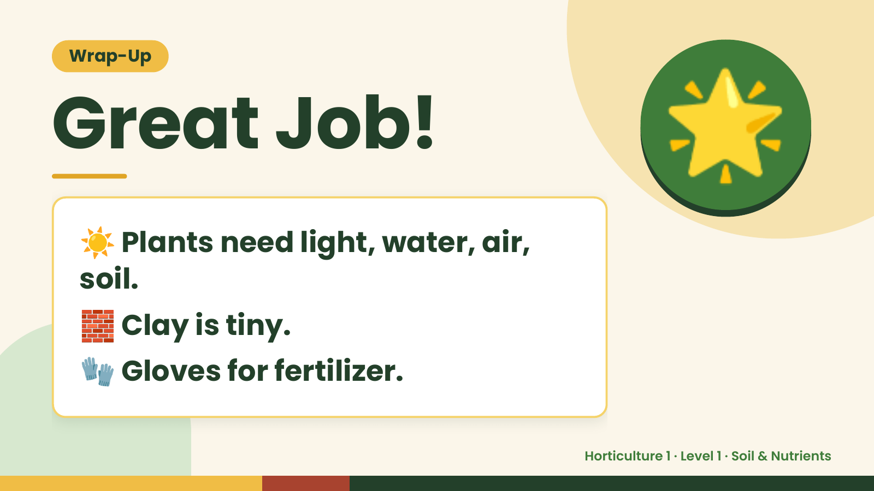
Notes:
Wrap-Up
Great Job!
☀️Plants need light, water, air,
🌟
soil.
🧱 Clay is tiny.
🧤 Gloves for fertilizer.
Horticulture 1 · Level 1 · Soil & Nutrients

