Slide 1
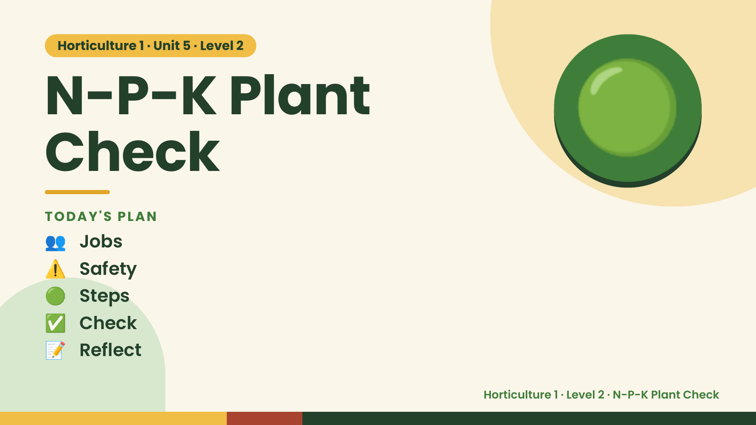
Notes:
Horticulture 1 · Unit 5 · Level 2
N-P-K Plant
Check
👥 Jobs
TODAY'S PLAN
🟢
⚠️ Safety
🟢 Steps
✅ Check
📝 Reflect
Horticulture 1 · Level 2 · N-P-K Plant Check

Slide 2

Notes:
Get ready
Jobs
🧑‍🌾 Grower
Does the main plant job
with the tools
🧺 Supply helper
Gets and returns supplies
and tools to staff
📸 Recorder
Takes photos and fills in
the chart
🧽 Clean-up captain
Sweeps, wipes tables,
checks hands are
washed
Horticulture 1 · Level 2 · N-P-K Plant Check

Slide 3
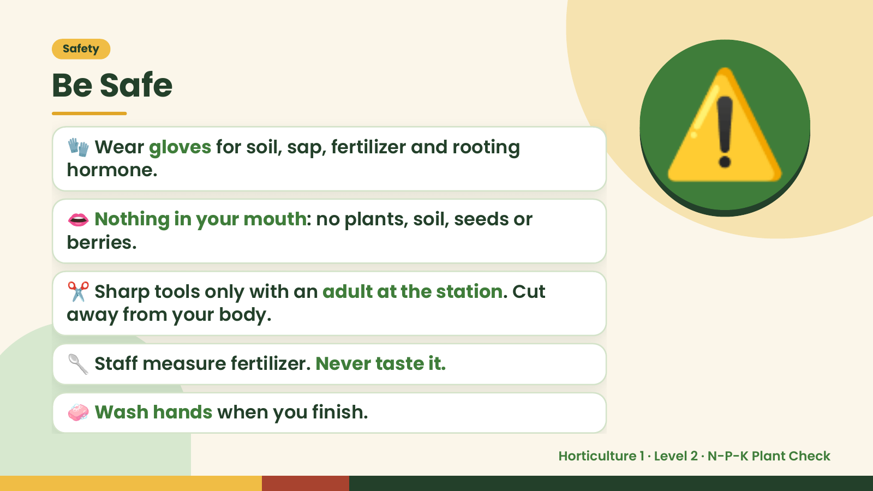
Notes:
Safety
Be Safe
🧤 Wear gloves for soil, sap, fertilizer and rooting
hormone.
👄 Nothing in your mouth: no plants, soil, seeds or
berries.
⚠️
✂️ Sharp tools only with an adult at the station. Cut
away from your body.
🥄 Staff measure fertilizer. Never taste it.
🧼 Wash hands when you finish.
Horticulture 1 · Level 2 · N-P-K Plant Check

Slide 4
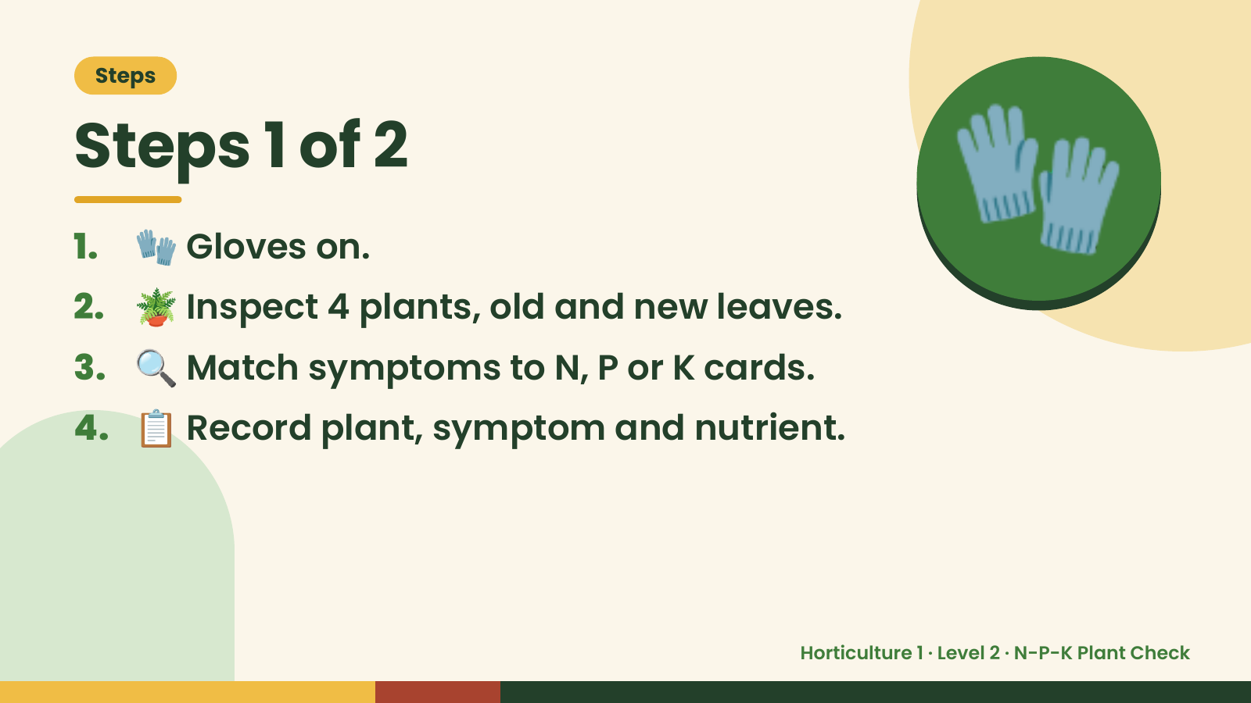
Notes:
Steps
Steps 1 of 2
1. 🧤 Gloves on.
2. 🪴 Inspect 4 plants, old and new leaves.
3. 🔍 Match symptoms to N, P or K cards.
🧤
4. 📋 Record plant, symptom and nutrient.
Horticulture 1 · Level 2 · N-P-K Plant Check

Slide 5
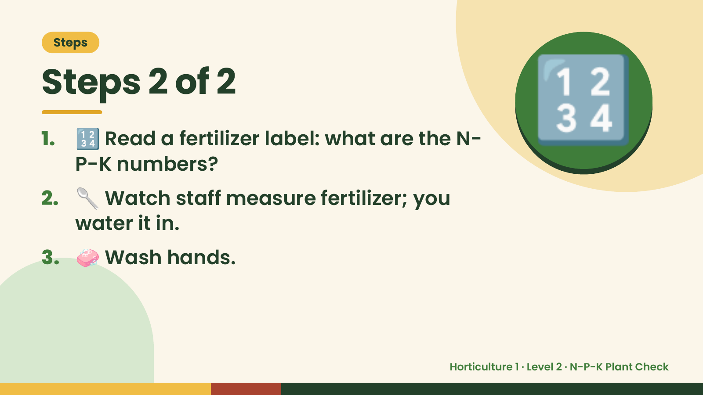
Notes:
Steps
Steps 2 of 2
1. 🔢 Read a fertilizer label: what are the N-
P-K numbers?
2. 🥄 Watch staff measure fertilizer; you
water it in.
🔢
3. 🧼 Wash hands.
Horticulture 1 · Level 2 · N-P-K Plant Check

Slide 6
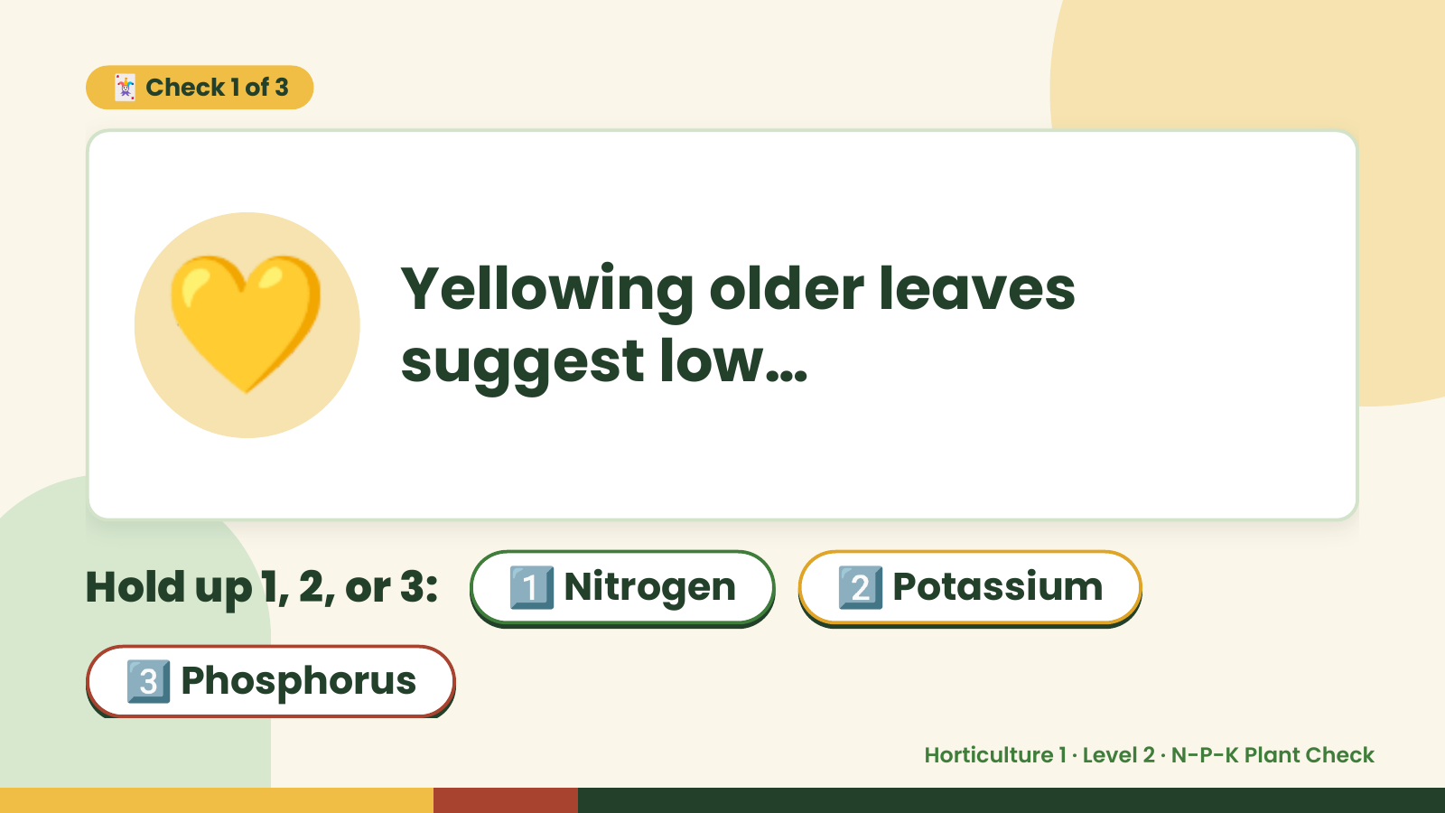
Notes:
🃏 Check 1 of 3
💛 Yellowing older leaves
suggest low…
Hold up 1, 2, or 3: 1️⃣ Nitrogen 2️⃣ Potassium
3️⃣ Phosphorus
Horticulture 1 · Level 2 · N-P-K Plant Check

Slide 7
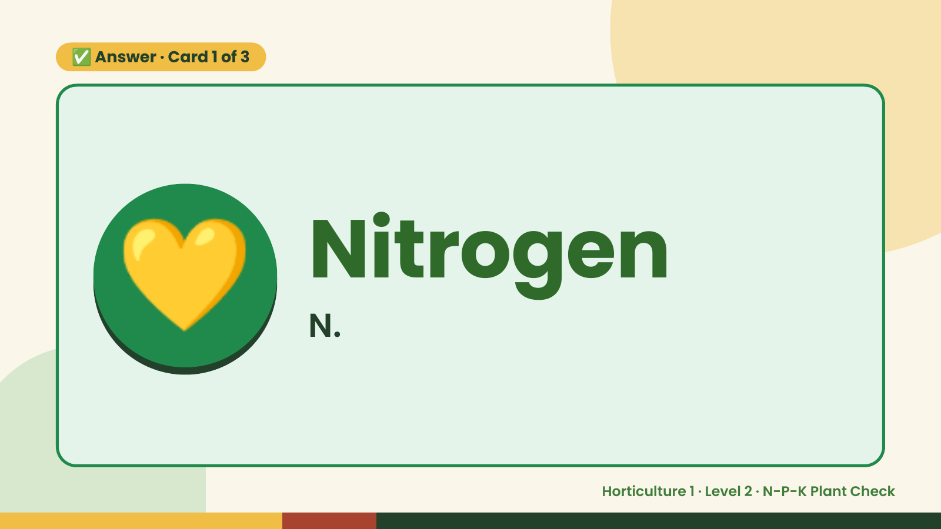
Notes:
✅ Answer · Card 1 of 3
💛 Nitrogen
N.
Horticulture 1 · Level 2 · N-P-K Plant Check

Slide 8
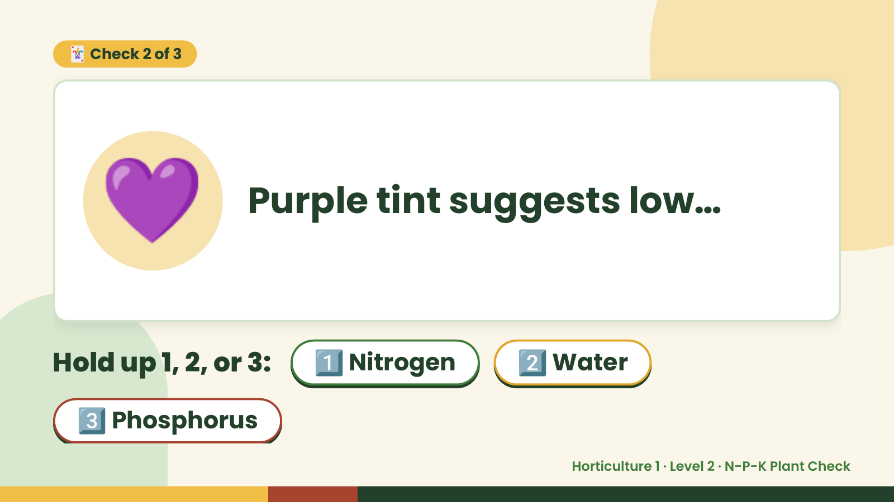
Notes:
🃏 Check 2 of 3
💜 Purple tint suggests low…
Hold up 1, 2, or 3: 1️⃣ Nitrogen 2️⃣ Water
3️⃣ Phosphorus
Horticulture 1 · Level 2 · N-P-K Plant Check

Slide 9
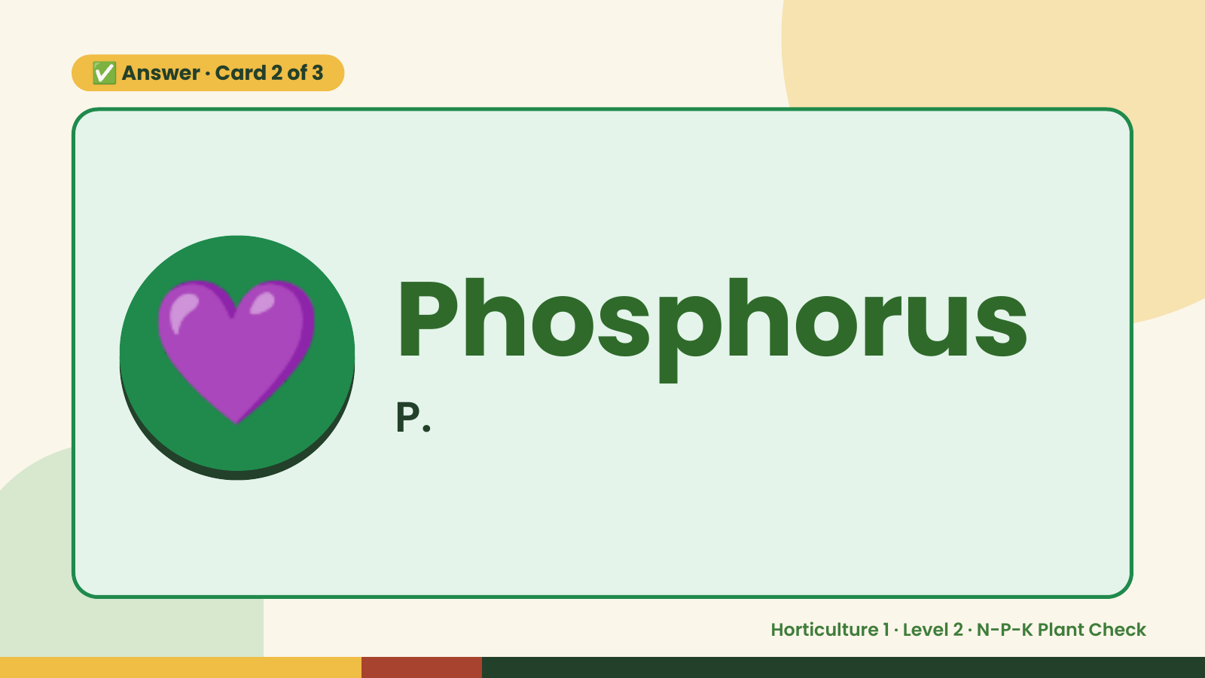
Notes:
✅ Answer · Card 2 of 3
💜 Phosphorus
P.
Horticulture 1 · Level 2 · N-P-K Plant Check

Slide 10
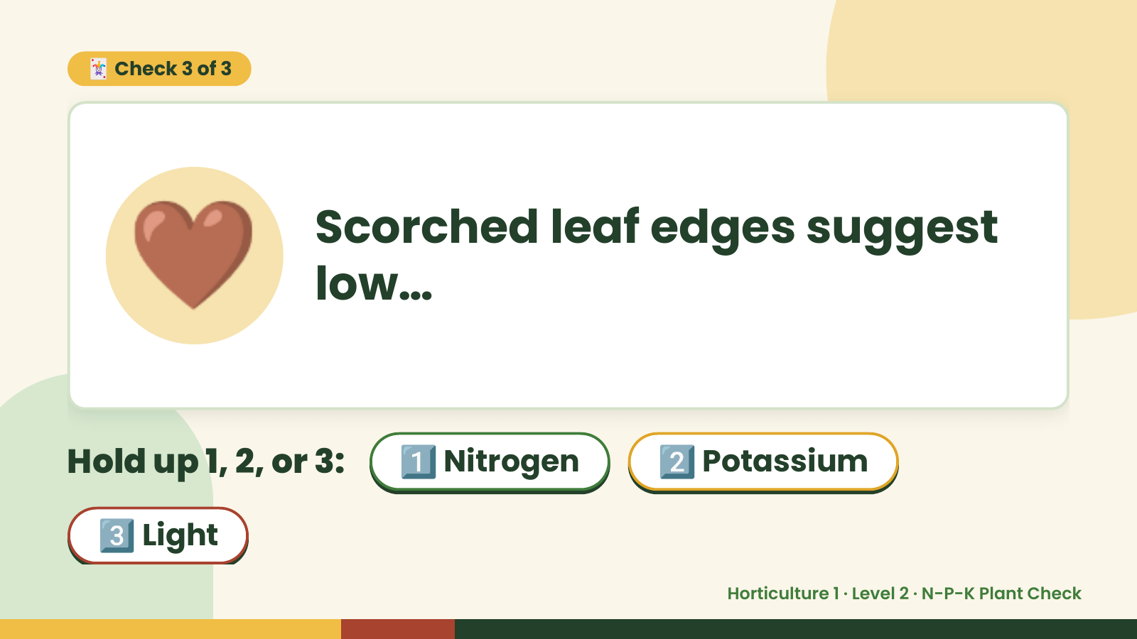
Notes:
🃏 Check 3 of 3
🤎 Scorched leaf edges suggest
low…
Hold up 1, 2, or 3: 1️⃣ Nitrogen 2️⃣ Potassium
3️⃣ Light
Horticulture 1 · Level 2 · N-P-K Plant Check

Slide 11
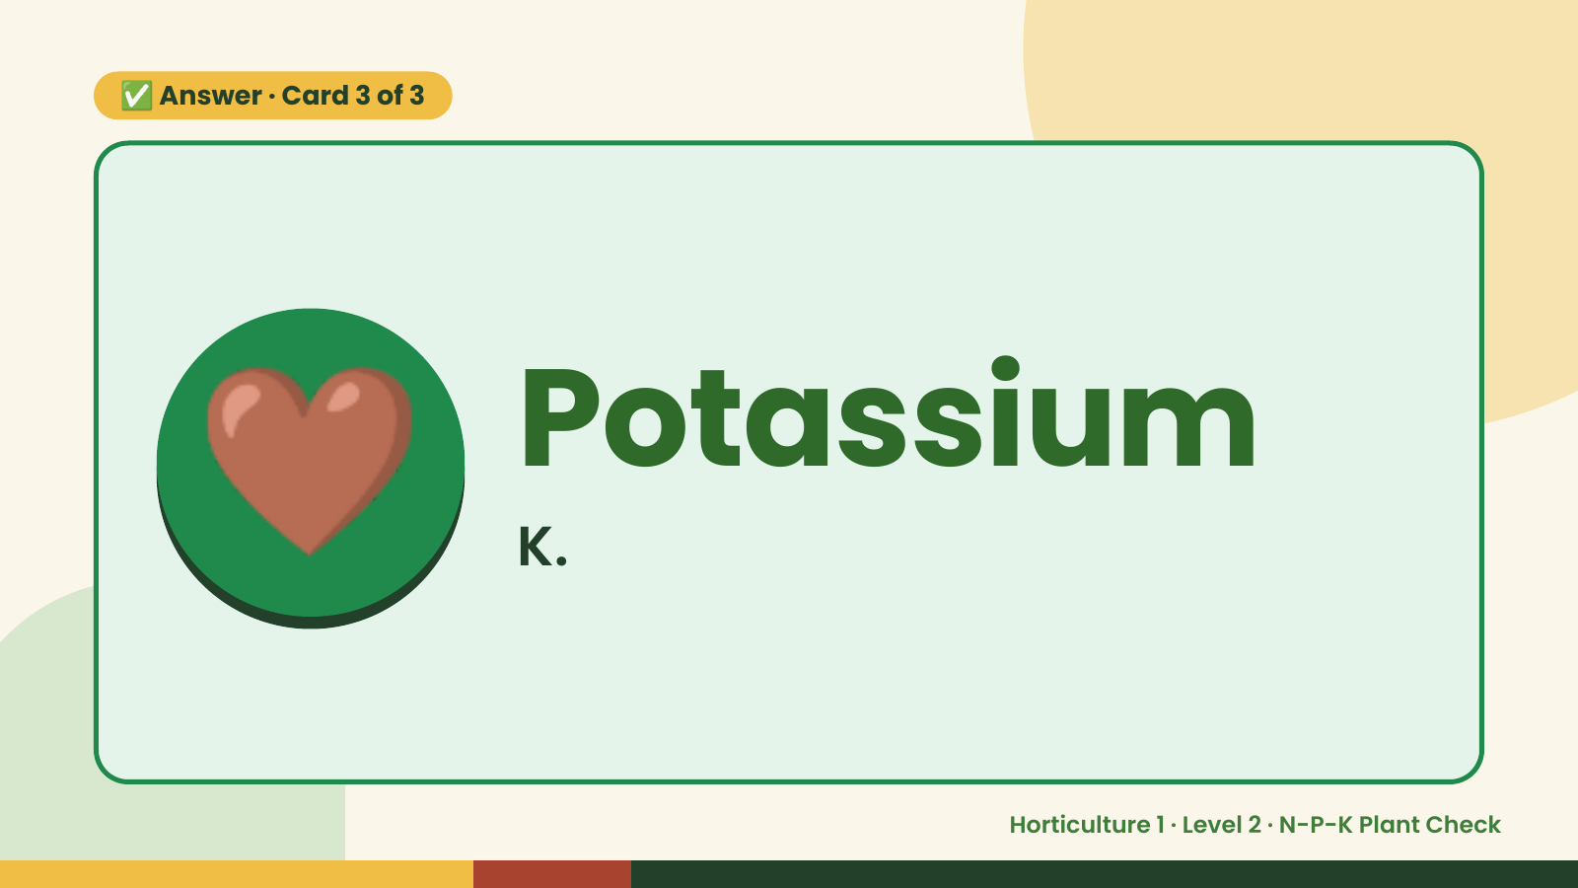
Notes:
✅ Answer · Card 3 of 3
🤎 Potassium
K.
Horticulture 1 · Level 2 · N-P-K Plant Check

Slide 12

Notes:
Wrap-Up
Clean Up +
Reflect
🧽
Return and count tools.
Sweep and wipe your area.
Wash hands, then do the reflection.
Horticulture 1 · Level 2 · N-P-K Plant Check

