Slide 1
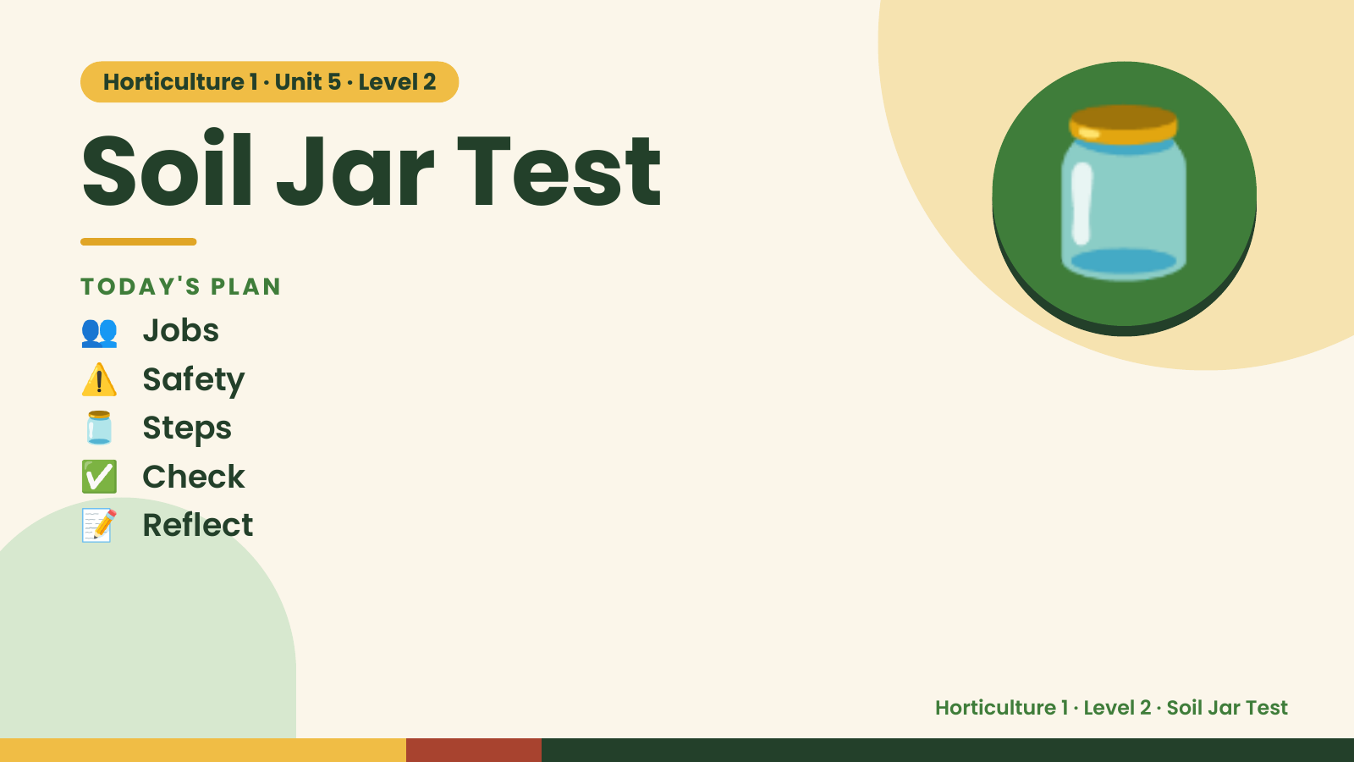
Notes:
Horticulture 1 · Unit 5 · Level 2
Soil Jar Test
👥 Jobs
TODAY'S PLAN
⚠️ Safety
🫙 Steps
🫙
✅ Check
📝 Reflect
Horticulture 1 · Level 2 · Soil Jar Test

Slide 2

Notes:
Get ready
Jobs
🧑‍🌾 Grower
Does the main plant job
with the tools
🧺 Supply helper
Gets and returns supplies
and tools to staff
📸 Recorder
Takes photos and fills in
the chart
🧽 Clean-up captain
Sweeps, wipes tables,
checks hands are
washed
Horticulture 1 · Level 2 · Soil Jar Test

Slide 3
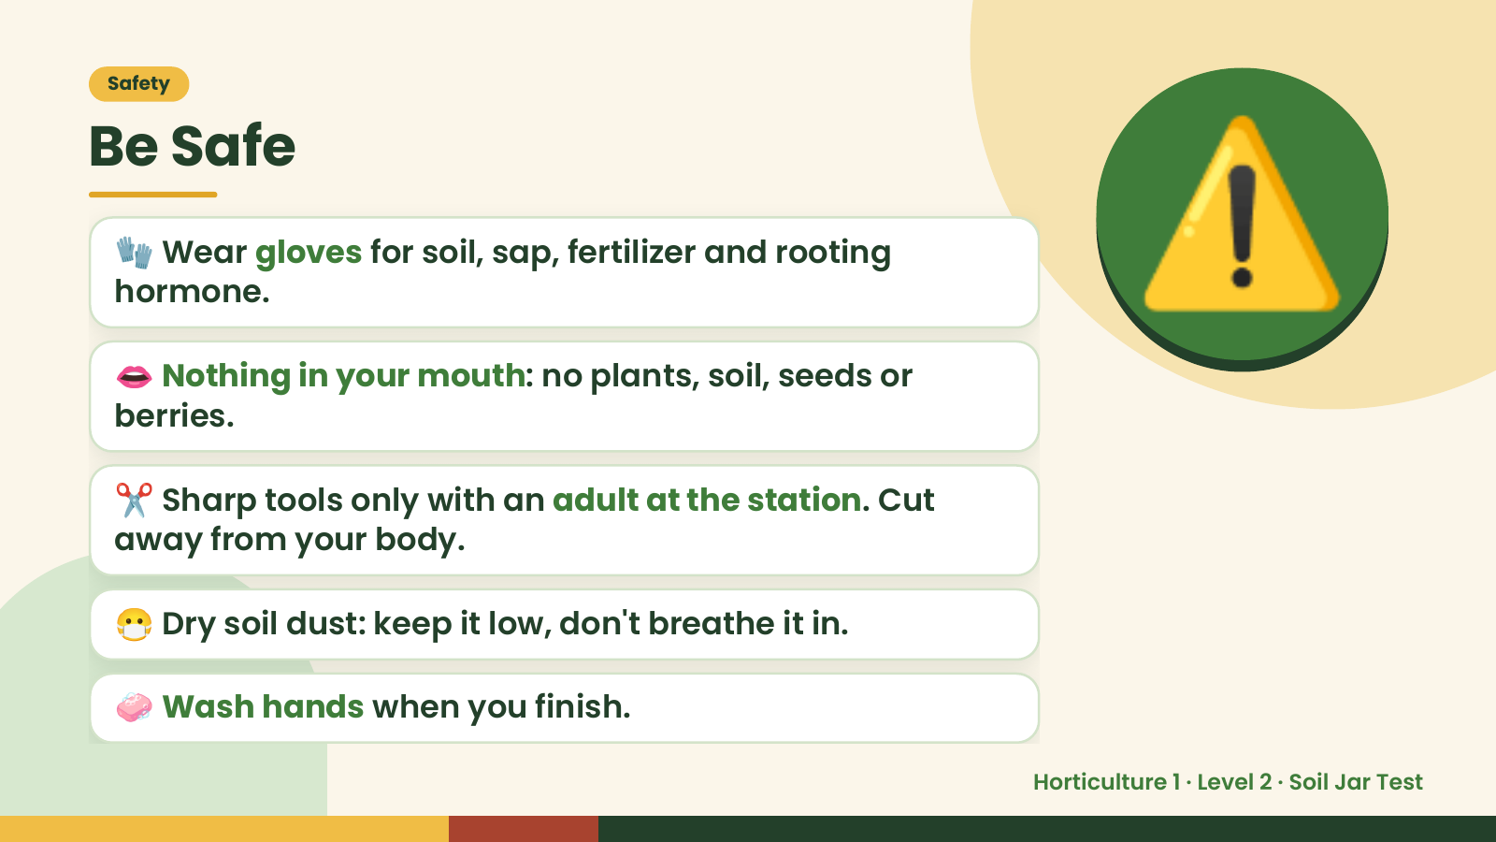
Notes:
Safety
Be Safe
🧤 Wear gloves for soil, sap, fertilizer and rooting
hormone.
👄 Nothing in your mouth: no plants, soil, seeds or
berries.
⚠️
✂️ Sharp tools only with an adult at the station. Cut
away from your body.
😷 Dry soil dust: keep it low, don't breathe it in.
🧼 Wash hands when you finish.
Horticulture 1 · Level 2 · Soil Jar Test

Slide 4
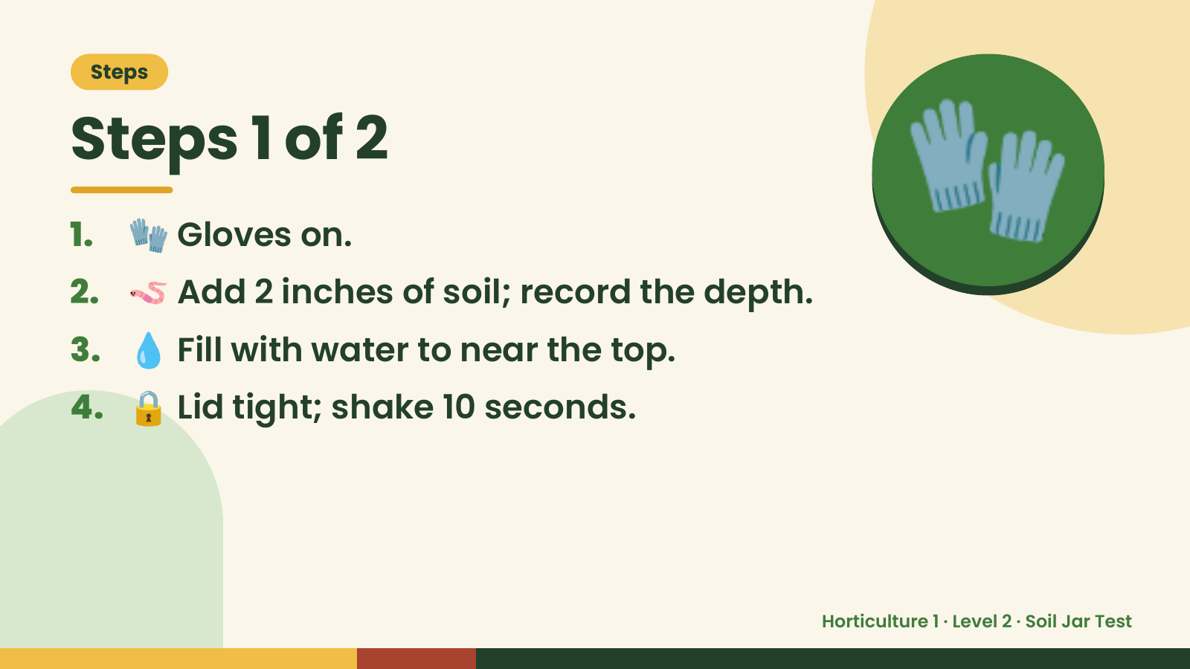
Notes:
Steps
Steps 1 of 2
1. 🧤 Gloves on.
2. 🪱 Add 2 inches of soil; record the depth.
3. 💧 Fill with water to near the top.
🧤
4. 🔒 Lid tight; shake 10 seconds.
Horticulture 1 · Level 2 · Soil Jar Test

Slide 5
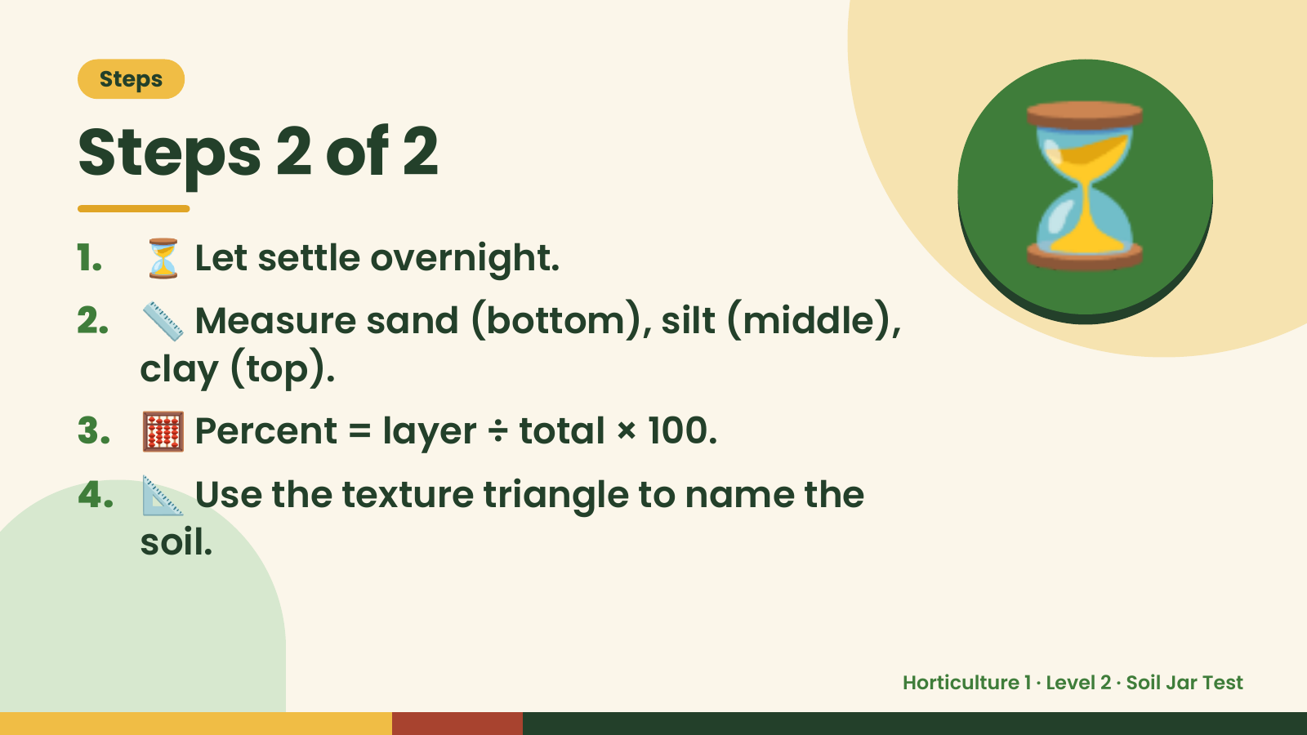
Notes:
Steps
Steps 2 of 2
1. ⏳ Let settle overnight.
2. 📏 Measure sand (bottom), silt (middle),
clay (top).
⏳
3. 🧮 Percent = layer ÷ total × 100.
4. 📐 Use the texture triangle to name the
soil.
Horticulture 1 · Level 2 · Soil Jar Test

Slide 6
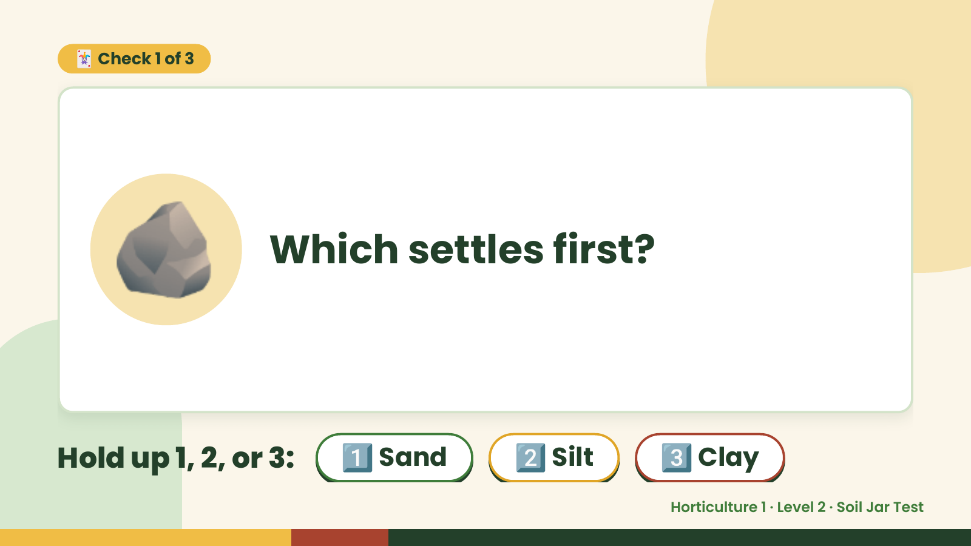
Notes:
🃏 Check 1 of 3
🪨 Which settles first?
Hold up 1, 2, or 3: 1️⃣ Sand 2️⃣ Silt 3️⃣ Clay
Horticulture 1 · Level 2 · Soil Jar Test

Slide 7
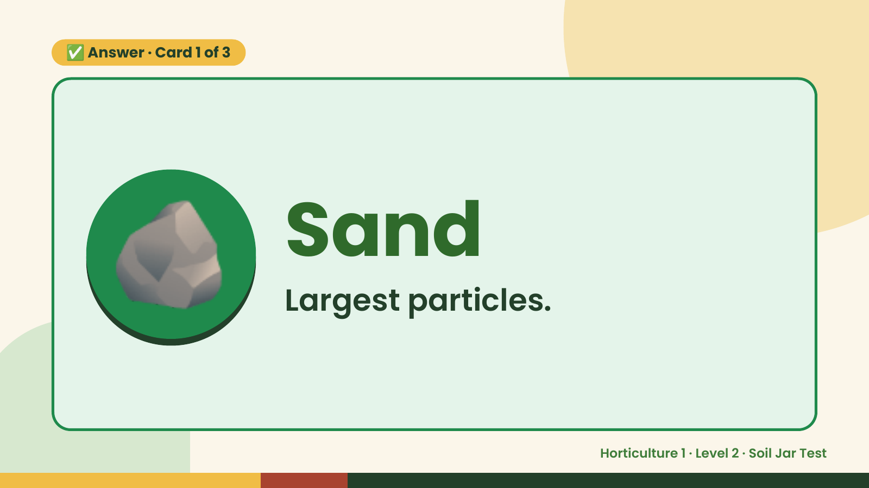
Notes:
✅ Answer · Card 1 of 3
🪨 Sand
Largest particles.
Horticulture 1 · Level 2 · Soil Jar Test

Slide 8
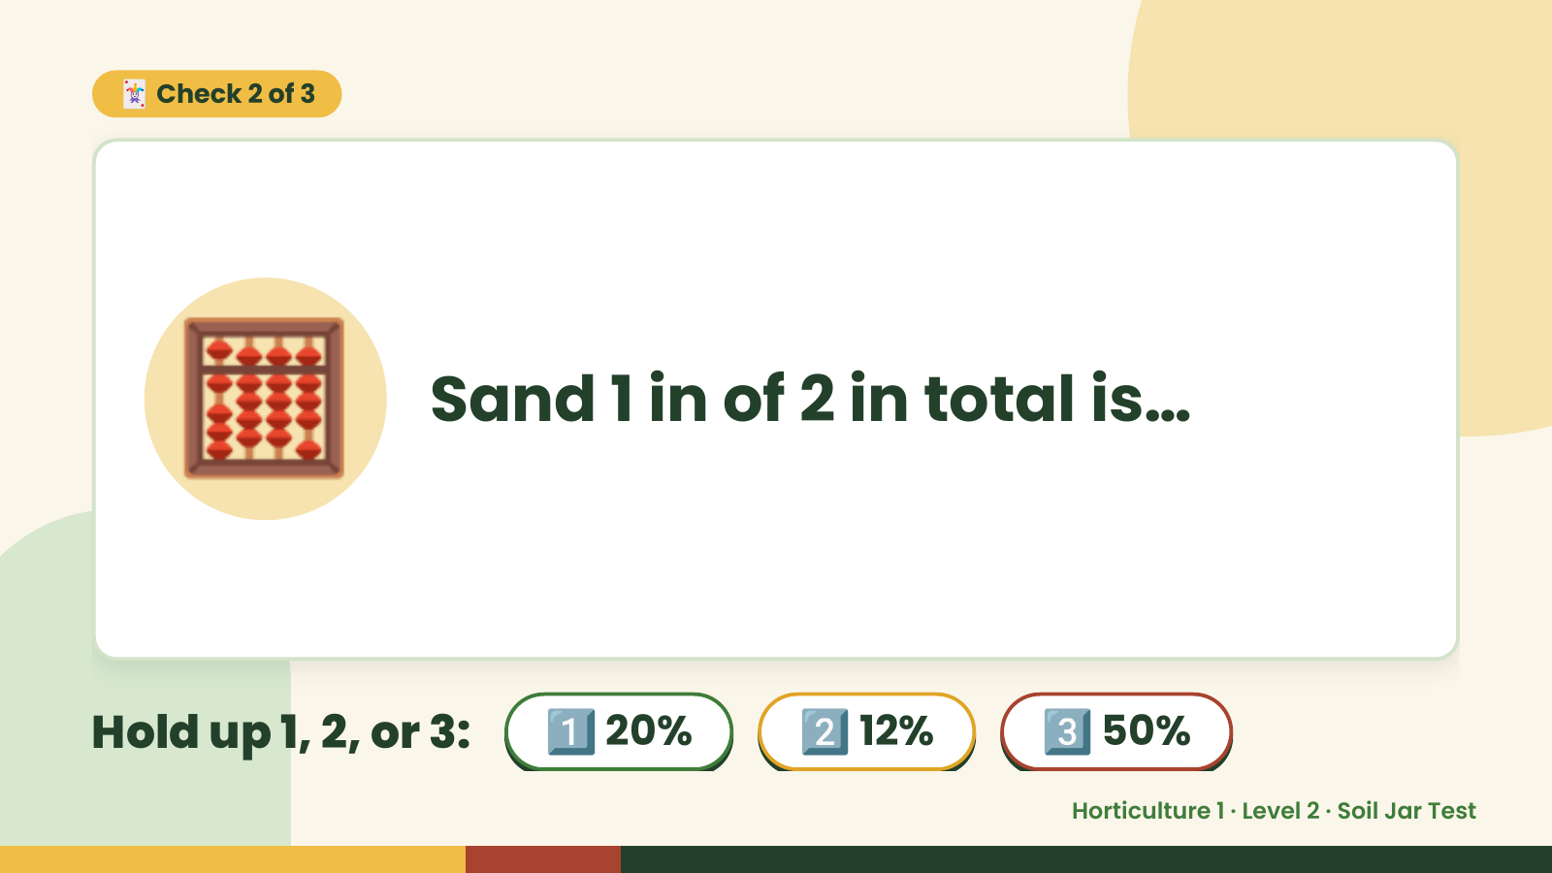
Notes:
🃏 Check 2 of 3
🧮 Sand 1 in of 2 in total is…
Hold up 1, 2, or 3: 1️⃣ 20% 2️⃣ 12% 3️⃣ 50%
Horticulture 1 · Level 2 · Soil Jar Test

Slide 9
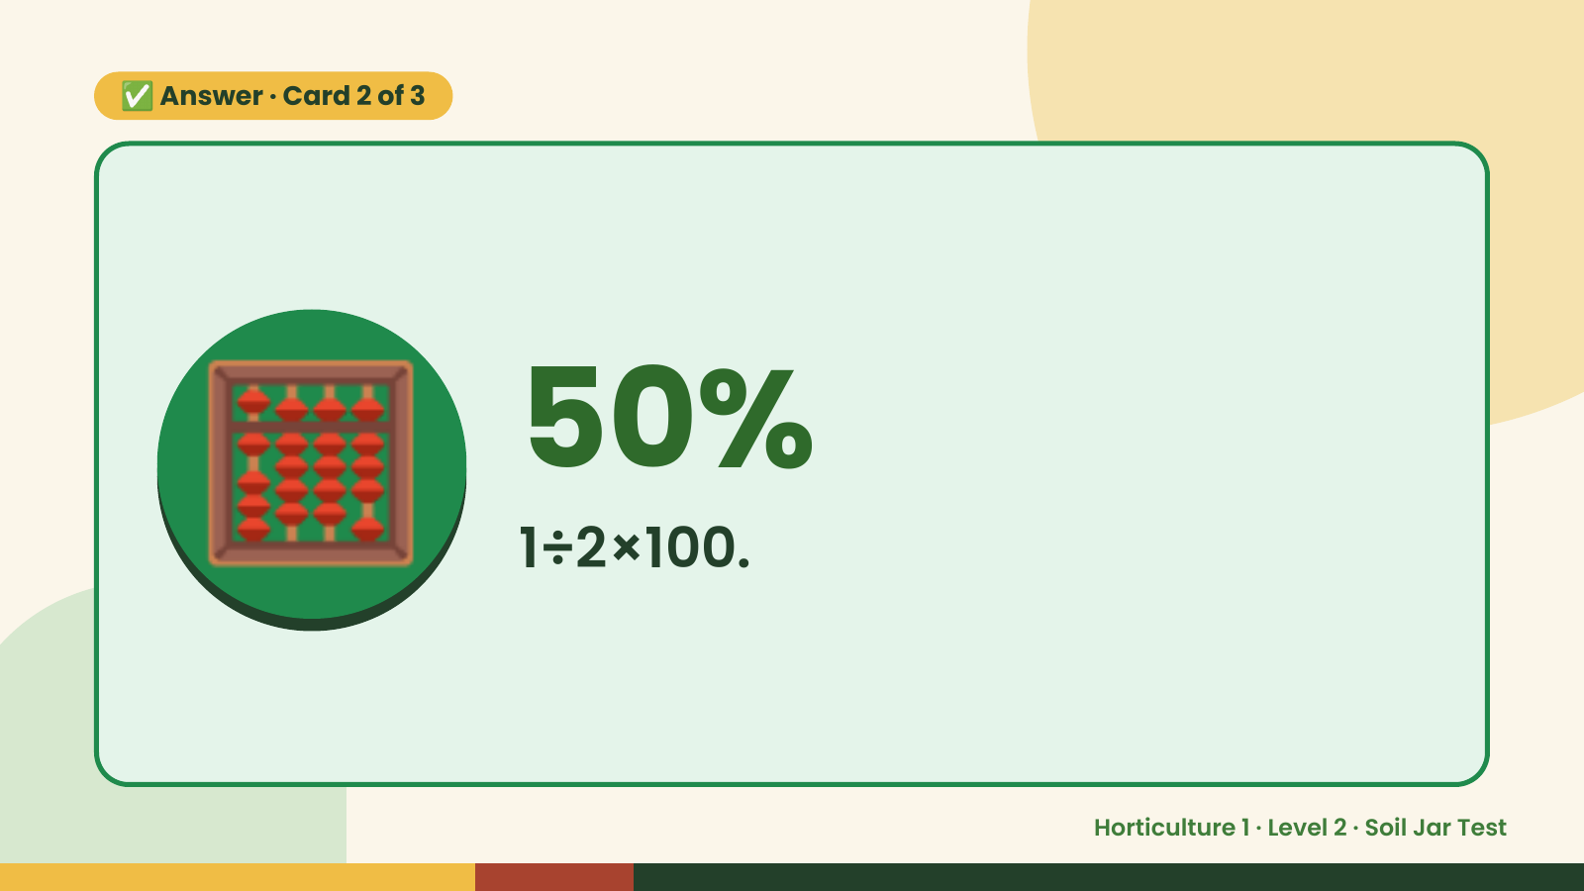
Notes:
✅ Answer · Card 2 of 3
🧮 50%
1÷2×100.
Horticulture 1 · Level 2 · Soil Jar Test

Slide 10
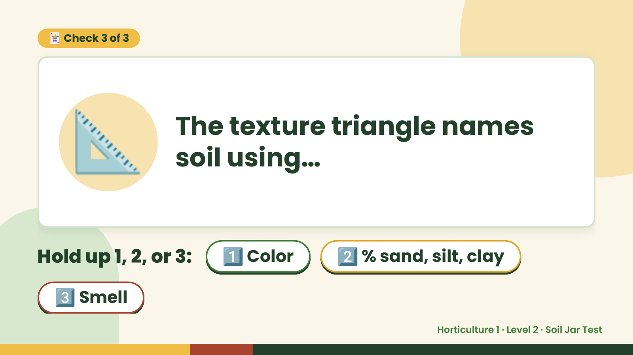
Notes:
🃏 Check 3 of 3
📐 The texture triangle names
soil using…
Hold up 1, 2, or 3: 1️⃣ Color 2️⃣ % sand, silt, clay
3️⃣ Smell
Horticulture 1 · Level 2 · Soil Jar Test

Slide 11
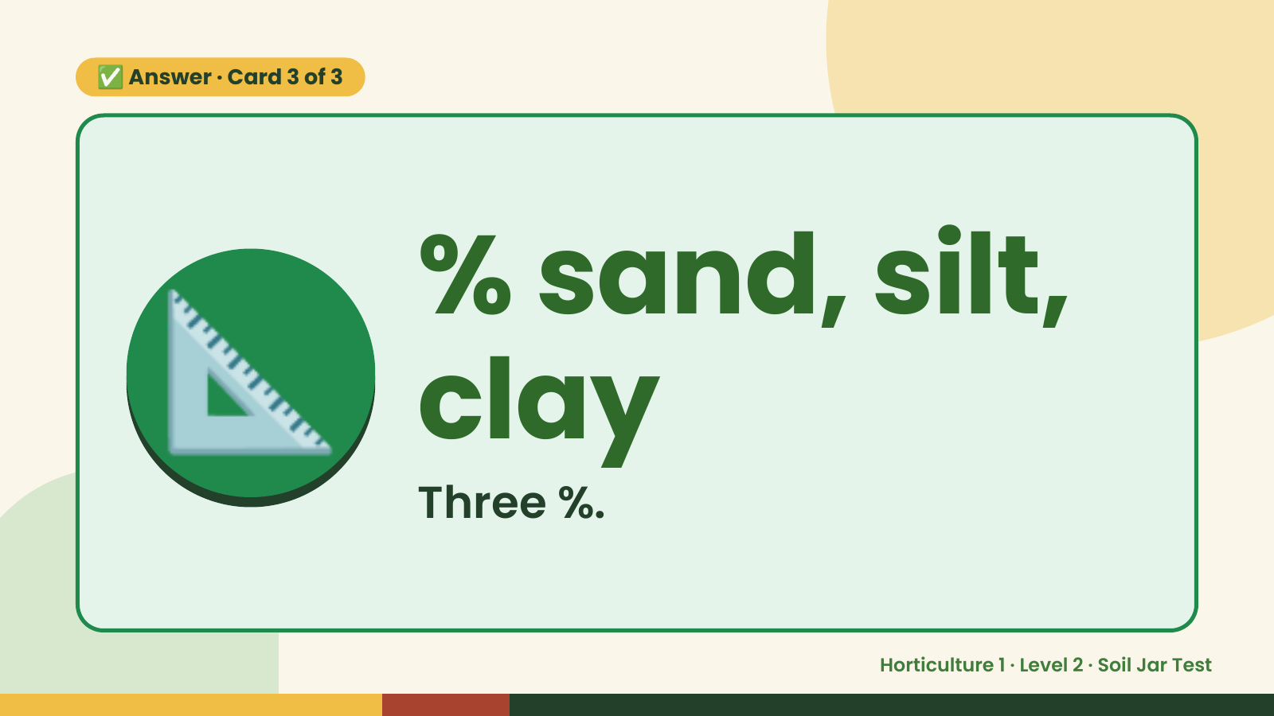
Notes:
✅ Answer · Card 3 of 3
📐 % sand, silt,
clay
Three %.
Horticulture 1 · Level 2 · Soil Jar Test

Slide 12

Notes:
Wrap-Up
Clean Up +
Reflect
🧽
Return and count tools.
Sweep and wipe your area.
Wash hands, then do the reflection.
Horticulture 1 · Level 2 · Soil Jar Test

