Slide 1
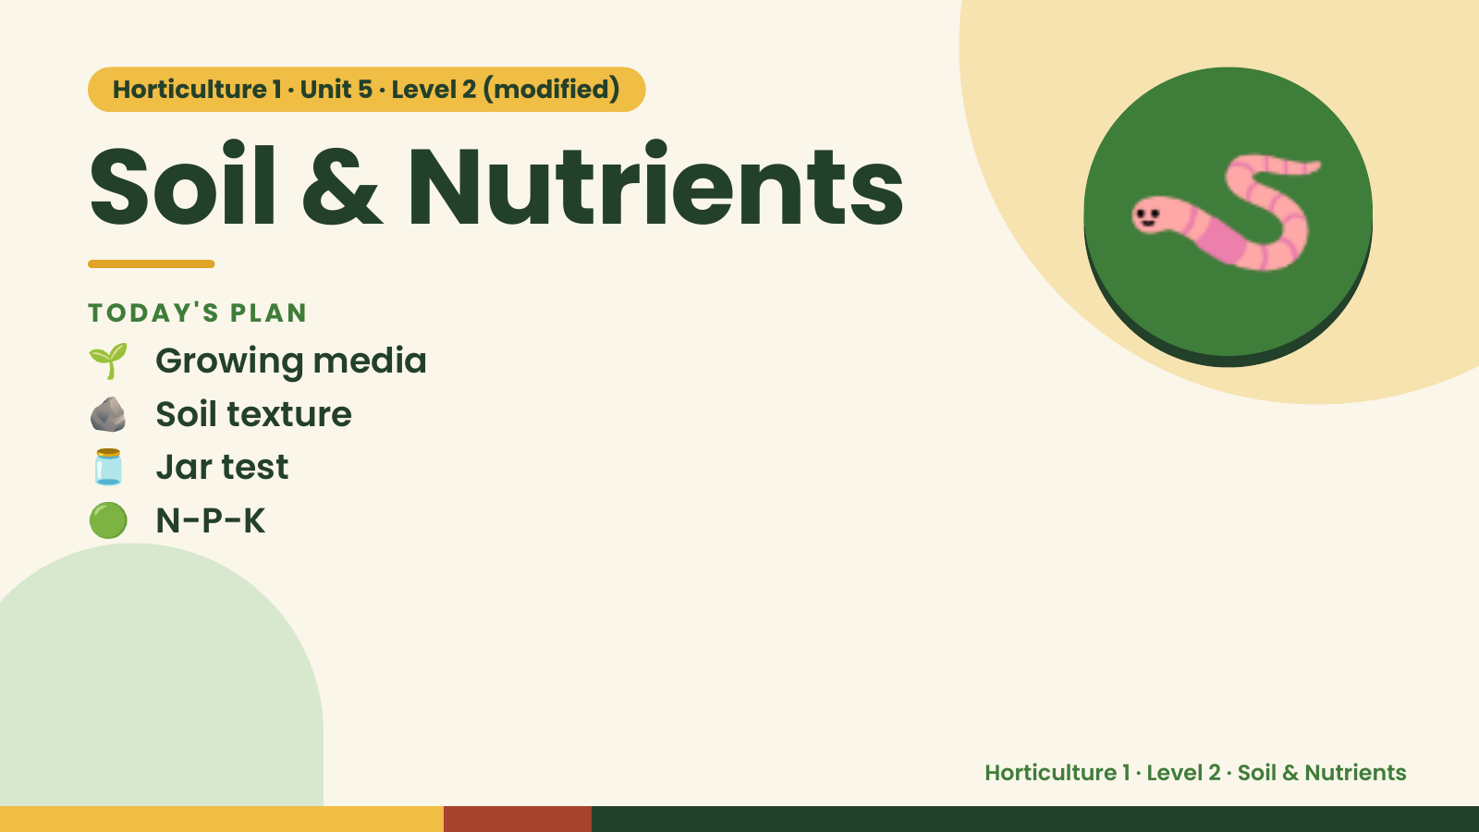
Notes:
Horticulture 1 · Unit 5 · Level 2 (modified)
Soil & Nutrients
🌱 Growing media
TODAY'S PLAN
🪨 Soil texture
🫙 Jar test
🪱
🟢 N-P-K
Horticulture 1 · Level 2 · Soil & Nutrients

Slide 2
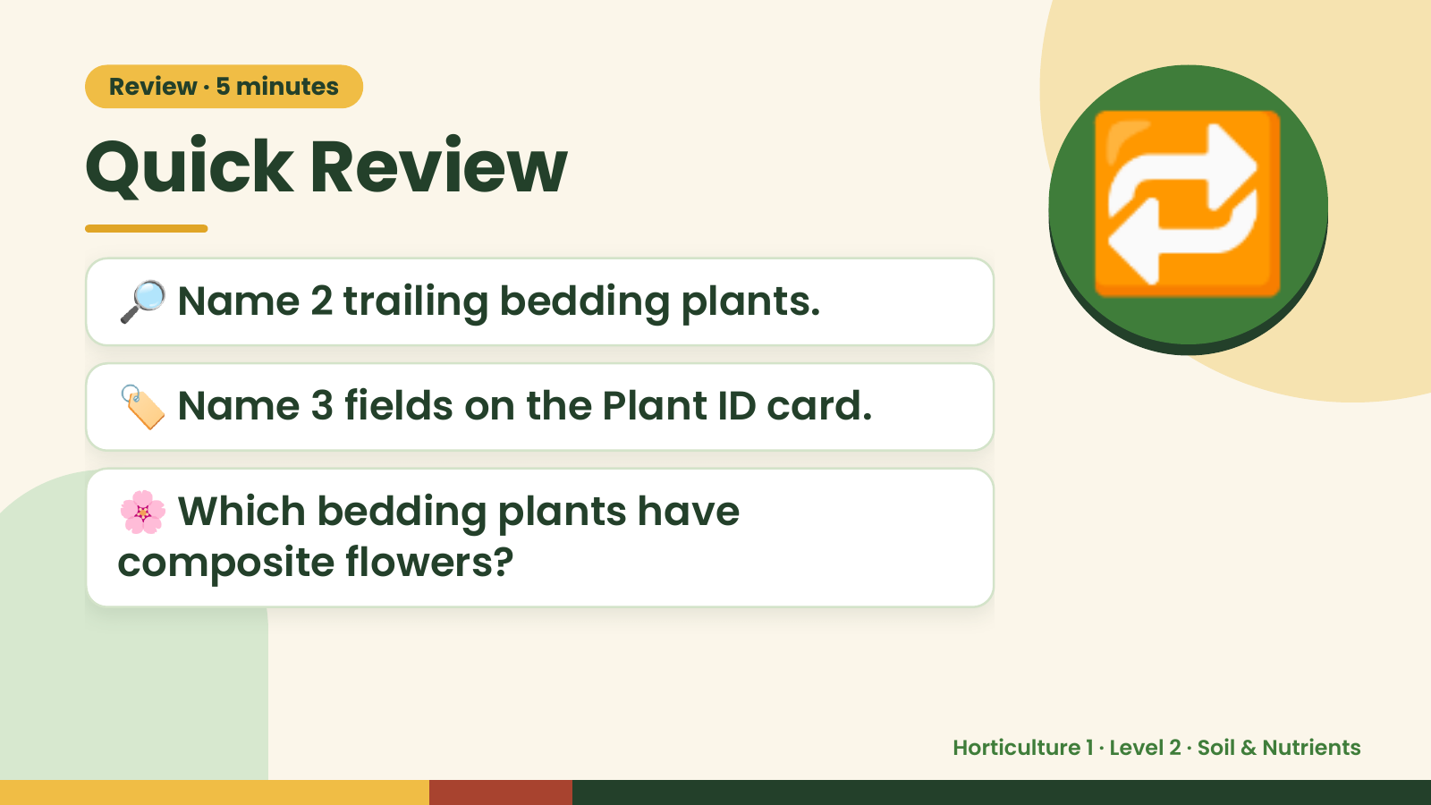
Notes:
Review · 5 minutes
Quick Review
🔎 Name 2 trailing bedding plants.
🏷️ Name 3 fields on the Plant ID card.
🔁
🌸 Which bedding plants have
composite flowers?
Horticulture 1 · Level 2 · Soil & Nutrients

Slide 3
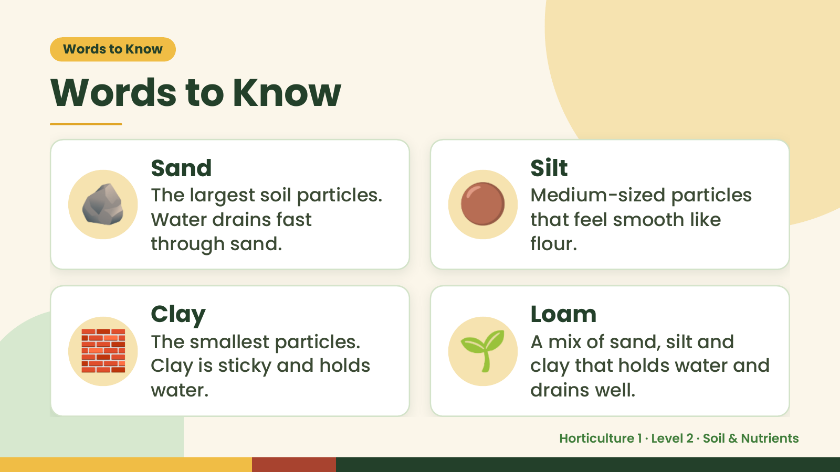
Notes:
Words to Know
Words to Know
🪨 Sand
The largest soil particles.
Water drains fast
through sand.
🟤 Silt
Medium-sized particles
that feel smooth like
flour.
🧱 Clay
The smallest particles.
Clay is sticky and holds
water.
🌱 Loam
A mix of sand, silt and
clay that holds water and
drains well.
Horticulture 1 · Level 2 · Soil & Nutrients

Slide 4
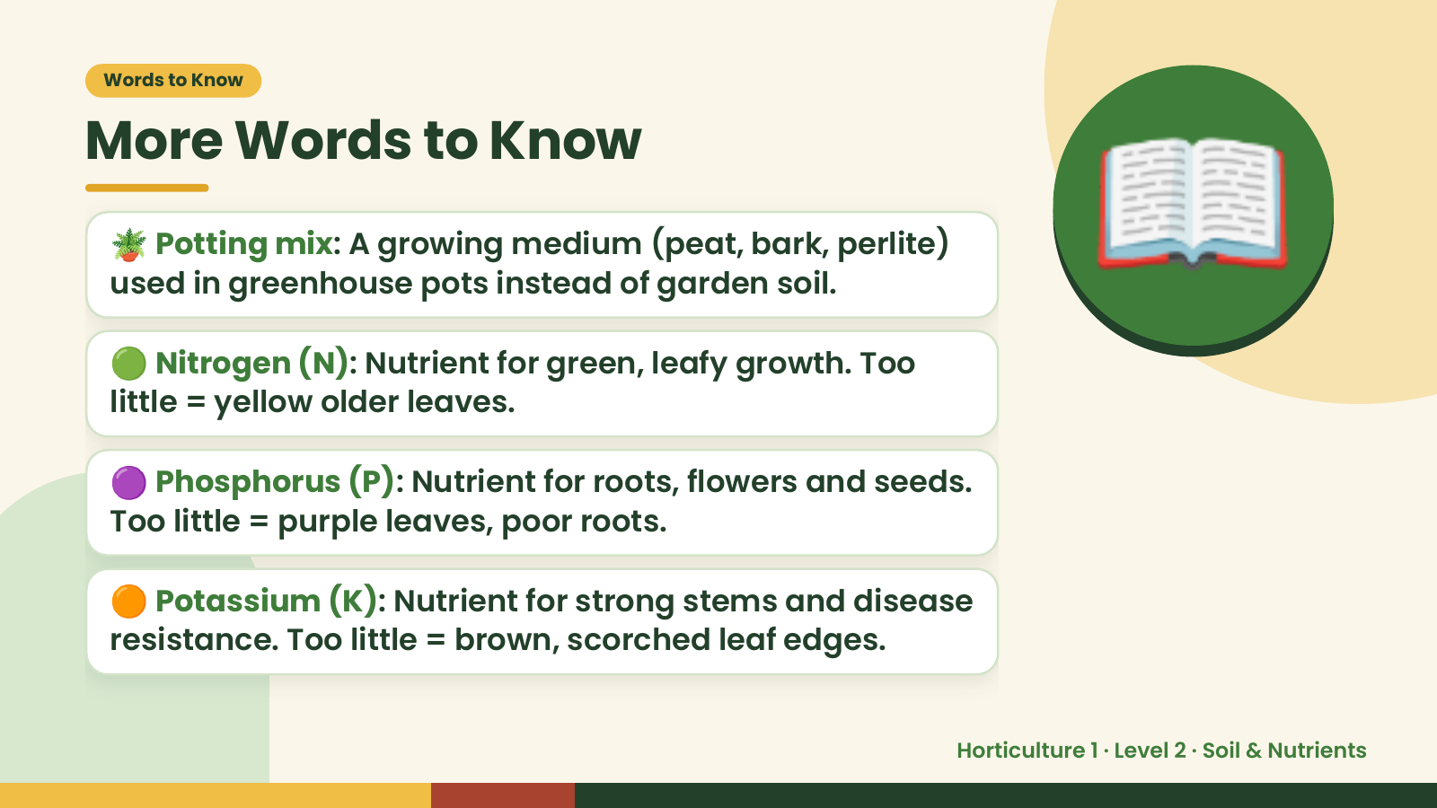
Notes:
Words to Know
More Words to Know
🪴 Potting mix: A growing medium (peat, bark, perlite)
used in greenhouse pots instead of garden soil.
🟢 Nitrogen (N): Nutrient for green, leafy growth. Too
little = yellow older leaves.
📖
🟣 Phosphorus (P): Nutrient for roots, flowers and seeds.
Too little = purple leaves, poor roots.
🟠 Potassium (K): Nutrient for strong stems and disease
resistance. Too little = brown, scorched leaf edges.
Horticulture 1 · Level 2 · Soil & Nutrients

Slide 5
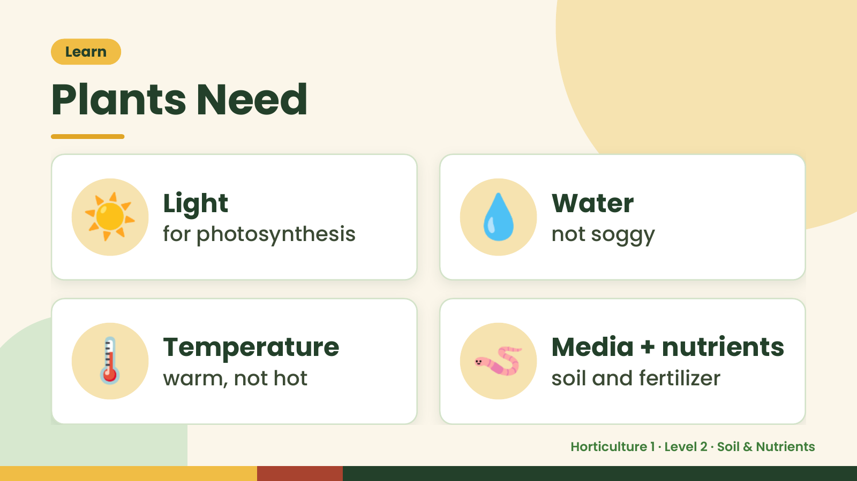
Notes:
Learn
Plants Need
☀️ Light
for photosynthesis 💧 Water
not soggy
🌡️ Temperature
warm, not hot 🪱 Media + nutrients
soil and fertilizer
Horticulture 1 · Level 2 · Soil & Nutrients

Slide 6
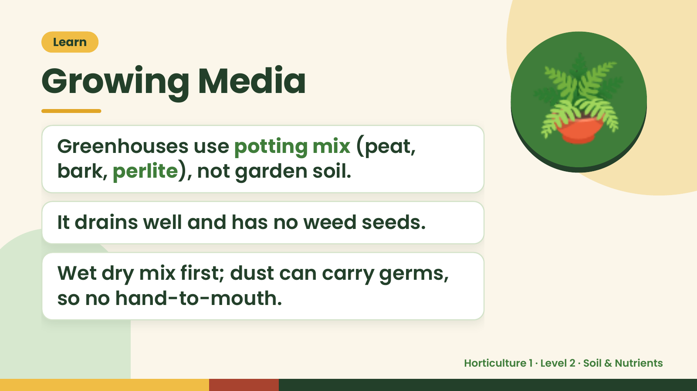
Notes:
Learn
Growing Media
Greenhouses use potting mix (peat,
bark, perlite), not garden soil.
🪴
It drains well and has no weed seeds.
Wet dry mix first; dust can carry germs,
so no hand-to-mouth.
Horticulture 1 · Level 2 · Soil & Nutrients

Slide 7
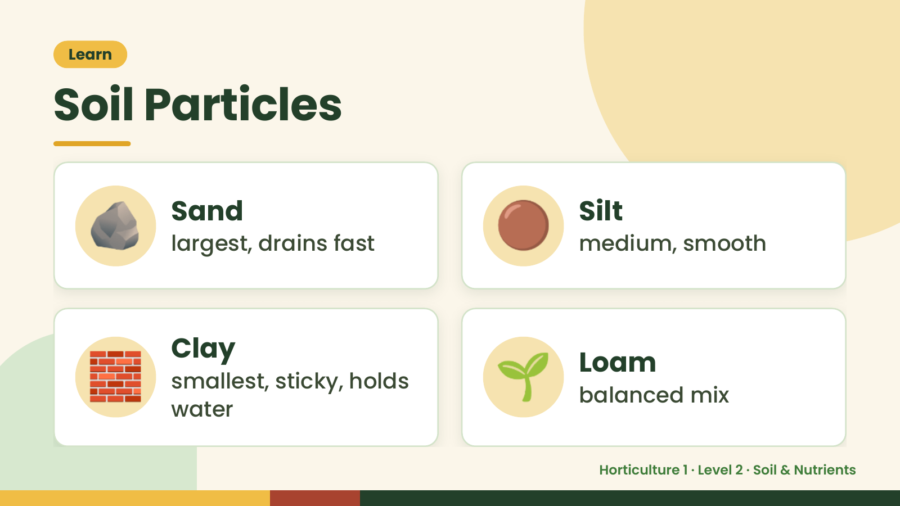
Notes:
Learn
Soil Particles
🪨 Sand
largest, drains fast 🟤 Silt
medium, smooth
🧱 Clay
smallest, sticky, holds
water
🌱 Loam
balanced mix
Horticulture 1 · Level 2 · Soil & Nutrients

Slide 8
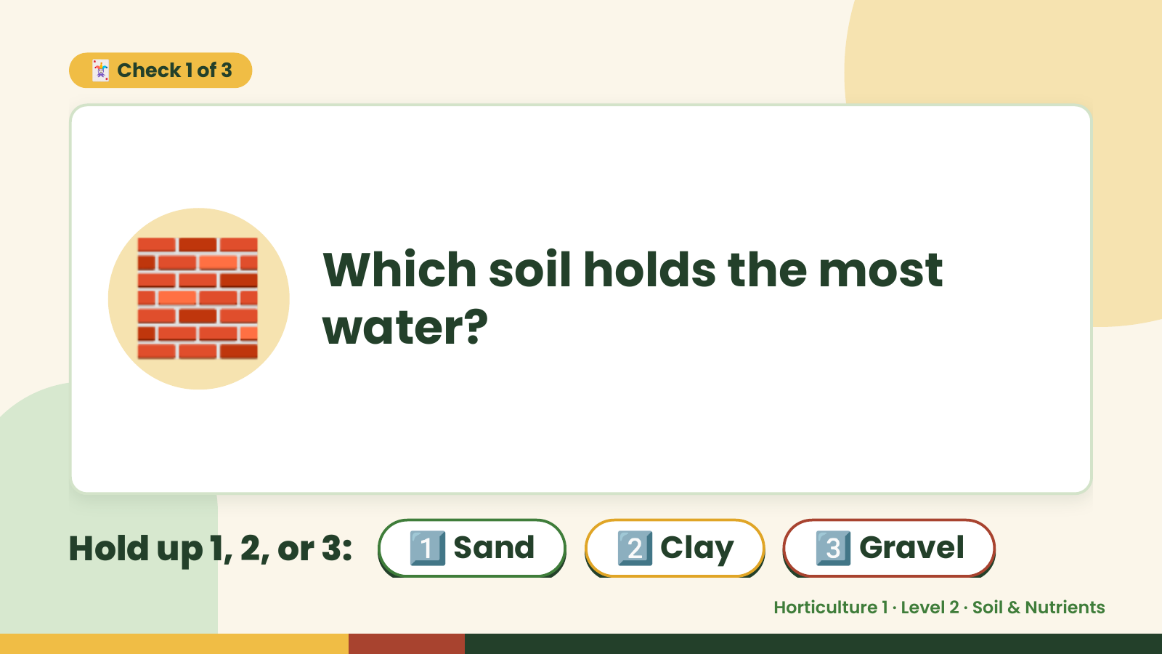
Notes:
🃏 Check 1 of 3
🧱 Which soil holds the most
water?
Hold up 1, 2, or 3: 1️⃣ Sand 2️⃣ Clay 3️⃣ Gravel
Horticulture 1 · Level 2 · Soil & Nutrients

Slide 9
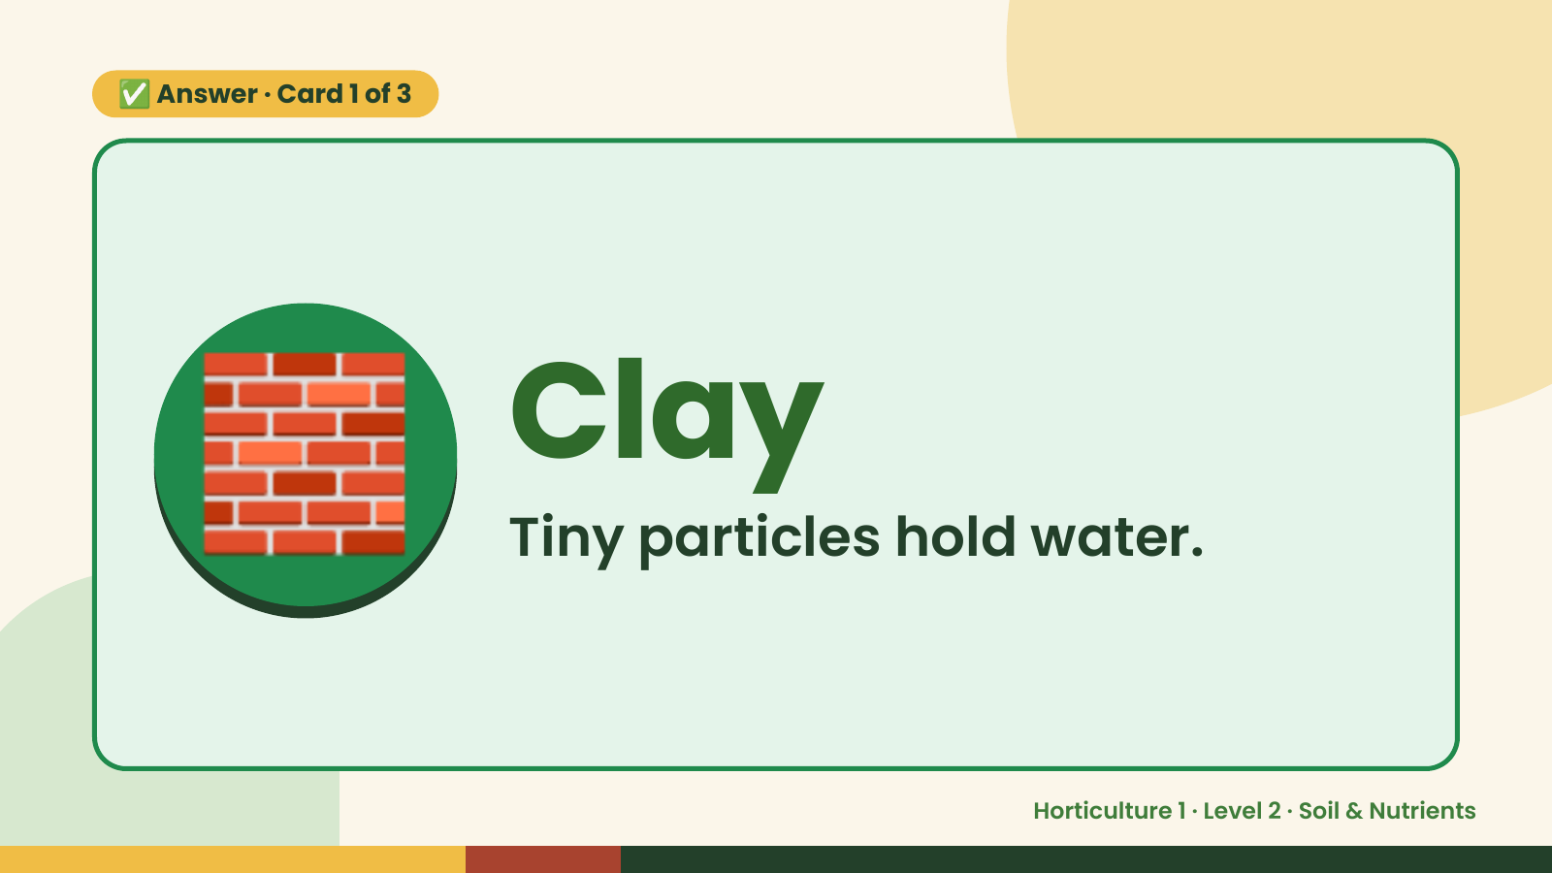
Notes:
✅ Answer · Card 1 of 3
🧱 Clay
Tiny particles hold water.
Horticulture 1 · Level 2 · Soil & Nutrients

Slide 10
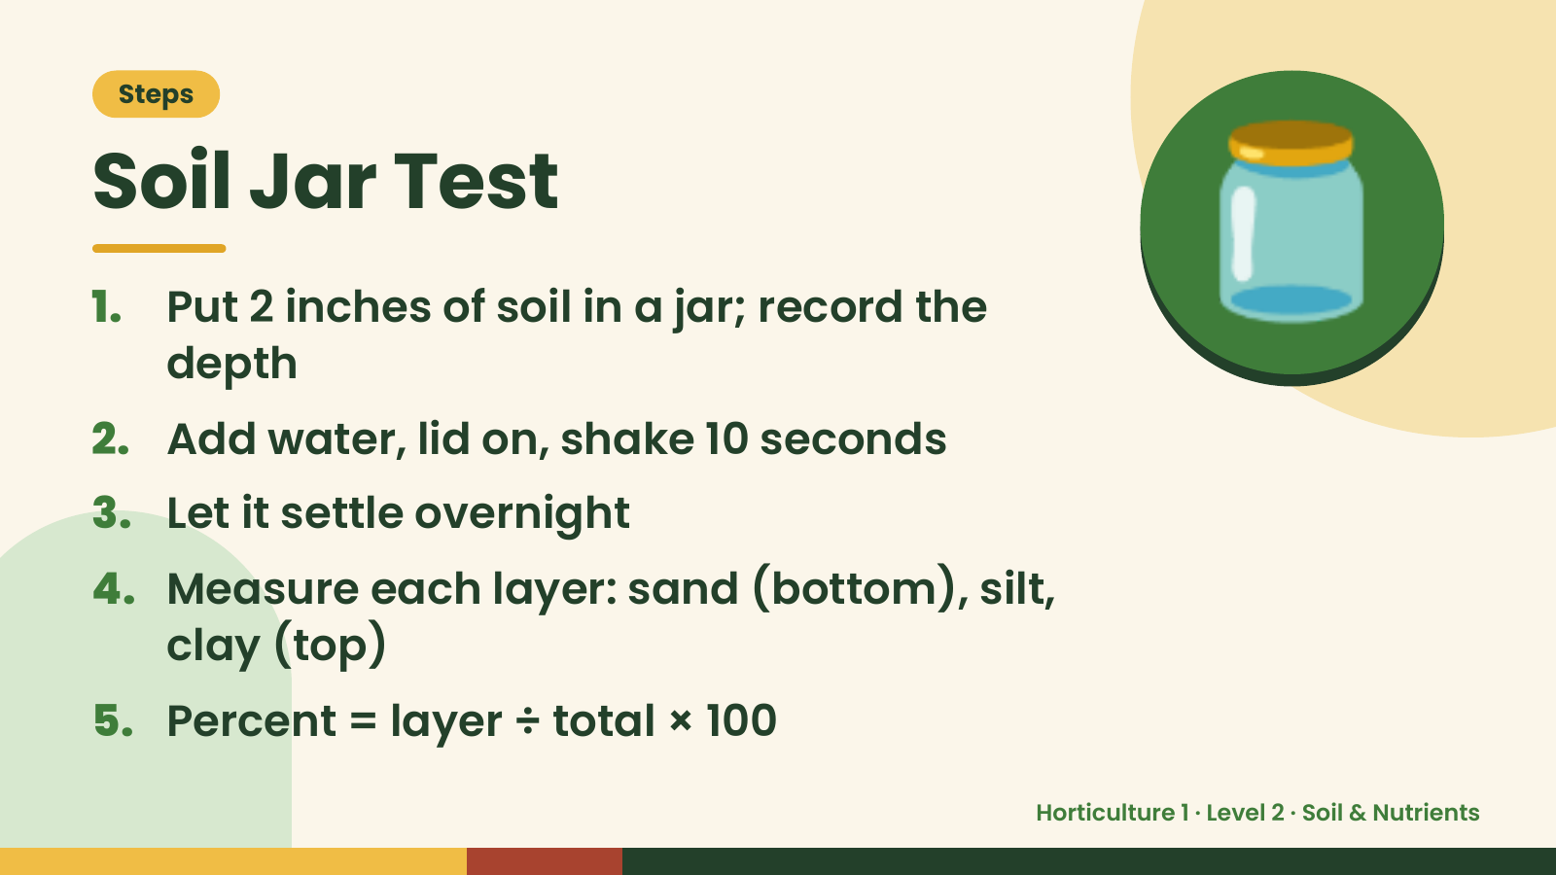
Notes:
Steps
Soil Jar Test
1. Put 2 inches of soil in a jar; record the
depth
2. Add water, lid on, shake 10 seconds
🫙
3. Let it settle overnight
4. Measure each layer: sand (bottom), silt,
clay (top)
5. Percent = layer ÷ total × 100
Horticulture 1 · Level 2 · Soil & Nutrients

Slide 11
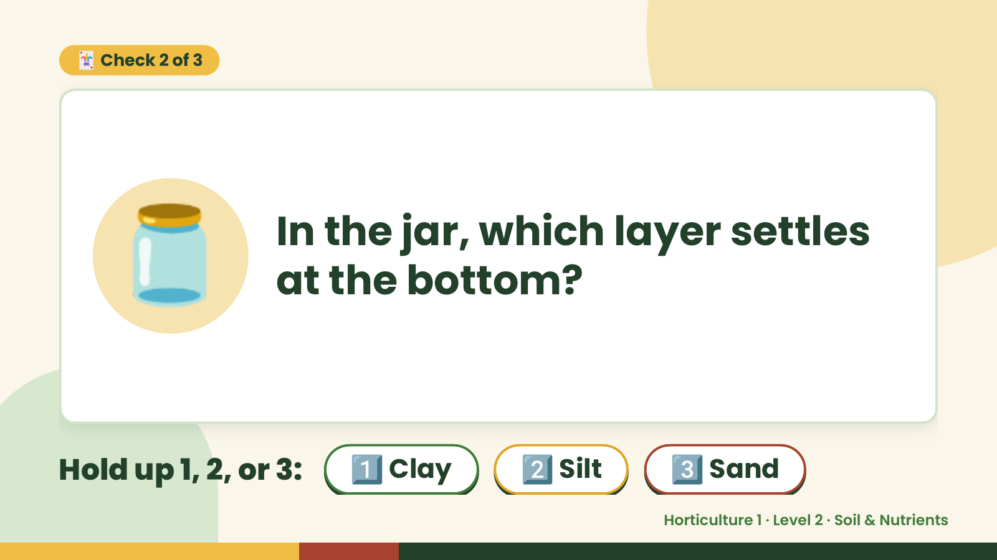
Notes:
🃏 Check 2 of 3
🫙 In the jar, which layer settles
at the bottom?
Hold up 1, 2, or 3: 1️⃣ Clay 2️⃣ Silt 3️⃣ Sand
Horticulture 1 · Level 2 · Soil & Nutrients

Slide 12
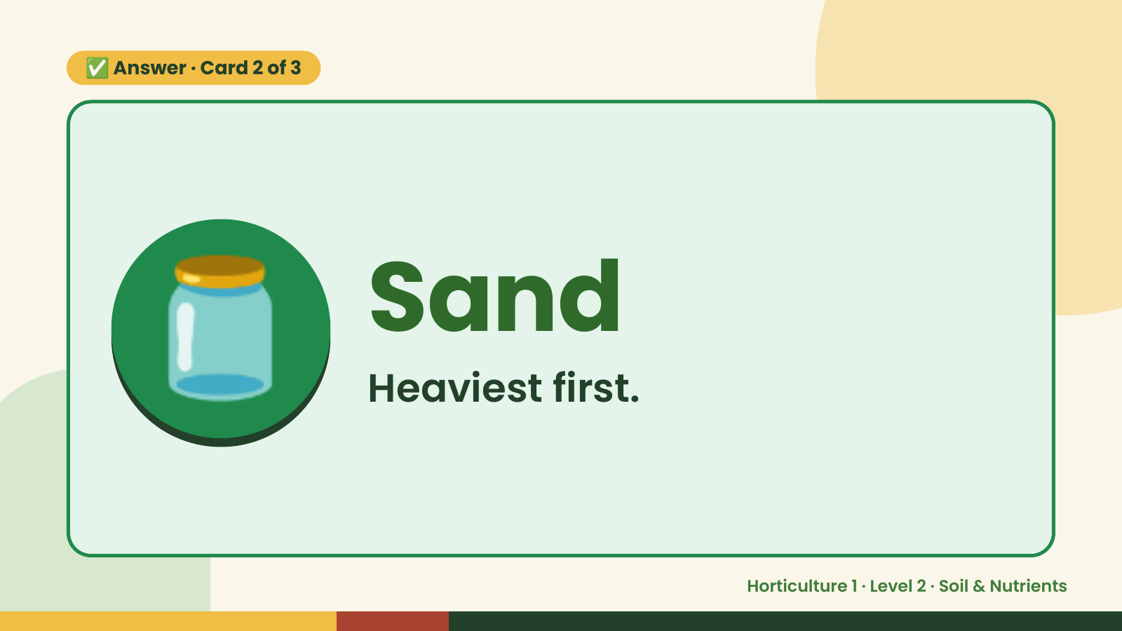
Notes:
✅ Answer · Card 2 of 3
🫙 Sand
Heaviest first.
Horticulture 1 · Level 2 · Soil & Nutrients

Slide 13
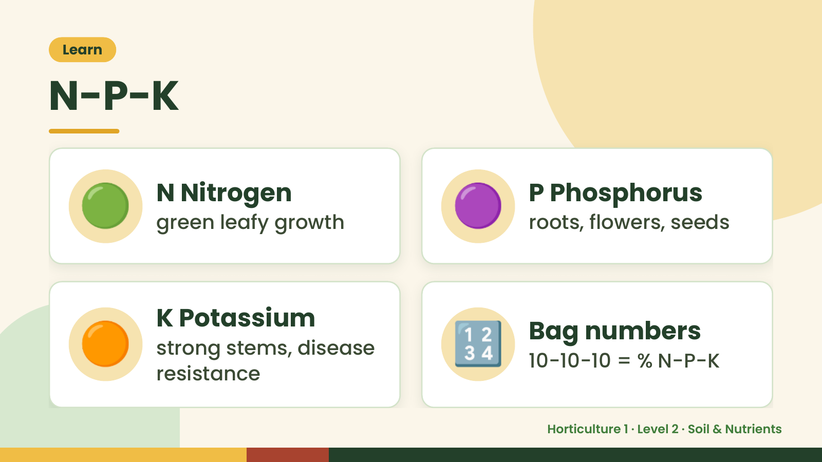
Notes:
Learn
N-P-K
🟢 N Nitrogen
green leafy growth 🟣 P Phosphorus
roots, flowers, seeds
🟠 K Potassium
strong stems, disease
resistance
🔢 Bag numbers
10-10-10 = % N-P-K
Horticulture 1 · Level 2 · Soil & Nutrients

Slide 14
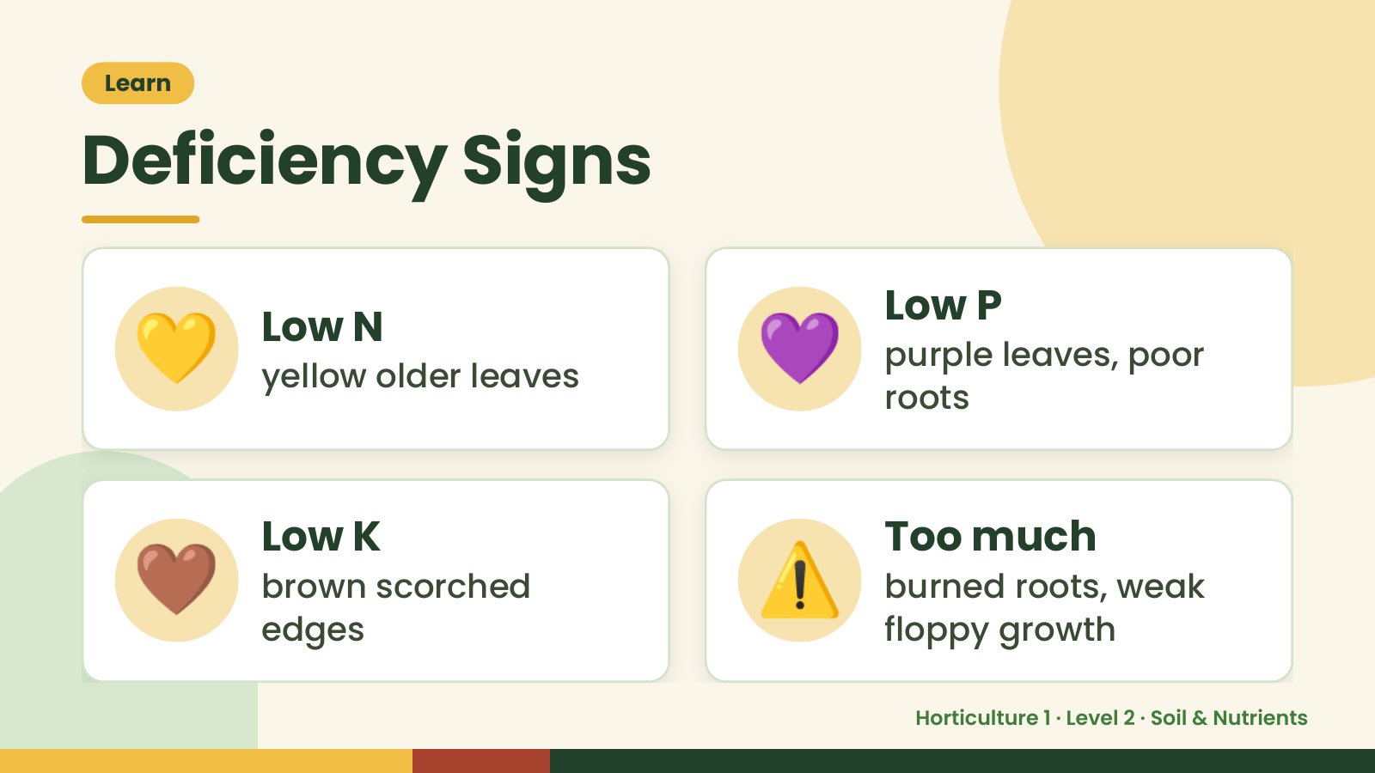
Notes:
Learn
Deficiency Signs
💛 Low N
yellow older leaves 💜 Low P
purple leaves, poor
roots
🤎 Low K
brown scorched
edges
⚠️ Too much
burned roots, weak
floppy growth
Horticulture 1 · Level 2 · Soil & Nutrients

Slide 15
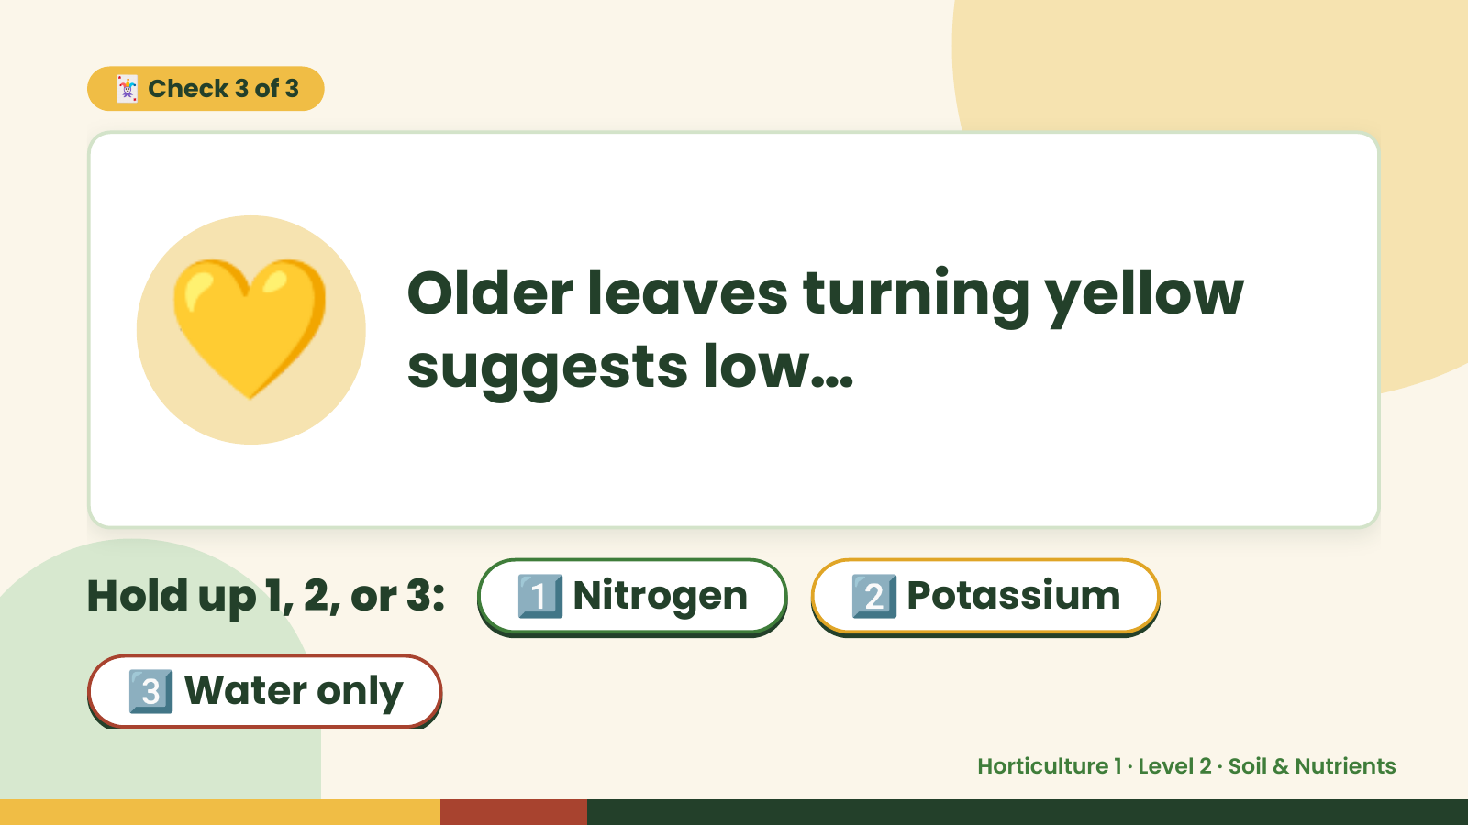
Notes:
🃏 Check 3 of 3
💛 Older leaves turning yellow
suggests low…
Hold up 1, 2, or 3: 1️⃣ Nitrogen 2️⃣ Potassium
3️⃣ Water only
Horticulture 1 · Level 2 · Soil & Nutrients

Slide 16
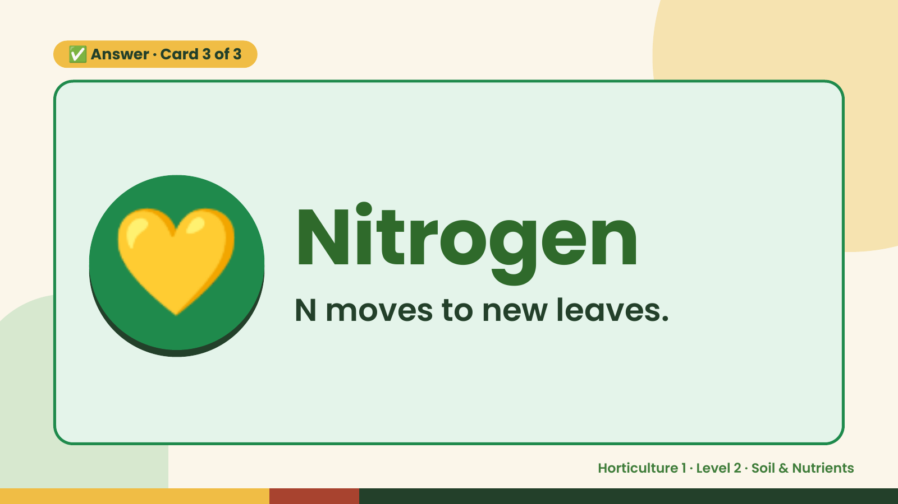
Notes:
✅ Answer · Card 3 of 3
💛 Nitrogen
N moves to new leaves.
Horticulture 1 · Level 2 · Soil & Nutrients

Slide 17
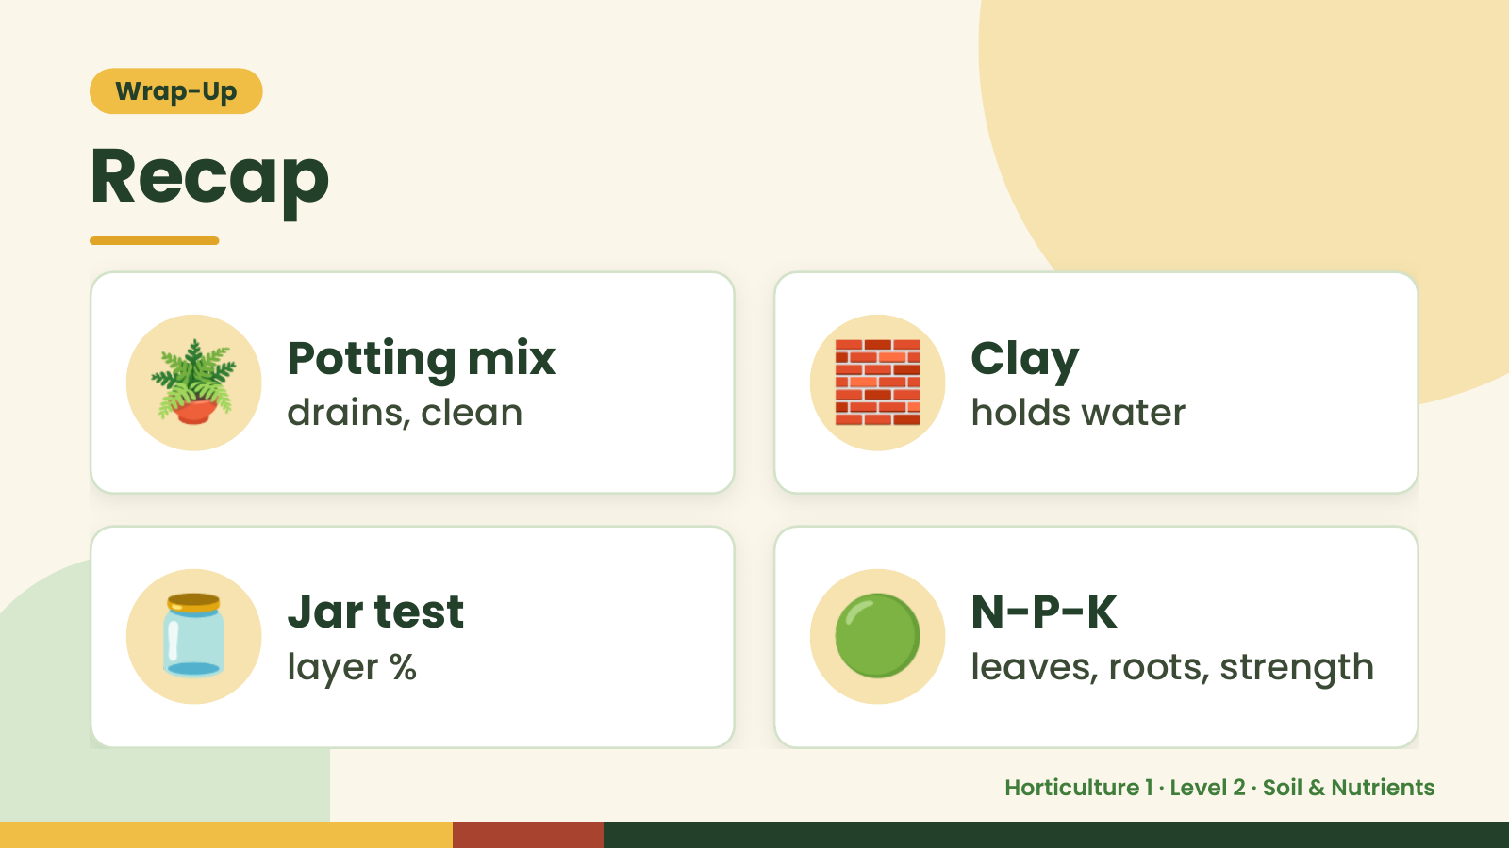
Notes:
Wrap-Up
Recap
🪴 Potting mix
drains, clean 🧱 Clay
holds water
🫙 Jar test
layer % 🟢 N-P-K
leaves, roots, strength
Horticulture 1 · Level 2 · Soil & Nutrients

Slide 18
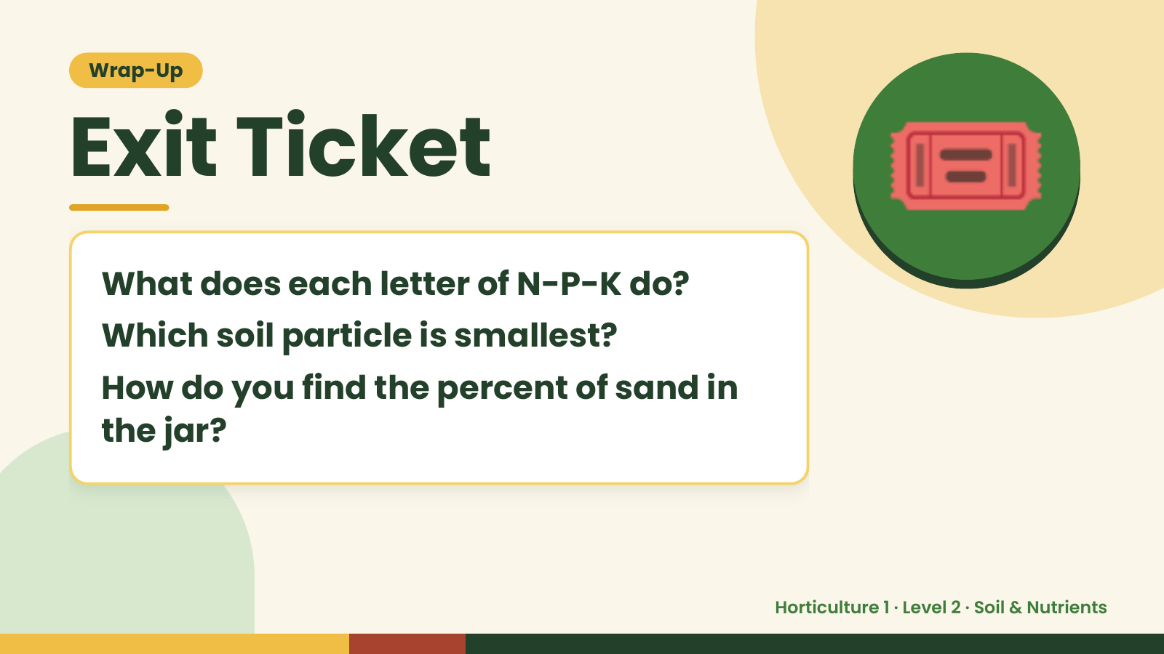
Notes:
Wrap-Up
Exit Ticket
What does each letter of N-P-K do?
Which soil particle is smallest?
🎟️
How do you find the percent of sand in
the jar?
Horticulture 1 · Level 2 · Soil & Nutrients

