Slide 1
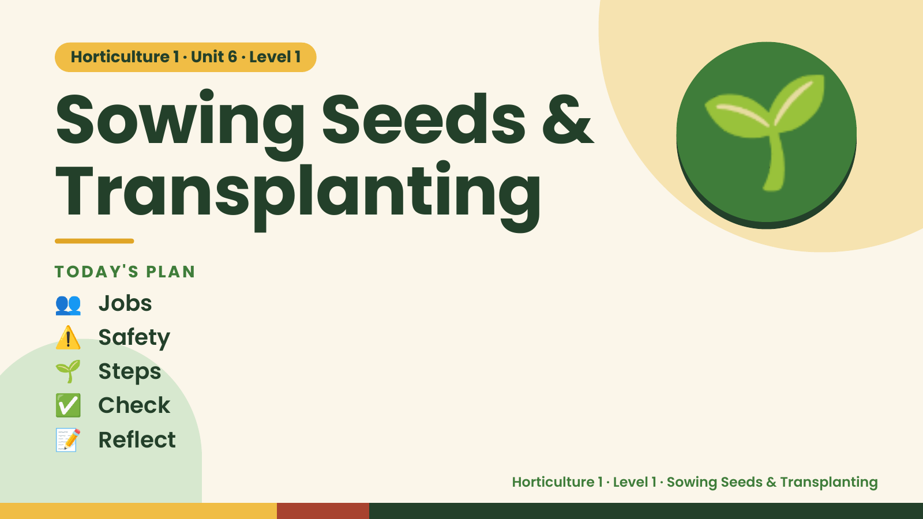
Notes:
Horticulture 1 · Unit 6 · Level 1
Sowing Seeds &
Transplanting
TODAY'S PLAN
🌱
👥 Jobs
⚠️ Safety
🌱 Steps
✅ Check
📝 Reflect
Horticulture 1 · Level 1 · Sowing Seeds & Transplanting

Slide 2
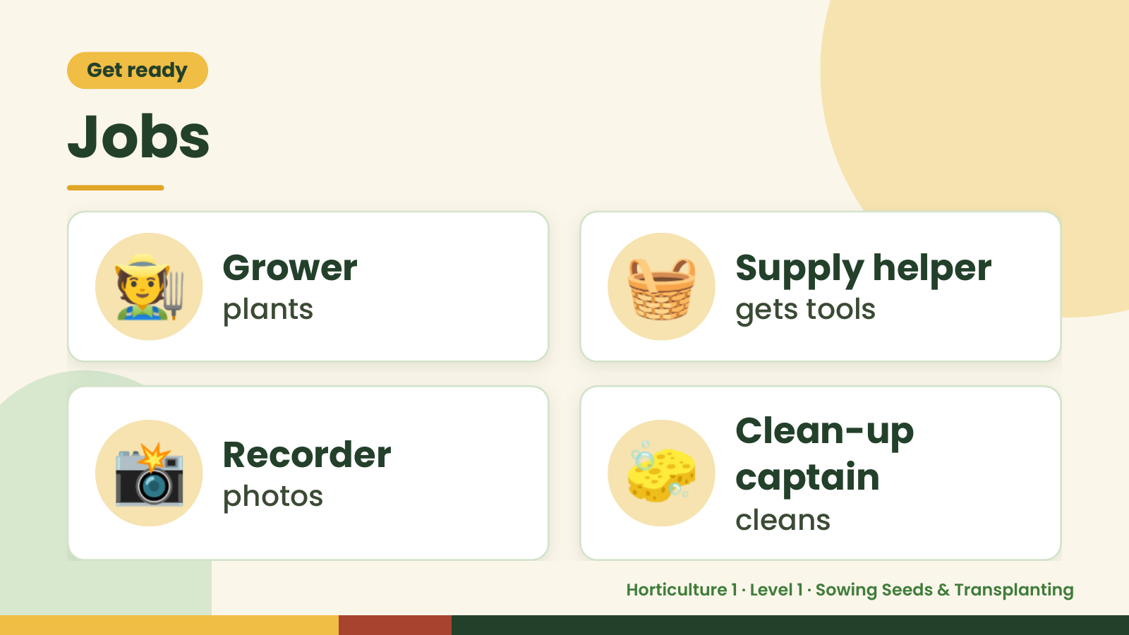
Notes:
Get ready
Jobs
🧑‍🌾 Grower
plants 🧺 Supply helper
gets tools
📸 Recorder
photos 🧽 Clean-up
captain
cleans
Horticulture 1 · Level 1 · Sowing Seeds & Transplanting

Slide 3
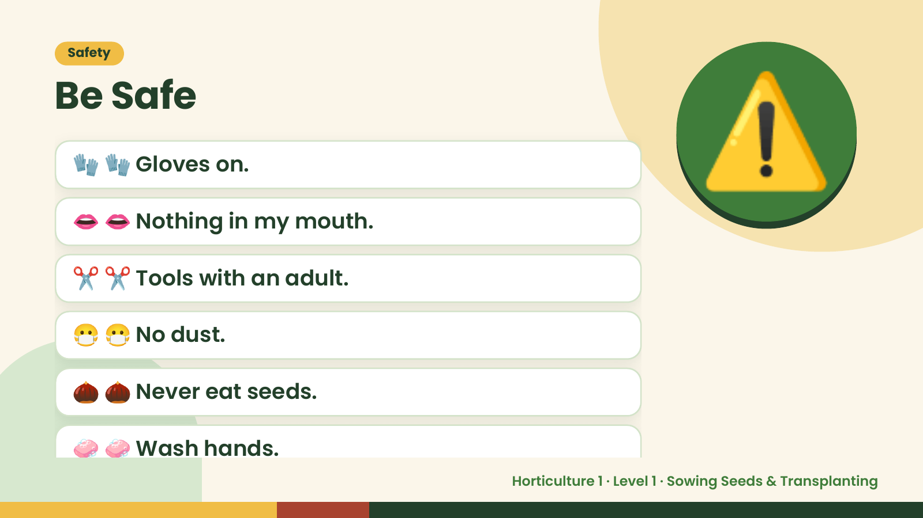
Notes:
Safety
Be Safe
🧤 🧤 Gloves on.
👄 👄 Nothing in my mouth.
✂️ ✂️ Tools with an adult.
⚠️
😷 😷 No dust.
🌰 🌰 Never eat seeds.
🧼 🧼 Wash hands.
Horticulture 1 · Level 1 · Sowing Seeds & Transplanting

Slide 4
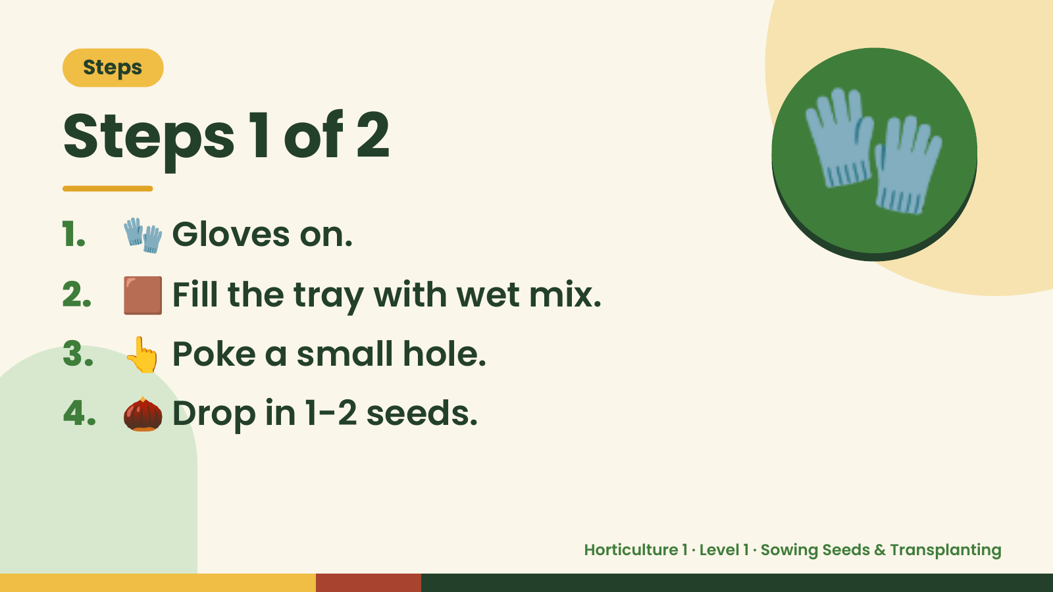
Notes:
Steps
Steps 1 of 2
1. 🧤 Gloves on.
2. 🟫 Fill the tray with wet mix.
🧤
3. 👆 Poke a small hole.
4. 🌰 Drop in 1-2 seeds.
Horticulture 1 · Level 1 · Sowing Seeds & Transplanting

Slide 5
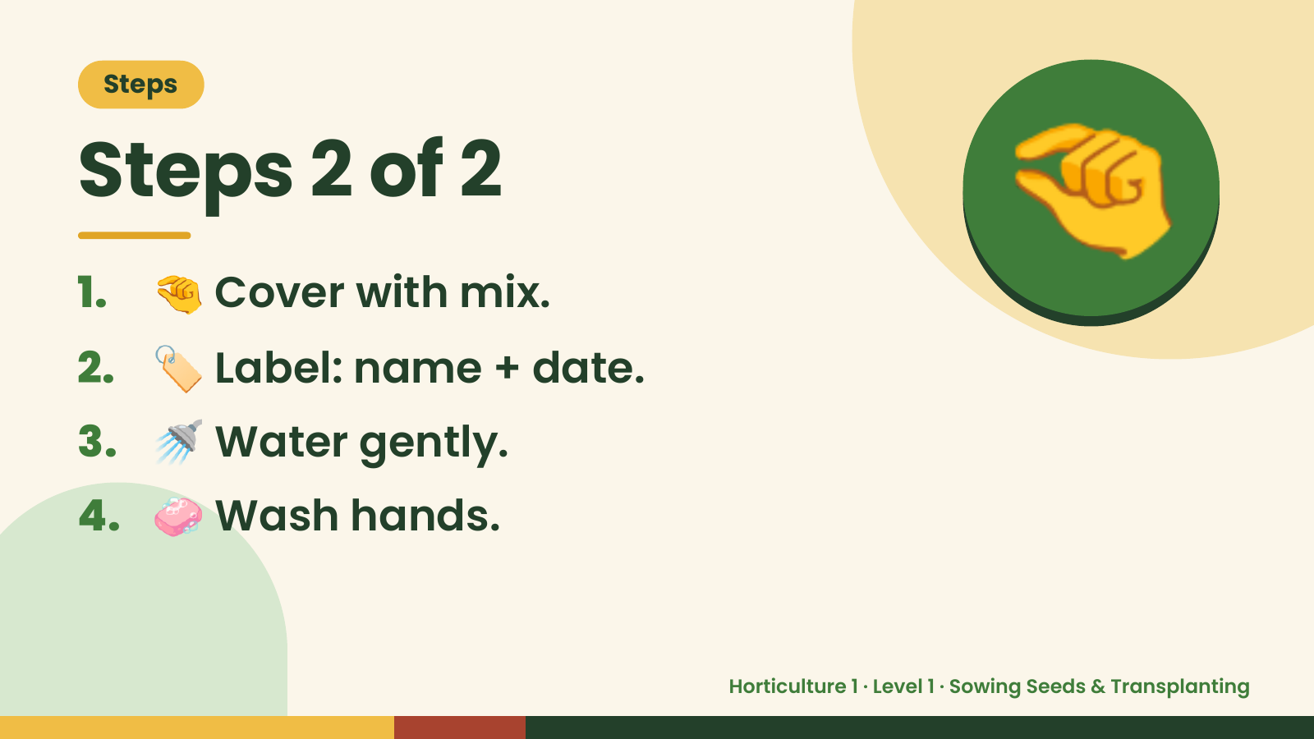
Notes:
Steps
Steps 2 of 2
1. 🤏 Cover with mix.
2. 🏷️ Label: name + date.
🤏
3. 🚿 Water gently.
4. 🧼 Wash hands.
Horticulture 1 · Level 1 · Sowing Seeds & Transplanting

Slide 6
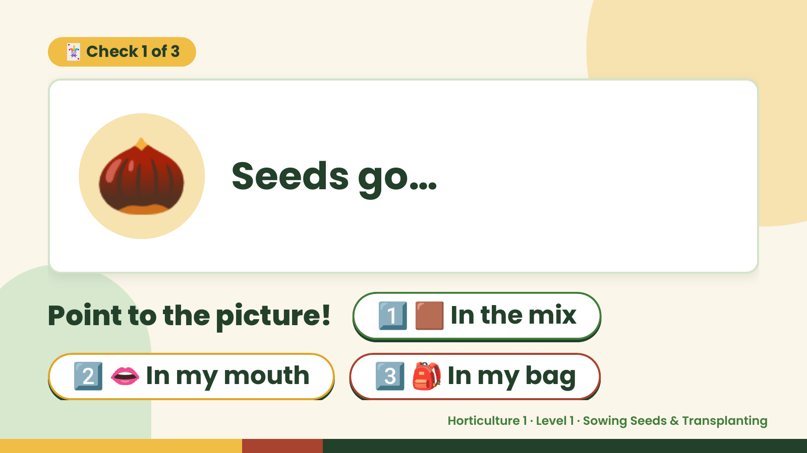
Notes:
🃏 Check 1 of 3
🌰 Seeds go…
Point to the picture! 1️⃣ 🟫 In the mix
2️⃣ 👄 In my mouth 3️⃣ 🎒 In my bag
Horticulture 1 · Level 1 · Sowing Seeds & Transplanting

Slide 7
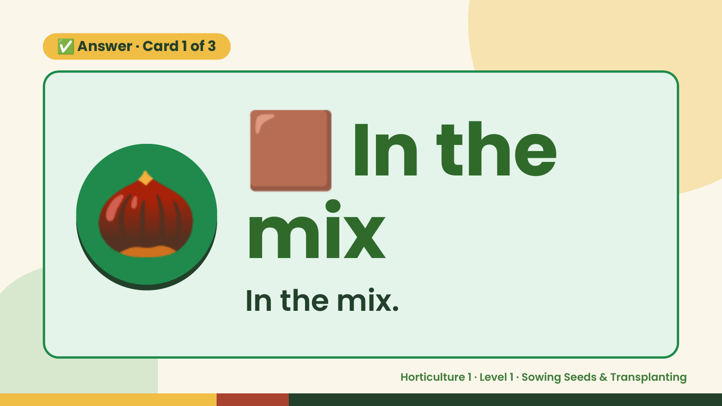
Notes:
🟫
✅ Answer · Card 1 of 3
🌰 mix
In the
In the mix.
Horticulture 1 · Level 1 · Sowing Seeds & Transplanting

Slide 8
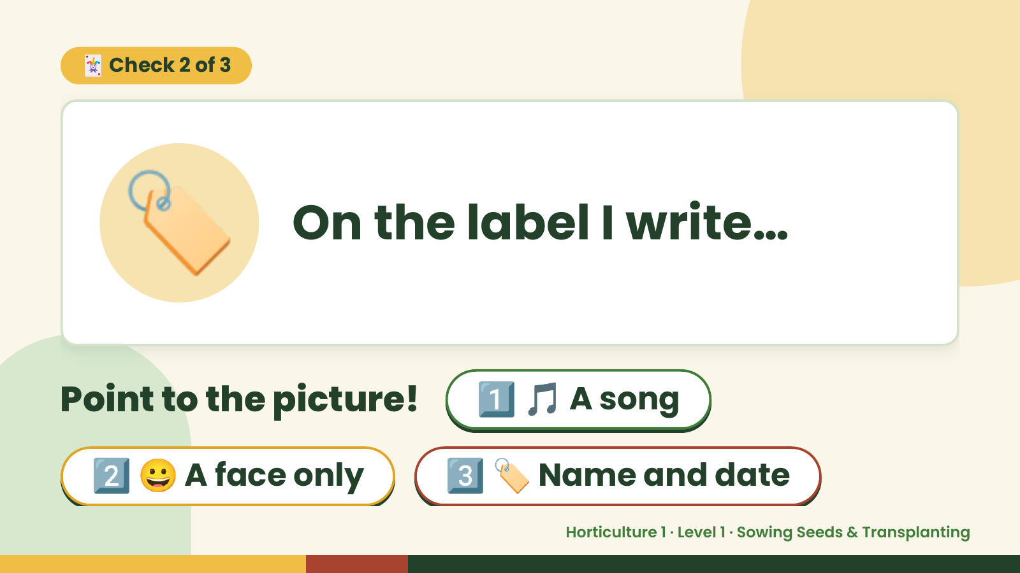
Notes:
🃏 Check 2 of 3
🏷️ On the label I write…
Point to the picture! 1️⃣ 🎵 A song
2️⃣ 😀 A face only 3️⃣ 🏷️ Name and date
Horticulture 1 · Level 1 · Sowing Seeds & Transplanting

Slide 9
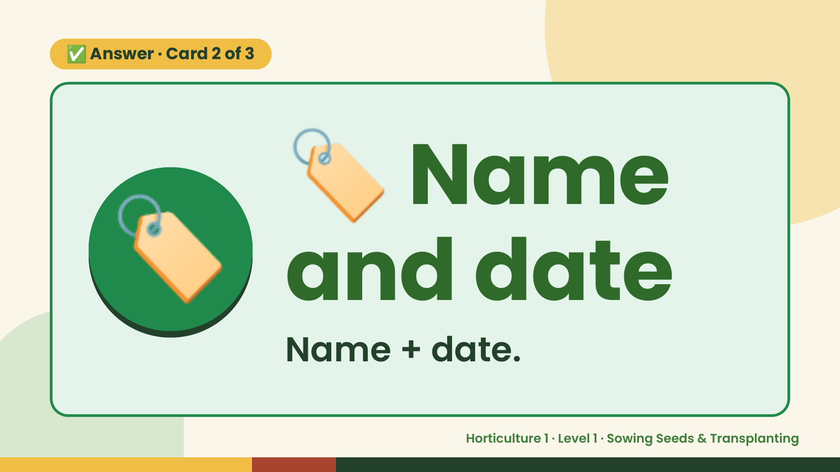
Notes:
🏷️
✅ Answer · Card 2 of 3
🏷️ and date
Name
Name + date.
Horticulture 1 · Level 1 · Sowing Seeds & Transplanting

Slide 10
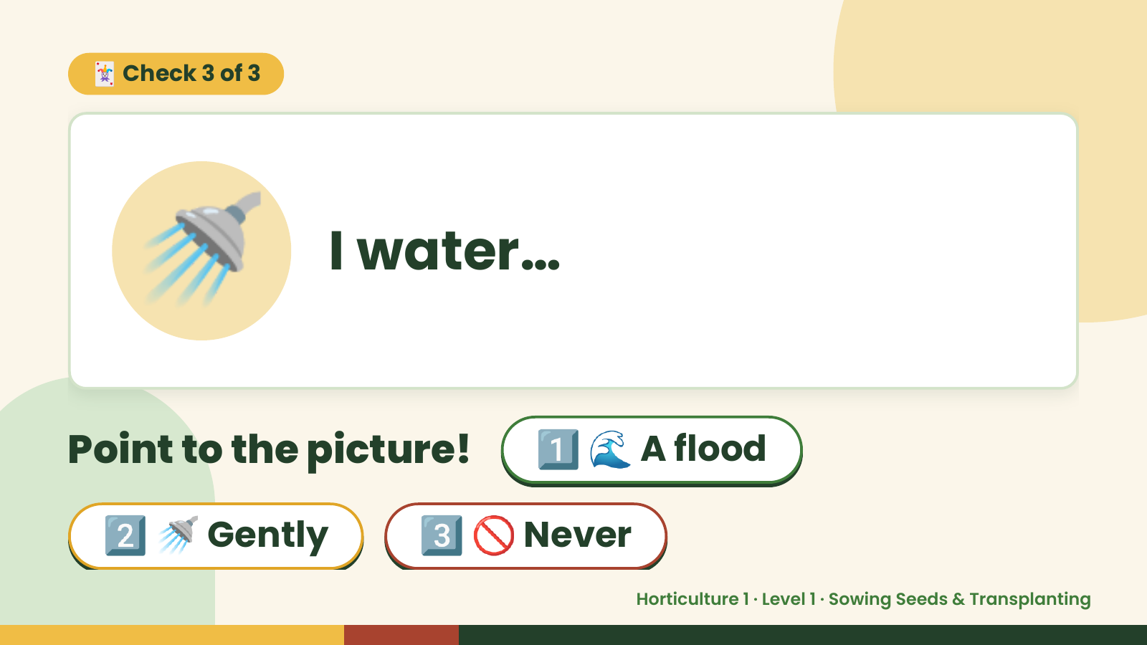
Notes:
🃏 Check 3 of 3
🚿 I water…
Point to the picture! 1️⃣ 🌊 A flood
2️⃣ 🚿 Gently 3️⃣ 🚫 Never
Horticulture 1 · Level 1 · Sowing Seeds & Transplanting

Slide 11
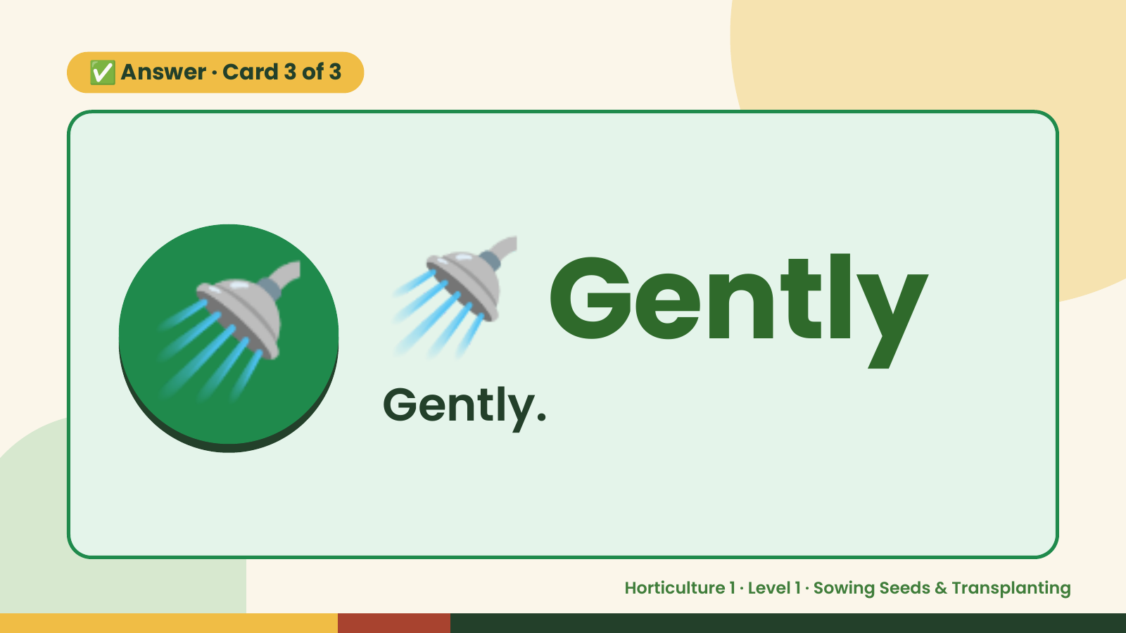
Notes:
✅ Answer · Card 3 of 3
🚿 🚿 Gently
Gently.
Horticulture 1 · Level 1 · Sowing Seeds & Transplanting

Slide 12

Notes:
Wrap-Up
Clean Up +
Reflect
🧽
🧽 Clean the table.
🧰 Give tools back.
🧼 Wash hands.
Horticulture 1 · Level 1 · Sowing Seeds & Transplanting

