Slide 1
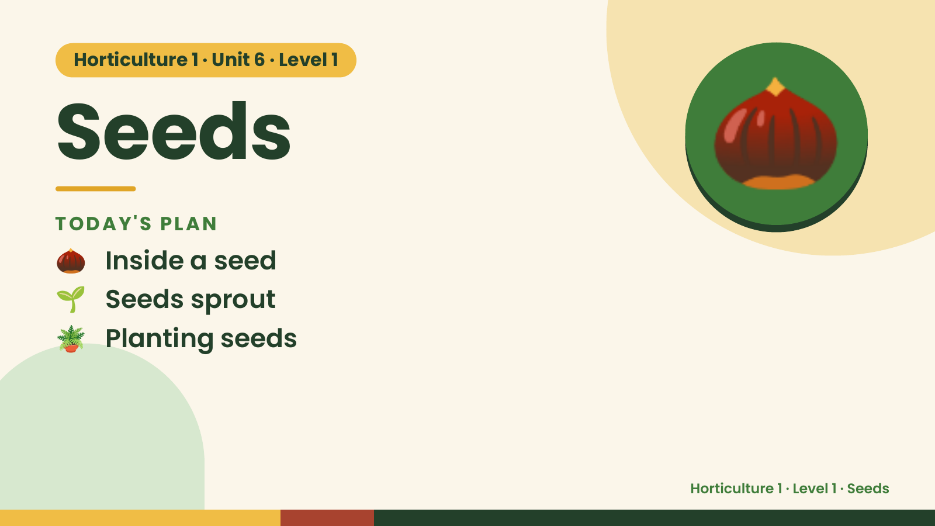
Notes:
Horticulture 1 · Unit 6 · Level 1
Seeds
TODAY'S PLAN
🌰 Inside a seed
🌰
🌱 Seeds sprout
🪴 Planting seeds
Horticulture 1 · Level 1 · Seeds

Slide 2
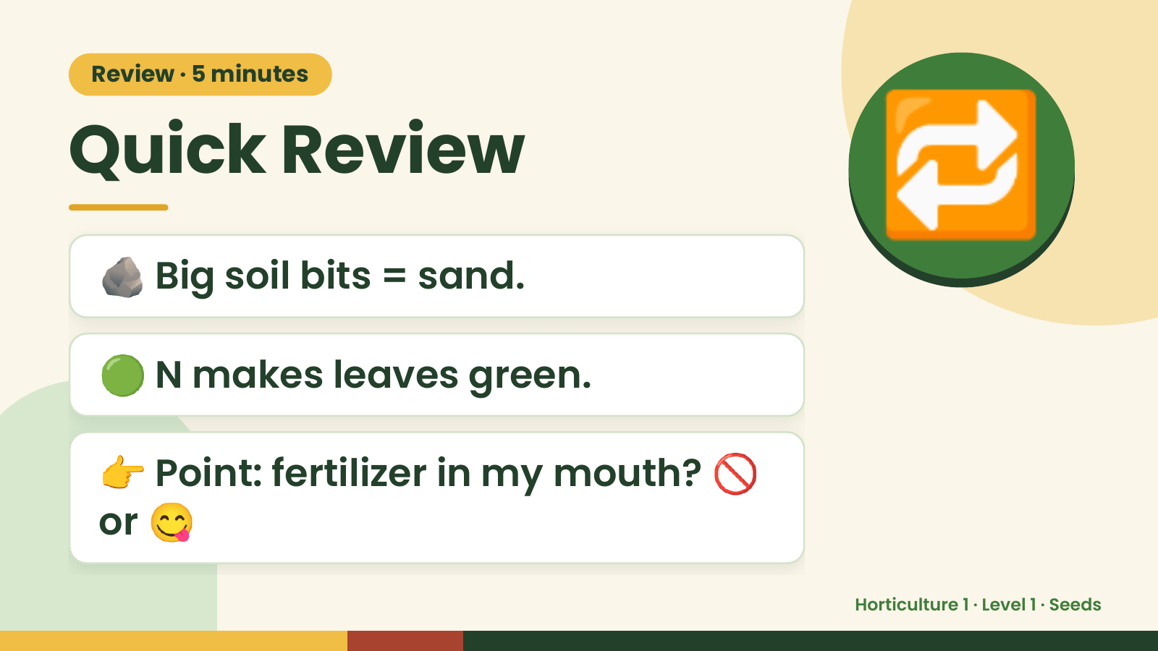
Notes:
Review · 5 minutes
Quick Review
🪨 Big soil bits = sand.
🔁
🟢 N makes leaves green.
👉 Point: fertilizer in my mouth? 🚫
or 😋
Horticulture 1 · Level 1 · Seeds

Slide 3
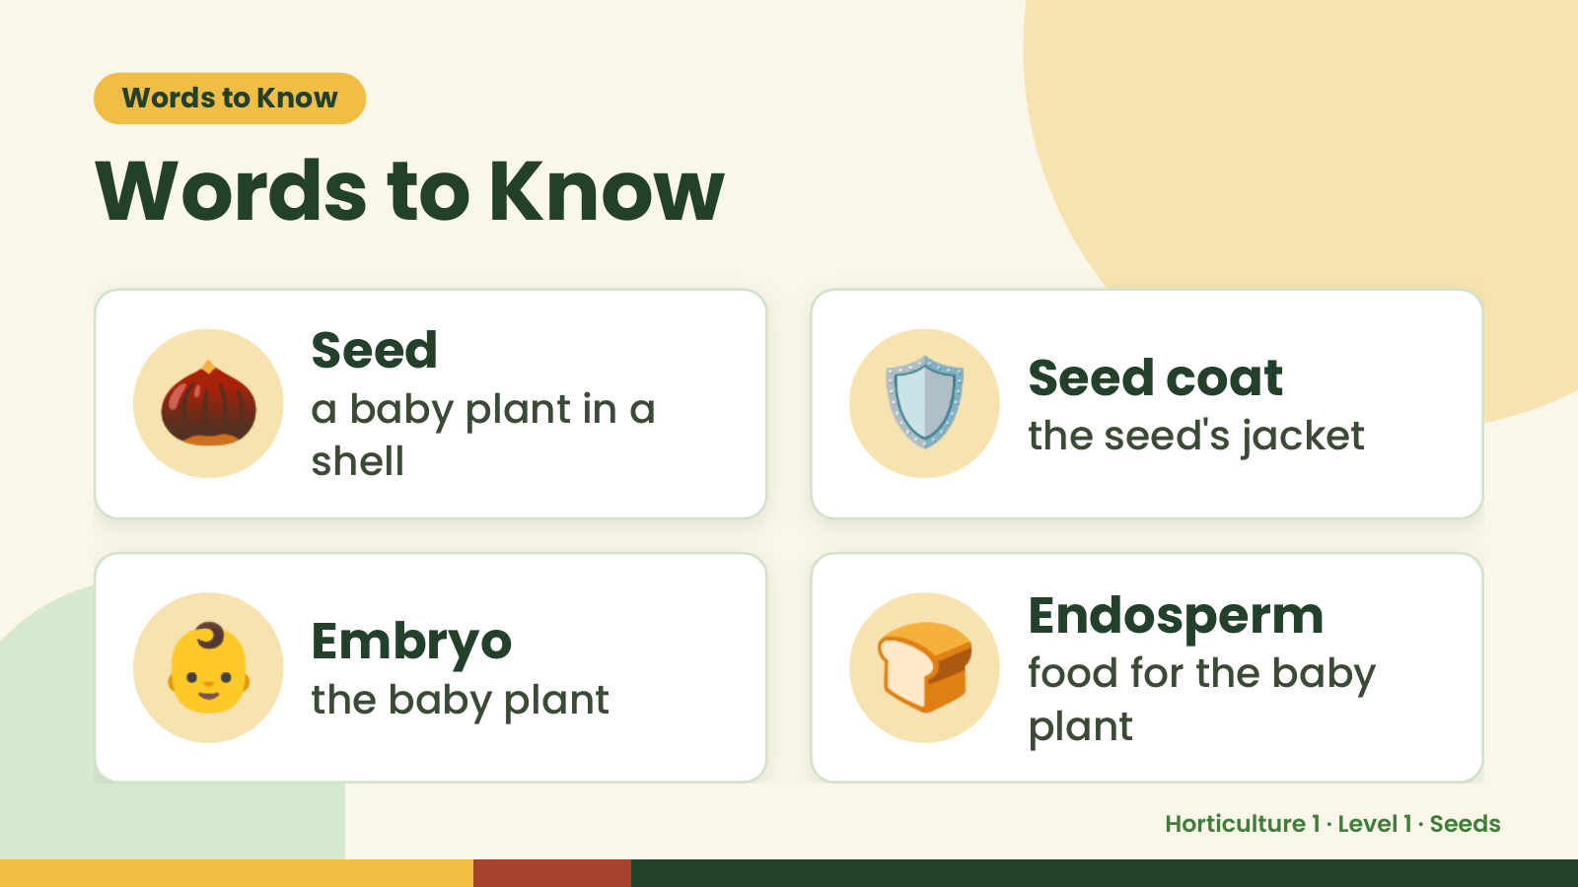
Notes:
Words to Know
Words to Know
🌰 Seed
a baby plant in a
shell
🛡️ Seed coat
the seed's jacket
👶 Embryo
the baby plant 🍞 Endosperm
food for the baby
plant
Horticulture 1 · Level 1 · Seeds

Slide 4
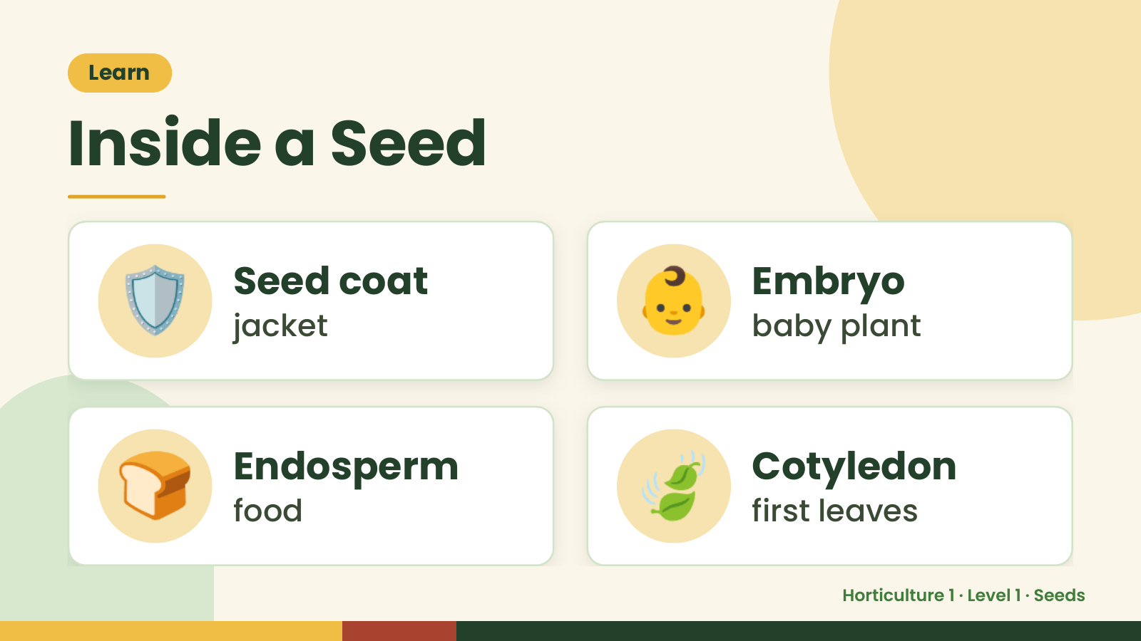
Notes:
Learn
Inside a Seed
🛡️ Seed coat
jacket 👶 Embryo
baby plant
🍞 Endosperm
food 🍃 Cotyledon
first leaves
Horticulture 1 · Level 1 · Seeds

Slide 5
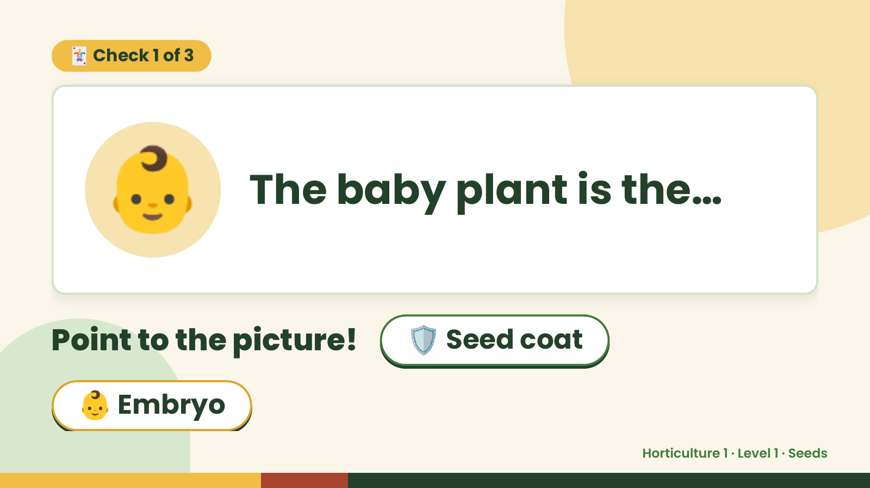
Notes:
🃏 Check 1 of 3
👶 The baby plant is the…
Point to the picture! 🛡️ Seed coat
👶 Embryo
Horticulture 1 · Level 1 · Seeds

Slide 6
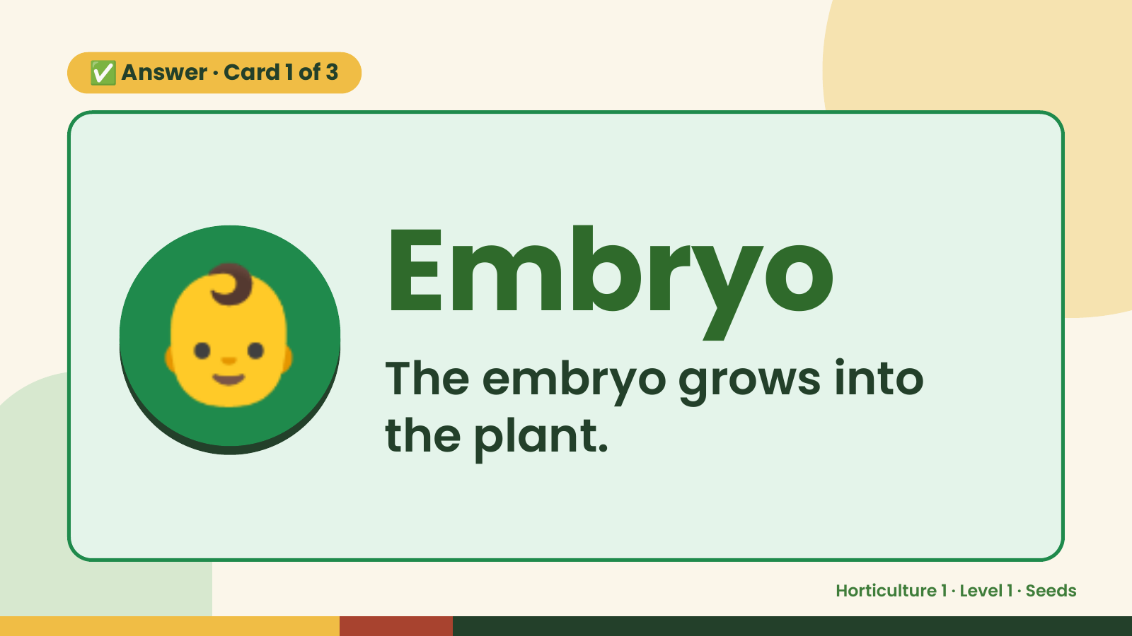
Notes:
✅ Answer · Card 1 of 3
👶 Embryo
The embryo grows into
the plant.
Horticulture 1 · Level 1 · Seeds

Slide 7
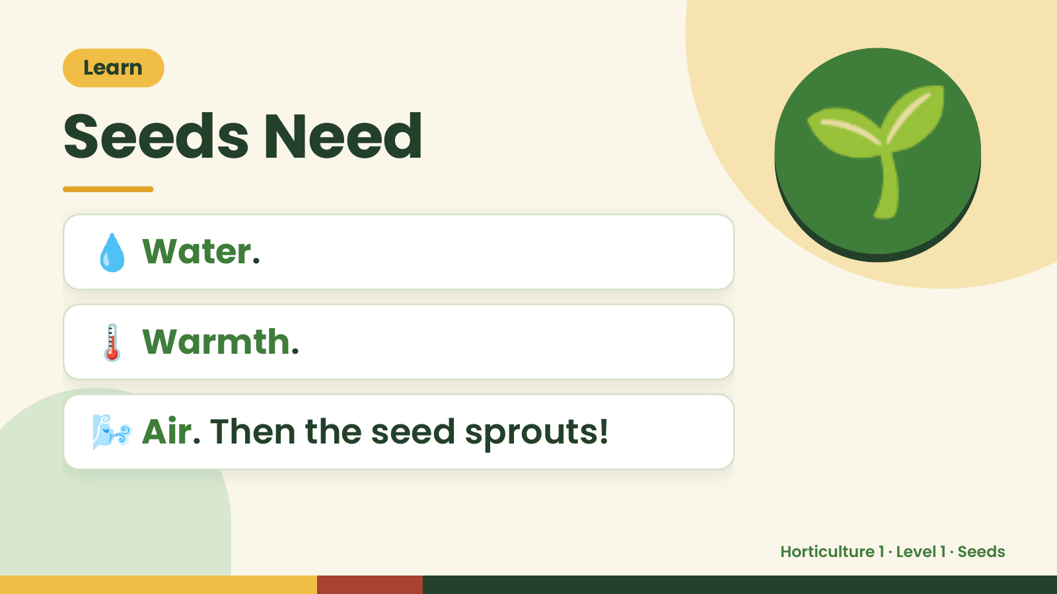
Notes:
Learn
Seeds Need
💧 Water.
🌱
🌡️ Warmth.
🌬️ Air. Then the seed sprouts!
Horticulture 1 · Level 1 · Seeds

Slide 8
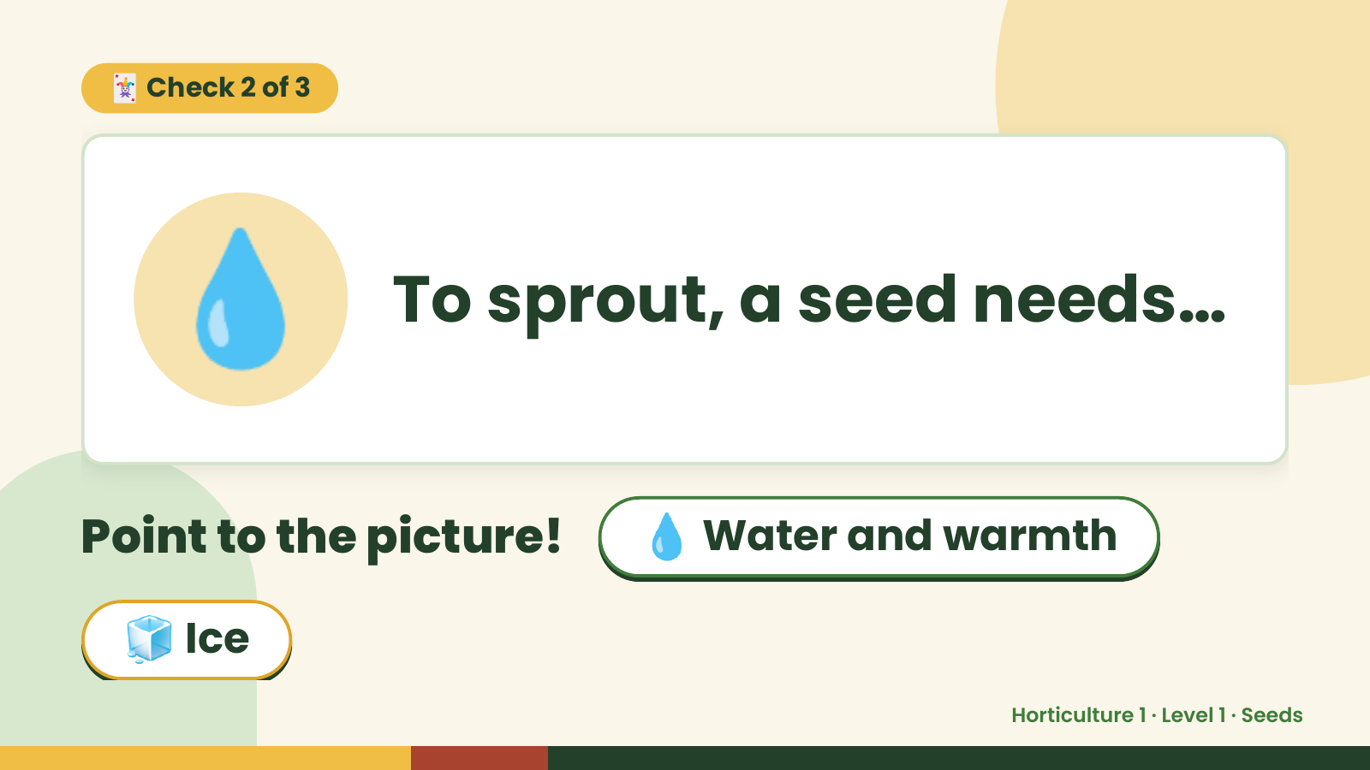
Notes:
🃏 Check 2 of 3
💧 To sprout, a seed needs…
Point to the picture! 💧 Water and warmth
🧊 Ice
Horticulture 1 · Level 1 · Seeds

Slide 9
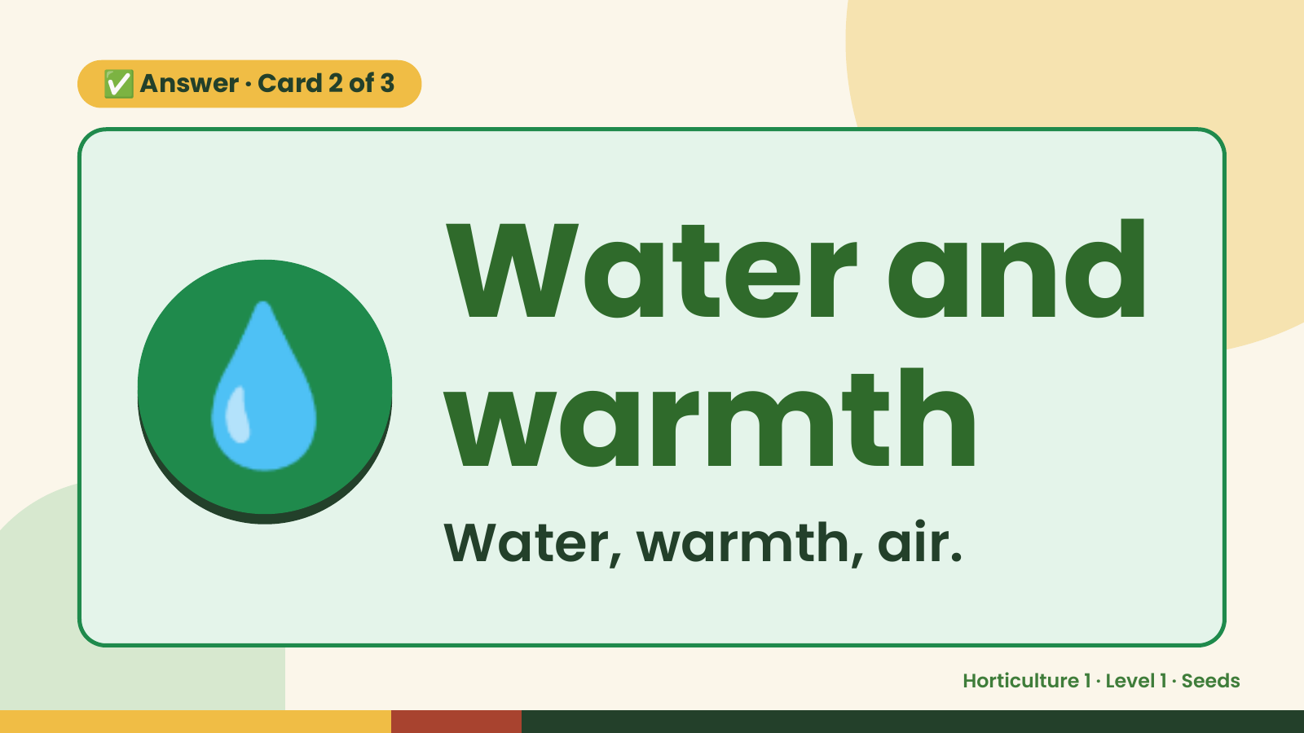
Notes:
✅ Answer · Card 2 of 3
💧 Water and
warmth
Water, warmth, air.
Horticulture 1 · Level 1 · Seeds

Slide 10
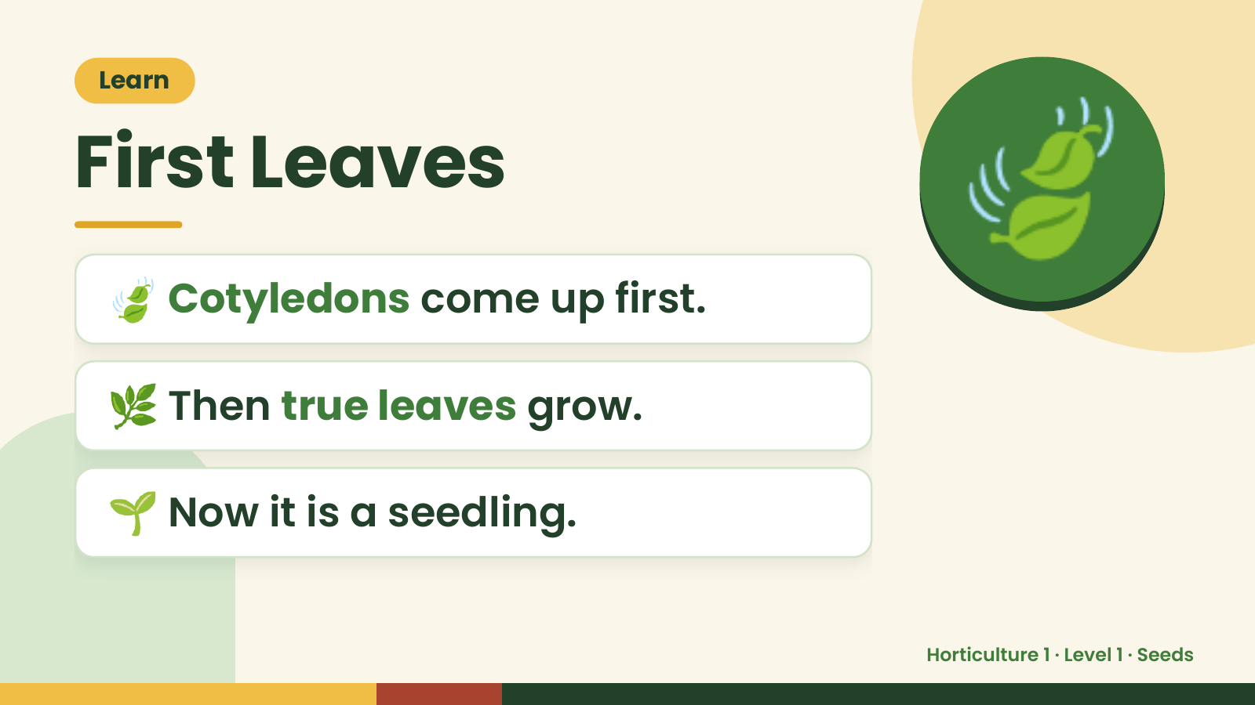
Notes:
Learn
First Leaves
🍃 Cotyledons come up first.
🍃
🌿 Then true leaves grow.
🌱 Now it is a seedling.
Horticulture 1 · Level 1 · Seeds

Slide 11
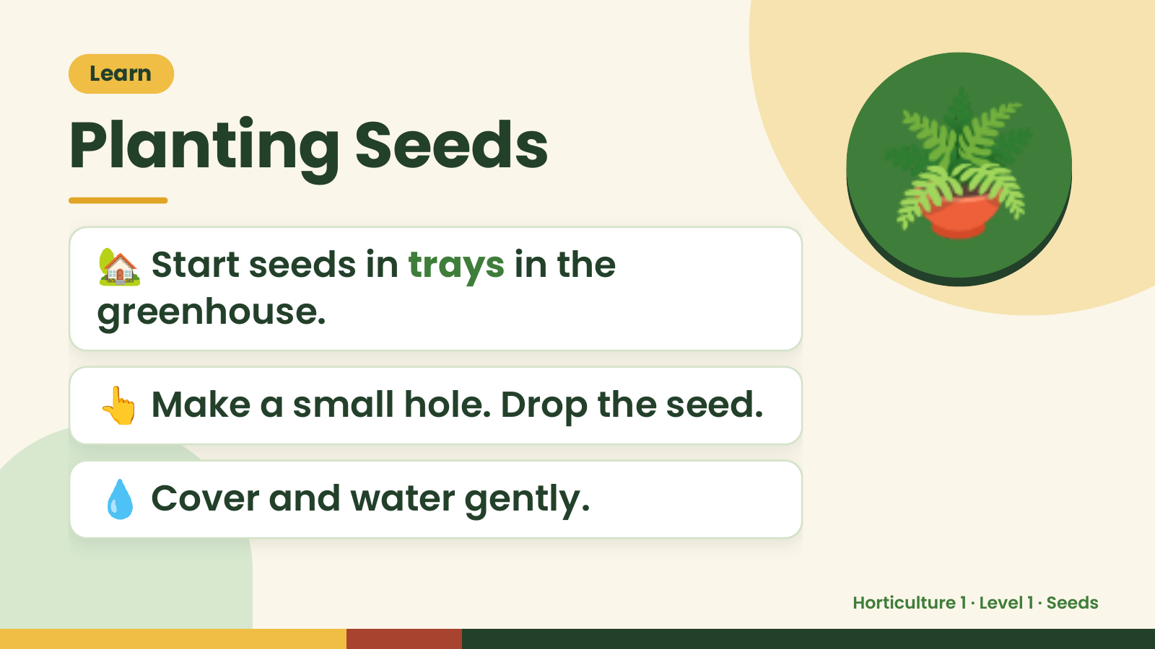
Notes:
Learn
Planting Seeds
🏡 Start seeds in trays in the
greenhouse.
🪴
👆 Make a small hole. Drop the seed.
💧 Cover and water gently.
Horticulture 1 · Level 1 · Seeds

Slide 12
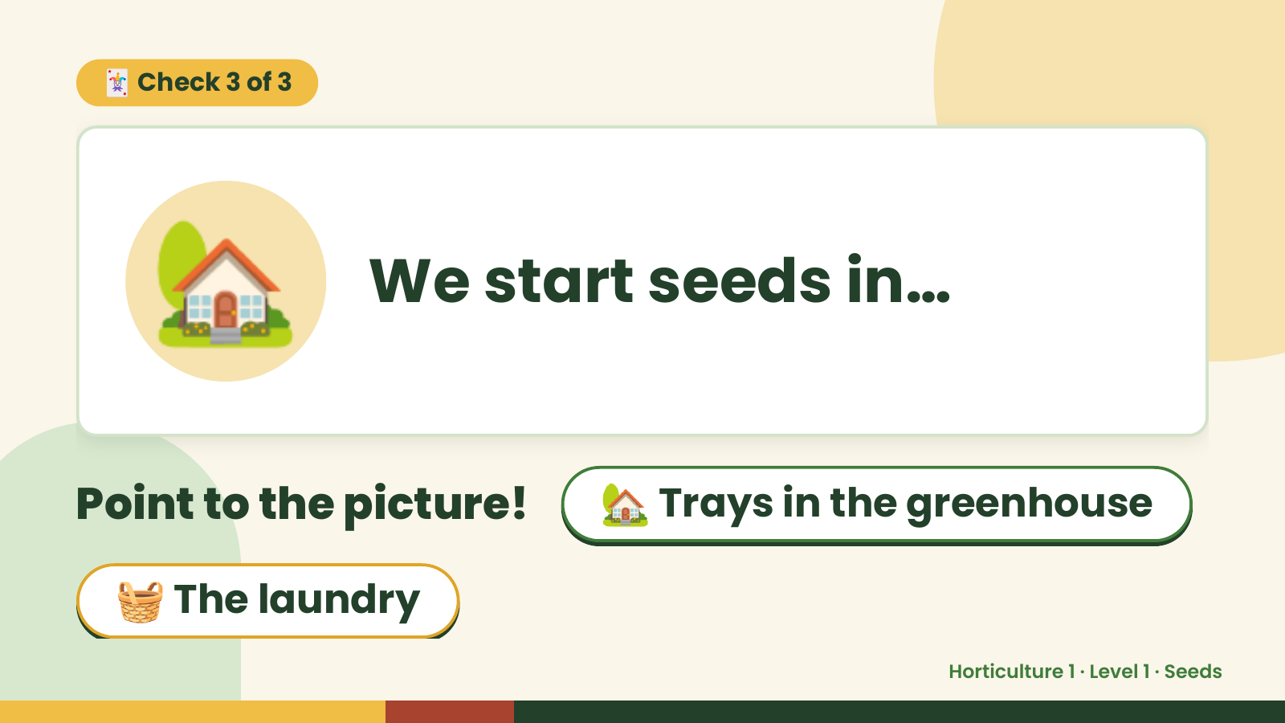
Notes:
🃏 Check 3 of 3
🏡 We start seeds in…
Point to the picture! 🏡 Trays in the greenhouse
🧺 The laundry
Horticulture 1 · Level 1 · Seeds

Slide 13
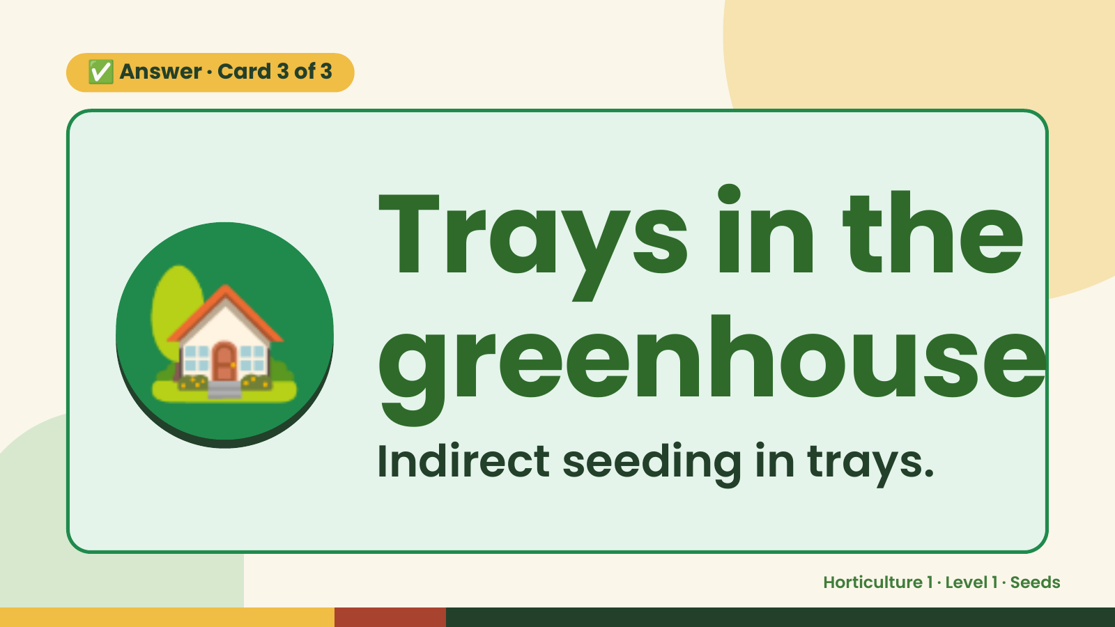
Notes:
✅ Answer · Card 3 of 3
🏡 Trays in the
greenhouse
Indirect seeding in trays.
Horticulture 1 · Level 1 · Seeds

Slide 14
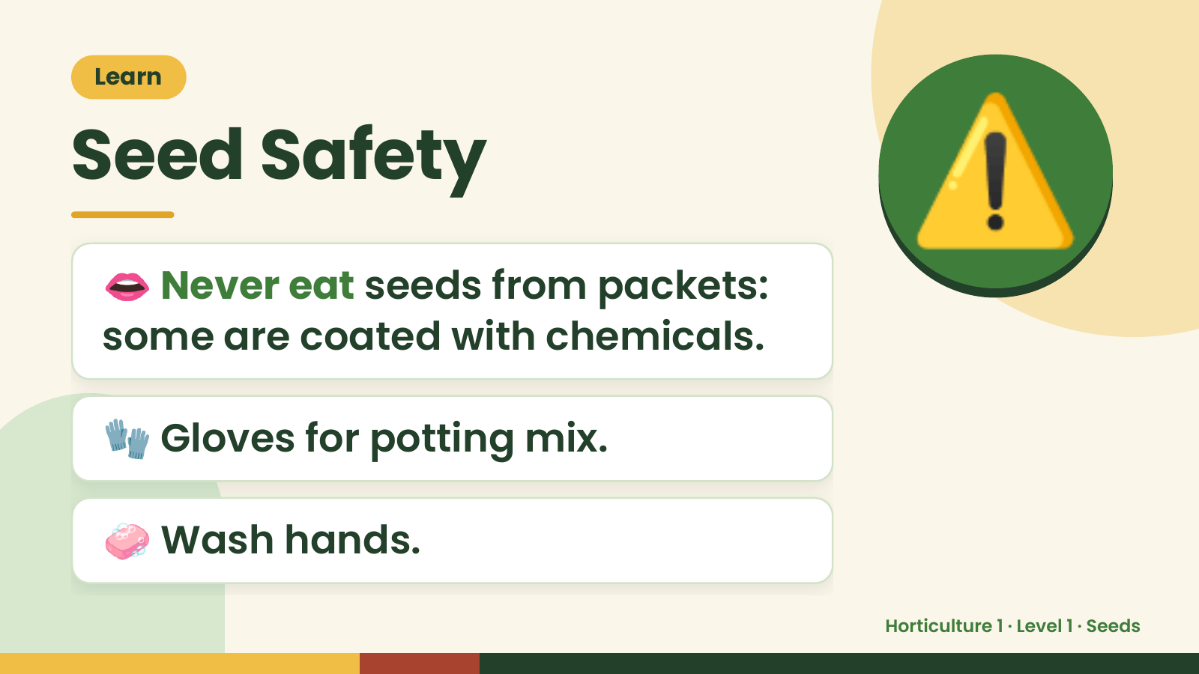
Notes:
Learn
Seed Safety
👄 Never eat seeds from packets:
some are coated with chemicals.
⚠️
🧤 Gloves for potting mix.
🧼 Wash hands.
Horticulture 1 · Level 1 · Seeds

Slide 15
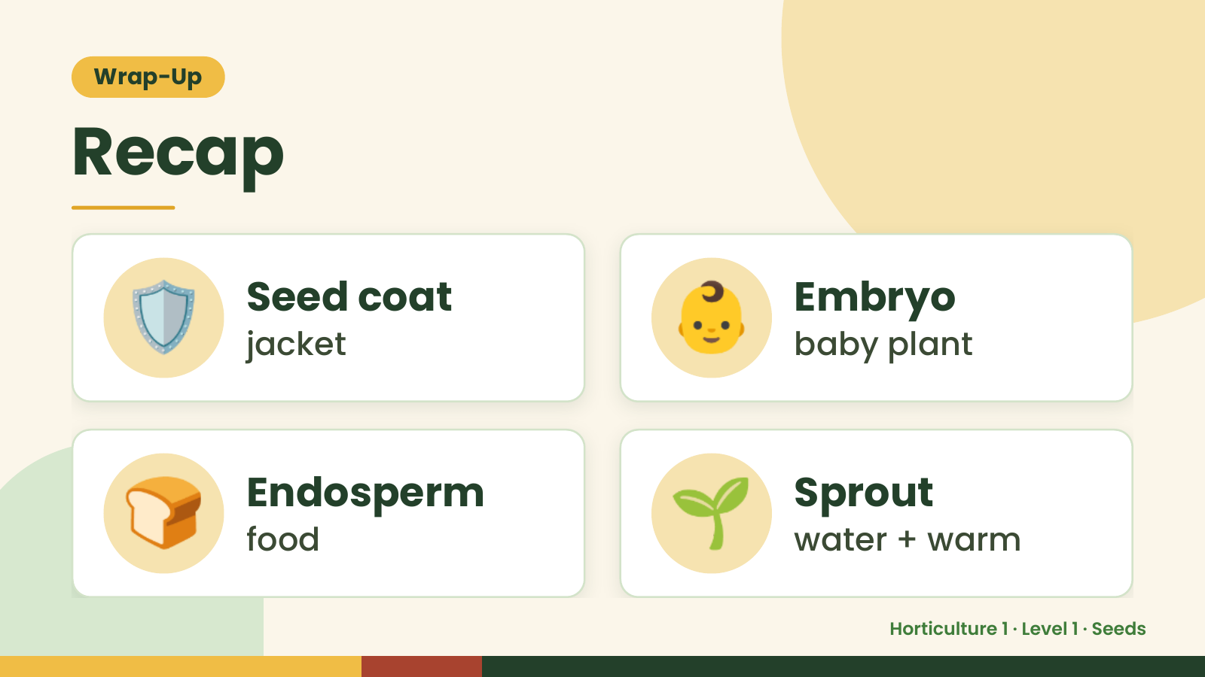
Notes:
Wrap-Up
Recap
🛡️ Seed coat
jacket 👶 Embryo
baby plant
🍞 Endosperm
food 🌱 Sprout
water + warm
Horticulture 1 · Level 1 · Seeds

Slide 16
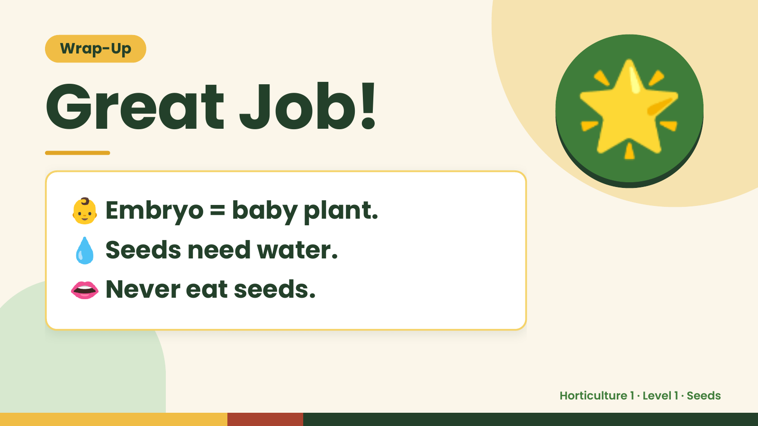
Notes:
Wrap-Up
Great Job!
👶 Embryo = baby plant.
🌟
💧 Seeds need water.
👄 Never eat seeds.
Horticulture 1 · Level 1 · Seeds

