Slide 1
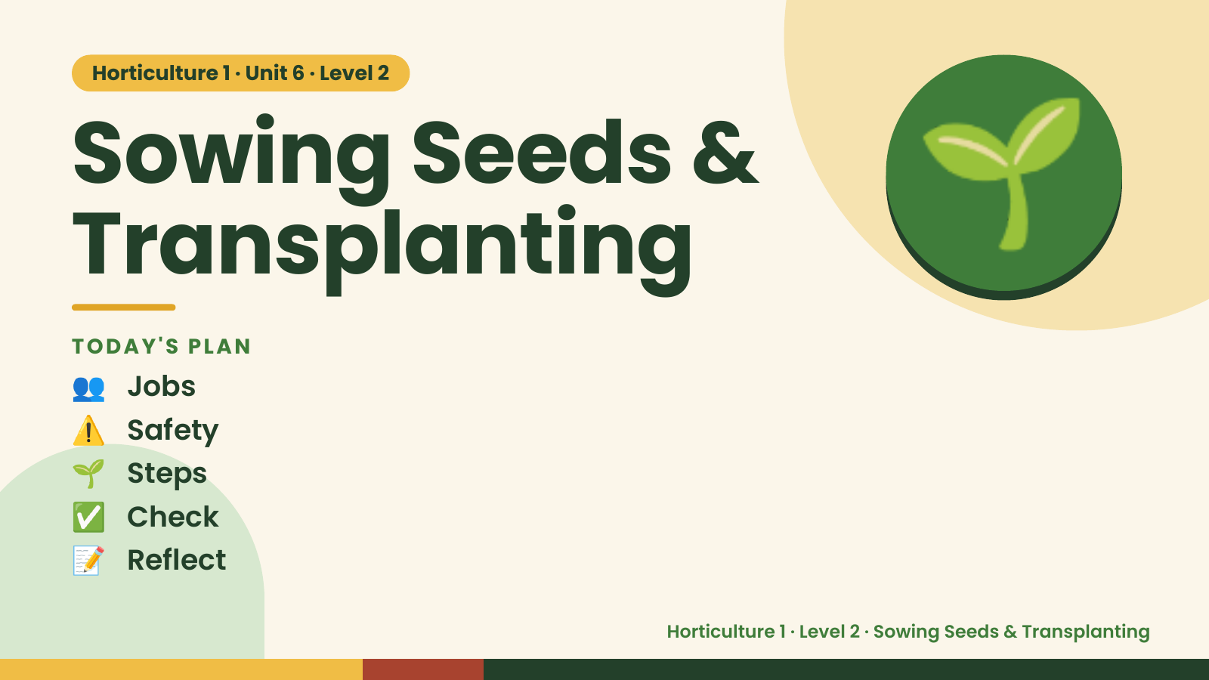
Notes:
Horticulture 1 · Unit 6 · Level 2
Sowing Seeds &
Transplanting
👥 Jobs
TODAY'S PLAN
🌱
⚠️ Safety
🌱 Steps
✅ Check
📝 Reflect
Horticulture 1 · Level 2 · Sowing Seeds & Transplanting

Slide 2

Notes:
Get ready
Jobs
🧑‍🌾 Grower
Does the main plant job
with the tools
🧺 Supply helper
Gets and returns supplies
and tools to staff
📸 Recorder
Takes photos and fills in
the chart
🧽 Clean-up captain
Sweeps, wipes tables,
checks hands are
washed
Horticulture 1 · Level 2 · Sowing Seeds & Transplanting

Slide 3
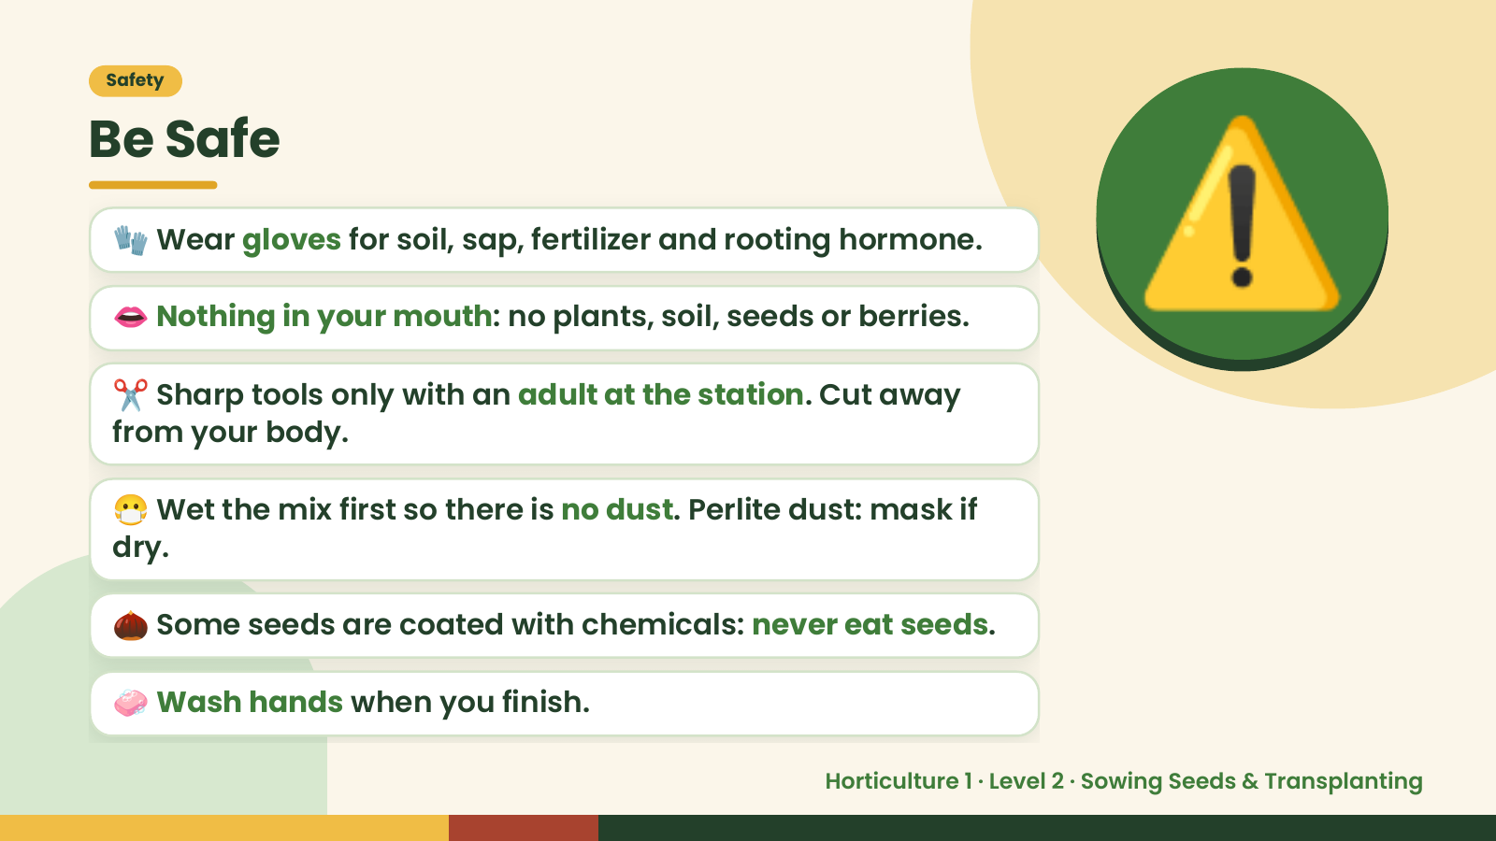
Notes:
Safety
Be Safe
🧤 Wear gloves for soil, sap, fertilizer and rooting hormone.
👄 Nothing in your mouth: no plants, soil, seeds or berries.
✂️ Sharp tools only with an adult at the station. Cut away
from your body.
⚠️
😷 Wet the mix first so there is no dust. Perlite dust: mask if
dry.
🌰 Some seeds are coated with chemicals: never eat seeds.
🧼 Wash hands when you finish.
Horticulture 1 · Level 2 · Sowing Seeds & Transplanting

Slide 4
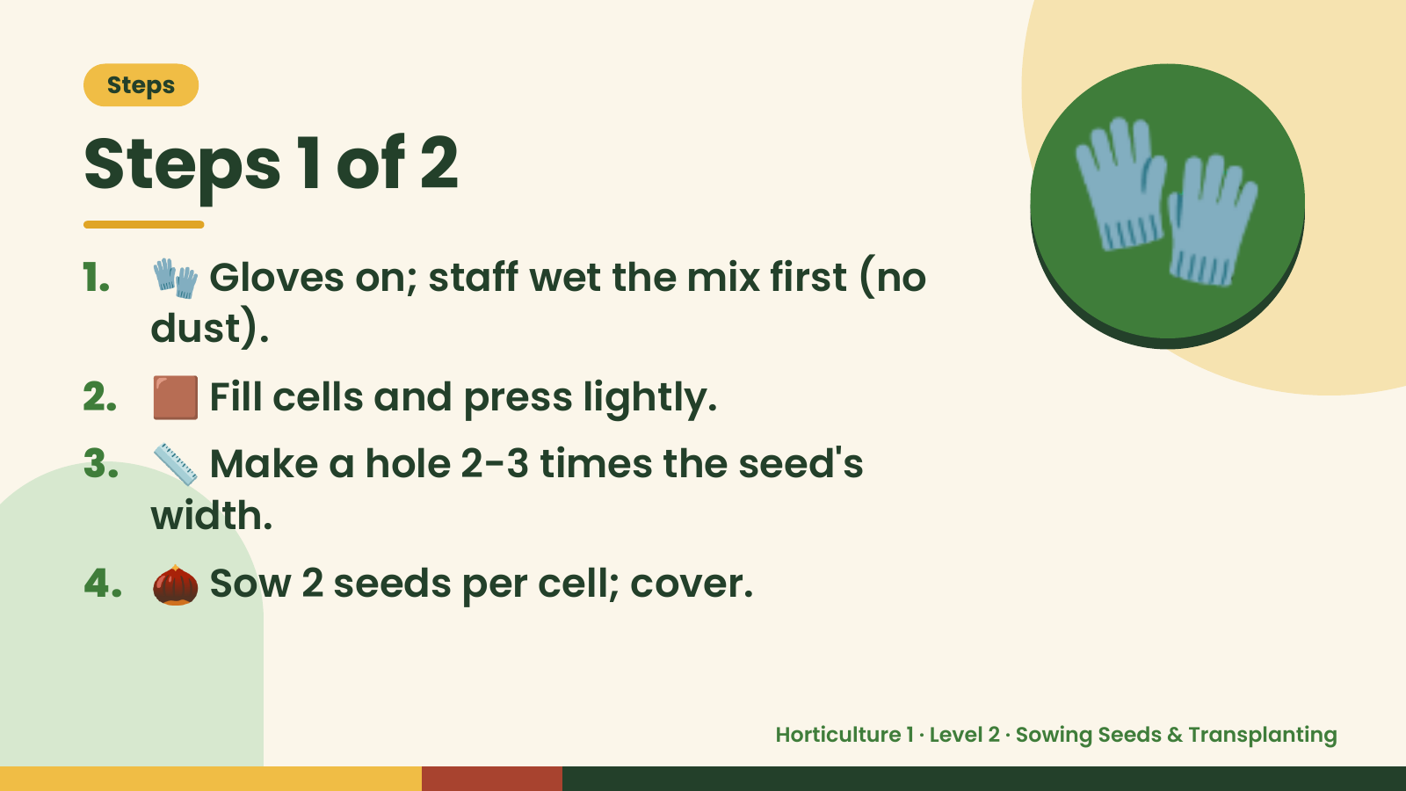
Notes:
Steps
Steps 1 of 2
1. 🧤 Gloves on; staff wet the mix first (no
dust).
2. 🟫 Fill cells and press lightly.
🧤
3. 📏 Make a hole 2-3 times the seed's
width.
4. 🌰 Sow 2 seeds per cell; cover.
Horticulture 1 · Level 2 · Sowing Seeds & Transplanting

Slide 5
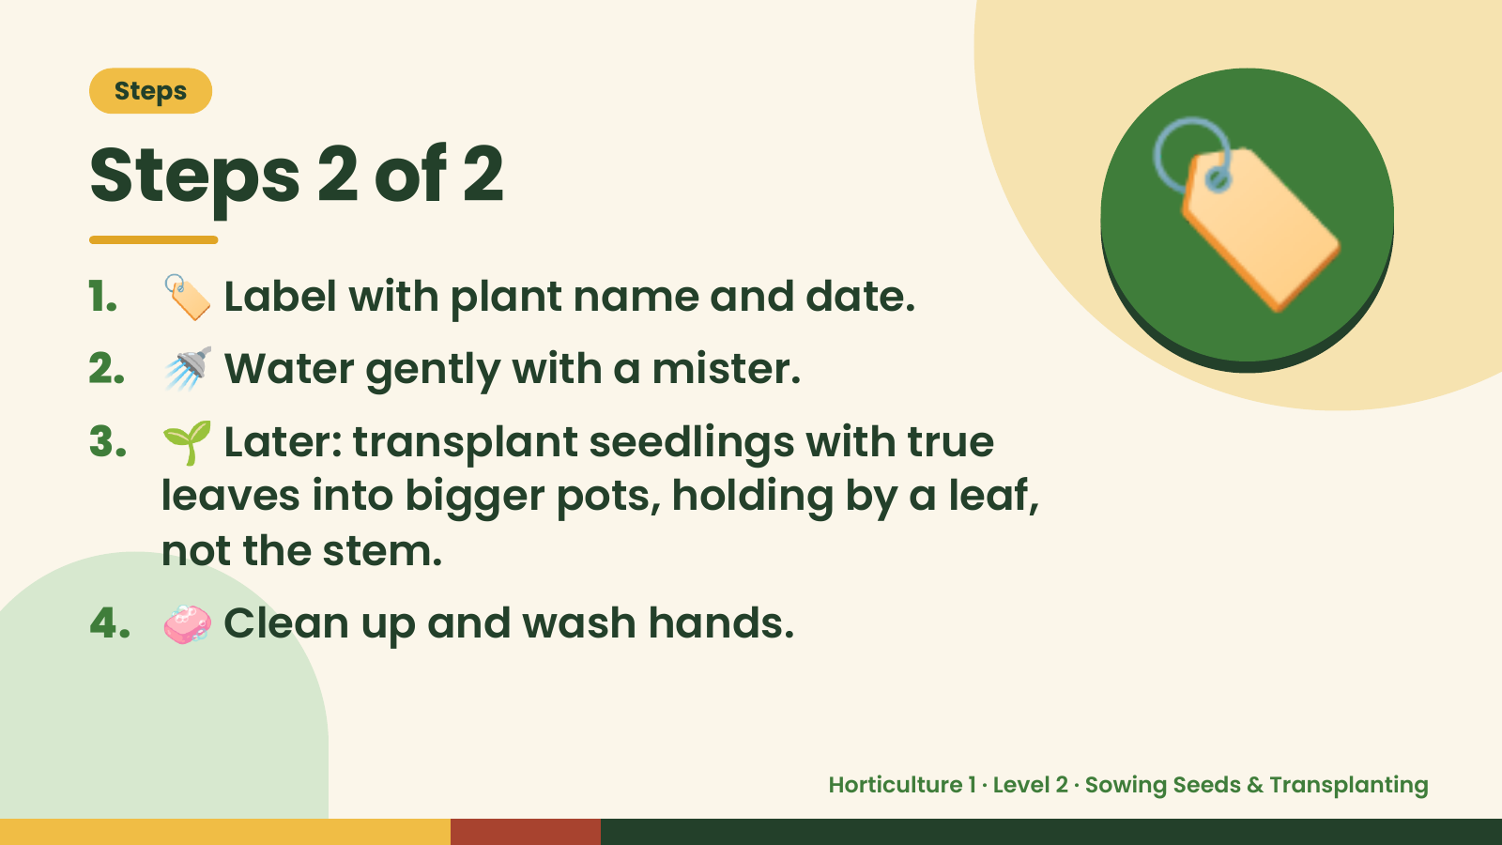
Notes:
Steps
Steps 2 of 2
1. 🏷️ Label with plant name and date.
2. 🚿 Water gently with a mister.
3. 🌱 Later: transplant seedlings with true
🏷️
leaves into bigger pots, holding by a leaf,
not the stem.
4. 🧼 Clean up and wash hands.
Horticulture 1 · Level 2 · Sowing Seeds & Transplanting

Slide 6
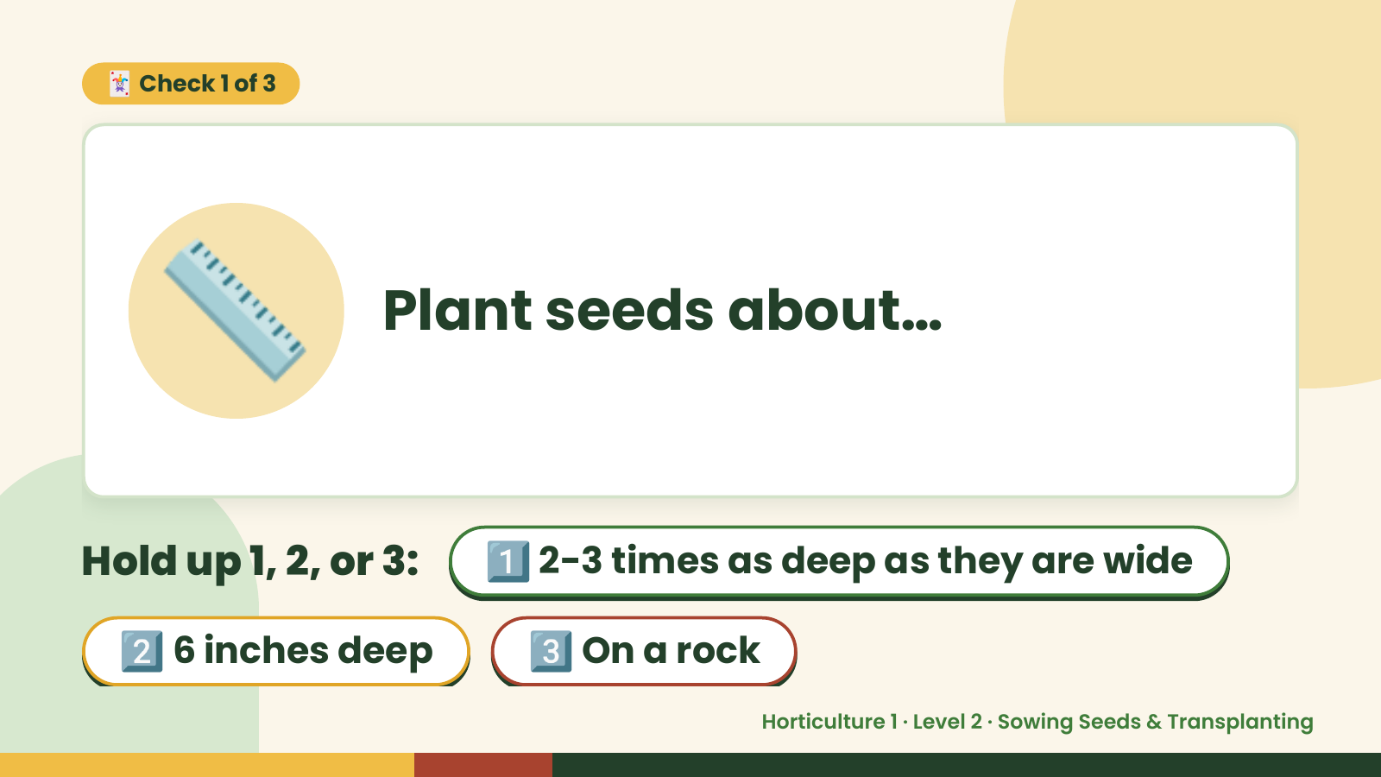
Notes:
🃏 Check 1 of 3
📏 Plant seeds about…
Hold up 1, 2, or 3: 1️⃣ 2-3 times as deep as they are wide
2️⃣ 6 inches deep 3️⃣ On a rock
Horticulture 1 · Level 2 · Sowing Seeds & Transplanting

Slide 7
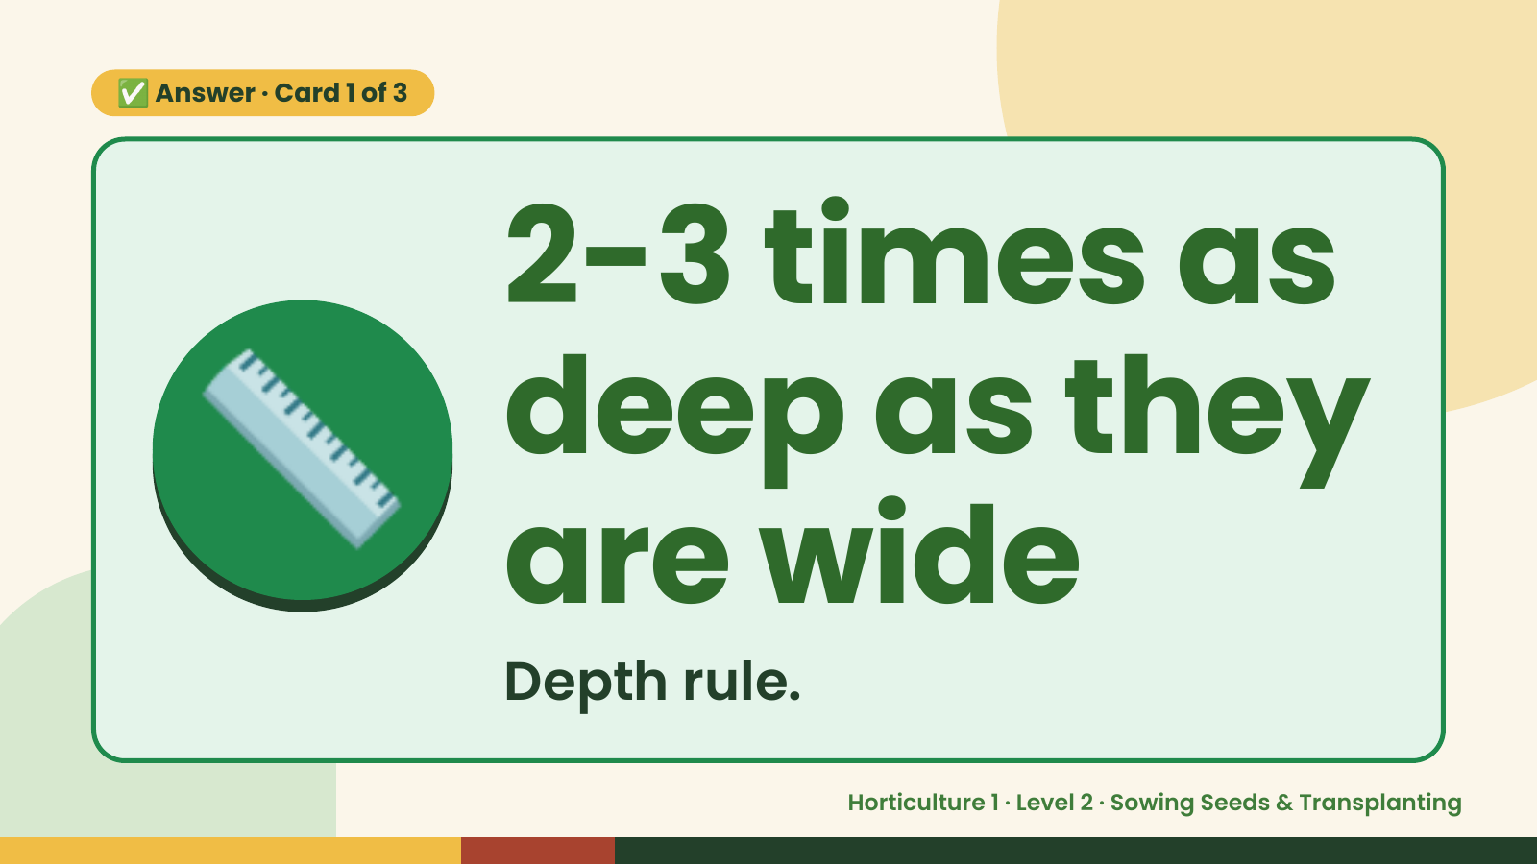
Notes:
✅ Answer · Card 1 of 3
📏 2-3 times as
deep as they
are wide
Depth rule.
Horticulture 1 · Level 2 · Sowing Seeds & Transplanting

Slide 8
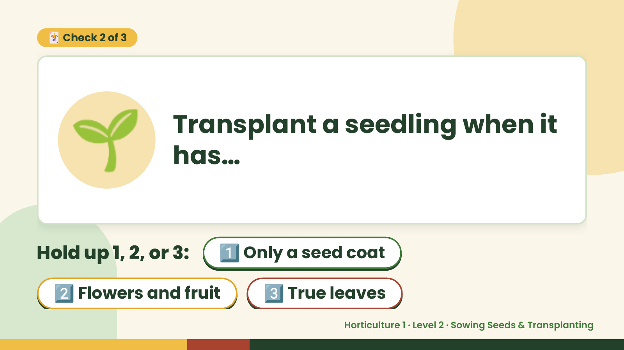
Notes:
🃏 Check 2 of 3
🌱 Transplant a seedling when it
has…
Hold up 1, 2, or 3: 1️⃣ Only a seed coat
2️⃣ Flowers and fruit 3️⃣ True leaves
Horticulture 1 · Level 2 · Sowing Seeds & Transplanting

Slide 9
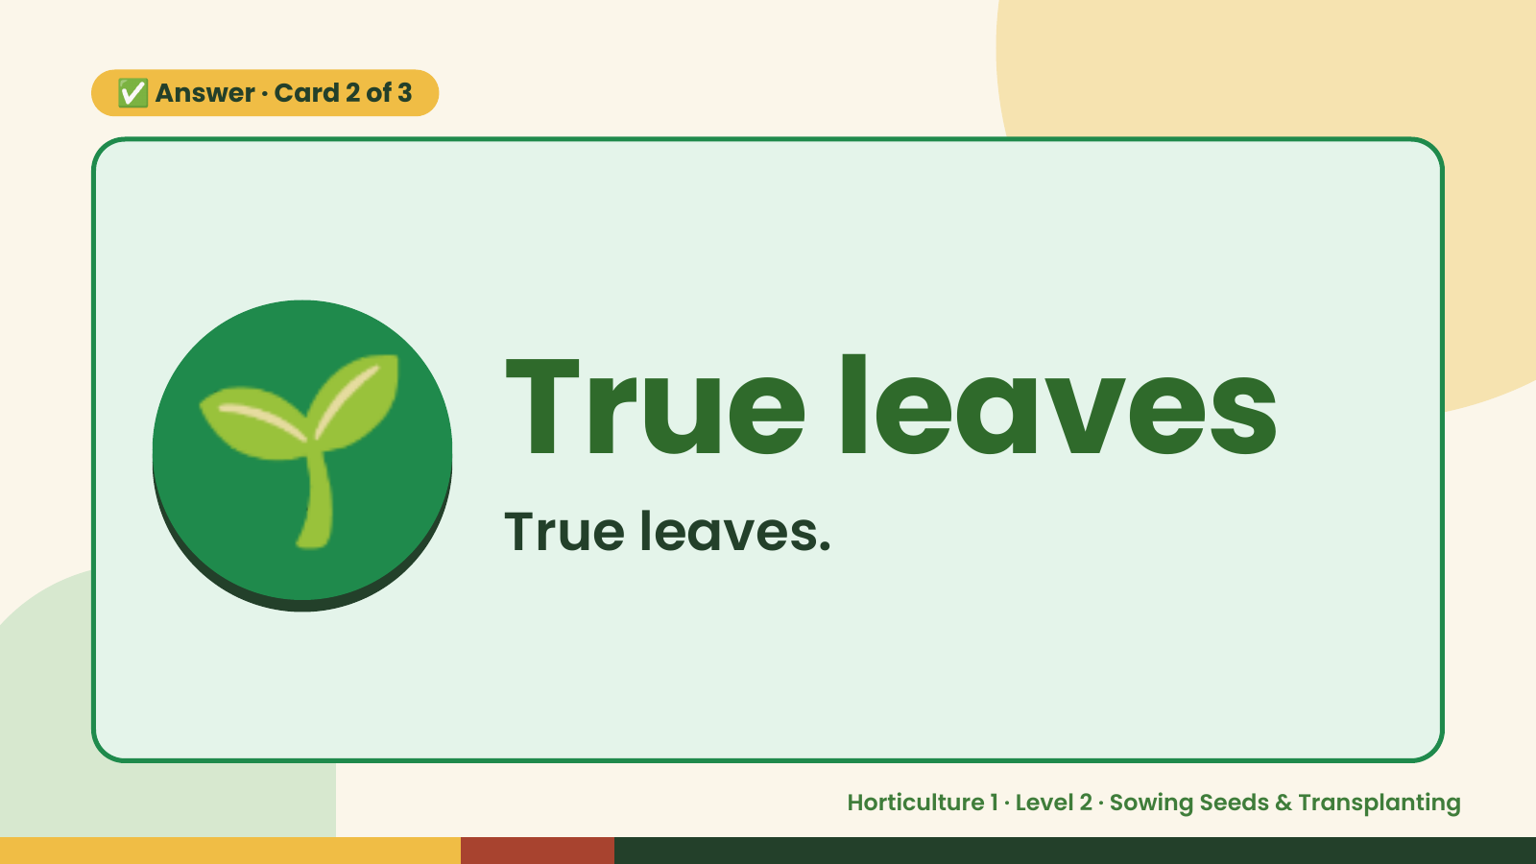
Notes:
✅ Answer · Card 2 of 3
🌱 True leaves
True leaves.
Horticulture 1 · Level 2 · Sowing Seeds & Transplanting

Slide 10
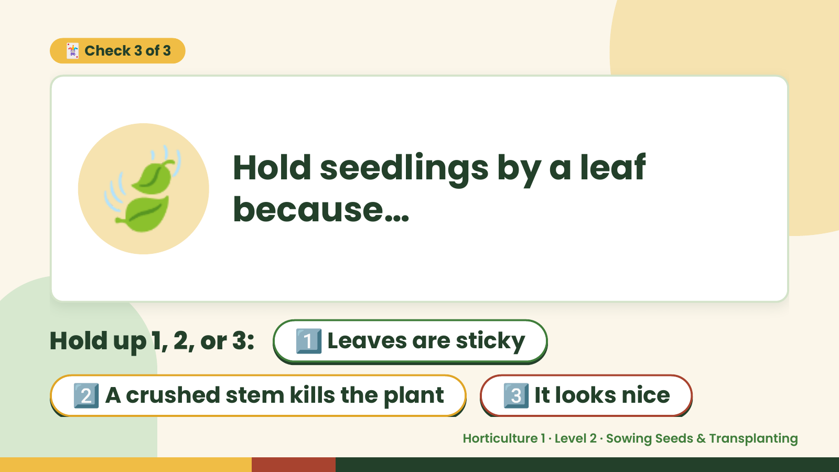
Notes:
🃏 Check 3 of 3
🍃 Hold seedlings by a leaf
because…
Hold up 1, 2, or 3: 1️⃣ Leaves are sticky
2️⃣ A crushed stem kills the plant 3️⃣ It looks nice
Horticulture 1 · Level 2 · Sowing Seeds & Transplanting

Slide 11
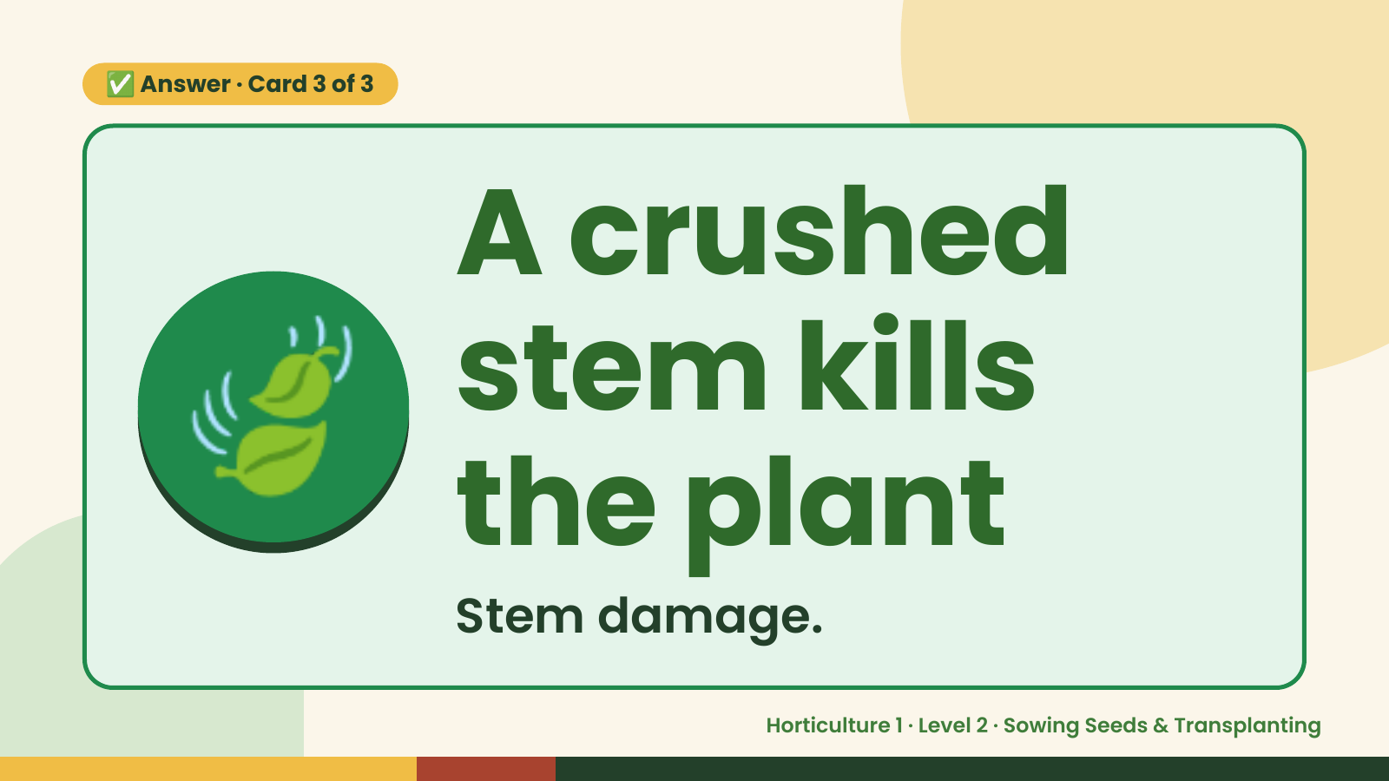
Notes:
✅ Answer · Card 3 of 3
🍃 A crushed
stem kills
the plant
Stem damage.
Horticulture 1 · Level 2 · Sowing Seeds & Transplanting

Slide 12

Notes:
Wrap-Up
Clean Up +
Reflect
🧽
Return and count tools.
Sweep and wipe your area.
Wash hands, then do the reflection.
Horticulture 1 · Level 2 · Sowing Seeds & Transplanting

