Slide 1
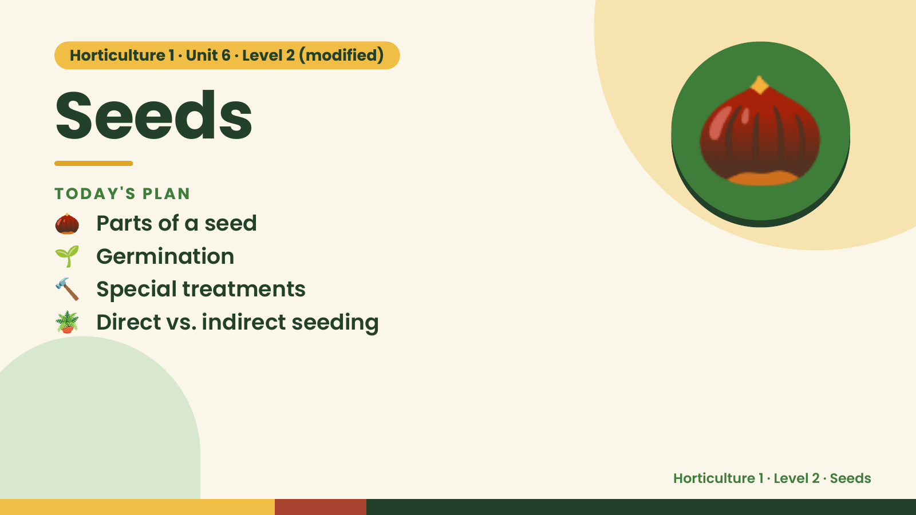
Notes:
Horticulture 1 · Unit 6 · Level 2 (modified)
Seeds
🌰 Parts of a seed
TODAY'S PLAN
🌱 Germination
🔨 Special treatments
🌰
🪴 Direct vs. indirect seeding
Horticulture 1 · Level 2 · Seeds

Slide 2
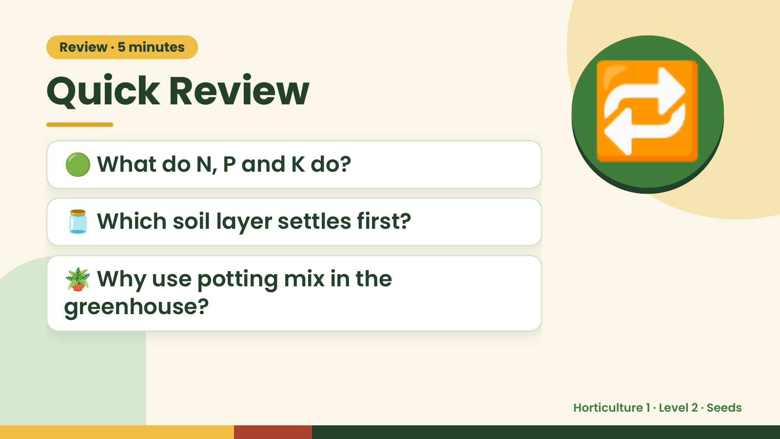
Notes:
Review · 5 minutes
Quick Review
🟢 What do N, P and K do?
🫙 Which soil layer settles first?
🔁
🪴 Why use potting mix in the
greenhouse?
Horticulture 1 · Level 2 · Seeds

Slide 3
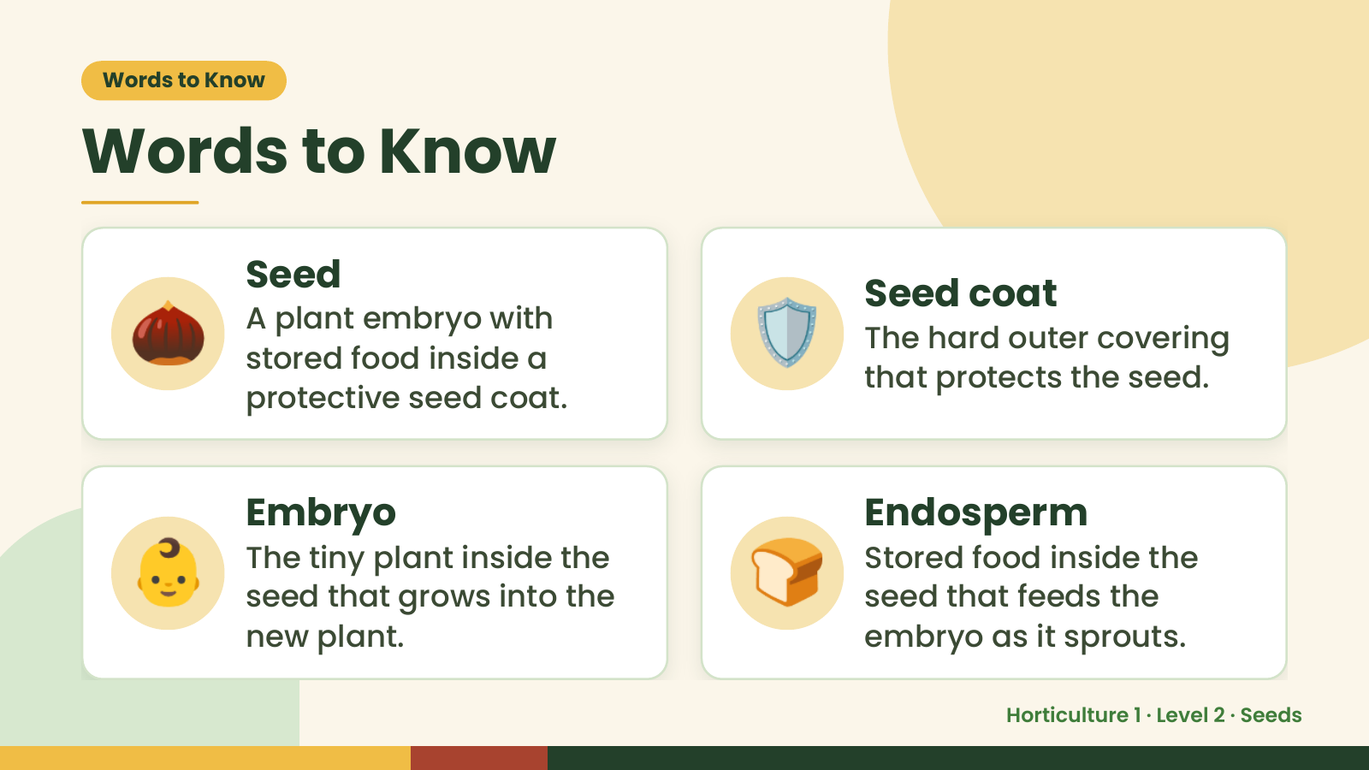
Notes:
Words to Know
Words to Know
🌰 Seed
A plant embryo with
stored food inside a
protective seed coat.
🛡️ Seed coat
The hard outer covering
that protects the seed.
👶 Embryo
The tiny plant inside the
seed that grows into the
new plant.
🍞 Endosperm
Stored food inside the
seed that feeds the
embryo as it sprouts.
Horticulture 1 · Level 2 · Seeds

Slide 4
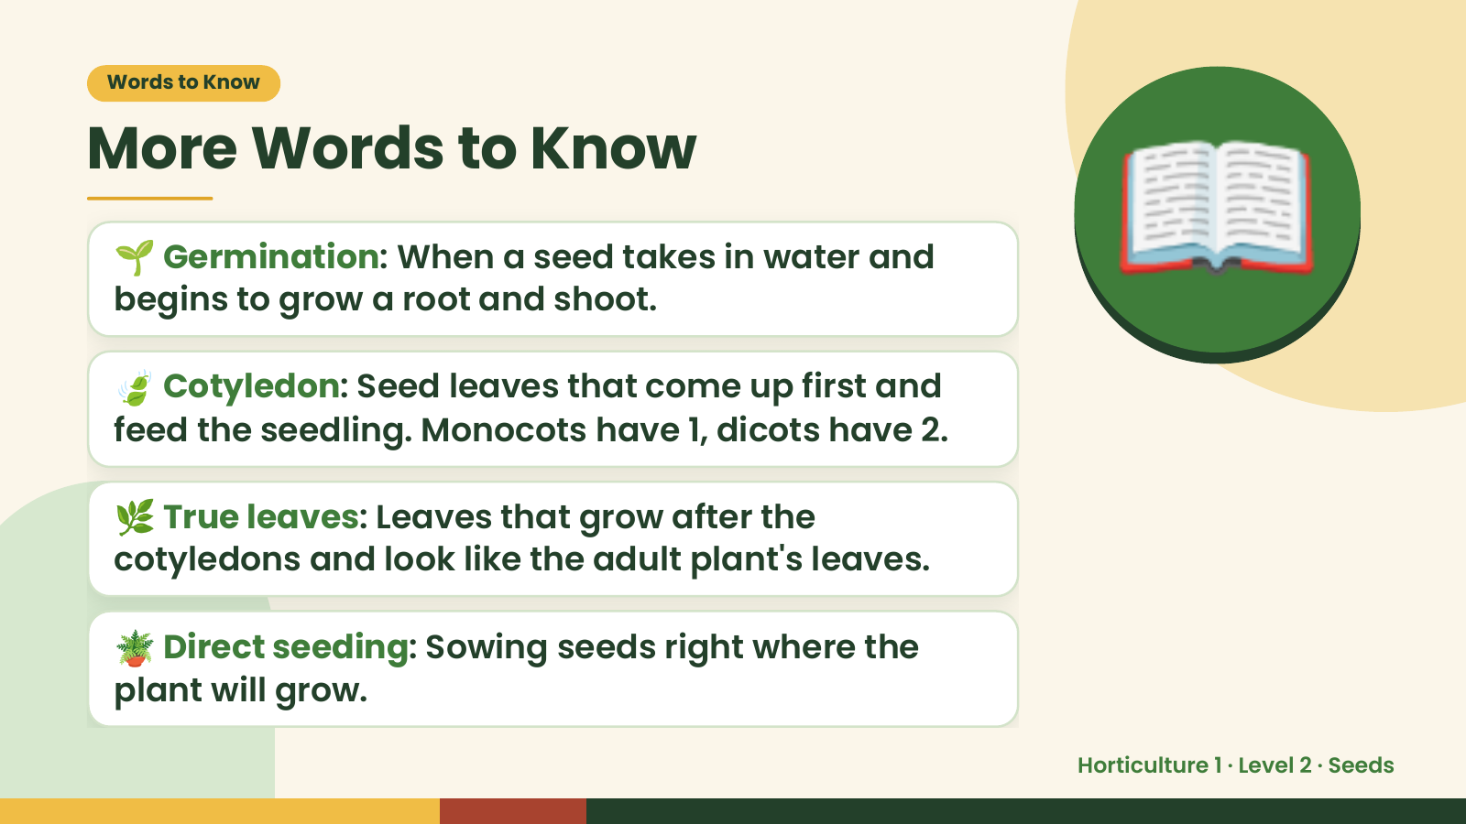
Notes:
Words to Know
More Words to Know
🌱 Germination: When a seed takes in water and
begins to grow a root and shoot.
🍃 Cotyledon: Seed leaves that come up first and
feed the seedling. Monocots have 1, dicots have 2.
📖
🌿 True leaves: Leaves that grow after the
cotyledons and look like the adult plant's leaves.
🪴 Direct seeding: Sowing seeds right where the
plant will grow.
Horticulture 1 · Level 2 · Seeds

Slide 5
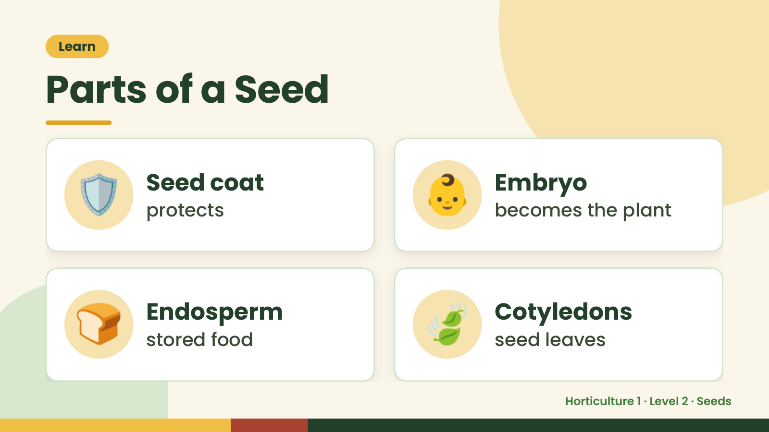
Notes:
Learn
Parts of a Seed
🛡️ Seed coat
protects 👶 Embryo
becomes the plant
🍞 Endosperm
stored food 🍃 Cotyledons
seed leaves
Horticulture 1 · Level 2 · Seeds

Slide 6
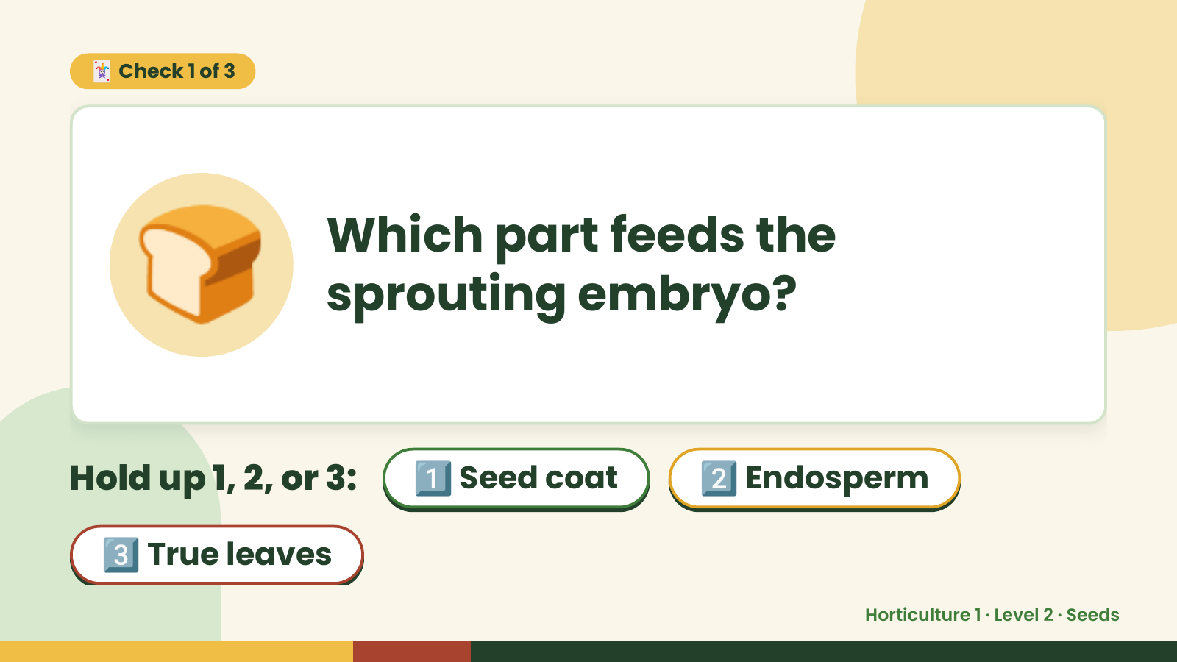
Notes:
🃏 Check 1 of 3
🍞 Which part feeds the
sprouting embryo?
Hold up 1, 2, or 3: 1️⃣ Seed coat 2️⃣ Endosperm
3️⃣ True leaves
Horticulture 1 · Level 2 · Seeds

Slide 7
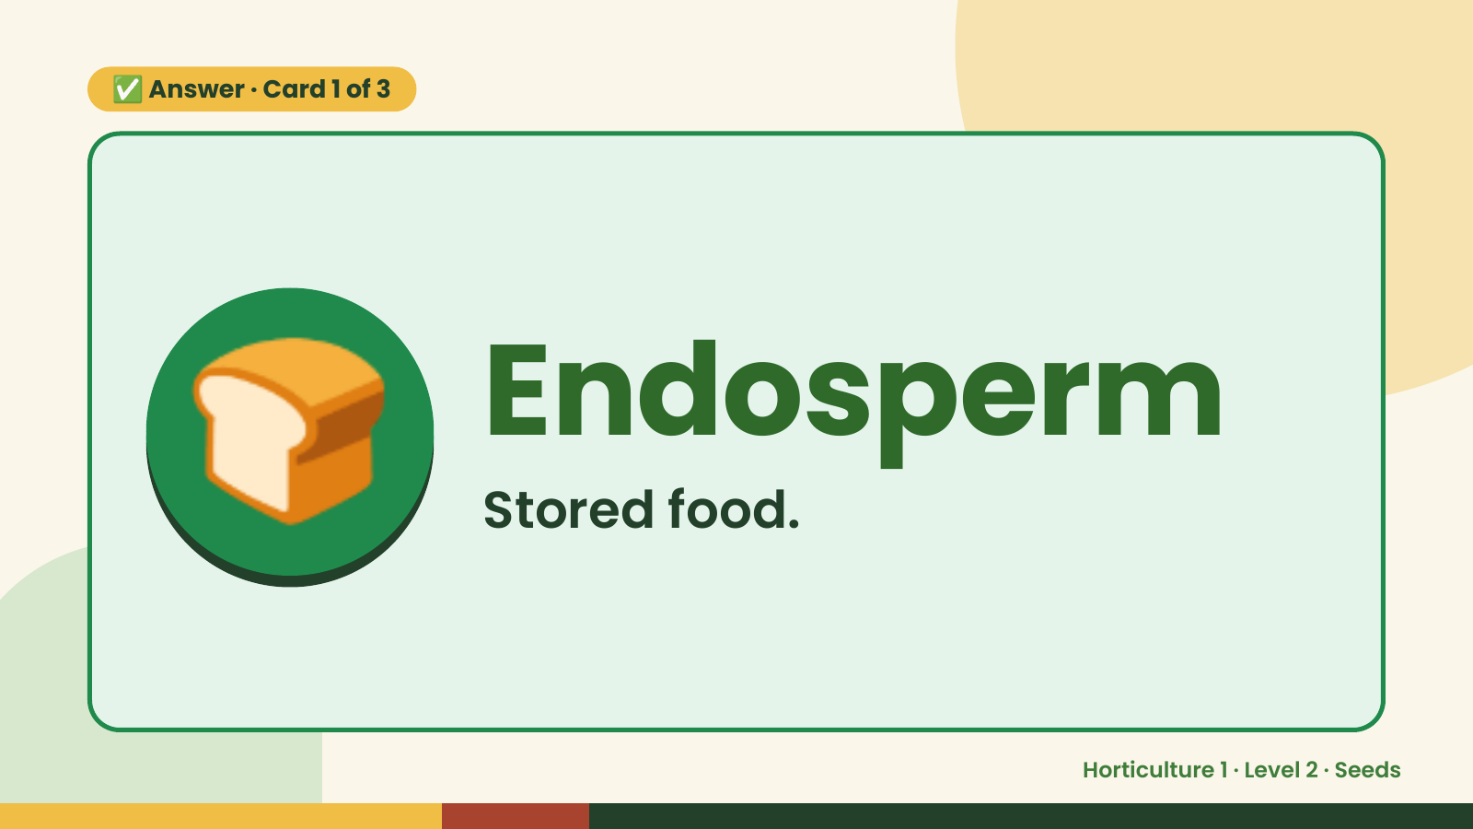
Notes:
✅ Answer · Card 1 of 3
🍞 Endosperm
Stored food.
Horticulture 1 · Level 2 · Seeds

Slide 8
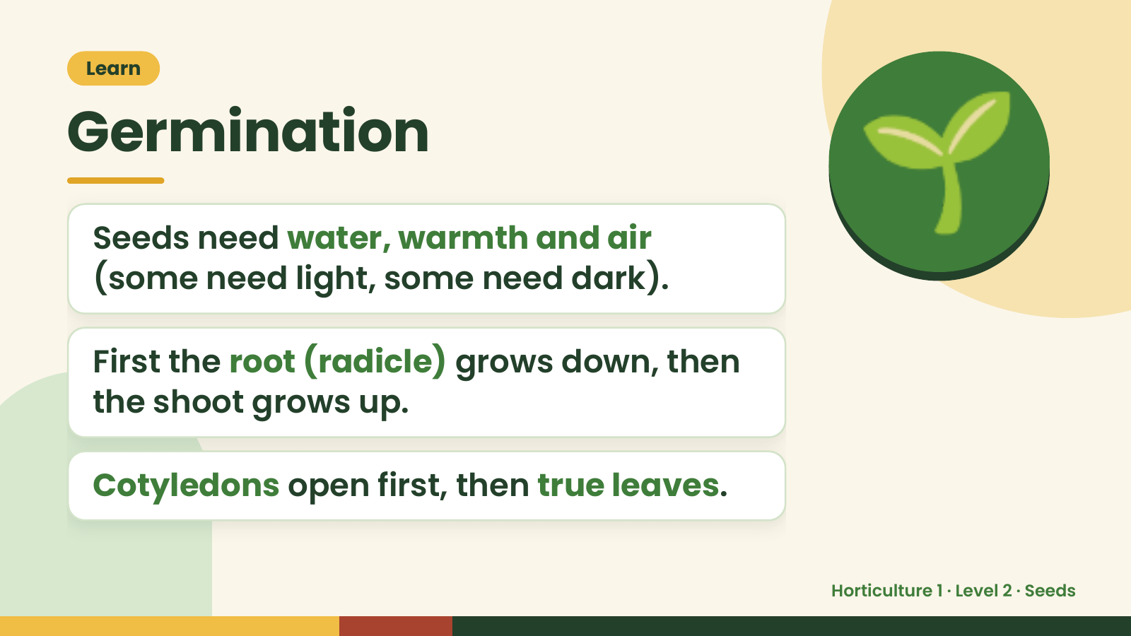
Notes:
Learn
Germination
Seeds need water, warmth and air
(some need light, some need dark).
🌱
First the root (radicle) grows down, then
the shoot grows up.
Cotyledons open first, then true leaves.
Horticulture 1 · Level 2 · Seeds

Slide 9
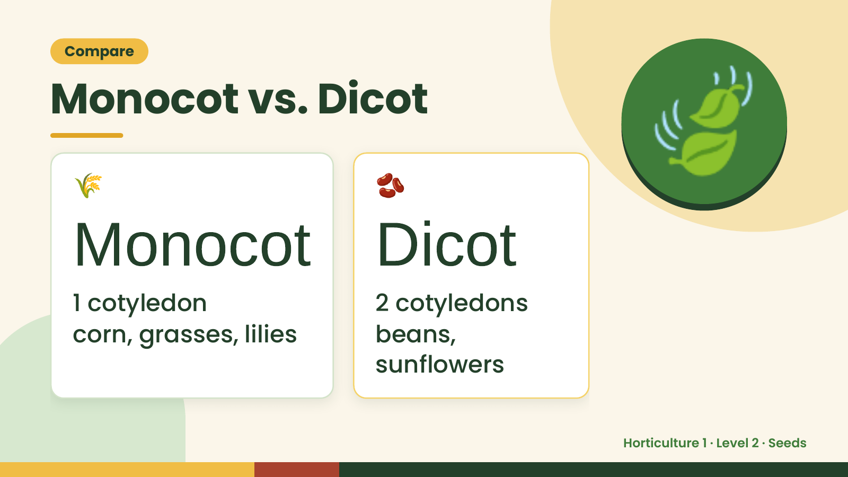
Notes:
Compare
Monocot vs. Dicot
🌾
Monocot Dicot
🫘
🍃
1 cotyledon 2 cotyledons
corn, grasses, lilies beans,
sunflowers
Horticulture 1 · Level 2 · Seeds

Slide 10
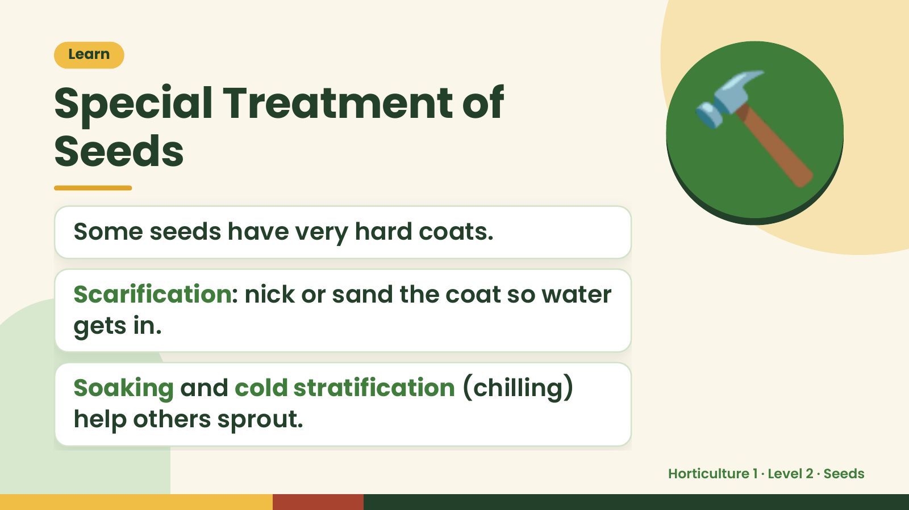
Notes:
Learn
Special Treatment of
Seeds
Some seeds have very hard coats.
🔨
Scarification: nick or sand the coat so water
gets in.
Soaking and cold stratification (chilling)
help others sprout.
Horticulture 1 · Level 2 · Seeds

Slide 11
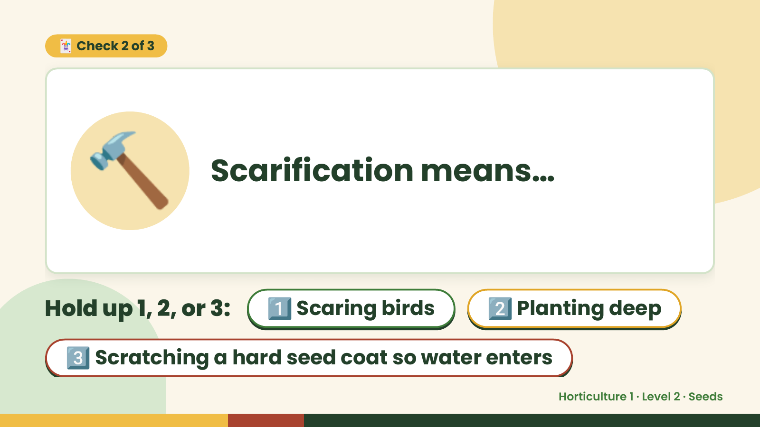
Notes:
🃏 Check 2 of 3
🔨 Scarification means…
Hold up 1, 2, or 3: 1️⃣ Scaring birds 2️⃣ Planting deep
3️⃣ Scratching a hard seed coat so water enters
Horticulture 1 · Level 2 · Seeds

Slide 12
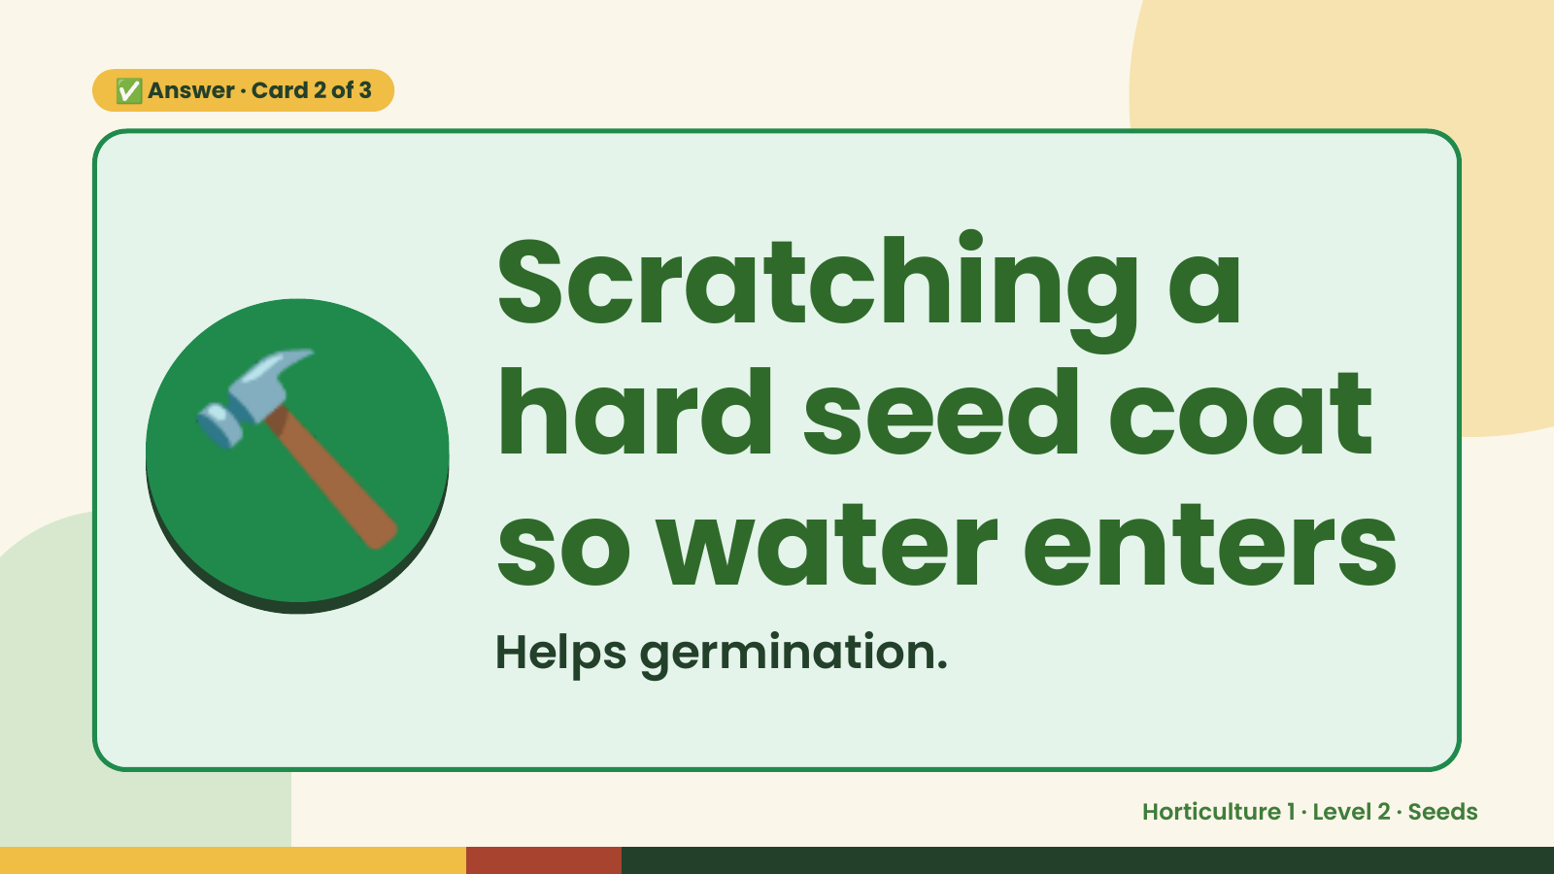
Notes:
✅ Answer · Card 2 of 3
🔨 Scratching a
hard seed coat
so water enters
Helps germination.
Horticulture 1 · Level 2 · Seeds

Slide 13
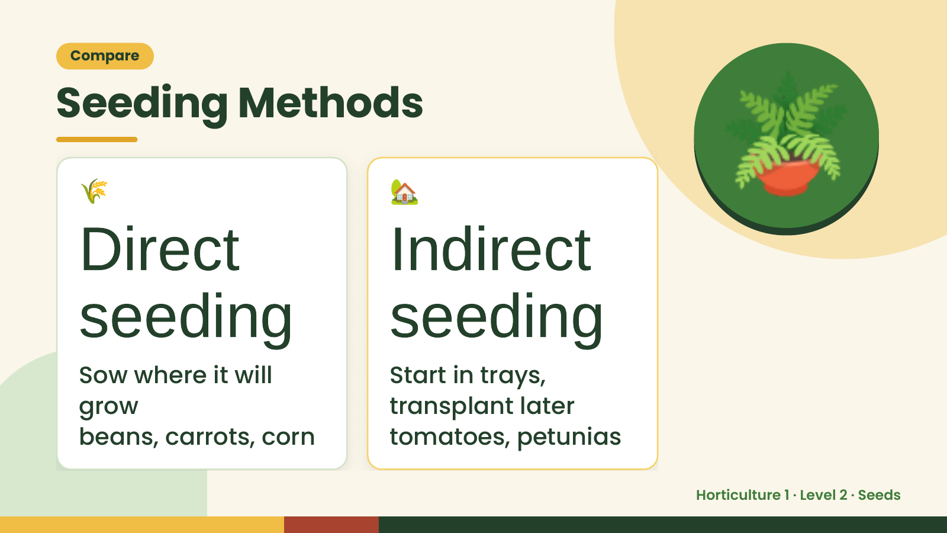
Notes:
Compare
Seeding Methods
🌾
Direct
🏡
Indirect
🪴
seeding
Sow where it will
seeding
Start in trays,
grow transplant later
beans, carrots, corn tomatoes, petunias
Horticulture 1 · Level 2 · Seeds

Slide 14
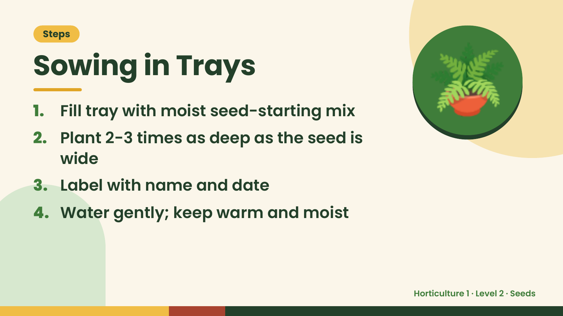
Notes:
Steps
Sowing in Trays
1. Fill tray with moist seed-starting mix
2. Plant 2-3 times as deep as the seed is
wide
🪴
3. Label with name and date
4. Water gently; keep warm and moist
Horticulture 1 · Level 2 · Seeds

Slide 15
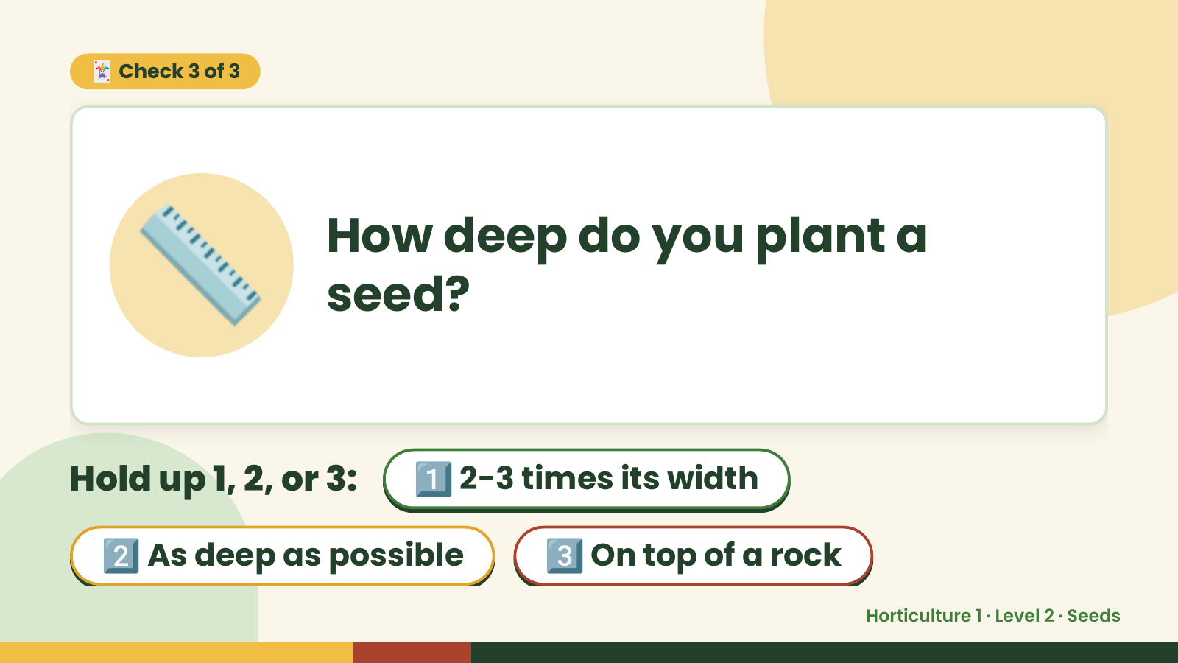
Notes:
🃏 Check 3 of 3
📏 How deep do you plant a
seed?
Hold up 1, 2, or 3: 1️⃣ 2-3 times its width
2️⃣ As deep as possible 3️⃣ On top of a rock
Horticulture 1 · Level 2 · Seeds

Slide 16
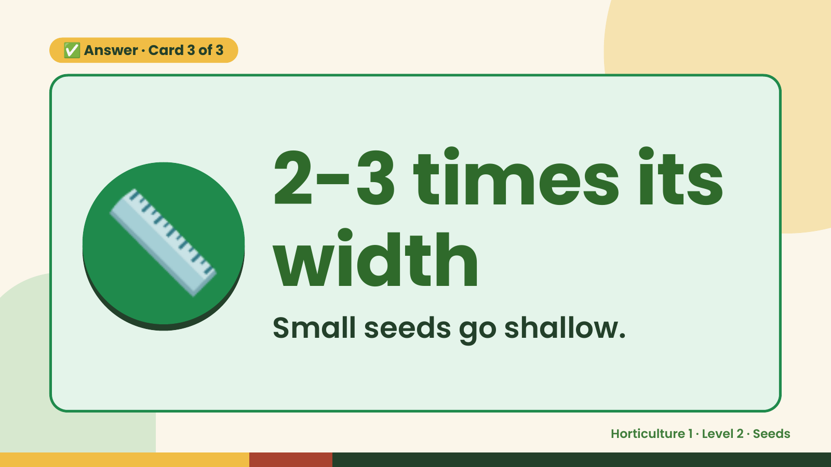
Notes:
✅ Answer · Card 3 of 3
📏 2-3 times its
width
Small seeds go shallow.
Horticulture 1 · Level 2 · Seeds

Slide 17
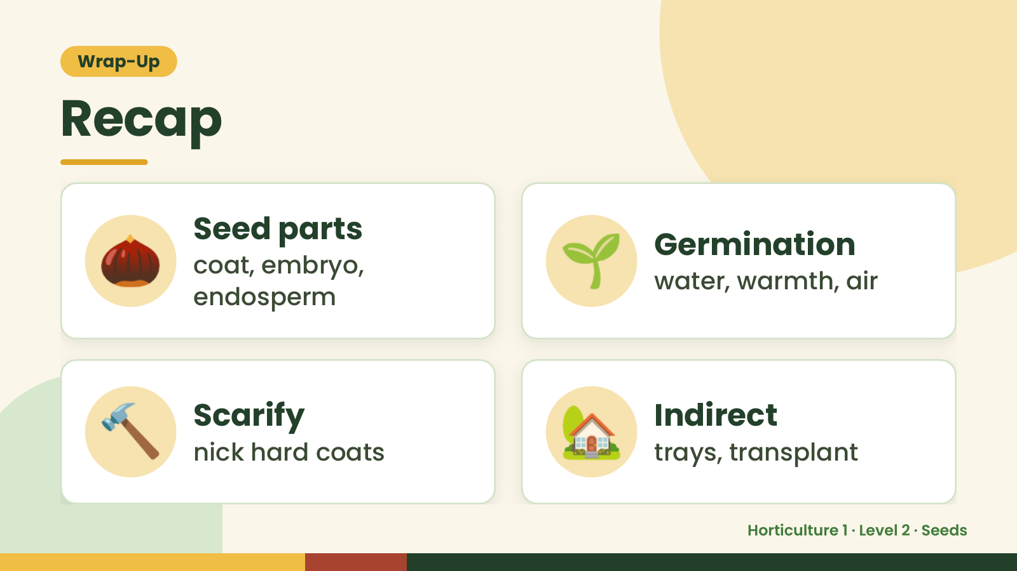
Notes:
Wrap-Up
Recap
🌰 Seed parts
coat, embryo,
endosperm
🌱 Germination
water, warmth, air
🔨 Scarify
nick hard coats 🏡 Indirect
trays, transplant
Horticulture 1 · Level 2 · Seeds

Slide 18
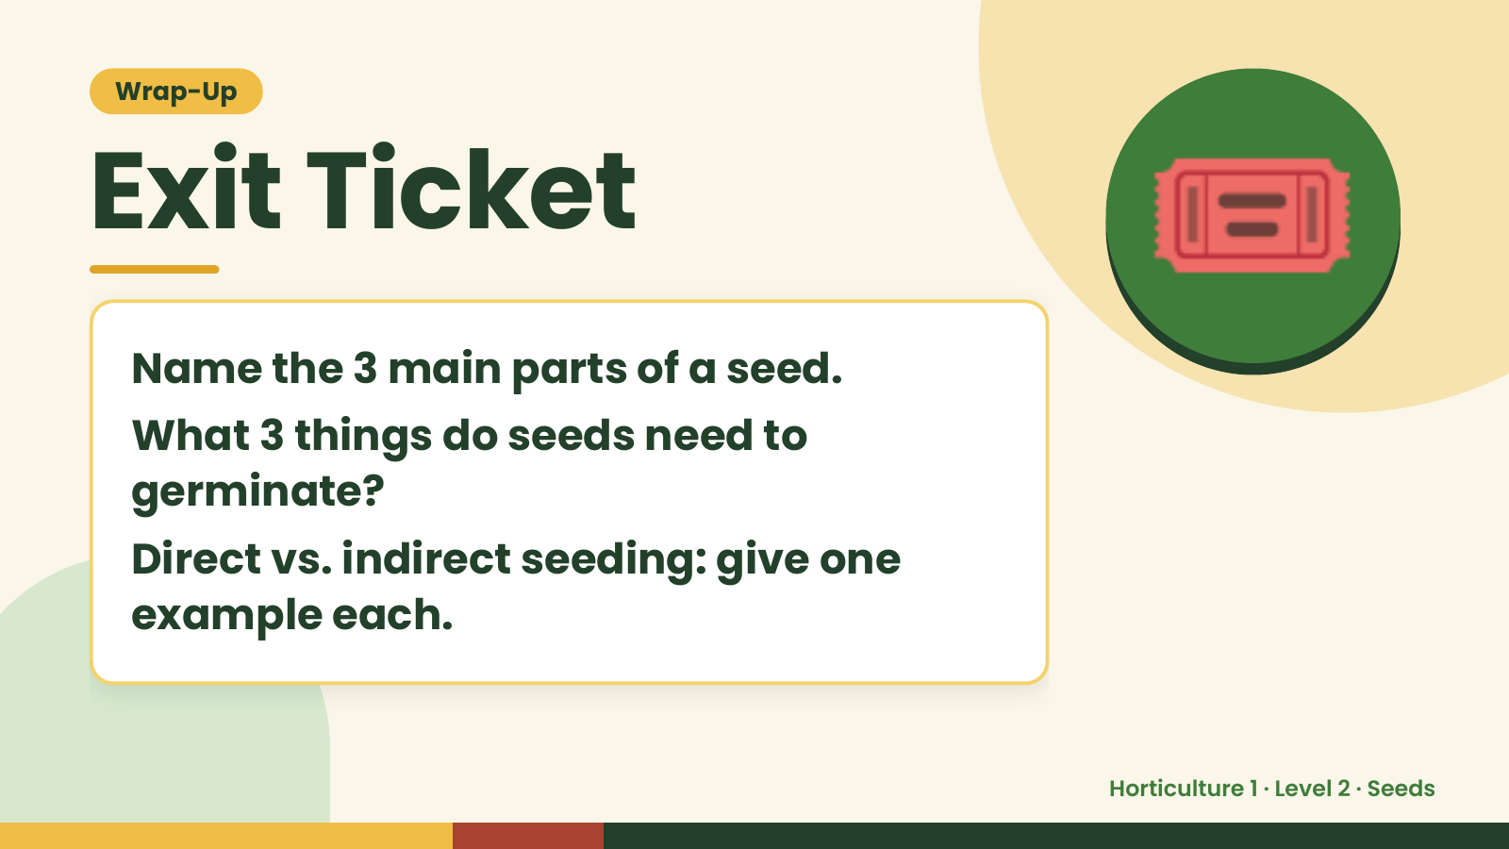
Notes:
Wrap-Up
Exit Ticket
Name the 3 main parts of a seed.
What 3 things do seeds need to
🎟️
germinate?
Direct vs. indirect seeding: give one
example each.
Horticulture 1 · Level 2 · Seeds

