Slide 1
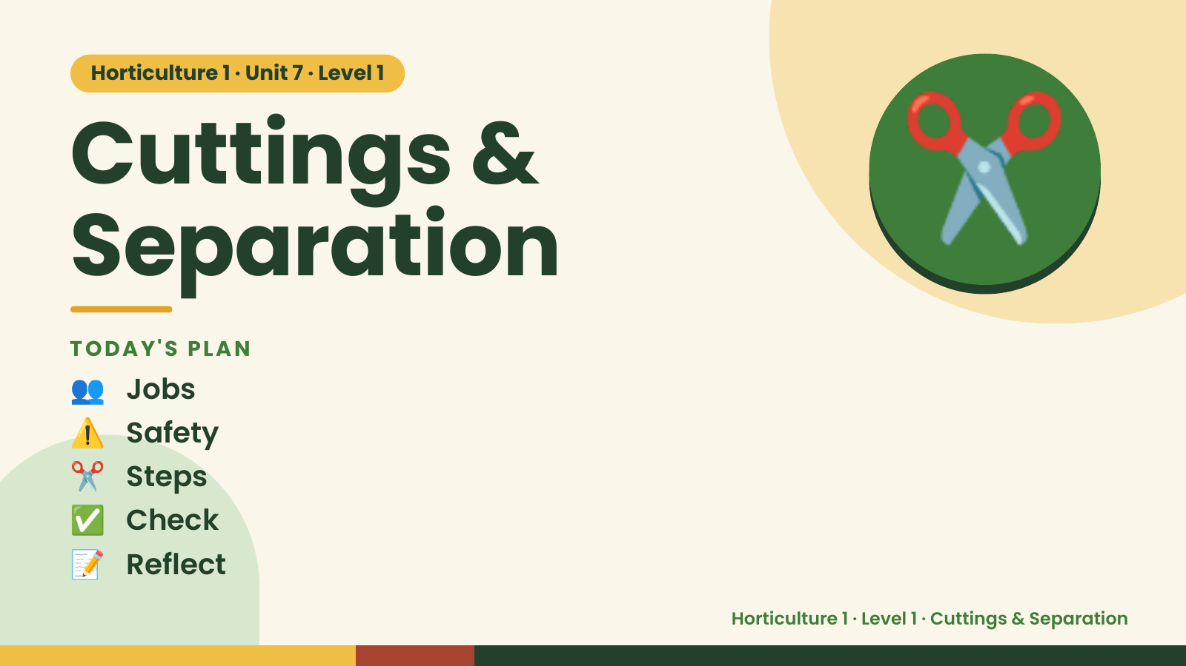
Notes:
Horticulture 1 · Unit 7 · Level 1
Cuttings &
Separation
TODAY'S PLAN
✂️
👥 Jobs
⚠️ Safety
✂️ Steps
✅ Check
📝 Reflect
Horticulture 1 · Level 1 · Cuttings & Separation

Slide 2

Notes:
Get ready
Jobs
🧑‍🌾 Grower
plants 🧺 Supply helper
gets tools
📸 Recorder
photos 🧽 Clean-up
captain
cleans
Horticulture 1 · Level 1 · Cuttings & Separation

Slide 3
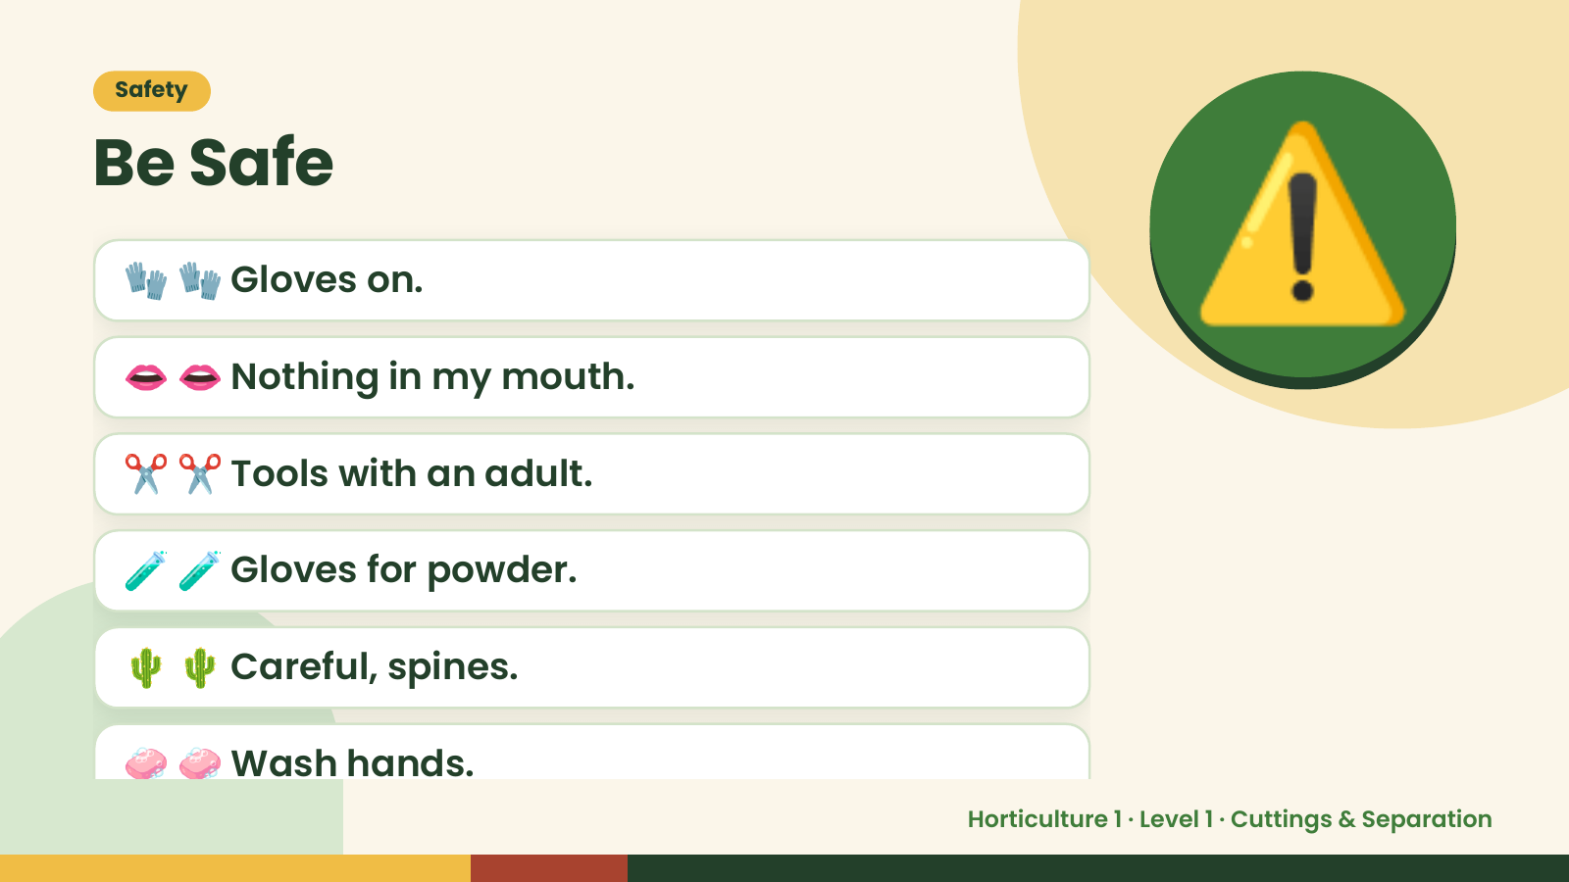
Notes:
Safety
Be Safe
🧤 🧤 Gloves on.
👄 👄 Nothing in my mouth.
✂️ ✂️ Tools with an adult.
⚠️
🧪 🧪 Gloves for powder.
🌵 🌵 Careful, spines.
🧼 🧼 Wash hands.
Horticulture 1 · Level 1 · Cuttings & Separation

Slide 4
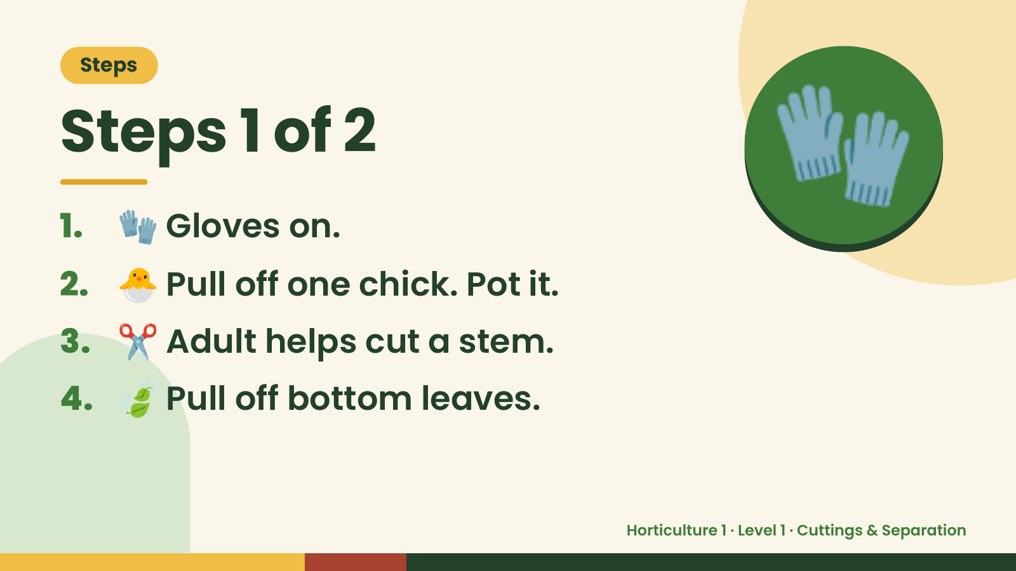
Notes:
Steps
Steps 1 of 2
1. 🧤 Gloves on.
2. 🐣 Pull off one chick. Pot it.
🧤
3. ✂️ Adult helps cut a stem.
4. 🍃 Pull off bottom leaves.
Horticulture 1 · Level 1 · Cuttings & Separation

Slide 5
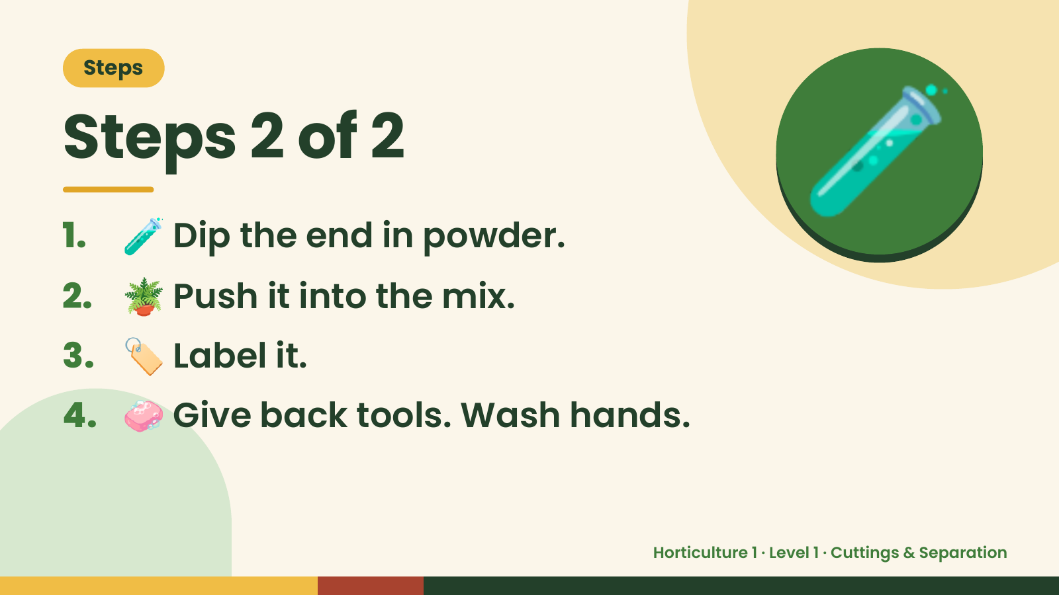
Notes:
Steps
Steps 2 of 2
1. 🧪 Dip the end in powder.
2. 🪴 Push it into the mix.
🧪
3. 🏷️ Label it.
4. 🧼 Give back tools. Wash hands.
Horticulture 1 · Level 1 · Cuttings & Separation

Slide 6
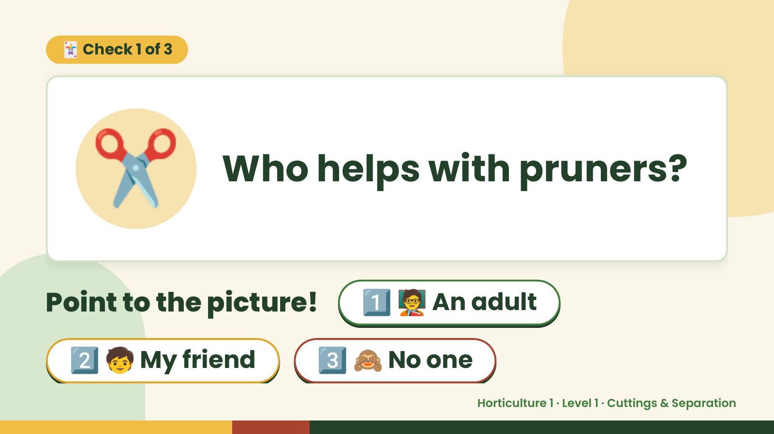
Notes:
🃏 Check 1 of 3
✂️ Who helps with pruners?
Point to the picture! 1️⃣ 🧑‍🏫 An adult
2️⃣ 🧒 My friend 3️⃣ 🙈 No one
Horticulture 1 · Level 1 · Cuttings & Separation

Slide 7
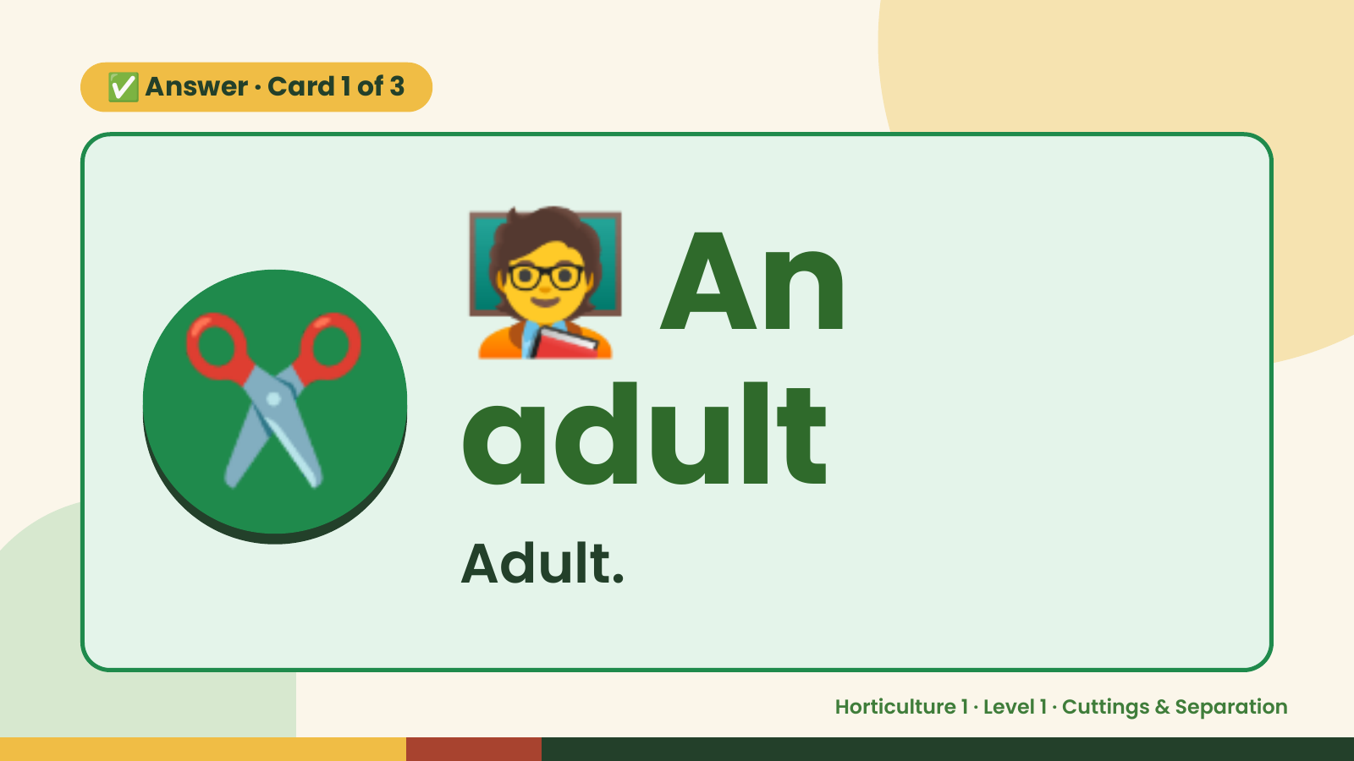
Notes:
🧑‍🏫
✅ Answer · Card 1 of 3
✂️ adult
An
Adult.
Horticulture 1 · Level 1 · Cuttings & Separation

Slide 8
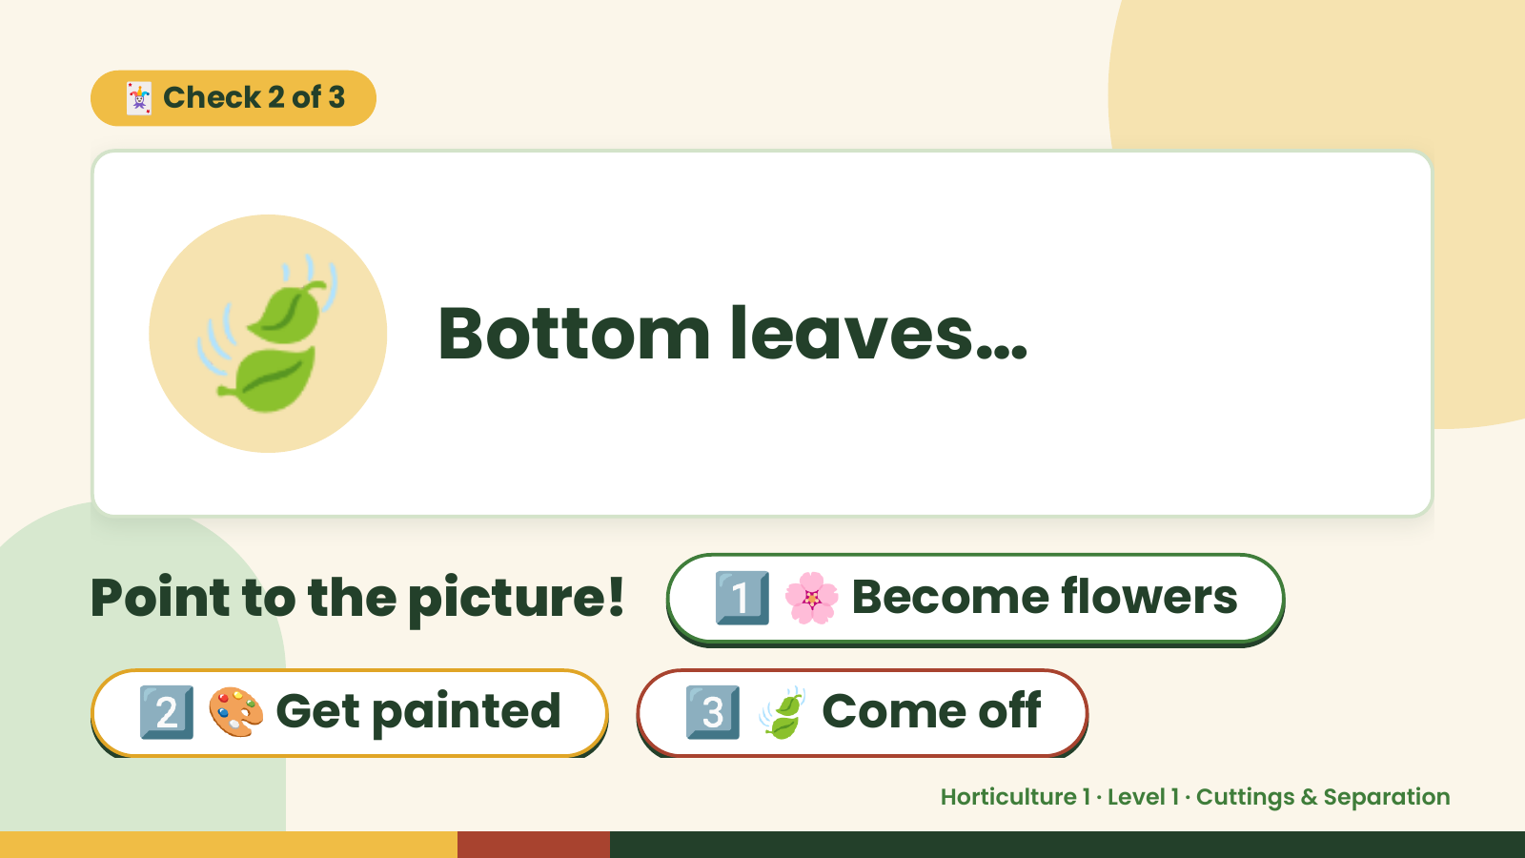
Notes:
🃏 Check 2 of 3
🍃 Bottom leaves…
Point to the picture! 1️⃣ 🌸 Become flowers
2️⃣ 🎨 Get painted 3️⃣ 🍃 Come off
Horticulture 1 · Level 1 · Cuttings & Separation

Slide 9
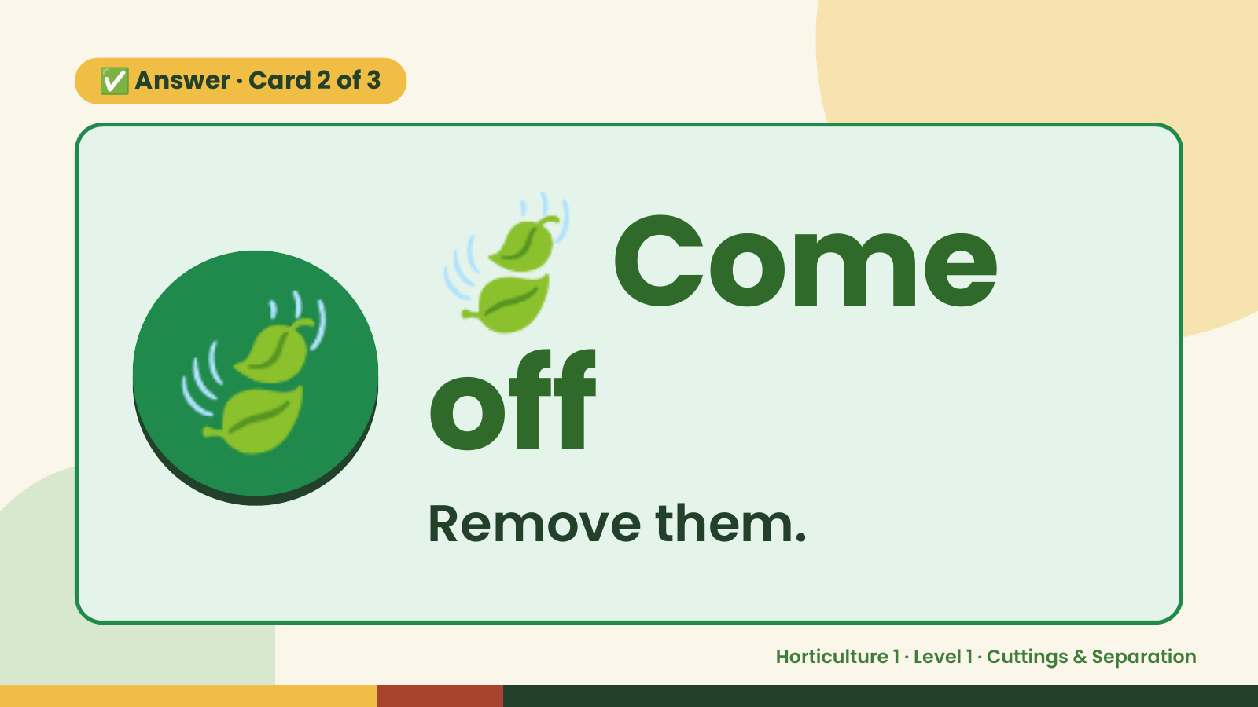
Notes:
🍃
✅ Answer · Card 2 of 3
🍃 off Come
Remove them.
Horticulture 1 · Level 1 · Cuttings & Separation

Slide 10
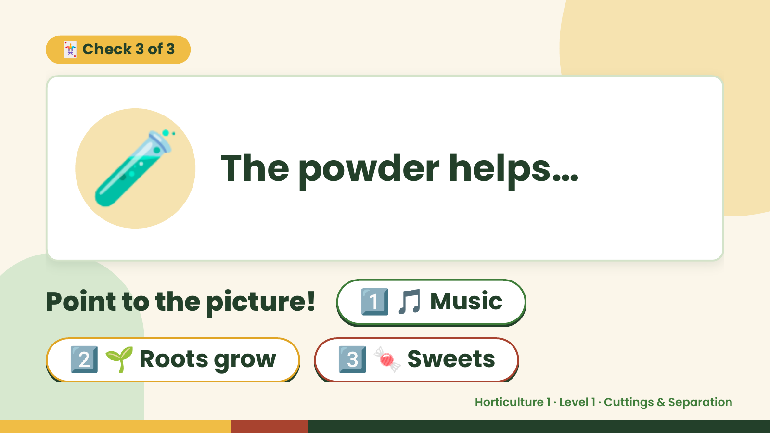
Notes:
🃏 Check 3 of 3
🧪 The powder helps…
Point to the picture! 1️⃣ 🎵 Music
2️⃣ 🌱 Roots grow 3️⃣ 🍬 Sweets
Horticulture 1 · Level 1 · Cuttings & Separation

Slide 11
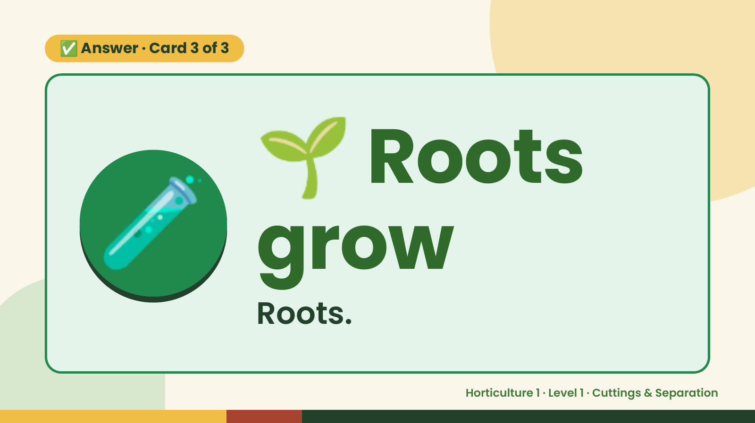
Notes:
🌱
✅ Answer · Card 3 of 3
🧪 grow
Roots
Roots.
Horticulture 1 · Level 1 · Cuttings & Separation

Slide 12

Notes:
Wrap-Up
Clean Up +
Reflect
🧽
🧽 Clean the table.
🧰 Give tools back.
🧼 Wash hands.
Horticulture 1 · Level 1 · Cuttings & Separation

