Slide 1
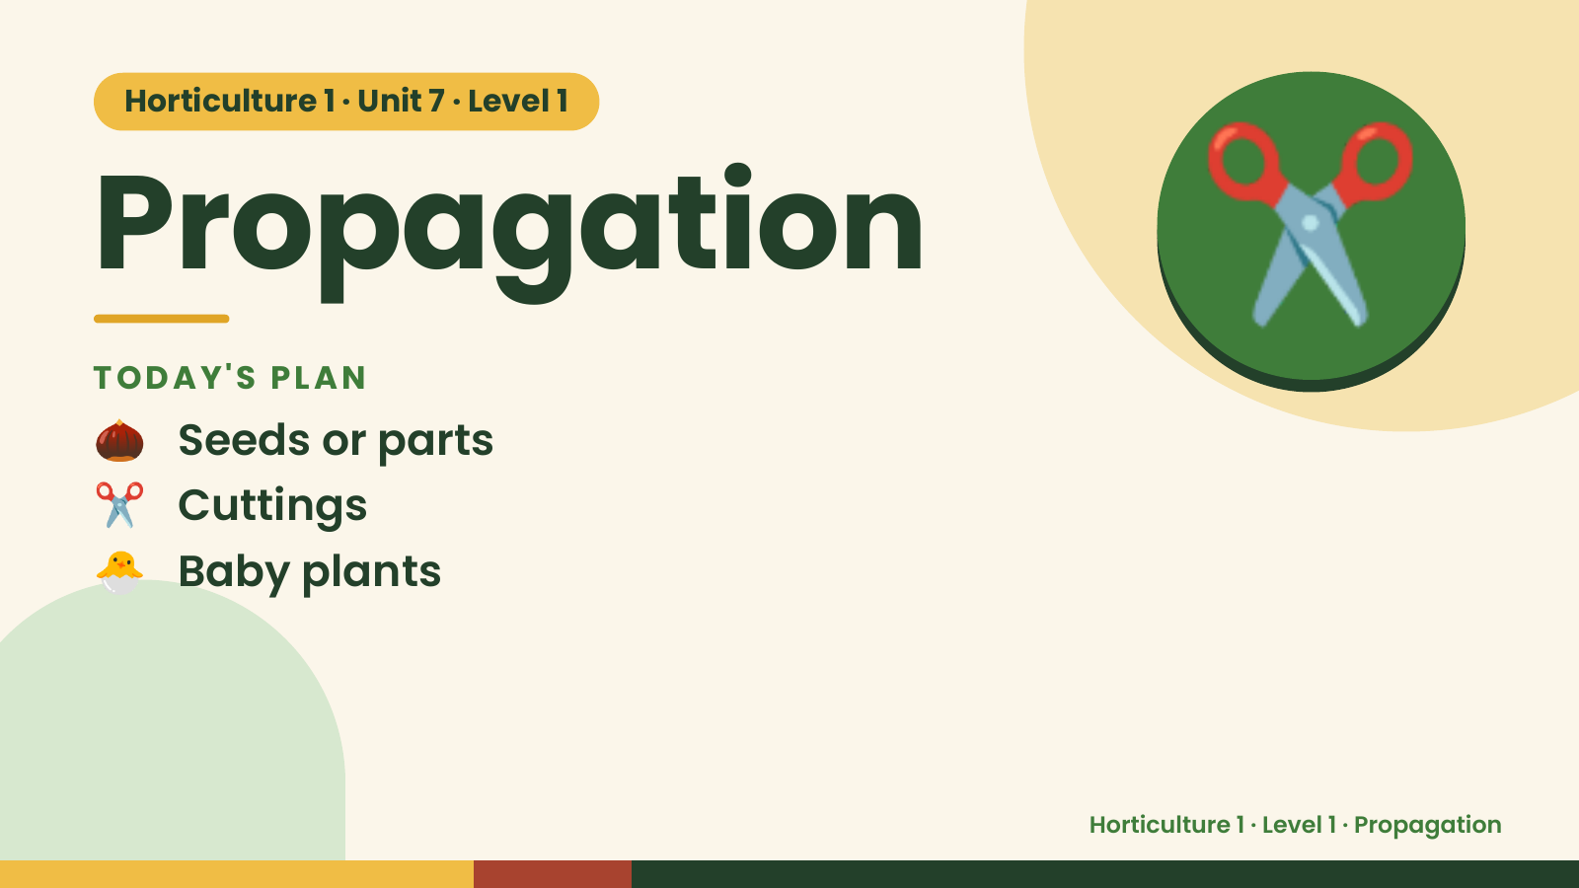
Notes:
Horticulture 1 · Unit 7 · Level 1
Propagation
TODAY'S PLAN
🌰 Seeds or parts
✂️
✂️ Cuttings
🐣 Baby plants
Horticulture 1 · Level 1 · Propagation

Slide 2
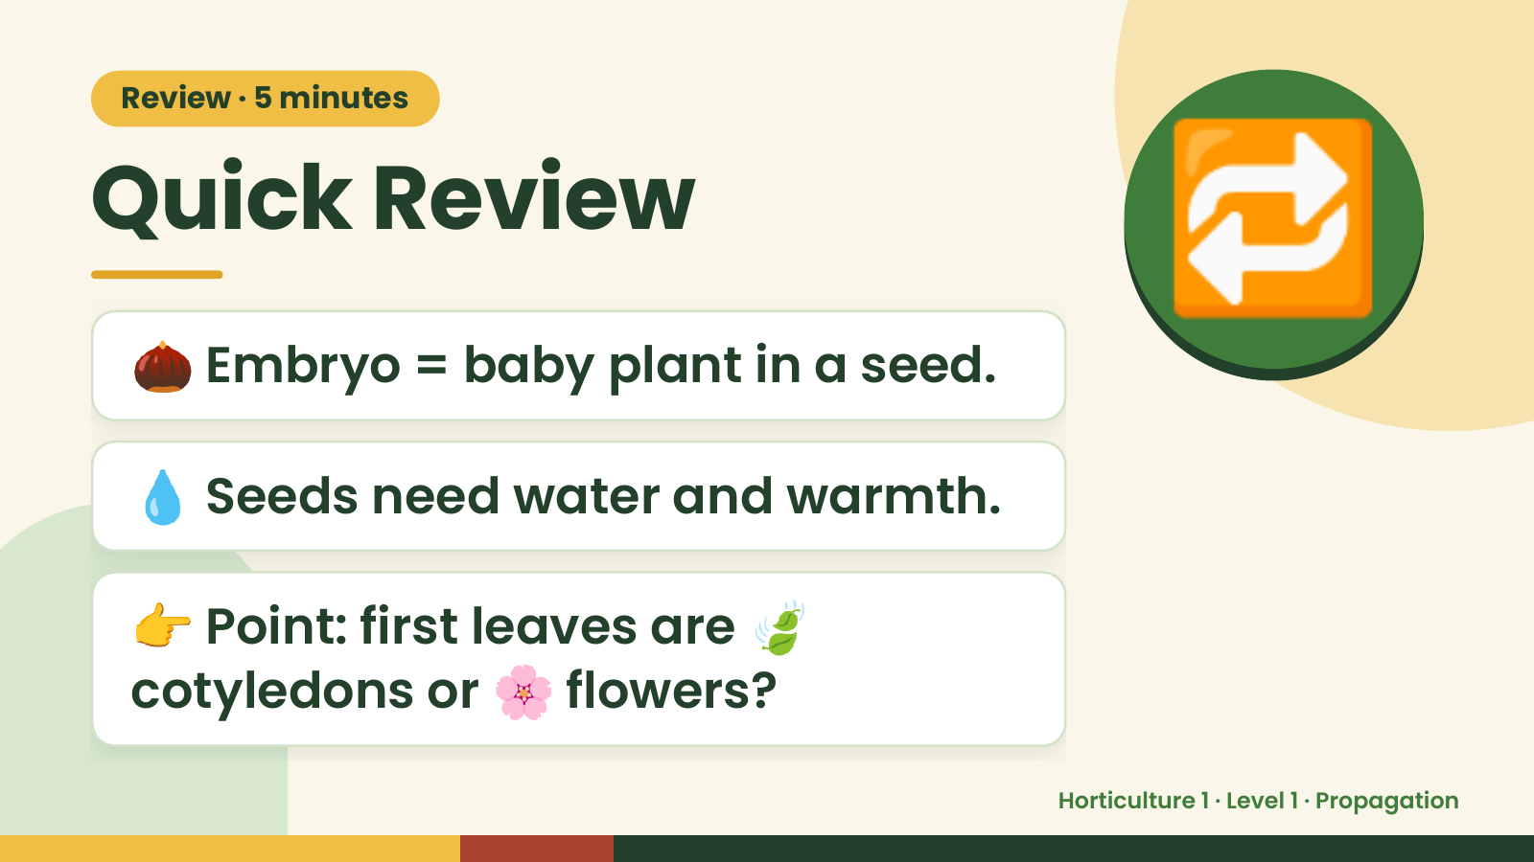
Notes:
Review · 5 minutes
Quick Review
🌰 Embryo = baby plant in a seed.
🔁
💧 Seeds need water and warmth.
👉 Point: first leaves are 🍃
cotyledons or 🌸 flowers?
Horticulture 1 · Level 1 · Propagation

Slide 3
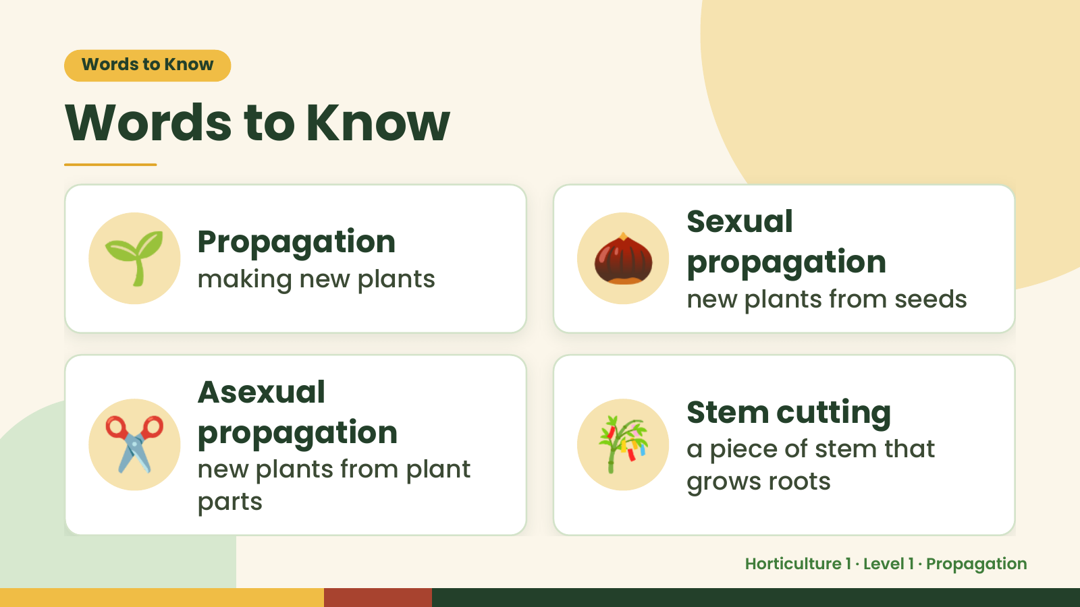
Notes:
Words to Know
Words to Know
🌱 Propagation
making new plants 🌰 Sexual
propagation
new plants from seeds
✂️ Asexual
propagation
new plants from plant
parts
🎋 Stem cutting
a piece of stem that
grows roots
Horticulture 1 · Level 1 · Propagation

Slide 4
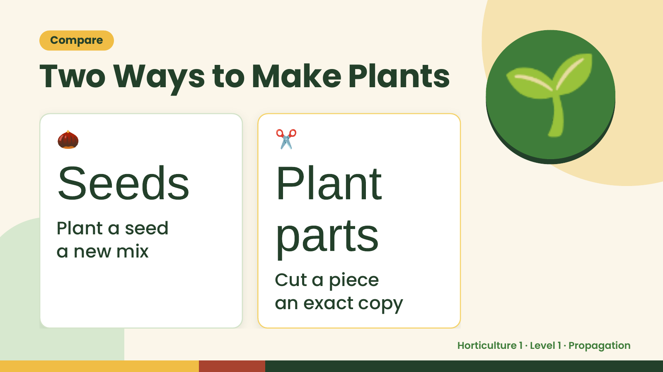
Notes:
Compare
Two Ways to Make Plants
🌰
Seeds
✂️
Plant
🌱
Plant a seed
a new mix parts
Cut a piece
an exact copy
Horticulture 1 · Level 1 · Propagation

Slide 5
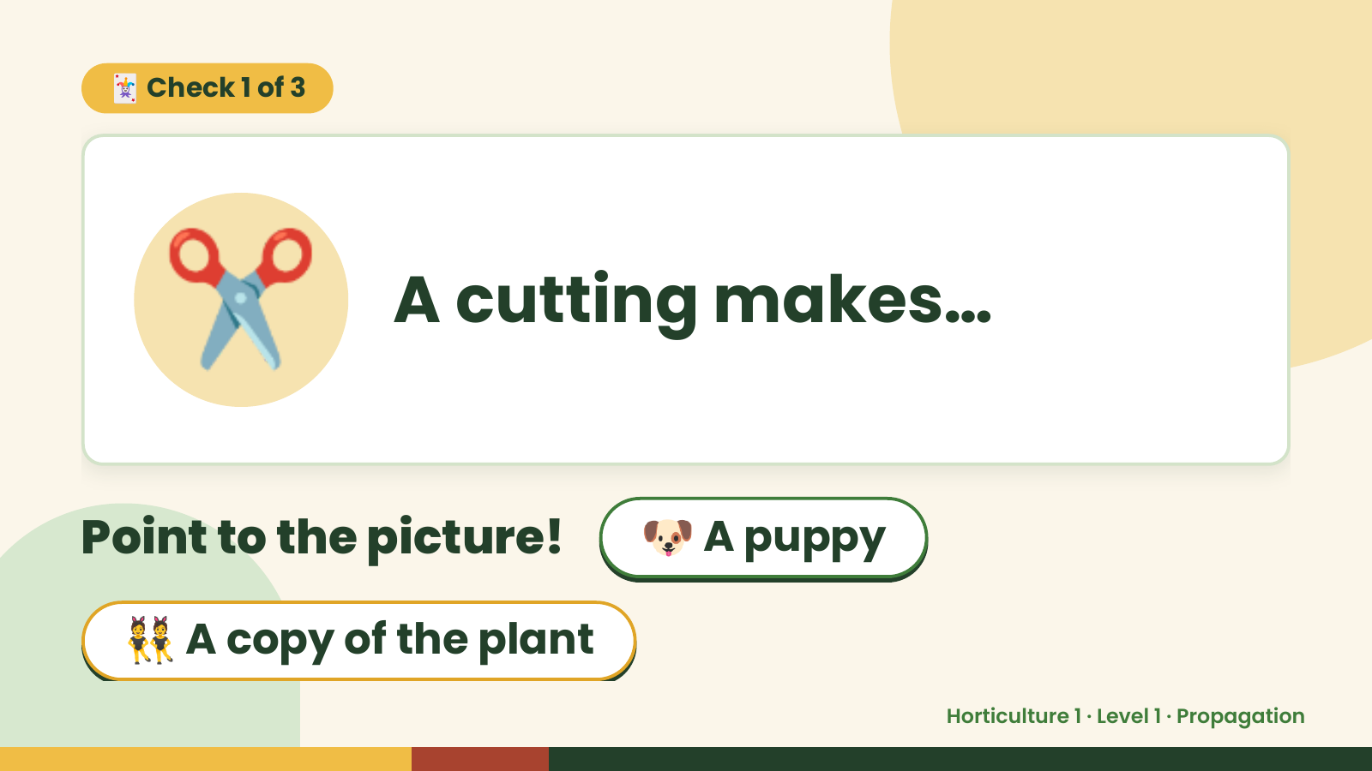
Notes:
🃏 Check 1 of 3
✂️ A cutting makes…
Point to the picture! 🐶 A puppy
👯 A copy of the plant
Horticulture 1 · Level 1 · Propagation

Slide 6
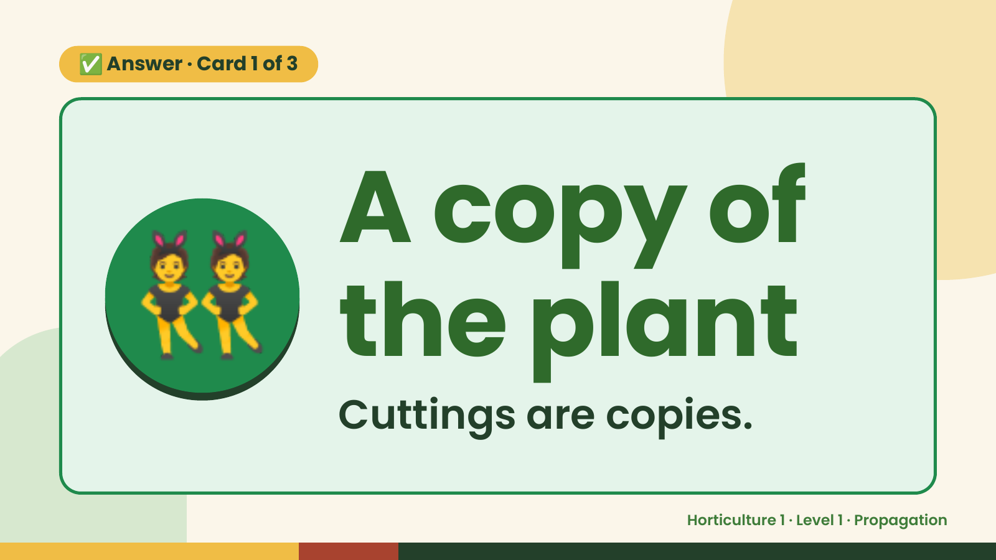
Notes:
✅ Answer · Card 1 of 3
👯 A copy of
the plant
Cuttings are copies.
Horticulture 1 · Level 1 · Propagation

Slide 7
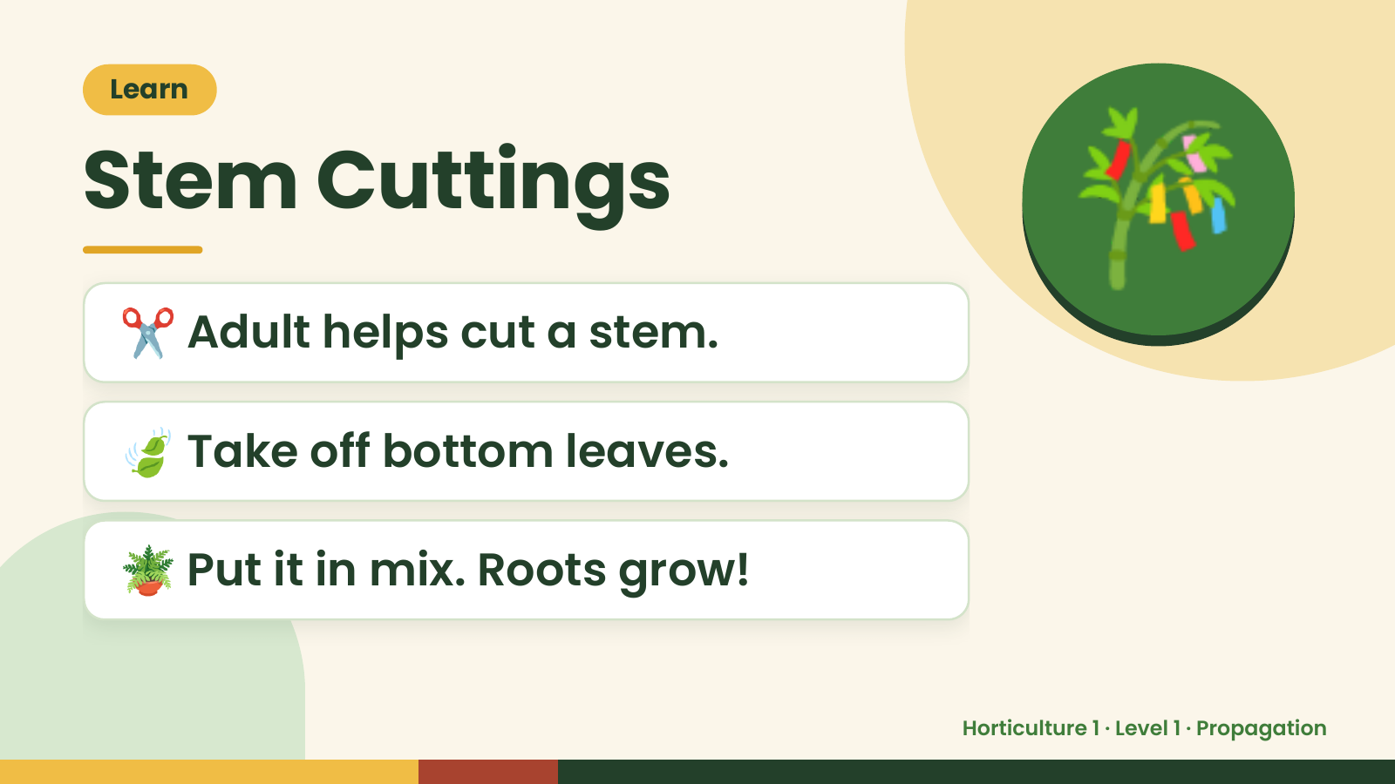
Notes:
Learn
Stem Cuttings
✂️ Adult helps cut a stem.
🎋
🍃 Take off bottom leaves.
🪴 Put it in mix. Roots grow!
Horticulture 1 · Level 1 · Propagation

Slide 8
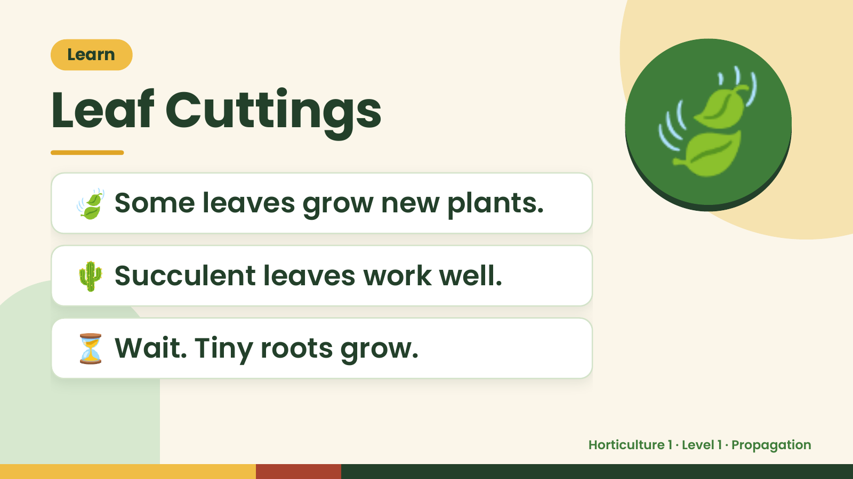
Notes:
Learn
Leaf Cuttings
🍃 Some leaves grow new plants.
🍃
🌵 Succulent leaves work well.
⏳ Wait. Tiny roots grow.
Horticulture 1 · Level 1 · Propagation

Slide 9
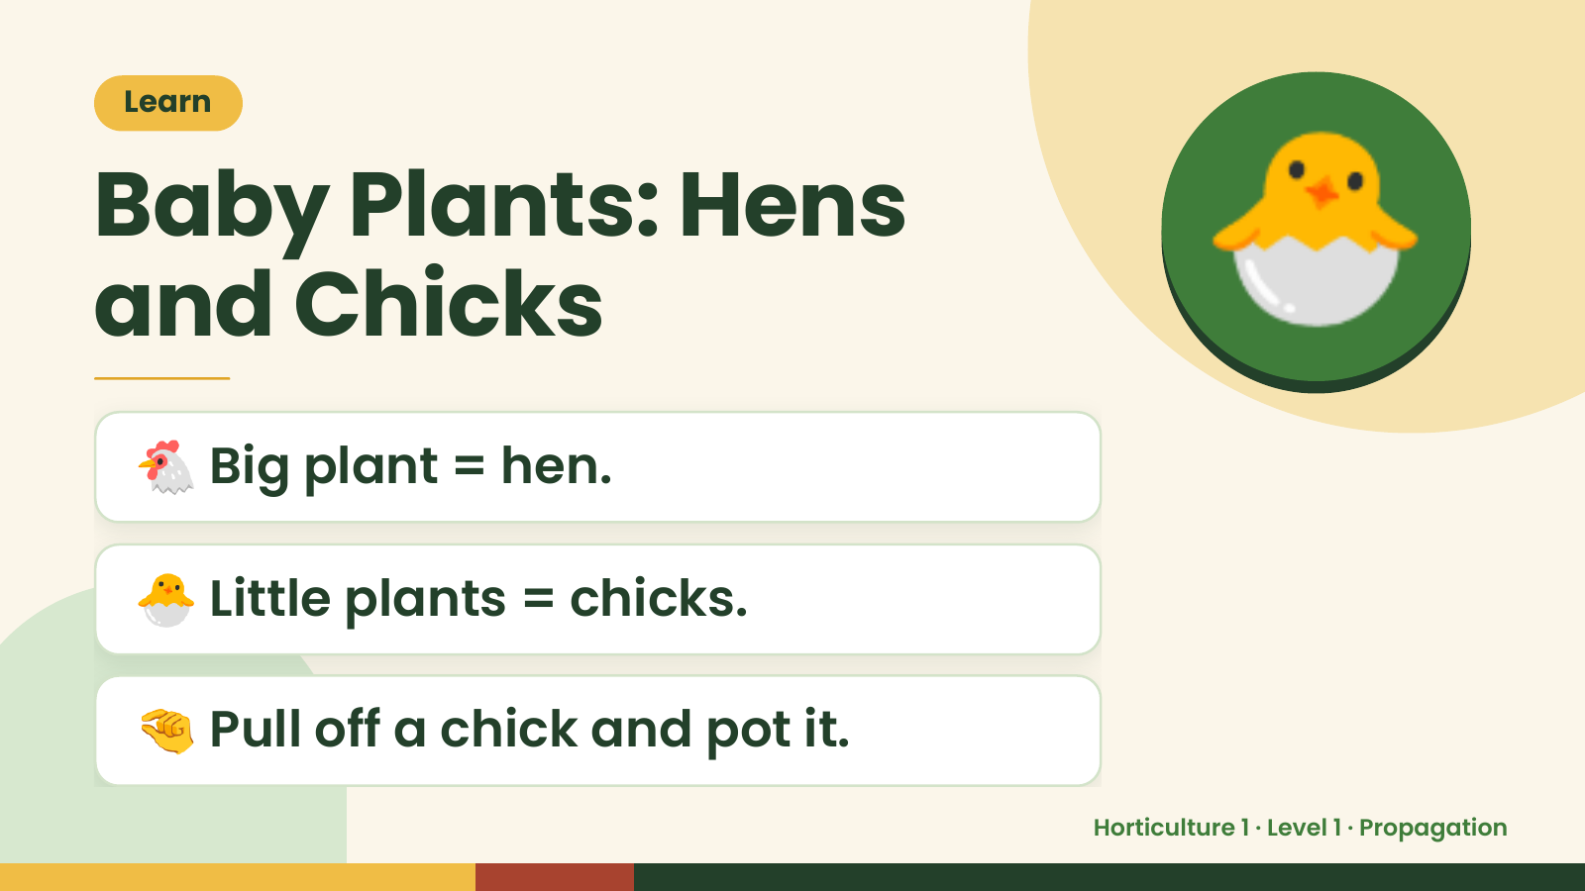
Notes:
Learn
Baby Plants: Hens
and Chicks
🐔 Big plant = hen.
🐣
🐣 Little plants = chicks.
🤏 Pull off a chick and pot it.
Horticulture 1 · Level 1 · Propagation

Slide 10
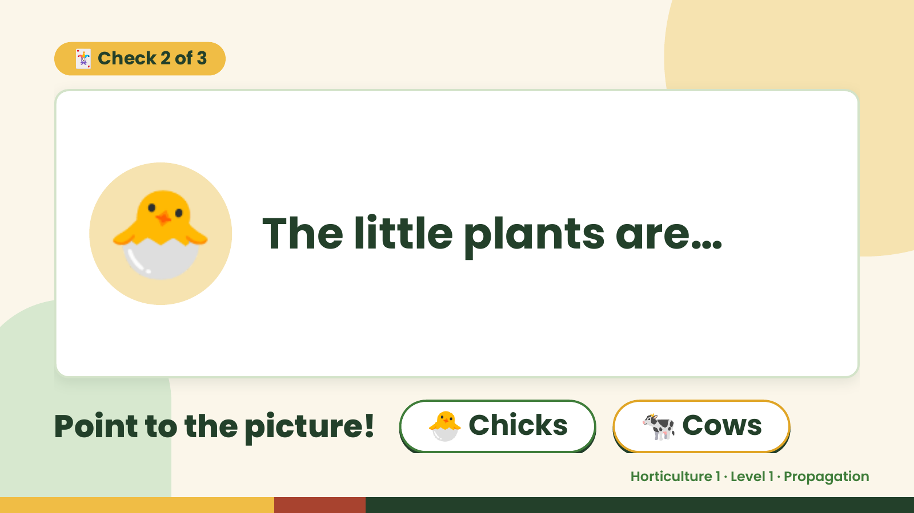
Notes:
🃏 Check 2 of 3
🐣 The little plants are…
Point to the picture! 🐣 Chicks 🐄 Cows
Horticulture 1 · Level 1 · Propagation

Slide 11
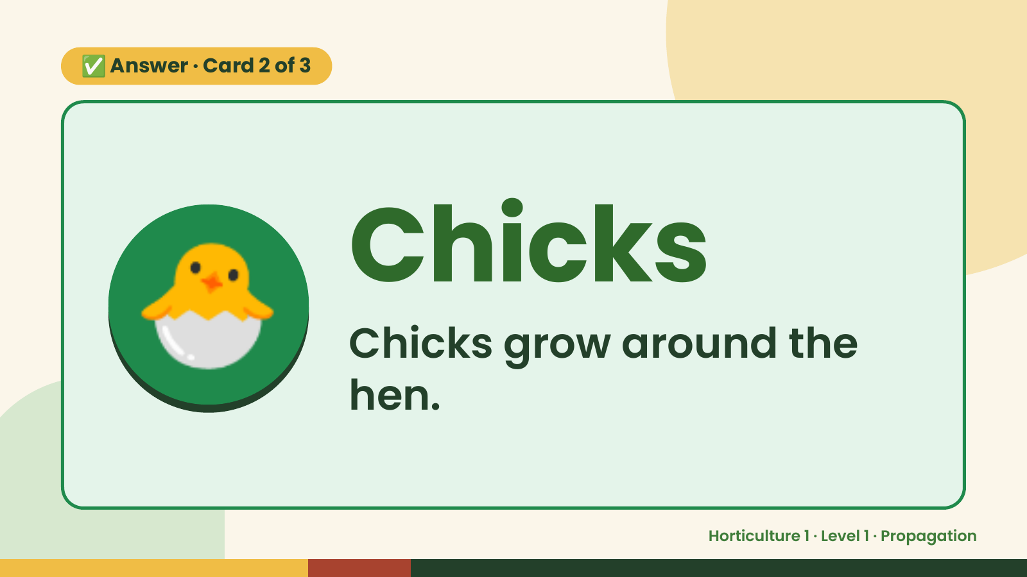
Notes:
✅ Answer · Card 2 of 3
🐣 Chicks
Chicks grow around the
hen.
Horticulture 1 · Level 1 · Propagation

Slide 12
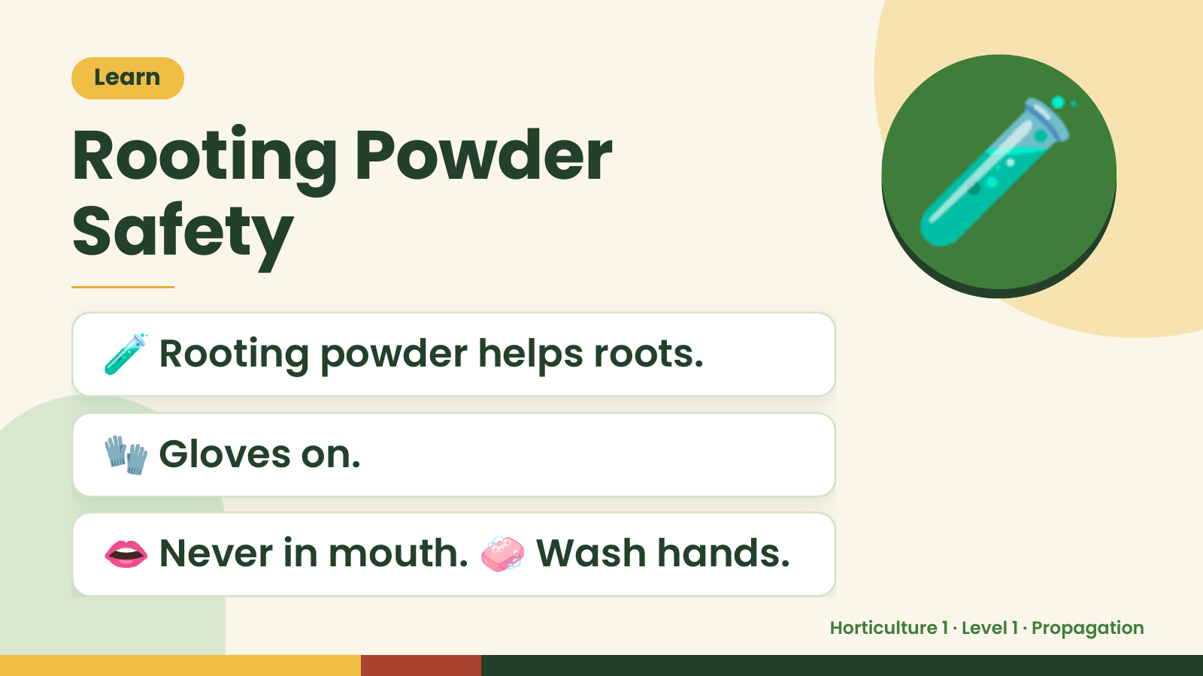
Notes:
Learn
Rooting Powder
Safety
🧪 Rooting powder helps roots.
🧪
🧤 Gloves on.
👄 Never in mouth. 🧼 Wash hands.
Horticulture 1 · Level 1 · Propagation

Slide 13
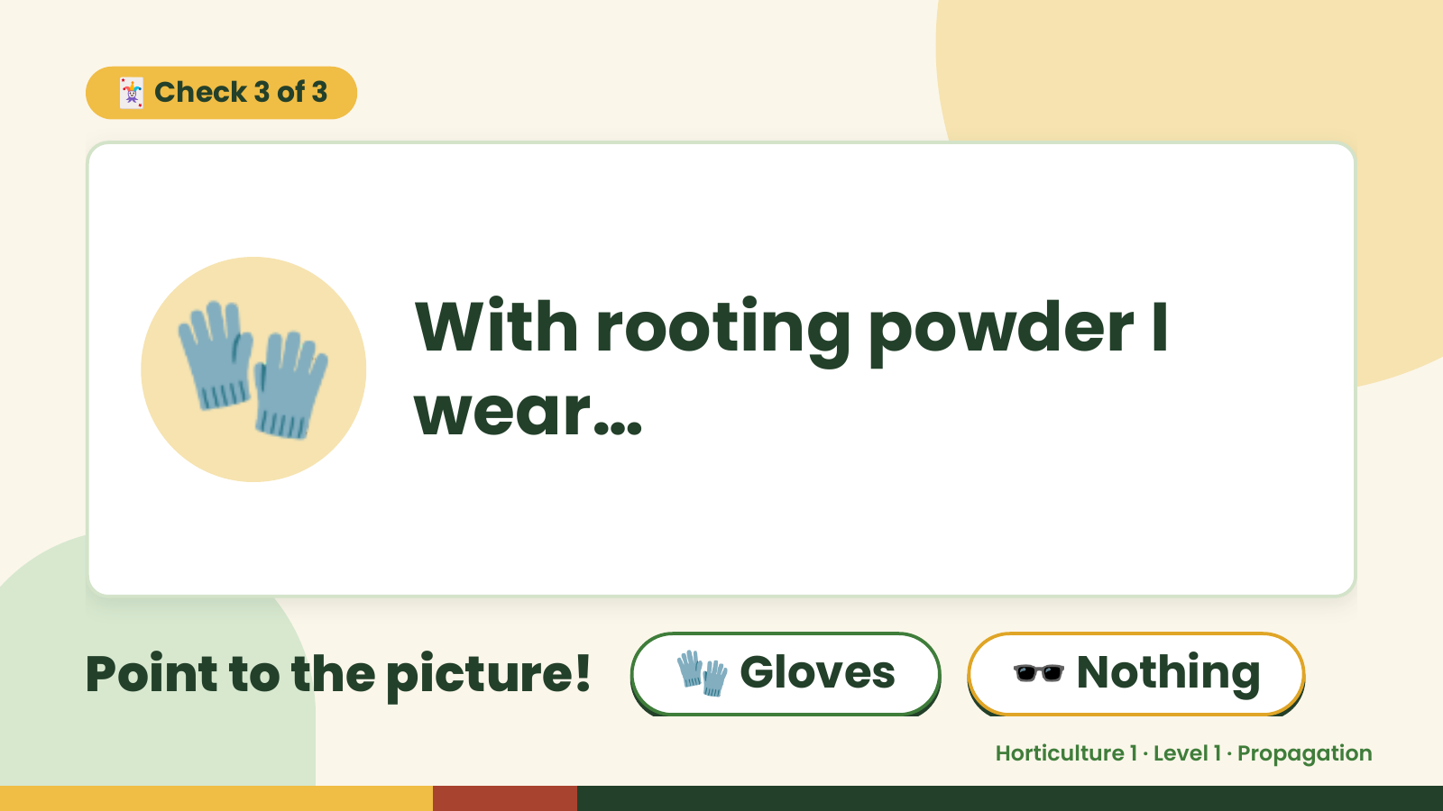
Notes:
🃏 Check 3 of 3
🧤 With rooting powder I
wear…
Point to the picture! 🧤 Gloves 🕶️ Nothing
Horticulture 1 · Level 1 · Propagation

Slide 14
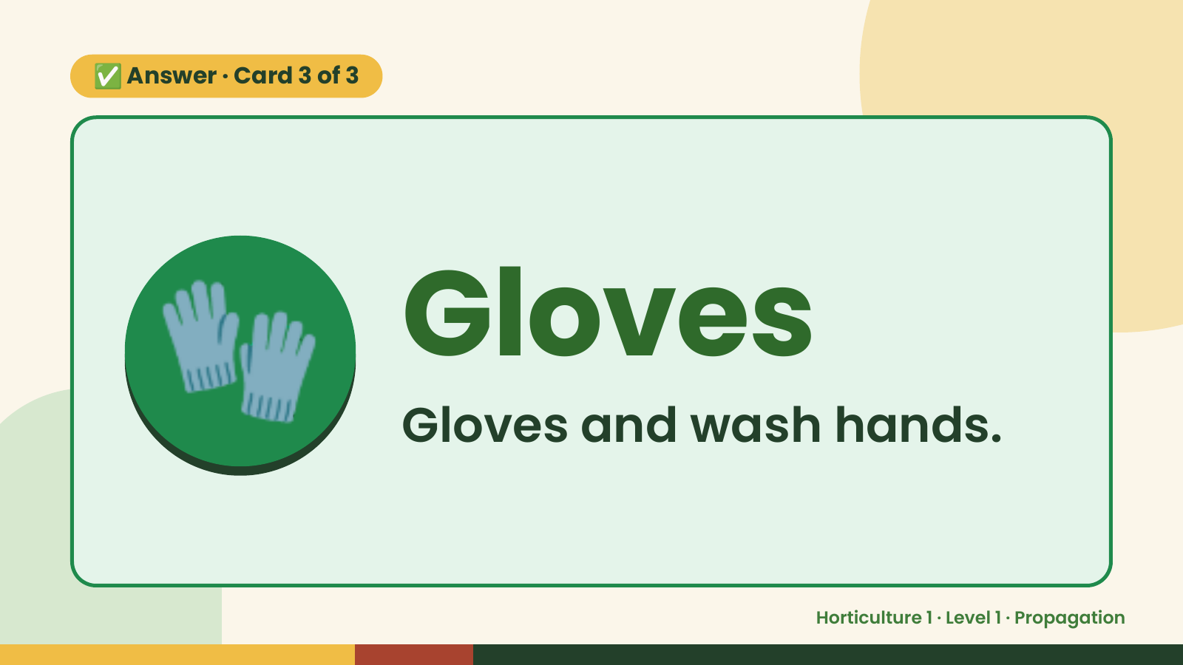
Notes:
✅ Answer · Card 3 of 3
🧤 Gloves
Gloves and wash hands.
Horticulture 1 · Level 1 · Propagation

Slide 15
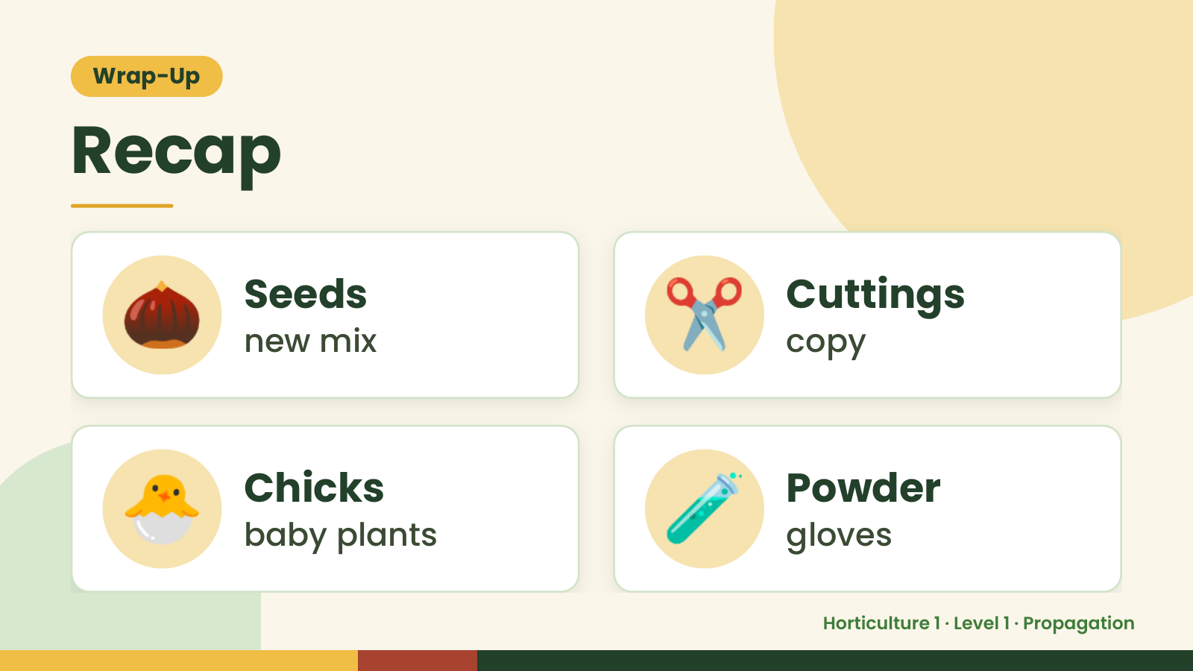
Notes:
Wrap-Up
Recap
🌰 Seeds
new mix ✂️ Cuttings
copy
🐣 Chicks
baby plants 🧪 Powder
gloves
Horticulture 1 · Level 1 · Propagation

Slide 16
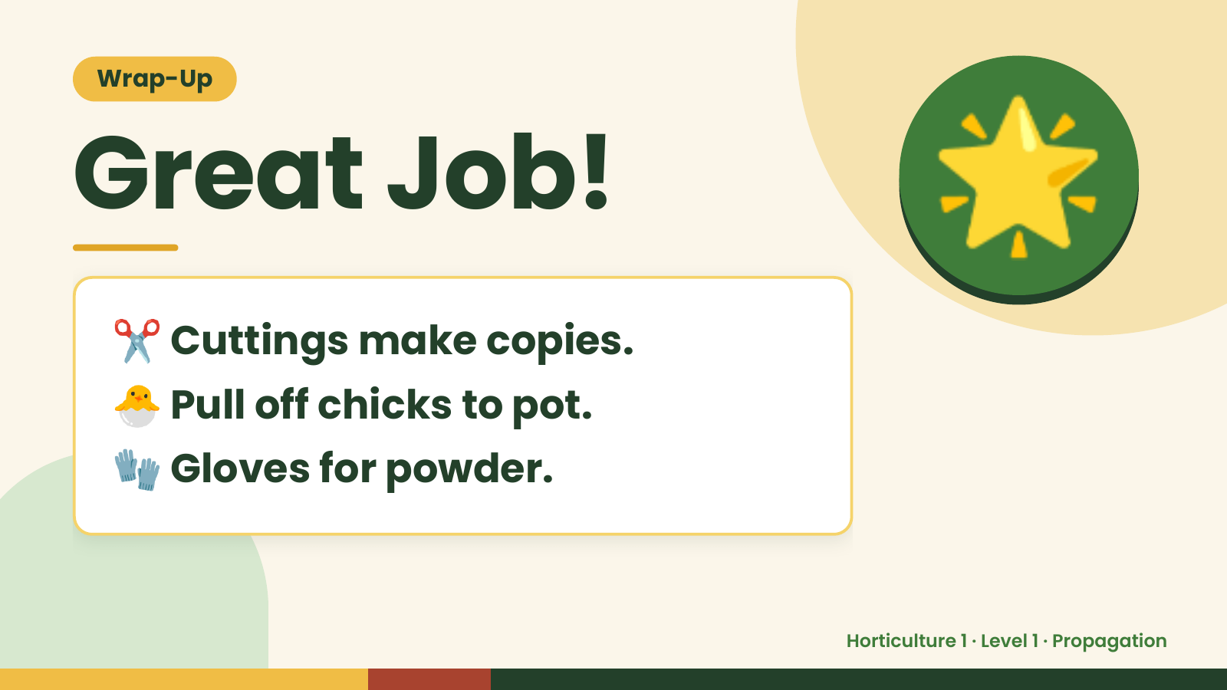
Notes:
Wrap-Up
Great Job!
✂️ Cuttings make copies.
🌟
🐣 Pull off chicks to pot.
🧤 Gloves for powder.
Horticulture 1 · Level 1 · Propagation

