Slide 1
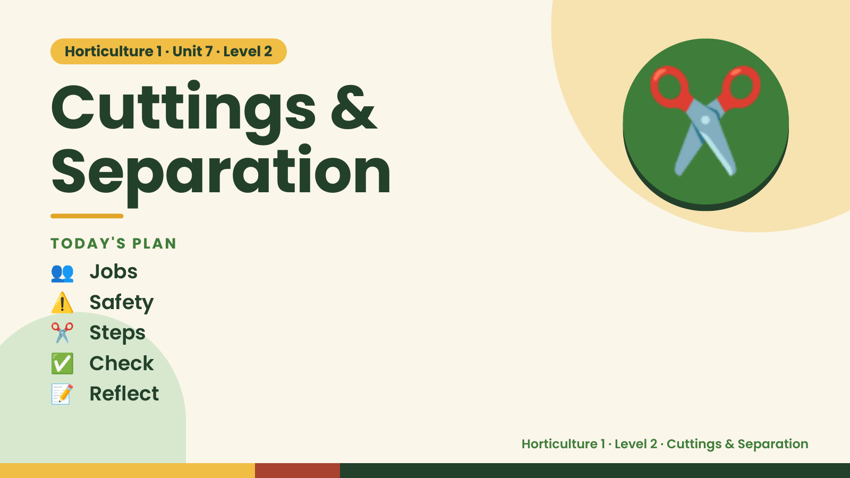
Notes:
Horticulture 1 · Unit 7 · Level 2
Cuttings &
Separation
👥 Jobs
TODAY'S PLAN
✂️
⚠️ Safety
✂️ Steps
✅ Check
📝 Reflect
Horticulture 1 · Level 2 · Cuttings & Separation

Slide 2

Notes:
Get ready
Jobs
🧑‍🌾 Grower
Does the main plant job
with the tools
🧺 Supply helper
Gets and returns supplies
and tools to staff
📸 Recorder
Takes photos and fills in
the chart
🧽 Clean-up captain
Sweeps, wipes tables,
checks hands are
washed
Horticulture 1 · Level 2 · Cuttings & Separation

Slide 3
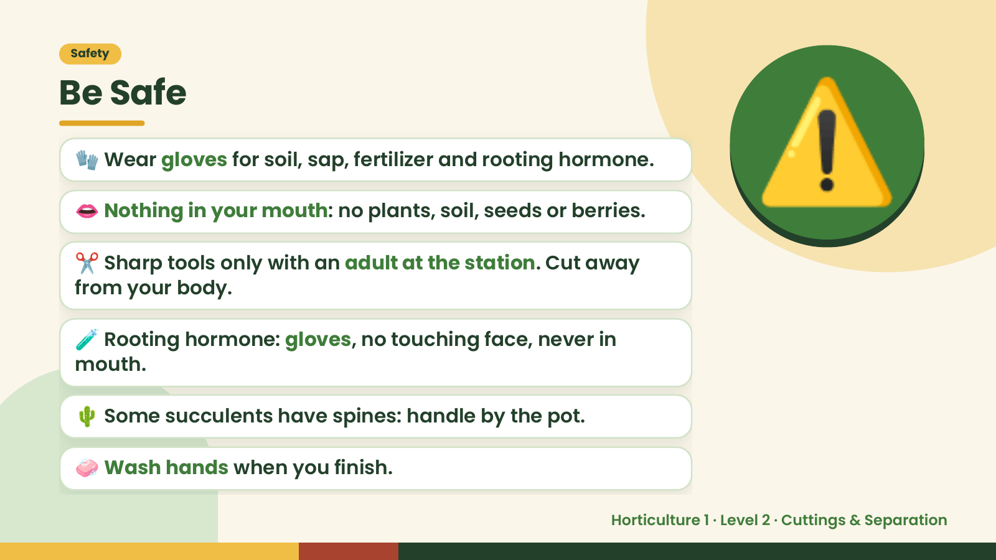
Notes:
Safety
Be Safe
🧤 Wear gloves for soil, sap, fertilizer and rooting hormone.
👄 Nothing in your mouth: no plants, soil, seeds or berries.
✂️ Sharp tools only with an adult at the station. Cut away
from your body.
⚠️
🧪 Rooting hormone: gloves, no touching face, never in
mouth.
🌵 Some succulents have spines: handle by the pot.
🧼 Wash hands when you finish.
Horticulture 1 · Level 2 · Cuttings & Separation

Slide 4
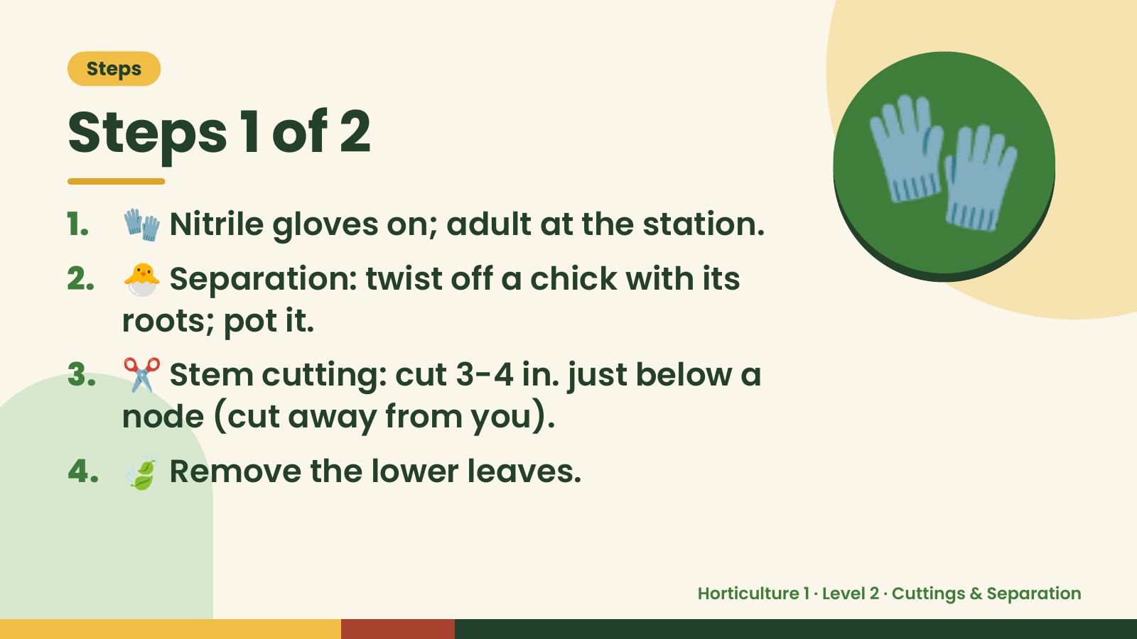
Notes:
Steps
Steps 1 of 2
1. 🧤 Nitrile gloves on; adult at the station.
2. 🐣 Separation: twist off a chick with its
roots; pot it.
🧤
3. ✂️ Stem cutting: cut 3-4 in. just below a
node (cut away from you).
4. 🍃 Remove the lower leaves.
Horticulture 1 · Level 2 · Cuttings & Separation

Slide 5
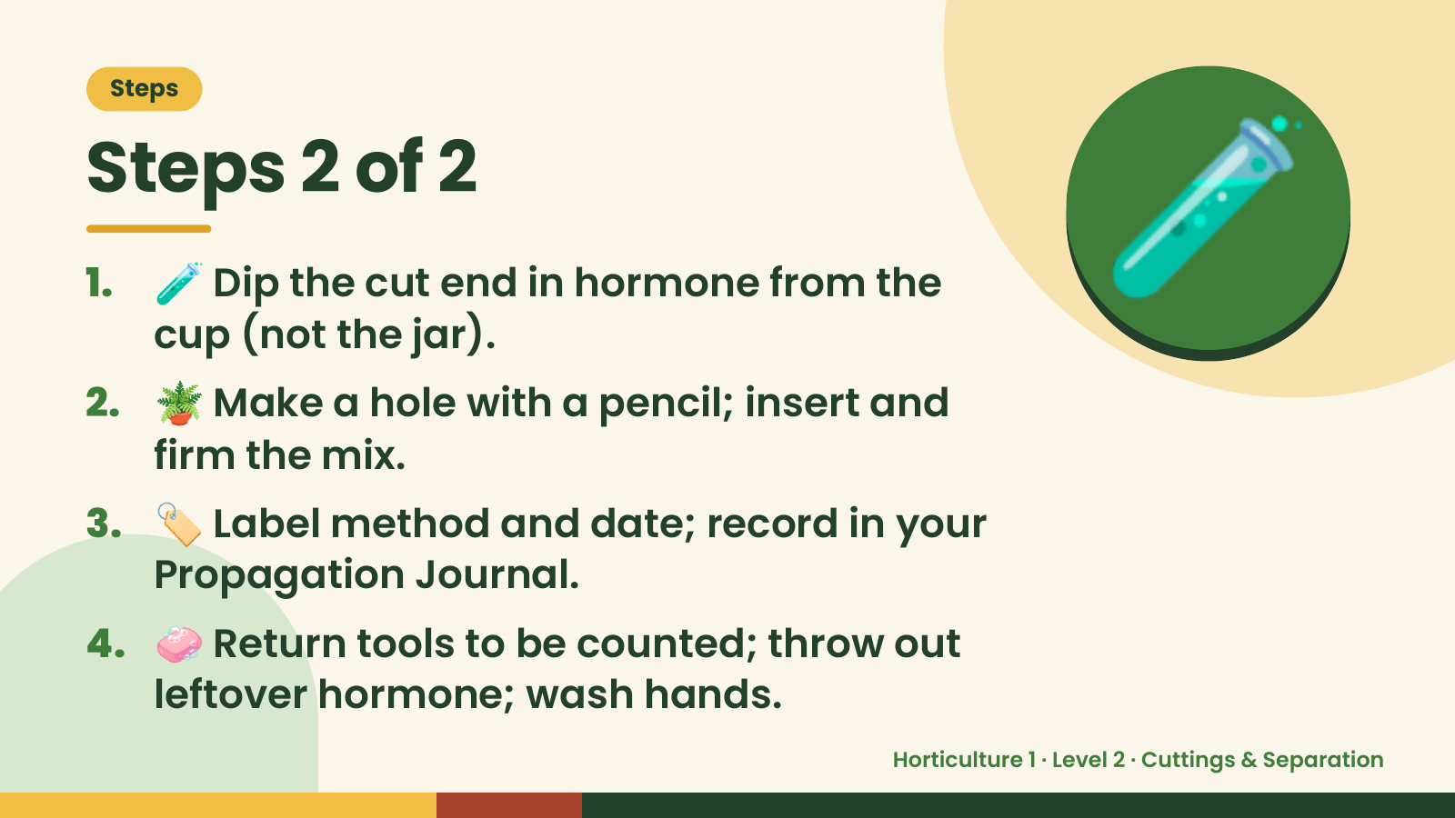
Notes:
Steps
Steps 2 of 2
1. 🧪 Dip the cut end in hormone from the
cup (not the jar).
2. 🪴 Make a hole with a pencil; insert and
firm the mix.
🧪
3. 🏷️ Label method and date; record in your
Propagation Journal.
4. 🧼 Return tools to be counted; throw out
leftover hormone; wash hands.
Horticulture 1 · Level 2 · Cuttings & Separation

Slide 6
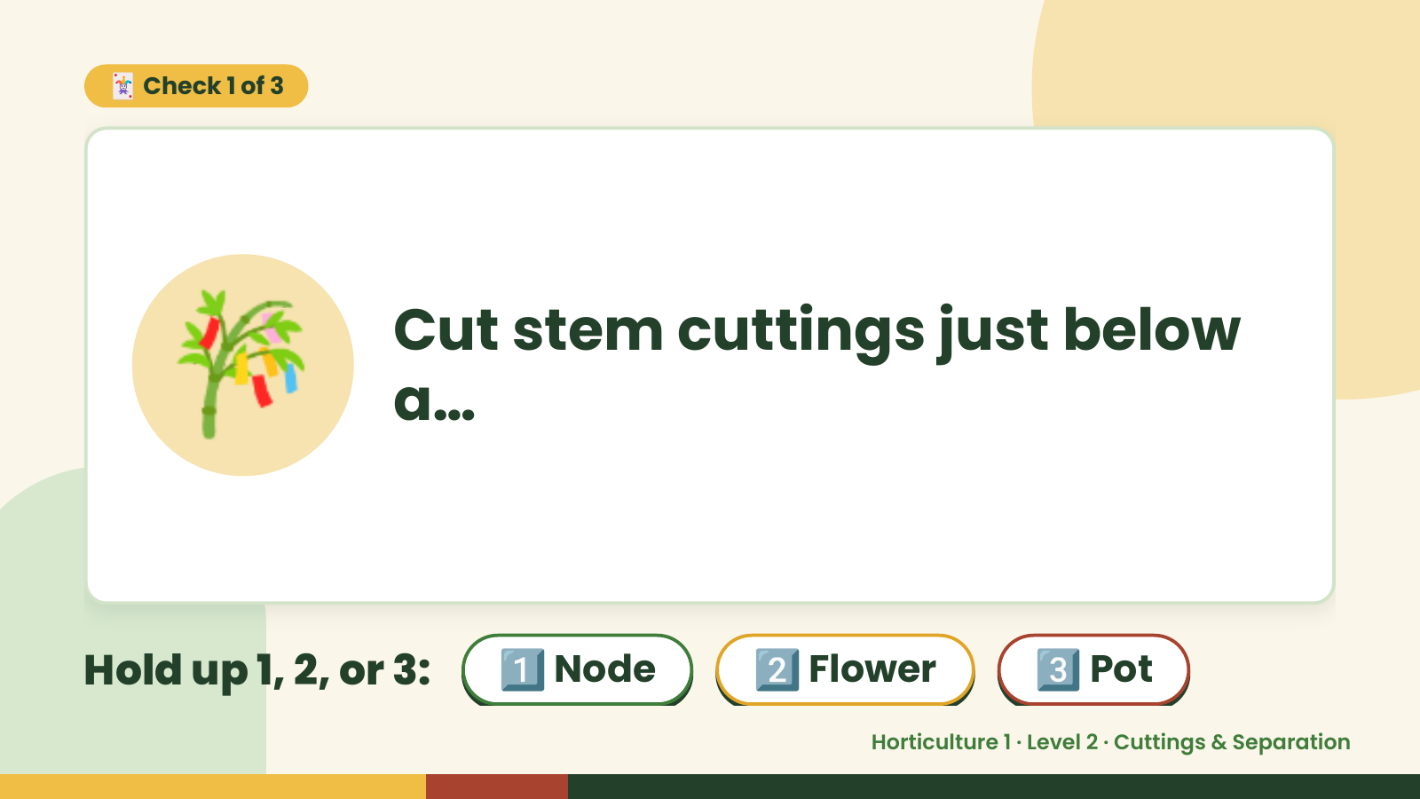
Notes:
🃏 Check 1 of 3
🎋 Cut stem cuttings just below
a…
Hold up 1, 2, or 3: 1️⃣ Node 2️⃣ Flower 3️⃣ Pot
Horticulture 1 · Level 2 · Cuttings & Separation

Slide 7
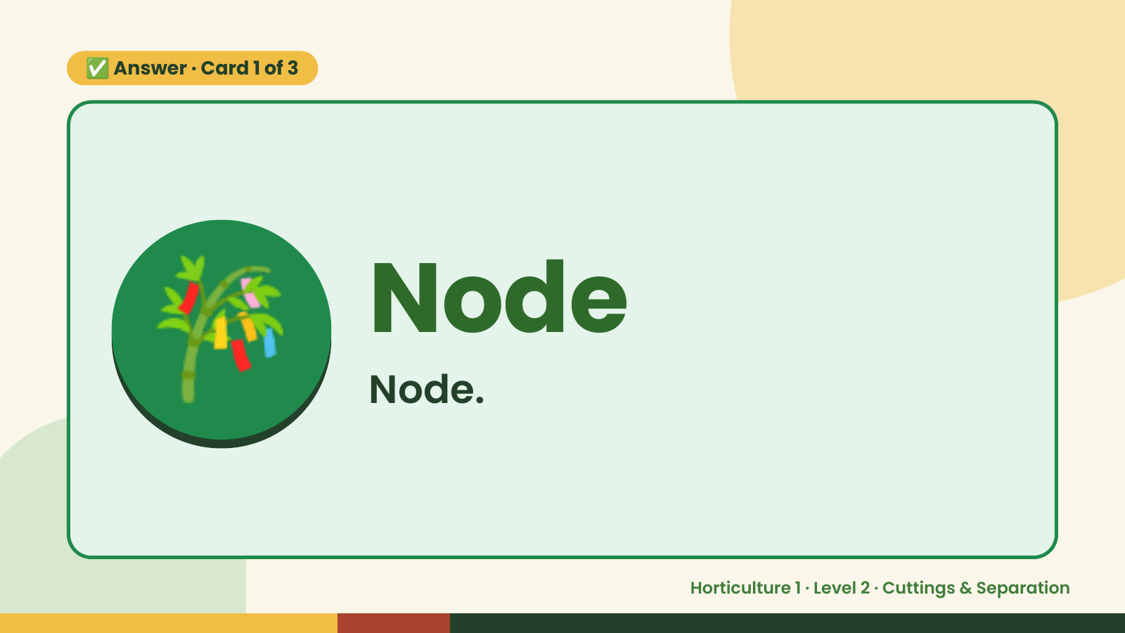
Notes:
✅ Answer · Card 1 of 3
🎋 Node
Node.
Horticulture 1 · Level 2 · Cuttings & Separation

Slide 8
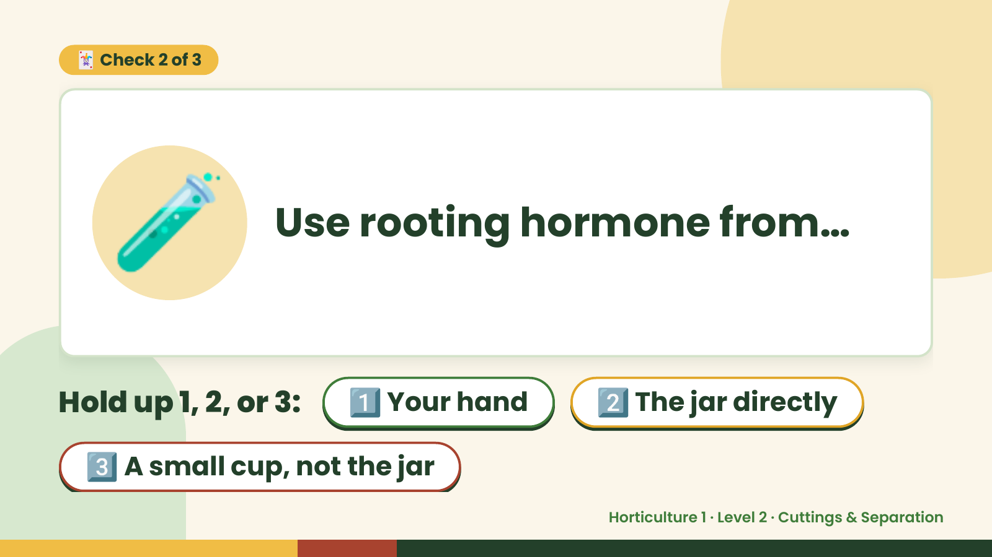
Notes:
🃏 Check 2 of 3
🧪 Use rooting hormone from…
Hold up 1, 2, or 3: 1️⃣ Your hand 2️⃣ The jar directly
3️⃣ A small cup, not the jar
Horticulture 1 · Level 2 · Cuttings & Separation

Slide 9
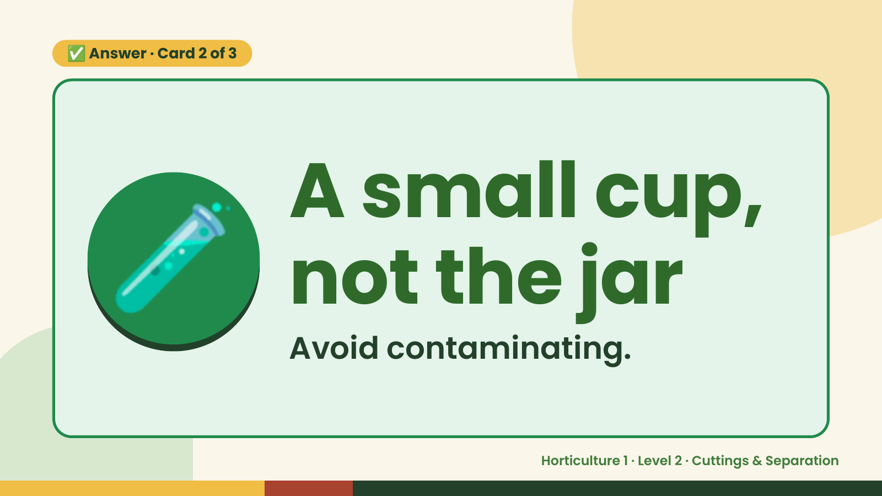
Notes:
✅ Answer · Card 2 of 3
🧪 A small cup,
not the jar
Avoid contaminating.
Horticulture 1 · Level 2 · Cuttings & Separation

Slide 10
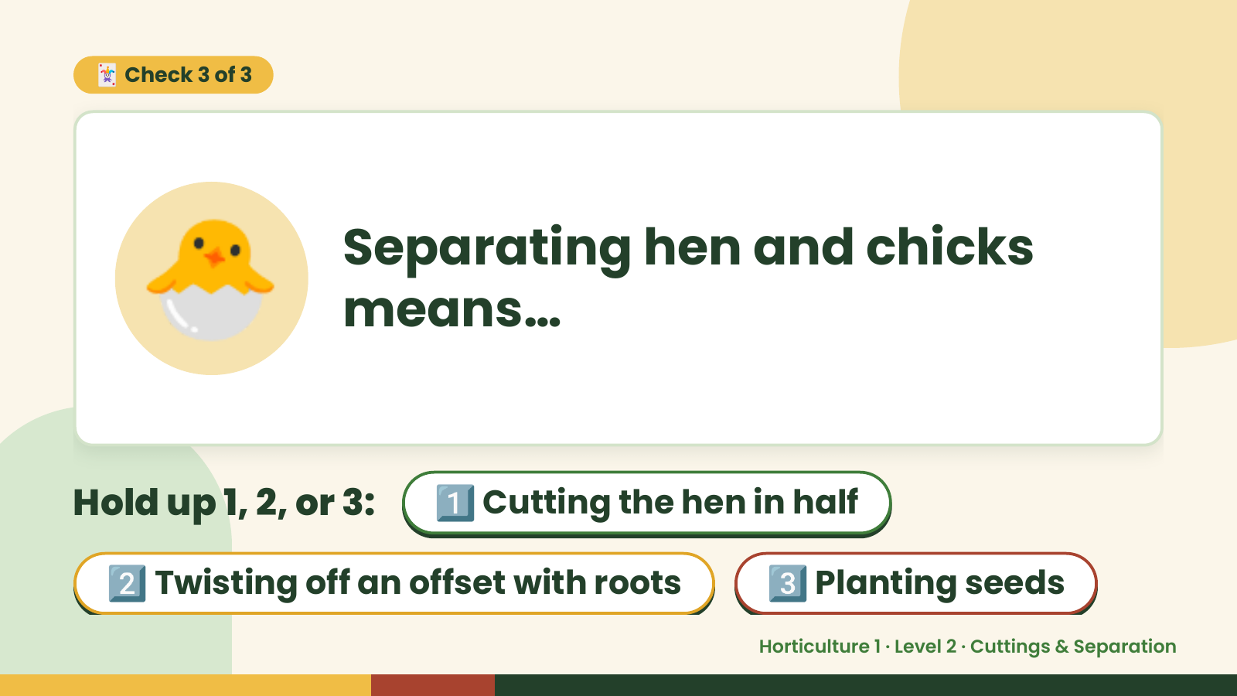
Notes:
🃏 Check 3 of 3
🐣 Separating hen and chicks
means…
Hold up 1, 2, or 3: 1️⃣ Cutting the hen in half
2️⃣ Twisting off an offset with roots 3️⃣ Planting seeds
Horticulture 1 · Level 2 · Cuttings & Separation

Slide 11
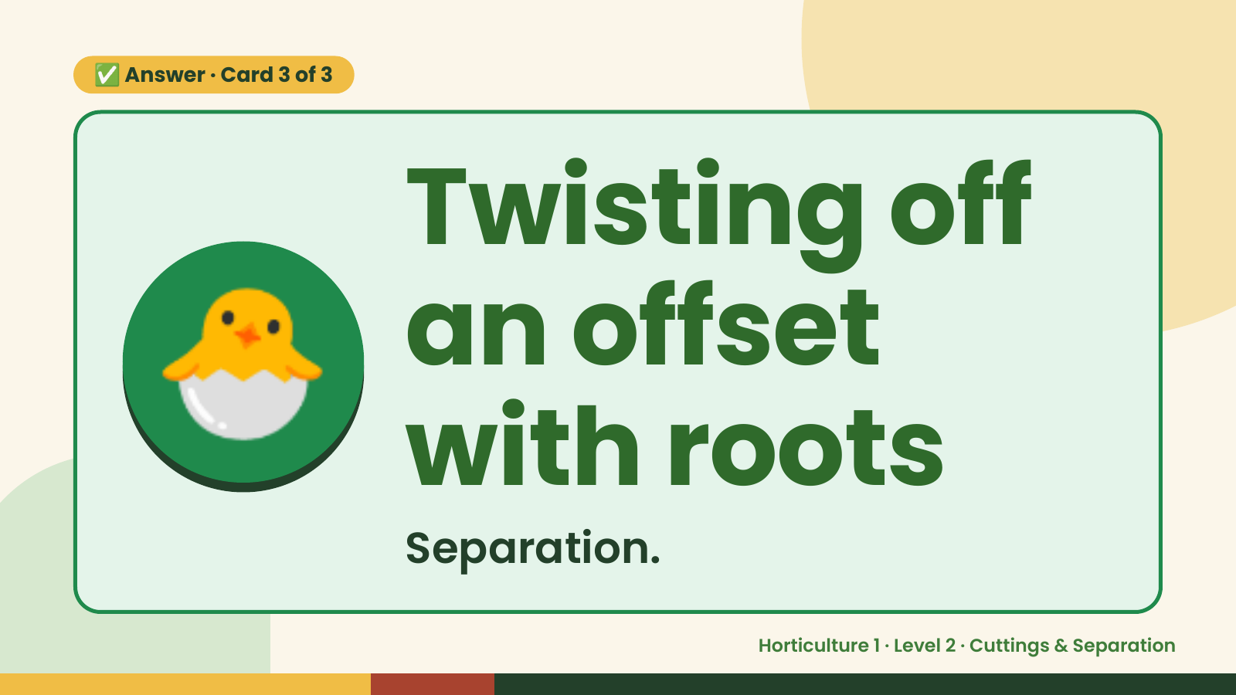
Notes:
✅ Answer · Card 3 of 3
🐣 Twisting off
an offset
with roots
Separation.
Horticulture 1 · Level 2 · Cuttings & Separation

Slide 12

Notes:
Wrap-Up
Clean Up +
Reflect
🧽
Return and count tools.
Sweep and wipe your area.
Wash hands, then do the reflection.
Horticulture 1 · Level 2 · Cuttings & Separation

