Slide 1
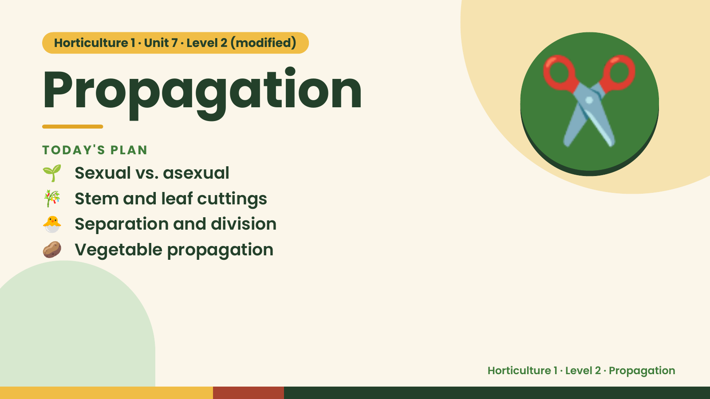
Notes:
Horticulture 1 · Unit 7 · Level 2 (modified)
Propagation
🌱 Sexual vs. asexual
TODAY'S PLAN
🎋 Stem and leaf cuttings
🐣 Separation and division
✂️
🥔 Vegetable propagation
Horticulture 1 · Level 2 · Propagation

Slide 2
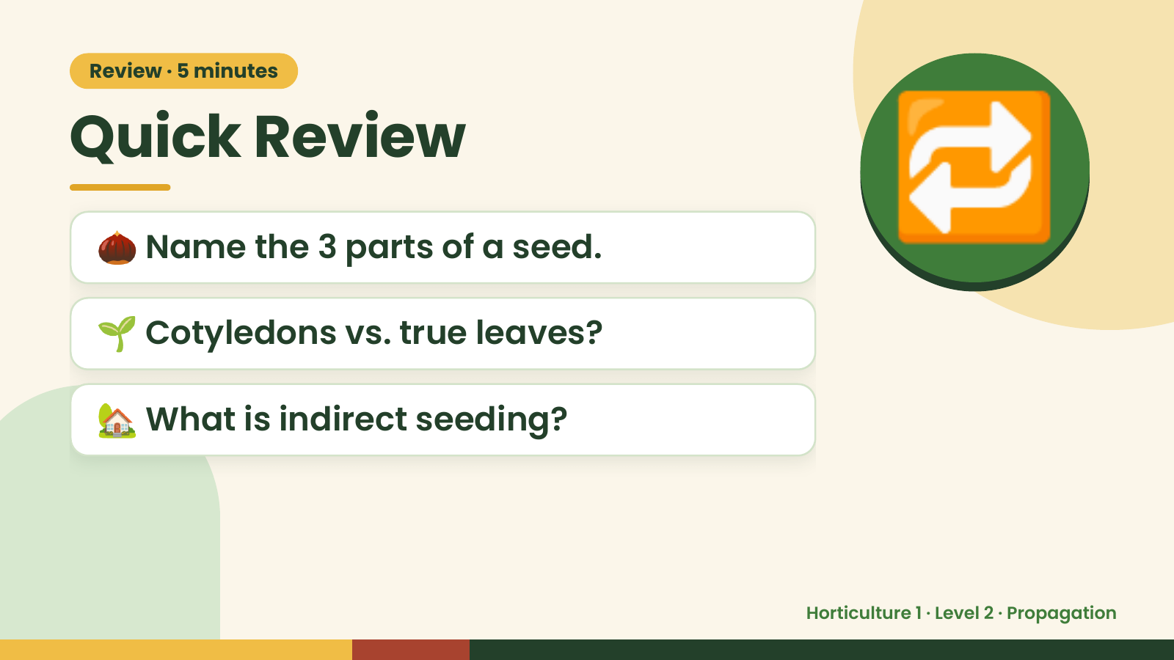
Notes:
Review · 5 minutes
Quick Review
🌰 Name the 3 parts of a seed.
🌱 Cotyledons vs. true leaves?
🔁
🏡 What is indirect seeding?
Horticulture 1 · Level 2 · Propagation

Slide 3
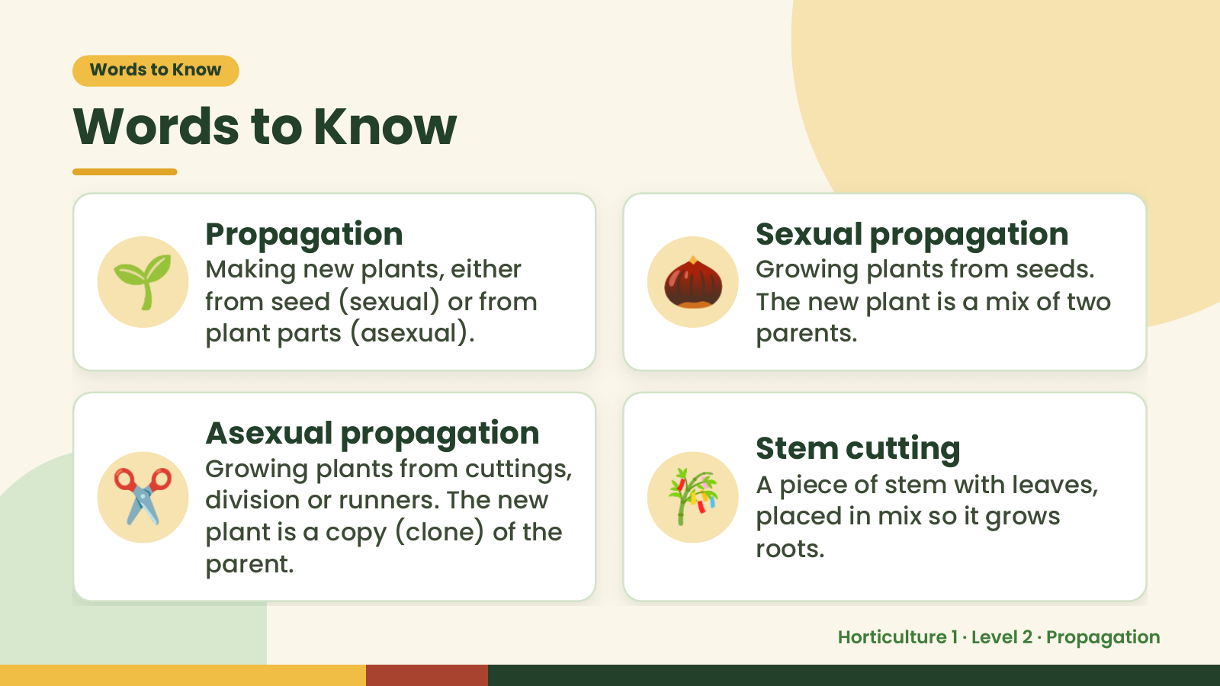
Notes:
Words to Know
Words to Know
🌱 Propagation
Making new plants, either
from seed (sexual) or from
plant parts (asexual).
🌰 Sexual propagation
Growing plants from seeds.
The new plant is a mix of two
parents.
✂️ 🎋
Asexual propagation Stem cutting
Growing plants from cuttings,
A piece of stem with leaves,
division or runners. The new
placed in mix so it grows
plant is a copy (clone) of the
roots.
parent.
Horticulture 1 · Level 2 · Propagation

Slide 4
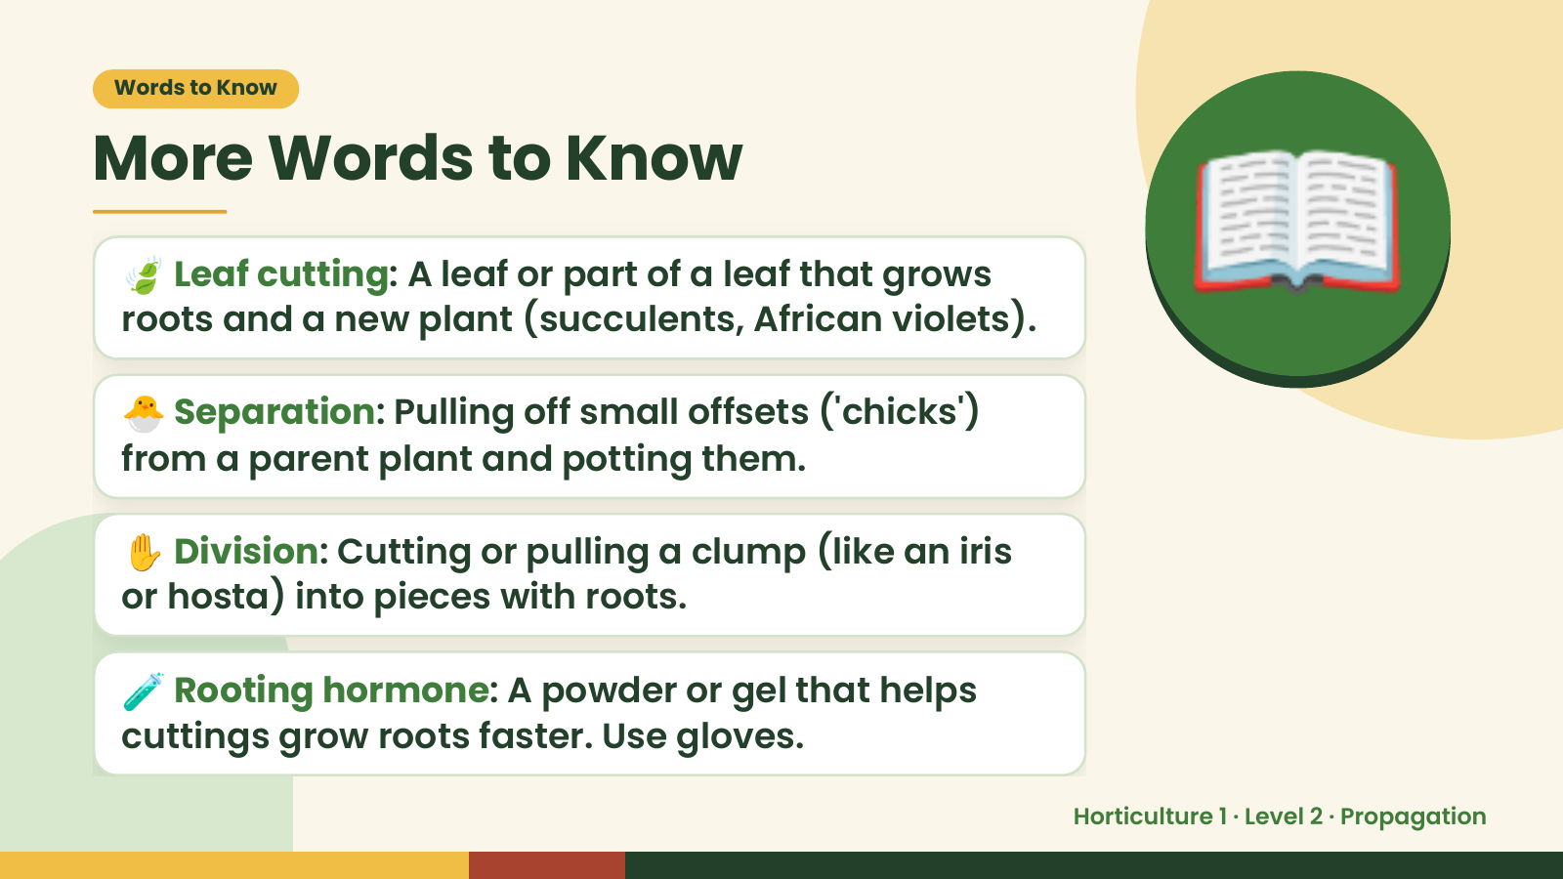
Notes:
Words to Know
More Words to Know
🍃 Leaf cutting: A leaf or part of a leaf that grows
roots and a new plant (succulents, African violets).
🐣 Separation: Pulling off small offsets ('chicks')
from a parent plant and potting them.
📖
✋ Division: Cutting or pulling a clump (like an iris
or hosta) into pieces with roots.
🧪 Rooting hormone: A powder or gel that helps
cuttings grow roots faster. Use gloves.
Horticulture 1 · Level 2 · Propagation

Slide 5
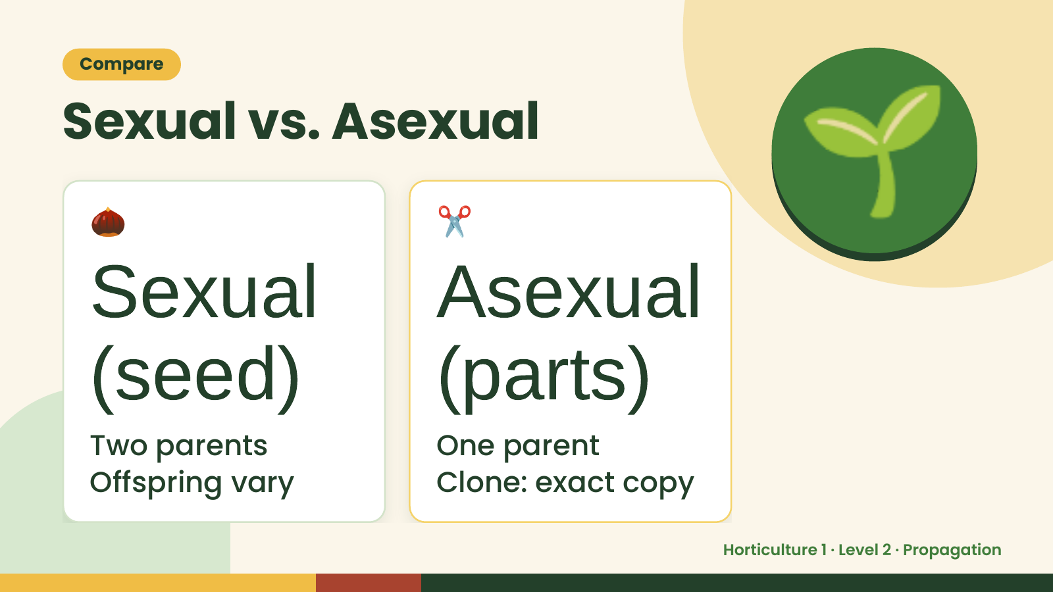
Notes:
Compare
Sexual vs. Asexual
🌰
Sexual
✂️
Asexual
🌱
(seed)
Two parents
(parts)
One parent
Offspring vary Clone: exact copy
Horticulture 1 · Level 2 · Propagation

Slide 6
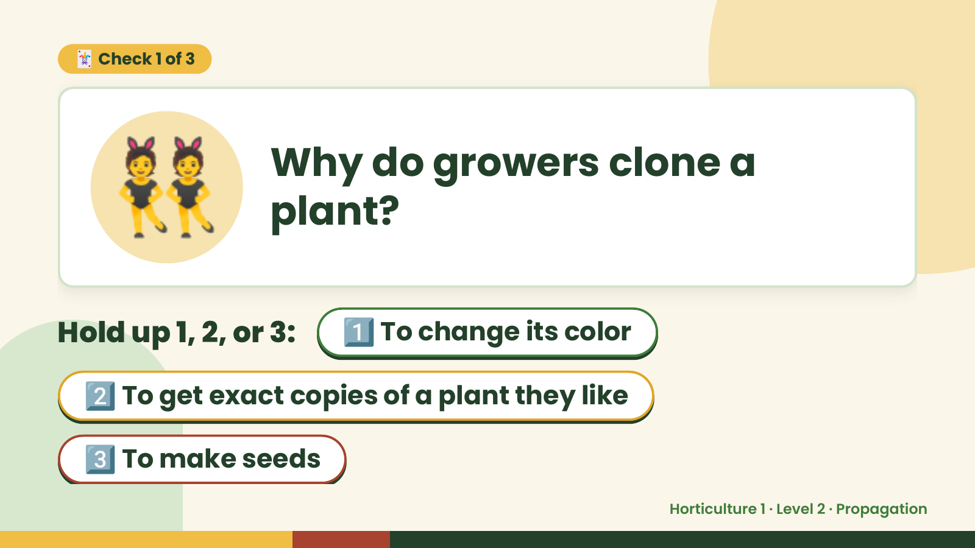
Notes:
👯
🃏 Check 1 of 3
Why do growers clone a
plant?
Hold up 1, 2, or 3: 1️⃣ To change its color
2️⃣ To get exact copies of a plant they like
3️⃣ To make seeds
Horticulture 1 · Level 2 · Propagation

Slide 7
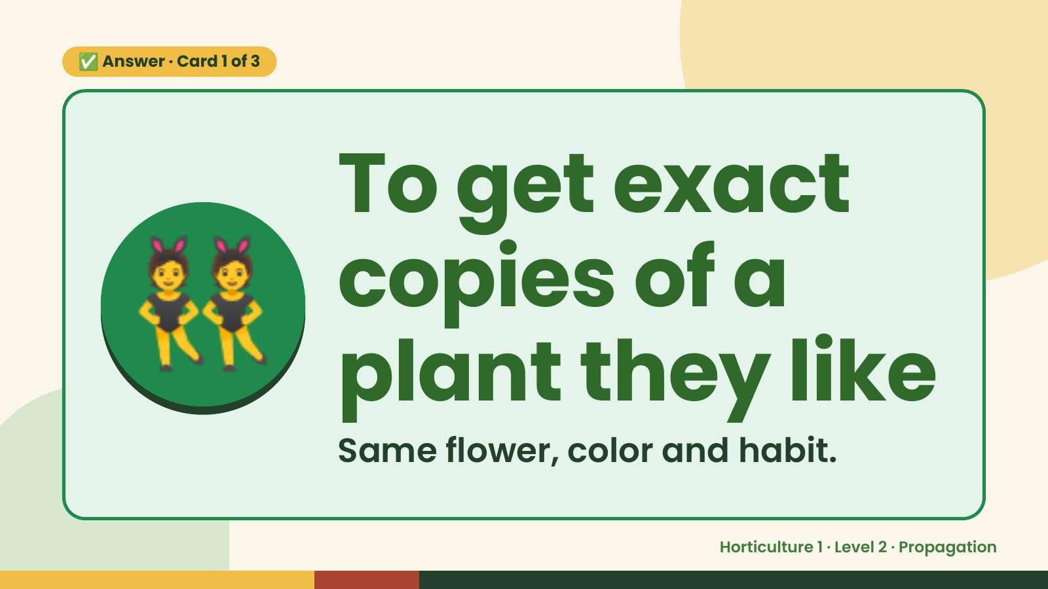
Notes:
✅ Answer · Card 1 of 3
👯 To get exact
copies of a
plant they like
Same flower, color and habit.
Horticulture 1 · Level 2 · Propagation

Slide 8
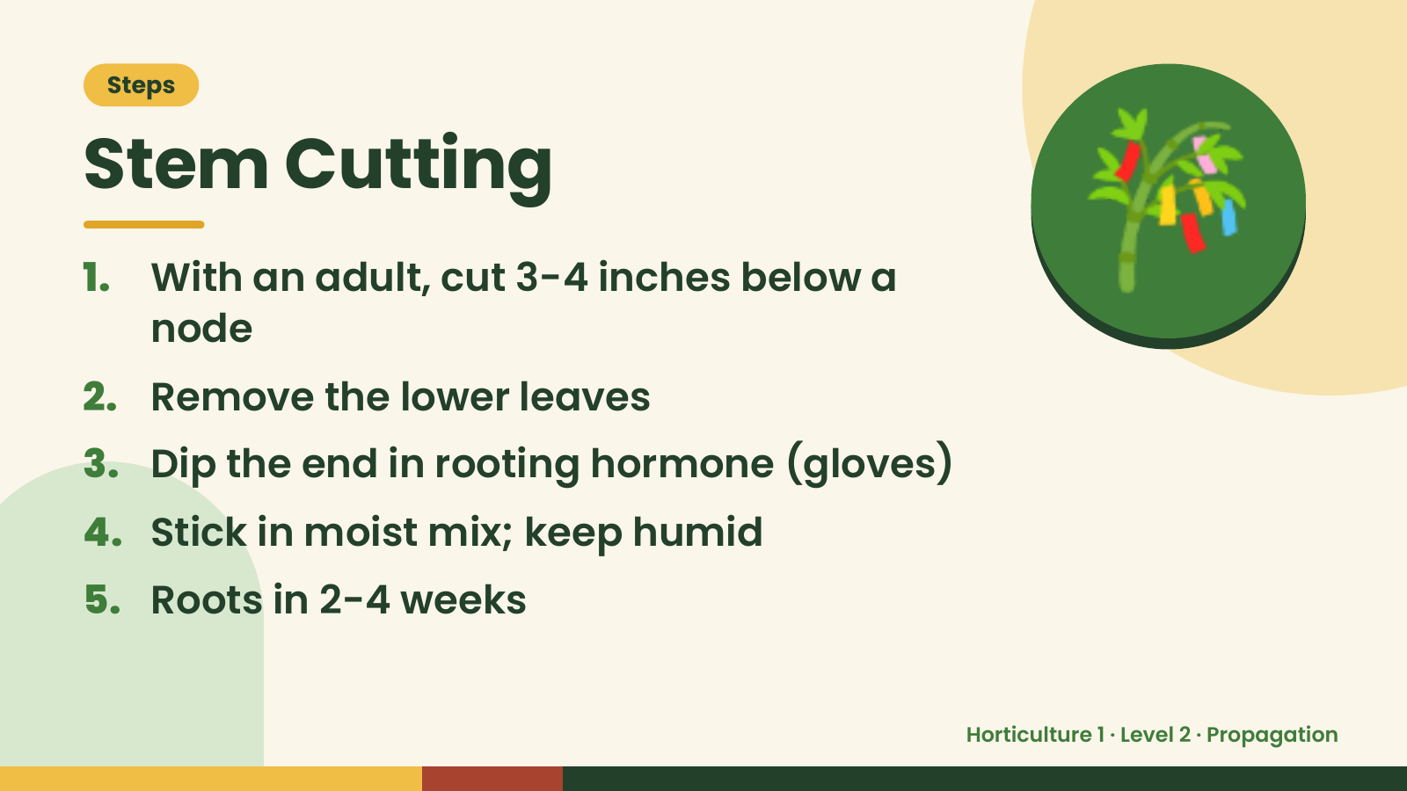
Notes:
Steps
Stem Cutting
1. With an adult, cut 3-4 inches below a
node
2. Remove the lower leaves
🎋
3. Dip the end in rooting hormone (gloves)
4. Stick in moist mix; keep humid
5. Roots in 2-4 weeks
Horticulture 1 · Level 2 · Propagation

Slide 9
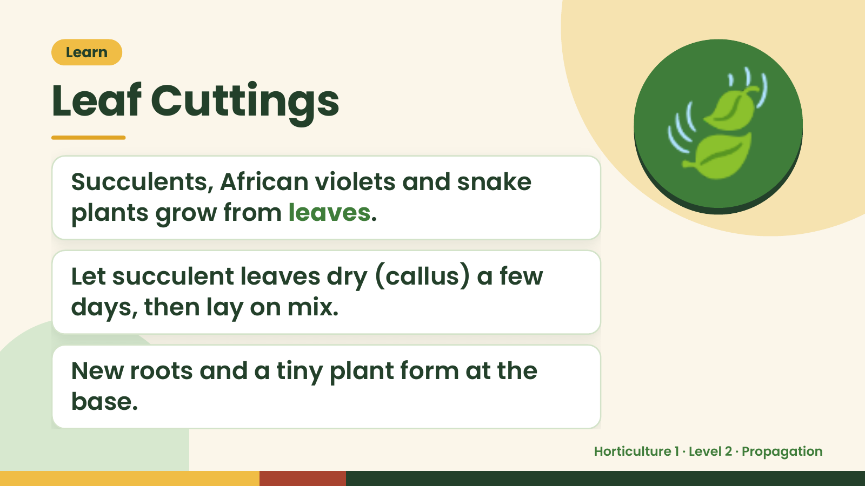
Notes:
Learn
Leaf Cuttings
Succulents, African violets and snake
plants grow from leaves.
🍃
Let succulent leaves dry (callus) a few
days, then lay on mix.
New roots and a tiny plant form at the
base.
Horticulture 1 · Level 2 · Propagation

Slide 10
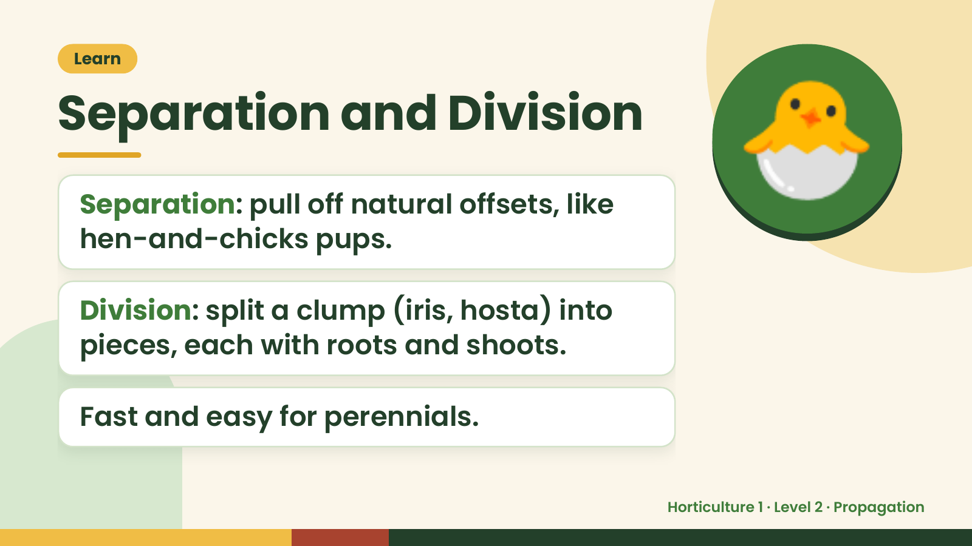
Notes:
Learn
Separation and Division
Separation: pull off natural offsets, like
hen-and-chicks pups.
🐣
Division: split a clump (iris, hosta) into
pieces, each with roots and shoots.
Fast and easy for perennials.
Horticulture 1 · Level 2 · Propagation

Slide 11
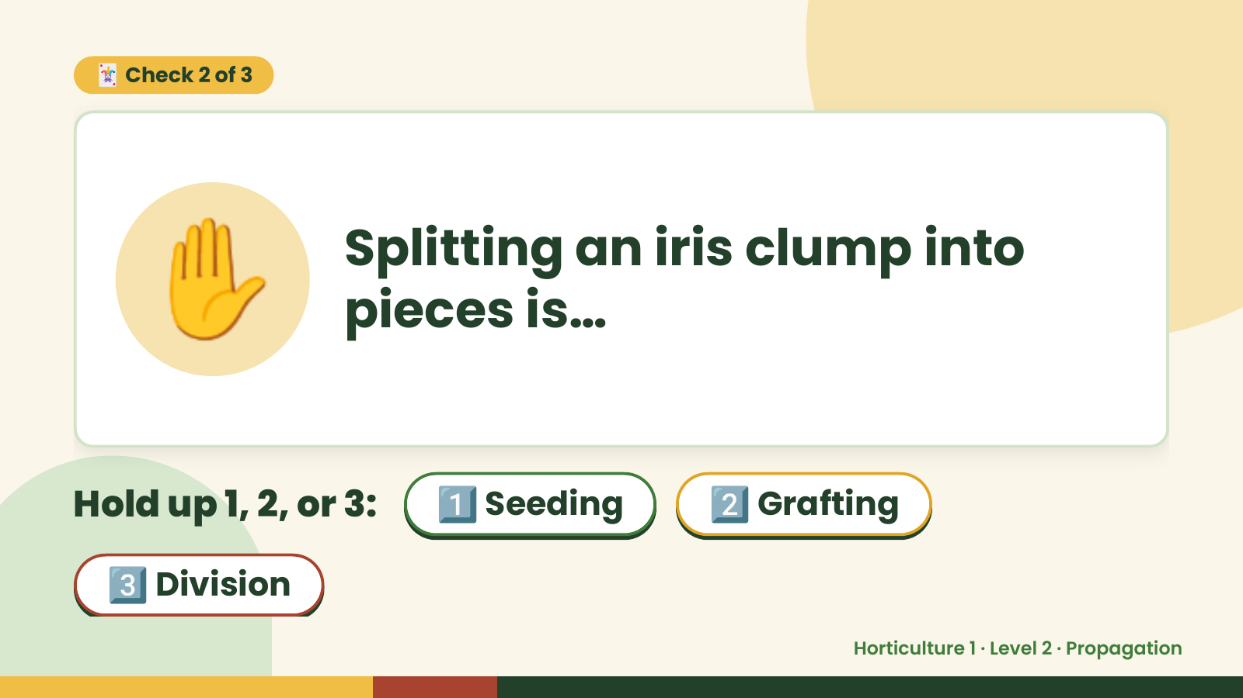
Notes:
🃏 Check 2 of 3
✋ Splitting an iris clump into
pieces is…
Hold up 1, 2, or 3: 1️⃣ Seeding 2️⃣ Grafting
3️⃣ Division
Horticulture 1 · Level 2 · Propagation

Slide 12
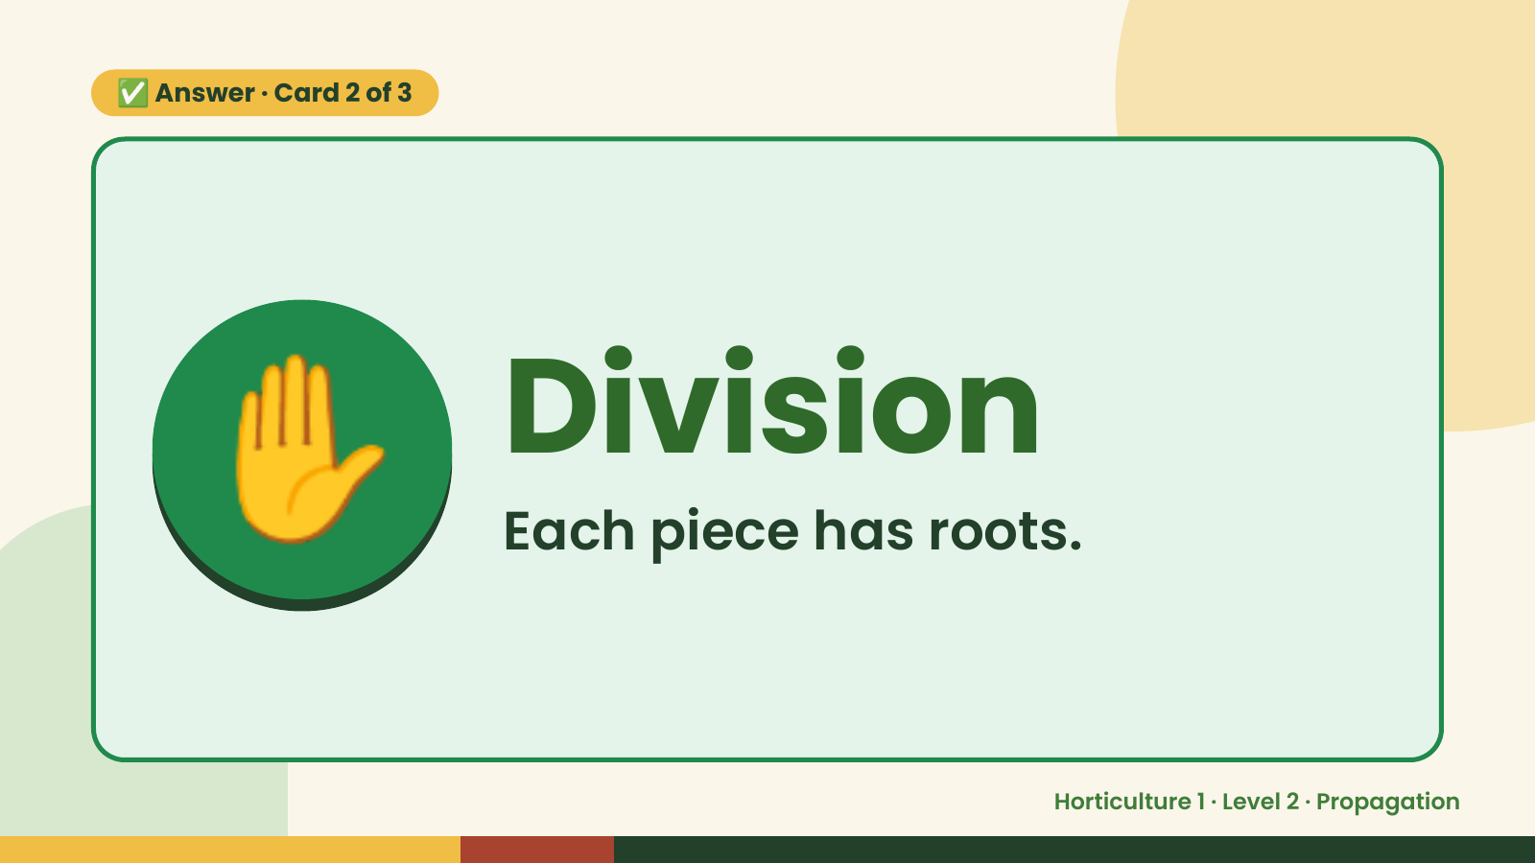
Notes:
✅ Answer · Card 2 of 3
✋ Division
Each piece has roots.
Horticulture 1 · Level 2 · Propagation

Slide 13
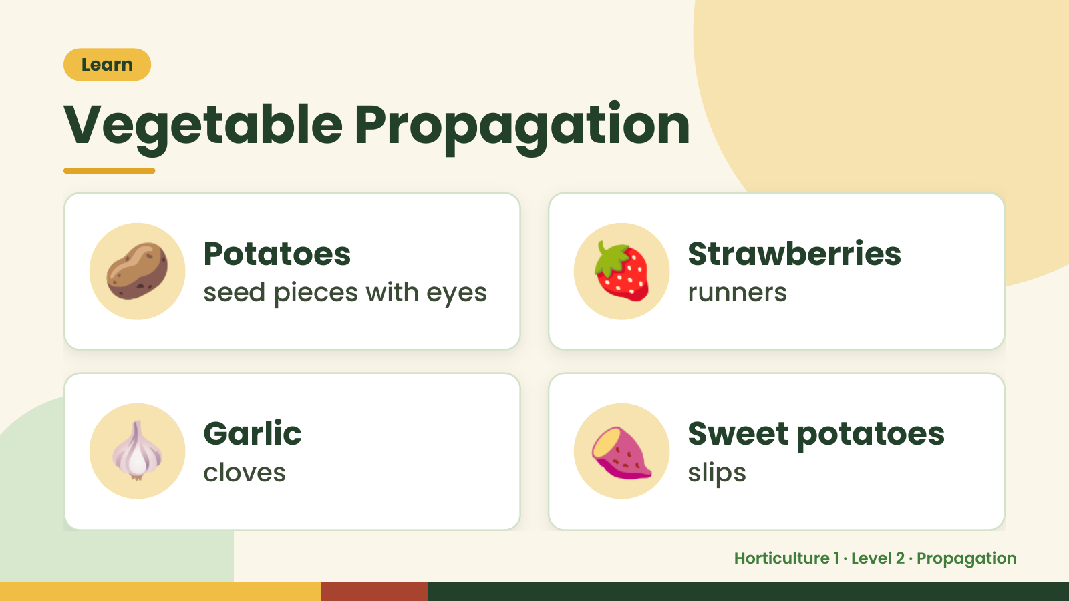
Notes:
Learn
Vegetable Propagation
🥔 Potatoes
seed pieces with eyes 🍓 Strawberries
runners
🧄 Garlic
cloves 🍠 Sweet potatoes
slips
Horticulture 1 · Level 2 · Propagation

Slide 14
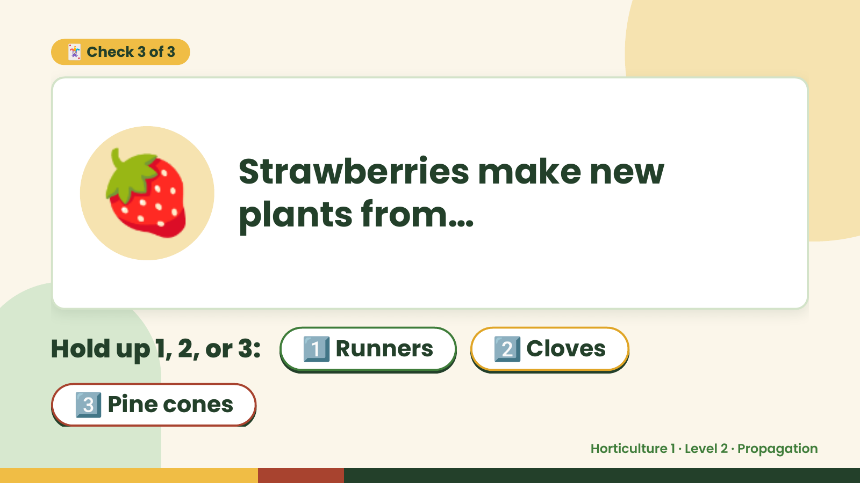
Notes:
🃏 Check 3 of 3
🍓 Strawberries make new
plants from…
Hold up 1, 2, or 3: 1️⃣ Runners 2️⃣ Cloves
3️⃣ Pine cones
Horticulture 1 · Level 2 · Propagation

Slide 15
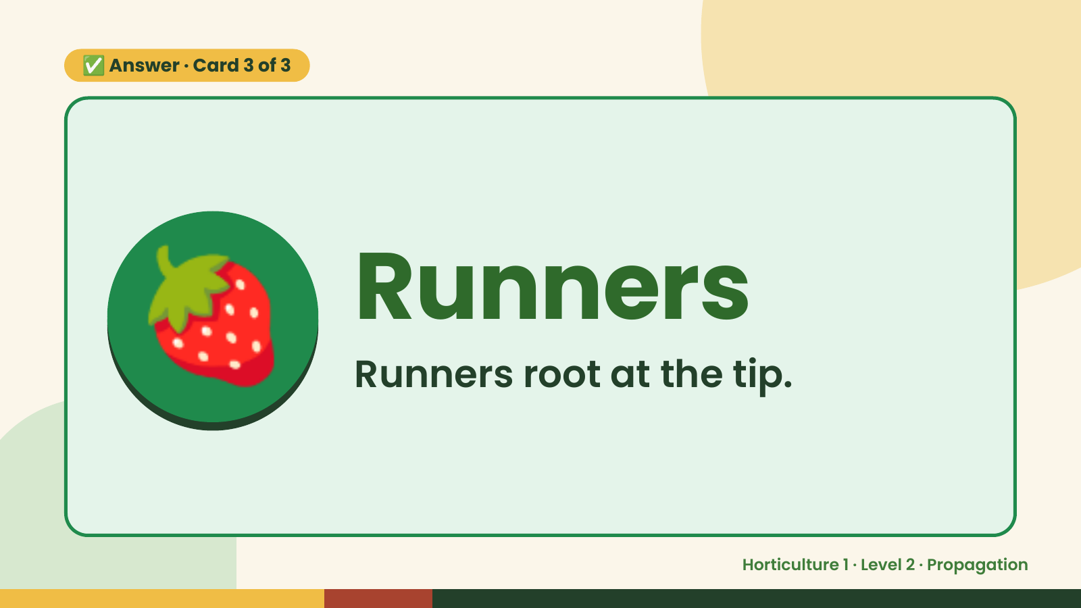
Notes:
✅ Answer · Card 3 of 3
🍓 Runners
Runners root at the tip.
Horticulture 1 · Level 2 · Propagation

Slide 16
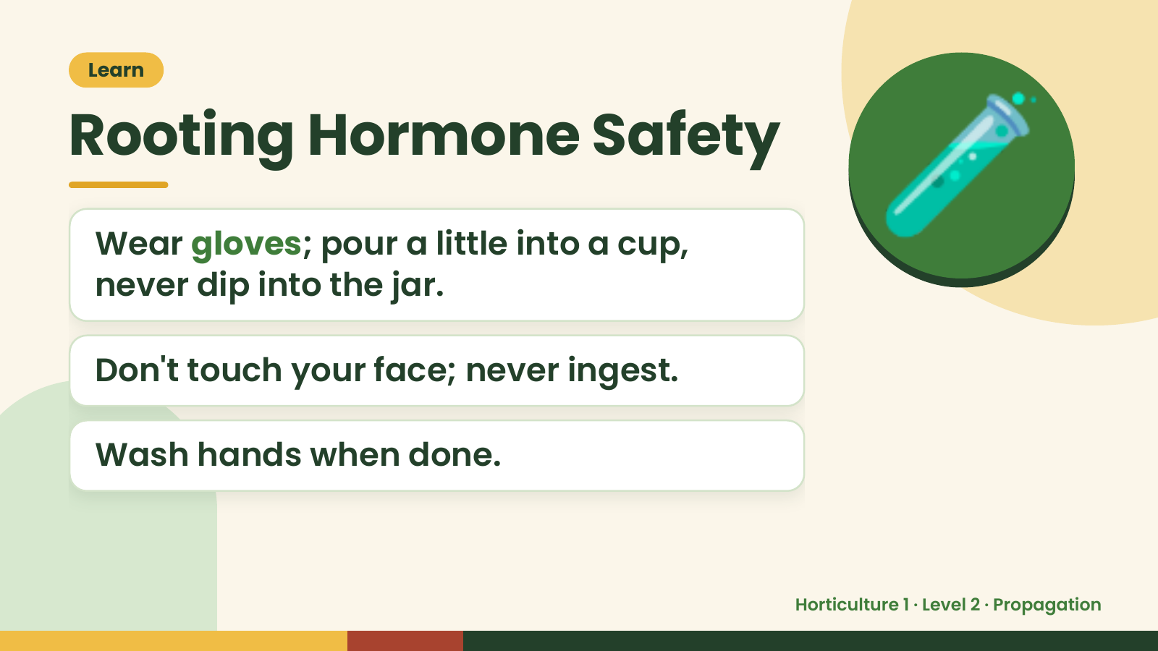
Notes:
Learn
Rooting Hormone Safety
Wear gloves; pour a little into a cup,
never dip into the jar.
🧪
Don't touch your face; never ingest.
Wash hands when done.
Horticulture 1 · Level 2 · Propagation

Slide 17
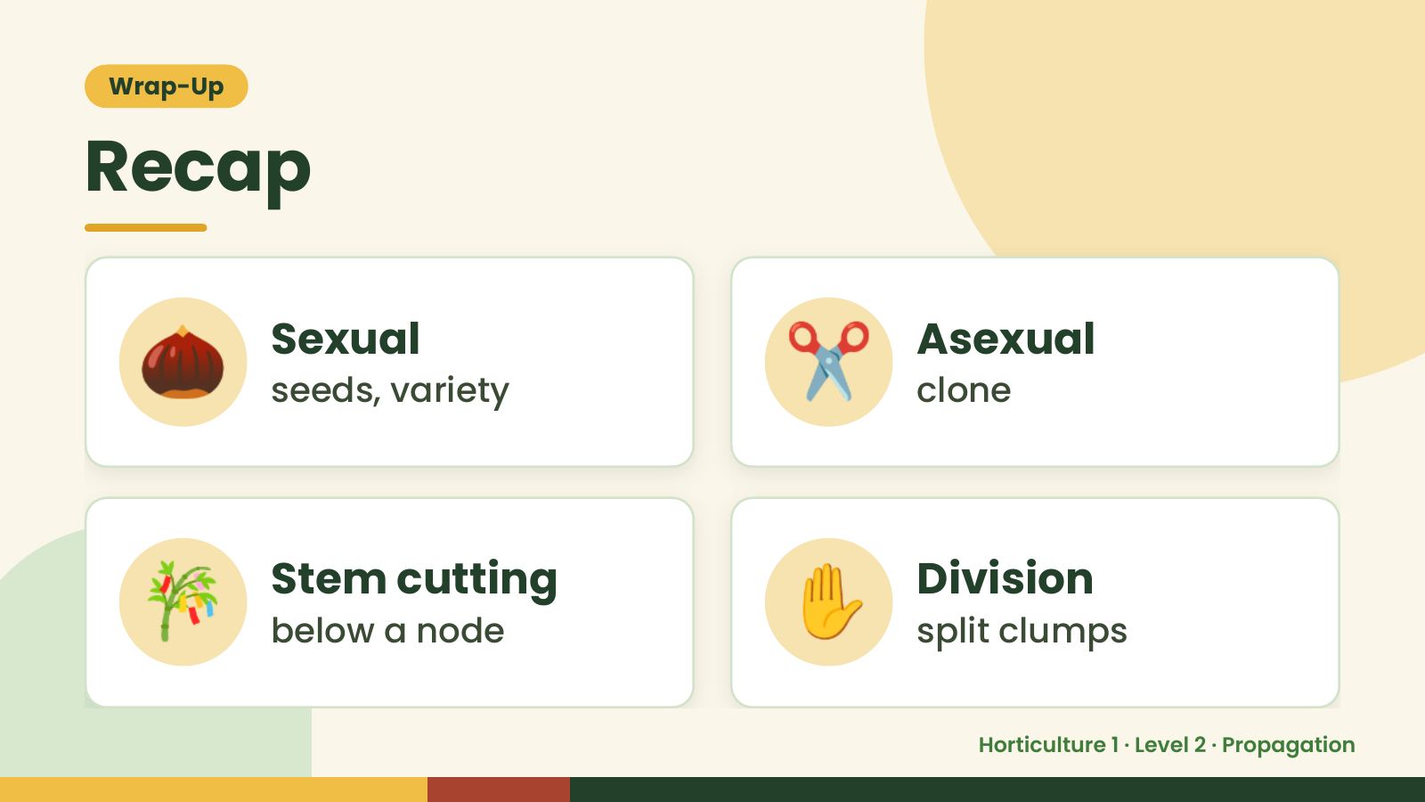
Notes:
Wrap-Up
Recap
🌰 Sexual
seeds, variety ✂️ Asexual
clone
🎋 Stem cutting
below a node ✋ Division
split clumps
Horticulture 1 · Level 2 · Propagation

Slide 18
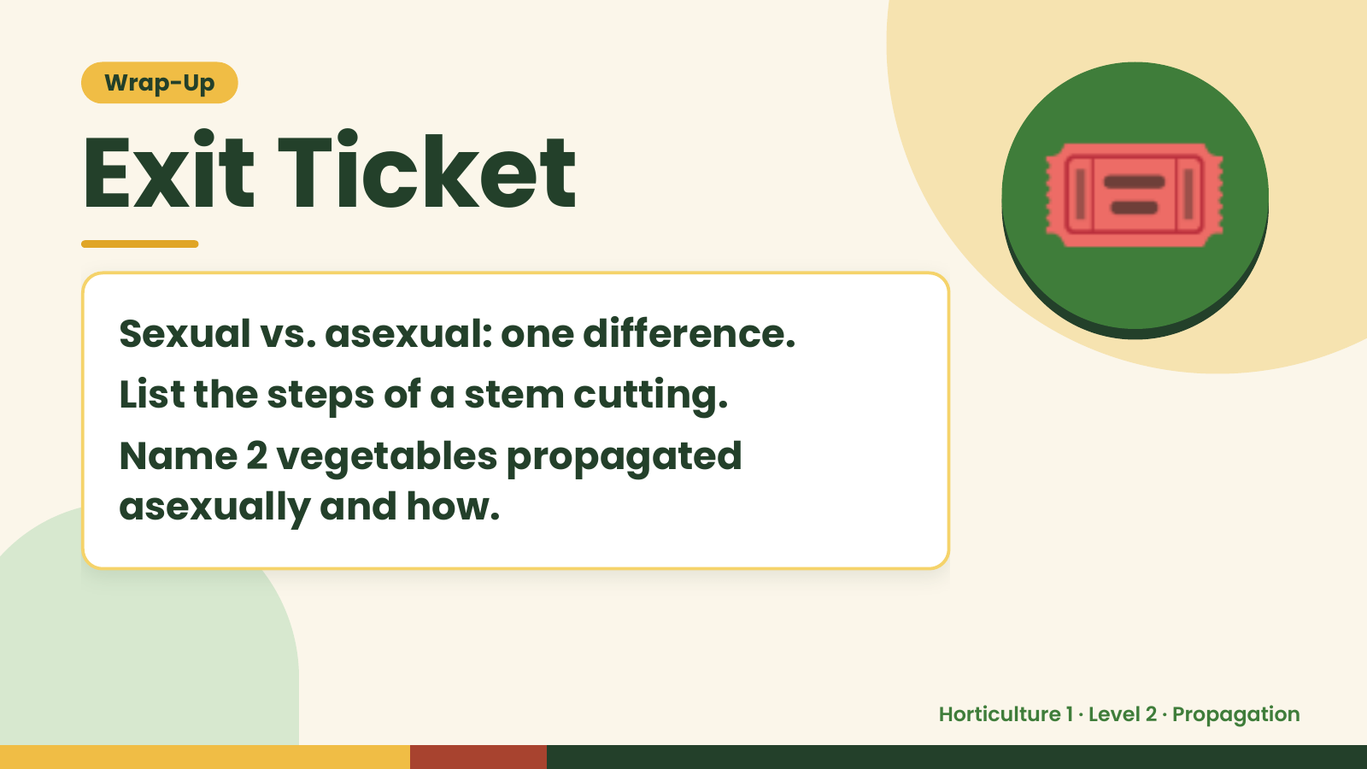
Notes:
Wrap-Up
Exit Ticket
Sexual vs. asexual: one difference.
List the steps of a stem cutting.
🎟️
Name 2 vegetables propagated
asexually and how.
Horticulture 1 · Level 2 · Propagation

