Slide 1
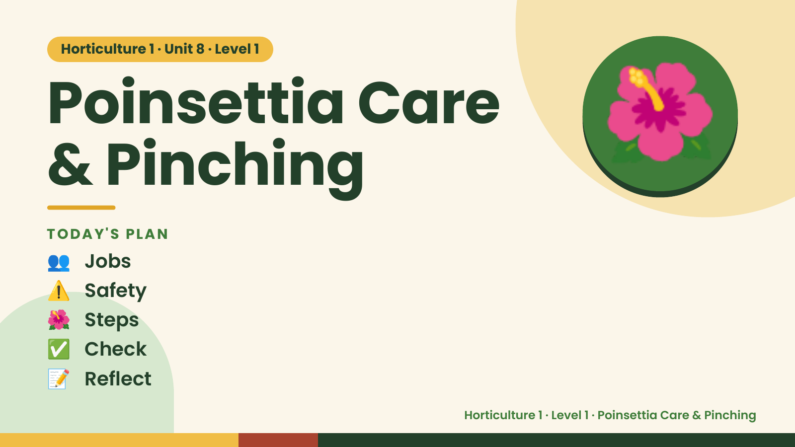
Notes:
Horticulture 1 · Unit 8 · Level 1
Poinsettia Care
& Pinching
TODAY'S PLAN
🌺
👥 Jobs
⚠️ Safety
🌺 Steps
✅ Check
📝 Reflect
Horticulture 1 · Level 1 · Poinsettia Care & Pinching

Slide 2

Notes:
Get ready
Jobs
🧑‍🌾 Grower
plants 🧺 Supply helper
gets tools
📸 Recorder
photos 🧽 Clean-up
captain
cleans
Horticulture 1 · Level 1 · Poinsettia Care & Pinching

Slide 3
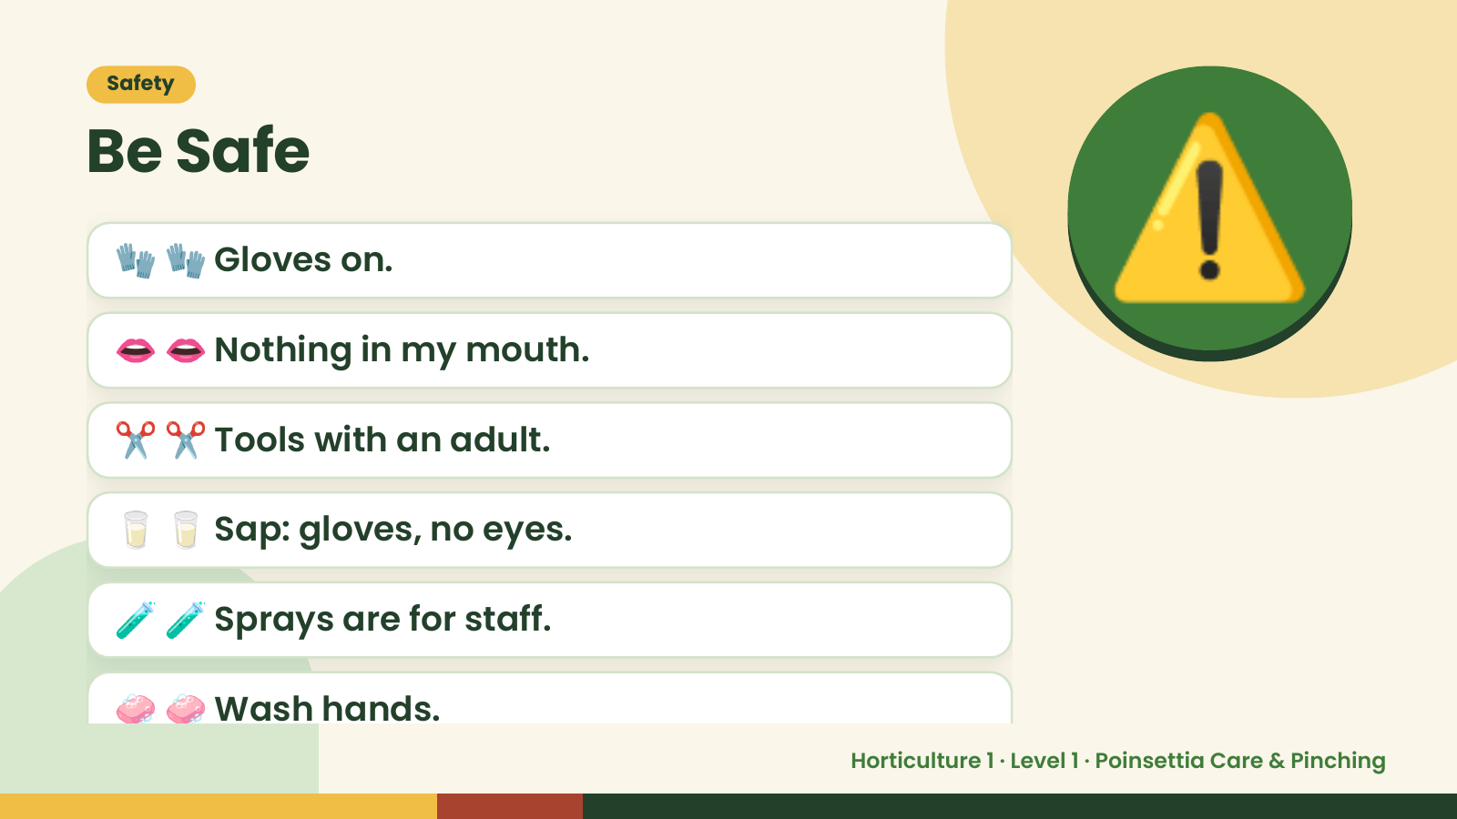
Notes:
Safety
Be Safe
🧤 🧤 Gloves on.
👄 👄 Nothing in my mouth.
✂️ ✂️ Tools with an adult.
⚠️
🥛 🥛 Sap: gloves, no eyes.
🧪 🧪 Sprays are for staff.
🧼 🧼 Wash hands.
Horticulture 1 · Level 1 · Poinsettia Care & Pinching

Slide 4
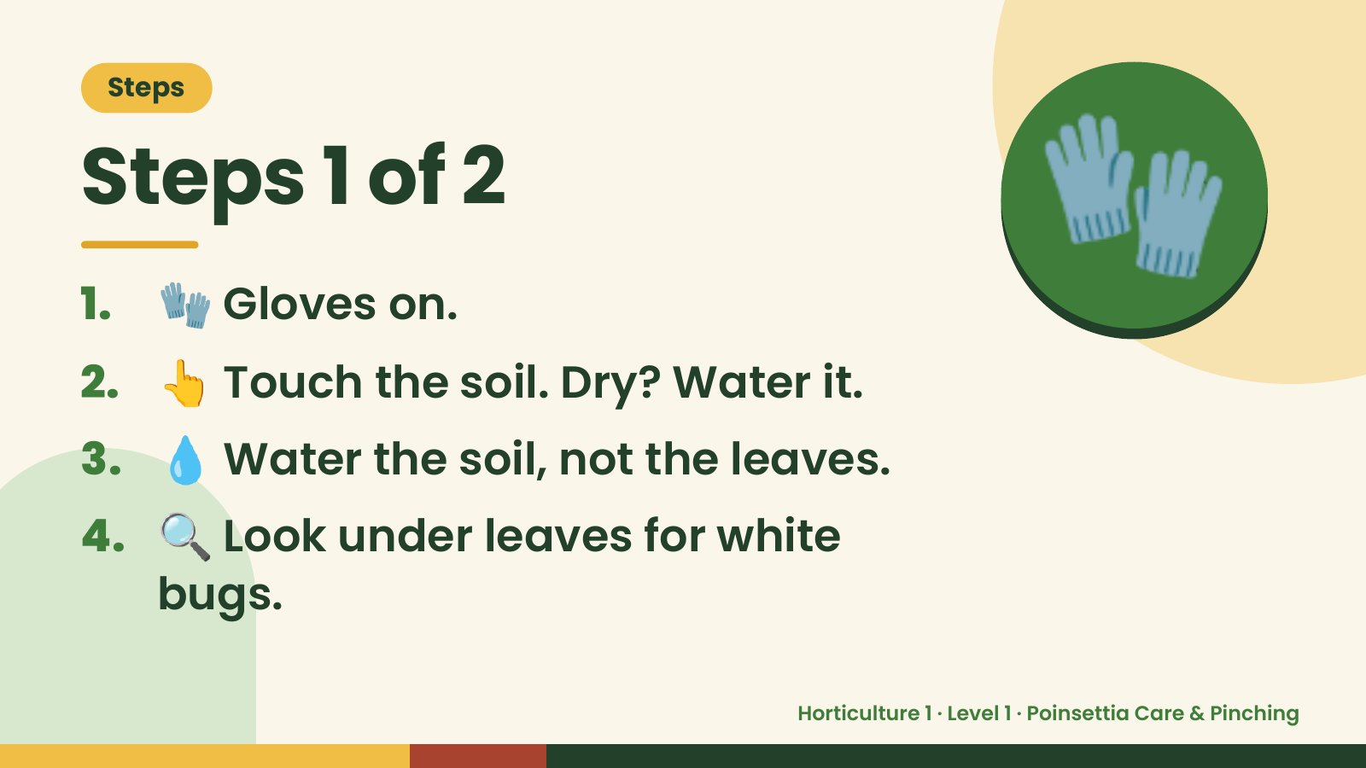
Notes:
Steps
Steps 1 of 2
1. 🧤 Gloves on.
2. 👆 Touch the soil. Dry? Water it.
🧤
3. 💧 Water the soil, not the leaves.
4. 🔍 Look under leaves for white
bugs.
Horticulture 1 · Level 1 · Poinsettia Care & Pinching

Slide 5
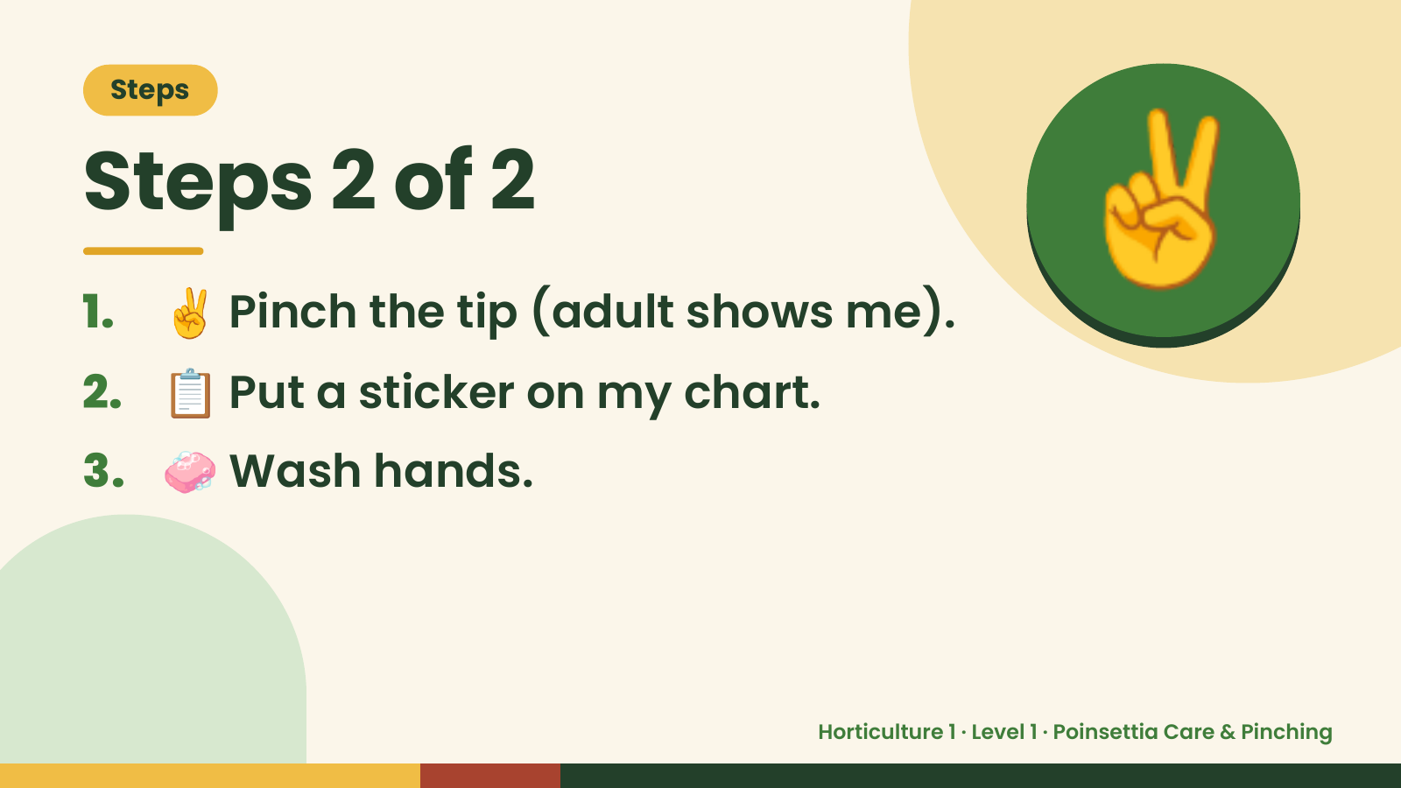
Notes:
Steps
Steps 2 of 2
1. ✌️ Pinch the tip (adult shows me).
2. 📋 Put a sticker on my chart.
✌️
3. 🧼 Wash hands.
Horticulture 1 · Level 1 · Poinsettia Care & Pinching

Slide 6
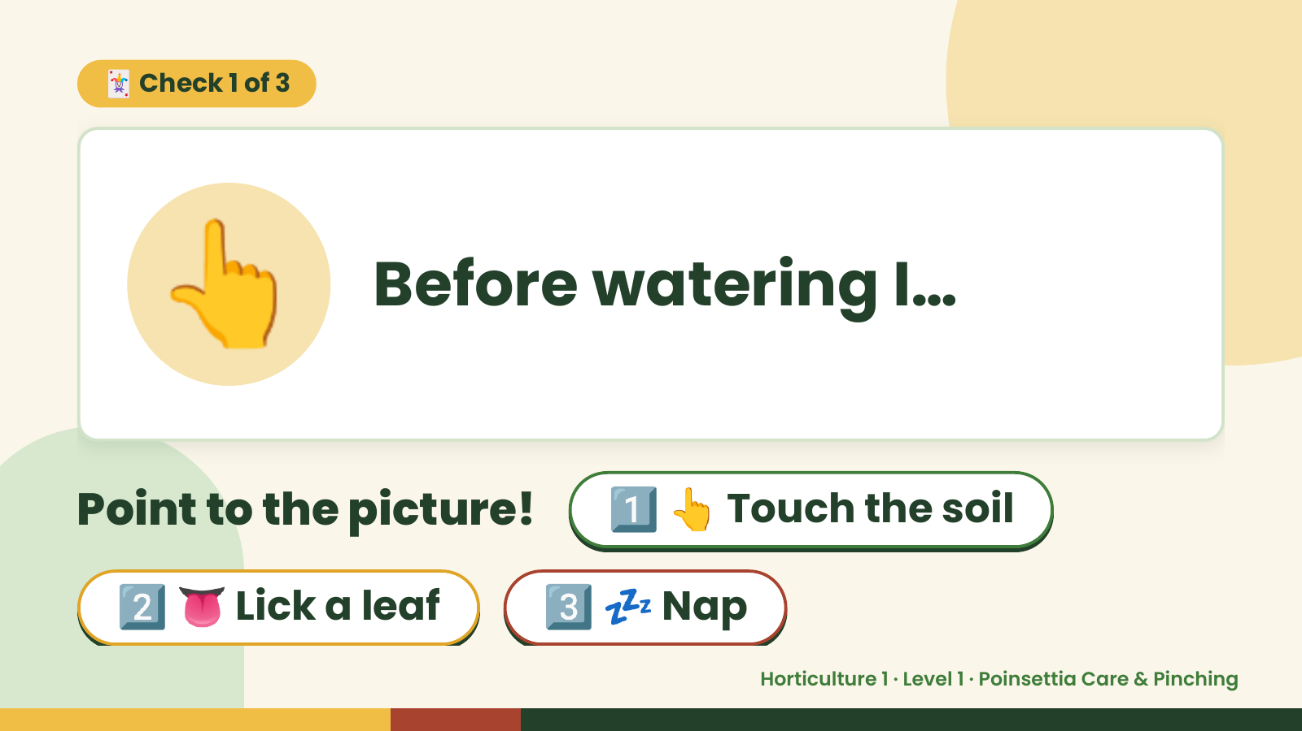
Notes:
🃏 Check 1 of 3
👆 Before watering I…
Point to the picture! 1️⃣ 👆 Touch the soil
2️⃣ 👅 Lick a leaf 3️⃣ 💤 Nap
Horticulture 1 · Level 1 · Poinsettia Care & Pinching

Slide 7
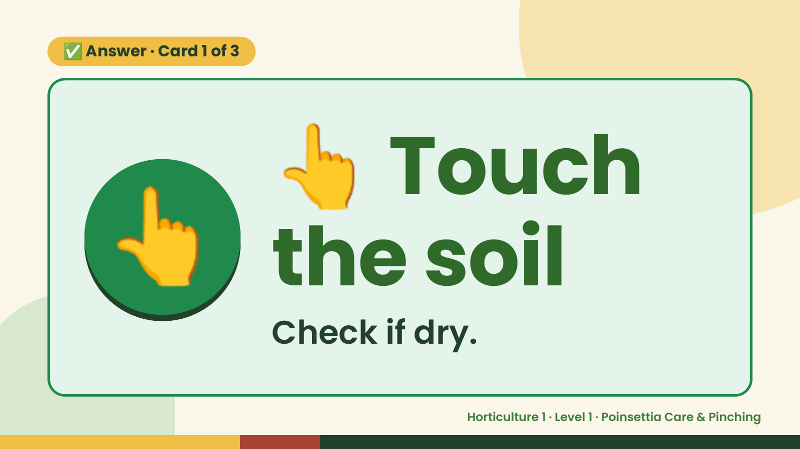
Notes:
👆
✅ Answer · Card 1 of 3
👆 the soil
Touch
Check if dry.
Horticulture 1 · Level 1 · Poinsettia Care & Pinching

Slide 8
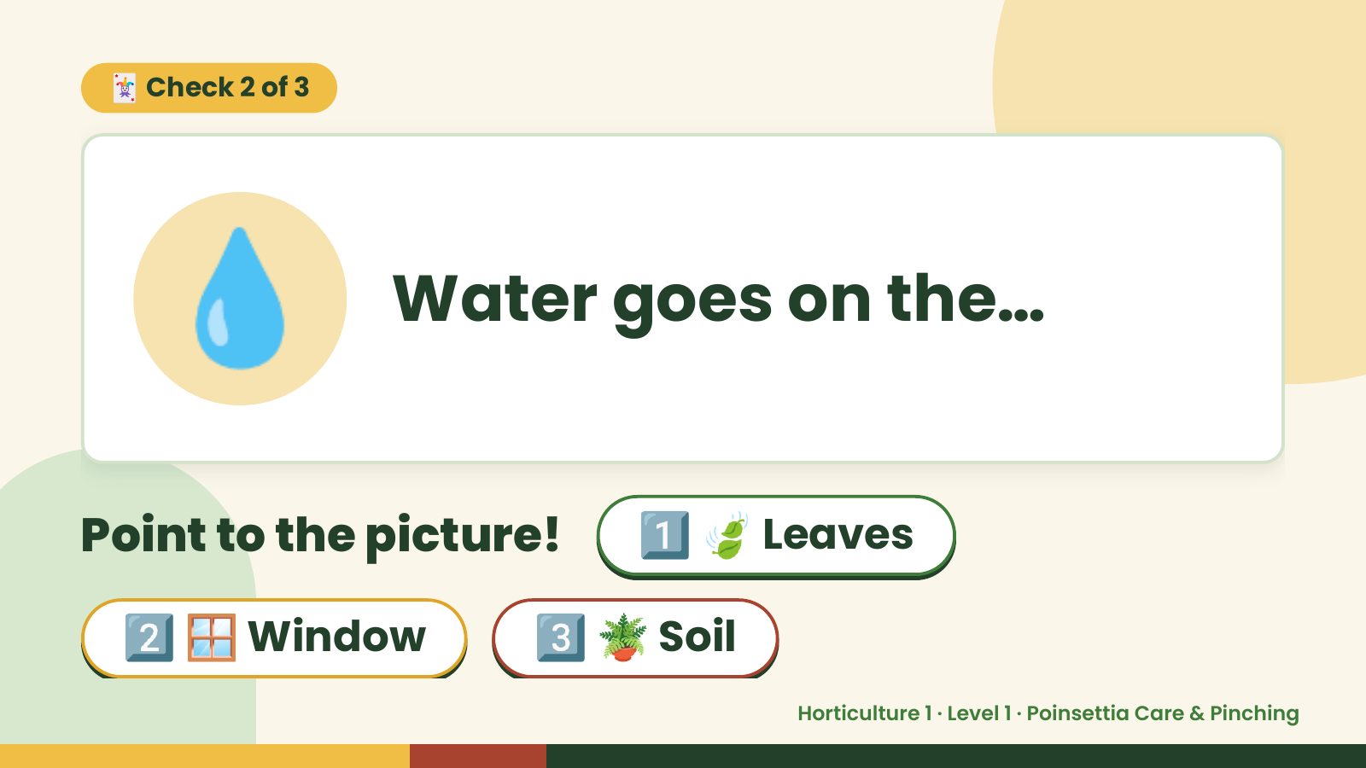
Notes:
🃏 Check 2 of 3
💧 Water goes on the…
Point to the picture! 1️⃣ 🍃 Leaves
2️⃣ 🪟 Window 3️⃣ 🪴 Soil
Horticulture 1 · Level 1 · Poinsettia Care & Pinching

Slide 9
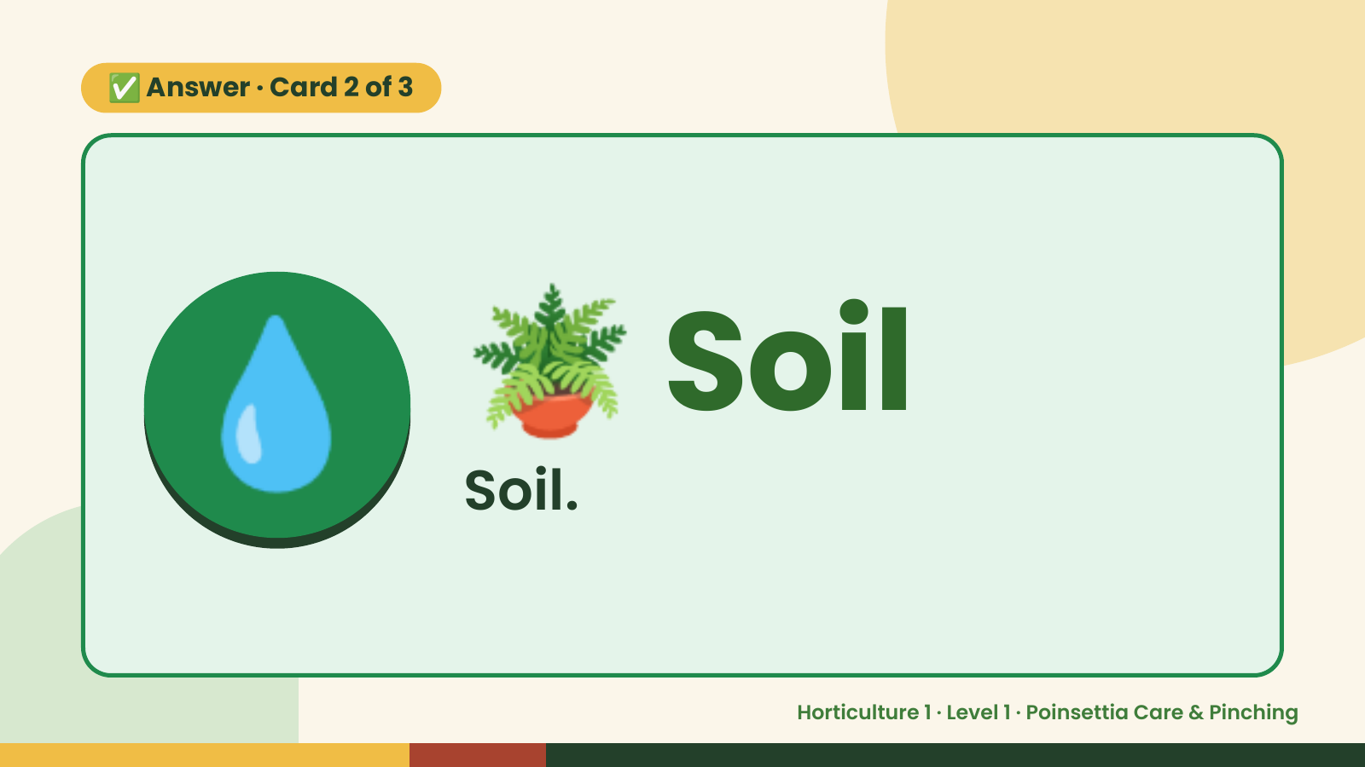
Notes:
✅ Answer · Card 2 of 3
💧 🪴 Soil
Soil.
Horticulture 1 · Level 1 · Poinsettia Care & Pinching

Slide 10
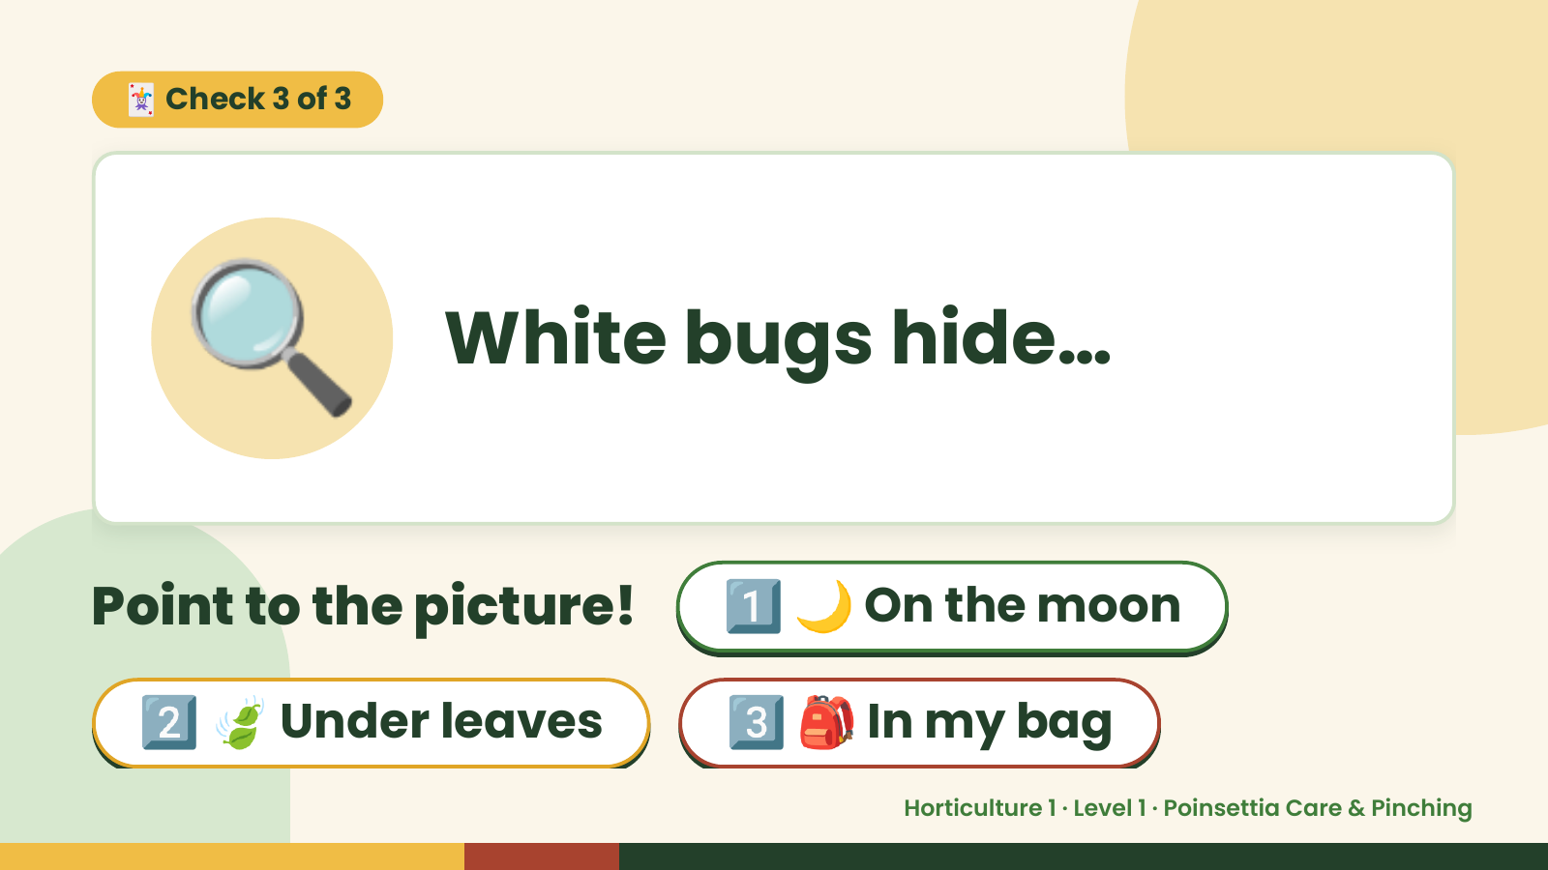
Notes:
🃏 Check 3 of 3
🔍 White bugs hide…
Point to the picture! 1️⃣ 🌙 On the moon
2️⃣ 🍃 Under leaves 3️⃣ 🎒 In my bag
Horticulture 1 · Level 1 · Poinsettia Care & Pinching

Slide 11
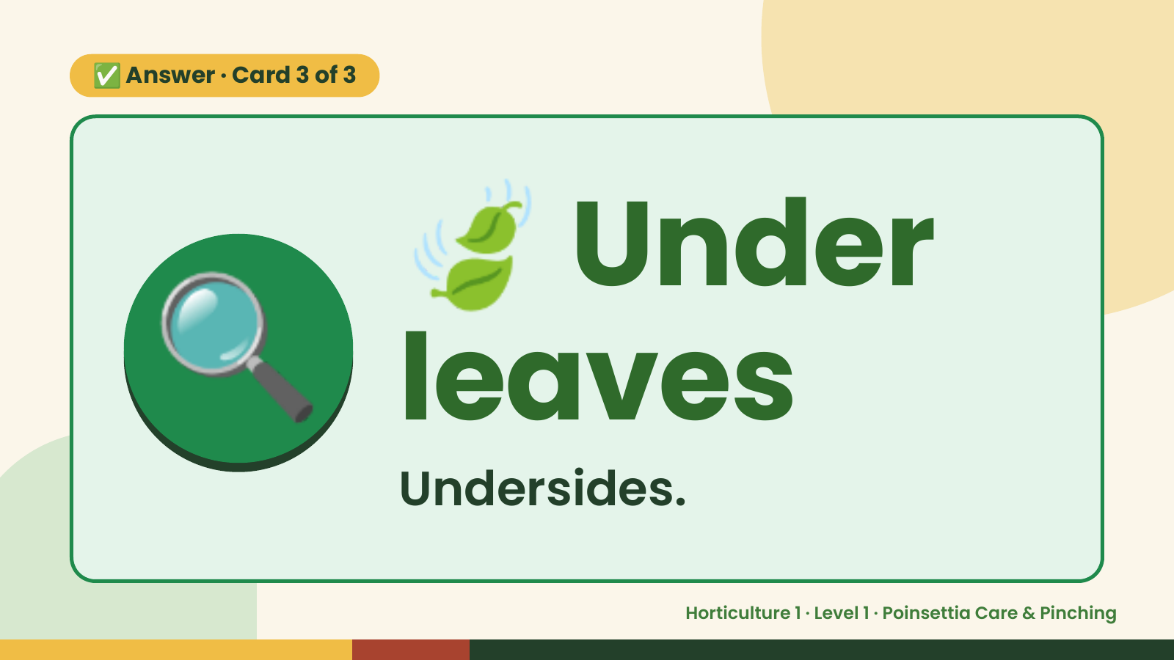
Notes:
🍃
✅ Answer · Card 3 of 3
🔍 leaves
Under
Undersides.
Horticulture 1 · Level 1 · Poinsettia Care & Pinching

Slide 12

Notes:
Wrap-Up
Clean Up +
Reflect
🧽
🧽 Clean the table.
🧰 Give tools back.
🧼 Wash hands.
Horticulture 1 · Level 1 · Poinsettia Care & Pinching

