Slide 1
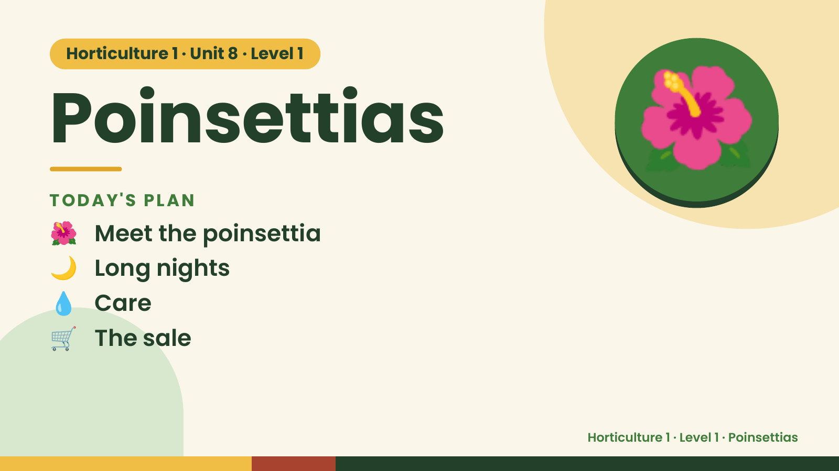
Notes:
Horticulture 1 · Unit 8 · Level 1
Poinsettias
TODAY'S PLAN
🌺 Meet the poinsettia
🌺
🌙 Long nights
💧 Care
🛒 The sale
Horticulture 1 · Level 1 · Poinsettias

Slide 2
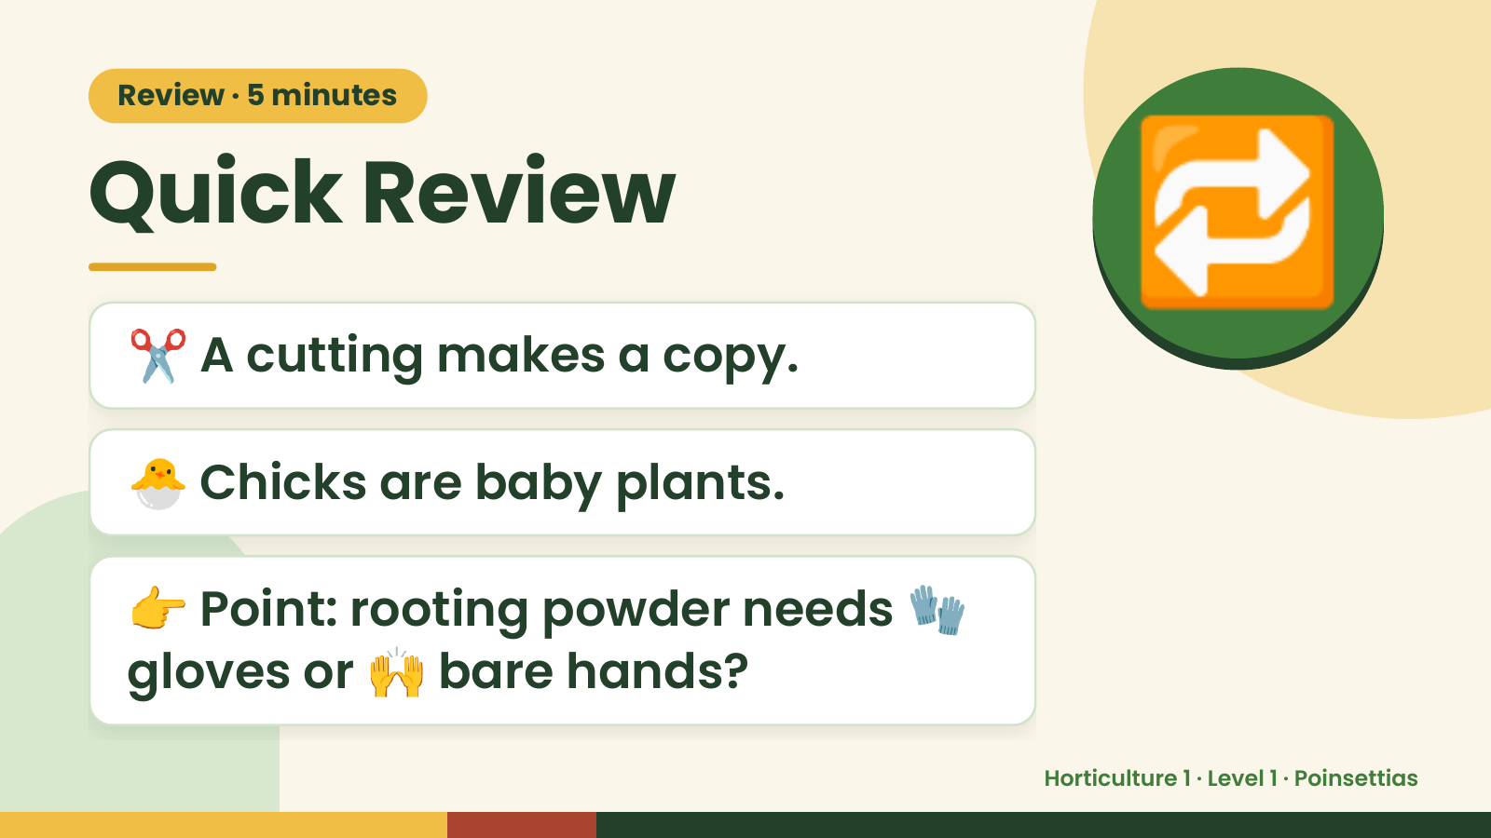
Notes:
Review · 5 minutes
Quick Review
✂️ A cutting makes a copy.
🔁
🐣 Chicks are baby plants.
👉 Point: rooting powder needs 🧤
gloves or 🙌 bare hands?
Horticulture 1 · Level 1 · Poinsettias

Slide 3
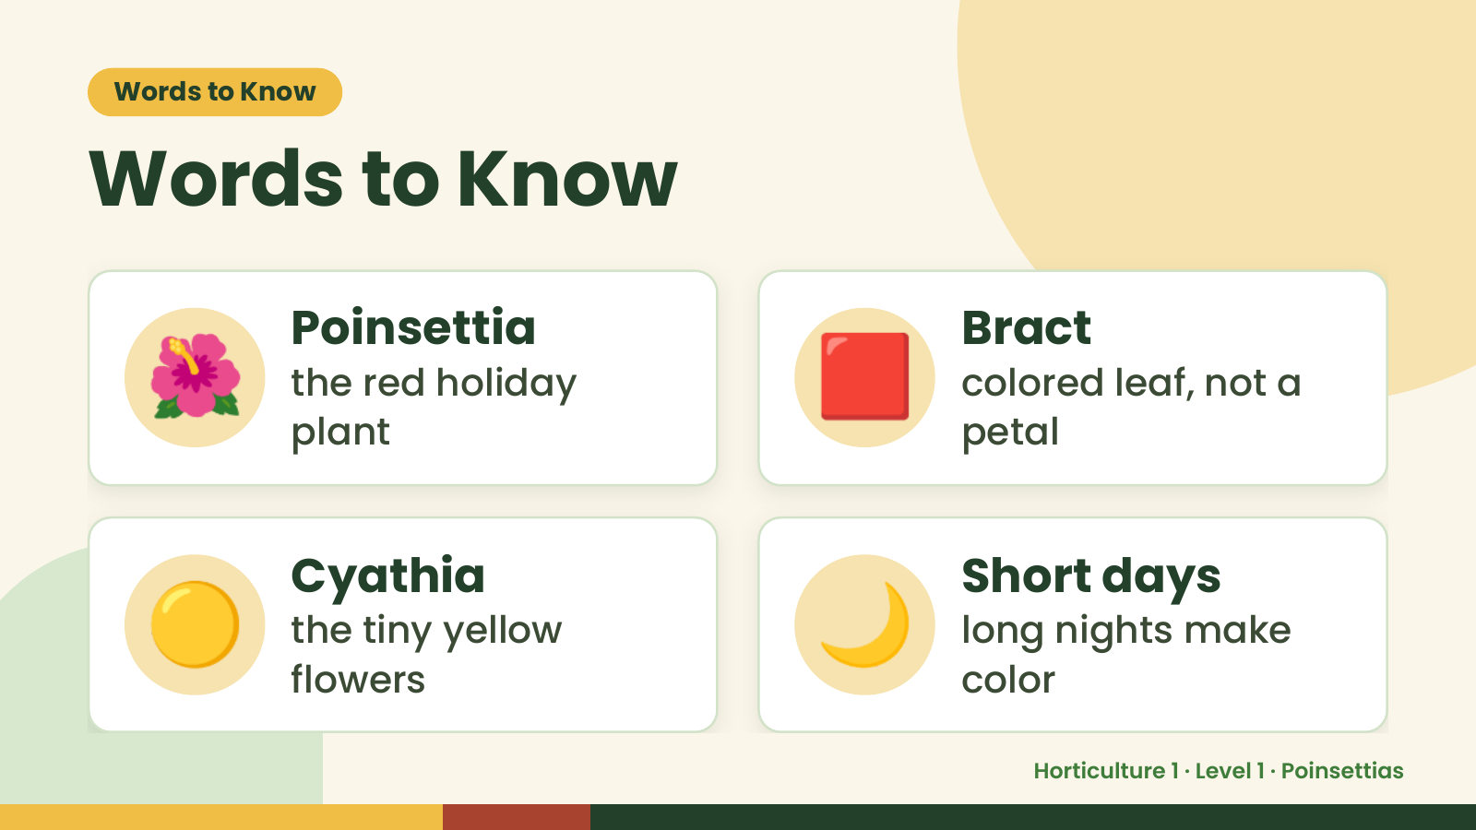
Notes:
Words to Know
Words to Know
🌺 Poinsettia
the red holiday
plant
🟥 Bract
colored leaf, not a
petal
🟡 Cyathia
the tiny yellow
flowers
🌙 Short days
long nights make
color
Horticulture 1 · Level 1 · Poinsettias

Slide 4
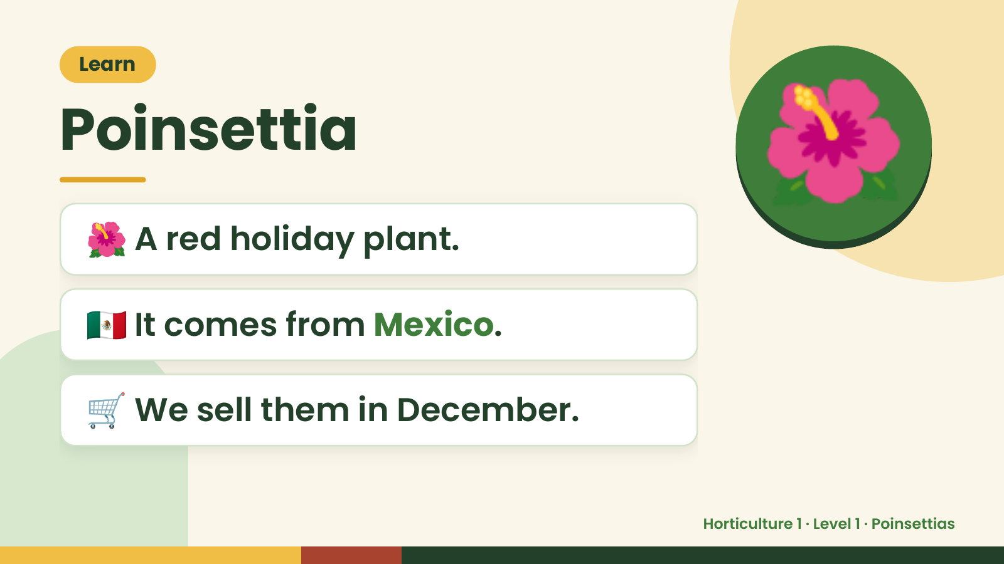
Notes:
Learn
Poinsettia
🌺 A red holiday plant.
🌺
🇲🇽 It comes from Mexico.
🛒 We sell them in December.
Horticulture 1 · Level 1 · Poinsettias

Slide 5
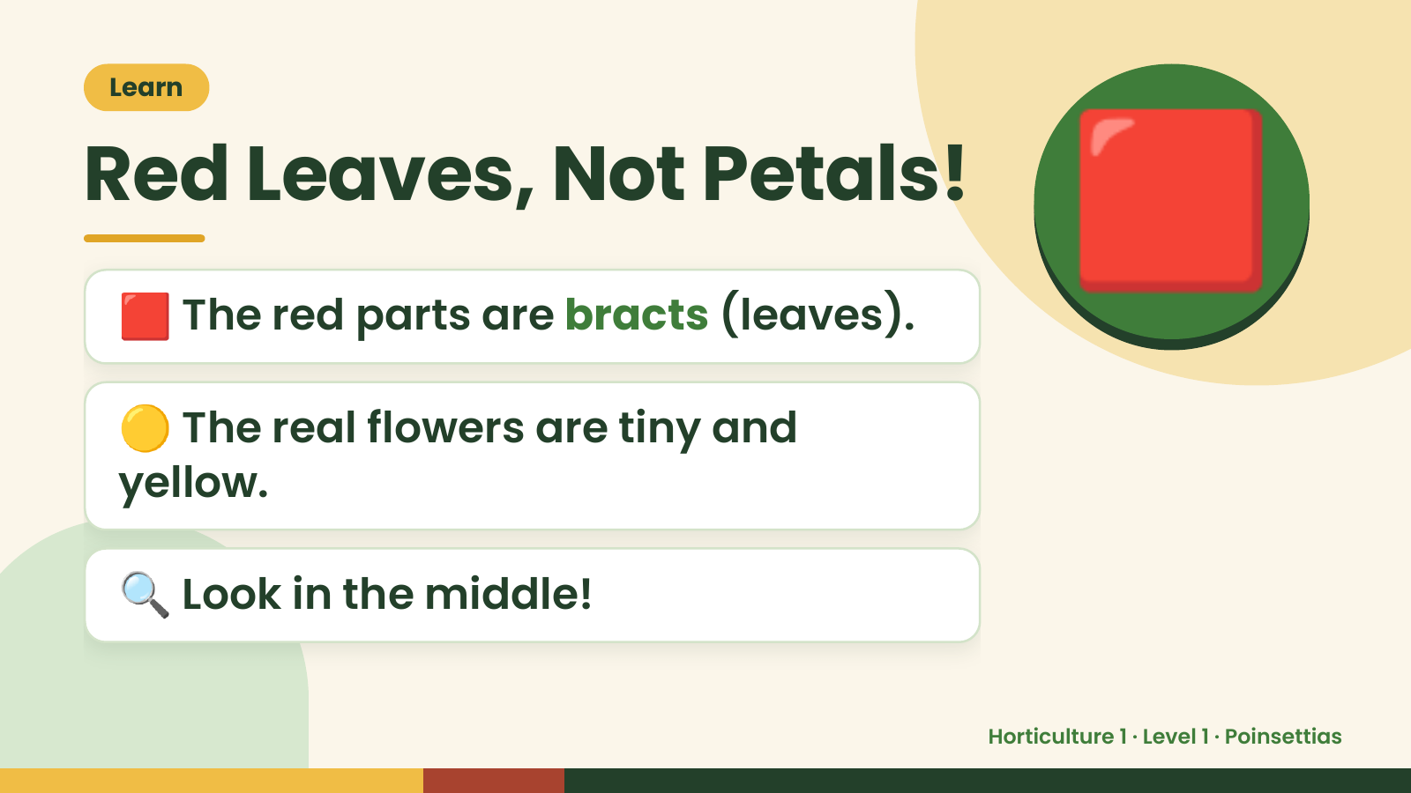
Notes:
Learn
Red Leaves, Not Petals!
🟥 The red parts are bracts (leaves).
🟡 The real flowers are tiny and
🟥
yellow.
🔍 Look in the middle!
Horticulture 1 · Level 1 · Poinsettias

Slide 6
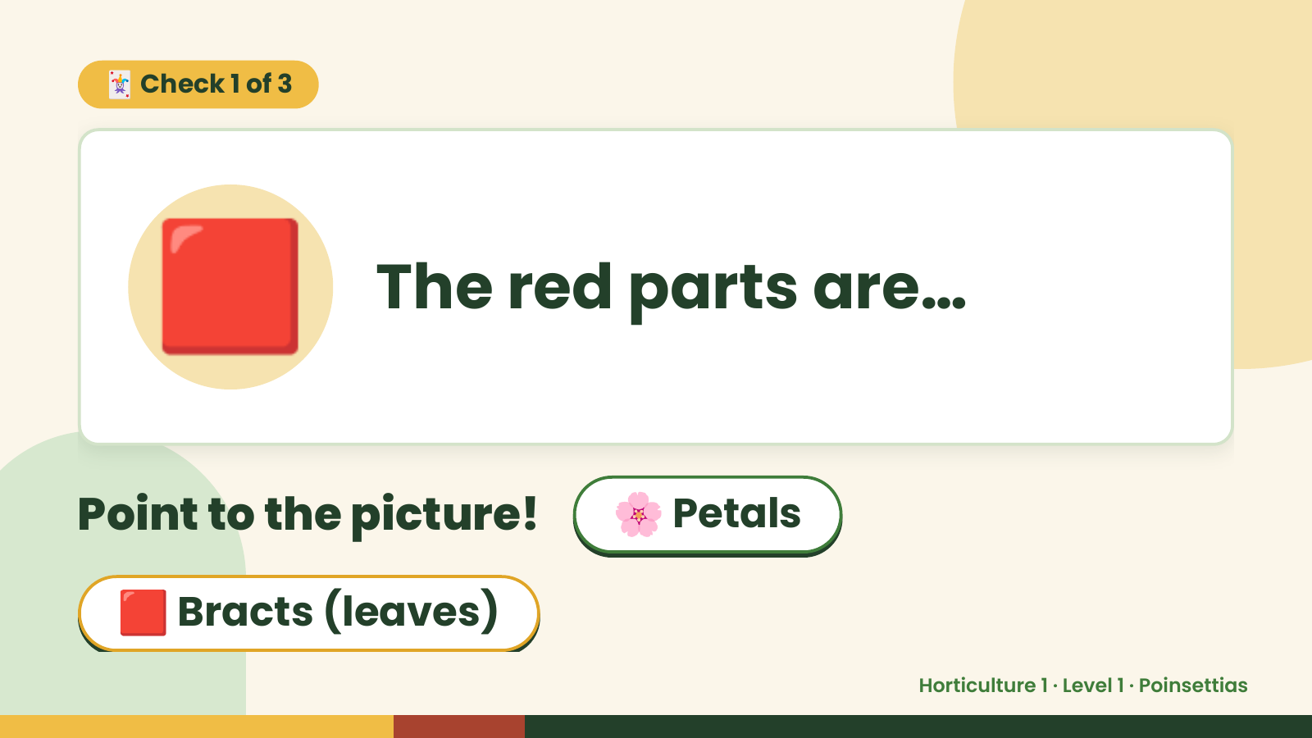
Notes:
🃏 Check 1 of 3
🟥 The red parts are…
Point to the picture! 🌸 Petals
🟥 Bracts (leaves)
Horticulture 1 · Level 1 · Poinsettias

Slide 7
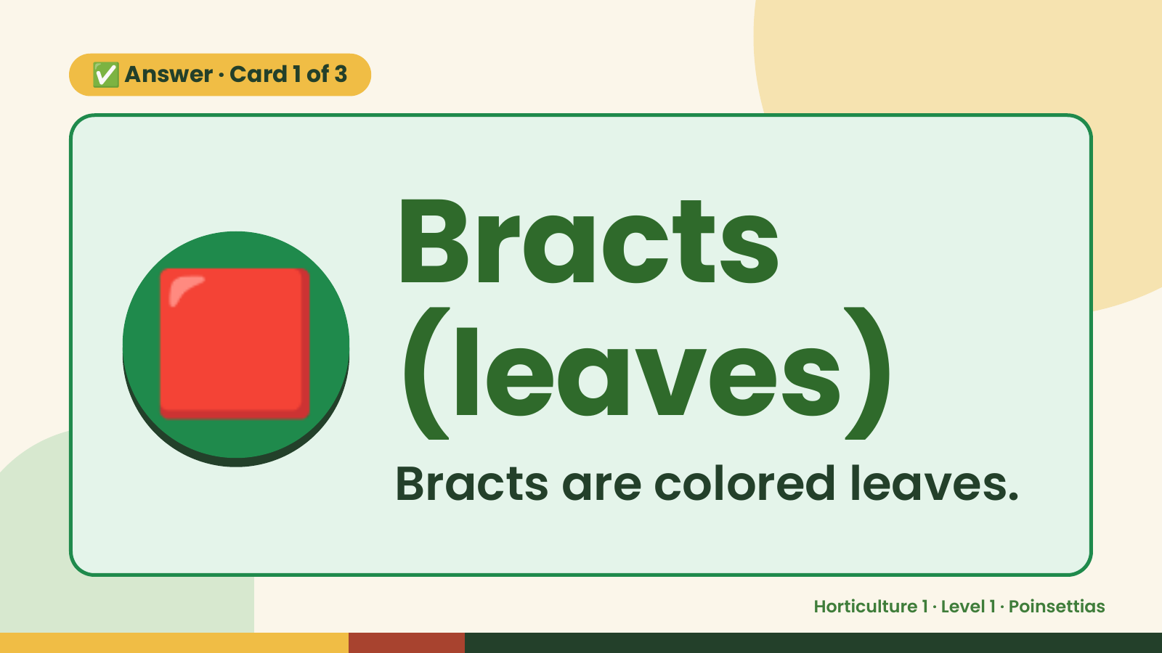
Notes:
✅ Answer · Card 1 of 3
🟥 Bracts
(leaves)
Bracts are colored leaves.
Horticulture 1 · Level 1 · Poinsettias

Slide 8
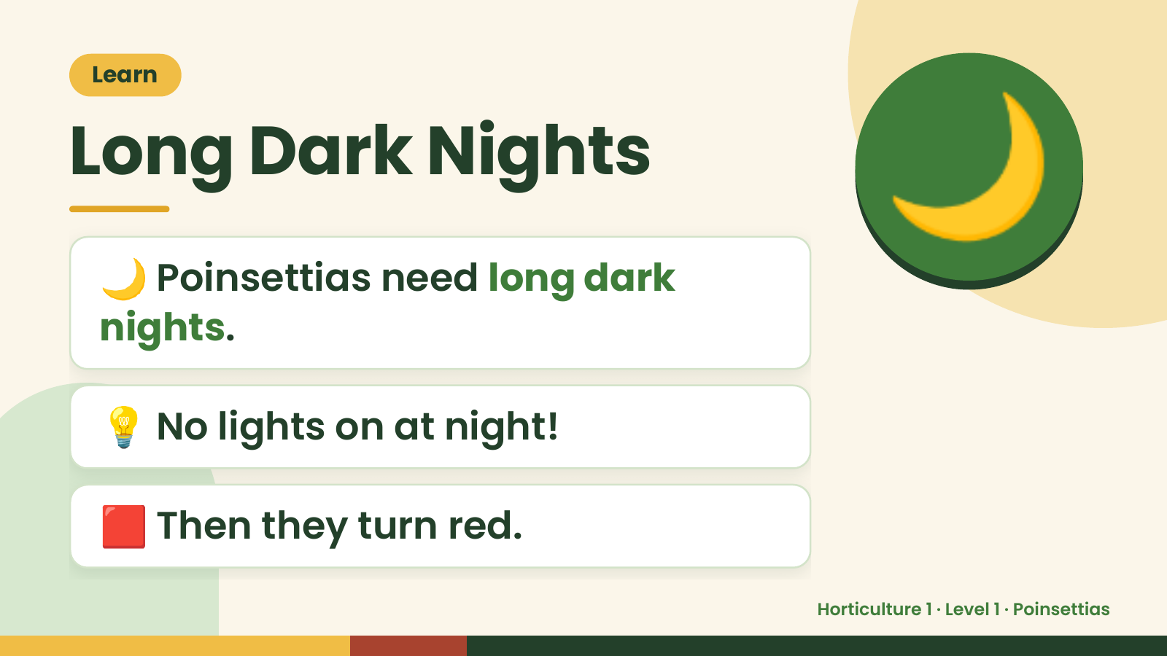
Notes:
Learn
Long Dark Nights
🌙 Poinsettias need long dark
nights.
🌙
💡 No lights on at night!
🟥 Then they turn red.
Horticulture 1 · Level 1 · Poinsettias

Slide 9
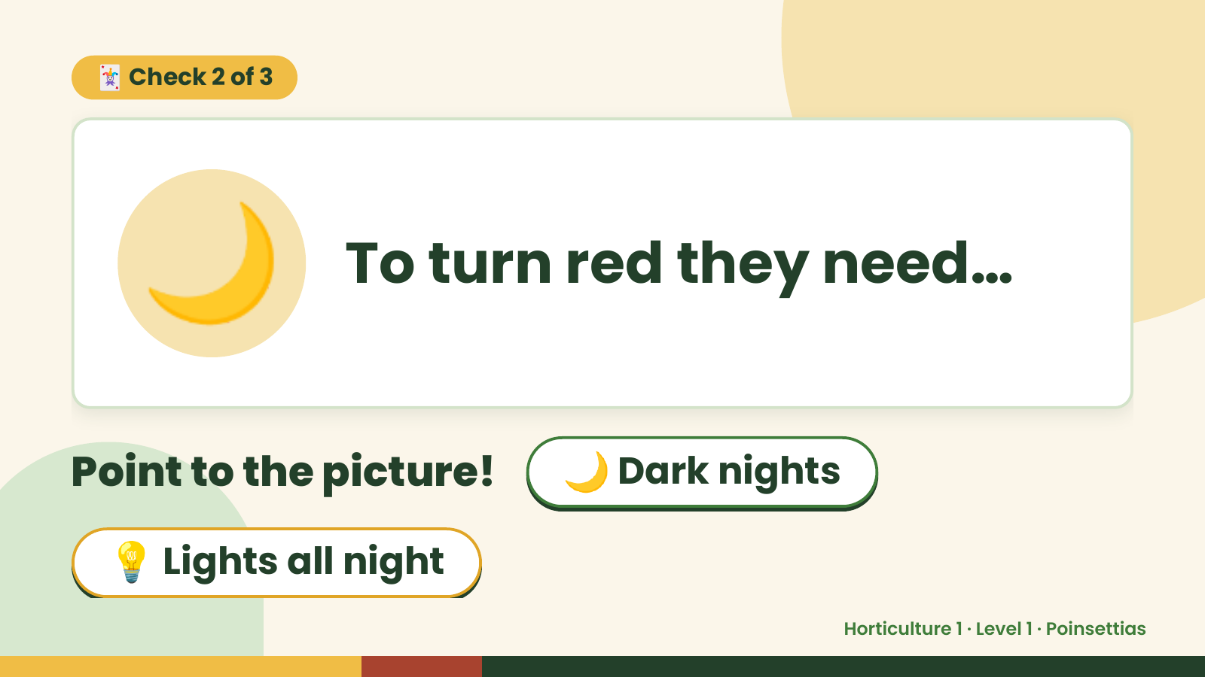
Notes:
🃏 Check 2 of 3
🌙 To turn red they need…
Point to the picture! 🌙 Dark nights
💡 Lights all night
Horticulture 1 · Level 1 · Poinsettias

Slide 10
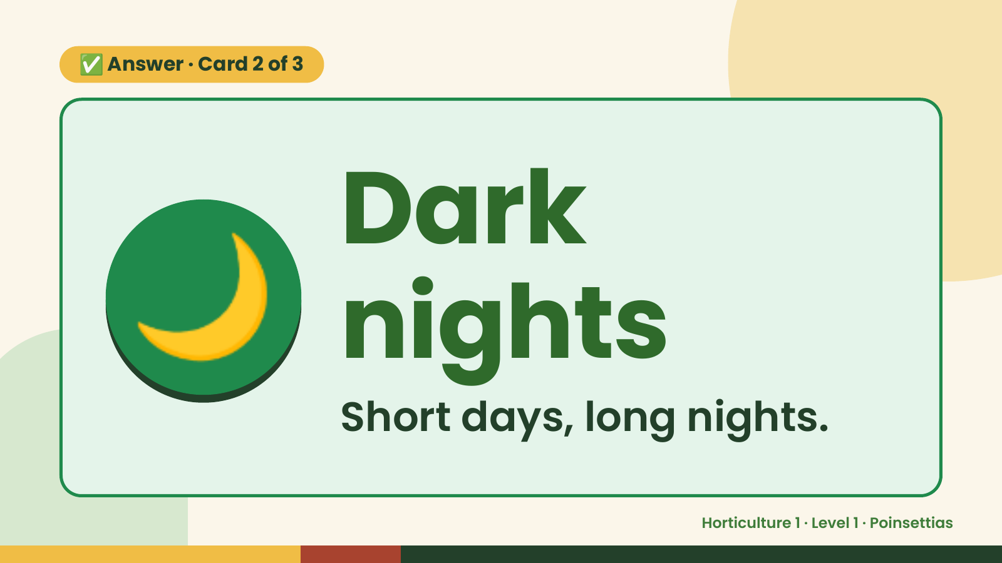
Notes:
✅ Answer · Card 2 of 3
🌙 Dark
nights
Short days, long nights.
Horticulture 1 · Level 1 · Poinsettias

Slide 11
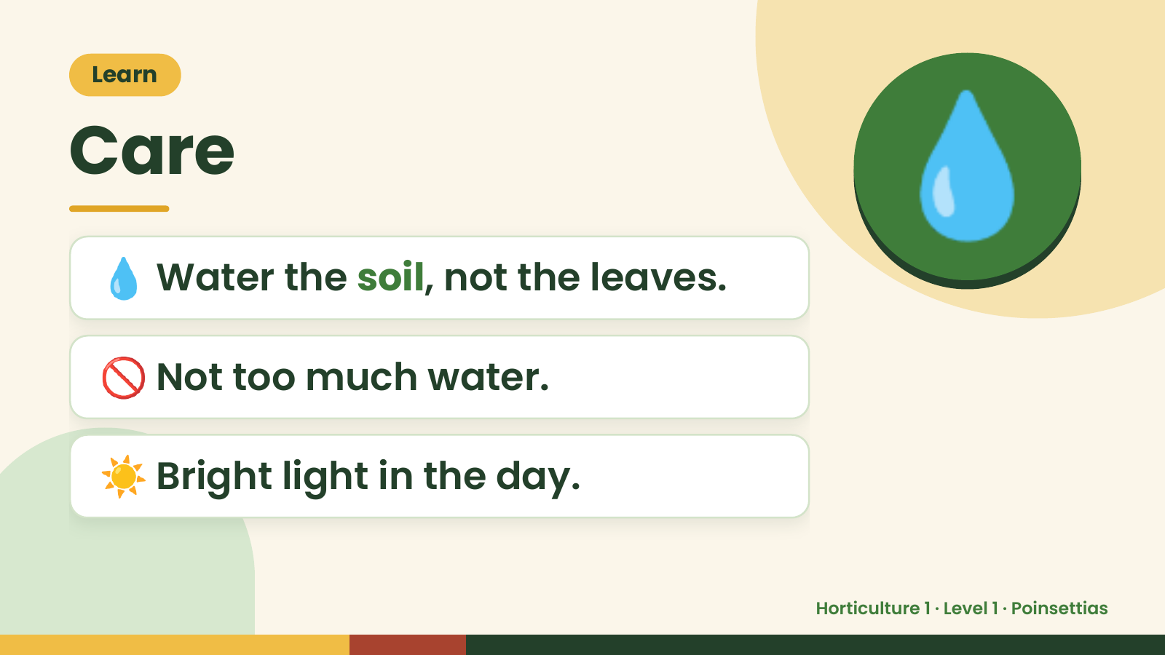
Notes:
Learn
Care
💧 Water the soil, not the leaves.
💧
🚫 Not too much water.
☀️ Bright light in the day.
Horticulture 1 · Level 1 · Poinsettias

Slide 12
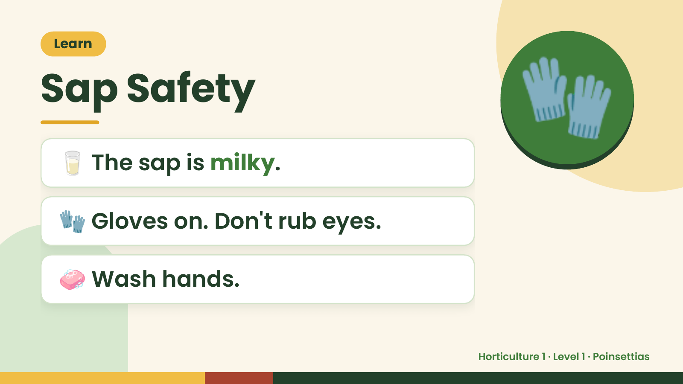
Notes:
Learn
Sap Safety
🥛 The sap is milky.
🧤
🧤 Gloves on. Don't rub eyes.
🧼 Wash hands.
Horticulture 1 · Level 1 · Poinsettias

Slide 13
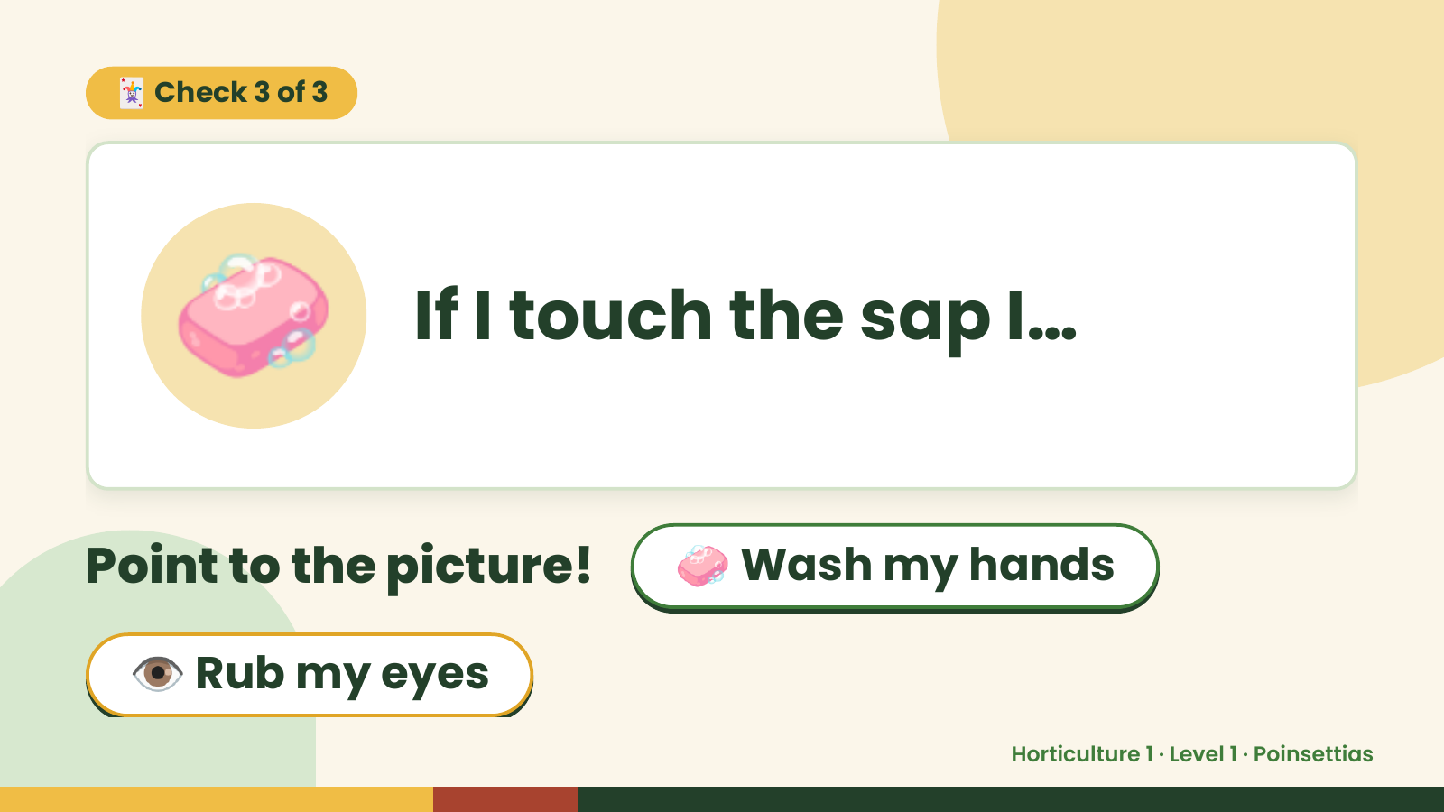
Notes:
🃏 Check 3 of 3
🧼 If I touch the sap I…
Point to the picture! 🧼 Wash my hands
👁️ Rub my eyes
Horticulture 1 · Level 1 · Poinsettias

Slide 14
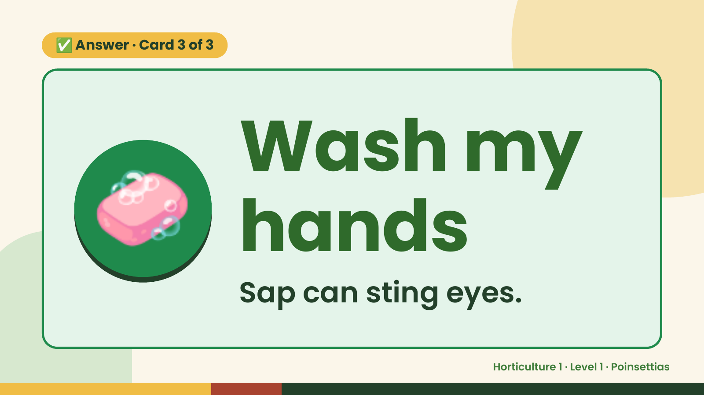
Notes:
✅ Answer · Card 3 of 3
🧼 Wash my
hands
Sap can sting eyes.
Horticulture 1 · Level 1 · Poinsettias

Slide 15
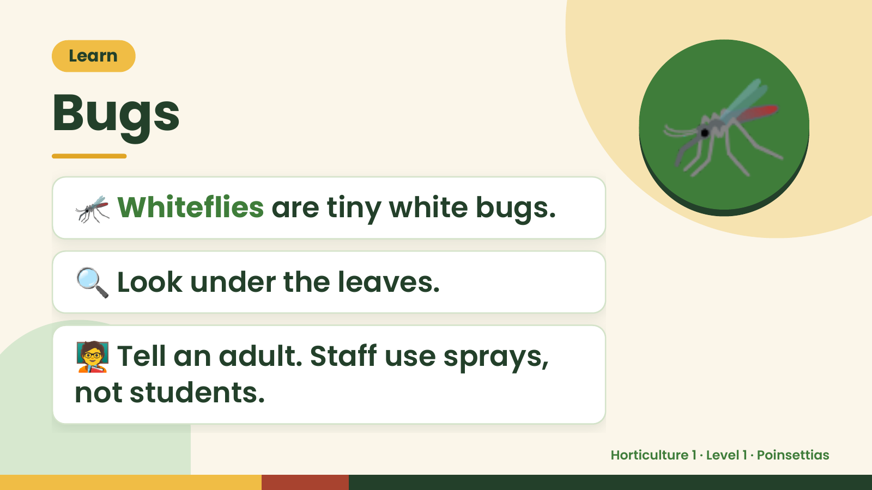
Notes:
Learn
Bugs
🦟 Whiteflies are tiny white bugs.
🦟
🔍 Look under the leaves.
🧑‍🏫 Tell an adult. Staff use sprays,
not students.
Horticulture 1 · Level 1 · Poinsettias

Slide 16
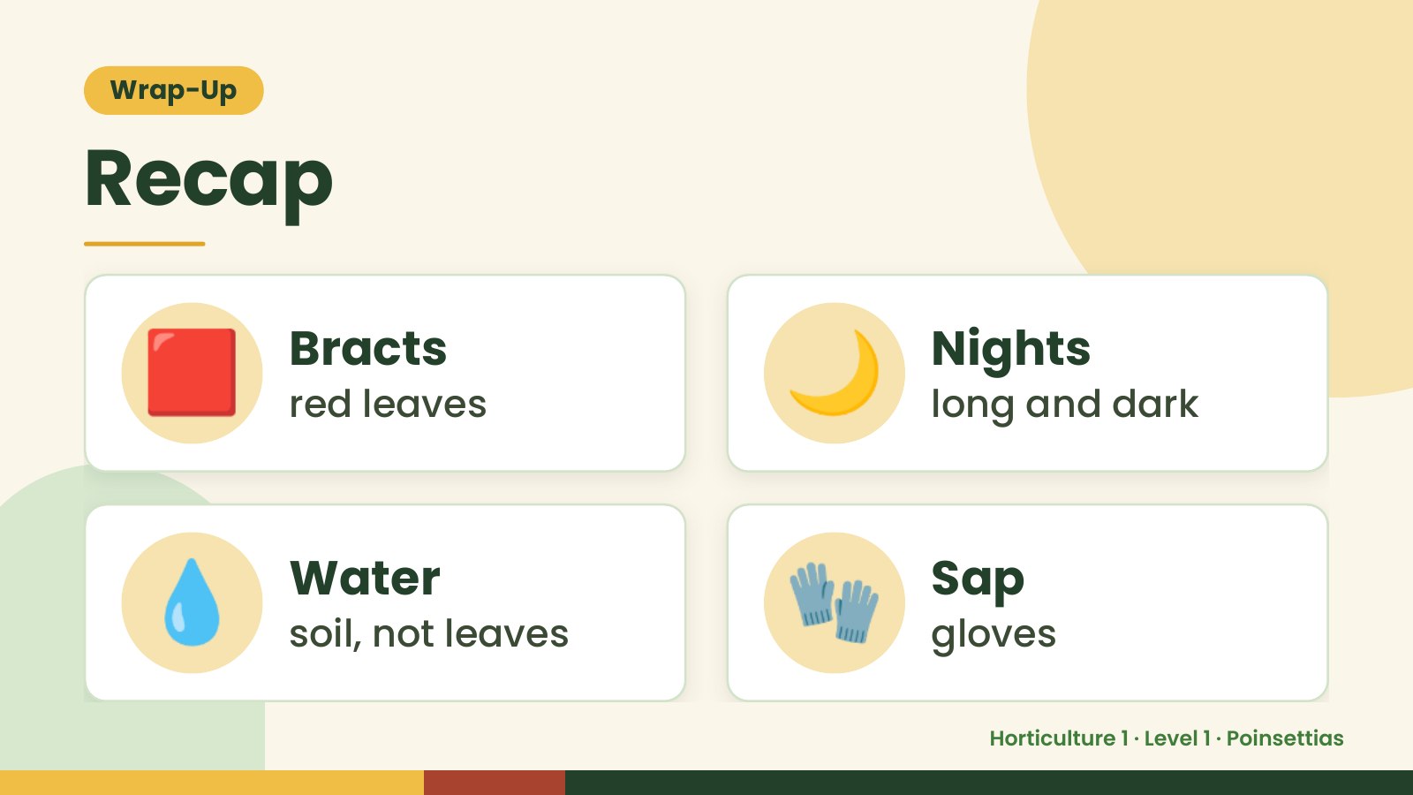
Notes:
Wrap-Up
Recap
🟥 Bracts
red leaves 🌙 Nights
long and dark
💧 Water
soil, not leaves 🧤 Sap
gloves
Horticulture 1 · Level 1 · Poinsettias

Slide 17
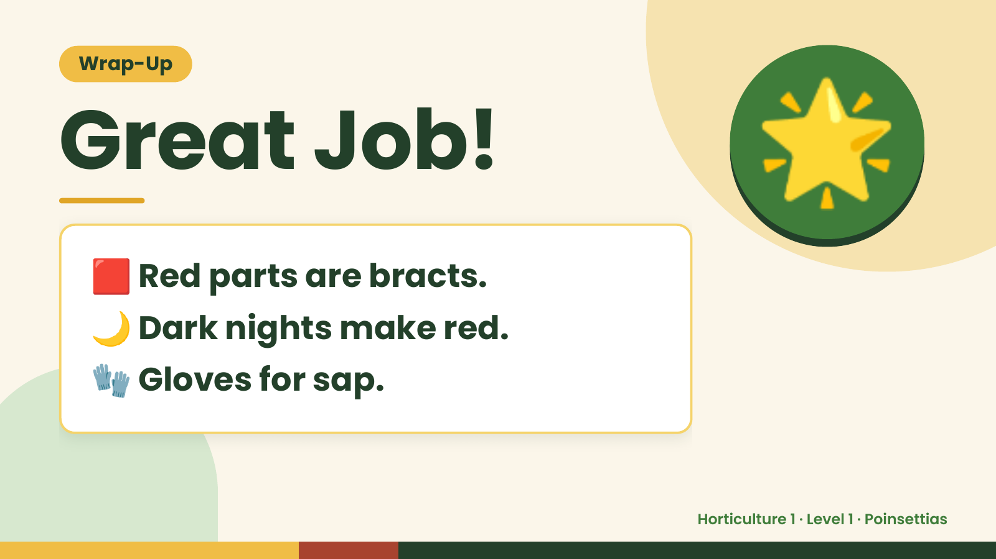
Notes:
Wrap-Up
Great Job!
🟥 Red parts are bracts.
🌟
🌙 Dark nights make red.
🧤 Gloves for sap.
Horticulture 1 · Level 1 · Poinsettias

