Slide 1

Notes:
Horticulture 1 · Unit 8 · Level 2
Poinsettia Care &
Pinching
👥 Jobs
TODAY'S PLAN
🌺
⚠️ Safety
🌺 Steps
✅ Check
📝 Reflect
Horticulture 1 · Level 2 · Poinsettia Care & Pinching

Slide 2

Notes:
Get ready
Jobs
🧑‍🌾 Grower
Does the main plant job
with the tools
🧺 Supply helper
Gets and returns supplies
and tools to staff
📸 Recorder
Takes photos and fills in
the chart
🧽 Clean-up captain
Sweeps, wipes tables,
checks hands are
washed
Horticulture 1 · Level 2 · Poinsettia Care & Pinching

Slide 3
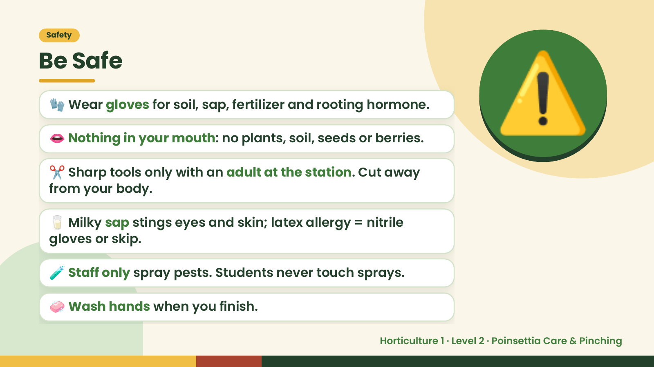
Notes:
Safety
Be Safe
🧤 Wear gloves for soil, sap, fertilizer and rooting hormone.
👄 Nothing in your mouth: no plants, soil, seeds or berries.
✂️ Sharp tools only with an adult at the station. Cut away
from your body.
⚠️
🥛 Milky sap stings eyes and skin; latex allergy = nitrile
gloves or skip.
🧪 Staff only spray pests. Students never touch sprays.
🧼 Wash hands when you finish.
Horticulture 1 · Level 2 · Poinsettia Care & Pinching

Slide 4
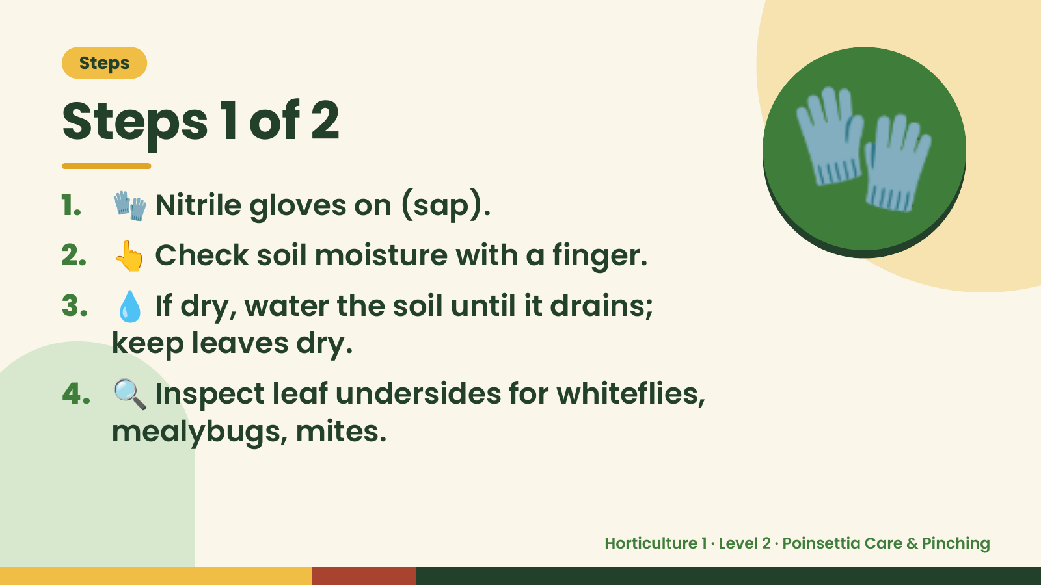
Notes:
Steps
Steps 1 of 2
1. 🧤 Nitrile gloves on (sap).
2. 👆 Check soil moisture with a finger.
3. 💧 If dry, water the soil until it drains;
🧤
keep leaves dry.
4. 🔍 Inspect leaf undersides for whiteflies,
mealybugs, mites.
Horticulture 1 · Level 2 · Poinsettia Care & Pinching

Slide 5
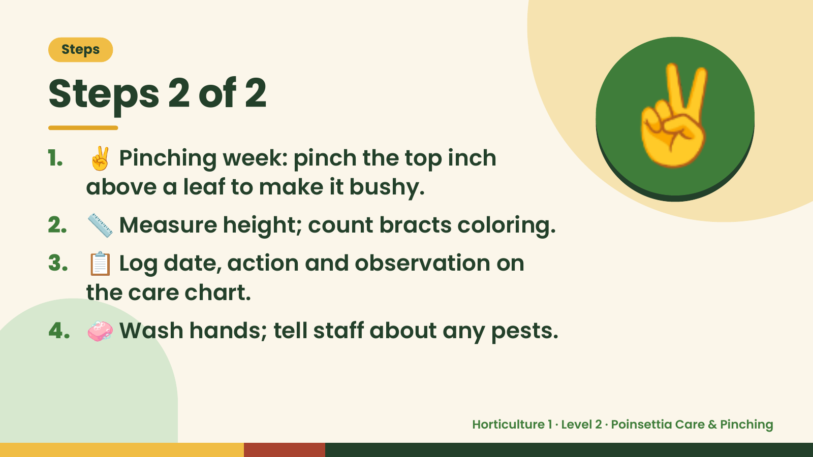
Notes:
Steps
Steps 2 of 2
1. ✌️ Pinching week: pinch the top inch
above a leaf to make it bushy.
2. 📏 Measure height; count bracts coloring.
✌️
3. 📋 Log date, action and observation on
the care chart.
4. 🧼 Wash hands; tell staff about any pests.
Horticulture 1 · Level 2 · Poinsettia Care & Pinching

Slide 6
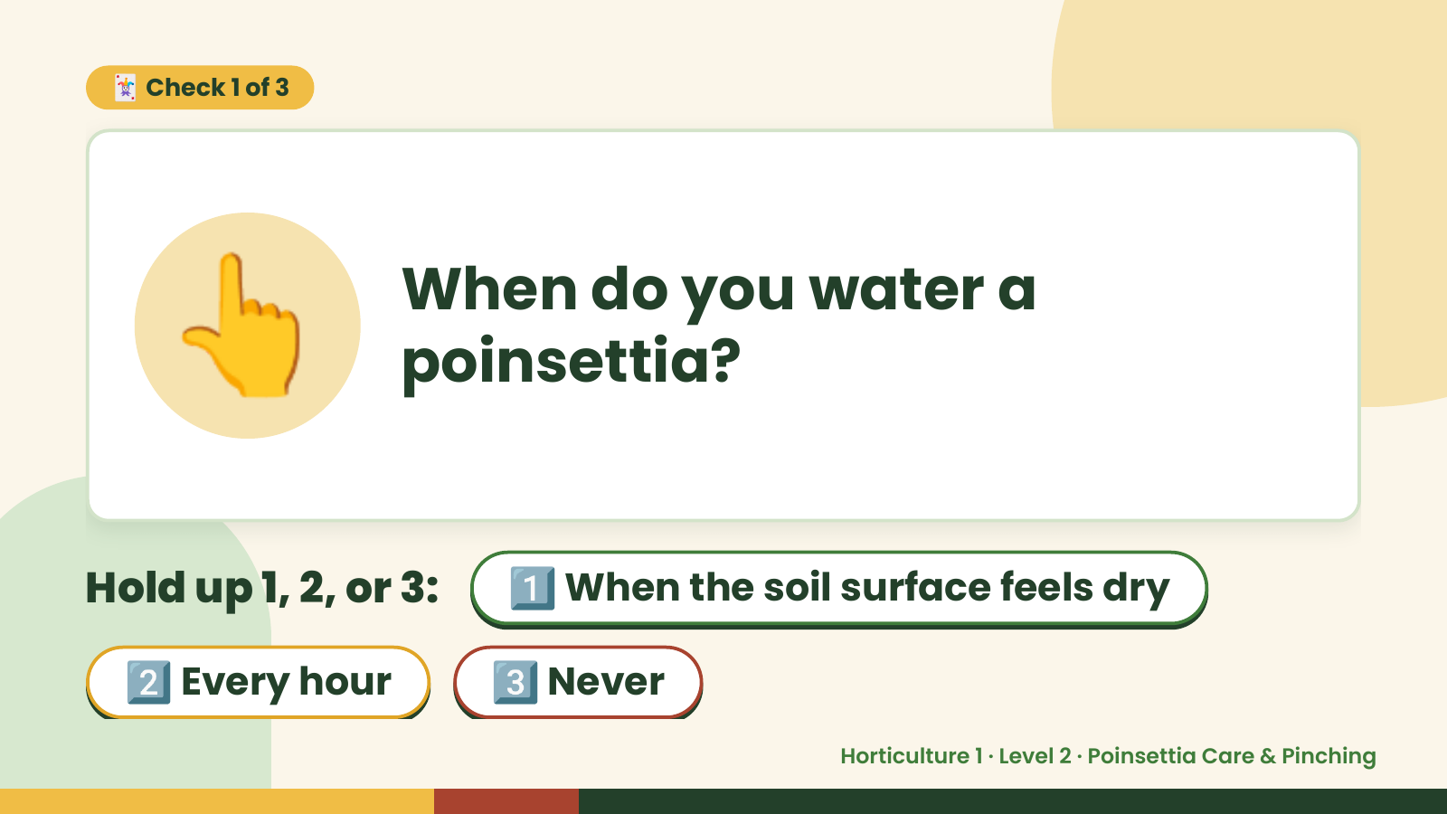
Notes:
🃏 Check 1 of 3
👆 When do you water a
poinsettia?
Hold up 1, 2, or 3: 1️⃣ When the soil surface feels dry
2️⃣ Every hour 3️⃣ Never
Horticulture 1 · Level 2 · Poinsettia Care & Pinching

Slide 7
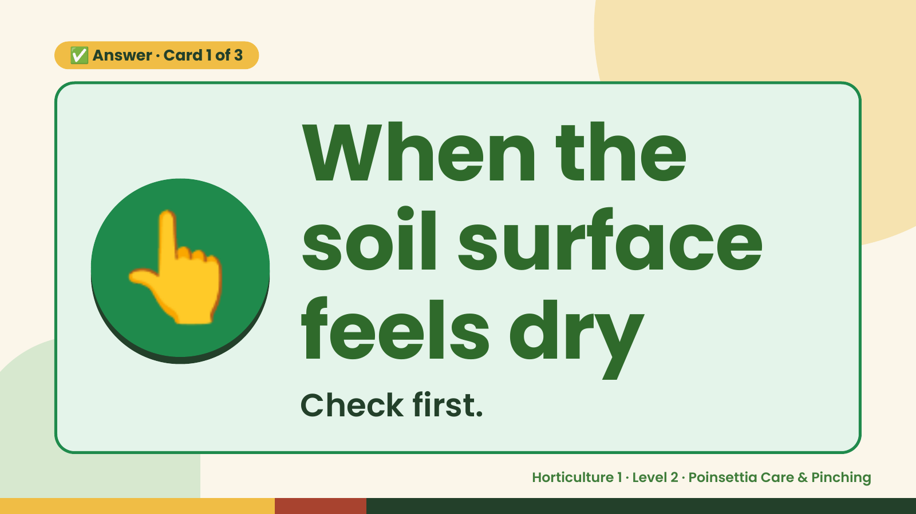
Notes:
✅ Answer · Card 1 of 3
👆 When the
soil surface
feels dry
Check first.
Horticulture 1 · Level 2 · Poinsettia Care & Pinching

Slide 8
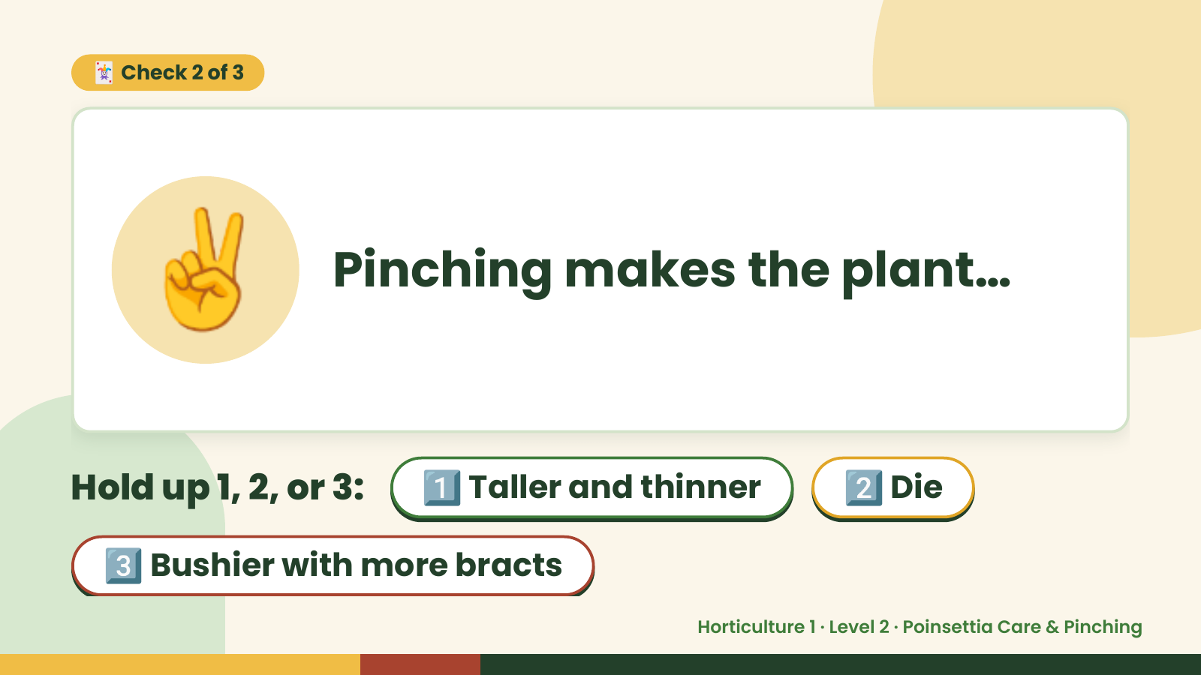
Notes:
🃏 Check 2 of 3
✌️ Pinching makes the plant…
Hold up 1, 2, or 3: 1️⃣ Taller and thinner 2️⃣ Die
3️⃣ Bushier with more bracts
Horticulture 1 · Level 2 · Poinsettia Care & Pinching

Slide 9
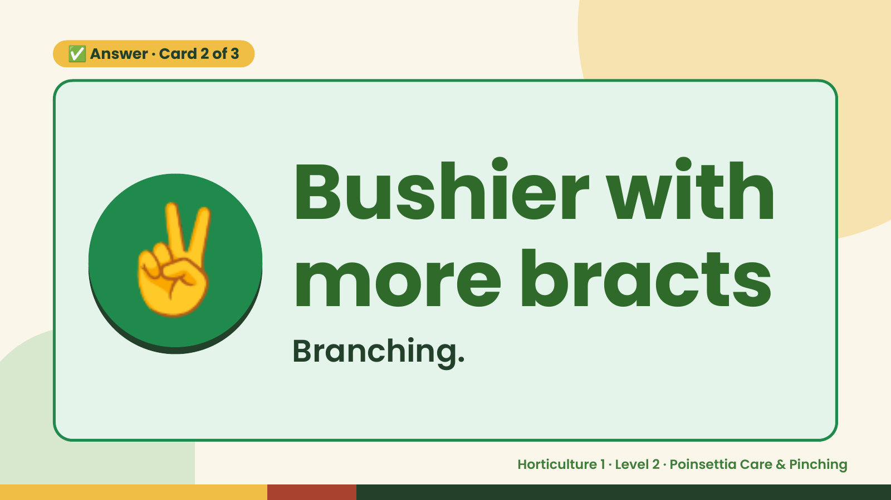
Notes:
✅ Answer · Card 2 of 3
✌️ Bushier with
more bracts
Branching.
Horticulture 1 · Level 2 · Poinsettia Care & Pinching

Slide 10
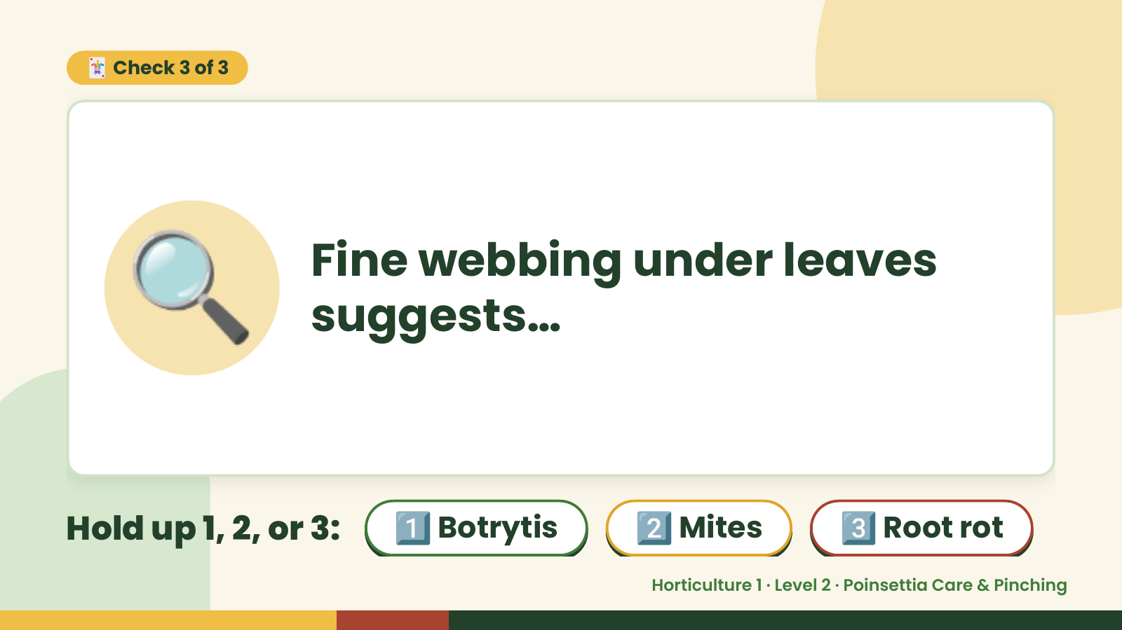
Notes:
🃏 Check 3 of 3
🔍 Fine webbing under leaves
suggests…
Hold up 1, 2, or 3: 1️⃣ Botrytis 2️⃣ Mites 3️⃣ Root rot
Horticulture 1 · Level 2 · Poinsettia Care & Pinching

Slide 11
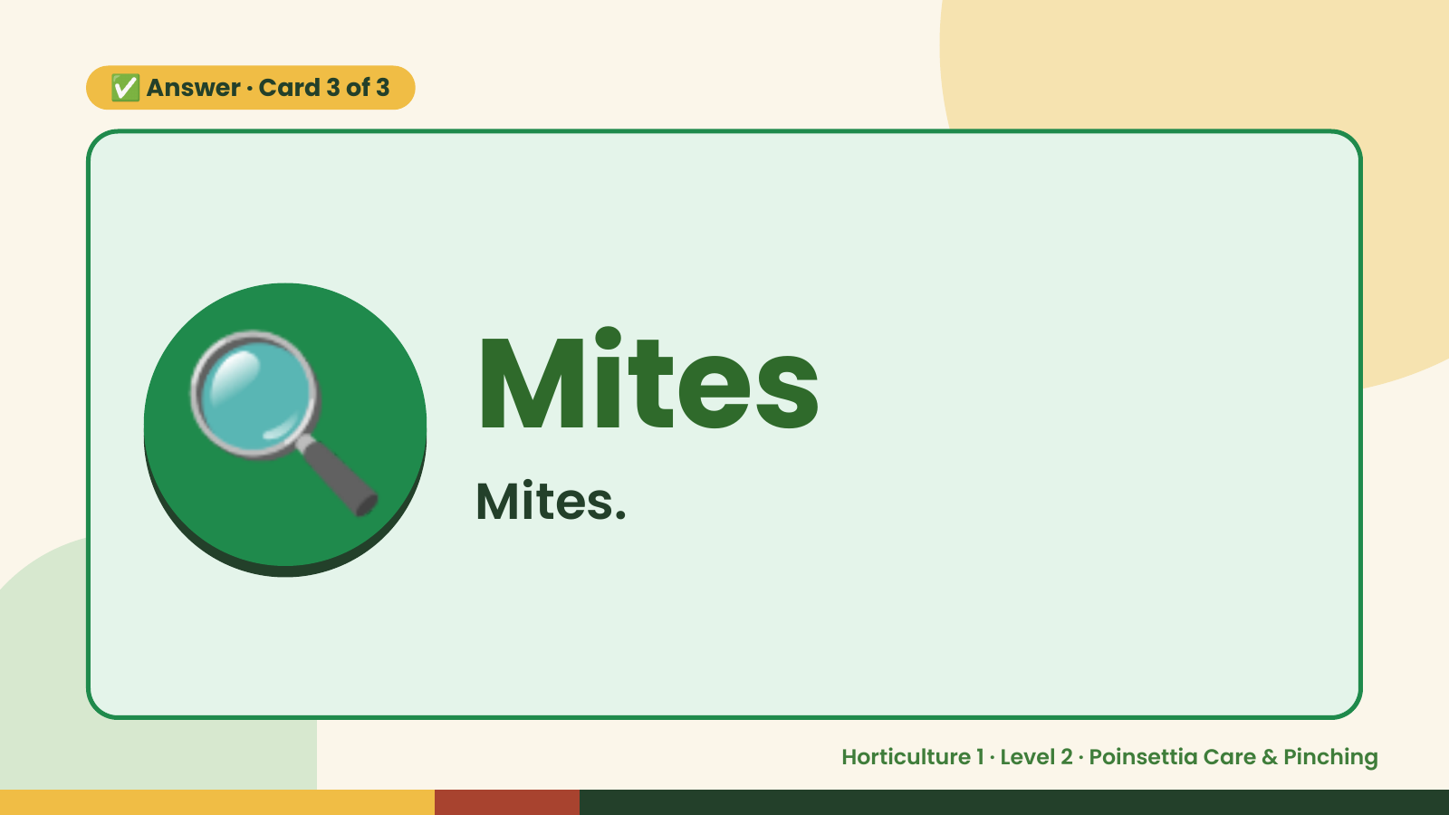
Notes:
✅ Answer · Card 3 of 3
🔍 Mites
Mites.
Horticulture 1 · Level 2 · Poinsettia Care & Pinching

Slide 12

Notes:
Wrap-Up
Clean Up +
Reflect
🧽
Return and count tools.
Sweep and wipe your area.
Wash hands, then do the reflection.
Horticulture 1 · Level 2 · Poinsettia Care & Pinching

