Slide 1
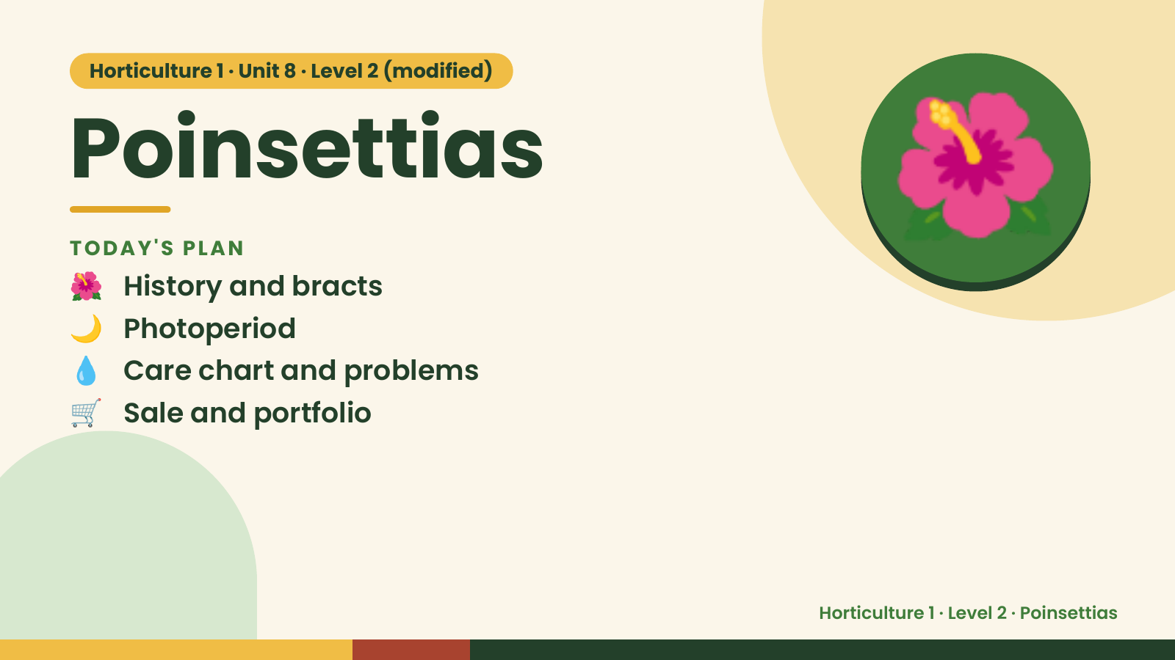
Notes:
Horticulture 1 · Unit 8 · Level 2 (modified)
Poinsettias
🌺 History and bracts
TODAY'S PLAN
🌙 Photoperiod
💧 Care chart and problems
🌺
🛒 Sale and portfolio
Horticulture 1 · Level 2 · Poinsettias

Slide 2
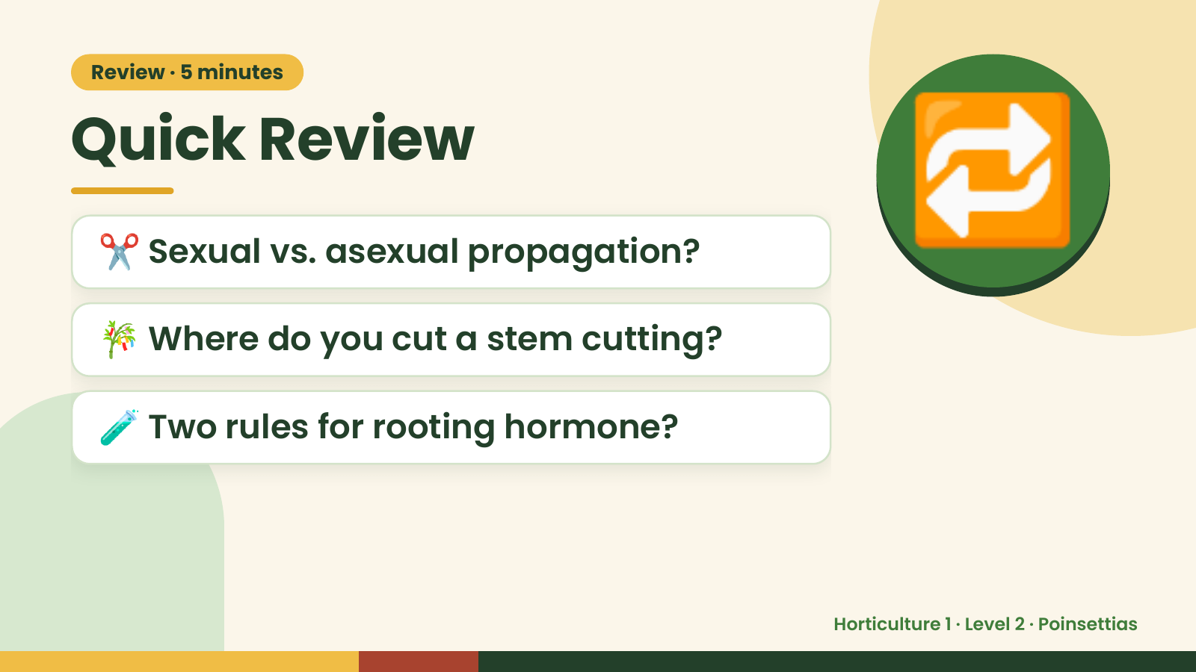
Notes:
Review · 5 minutes
Quick Review
✂️ Sexual vs. asexual propagation?
🎋 Where do you cut a stem cutting?
🔁
🧪 Two rules for rooting hormone?
Horticulture 1 · Level 2 · Poinsettias

Slide 3
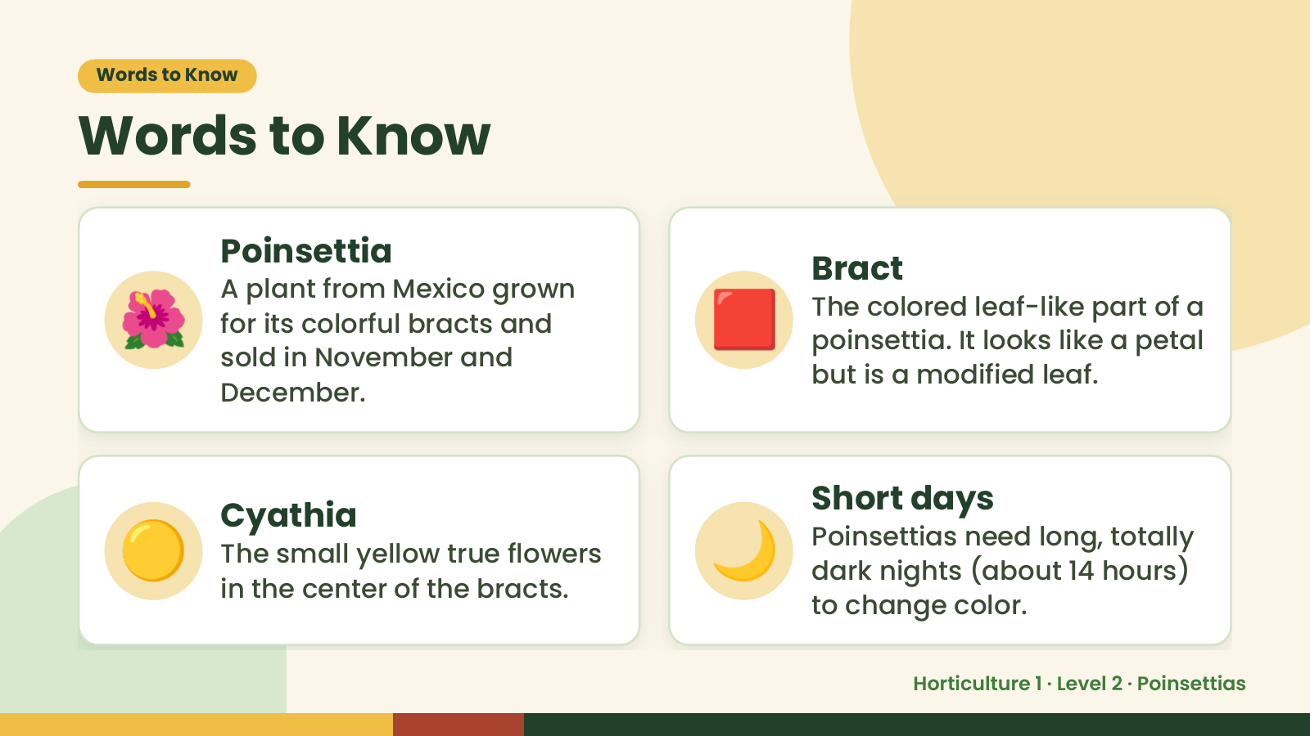
Notes:
Words to Know
Words to Know
🌺 🟥
Poinsettia
Bract
A plant from Mexico grown
The colored leaf-like part of a
for its colorful bracts and
poinsettia. It looks like a petal
sold in November and
but is a modified leaf.
December.
🟡 Cyathia
The small yellow true flowers
in the center of the bracts.
🌙 Short days
Poinsettias need long, totally
dark nights (about 14 hours)
to change color.
Horticulture 1 · Level 2 · Poinsettias

Slide 4
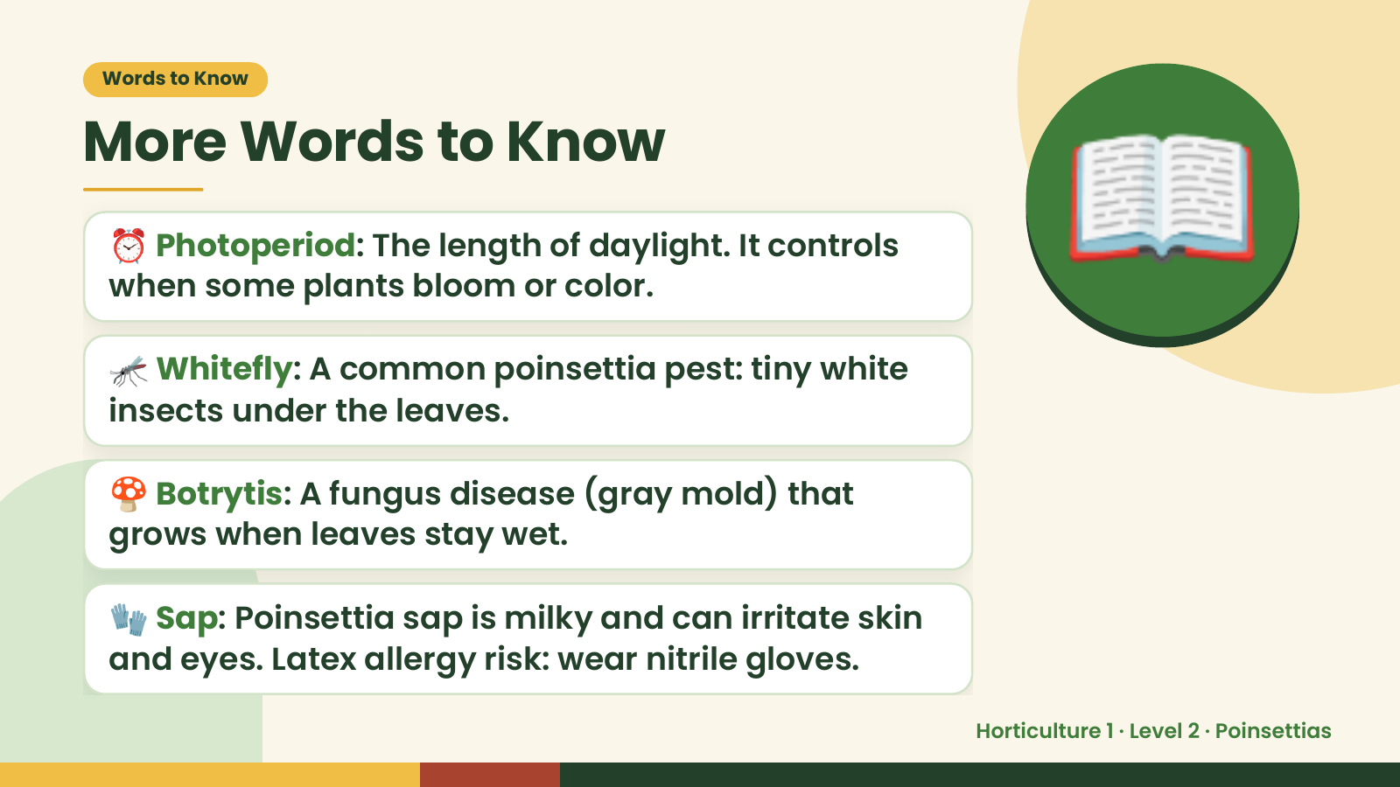
Notes:
Words to Know
More Words to Know
⏰ Photoperiod: The length of daylight. It controls
when some plants bloom or color.
🦟 Whitefly: A common poinsettia pest: tiny white
insects under the leaves.
📖
🍄 Botrytis: A fungus disease (gray mold) that
grows when leaves stay wet.
🧤 Sap: Poinsettia sap is milky and can irritate skin
and eyes. Latex allergy risk: wear nitrile gloves.
Horticulture 1 · Level 2 · Poinsettias

Slide 5
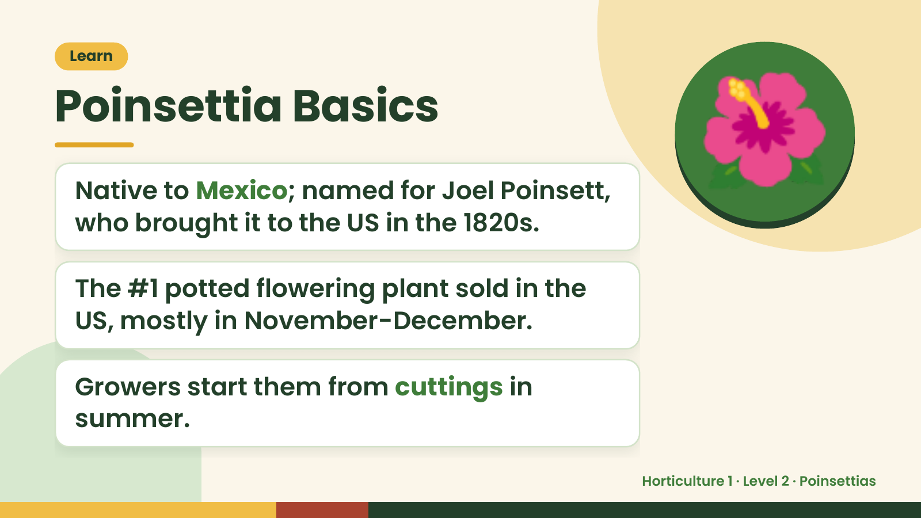
Notes:
Learn
Poinsettia Basics
Native to Mexico; named for Joel Poinsett,
who brought it to the US in the 1820s.
The #1 potted flowering plant sold in the
🌺
US, mostly in November-December.
Growers start them from cuttings in
summer.
Horticulture 1 · Level 2 · Poinsettias

Slide 6
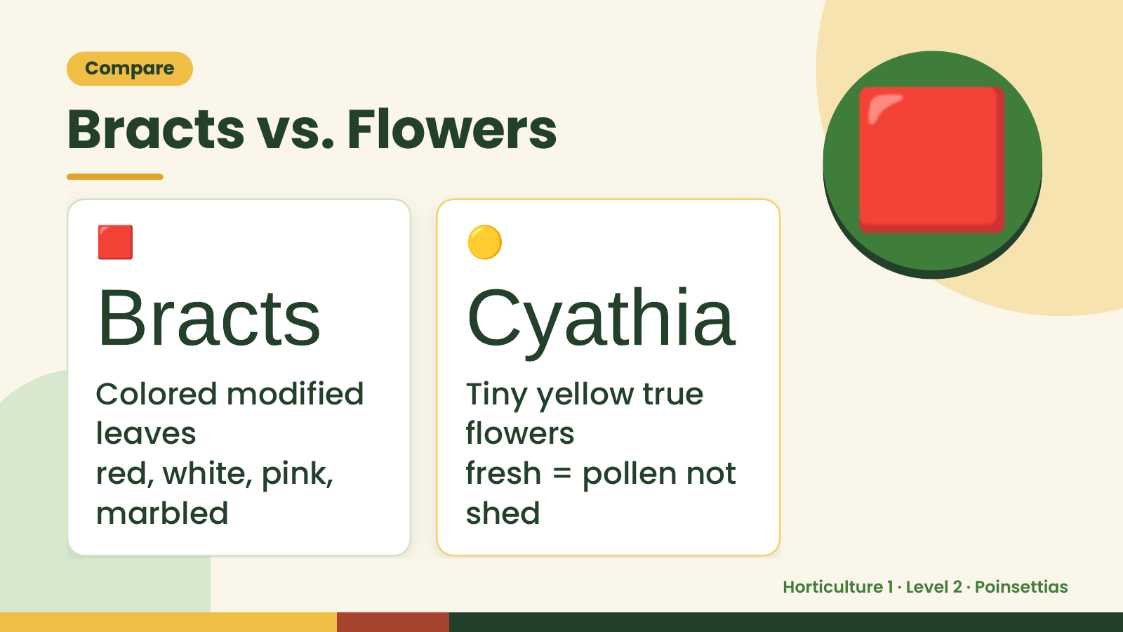
Notes:
Compare
Bracts vs. Flowers
🟥
Bracts
🟡
Cyathia
🟥
Colored modified Tiny yellow true
leaves flowers
red, white, pink, fresh = pollen not
marbled shed
Horticulture 1 · Level 2 · Poinsettias

Slide 7
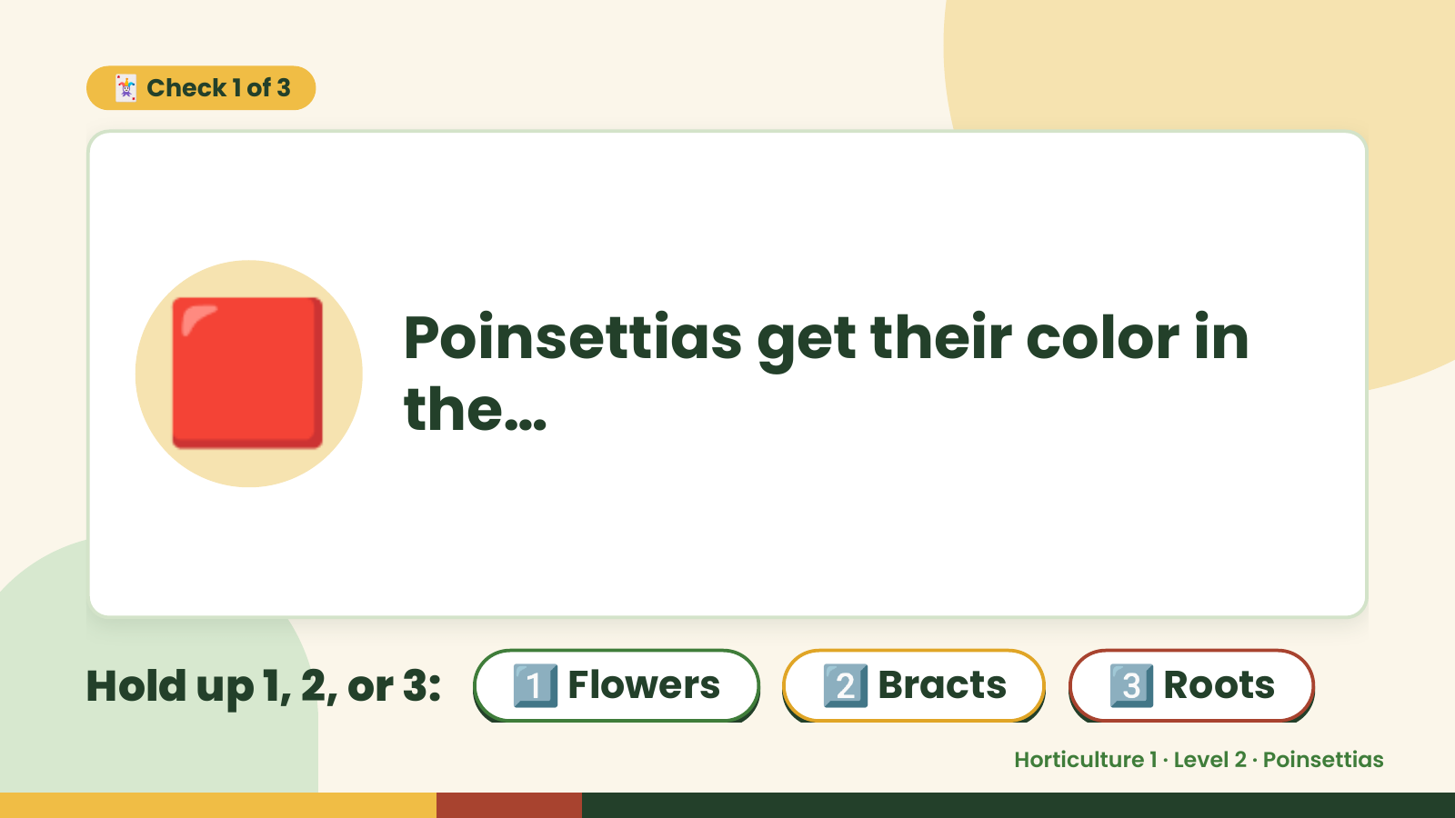
Notes:
🃏 Check 1 of 3
🟥 Poinsettias get their color in
the…
Hold up 1, 2, or 3: 1️⃣ Flowers 2️⃣ Bracts 3️⃣ Roots
Horticulture 1 · Level 2 · Poinsettias

Slide 8
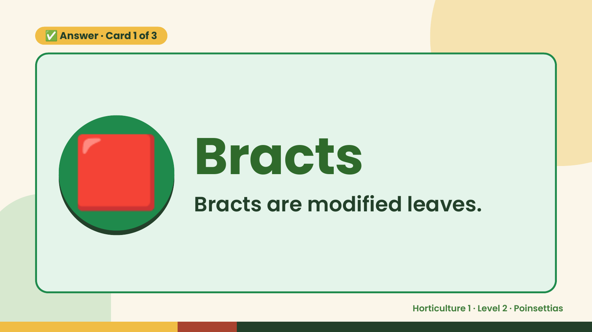
Notes:
✅ Answer · Card 1 of 3
🟥 Bracts
Bracts are modified leaves.
Horticulture 1 · Level 2 · Poinsettias

Slide 9
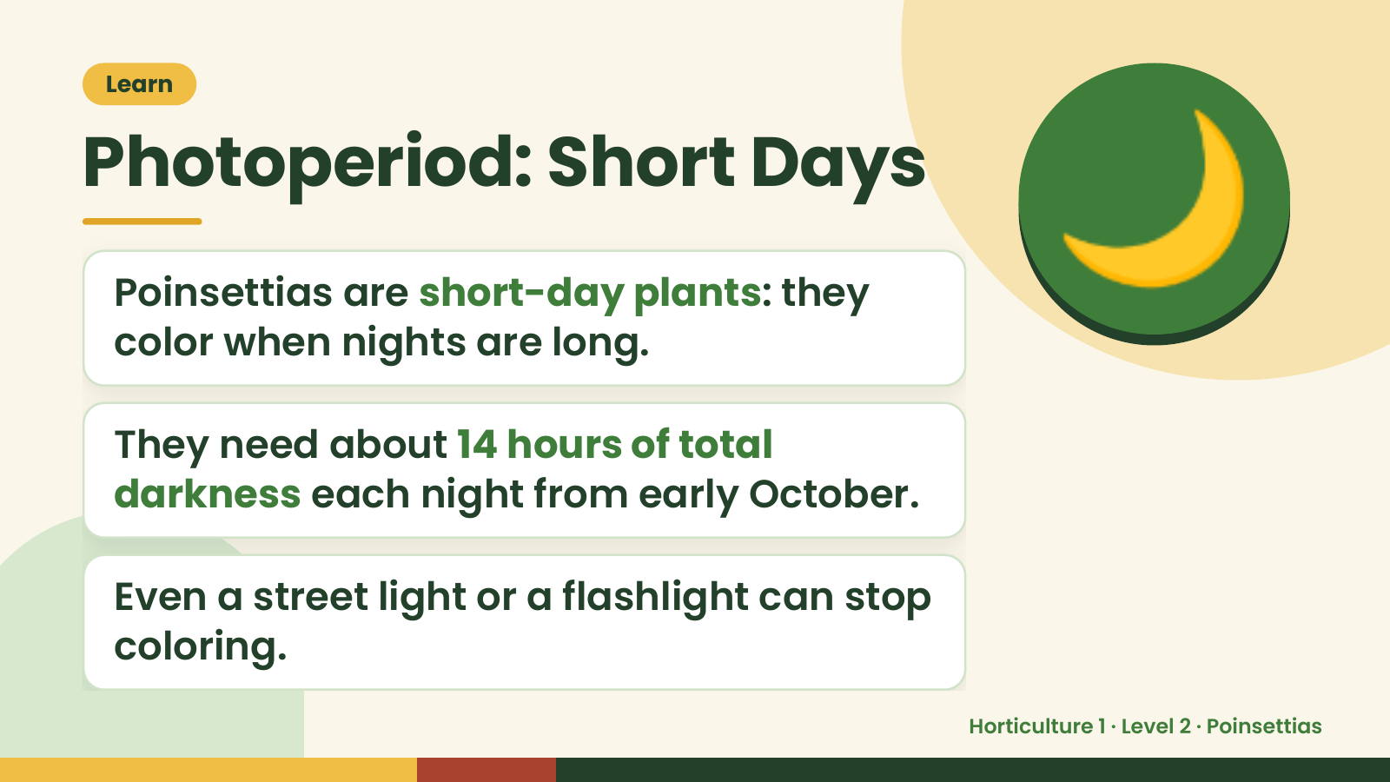
Notes:
Learn
Photoperiod: Short Days
Poinsettias are short-day plants: they
color when nights are long.
🌙
They need about 14 hours of total
darkness each night from early October.
Even a street light or a flashlight can stop
coloring.
Horticulture 1 · Level 2 · Poinsettias

Slide 10
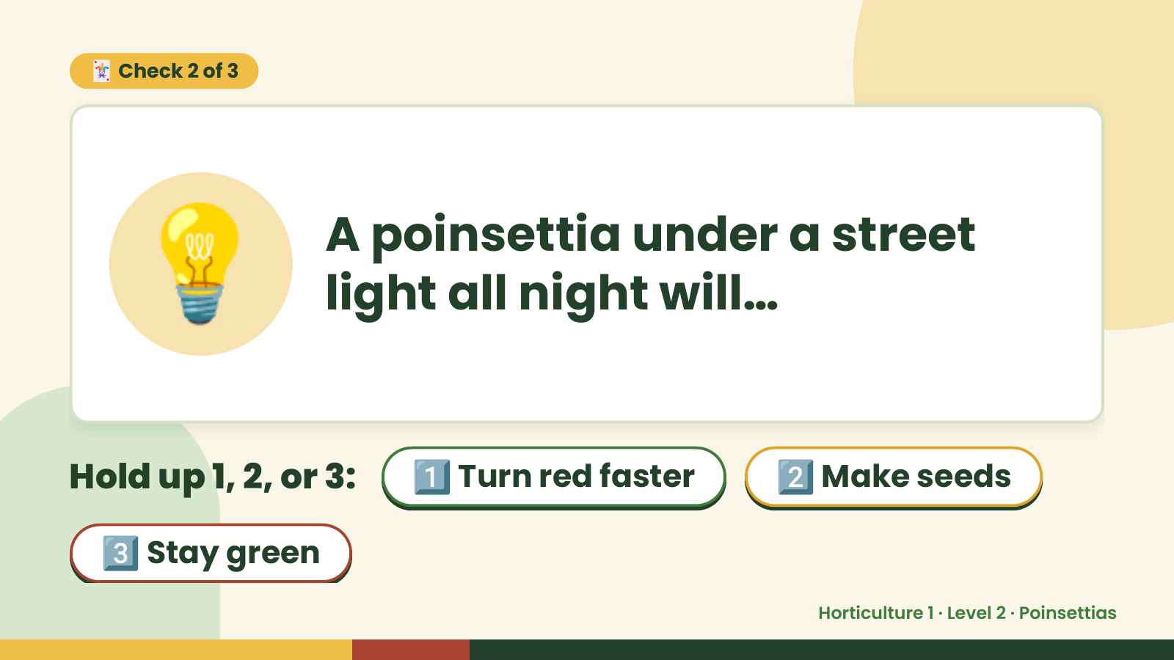
Notes:
🃏 Check 2 of 3
💡 A poinsettia under a street
light all night will…
Hold up 1, 2, or 3: 1️⃣ Turn red faster 2️⃣ Make seeds
3️⃣ Stay green
Horticulture 1 · Level 2 · Poinsettias

Slide 11
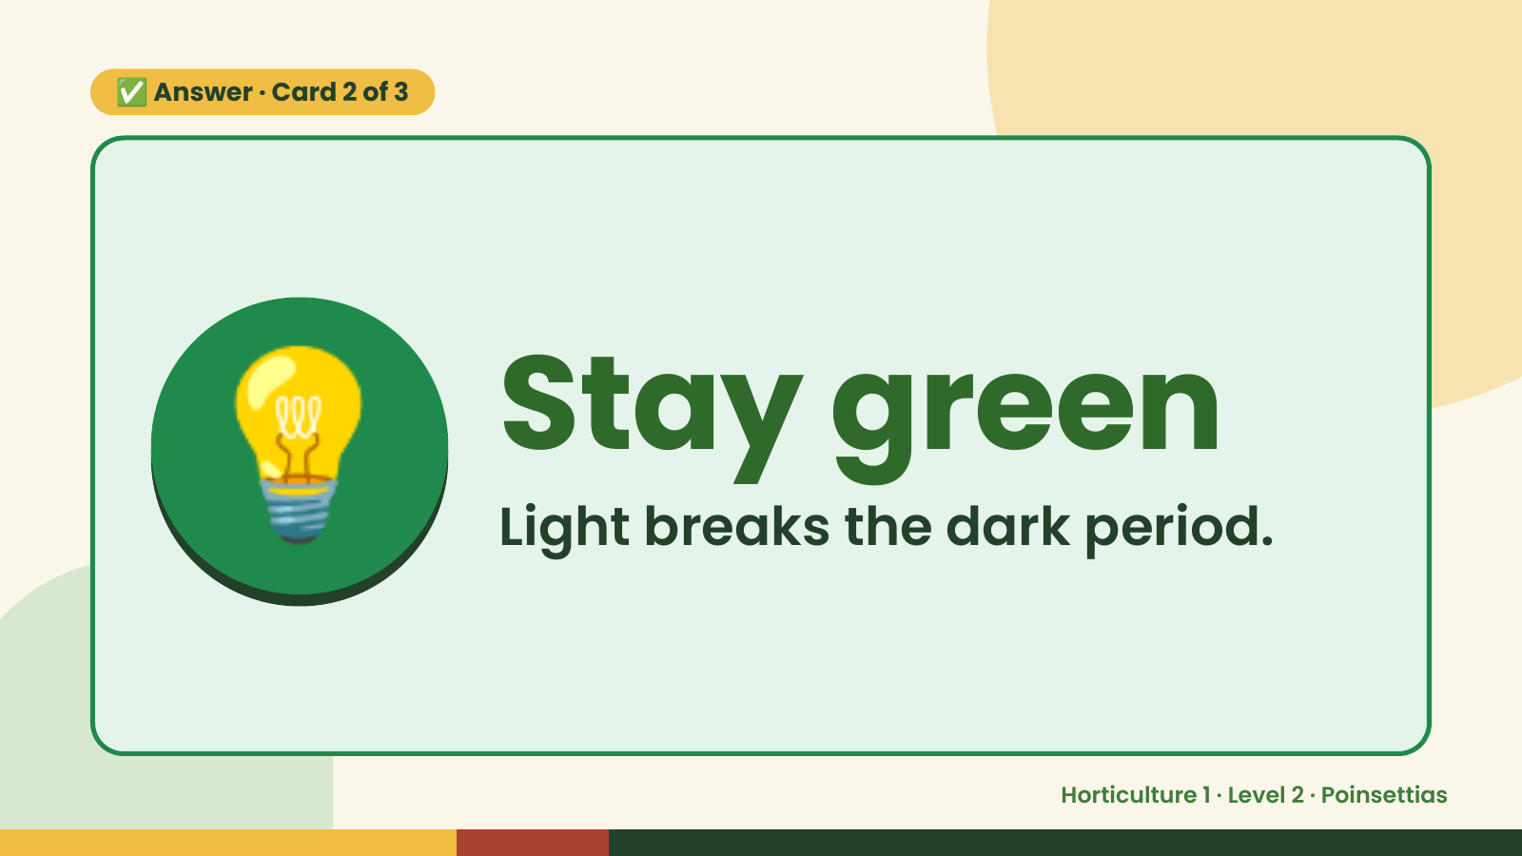
Notes:
✅ Answer · Card 2 of 3
💡 Stay green
Light breaks the dark period.
Horticulture 1 · Level 2 · Poinsettias

Slide 12
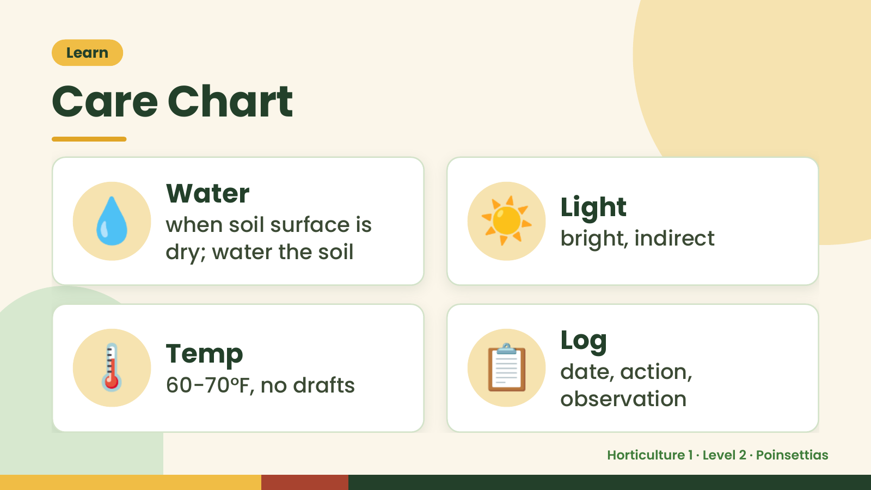
Notes:
Learn
Care Chart
💧 Water
when soil surface is
dry; water the soil
☀️ Light
bright, indirect
🌡️ Temp
60-70°F, no drafts 📋 Log
date, action,
observation
Horticulture 1 · Level 2 · Poinsettias

Slide 13
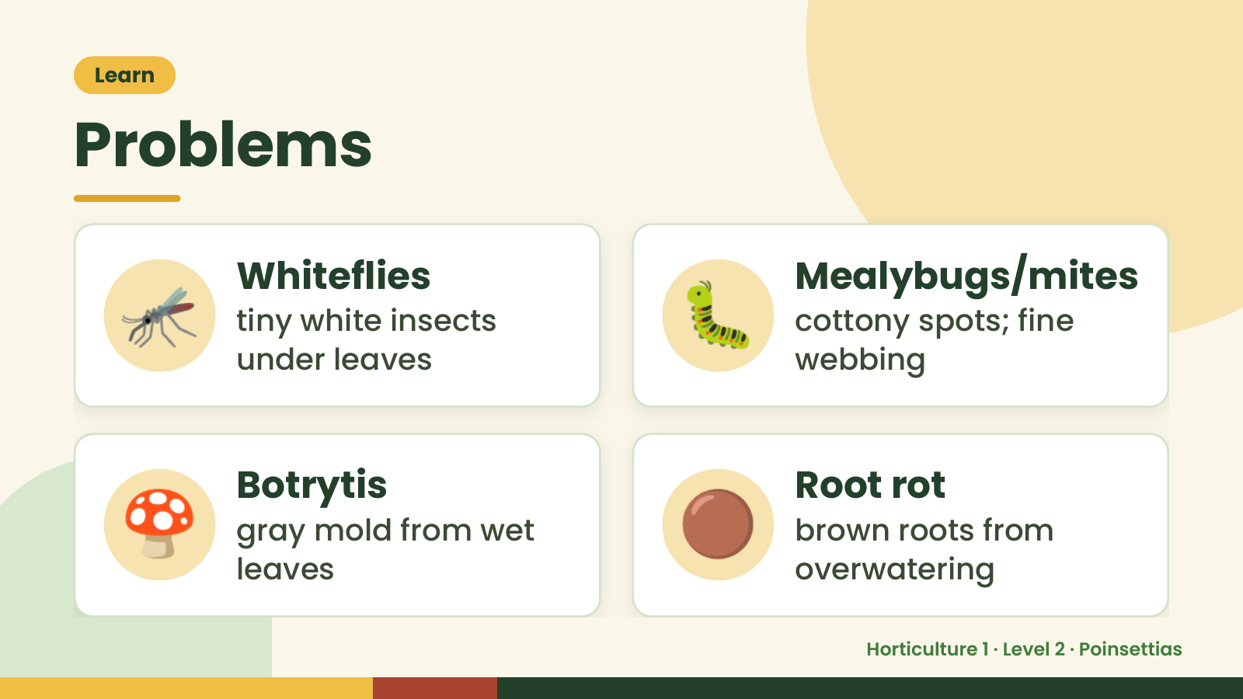
Notes:
Learn
Problems
🦟 Whiteflies
tiny white insects
under leaves
🐛 Mealybugs/mites
cottony spots; fine
webbing
🍄 Botrytis
gray mold from wet
leaves
🟤 Root rot
brown roots from
overwatering
Horticulture 1 · Level 2 · Poinsettias

Slide 14
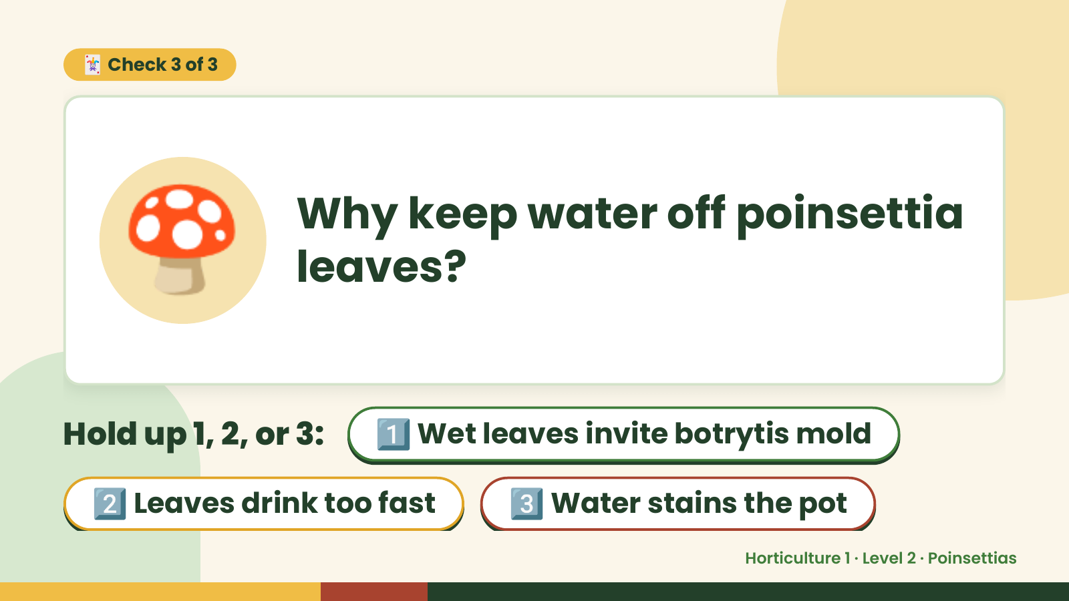
Notes:
🃏 Check 3 of 3
🍄 Why keep water off poinsettia
leaves?
Hold up 1, 2, or 3: 1️⃣ Wet leaves invite botrytis mold
2️⃣ Leaves drink too fast 3️⃣ Water stains the pot
Horticulture 1 · Level 2 · Poinsettias

Slide 15
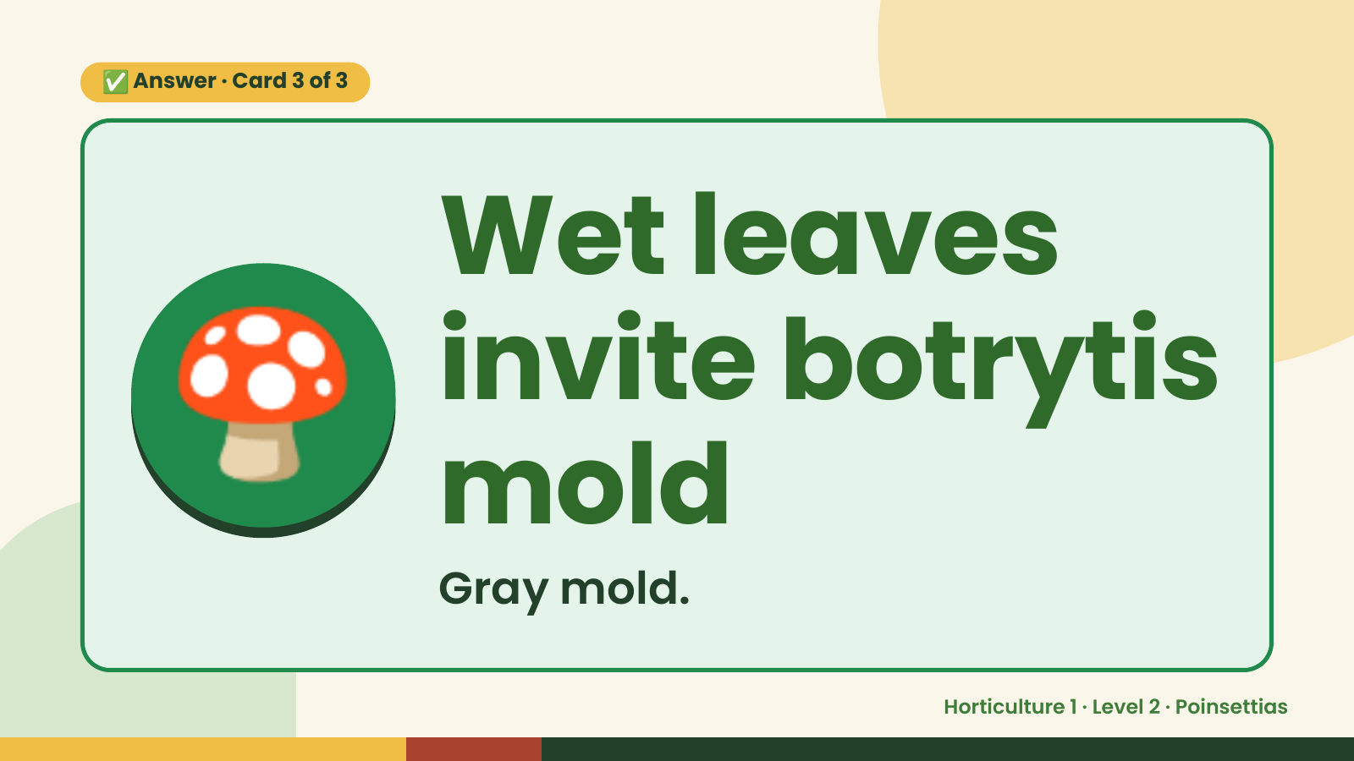
Notes:
✅ Answer · Card 3 of 3
🍄 Wet leaves
invite botrytis
mold
Gray mold.
Horticulture 1 · Level 2 · Poinsettias

Slide 16
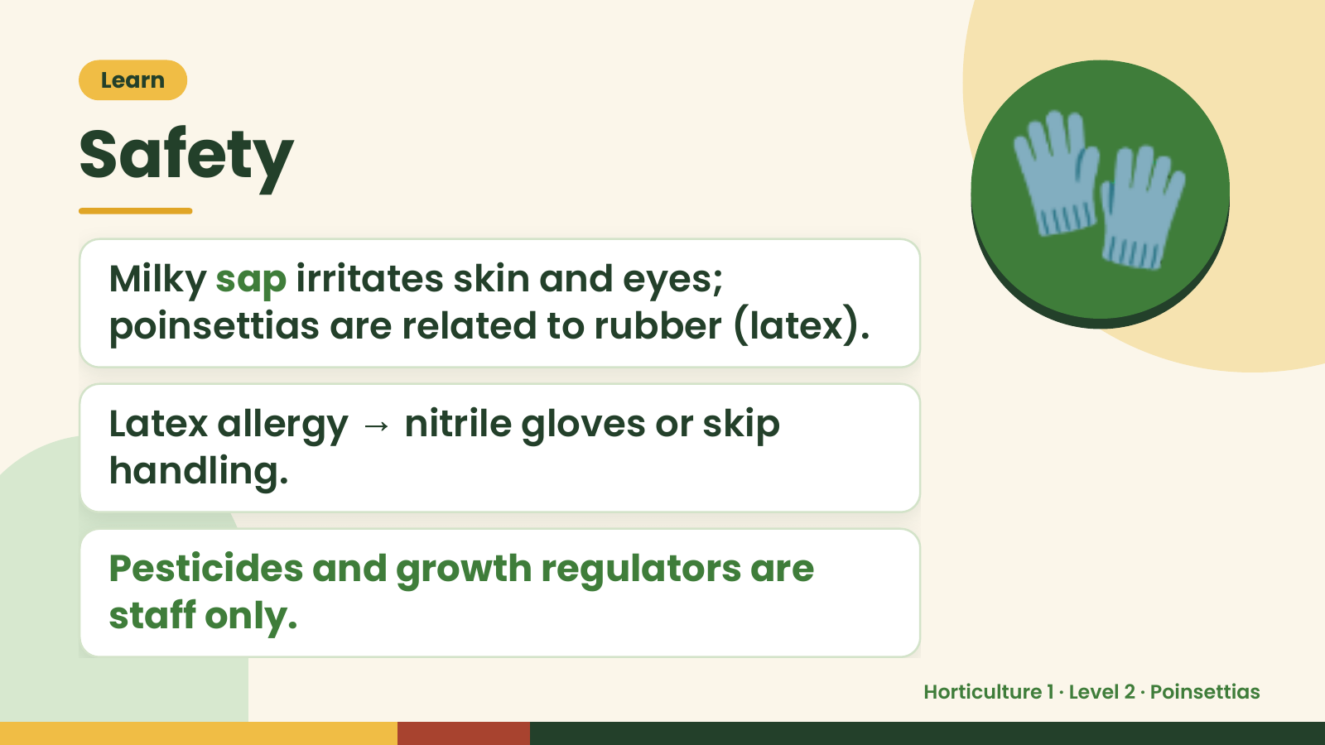
Notes:
Learn
Safety
Milky sap irritates skin and eyes;
poinsettias are related to rubber (latex).
🧤
Latex allergy → nitrile gloves or skip
handling.
Pesticides and growth regulators are
staff only.
Horticulture 1 · Level 2 · Poinsettias

Slide 17
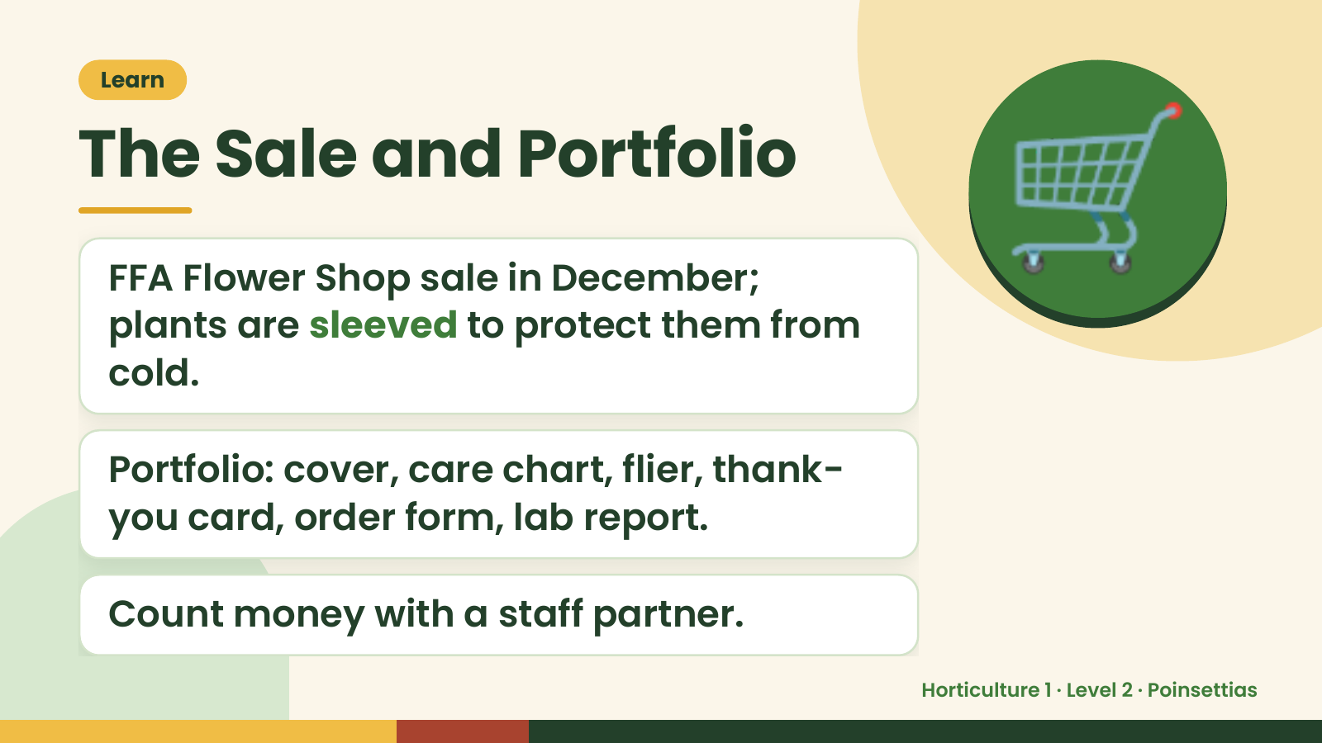
Notes:
Learn
The Sale and Portfolio
FFA Flower Shop sale in December;
plants are sleeved to protect them from
cold.
🛒
Portfolio: cover, care chart, flier, thank-
you card, order form, lab report.
Count money with a staff partner.
Horticulture 1 · Level 2 · Poinsettias

Slide 18
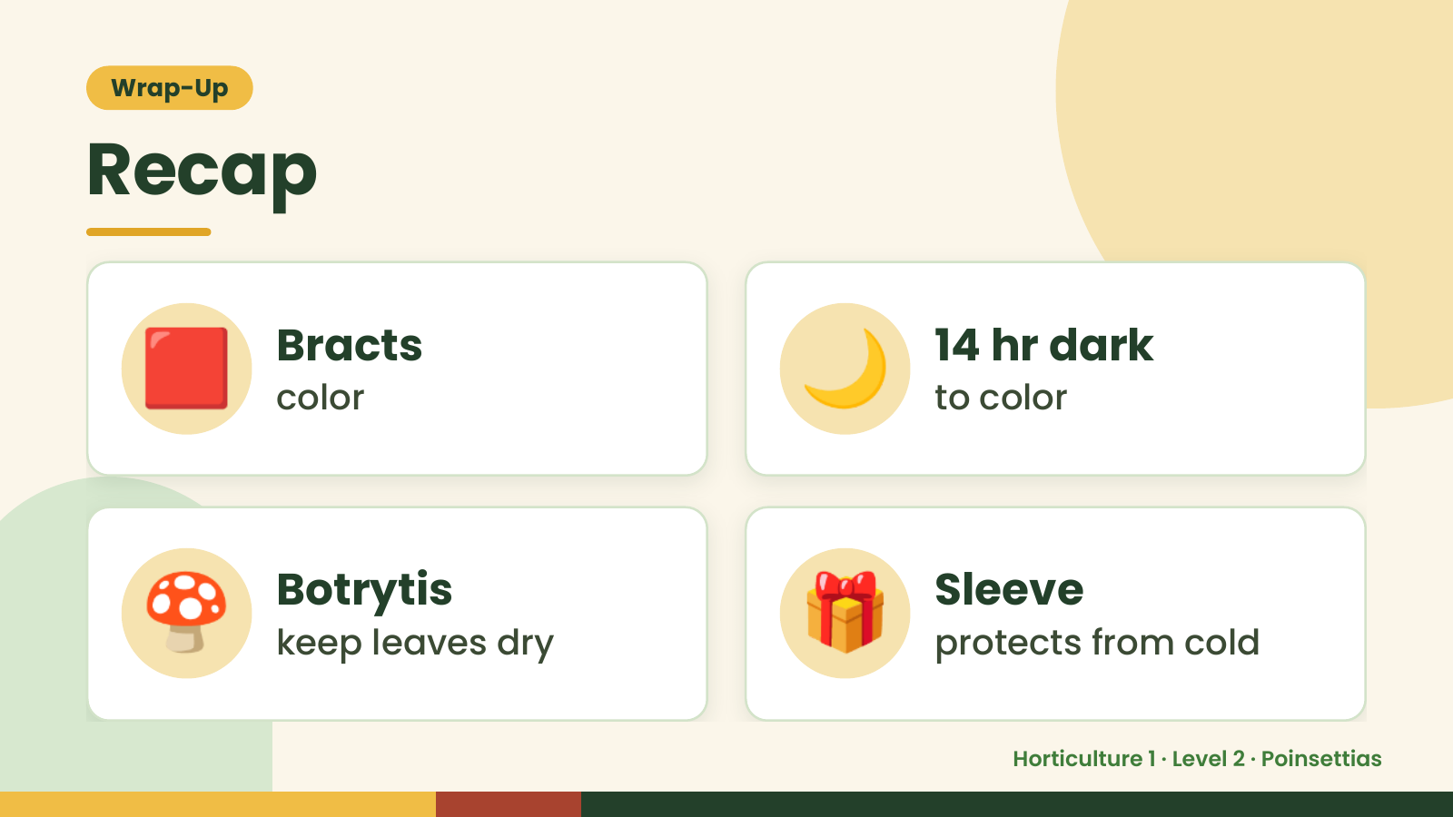
Notes:
Wrap-Up
Recap
🟥 Bracts
color 🌙 14 hr dark
to color
🍄 Botrytis
keep leaves dry 🎁 Sleeve
protects from cold
Horticulture 1 · Level 2 · Poinsettias

Slide 19
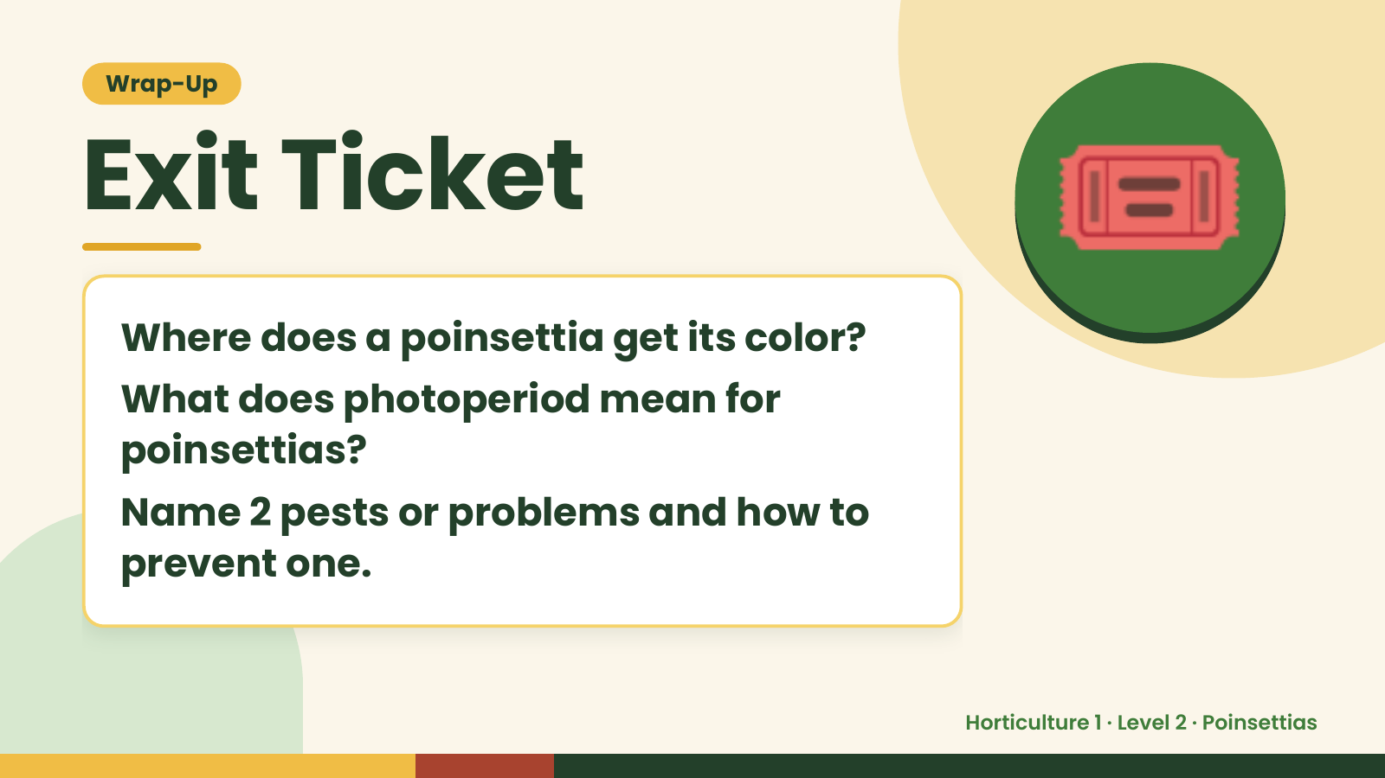
Notes:
Wrap-Up
Exit Ticket
Where does a poinsettia get its color?
What does photoperiod mean for
🎟️
poinsettias?
Name 2 pests or problems and how to
prevent one.
Horticulture 1 · Level 2 · Poinsettias

