Slide 1
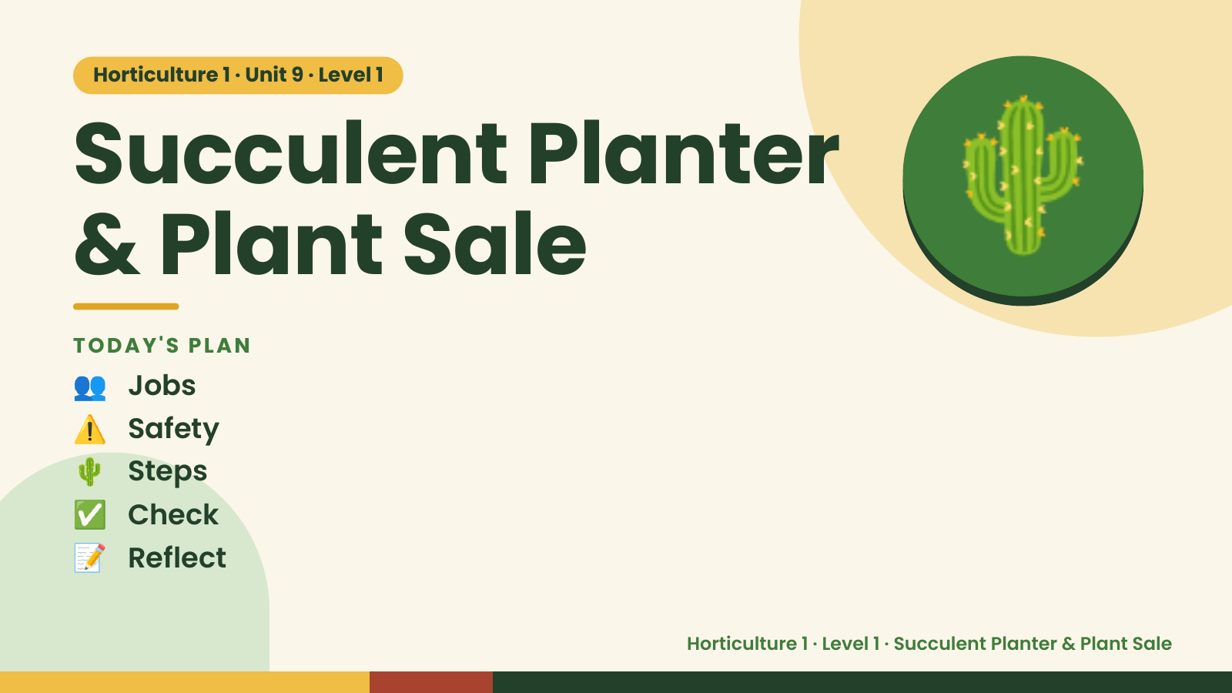
Notes:
Horticulture 1 · Unit 9 · Level 1
Succulent Planter
& Plant Sale
👥 Jobs
TODAY'S PLAN
🌵
⚠️ Safety
🌵 Steps
✅ Check
📝 Reflect
Horticulture 1 · Level 1 · Succulent Planter & Plant Sale

Slide 2

Notes:
Get ready
Jobs
🧑‍🌾 Grower
plants 🧺 Supply helper
gets tools
📸 Recorder
photos 🧽 Clean-up
captain
cleans
Horticulture 1 · Level 1 · Succulent Planter & Plant Sale

Slide 3
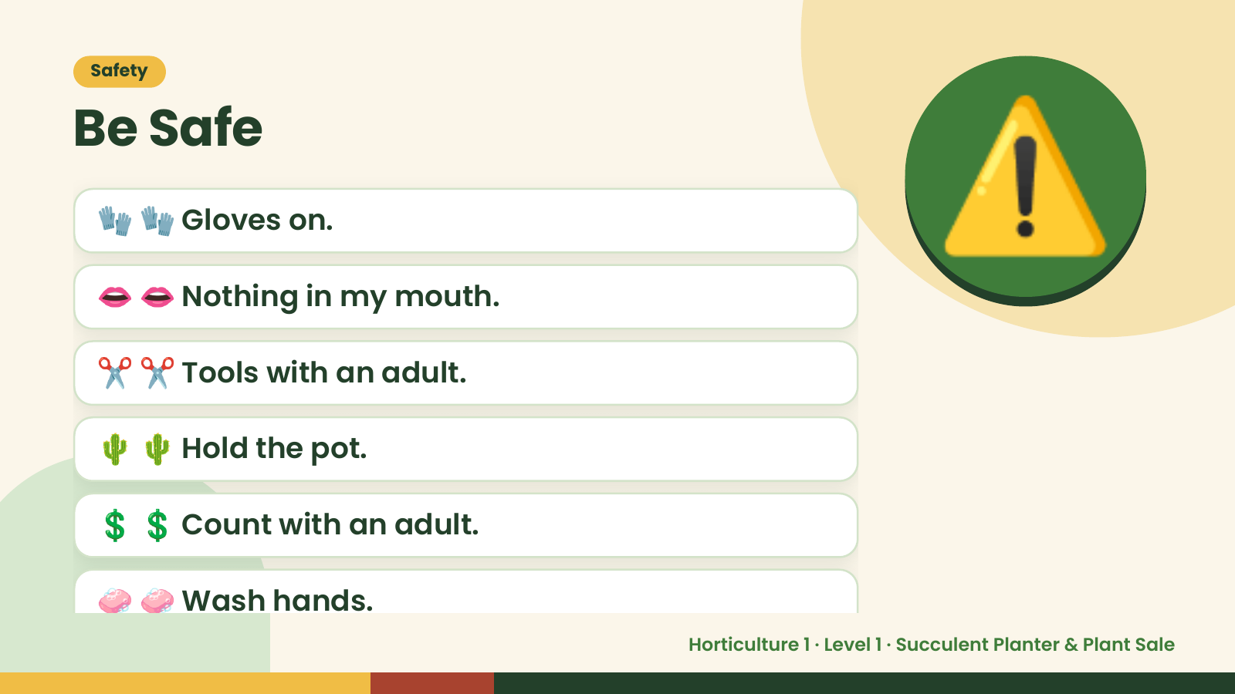
Notes:
Safety
Be Safe
🧤 🧤 Gloves on.
👄 👄 Nothing in my mouth.
✂️ ✂️ Tools with an adult.
⚠️
🌵 🌵 Hold the pot.
💲 💲 Count with an adult.
🧼 🧼 Wash hands.
Horticulture 1 · Level 1 · Succulent Planter & Plant Sale

Slide 4
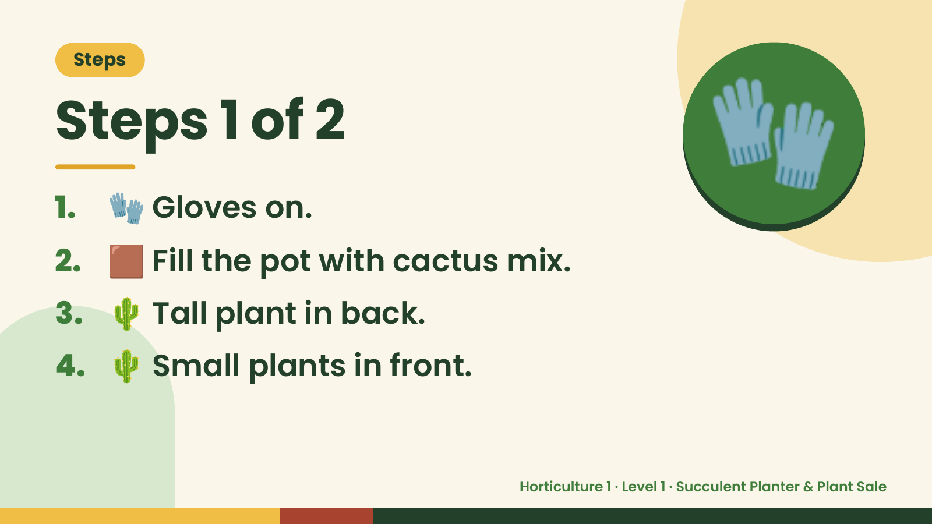
Notes:
Steps
Steps 1 of 2
1. 🧤 Gloves on.
2. 🟫 Fill the pot with cactus mix.
🧤
3. 🌵 Tall plant in back.
4. 🌵 Small plants in front.
Horticulture 1 · Level 1 · Succulent Planter & Plant Sale

Slide 5
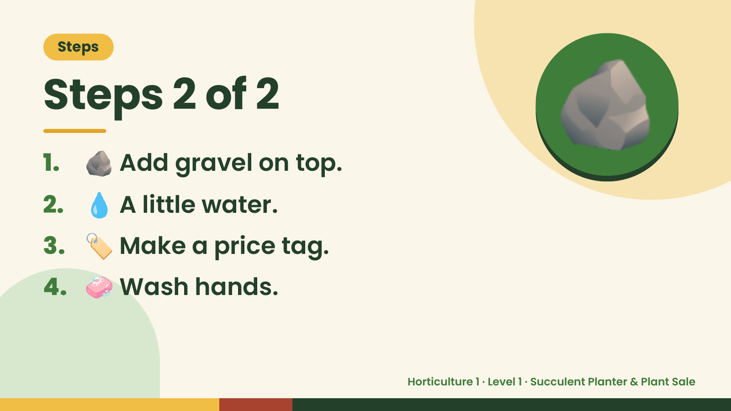
Notes:
Steps
Steps 2 of 2
1. 🪨 Add gravel on top.
2. 💧 A little water.
🪨
3. 🏷️ Make a price tag.
4. 🧼 Wash hands.
Horticulture 1 · Level 1 · Succulent Planter & Plant Sale

Slide 6
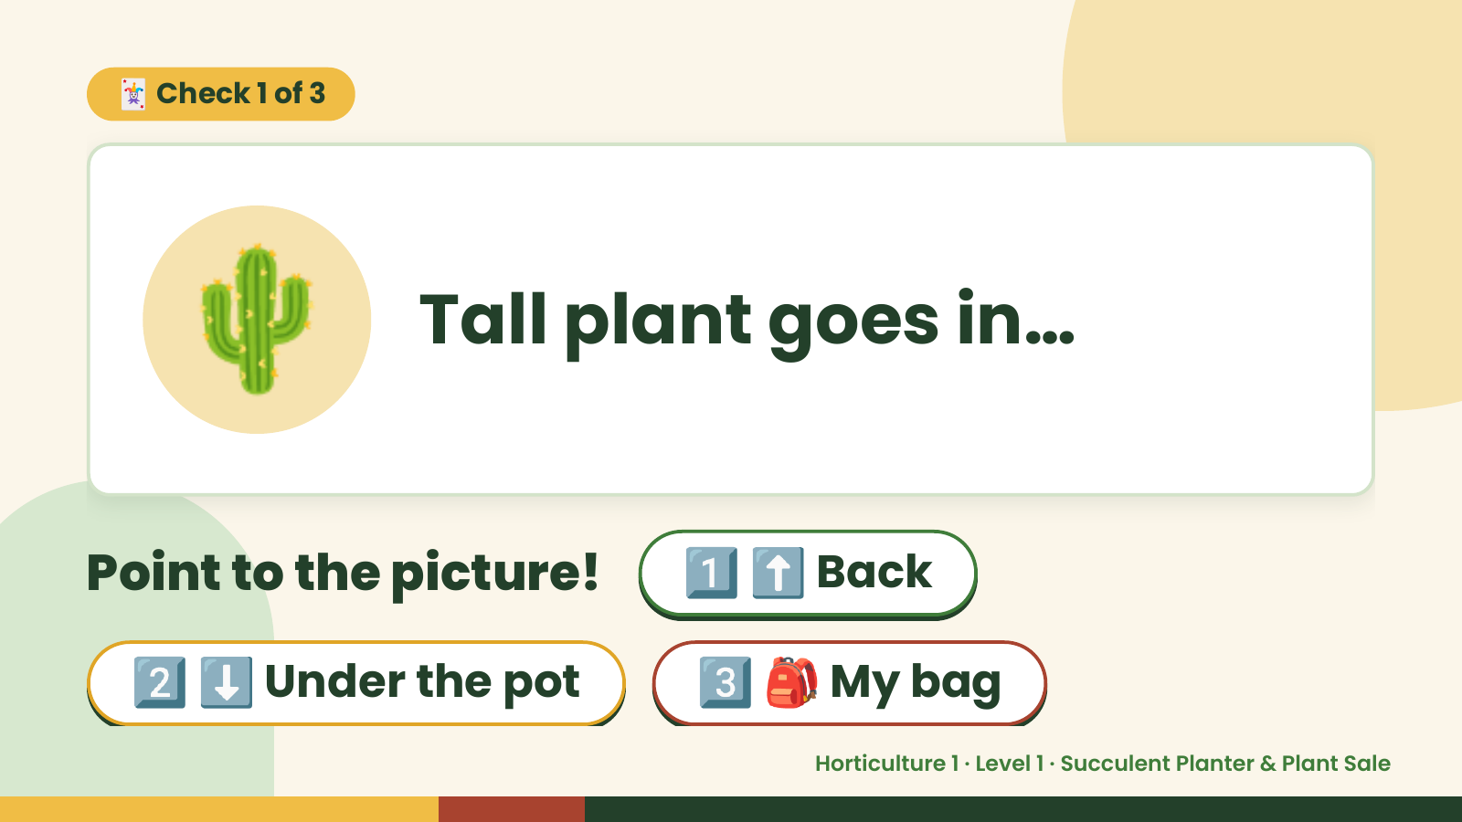
Notes:
🃏 Check 1 of 3
🌵 Tall plant goes in…
Point to the picture! 1️⃣ ⬆️ Back
2️⃣ ⬇️ Under the pot 3️⃣ 🎒 My bag
Horticulture 1 · Level 1 · Succulent Planter & Plant Sale

Slide 7
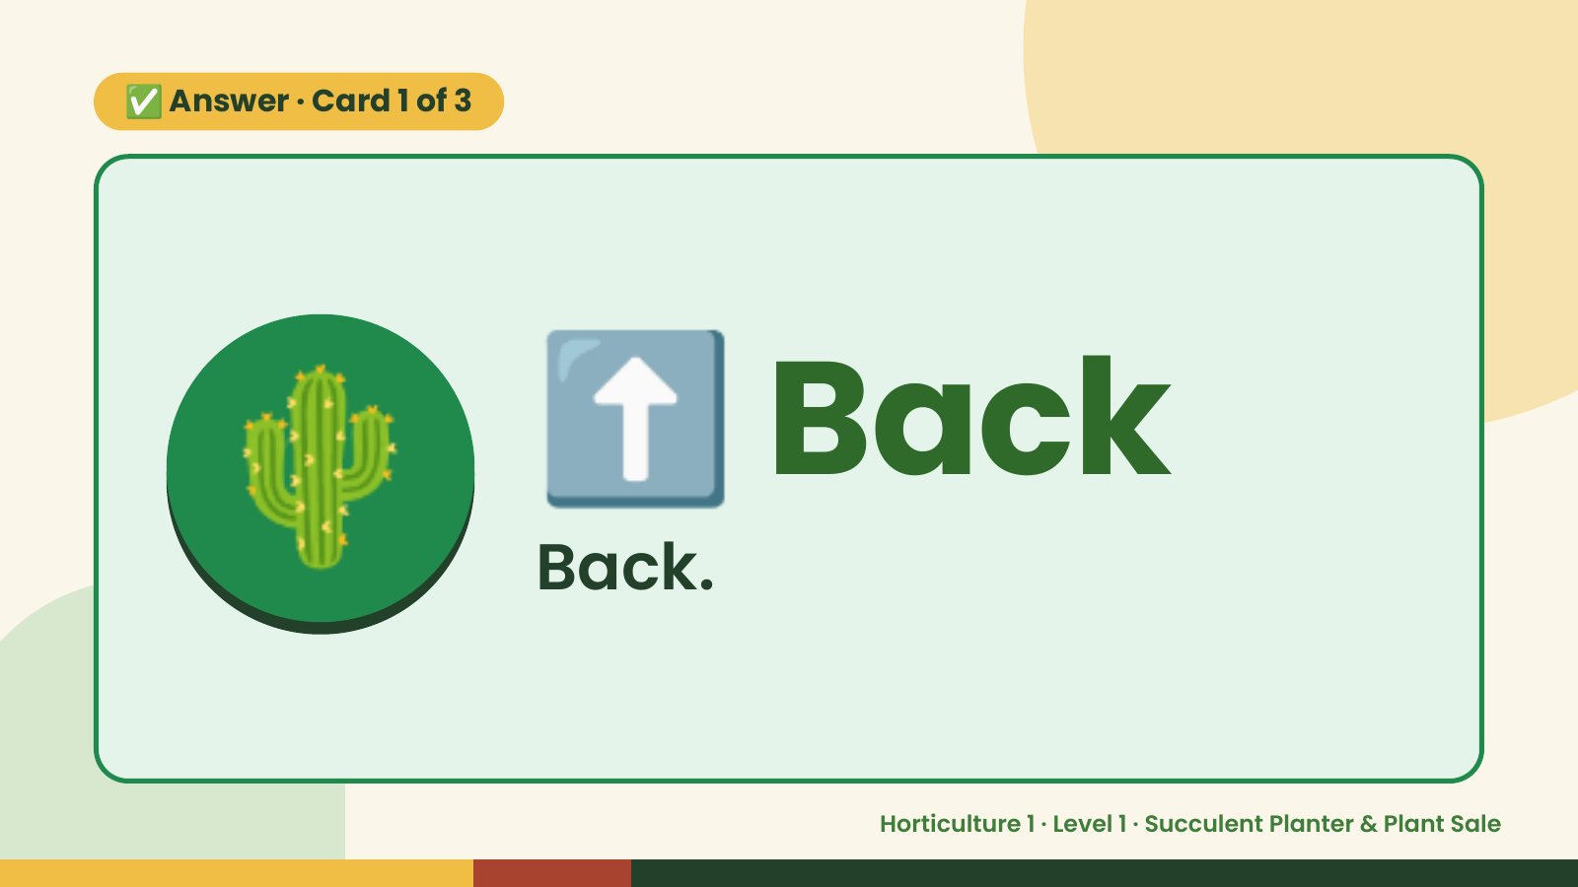
Notes:
✅ Answer · Card 1 of 3
🌵 ⬆️ Back
Back.
Horticulture 1 · Level 1 · Succulent Planter & Plant Sale

Slide 8
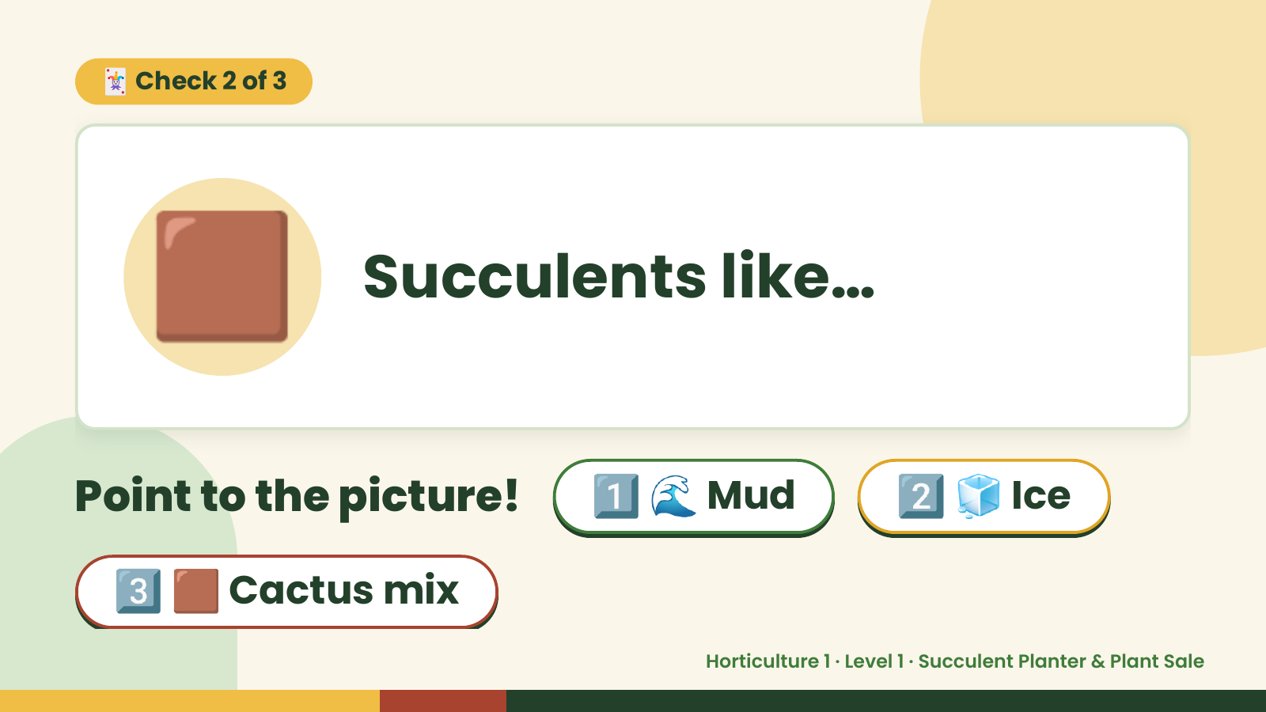
Notes:
🃏 Check 2 of 3
🟫 Succulents like…
Point to the picture! 1️⃣ 🌊 Mud 2️⃣ 🧊 Ice
3️⃣ 🟫 Cactus mix
Horticulture 1 · Level 1 · Succulent Planter & Plant Sale

Slide 9
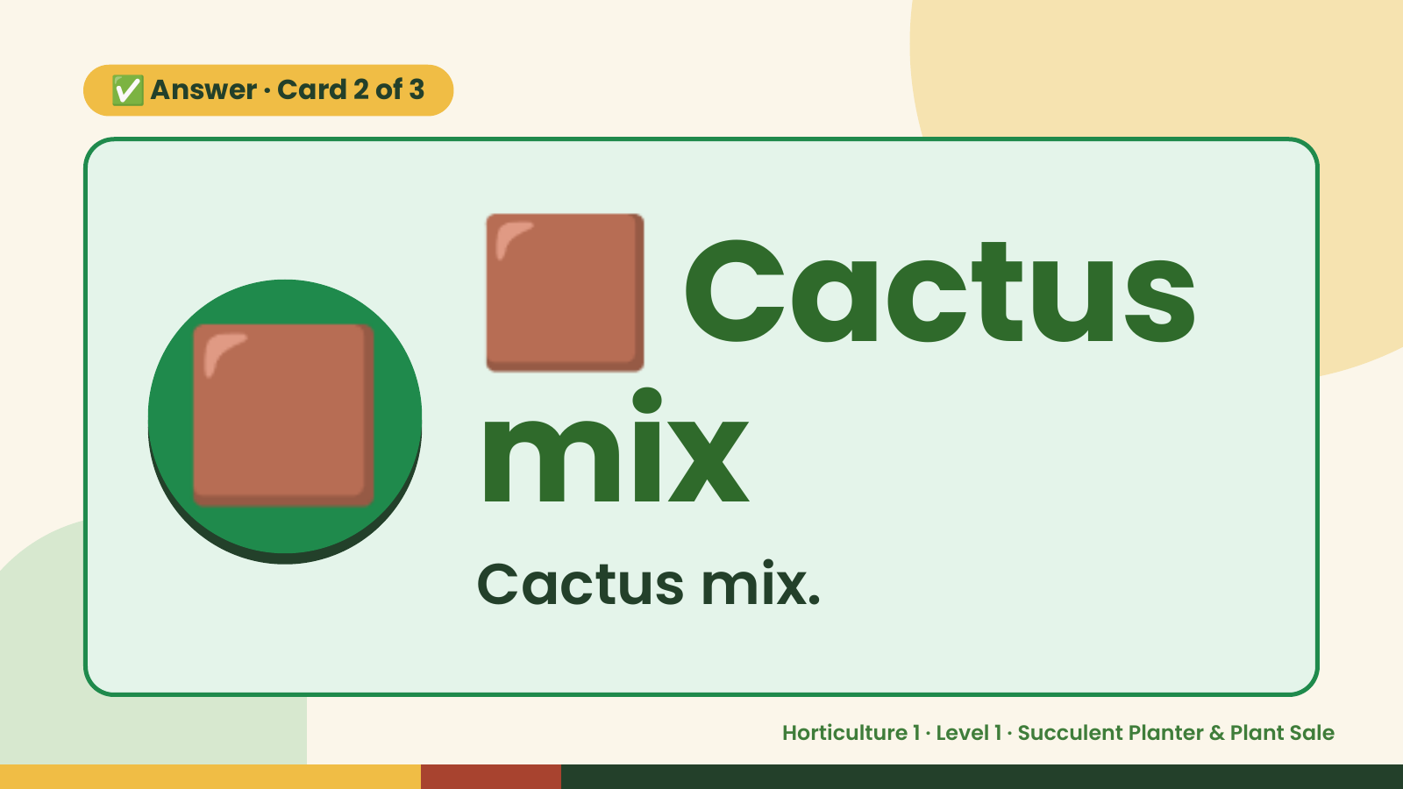
Notes:
🟫
✅ Answer · Card 2 of 3
🟫 mix
Cactus
Cactus mix.
Horticulture 1 · Level 1 · Succulent Planter & Plant Sale

Slide 10
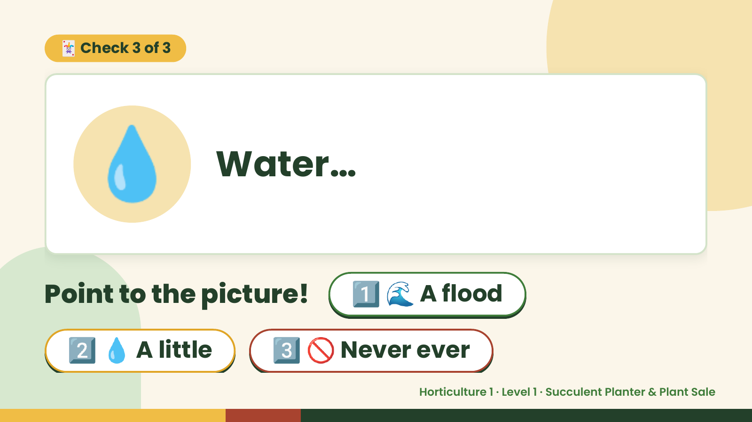
Notes:
🃏 Check 3 of 3
💧 Water…
Point to the picture! 1️⃣ 🌊 A flood
2️⃣ 💧 A little 3️⃣ 🚫 Never ever
Horticulture 1 · Level 1 · Succulent Planter & Plant Sale

Slide 11
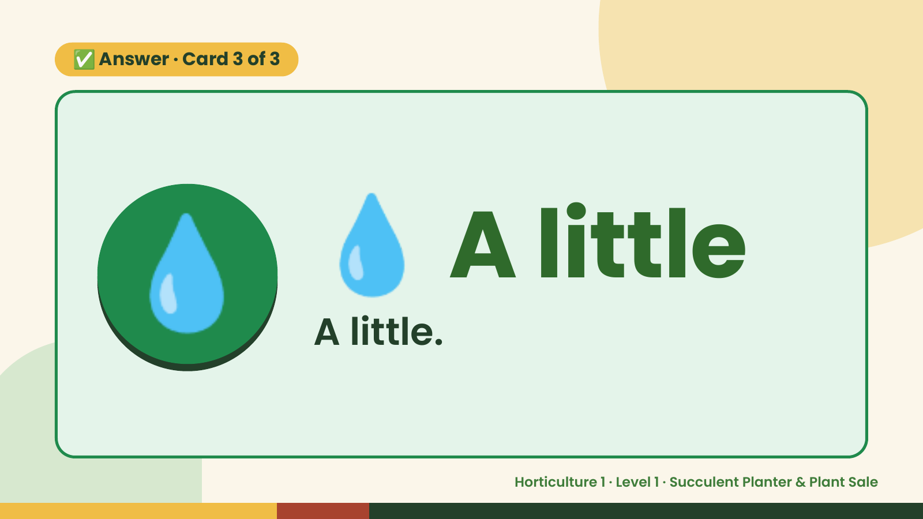
Notes:
✅ Answer · Card 3 of 3
💧 💧 A little
A little.
Horticulture 1 · Level 1 · Succulent Planter & Plant Sale

Slide 12

Notes:
Wrap-Up
Clean Up +
Reflect
🧽
🧽 Clean the table.
🧰 Give tools back.
🧼 Wash hands.
Horticulture 1 · Level 1 · Succulent Planter & Plant Sale

