Slide 1
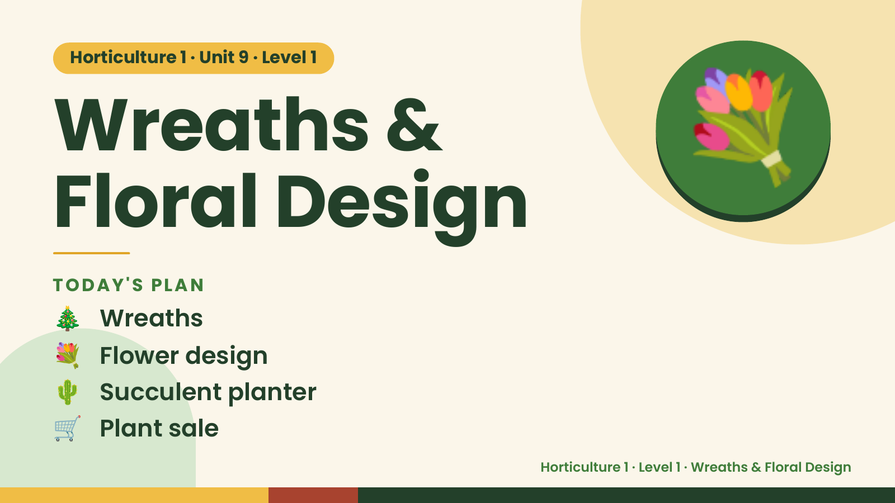
Notes:
Horticulture 1 · Unit 9 · Level 1
Wreaths &
Floral Design
💐
🎄 Wreaths
TODAY'S PLAN
💐 Flower design
🌵 Succulent planter
🛒 Plant sale
Horticulture 1 · Level 1 · Wreaths & Floral Design

Slide 2
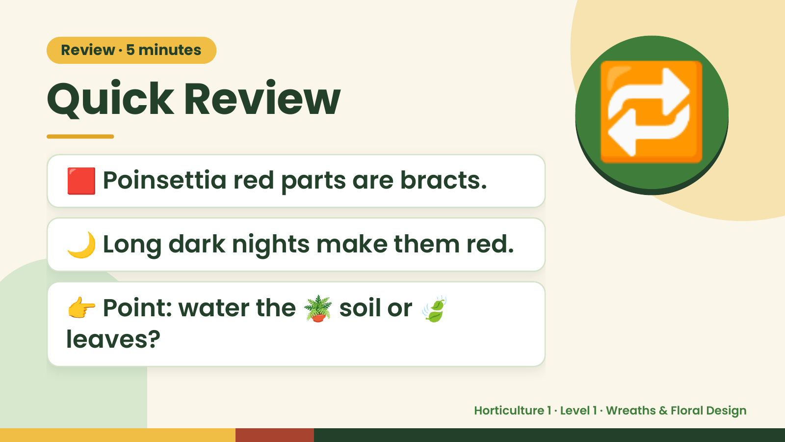
Notes:
Review · 5 minutes
Quick Review
🟥 Poinsettia red parts are bracts.
🌙 Long dark nights make them red.
🔁
👉 Point: water the 🪴 soil or 🍃
leaves?
Horticulture 1 · Level 1 · Wreaths & Floral Design

Slide 3
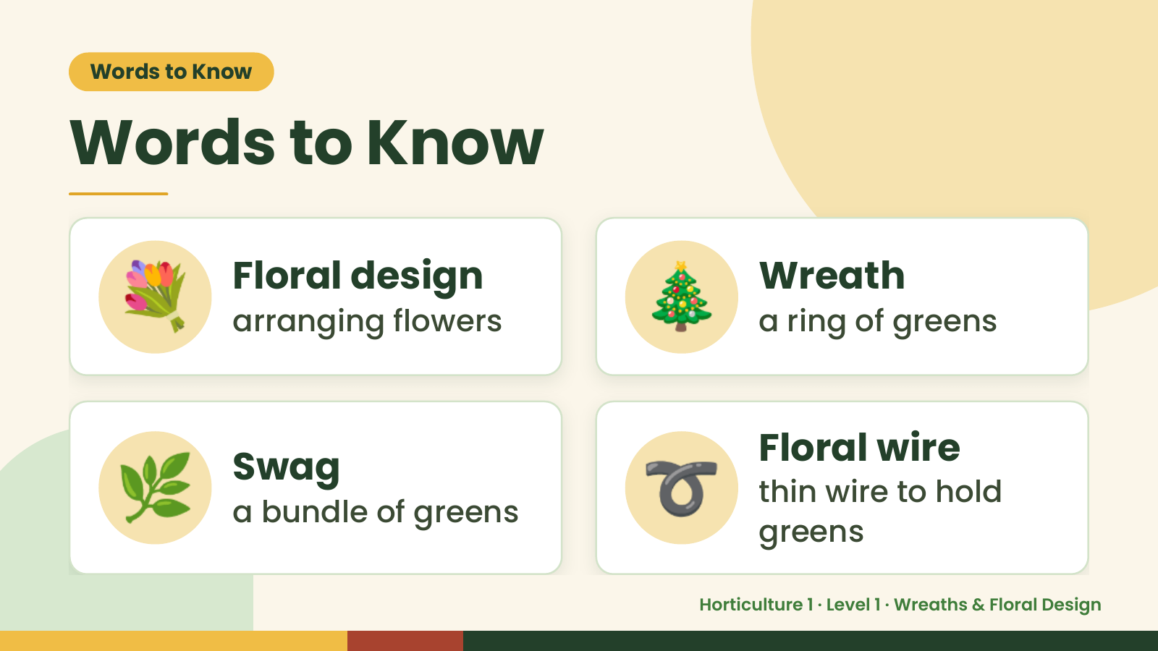
Notes:
Words to Know
Words to Know
💐 Floral design
arranging flowers 🎄 Wreath
a ring of greens
🌿 Swag
a bundle of greens ➰ Floral wire
thin wire to hold
greens
Horticulture 1 · Level 1 · Wreaths & Floral Design

Slide 4
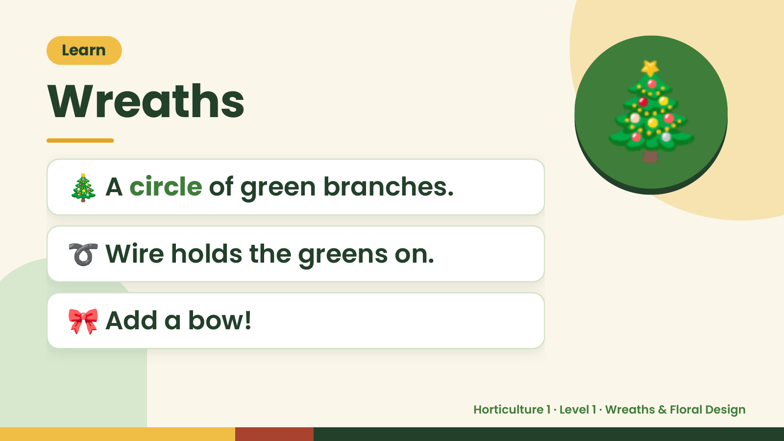
Notes:
Learn
Wreaths
🎄 A circle of green branches.
🎄
➰ Wire holds the greens on.
🎀 Add a bow!
Horticulture 1 · Level 1 · Wreaths & Floral Design

Slide 5
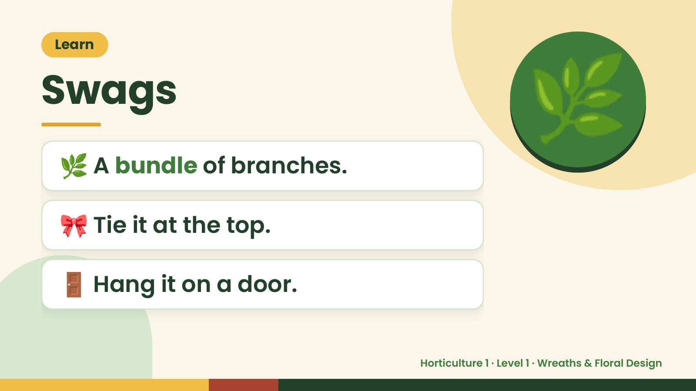
Notes:
Learn
Swags
🌿 A bundle of branches.
🌿
🎀 Tie it at the top.
🚪 Hang it on a door.
Horticulture 1 · Level 1 · Wreaths & Floral Design

Slide 6
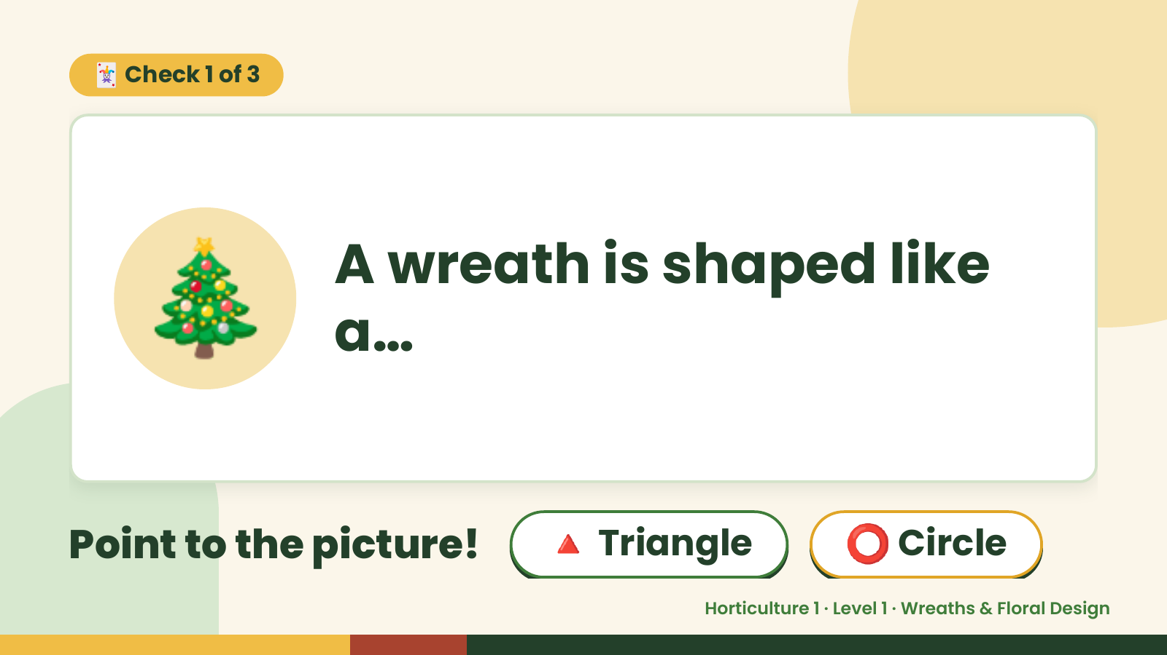
Notes:
🃏 Check 1 of 3
🎄 A wreath is shaped like
a…
Point to the picture! 🔺 Triangle ⭕ Circle
Horticulture 1 · Level 1 · Wreaths & Floral Design

Slide 7
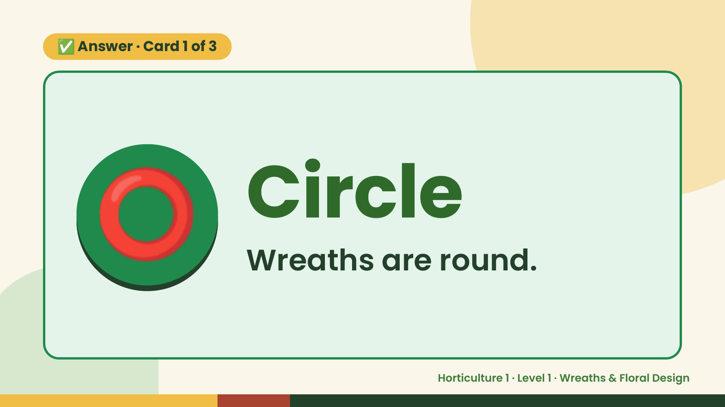
Notes:
✅ Answer · Card 1 of 3
⭕ Circle
Wreaths are round.
Horticulture 1 · Level 1 · Wreaths & Floral Design

Slide 8
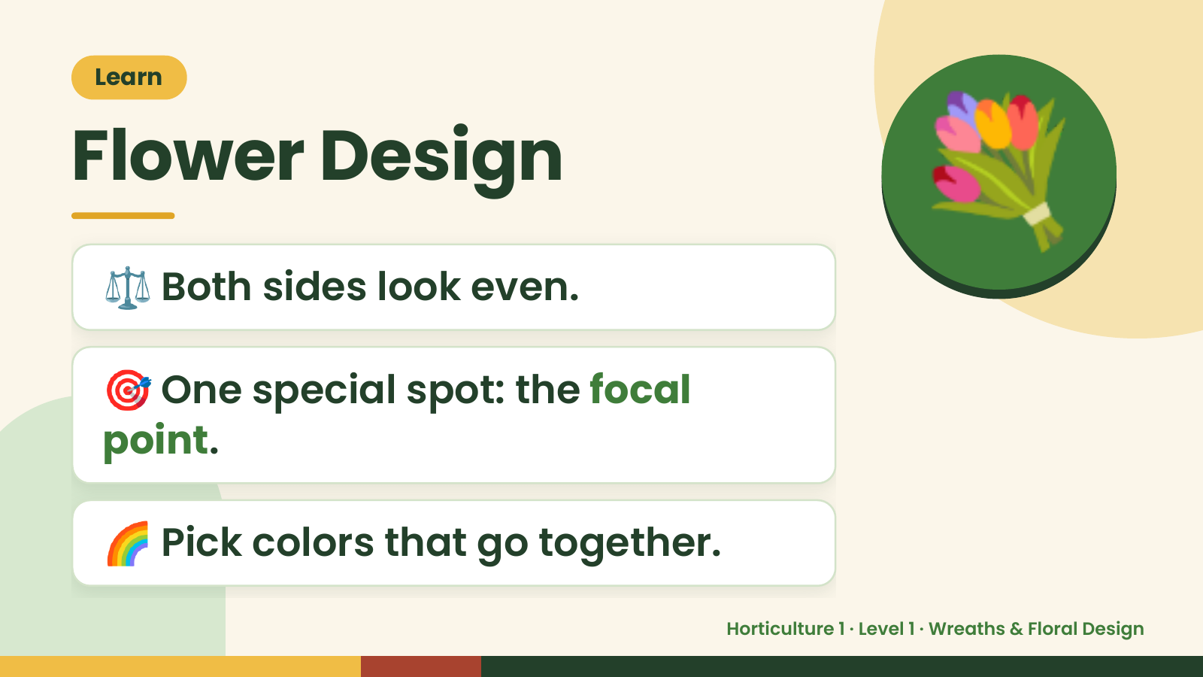
Notes:
Learn
Flower Design
⚖️ Both sides look even.
💐
🎯 One special spot: the focal
point.
🌈 Pick colors that go together.
Horticulture 1 · Level 1 · Wreaths & Floral Design

Slide 9
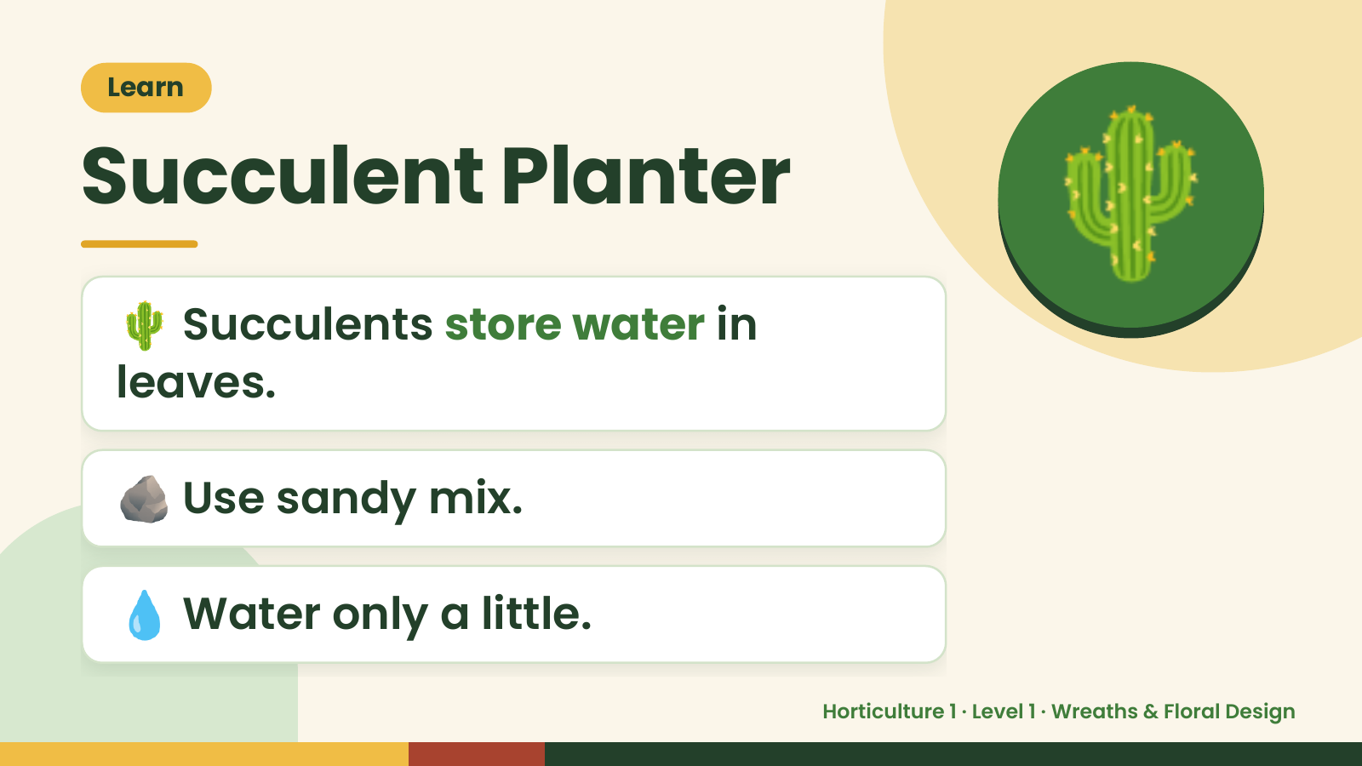
Notes:
Learn
Succulent Planter
🌵 Succulents store water in
leaves.
🌵
🪨 Use sandy mix.
💧 Water only a little.
Horticulture 1 · Level 1 · Wreaths & Floral Design

Slide 10
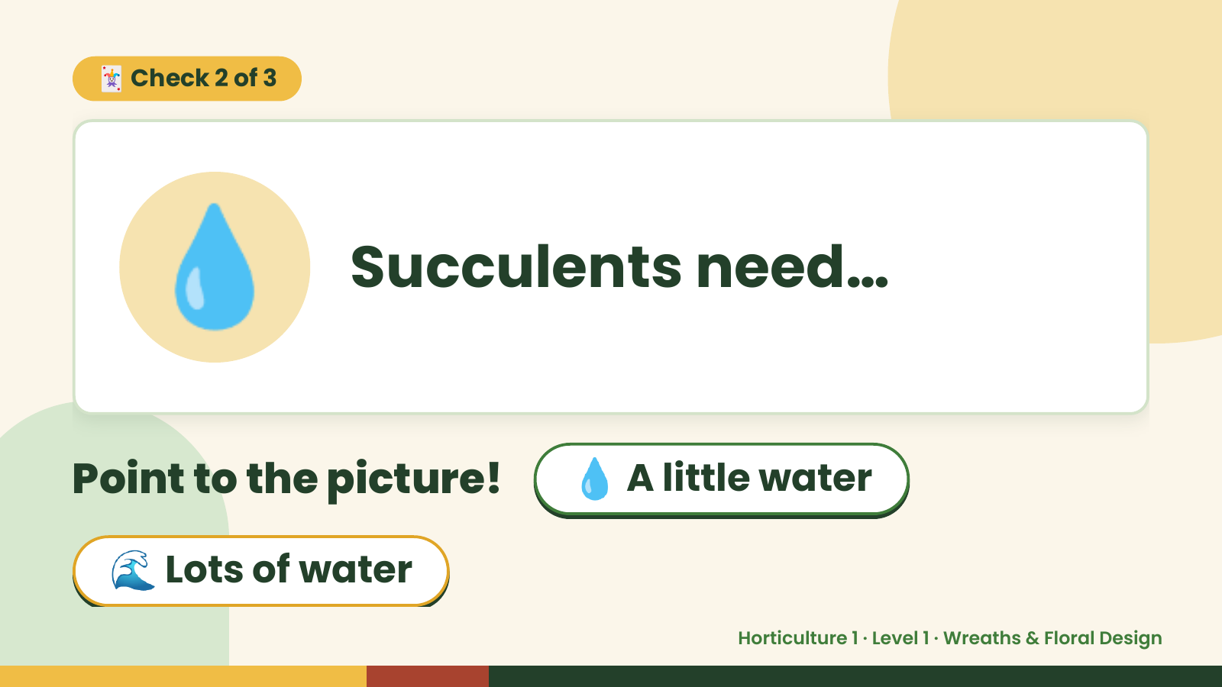
Notes:
🃏 Check 2 of 3
💧 Succulents need…
Point to the picture! 💧 A little water
🌊 Lots of water
Horticulture 1 · Level 1 · Wreaths & Floral Design

Slide 11
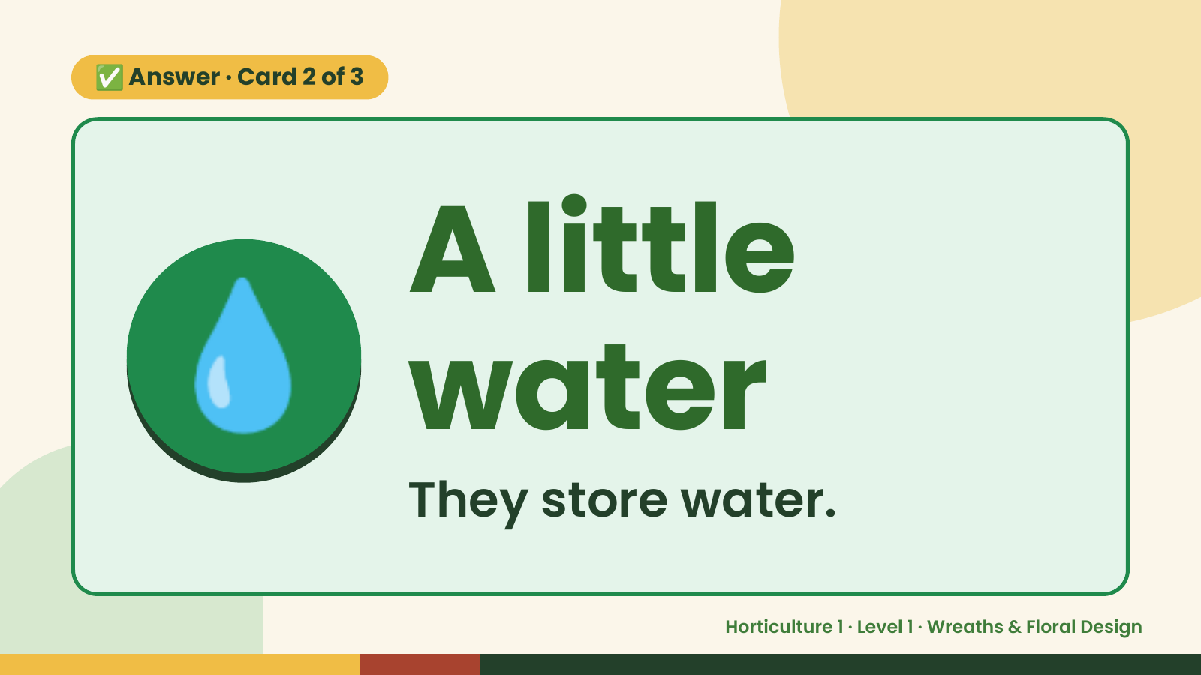
Notes:
✅ Answer · Card 2 of 3
💧 A little
water
They store water.
Horticulture 1 · Level 1 · Wreaths & Floral Design

Slide 12
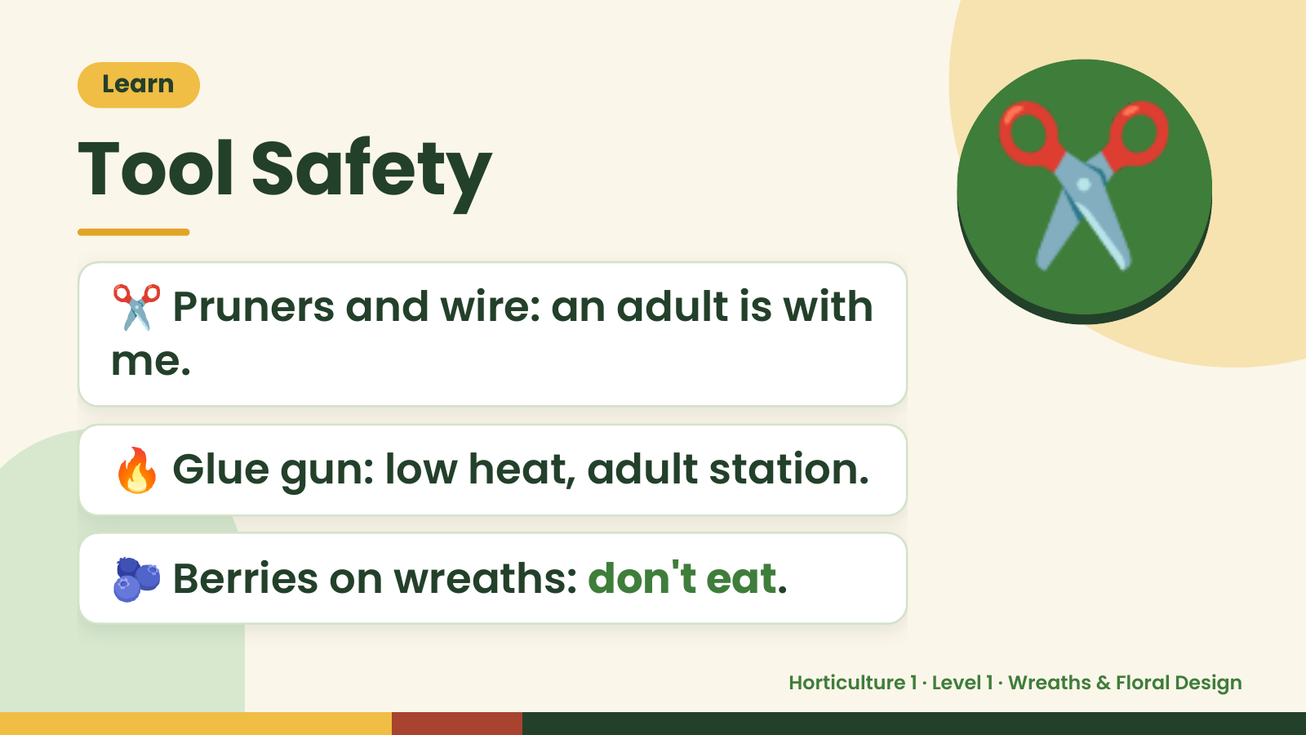
Notes:
Learn
Tool Safety
✂️ Pruners and wire: an adult is with
me.
✂️
🔥 Glue gun: low heat, adult station.
🫐 Berries on wreaths: don't eat.
Horticulture 1 · Level 1 · Wreaths & Floral Design

Slide 13
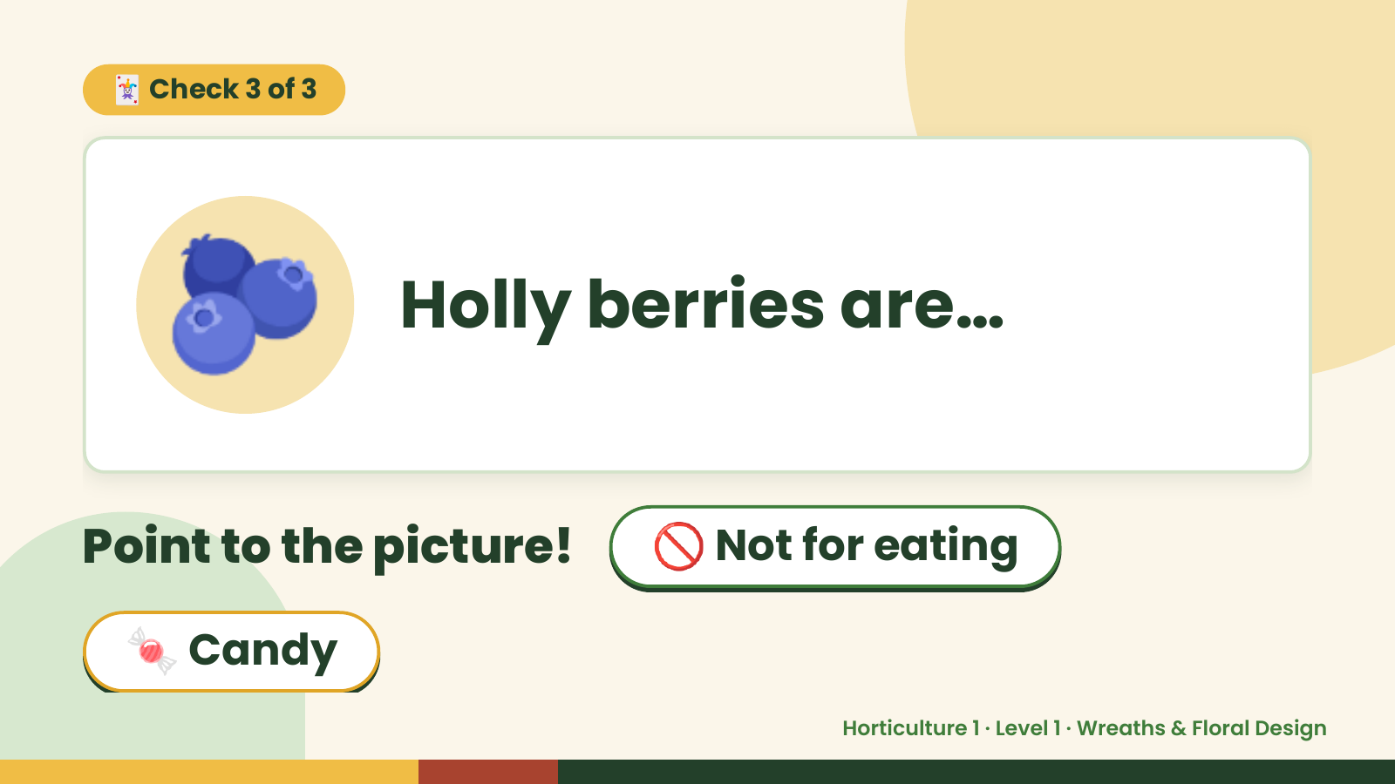
Notes:
🃏 Check 3 of 3
🫐 Holly berries are…
Point to the picture! 🚫 Not for eating
🍬 Candy
Horticulture 1 · Level 1 · Wreaths & Floral Design

Slide 14
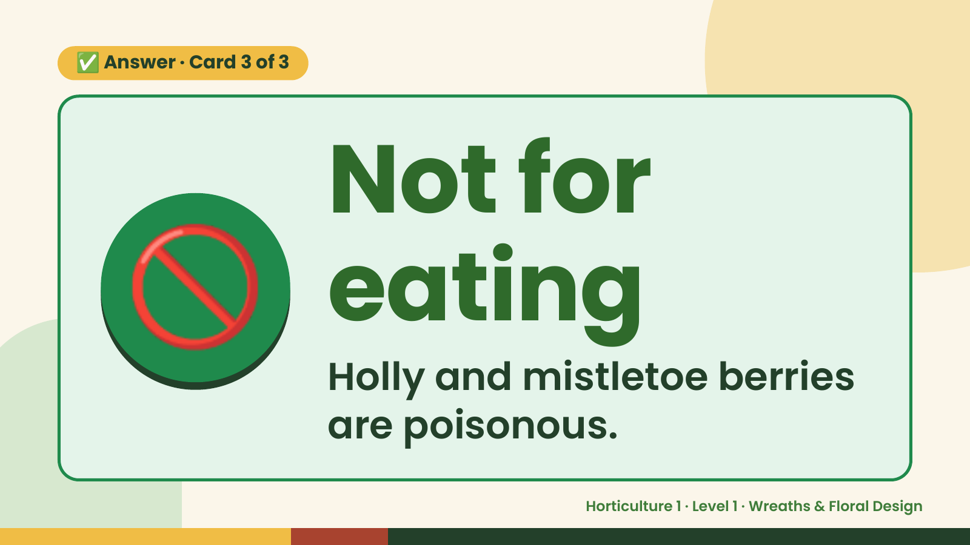
Notes:
✅ Answer · Card 3 of 3
🚫 Not for
eating
Holly and mistletoe berries
are poisonous.
Horticulture 1 · Level 1 · Wreaths & Floral Design

Slide 15
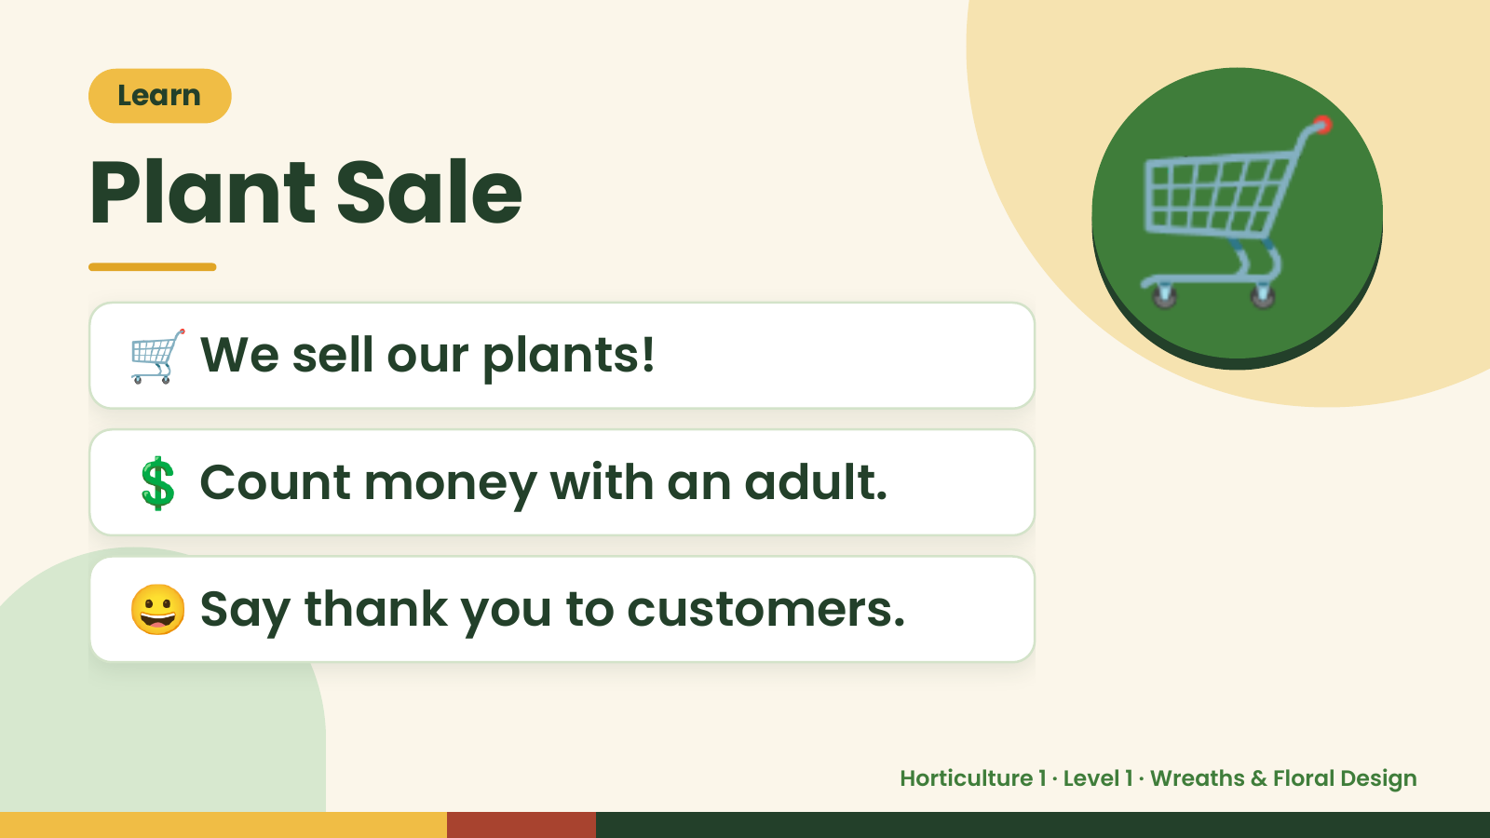
Notes:
Learn
Plant Sale
🛒 We sell our plants!
🛒
💲 Count money with an adult.
😀 Say thank you to customers.
Horticulture 1 · Level 1 · Wreaths & Floral Design

Slide 16
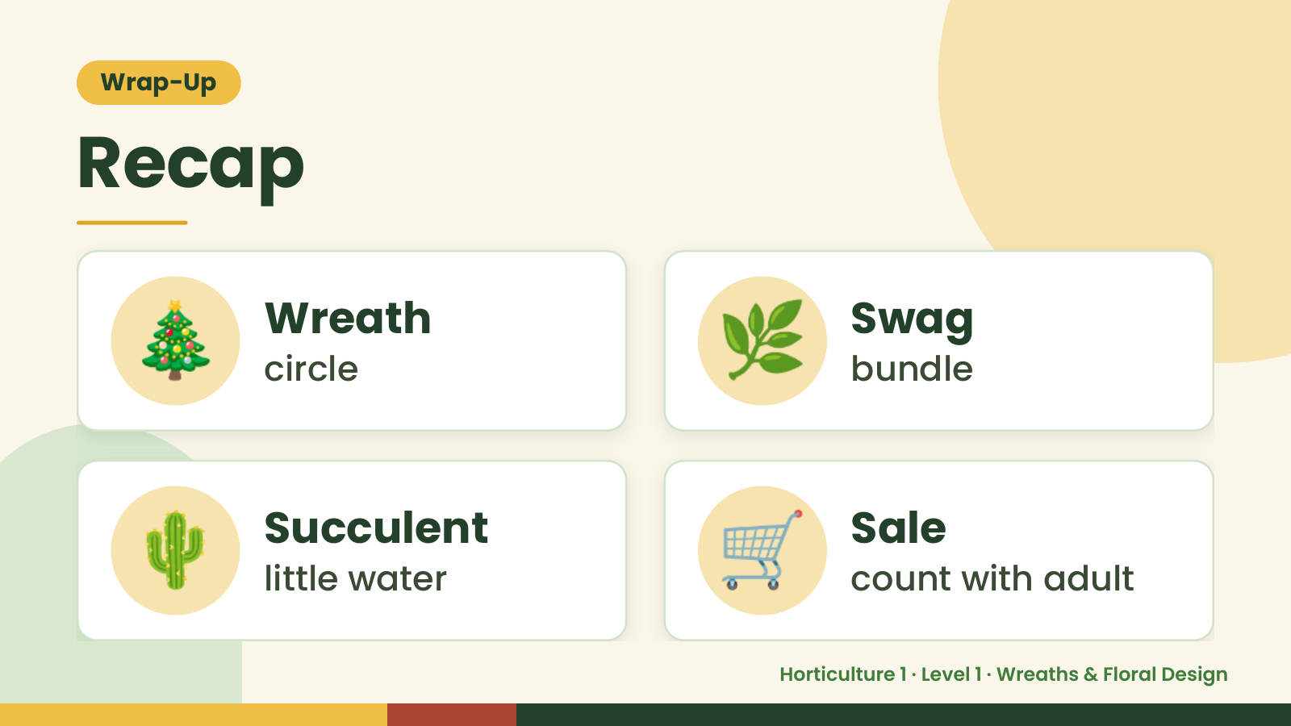
Notes:
Wrap-Up
Recap
🎄 Wreath
circle 🌿 Swag
bundle
🌵 Succulent
little water 🛒 Sale
count with adult
Horticulture 1 · Level 1 · Wreaths & Floral Design

Slide 17
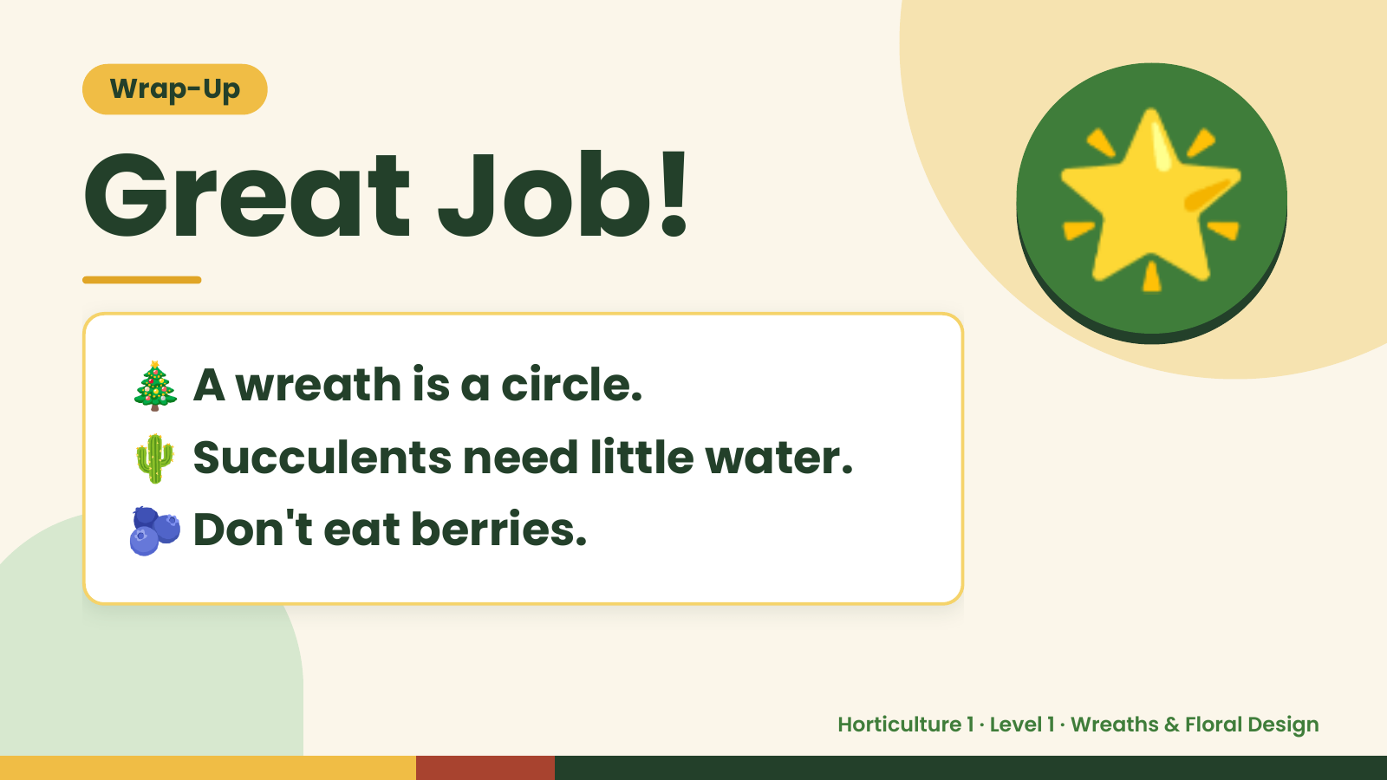
Notes:
Wrap-Up
Great Job!
🎄 A wreath is a circle.
🌟
🌵 Succulents need little water.
🫐 Don't eat berries.
Horticulture 1 · Level 1 · Wreaths & Floral Design

