Slide 1
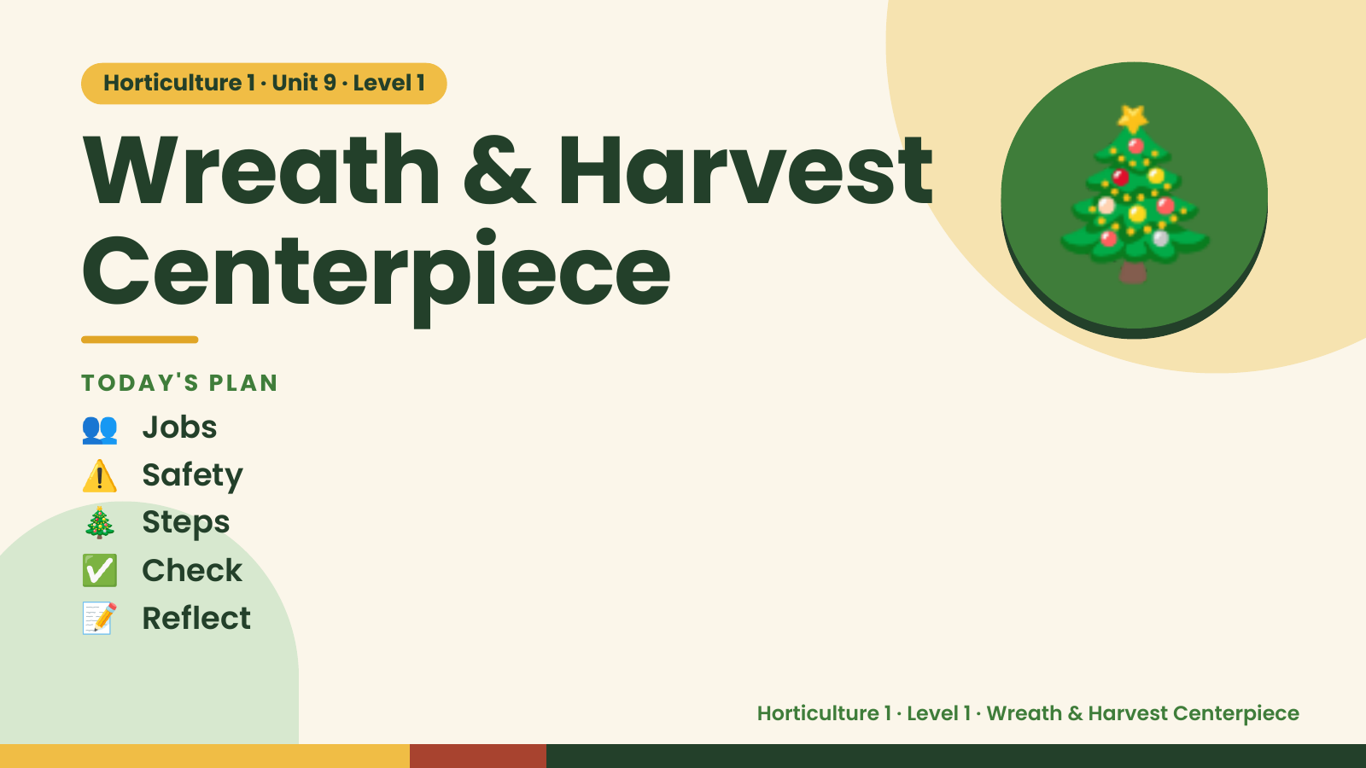
Notes:
Horticulture 1 · Unit 9 · Level 1
Wreath & Harvest
Centerpiece
👥 Jobs
TODAY'S PLAN
🎄
⚠️ Safety
🎄 Steps
✅ Check
📝 Reflect
Horticulture 1 · Level 1 · Wreath & Harvest Centerpiece

Slide 2

Notes:
Get ready
Jobs
🧑‍🌾 Grower
plants 🧺 Supply helper
gets tools
📸 Recorder
photos 🧽 Clean-up
captain
cleans
Horticulture 1 · Level 1 · Wreath & Harvest Centerpiece

Slide 3
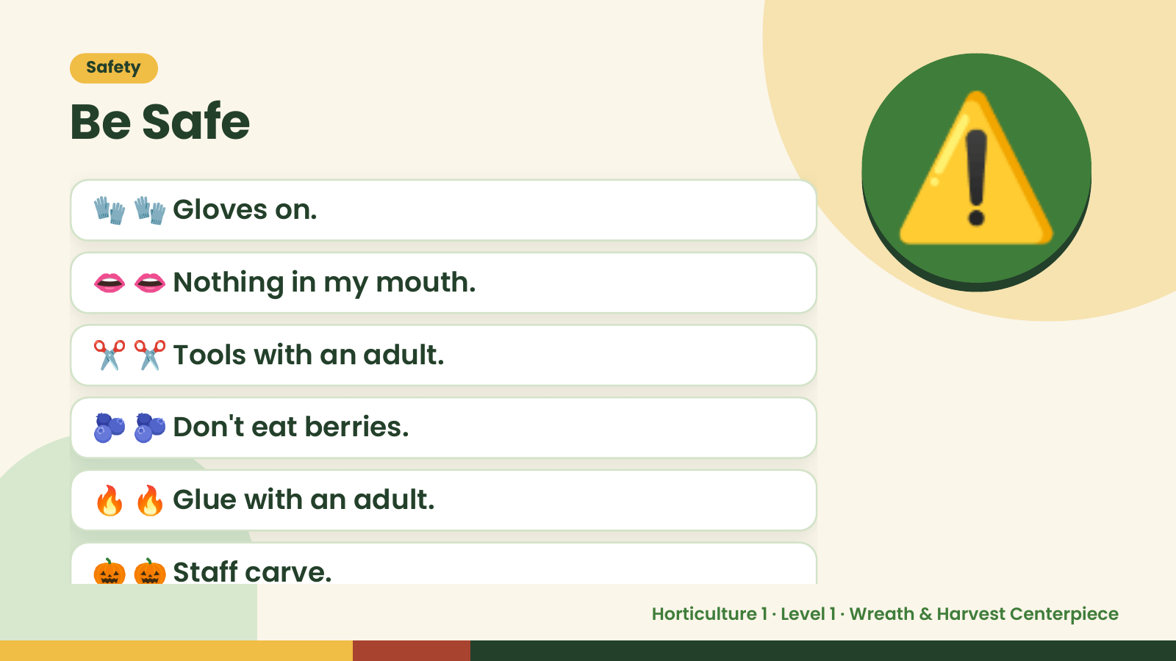
Notes:
Safety
Be Safe
🧤 🧤 Gloves on.
👄 👄 Nothing in my mouth.
✂️ ✂️ Tools with an adult.
⚠️
🫐 🫐 Don't eat berries.
🔥 🔥 Glue with an adult.
🎃 🎃 Staff carve.
Horticulture 1 · Level 1 · Wreath & Harvest Centerpiece

Slide 4
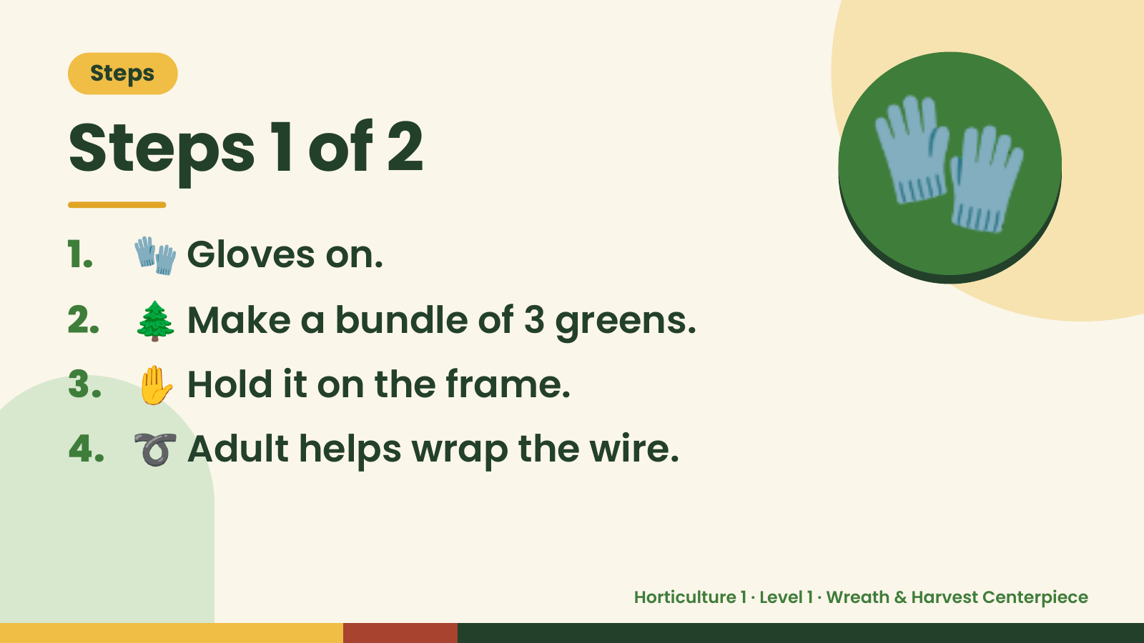
Notes:
Steps
Steps 1 of 2
1. 🧤 Gloves on.
2. 🌲 Make a bundle of 3 greens.
🧤
3. ✋ Hold it on the frame.
4. ➰ Adult helps wrap the wire.
Horticulture 1 · Level 1 · Wreath & Harvest Centerpiece

Slide 5
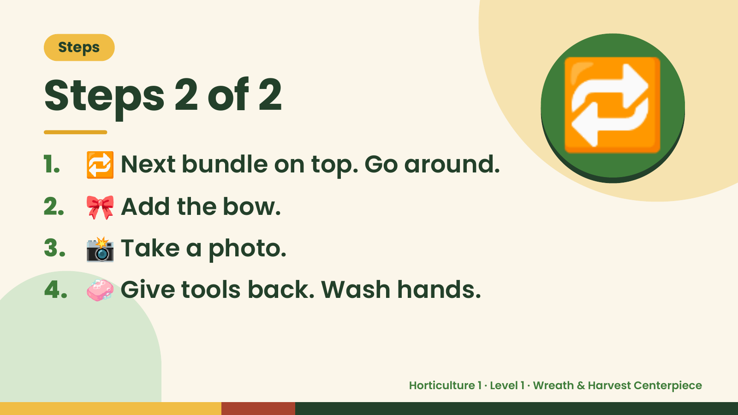
Notes:
Steps
Steps 2 of 2
1. 🔁 Next bundle on top. Go around.
2. 🎀 Add the bow.
🔁
3. 📸 Take a photo.
4. 🧼 Give tools back. Wash hands.
Horticulture 1 · Level 1 · Wreath & Harvest Centerpiece

Slide 6
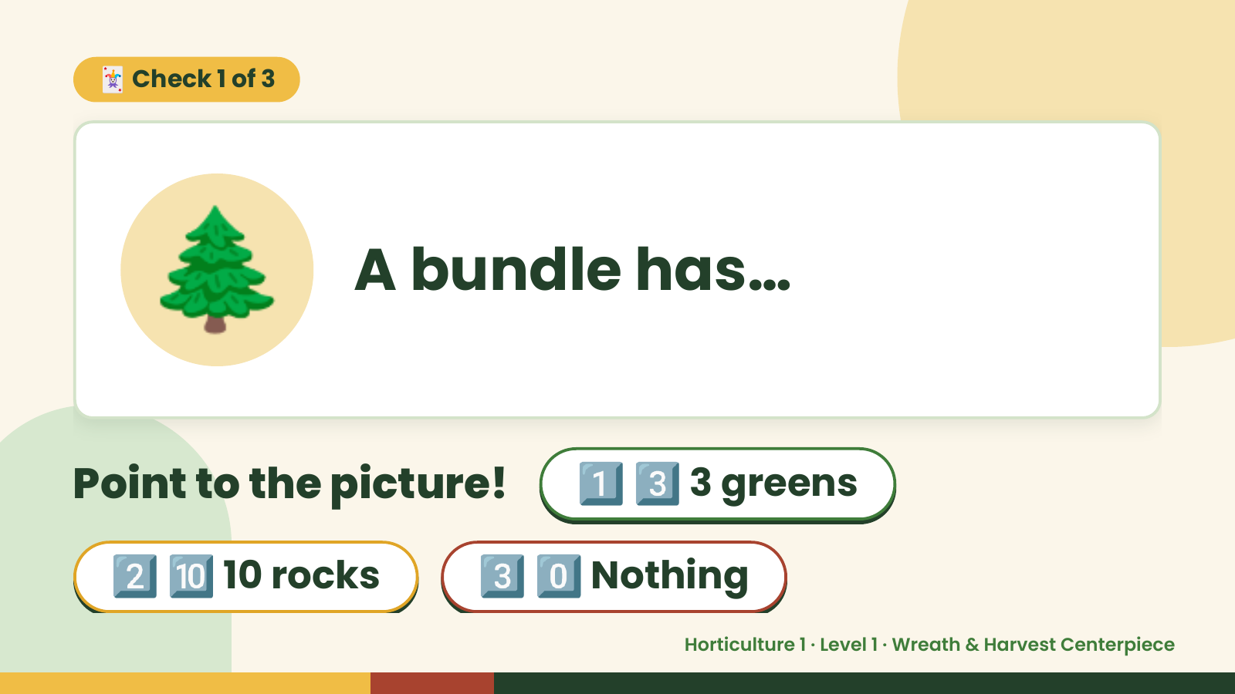
Notes:
🃏 Check 1 of 3
🌲 A bundle has…
Point to the picture! 1️⃣ 3️⃣ 3 greens
2️⃣ 🔟 10 rocks 3️⃣ 0️⃣ Nothing
Horticulture 1 · Level 1 · Wreath & Harvest Centerpiece

Slide 7
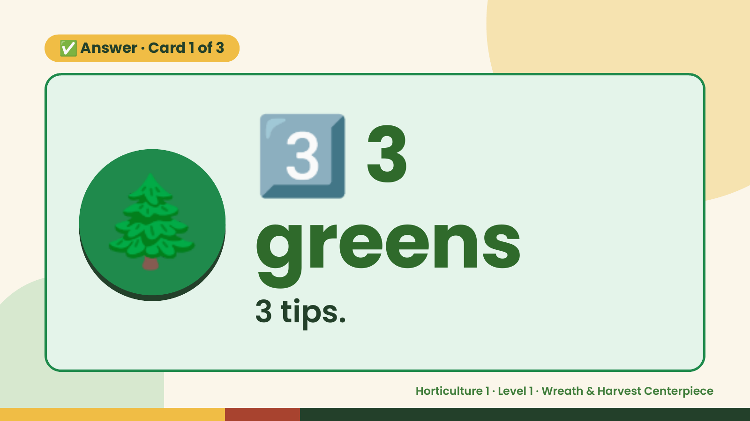
Notes:
3️⃣
✅ Answer · Card 1 of 3
🌲 greens
3
3 tips.
Horticulture 1 · Level 1 · Wreath & Harvest Centerpiece

Slide 8
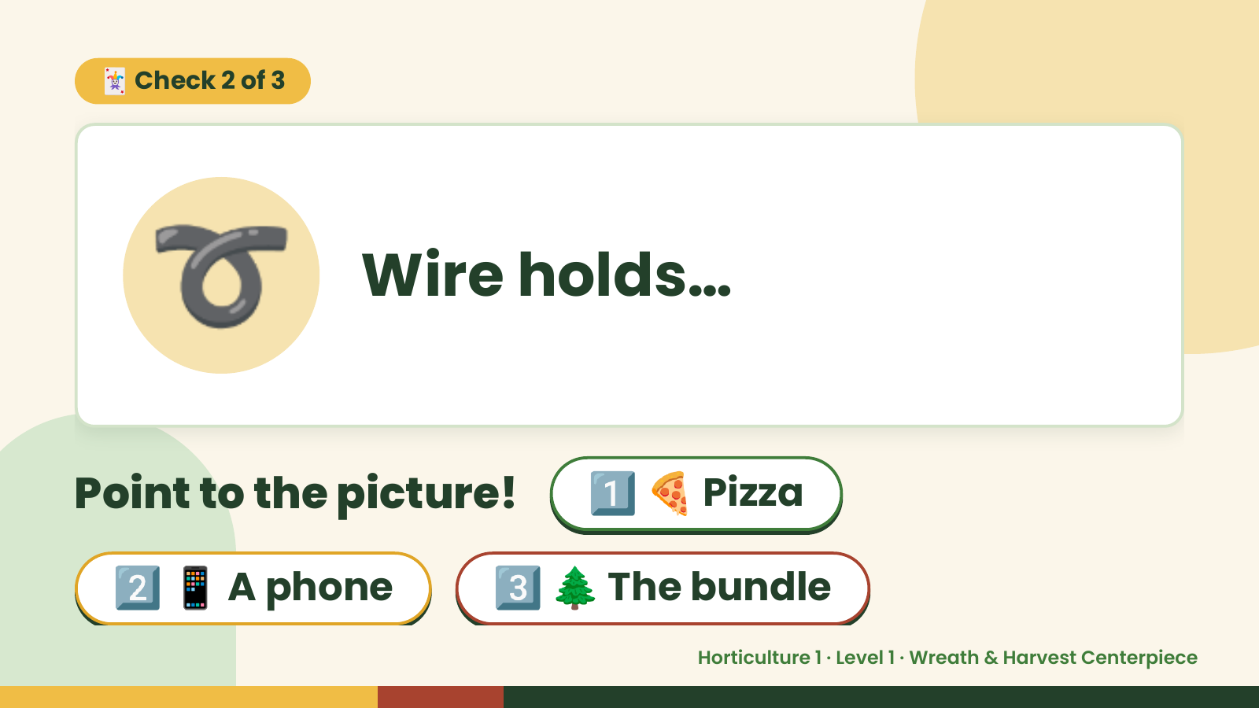
Notes:
🃏 Check 2 of 3
➰ Wire holds…
Point to the picture! 1️⃣ 🍕 Pizza
2️⃣ 📱 A phone 3️⃣ 🌲 The bundle
Horticulture 1 · Level 1 · Wreath & Harvest Centerpiece

Slide 9
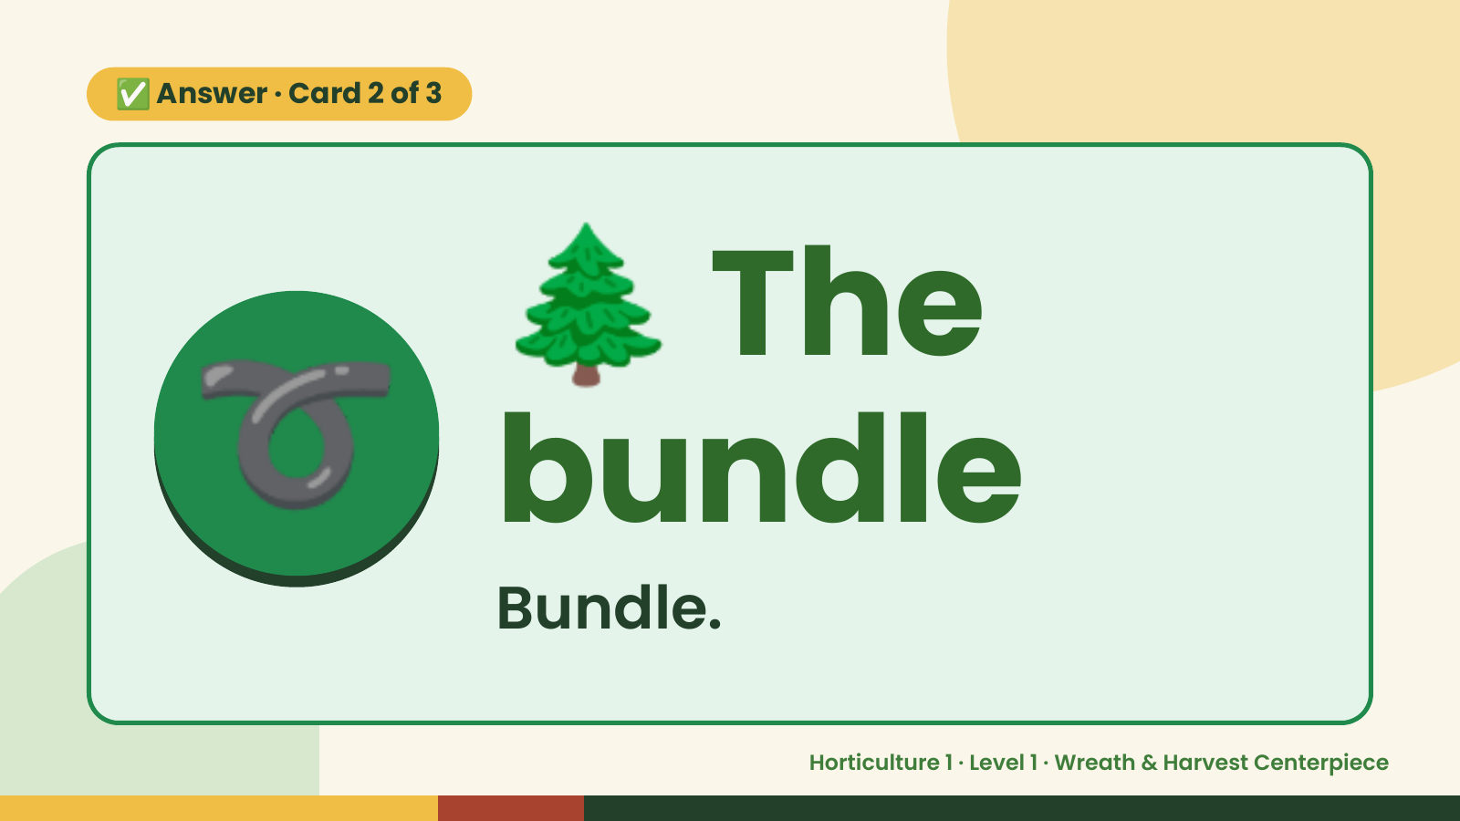
Notes:
🌲
✅ Answer · Card 2 of 3
➰ bundle
The
Bundle.
Horticulture 1 · Level 1 · Wreath & Harvest Centerpiece

Slide 10
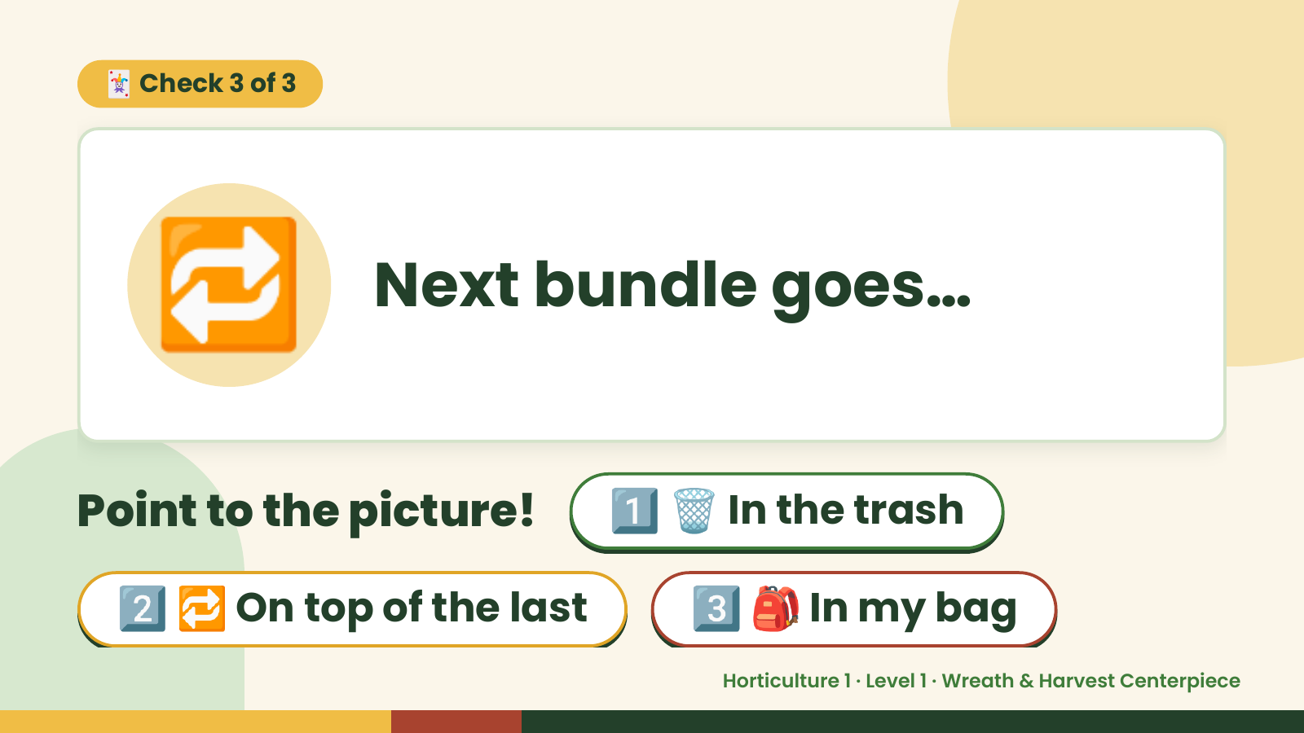
Notes:
🃏 Check 3 of 3
🔁 Next bundle goes…
Point to the picture! 1️⃣ 🗑️ In the trash
2️⃣ 🔁 On top of the last 3️⃣ 🎒 In my bag
Horticulture 1 · Level 1 · Wreath & Harvest Centerpiece

Slide 11
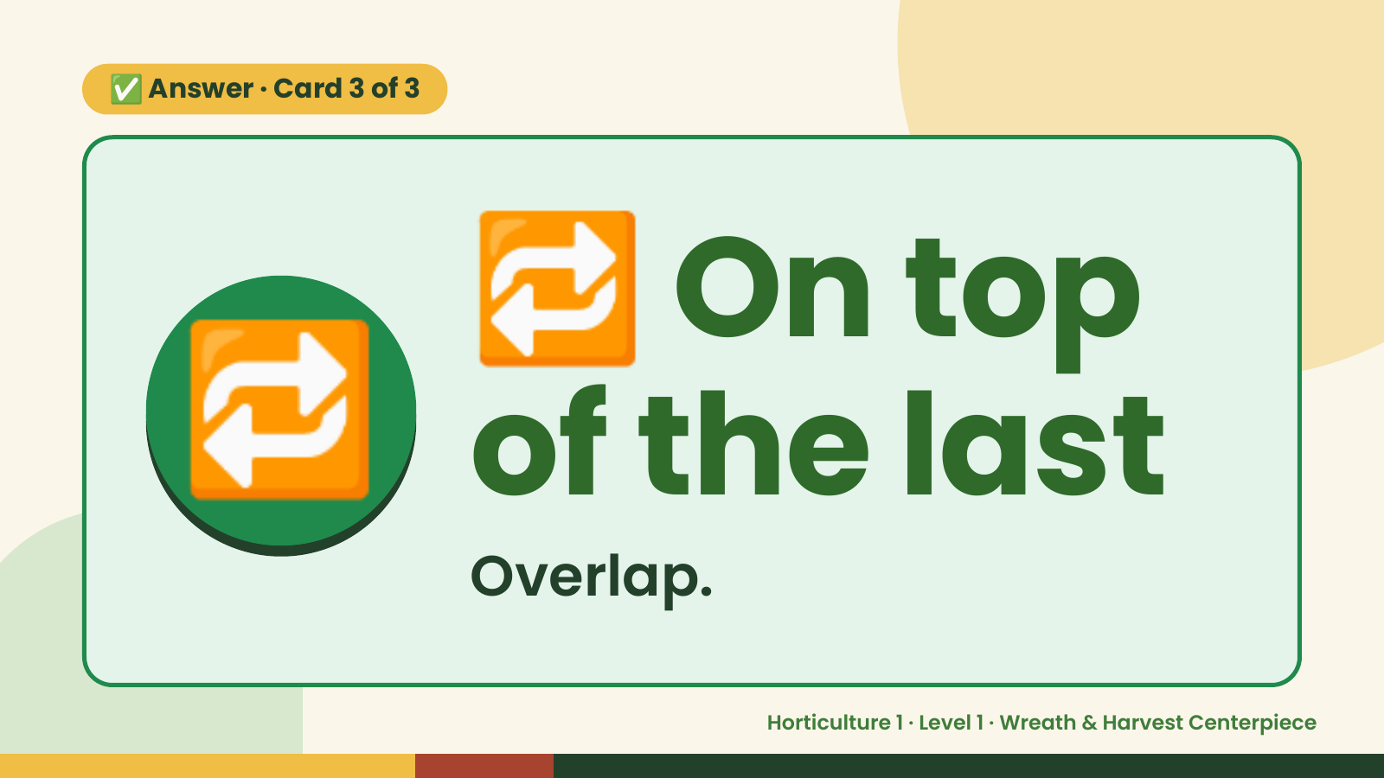
Notes:
🔁
✅ Answer · Card 3 of 3
🔁 of the last
On top
Overlap.
Horticulture 1 · Level 1 · Wreath & Harvest Centerpiece

Slide 12

Notes:
Wrap-Up
Clean Up +
Reflect
🧽
🧽 Clean the table.
🧰 Give tools back.
🧼 Wash hands.
Horticulture 1 · Level 1 · Wreath & Harvest Centerpiece

