Slide 1
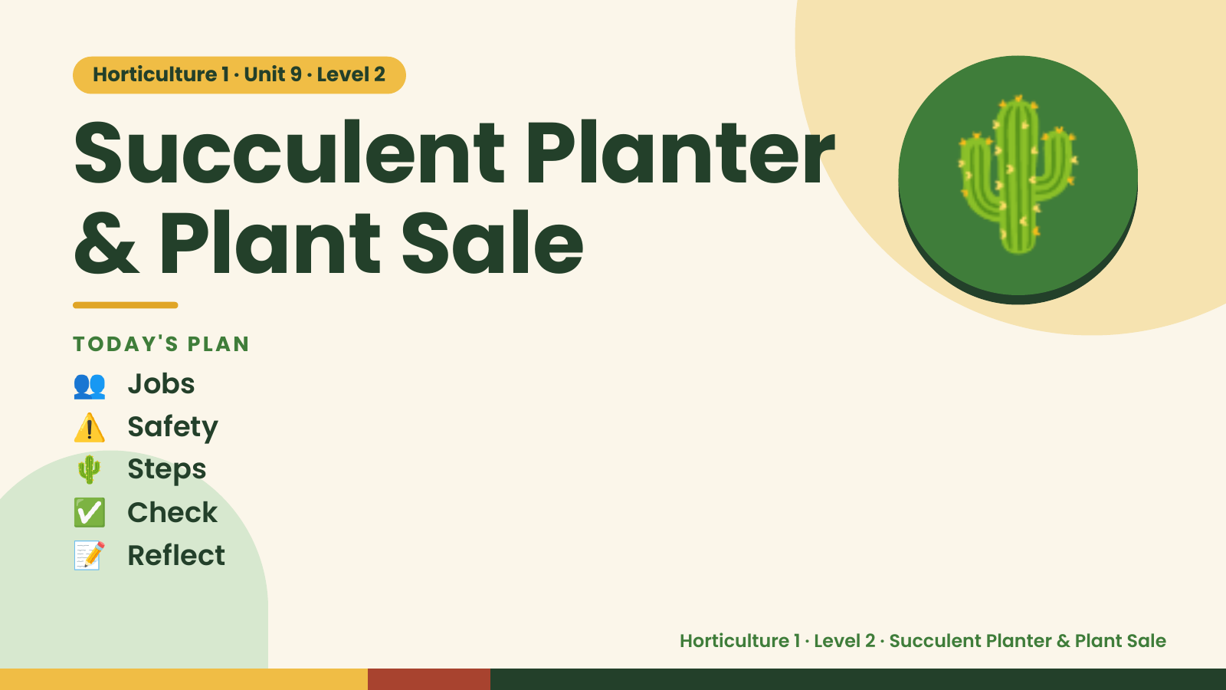
Notes:
Horticulture 1 · Unit 9 · Level 2
Succulent Planter
& Plant Sale
👥 Jobs
TODAY'S PLAN
🌵
⚠️ Safety
🌵 Steps
✅ Check
📝 Reflect
Horticulture 1 · Level 2 · Succulent Planter & Plant Sale

Slide 2

Notes:
Get ready
Jobs
🧑‍🌾 Grower
Does the main plant job
with the tools
🧺 Supply helper
Gets and returns supplies
and tools to staff
📸 Recorder
Takes photos and fills in
the chart
🧽 Clean-up captain
Sweeps, wipes tables,
checks hands are
washed
Horticulture 1 · Level 2 · Succulent Planter & Plant Sale

Slide 3
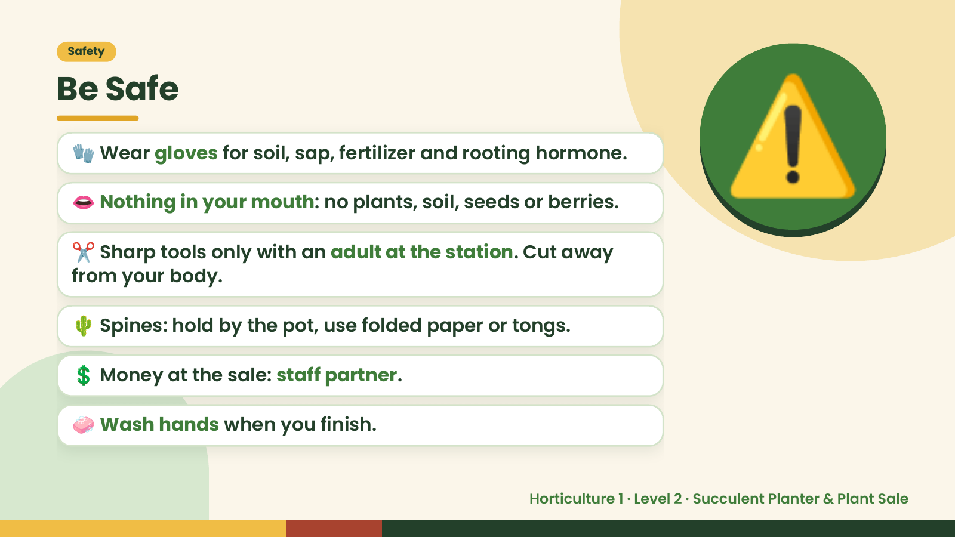
Notes:
Safety
Be Safe
🧤 Wear gloves for soil, sap, fertilizer and rooting hormone.
👄 Nothing in your mouth: no plants, soil, seeds or berries.
✂️ Sharp tools only with an adult at the station. Cut away
from your body.
⚠️
🌵 Spines: hold by the pot, use folded paper or tongs.
💲 Money at the sale: staff partner.
🧼 Wash hands when you finish.
Horticulture 1 · Level 2 · Succulent Planter & Plant Sale

Slide 4
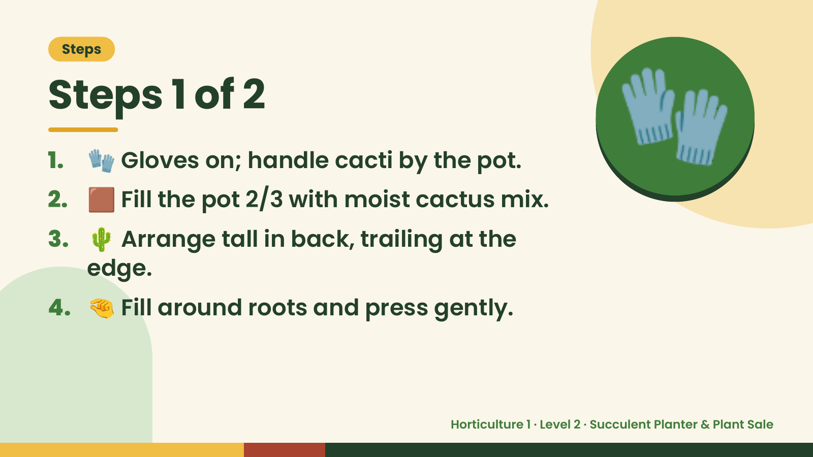
Notes:
Steps
Steps 1 of 2
1. 🧤 Gloves on; handle cacti by the pot.
2. 🟫 Fill the pot 2/3 with moist cactus mix.
3. 🌵 Arrange tall in back, trailing at the
🧤
edge.
4. 🤏 Fill around roots and press gently.
Horticulture 1 · Level 2 · Succulent Planter & Plant Sale

Slide 5
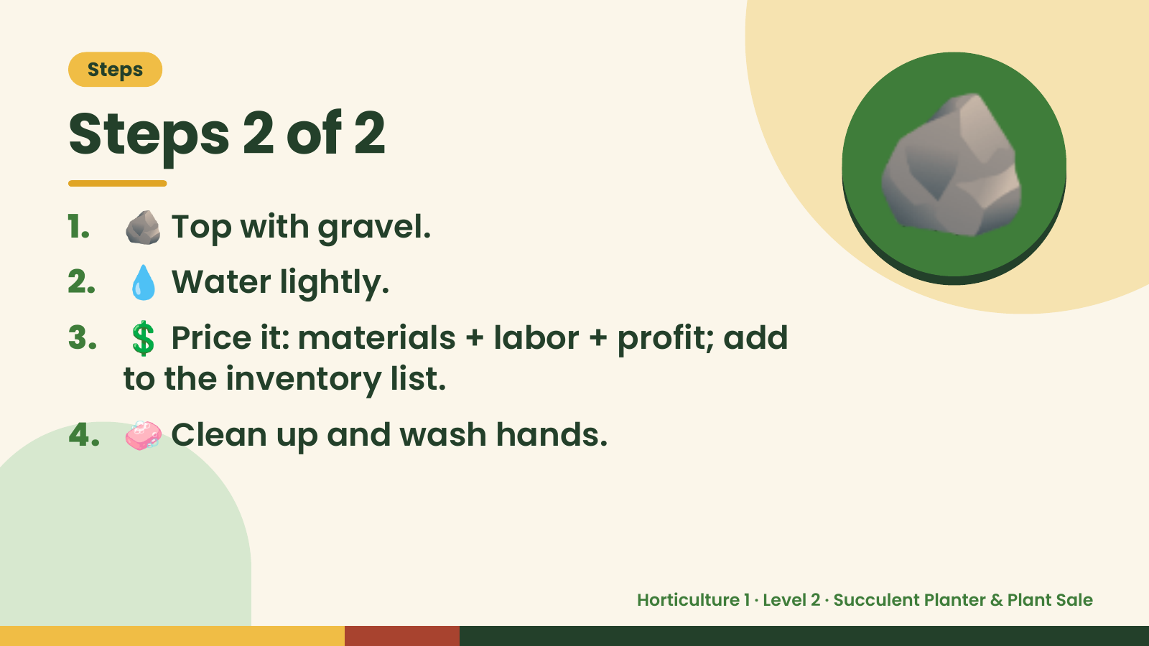
Notes:
Steps
Steps 2 of 2
1. 🪨 Top with gravel.
2. 💧 Water lightly.
3. 💲 Price it: materials + labor + profit; add
🪨
to the inventory list.
4. 🧼 Clean up and wash hands.
Horticulture 1 · Level 2 · Succulent Planter & Plant Sale

Slide 6
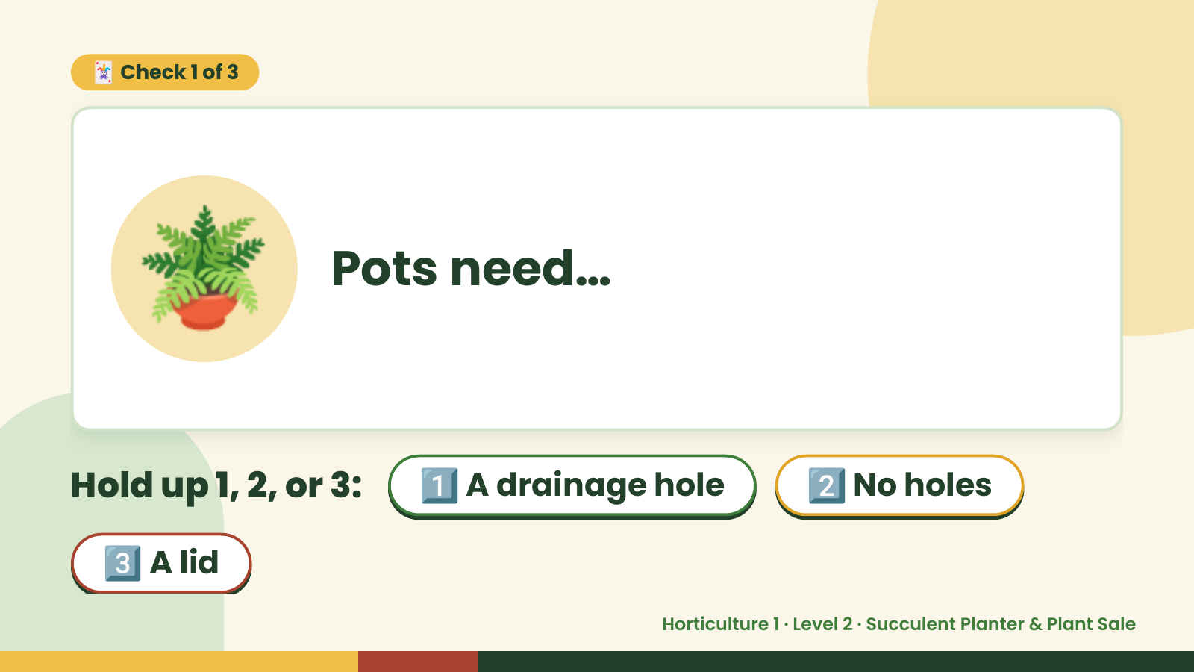
Notes:
🃏 Check 1 of 3
🪴 Pots need…
Hold up 1, 2, or 3: 1️⃣ A drainage hole 2️⃣ No holes
3️⃣ A lid
Horticulture 1 · Level 2 · Succulent Planter & Plant Sale

Slide 7
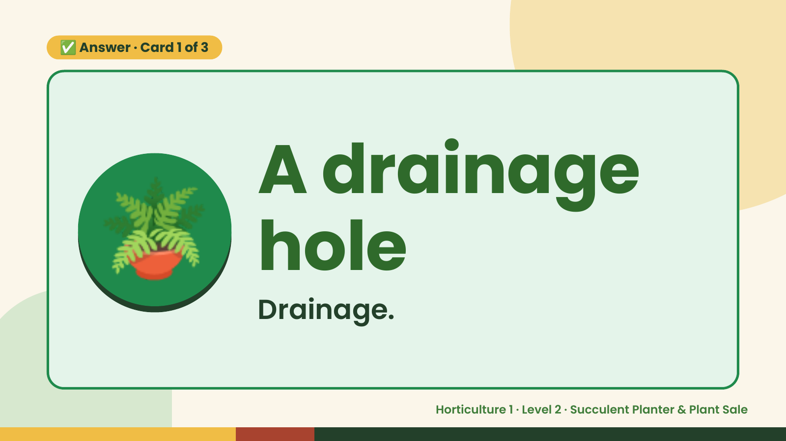
Notes:
✅ Answer · Card 1 of 3
🪴 A drainage
hole
Drainage.
Horticulture 1 · Level 2 · Succulent Planter & Plant Sale

Slide 8
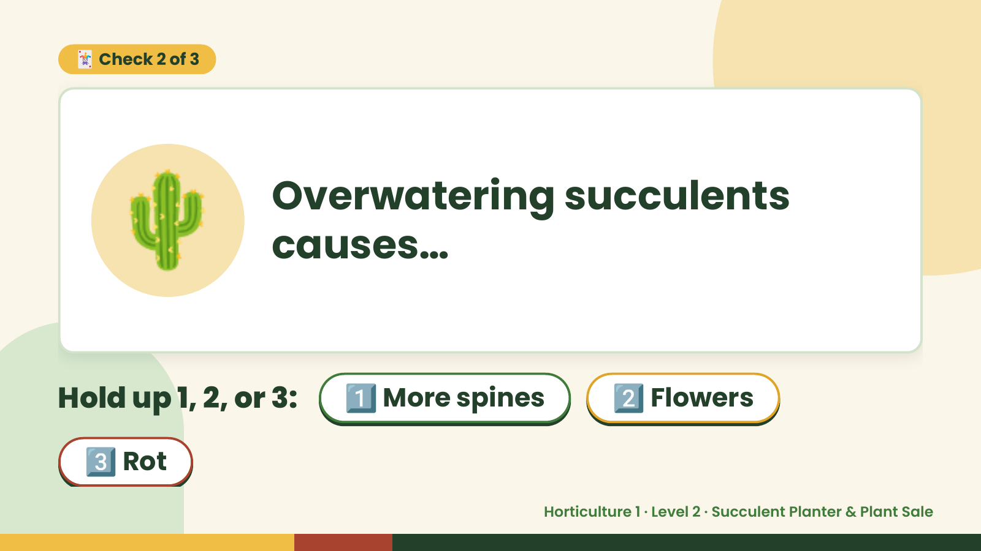
Notes:
🃏 Check 2 of 3
🌵 Overwatering succulents
causes…
Hold up 1, 2, or 3: 1️⃣ More spines 2️⃣ Flowers
3️⃣ Rot
Horticulture 1 · Level 2 · Succulent Planter & Plant Sale

Slide 9
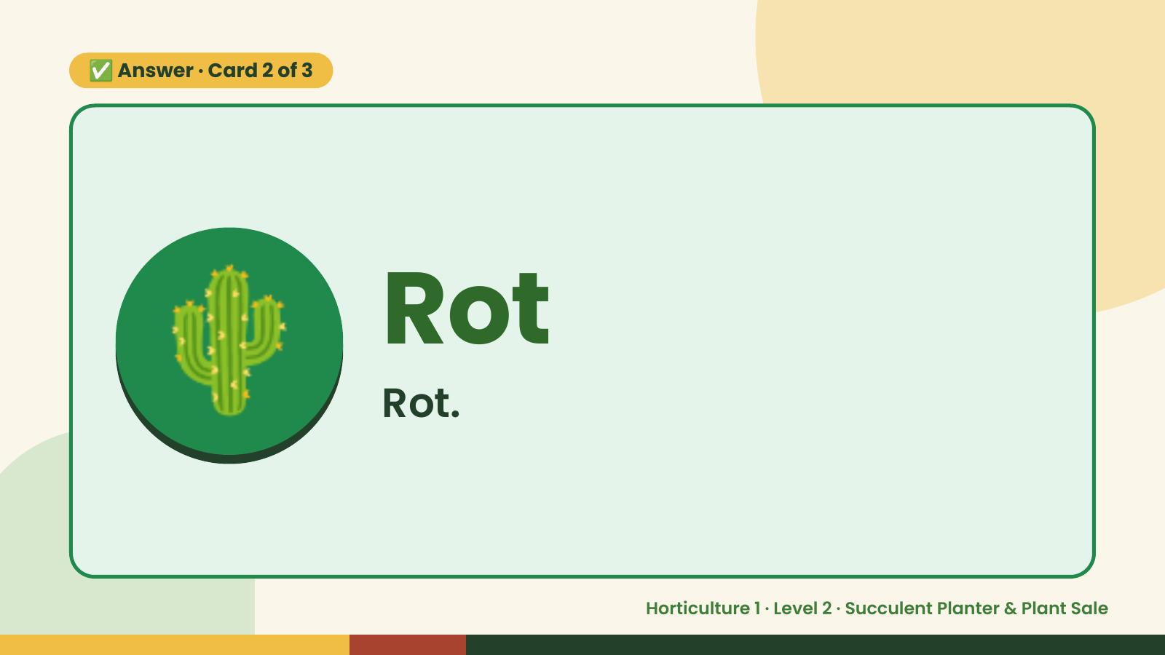
Notes:
✅ Answer · Card 2 of 3
🌵 Rot
Rot.
Horticulture 1 · Level 2 · Succulent Planter & Plant Sale

Slide 10
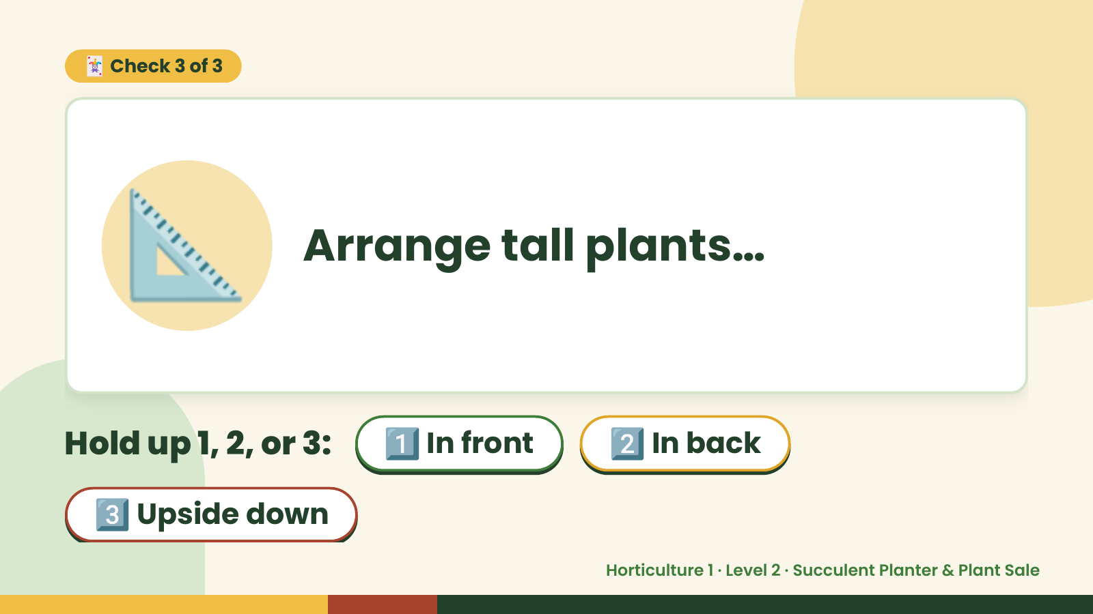
Notes:
🃏 Check 3 of 3
📐 Arrange tall plants…
Hold up 1, 2, or 3: 1️⃣ In front 2️⃣ In back
3️⃣ Upside down
Horticulture 1 · Level 2 · Succulent Planter & Plant Sale

Slide 11
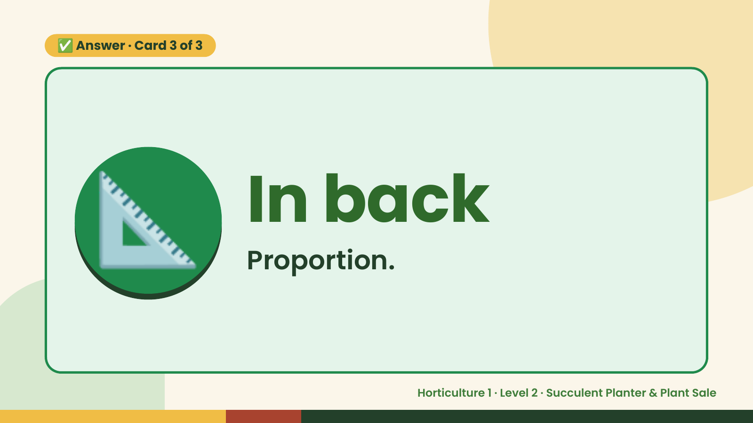
Notes:
✅ Answer · Card 3 of 3
📐 In back
Proportion.
Horticulture 1 · Level 2 · Succulent Planter & Plant Sale

Slide 12

Notes:
Wrap-Up
Clean Up +
Reflect
🧽
Return and count tools.
Sweep and wipe your area.
Wash hands, then do the reflection.
Horticulture 1 · Level 2 · Succulent Planter & Plant Sale

