Slide 1

Notes:
Horticulture 1 · Unit 9 · Level 2 (modified)
Wreaths & Floral
Design
🎄 Wreaths and swags
TODAY'S PLAN
💐
💐 Design principles
🌵 Succulent planters
💲 Pricing and the plant sale
Horticulture 1 · Level 2 · Wreaths & Floral Design

Slide 2
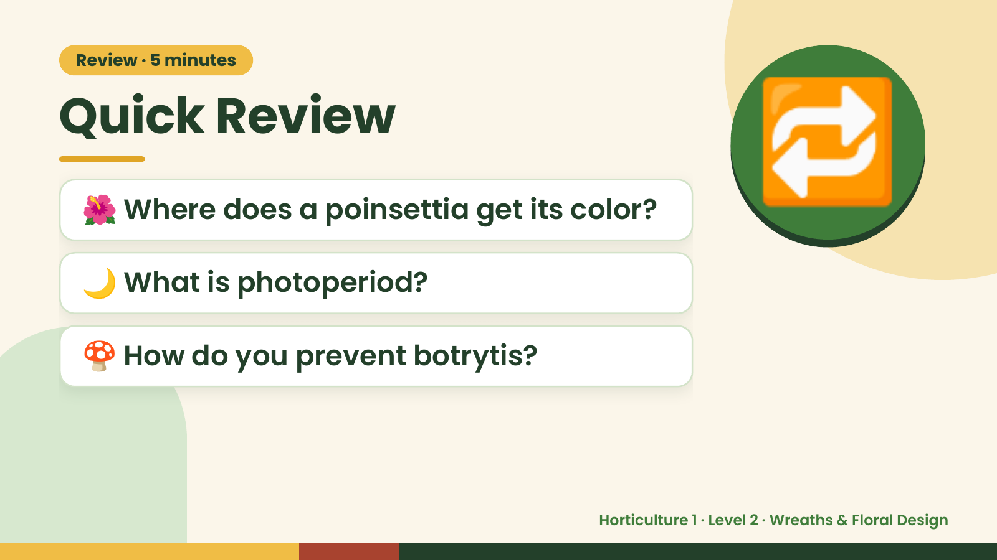
Notes:
Review · 5 minutes
Quick Review
🌺 Where does a poinsettia get its color?
🌙 What is photoperiod?
🔁
🍄 How do you prevent botrytis?
Horticulture 1 · Level 2 · Wreaths & Floral Design

Slide 3
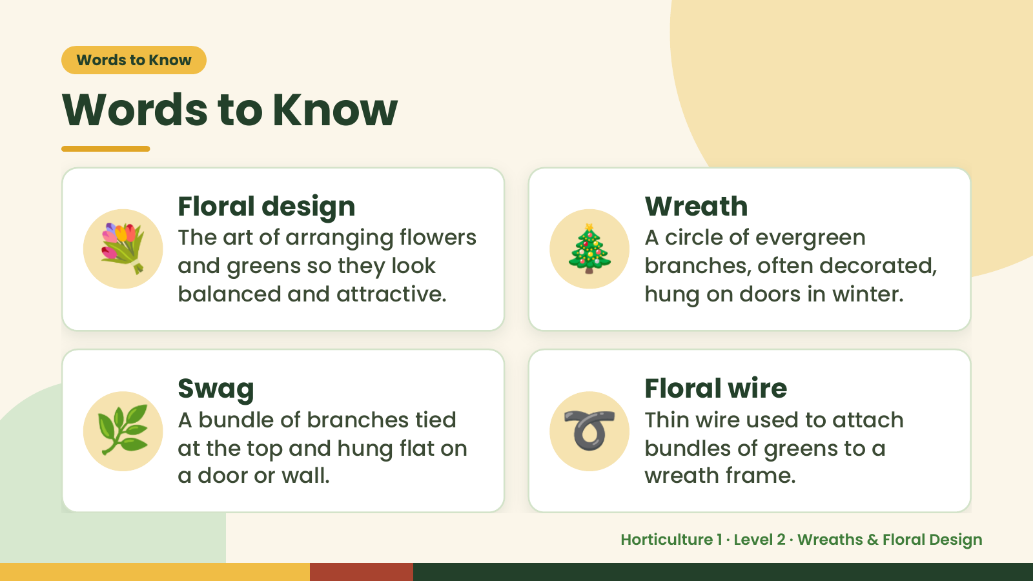
Notes:
Words to Know
Words to Know
💐 Floral design
The art of arranging flowers
and greens so they look
balanced and attractive.
🎄 Wreath
A circle of evergreen
branches, often decorated,
hung on doors in winter.
🌿 Swag
A bundle of branches tied
at the top and hung flat on
a door or wall.
➰ Floral wire
Thin wire used to attach
bundles of greens to a
wreath frame.
Horticulture 1 · Level 2 · Wreaths & Floral Design

Slide 4
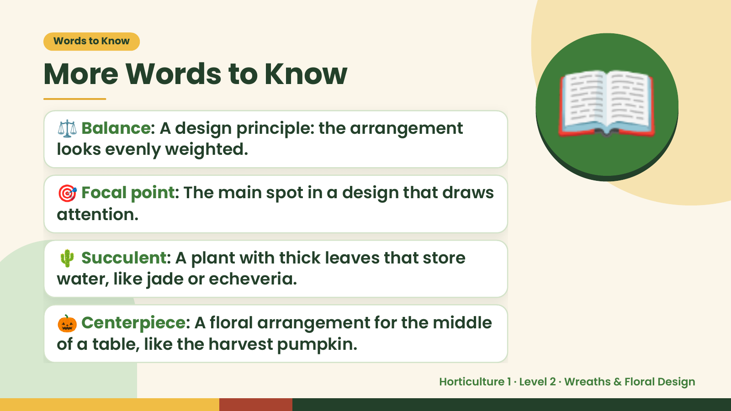
Notes:
Words to Know
More Words to Know
⚖️ Balance: A design principle: the arrangement
looks evenly weighted.
🎯 Focal point: The main spot in a design that draws
attention.
📖
🌵 Succulent: A plant with thick leaves that store
water, like jade or echeveria.
🎃 Centerpiece: A floral arrangement for the middle
of a table, like the harvest pumpkin.
Horticulture 1 · Level 2 · Wreaths & Floral Design

Slide 5
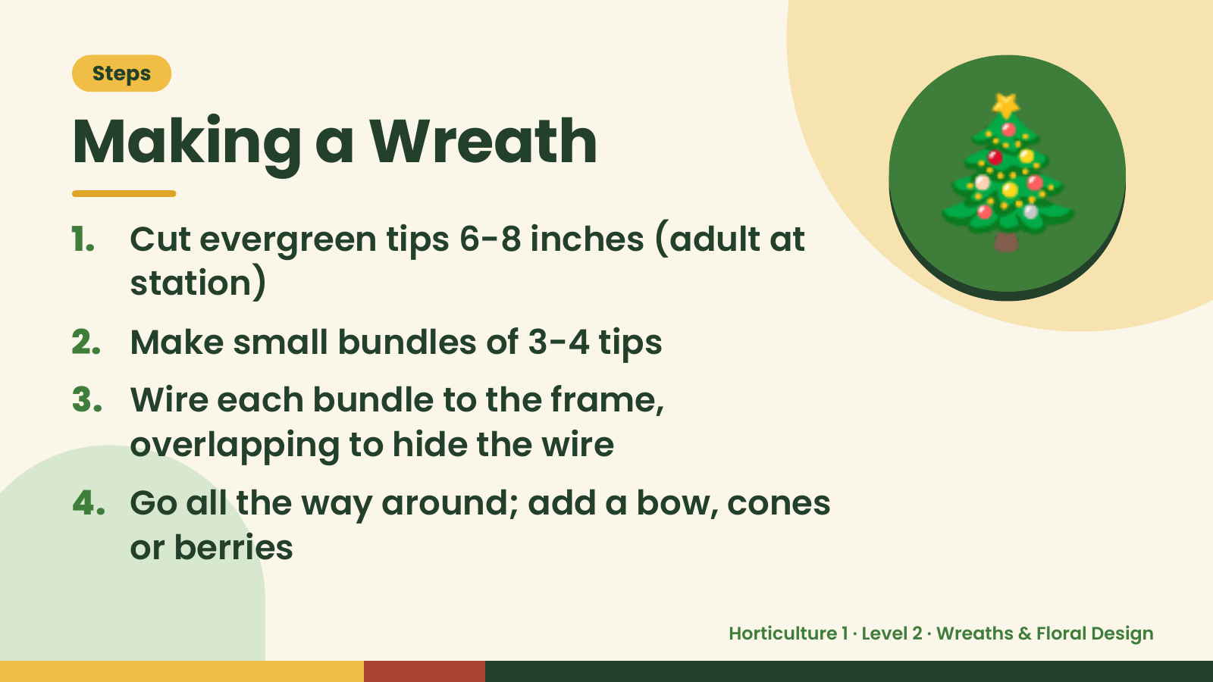
Notes:
Steps
Making a Wreath
1. Cut evergreen tips 6-8 inches (adult at
station)
2. Make small bundles of 3-4 tips
🎄
3. Wire each bundle to the frame,
overlapping to hide the wire
4. Go all the way around; add a bow, cones
or berries
Horticulture 1 · Level 2 · Wreaths & Floral Design

Slide 6
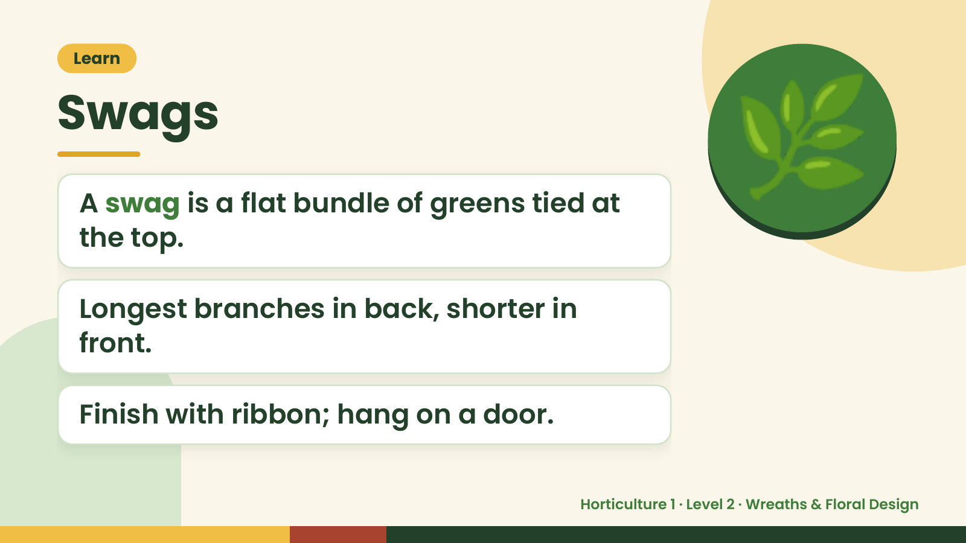
Notes:
Learn
Swags
A swag is a flat bundle of greens tied at
the top.
🌿
Longest branches in back, shorter in
front.
Finish with ribbon; hang on a door.
Horticulture 1 · Level 2 · Wreaths & Floral Design

Slide 7
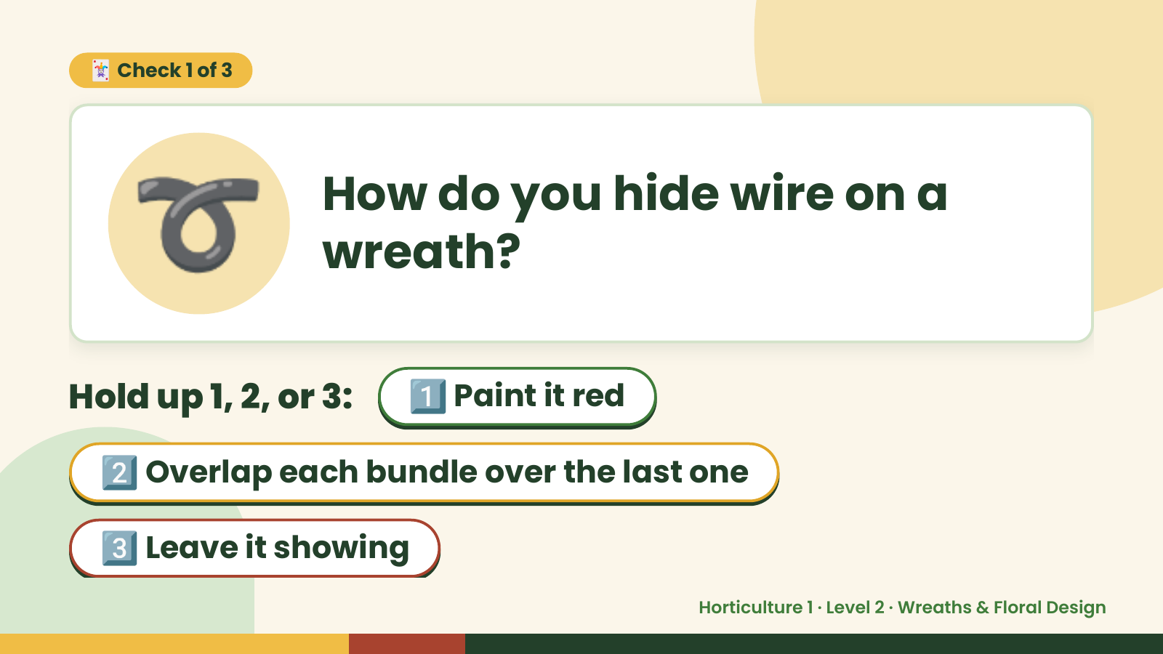
Notes:
➰
🃏 Check 1 of 3
How do you hide wire on a
wreath?
Hold up 1, 2, or 3: 1️⃣ Paint it red
2️⃣ Overlap each bundle over the last one
3️⃣ Leave it showing
Horticulture 1 · Level 2 · Wreaths & Floral Design

Slide 8
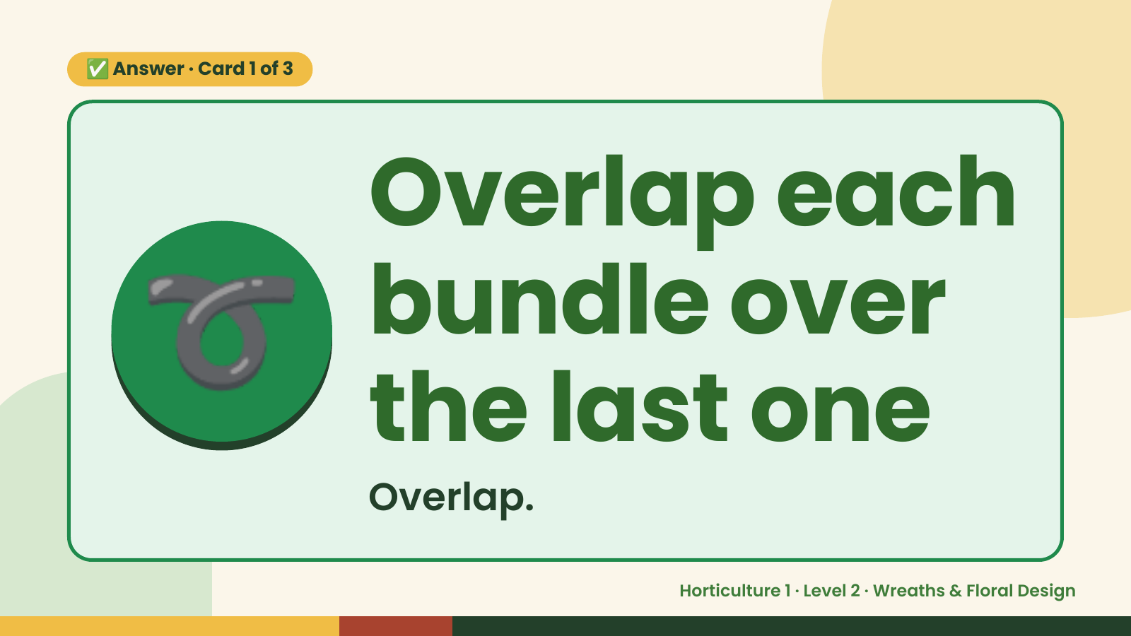
Notes:
✅ Answer · Card 1 of 3
➰ Overlap each
bundle over
the last one
Overlap.
Horticulture 1 · Level 2 · Wreaths & Floral Design

Slide 9
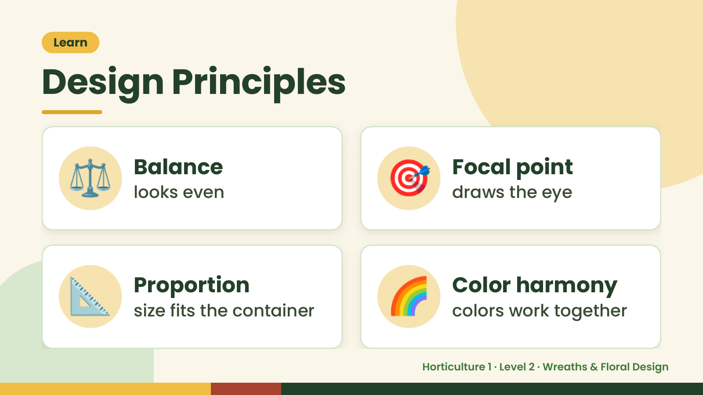
Notes:
Learn
Design Principles
⚖️ Balance
looks even 🎯 Focal point
draws the eye
📐 Proportion
size fits the container 🌈 Color harmony
colors work together
Horticulture 1 · Level 2 · Wreaths & Floral Design

Slide 10
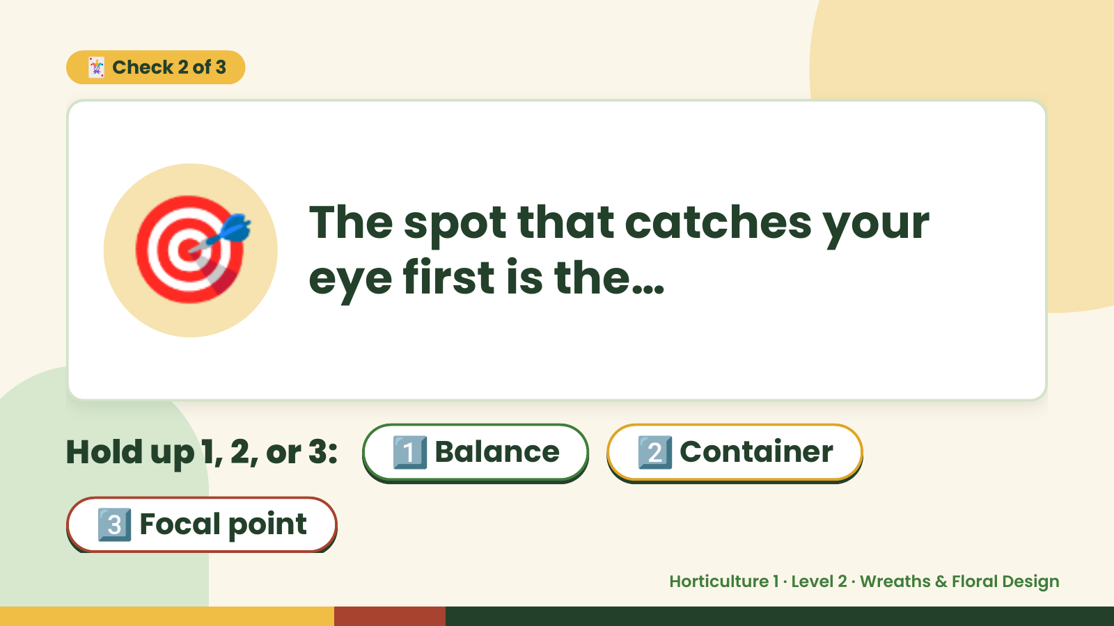
Notes:
🃏 Check 2 of 3
🎯 The spot that catches your
eye first is the…
Hold up 1, 2, or 3: 1️⃣ Balance 2️⃣ Container
3️⃣ Focal point
Horticulture 1 · Level 2 · Wreaths & Floral Design

Slide 11
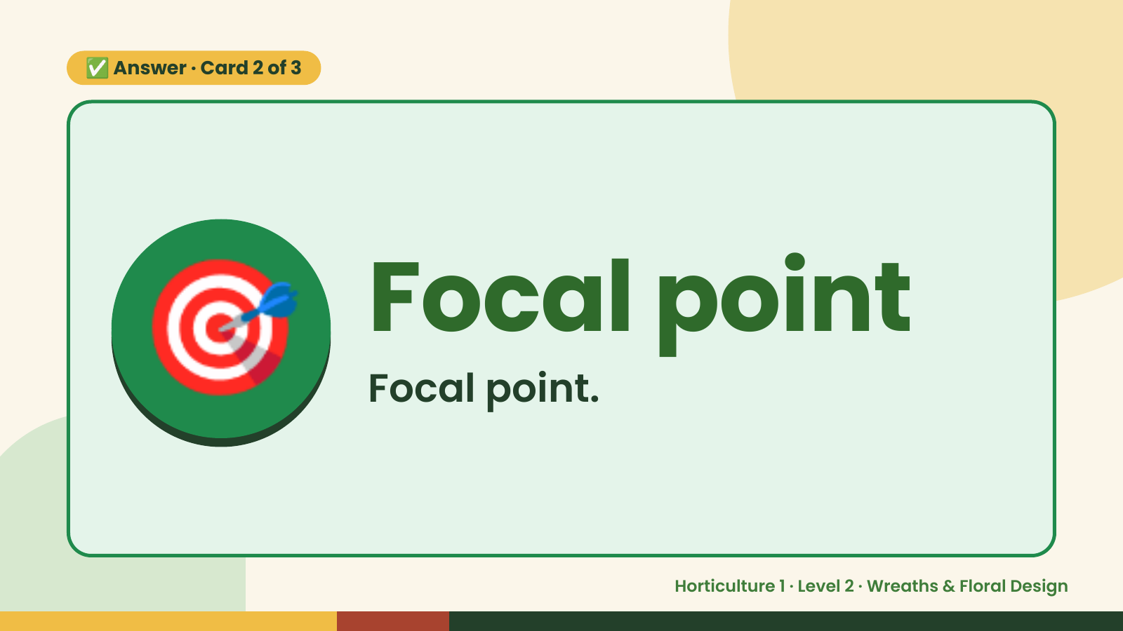
Notes:
✅ Answer · Card 2 of 3
🎯 Focal point
Focal point.
Horticulture 1 · Level 2 · Wreaths & Floral Design

Slide 12
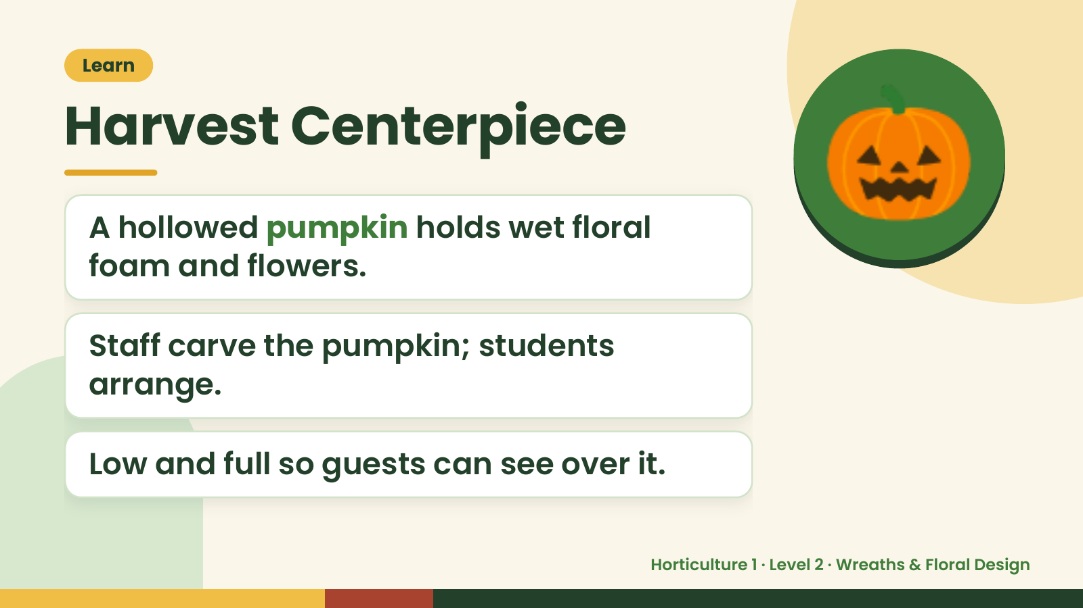
Notes:
Learn
Harvest Centerpiece
A hollowed pumpkin holds wet floral
foam and flowers.
🎃
Staff carve the pumpkin; students
arrange.
Low and full so guests can see over it.
Horticulture 1 · Level 2 · Wreaths & Floral Design

Slide 13
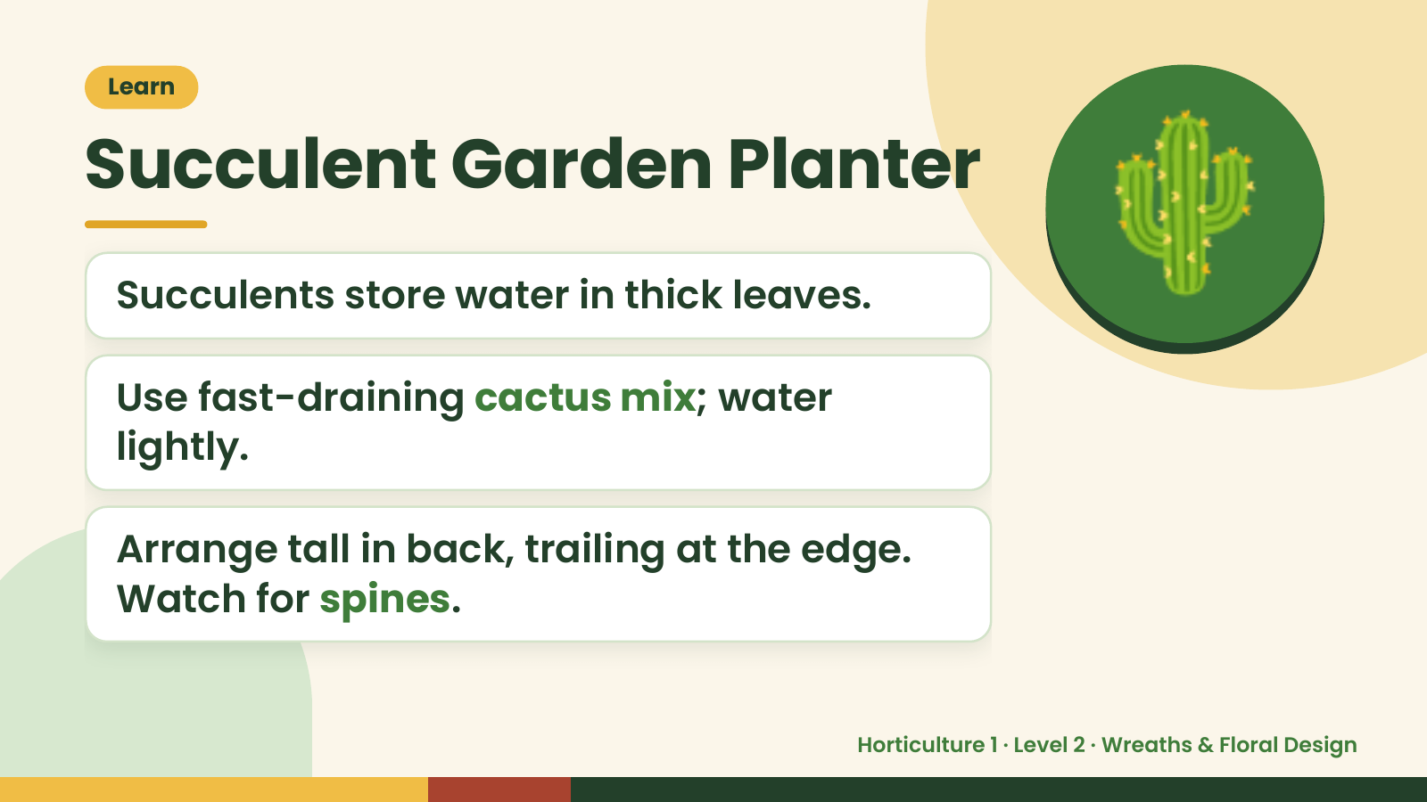
Notes:
Learn
Succulent Garden Planter
Succulents store water in thick leaves.
Use fast-draining cactus mix; water
lightly.
🌵
Arrange tall in back, trailing at the edge.
Watch for spines.
Horticulture 1 · Level 2 · Wreaths & Floral Design

Slide 14
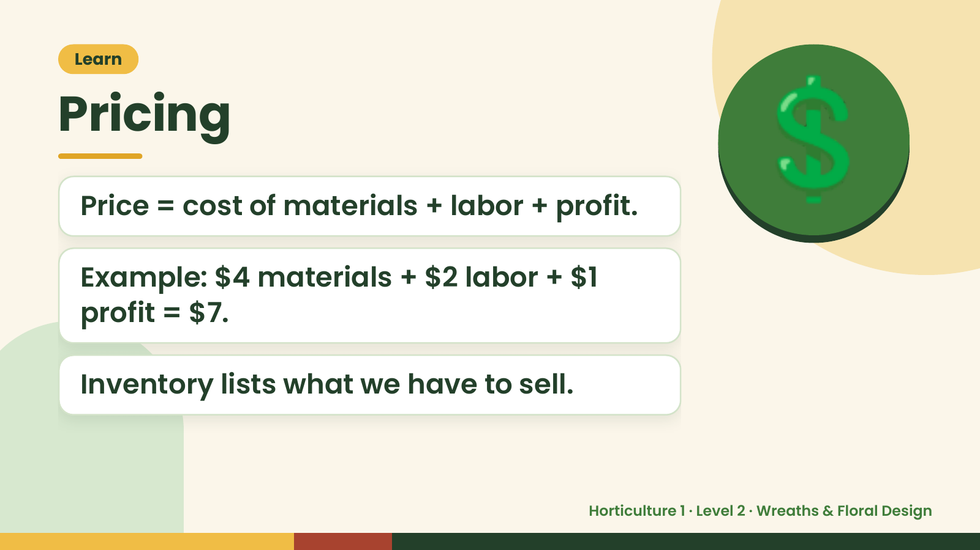
Notes:
Learn
Pricing
Price = cost of materials + labor + profit.
Example: $4 materials + $2 labor + $1
💲
profit = $7.
Inventory lists what we have to sell.
Horticulture 1 · Level 2 · Wreaths & Floral Design

Slide 15
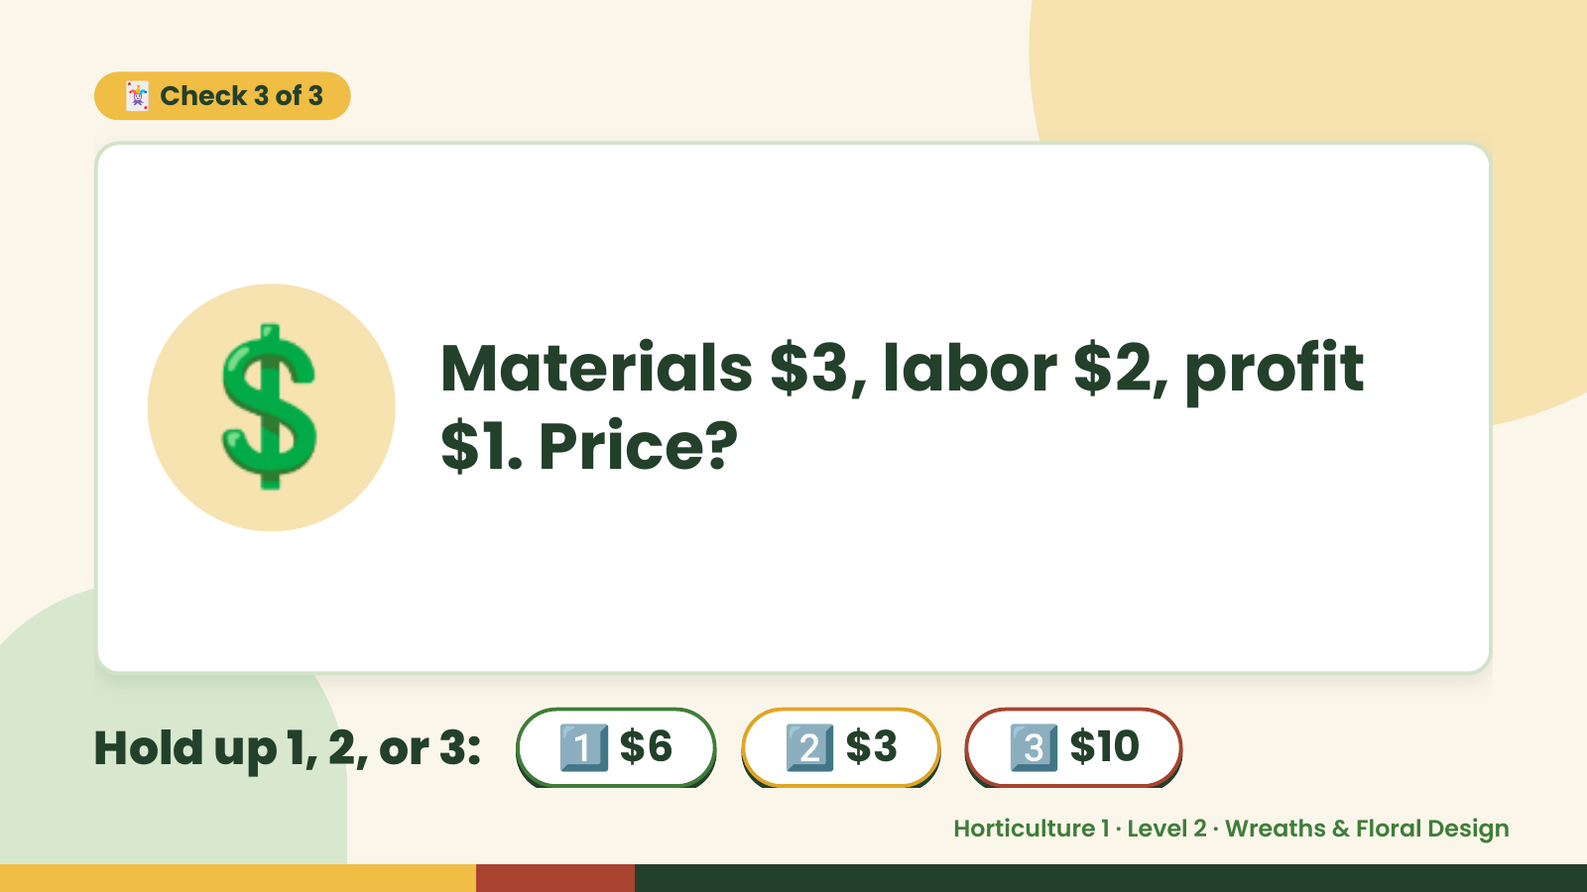
Notes:
🃏 Check 3 of 3
💲 Materials $3, labor $2, profit
$1. Price?
Hold up 1, 2, or 3: 1️⃣ $6 2️⃣ $3 3️⃣ $10
Horticulture 1 · Level 2 · Wreaths & Floral Design

Slide 16
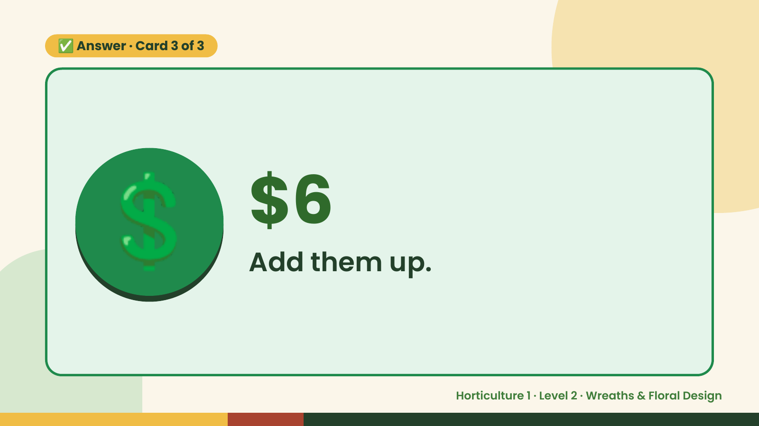
Notes:
✅ Answer · Card 3 of 3
💲 $6
Add them up.
Horticulture 1 · Level 2 · Wreaths & Floral Design

Slide 17
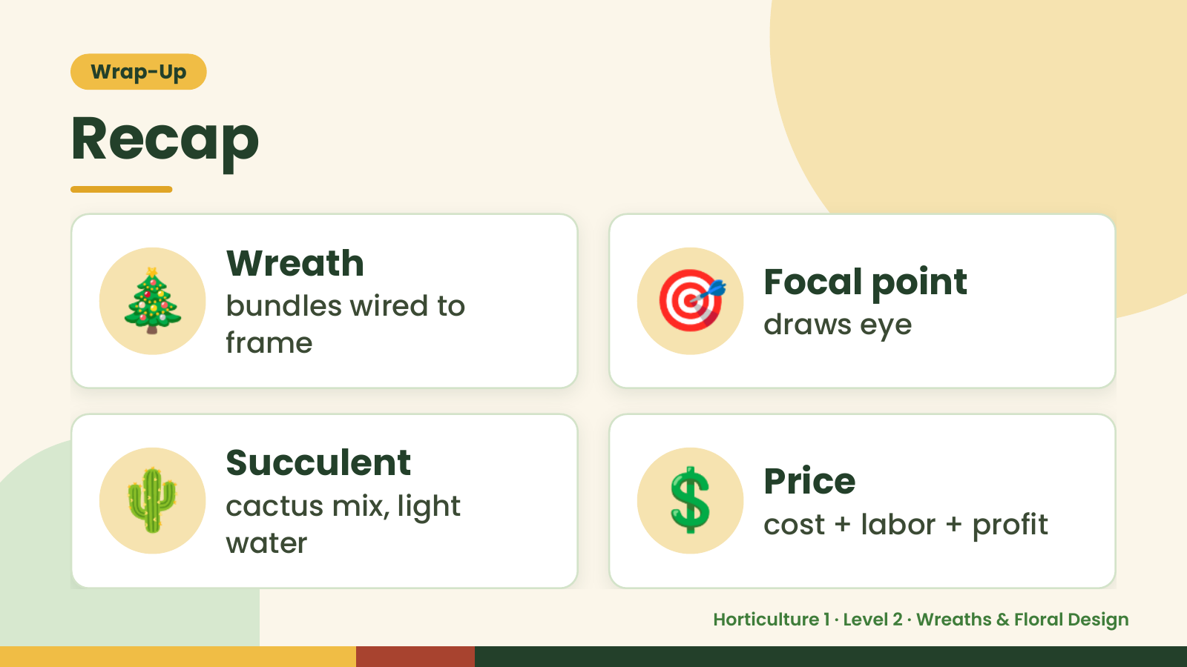
Notes:
Wrap-Up
Recap
🎄 Wreath
bundles wired to
frame
🎯 Focal point
draws eye
🌵 Succulent
cactus mix, light
water
💲 Price
cost + labor + profit
Horticulture 1 · Level 2 · Wreaths & Floral Design

Slide 18
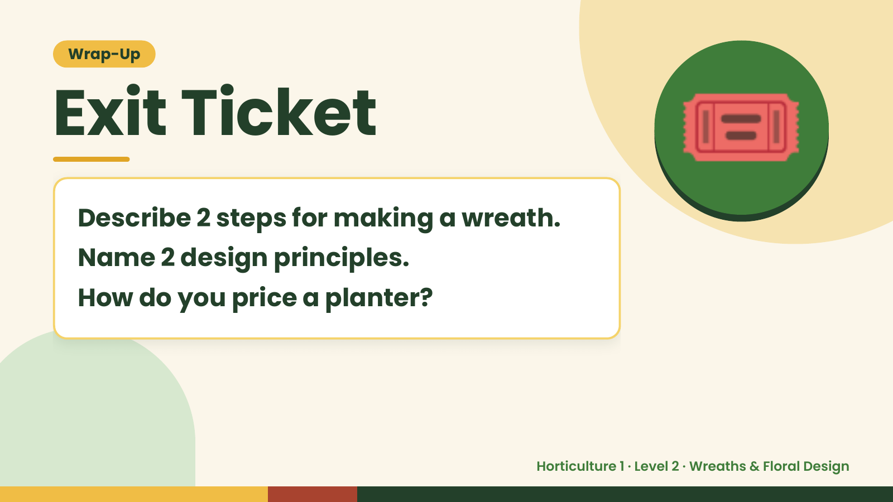
Notes:
Wrap-Up
Exit Ticket
Describe 2 steps for making a wreath.
Name 2 design principles.
🎟️
How do you price a planter?
Horticulture 1 · Level 2 · Wreaths & Floral Design

