Slide 1
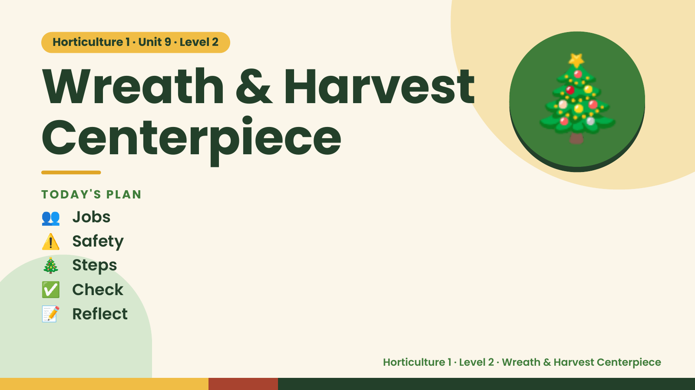
Notes:
Horticulture 1 · Unit 9 · Level 2
Wreath & Harvest
Centerpiece
👥 Jobs
TODAY'S PLAN
🎄
⚠️ Safety
🎄 Steps
✅ Check
📝 Reflect
Horticulture 1 · Level 2 · Wreath & Harvest Centerpiece

Slide 2

Notes:
Get ready
Jobs
🧑‍🌾 Grower
Does the main plant job
with the tools
🧺 Supply helper
Gets and returns supplies
and tools to staff
📸 Recorder
Takes photos and fills in
the chart
🧽 Clean-up captain
Sweeps, wipes tables,
checks hands are
washed
Horticulture 1 · Level 2 · Wreath & Harvest Centerpiece

Slide 3
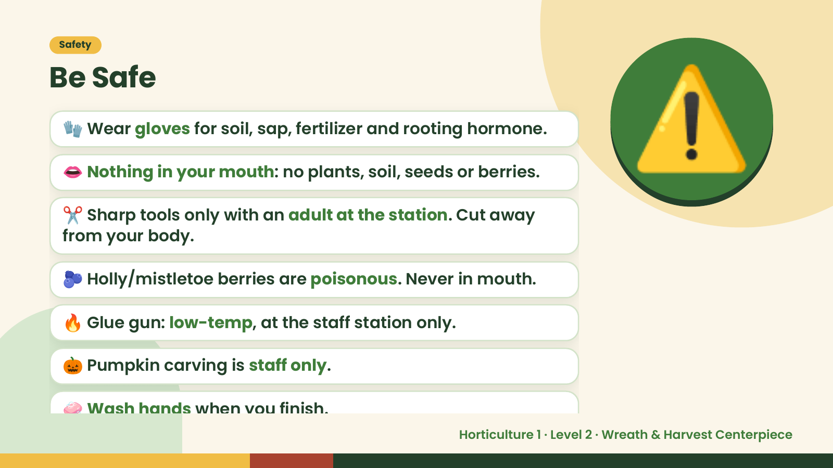
Notes:
Safety
Be Safe
🧤 Wear gloves for soil, sap, fertilizer and rooting hormone.
👄 Nothing in your mouth: no plants, soil, seeds or berries.
✂️ Sharp tools only with an adult at the station. Cut away
from your body.
⚠️
🫐 Holly/mistletoe berries are poisonous. Never in mouth.
🔥 Glue gun: low-temp, at the staff station only.
🎃 Pumpkin carving is staff only.
🧼 Wash hands when you finish.
Horticulture 1 · Level 2 · Wreath & Harvest Centerpiece

Slide 4
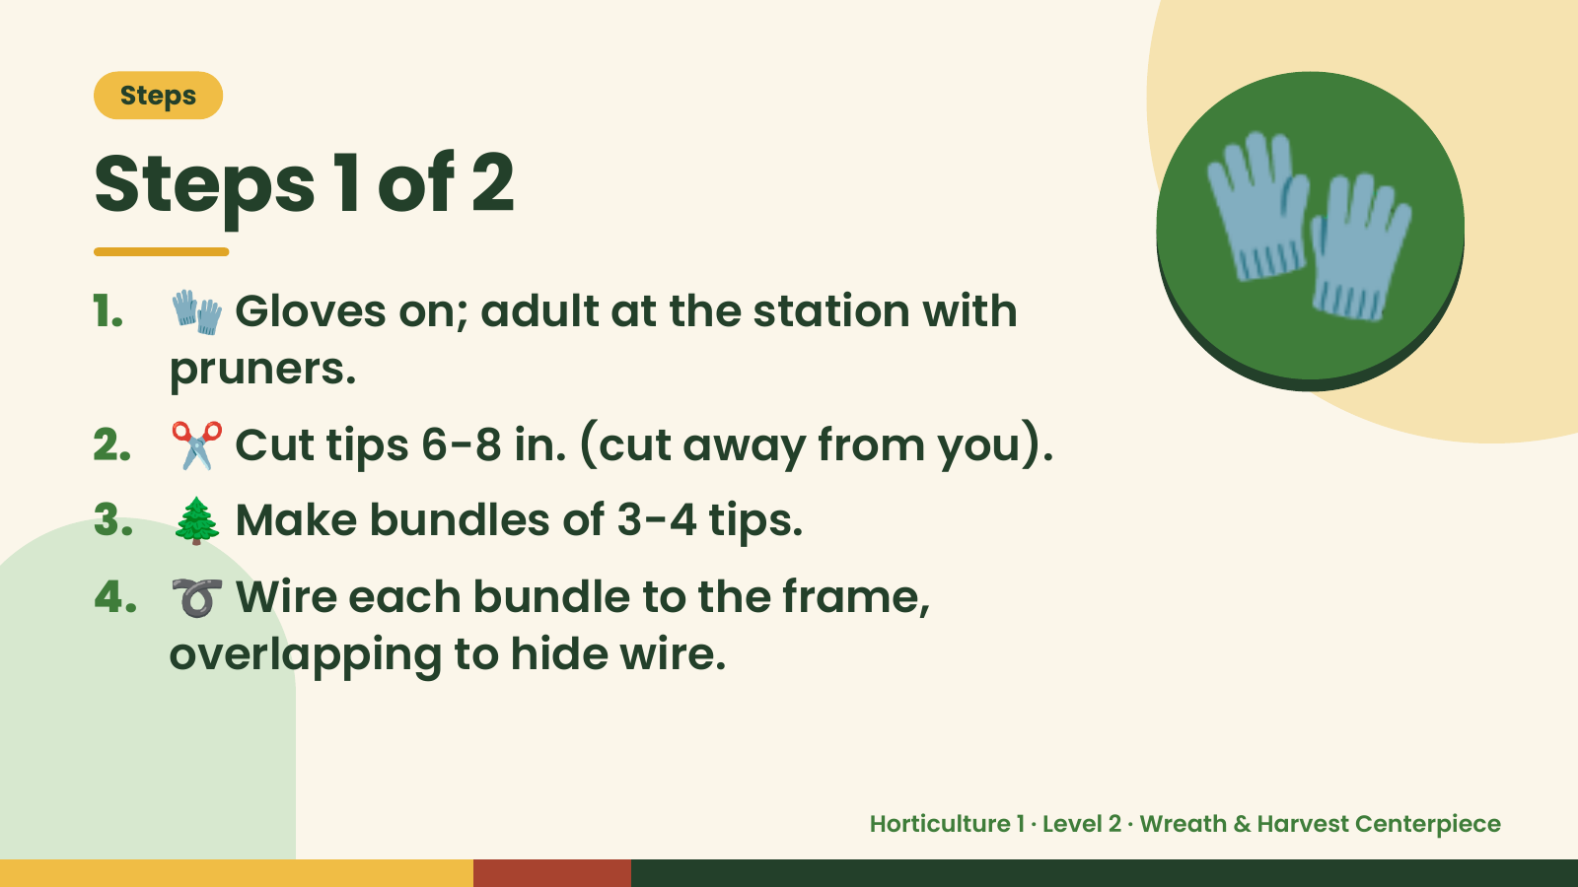
Notes:
Steps
Steps 1 of 2
1. 🧤 Gloves on; adult at the station with
pruners.
2. ✂️ Cut tips 6-8 in. (cut away from you).
🧤
3. 🌲 Make bundles of 3-4 tips.
4. ➰ Wire each bundle to the frame,
overlapping to hide wire.
Horticulture 1 · Level 2 · Wreath & Harvest Centerpiece

Slide 5
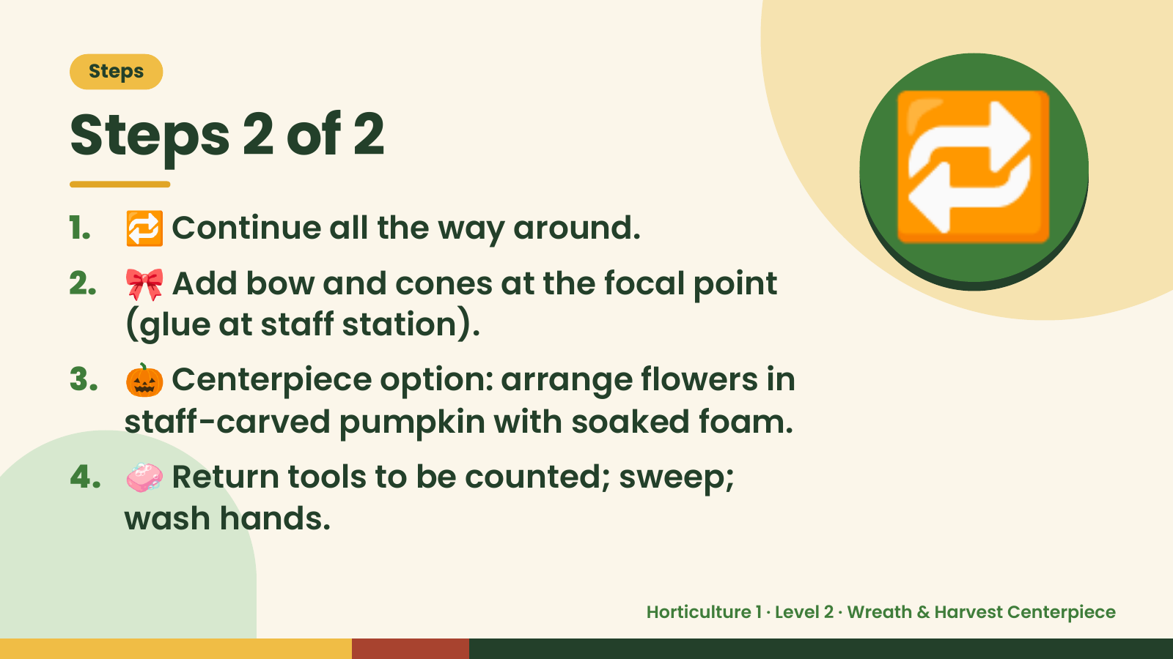
Notes:
Steps
Steps 2 of 2
1. 🔁 Continue all the way around.
2. 🎀 Add bow and cones at the focal point
(glue at staff station).
🔁
3. 🎃 Centerpiece option: arrange flowers in
staff-carved pumpkin with soaked foam.
4. 🧼 Return tools to be counted; sweep;
wash hands.
Horticulture 1 · Level 2 · Wreath & Harvest Centerpiece

Slide 6
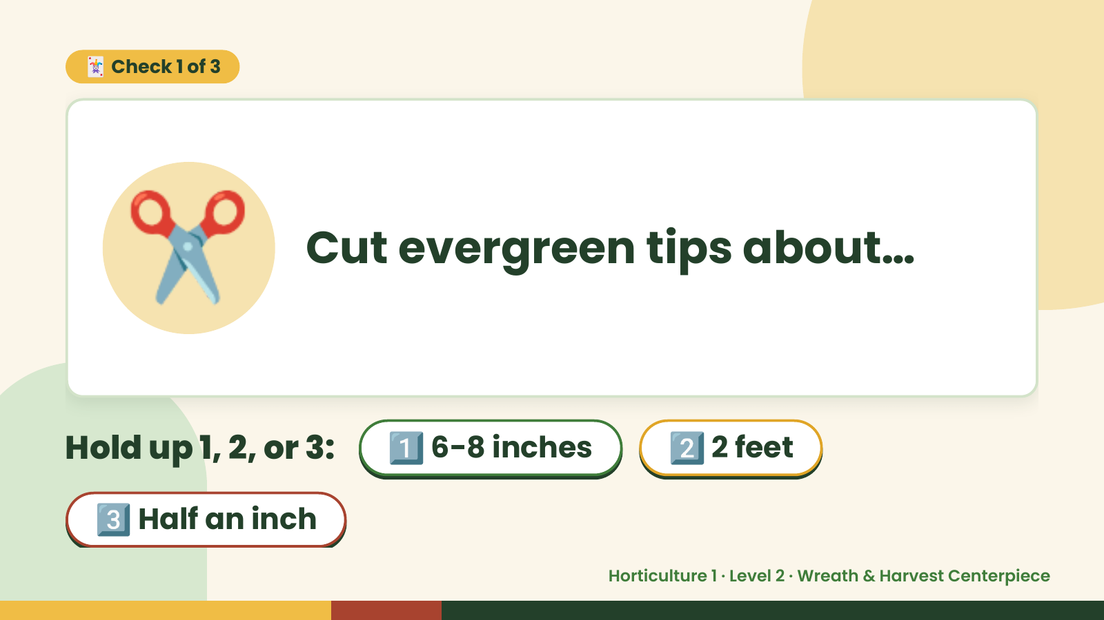
Notes:
🃏 Check 1 of 3
✂️ Cut evergreen tips about…
Hold up 1, 2, or 3: 1️⃣ 6-8 inches 2️⃣ 2 feet
3️⃣ Half an inch
Horticulture 1 · Level 2 · Wreath & Harvest Centerpiece

Slide 7
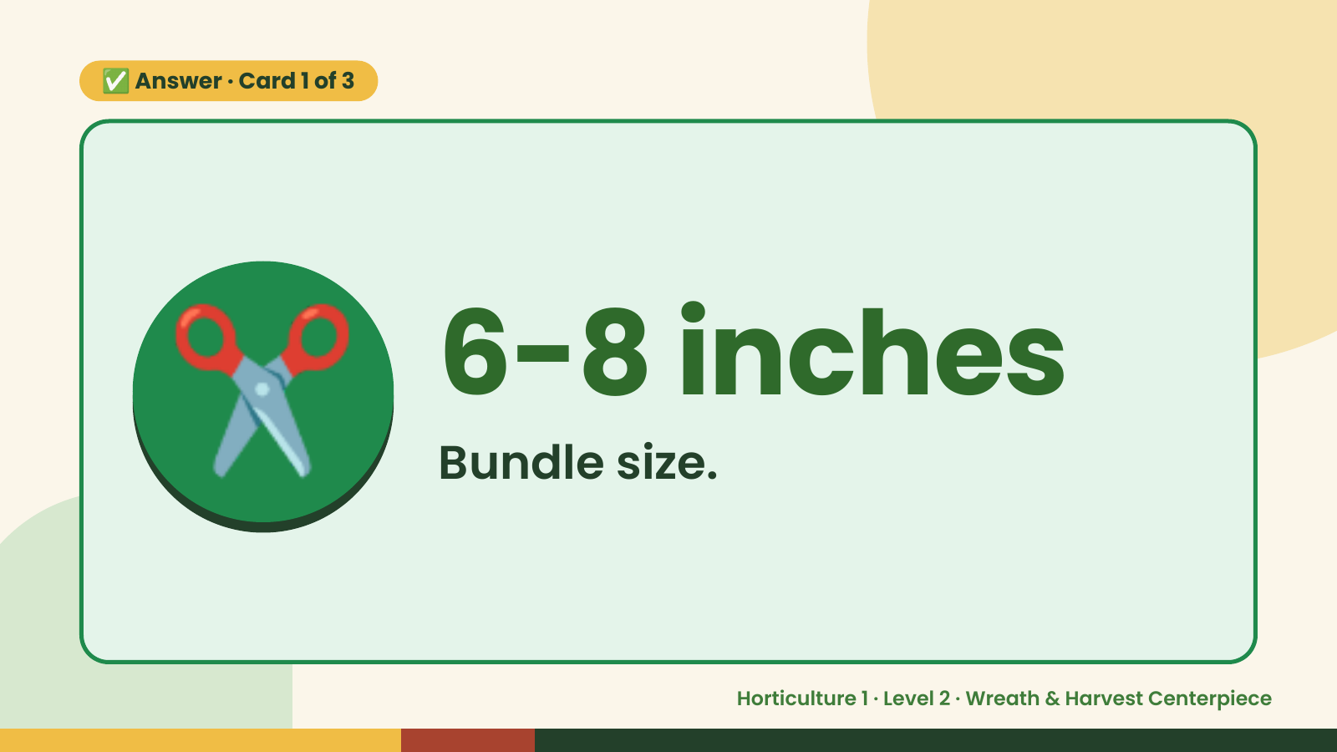
Notes:
✅ Answer · Card 1 of 3
✂️ 6-8 inches
Bundle size.
Horticulture 1 · Level 2 · Wreath & Harvest Centerpiece

Slide 8
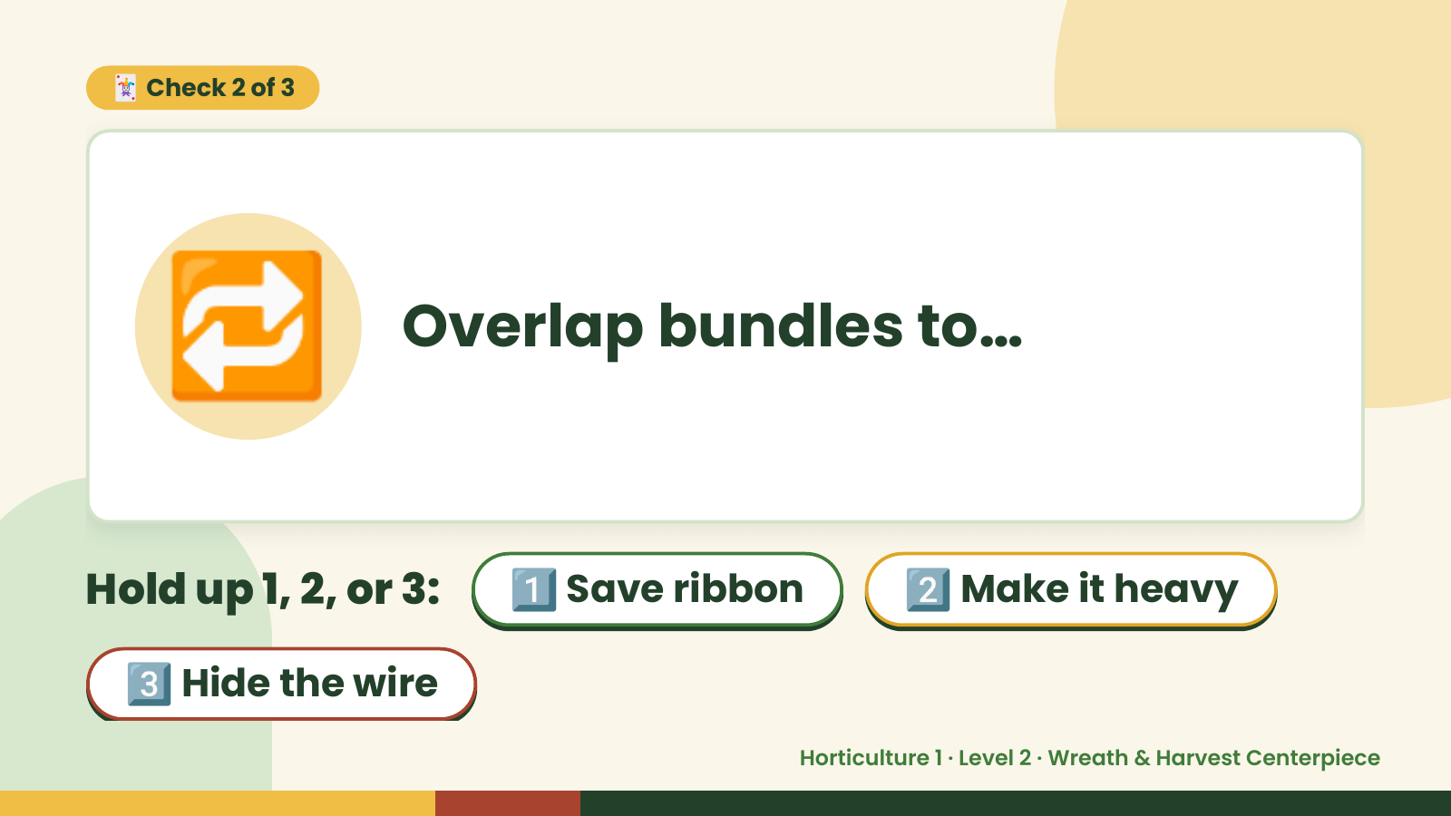
Notes:
🃏 Check 2 of 3
🔁 Overlap bundles to…
Hold up 1, 2, or 3: 1️⃣ Save ribbon 2️⃣ Make it heavy
3️⃣ Hide the wire
Horticulture 1 · Level 2 · Wreath & Harvest Centerpiece

Slide 9
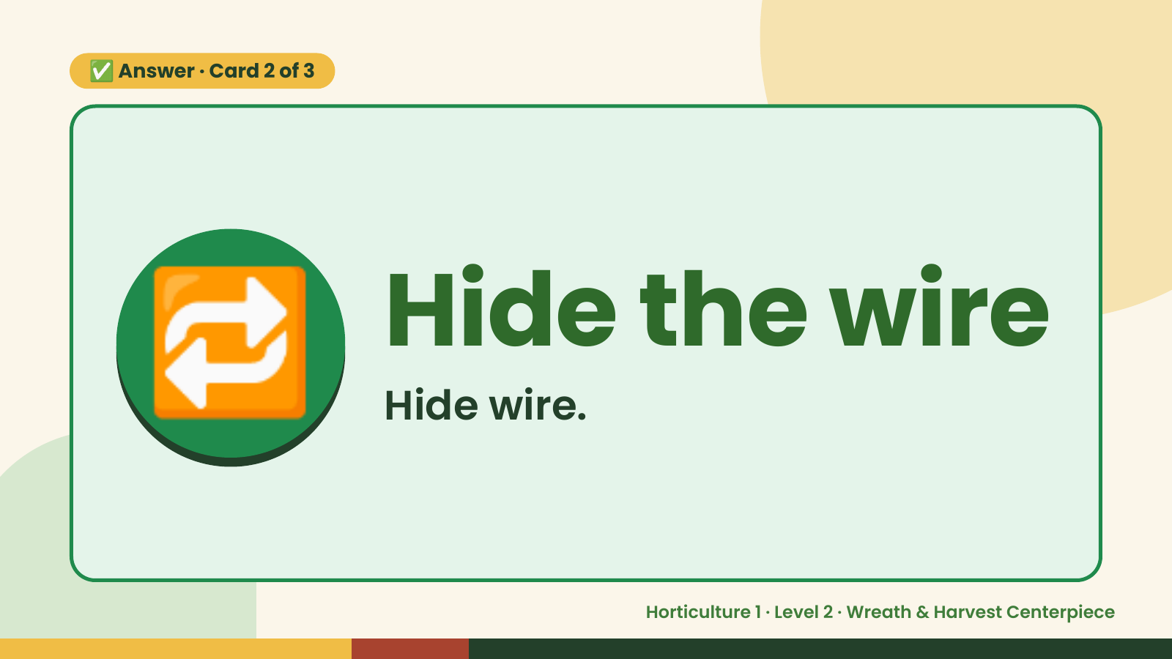
Notes:
✅ Answer · Card 2 of 3
🔁 Hide the wire
Hide wire.
Horticulture 1 · Level 2 · Wreath & Harvest Centerpiece

Slide 10
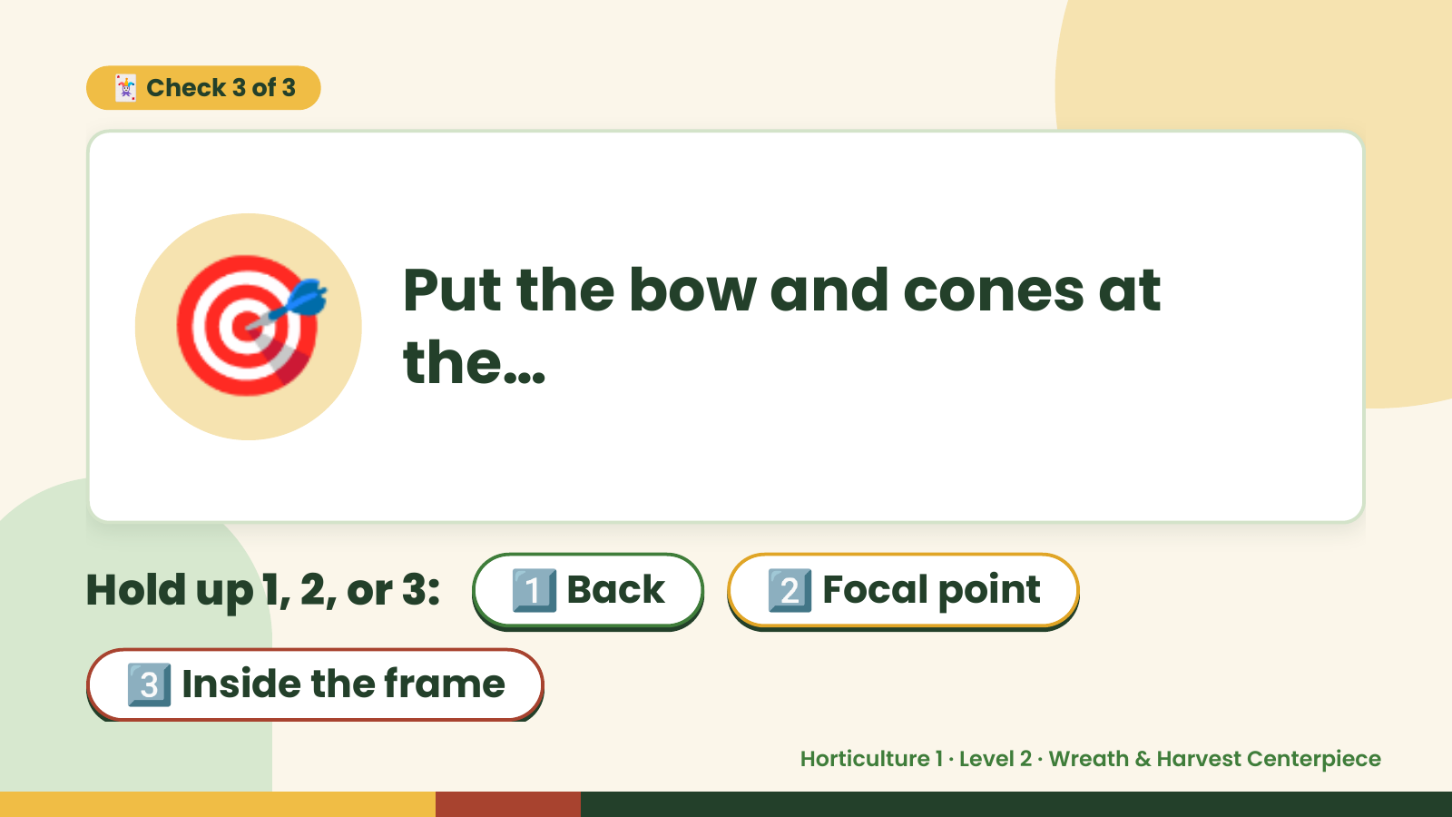
Notes:
🃏 Check 3 of 3
🎯 Put the bow and cones at
the…
Hold up 1, 2, or 3: 1️⃣ Back 2️⃣ Focal point
3️⃣ Inside the frame
Horticulture 1 · Level 2 · Wreath & Harvest Centerpiece

Slide 11
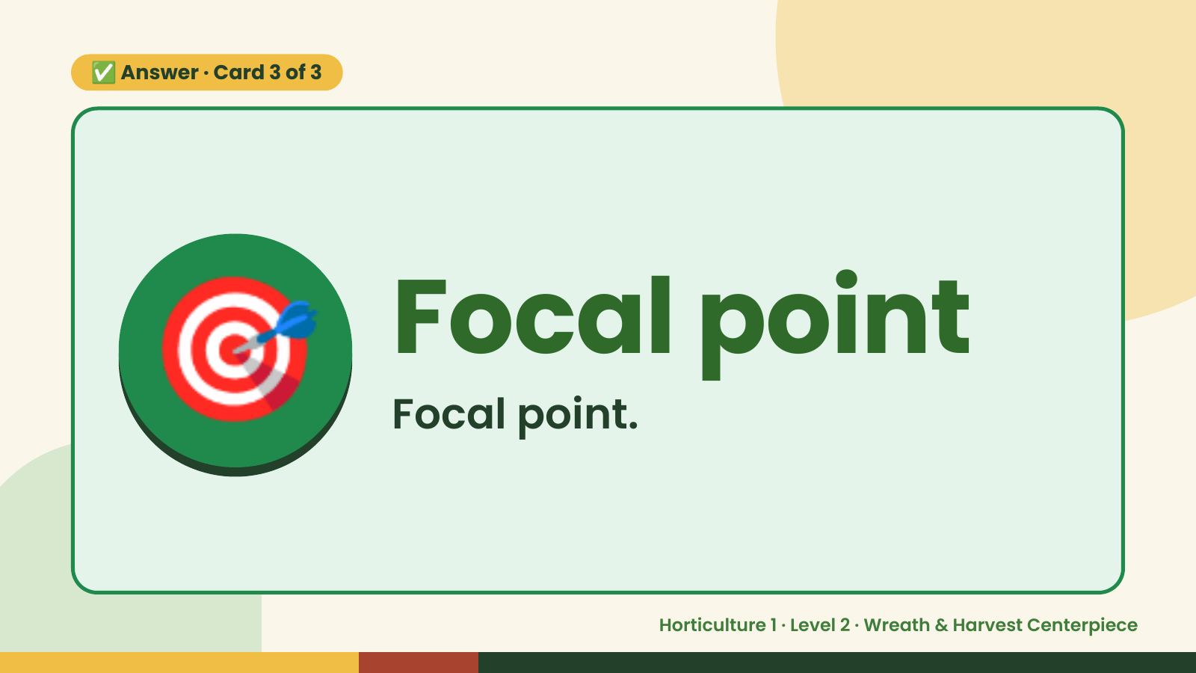
Notes:
✅ Answer · Card 3 of 3
🎯 Focal point
Focal point.
Horticulture 1 · Level 2 · Wreath & Harvest Centerpiece

Slide 12

Notes:
Wrap-Up
Clean Up +
Reflect
🧽
Return and count tools.
Sweep and wipe your area.
Wash hands, then do the reflection.
Horticulture 1 · Level 2 · Wreath & Harvest Centerpiece

