Slide 1
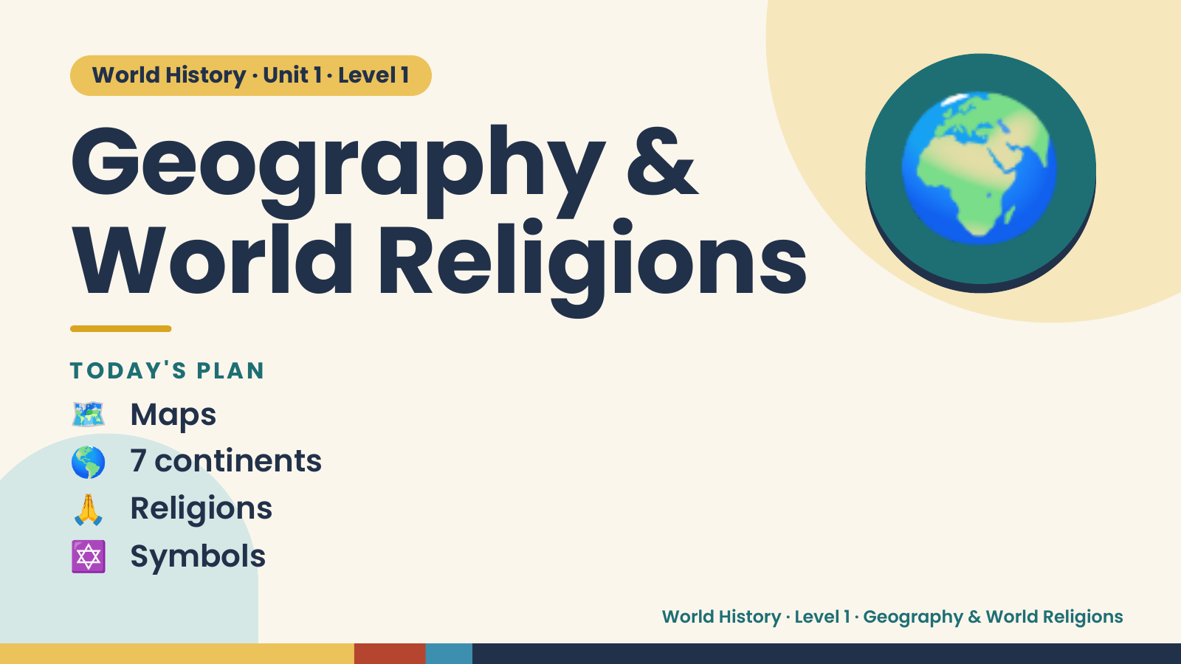
Notes:
World History · Unit 1 · Level 1
Geography &
World Religions
🌍
🗺️ Maps
TODAY'S PLAN
🌎 7 continents
🙏 Religions
✡️ Symbols
World History · Level 1 · Geography & World Religions

Slide 2
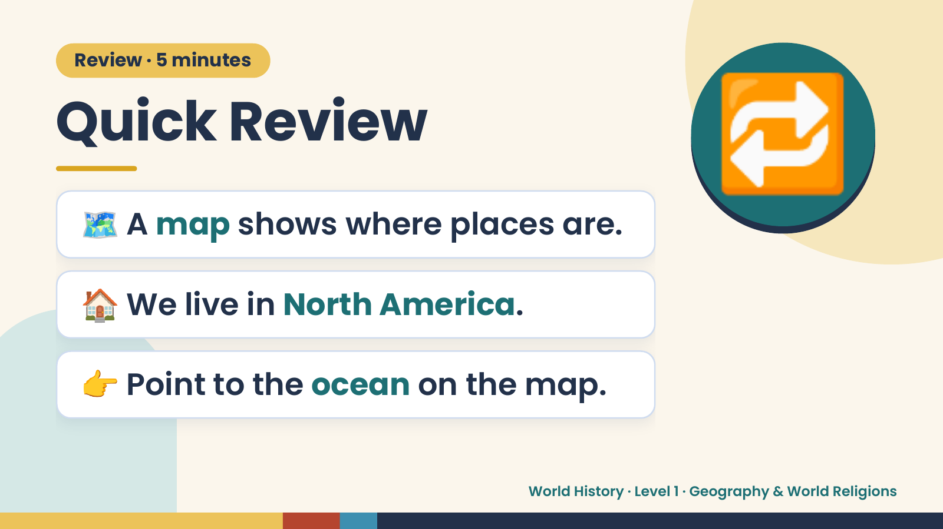
Notes:
Review · 5 minutes
Quick Review
🗺️ A map shows where places are.
🔁
🏠 We live in North America.
👉 Point to the ocean on the map.
World History · Level 1 · Geography & World Religions

Slide 3
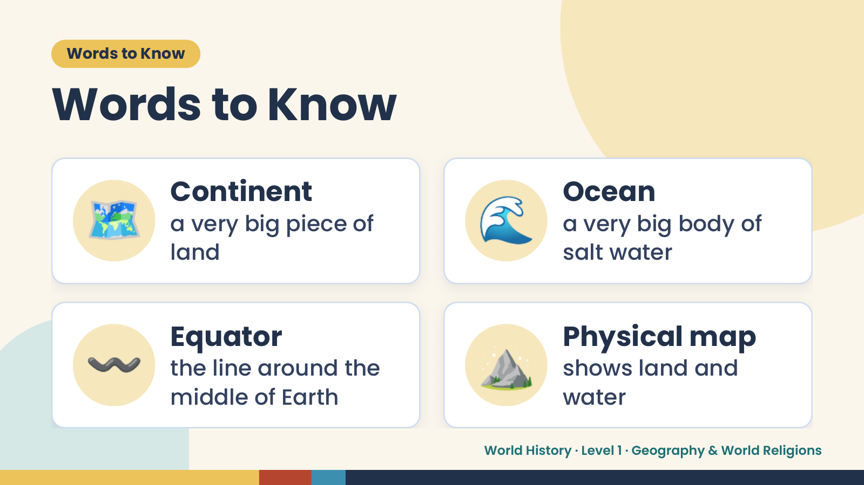
Notes:
Words to Know
Words to Know
🗺️ Continent
a very big piece of
land
🌊 Ocean
a very big body of
salt water
〰️ Equator
the line around the
middle of Earth
⛰️ Physical map
shows land and
water
World History · Level 1 · Geography & World Religions

Slide 4
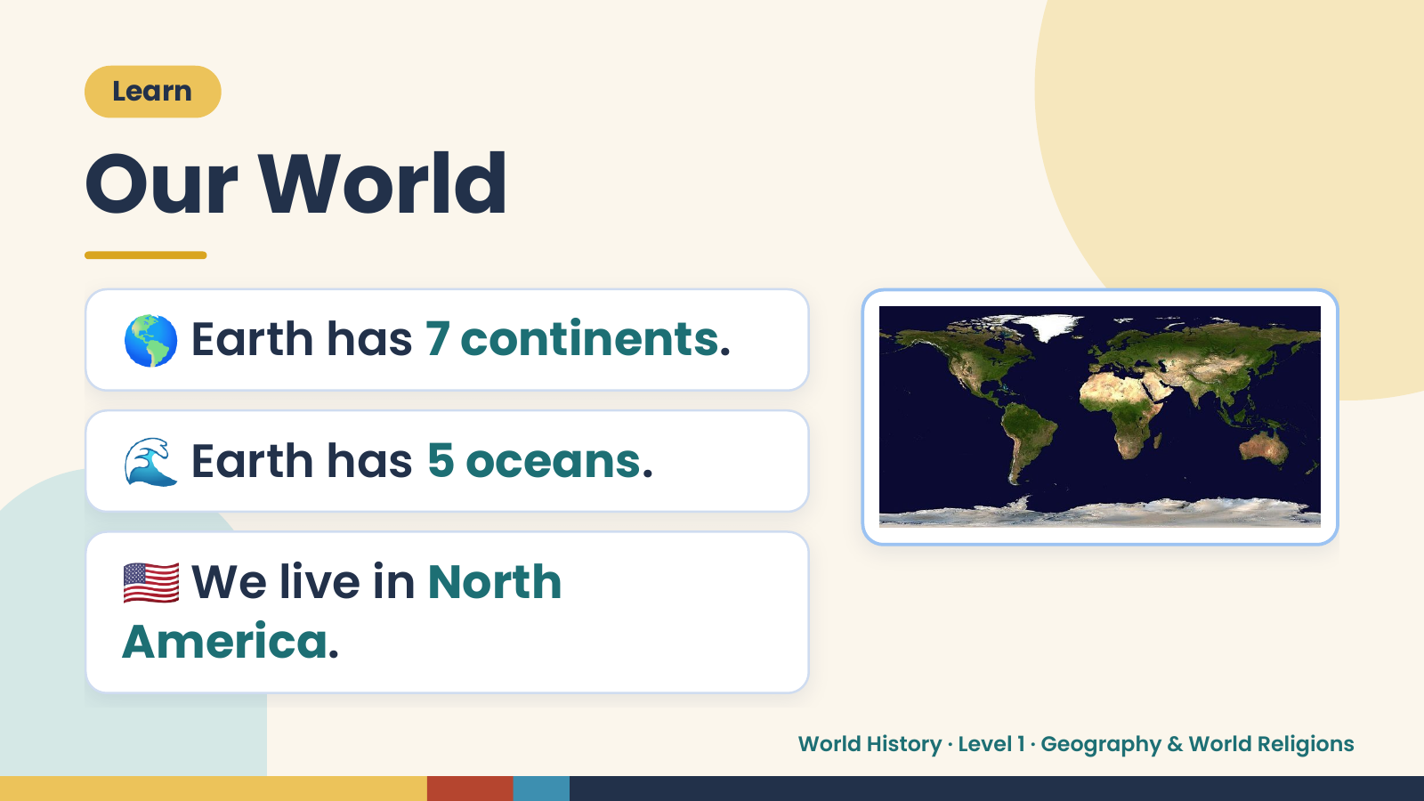
Notes:
Learn
Our World
🌎 Earth has 7 continents.
🌊 Earth has 5 oceans.
🇺🇸 We live in North
America.
World History · Level 1 · Geography & World Religions

Slide 5
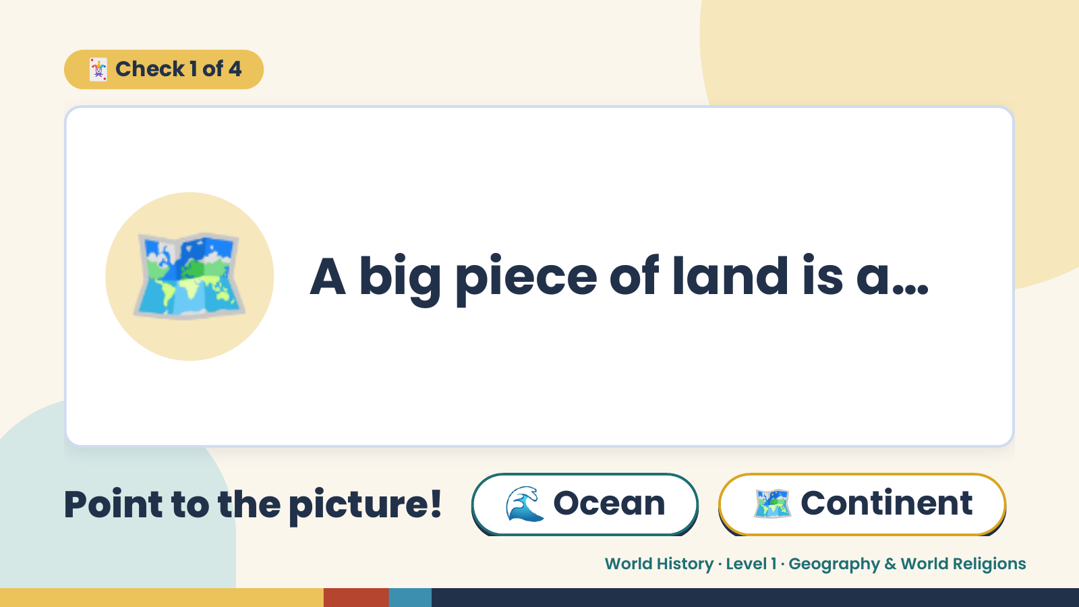
Notes:
🃏 Check 1 of 4
🗺️ A big piece of land is a…
Point to the picture! 🌊 Ocean 🗺️ Continent
World History · Level 1 · Geography & World Religions

Slide 6
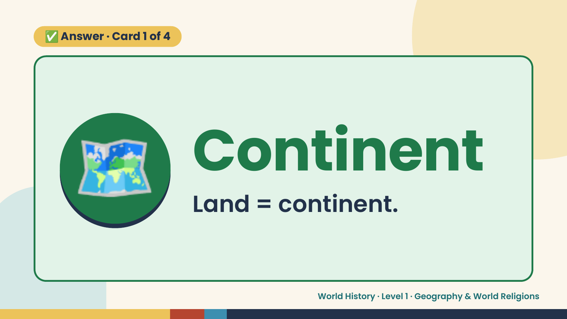
Notes:
✅ Answer · Card 1 of 4
🗺️ Continent
Land = continent.
World History · Level 1 · Geography & World Religions

Slide 7
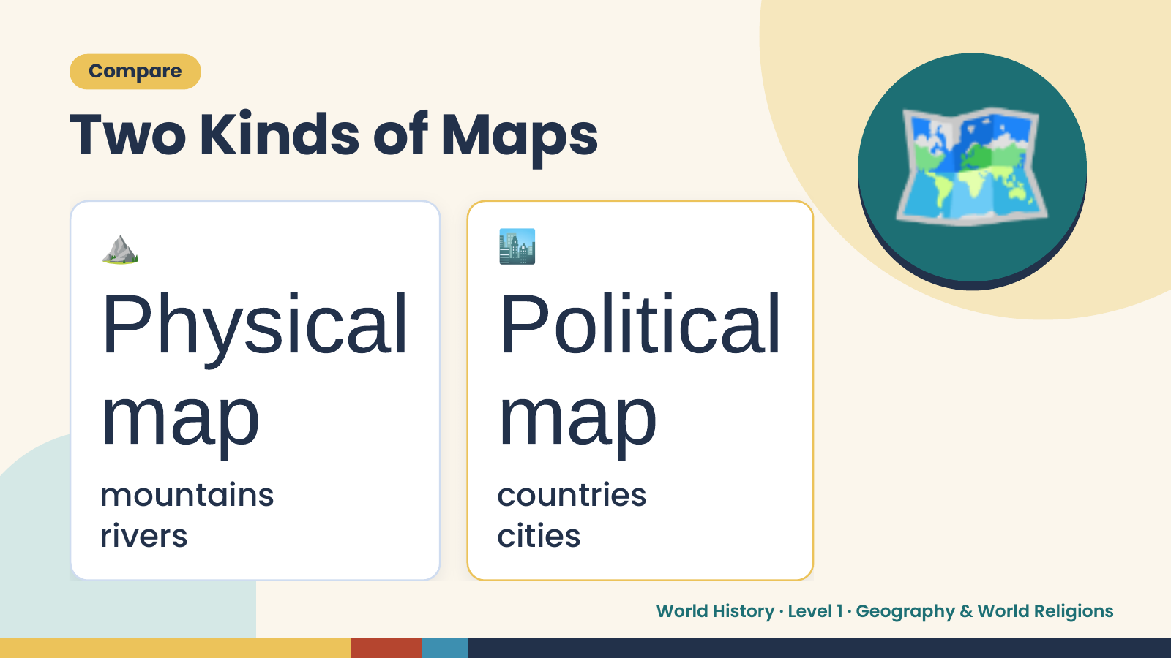
Notes:
Compare
Two Kinds of Maps
⛰️ 🏙️
Physical Political
🗺️
map
mountains
map countries
rivers cities
World History · Level 1 · Geography & World Religions

Slide 8
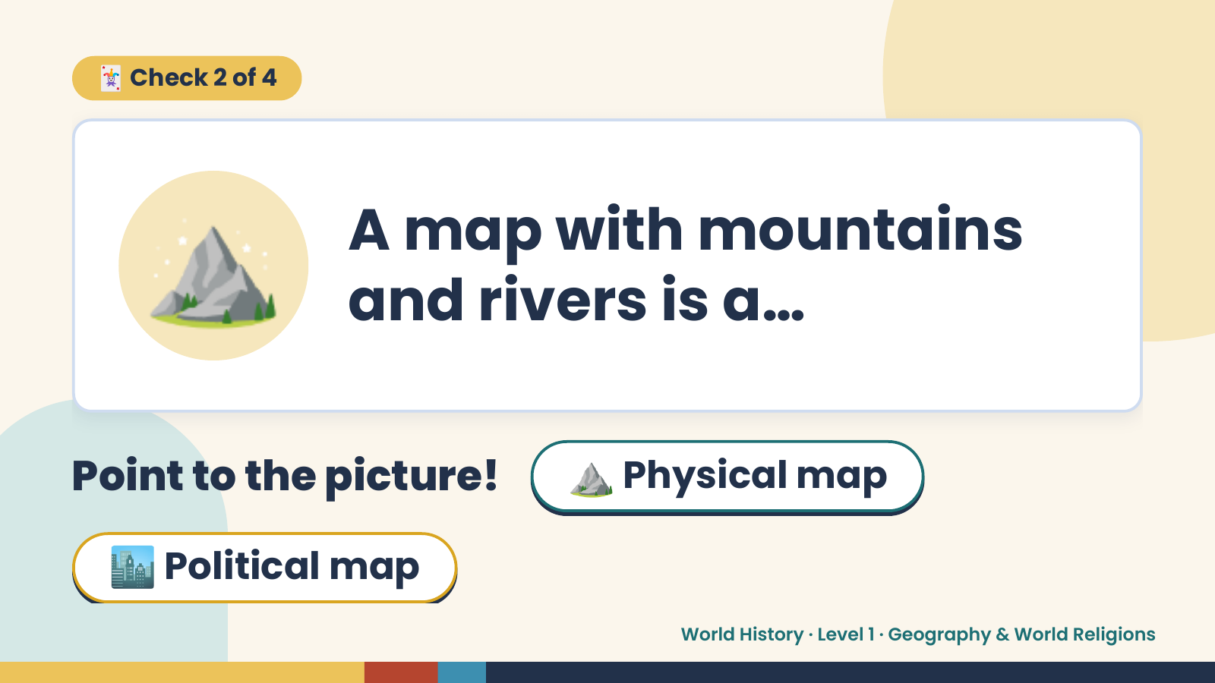
Notes:
🃏 Check 2 of 4
⛰️ A map with mountains
and rivers is a…
Point to the picture! ⛰️ Physical map
🏙️ Political map
World History · Level 1 · Geography & World Religions

Slide 9
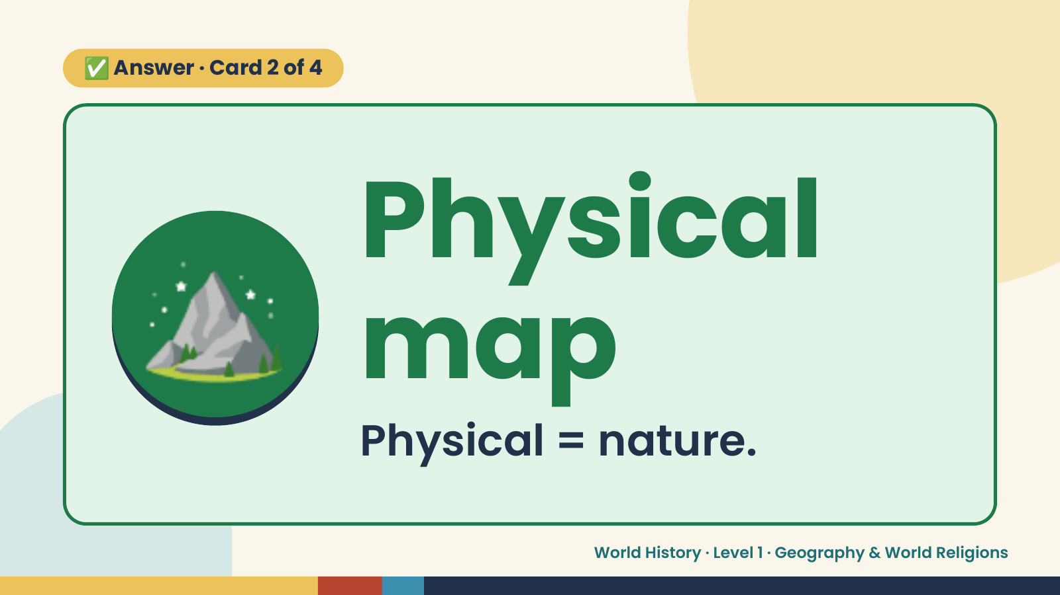
Notes:
✅ Answer · Card 2 of 4
⛰️ Physical
map
Physical = nature.
World History · Level 1 · Geography & World Religions

Slide 10
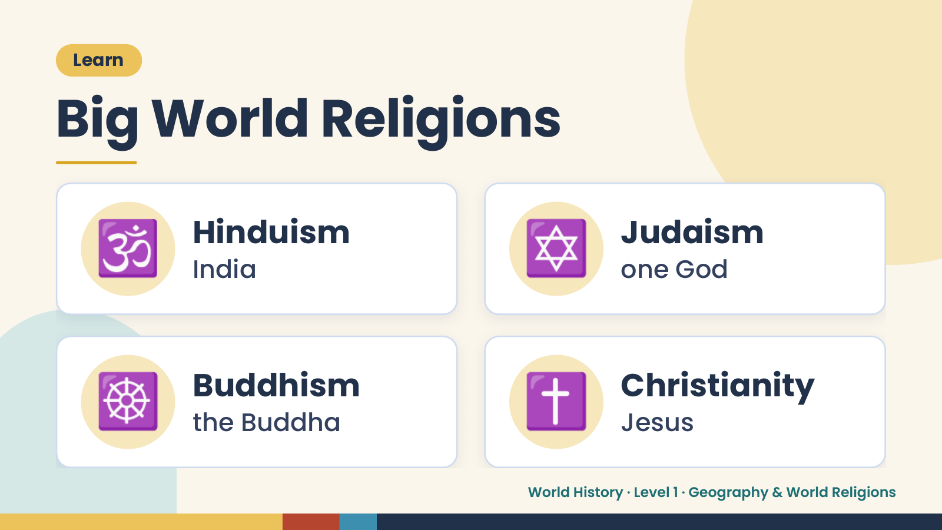
Notes:
Learn
Big World Religions
🕉️ Hinduism
India ✡️ Judaism
one God
☸️ Buddhism
the Buddha ✝️ Christianity
Jesus
World History · Level 1 · Geography & World Religions

Slide 11
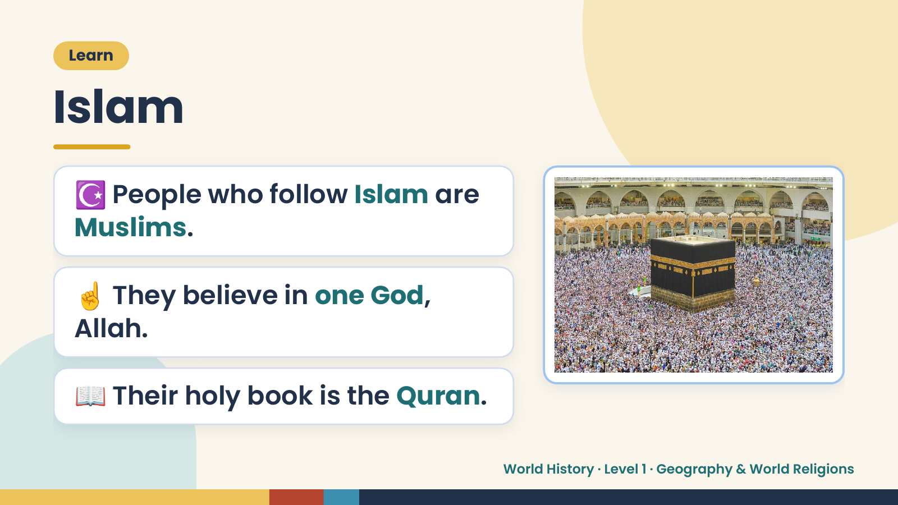
Notes:
Learn
Islam
☪️ People who follow Islam are
Muslims.
☝️ They believe in one God,
Allah.
📖 Their holy book is the Quran.
World History · Level 1 · Geography & World Religions

Slide 12
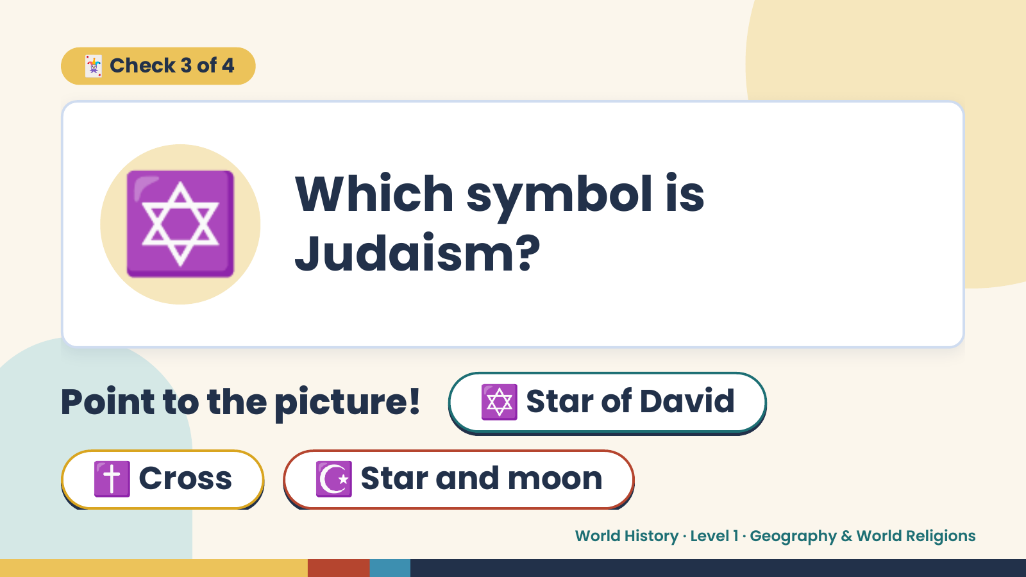
Notes:
🃏 Check 3 of 4
✡️ Which symbol is
Judaism?
Point to the picture! ✡️ Star of David
✝️ Cross ☪️ Star and moon
World History · Level 1 · Geography & World Religions

Slide 13
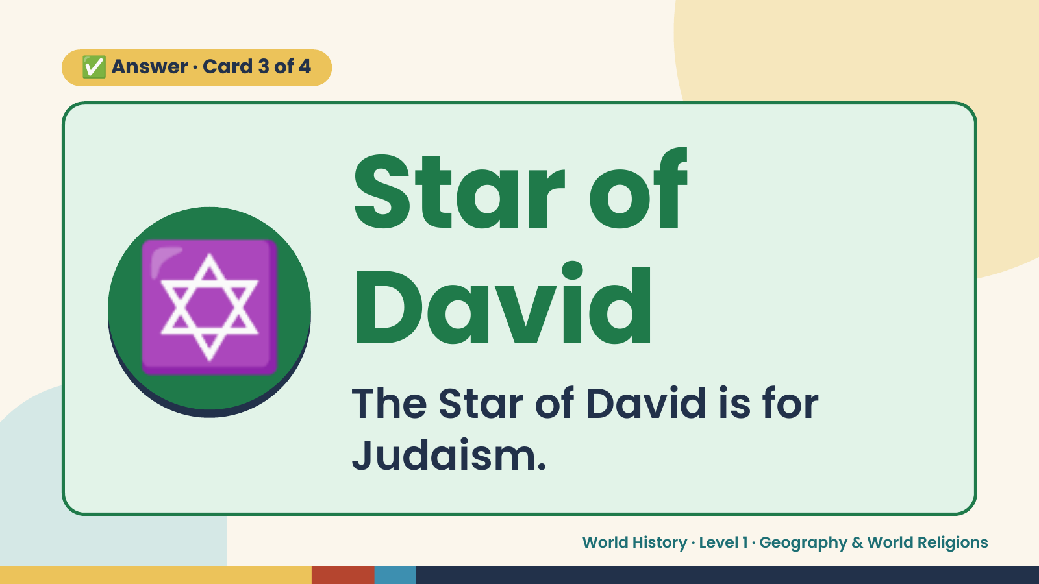
Notes:
✅ Answer · Card 3 of 4
✡️ Star of
David
The Star of David is for
Judaism.
World History · Level 1 · Geography & World Religions

Slide 14
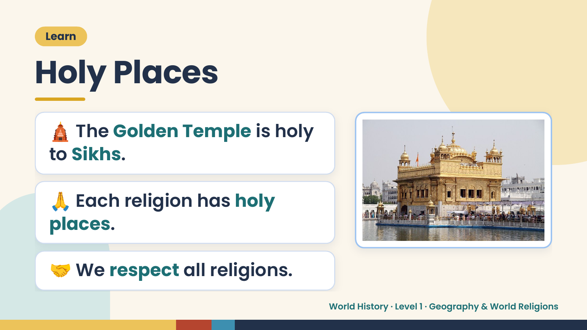
Notes:
Learn
Holy Places
🛕 The Golden Temple is holy
to Sikhs.
🙏 Each religion has holy
places.
🤝 We respect all religions.
World History · Level 1 · Geography & World Religions

Slide 15
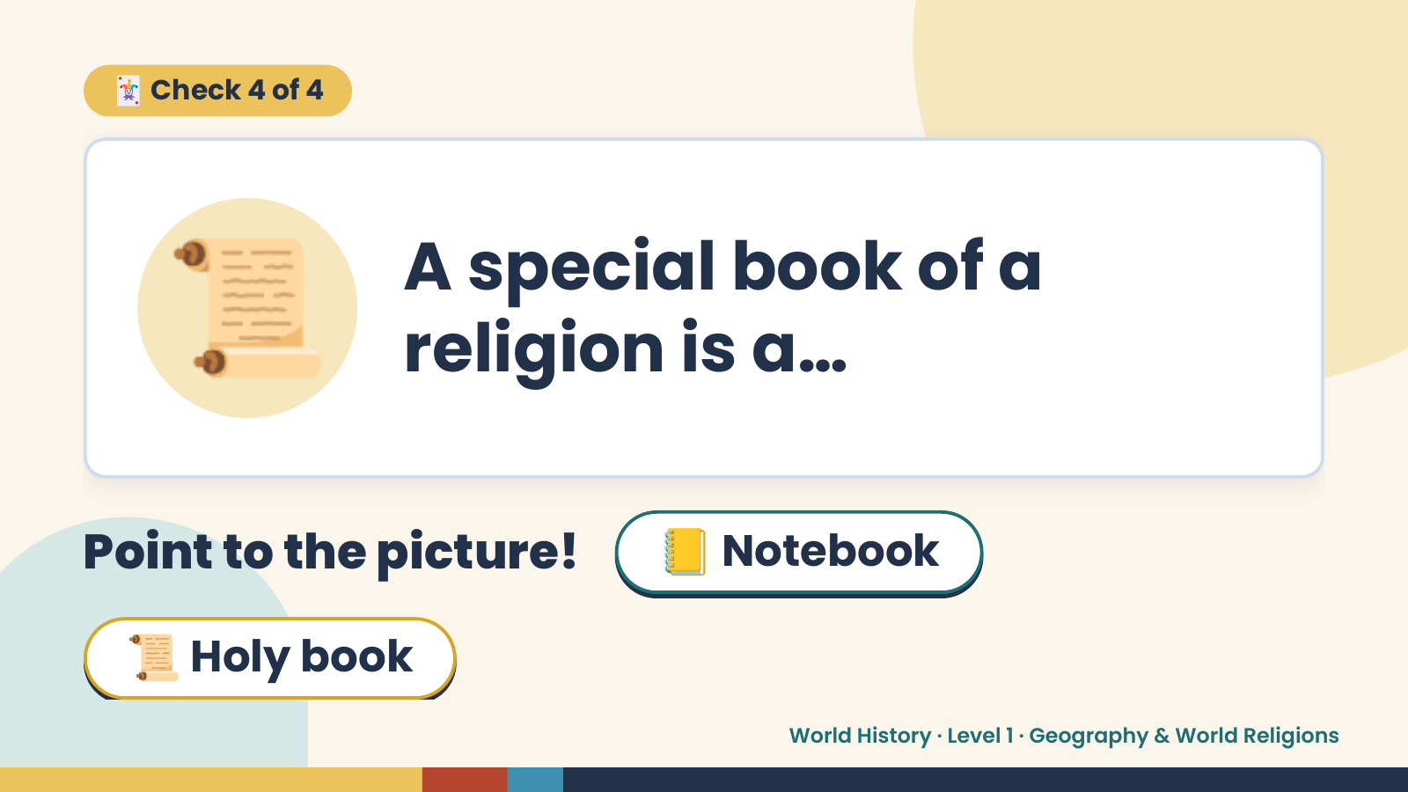
Notes:
🃏 Check 4 of 4
📜 A special book of a
religion is a…
Point to the picture! 📒 Notebook
📜 Holy book
World History · Level 1 · Geography & World Religions

Slide 16
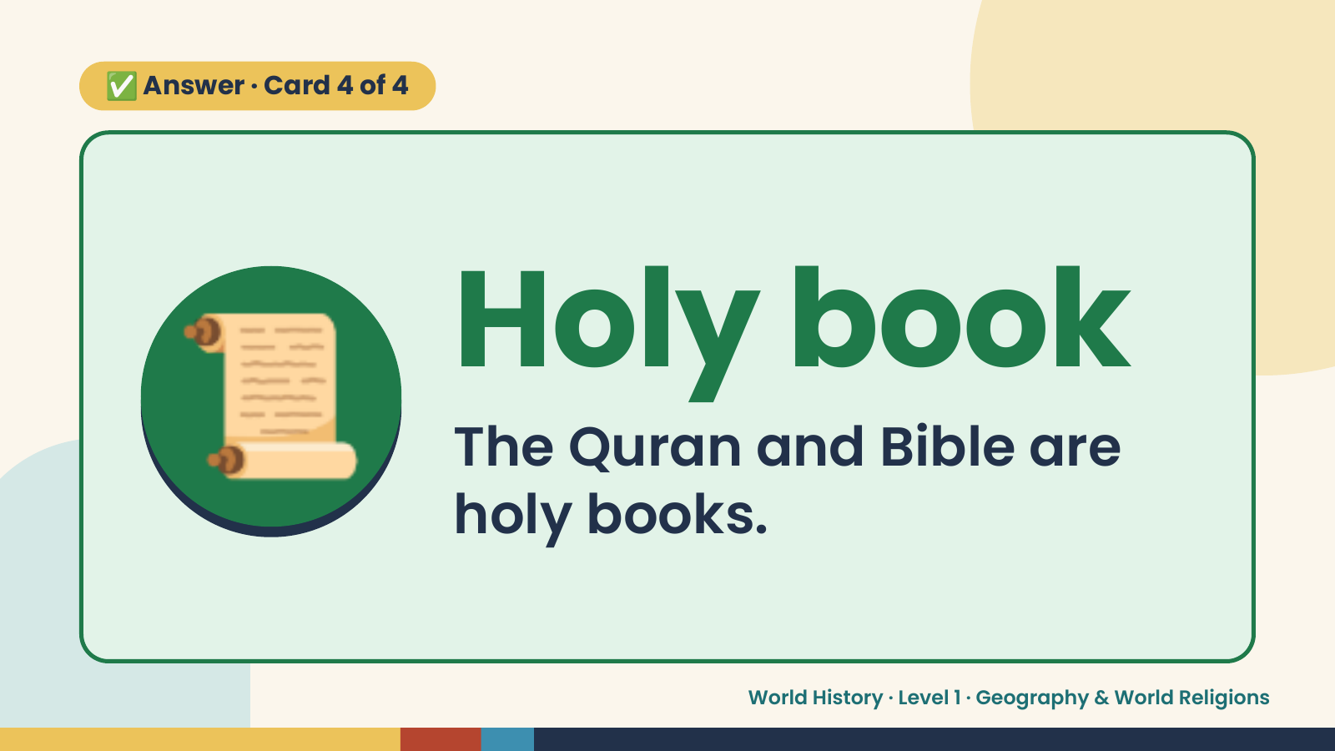
Notes:
✅ Answer · Card 4 of 4
📜 Holy book
The Quran and Bible are
holy books.
World History · Level 1 · Geography & World Religions

Slide 17
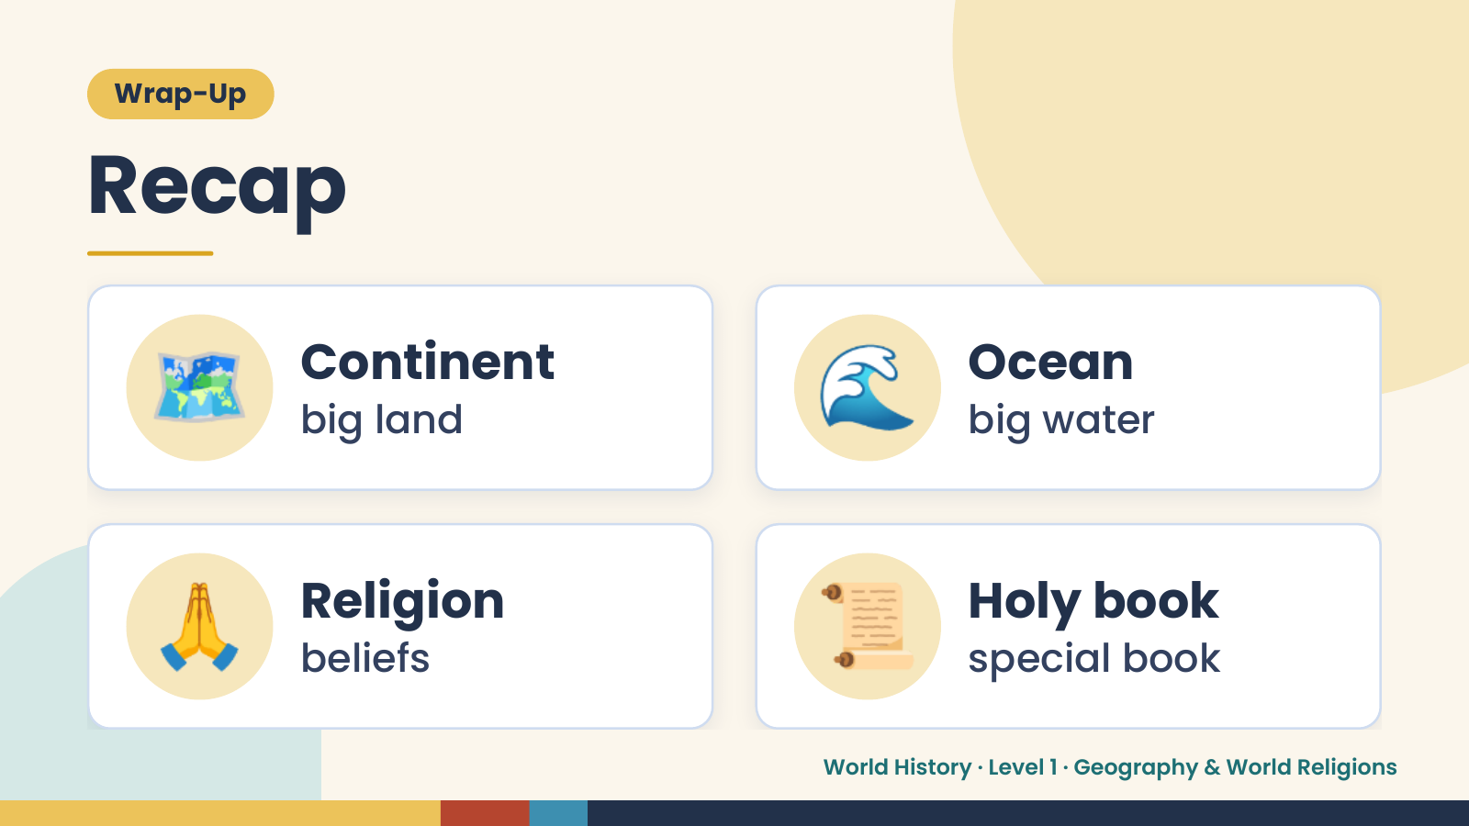
Notes:
Wrap-Up
Recap
🗺️ Continent
big land 🌊 Ocean
big water
🙏 Religion
beliefs 📜 Holy book
special book
World History · Level 1 · Geography & World Religions

Slide 18
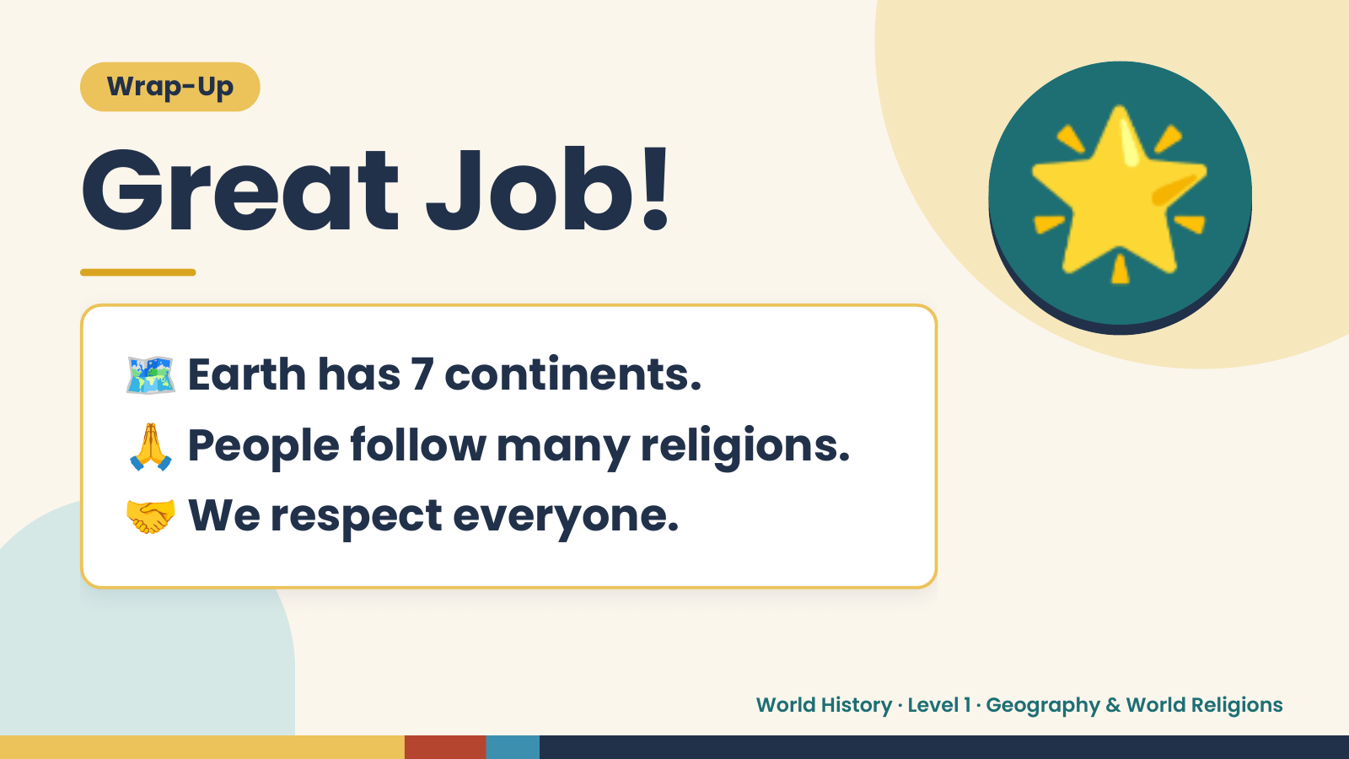
Notes:
Wrap-Up
Great Job!
🗺️ Earth has 7 continents.
🌟
🙏 People follow many religions.
🤝 We respect everyone.
World History · Level 1 · Geography & World Religions

