Slide 1
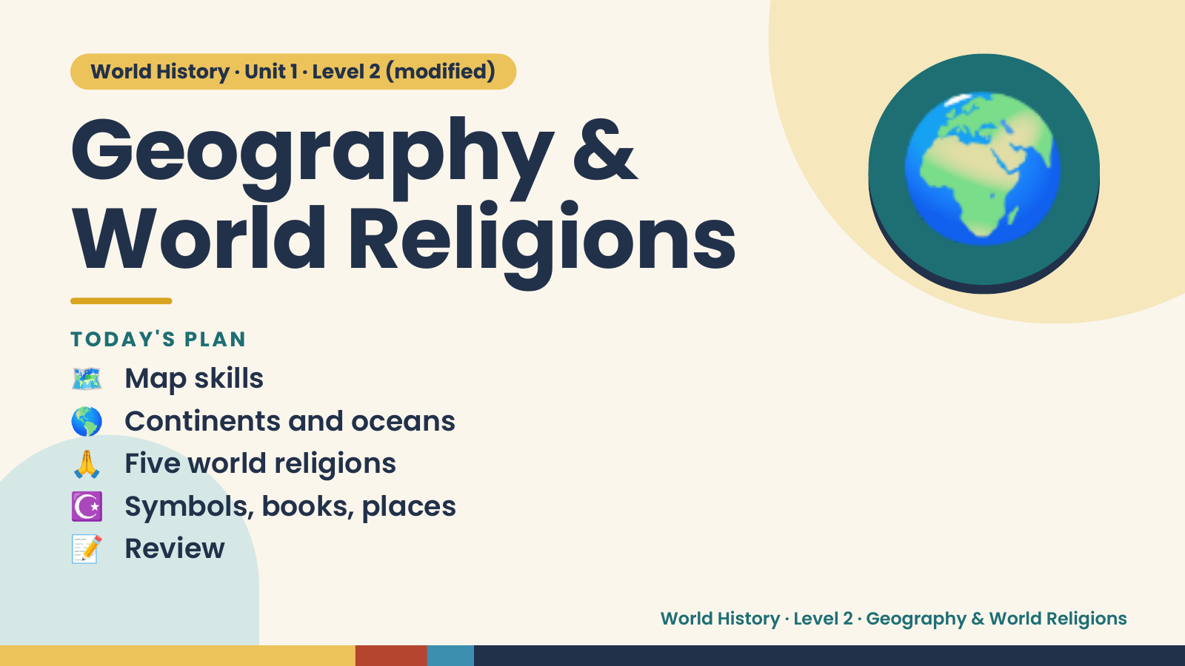
Notes:
World History · Unit 1 · Level 2 (modified)
Geography &
World Religions
🗺️ Map skills
TODAY'S PLAN
🌍
🌎 Continents and oceans
🙏 Five world religions
☪️ Symbols, books, places
📝 Review
World History · Level 2 · Geography & World Religions

Slide 2
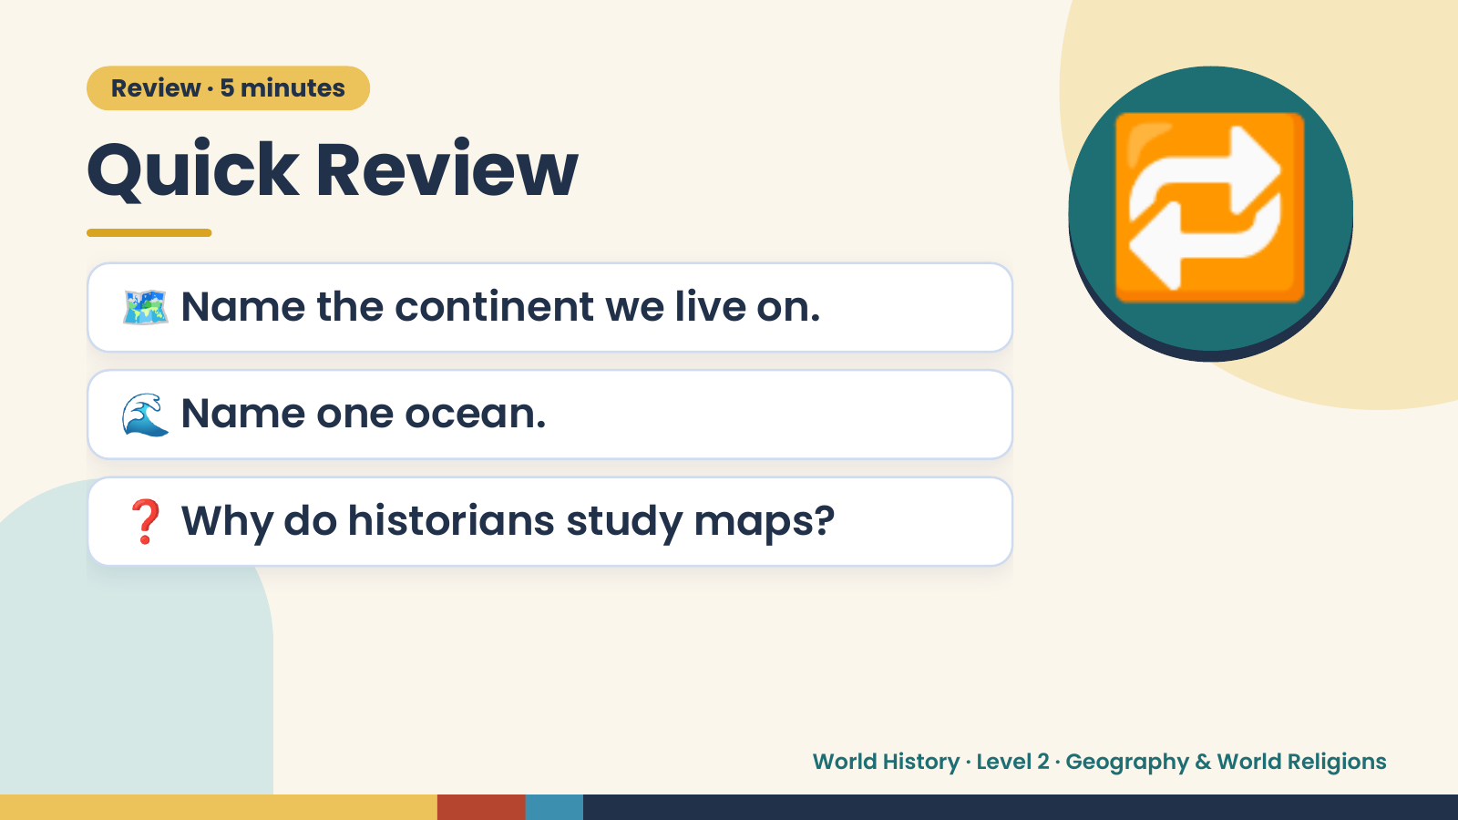
Notes:
Review · 5 minutes
Quick Review
🗺️ Name the continent we live on.
🌊 Name one ocean.
🔁
❓ Why do historians study maps?
World History · Level 2 · Geography & World Religions

Slide 3
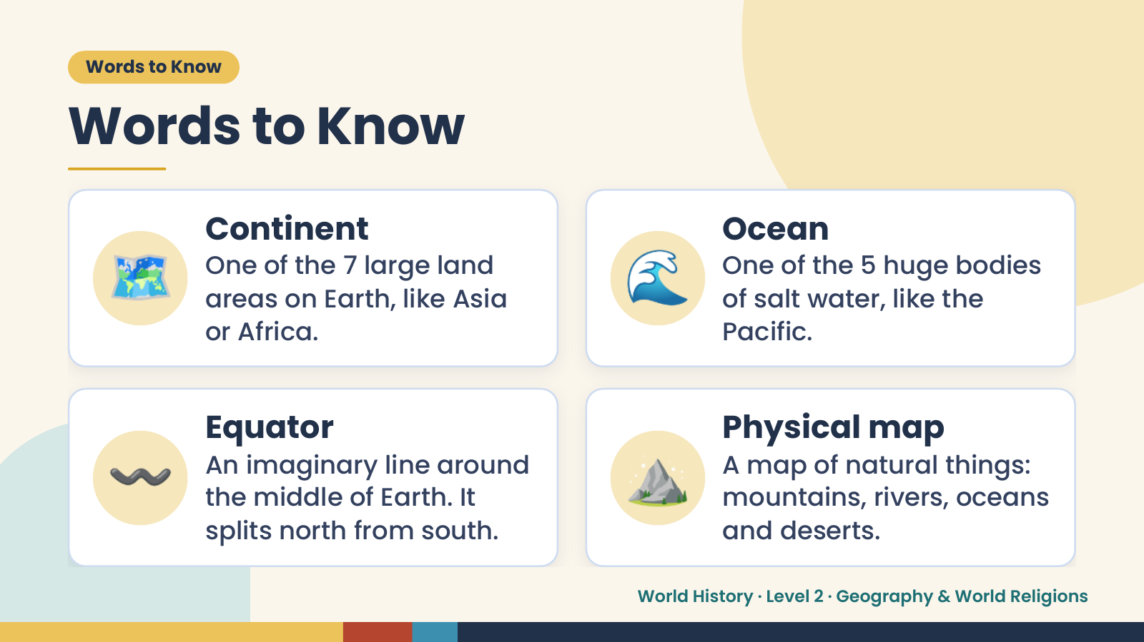
Notes:
Words to Know
Words to Know
🗺️ Continent
One of the 7 large land
areas on Earth, like Asia
or Africa.
🌊 Ocean
One of the 5 huge bodies
of salt water, like the
Pacific.
〰️ Equator
An imaginary line around
the middle of Earth. It
splits north from south.
⛰️ Physical map
A map of natural things:
mountains, rivers, oceans
and deserts.
World History · Level 2 · Geography & World Religions

Slide 4
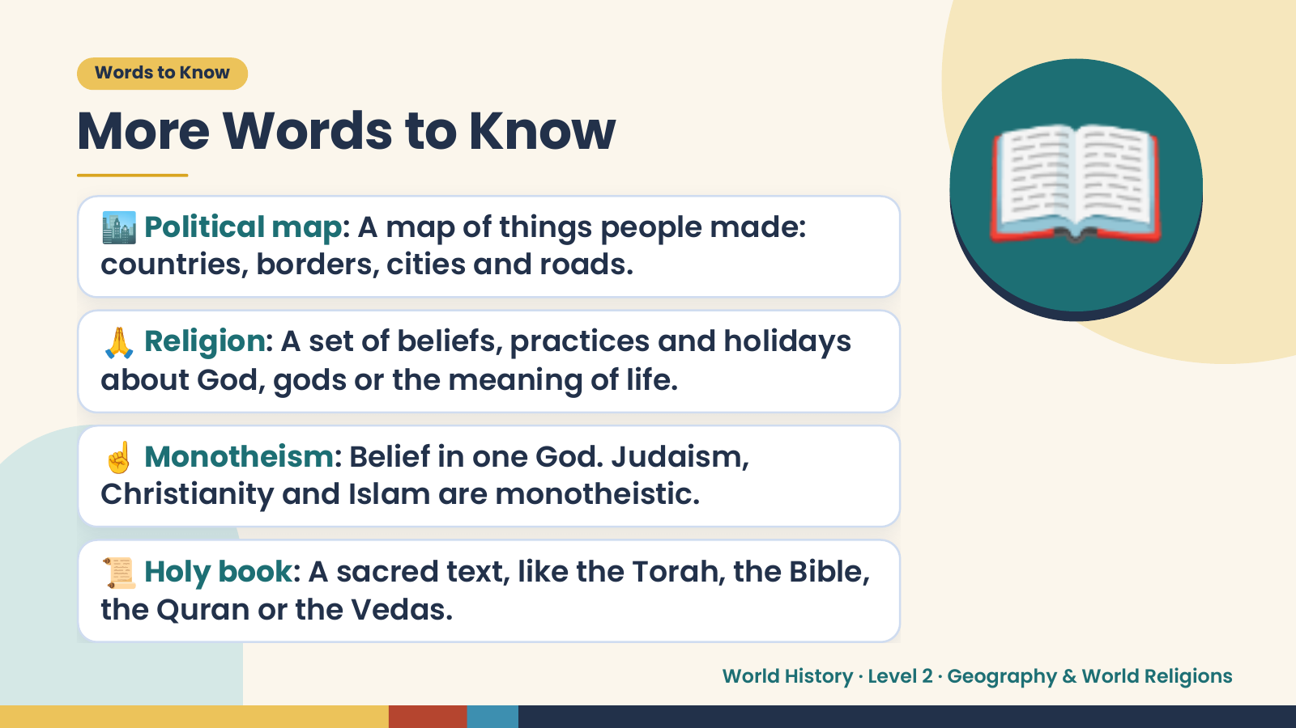
Notes:
Words to Know
More Words to Know
🏙️ Political map: A map of things people made:
countries, borders, cities and roads.
🙏 Religion: A set of beliefs, practices and holidays
about God, gods or the meaning of life.
📖
☝️ Monotheism: Belief in one God. Judaism,
Christianity and Islam are monotheistic.
📜 Holy book: A sacred text, like the Torah, the Bible,
the Quran or the Vedas.
World History · Level 2 · Geography & World Religions

Slide 5
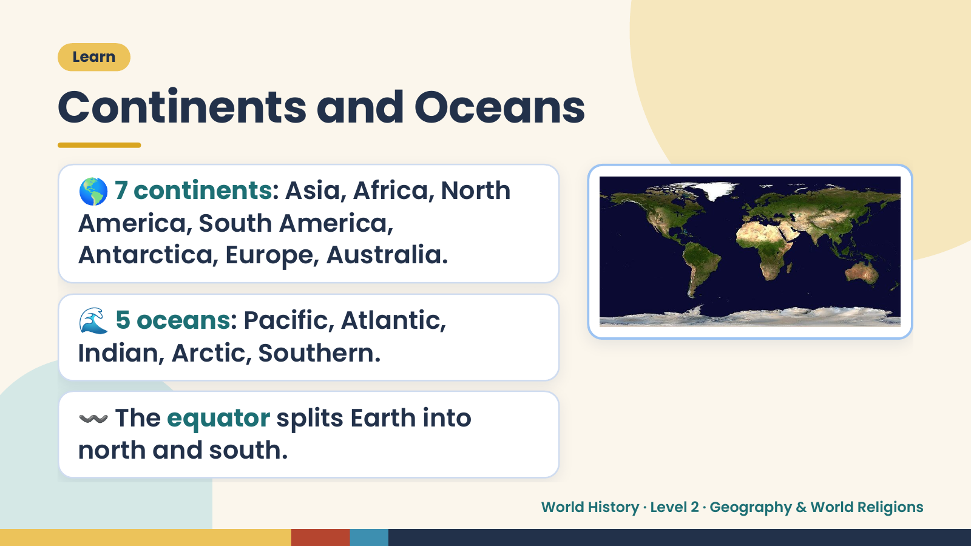
Notes:
Learn
Continents and Oceans
🌎 7 continents: Asia, Africa, North
America, South America,
Antarctica, Europe, Australia.
🌊 5 oceans: Pacific, Atlantic,
Indian, Arctic, Southern.
〰️ The equator splits Earth into
north and south.
World History · Level 2 · Geography & World Religions

Slide 6
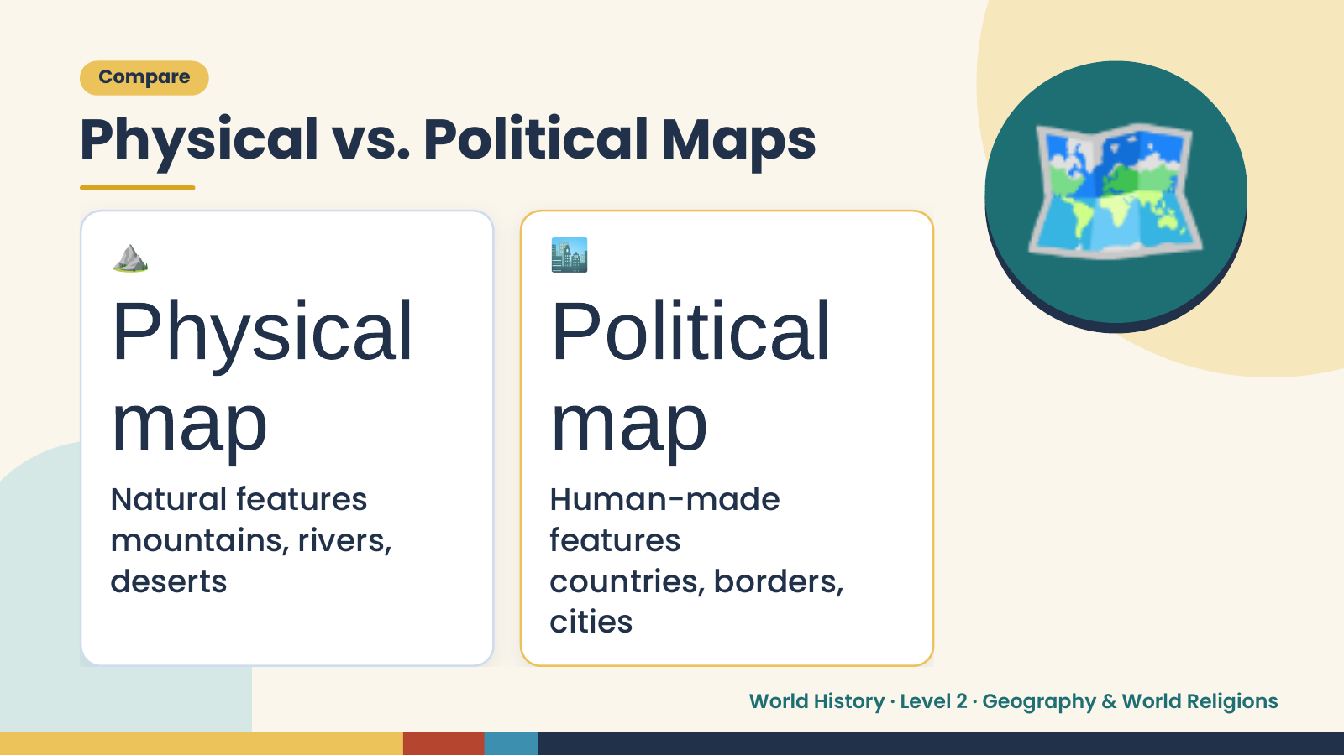
Notes:
Compare
Physical vs. Political Maps
⛰️
Physical
🏙️
Political
🗺️
map
Natural features
map
Human-made
mountains, rivers, features
deserts countries, borders,
cities
World History · Level 2 · Geography & World Religions

Slide 7
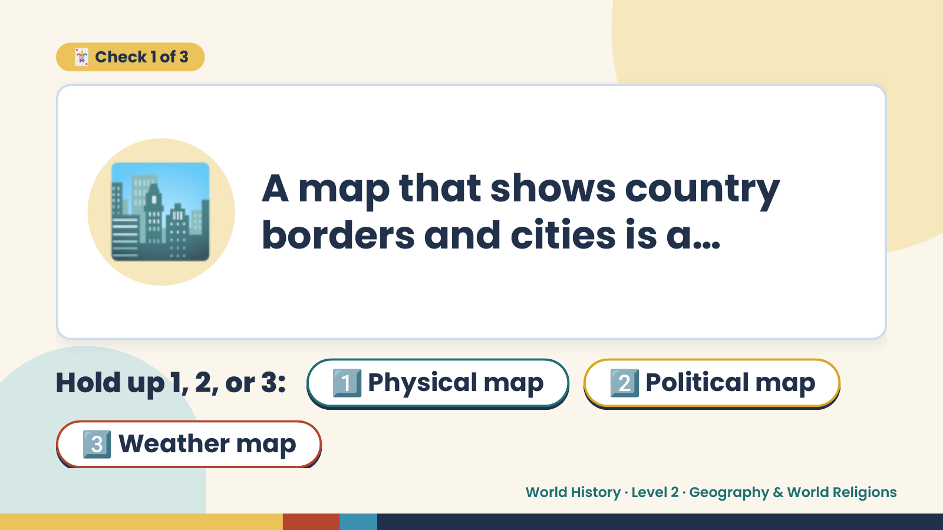
Notes:
🃏 Check 1 of 3
🏙️ A map that shows country
borders and cities is a…
Hold up 1, 2, or 3: 1️⃣ Physical map 2️⃣ Political map
3️⃣ Weather map
World History · Level 2 · Geography & World Religions

Slide 8
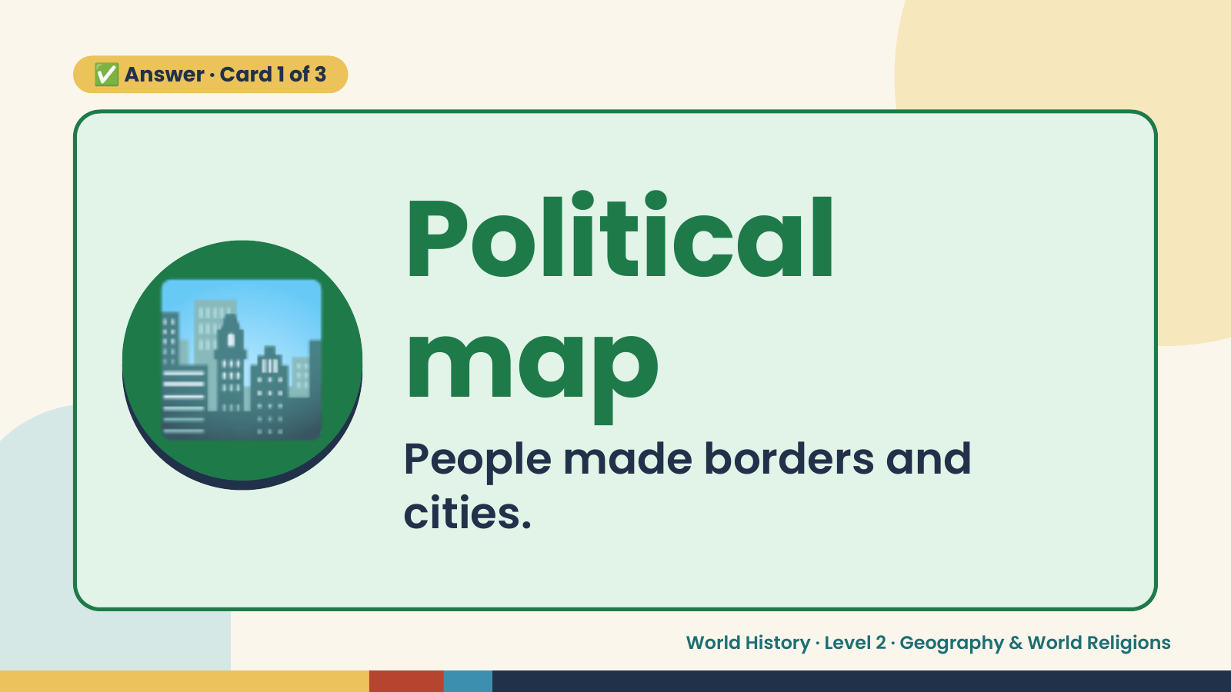
Notes:
✅ Answer · Card 1 of 3
🏙️ Political
map
People made borders and
cities.
World History · Level 2 · Geography & World Religions

Slide 9
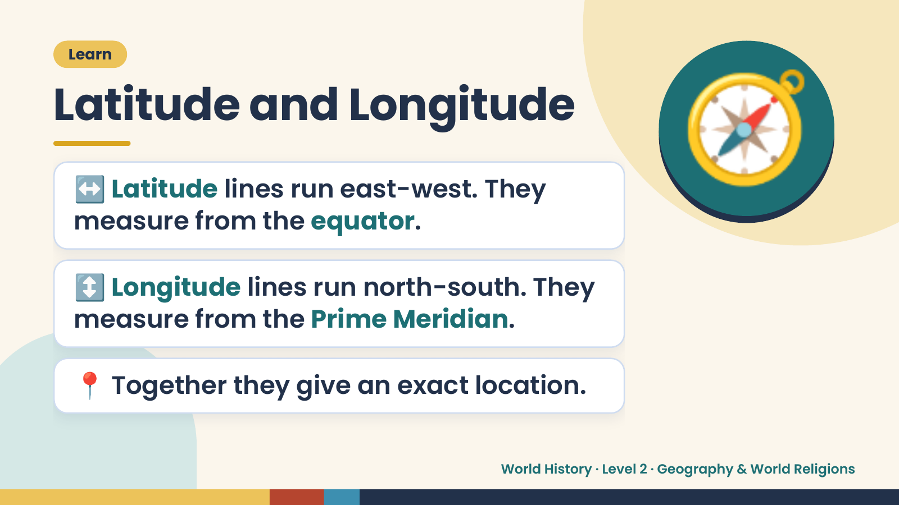
Notes:
Learn
Latitude and Longitude
↔️ Latitude lines run east-west. They
measure from the equator.
🧭
↕️ Longitude lines run north-south. They
measure from the Prime Meridian.
📍 Together they give an exact location.
World History · Level 2 · Geography & World Religions

Slide 10
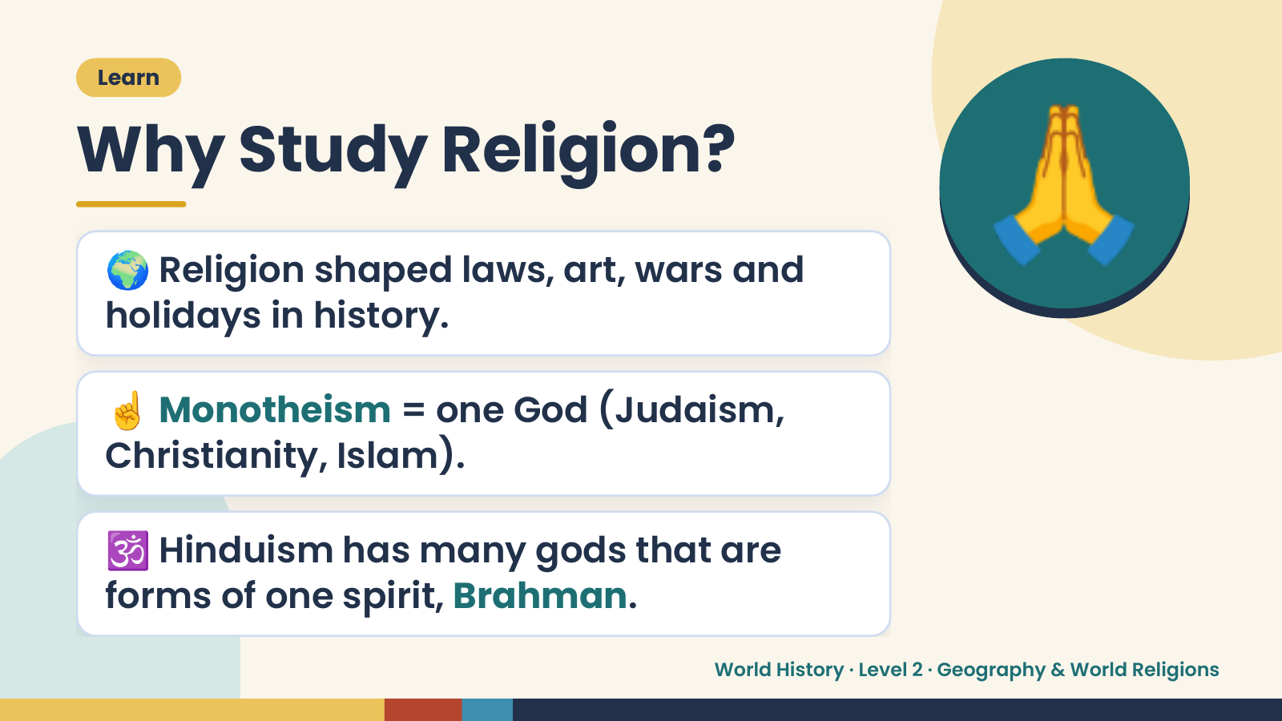
Notes:
Learn
Why Study Religion?
🌍 Religion shaped laws, art, wars and
holidays in history.
🙏
☝️ Monotheism = one God (Judaism,
Christianity, Islam).
🕉️ Hinduism has many gods that are
forms of one spirit, Brahman.
World History · Level 2 · Geography & World Religions

Slide 11
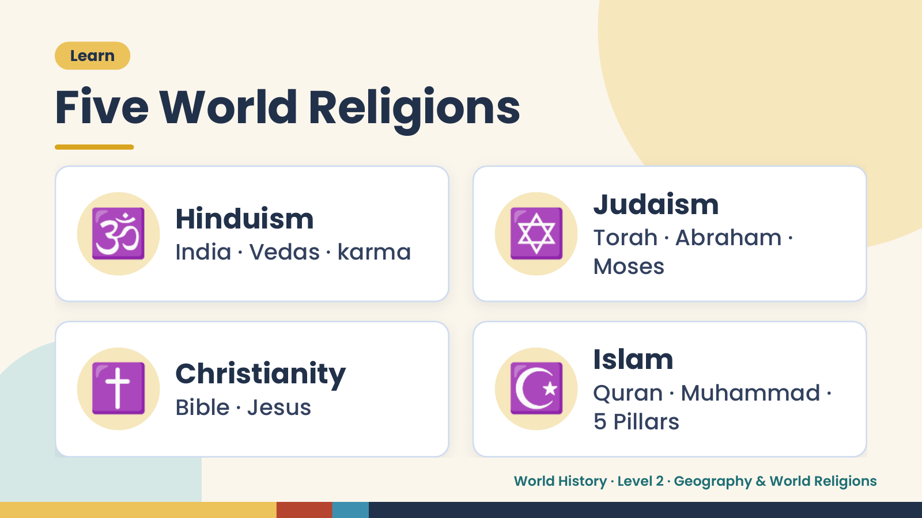
Notes:
Learn
Five World Religions
🕉️ Hinduism
India · Vedas · karma ✡️ Judaism
Torah · Abraham ·
Moses
✝️ Christianity
Bible · Jesus ☪️ Islam
Quran · Muhammad ·
5 Pillars
World History · Level 2 · Geography & World Religions

Slide 12
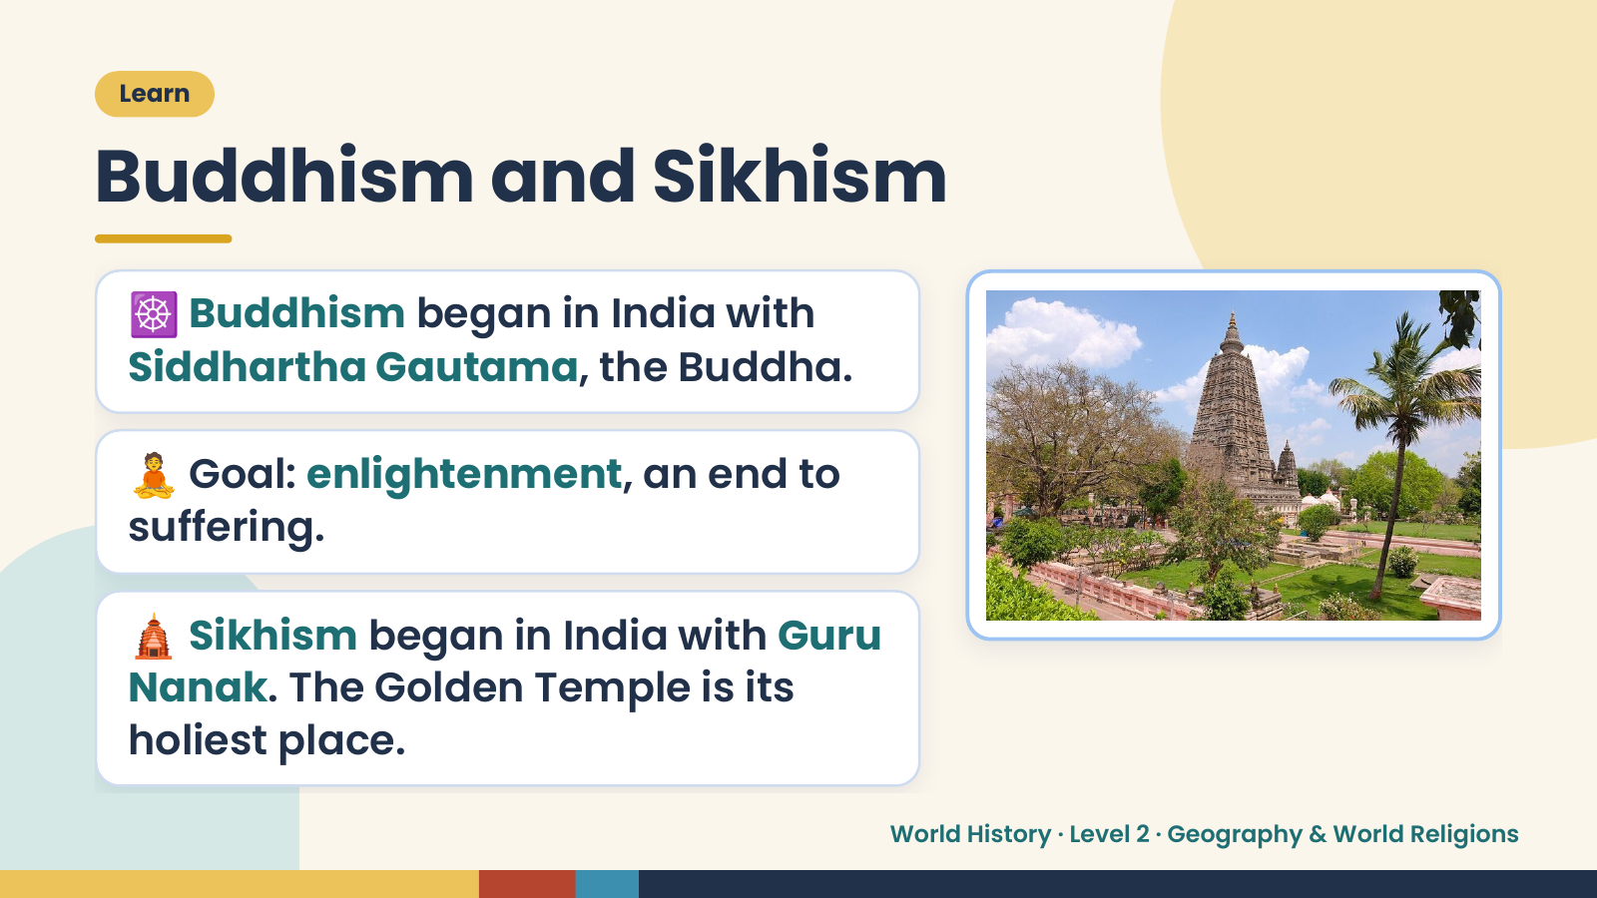
Notes:
Learn
Buddhism and Sikhism
☸️ Buddhism began in India with
Siddhartha Gautama, the Buddha.
🧘 Goal: enlightenment, an end to
suffering.
🛕 Sikhism began in India with Guru
Nanak. The Golden Temple is its
holiest place.
World History · Level 2 · Geography & World Religions

Slide 13
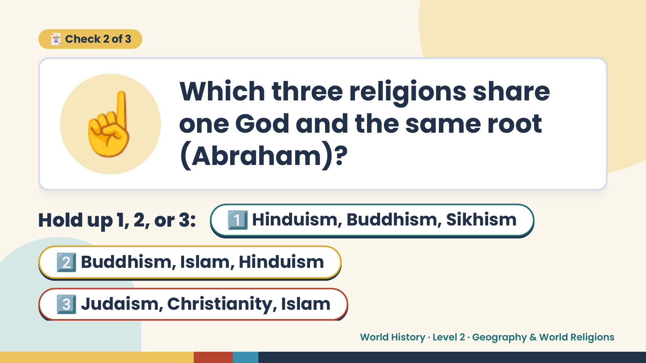
Notes:
☝️
🃏 Check 2 of 3
Which three religions share
one God and the same root
(Abraham)?
Hold up 1, 2, or 3: 1️⃣ Hinduism, Buddhism, Sikhism
2️⃣ Buddhism, Islam, Hinduism
3️⃣ Judaism, Christianity, Islam
World History · Level 2 · Geography & World Religions

Slide 14
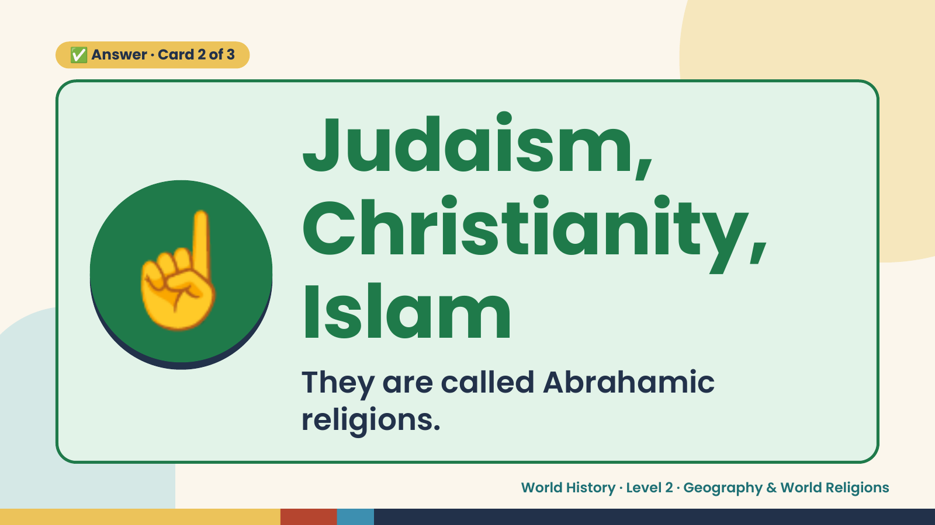
Notes:
✅ Answer · Card 2 of 3
☝️
Judaism,
Christianity,
Islam
They are called Abrahamic
religions.
World History · Level 2 · Geography & World Religions

Slide 15
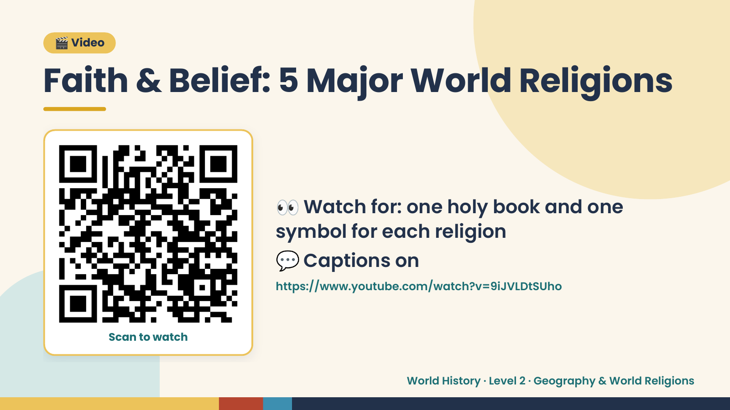
Notes:
🎬 Video
Faith & Belief: 5 Major World Religions
👀 Watch for: one holy book and one
symbol for each religion
💬 Captions on
https://www.youtube.com/watch?v=9iJVLDtSUho
Scan to watch
World History · Level 2 · Geography & World Religions

Slide 16
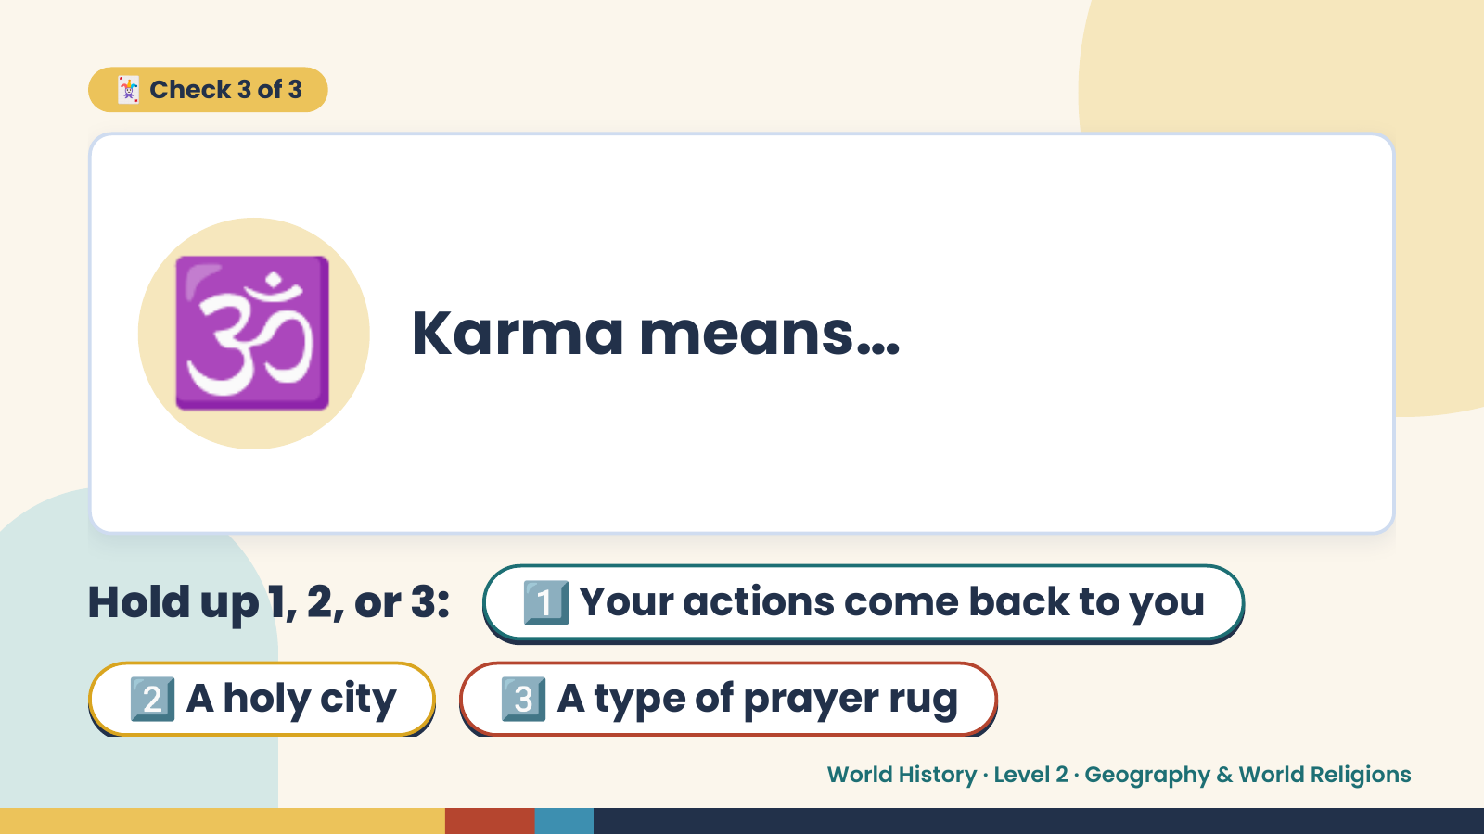
Notes:
🃏 Check 3 of 3
🕉️ Karma means…
Hold up 1, 2, or 3: 1️⃣ Your actions come back to you
2️⃣ A holy city 3️⃣ A type of prayer rug
World History · Level 2 · Geography & World Religions

Slide 17
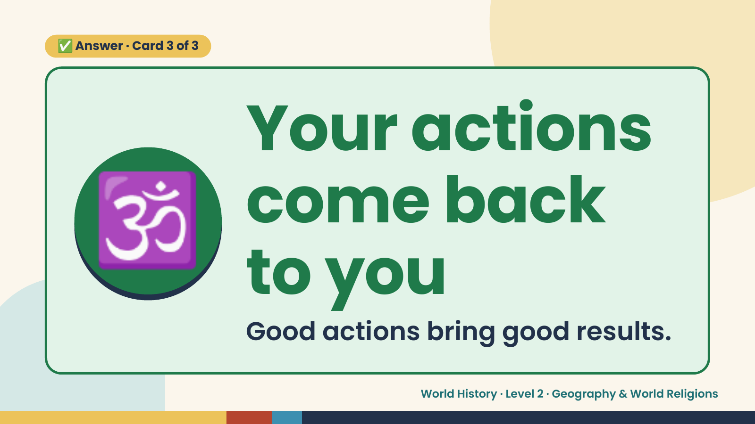
Notes:
✅ Answer · Card 3 of 3
🕉️ Your actions
come back
to you
Good actions bring good results.
World History · Level 2 · Geography & World Religions

Slide 18
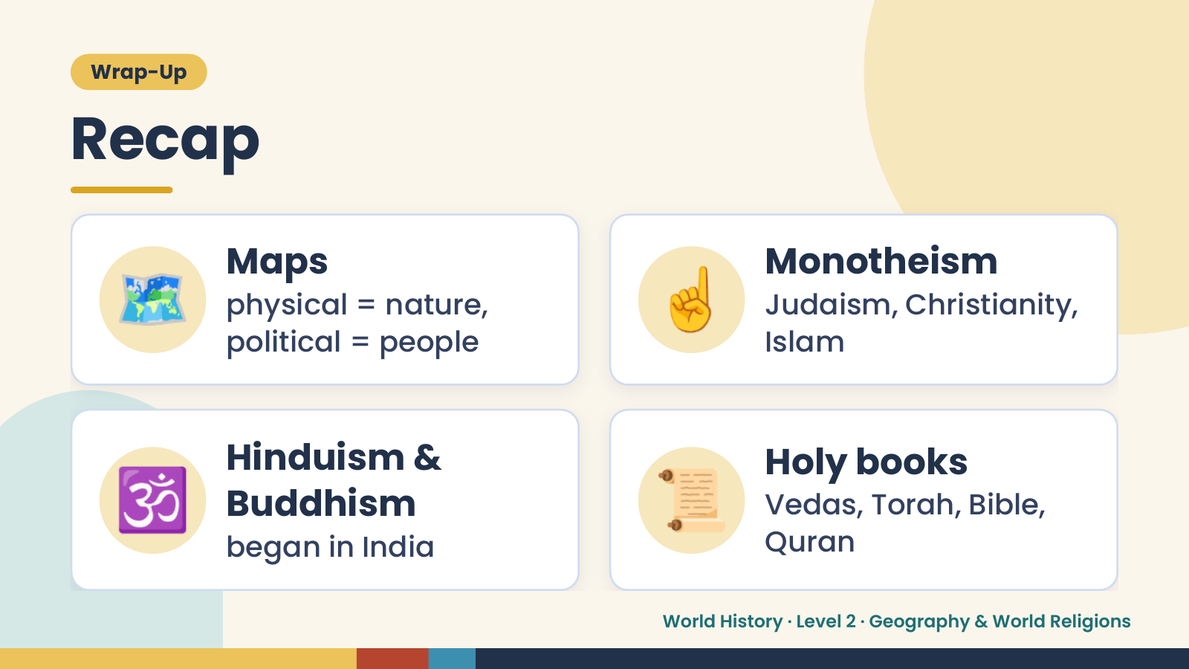
Notes:
Wrap-Up
Recap
🗺️ Maps
physical = nature,
political = people
☝️ Monotheism
Judaism, Christianity,
Islam
🕉️ Hinduism &
Buddhism
began in India
📜 Holy books
Vedas, Torah, Bible,
Quran
World History · Level 2 · Geography & World Religions

Slide 19
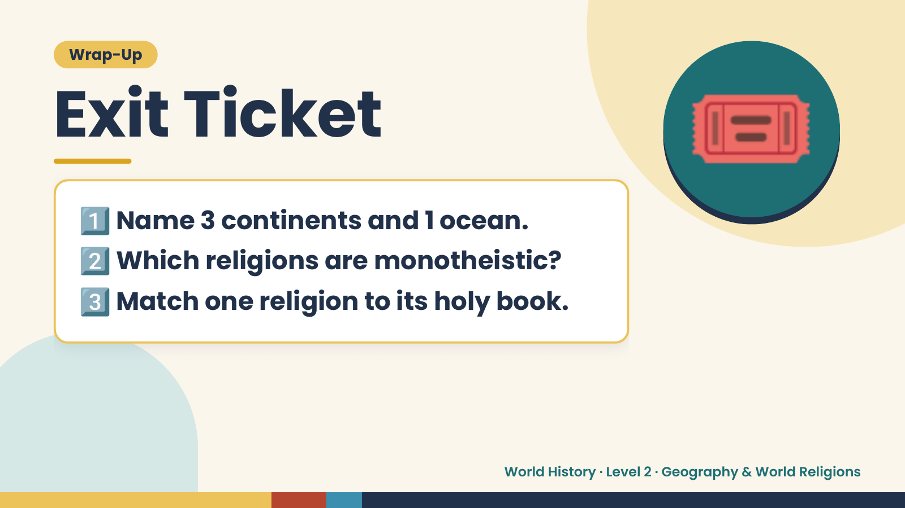
Notes:
Wrap-Up
Exit Ticket
1️⃣
2️⃣
Name 3 continents and 1 ocean.
Which religions are monotheistic?
🎟️
3️⃣Match one religion to its holy book.
World History · Level 2 · Geography & World Religions

