Slide 1
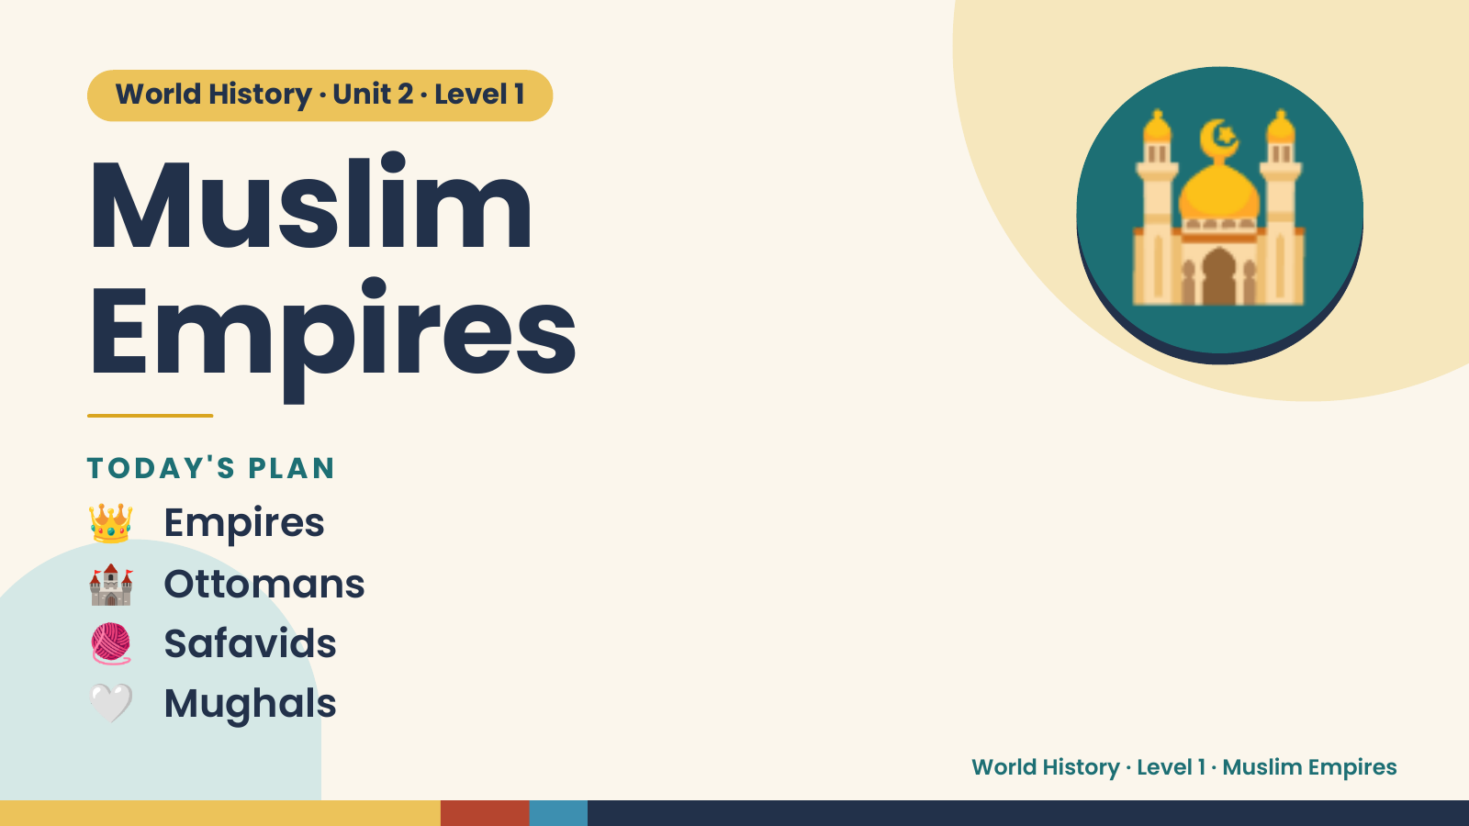
Notes:
World History · Unit 2 · Level 1
Muslim
Empires
🕌
👑 Empires
TODAY'S PLAN
🏰 Ottomans
🧶 Safavids
🤍 Mughals
World History · Level 1 · Muslim Empires

Slide 2
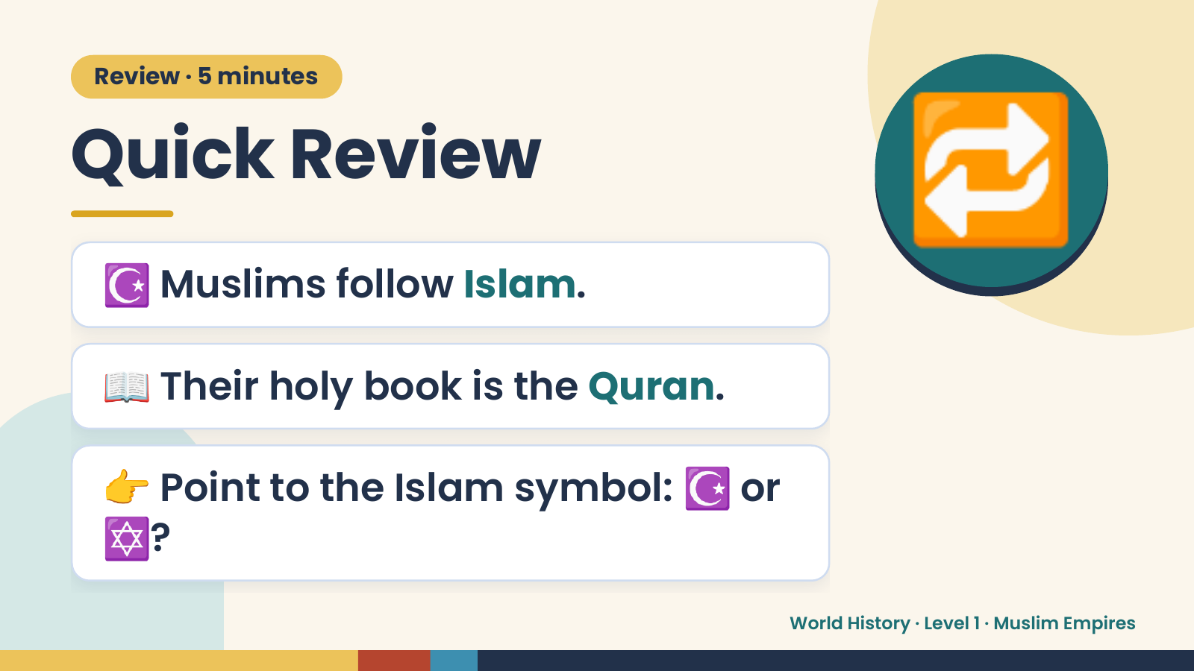
Notes:
Review · 5 minutes
Quick Review
☪️ Muslims follow Islam.
🔁
📖 Their holy book is the Quran.
👉 Point to the Islam symbol: ☪️ or
✡️?
World History · Level 1 · Muslim Empires

Slide 3
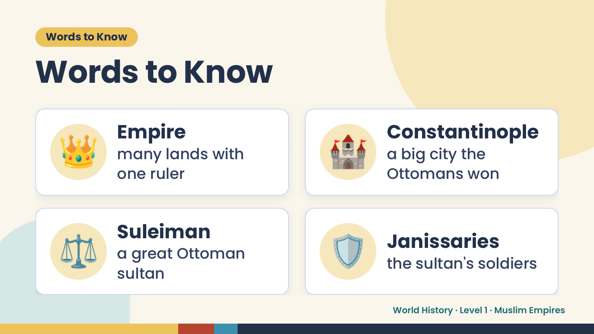
Notes:
Words to Know
Words to Know
👑 Empire
many lands with
one ruler
🏰 Constantinople
a big city the
Ottomans won
⚖️ Suleiman
a great Ottoman
sultan
🛡️ Janissaries
the sultan's soldiers
World History · Level 1 · Muslim Empires

Slide 4
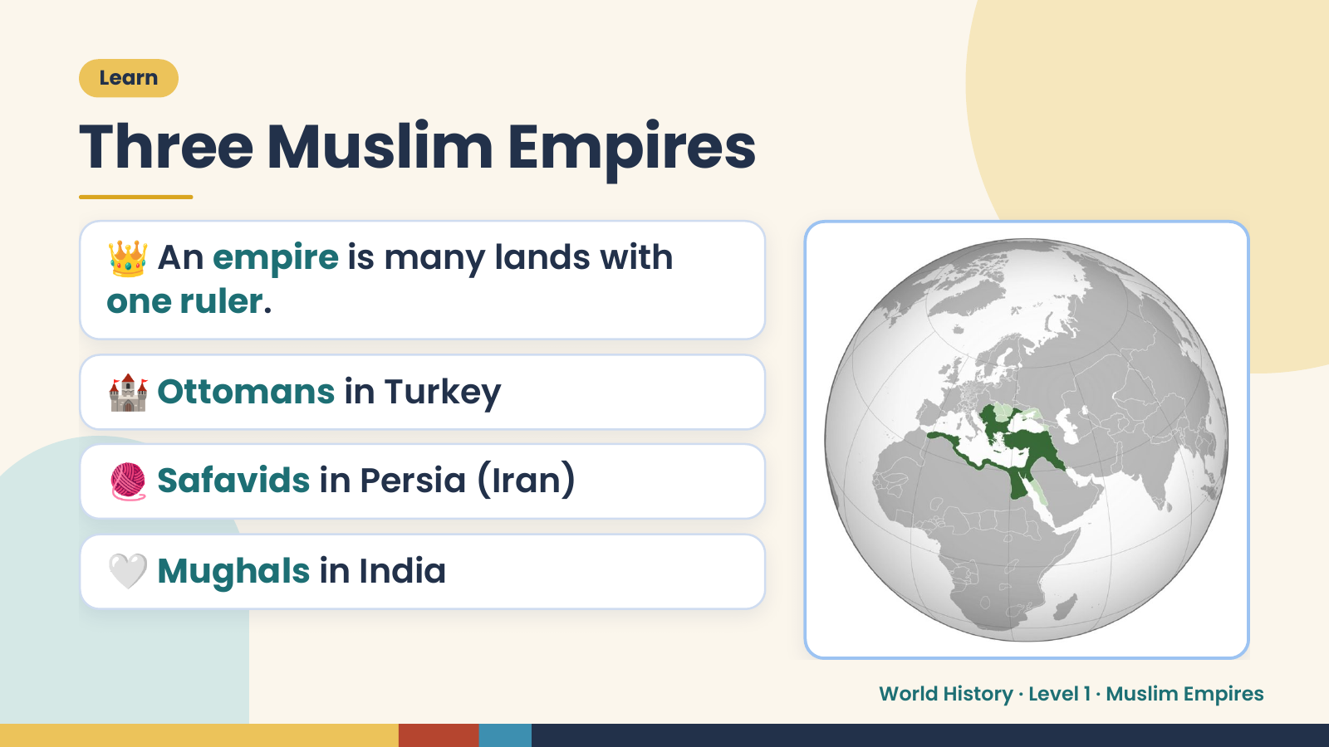
Notes:
Learn
Three Muslim Empires
👑 An empire is many lands with
one ruler.
🏰 Ottomans in Turkey
🧶 Safavids in Persia (Iran)
🤍 Mughals in India
World History · Level 1 · Muslim Empires

Slide 5
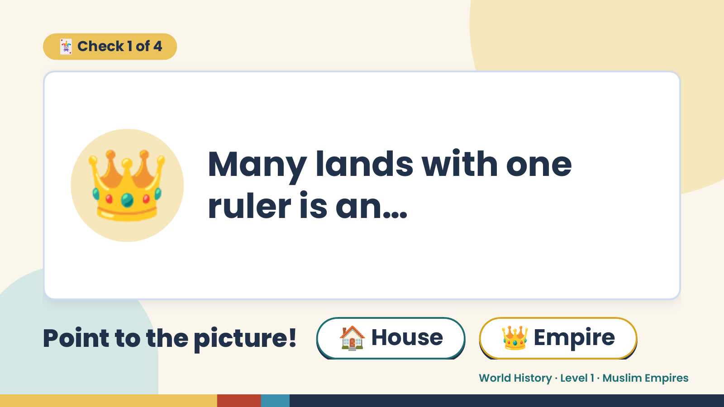
Notes:
🃏 Check 1 of 4
👑 Many lands with one
ruler is an…
Point to the picture! 🏠 House 👑 Empire
World History · Level 1 · Muslim Empires

Slide 6
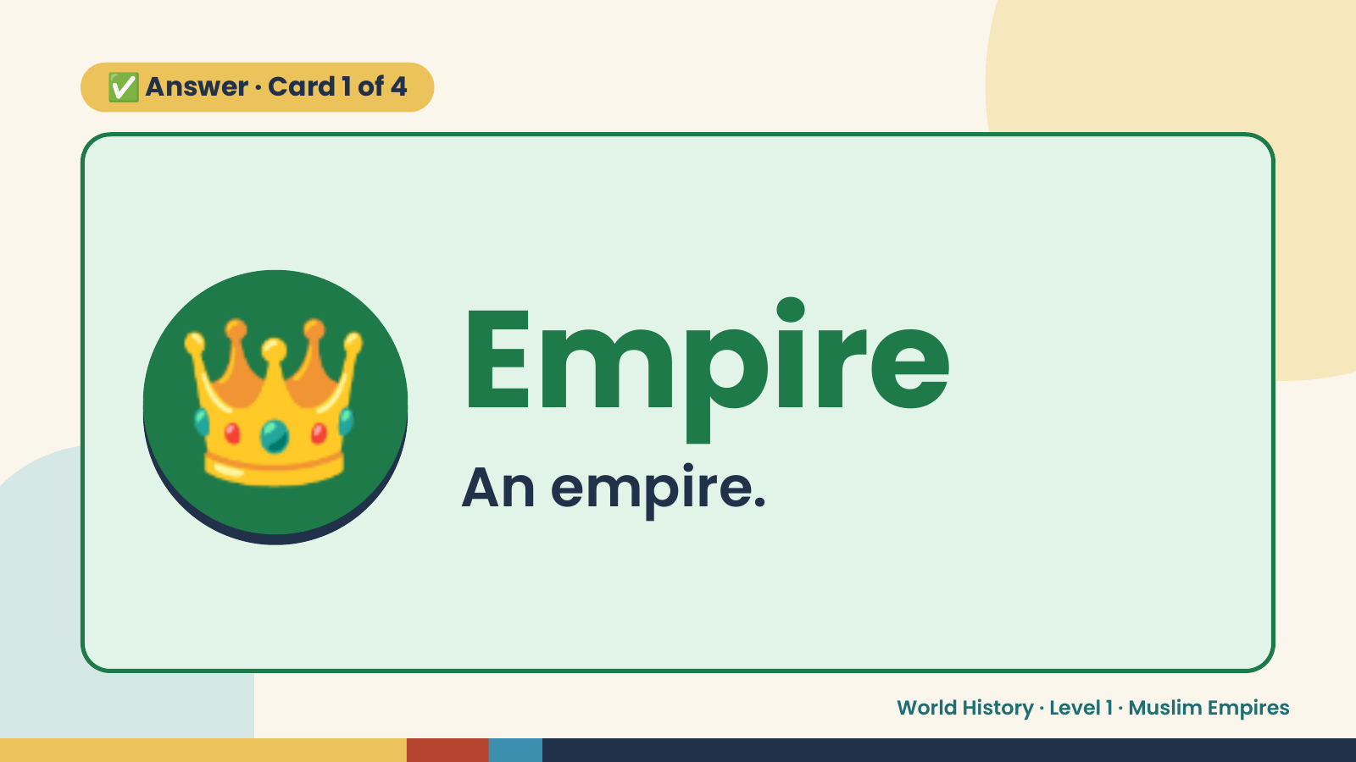
Notes:
✅ Answer · Card 1 of 4
👑 Empire
An empire.
World History · Level 1 · Muslim Empires

Slide 7
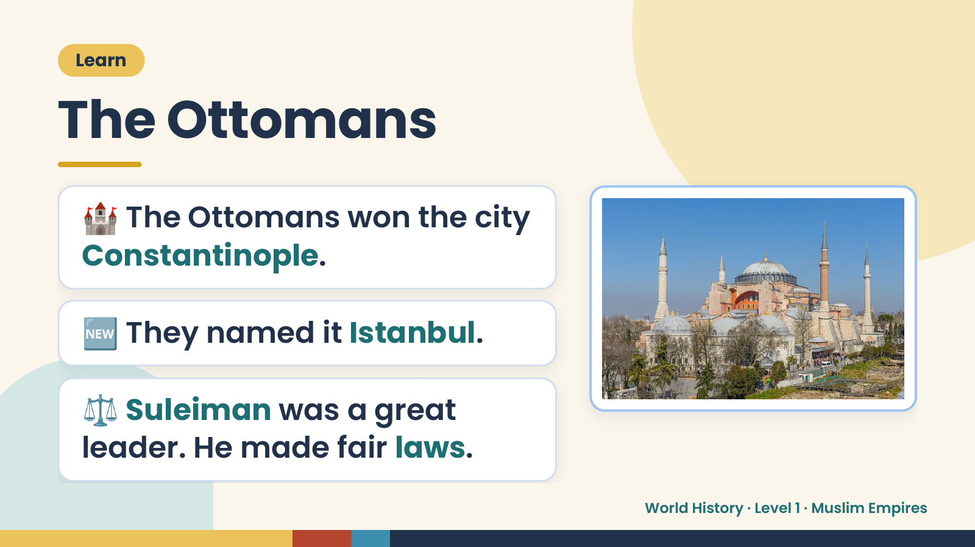
Notes:
Learn
The Ottomans
🏰 The Ottomans won the city
Constantinople.
🆕 They named it Istanbul.
⚖️ Suleiman was a great
leader. He made fair laws.
World History · Level 1 · Muslim Empires

Slide 8
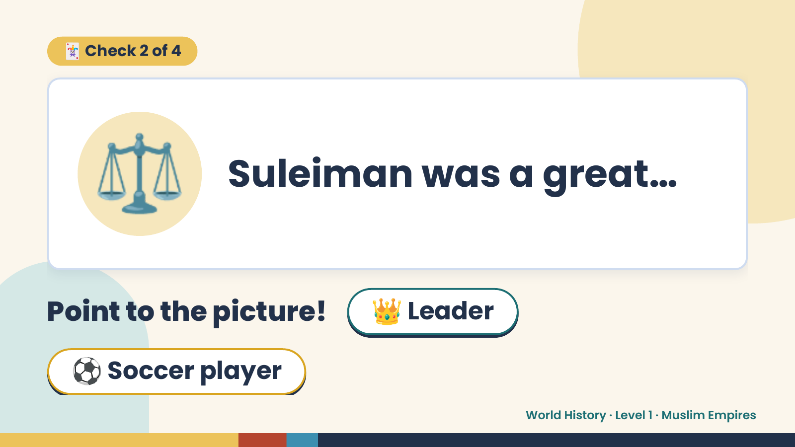
Notes:
🃏 Check 2 of 4
⚖️ Suleiman was a great…
Point to the picture! 👑 Leader
⚽ Soccer player
World History · Level 1 · Muslim Empires

Slide 9
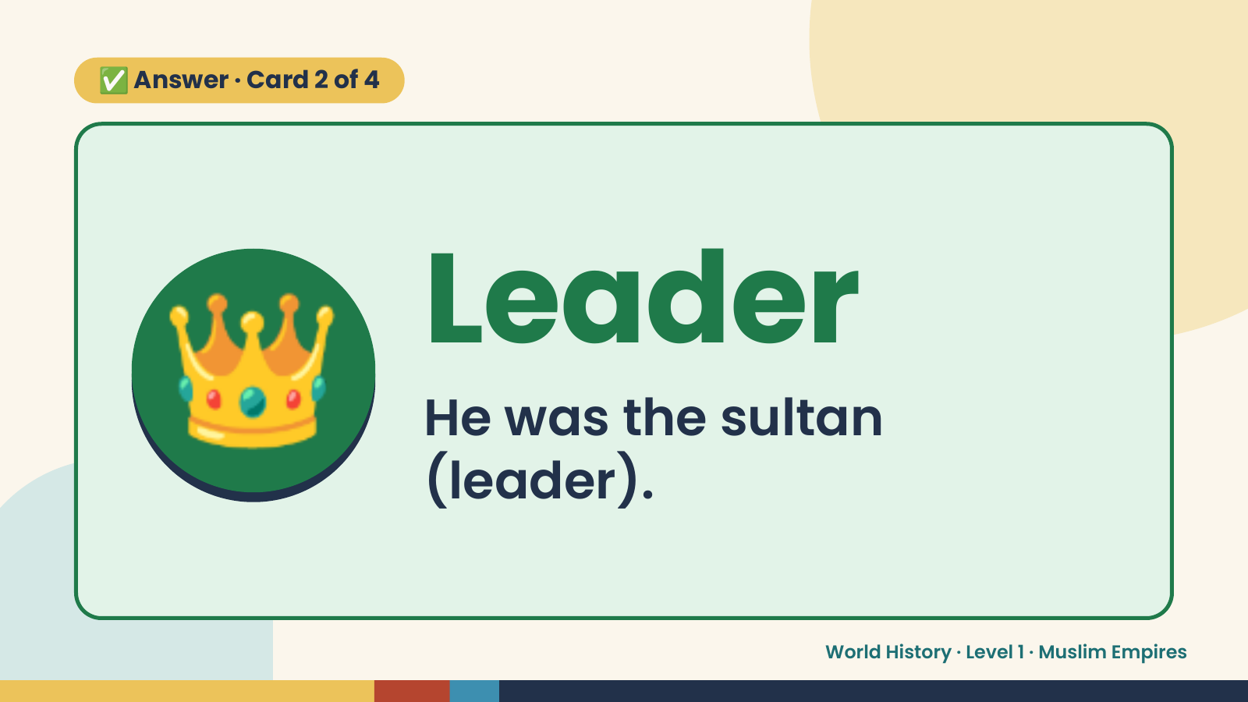
Notes:
✅ Answer · Card 2 of 4
👑 Leader
He was the sultan
(leader).
World History · Level 1 · Muslim Empires

Slide 10
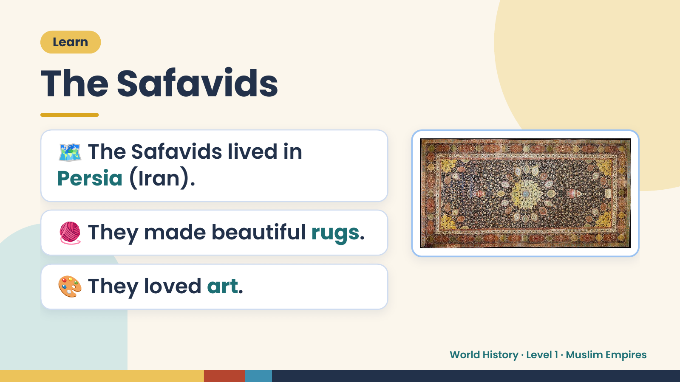
Notes:
Learn
The Safavids
🗺️ The Safavids lived in
Persia (Iran).
🧶 They made beautiful rugs.
🎨 They loved art.
World History · Level 1 · Muslim Empires

Slide 11
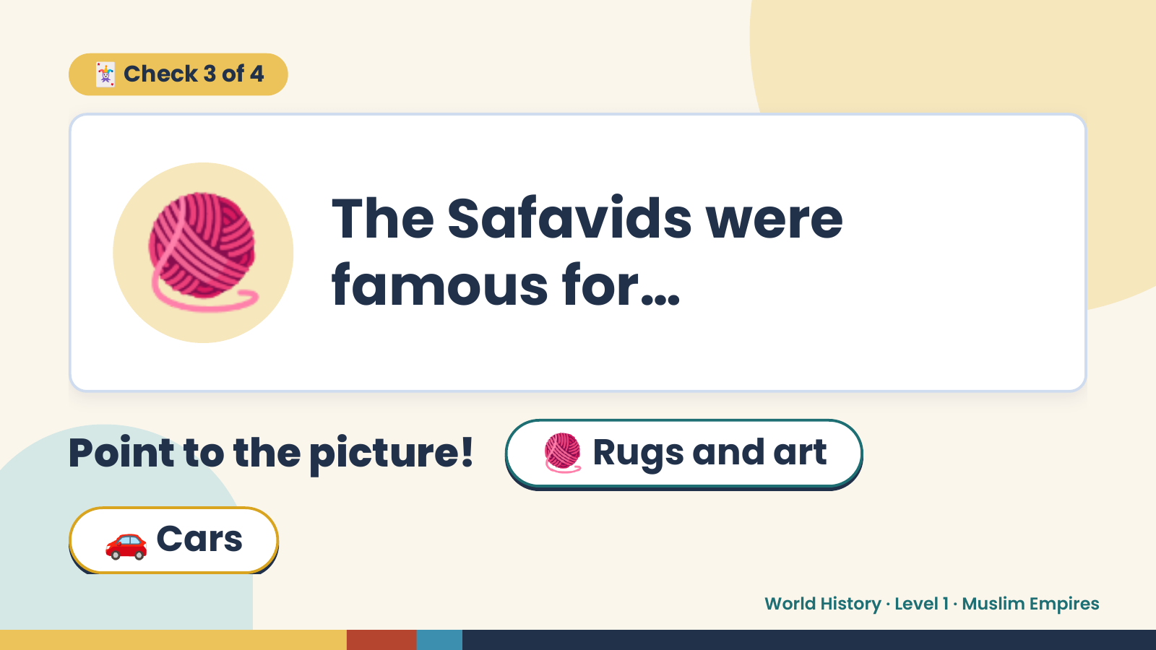
Notes:
🃏 Check 3 of 4
🧶 The Safavids were
famous for…
Point to the picture! 🧶 Rugs and art
🚗 Cars
World History · Level 1 · Muslim Empires

Slide 12
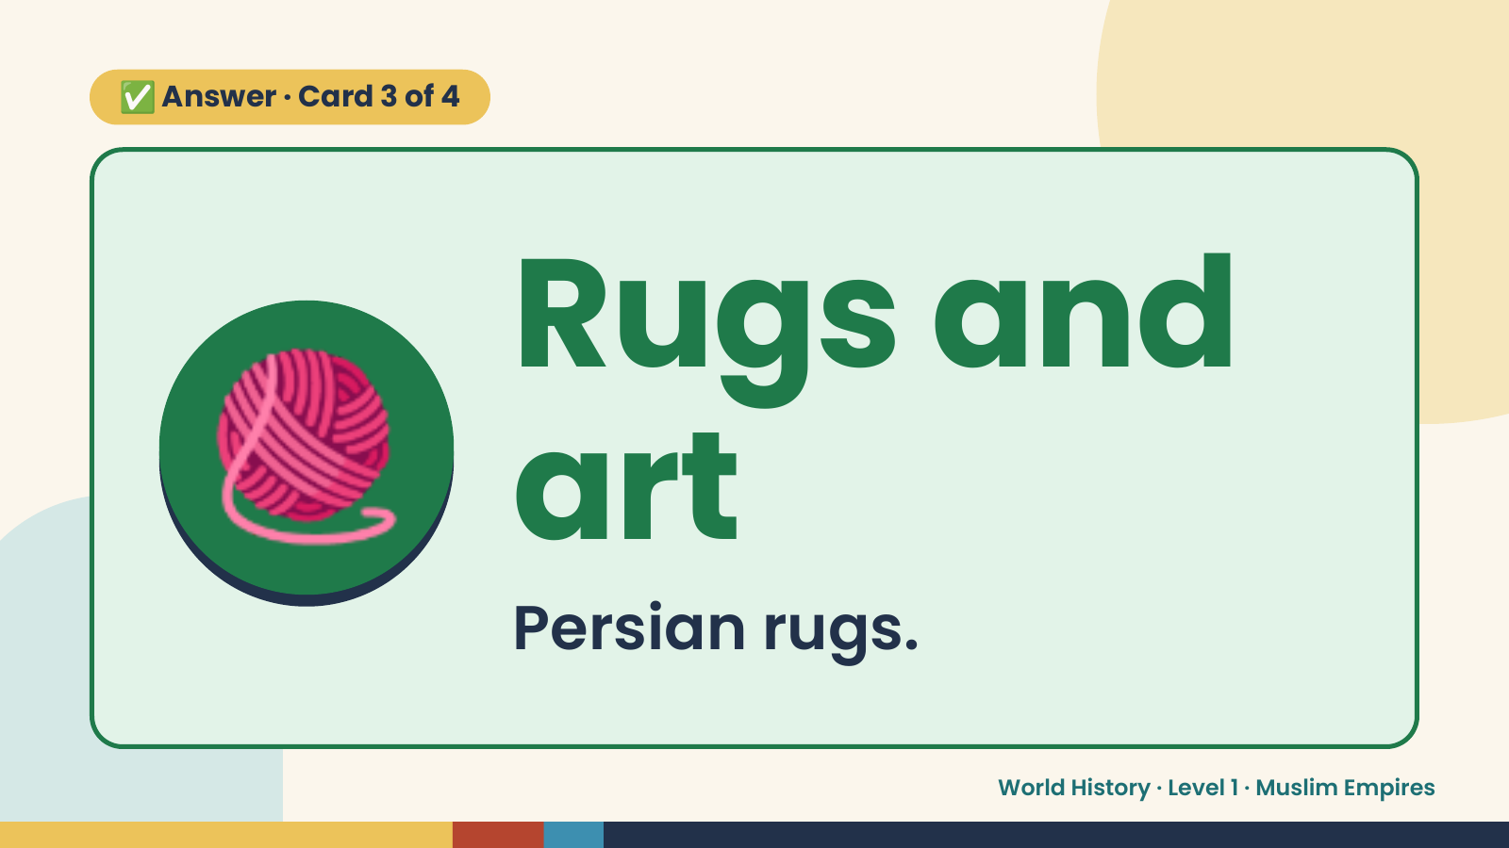
Notes:
✅ Answer · Card 3 of 4
🧶 Rugs and
art
Persian rugs.
World History · Level 1 · Muslim Empires

Slide 13
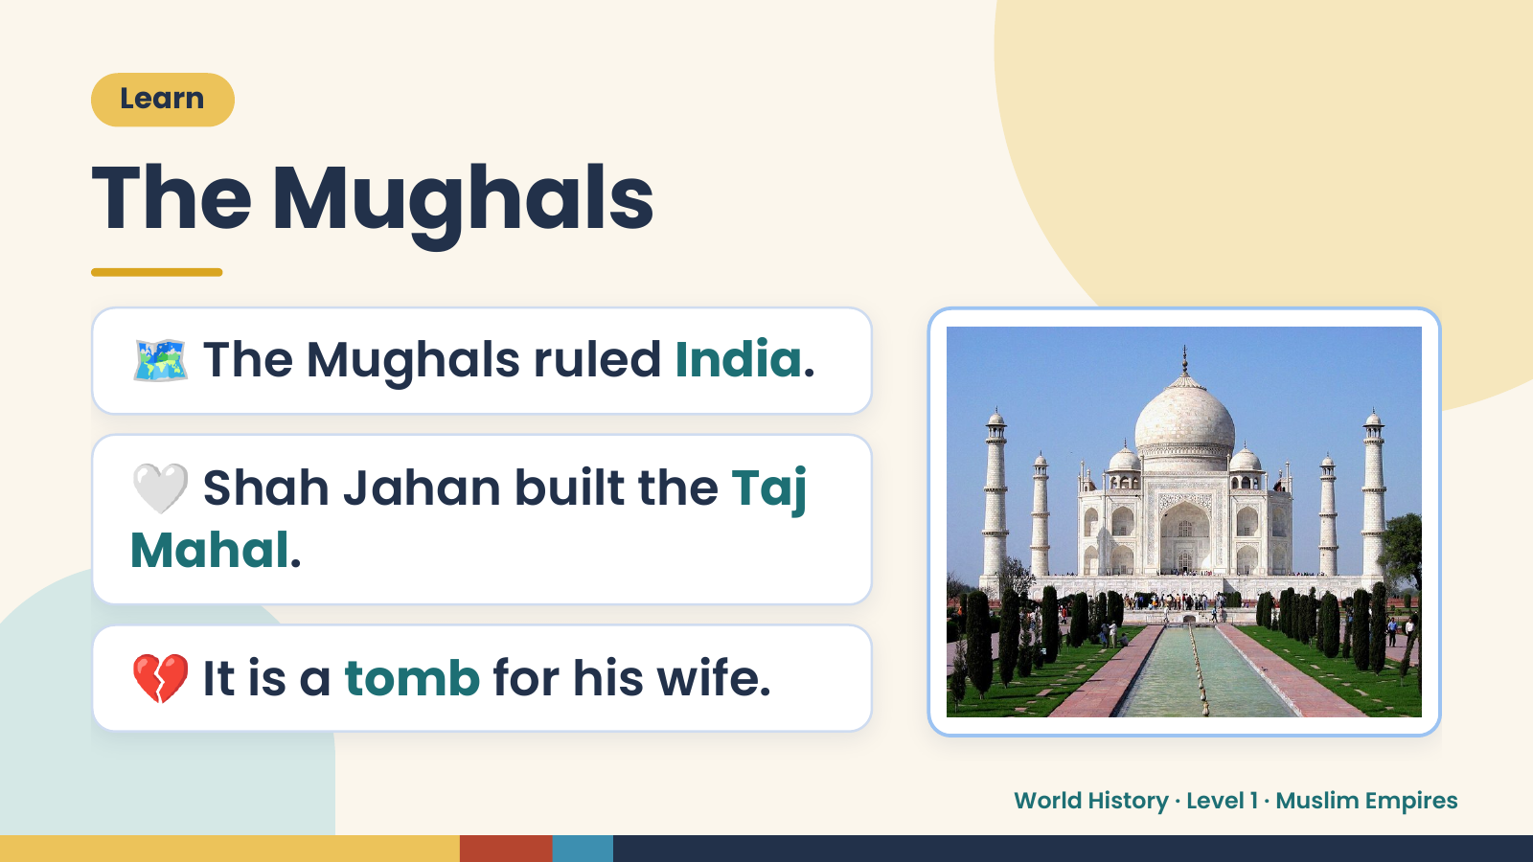
Notes:
Learn
The Mughals
🗺️ The Mughals ruled India.
🤍 Shah Jahan built the Taj
Mahal.
💔 It is a tomb for his wife.
World History · Level 1 · Muslim Empires

Slide 14
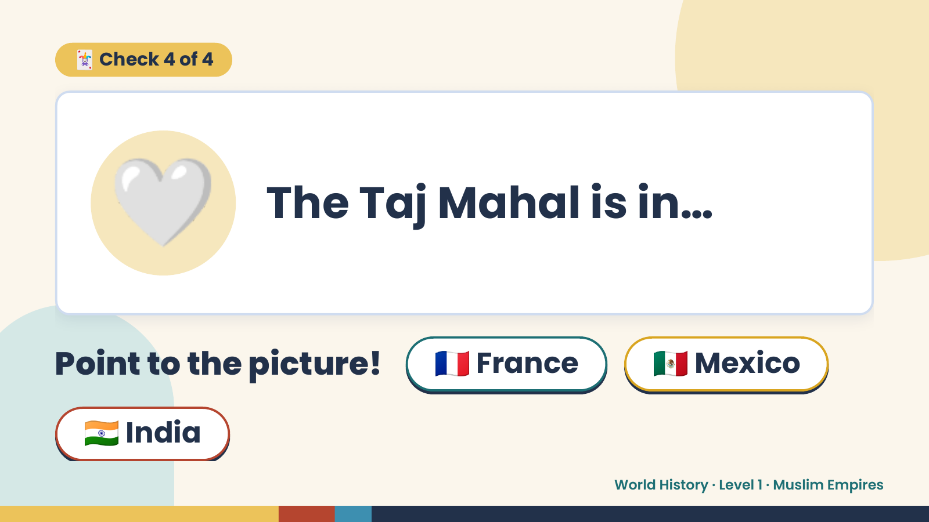
Notes:
🃏 Check 4 of 4
🤍 The Taj Mahal is in…
Point to the picture! 🇫🇷 France 🇲🇽 Mexico
🇮🇳 India
World History · Level 1 · Muslim Empires

Slide 15
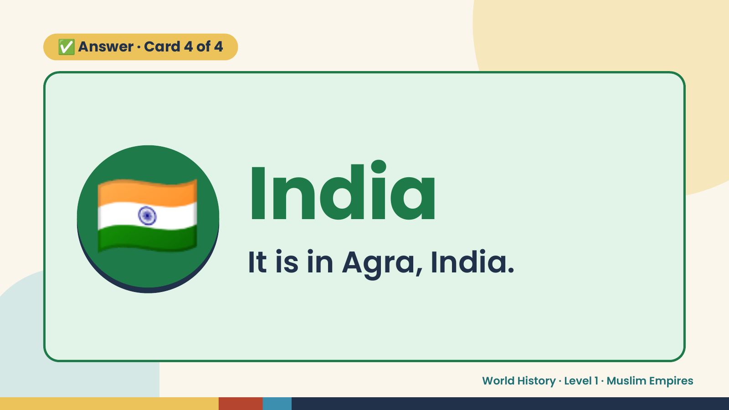
Notes:
✅ Answer · Card 4 of 4
🇮🇳 India
It is in Agra, India.
World History · Level 1 · Muslim Empires

Slide 16
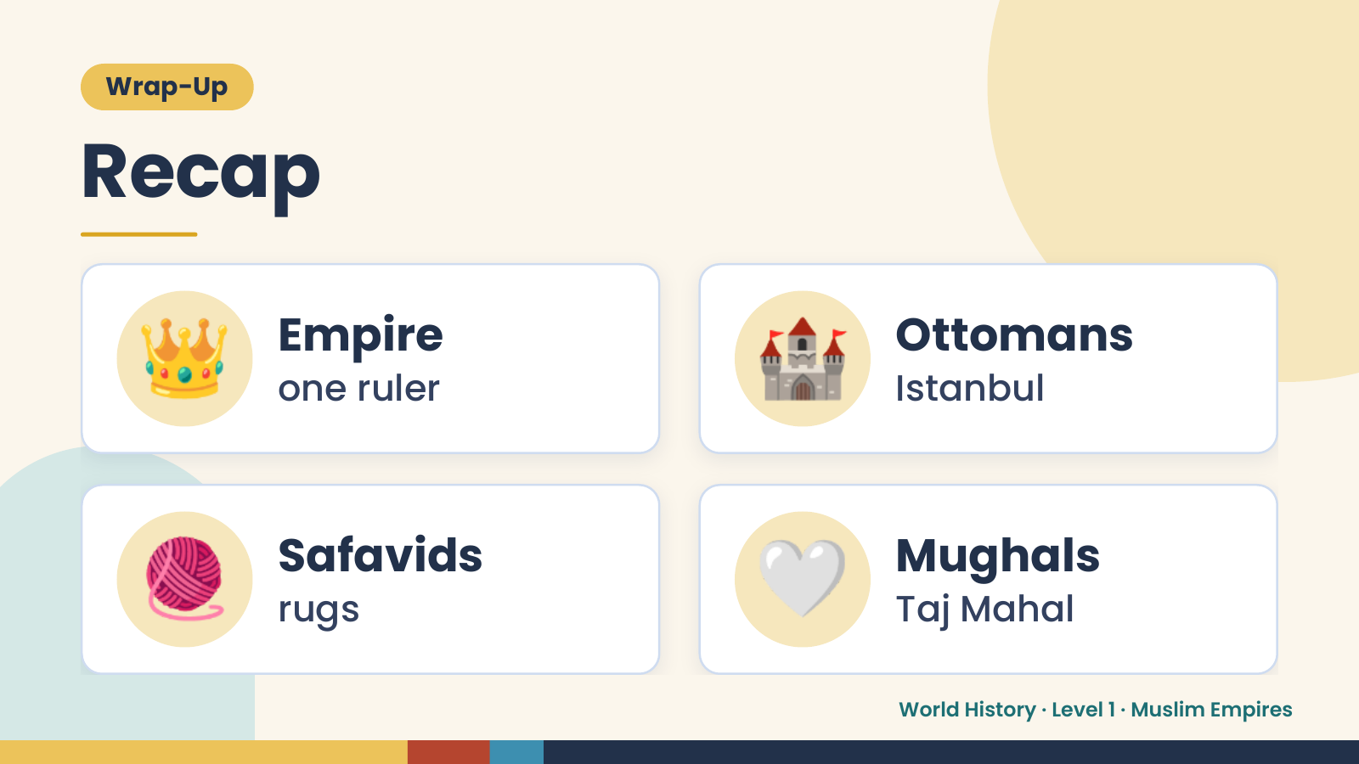
Notes:
Wrap-Up
Recap
👑 Empire
one ruler 🏰 Ottomans
Istanbul
🧶 Safavids
rugs 🤍 Mughals
Taj Mahal
World History · Level 1 · Muslim Empires

Slide 17
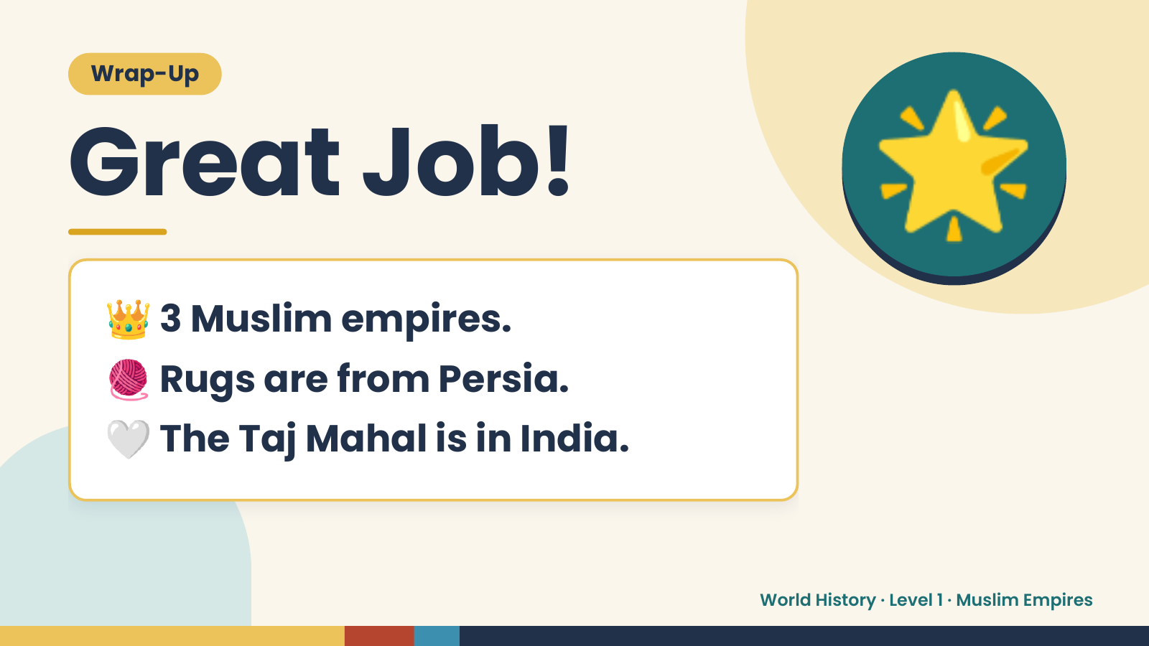
Notes:
Wrap-Up
Great Job!
👑 3 Muslim empires.
🌟
🧶 Rugs are from Persia.
🤍 The Taj Mahal is in India.
World History · Level 1 · Muslim Empires

