Slide 1
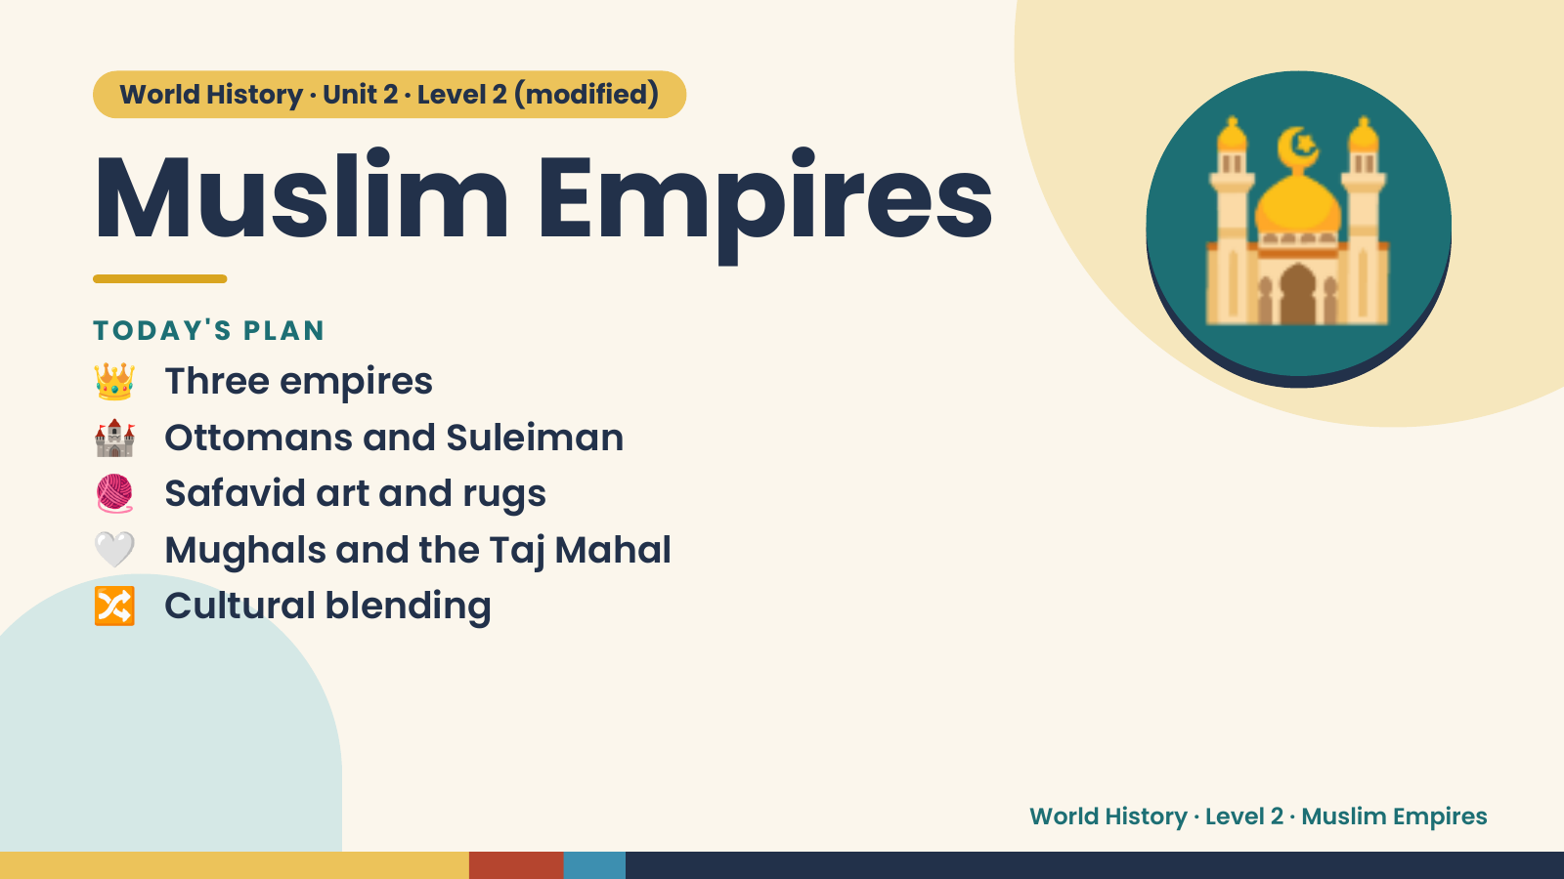
Notes:
World History · Unit 2 · Level 2 (modified)
Muslim Empires
👑 Three empires
TODAY'S PLAN
🏰 Ottomans and Suleiman
🧶 Safavid art and rugs
🕌
🤍 Mughals and the Taj Mahal
🔀 Cultural blending
World History · Level 2 · Muslim Empires

Slide 2
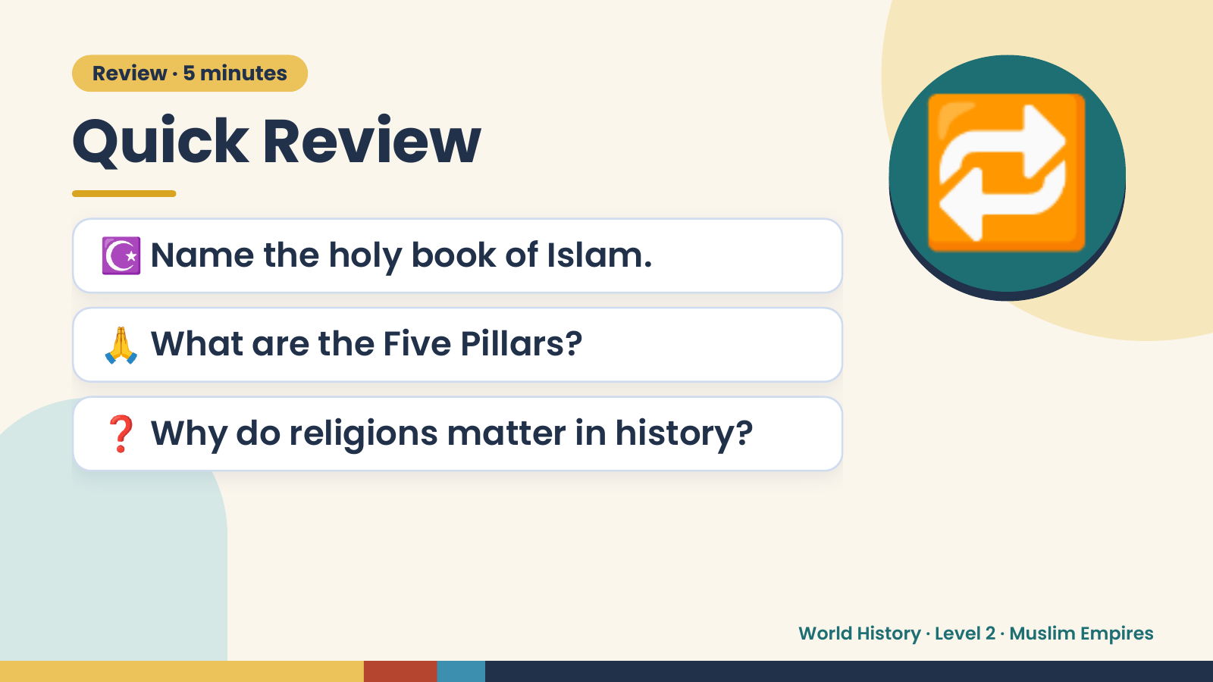
Notes:
Review · 5 minutes
Quick Review
☪️ Name the holy book of Islam.
🙏 What are the Five Pillars?
🔁
❓ Why do religions matter in history?
World History · Level 2 · Muslim Empires

Slide 3
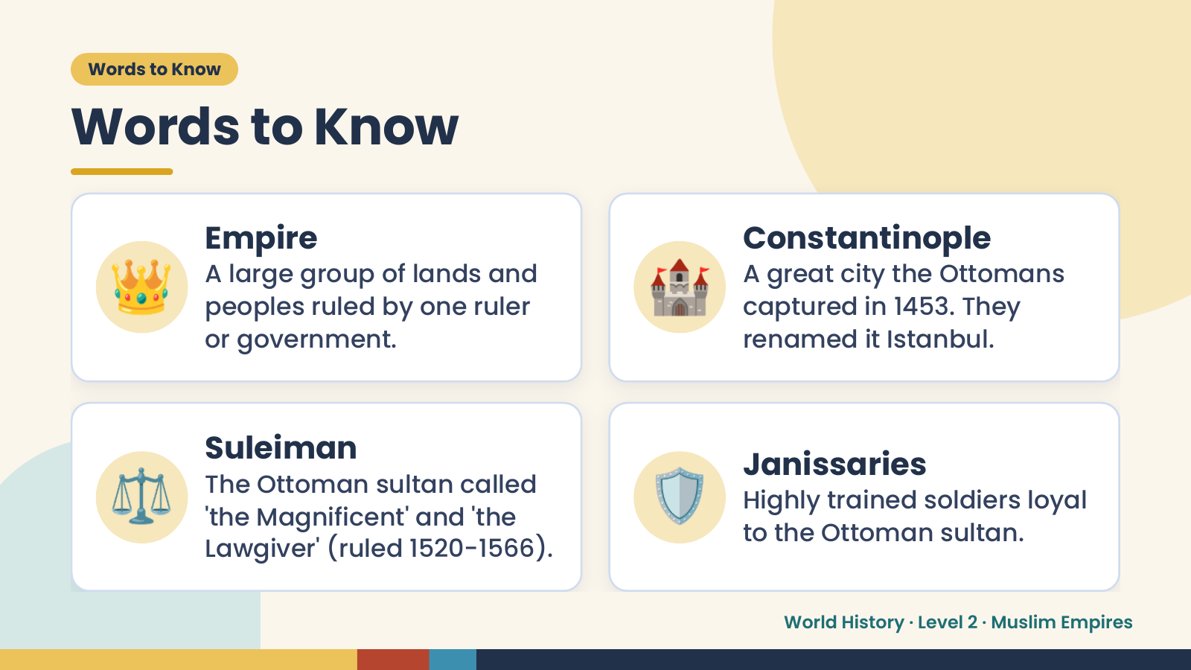
Notes:
Words to Know
Words to Know
👑 Empire
A large group of lands and
peoples ruled by one ruler
or government.
🏰 Constantinople
A great city the Ottomans
captured in 1453. They
renamed it Istanbul.
⚖️ Suleiman
The Ottoman sultan called
'the Magnificent' and 'the
Lawgiver' (ruled 1520-1566).
🛡️ Janissaries
Highly trained soldiers loyal
to the Ottoman sultan.
World History · Level 2 · Muslim Empires

Slide 4
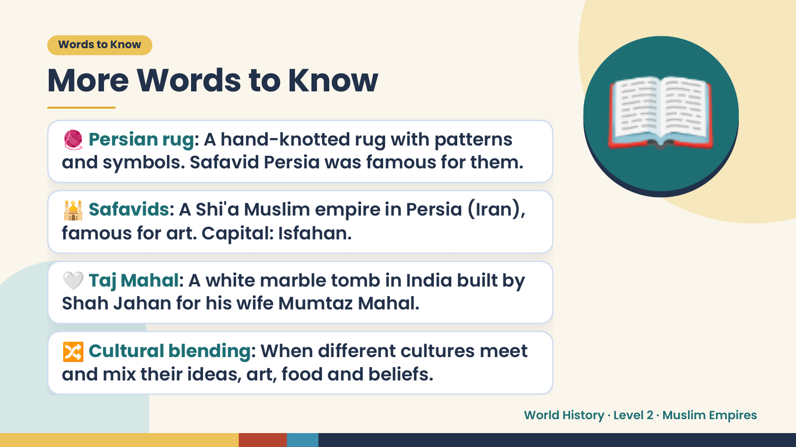
Notes:
Words to Know
More Words to Know
🧶 Persian rug: A hand-knotted rug with patterns
and symbols. Safavid Persia was famous for them.
🕌 Safavids: A Shi'a Muslim empire in Persia (Iran),
famous for art. Capital: Isfahan.
📖
🤍 Taj Mahal: A white marble tomb in India built by
Shah Jahan for his wife Mumtaz Mahal.
🔀 Cultural blending: When different cultures meet
and mix their ideas, art, food and beliefs.
World History · Level 2 · Muslim Empires

Slide 5
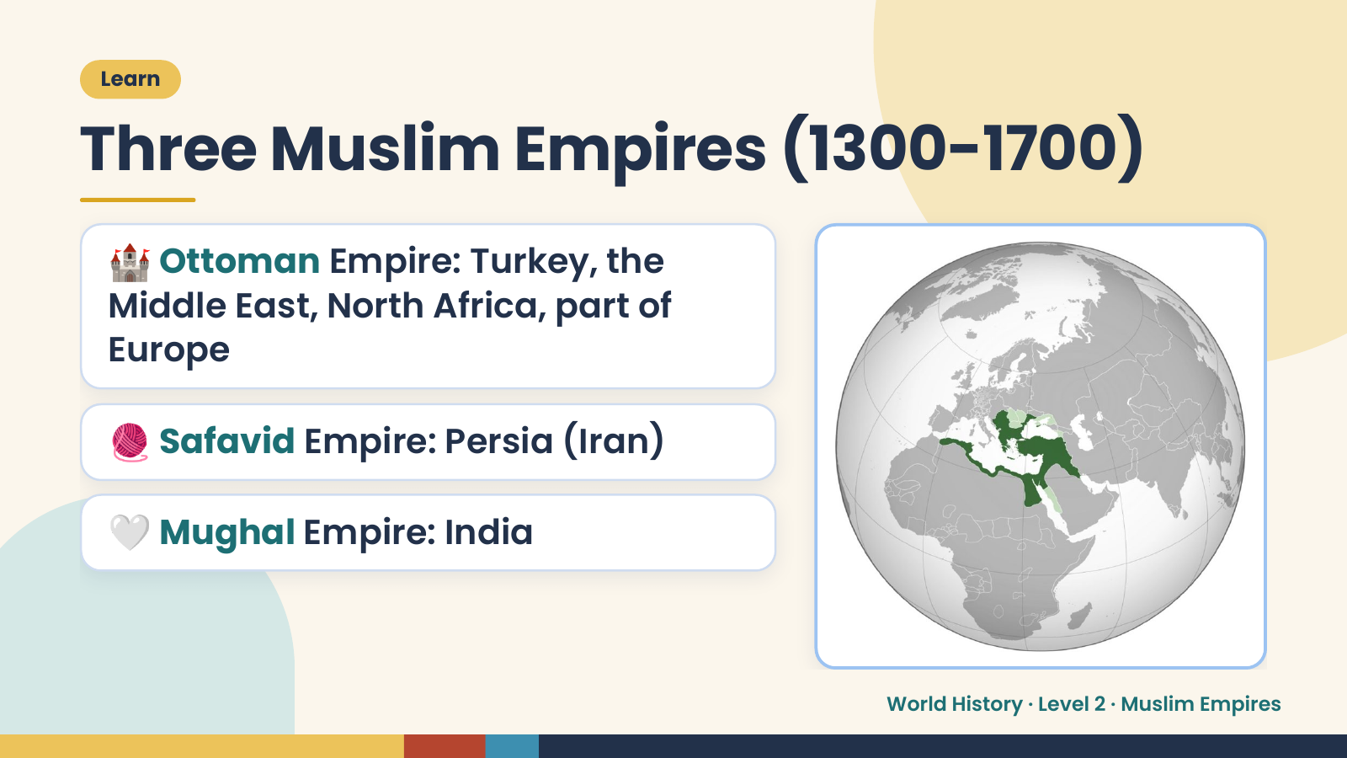
Notes:
Learn
Three Muslim Empires (1300-1700)
🏰 Ottoman Empire: Turkey, the
Middle East, North Africa, part of
Europe
🧶 Safavid Empire: Persia (Iran)
🤍 Mughal Empire: India
World History · Level 2 · Muslim Empires

Slide 6
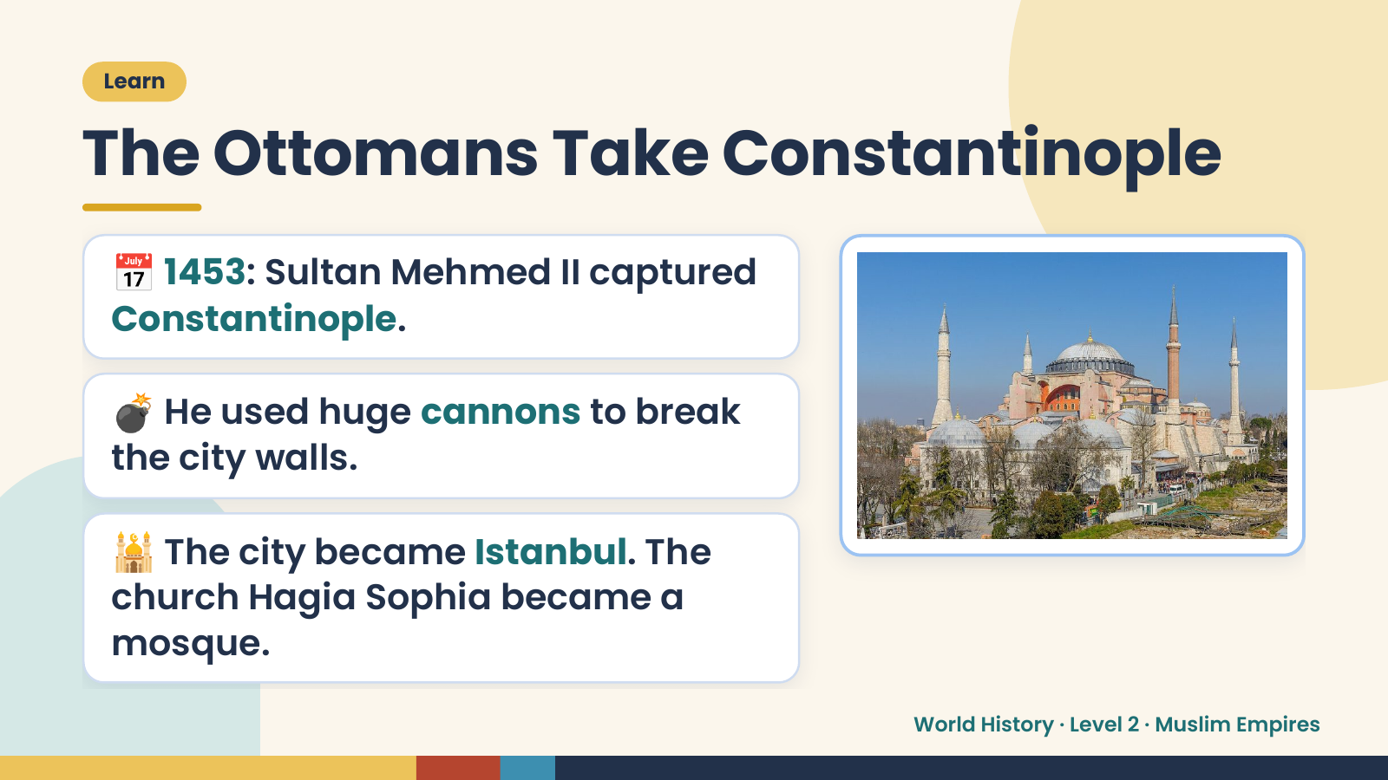
Notes:
Learn
The Ottomans Take Constantinople
📅 1453: Sultan Mehmed II captured
Constantinople.
💣 He used huge cannons to break
the city walls.
🕌 The city became Istanbul. The
church Hagia Sophia became a
mosque.
World History · Level 2 · Muslim Empires

Slide 7
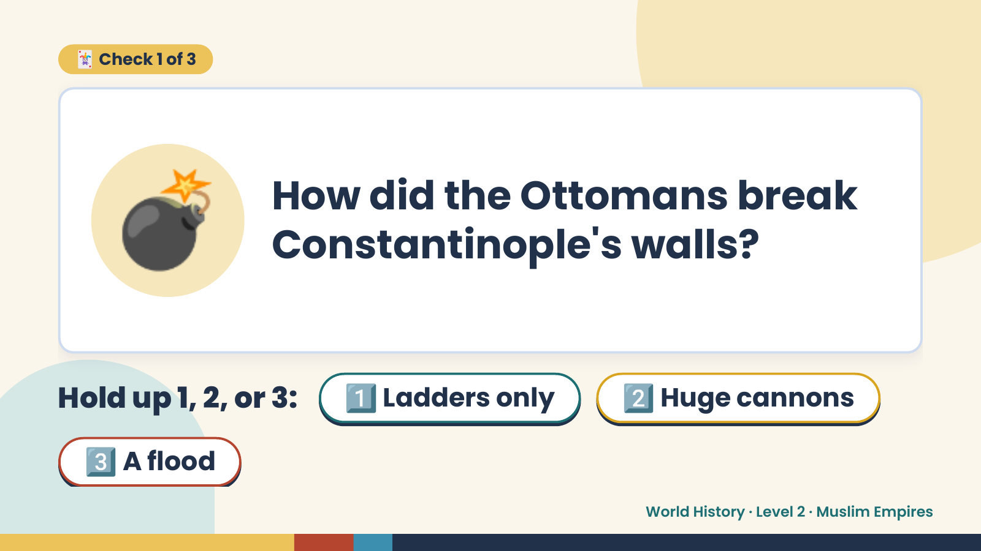
Notes:
🃏 Check 1 of 3
💣 How did the Ottomans break
Constantinople's walls?
Hold up 1, 2, or 3: 1️⃣ Ladders only 2️⃣ Huge cannons
3️⃣ A flood
World History · Level 2 · Muslim Empires

Slide 8
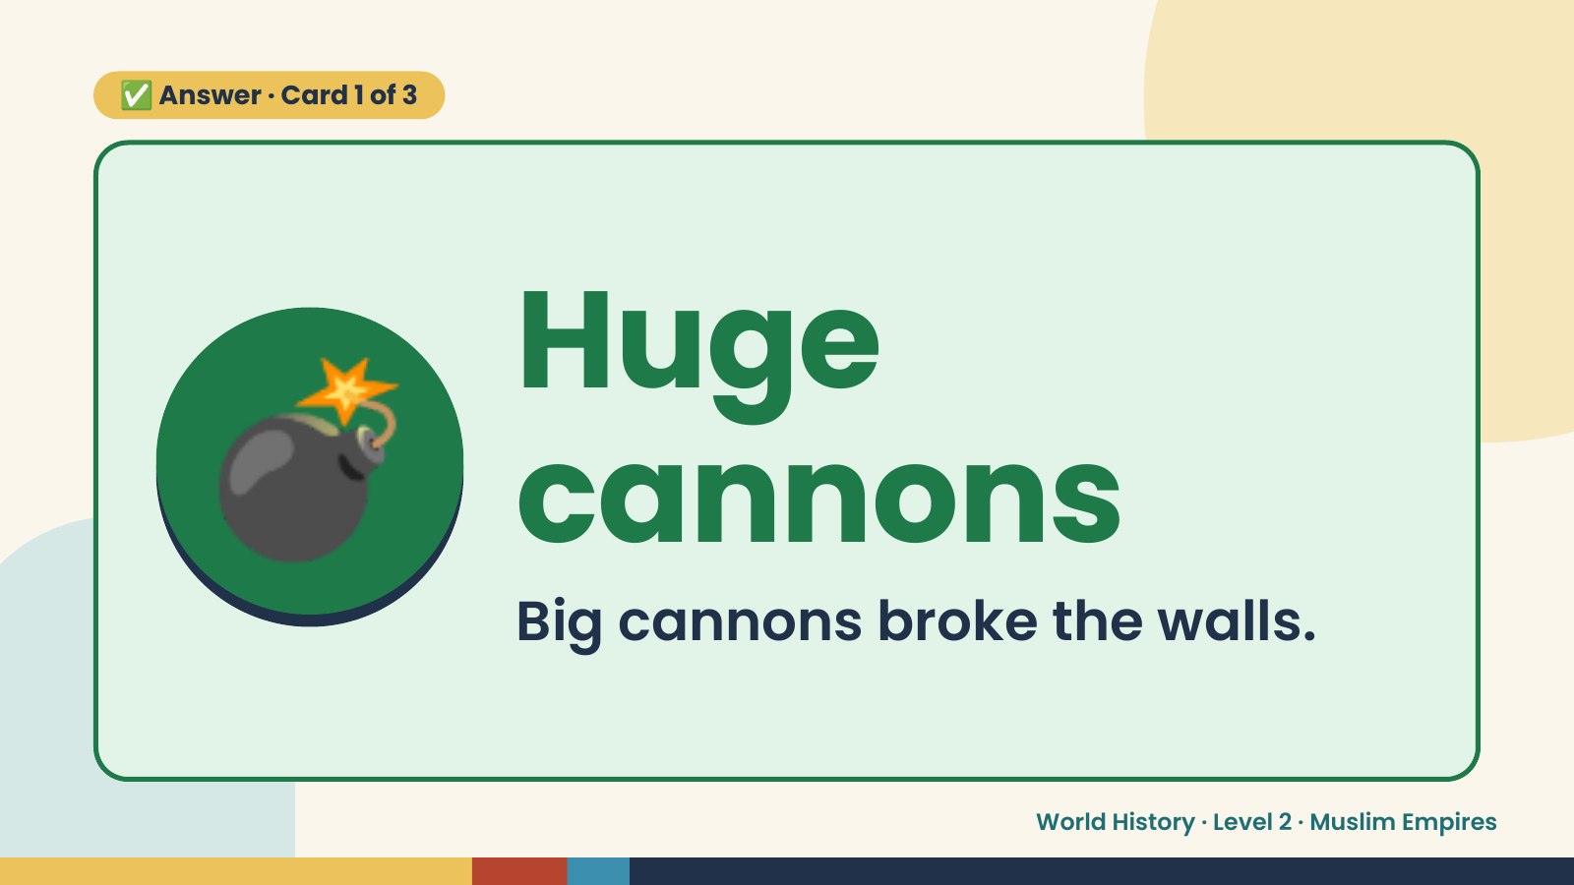
Notes:
✅ Answer · Card 1 of 3
💣 Huge
cannons
Big cannons broke the walls.
World History · Level 2 · Muslim Empires

Slide 9
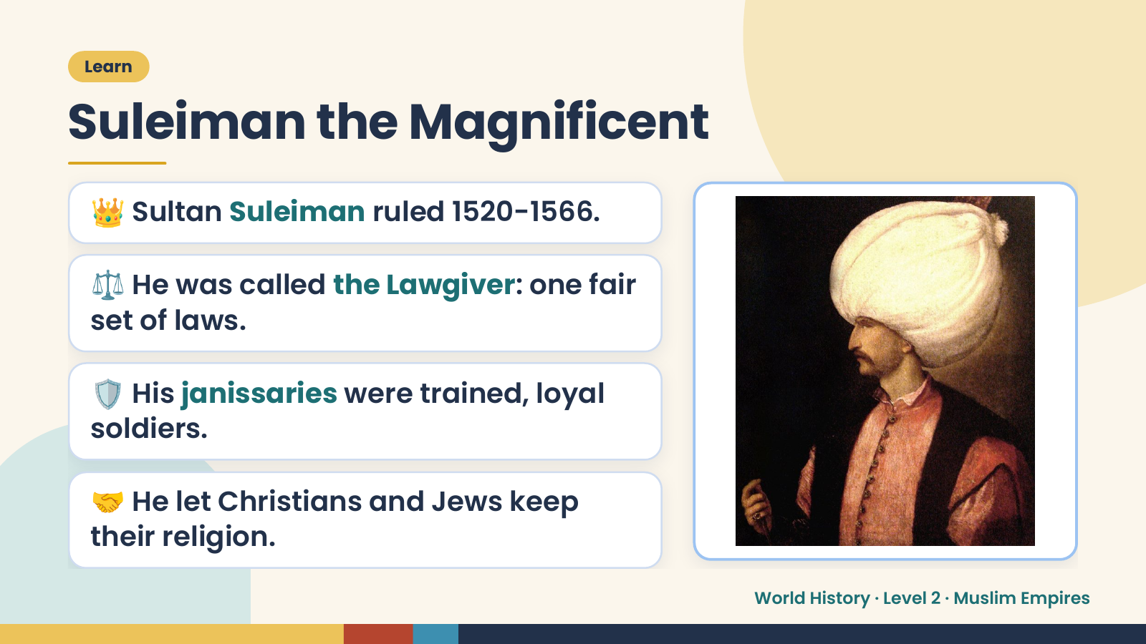
Notes:
Learn
Suleiman the Magnificent
👑 Sultan Suleiman ruled 1520-1566.
⚖️ He was called the Lawgiver: one fair
set of laws.
🛡️ His janissaries were trained, loyal
soldiers.
🤝 He let Christians and Jews keep
their religion.
World History · Level 2 · Muslim Empires

Slide 10
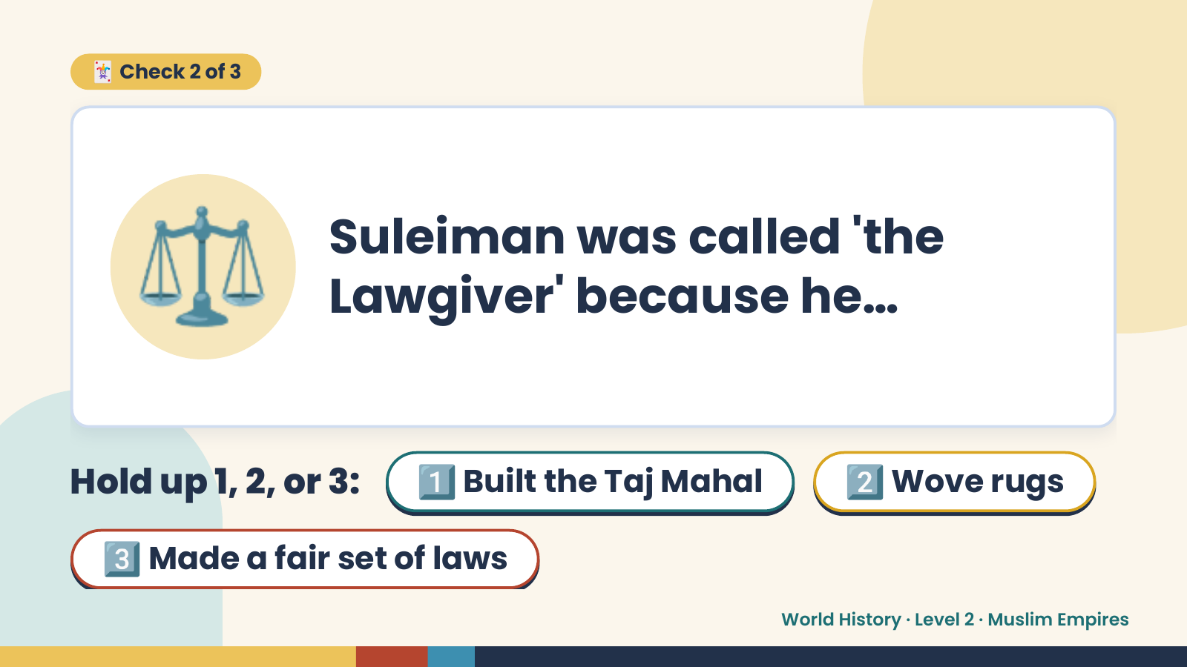
Notes:
🃏 Check 2 of 3
⚖️ Suleiman was called 'the
Lawgiver' because he…
Hold up 1, 2, or 3: 1️⃣ Built the Taj Mahal 2️⃣ Wove rugs
3️⃣ Made a fair set of laws
World History · Level 2 · Muslim Empires

Slide 11
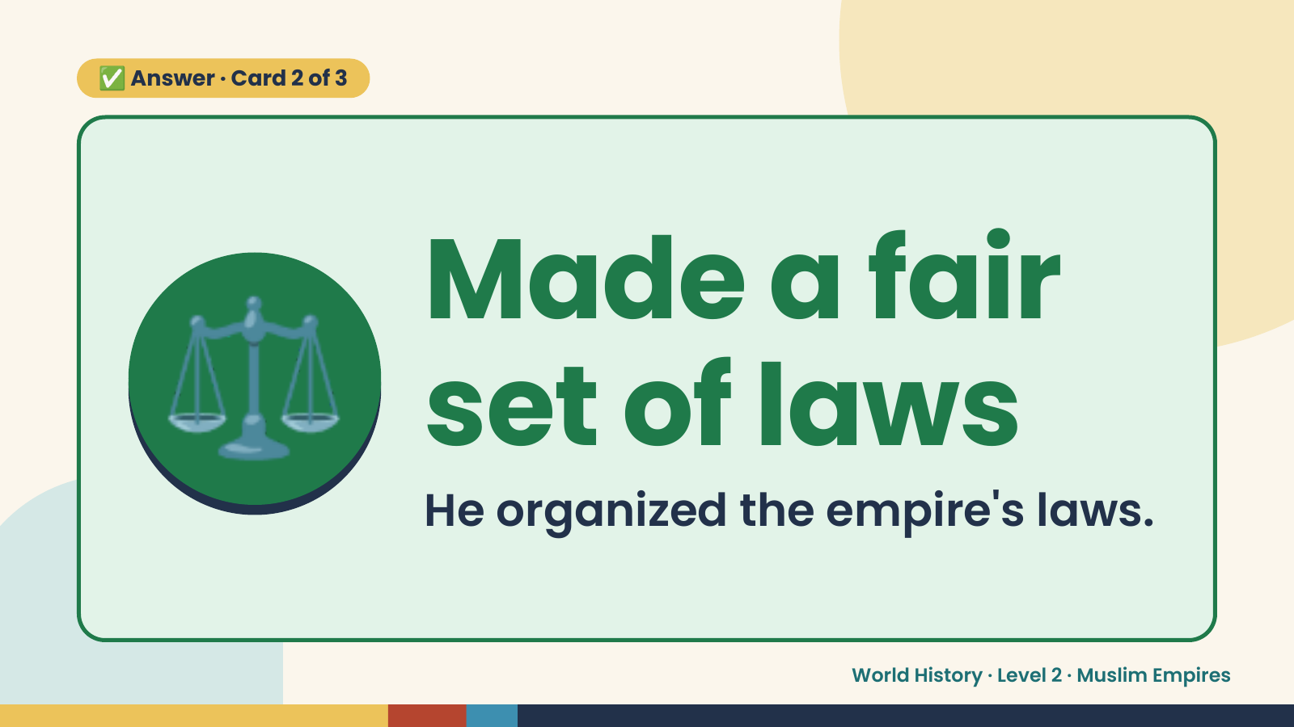
Notes:
✅ Answer · Card 2 of 3
⚖️ Made a fair
set of laws
He organized the empire's laws.
World History · Level 2 · Muslim Empires

Slide 12
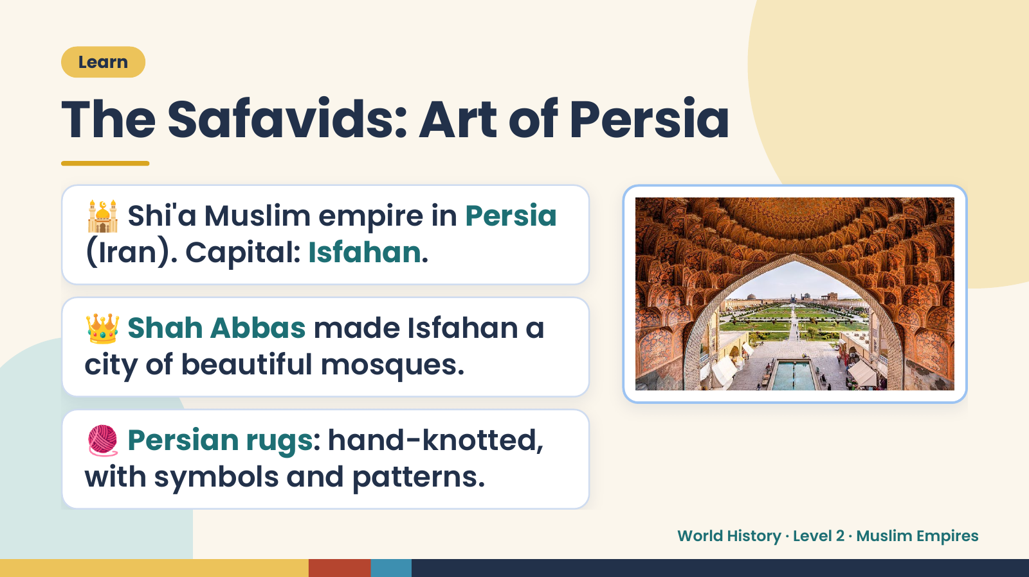
Notes:
Learn
The Safavids: Art of Persia
🕌 Shi'a Muslim empire in Persia
(Iran). Capital: Isfahan.
👑 Shah Abbas made Isfahan a
city of beautiful mosques.
🧶 Persian rugs: hand-knotted,
with symbols and patterns.
World History · Level 2 · Muslim Empires

Slide 13
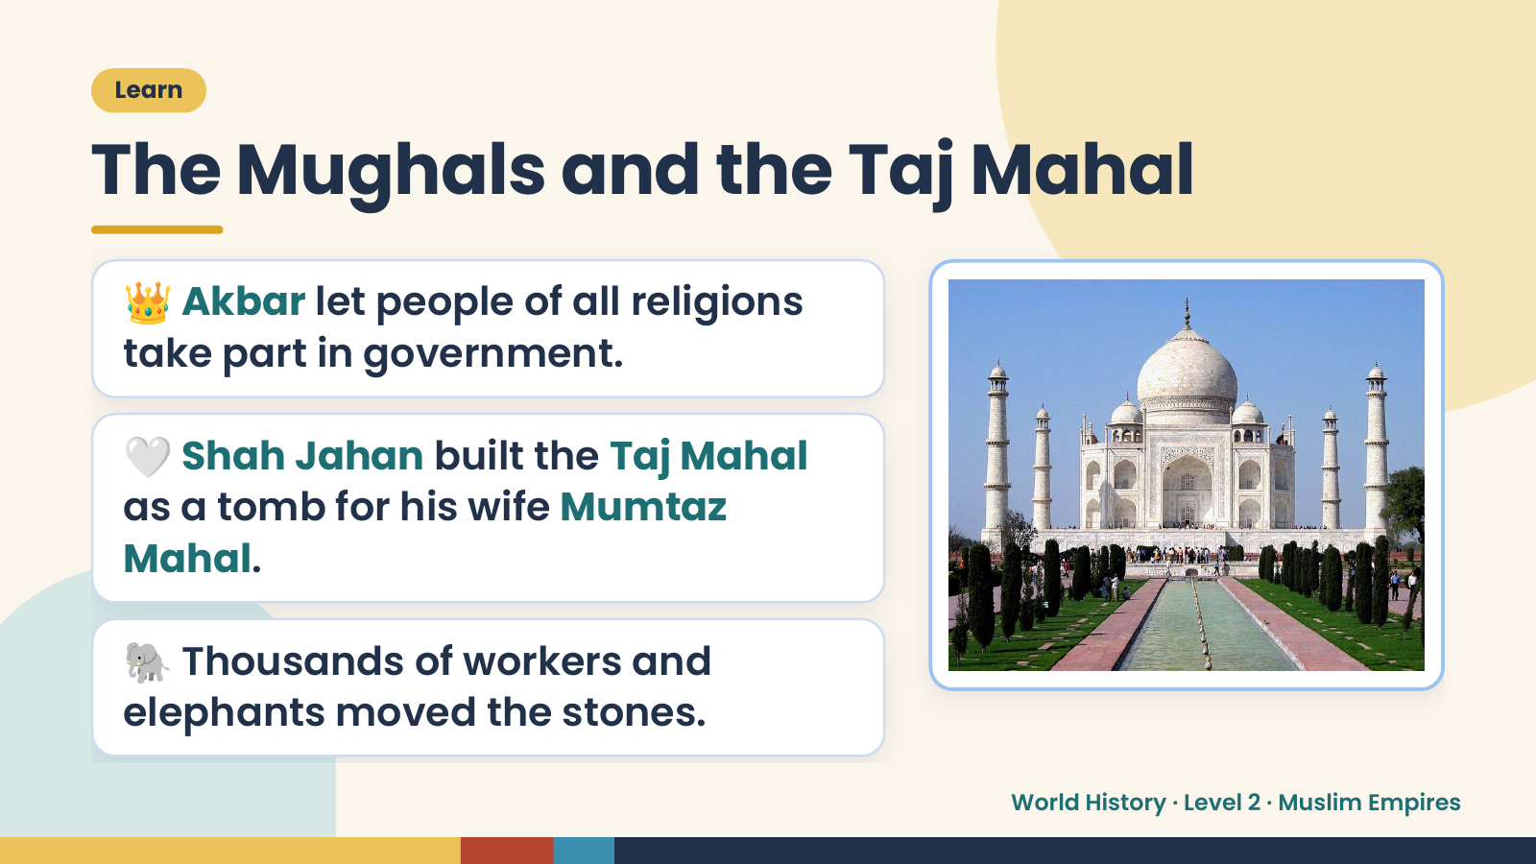
Notes:
Learn
The Mughals and the Taj Mahal
👑 Akbar let people of all religions
take part in government.
🤍 Shah Jahan built the Taj Mahal
as a tomb for his wife Mumtaz
Mahal.
🐘 Thousands of workers and
elephants moved the stones.
World History · Level 2 · Muslim Empires

Slide 14
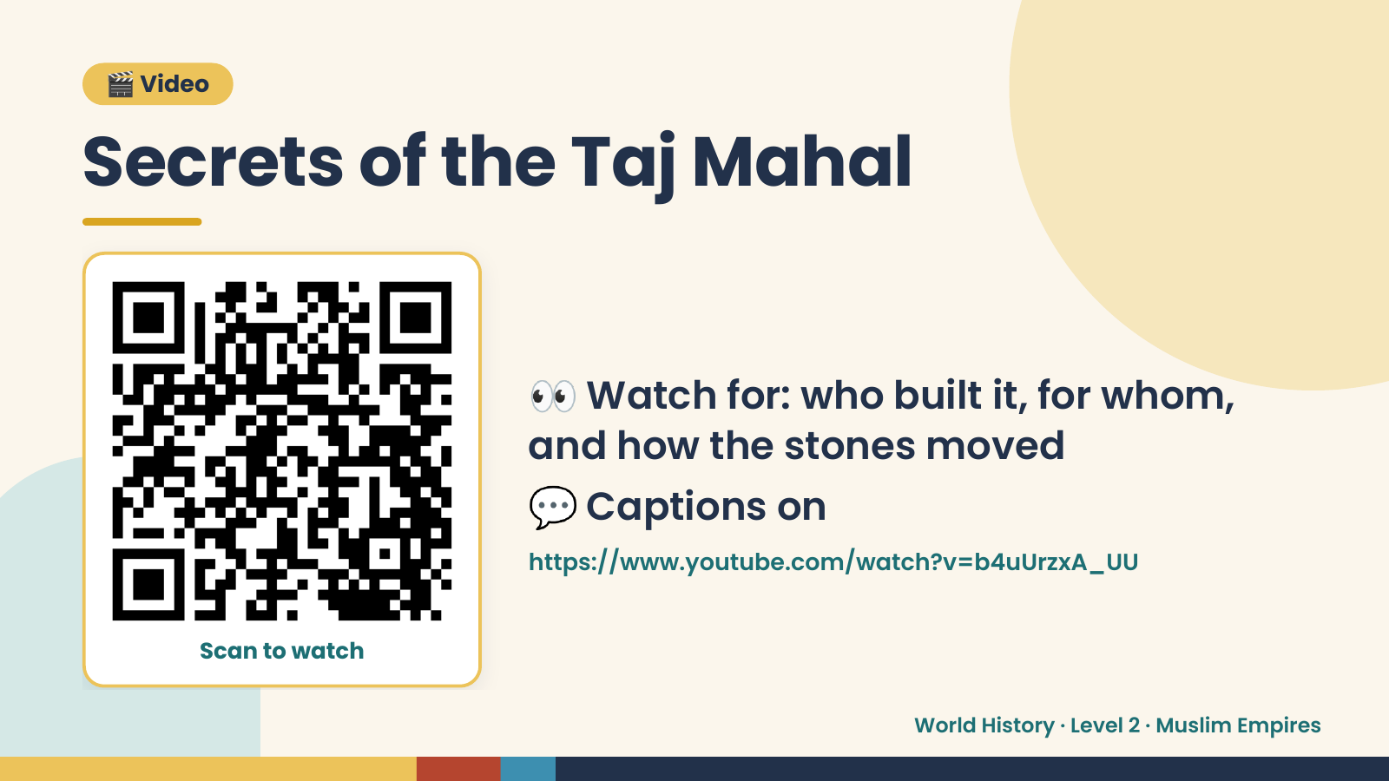
Notes:
🎬 Video
Secrets of the Taj Mahal
👀 Watch for: who built it, for whom,
and how the stones moved
💬 Captions on
https://www.youtube.com/watch?v=b4uUrzxA_UU
Scan to watch
World History · Level 2 · Muslim Empires

Slide 15
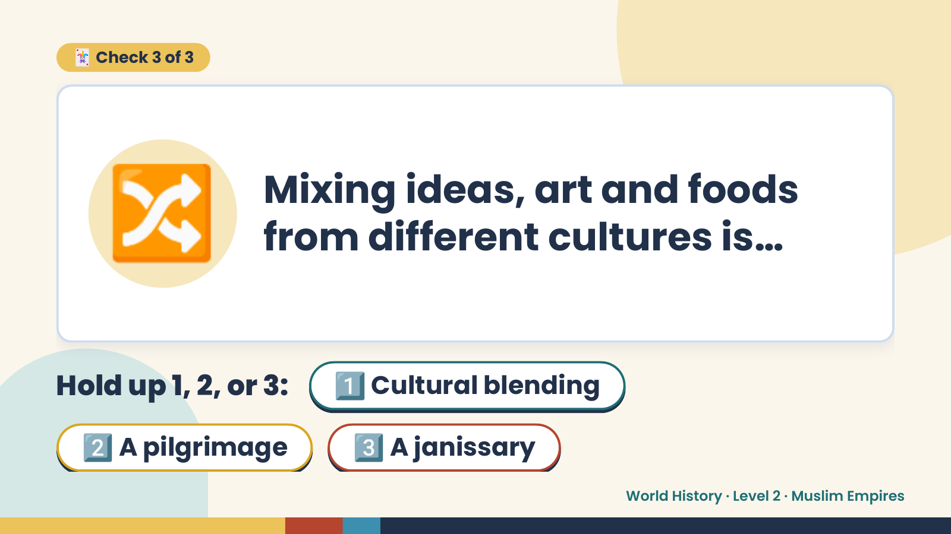
Notes:
🃏 Check 3 of 3
🔀 Mixing ideas, art and foods
from different cultures is…
Hold up 1, 2, or 3: 1️⃣ Cultural blending
2️⃣ A pilgrimage 3️⃣ A janissary
World History · Level 2 · Muslim Empires

Slide 16
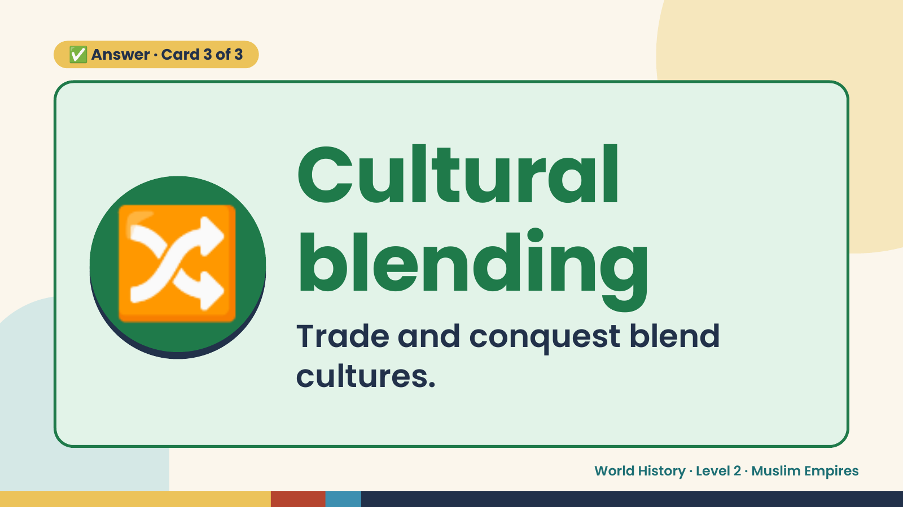
Notes:
✅ Answer · Card 3 of 3
🔀 Cultural
blending
Trade and conquest blend
cultures.
World History · Level 2 · Muslim Empires

Slide 17
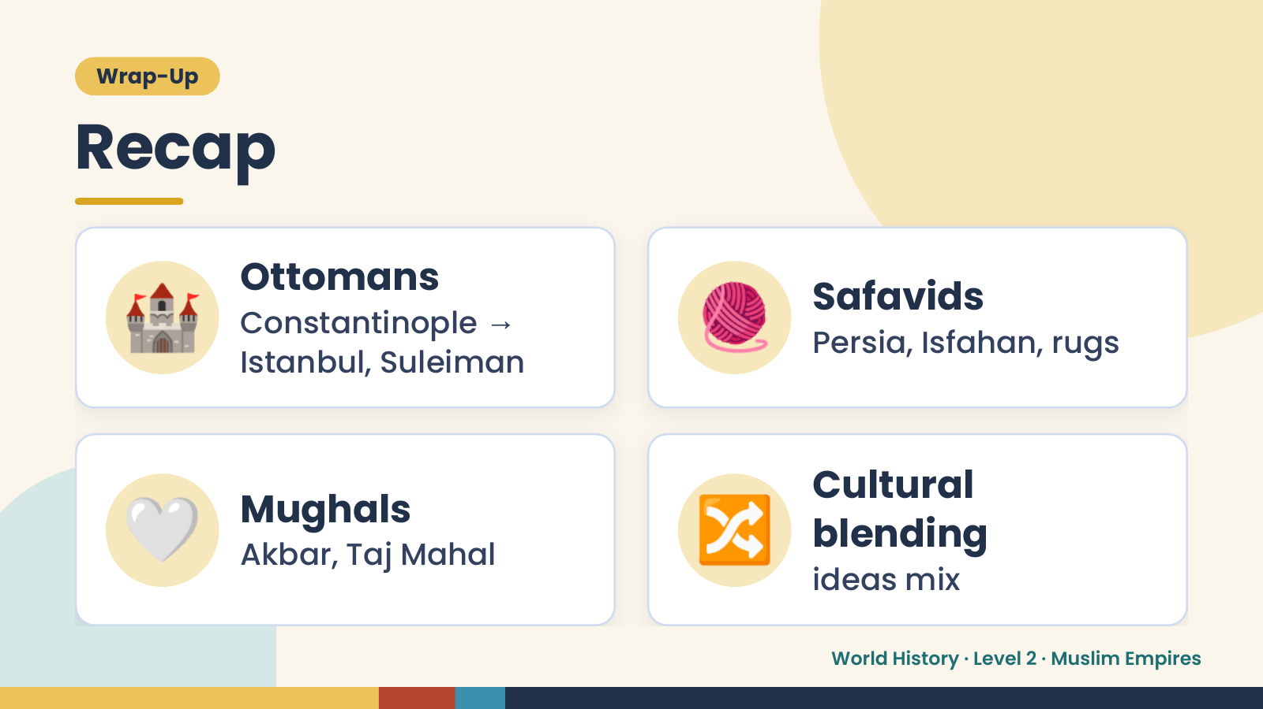
Notes:
Wrap-Up
Recap
🏰 Ottomans
Constantinople →
Istanbul, Suleiman
🧶 Safavids
Persia, Isfahan, rugs
🤍 Mughals
Akbar, Taj Mahal 🔀 Cultural
blending
ideas mix
World History · Level 2 · Muslim Empires

Slide 18
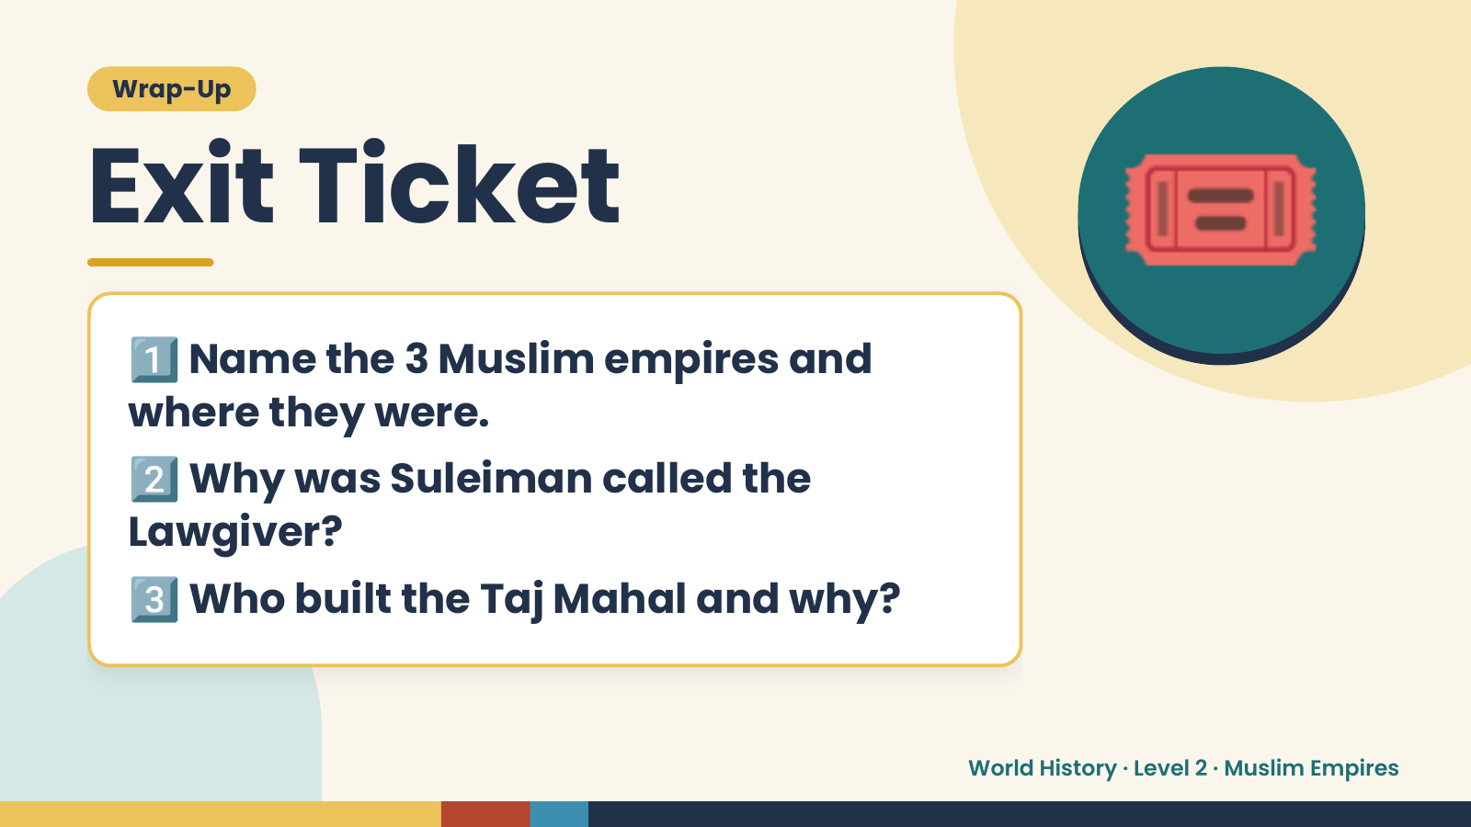
Notes:
Wrap-Up
Exit Ticket
1️⃣
Name the 3 Muslim empires and
where they were.
🎟️
2️⃣
Why was Suleiman called the
Lawgiver?
3️⃣Who built the Taj Mahal and why?
World History · Level 2 · Muslim Empires

