Slide 1
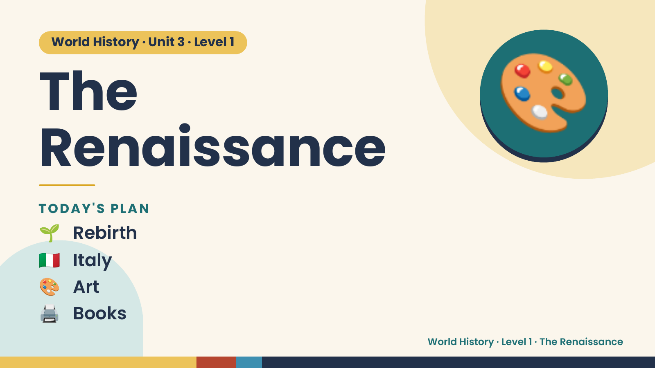
Notes:
World History · Unit 3 · Level 1
The
Renaissance
🎨
🌱 Rebirth
TODAY'S PLAN
🇮🇹 Italy
🎨 Art
🖨️ Books
World History · Level 1 · The Renaissance

Slide 2
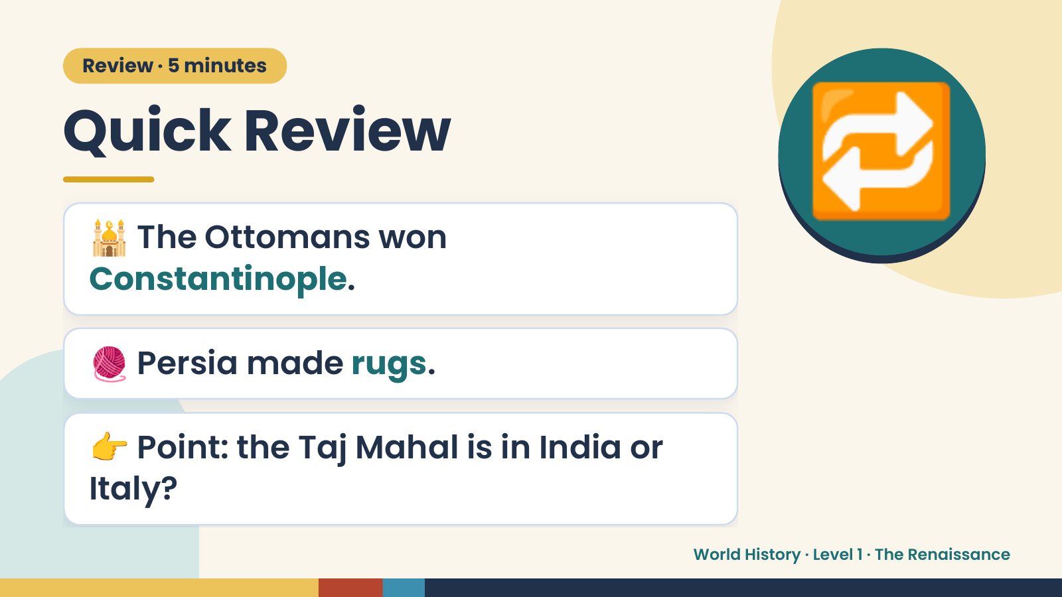
Notes:
Review · 5 minutes
Quick Review
🕌 The Ottomans won
Constantinople.
🔁
🧶 Persia made rugs.
👉 Point: the Taj Mahal is in India or
Italy?
World History · Level 1 · The Renaissance

Slide 3
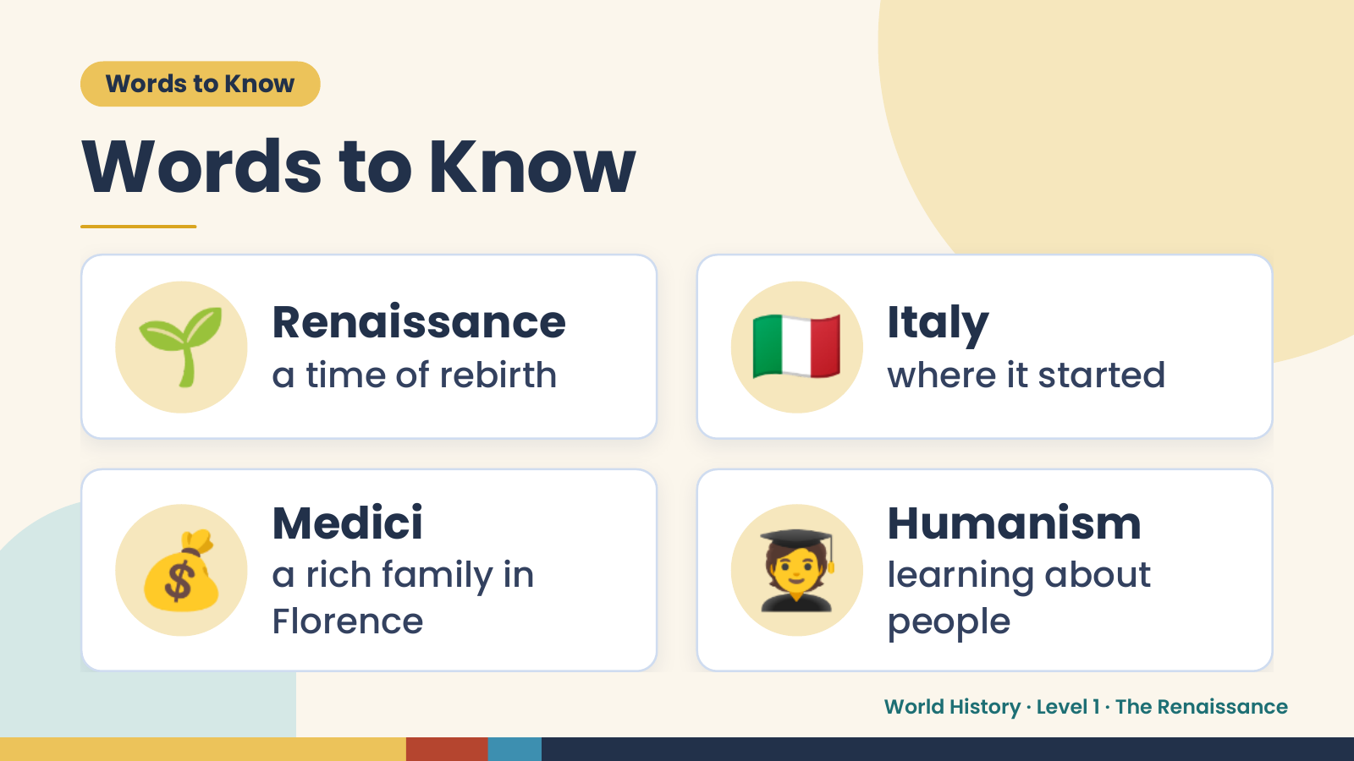
Notes:
Words to Know
Words to Know
🌱 Renaissance
a time of rebirth 🇮🇹 Italy
where it started
💰 Medici
a rich family in
Florence
🧑‍🎓 Humanism
learning about
people
World History · Level 1 · The Renaissance

Slide 4
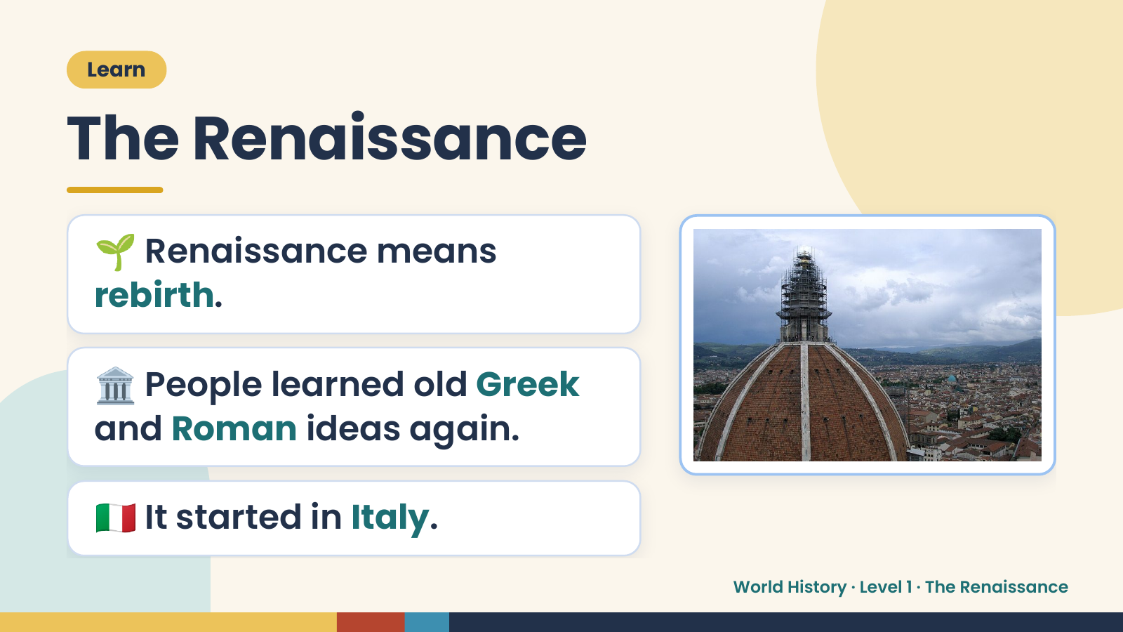
Notes:
Learn
The Renaissance
🌱 Renaissance means
rebirth.
🏛️ People learned old Greek
and Roman ideas again.
🇮🇹 It started in Italy.
World History · Level 1 · The Renaissance

Slide 5
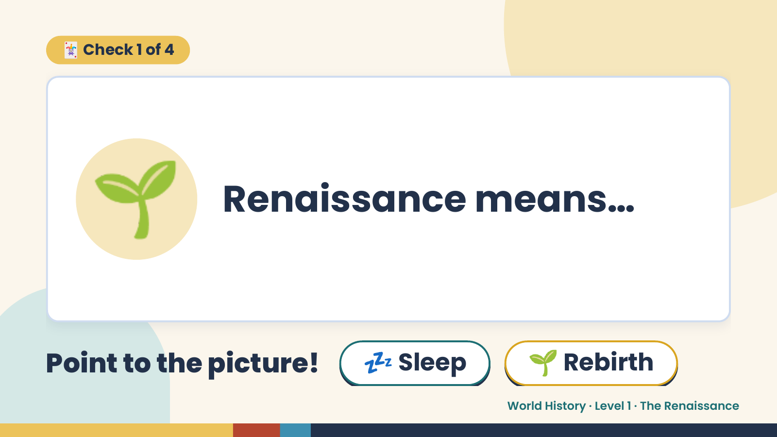
Notes:
🃏 Check 1 of 4
🌱 Renaissance means…
Point to the picture! 💤 Sleep 🌱 Rebirth
World History · Level 1 · The Renaissance

Slide 6
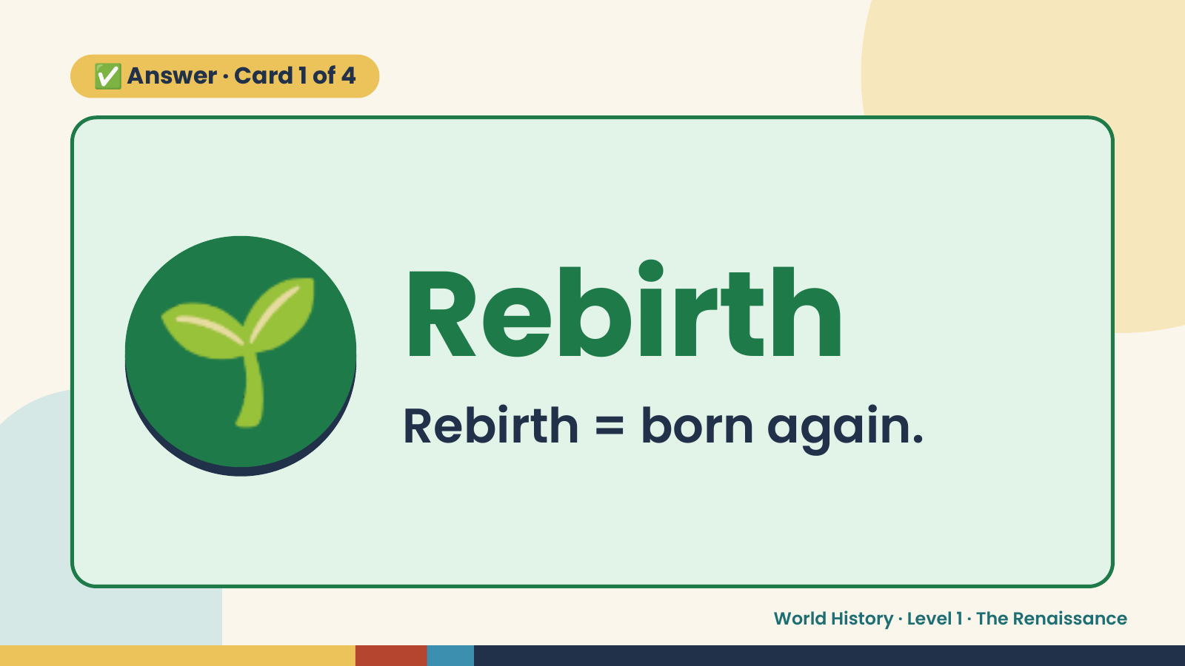
Notes:
✅ Answer · Card 1 of 4
🌱 Rebirth
Rebirth = born again.
World History · Level 1 · The Renaissance

Slide 7
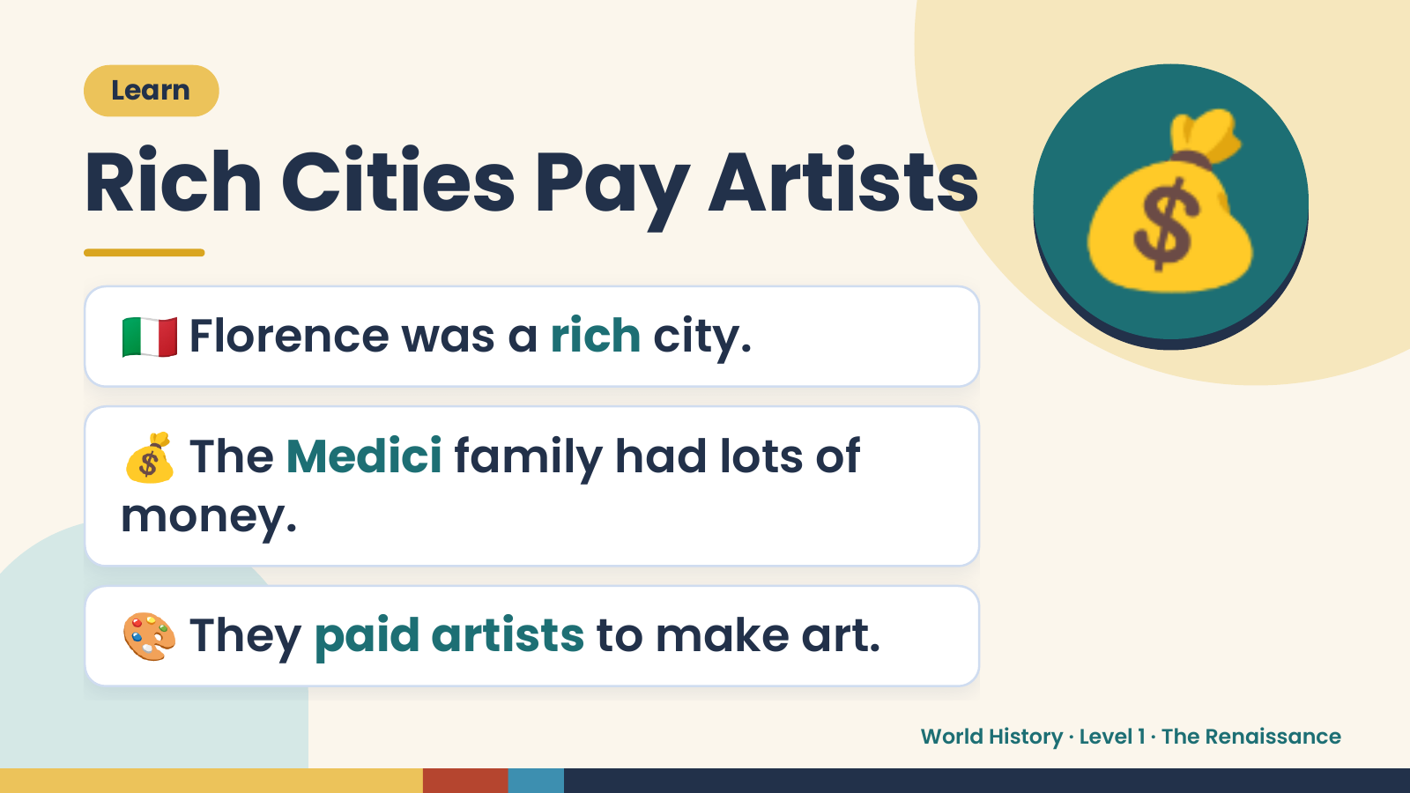
Notes:
Learn
Rich Cities Pay Artists
🇮🇹 Florence was a rich city.
💰
💰 The Medici family had lots of
money.
🎨 They paid artists to make art.
World History · Level 1 · The Renaissance

Slide 8
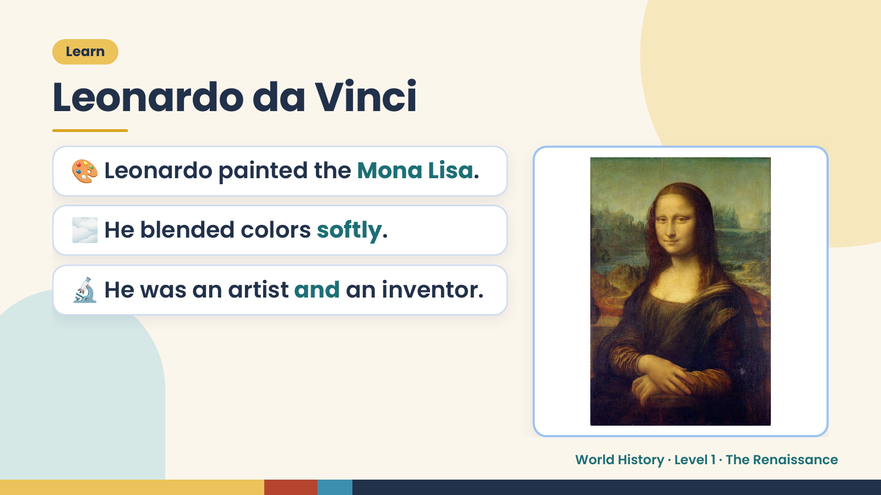
Notes:
Learn
Leonardo da Vinci
🎨 Leonardo painted the Mona Lisa.
🌫️ He blended colors softly.
🔬 He was an artist and an inventor.
World History · Level 1 · The Renaissance

Slide 9
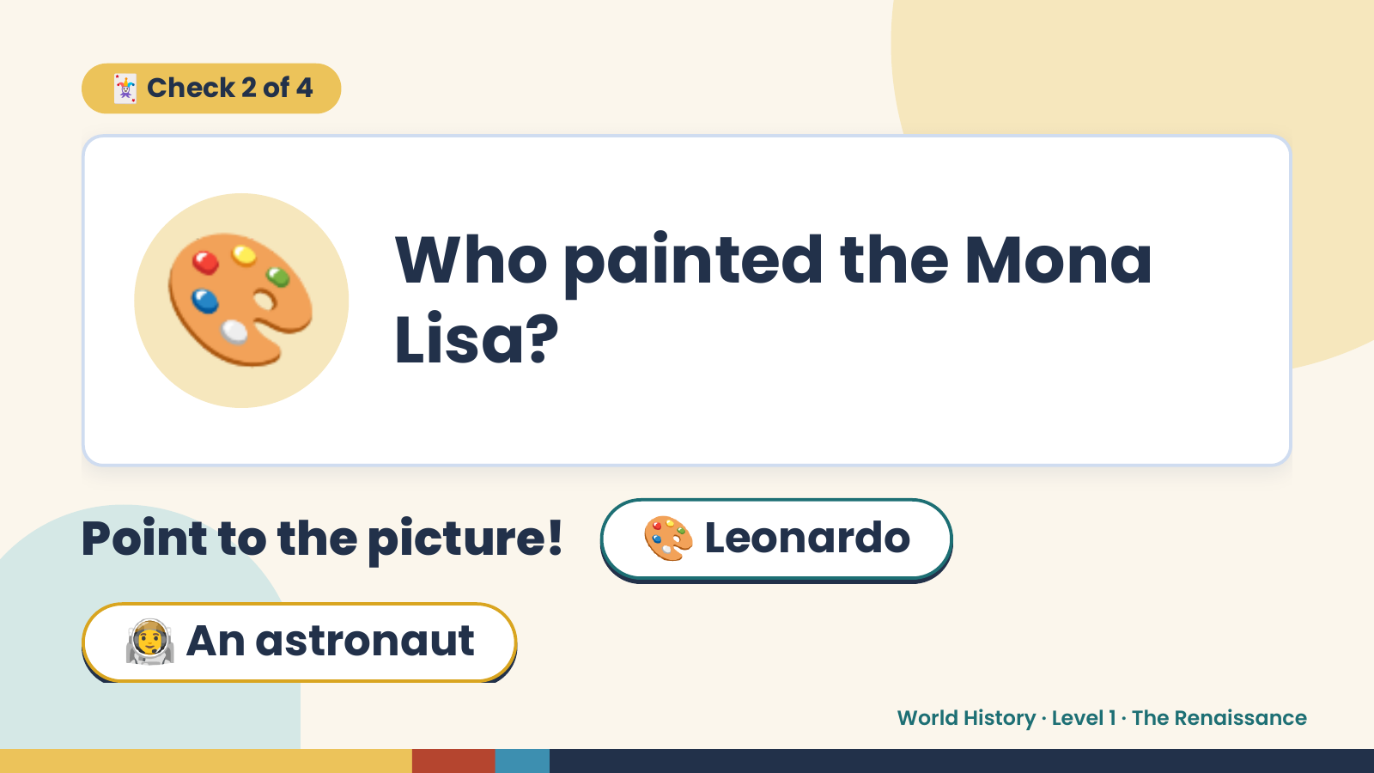
Notes:
🃏 Check 2 of 4
🎨 Who painted the Mona
Lisa?
Point to the picture! 🎨 Leonardo
🧑‍🚀 An astronaut
World History · Level 1 · The Renaissance

Slide 10
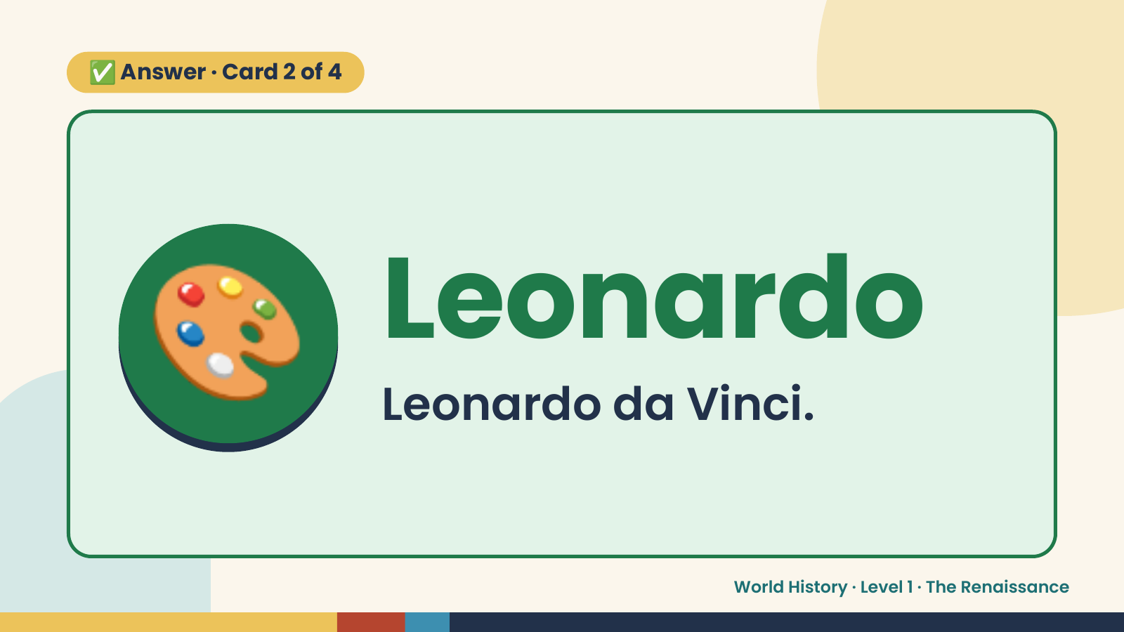
Notes:
✅ Answer · Card 2 of 4
🎨 Leonardo
Leonardo da Vinci.
World History · Level 1 · The Renaissance

Slide 11
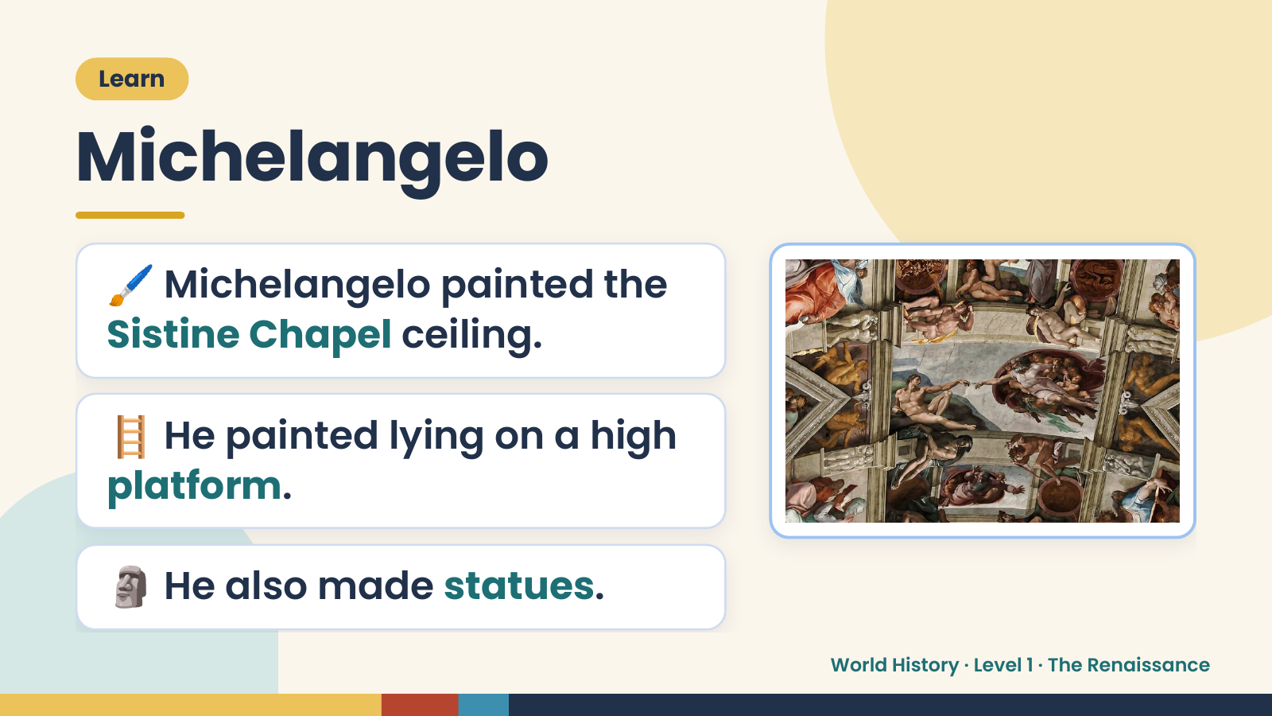
Notes:
Learn
Michelangelo
🖌️ Michelangelo painted the
Sistine Chapel ceiling.
🪜 He painted lying on a high
platform.
🗿 He also made statues.
World History · Level 1 · The Renaissance

Slide 12
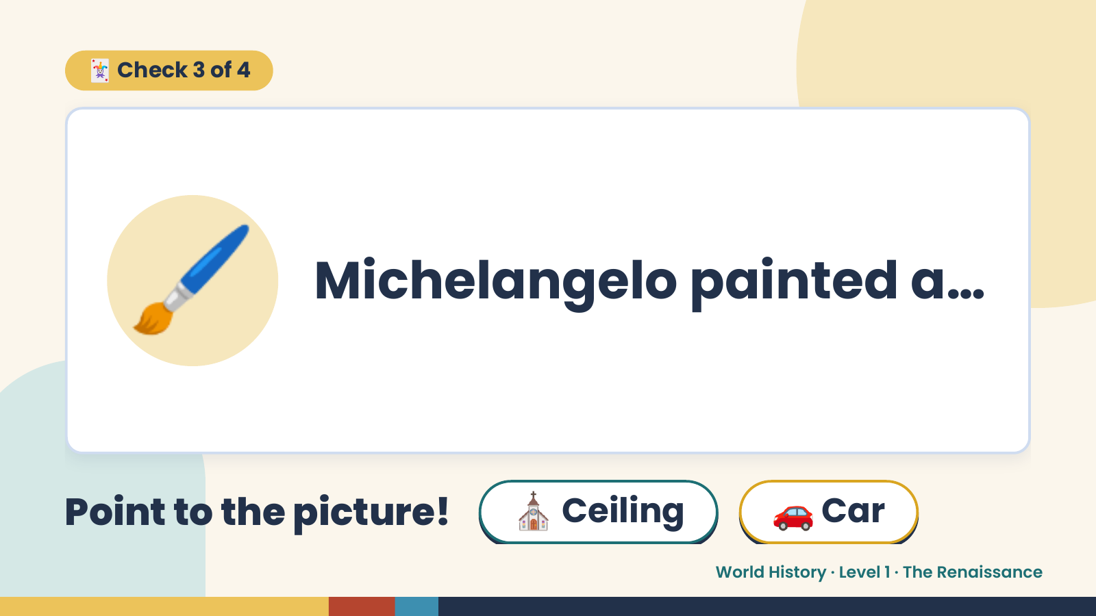
Notes:
🃏 Check 3 of 4
🖌️ Michelangelo painted a…
Point to the picture! ⛪ Ceiling 🚗 Car
World History · Level 1 · The Renaissance

Slide 13
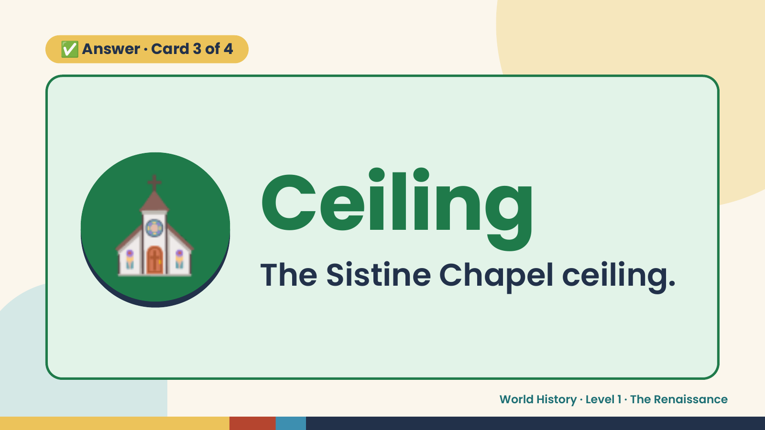
Notes:
✅ Answer · Card 3 of 4
⛪ Ceiling
The Sistine Chapel ceiling.
World History · Level 1 · The Renaissance

Slide 14
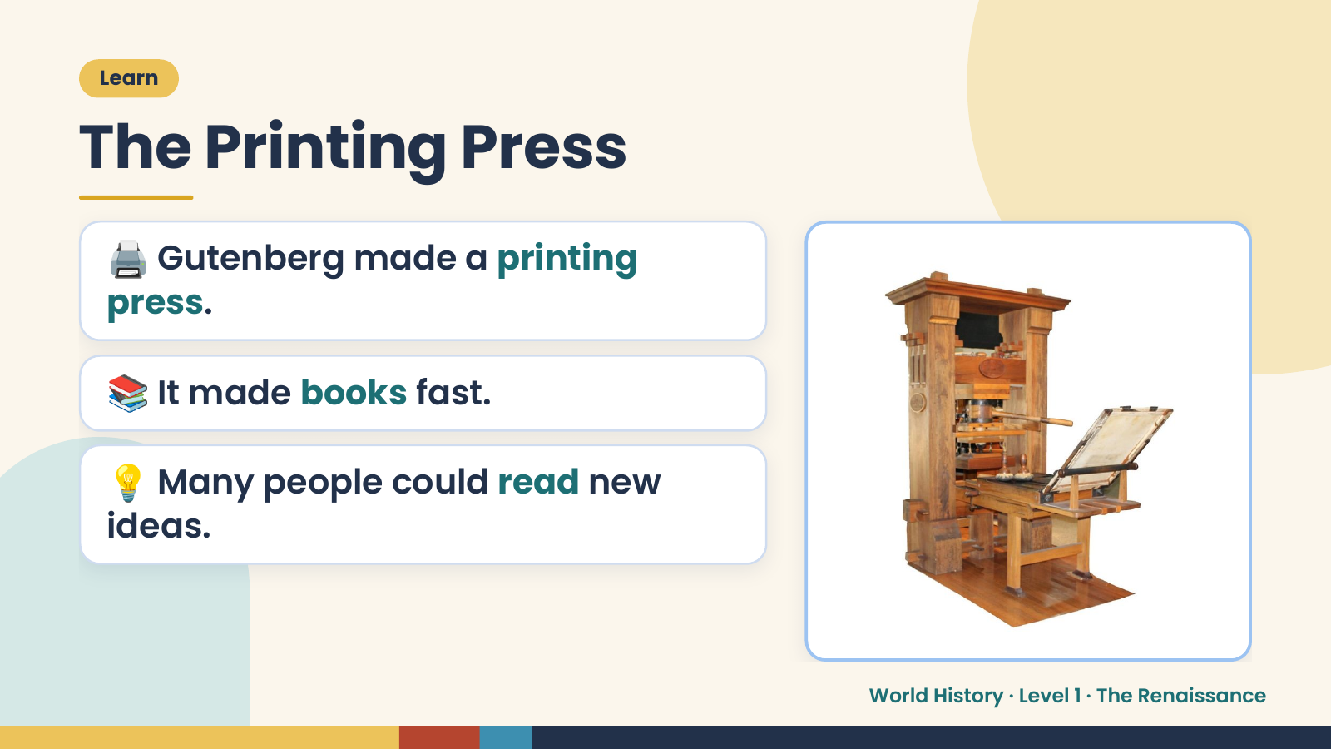
Notes:
Learn
The Printing Press
🖨️ Gutenberg made a printing
press.
📚 It made books fast.
💡 Many people could read new
ideas.
World History · Level 1 · The Renaissance

Slide 15
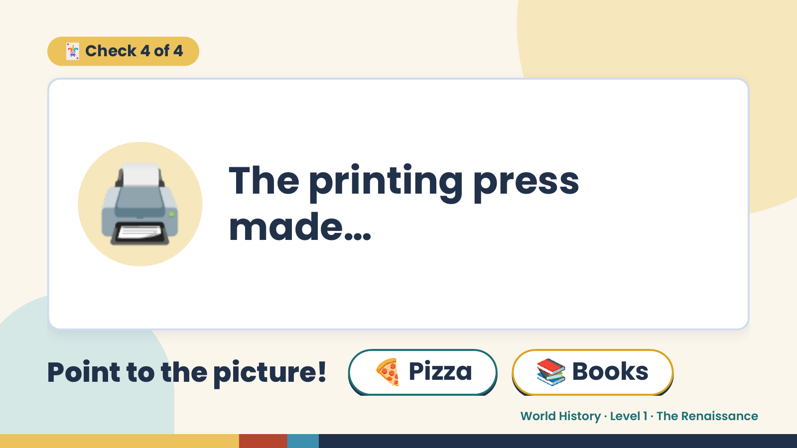
Notes:
🃏 Check 4 of 4
🖨️ The printing press
made…
Point to the picture! 🍕 Pizza 📚 Books
World History · Level 1 · The Renaissance

Slide 16
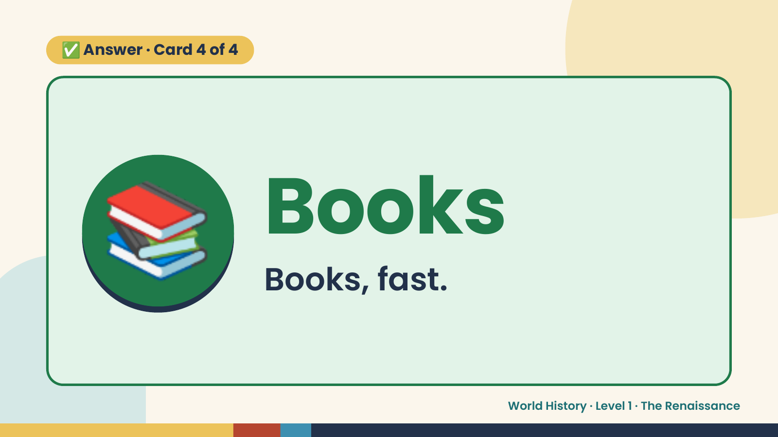
Notes:
✅ Answer · Card 4 of 4
📚 Books
Books, fast.
World History · Level 1 · The Renaissance

Slide 17
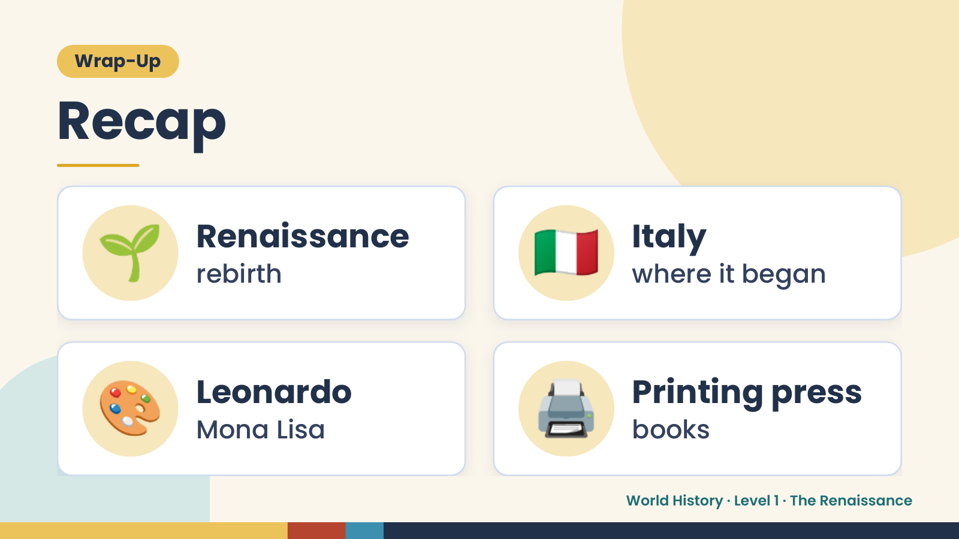
Notes:
Wrap-Up
Recap
🌱 Renaissance
rebirth 🇮🇹 Italy
where it began
🎨 Leonardo
Mona Lisa 🖨️ Printing press
books
World History · Level 1 · The Renaissance

Slide 18
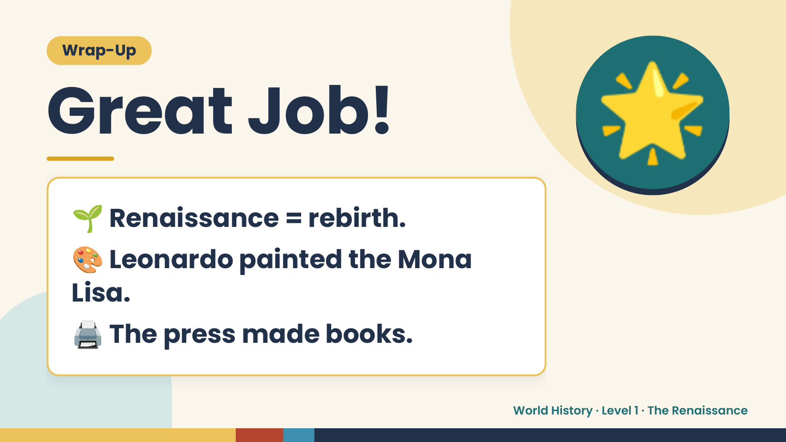
Notes:
Wrap-Up
Great Job!
🌱 Renaissance = rebirth.
🌟
🎨 Leonardo painted the Mona
Lisa.
🖨️ The press made books.
World History · Level 1 · The Renaissance

