Slide 1
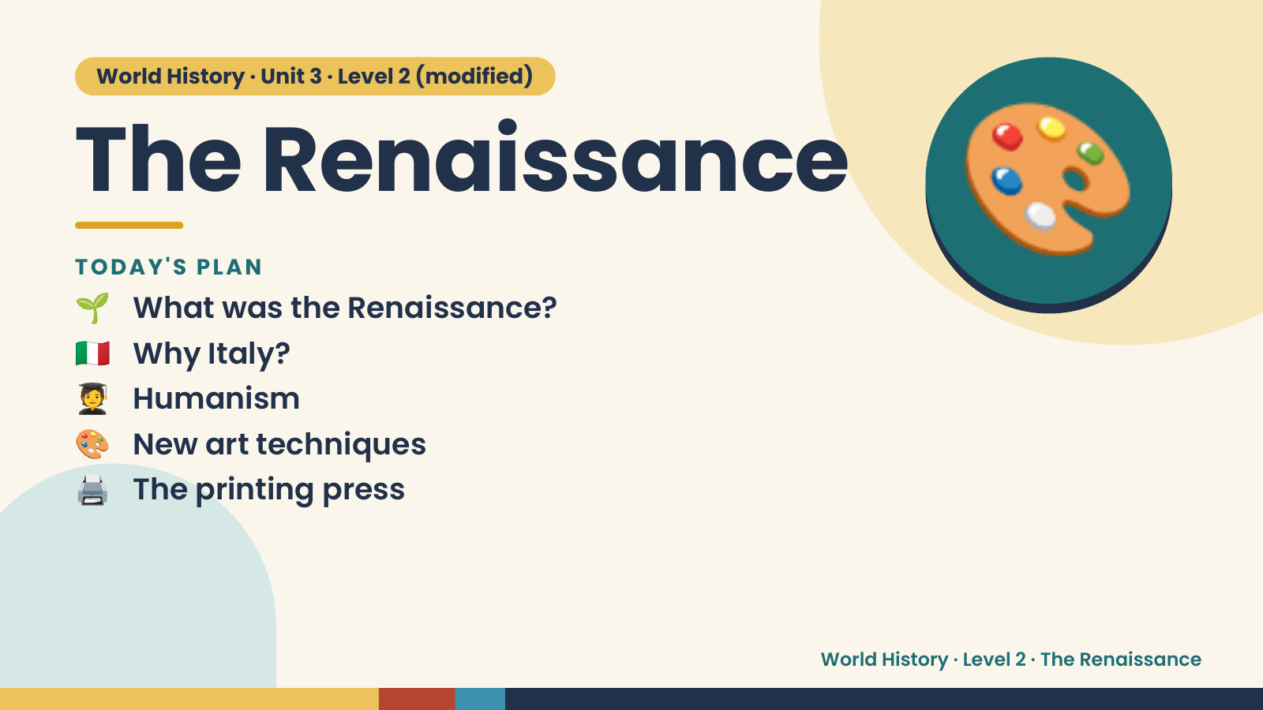
Notes:
World History · Unit 3 · Level 2 (modified)
The Renaissance
🌱 What was the Renaissance?
TODAY'S PLAN
🇮🇹 Why Italy?
🧑‍🎓 Humanism
🎨
🎨 New art techniques
🖨️ The printing press
World History · Level 2 · The Renaissance

Slide 2
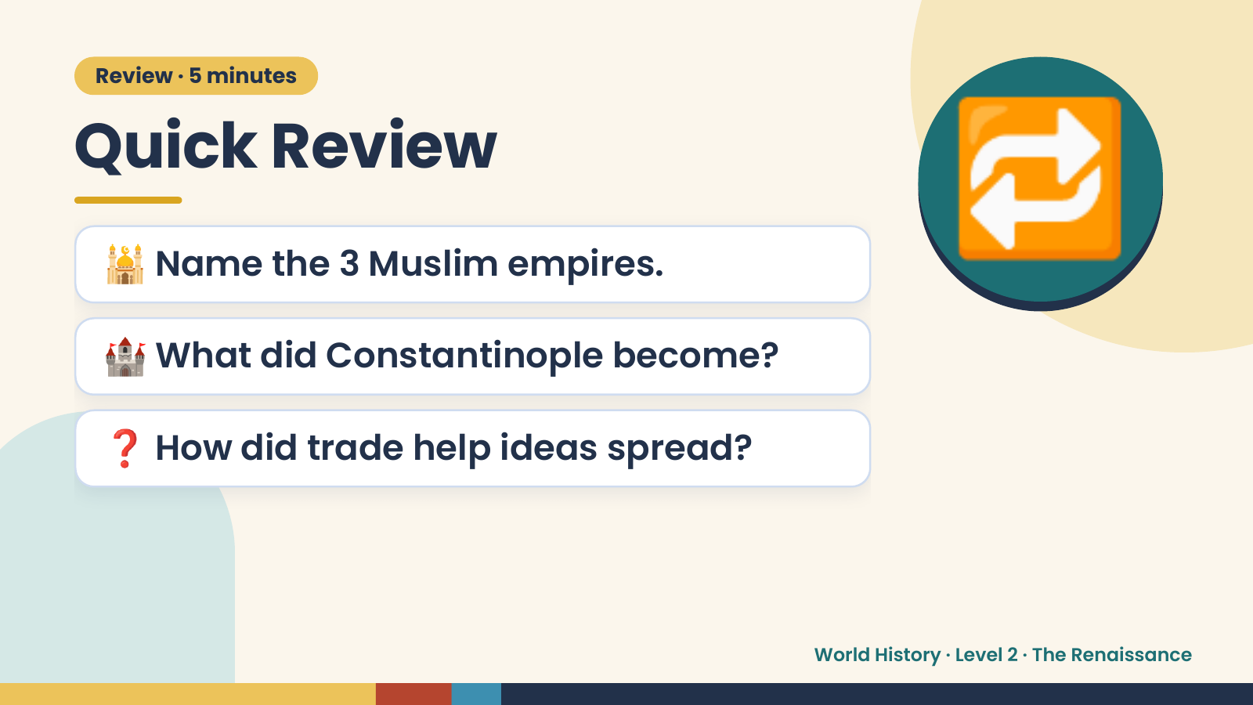
Notes:
Review · 5 minutes
Quick Review
🕌 Name the 3 Muslim empires.
🏰 What did Constantinople become?
🔁
❓ How did trade help ideas spread?
World History · Level 2 · The Renaissance

Slide 3
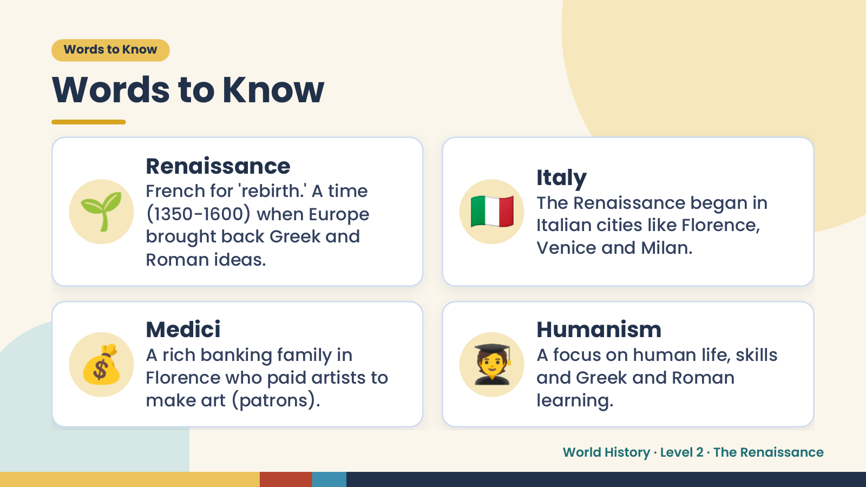
Notes:
Words to Know
Words to Know
🌱 🇮🇹
Renaissance
Italy
French for 'rebirth.' A time
The Renaissance began in
(1350-1600) when Europe
Italian cities like Florence,
brought back Greek and
Venice and Milan.
Roman ideas.
💰 Medici
A rich banking family in
Florence who paid artists to
make art (patrons).
🧑‍🎓 Humanism
A focus on human life, skills
and Greek and Roman
learning.
World History · Level 2 · The Renaissance

Slide 4
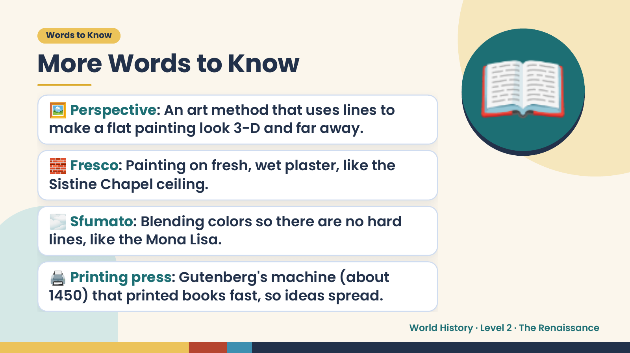
Notes:
Words to Know
More Words to Know
🖼️ Perspective: An art method that uses lines to
make a flat painting look 3-D and far away.
🧱 Fresco: Painting on fresh, wet plaster, like the
Sistine Chapel ceiling.
📖
🌫️ Sfumato: Blending colors so there are no hard
lines, like the Mona Lisa.
🖨️ Printing press: Gutenberg's machine (about
1450) that printed books fast, so ideas spread.
World History · Level 2 · The Renaissance

Slide 5
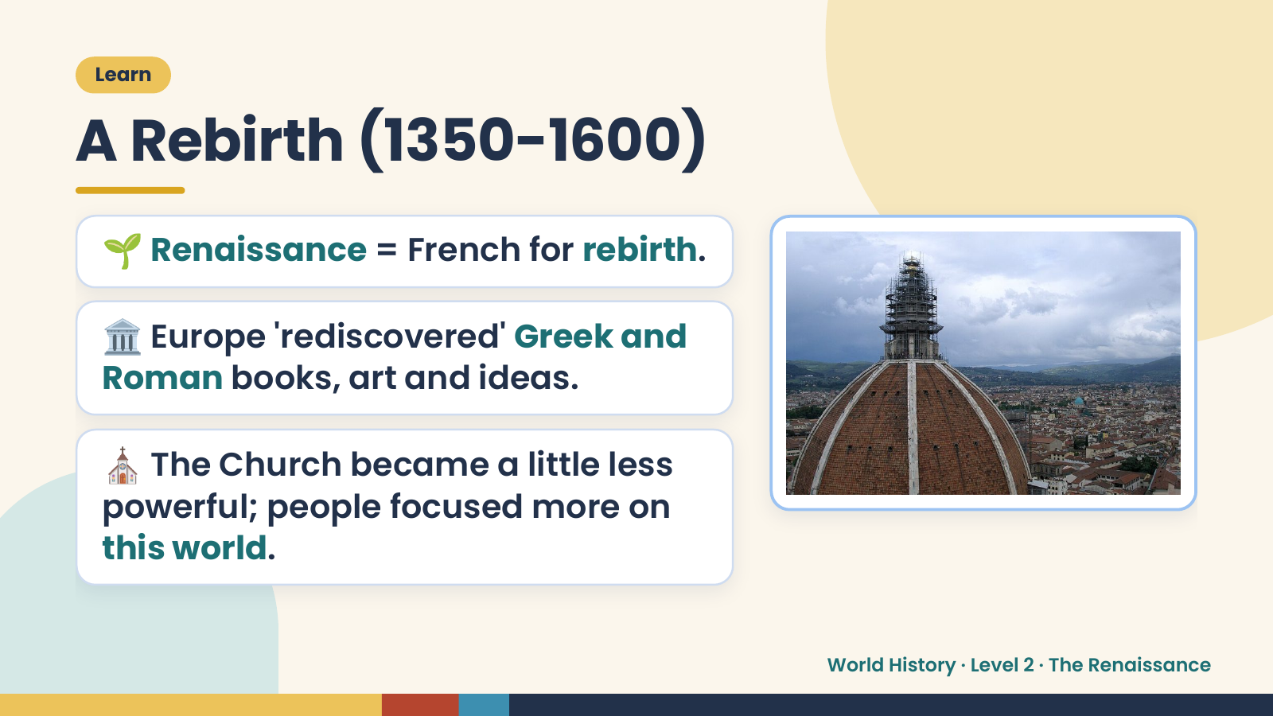
Notes:
Learn
A Rebirth (1350-1600)
🌱 Renaissance = French for rebirth.
🏛️ Europe 'rediscovered' Greek and
Roman books, art and ideas.
⛪ The Church became a little less
powerful; people focused more on
this world.
World History · Level 2 · The Renaissance

Slide 6
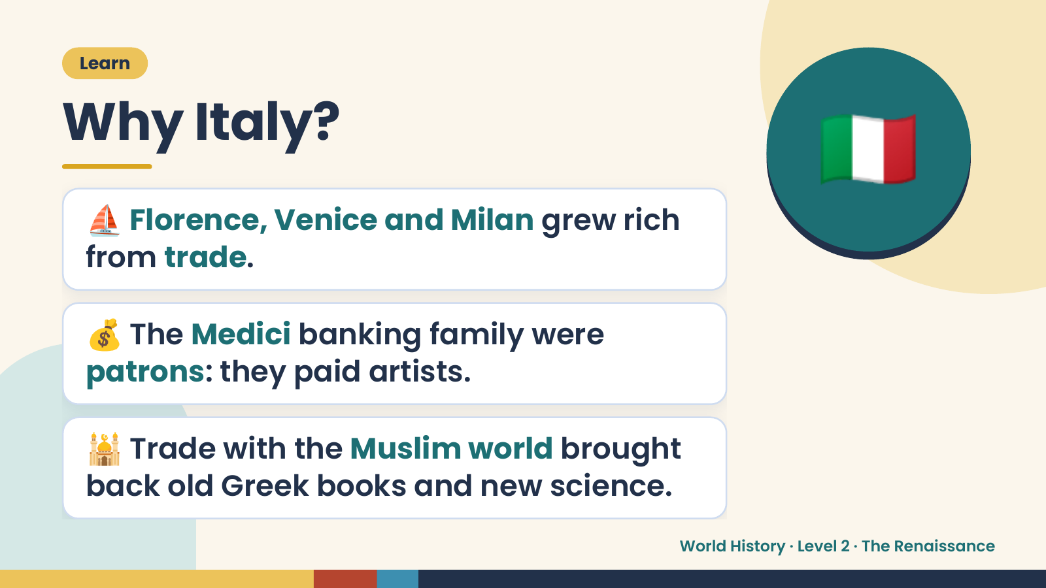
Notes:
🇮🇹
Learn
Why Italy?
⛵ Florence, Venice and Milan grew rich
from trade.
💰 The Medici banking family were
patrons: they paid artists.
🕌 Trade with the Muslim world brought
back old Greek books and new science.
World History · Level 2 · The Renaissance

Slide 7
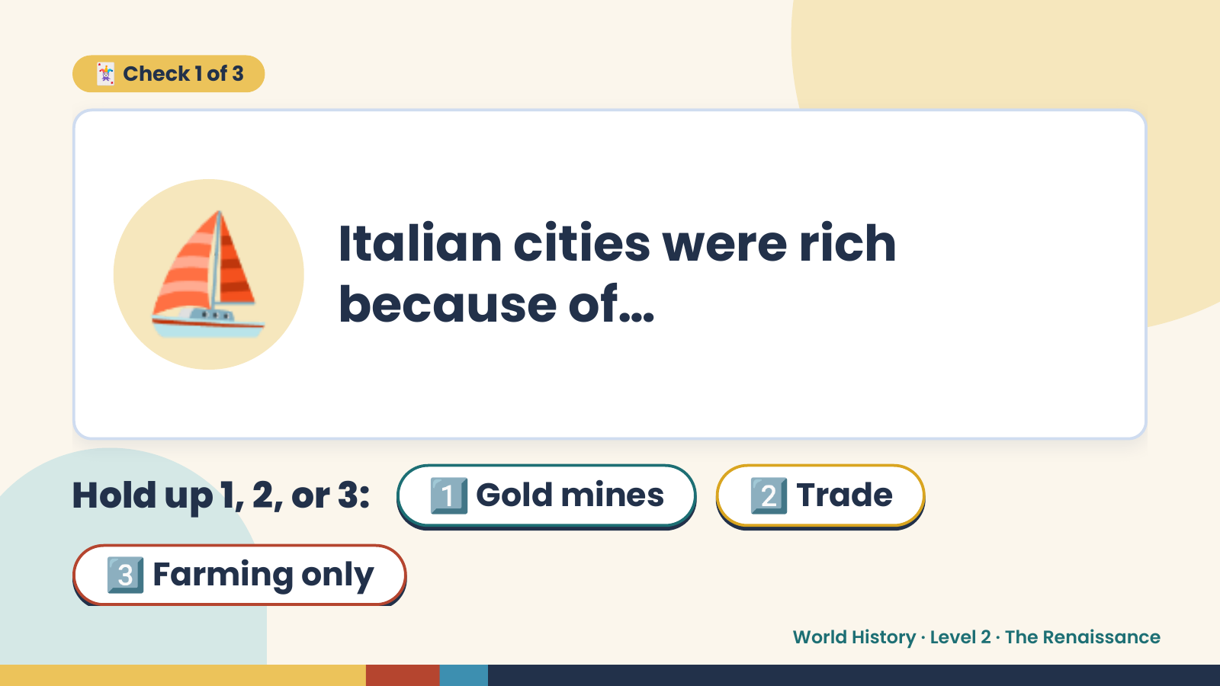
Notes:
🃏 Check 1 of 3
⛵ Italian cities were rich
because of…
Hold up 1, 2, or 3: 1️⃣ Gold mines 2️⃣ Trade
3️⃣ Farming only
World History · Level 2 · The Renaissance

Slide 8
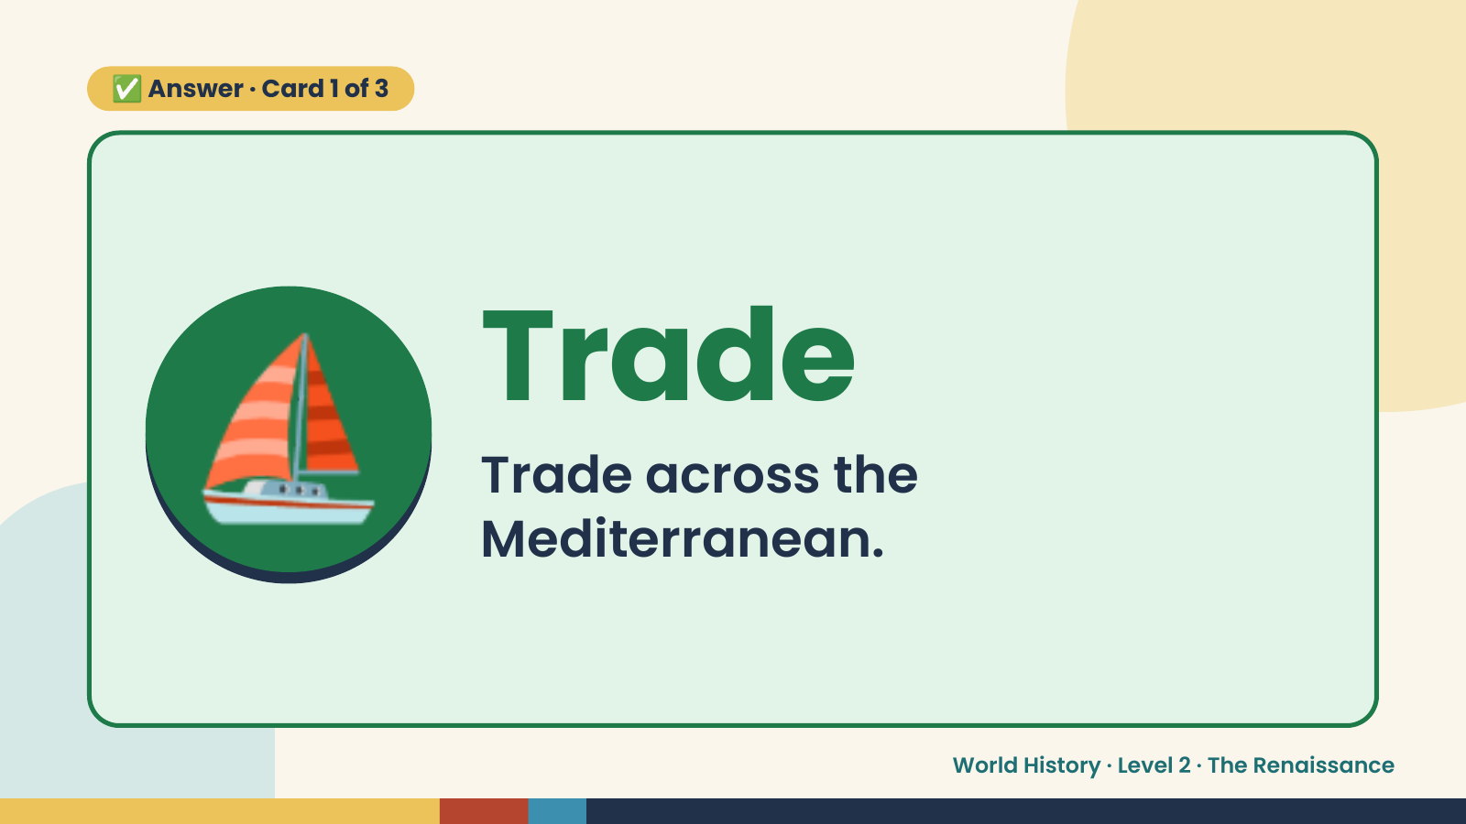
Notes:
✅ Answer · Card 1 of 3
⛵ Trade
Trade across the
Mediterranean.
World History · Level 2 · The Renaissance

Slide 9
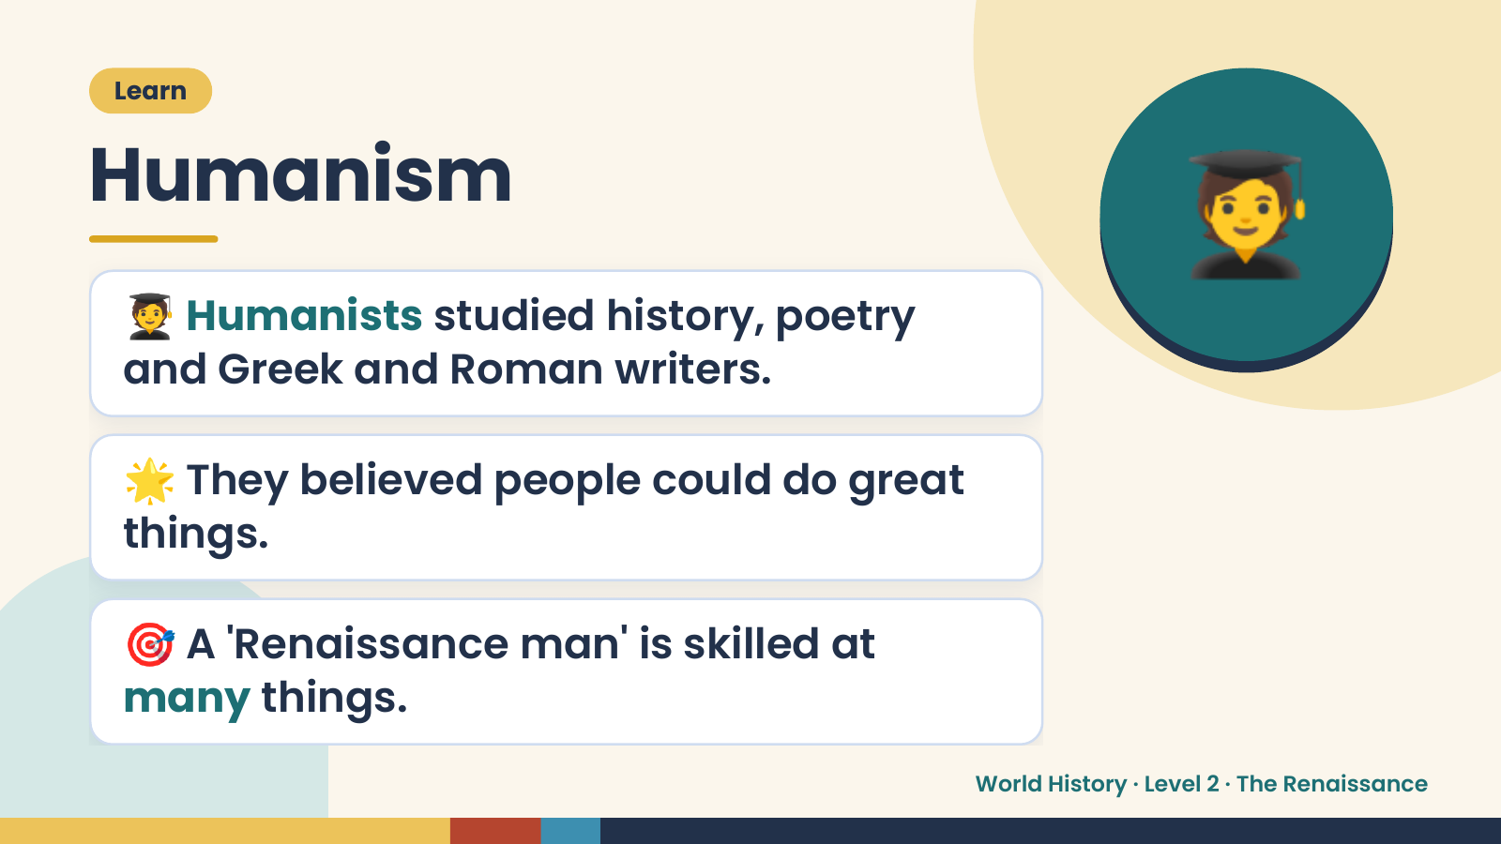
Notes:
🧑‍🎓
Learn
Humanism
🧑‍🎓 Humanists studied history, poetry
and Greek and Roman writers.
🌟 They believed people could do great
things.
🎯 A 'Renaissance man' is skilled at
many things.
World History · Level 2 · The Renaissance

Slide 10
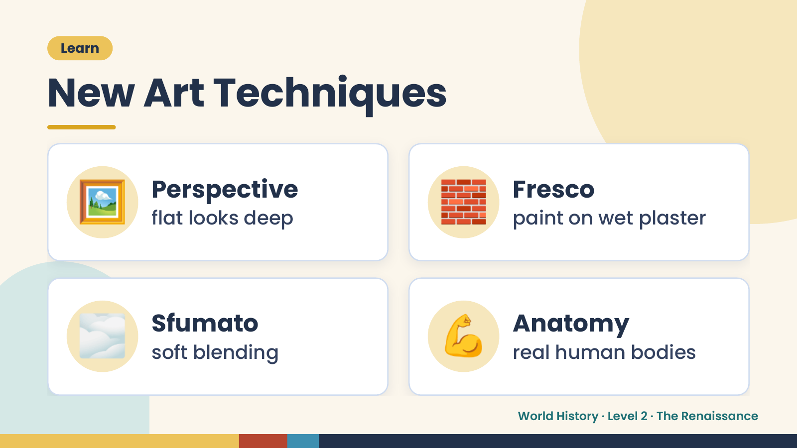
Notes:
Learn
New Art Techniques
🖼️ Perspective
flat looks deep 🧱 Fresco
paint on wet plaster
🌫️ Sfumato
soft blending 💪 Anatomy
real human bodies
World History · Level 2 · The Renaissance

Slide 11
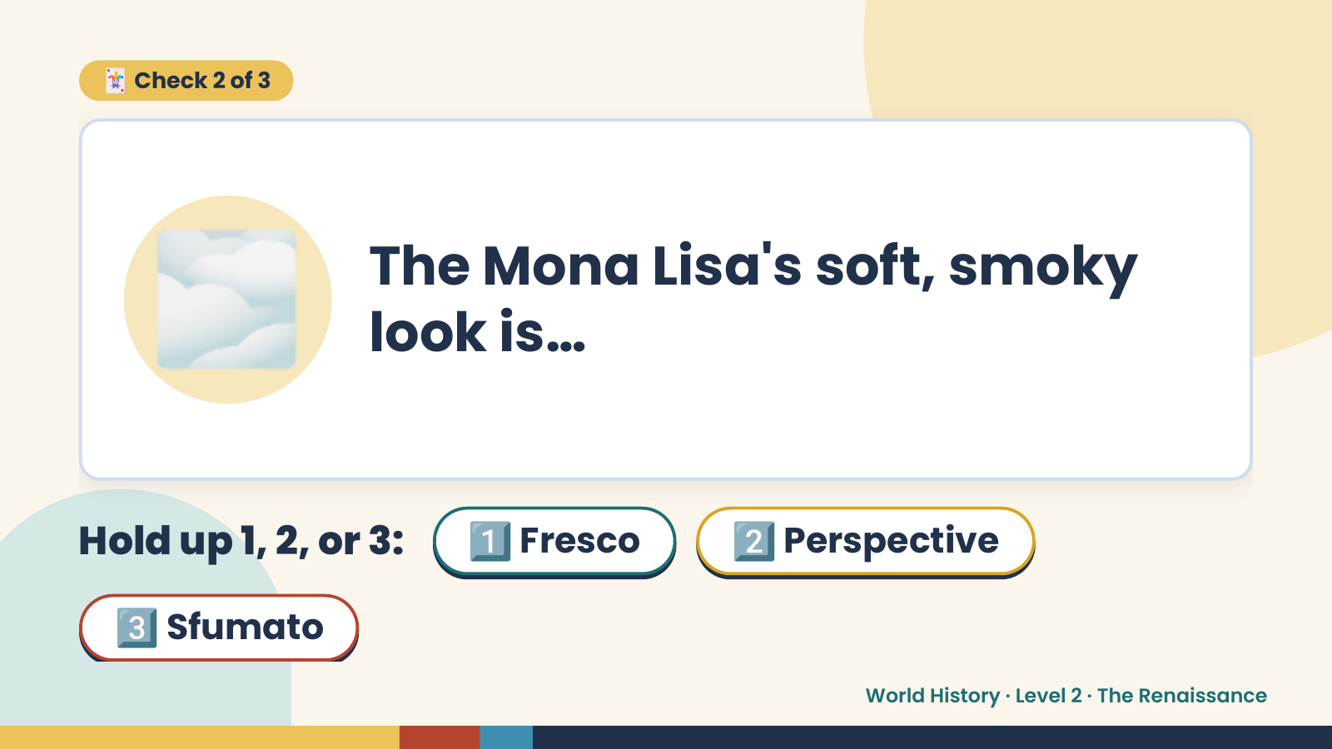
Notes:
🃏 Check 2 of 3
🌫️ The Mona Lisa's soft, smoky
look is…
Hold up 1, 2, or 3: 1️⃣ Fresco 2️⃣ Perspective
3️⃣ Sfumato
World History · Level 2 · The Renaissance

Slide 12
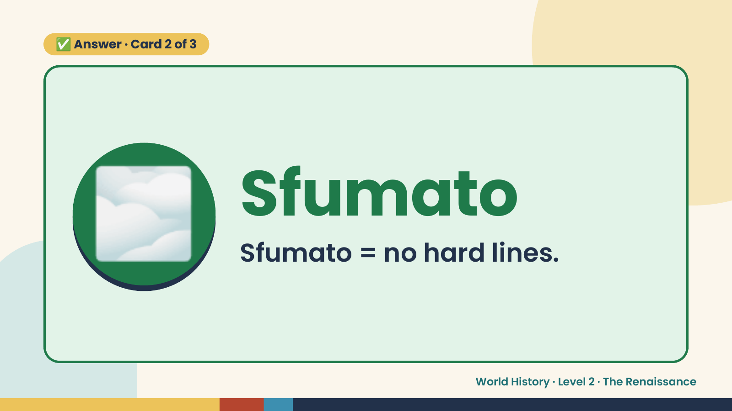
Notes:
✅ Answer · Card 2 of 3
🌫️ Sfumato
Sfumato = no hard lines.
World History · Level 2 · The Renaissance

Slide 13
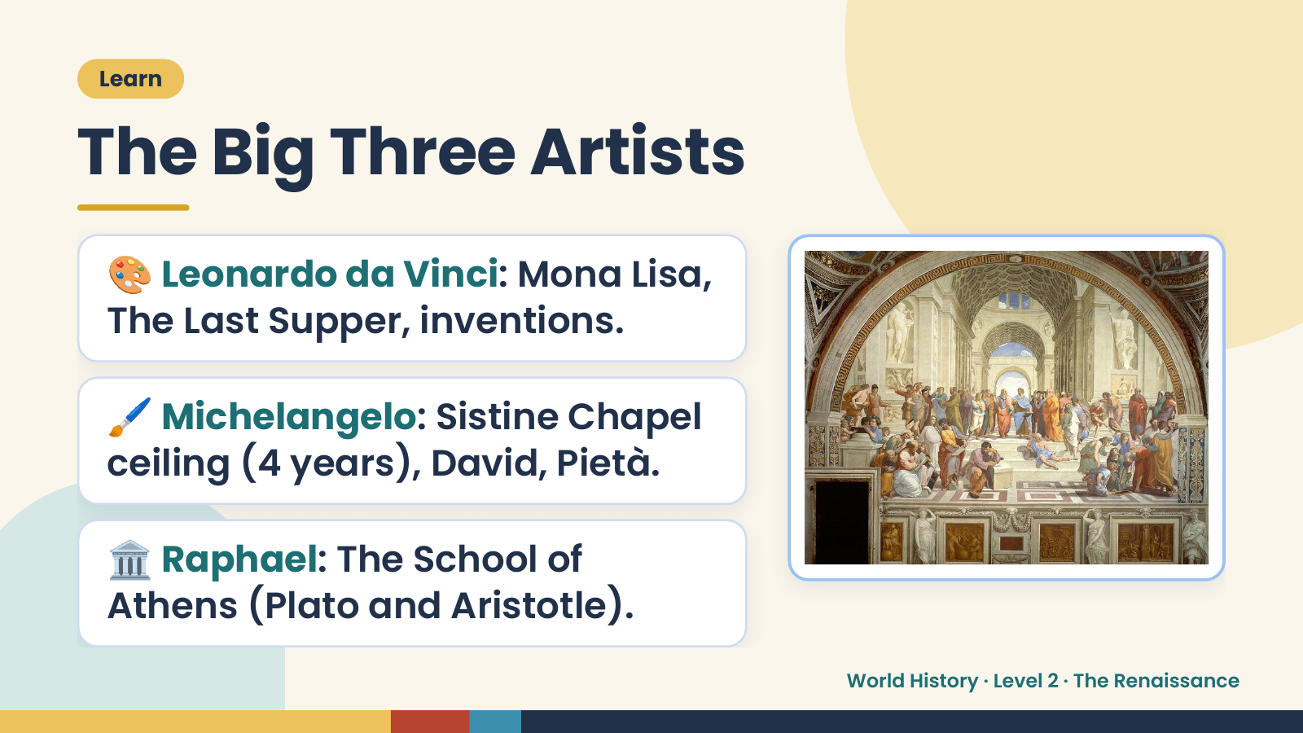
Notes:
Learn
The Big Three Artists
🎨 Leonardo da Vinci: Mona Lisa,
The Last Supper, inventions.
🖌️ Michelangelo: Sistine Chapel
ceiling (4 years), David, Pietà.
🏛️ Raphael: The School of
Athens (Plato and Aristotle).
World History · Level 2 · The Renaissance

Slide 14
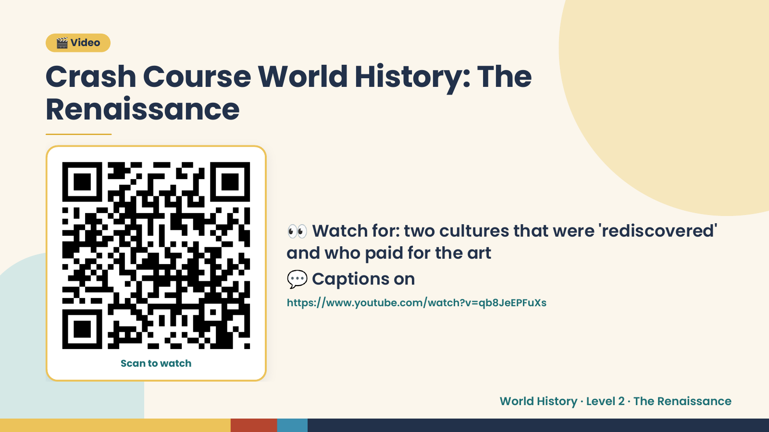
Notes:
🎬 Video
Crash Course World History: The
Renaissance
👀 Watch for: two cultures that were 'rediscovered'
and who paid for the art
💬 Captions on
https://www.youtube.com/watch?v=qb8JeEPFuXs
Scan to watch
World History · Level 2 · The Renaissance

Slide 15
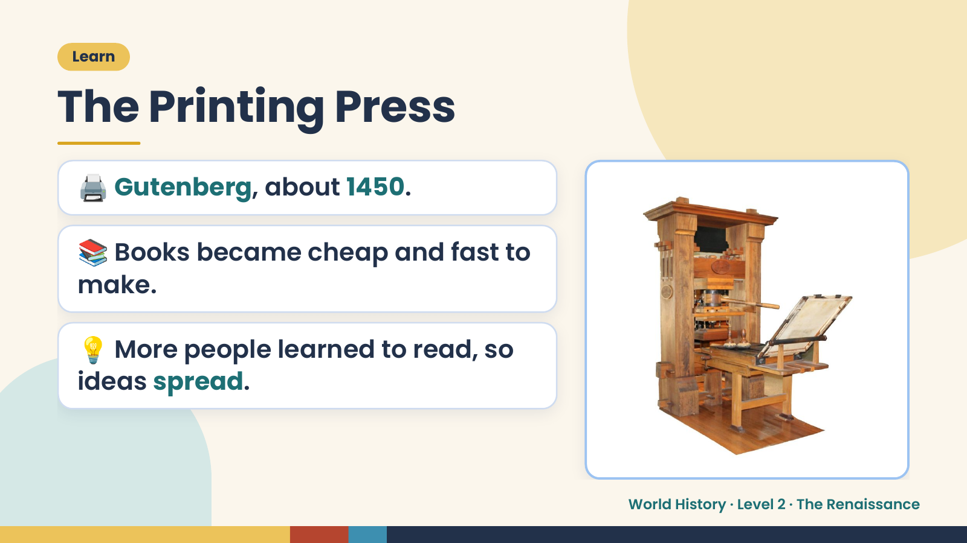
Notes:
Learn
The Printing Press
🖨️ Gutenberg, about 1450.
📚 Books became cheap and fast to
make.
💡 More people learned to read, so
ideas spread.
World History · Level 2 · The Renaissance

Slide 16
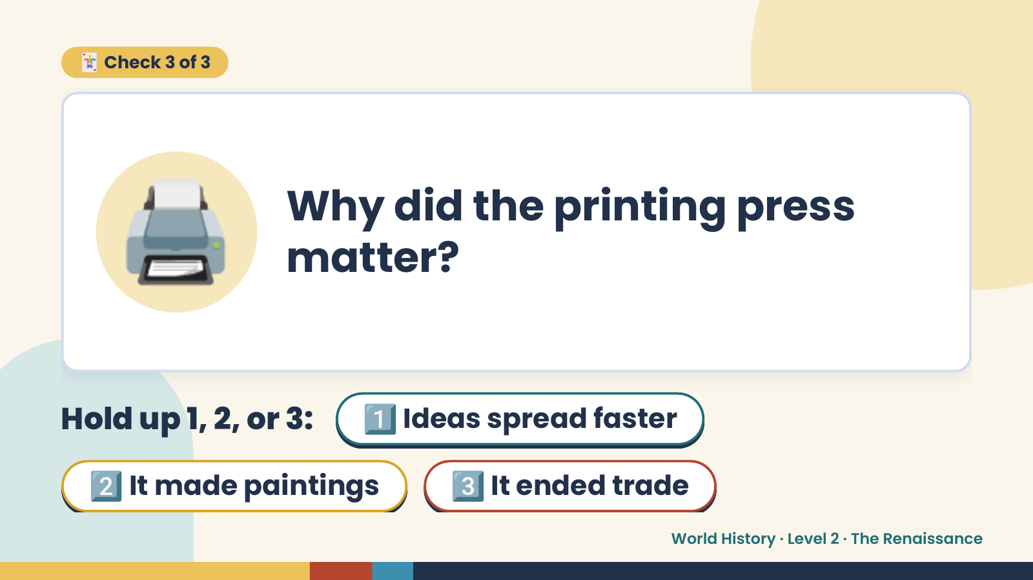
Notes:
🃏 Check 3 of 3
🖨️ Why did the printing press
matter?
Hold up 1, 2, or 3: 1️⃣ Ideas spread faster
2️⃣ It made paintings 3️⃣ It ended trade
World History · Level 2 · The Renaissance

Slide 17
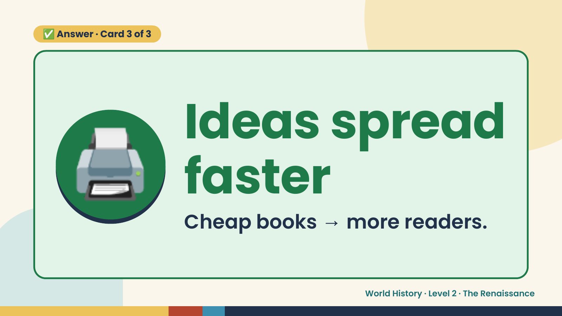
Notes:
✅ Answer · Card 3 of 3
🖨️ Ideas spread
faster
Cheap books → more readers.
World History · Level 2 · The Renaissance

Slide 18
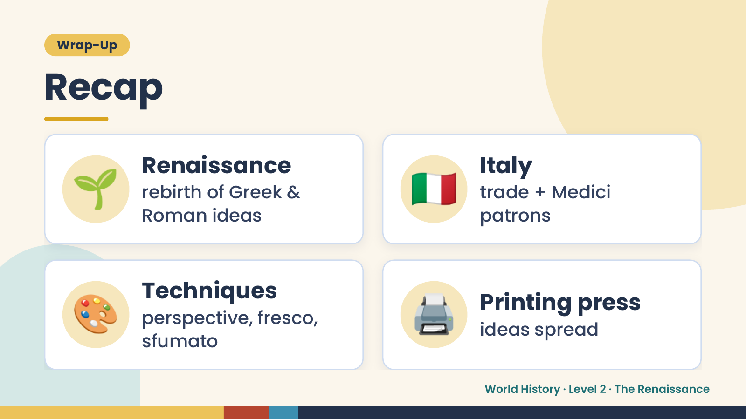
Notes:
Wrap-Up
Recap
🌱 Renaissance
rebirth of Greek &
Roman ideas
🇮🇹 Italy
trade + Medici
patrons
🎨 Techniques
perspective, fresco,
sfumato
🖨️ Printing press
ideas spread
World History · Level 2 · The Renaissance

Slide 19
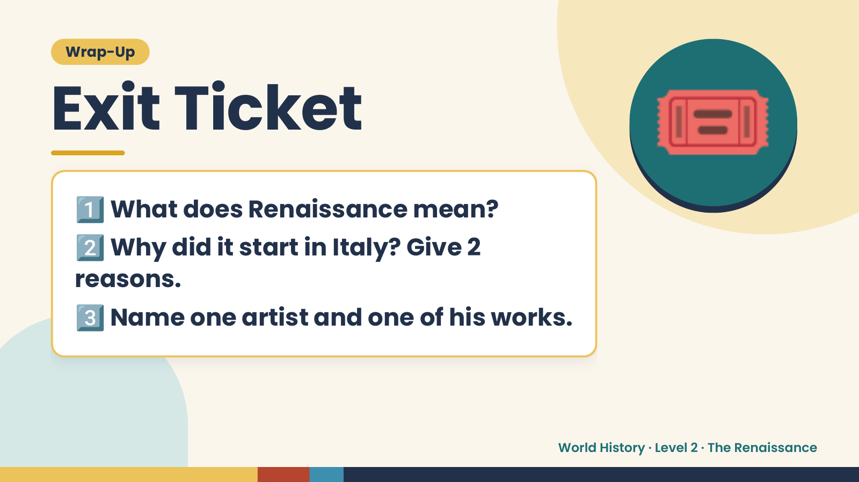
Notes:
Wrap-Up
Exit Ticket
1️⃣
2️⃣
What does Renaissance mean?
Why did it start in Italy? Give 2
🎟️
reasons.
3️⃣Name one artist and one of his works.
World History · Level 2 · The Renaissance

