Slide 1
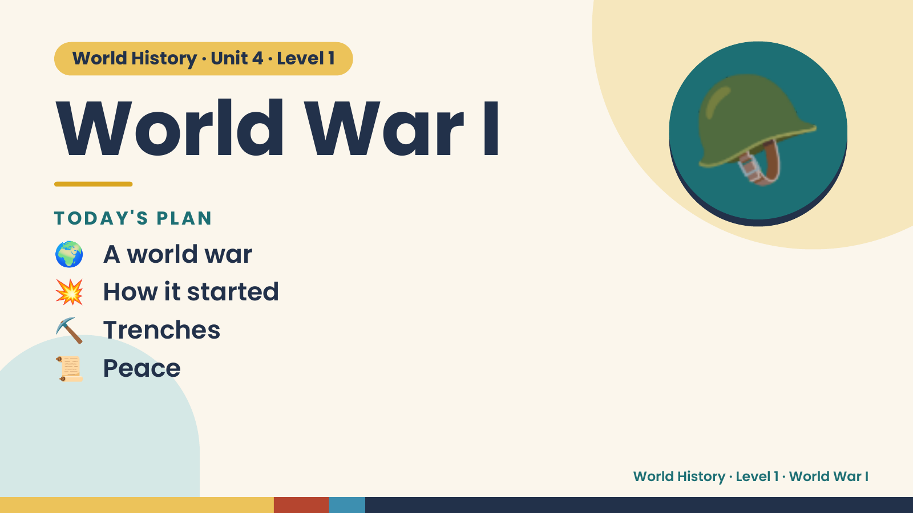
Notes:
World History · Unit 4 · Level 1
World War I
TODAY'S PLAN
🌍 A world war
🪖
💥 How it started
⛏️ Trenches
📜 Peace
World History · Level 1 · World War I

Slide 2
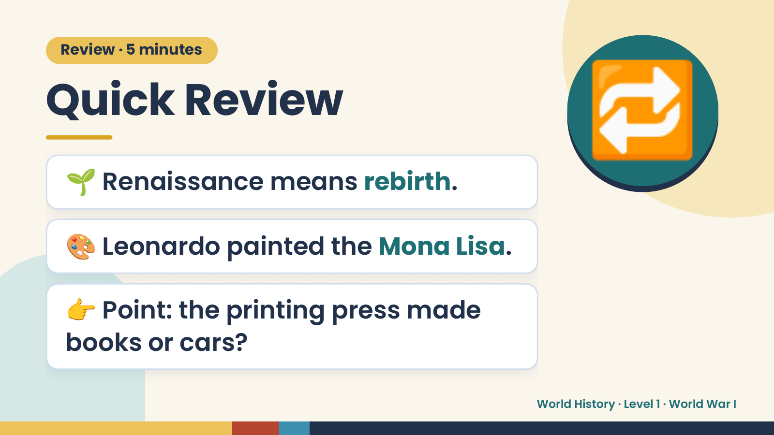
Notes:
Review · 5 minutes
Quick Review
🌱 Renaissance means rebirth.
🔁
🎨 Leonardo painted the Mona Lisa.
👉 Point: the printing press made
books or cars?
World History · Level 1 · World War I

Slide 3
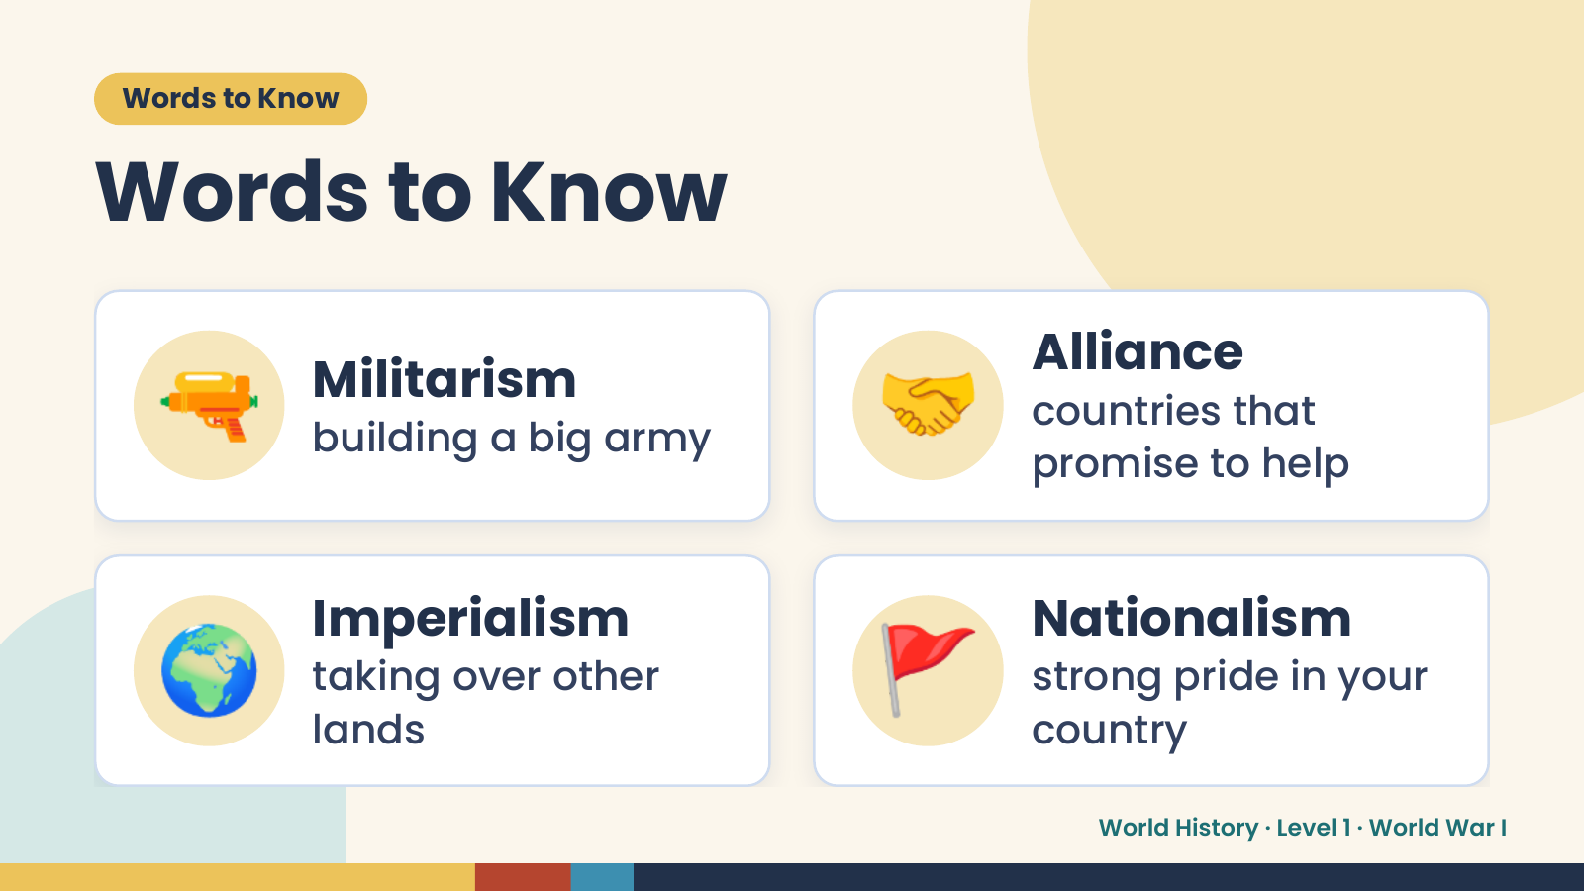
Notes:
Words to Know
Words to Know
🔫 Militarism
building a big army 🤝 Alliance
countries that
promise to help
🌍 Imperialism
taking over other
lands
🚩 Nationalism
strong pride in your
country
World History · Level 1 · World War I

Slide 4
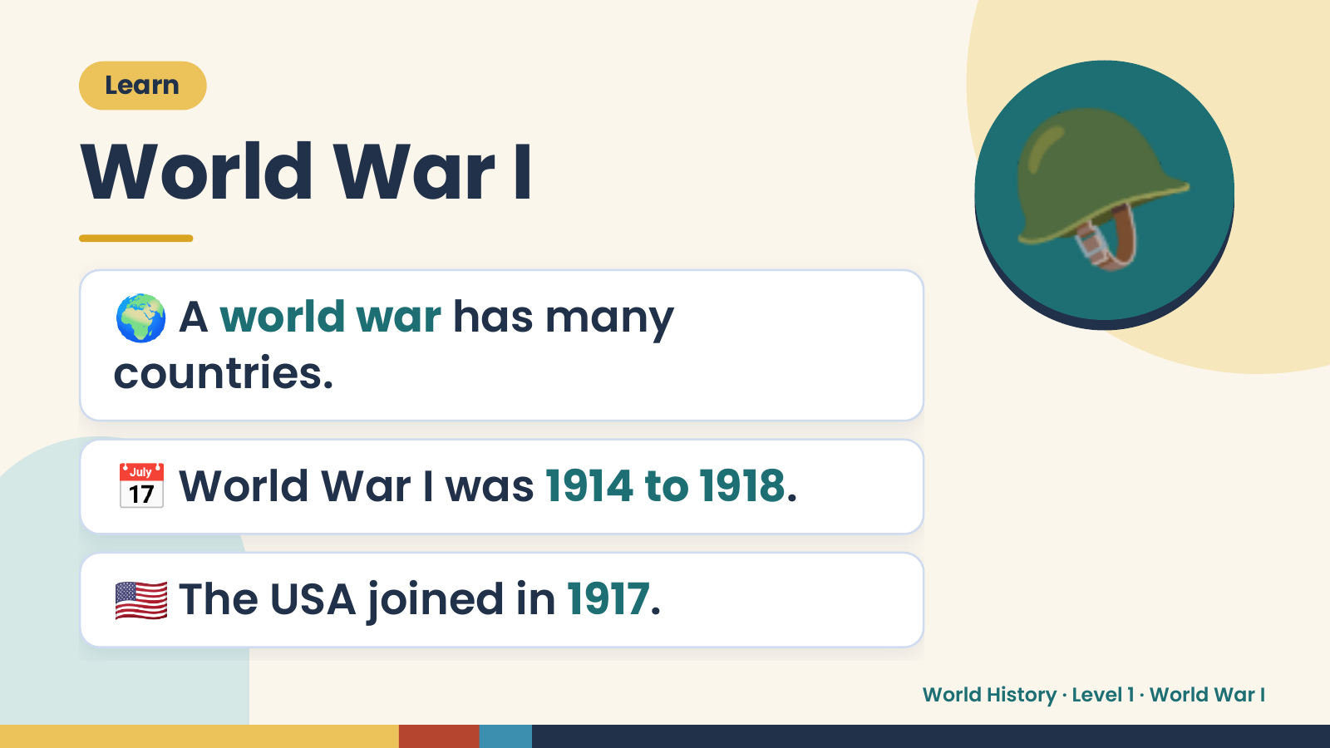
Notes:
Learn
World War I
🌍 A world war has many
countries.
🪖
📅 World War I was 1914 to 1918.
🇺🇸 The USA joined in 1917.
World History · Level 1 · World War I

Slide 5
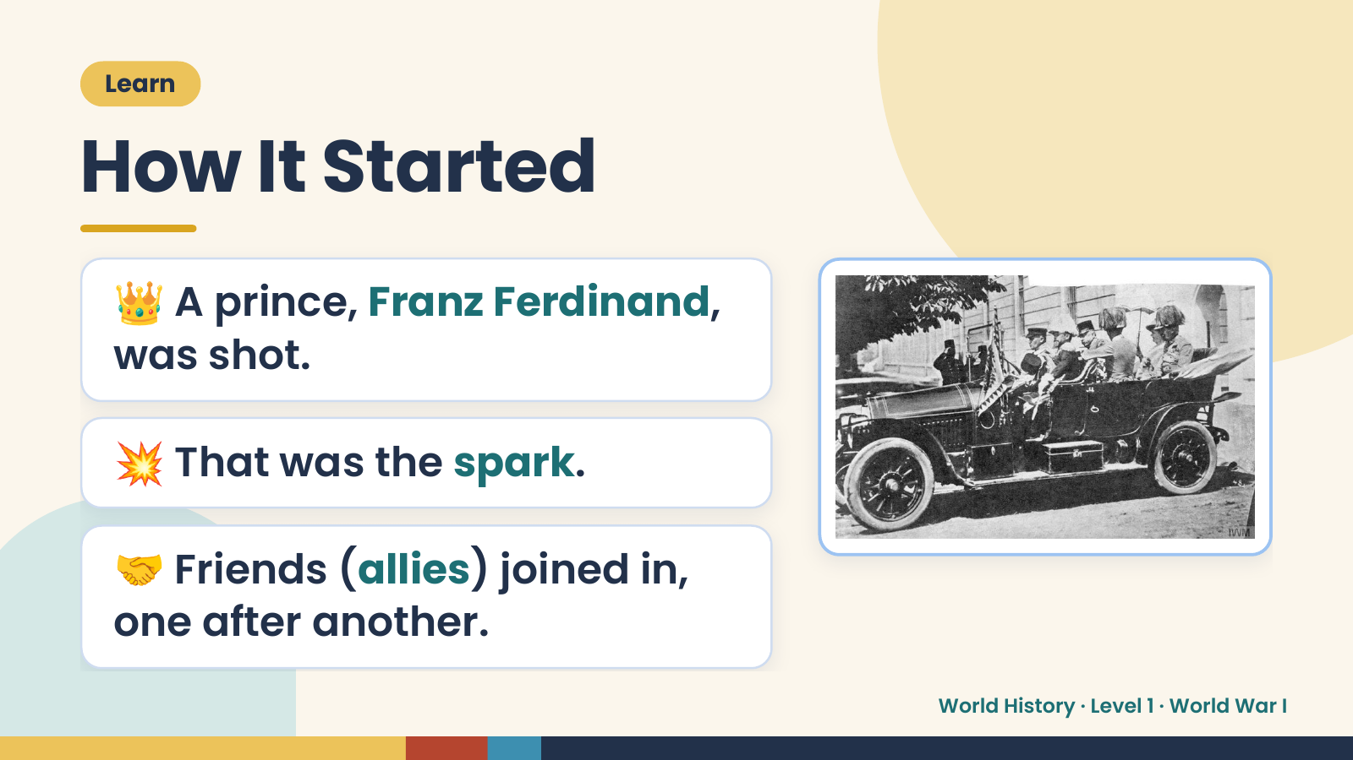
Notes:
Learn
How It Started
👑 A prince, Franz Ferdinand,
was shot.
💥 That was the spark.
🤝 Friends (allies) joined in,
one after another.
World History · Level 1 · World War I

Slide 6
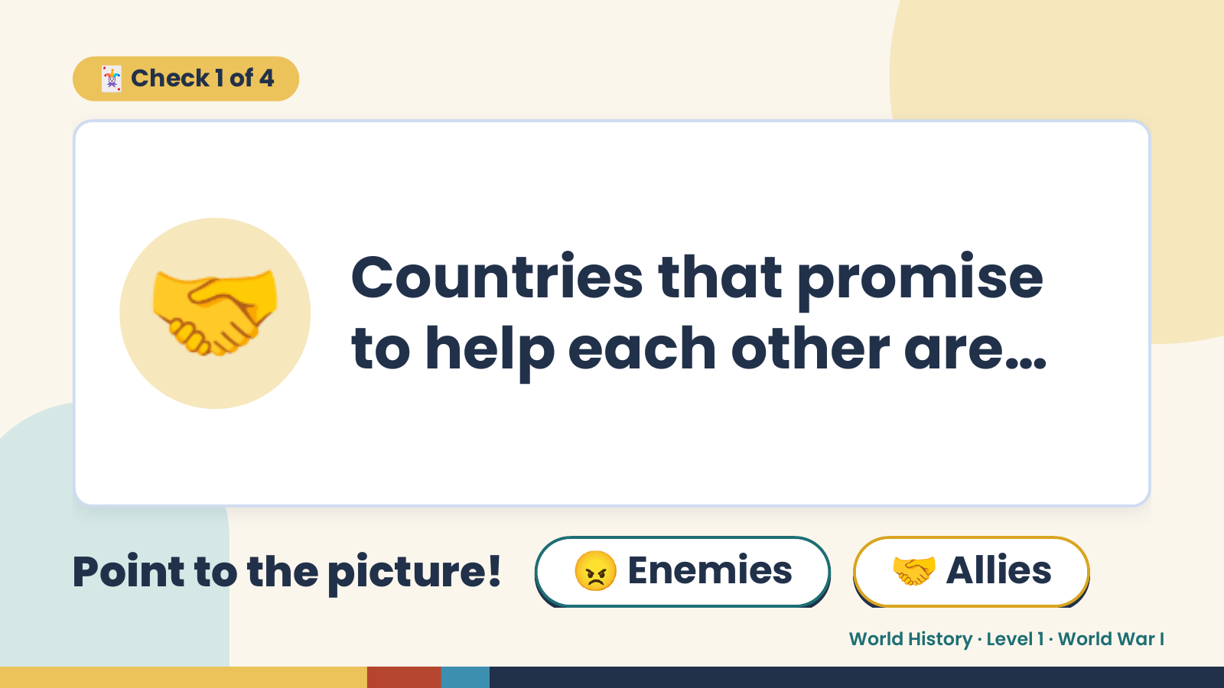
Notes:
🃏 Check 1 of 4
🤝 Countries that promise
to help each other are…
Point to the picture! 😠 Enemies 🤝 Allies
World History · Level 1 · World War I

Slide 7
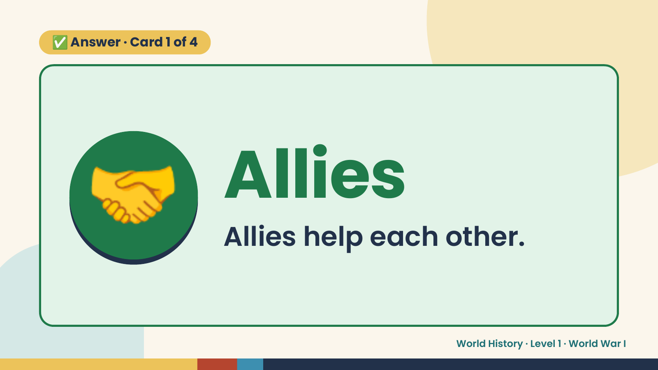
Notes:
✅ Answer · Card 1 of 4
🤝 Allies
Allies help each other.
World History · Level 1 · World War I

Slide 8
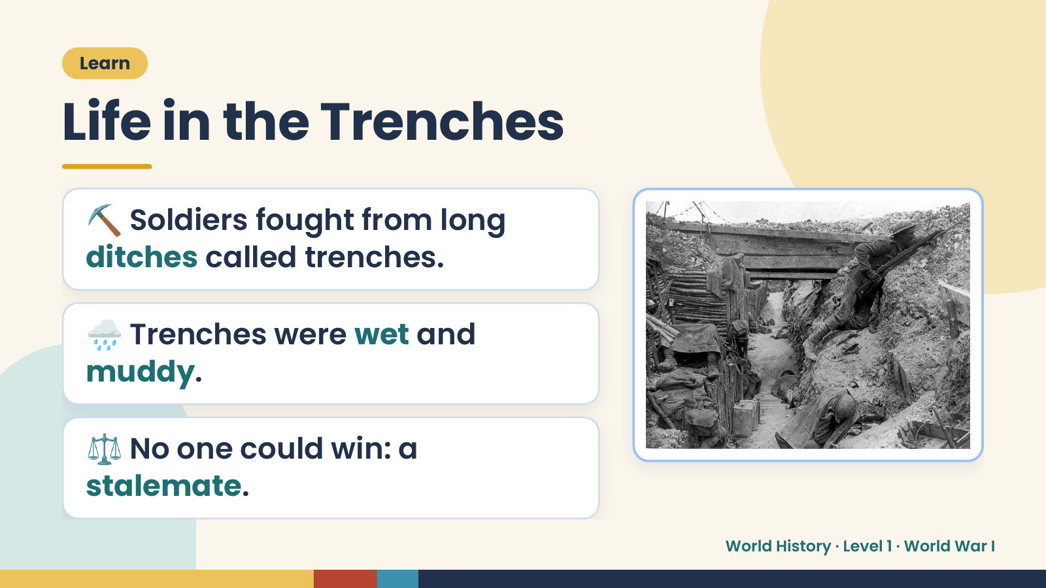
Notes:
Learn
Life in the Trenches
⛏️ Soldiers fought from long
ditches called trenches.
🌧️ Trenches were wet and
muddy.
⚖️ No one could win: a
stalemate.
World History · Level 1 · World War I

Slide 9
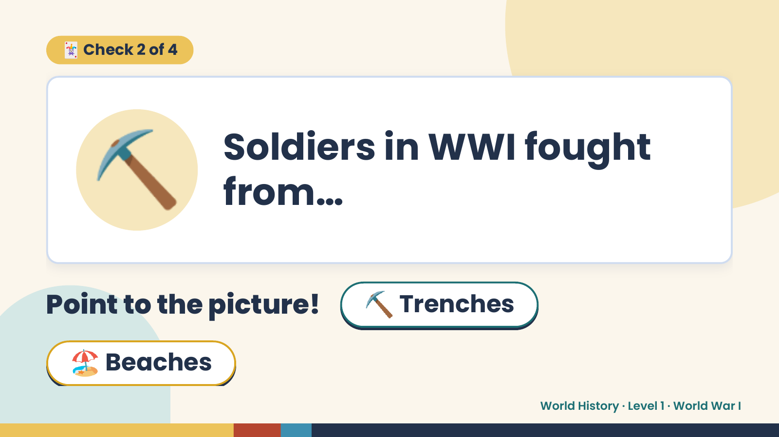
Notes:
🃏 Check 2 of 4
⛏️ Soldiers in WWI fought
from…
Point to the picture! ⛏️ Trenches
🏖️ Beaches
World History · Level 1 · World War I

Slide 10
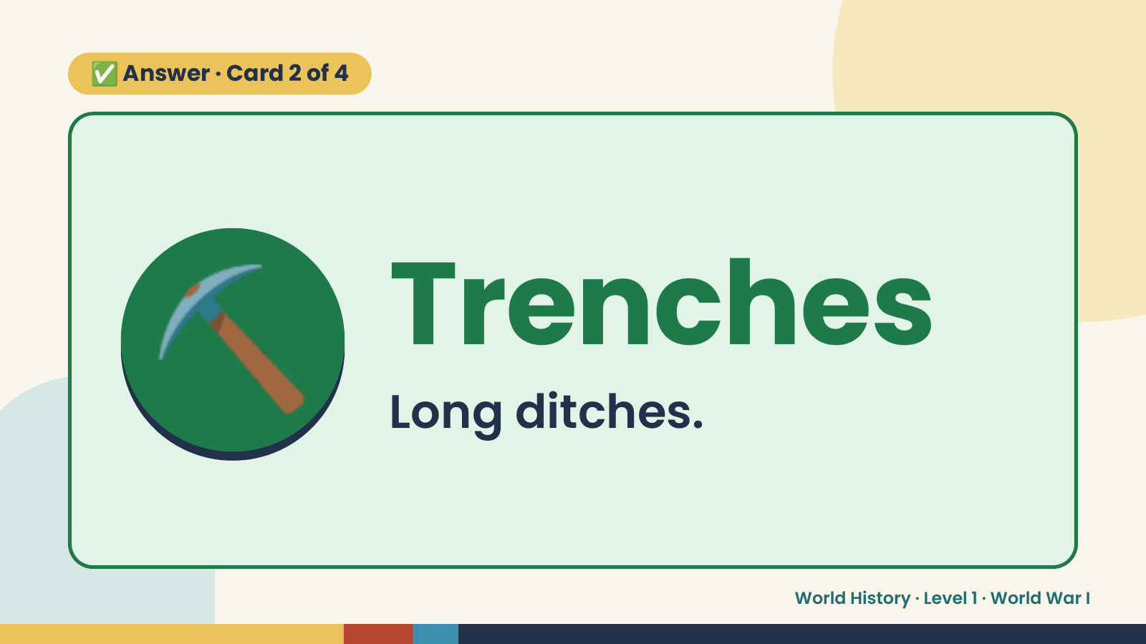
Notes:
✅ Answer · Card 2 of 4
⛏️ Trenches
Long ditches.
World History · Level 1 · World War I

Slide 11
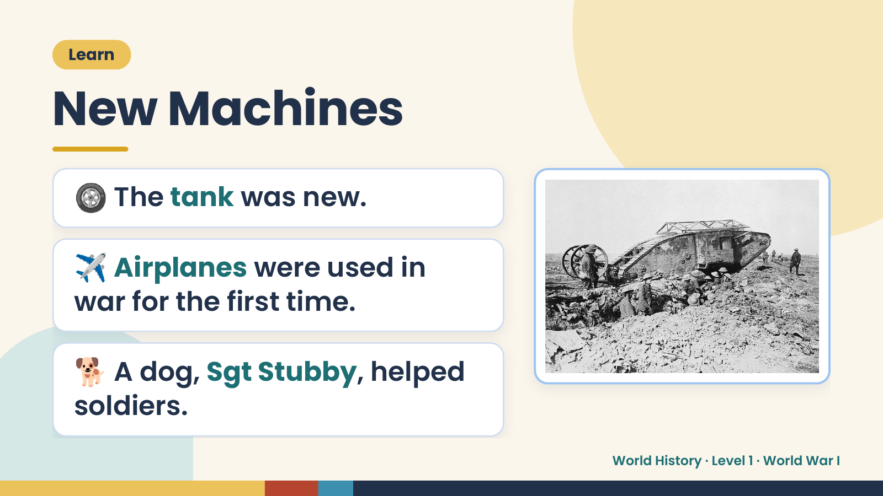
Notes:
Learn
New Machines
🛞 The tank was new.
✈️ Airplanes were used in
war for the first time.
🐕 A dog, Sgt Stubby, helped
soldiers.
World History · Level 1 · World War I

Slide 12
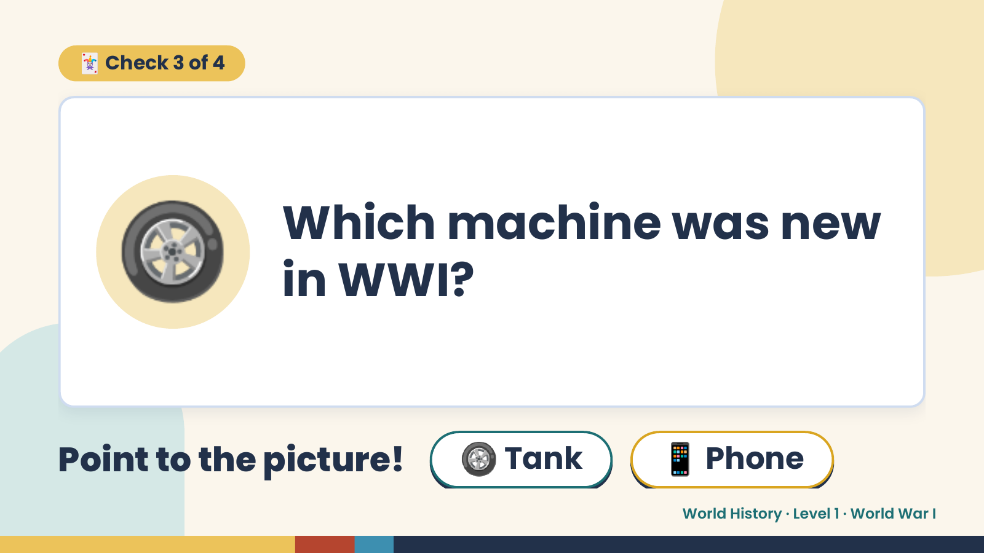
Notes:
🃏 Check 3 of 4
🛞 Which machine was new
in WWI?
Point to the picture! 🛞 Tank 📱 Phone
World History · Level 1 · World War I

Slide 13
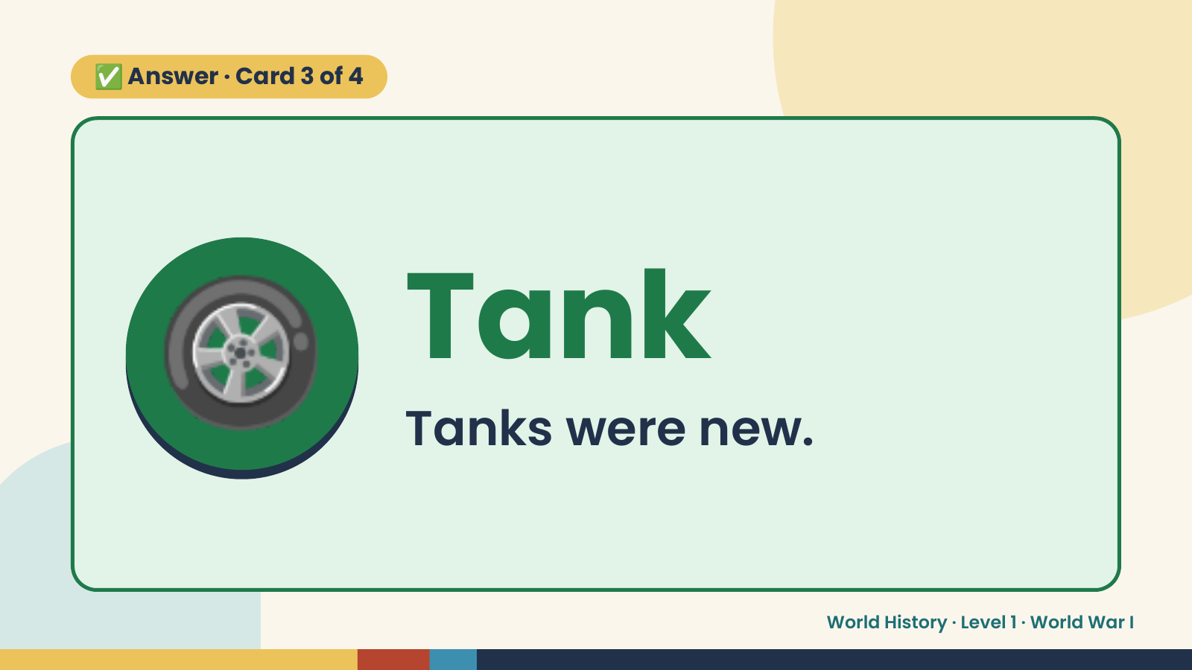
Notes:
✅ Answer · Card 3 of 4
🛞 Tank
Tanks were new.
World History · Level 1 · World War I

Slide 14
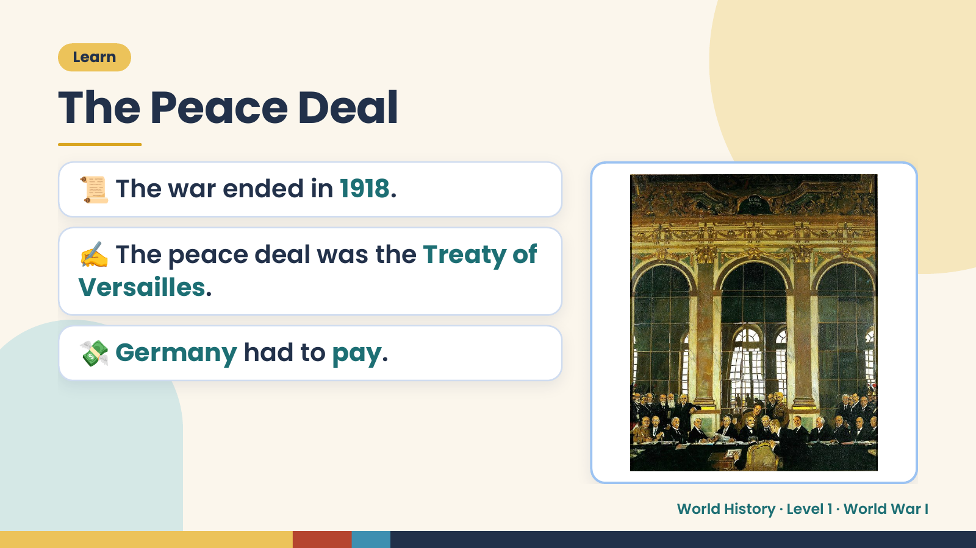
Notes:
Learn
The Peace Deal
📜 The war ended in 1918.
✍️ The peace deal was the Treaty of
Versailles.
💸 Germany had to pay.
World History · Level 1 · World War I

Slide 15
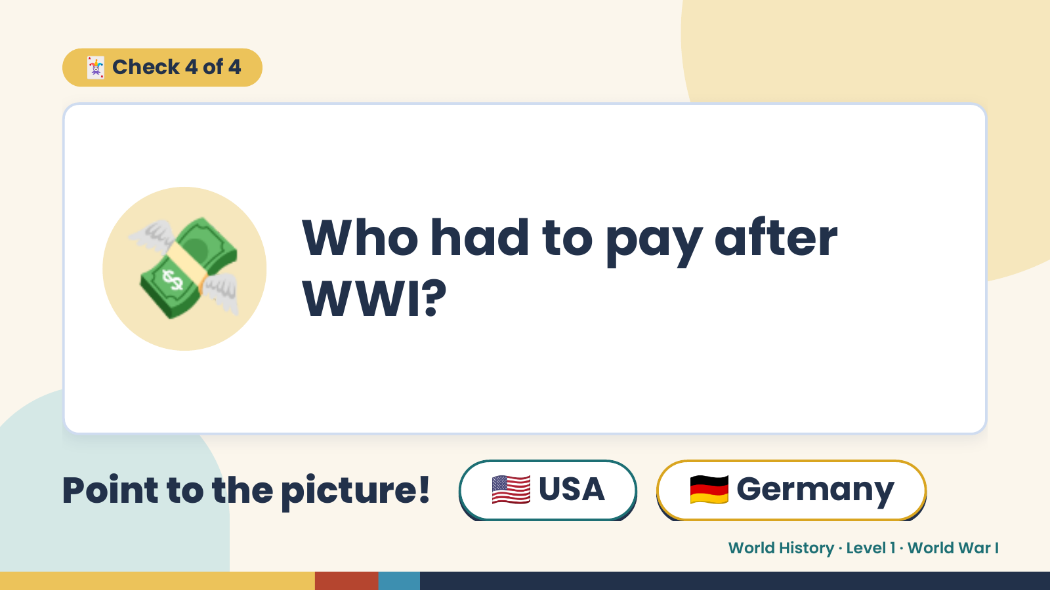
Notes:
🃏 Check 4 of 4
💸 Who had to pay after
WWI?
Point to the picture! 🇺🇸 USA 🇩🇪 Germany
World History · Level 1 · World War I

Slide 16
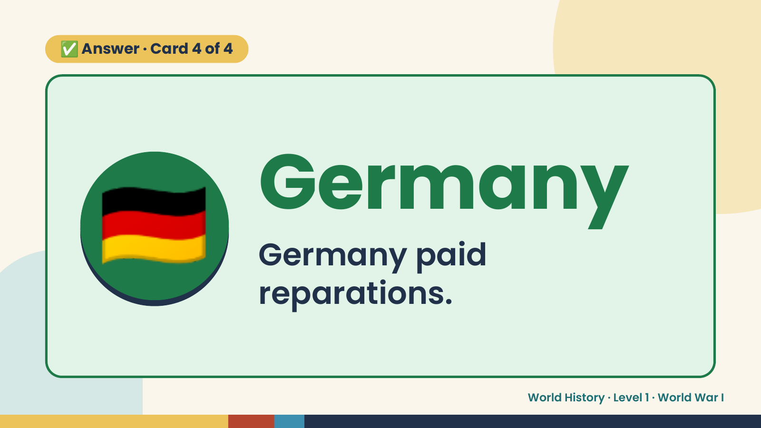
Notes:
✅ Answer · Card 4 of 4
🇩🇪 Germany
Germany paid
reparations.
World History · Level 1 · World War I

Slide 17
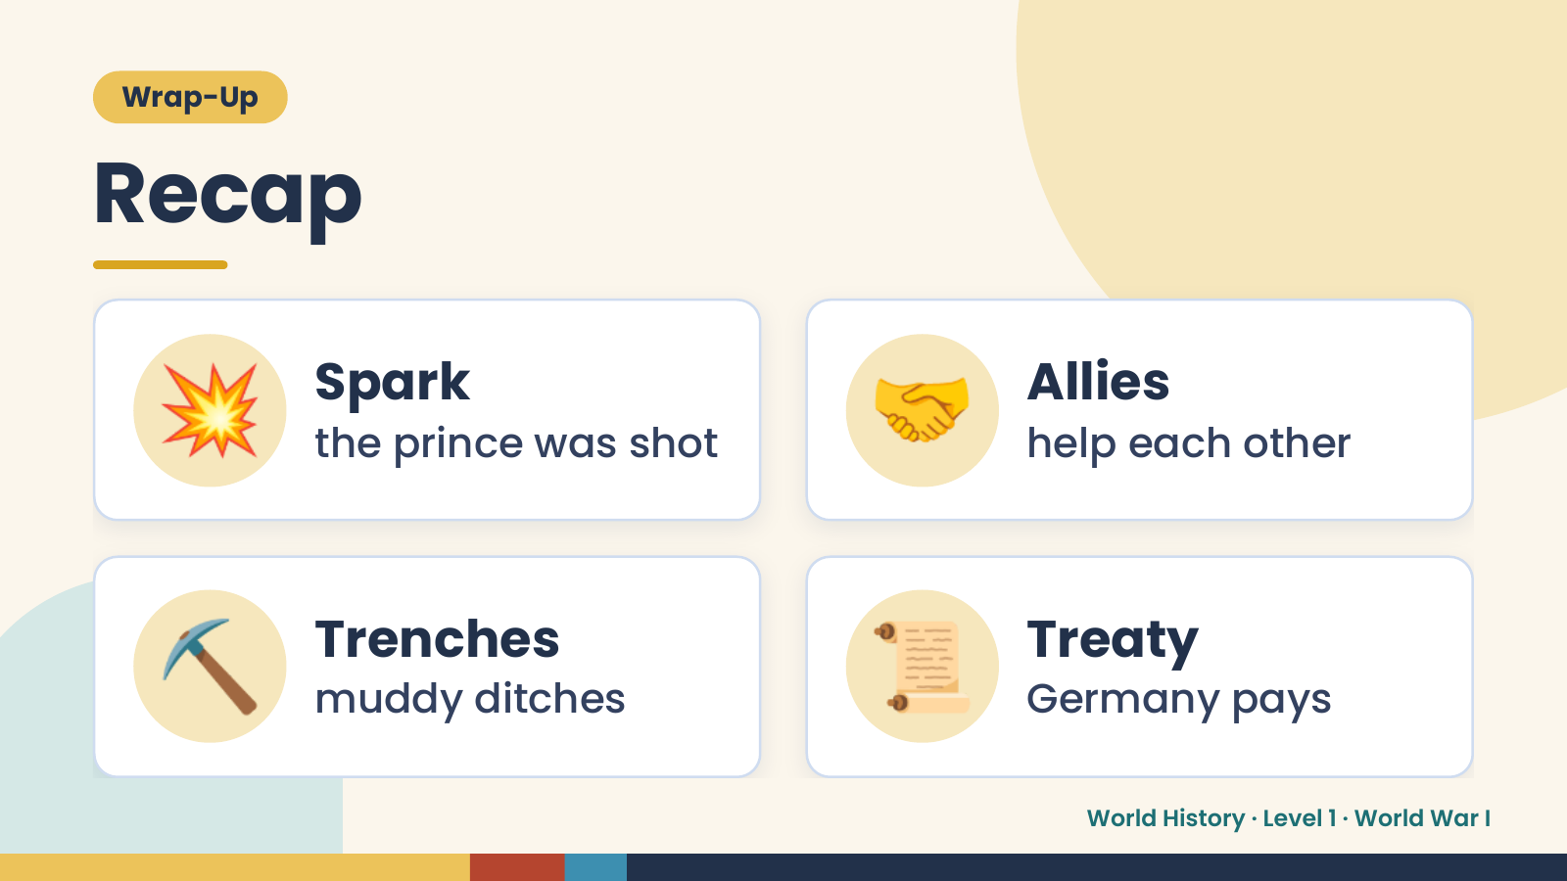
Notes:
Wrap-Up
Recap
💥 Spark
the prince was shot 🤝 Allies
help each other
⛏️ Trenches
muddy ditches 📜 Treaty
Germany pays
World History · Level 1 · World War I

Slide 18
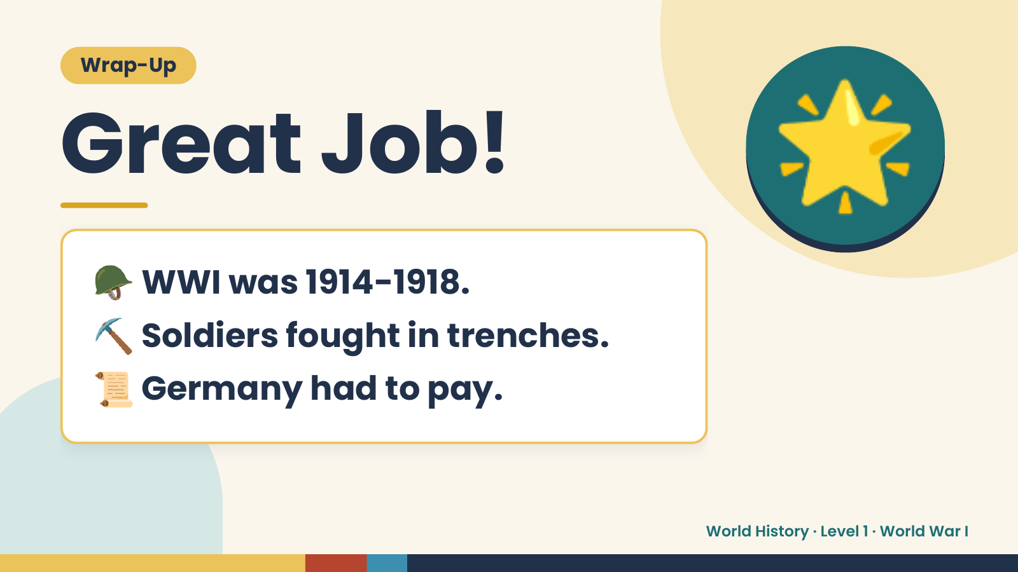
Notes:
Wrap-Up
Great Job!
🪖 WWI was 1914-1918.
🌟
⛏️ Soldiers fought in trenches.
📜 Germany had to pay.
World History · Level 1 · World War I

