Slide 1
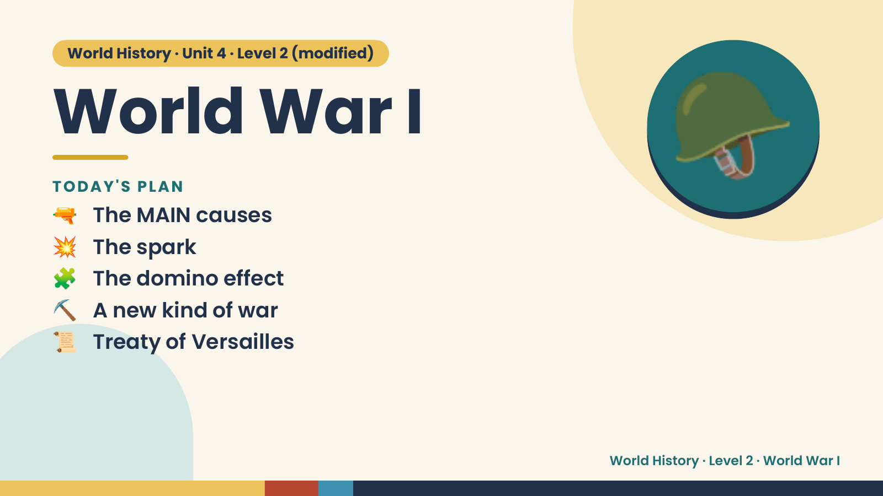
Notes:
World History · Unit 4 · Level 2 (modified)
World War I
🔫 The MAIN causes
TODAY'S PLAN
💥 The spark
🧩 The domino effect
🪖
⛏️ A new kind of war
📜 Treaty of Versailles
World History · Level 2 · World War I

Slide 2
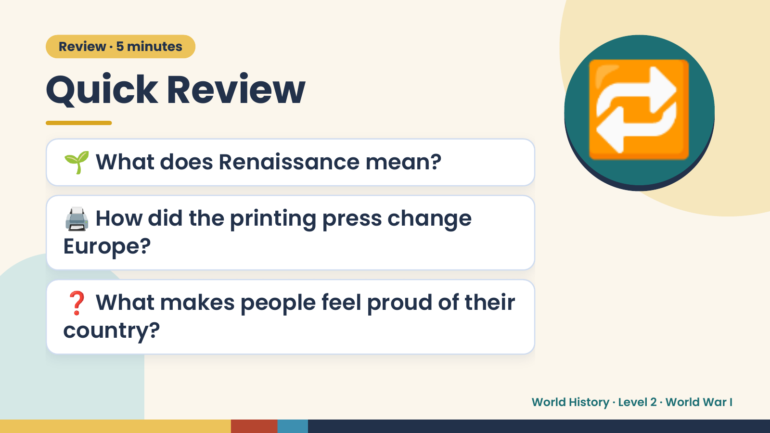
Notes:
Review · 5 minutes
Quick Review
🌱 What does Renaissance mean?
🖨️ How did the printing press change
🔁
Europe?
❓ What makes people feel proud of their
country?
World History · Level 2 · World War I

Slide 3
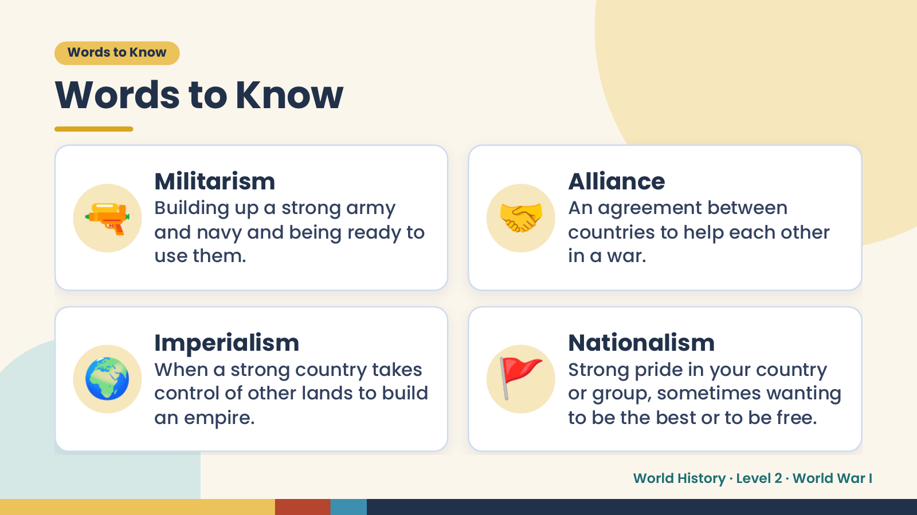
Notes:
Words to Know
Words to Know
🔫 Militarism
Building up a strong army
and navy and being ready to
use them.
🤝 Alliance
An agreement between
countries to help each other
in a war.
🌍 Imperialism
When a strong country takes
control of other lands to build
an empire.
🚩 Nationalism
Strong pride in your country
or group, sometimes wanting
to be the best or to be free.
World History · Level 2 · World War I

Slide 4
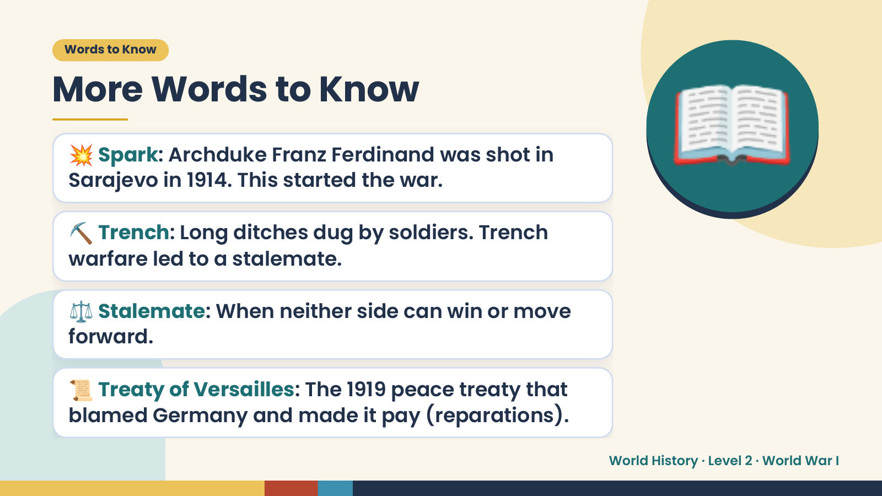
Notes:
Words to Know
More Words to Know
💥 Spark: Archduke Franz Ferdinand was shot in
Sarajevo in 1914. This started the war.
⛏️ Trench: Long ditches dug by soldiers. Trench
warfare led to a stalemate.
📖
⚖️ Stalemate: When neither side can win or move
forward.
📜 Treaty of Versailles: The 1919 peace treaty that
blamed Germany and made it pay (reparations).
World History · Level 2 · World War I

Slide 5
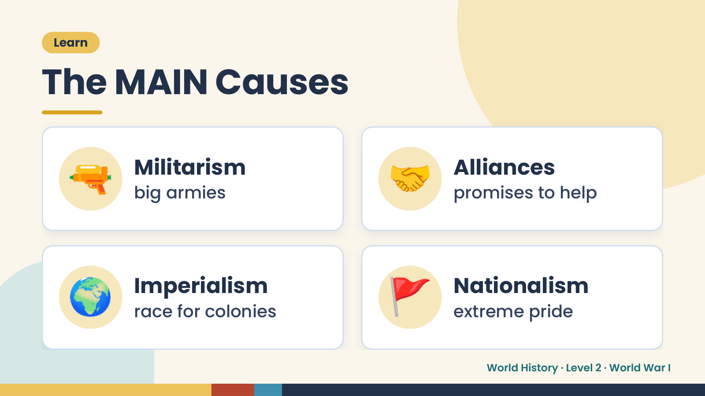
Notes:
Learn
The MAIN Causes
🔫 Militarism
big armies 🤝 Alliances
promises to help
🌍 Imperialism
race for colonies 🚩 Nationalism
extreme pride
World History · Level 2 · World War I

Slide 6
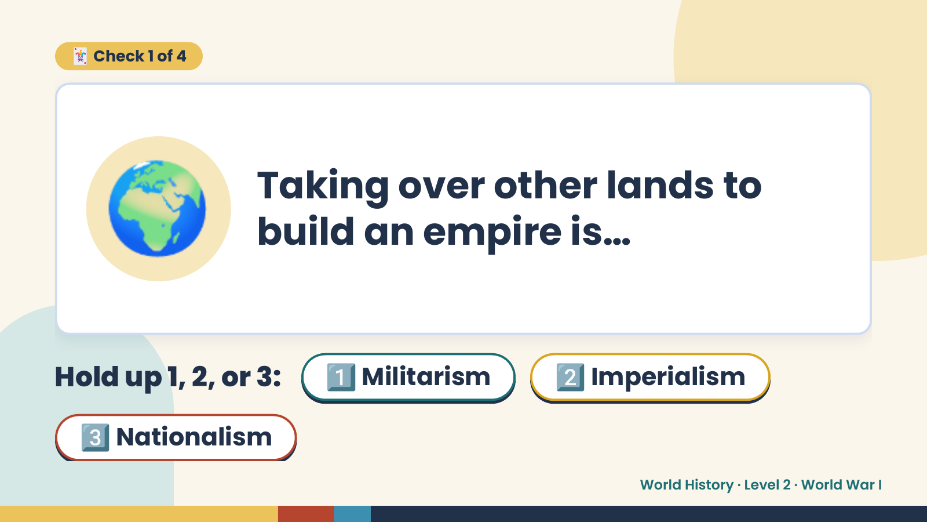
Notes:
🃏 Check 1 of 4
🌍 Taking over other lands to
build an empire is…
Hold up 1, 2, or 3: 1️⃣ Militarism 2️⃣ Imperialism
3️⃣ Nationalism
World History · Level 2 · World War I

Slide 7
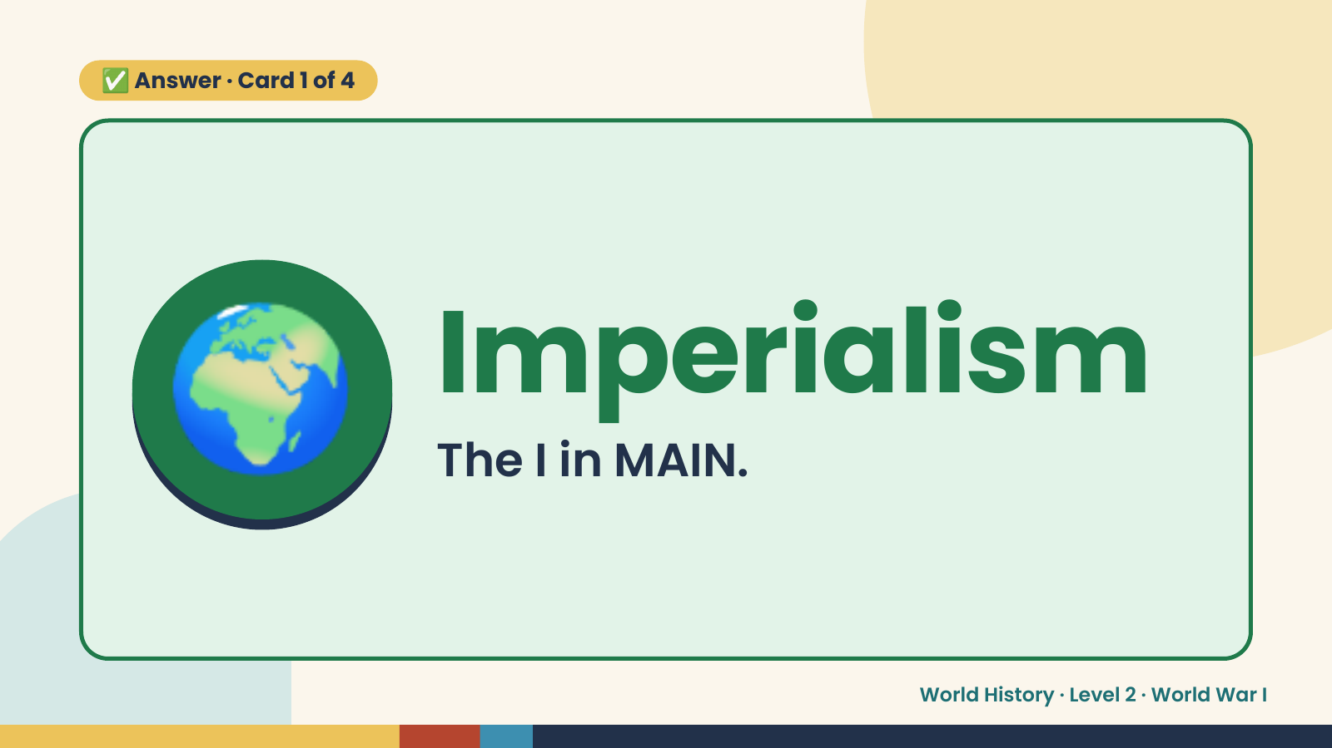
Notes:
✅ Answer · Card 1 of 4
🌍 Imperialism
The I in MAIN.
World History · Level 2 · World War I

Slide 8
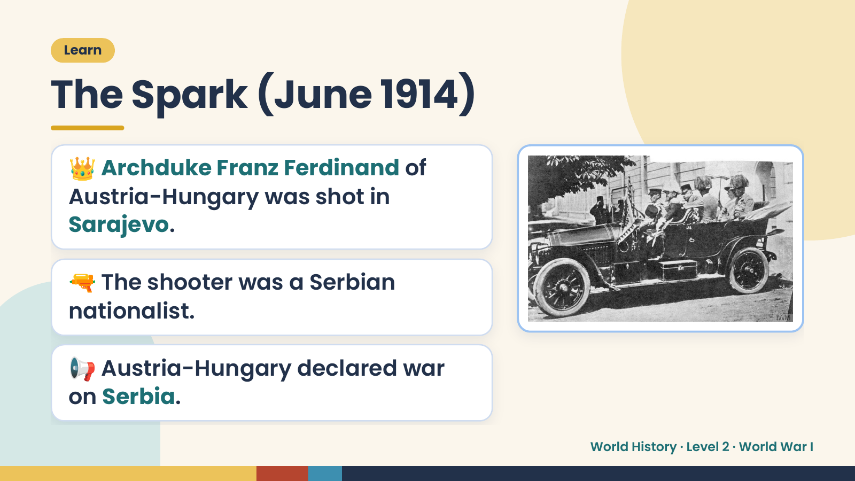
Notes:
Learn
The Spark (June 1914)
👑 Archduke Franz Ferdinand of
Austria-Hungary was shot in
Sarajevo.
🔫 The shooter was a Serbian
nationalist.
📢 Austria-Hungary declared war
on Serbia.
World History · Level 2 · World War I

Slide 9
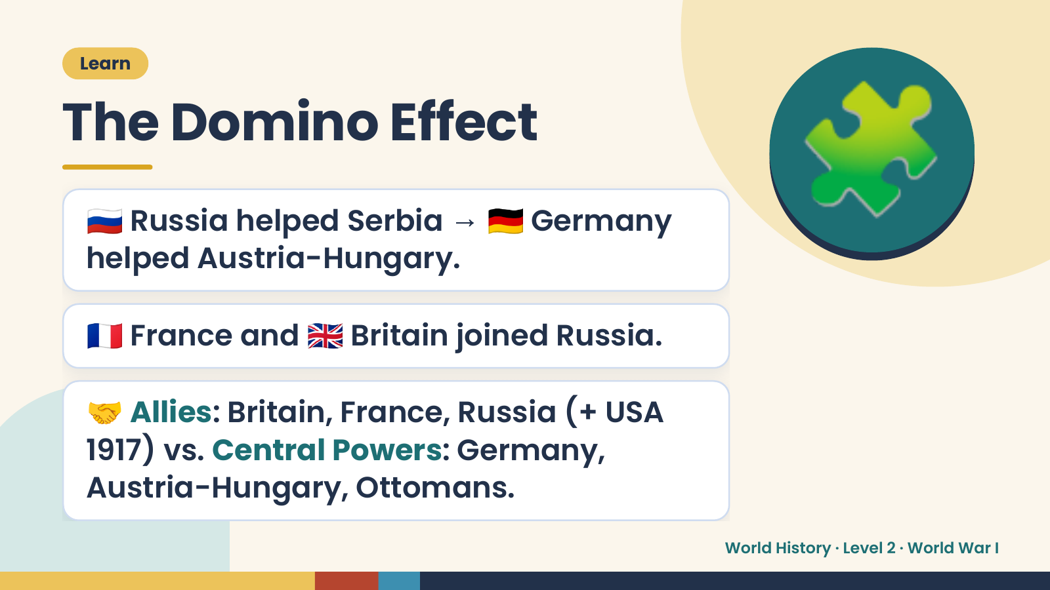
Notes:
Learn
The Domino Effect
🇷🇺 Russia helped Serbia → 🇩🇪 Germany
helped Austria-Hungary.
🧩
🇫🇷 France and 🇬🇧 Britain joined Russia.
🤝 Allies: Britain, France, Russia (+ USA
1917) vs. Central Powers: Germany,
Austria-Hungary, Ottomans.
World History · Level 2 · World War I

Slide 10
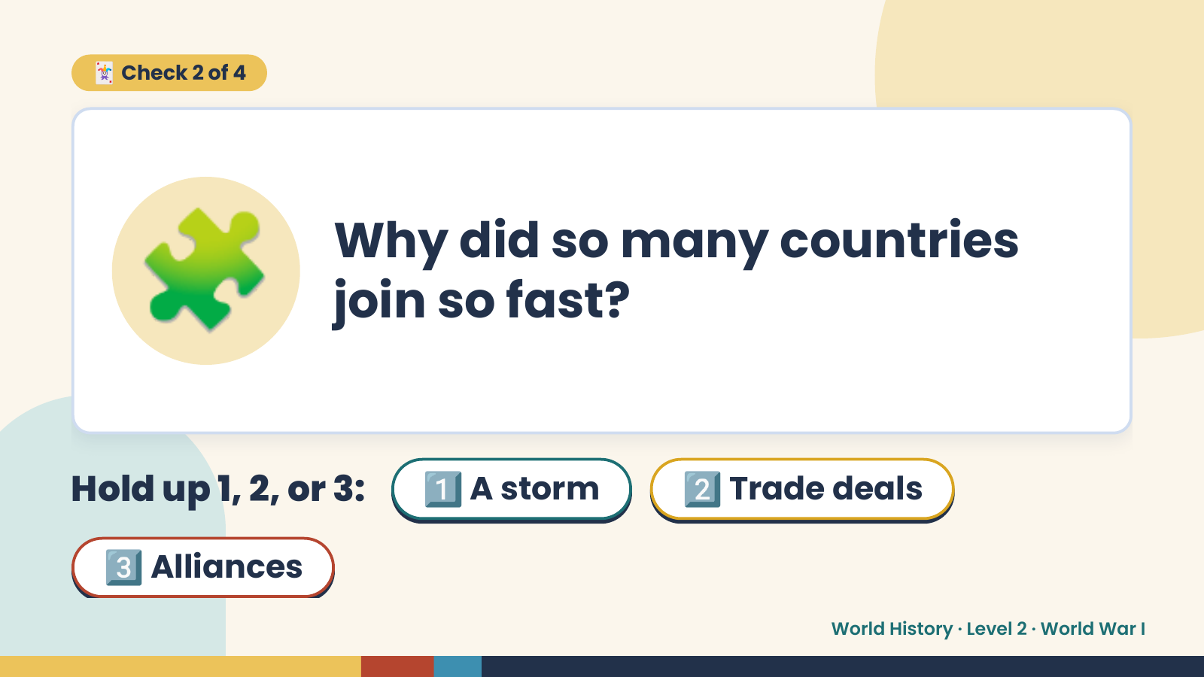
Notes:
🃏 Check 2 of 4
🧩 Why did so many countries
join so fast?
Hold up 1, 2, or 3: 1️⃣ A storm 2️⃣ Trade deals
3️⃣ Alliances
World History · Level 2 · World War I

Slide 11
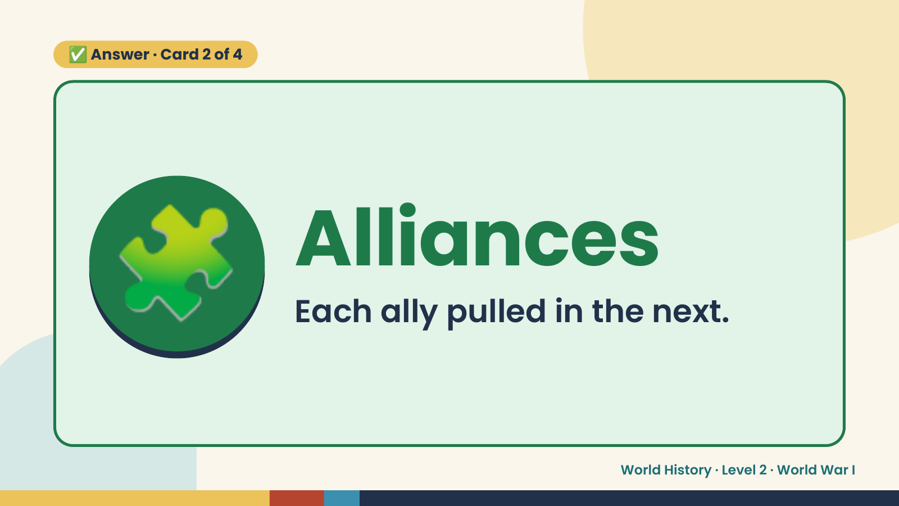
Notes:
✅ Answer · Card 2 of 4
🧩 Alliances
Each ally pulled in the next.
World History · Level 2 · World War I

Slide 12
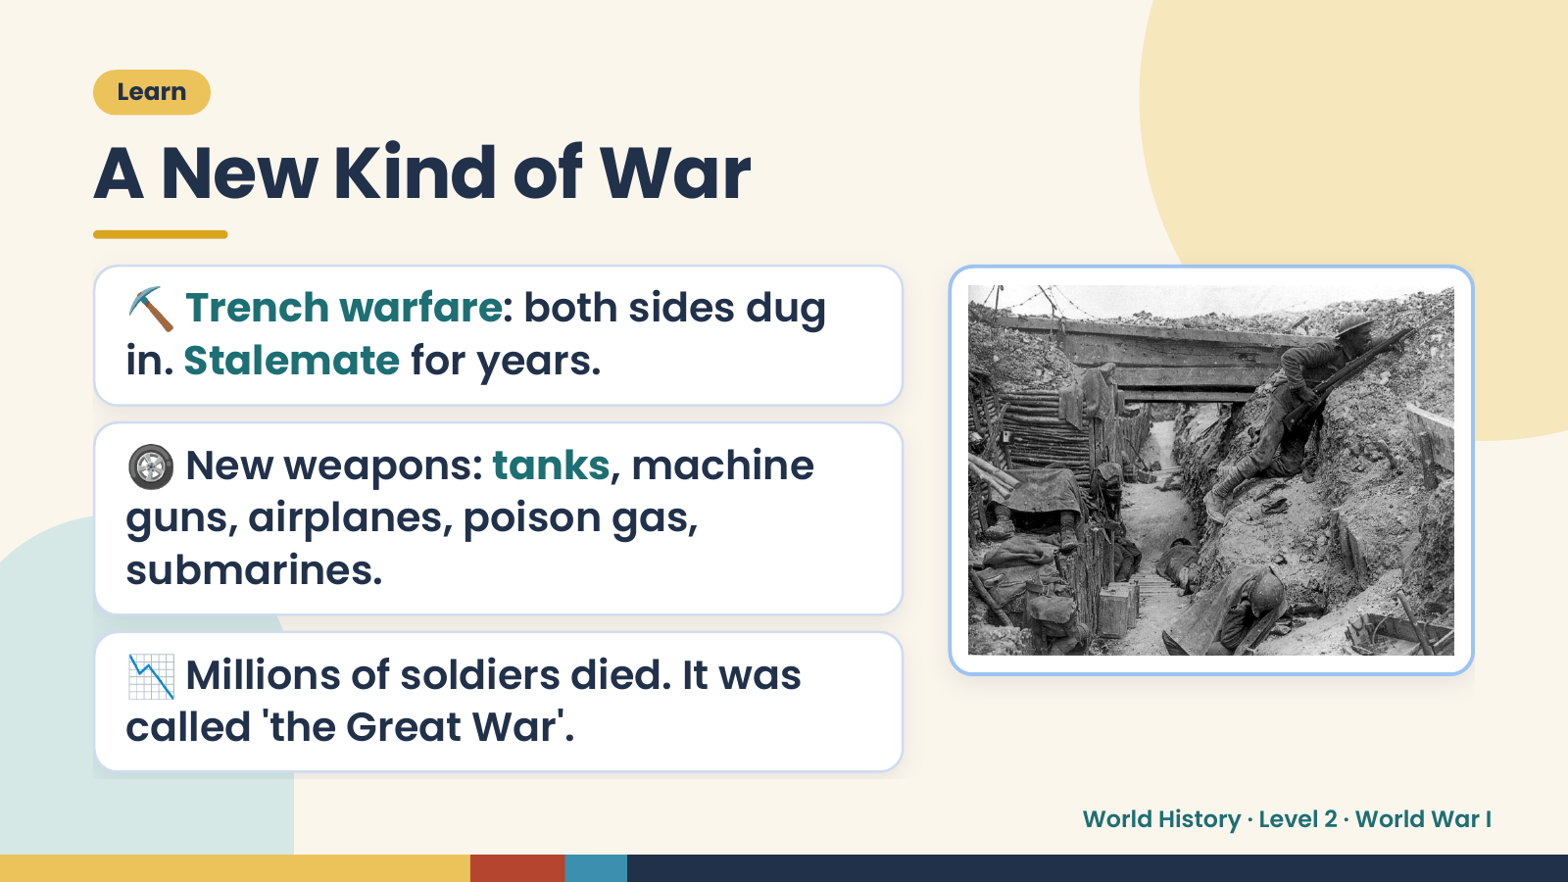
Notes:
Learn
A New Kind of War
⛏️ Trench warfare: both sides dug
in. Stalemate for years.
🛞 New weapons: tanks, machine
guns, airplanes, poison gas,
submarines.
📉 Millions of soldiers died. It was
called 'the Great War'.
World History · Level 2 · World War I

Slide 13
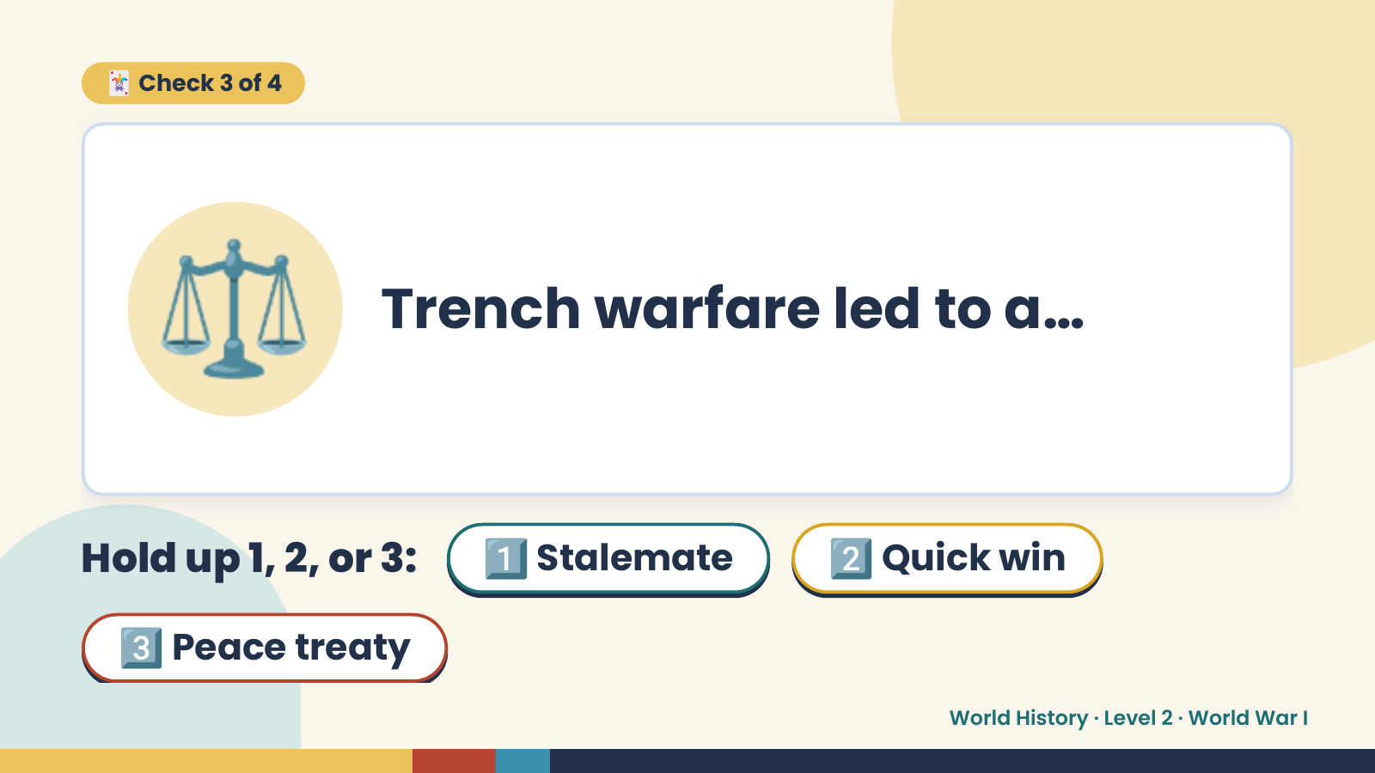
Notes:
🃏 Check 3 of 4
⚖️ Trench warfare led to a…
Hold up 1, 2, or 3: 1️⃣ Stalemate 2️⃣ Quick win
3️⃣ Peace treaty
World History · Level 2 · World War I

Slide 14
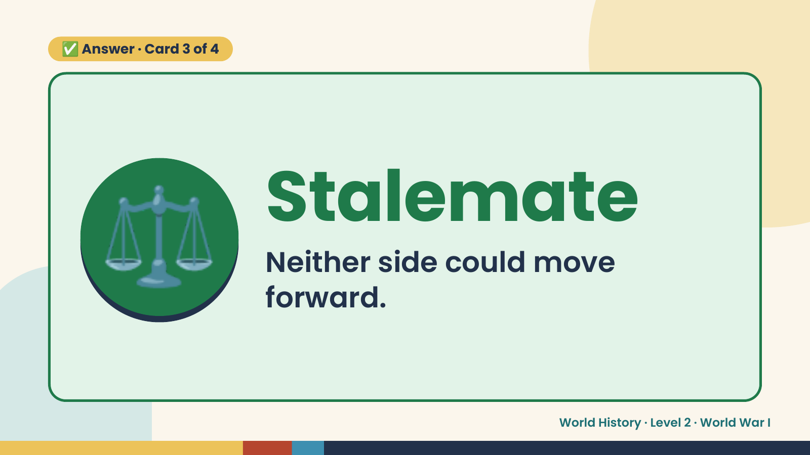
Notes:
✅ Answer · Card 3 of 4
⚖️ Stalemate
Neither side could move
forward.
World History · Level 2 · World War I

Slide 15
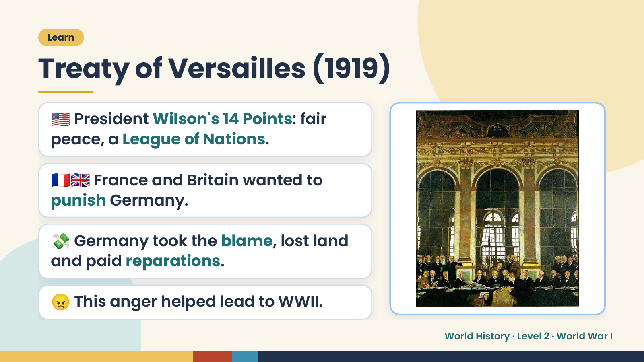
Notes:
Learn
Treaty of Versailles (1919)
🇺🇸 President Wilson's 14 Points: fair
peace, a League of Nations.
🇫🇷🇬🇧 France and Britain wanted to
punish Germany.
💸 Germany took the blame, lost land
and paid reparations.
😠 This anger helped lead to WWII.
World History · Level 2 · World War I

Slide 16
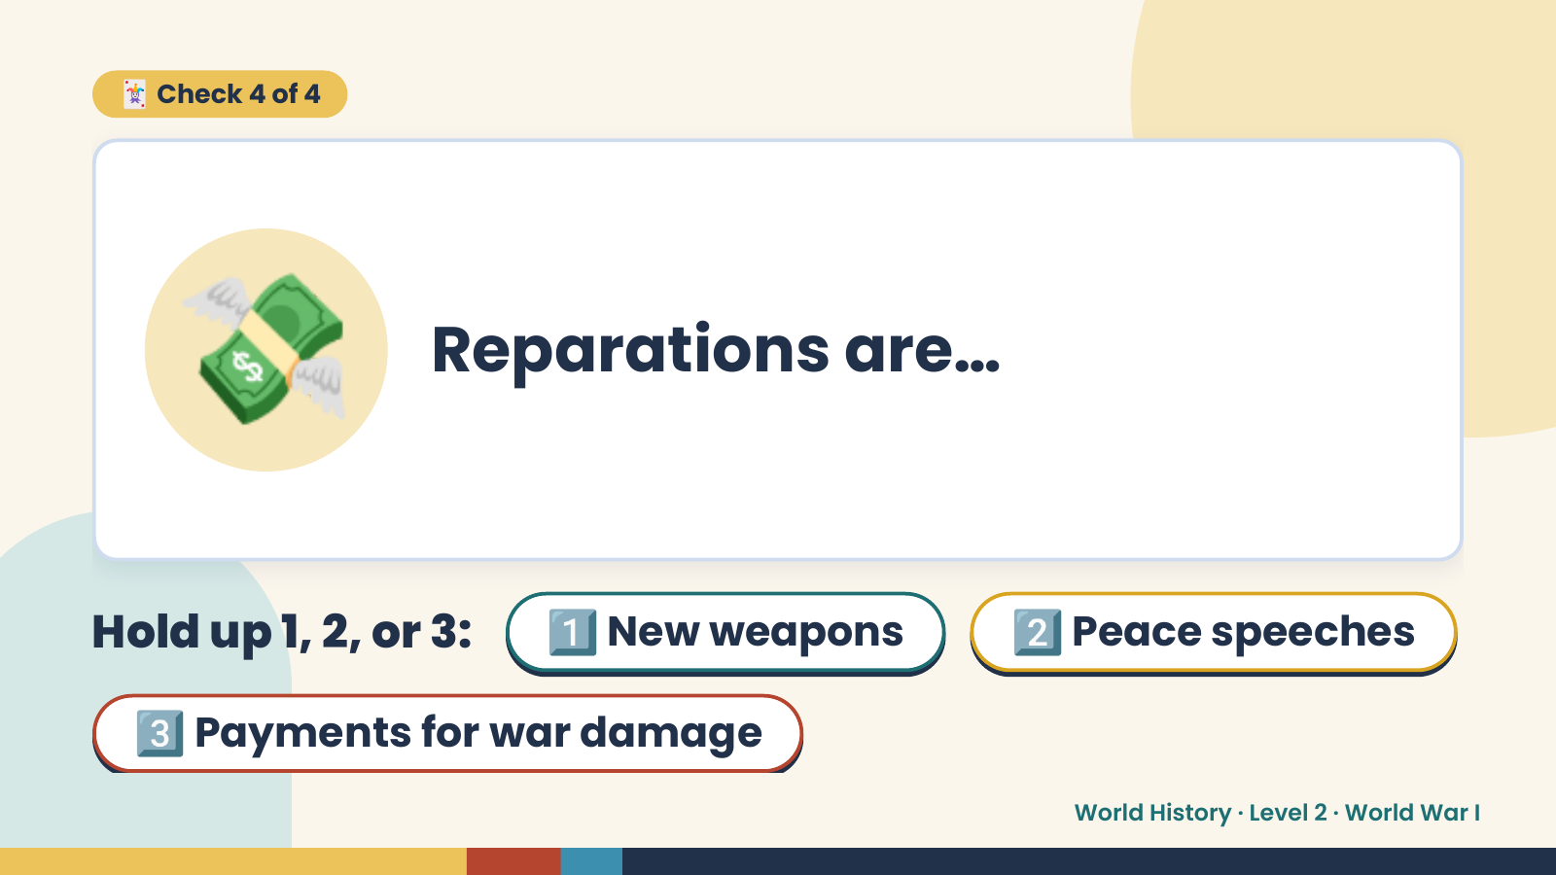
Notes:
🃏 Check 4 of 4
💸 Reparations are…
Hold up 1, 2, or 3: 1️⃣ New weapons 2️⃣ Peace speeches
3️⃣ Payments for war damage
World History · Level 2 · World War I

Slide 17
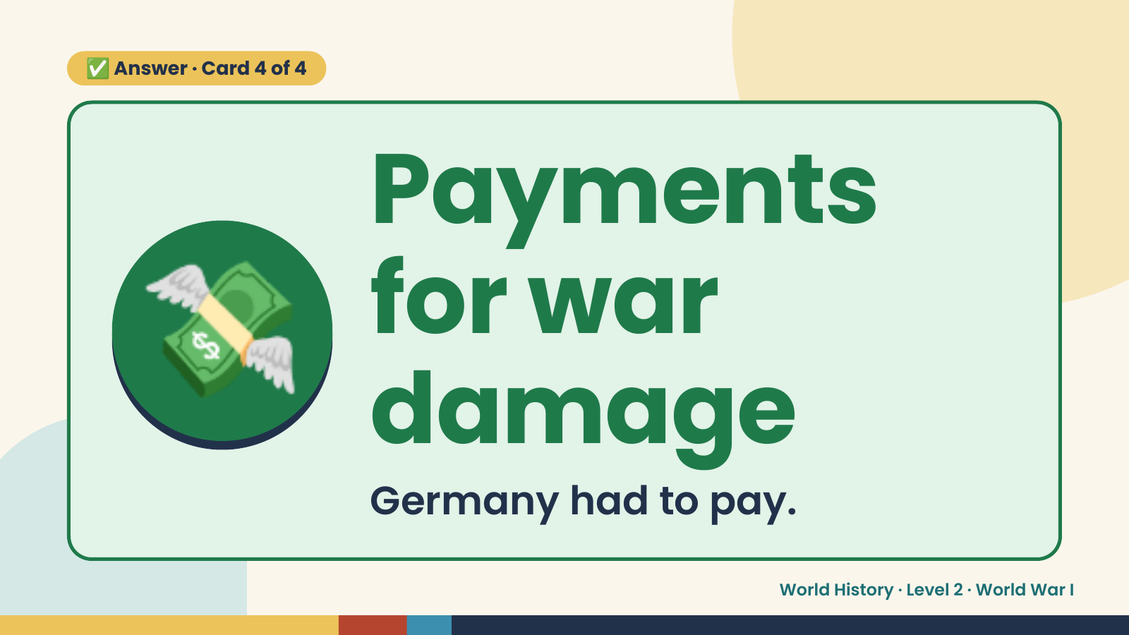
Notes:
✅ Answer · Card 4 of 4
💸 Payments
for war
damage
Germany had to pay.
World History · Level 2 · World War I

Slide 18
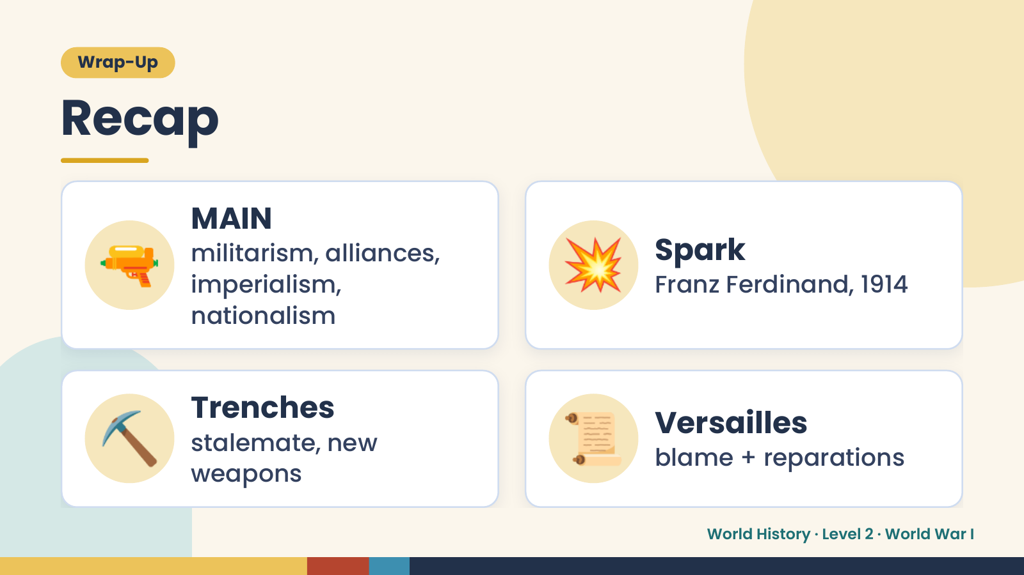
Notes:
Wrap-Up
Recap
🔫 MAIN
militarism, alliances,
imperialism,
nationalism
💥 Spark
Franz Ferdinand, 1914
⛏️ Trenches
stalemate, new
weapons
📜 Versailles
blame + reparations
World History · Level 2 · World War I

Slide 19
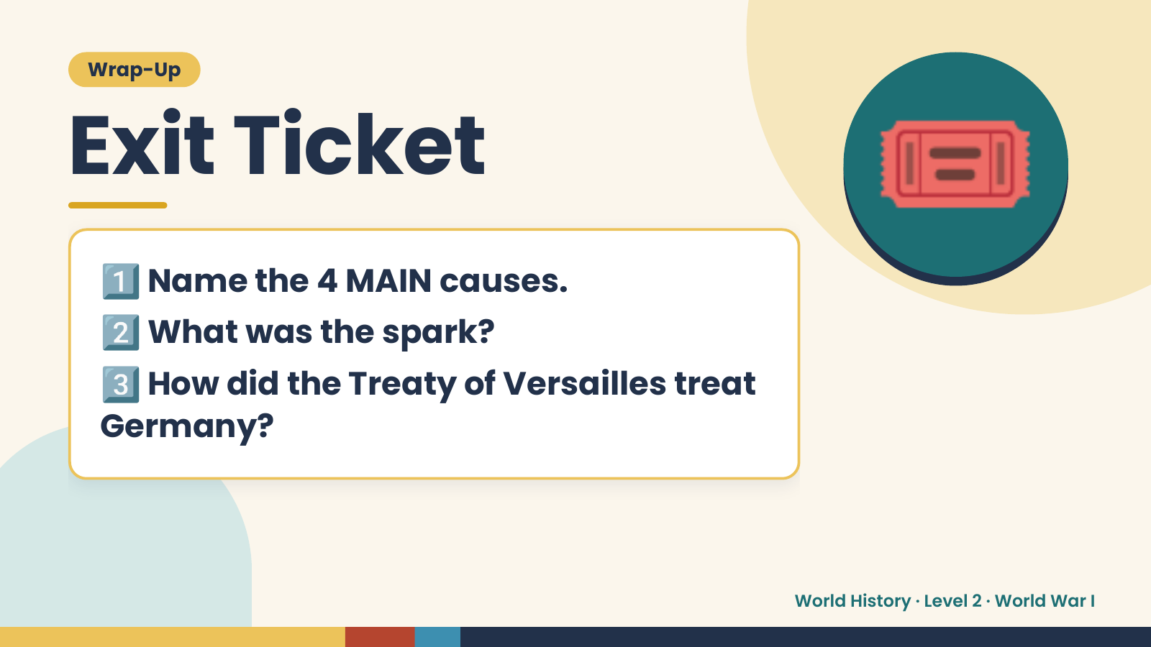
Notes:
Wrap-Up
Exit Ticket
1️⃣
2️⃣
Name the 4 MAIN causes.
What was the spark?
🎟️
3️⃣
How did the Treaty of Versailles treat
Germany?
World History · Level 2 · World War I

