Slide 1
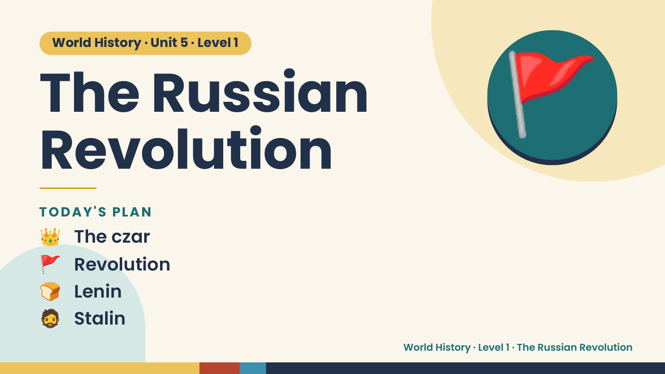
Notes:
World History · Unit 5 · Level 1
The Russian
Revolution
🚩
👑 The czar
TODAY'S PLAN
🚩 Revolution
🍞 Lenin
🧔 Stalin
World History · Level 1 · The Russian Revolution

Slide 2
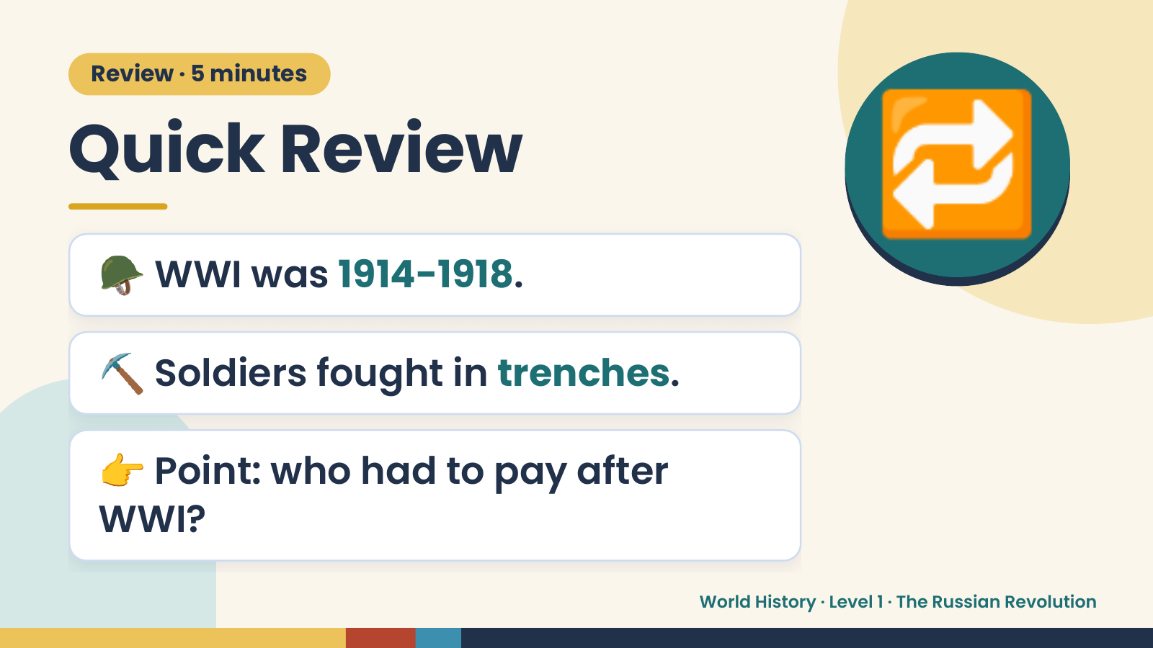
Notes:
Review · 5 minutes
Quick Review
🪖 WWI was 1914-1918.
🔁
⛏️ Soldiers fought in trenches.
👉 Point: who had to pay after
WWI?
World History · Level 1 · The Russian Revolution

Slide 3
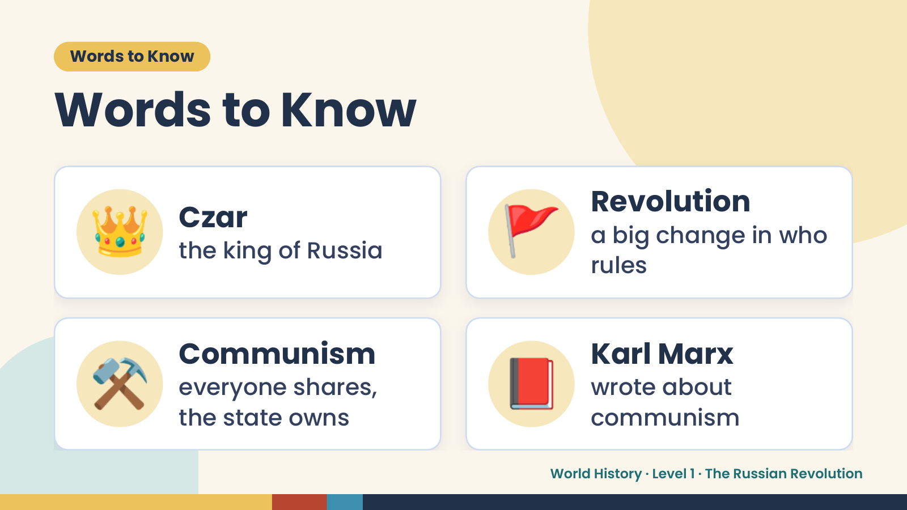
Notes:
Words to Know
Words to Know
👑 Czar
the king of Russia 🚩 Revolution
a big change in who
rules
⚒️ Communism
everyone shares,
the state owns
📕 Karl Marx
wrote about
communism
World History · Level 1 · The Russian Revolution

Slide 4
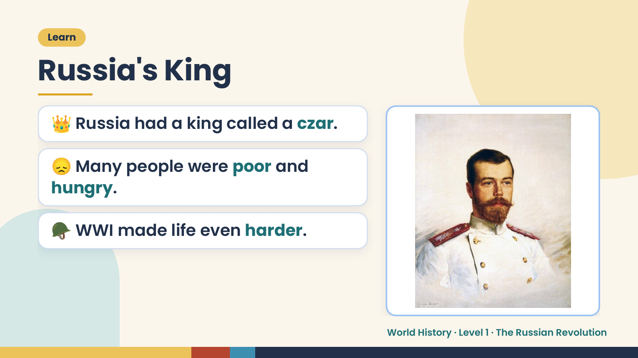
Notes:
Learn
Russia's King
👑 Russia had a king called a czar.
😞 Many people were poor and
hungry.
🪖 WWI made life even harder.
World History · Level 1 · The Russian Revolution

Slide 5
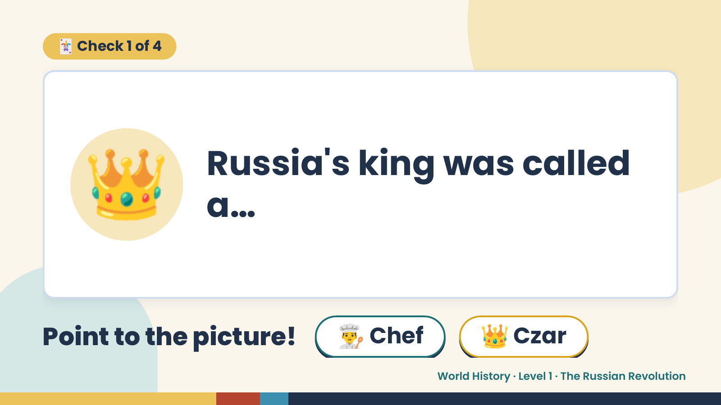
Notes:
🃏 Check 1 of 4
👑 Russia's king was called
a…
Point to the picture! 👨‍🍳 Chef 👑 Czar
World History · Level 1 · The Russian Revolution

Slide 6
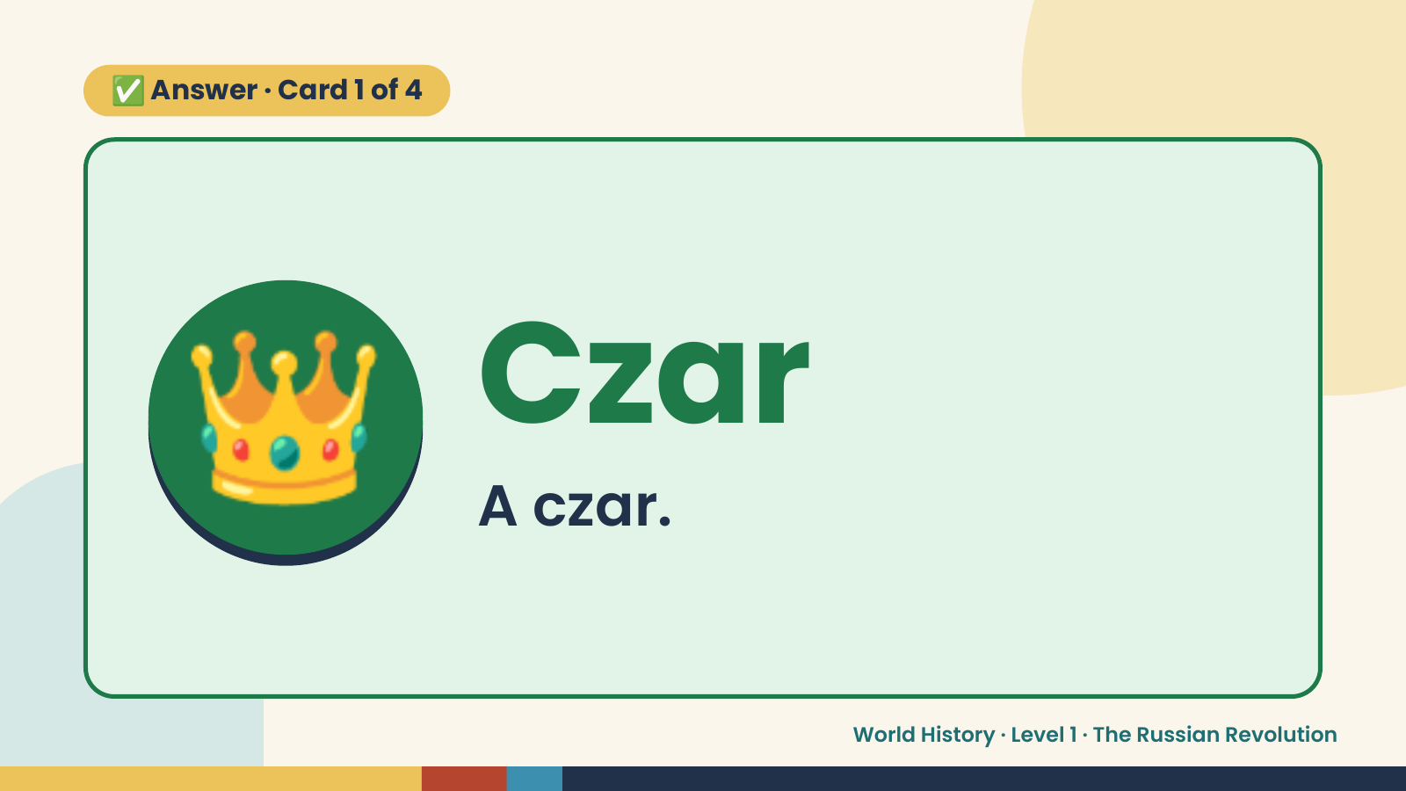
Notes:
✅ Answer · Card 1 of 4
👑 Czar
A czar.
World History · Level 1 · The Russian Revolution

Slide 7
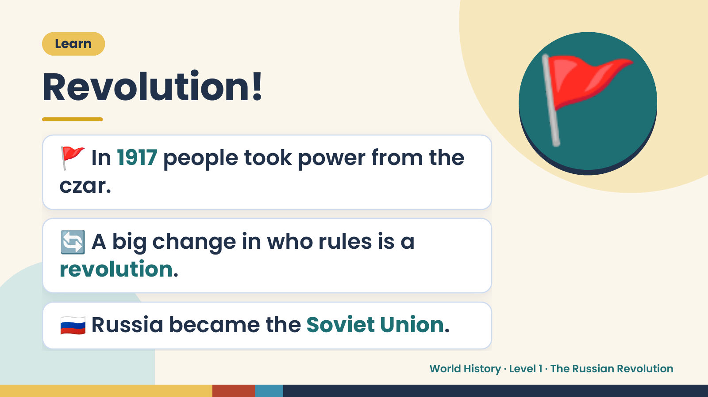
Notes:
Learn
Revolution!
🚩 In 1917 people took power from the
czar.
🚩
🔄 A big change in who rules is a
revolution.
🇷🇺 Russia became the Soviet Union.
World History · Level 1 · The Russian Revolution

Slide 8
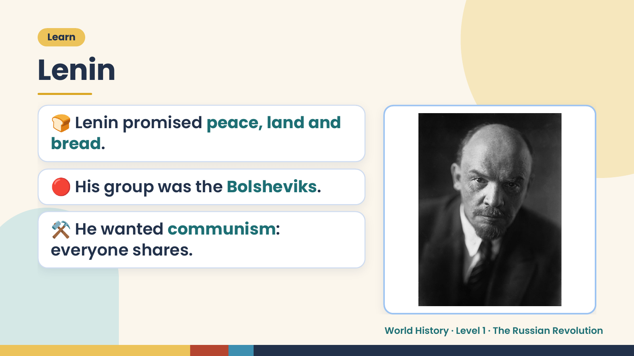
Notes:
Learn
Lenin
🍞 Lenin promised peace, land and
bread.
🔴 His group was the Bolsheviks.
⚒️ He wanted communism:
everyone shares.
World History · Level 1 · The Russian Revolution

Slide 9
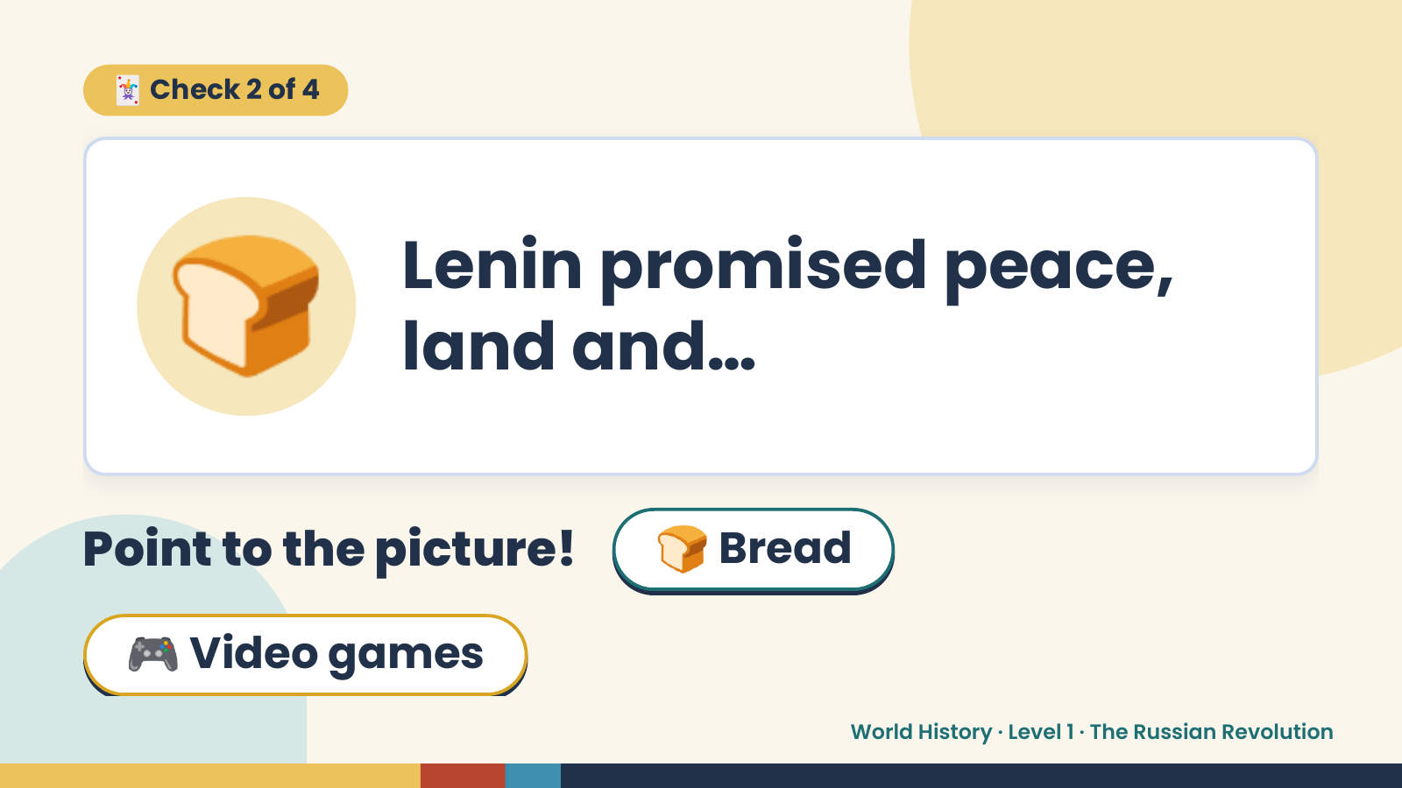
Notes:
🃏 Check 2 of 4
🍞 Lenin promised peace,
land and…
Point to the picture! 🍞 Bread
🎮 Video games
World History · Level 1 · The Russian Revolution

Slide 10
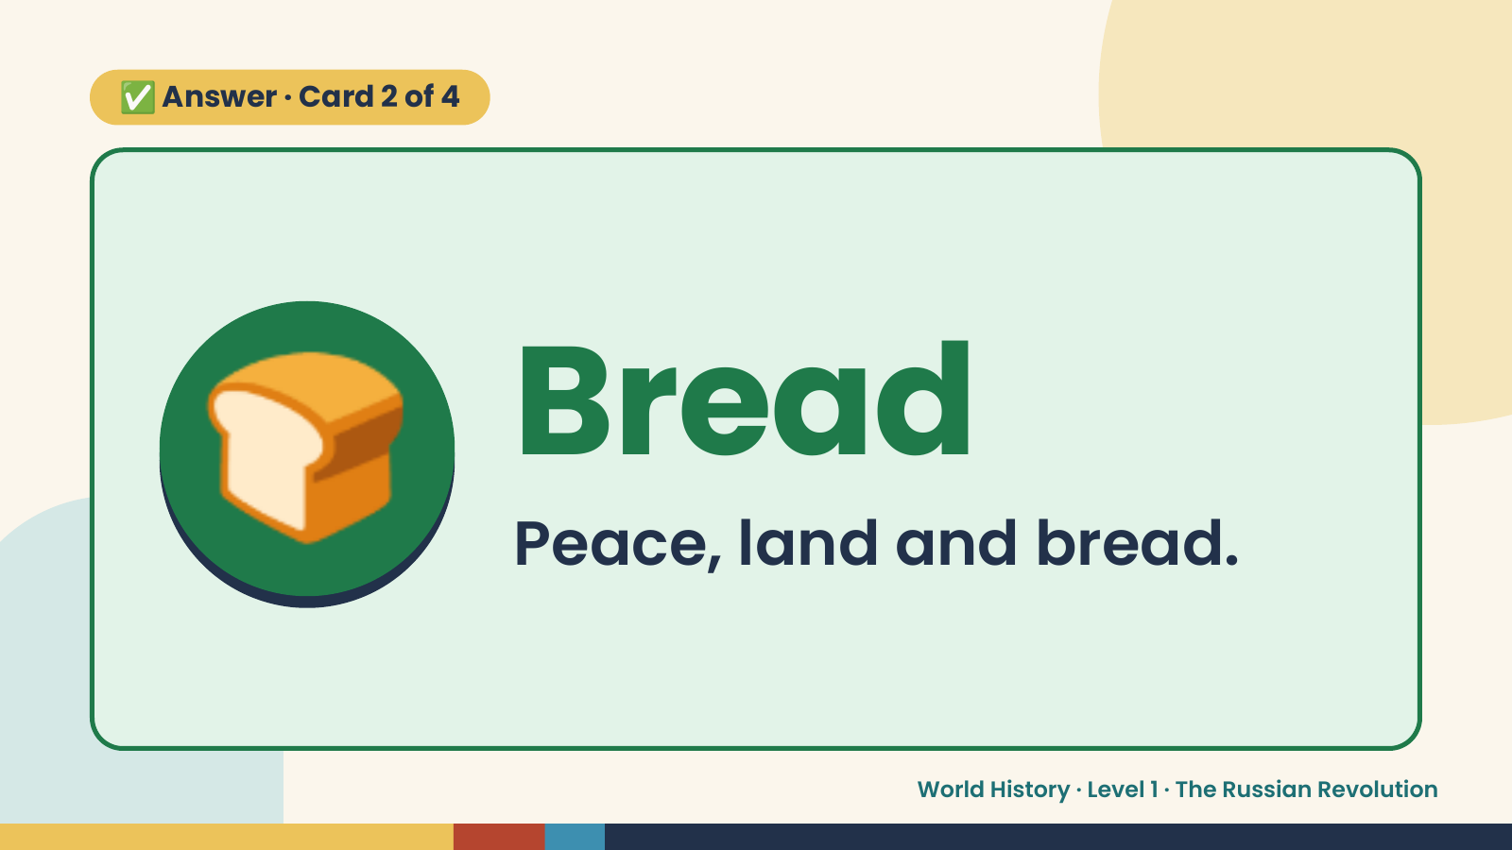
Notes:
✅ Answer · Card 2 of 4
🍞 Bread
Peace, land and bread.
World History · Level 1 · The Russian Revolution

Slide 11
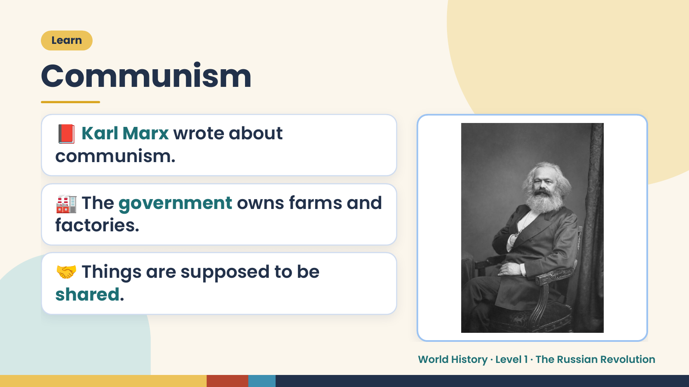
Notes:
Learn
Communism
📕 Karl Marx wrote about
communism.
🏭 The government owns farms and
factories.
🤝 Things are supposed to be
shared.
World History · Level 1 · The Russian Revolution

Slide 12
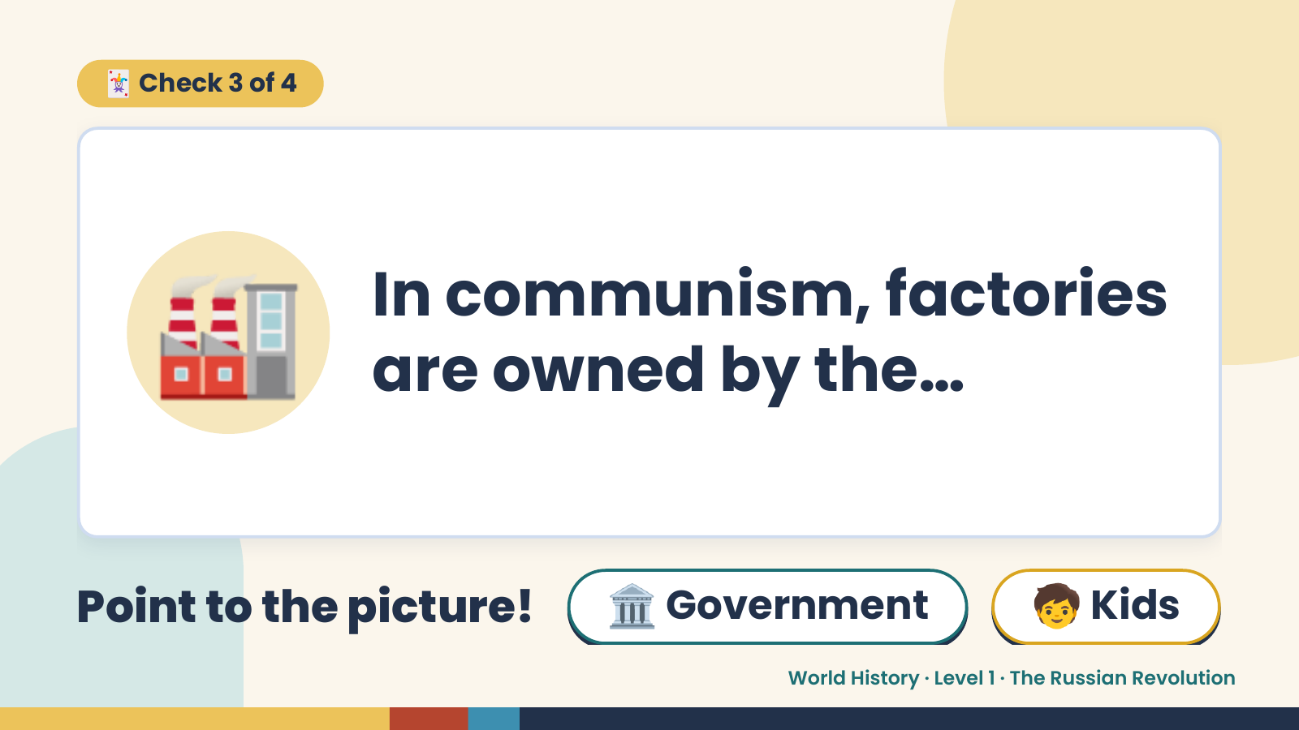
Notes:
🃏 Check 3 of 4
🏭 In communism, factories
are owned by the…
Point to the picture! 🏛️ Government 🧒 Kids
World History · Level 1 · The Russian Revolution

Slide 13
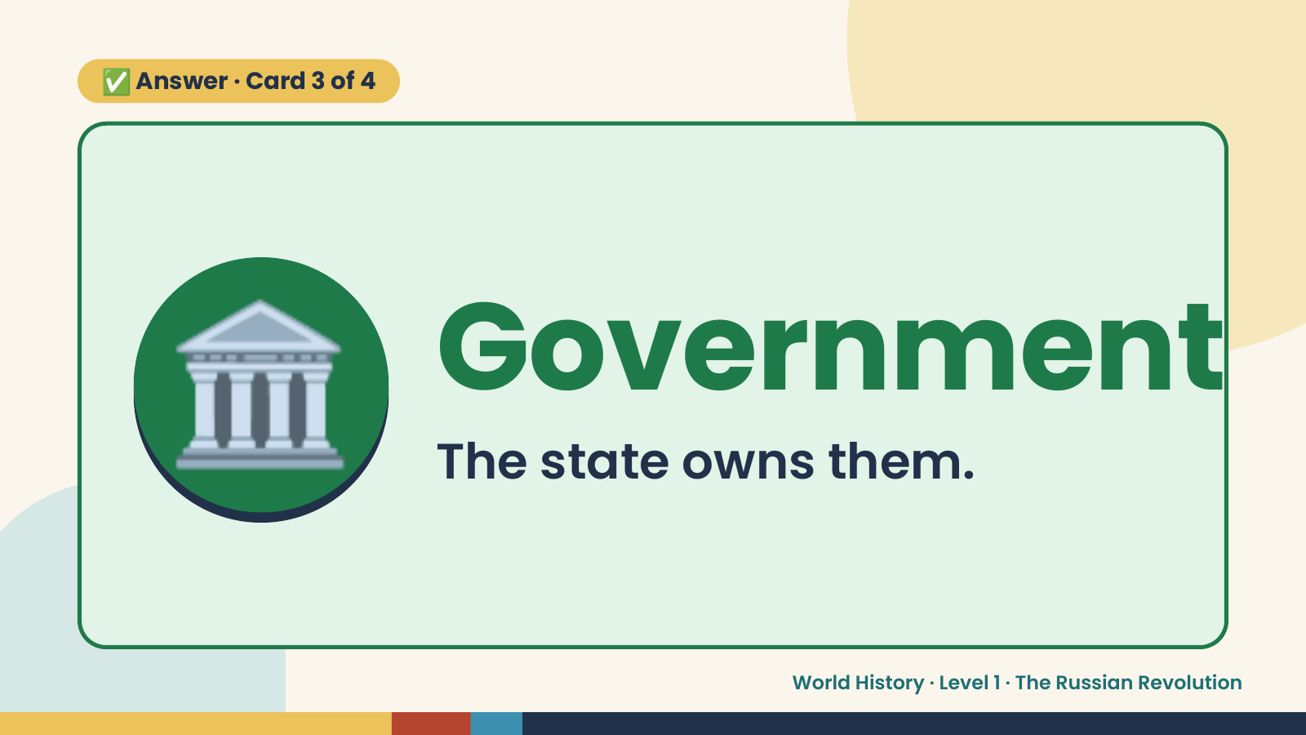
Notes:
✅ Answer · Card 3 of 4
🏛️ Government
The state owns them.
World History · Level 1 · The Russian Revolution

Slide 14
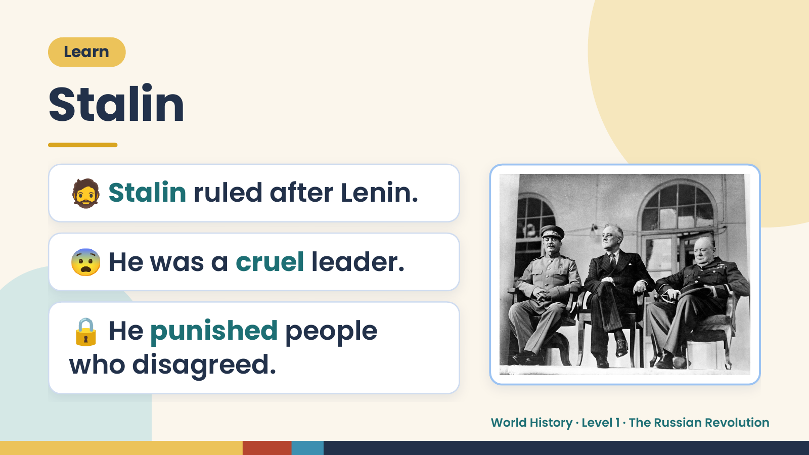
Notes:
Learn
Stalin
🧔 Stalin ruled after Lenin.
😨 He was a cruel leader.
🔒 He punished people
who disagreed.
World History · Level 1 · The Russian Revolution

Slide 15
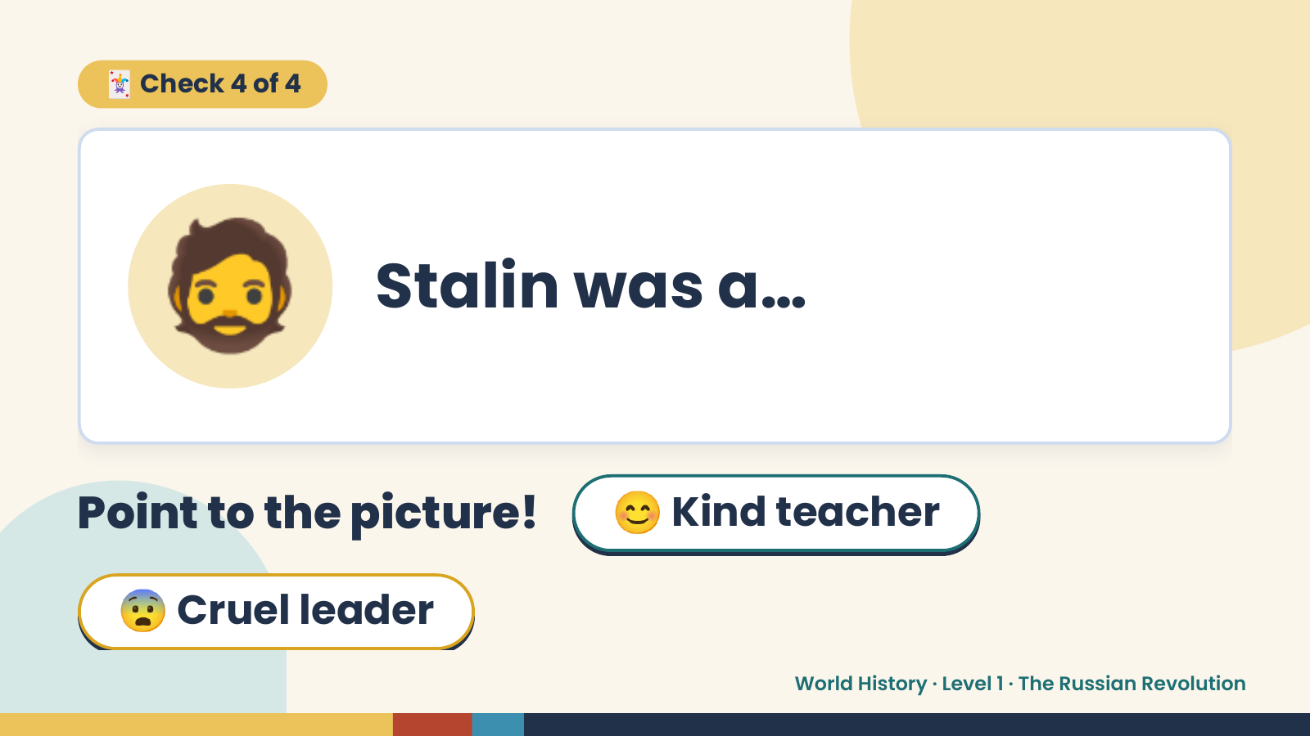
Notes:
🃏 Check 4 of 4
🧔 Stalin was a…
Point to the picture! 😊 Kind teacher
😨 Cruel leader
World History · Level 1 · The Russian Revolution

Slide 16
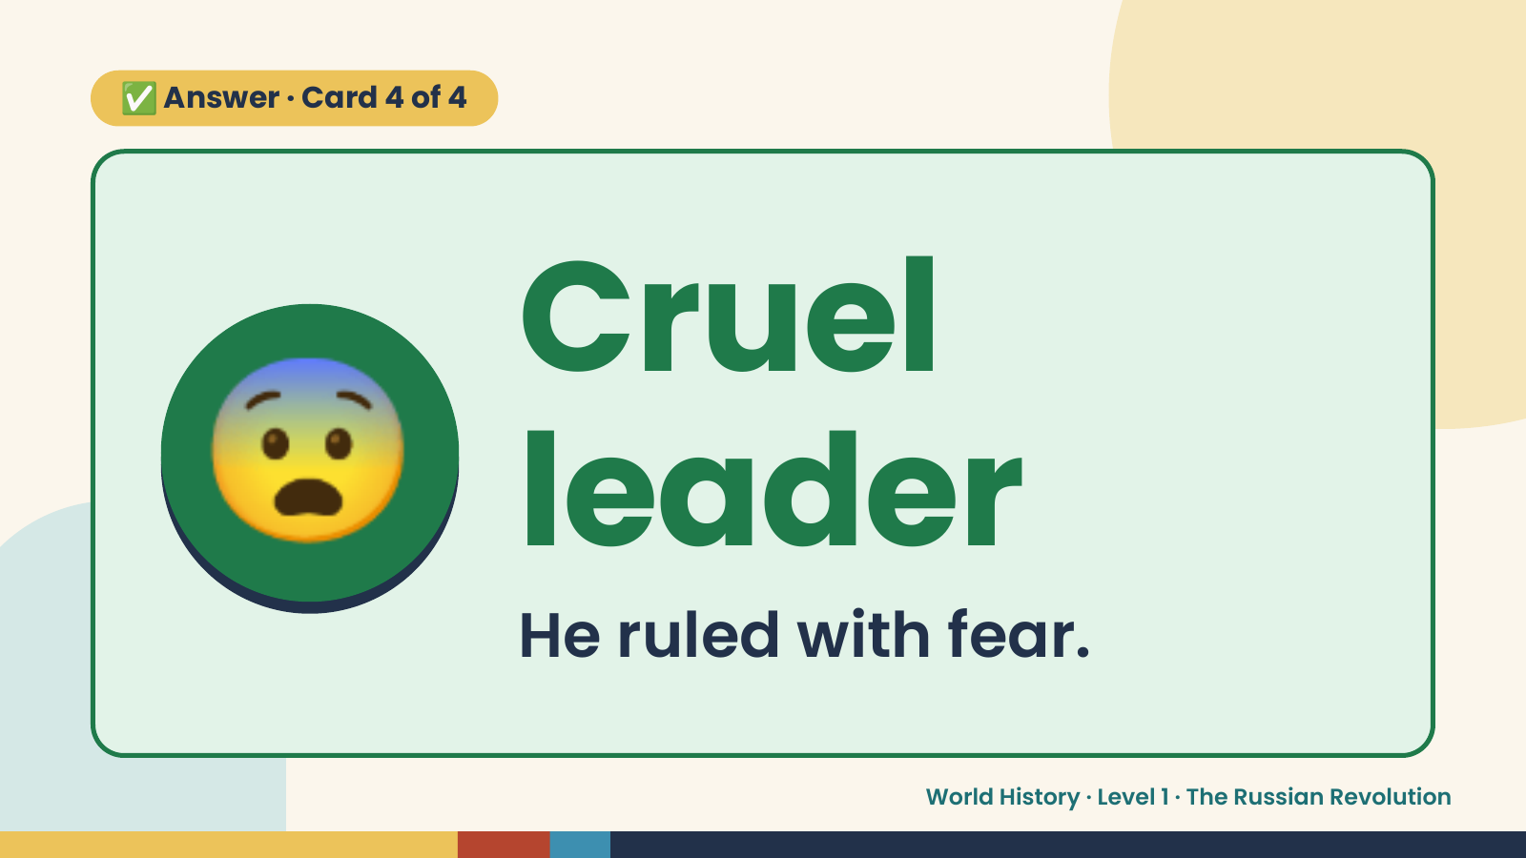
Notes:
✅ Answer · Card 4 of 4
😨 Cruel
leader
He ruled with fear.
World History · Level 1 · The Russian Revolution

Slide 17
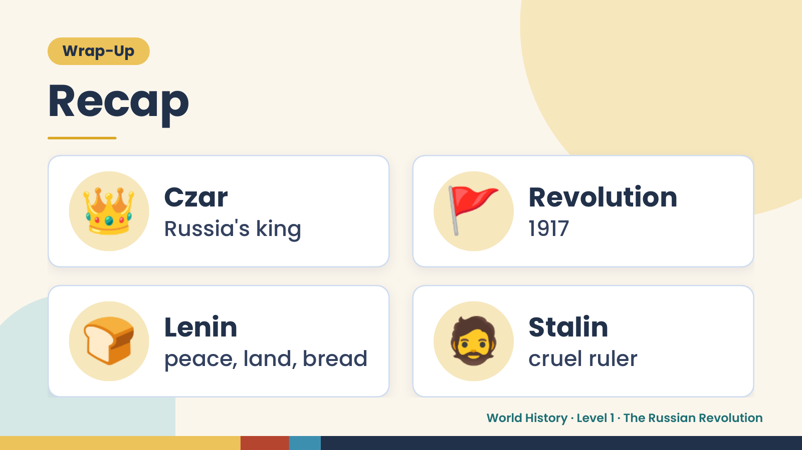
Notes:
Wrap-Up
Recap
👑 Czar
Russia's king 🚩 Revolution
1917
🍞 Lenin
peace, land, bread 🧔 Stalin
cruel ruler
World History · Level 1 · The Russian Revolution

Slide 18
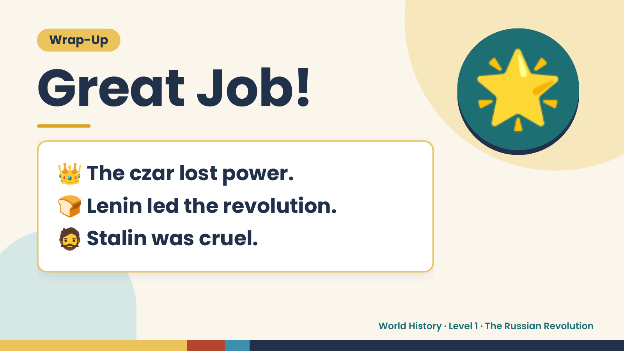
Notes:
Wrap-Up
Great Job!
👑 The czar lost power.
🌟
🍞 Lenin led the revolution.
🧔 Stalin was cruel.
World History · Level 1 · The Russian Revolution

