Slide 1
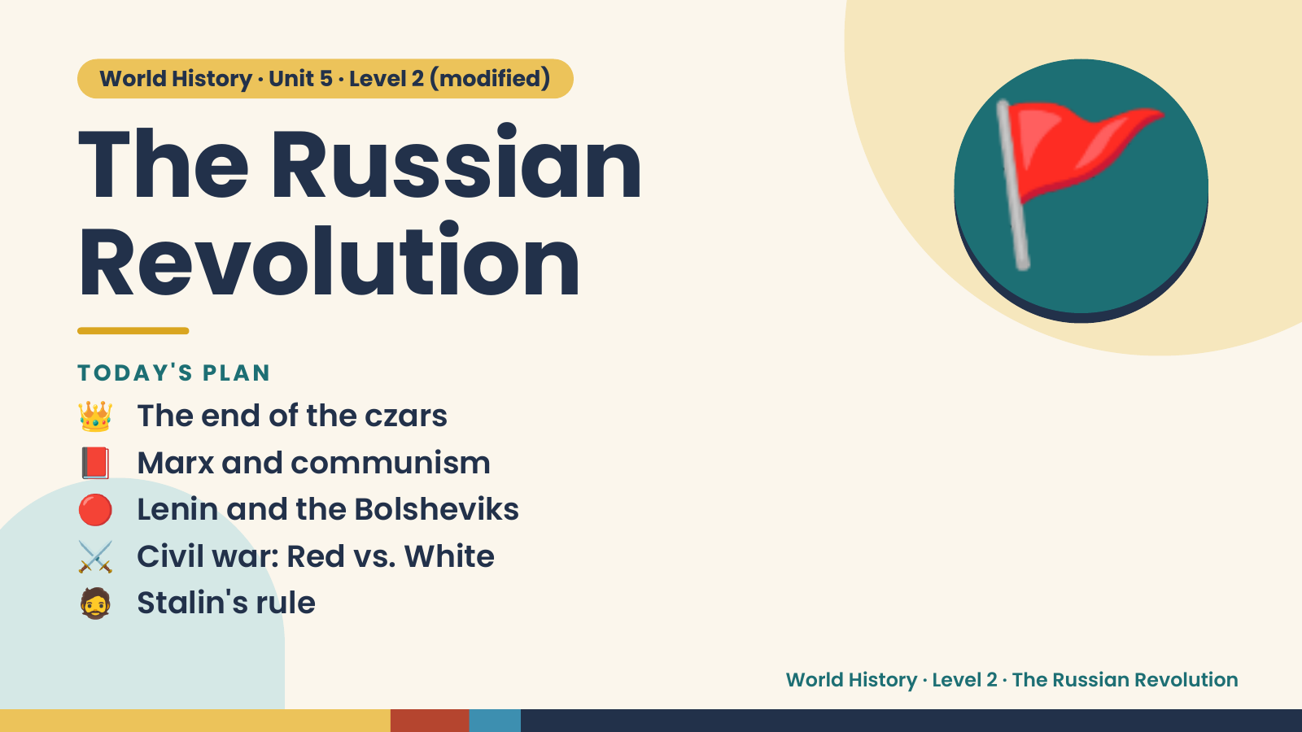
Notes:
World History · Unit 5 · Level 2 (modified)
The Russian
Revolution
👑 The end of the czars
TODAY'S PLAN
🚩
📕 Marx and communism
🔴 Lenin and the Bolsheviks
⚔️ Civil war: Red vs. White
🧔 Stalin's rule
World History · Level 2 · The Russian Revolution

Slide 2
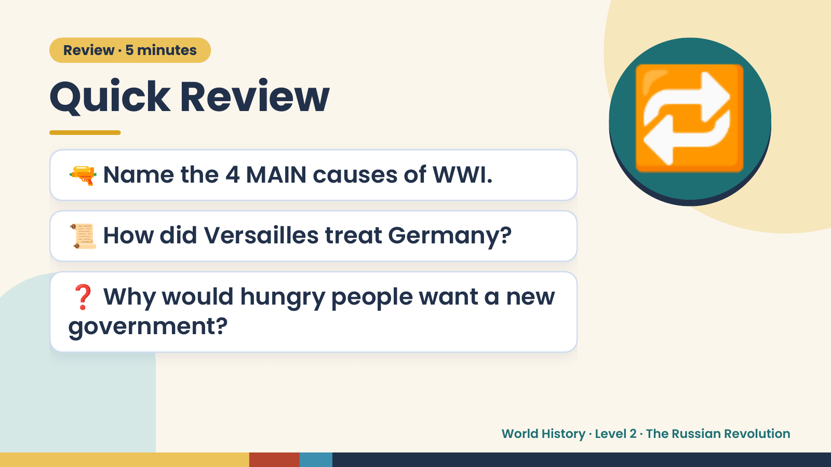
Notes:
Review · 5 minutes
Quick Review
🔫 Name the 4 MAIN causes of WWI.
📜 How did Versailles treat Germany?
🔁
❓ Why would hungry people want a new
government?
World History · Level 2 · The Russian Revolution

Slide 3
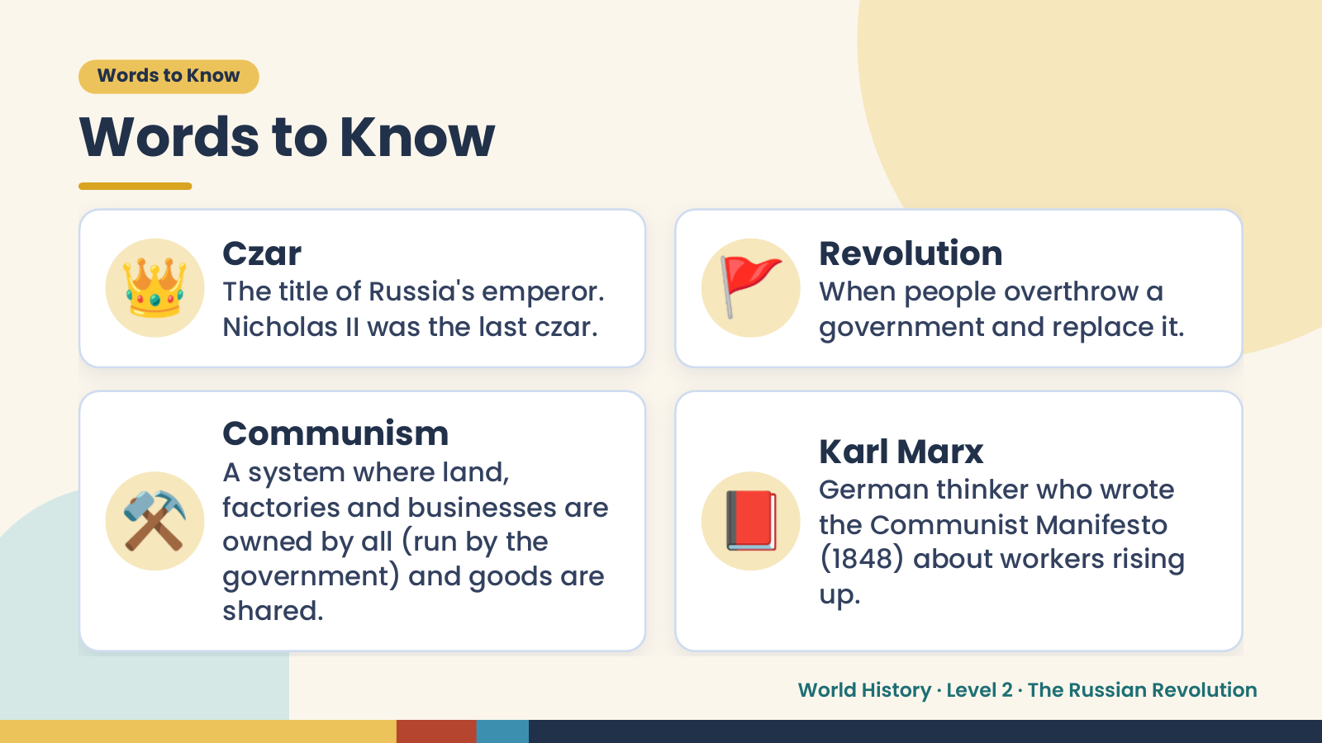
Notes:
Words to Know
Words to Know
👑 Czar
The title of Russia's emperor.
Nicholas II was the last czar.
🚩 Revolution
When people overthrow a
government and replace it.
⚒️ 📕
Communism
Karl Marx
A system where land,
German thinker who wrote
factories and businesses are
the Communist Manifesto
owned by all (run by the
(1848) about workers rising
government) and goods are
up.
shared.
World History · Level 2 · The Russian Revolution

Slide 4
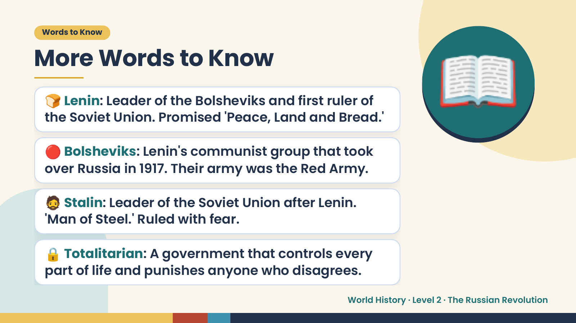
Notes:
Words to Know
More Words to Know
🍞 Lenin: Leader of the Bolsheviks and first ruler of
the Soviet Union. Promised 'Peace, Land and Bread.'
🔴 Bolsheviks: Lenin's communist group that took
over Russia in 1917. Their army was the Red Army.
📖
🧔 Stalin: Leader of the Soviet Union after Lenin.
'Man of Steel.' Ruled with fear.
🔒 Totalitarian: A government that controls every
part of life and punishes anyone who disagrees.
World History · Level 2 · The Russian Revolution

Slide 5
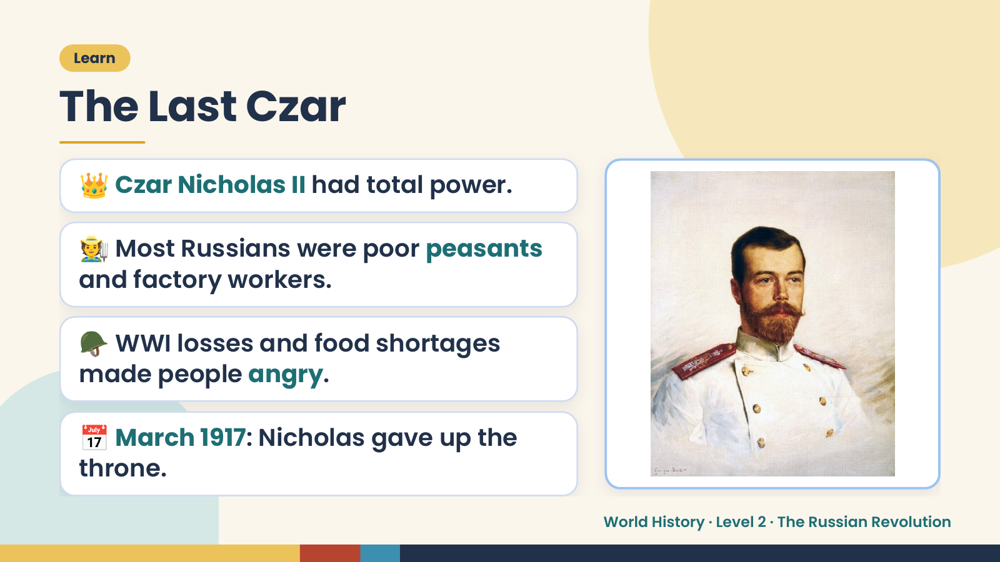
Notes:
Learn
The Last Czar
👑 Czar Nicholas II had total power.
🧑‍🌾 Most Russians were poor peasants
and factory workers.
🪖 WWI losses and food shortages
made people angry.
📅 March 1917: Nicholas gave up the
throne.
World History · Level 2 · The Russian Revolution

Slide 6
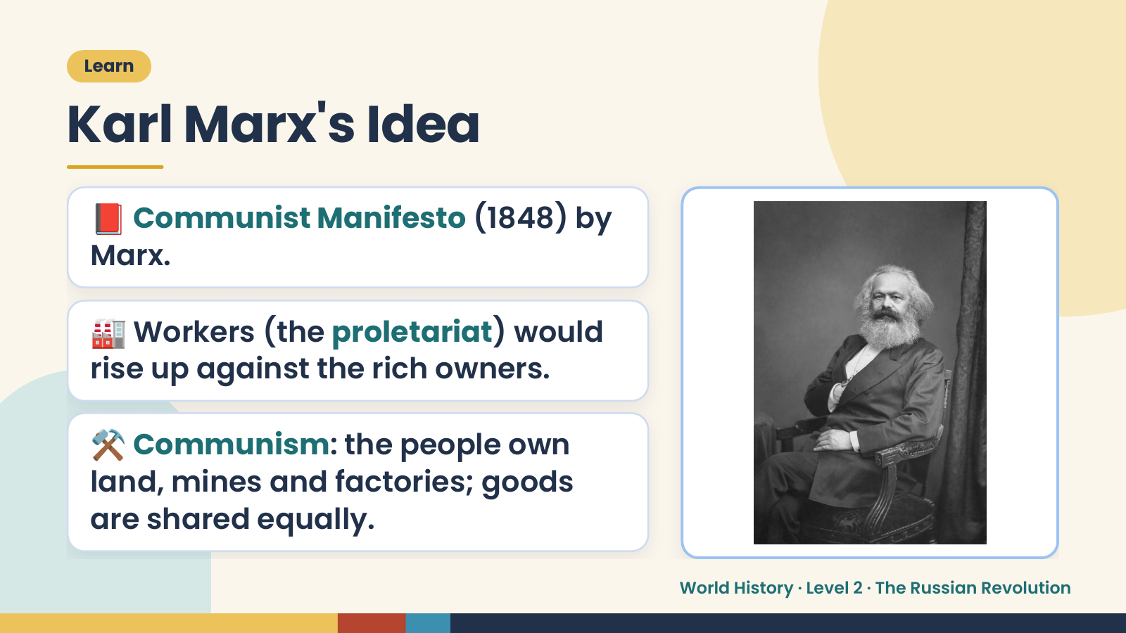
Notes:
Learn
Karl Marx's Idea
📕 Communist Manifesto (1848) by
Marx.
🏭 Workers (the proletariat) would
rise up against the rich owners.
⚒️ Communism: the people own
land, mines and factories; goods
are shared equally.
World History · Level 2 · The Russian Revolution

Slide 7
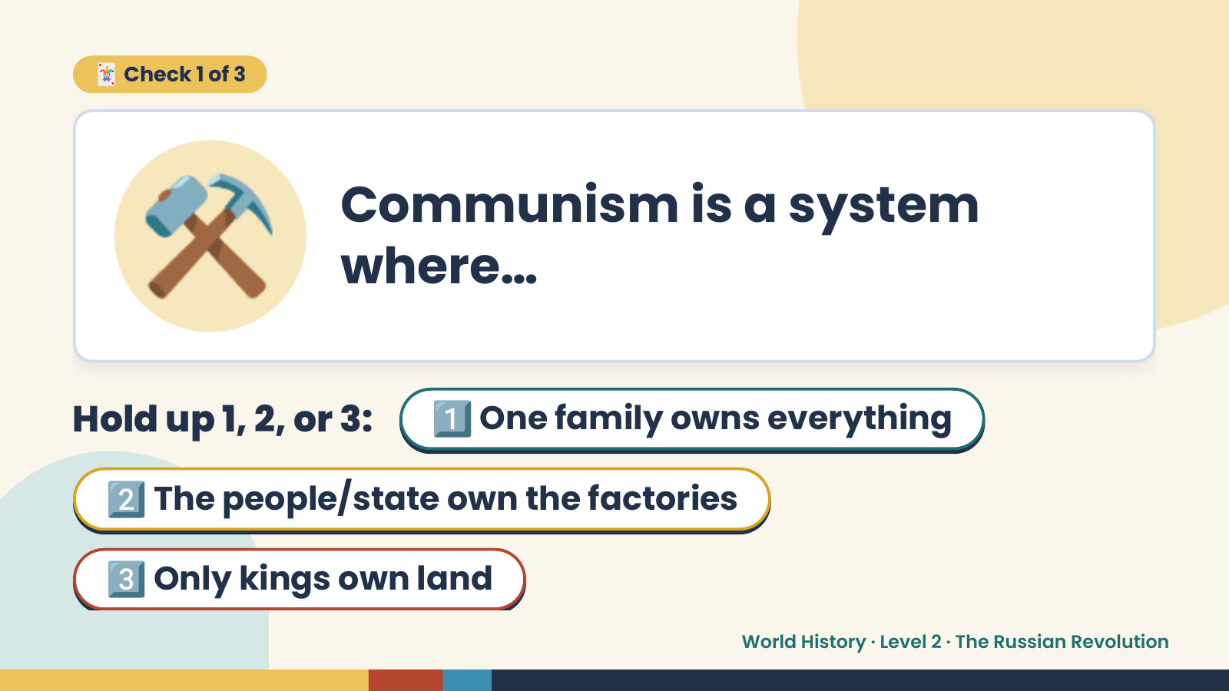
Notes:
⚒️
🃏 Check 1 of 3
Communism is a system
where…
Hold up 1, 2, or 3: 1️⃣ One family owns everything
2️⃣ The people/state own the factories
3️⃣ Only kings own land
World History · Level 2 · The Russian Revolution

Slide 8
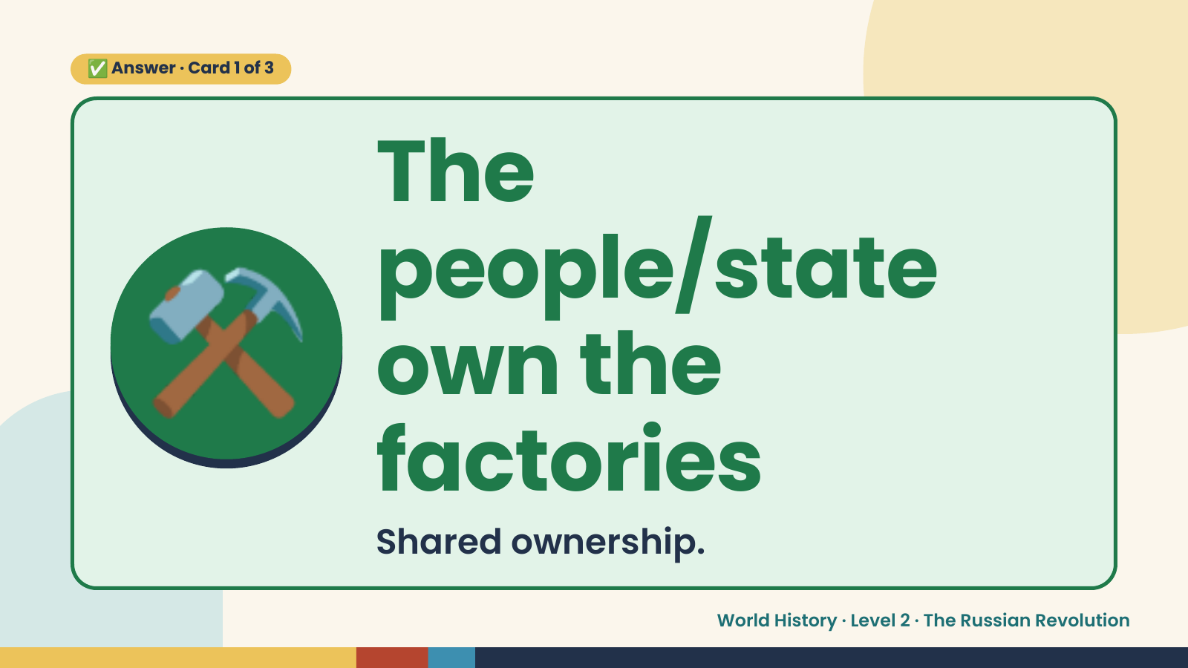
Notes:
✅ Answer · Card 1 of 3
⚒️
The
people/state
own the
factories
Shared ownership.
World History · Level 2 · The Russian Revolution

Slide 9
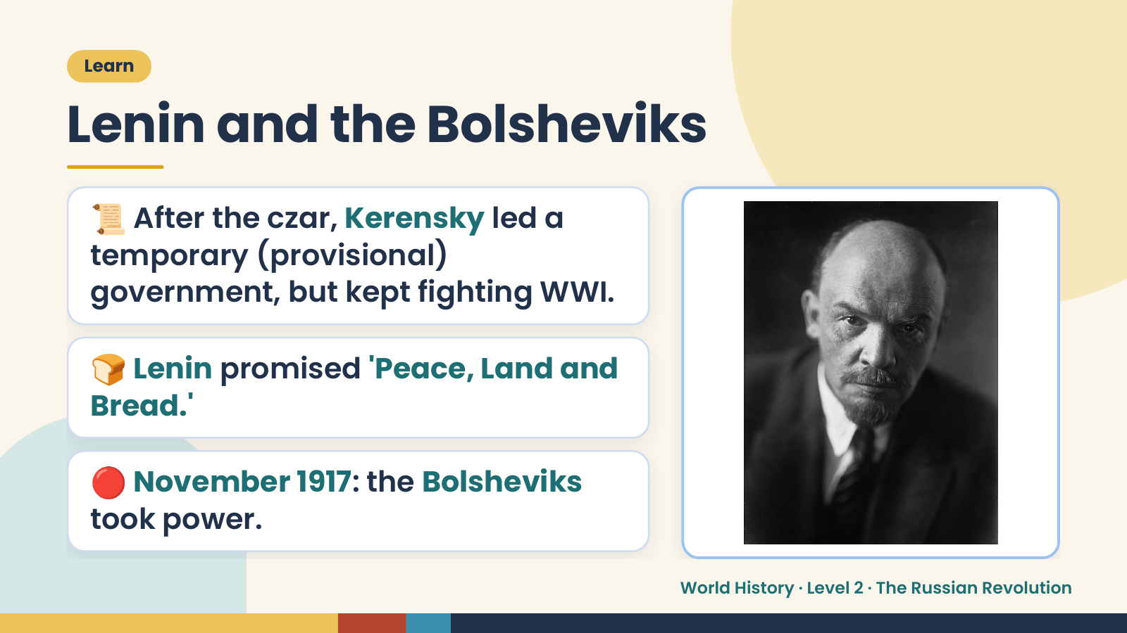
Notes:
Learn
Lenin and the Bolsheviks
📜 After the czar, Kerensky led a
temporary (provisional)
government, but kept fighting WWI.
🍞 Lenin promised 'Peace, Land and
Bread.'
🔴 November 1917: the Bolsheviks
took power.
World History · Level 2 · The Russian Revolution

Slide 10
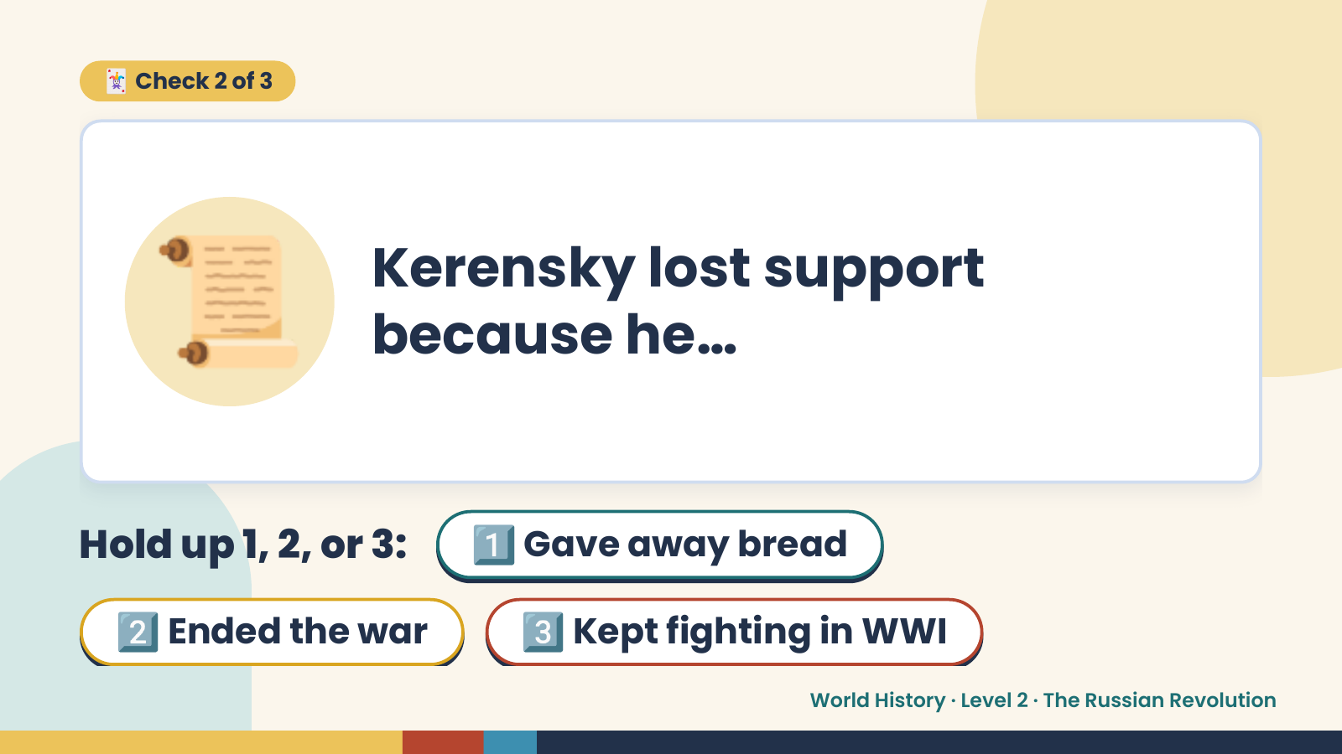
Notes:
🃏 Check 2 of 3
📜 Kerensky lost support
because he…
Hold up 1, 2, or 3:1️⃣ Gave away bread
2️⃣ Ended the war 3️⃣ Kept fighting in WWI
World History · Level 2 · The Russian Revolution

Slide 11
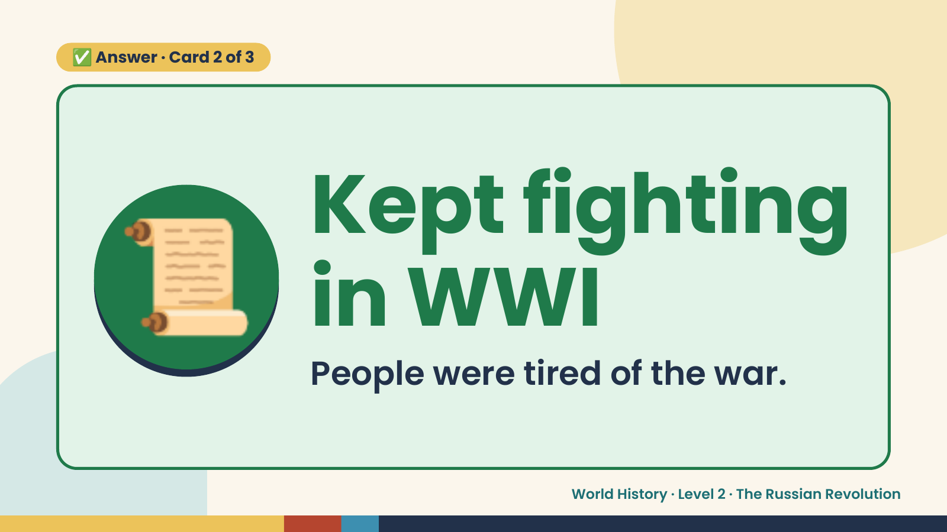
Notes:
✅ Answer · Card 2 of 3
📜 Kept fighting
in WWI
People were tired of the war.
World History · Level 2 · The Russian Revolution

Slide 12
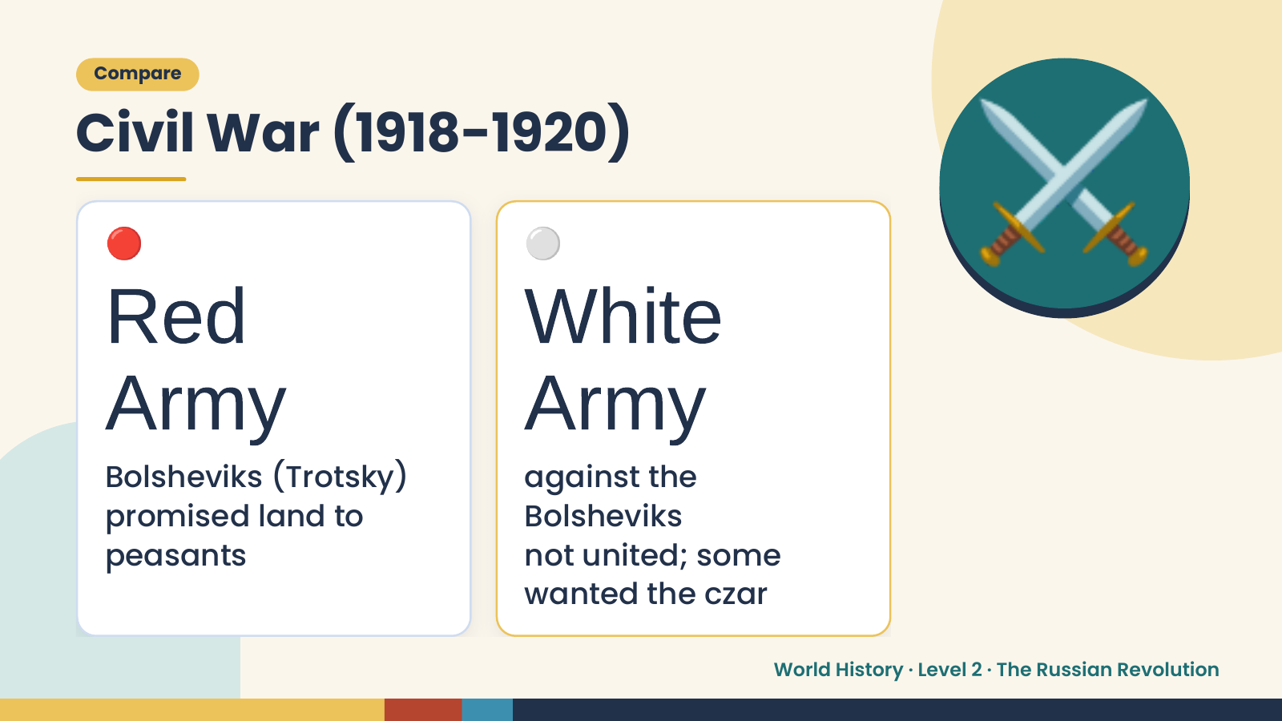
Notes:
Compare
Civil War (1918-1920)
🔴
Red
⚪
White
⚔️
Army
Bolsheviks (Trotsky)
Army
against the
promised land to Bolsheviks
peasants not united; some
wanted the czar
World History · Level 2 · The Russian Revolution

Slide 13
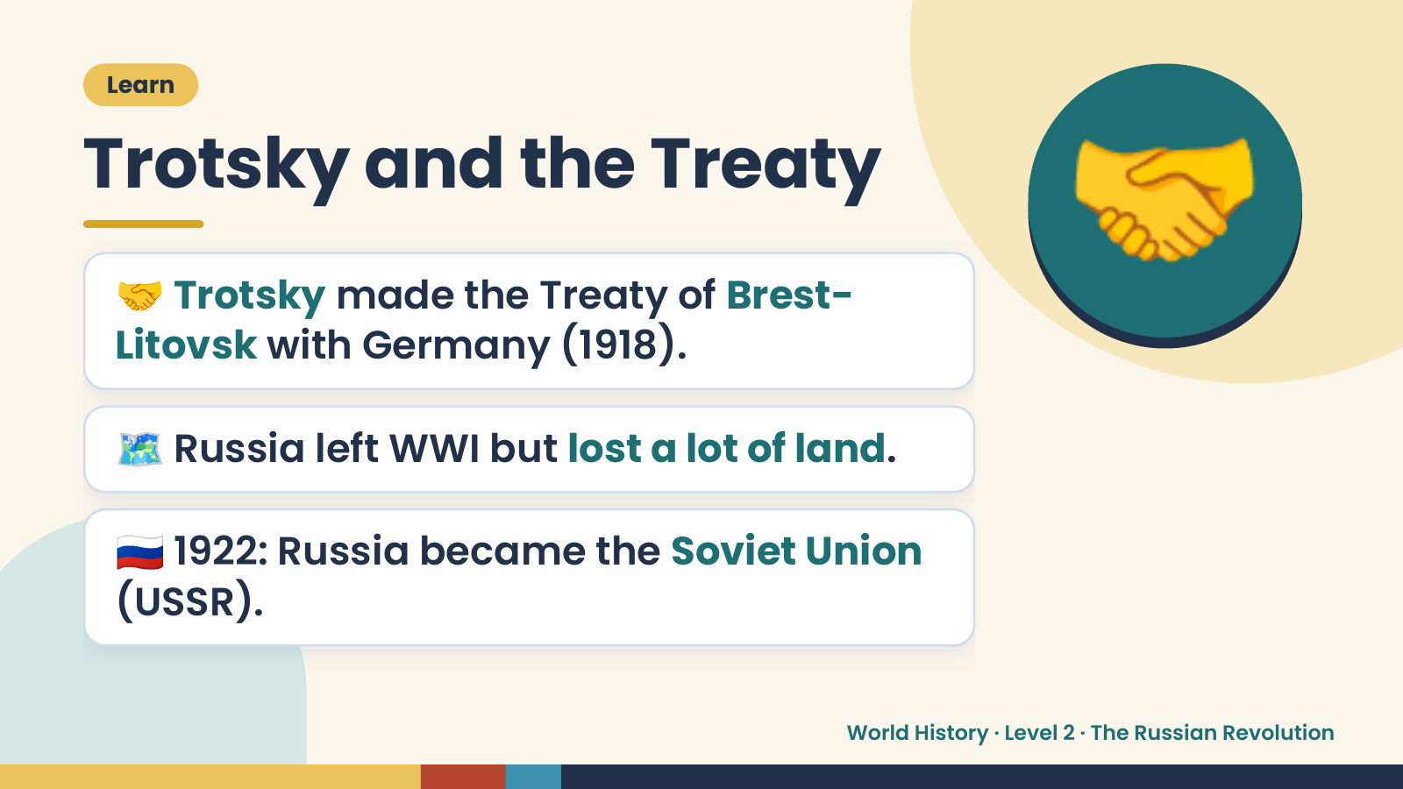
Notes:
Learn
Trotsky and the Treaty
🤝 Trotsky made the Treaty of Brest-
Litovsk with Germany (1918).
🤝
🗺️ Russia left WWI but lost a lot of land.
🇷🇺 1922: Russia became the Soviet Union
(USSR).
World History · Level 2 · The Russian Revolution

Slide 14
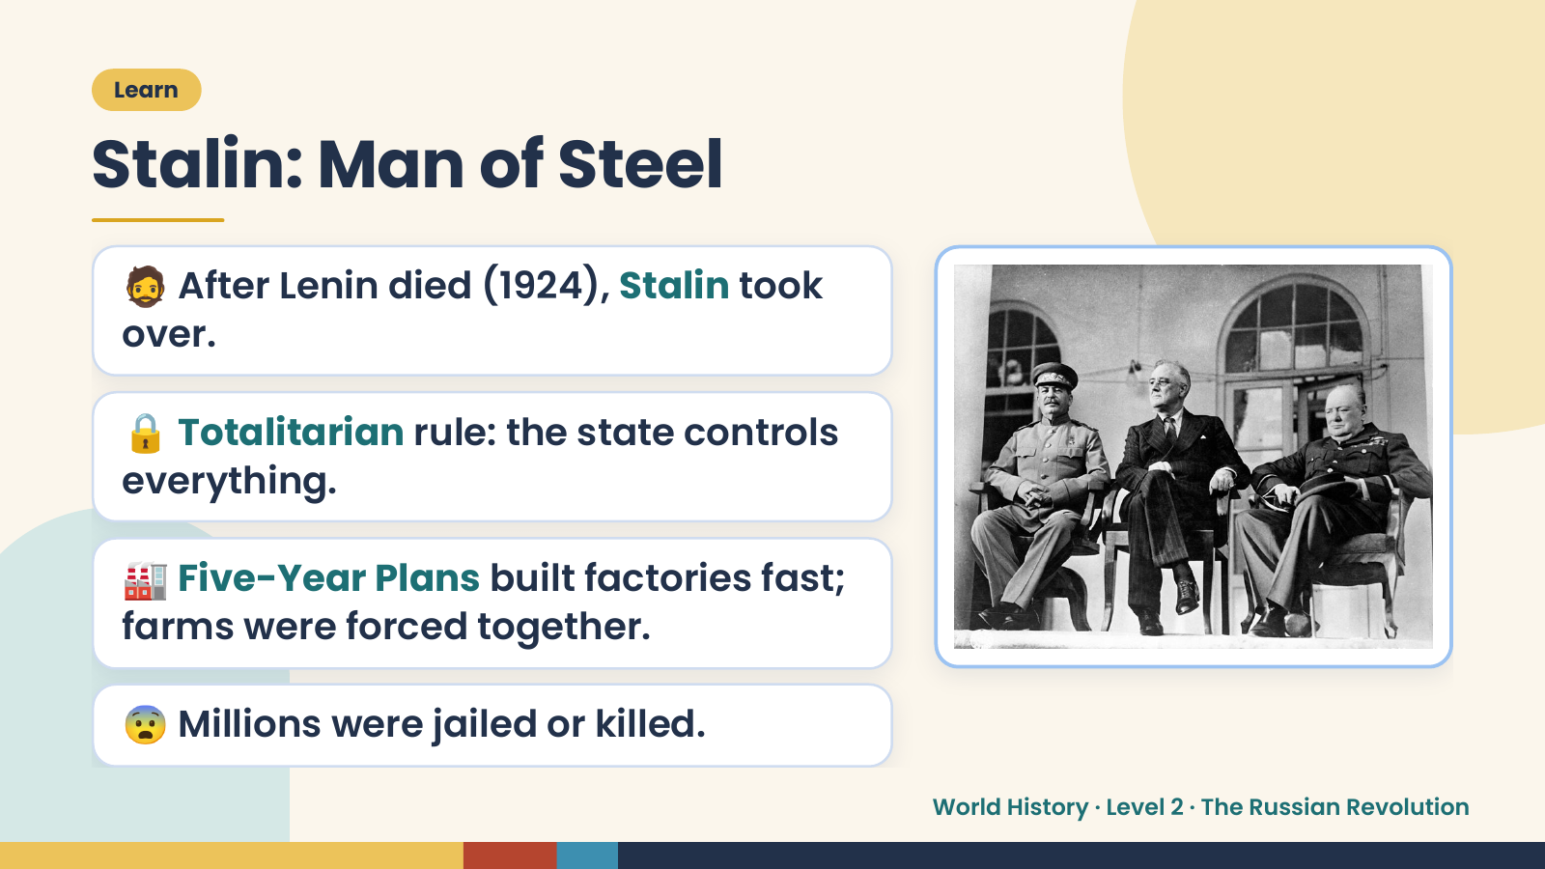
Notes:
Learn
Stalin: Man of Steel
🧔 After Lenin died (1924), Stalin took
over.
🔒 Totalitarian rule: the state controls
everything.
🏭 Five-Year Plans built factories fast;
farms were forced together.
😨 Millions were jailed or killed.
World History · Level 2 · The Russian Revolution

Slide 15
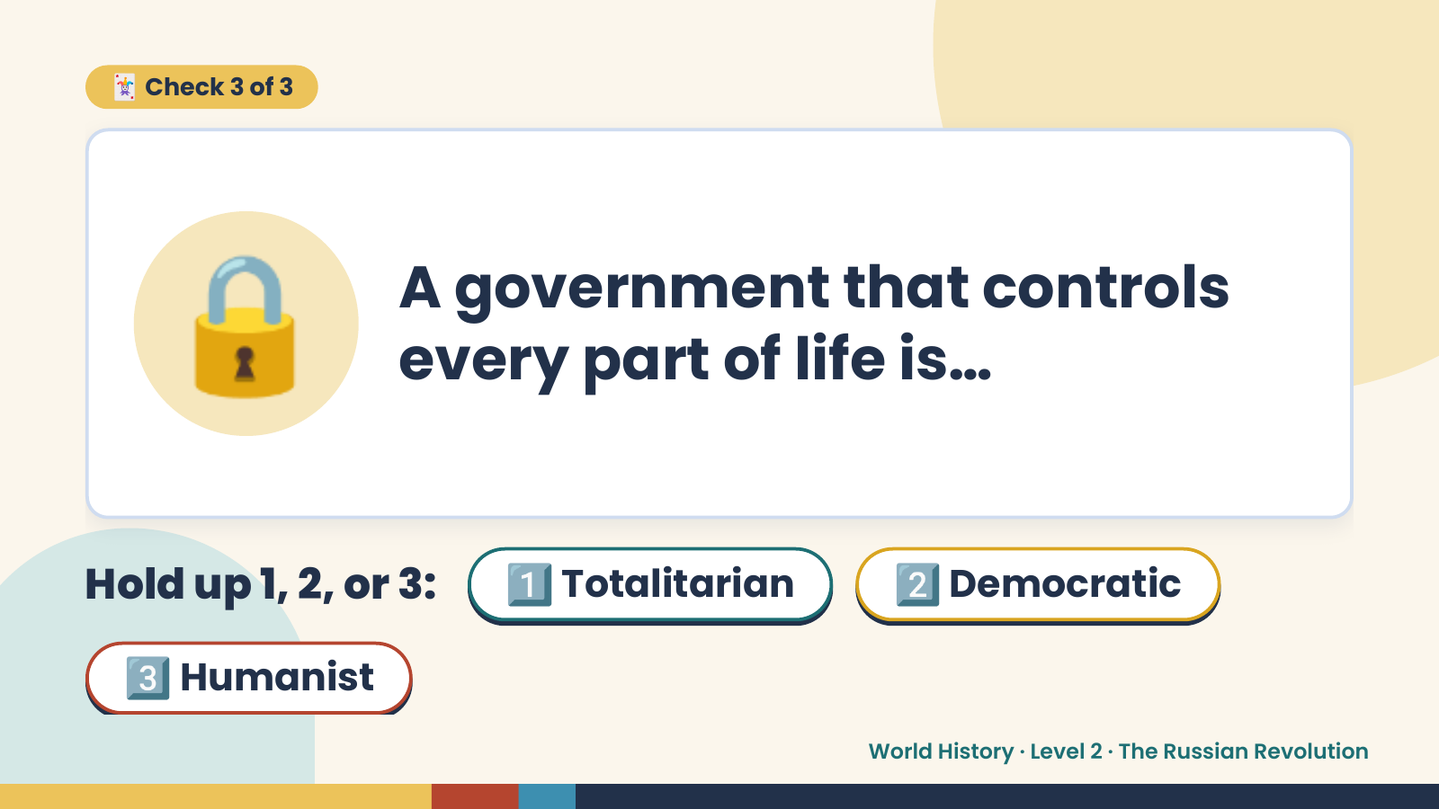
Notes:
🃏 Check 3 of 3
🔒 A government that controls
every part of life is…
Hold up 1, 2, or 3: 1️⃣ Totalitarian 2️⃣ Democratic
3️⃣ Humanist
World History · Level 2 · The Russian Revolution

Slide 16
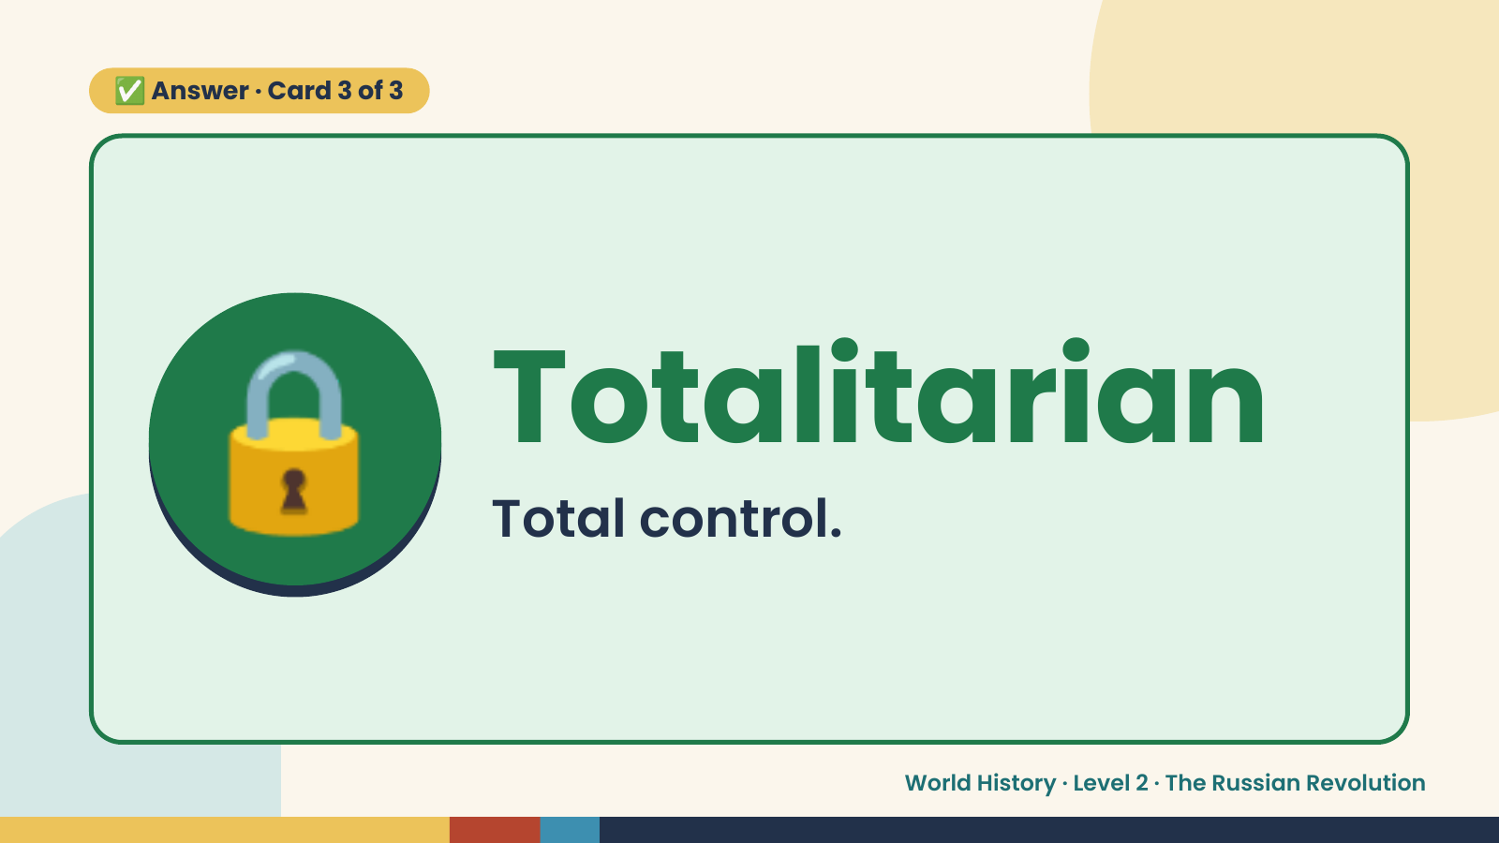
Notes:
✅ Answer · Card 3 of 3
🔒 Totalitarian
Total control.
World History · Level 2 · The Russian Revolution

Slide 17
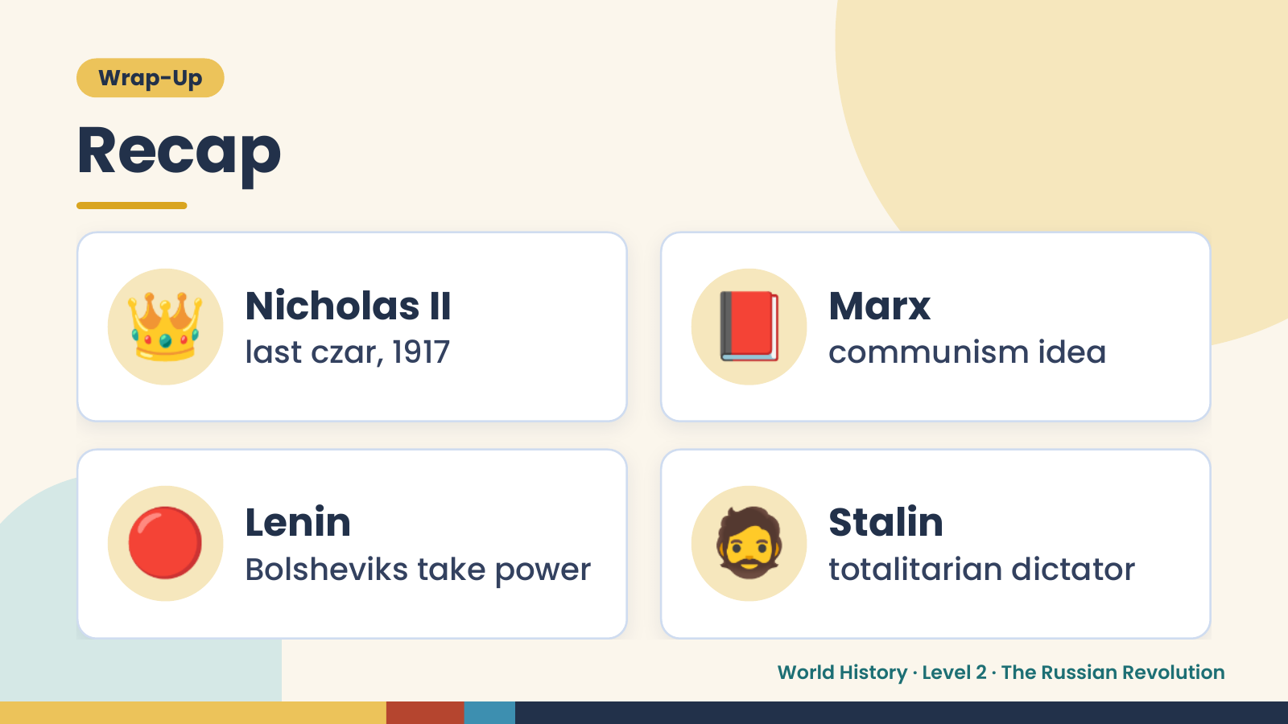
Notes:
Wrap-Up
Recap
👑 Nicholas II
last czar, 1917 📕 Marx
communism idea
🔴 Lenin
Bolsheviks take power 🧔 Stalin
totalitarian dictator
World History · Level 2 · The Russian Revolution

Slide 18
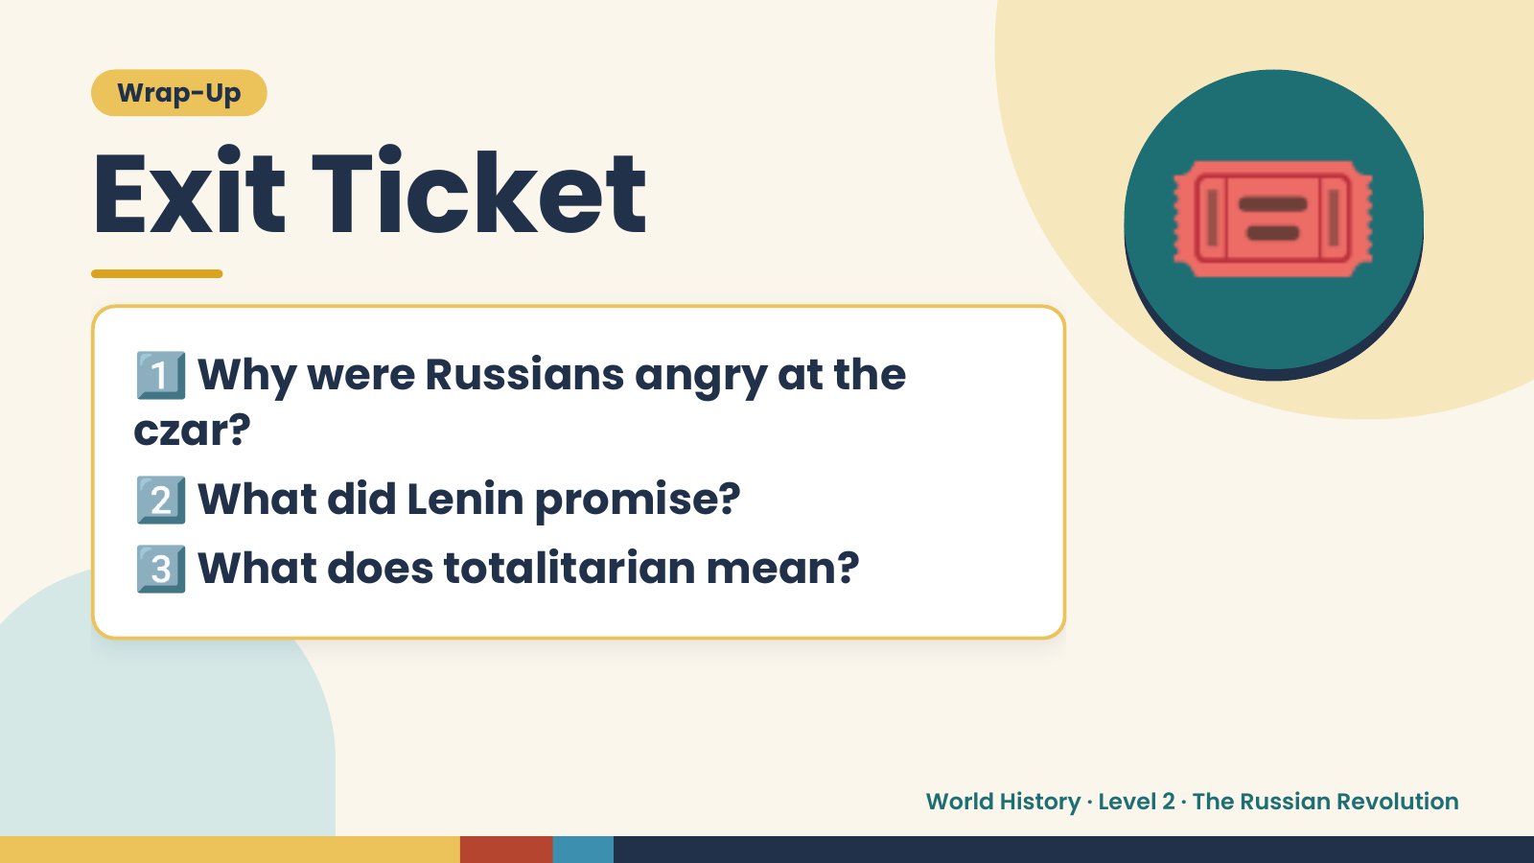
Notes:
Wrap-Up
Exit Ticket
1️⃣
Why were Russians angry at the
czar?
🎟️
2️⃣What did Lenin promise?
3️⃣What does totalitarian mean?
World History · Level 2 · The Russian Revolution

