Slide 1
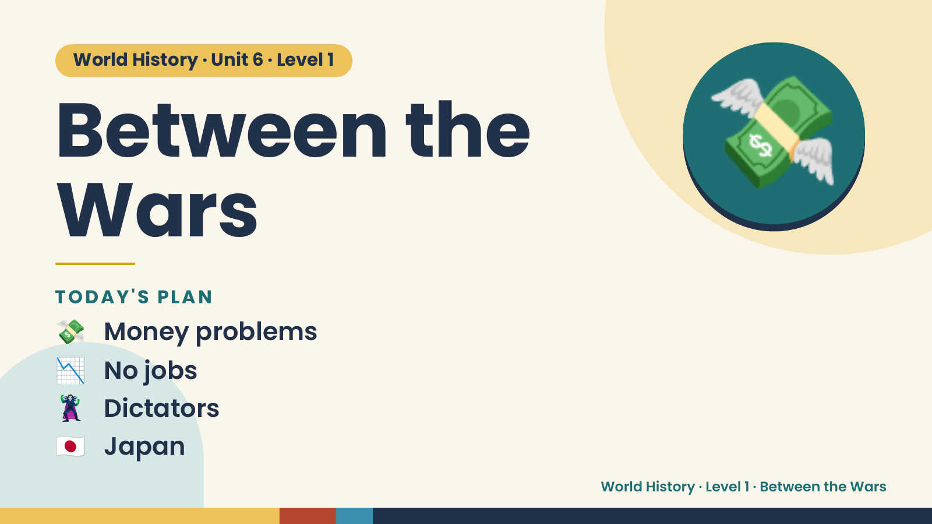
Notes:
World History · Unit 6 · Level 1
Between the
Wars
💸
💸 Money problems
TODAY'S PLAN
📉 No jobs
🦹 Dictators
🇯🇵 Japan
World History · Level 1 · Between the Wars

Slide 2
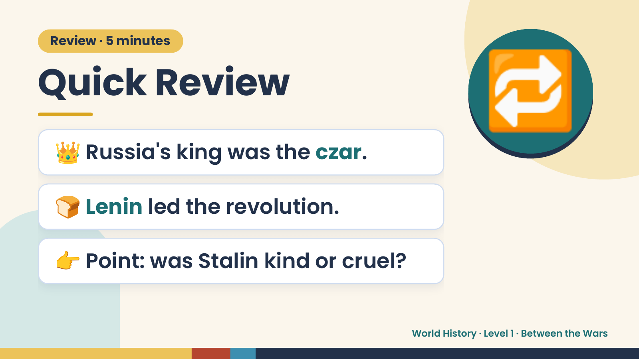
Notes:
Review · 5 minutes
Quick Review
👑 Russia's king was the czar.
🔁
🍞 Lenin led the revolution.
👉 Point: was Stalin kind or cruel?
World History · Level 1 · Between the Wars

Slide 3
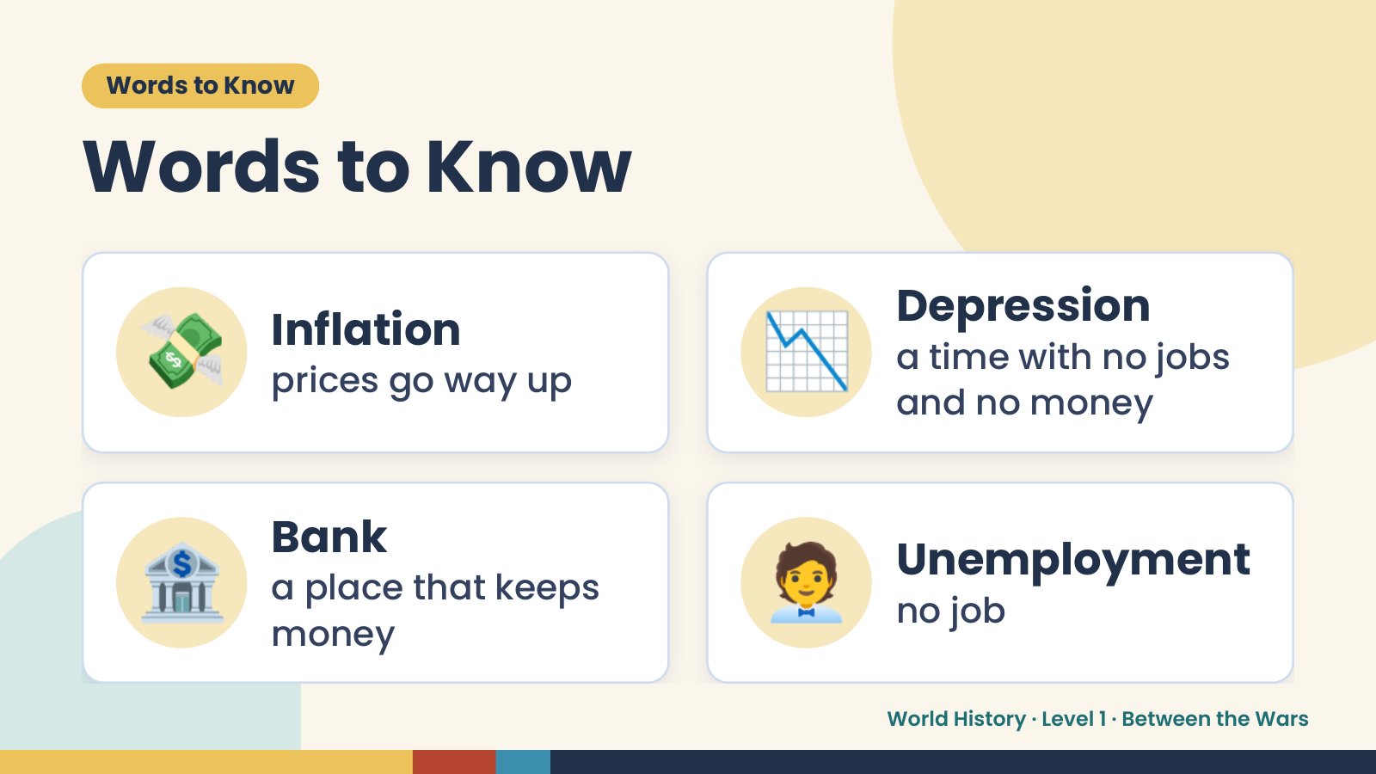
Notes:
Words to Know
Words to Know
💸 Inflation
prices go way up 📉 Depression
a time with no jobs
and no money
🏦 Bank
a place that keeps
money
🧑‍💼 Unemployment
no job
World History · Level 1 · Between the Wars

Slide 4
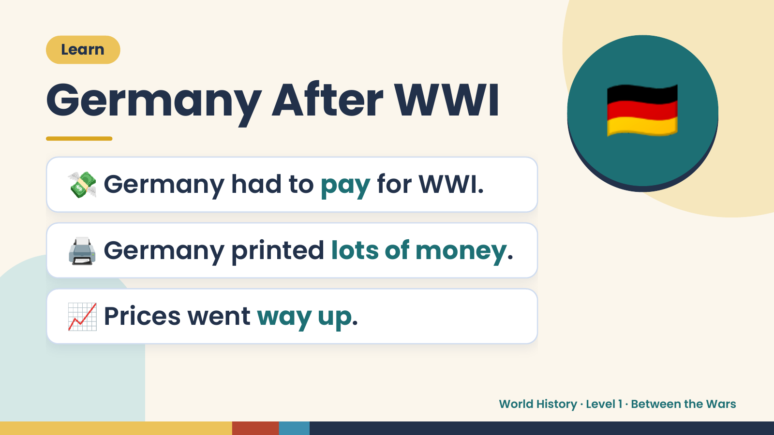
Notes:
🇩🇪
Learn
Germany After WWI
💸 Germany had to pay for WWI.
🖨️ Germany printed lots of money.
📈 Prices went way up.
World History · Level 1 · Between the Wars

Slide 5
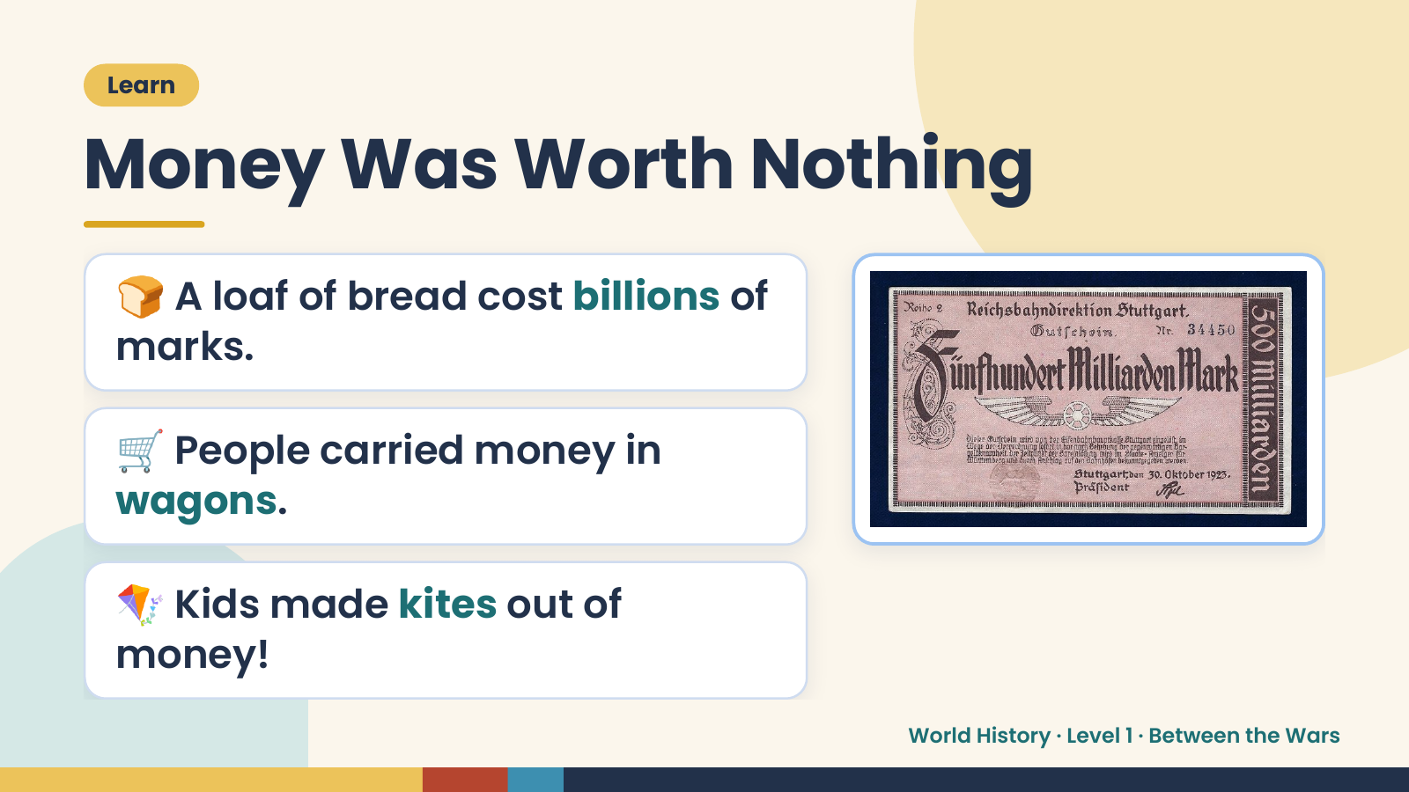
Notes:
Learn
Money Was Worth Nothing
🍞 A loaf of bread cost billions of
marks.
🛒 People carried money in
wagons.
🪁 Kids made kites out of
money!
World History · Level 1 · Between the Wars

Slide 6
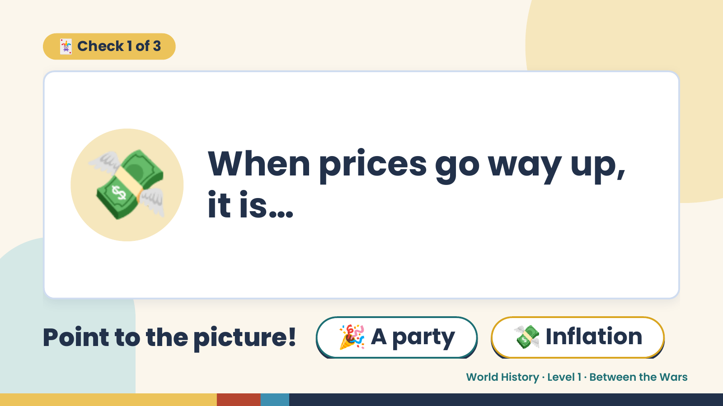
Notes:
🃏 Check 1 of 3
💸 When prices go way up,
it is…
Point to the picture! 🎉 A party 💸 Inflation
World History · Level 1 · Between the Wars

Slide 7
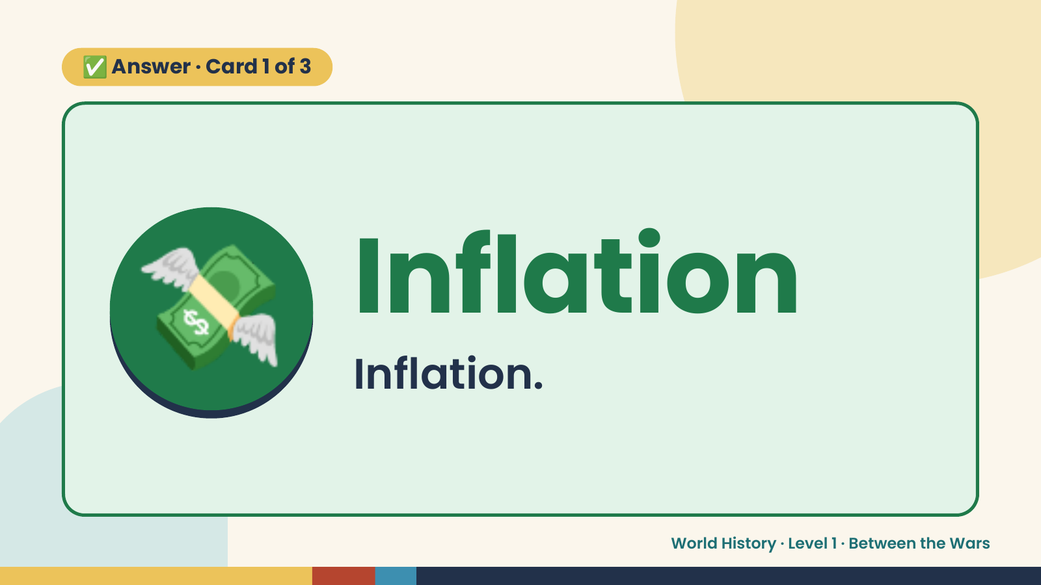
Notes:
✅ Answer · Card 1 of 3
💸 Inflation
Inflation.
World History · Level 1 · Between the Wars

Slide 8
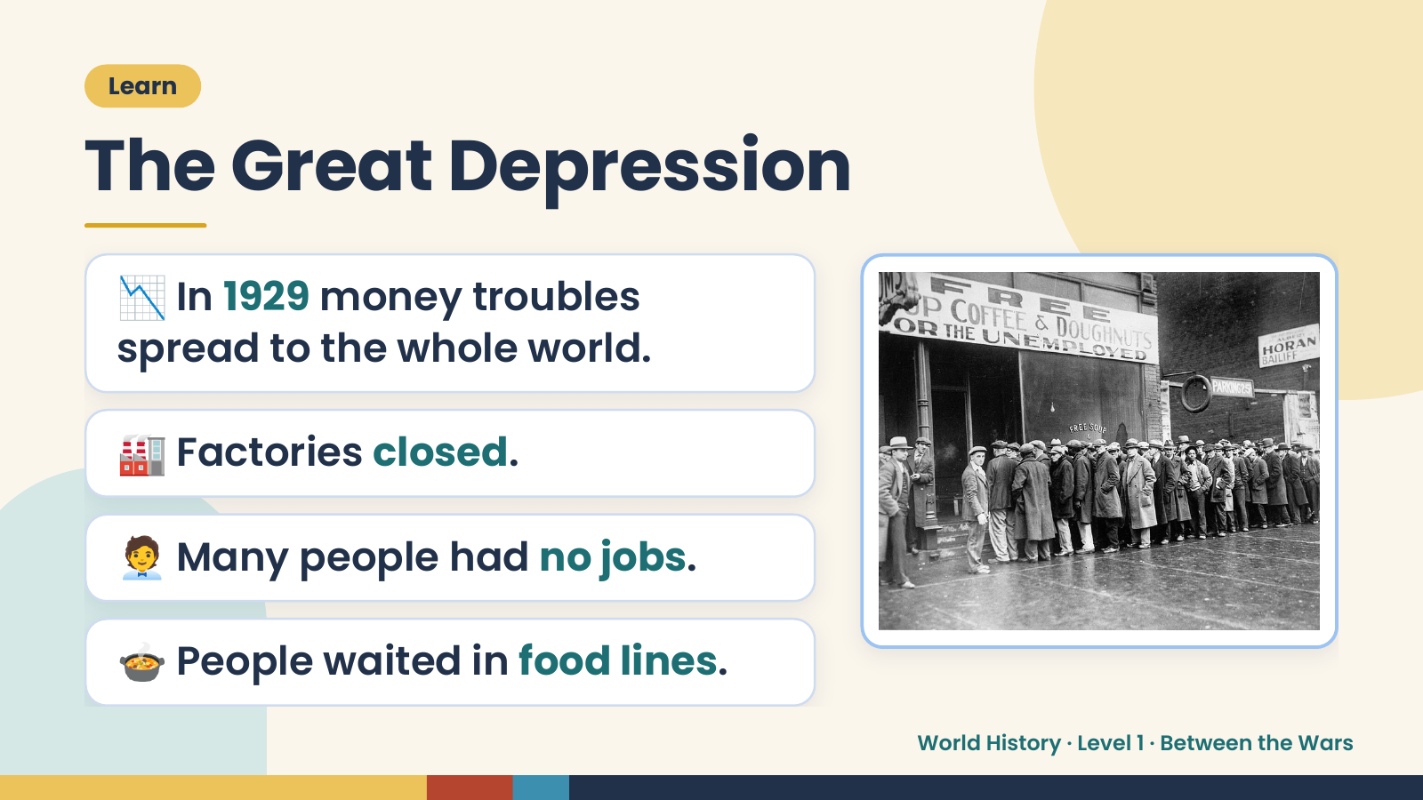
Notes:
Learn
The Great Depression
📉 In 1929 money troubles
spread to the whole world.
🏭 Factories closed.
🧑‍💼 Many people had no jobs.
🍲 People waited in food lines.
World History · Level 1 · Between the Wars

Slide 9
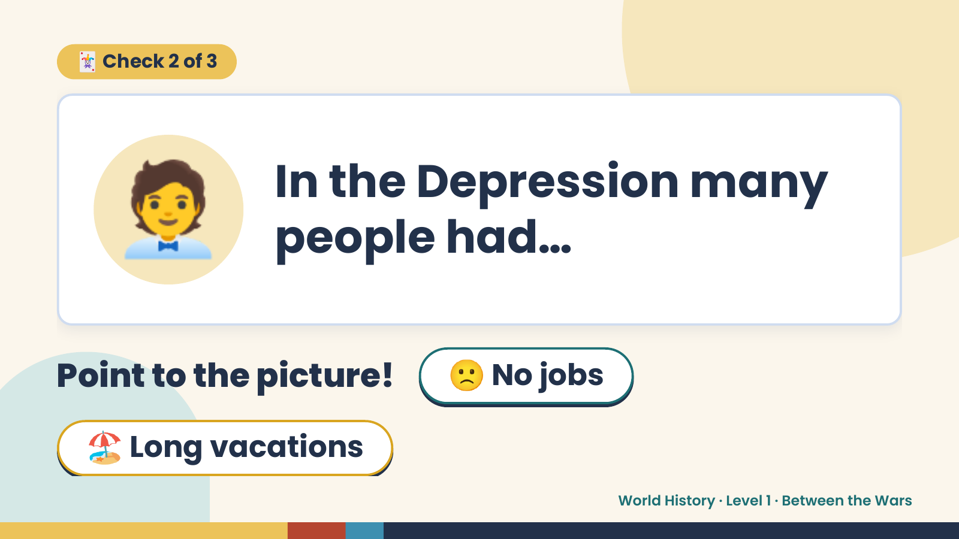
Notes:
🃏 Check 2 of 3
🧑‍💼 In the Depression many
people had…
Point to the picture! 🙁 No jobs
🏖️ Long vacations
World History · Level 1 · Between the Wars

Slide 10
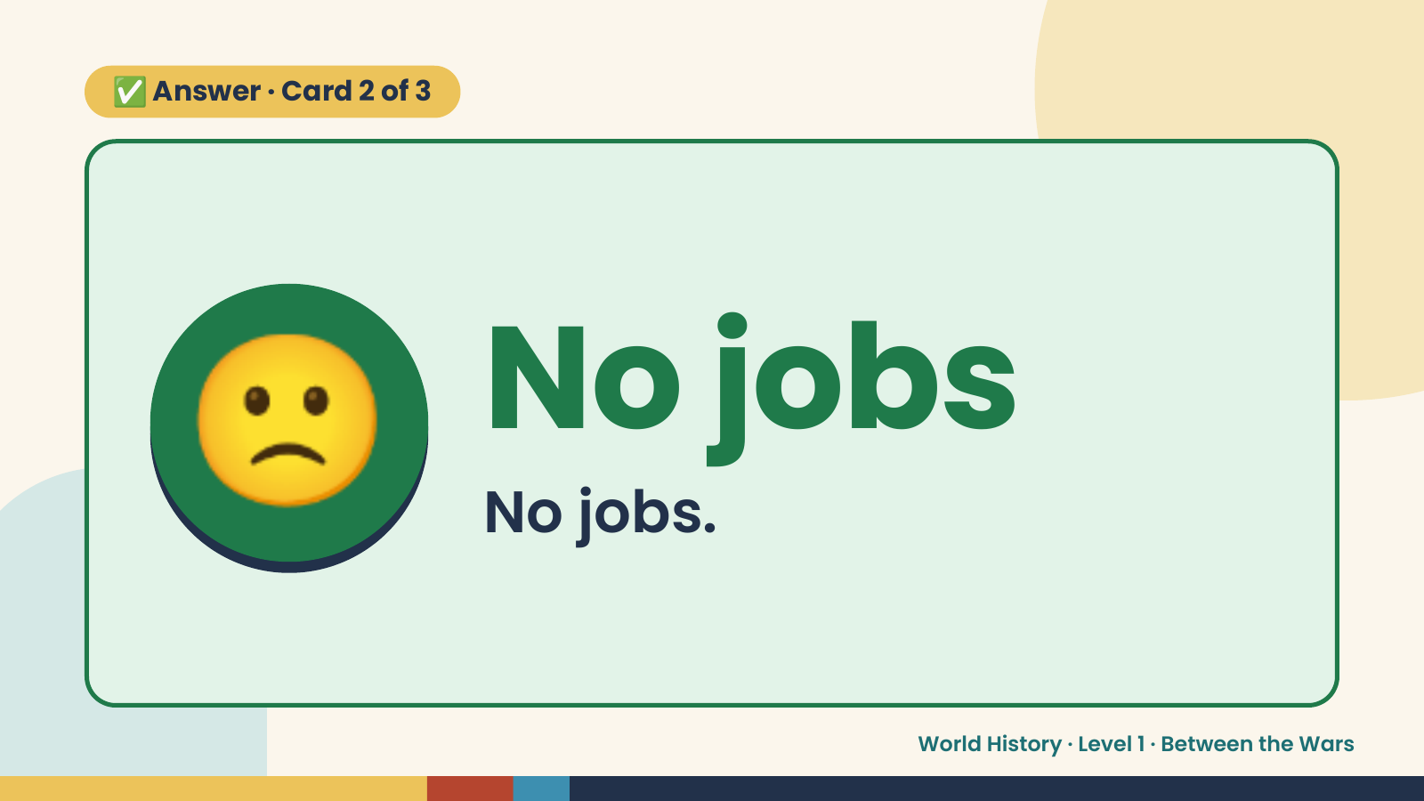
Notes:
✅ Answer · Card 2 of 3
🙁 No jobs
No jobs.
World History · Level 1 · Between the Wars

Slide 11
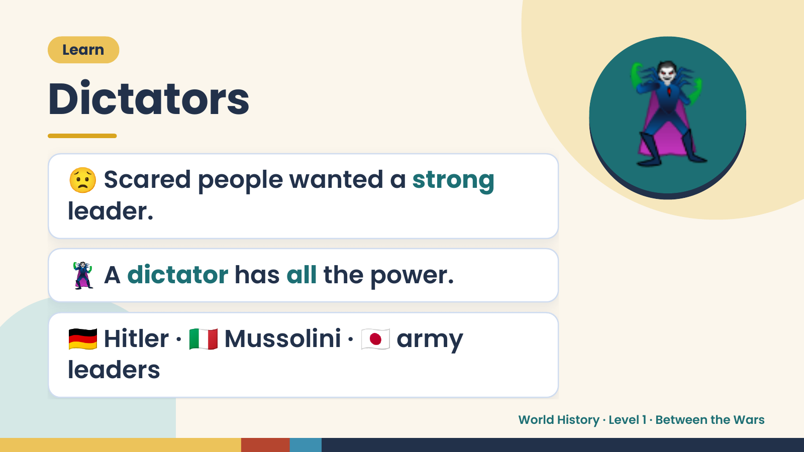
Notes:
Learn
Dictators
😟 Scared people wanted a strong
leader.
🦹
🦹 A dictator has all the power.
🇩🇪 Hitler · 🇮🇹 Mussolini · 🇯🇵 army
leaders
World History · Level 1 · Between the Wars

Slide 12
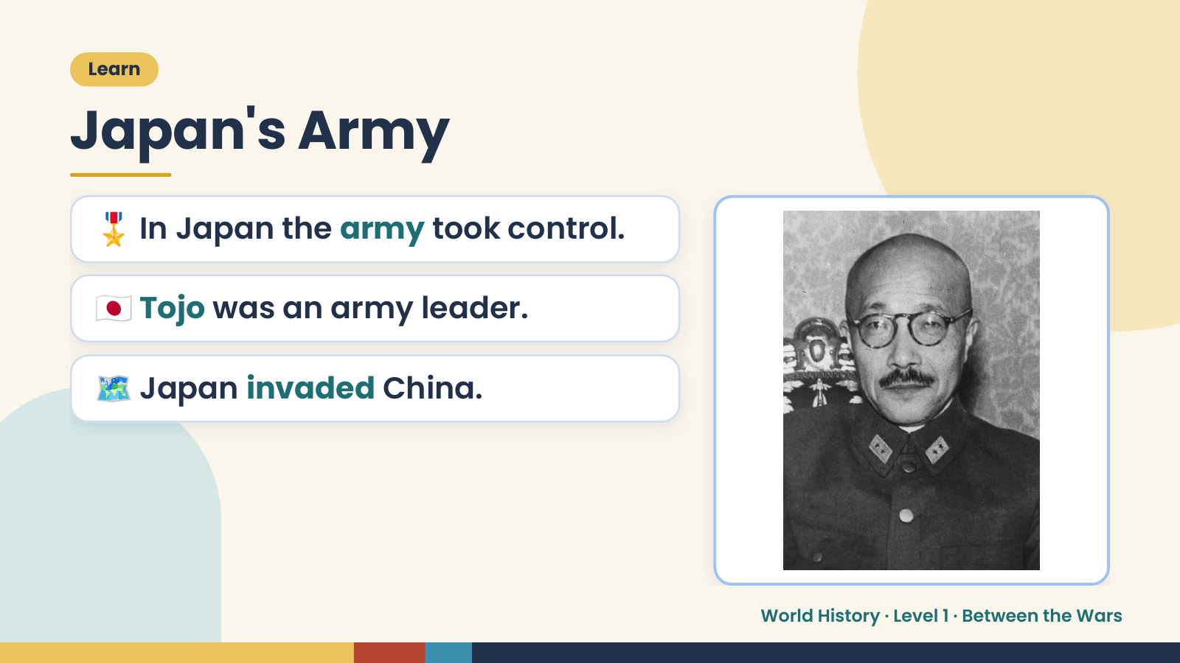
Notes:
Learn
Japan's Army
🎖️ In Japan the army took control.
🇯🇵 Tojo was an army leader.
🗺️ Japan invaded China.
World History · Level 1 · Between the Wars

Slide 13
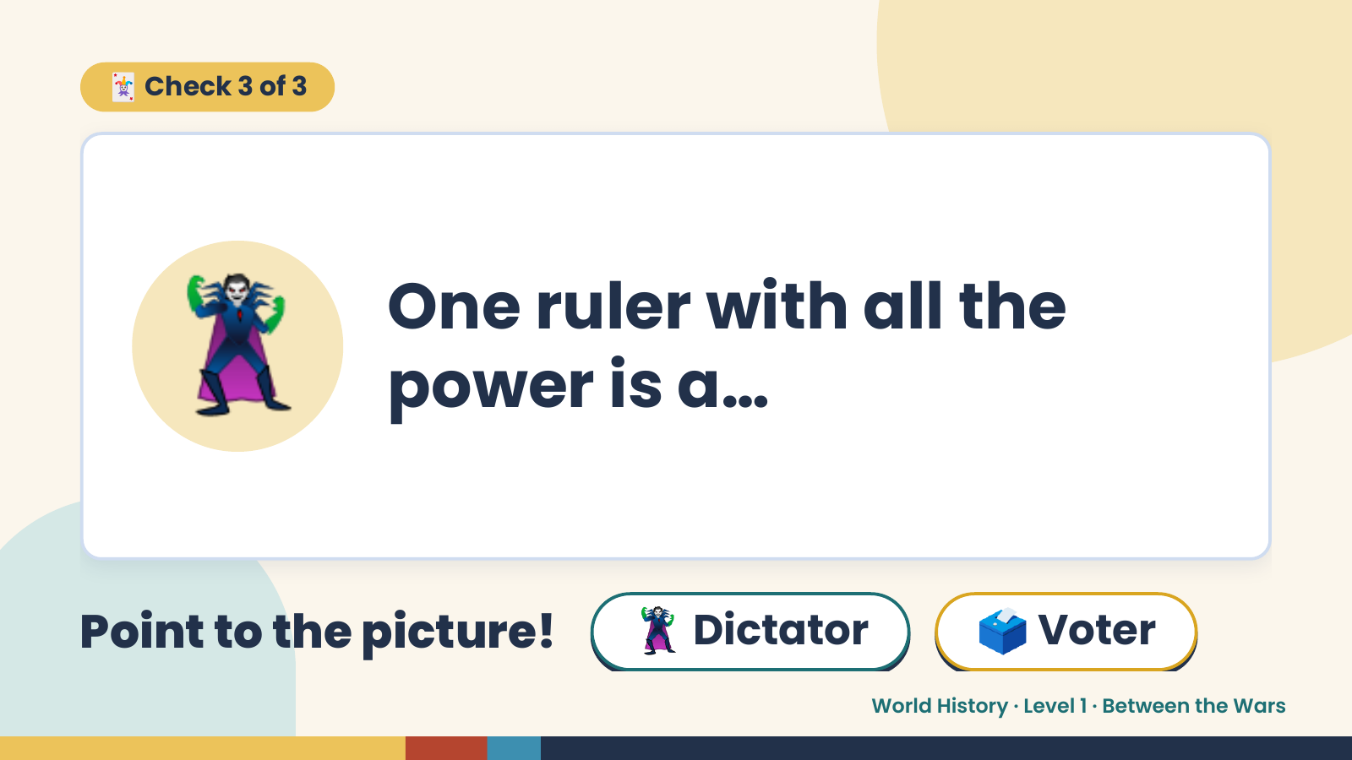
Notes:
🃏 Check 3 of 3
🦹 One ruler with all the
power is a…
Point to the picture! 🦹 Dictator 🗳️ Voter
World History · Level 1 · Between the Wars

Slide 14
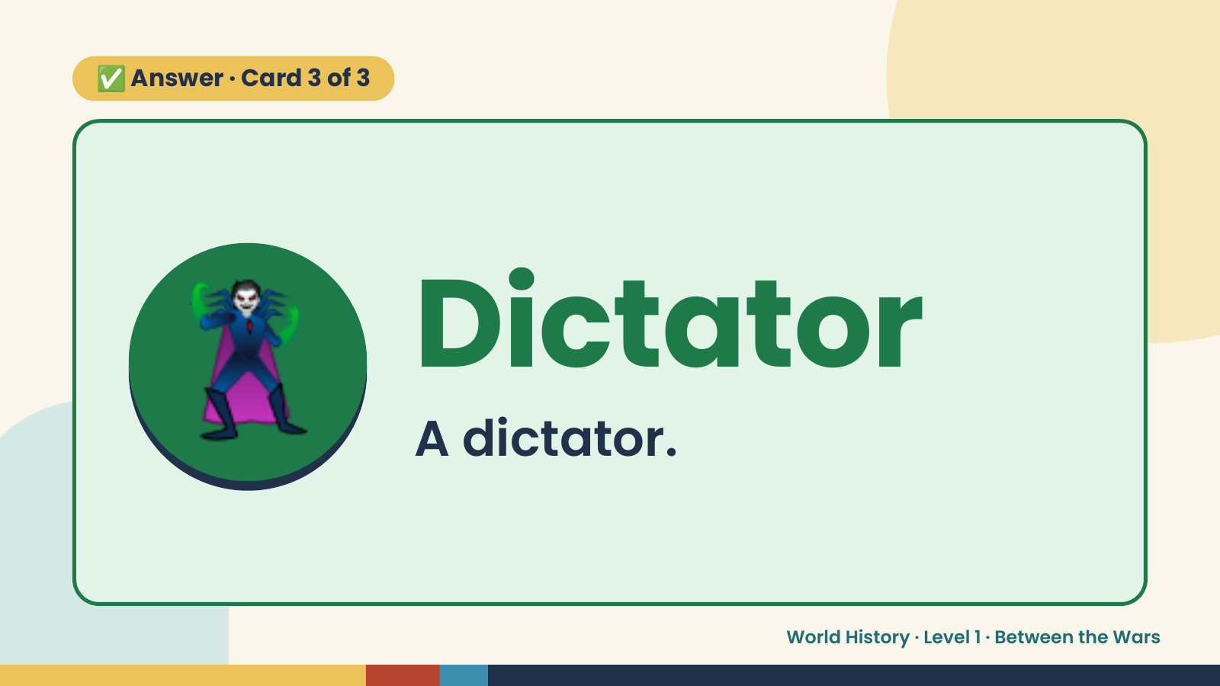
Notes:
✅ Answer · Card 3 of 3
🦹 Dictator
A dictator.
World History · Level 1 · Between the Wars

Slide 15
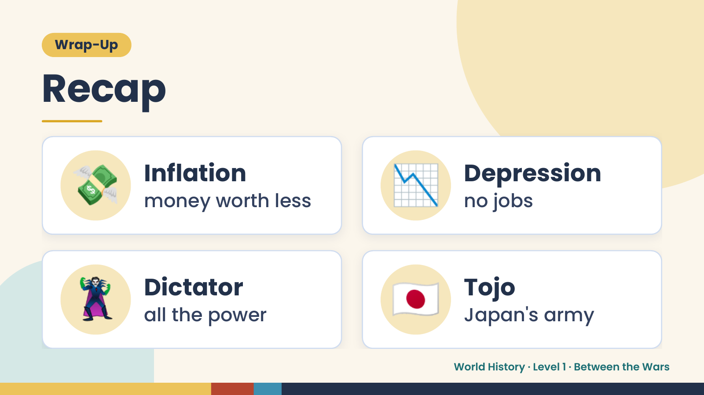
Notes:
Wrap-Up
Recap
💸 Inflation
money worth less 📉 Depression
no jobs
🦹 Dictator
all the power 🇯🇵 Tojo
Japan's army
World History · Level 1 · Between the Wars

Slide 16
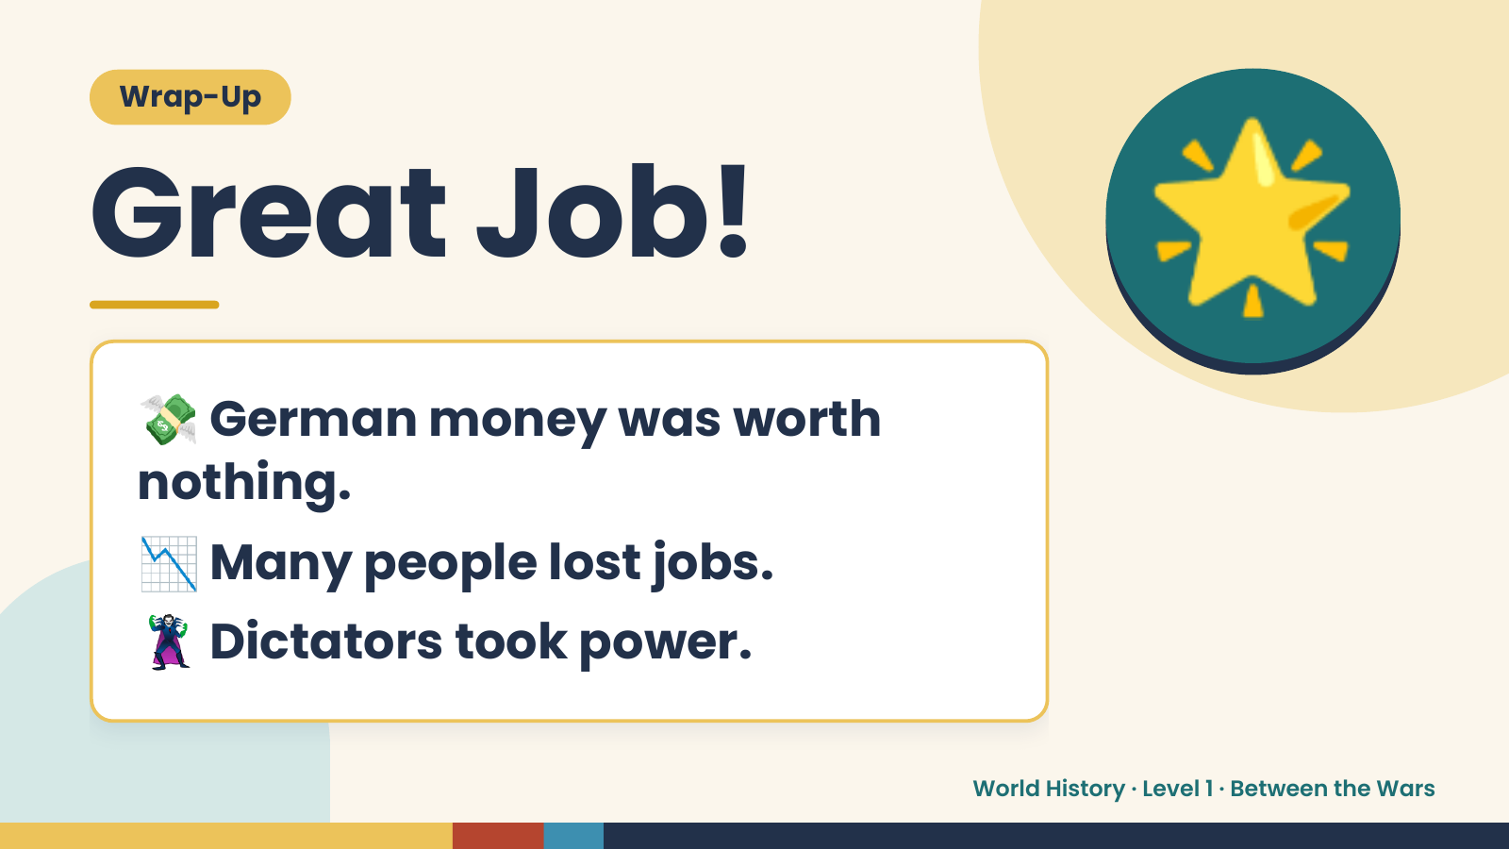
Notes:
Wrap-Up
Great Job!
💸German money was worth
🌟
nothing.
📉 Many people lost jobs.
🦹 Dictators took power.
World History · Level 1 · Between the Wars

