Slide 1
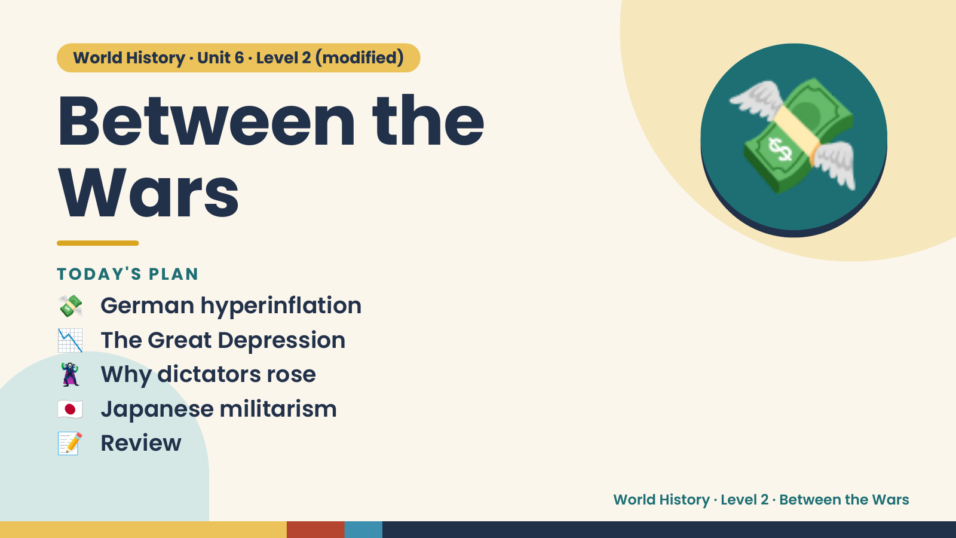
Notes:
World History · Unit 6 · Level 2 (modified)
Between the
Wars
💸 German hyperinflation
TODAY'S PLAN
💸
📉 The Great Depression
🦹 Why dictators rose
🇯🇵 Japanese militarism
📝 Review
World History · Level 2 · Between the Wars

Slide 2
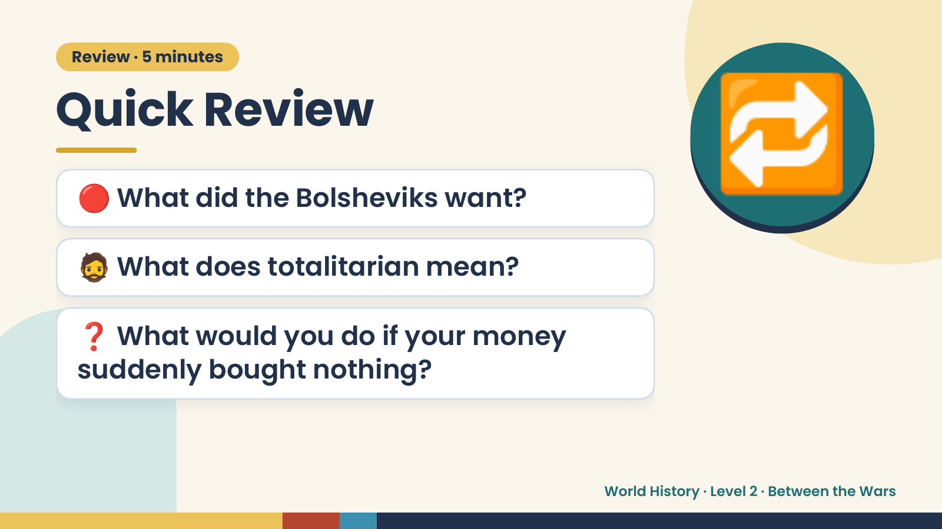
Notes:
Review · 5 minutes
Quick Review
🔴 What did the Bolsheviks want?
🧔 What does totalitarian mean?
🔁
❓ What would you do if your money
suddenly bought nothing?
World History · Level 2 · Between the Wars

Slide 3
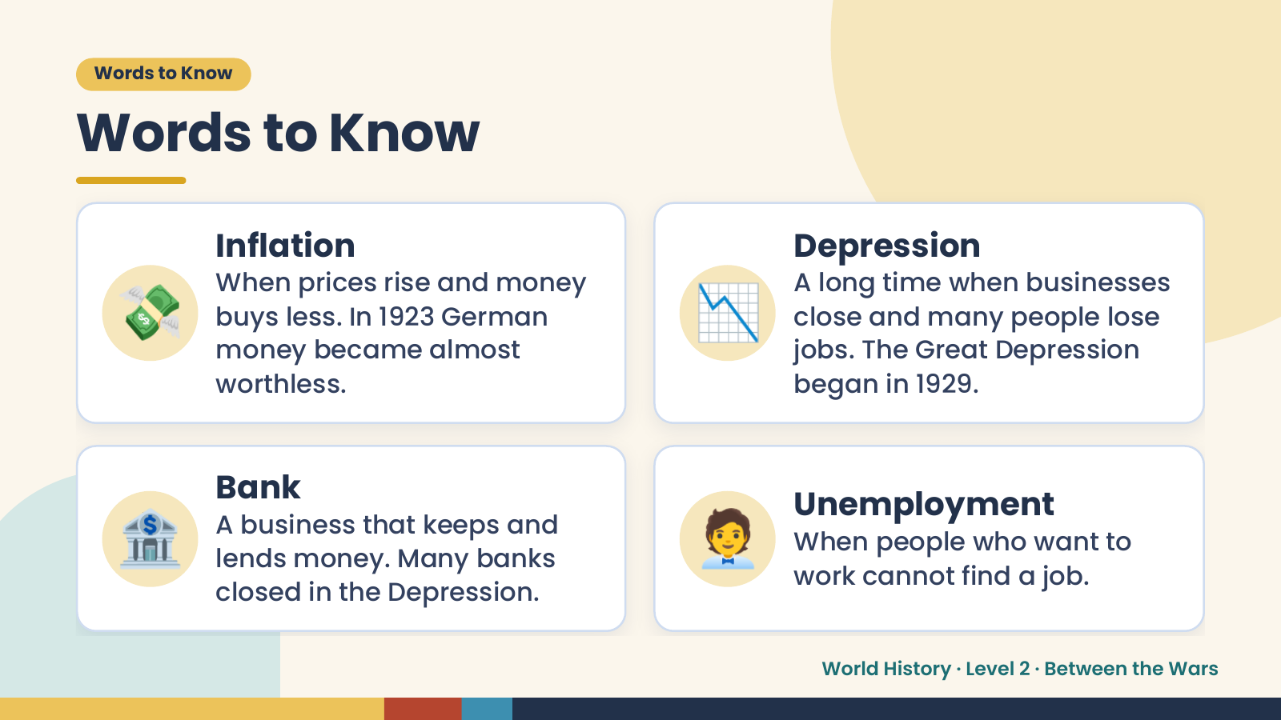
Notes:
Words to Know
Words to Know
💸 📉
Inflation Depression
When prices rise and money A long time when businesses
buys less. In 1923 German close and many people lose
money became almost jobs. The Great Depression
worthless. began in 1929.
🏦 Bank
A business that keeps and
lends money. Many banks
closed in the Depression.
🧑‍💼 Unemployment
When people who want to
work cannot find a job.
World History · Level 2 · Between the Wars

Slide 4
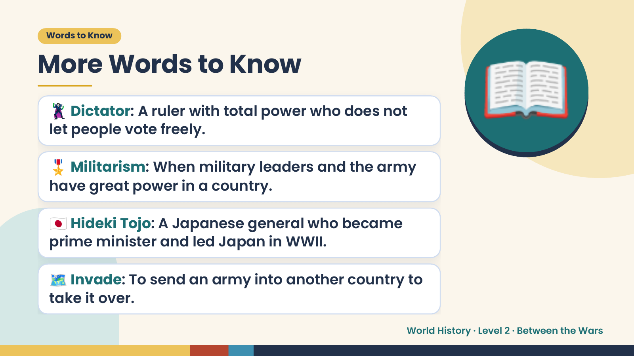
Notes:
Words to Know
More Words to Know
🦹 Dictator: A ruler with total power who does not
let people vote freely.
🎖️ Militarism: When military leaders and the army
have great power in a country.
📖
🇯🇵 Hideki Tojo: A Japanese general who became
prime minister and led Japan in WWII.
🗺️ Invade: To send an army into another country to
take it over.
World History · Level 2 · Between the Wars

Slide 5
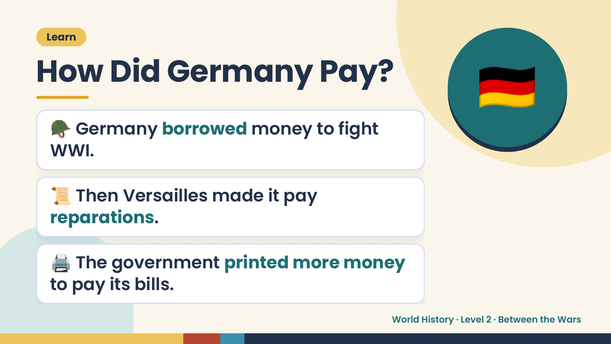
Notes:
🇩🇪
Learn
How Did Germany Pay?
🪖 Germany borrowed money to fight
WWI.
📜 Then Versailles made it pay
reparations.
🖨️ The government printed more money
to pay its bills.
World History · Level 2 · Between the Wars

Slide 6
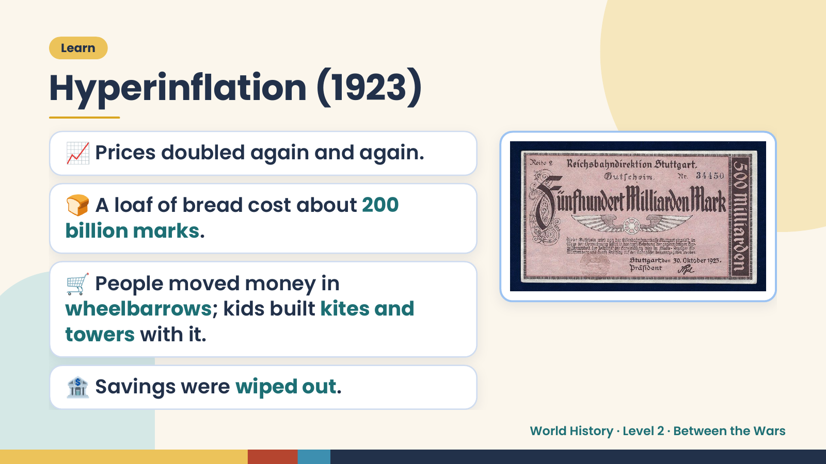
Notes:
Learn
Hyperinflation (1923)
📈 Prices doubled again and again.
🍞 A loaf of bread cost about 200
billion marks.
🛒 People moved money in
wheelbarrows; kids built kites and
towers with it.
🏦 Savings were wiped out.
World History · Level 2 · Between the Wars

Slide 7
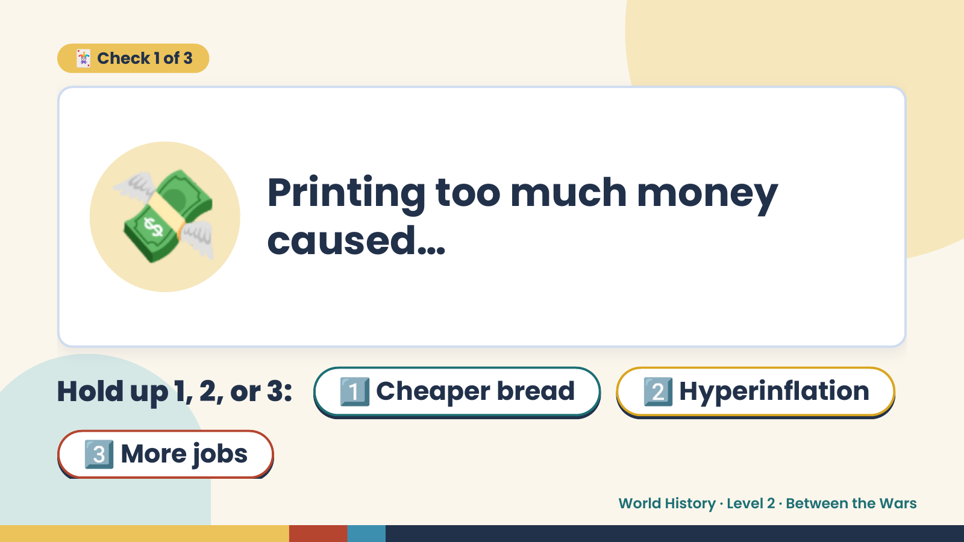
Notes:
🃏 Check 1 of 3
💸 Printing too much money
caused…
Hold up 1, 2, or 3: 1️⃣ Cheaper bread 2️⃣ Hyperinflation
3️⃣ More jobs
World History · Level 2 · Between the Wars

Slide 8
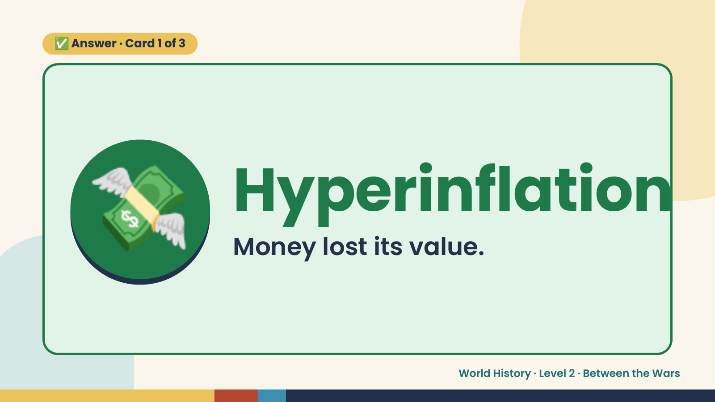
Notes:
✅ Answer · Card 1 of 3
💸 Hyperinflation
Money lost its value.
World History · Level 2 · Between the Wars

Slide 9
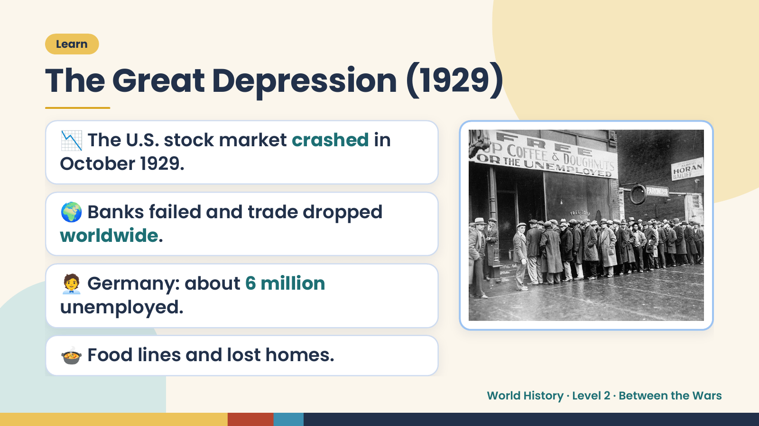
Notes:
Learn
The Great Depression (1929)
📉 The U.S. stock market crashed in
October 1929.
🌍 Banks failed and trade dropped
worldwide.
🧑‍💼 Germany: about 6 million
unemployed.
🍲 Food lines and lost homes.
World History · Level 2 · Between the Wars

Slide 10
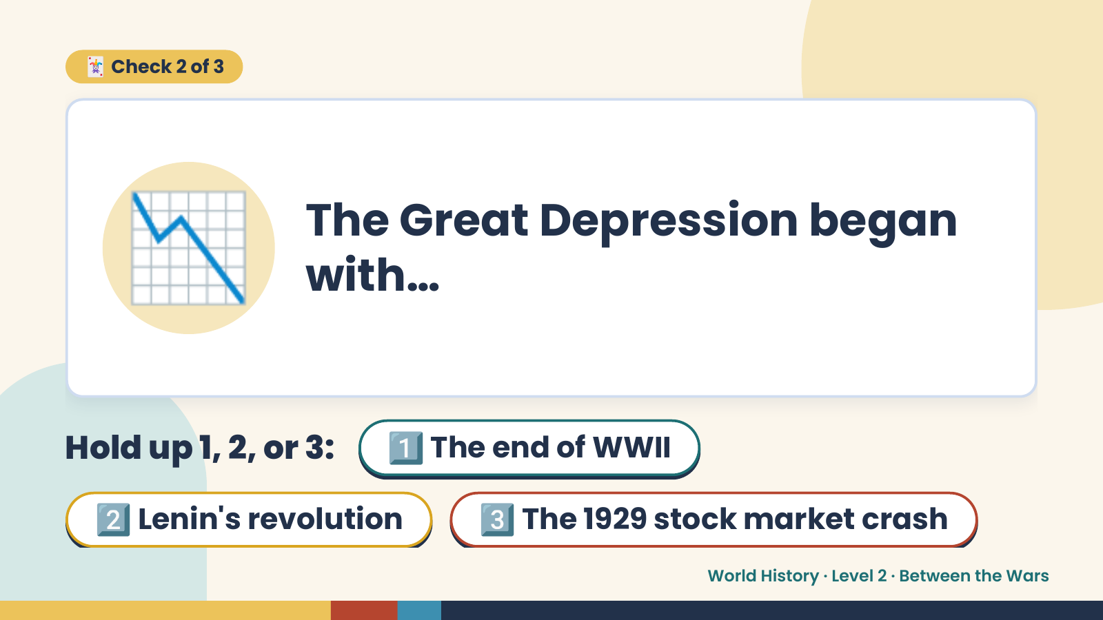
Notes:
🃏 Check 2 of 3
📉 The Great Depression began
with…
Hold up 1, 2, or 3: 1️⃣ The end of WWII
2️⃣ Lenin's revolution 3️⃣ The 1929 stock market crash
World History · Level 2 · Between the Wars

Slide 11
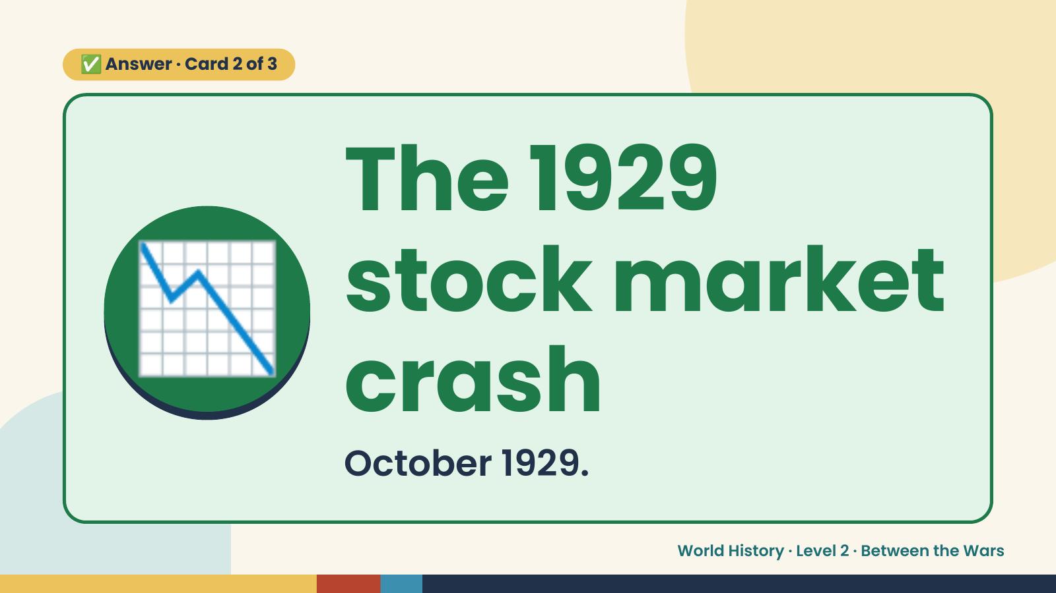
Notes:
✅ Answer · Card 2 of 3
📉 The 1929
stock market
crash
October 1929.
World History · Level 2 · Between the Wars

Slide 12
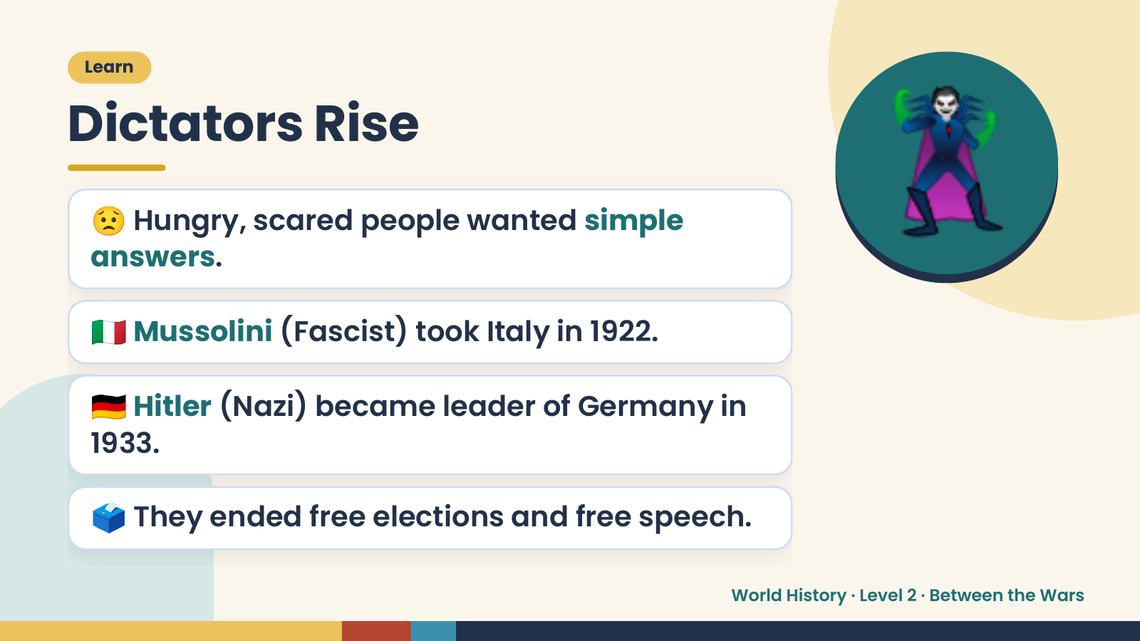
Notes:
Learn
Dictators Rise
😟 Hungry, scared people wanted simple
answers.
🇮🇹 Mussolini (Fascist) took Italy in 1922.
🦹
🇩🇪 Hitler (Nazi) became leader of Germany in
1933.
🗳️ They ended free elections and free speech.
World History · Level 2 · Between the Wars

Slide 13
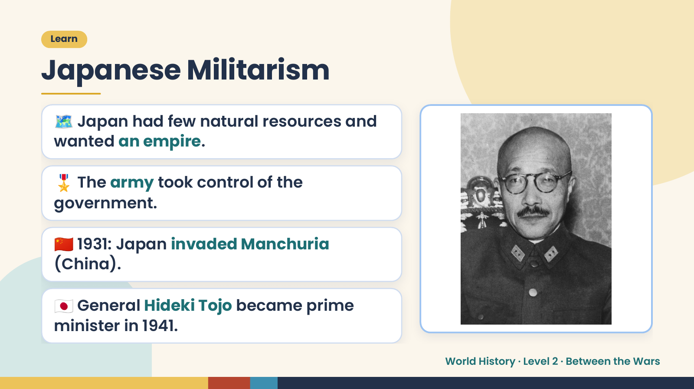
Notes:
Learn
Japanese Militarism
🗺️ Japan had few natural resources and
wanted an empire.
🎖️ The army took control of the
government.
🇨🇳 1931: Japan invaded Manchuria
(China).
🇯🇵 General Hideki Tojo became prime
minister in 1941.
World History · Level 2 · Between the Wars

Slide 14
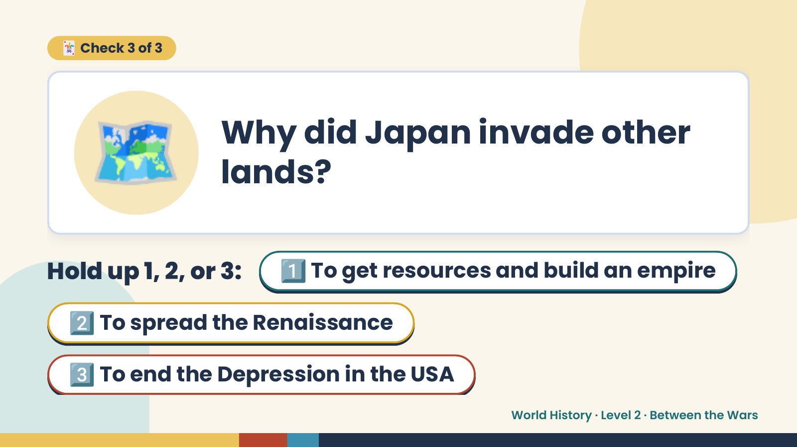
Notes:
🗺️
🃏 Check 3 of 3
Why did Japan invade other
lands?
Hold up 1, 2, or 3: 1️⃣ To get resources and build an empire
2️⃣ To spread the Renaissance
3️⃣ To end the Depression in the USA
World History · Level 2 · Between the Wars

Slide 15
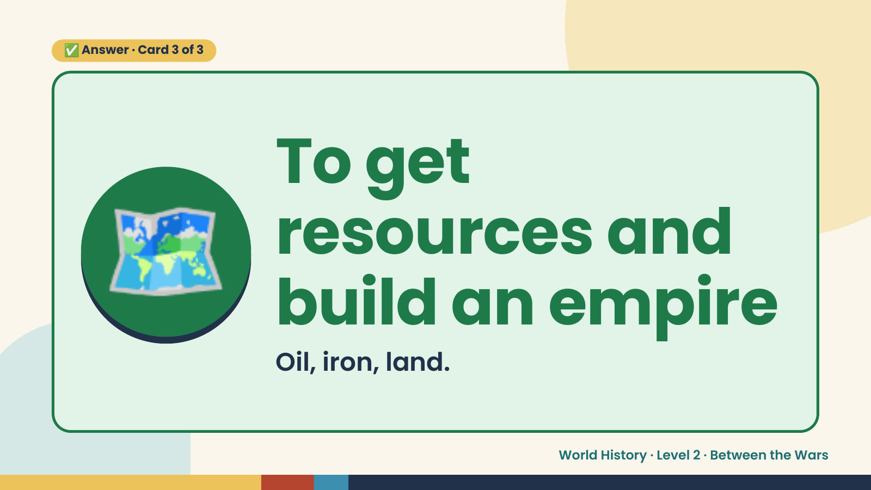
Notes:
✅ Answer · Card 3 of 3
🗺️ To get
resources and
build an empire
Oil, iron, land.
World History · Level 2 · Between the Wars

Slide 16
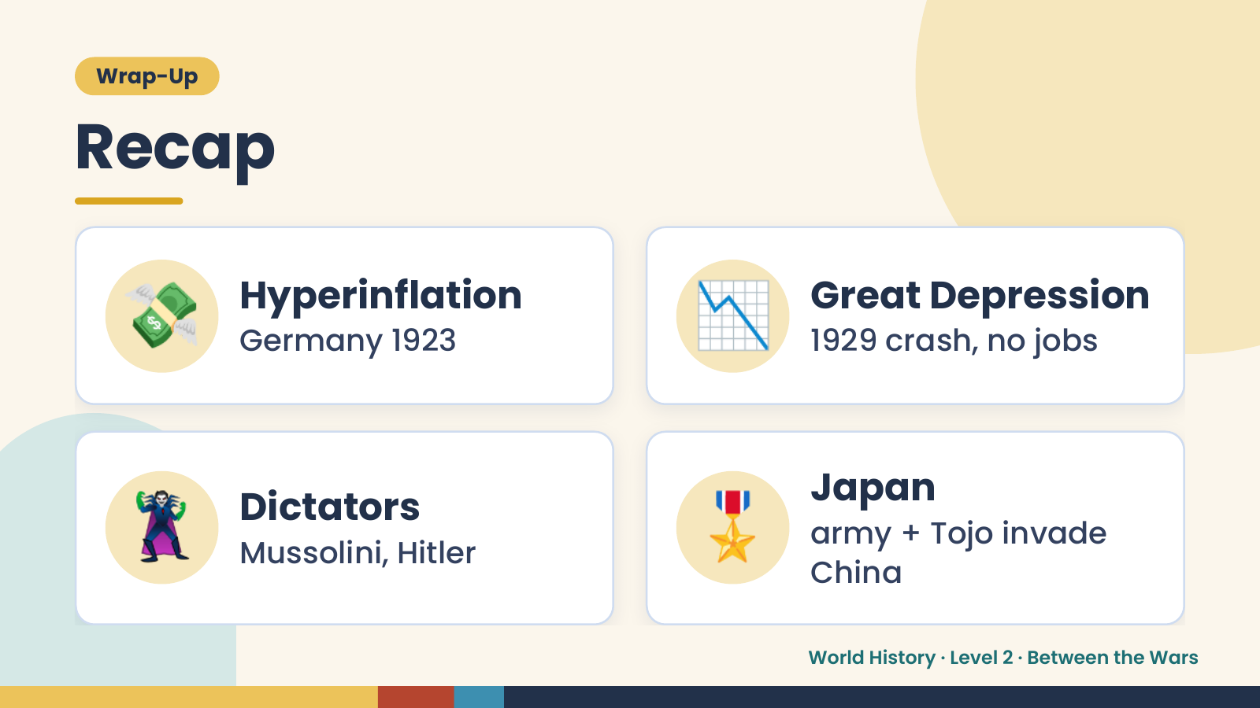
Notes:
Wrap-Up
Recap
💸 Hyperinflation
Germany 1923 📉 Great Depression
1929 crash, no jobs
🦹 Dictators
Mussolini, Hitler 🎖️ Japan
army + Tojo invade
China
World History · Level 2 · Between the Wars

Slide 17
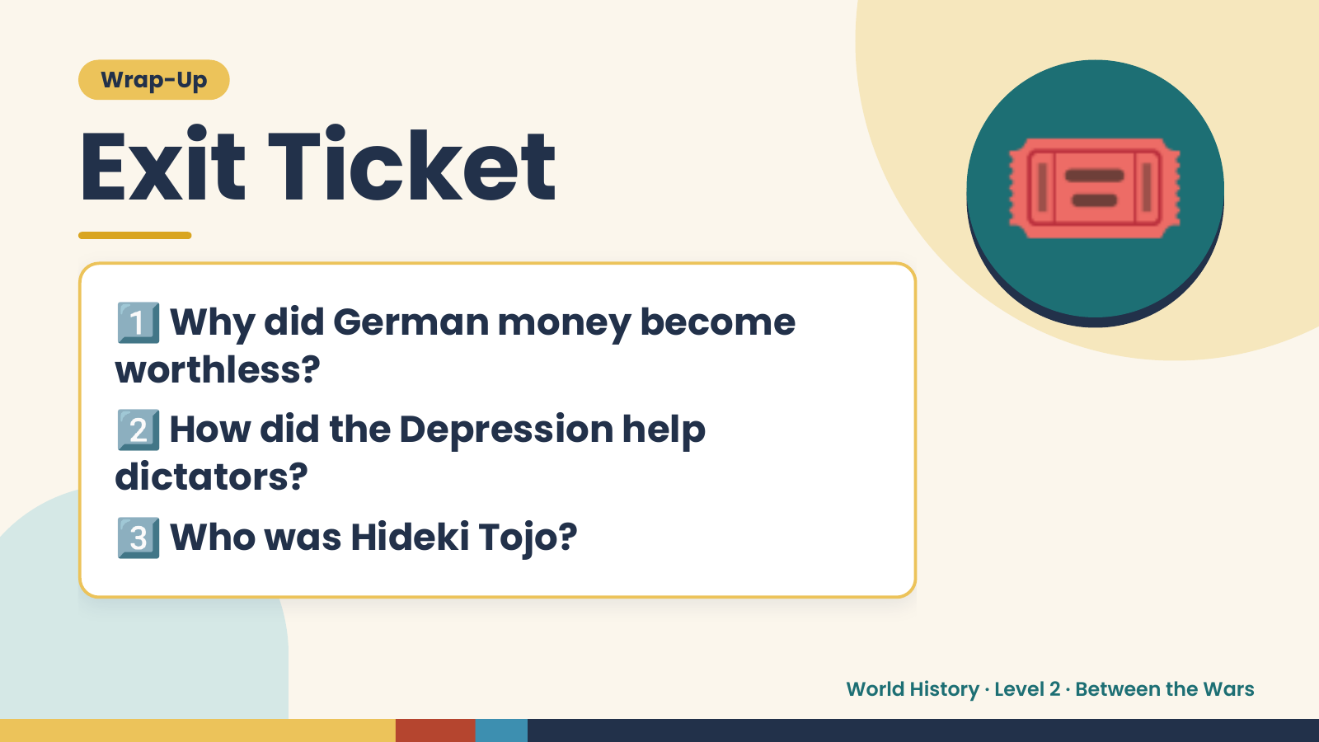
Notes:
Wrap-Up
Exit Ticket
1️⃣
Why did German money become
worthless?
🎟️
2️⃣
How did the Depression help
dictators?
3️⃣Who was Hideki Tojo?
World History · Level 2 · Between the Wars

