Slide 1
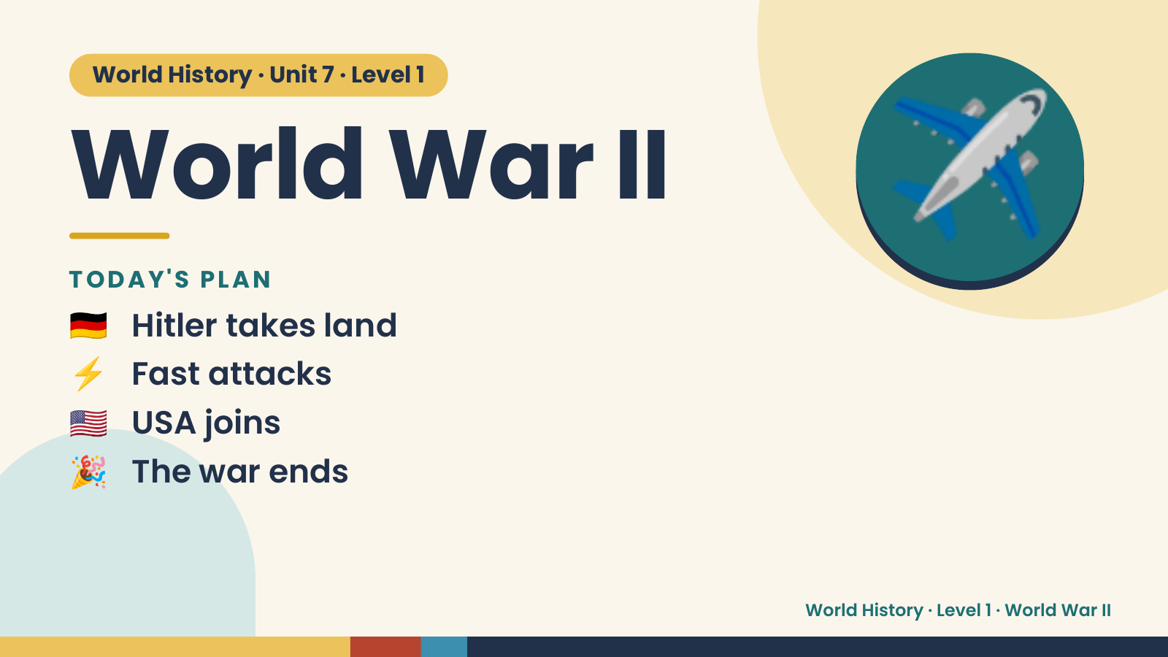
Notes:
World History · Unit 7 · Level 1
World War II
TODAY'S PLAN
🇩🇪 Hitler takes land
✈️
⚡ Fast attacks
🇺🇸 USA joins
🎉 The war ends
World History · Level 1 · World War II

Slide 2
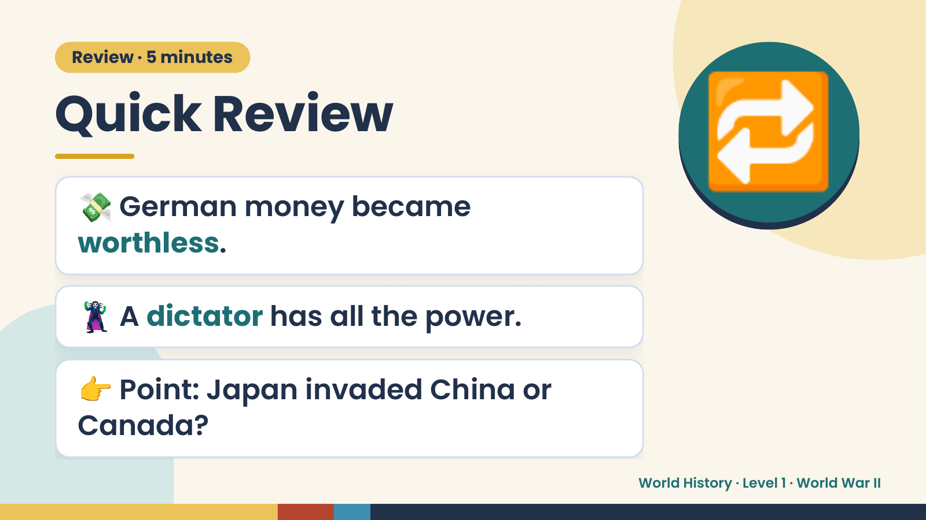
Notes:
Review · 5 minutes
Quick Review
💸 German money became
worthless.
🔁
🦹 A dictator has all the power.
👉 Point: Japan invaded China or
Canada?
World History · Level 1 · World War II

Slide 3
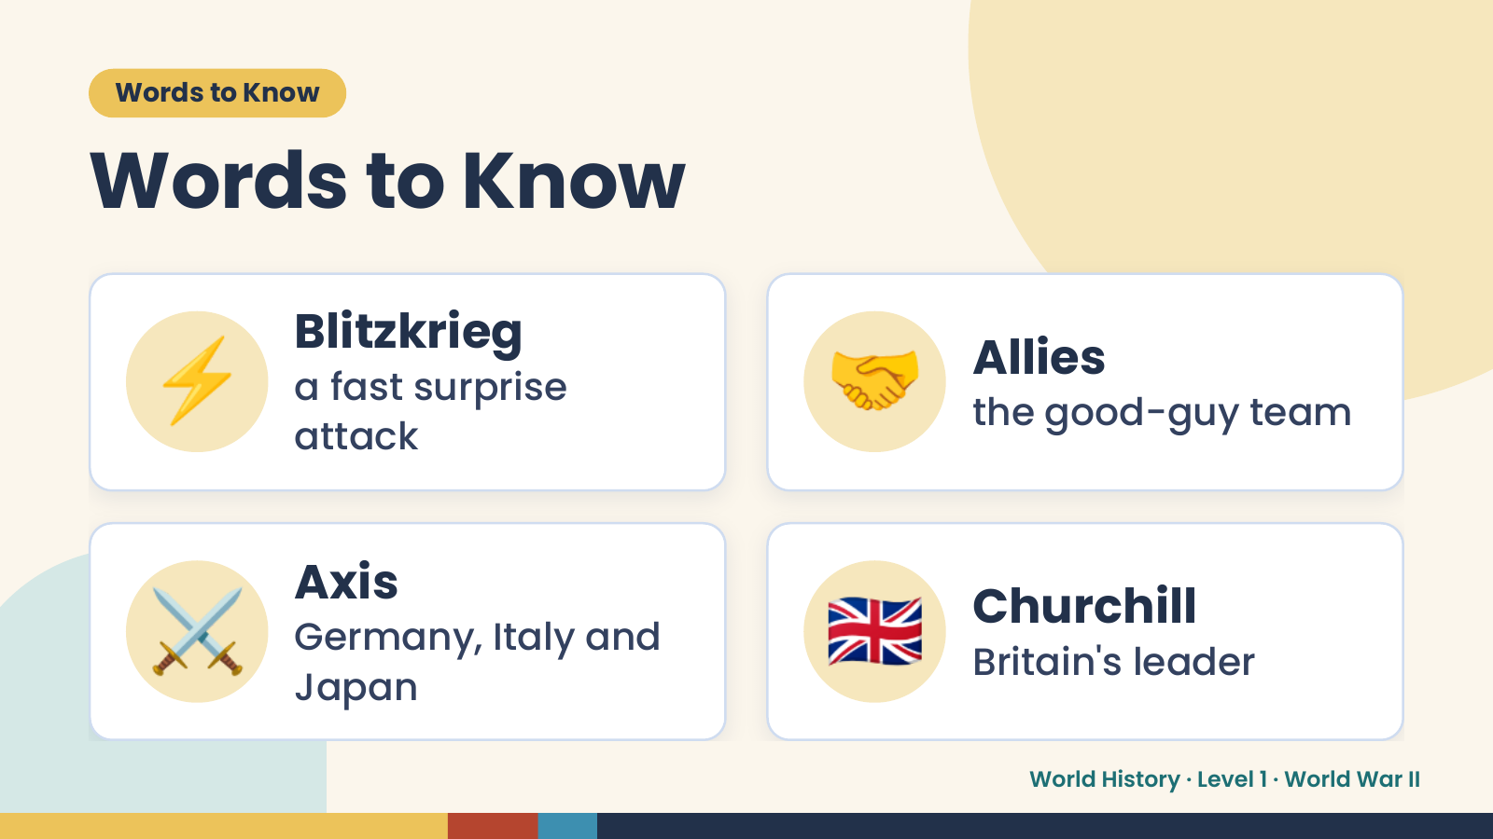
Notes:
Words to Know
Words to Know
⚡ Blitzkrieg
a fast surprise
attack
🤝 Allies
the good-guy team
⚔️ Axis
Germany, Italy and
Japan
🇬🇧 Churchill
Britain's leader
World History · Level 1 · World War II

Slide 4
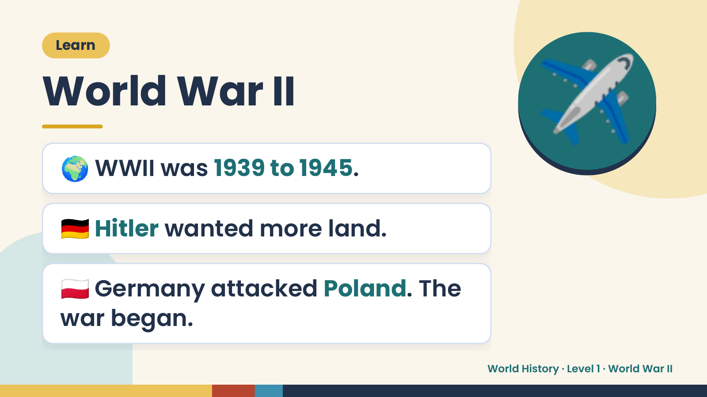
Notes:
Learn
World War II
🌍 WWII was 1939 to 1945.
✈️
🇩🇪 Hitler wanted more land.
🇵🇱 Germany attacked Poland. The
war began.
World History · Level 1 · World War II

Slide 5
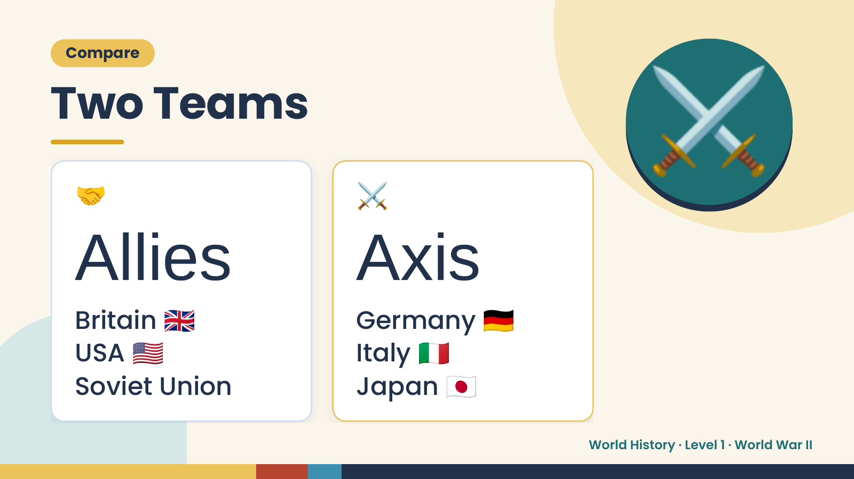
Notes:
Compare
Two Teams
🤝 ⚔️
⚔️
Allies
🇬🇧
Axis🇩🇪
🇺🇸 🇮🇹
Britain Germany
USA Italy
Soviet Union Japan 🇯🇵
World History · Level 1 · World War II

Slide 6
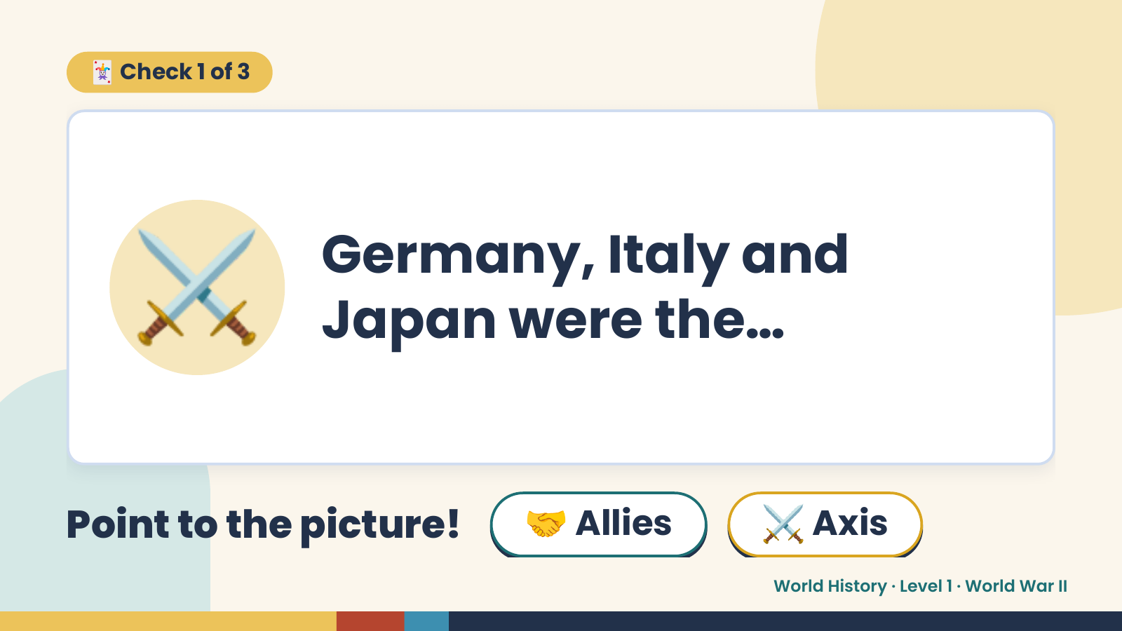
Notes:
🃏 Check 1 of 3
⚔️ Germany, Italy and
Japan were the…
Point to the picture! 🤝 Allies ⚔️ Axis
World History · Level 1 · World War II

Slide 7
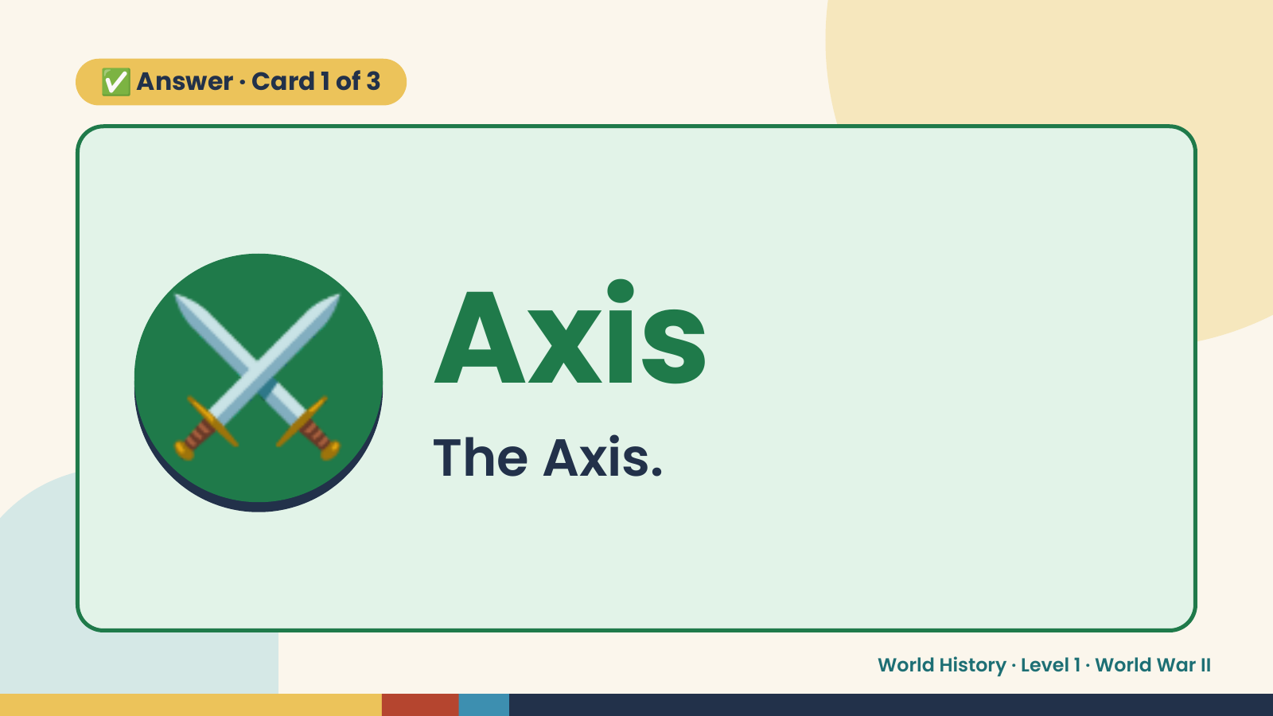
Notes:
✅ Answer · Card 1 of 3
⚔️ Axis
The Axis.
World History · Level 1 · World War II

Slide 8
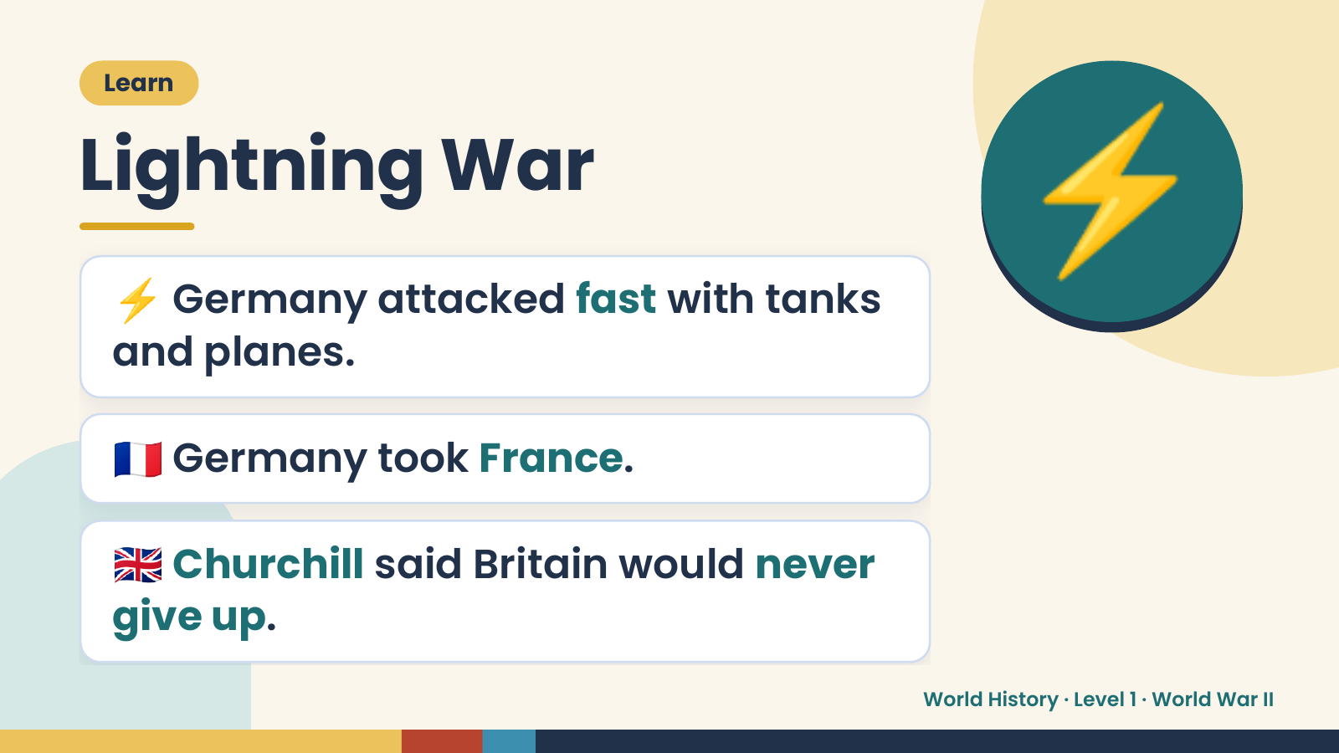
Notes:
Learn
Lightning War
⚡ Germany attacked fast with tanks
and planes.
⚡
🇫🇷 Germany took France.
🇬🇧 Churchill said Britain would never
give up.
World History · Level 1 · World War II

Slide 9
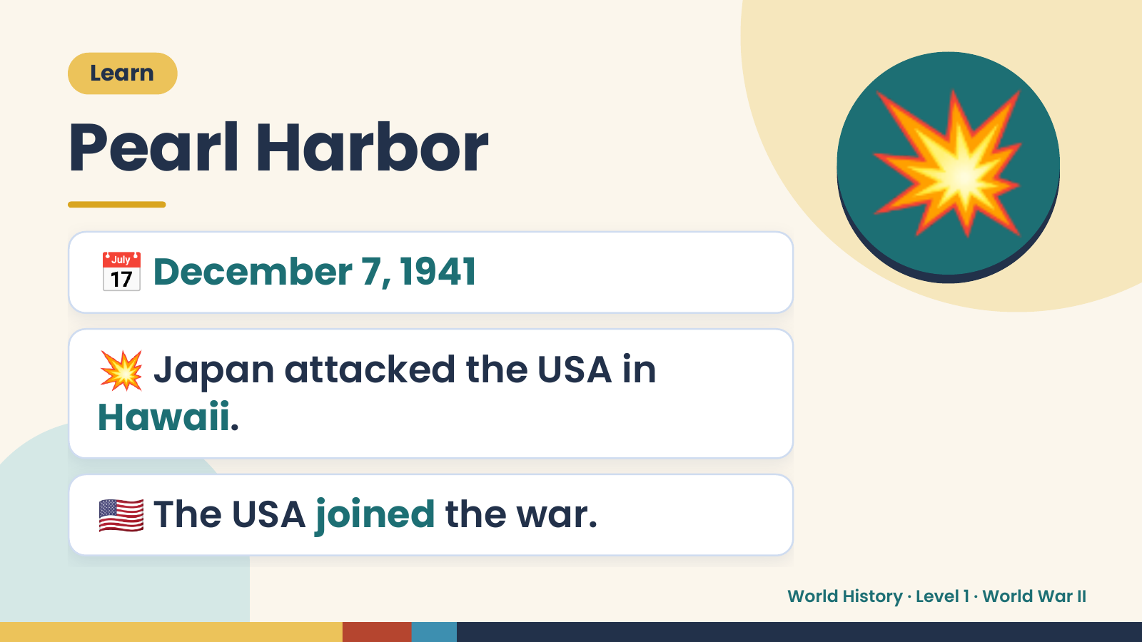
Notes:
Learn
Pearl Harbor
📅 December 7, 1941
💥
💥 Japan attacked the USA in
Hawaii.
🇺🇸 The USA joined the war.
World History · Level 1 · World War II

Slide 10
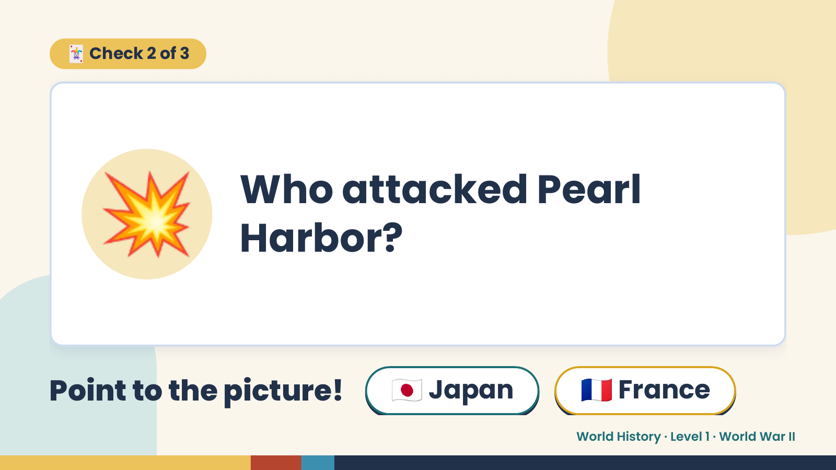
Notes:
🃏 Check 2 of 3
💥 Who attacked Pearl
Harbor?
Point to the picture! 🇯🇵 Japan 🇫🇷 France
World History · Level 1 · World War II

Slide 11
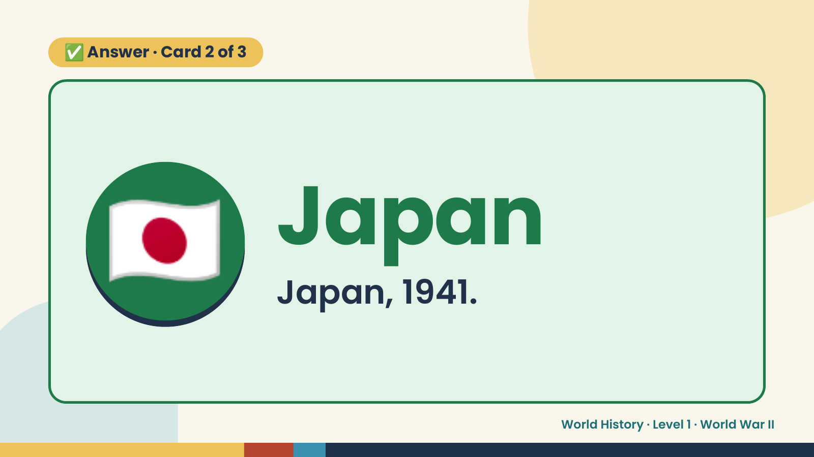
Notes:
✅ Answer · Card 2 of 3
🇯🇵 Japan
Japan, 1941.
World History · Level 1 · World War II

Slide 12
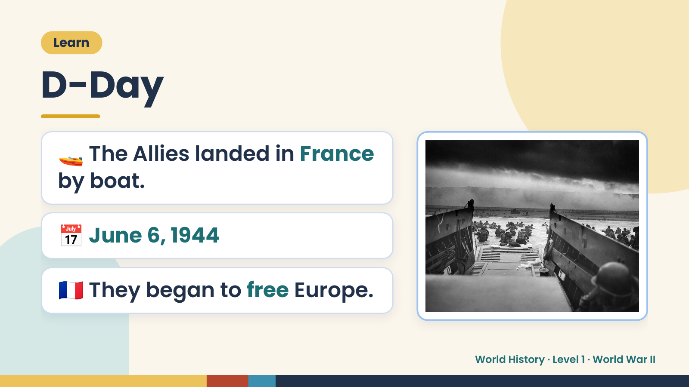
Notes:
Learn
D-Day
🚤 The Allies landed in France
by boat.
📅 June 6, 1944
🇫🇷 They began to free Europe.
World History · Level 1 · World War II

Slide 13
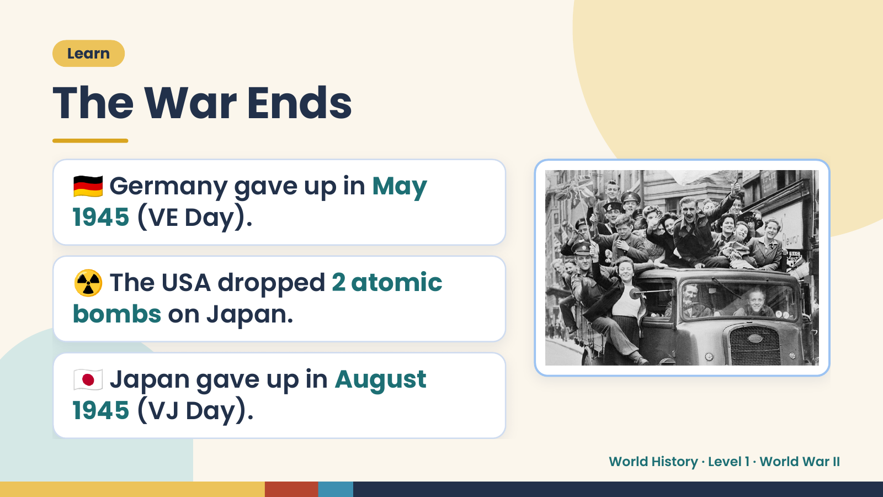
Notes:
Learn
The War Ends
🇩🇪 Germany gave up in May
1945 (VE Day).
☢️ The USA dropped 2 atomic
bombs on Japan.
🇯🇵 Japan gave up in August
1945 (VJ Day).
World History · Level 1 · World War II

Slide 14
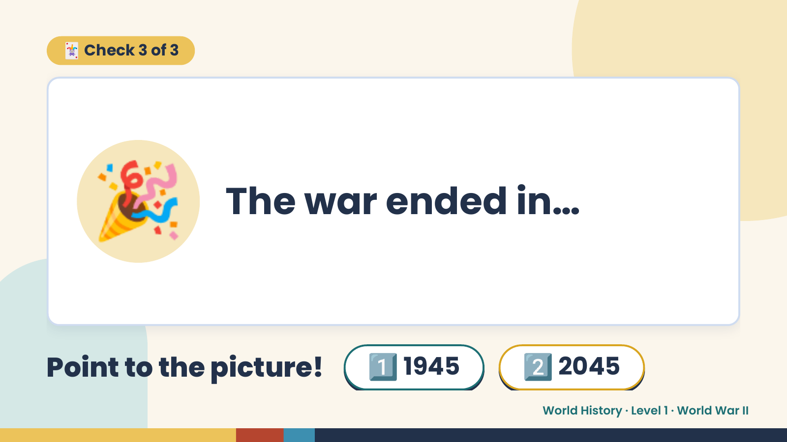
Notes:
🃏 Check 3 of 3
🎉 The war ended in…
Point to the picture! 1️⃣ 1945 2️⃣ 2045
World History · Level 1 · World War II

Slide 15
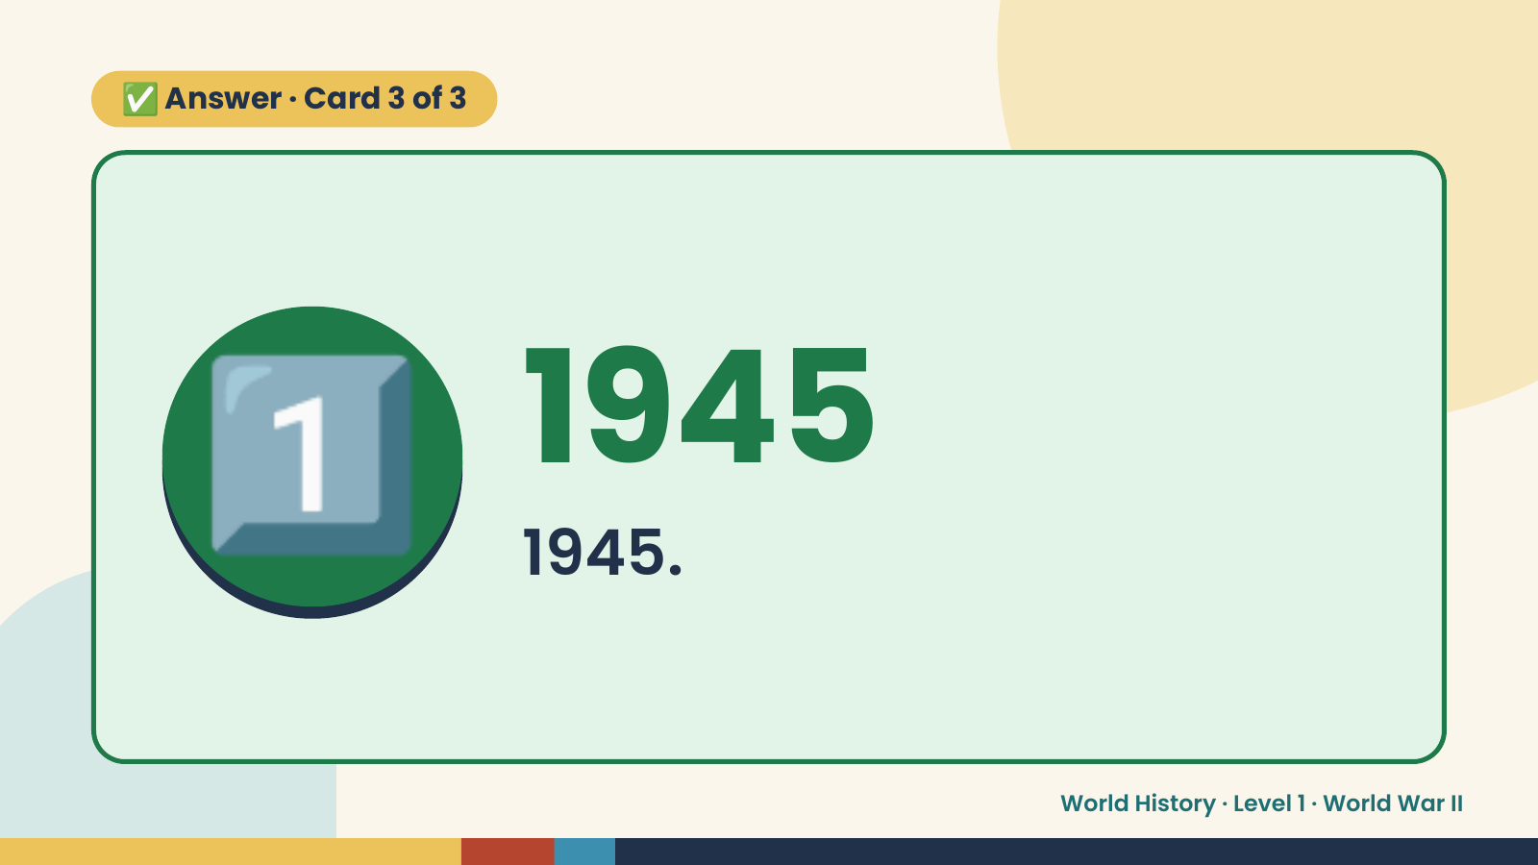
Notes:
✅ Answer · Card 3 of 3
1️⃣ 1945
1945.
World History · Level 1 · World War II

Slide 16
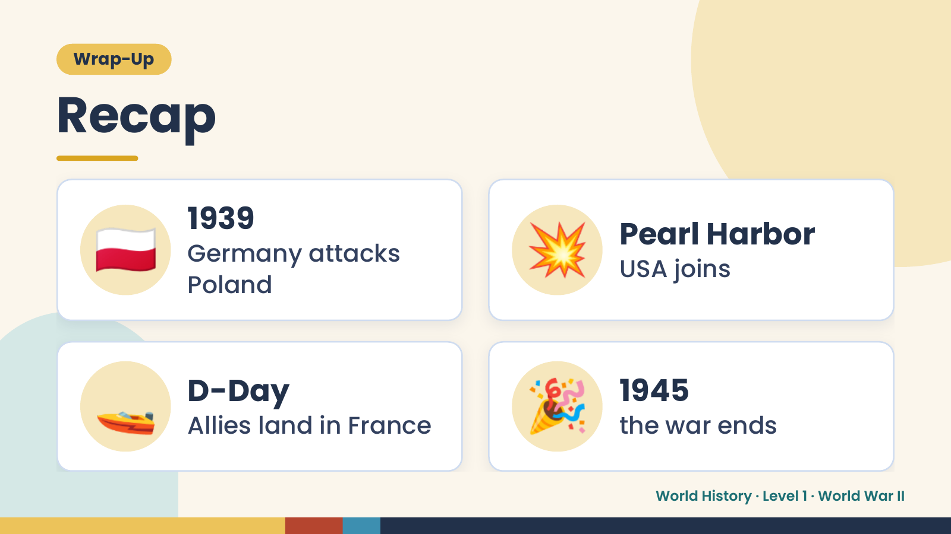
Notes:
Wrap-Up
Recap
🇵🇱 1939
Germany attacks
Poland
💥 Pearl Harbor
USA joins
🚤 D-Day
Allies land in France 🎉 1945
the war ends
World History · Level 1 · World War II

Slide 17
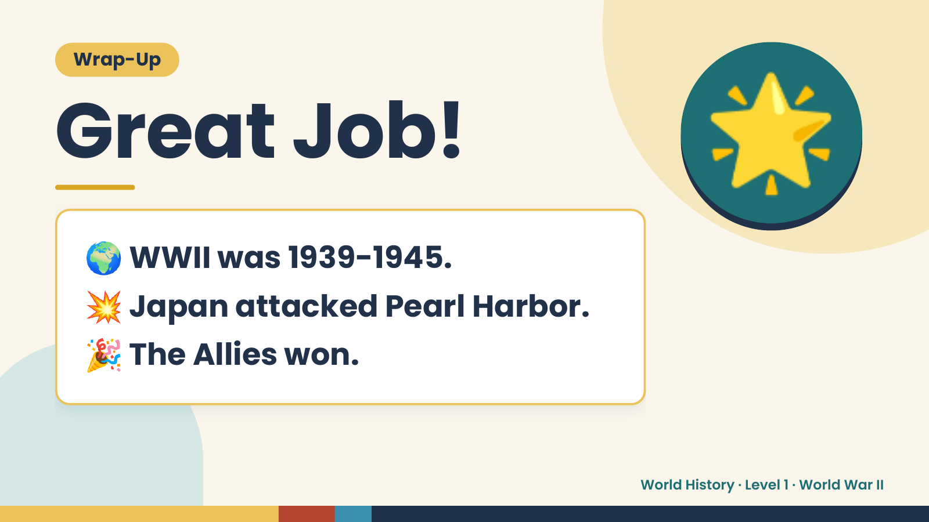
Notes:
Wrap-Up
Great Job!
🌍 WWII was 1939-1945.
🌟
💥 Japan attacked Pearl Harbor.
🎉 The Allies won.
World History · Level 1 · World War II

