Slide 1
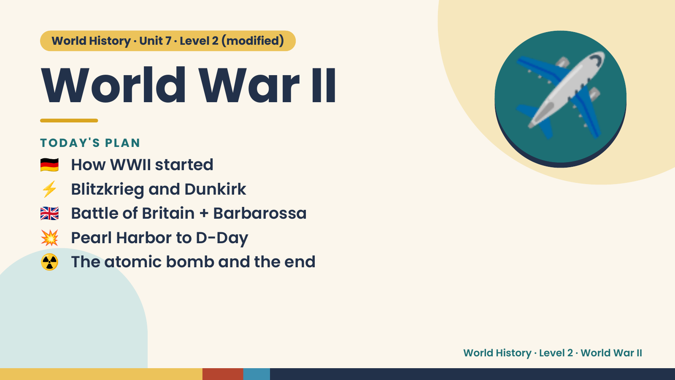
Notes:
World History · Unit 7 · Level 2 (modified)
World War II
🇩🇪 How WWII started
TODAY'S PLAN
⚡ Blitzkrieg and Dunkirk
🇬🇧 Battle of Britain + Barbarossa
✈️
💥 Pearl Harbor to D-Day
☢️ The atomic bomb and the end
World History · Level 2 · World War II

Slide 2
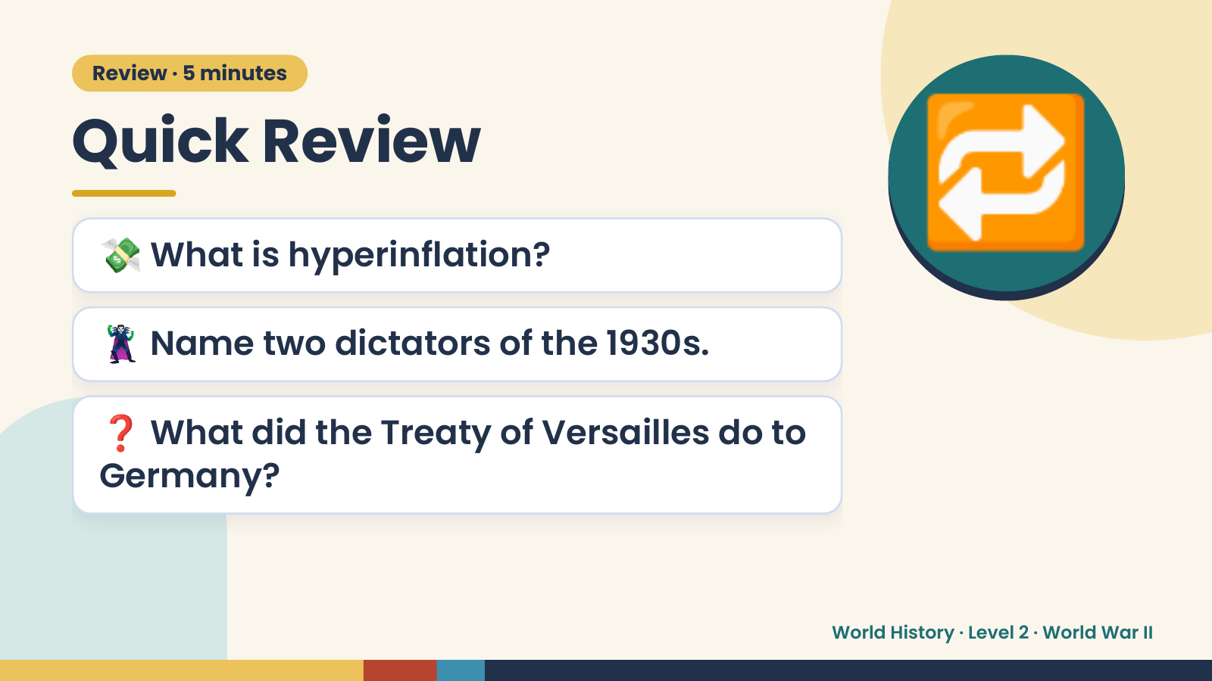
Notes:
Review · 5 minutes
Quick Review
💸 What is hyperinflation?
🦹 Name two dictators of the 1930s.
🔁
❓ What did the Treaty of Versailles do to
Germany?
World History · Level 2 · World War II

Slide 3
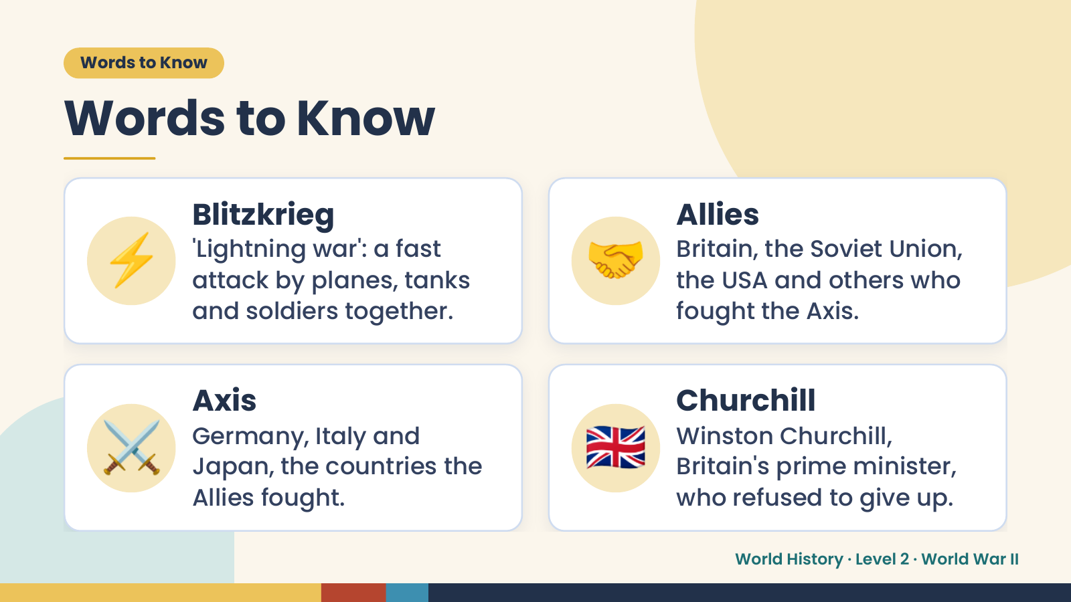
Notes:
Words to Know
Words to Know
⚡ Blitzkrieg
'Lightning war': a fast
attack by planes, tanks
and soldiers together.
🤝 Allies
Britain, the Soviet Union,
the USA and others who
fought the Axis.
⚔️ Axis
Germany, Italy and
Japan, the countries the
Allies fought.
🇬🇧 Churchill
Winston Churchill,
Britain's prime minister,
who refused to give up.
World History · Level 2 · World War II

Slide 4
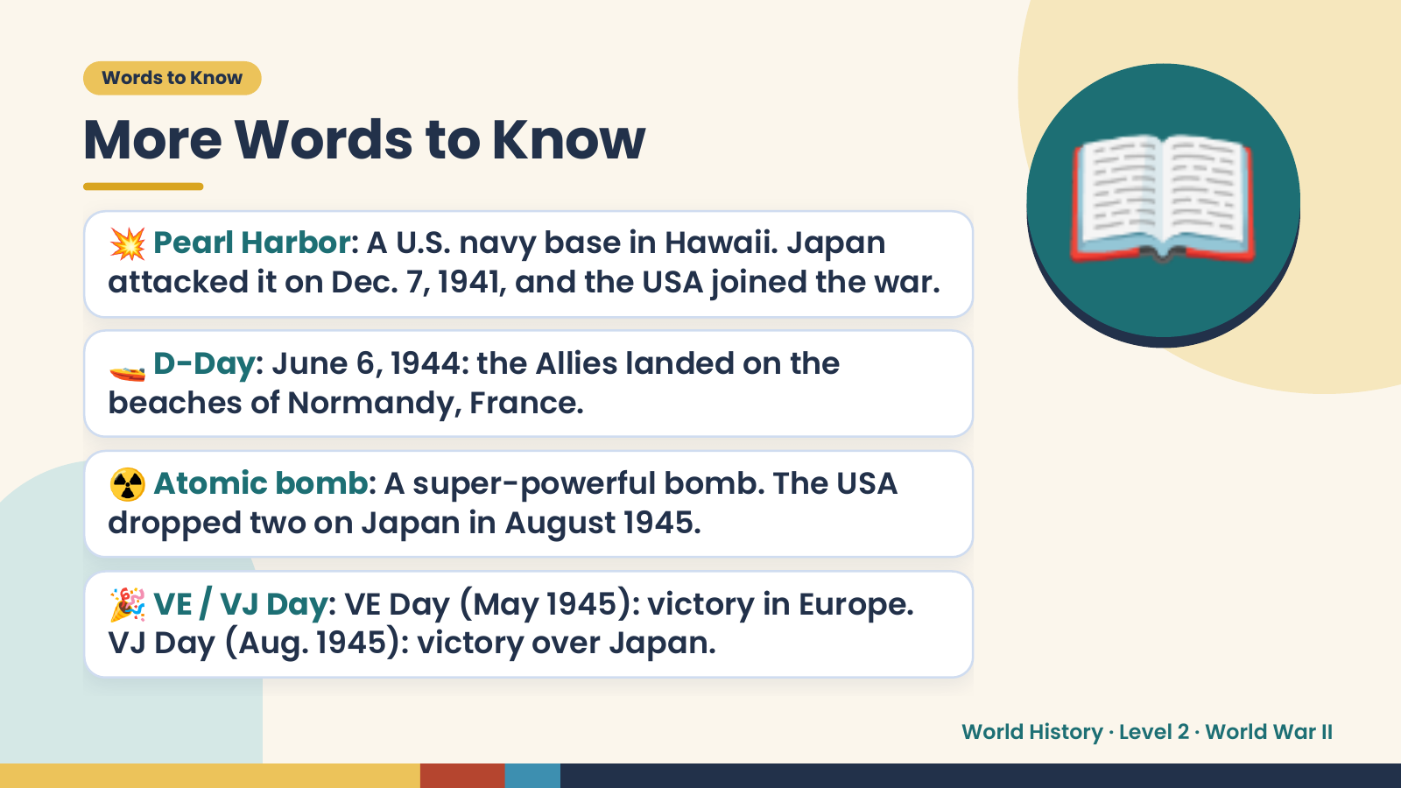
Notes:
Words to Know
More Words to Know
💥 Pearl Harbor: A U.S. navy base in Hawaii. Japan
attacked it on Dec. 7, 1941, and the USA joined the war.
🚤 D-Day: June 6, 1944: the Allies landed on the
beaches of Normandy, France.
📖
☢️ Atomic bomb: A super-powerful bomb. The USA
dropped two on Japan in August 1945.
🎉 VE / VJ Day: VE Day (May 1945): victory in Europe.
VJ Day (Aug. 1945): victory over Japan.
World History · Level 2 · World War II

Slide 5
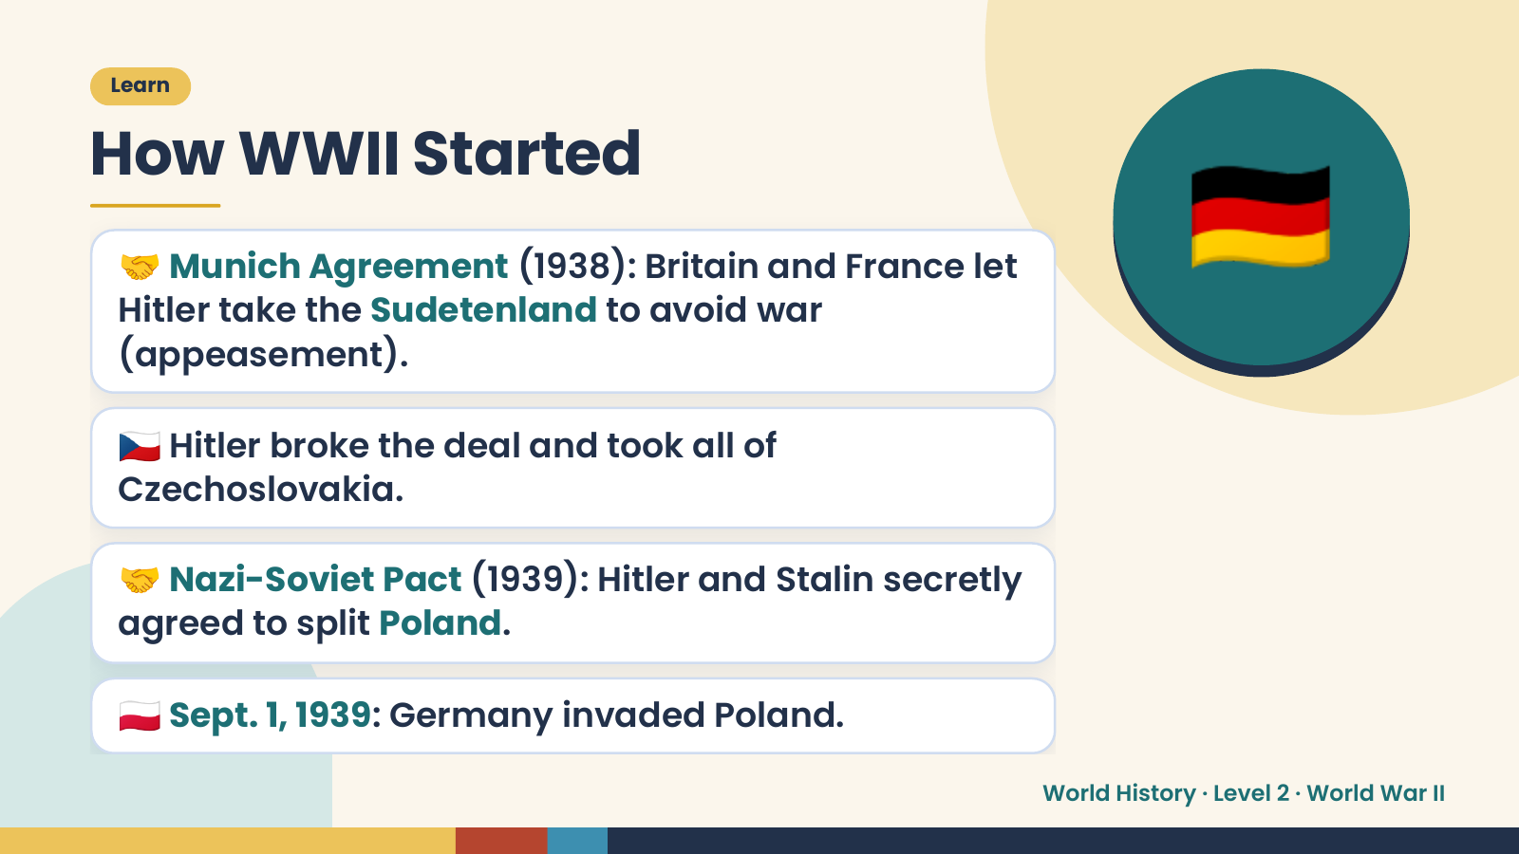
Notes:
🇩🇪
Learn
How WWII Started
🤝 Munich Agreement (1938): Britain and France let
Hitler take the Sudetenland to avoid war
(appeasement).
🇨🇿 Hitler broke the deal and took all of
Czechoslovakia.
🤝 Nazi-Soviet Pact (1939): Hitler and Stalin secretly
agreed to split Poland.
🇵🇱 Sept. 1, 1939: Germany invaded Poland.
World History · Level 2 · World War II

Slide 6
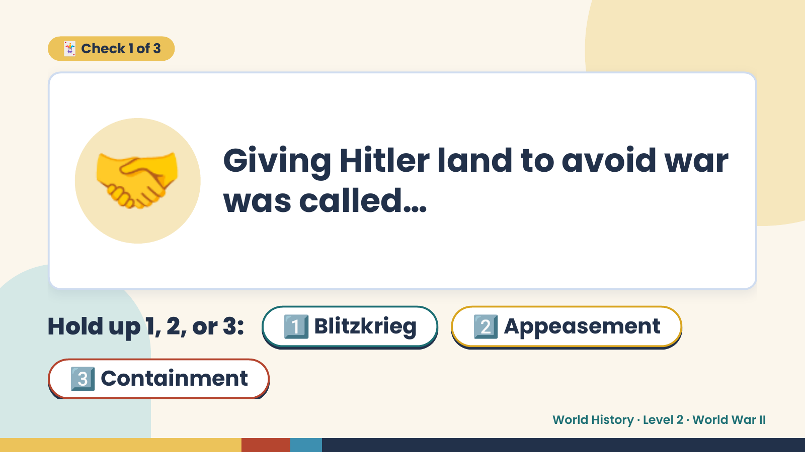
Notes:
🃏 Check 1 of 3
🤝 Giving Hitler land to avoid war
was called…
Hold up 1, 2, or 3: 1️⃣ Blitzkrieg 2️⃣ Appeasement
3️⃣ Containment
World History · Level 2 · World War II

Slide 7
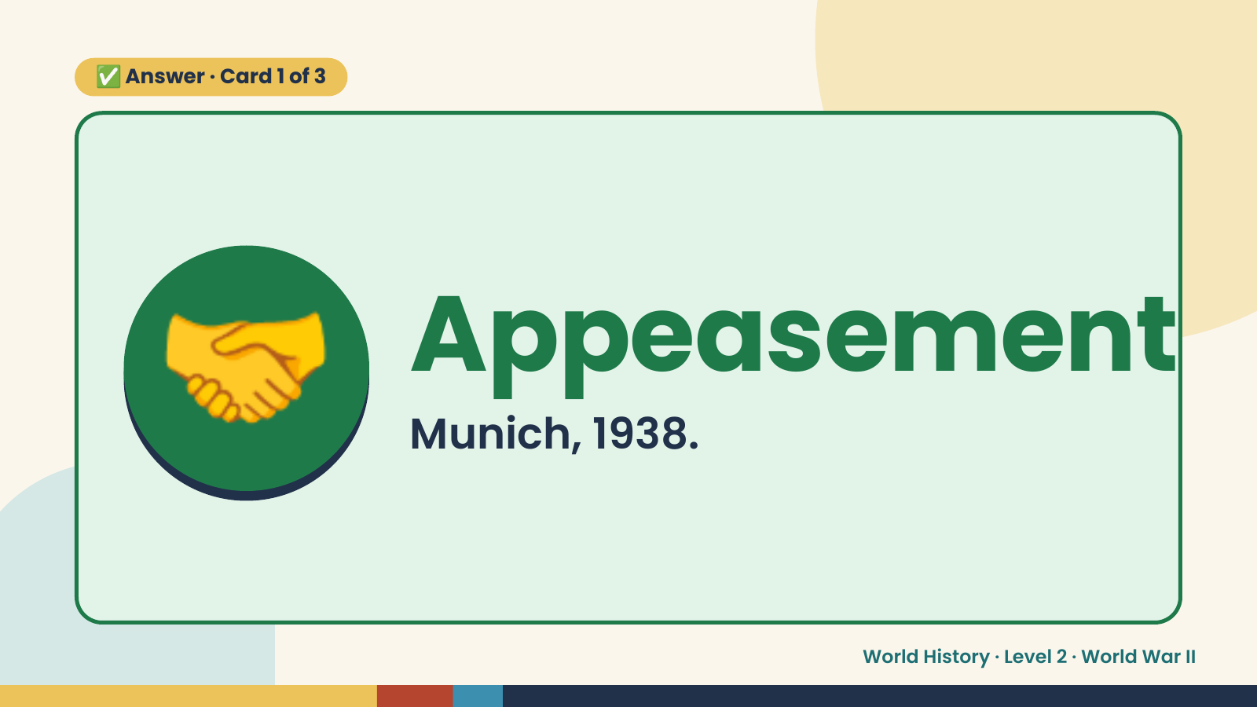
Notes:
✅ Answer · Card 1 of 3
🤝 Appeasement
Munich, 1938.
World History · Level 2 · World War II

Slide 8
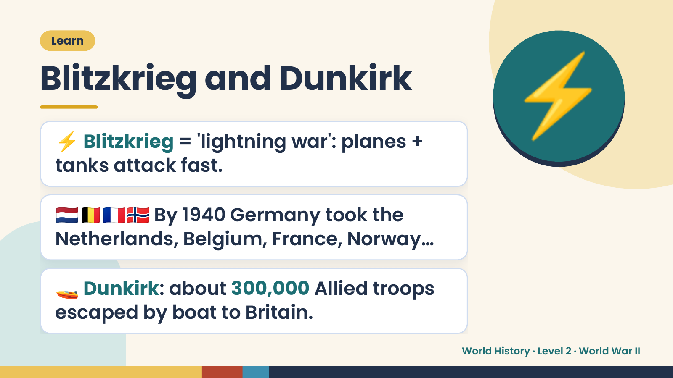
Notes:
Learn
Blitzkrieg and Dunkirk
⚡ Blitzkrieg = 'lightning war': planes +
tanks attack fast.
⚡
🇳🇱🇧🇪🇫🇷🇳🇴 By 1940 Germany took the
Netherlands, Belgium, France, Norway…
🚤 Dunkirk: about 300,000 Allied troops
escaped by boat to Britain.
World History · Level 2 · World War II

Slide 9
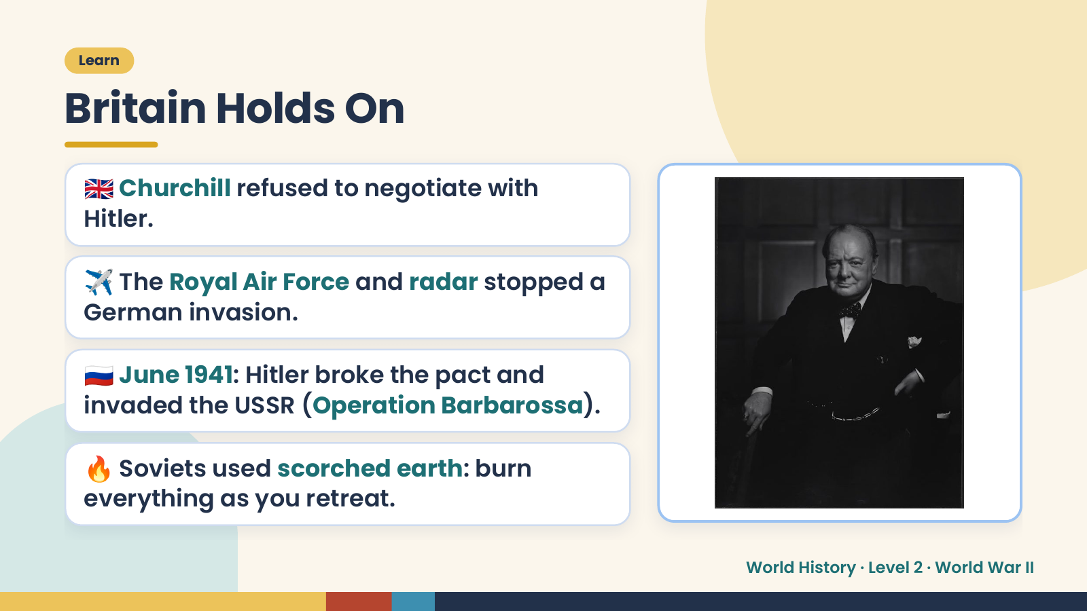
Notes:
Learn
Britain Holds On
🇬🇧 Churchill refused to negotiate with
Hitler.
✈️ The Royal Air Force and radar stopped a
German invasion.
🇷🇺 June 1941: Hitler broke the pact and
invaded the USSR (Operation Barbarossa).
🔥 Soviets used scorched earth: burn
everything as you retreat.
World History · Level 2 · World War II

Slide 10
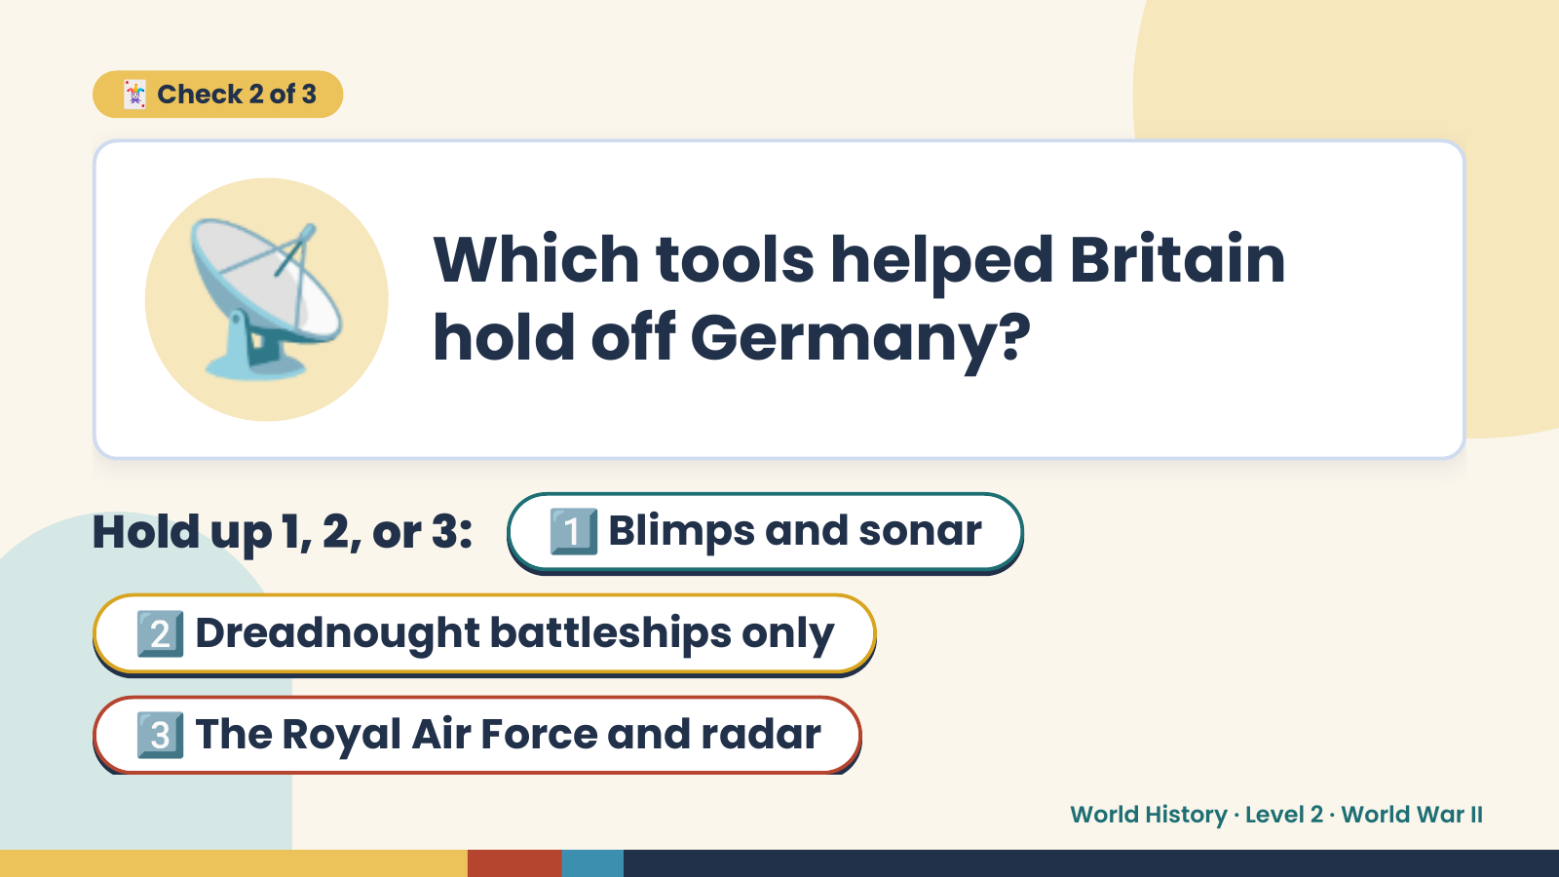
Notes:
📡
🃏 Check 2 of 3
Which tools helped Britain
hold off Germany?
Hold up 1, 2, or 3: 1️⃣ Blimps and sonar
2️⃣ Dreadnought battleships only
3️⃣ The Royal Air Force and radar
World History · Level 2 · World War II

Slide 11
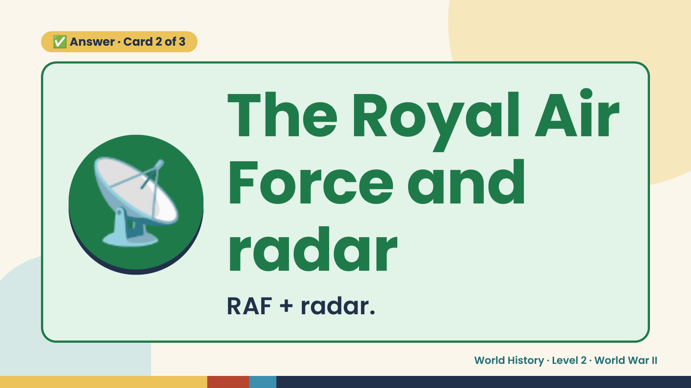
Notes:
✅ Answer · Card 2 of 3
📡 The Royal Air
Force and
radar
RAF + radar.
World History · Level 2 · World War II

Slide 12
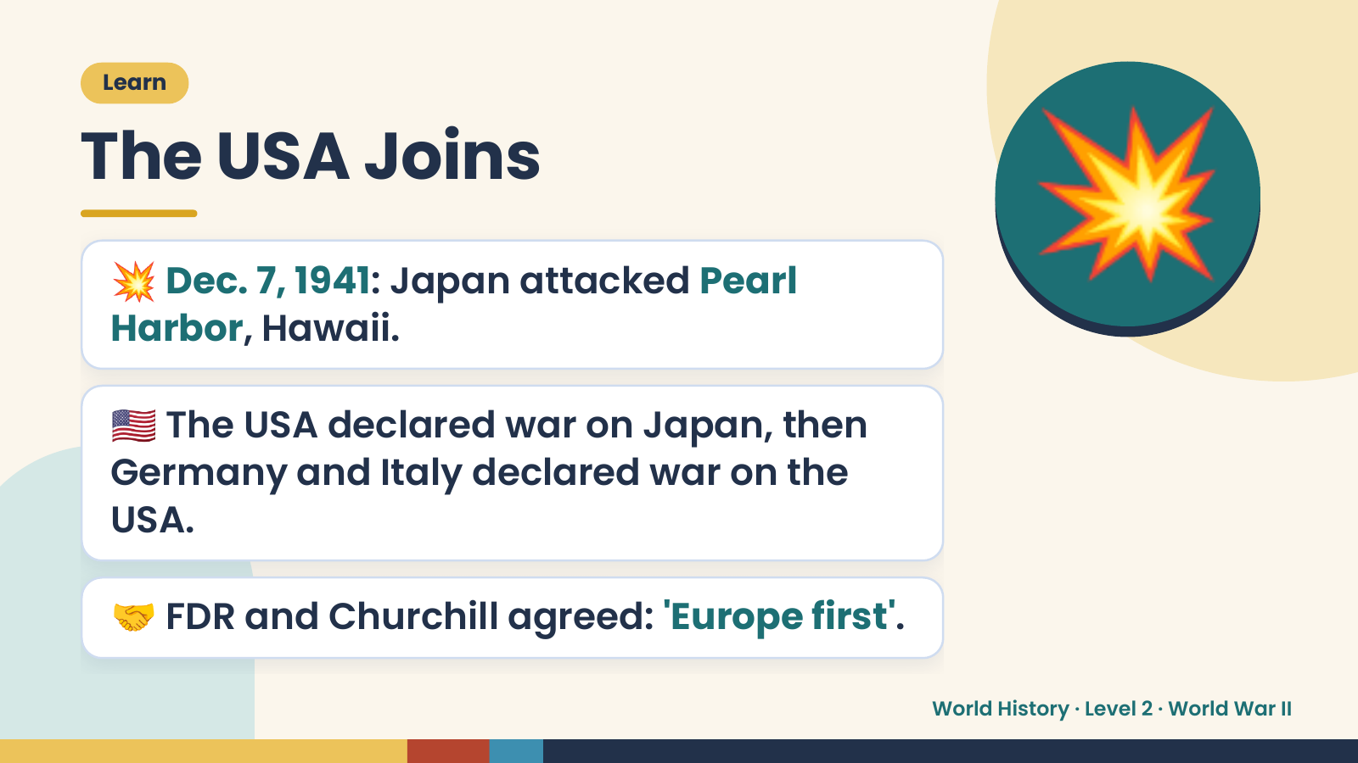
Notes:
Learn
The USA Joins
💥 Dec. 7, 1941: Japan attacked Pearl
Harbor, Hawaii.
🇺🇸 The USA declared war on Japan, then
💥
Germany and Italy declared war on the
USA.
🤝 FDR and Churchill agreed: 'Europe first'.
World History · Level 2 · World War II

Slide 13
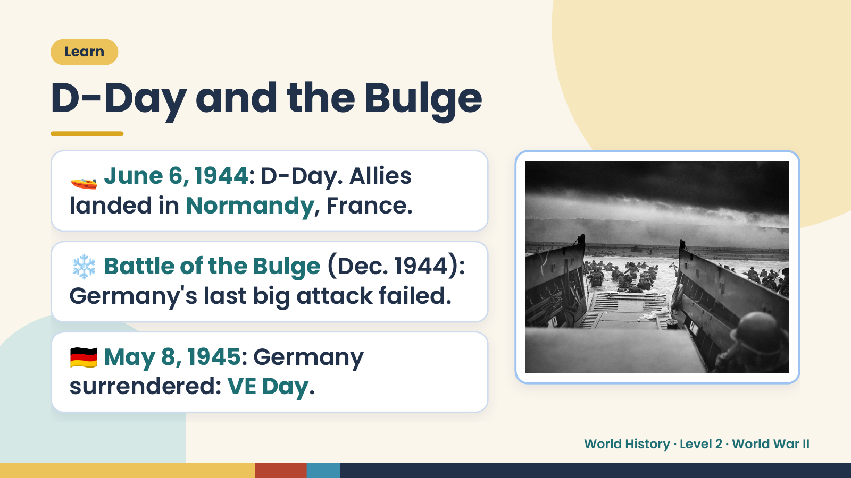
Notes:
Learn
D-Day and the Bulge
🚤 June 6, 1944: D-Day. Allies
landed in Normandy, France.
❄️ Battle of the Bulge (Dec. 1944):
Germany's last big attack failed.
🇩🇪 May 8, 1945: Germany
surrendered: VE Day.
World History · Level 2 · World War II

Slide 14
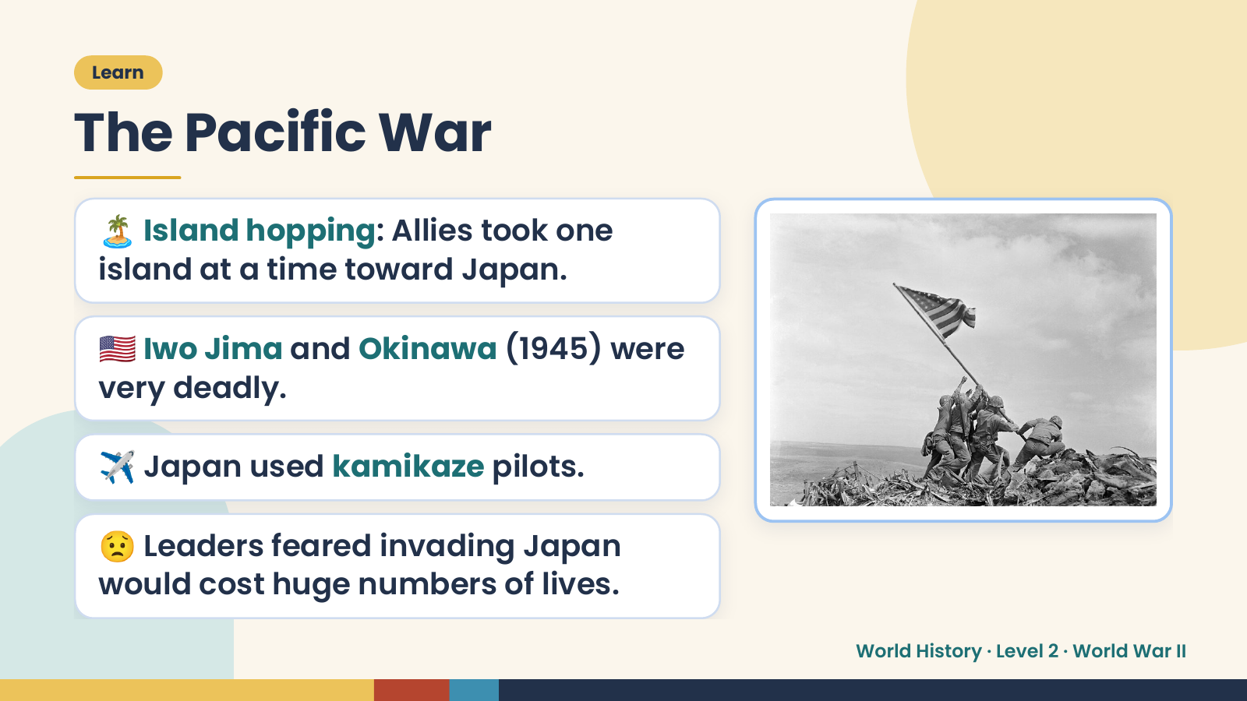
Notes:
Learn
The Pacific War
🏝️ Island hopping: Allies took one
island at a time toward Japan.
🇺🇸 Iwo Jima and Okinawa (1945) were
very deadly.
✈️ Japan used kamikaze pilots.
😟 Leaders feared invading Japan
would cost huge numbers of lives.
World History · Level 2 · World War II

Slide 15
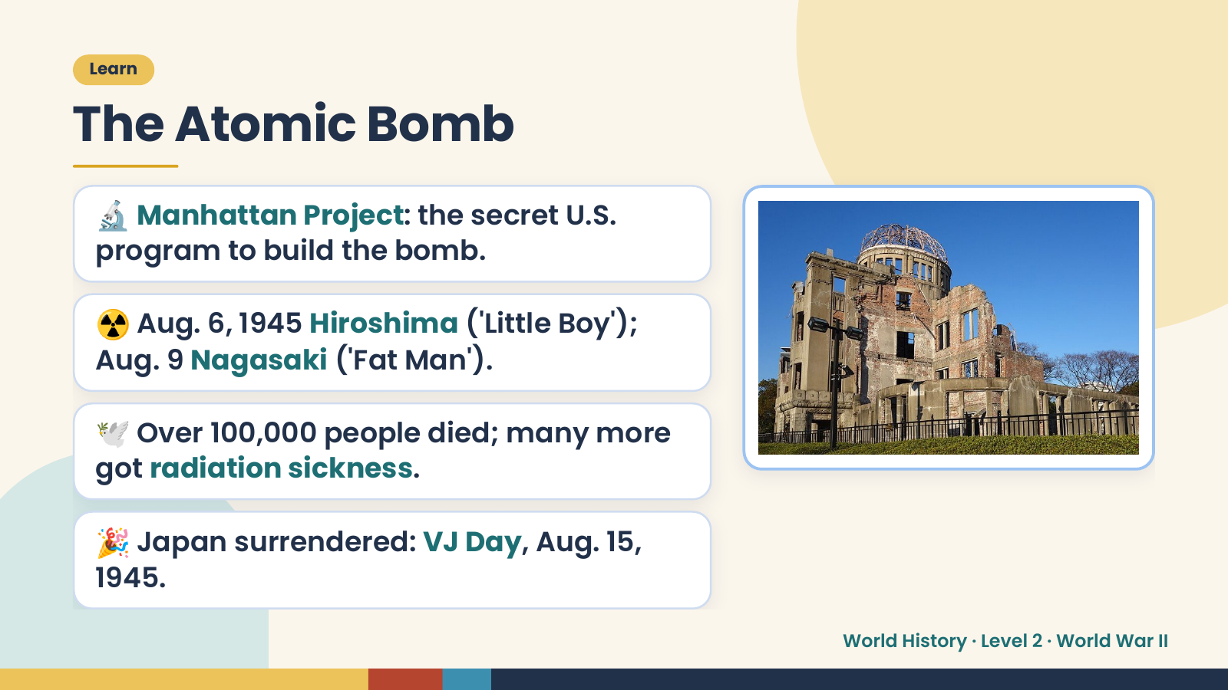
Notes:
Learn
The Atomic Bomb
🔬 Manhattan Project: the secret U.S.
program to build the bomb.
☢️ Aug. 6, 1945 Hiroshima ('Little Boy');
Aug. 9 Nagasaki ('Fat Man').
🕊️ Over 100,000 people died; many more
got radiation sickness.
🎉 Japan surrendered: VJ Day, Aug. 15,
1945.
World History · Level 2 · World War II

Slide 16
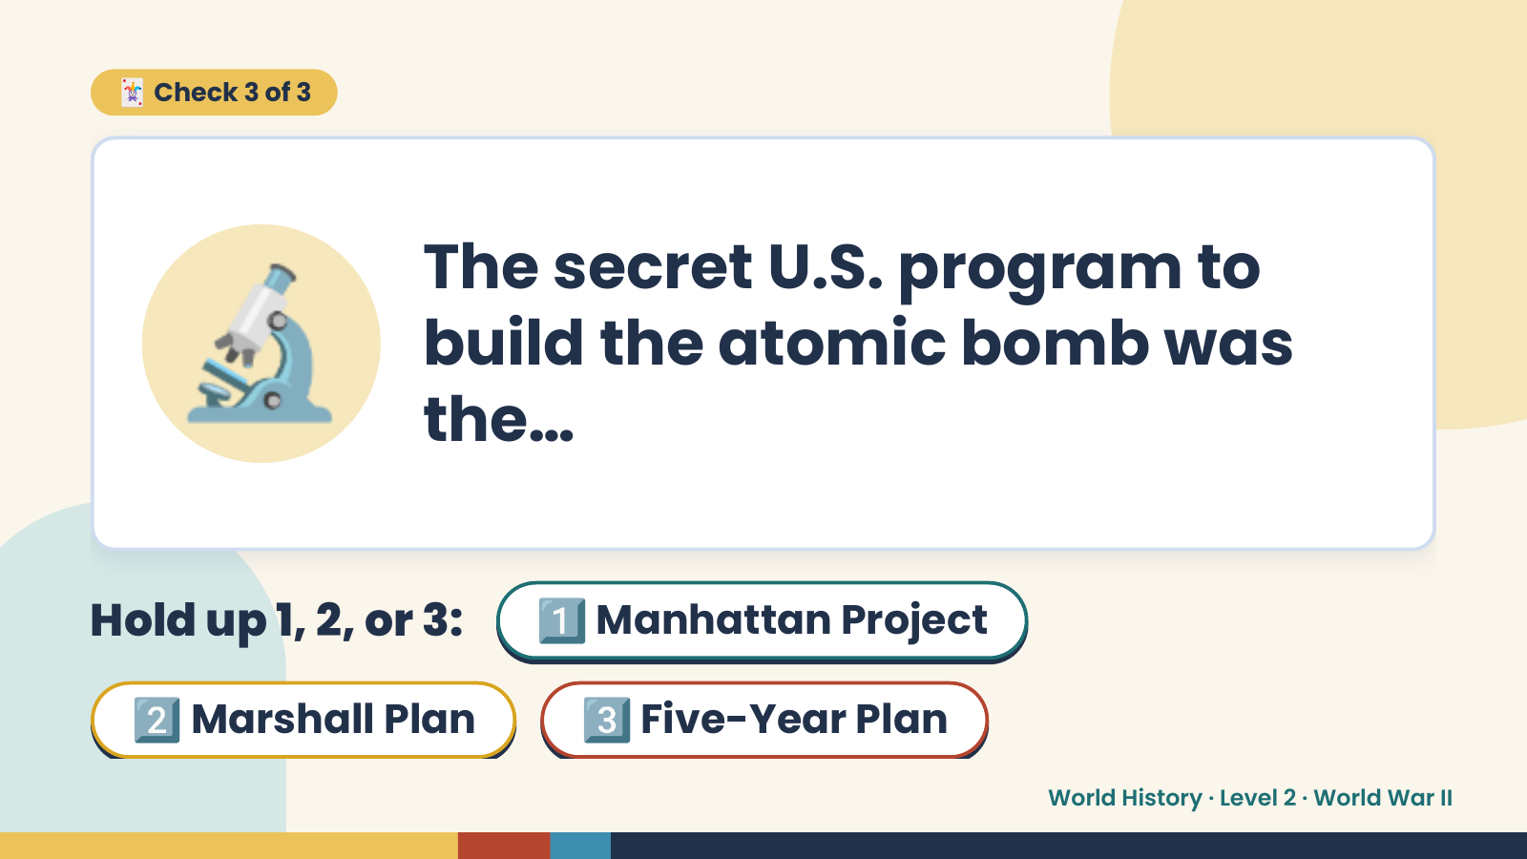
Notes:
🃏 Check 3 of 3
🔬 The secret U.S. program to
build the atomic bomb was
the…
Hold up 1, 2, or 3: 1️⃣ Manhattan Project
2️⃣ Marshall Plan 3️⃣ Five-Year Plan
World History · Level 2 · World War II

Slide 17
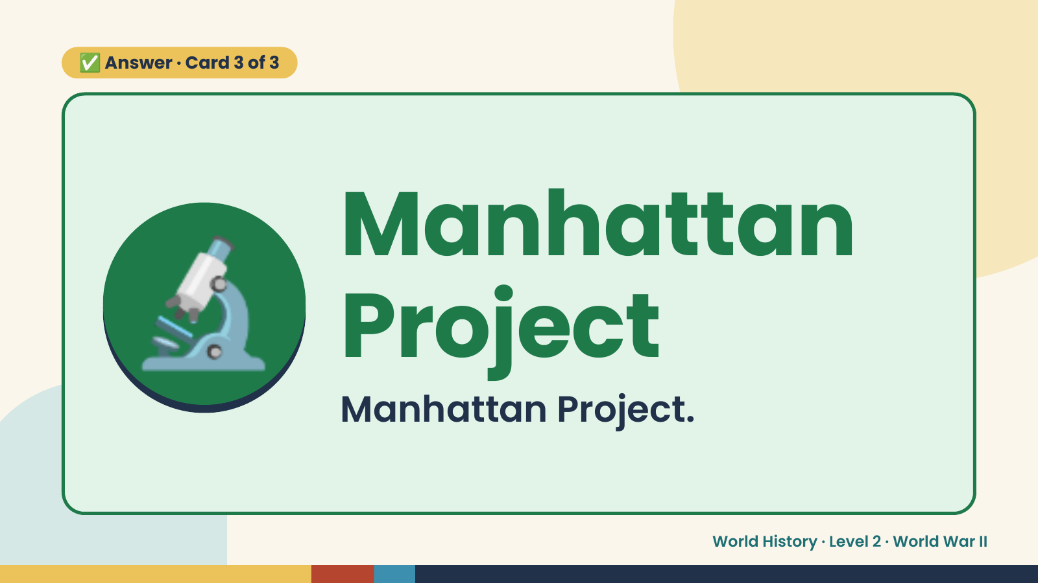
Notes:
✅ Answer · Card 3 of 3
🔬 Manhattan
Project
Manhattan Project.
World History · Level 2 · World War II

Slide 18
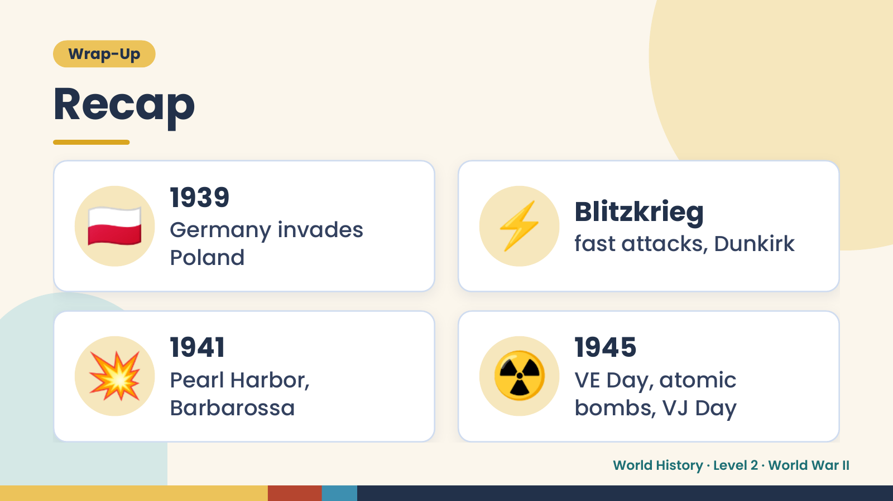
Notes:
Wrap-Up
Recap
🇵🇱 1939
Germany invades
Poland
⚡ Blitzkrieg
fast attacks, Dunkirk
💥 1941
Pearl Harbor,
Barbarossa
☢️ 1945
VE Day, atomic
bombs, VJ Day
World History · Level 2 · World War II

Slide 19
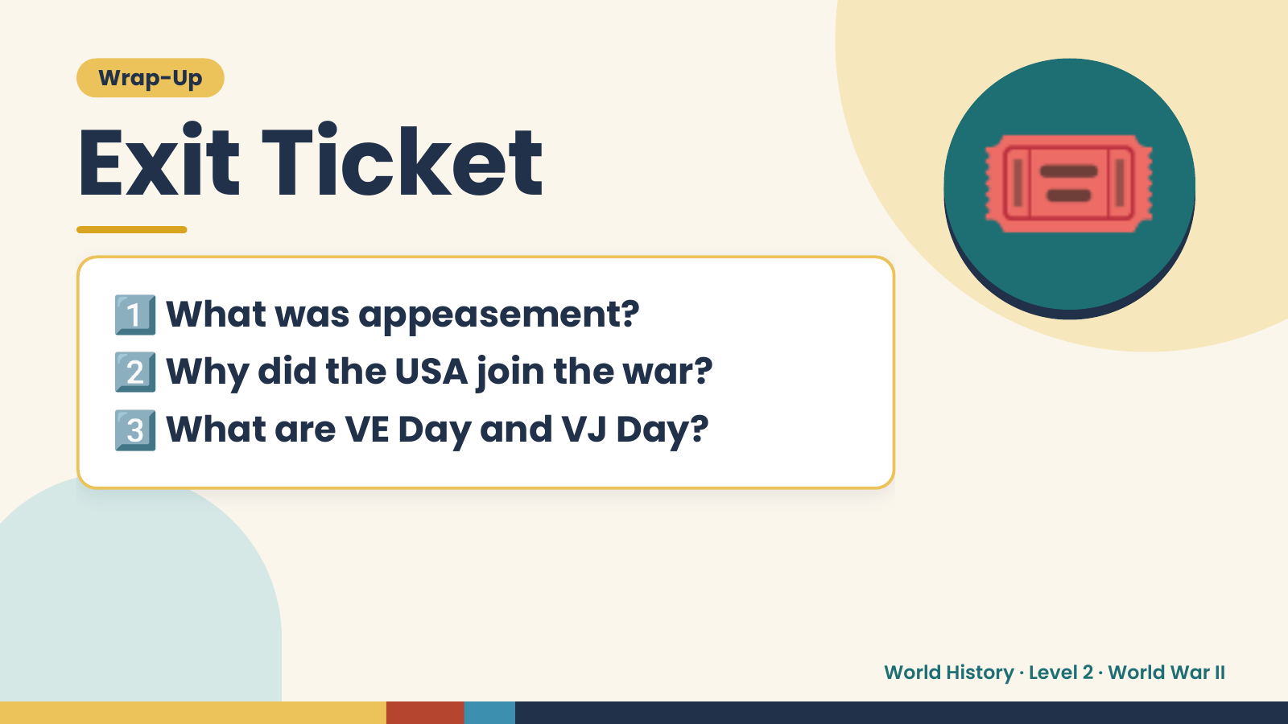
Notes:
Wrap-Up
Exit Ticket
1️⃣
2️⃣
What was appeasement?
Why did the USA join the war?
🎟️
3️⃣What are VE Day and VJ Day?
World History · Level 2 · World War II

