Slide 1
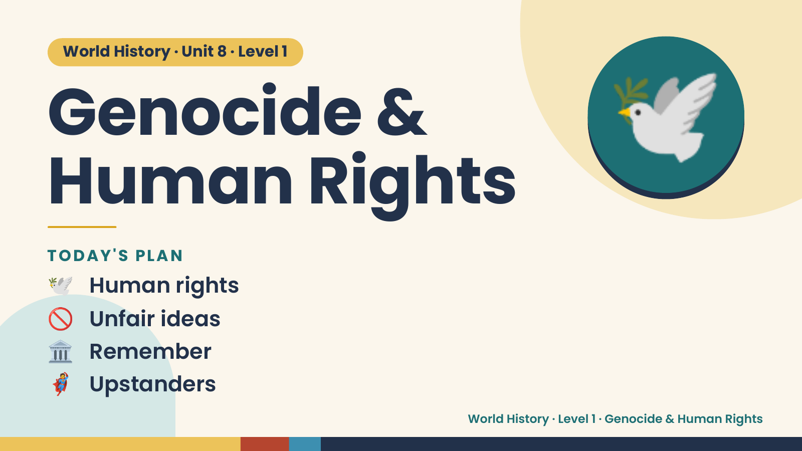
Notes:
World History · Unit 8 · Level 1
Genocide &
Human Rights
🕊️
🕊️ Human rights
TODAY'S PLAN
🚫 Unfair ideas
🏛️ Remember
🦸 Upstanders
World History · Level 1 · Genocide & Human Rights

Slide 2
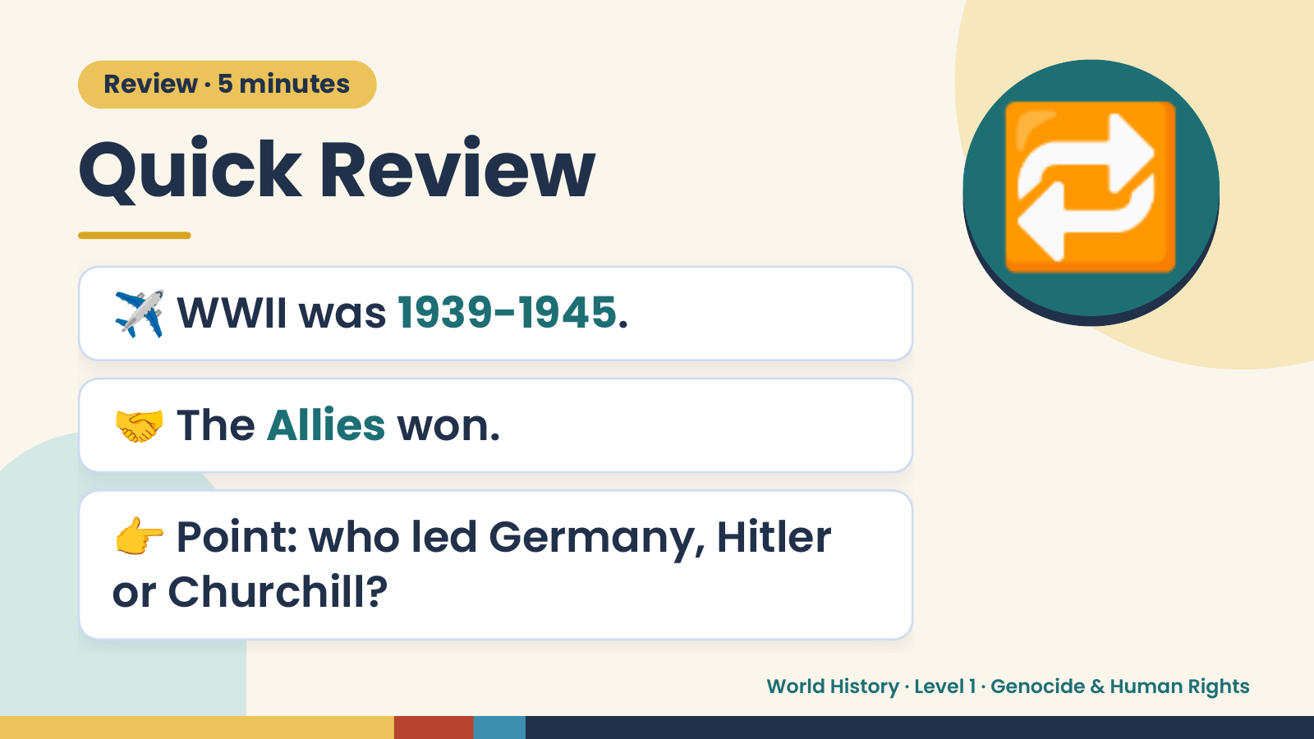
Notes:
Review · 5 minutes
Quick Review
✈️ WWII was 1939-1945.
🔁
🤝 The Allies won.
👉 Point: who led Germany, Hitler
or Churchill?
World History · Level 1 · Genocide & Human Rights

Slide 3
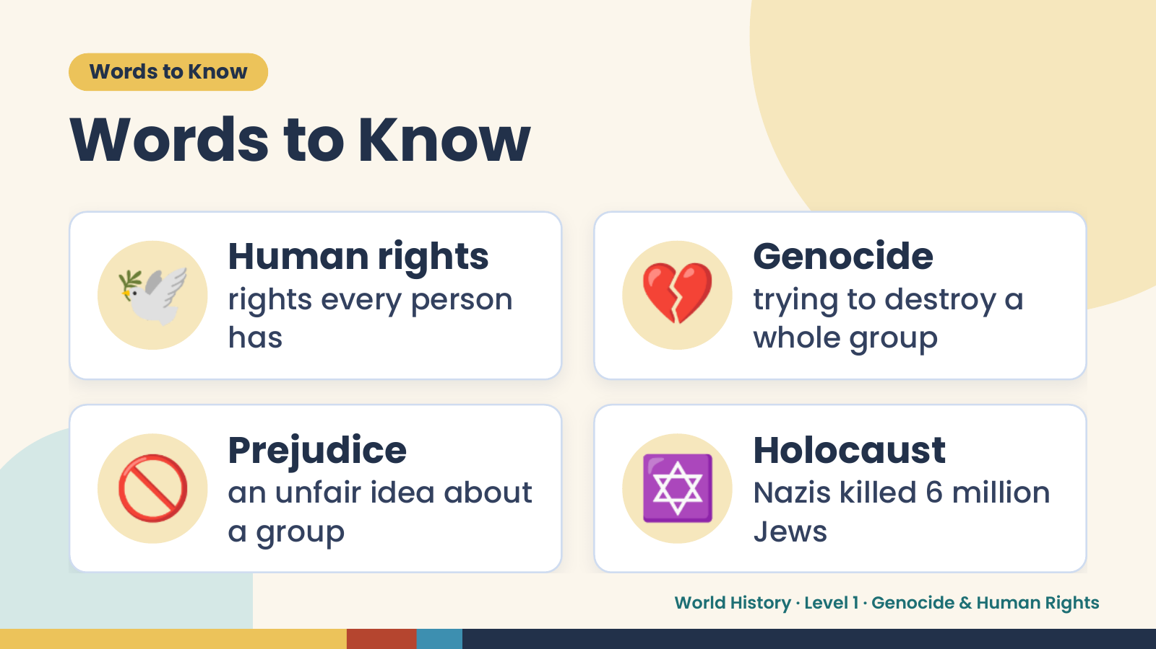
Notes:
Words to Know
Words to Know
🕊️ Human rights
rights every person
has
💔 Genocide
trying to destroy a
whole group
🚫 Prejudice
an unfair idea about
a group
✡️ Holocaust
Nazis killed 6 million
Jews
World History · Level 1 · Genocide & Human Rights

Slide 4
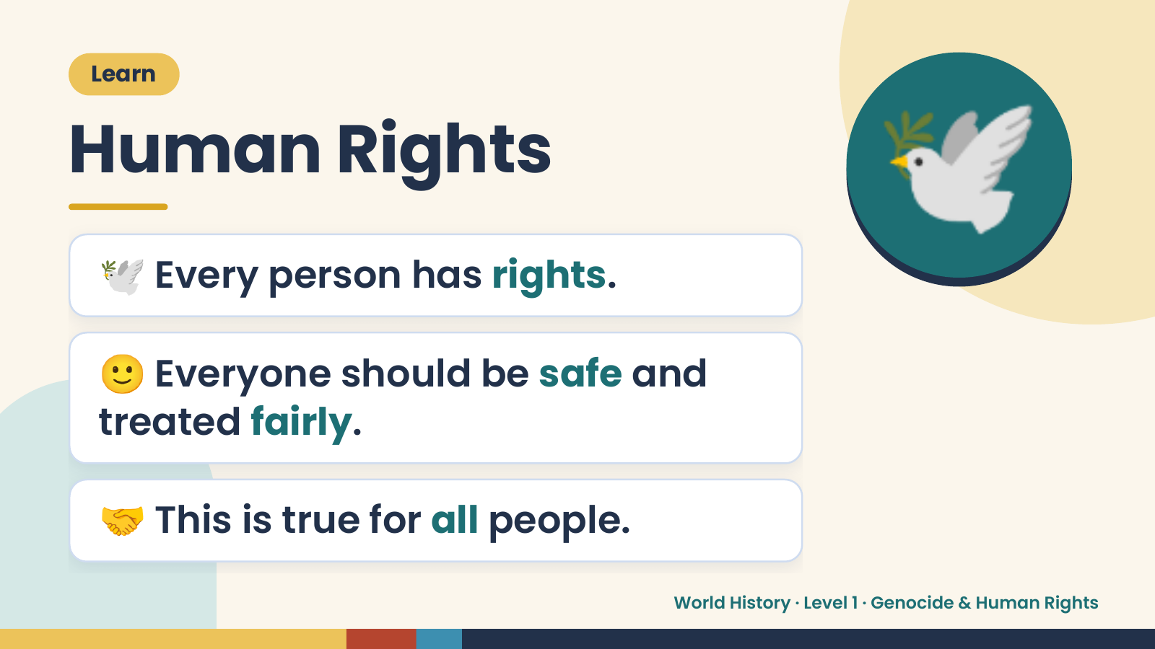
Notes:
Learn
Human Rights
🕊️ Every person has rights.
🕊️
🙂 Everyone should be safe and
treated fairly.
🤝 This is true for all people.
World History · Level 1 · Genocide & Human Rights

Slide 5
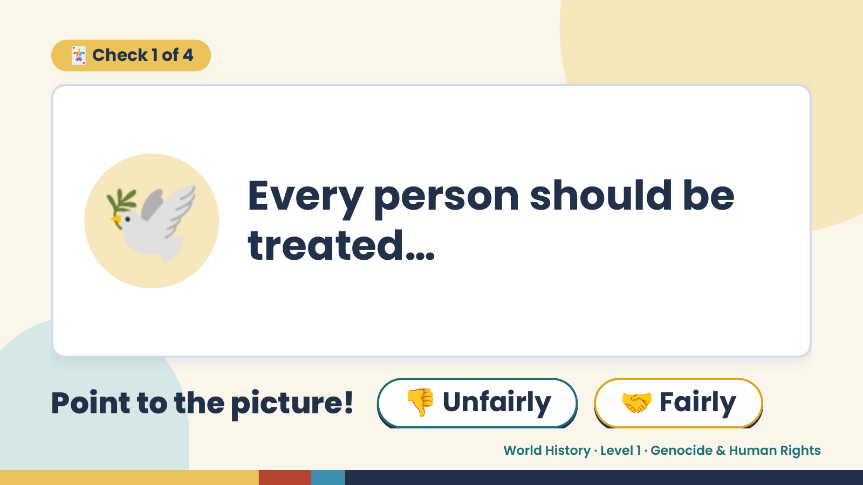
Notes:
🃏 Check 1 of 4
🕊️ Every person should be
treated…
Point to the picture! 👎 Unfairly 🤝 Fairly
World History · Level 1 · Genocide & Human Rights

Slide 6
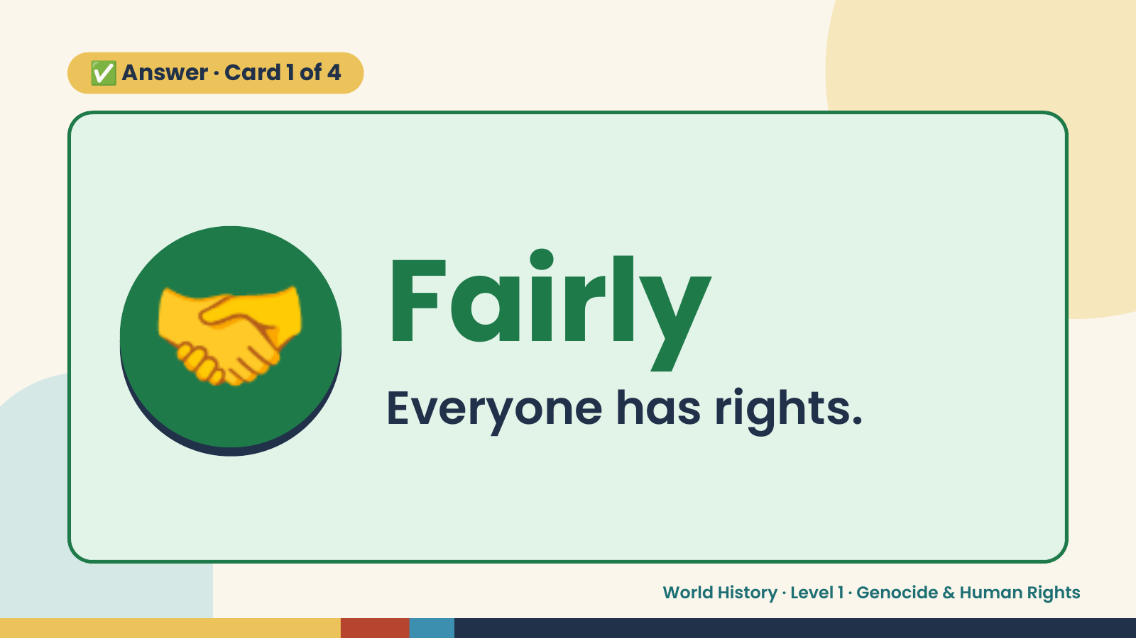
Notes:
✅ Answer · Card 1 of 4
🤝 Fairly
Everyone has rights.
World History · Level 1 · Genocide & Human Rights

Slide 7
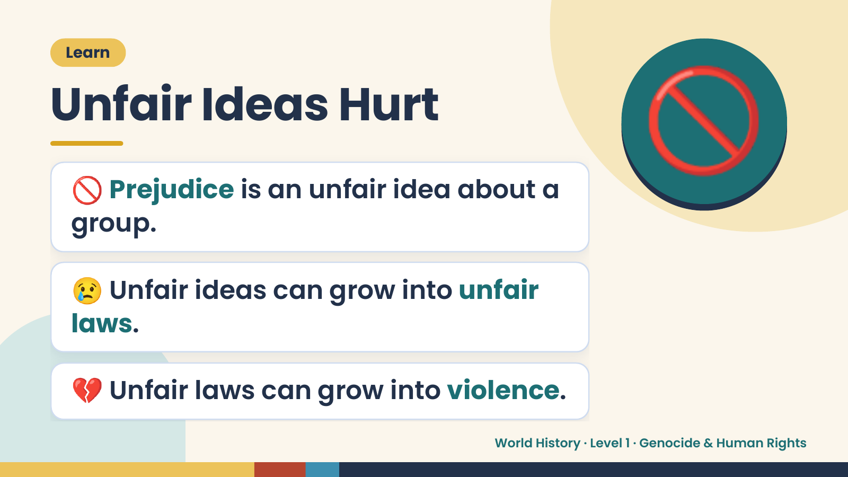
Notes:
Learn
Unfair Ideas Hurt
🚫 Prejudice is an unfair idea about a
group.
🚫
😢 Unfair ideas can grow into unfair
laws.
💔 Unfair laws can grow into violence.
World History · Level 1 · Genocide & Human Rights

Slide 8
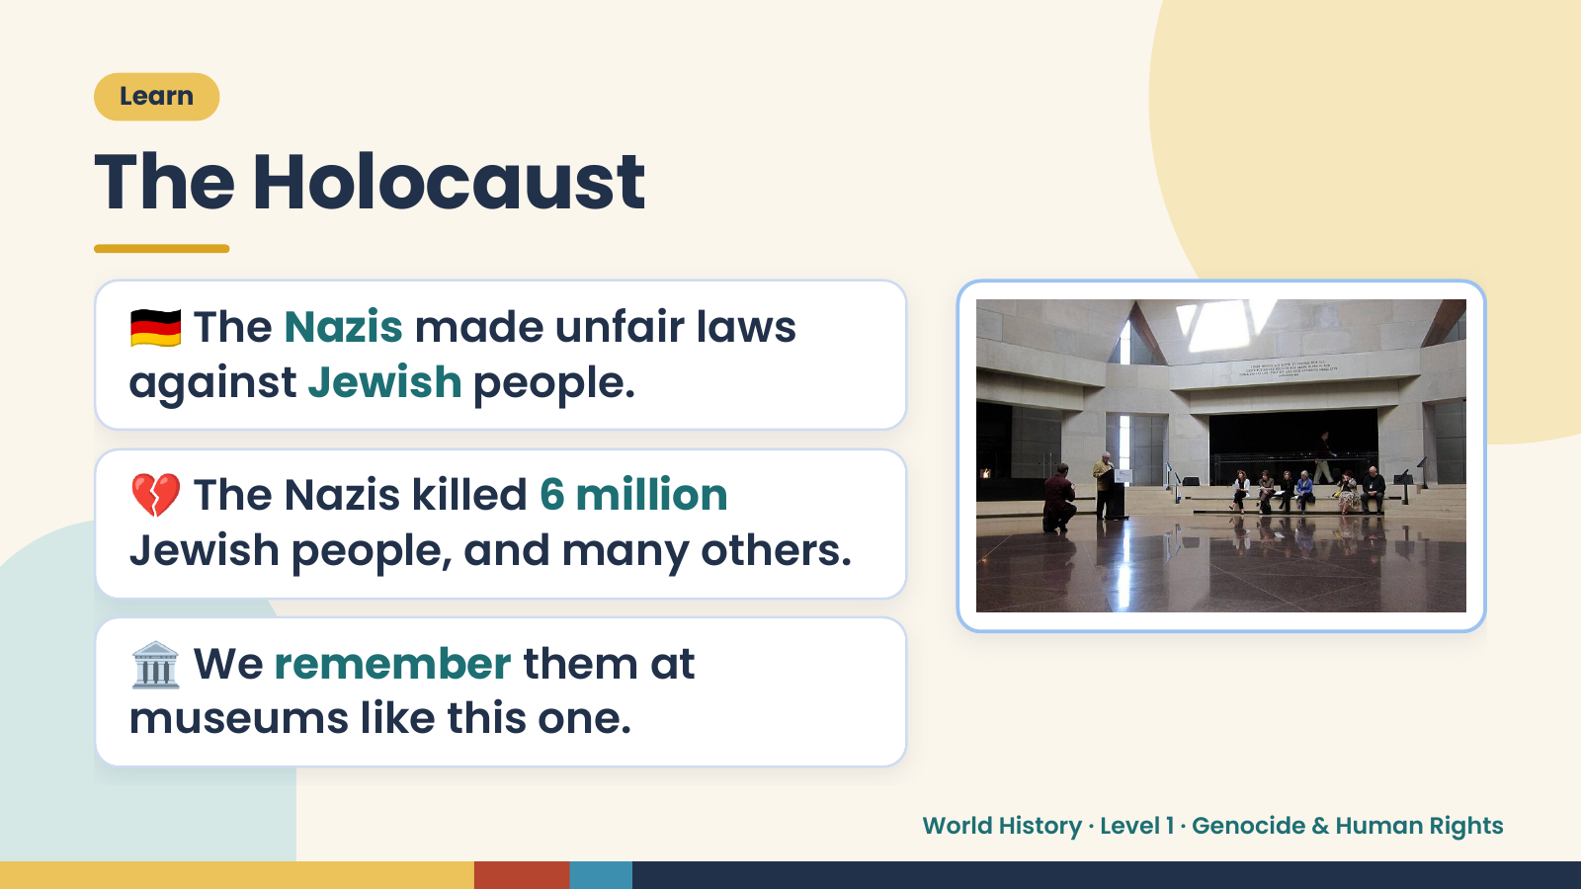
Notes:
Learn
The Holocaust
🇩🇪 The Nazis made unfair laws
against Jewish people.
💔 The Nazis killed 6 million
Jewish people, and many others.
🏛️ We remember them at
museums like this one.
World History · Level 1 · Genocide & Human Rights

Slide 9
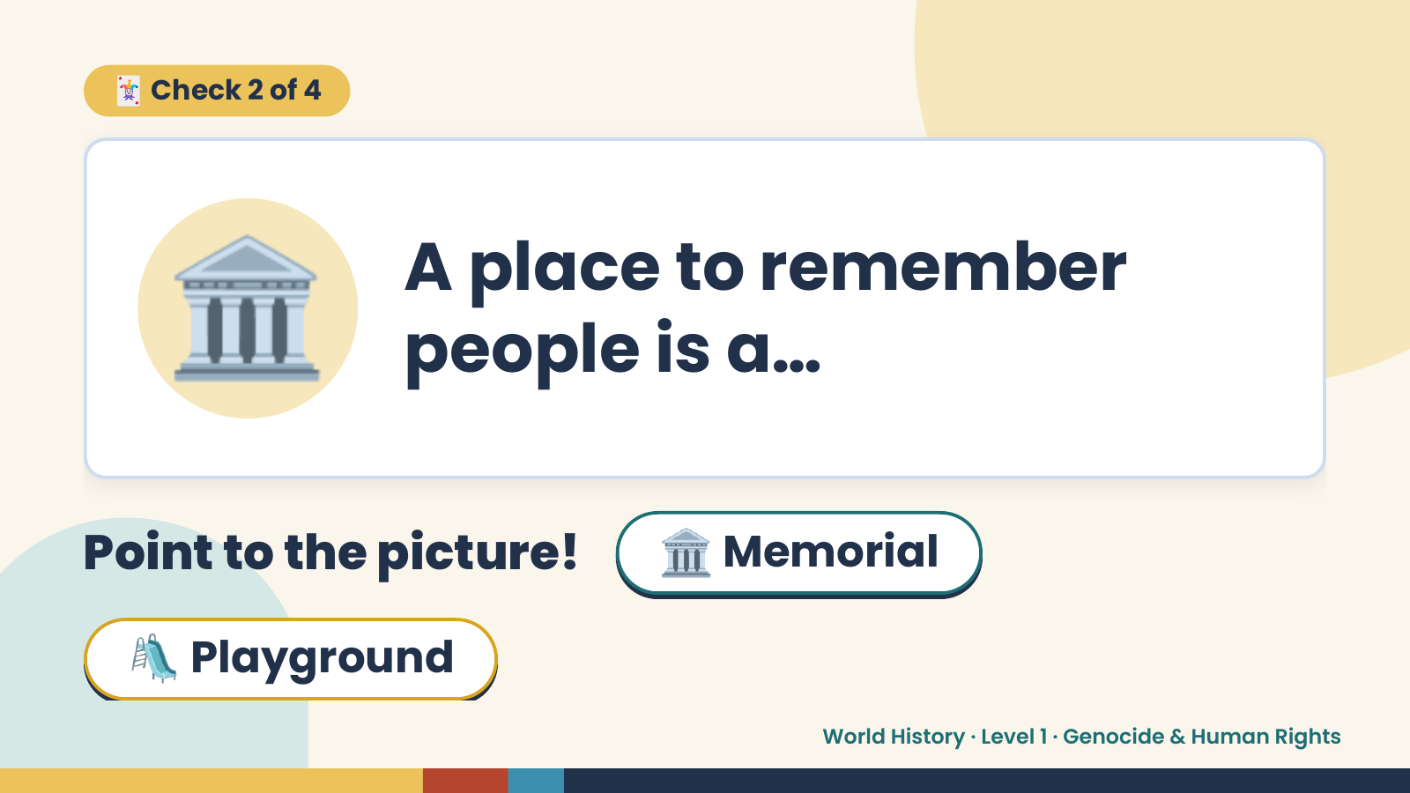
Notes:
🃏 Check 2 of 4
🏛️ A place to remember
people is a…
Point to the picture! 🏛️ Memorial
🛝 Playground
World History · Level 1 · Genocide & Human Rights

Slide 10
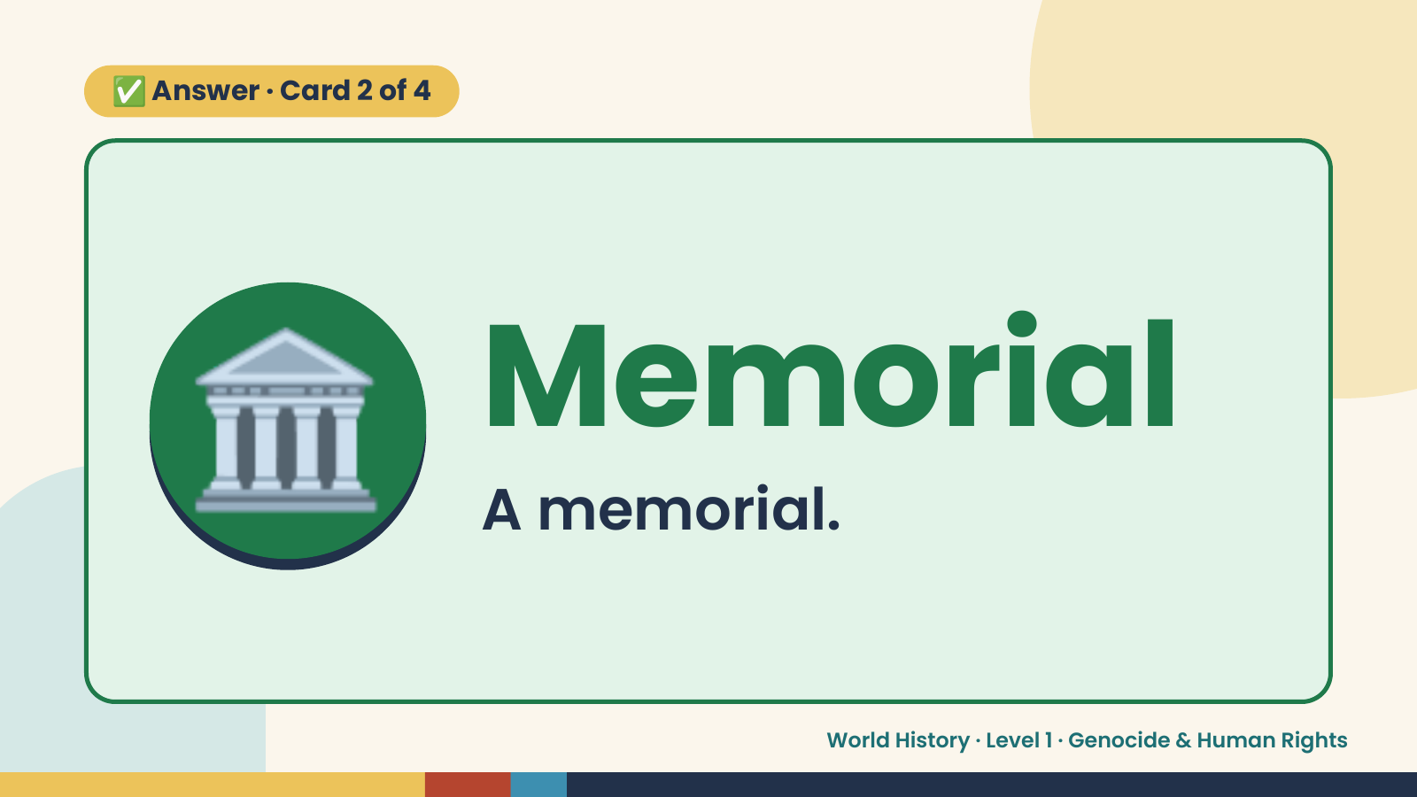
Notes:
✅ Answer · Card 2 of 4
🏛️ Memorial
A memorial.
World History · Level 1 · Genocide & Human Rights

Slide 11
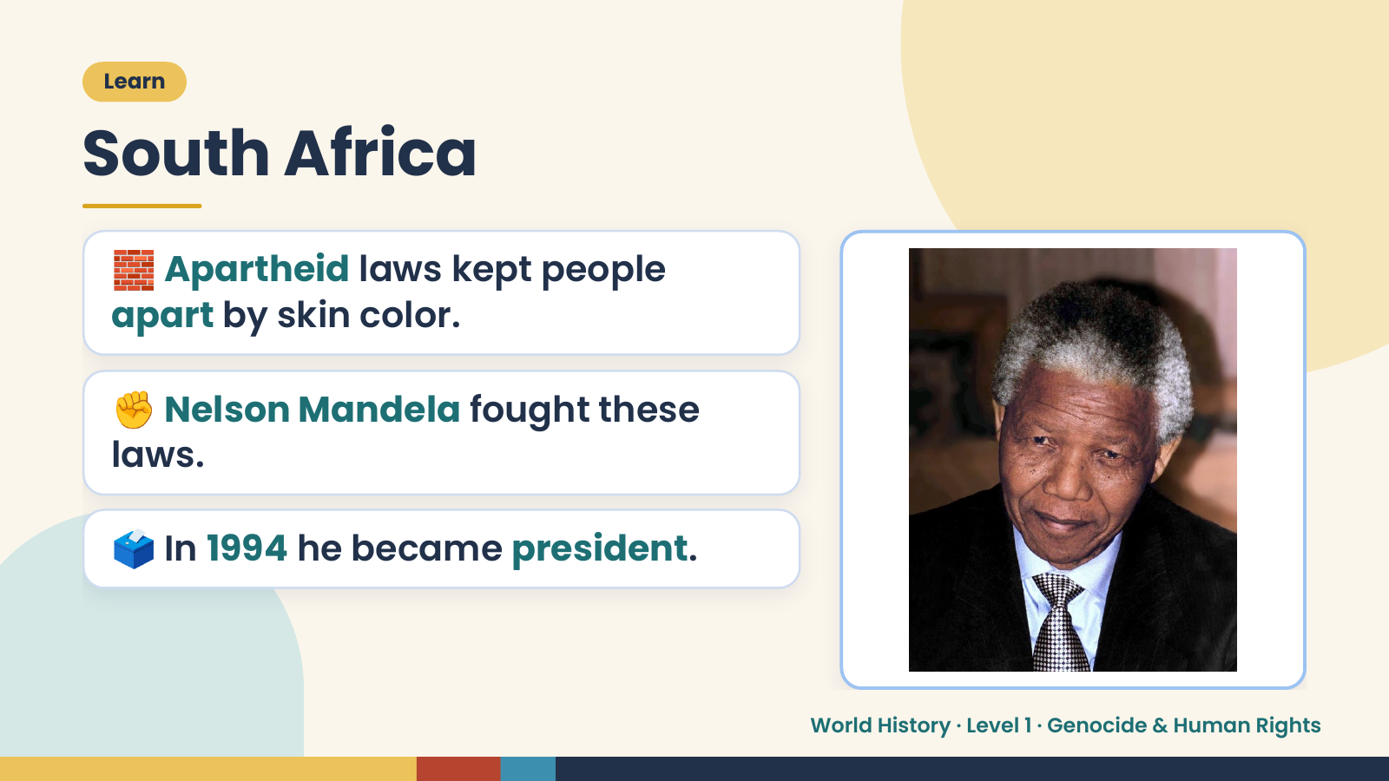
Notes:
Learn
South Africa
🧱 Apartheid laws kept people
apart by skin color.
✊ Nelson Mandela fought these
laws.
🗳️ In 1994 he became president.
World History · Level 1 · Genocide & Human Rights

Slide 12
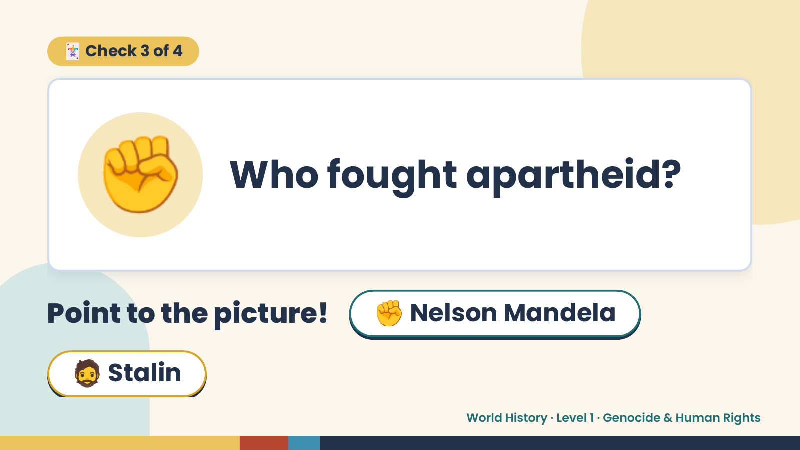
Notes:
🃏 Check 3 of 4
✊ Who fought apartheid?
Point to the picture! ✊ Nelson Mandela
🧔 Stalin
World History · Level 1 · Genocide & Human Rights

Slide 13
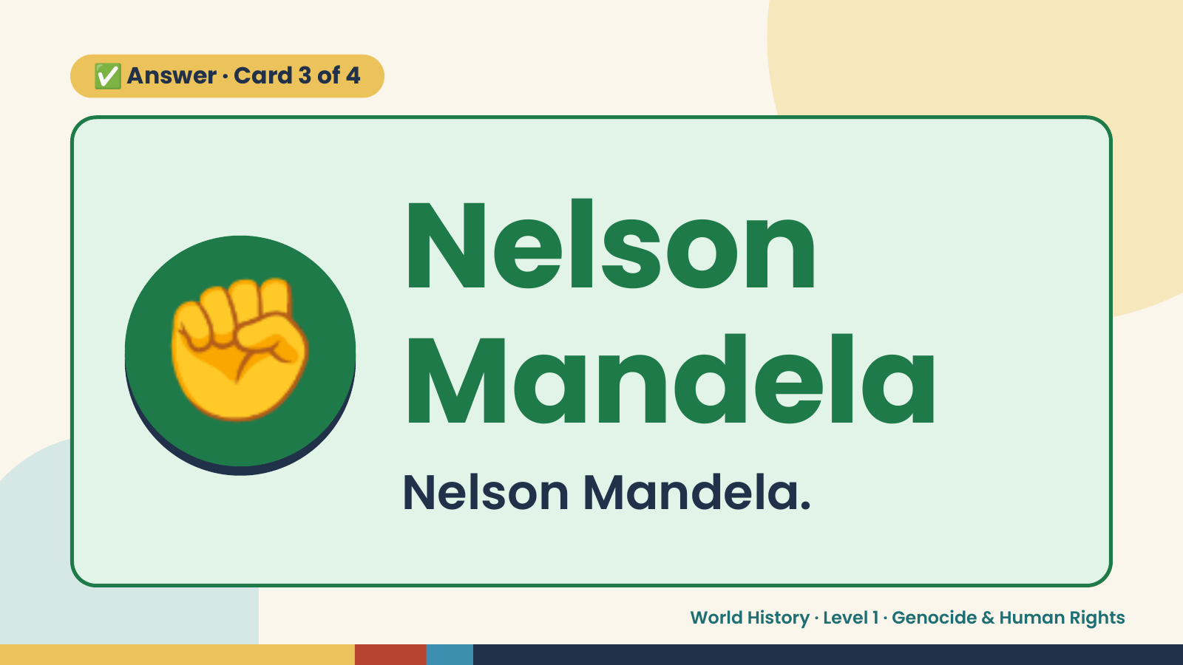
Notes:
✅ Answer · Card 3 of 4
✊ Nelson
Mandela
Nelson Mandela.
World History · Level 1 · Genocide & Human Rights

Slide 14
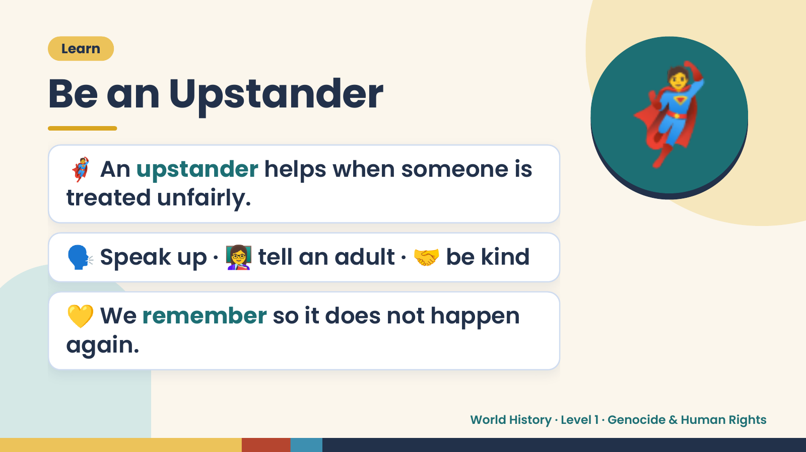
Notes:
Learn
Be an Upstander
🦸 An upstander helps when someone is
treated unfairly.
🦸
🗣️ Speak up · 👩‍🏫 tell an adult · 🤝 be kind
💛 We remember so it does not happen
again.
World History · Level 1 · Genocide & Human Rights

Slide 15
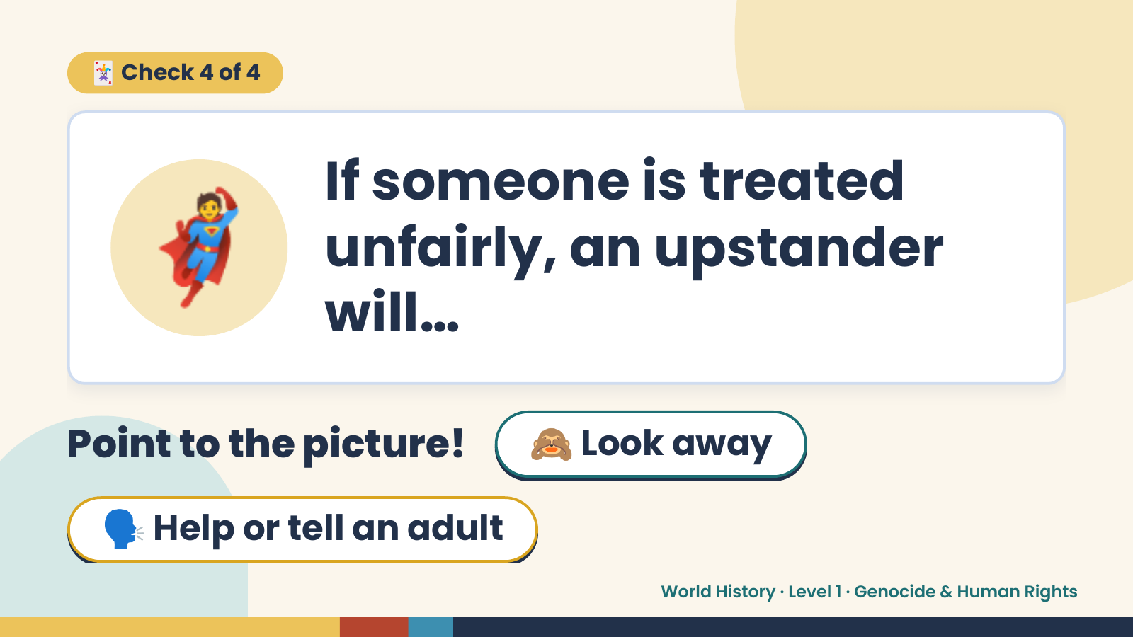
Notes:
🃏 Check 4 of 4
🦸 If someone is treated
unfairly, an upstander
will…
Point to the picture! 🙈 Look away
🗣️ Help or tell an adult
World History · Level 1 · Genocide & Human Rights

Slide 16
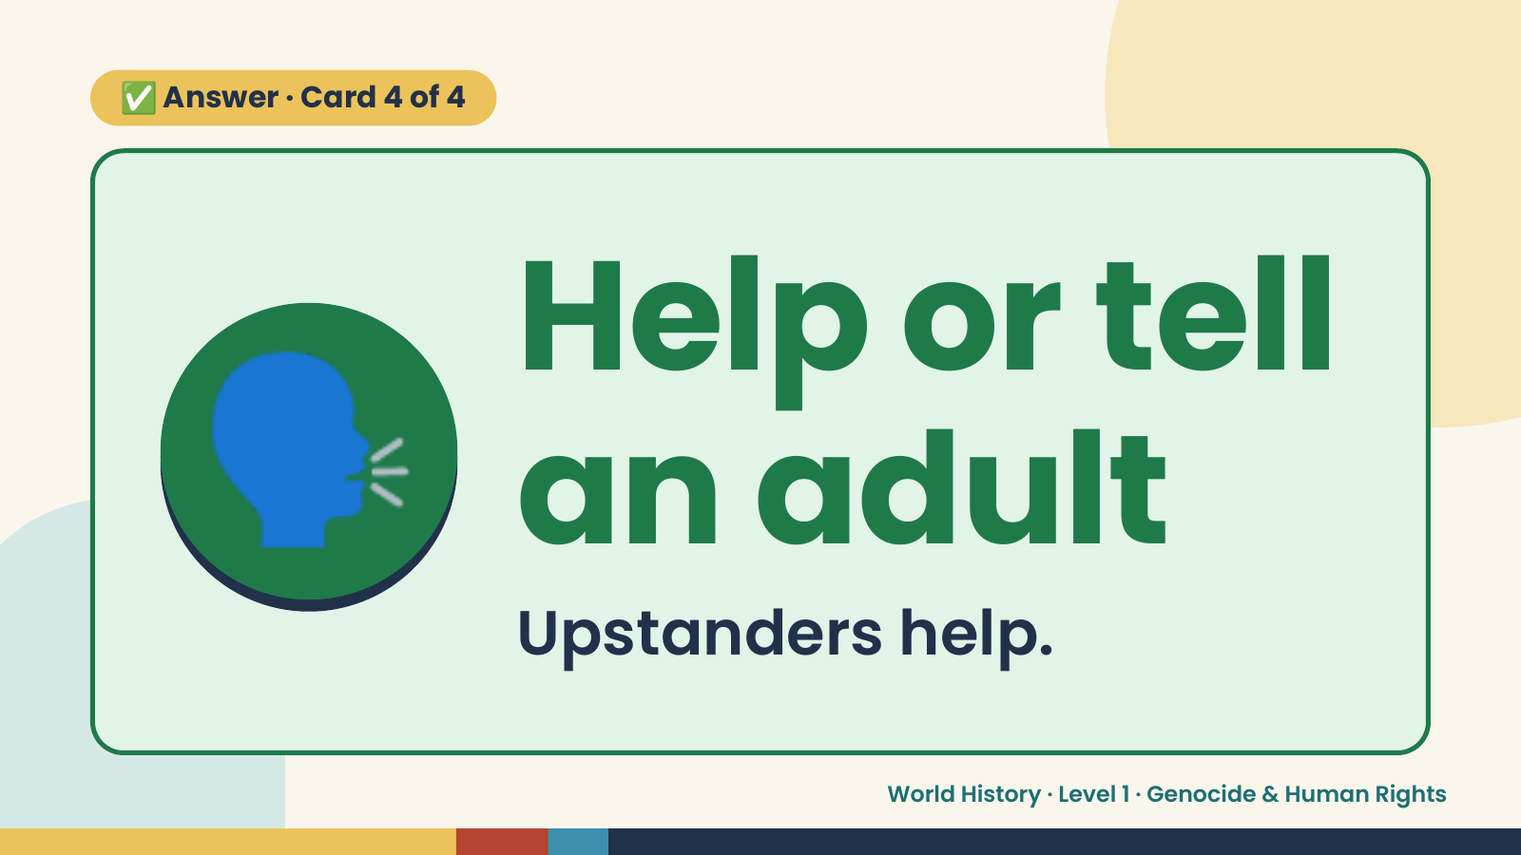
Notes:
✅ Answer · Card 4 of 4
🗣️ Help or tell
an adult
Upstanders help.
World History · Level 1 · Genocide & Human Rights

Slide 17
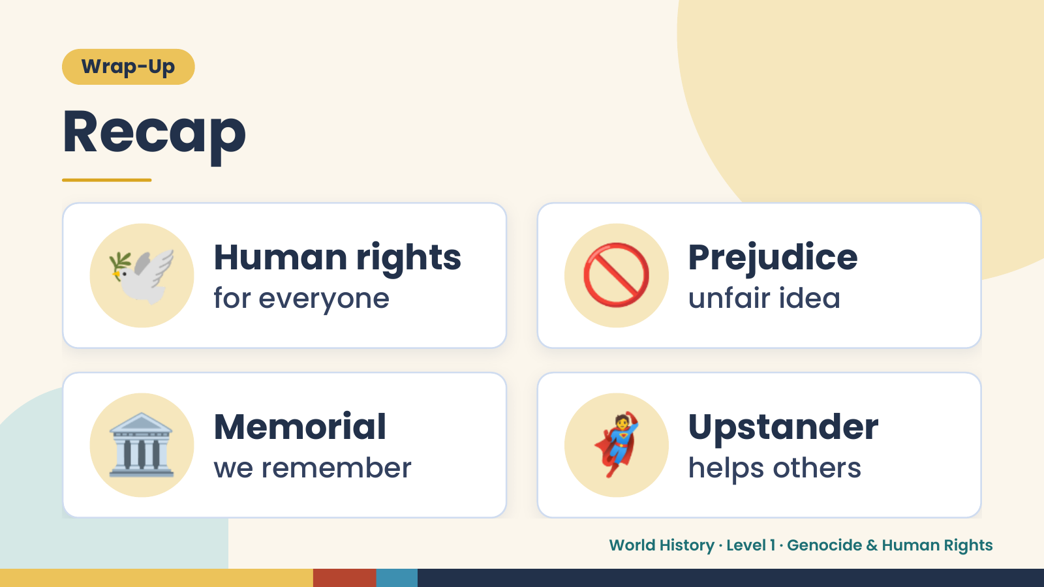
Notes:
Wrap-Up
Recap
🕊️ Human rights
for everyone 🚫 Prejudice
unfair idea
🏛️ Memorial
we remember 🦸 Upstander
helps others
World History · Level 1 · Genocide & Human Rights

Slide 18
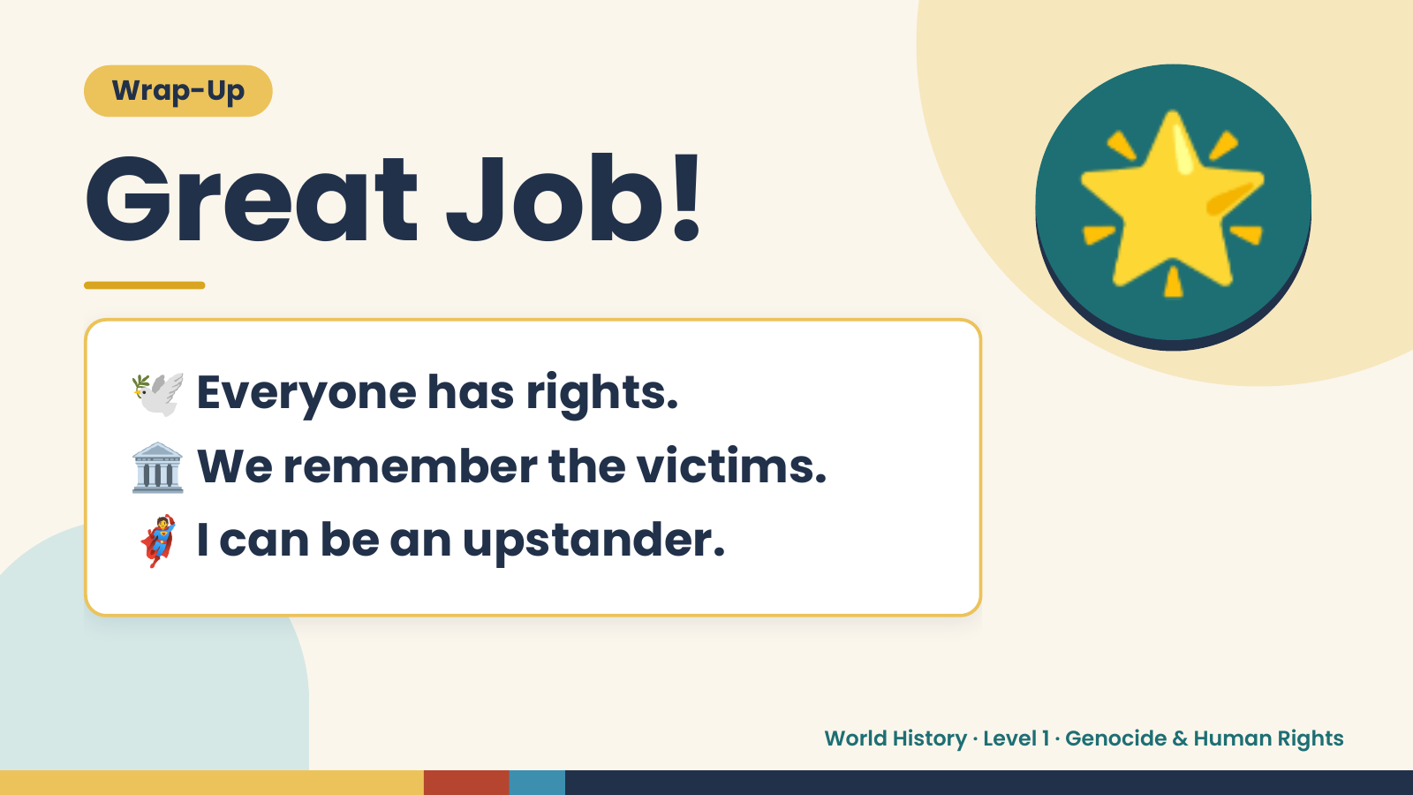
Notes:
Wrap-Up
Great Job!
🕊️ Everyone has rights.
🌟
🏛️ We remember the victims.
🦸 I can be an upstander.
World History · Level 1 · Genocide & Human Rights

