Slide 1
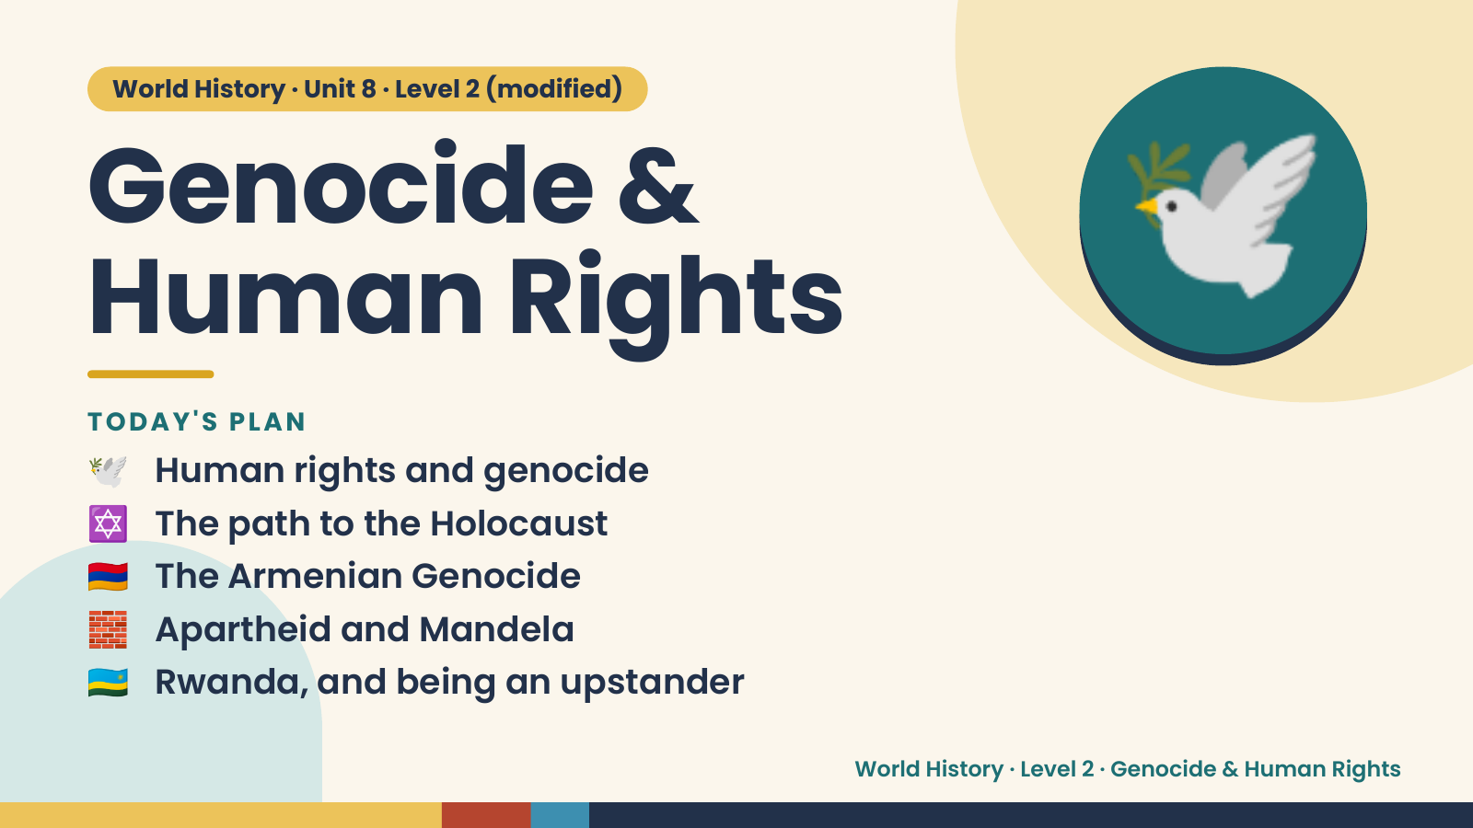
Notes:
World History · Unit 8 · Level 2 (modified)
Genocide &
Human Rights
🕊️ Human rights and genocide
TODAY'S PLAN
🕊️
✡️ The path to the Holocaust
🇦🇲 The Armenian Genocide
🧱 Apartheid and Mandela
🇷🇼 Rwanda, and being an upstander
World History · Level 2 · Genocide & Human Rights

Slide 2
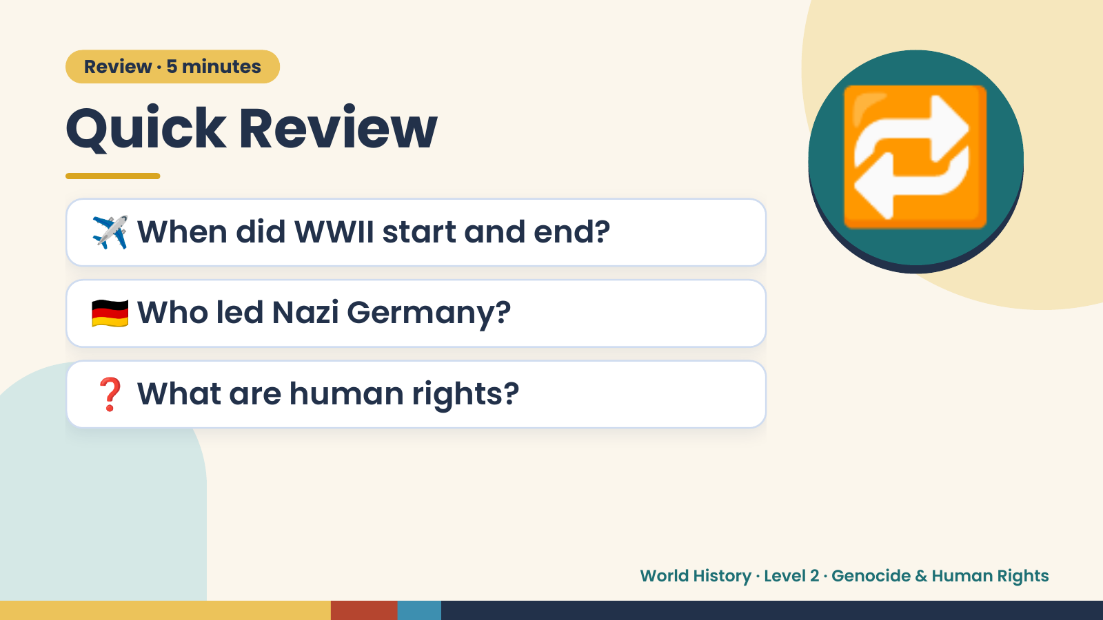
Notes:
Review · 5 minutes
Quick Review
✈️ When did WWII start and end?
🇩🇪 Who led Nazi Germany?
🔁
❓ What are human rights?
World History · Level 2 · Genocide & Human Rights

Slide 3
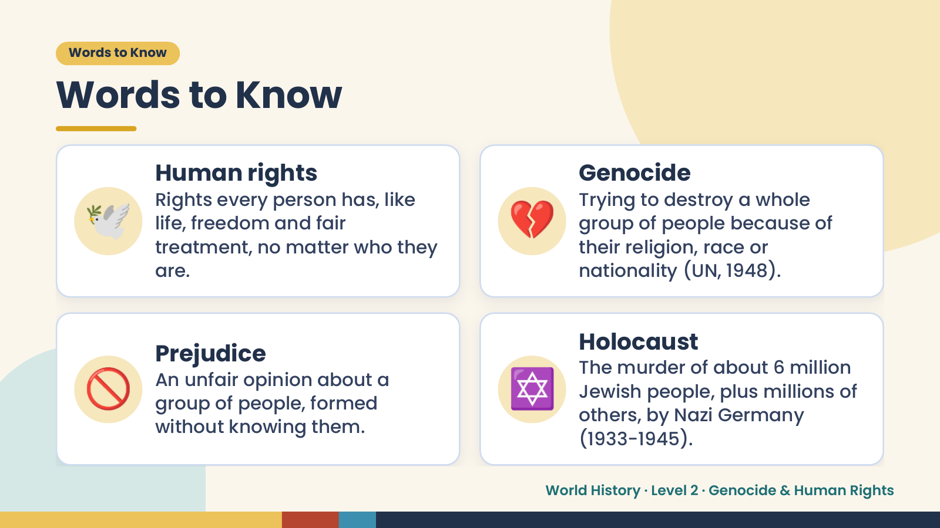
Notes:
Words to Know
Words to Know
🕊️ 💔
Human rights Genocide
Rights every person has, like Trying to destroy a whole
life, freedom and fair group of people because of
treatment, no matter who they their religion, race or
are. nationality (UN, 1948).
🚫 ✡️
Holocaust
Prejudice
The murder of about 6 million
An unfair opinion about a
Jewish people, plus millions of
group of people, formed
others, by Nazi Germany
without knowing them.
(1933-1945).
World History · Level 2 · Genocide & Human Rights

Slide 4
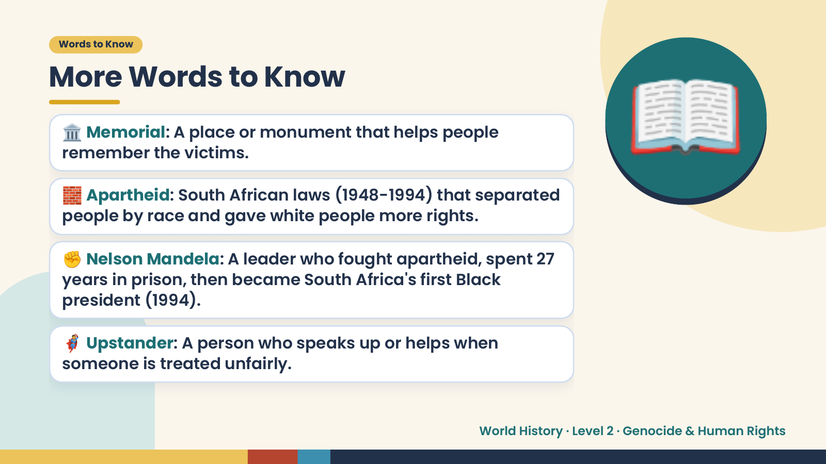
Notes:
Words to Know
More Words to Know
🏛️ Memorial: A place or monument that helps people
remember the victims.
🧱 Apartheid: South African laws (1948-1994) that separated
people by race and gave white people more rights.
✊ Nelson Mandela: A leader who fought apartheid, spent 27
📖
years in prison, then became South Africa's first Black
president (1994).
🦸 Upstander: A person who speaks up or helps when
someone is treated unfairly.
World History · Level 2 · Genocide & Human Rights

Slide 5
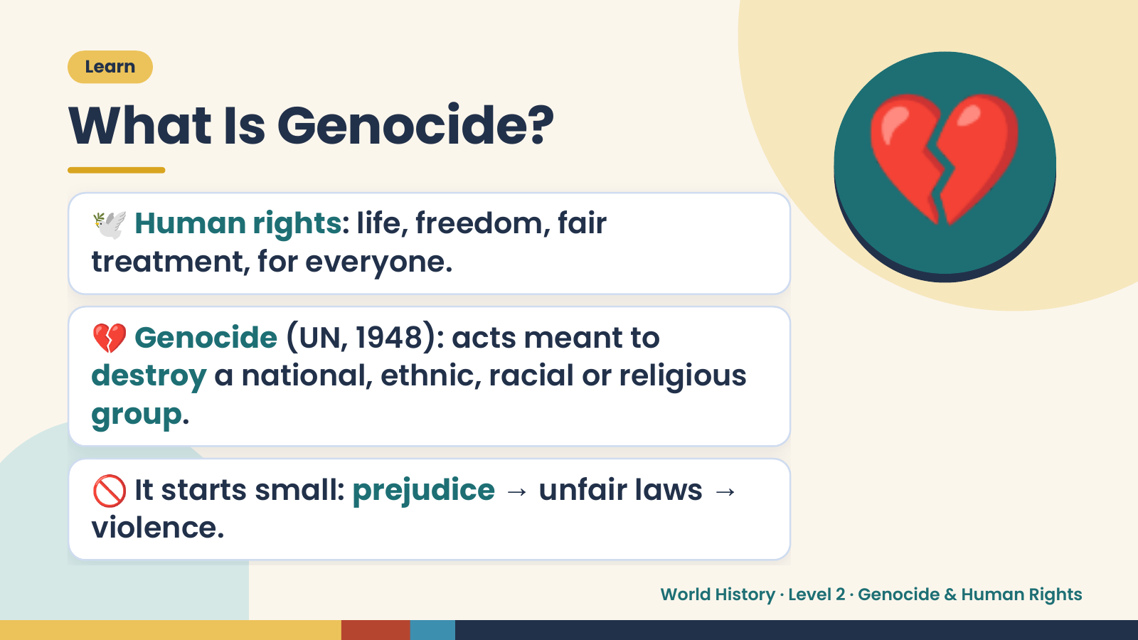
Notes:
Learn
What Is Genocide?
🕊️ Human rights: life, freedom, fair
treatment, for everyone.
💔 Genocide (UN, 1948): acts meant to
💔
destroy a national, ethnic, racial or religious
group.
🚫 It starts small: prejudice → unfair laws →
violence.
World History · Level 2 · Genocide & Human Rights

Slide 6
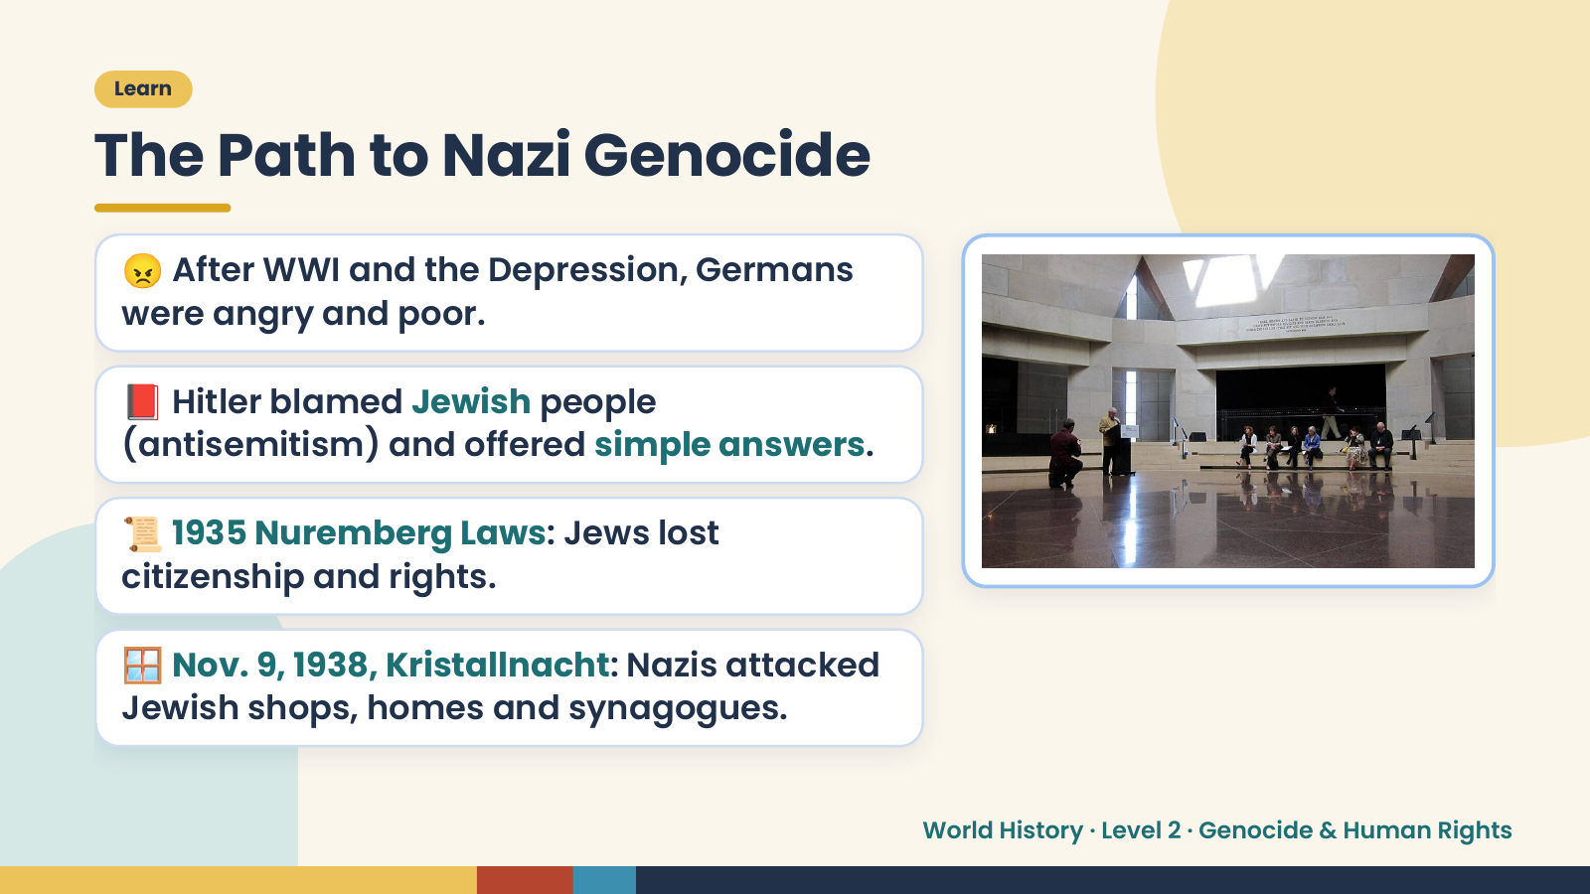
Notes:
Learn
The Path to Nazi Genocide
😠 After WWI and the Depression, Germans
were angry and poor.
📕 Hitler blamed Jewish people
(antisemitism) and offered simple answers.
📜 1935 Nuremberg Laws: Jews lost
citizenship and rights.
🪟 Nov. 9, 1938, Kristallnacht: Nazis attacked
Jewish shops, homes and synagogues.
World History · Level 2 · Genocide & Human Rights

Slide 7
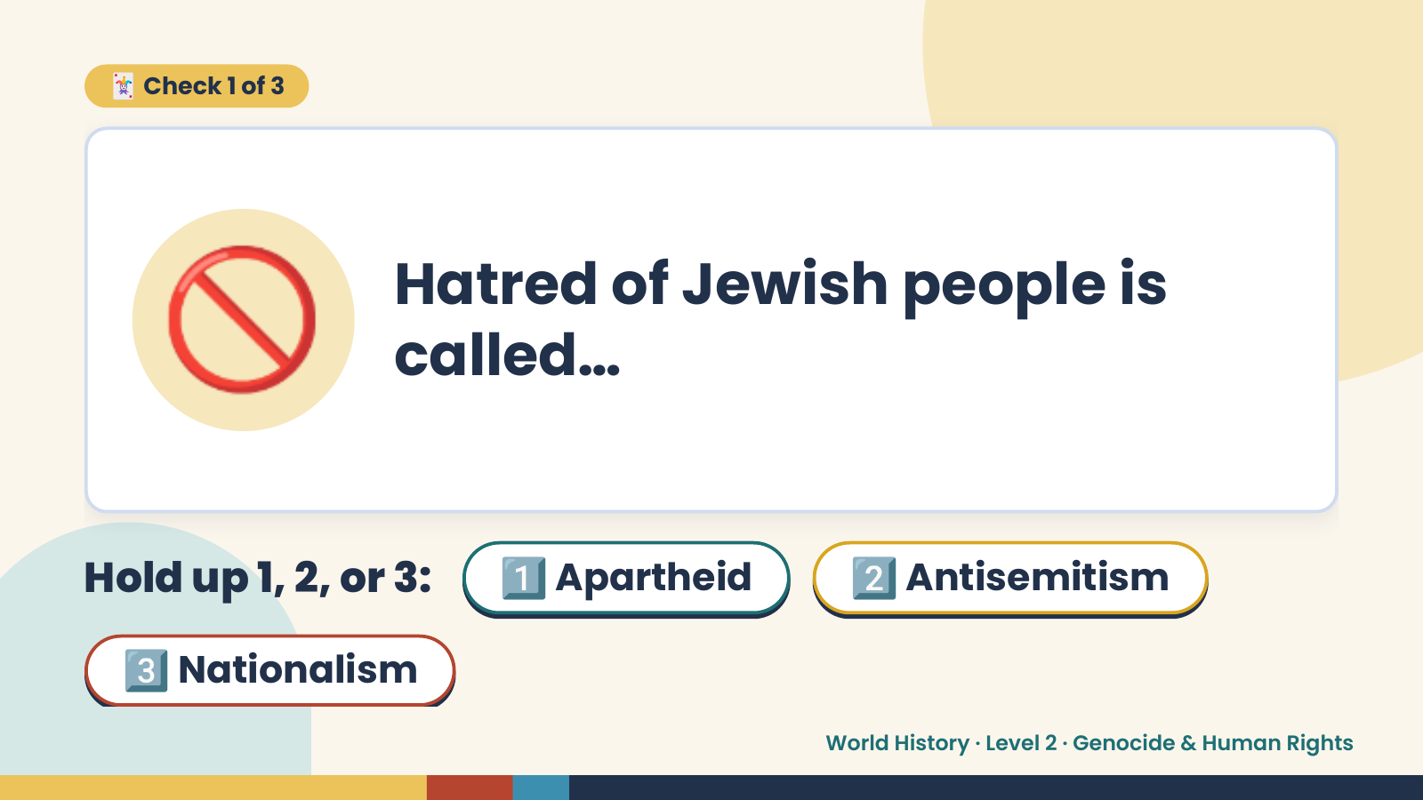
Notes:
🃏 Check 1 of 3
🚫 Hatred of Jewish people is
called…
Hold up 1, 2, or 3: 1️⃣ Apartheid 2️⃣ Antisemitism
3️⃣ Nationalism
World History · Level 2 · Genocide & Human Rights

Slide 8
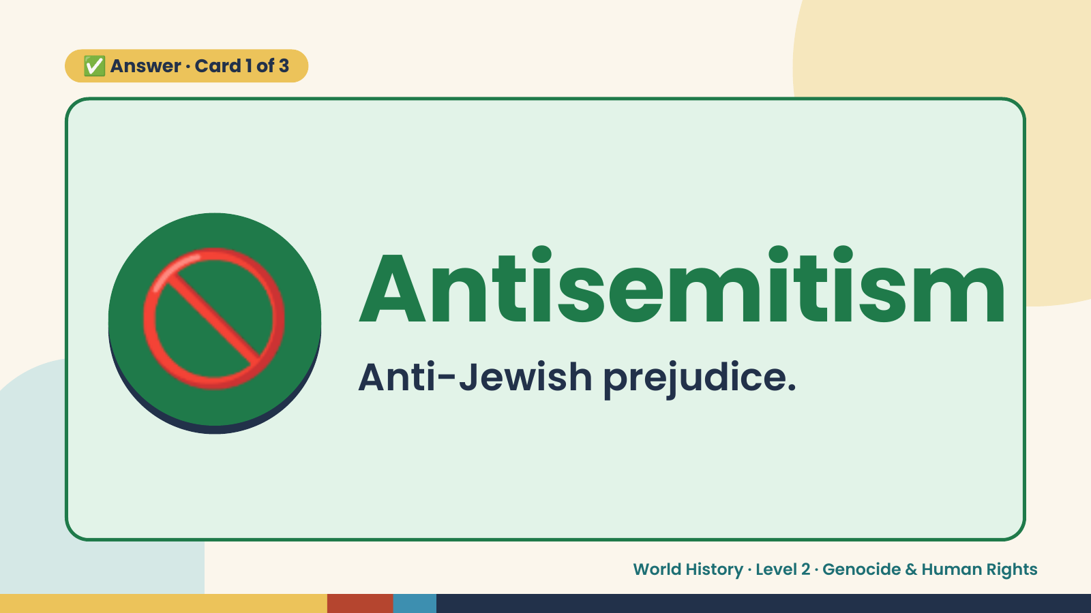
Notes:
✅ Answer · Card 1 of 3
🚫 Antisemitism
Anti-Jewish prejudice.
World History · Level 2 · Genocide & Human Rights

Slide 9
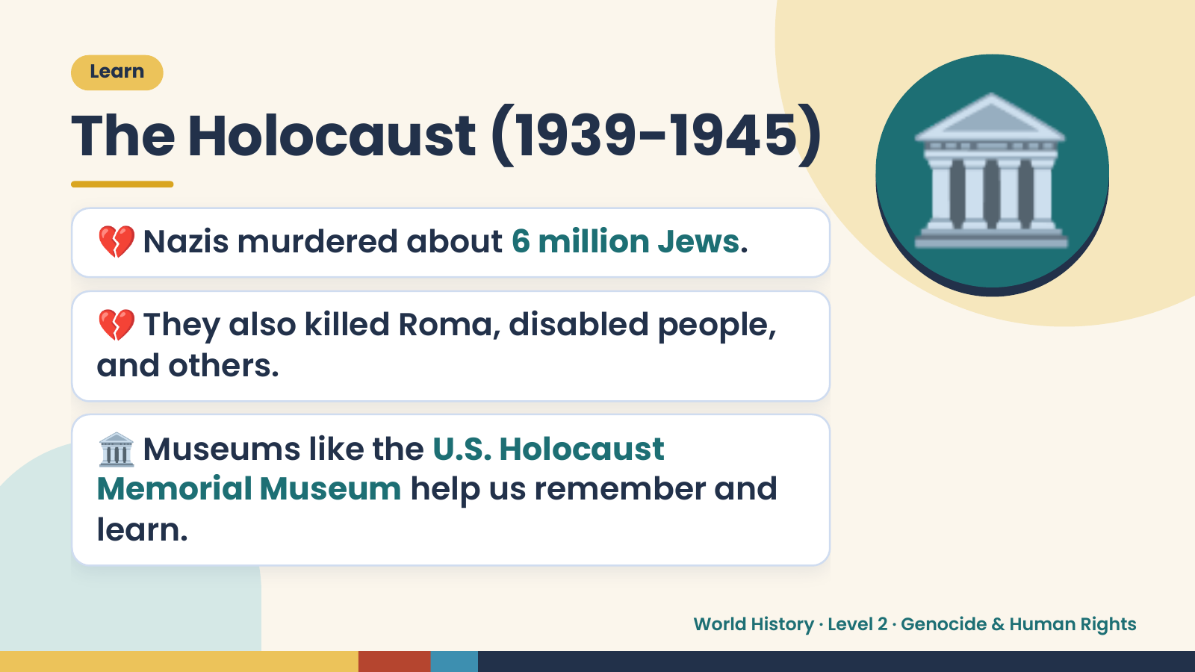
Notes:
Learn
The Holocaust (1939-1945)
💔 Nazis murdered about 6 million Jews.
💔 They also killed Roma, disabled people,
and others.
🏛️
🏛️ Museums like the U.S. Holocaust
Memorial Museum help us remember and
learn.
World History · Level 2 · Genocide & Human Rights

Slide 10
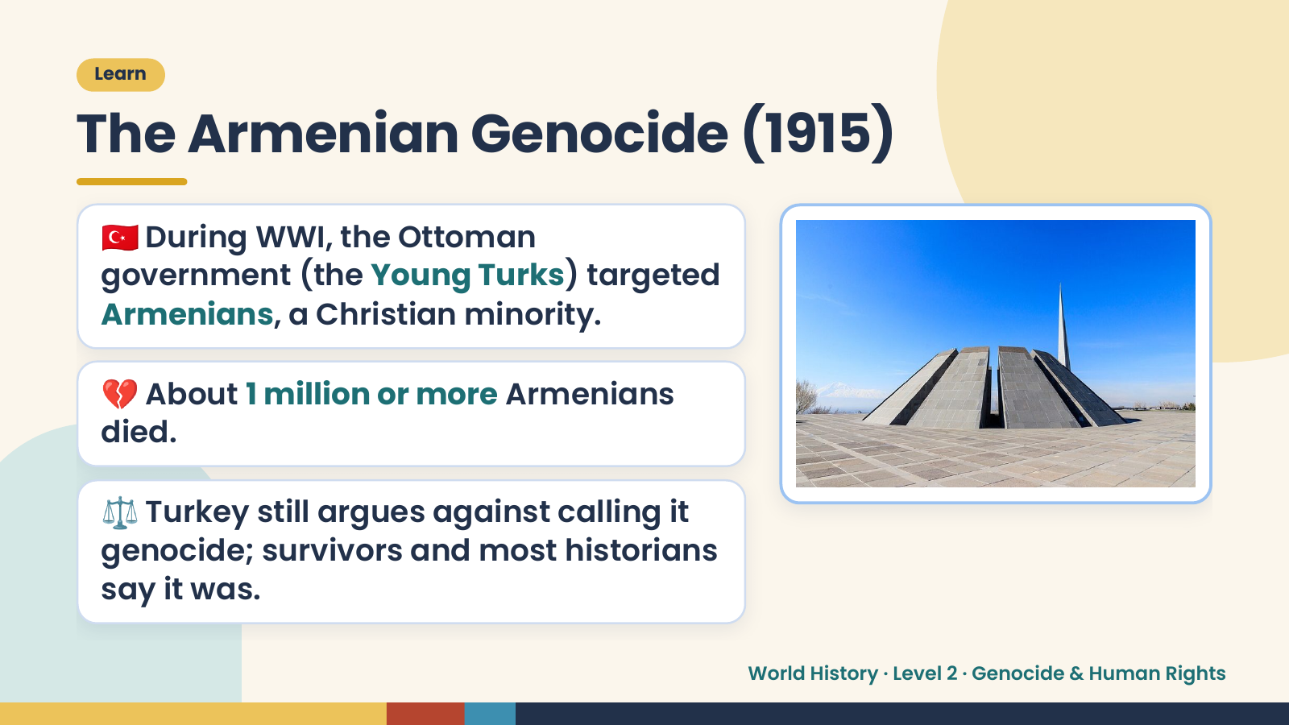
Notes:
Learn
The Armenian Genocide (1915)
🇹🇷 During WWI, the Ottoman
government (the Young Turks) targeted
Armenians, a Christian minority.
💔 About 1 million or more Armenians
died.
⚖️ Turkey still argues against calling it
genocide; survivors and most historians
say it was.
World History · Level 2 · Genocide & Human Rights

Slide 11
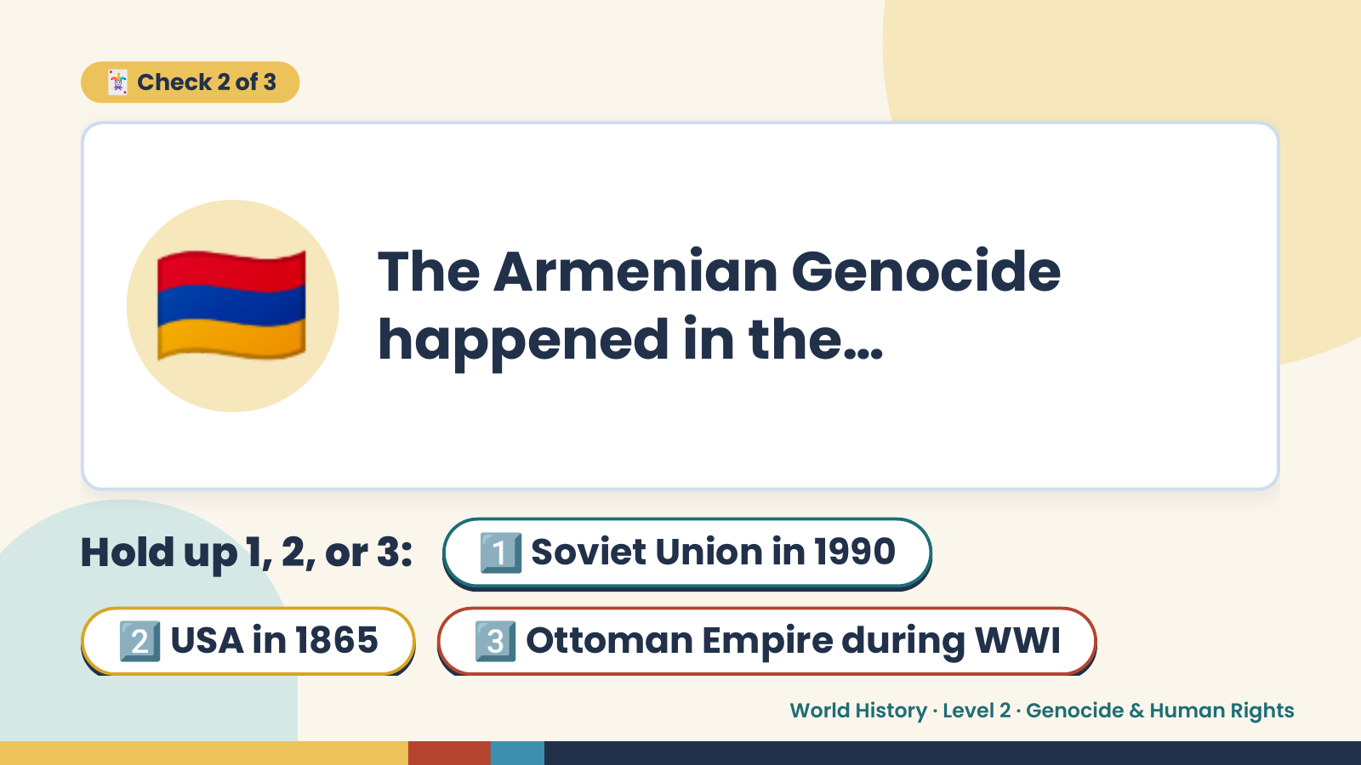
Notes:
🃏 Check 2 of 3
🇦🇲 The Armenian Genocide
happened in the…
Hold up 1, 2, or 3: 1️⃣ Soviet Union in 1990
2️⃣ USA in 1865 3️⃣ Ottoman Empire during WWI
World History · Level 2 · Genocide & Human Rights

Slide 12
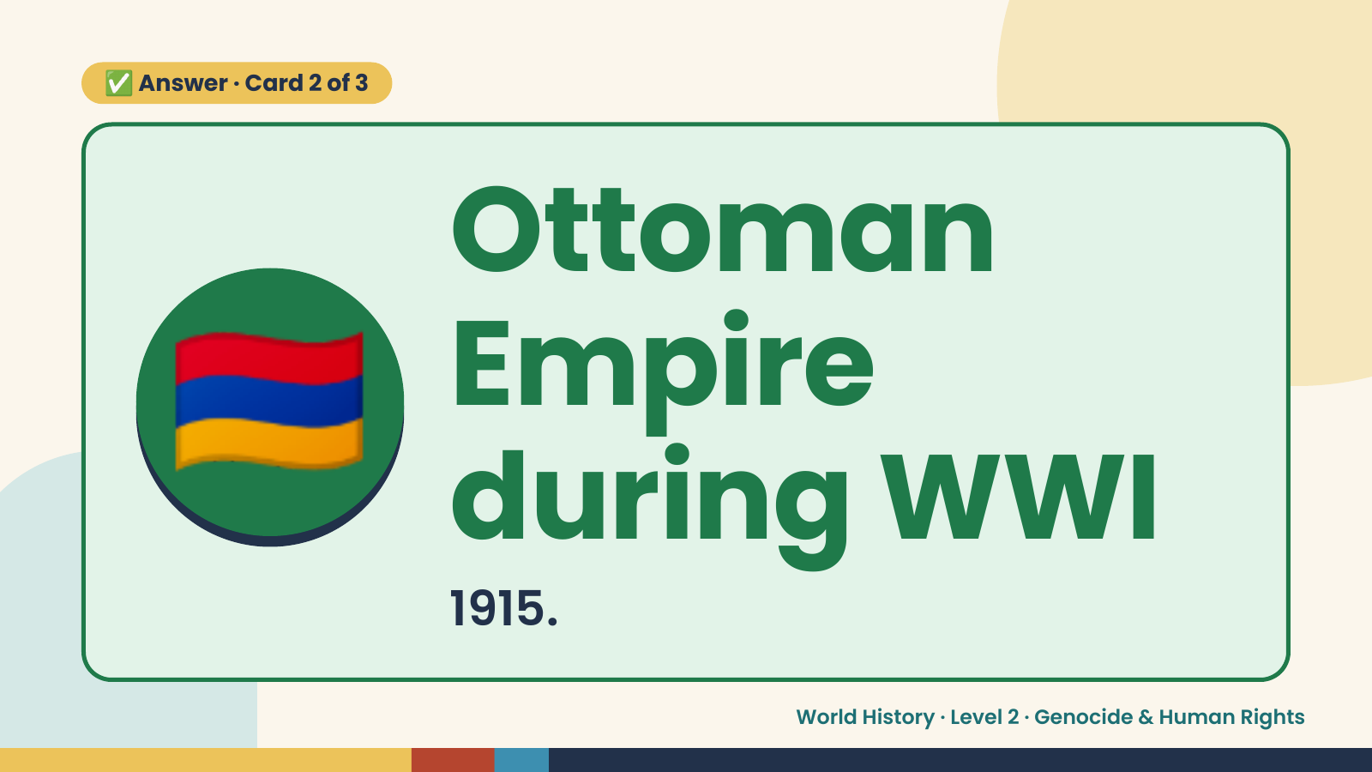
Notes:
✅ Answer · Card 2 of 3
🇦🇲 Ottoman
Empire
during WWI
1915.
World History · Level 2 · Genocide & Human Rights

Slide 13
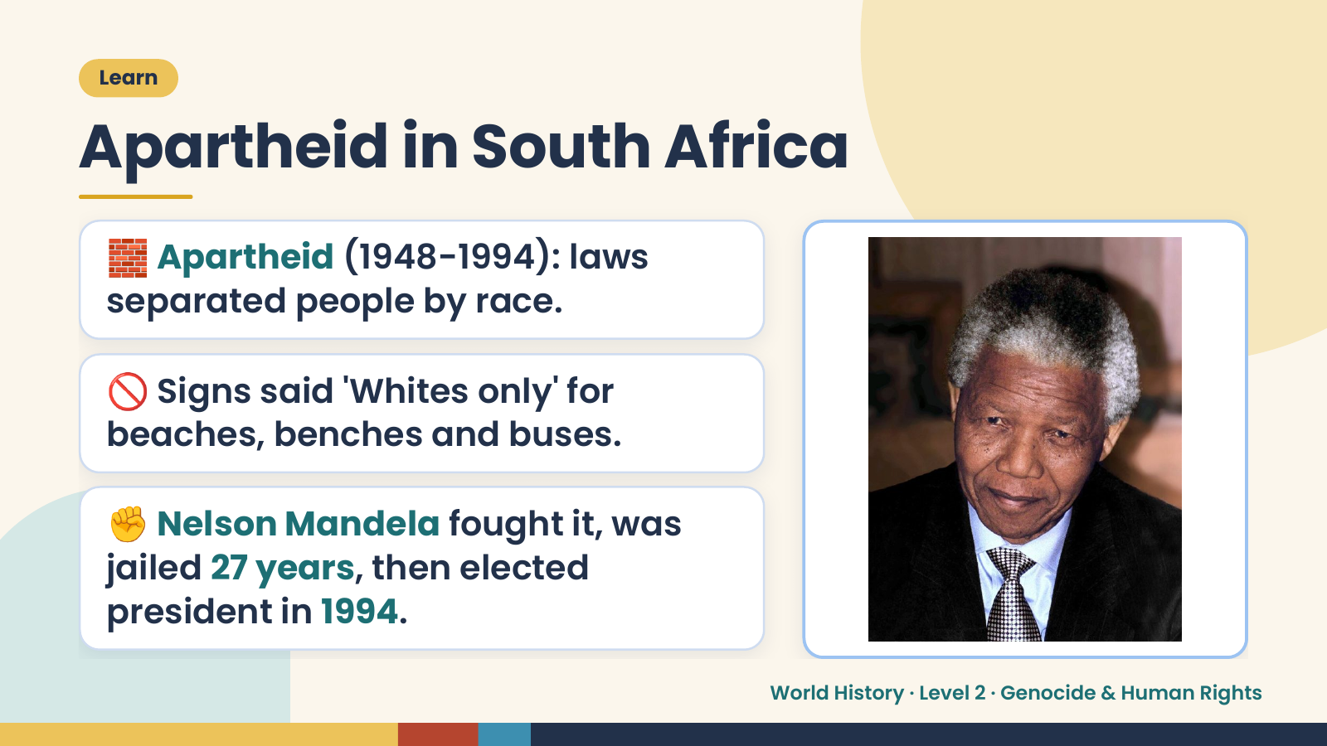
Notes:
Learn
Apartheid in South Africa
🧱 Apartheid (1948-1994): laws
separated people by race.
🚫 Signs said 'Whites only' for
beaches, benches and buses.
✊ Nelson Mandela fought it, was
jailed 27 years, then elected
president in 1994.
World History · Level 2 · Genocide & Human Rights

Slide 14
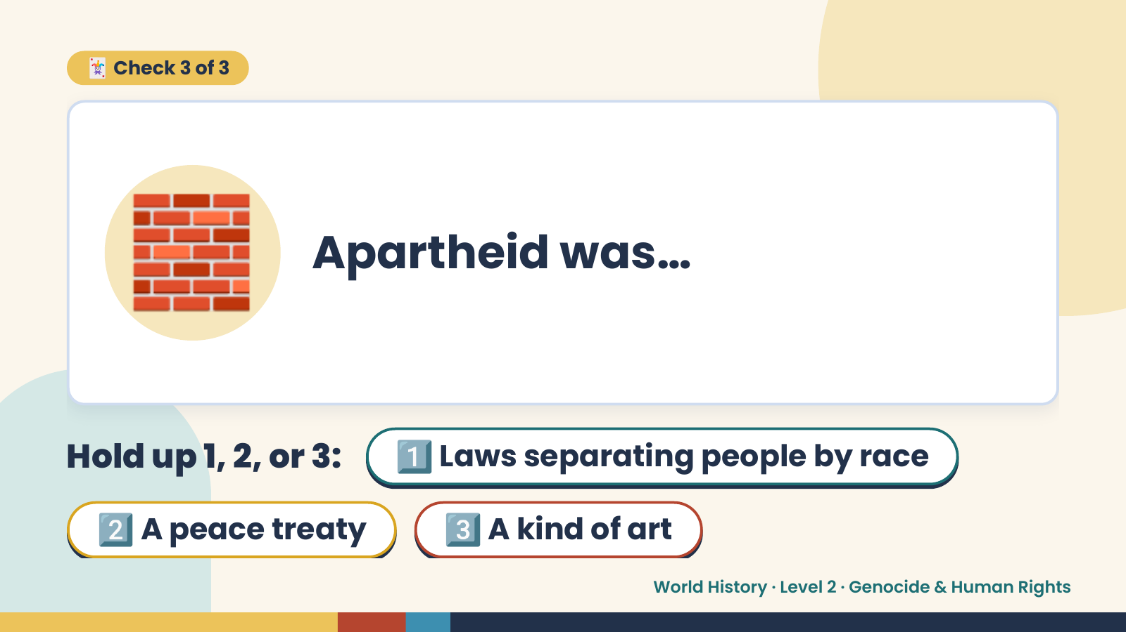
Notes:
🃏 Check 3 of 3
🧱 Apartheid was…
Hold up 1, 2, or 3: 1️⃣ Laws separating people by race
2️⃣ A peace treaty 3️⃣ A kind of art
World History · Level 2 · Genocide & Human Rights

Slide 15
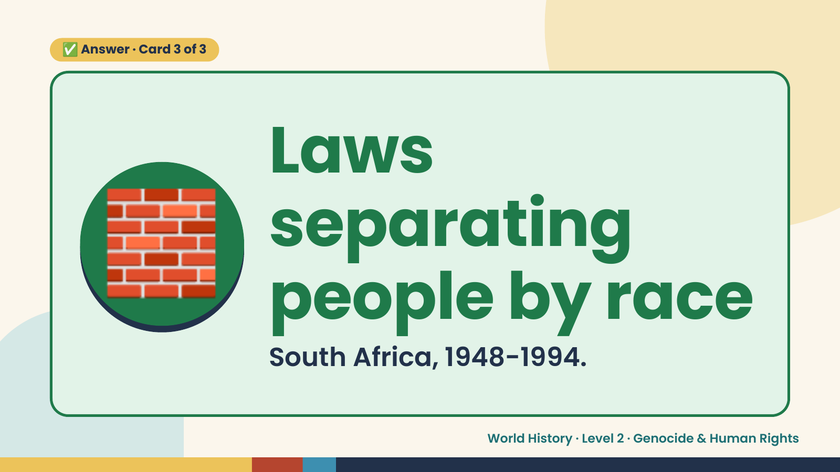
Notes:
✅ Answer · Card 3 of 3
🧱 Laws
separating
people by race
South Africa, 1948-1994.
World History · Level 2 · Genocide & Human Rights

Slide 16
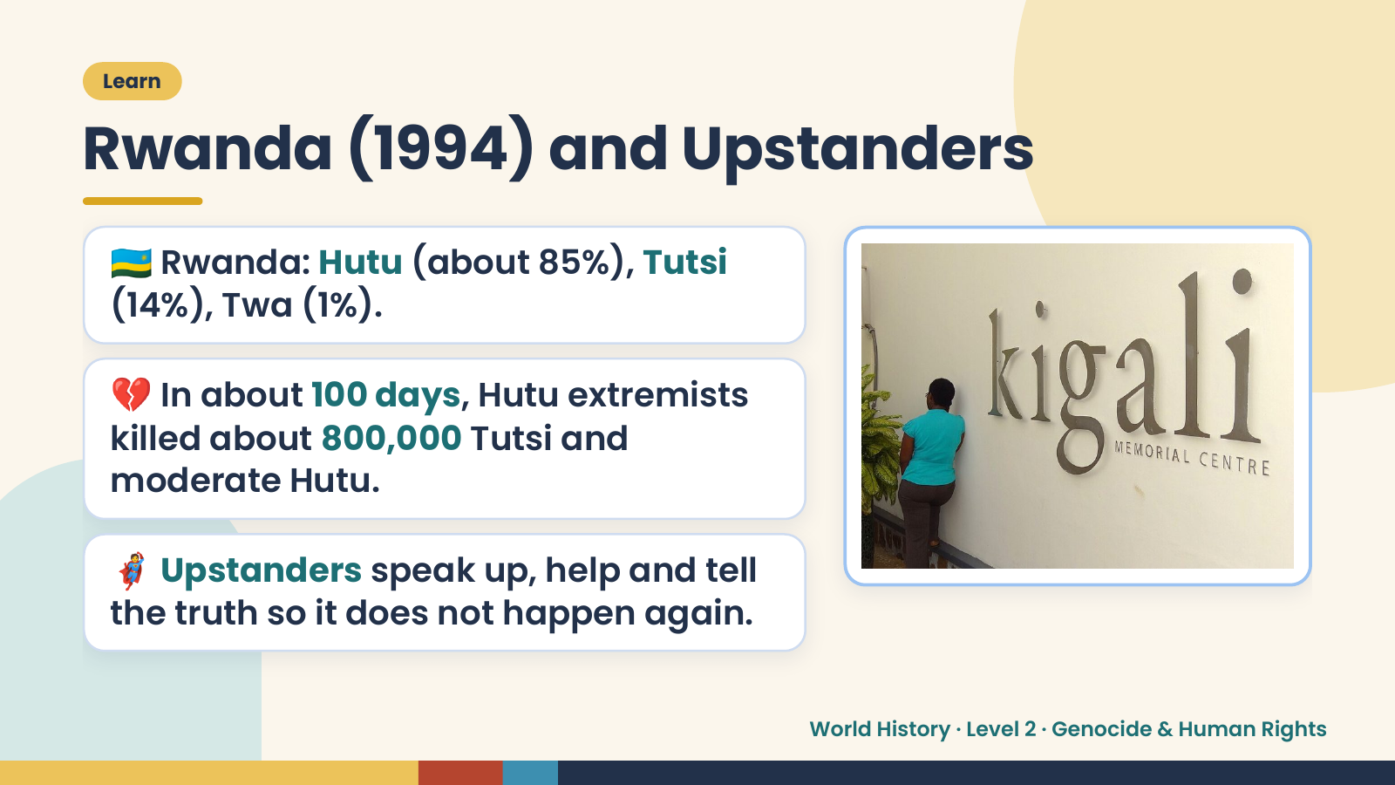
Notes:
Learn
Rwanda (1994) and Upstanders
🇷🇼 Rwanda: Hutu (about 85%), Tutsi
(14%), Twa (1%).
💔 In about 100 days, Hutu extremists
killed about 800,000 Tutsi and
moderate Hutu.
🦸 Upstanders speak up, help and tell
the truth so it does not happen again.
World History · Level 2 · Genocide & Human Rights

Slide 17
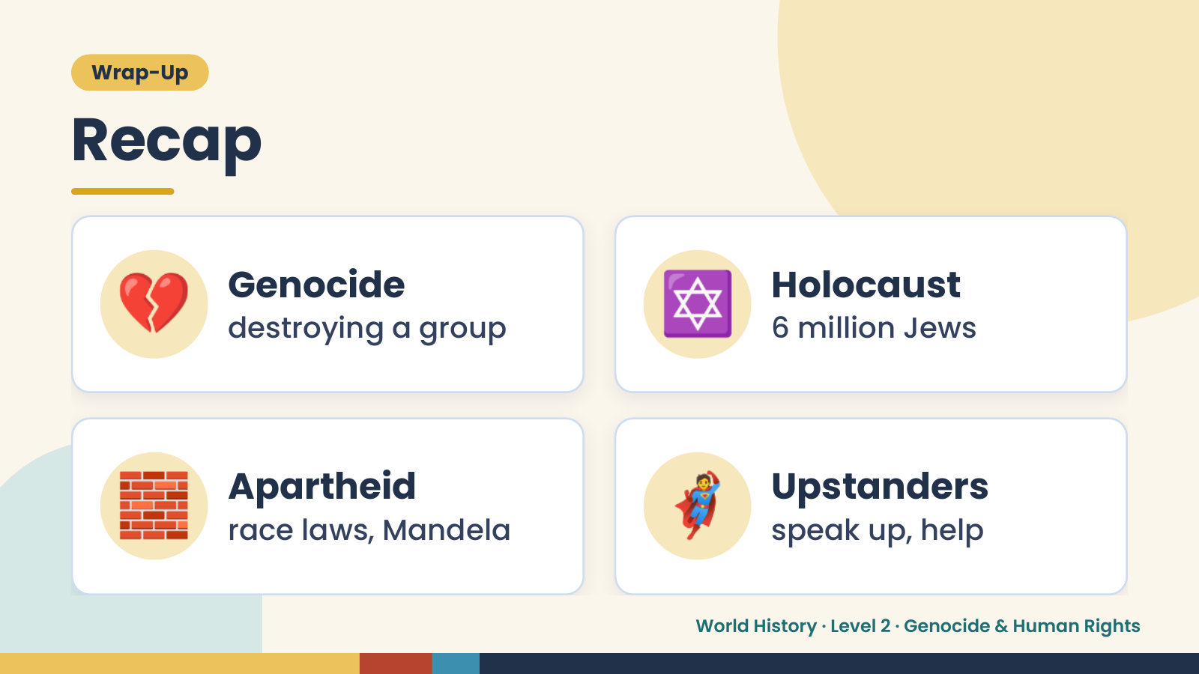
Notes:
Wrap-Up
Recap
💔 Genocide
destroying a group ✡️ Holocaust
6 million Jews
🧱 Apartheid
race laws, Mandela 🦸 Upstanders
speak up, help
World History · Level 2 · Genocide & Human Rights

Slide 18
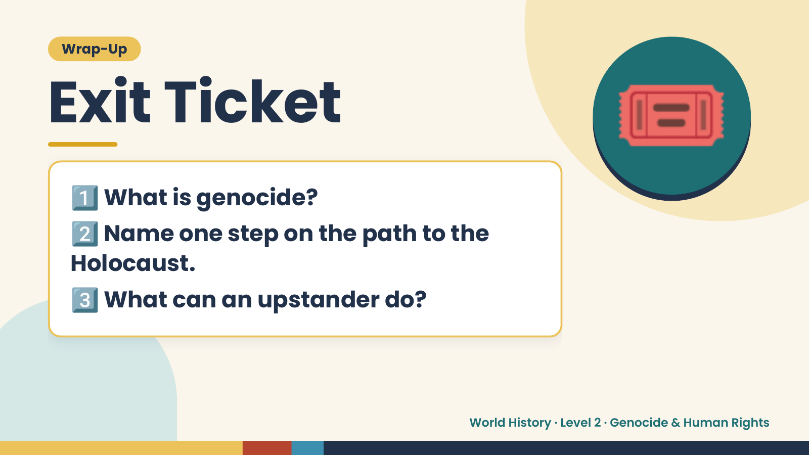
Notes:
Wrap-Up
Exit Ticket
1️⃣
2️⃣
What is genocide?
Name one step on the path to the
🎟️
Holocaust.
3️⃣What can an upstander do?
World History · Level 2 · Genocide & Human Rights

