Slide 1
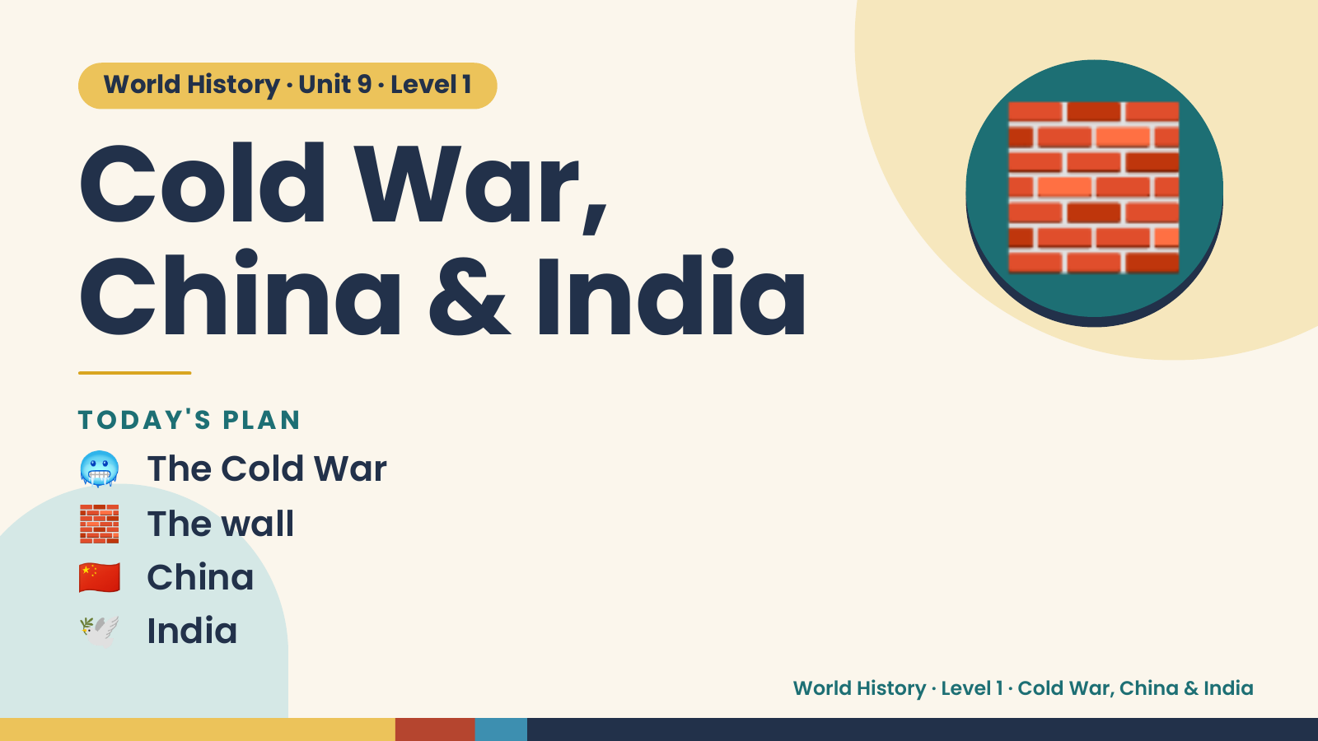
Notes:
World History · Unit 9 · Level 1
Cold War,
China & India
🧱
🥶 The Cold War
TODAY'S PLAN
🧱 The wall
🇨🇳 China
🕊️ India
World History · Level 1 · Cold War, China & India

Slide 2
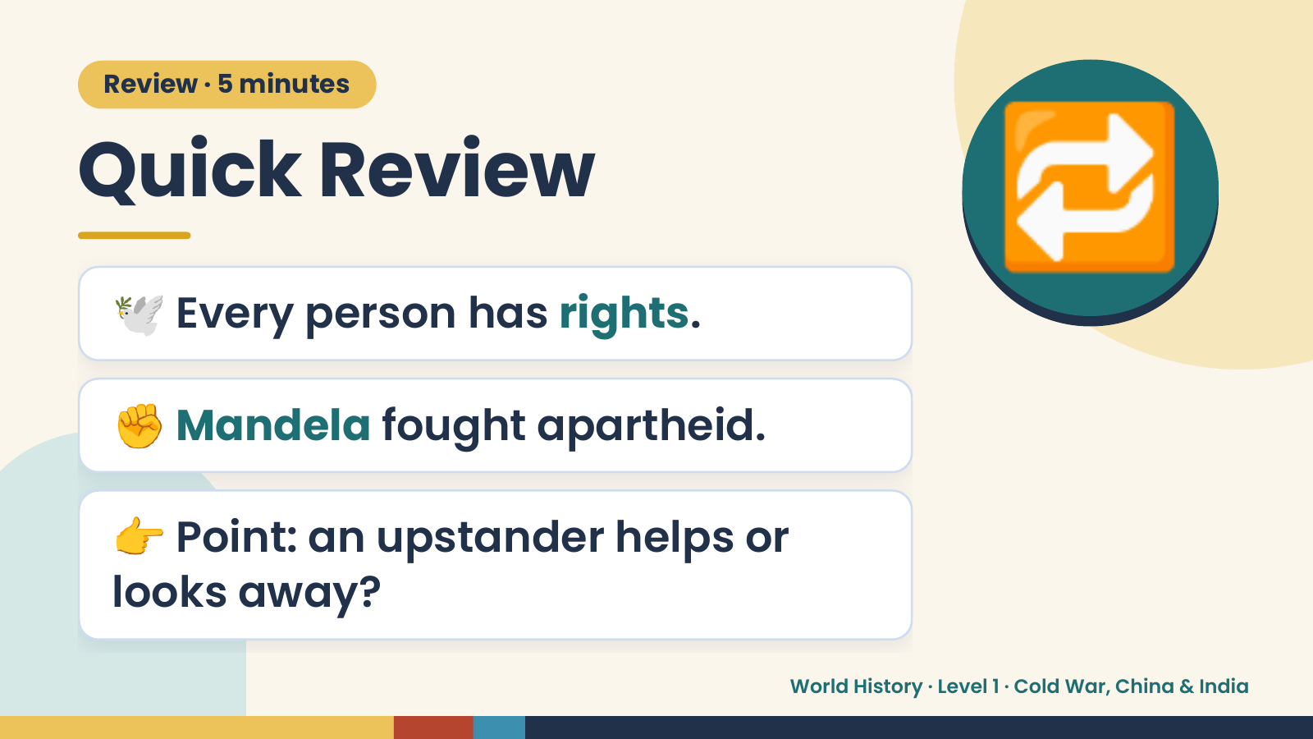
Notes:
Review · 5 minutes
Quick Review
🕊️ Every person has rights.
🔁
✊ Mandela fought apartheid.
👉 Point: an upstander helps or
looks away?
World History · Level 1 · Cold War, China & India

Slide 3
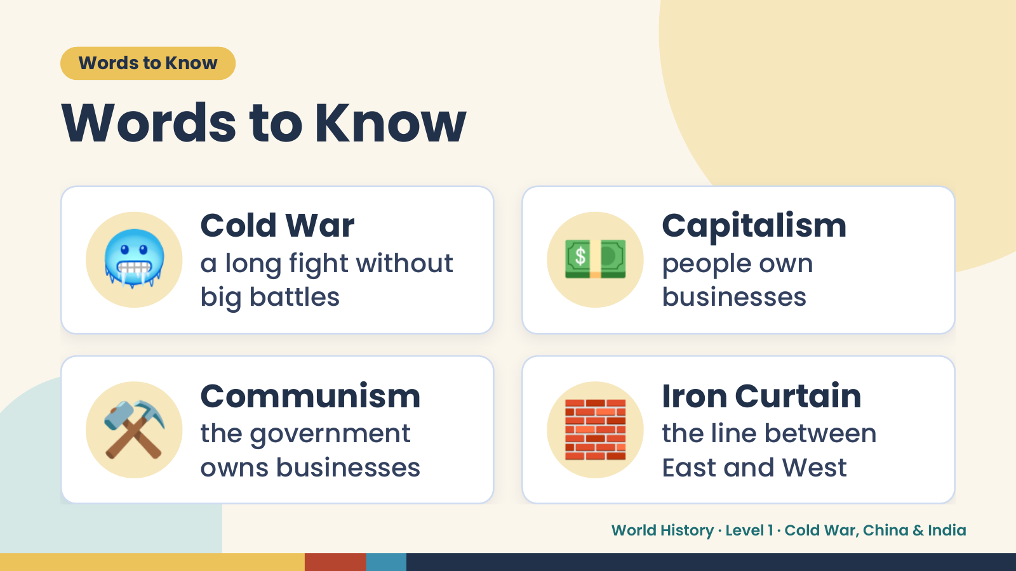
Notes:
Words to Know
Words to Know
🥶 Cold War
a long fight without
big battles
💵 Capitalism
people own
businesses
⚒️ Communism
the government
owns businesses
🧱 Iron Curtain
the line between
East and West
World History · Level 1 · Cold War, China & India

Slide 4
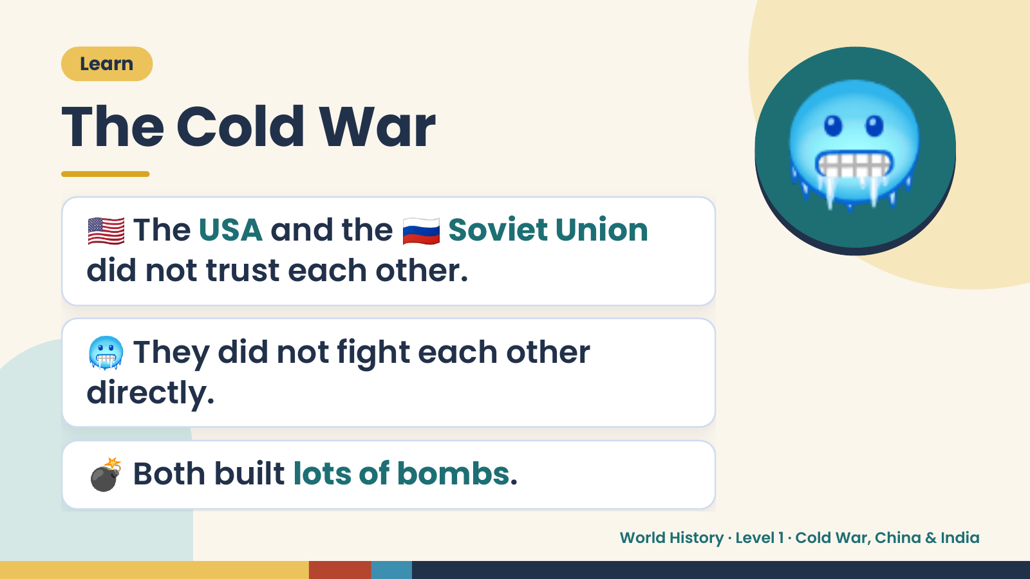
Notes:
Learn
The Cold War
🇺🇸 The USA and the 🇷🇺 Soviet Union
did not trust each other.
🥶
🥶 They did not fight each other
directly.
💣 Both built lots of bombs.
World History · Level 1 · Cold War, China & India

Slide 5
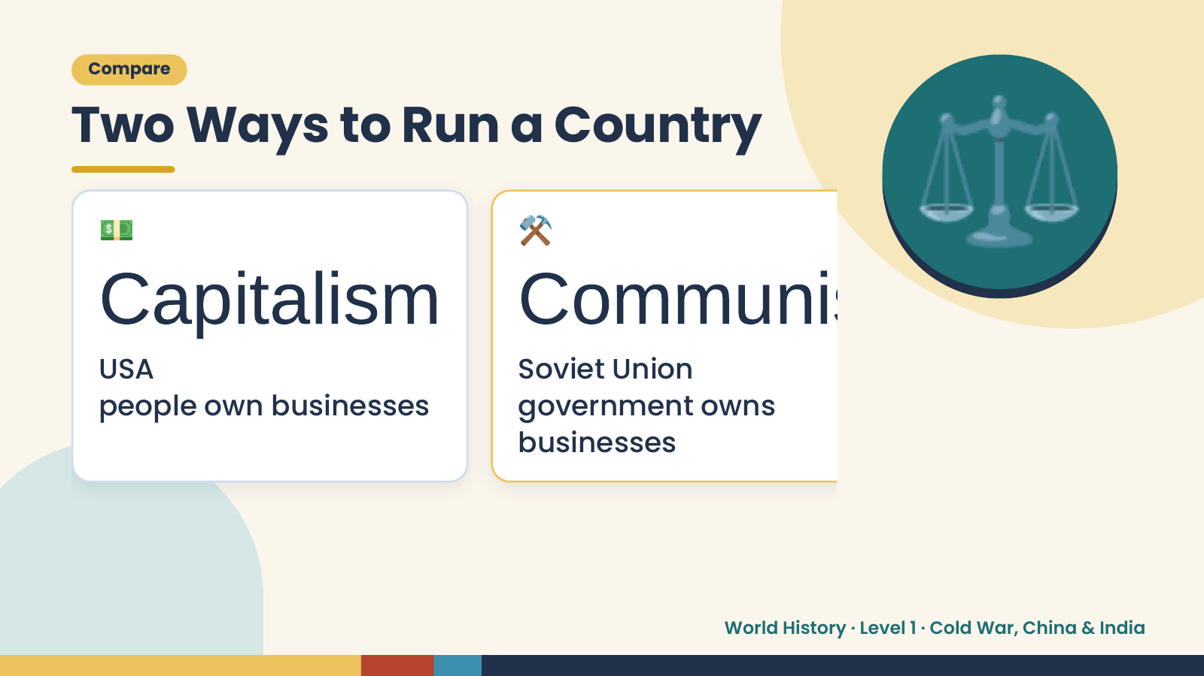
Notes:
Compare
Two Ways to Run a Country
💵
Capitalism Communis
USA
⚒️
Soviet Union
⚖️
people own businesses government owns
businesses
World History · Level 1 · Cold War, China & India

Slide 6
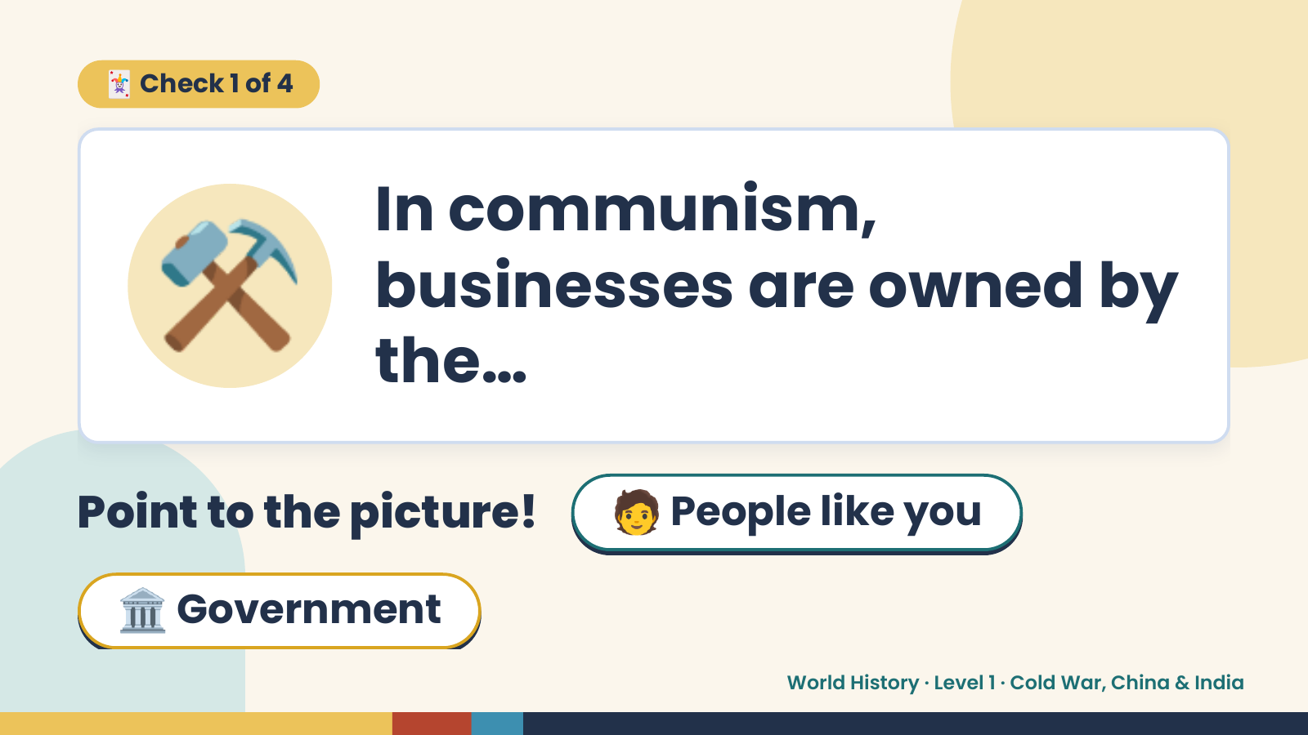
Notes:
🃏 Check 1 of 4
⚒️ In communism,
businesses are owned by
the…
Point to the picture! 🧑 People like you
🏛️ Government
World History · Level 1 · Cold War, China & India

Slide 7
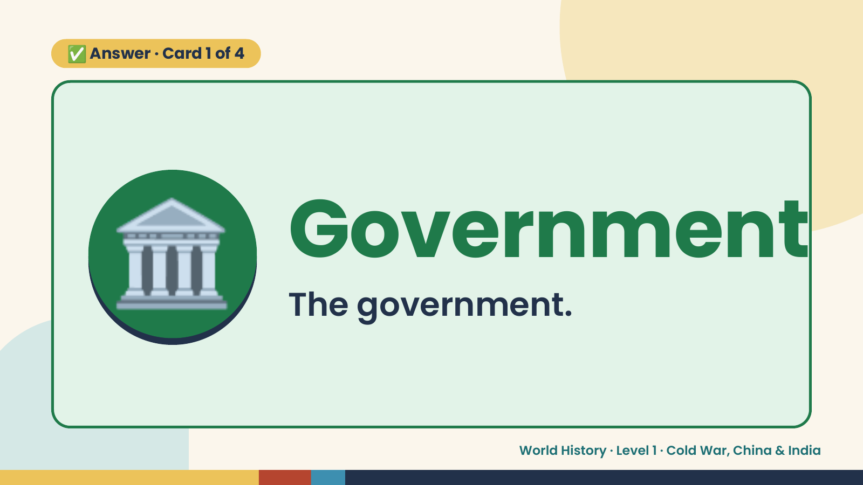
Notes:
✅ Answer · Card 1 of 4
🏛️ Government
The government.
World History · Level 1 · Cold War, China & India

Slide 8
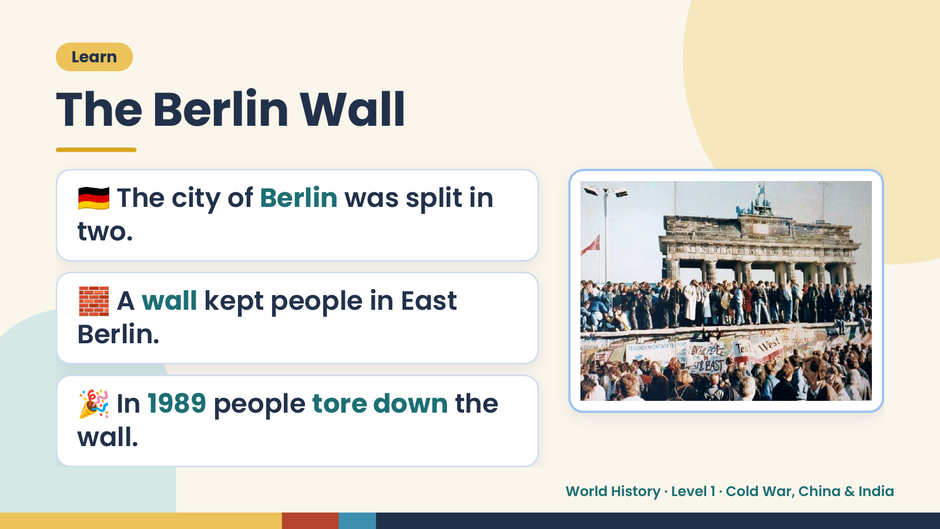
Notes:
Learn
The Berlin Wall
🇩🇪 The city of Berlin was split in
two.
🧱 A wall kept people in East
Berlin.
🎉 In 1989 people tore down the
wall.
World History · Level 1 · Cold War, China & India

Slide 9
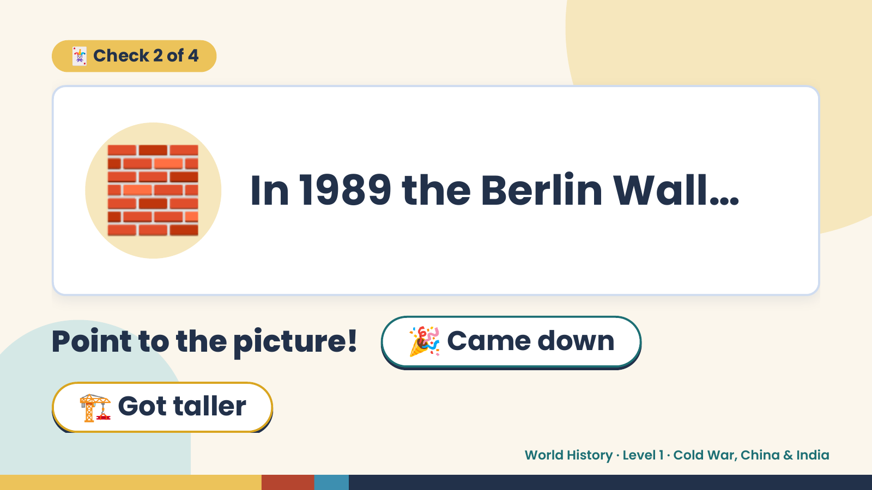
Notes:
🃏 Check 2 of 4
🧱 In 1989 the Berlin Wall…
Point to the picture! 🎉 Came down
🏗️ Got taller
World History · Level 1 · Cold War, China & India

Slide 10
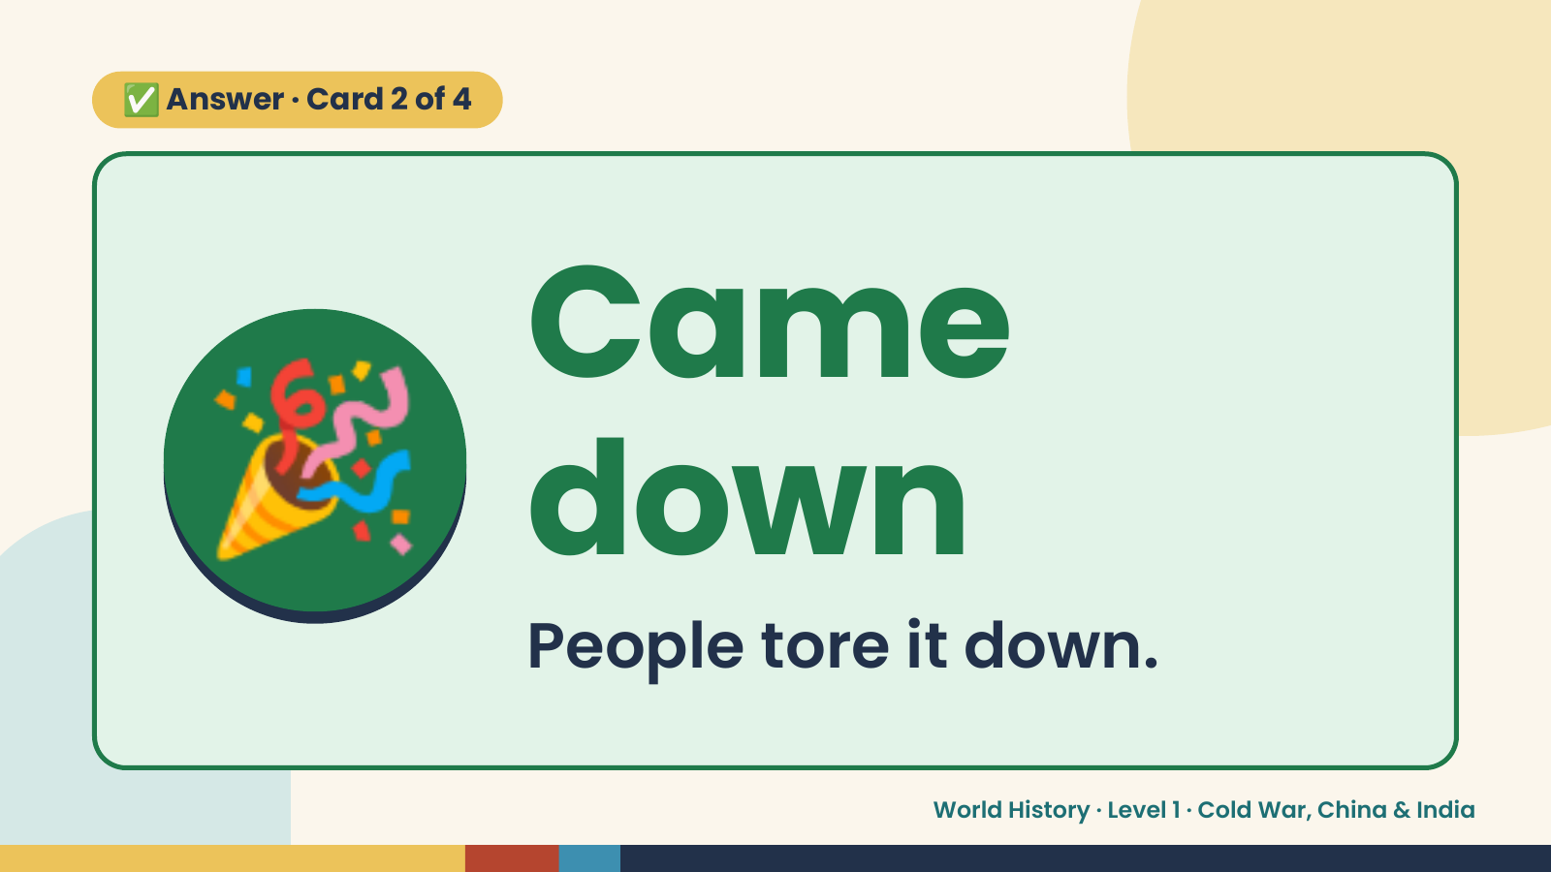
Notes:
✅ Answer · Card 2 of 4
🎉 Came
down
People tore it down.
World History · Level 1 · Cold War, China & India

Slide 11
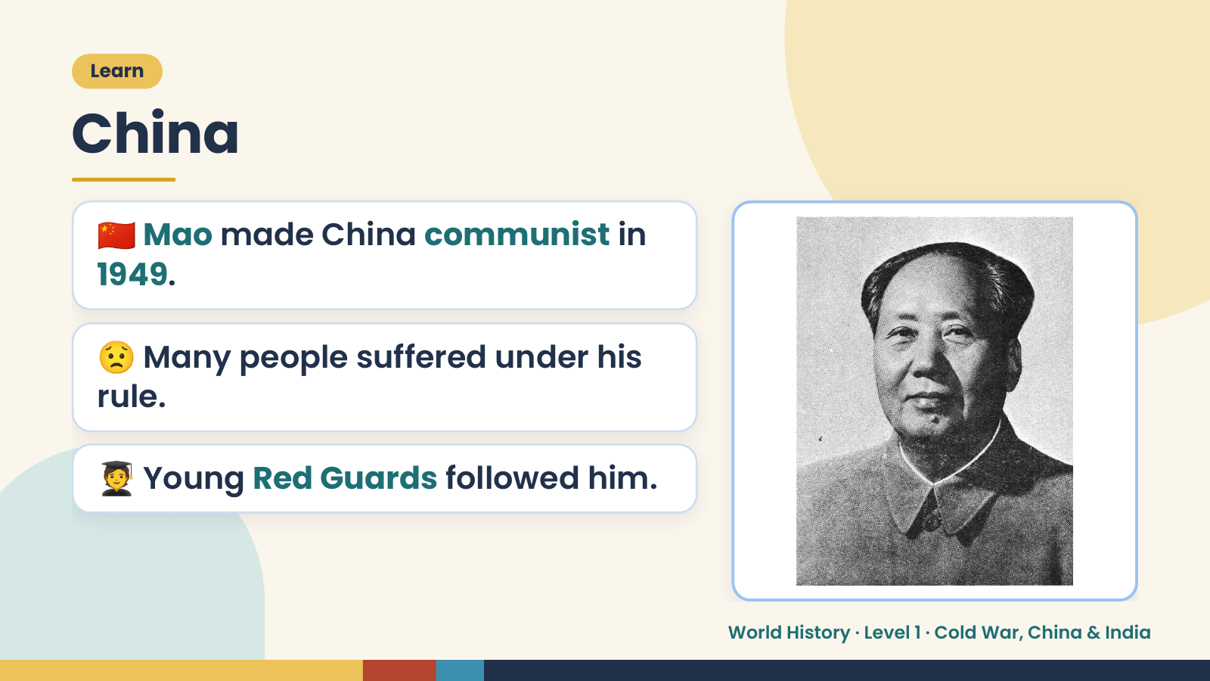
Notes:
Learn
China
🇨🇳 Mao made China communist in
1949.
😟 Many people suffered under his
rule.
🧑‍🎓 Young Red Guards followed him.
World History · Level 1 · Cold War, China & India

Slide 12
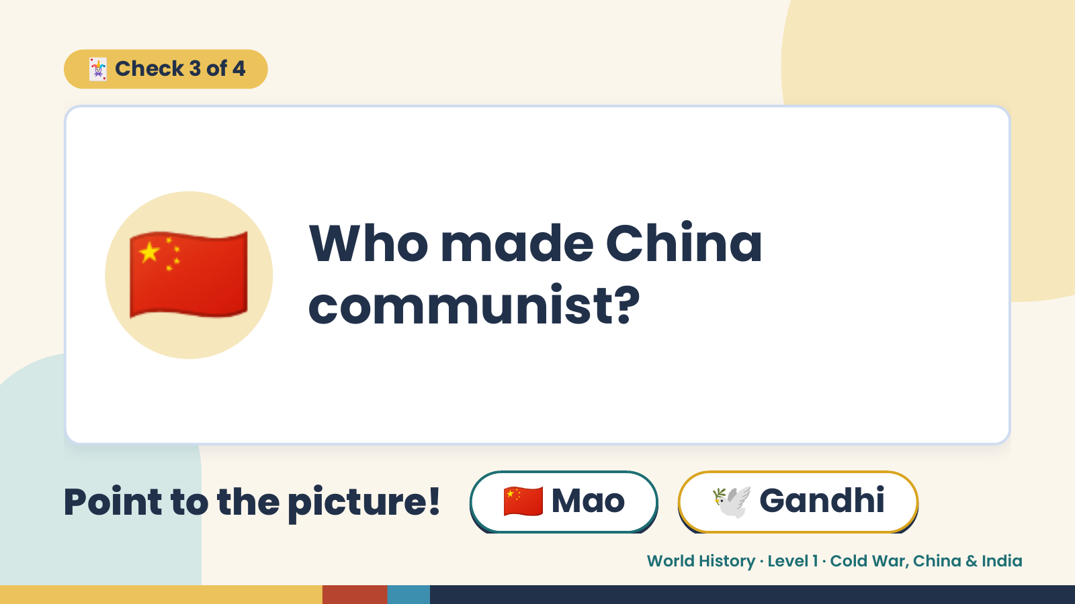
Notes:
🃏 Check 3 of 4
🇨🇳 Who made China
communist?
Point to the picture! 🇨🇳 Mao 🕊️ Gandhi
World History · Level 1 · Cold War, China & India

Slide 13
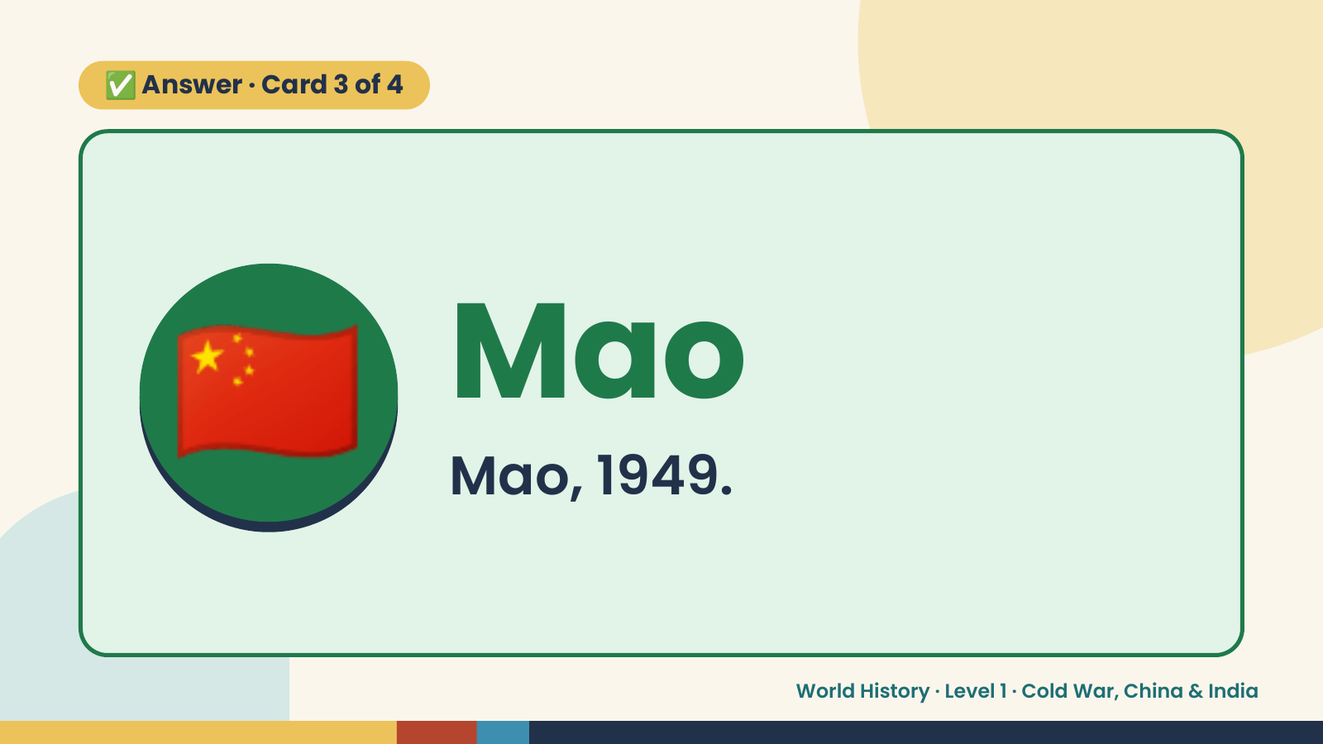
Notes:
✅ Answer · Card 3 of 4
🇨🇳 Mao
Mao, 1949.
World History · Level 1 · Cold War, China & India

Slide 14
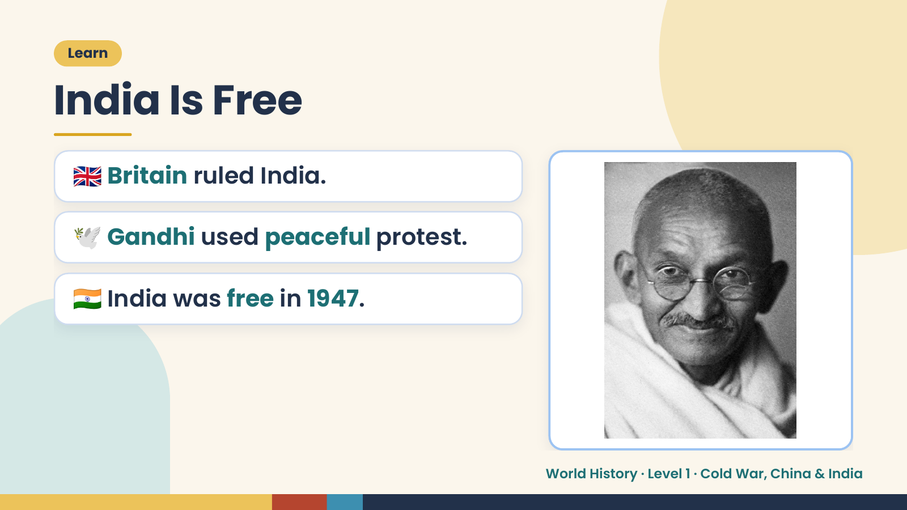
Notes:
Learn
India Is Free
🇬🇧 Britain ruled India.
🕊️ Gandhi used peaceful protest.
🇮🇳 India was free in 1947.
World History · Level 1 · Cold War, China & India

Slide 15
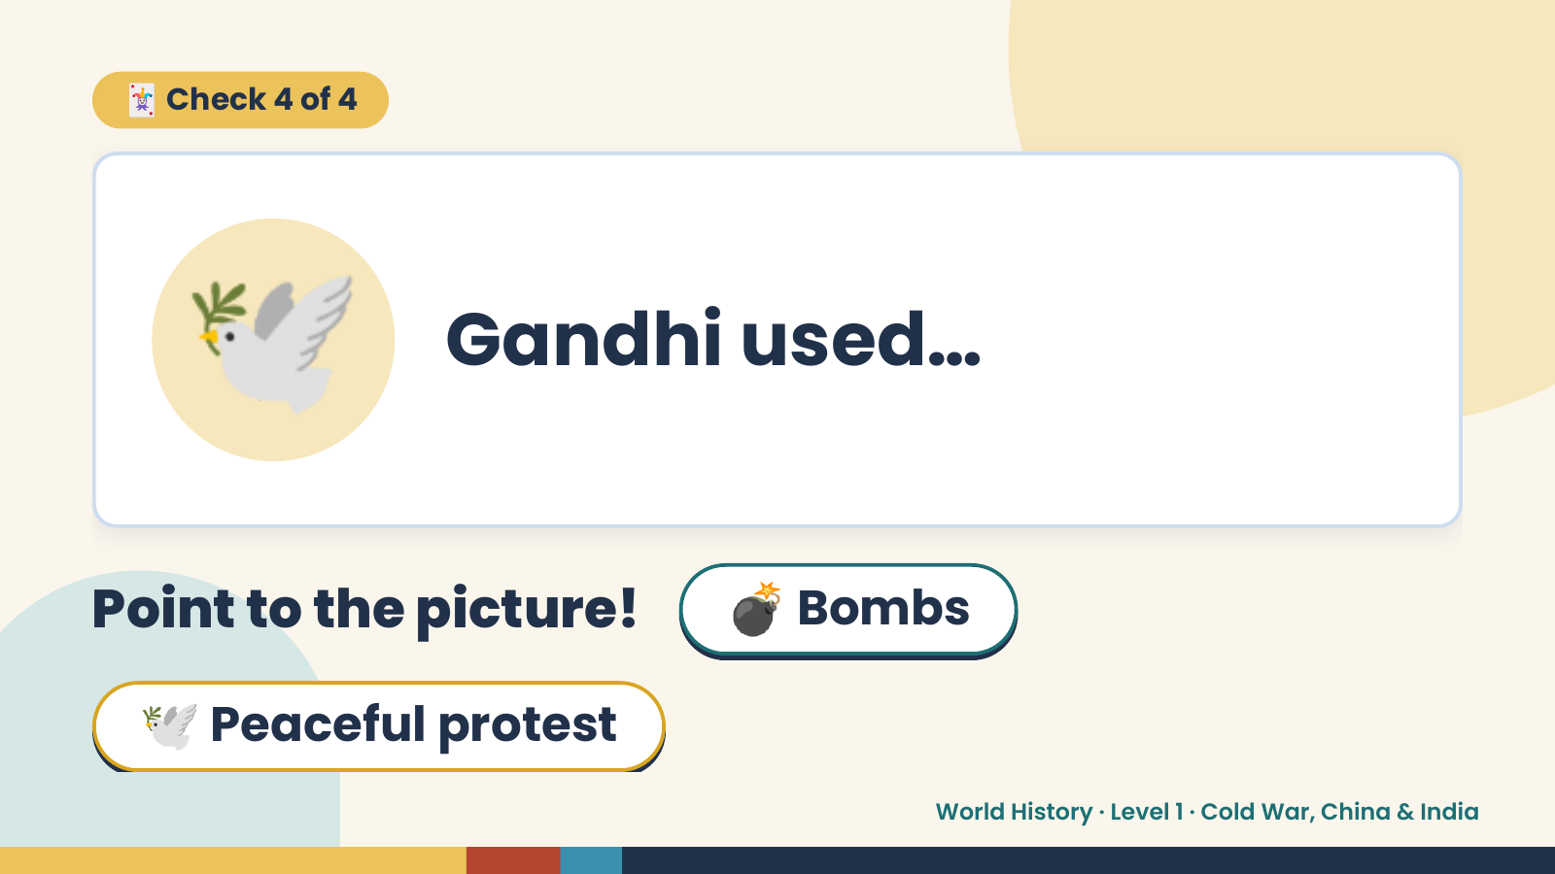
Notes:
🃏 Check 4 of 4
🕊️ Gandhi used…
Point to the picture! 💣 Bombs
🕊️ Peaceful protest
World History · Level 1 · Cold War, China & India

Slide 16
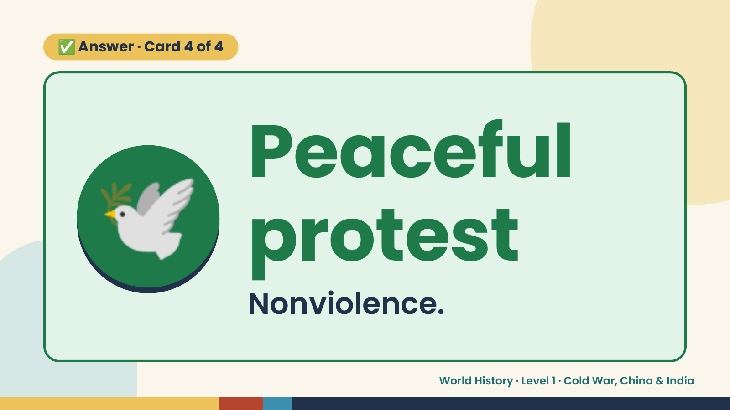
Notes:
✅ Answer · Card 4 of 4
🕊️ Peaceful
protest
Nonviolence.
World History · Level 1 · Cold War, China & India

Slide 17
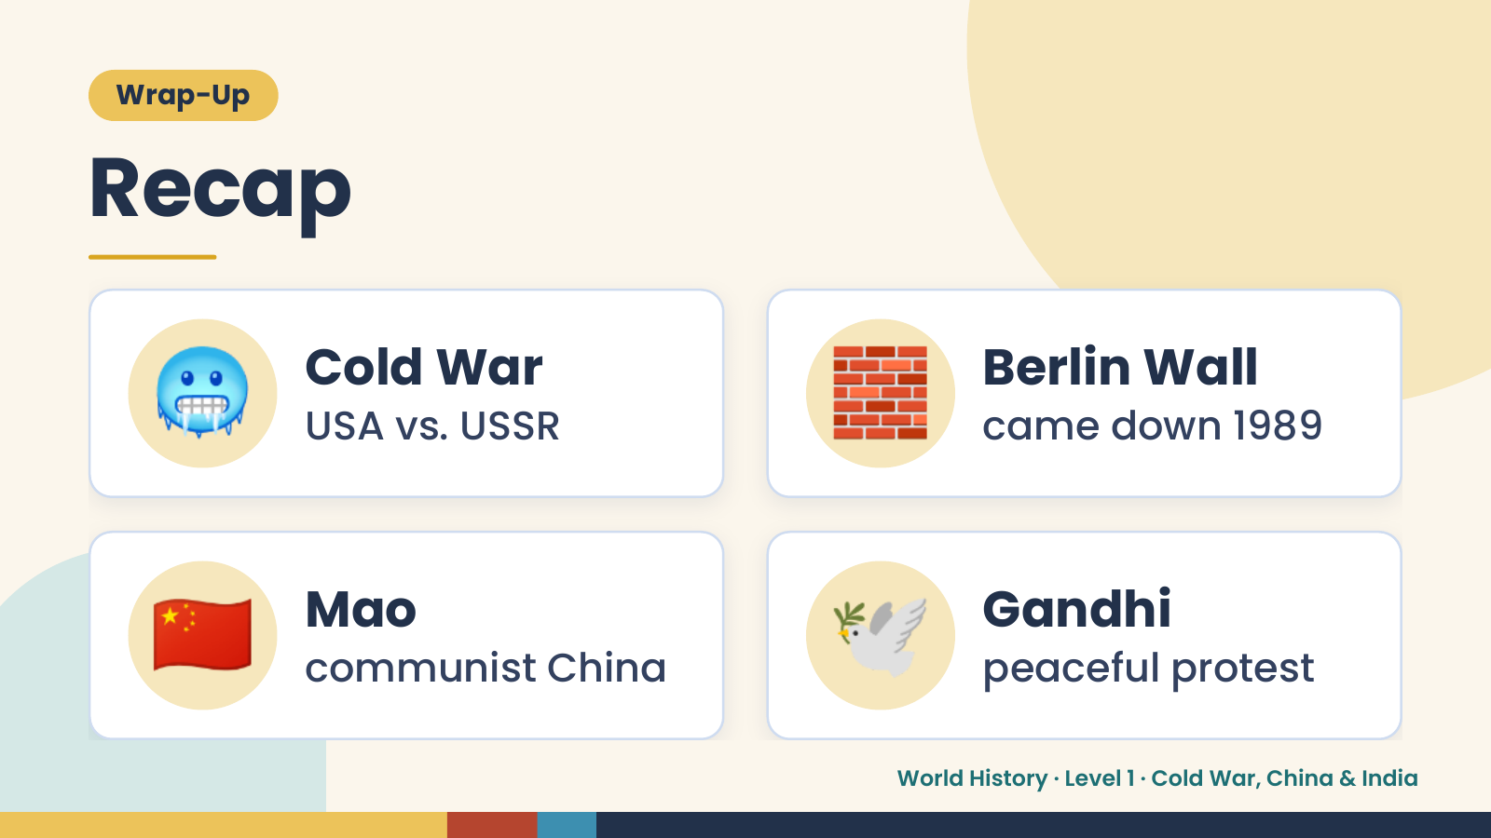
Notes:
Wrap-Up
Recap
🥶 Cold War
USA vs. USSR 🧱 Berlin Wall
came down 1989
🇨🇳 Mao
communist China 🕊️ Gandhi
peaceful protest
World History · Level 1 · Cold War, China & India

Slide 18
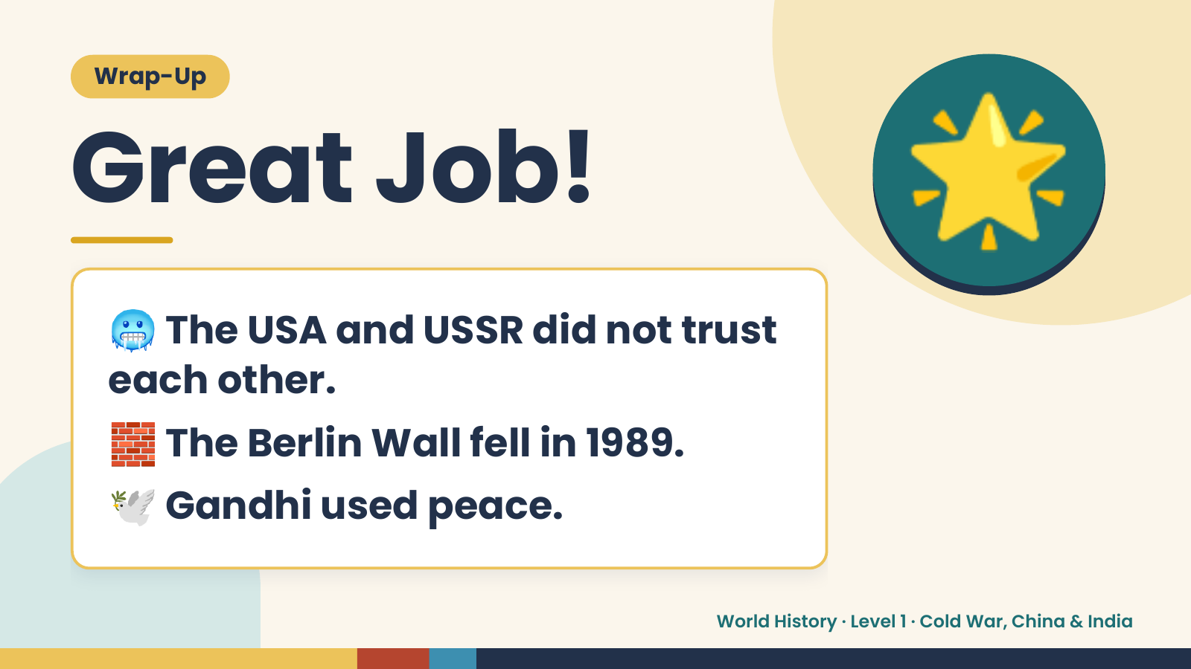
Notes:
Wrap-Up
Great Job!
🥶The USA and USSR did not trust
🌟
each other.
🧱 The Berlin Wall fell in 1989.
🕊️ Gandhi used peace.
World History · Level 1 · Cold War, China & India

