Slide 1
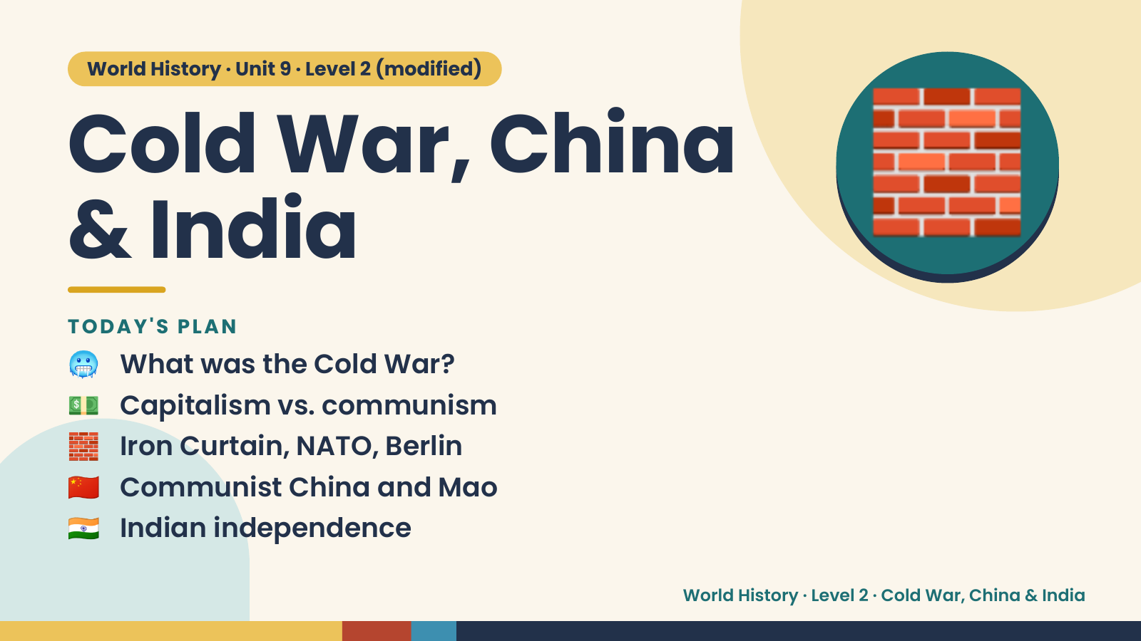
Notes:
World History · Unit 9 · Level 2 (modified)
Cold War, China
& India
🥶 What was the Cold War?
TODAY'S PLAN
🧱
💵 Capitalism vs. communism
🧱 Iron Curtain, NATO, Berlin
🇨🇳 Communist China and Mao
🇮🇳 Indian independence
World History · Level 2 · Cold War, China & India

Slide 2
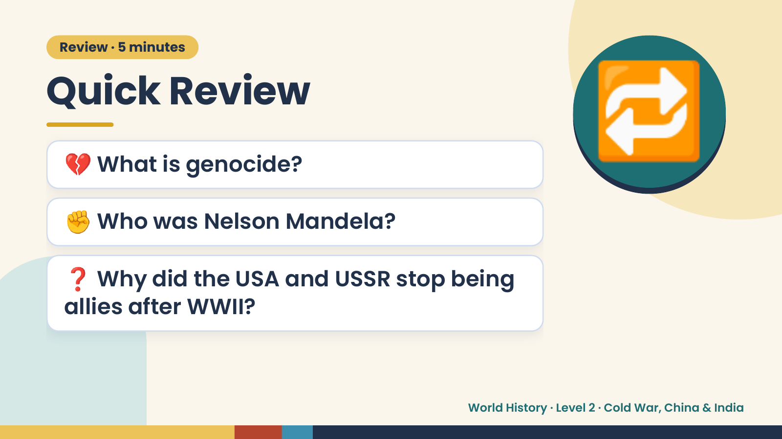
Notes:
Review · 5 minutes
Quick Review
💔 What is genocide?
✊ Who was Nelson Mandela?
🔁
❓ Why did the USA and USSR stop being
allies after WWII?
World History · Level 2 · Cold War, China & India

Slide 3
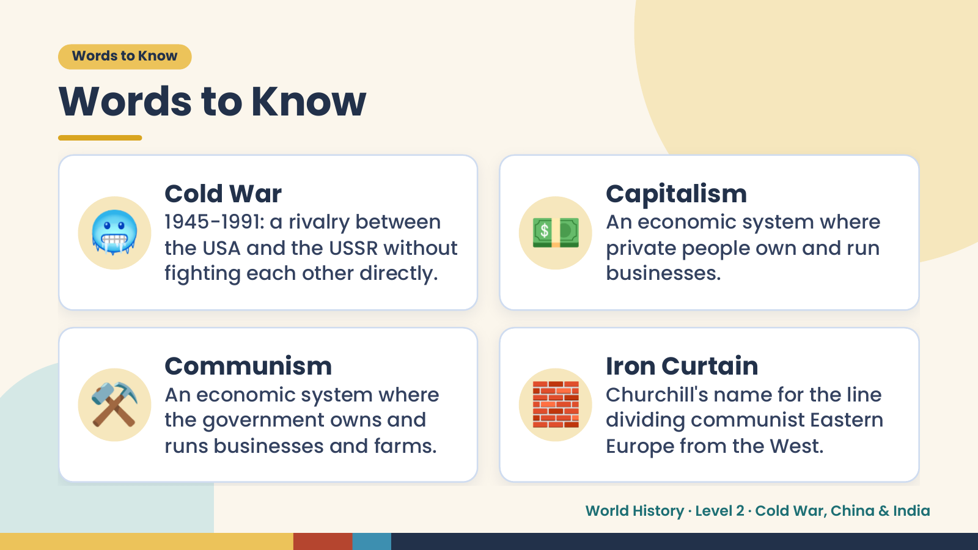
Notes:
Words to Know
Words to Know
🥶 Cold War
1945-1991: a rivalry between
the USA and the USSR without
fighting each other directly.
💵 Capitalism
An economic system where
private people own and run
businesses.
⚒️ Communism
An economic system where
the government owns and
runs businesses and farms.
🧱 Iron Curtain
Churchill's name for the line
dividing communist Eastern
Europe from the West.
World History · Level 2 · Cold War, China & India

Slide 4
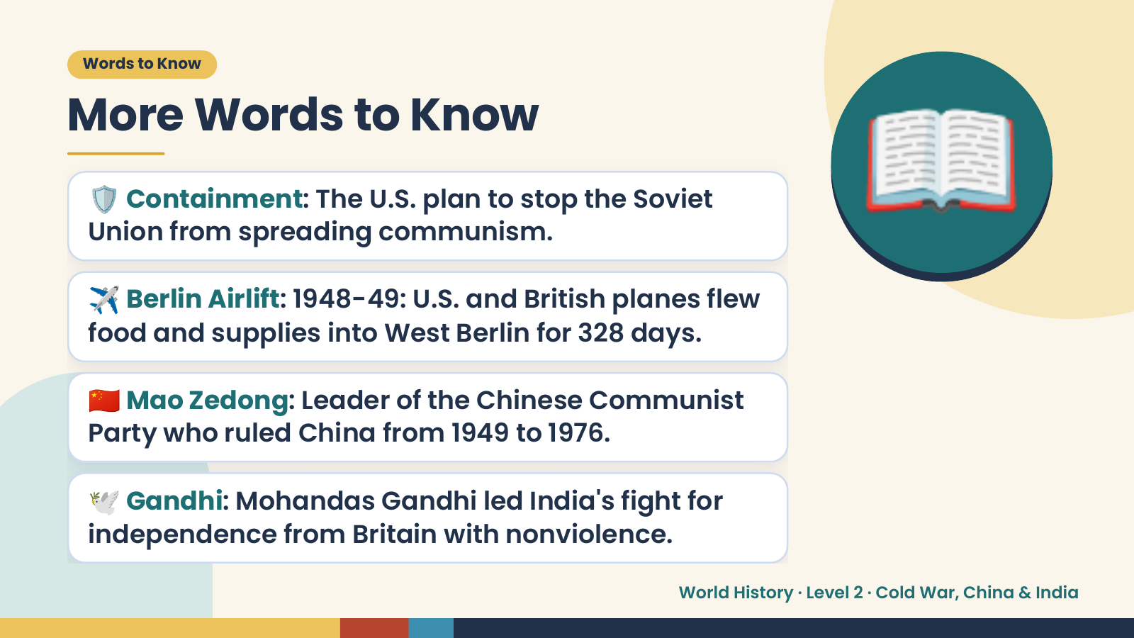
Notes:
Words to Know
More Words to Know
🛡️ Containment: The U.S. plan to stop the Soviet
Union from spreading communism.
✈️ Berlin Airlift: 1948-49: U.S. and British planes flew
food and supplies into West Berlin for 328 days.
📖
🇨🇳 Mao Zedong: Leader of the Chinese Communist
Party who ruled China from 1949 to 1976.
🕊️ Gandhi: Mohandas Gandhi led India's fight for
independence from Britain with nonviolence.
World History · Level 2 · Cold War, China & India

Slide 5
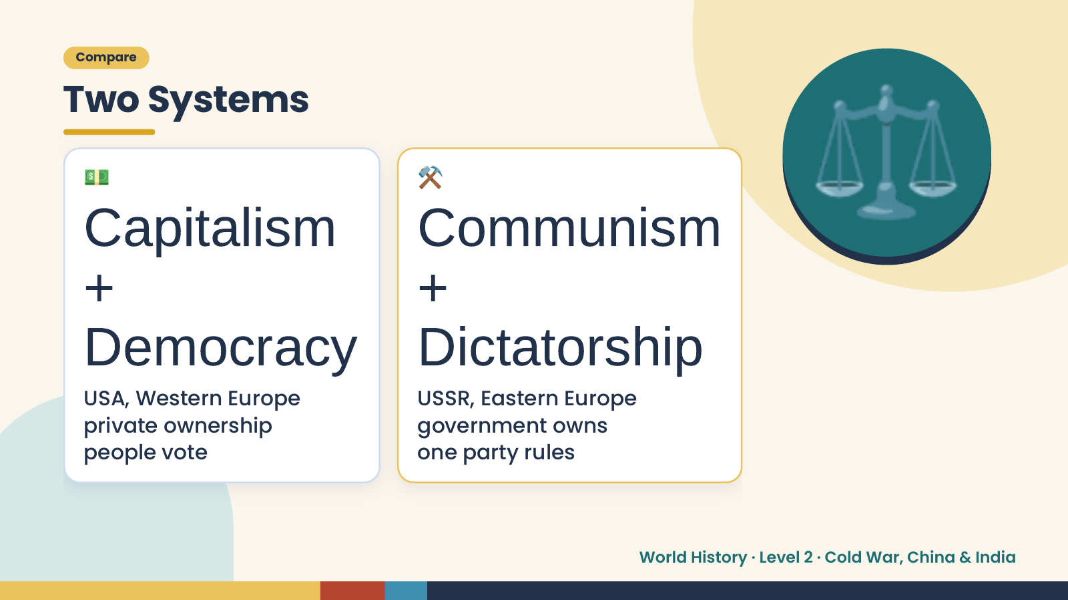
Notes:
Compare
Two Systems
💵
Capitalism Communism
+ +
⚒️ ⚖️
Democracy Dictatorship
USA, Western Europe USSR, Eastern Europe
private ownership government owns
people vote one party rules
World History · Level 2 · Cold War, China & India

Slide 6
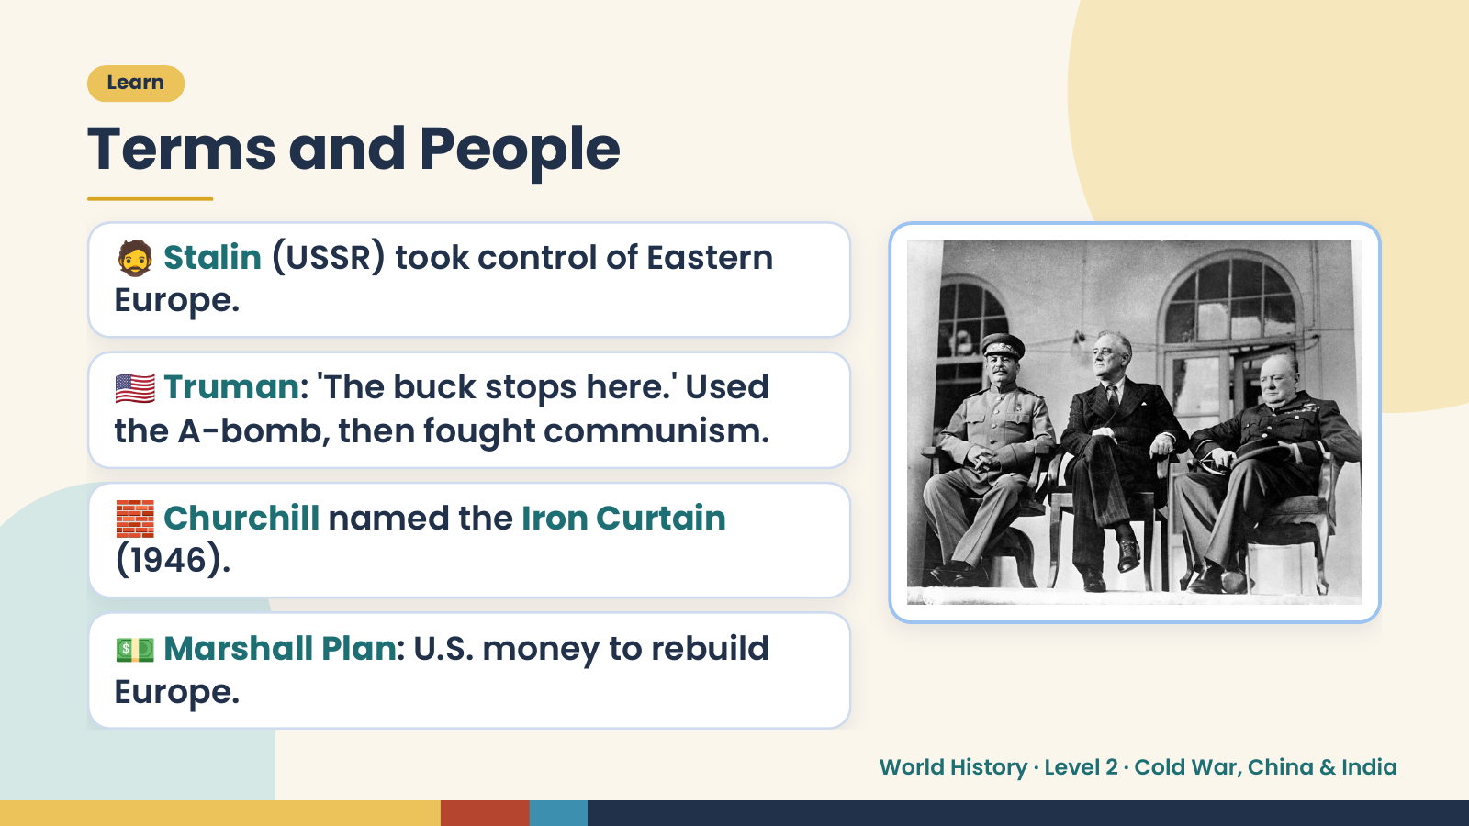
Notes:
Learn
Terms and People
🧔 Stalin (USSR) took control of Eastern
Europe.
🇺🇸 Truman: 'The buck stops here.' Used
the A-bomb, then fought communism.
🧱 Churchill named the Iron Curtain
(1946).
💵 Marshall Plan: U.S. money to rebuild
Europe.
World History · Level 2 · Cold War, China & India

Slide 7
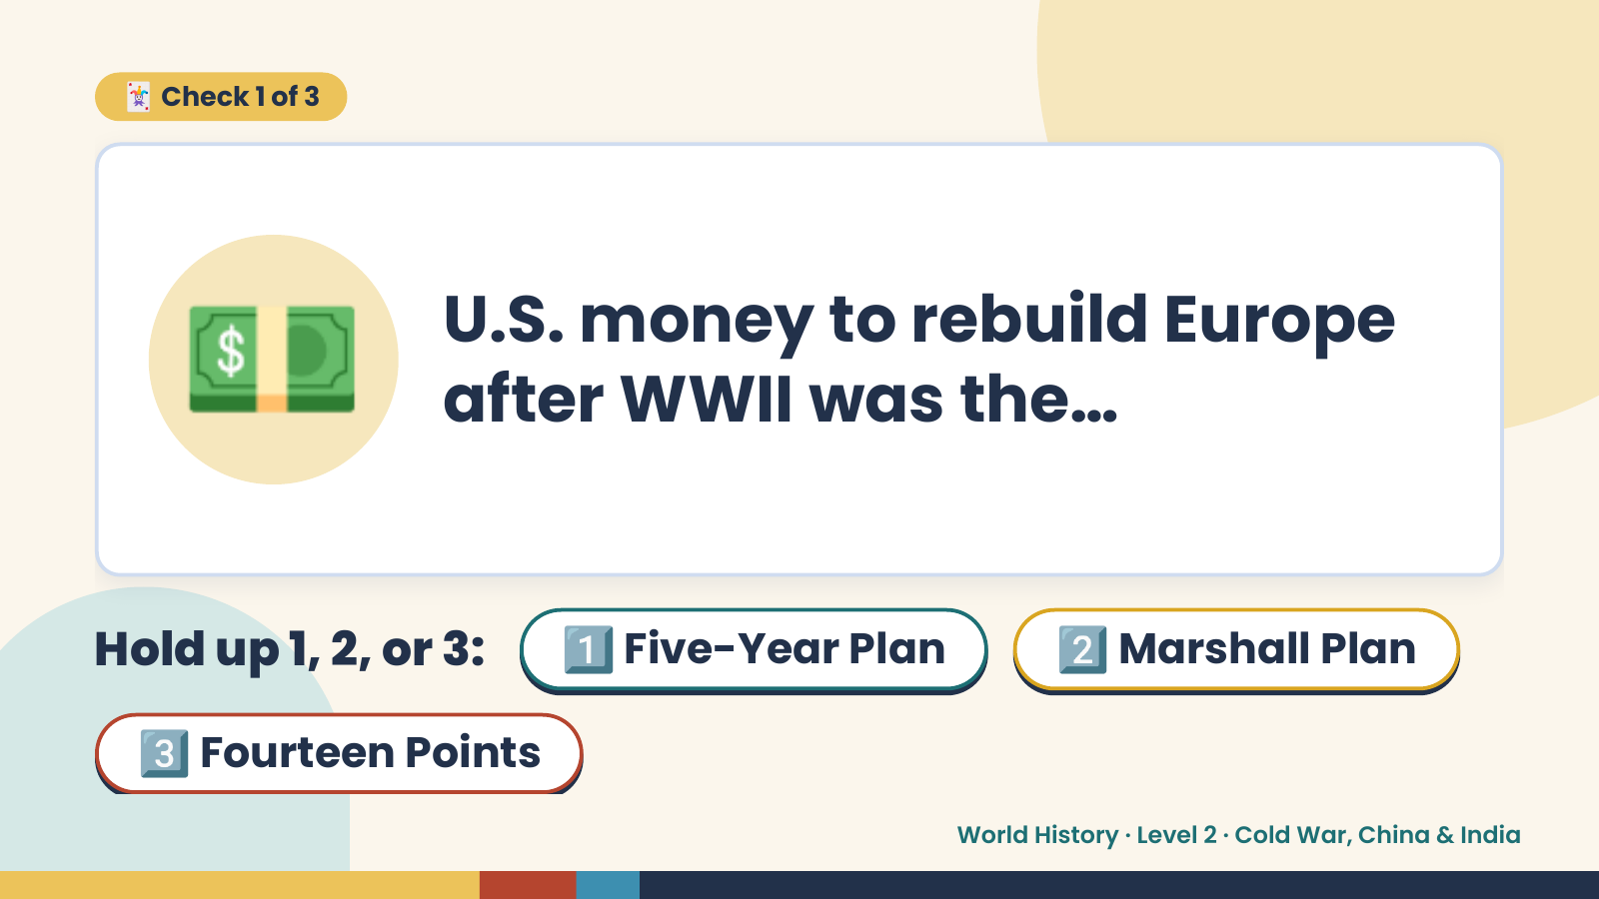
Notes:
🃏 Check 1 of 3
💵 U.S. money to rebuild Europe
after WWII was the…
Hold up 1, 2, or 3: 1️⃣ Five-Year Plan 2️⃣ Marshall Plan
3️⃣ Fourteen Points
World History · Level 2 · Cold War, China & India

Slide 8
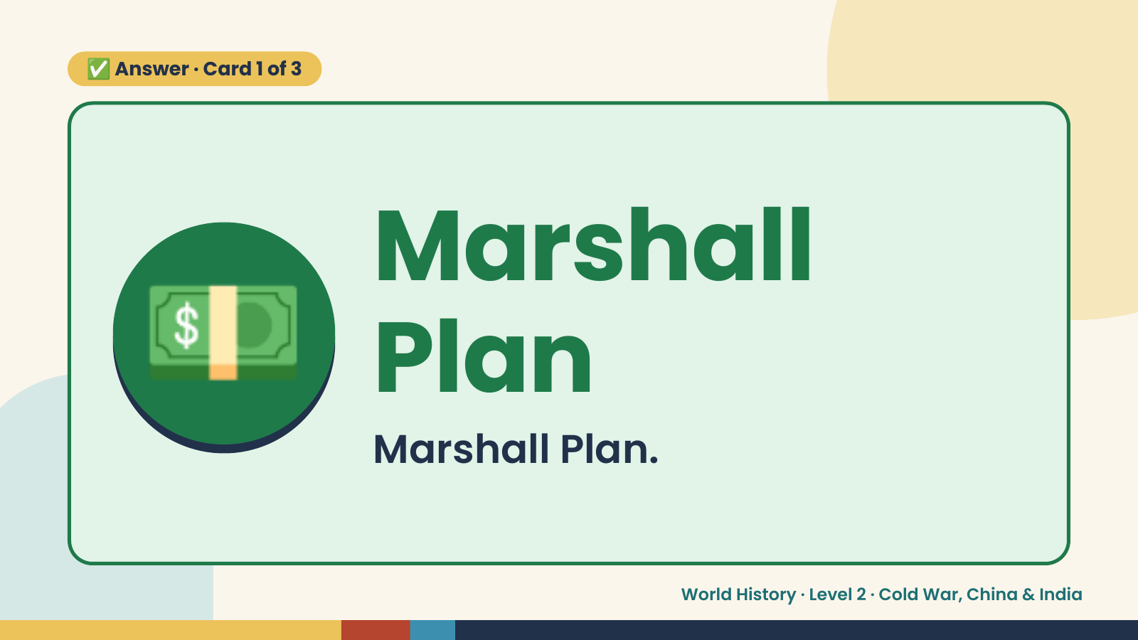
Notes:
✅ Answer · Card 1 of 3
💵 Marshall
Plan
Marshall Plan.
World History · Level 2 · Cold War, China & India

Slide 9
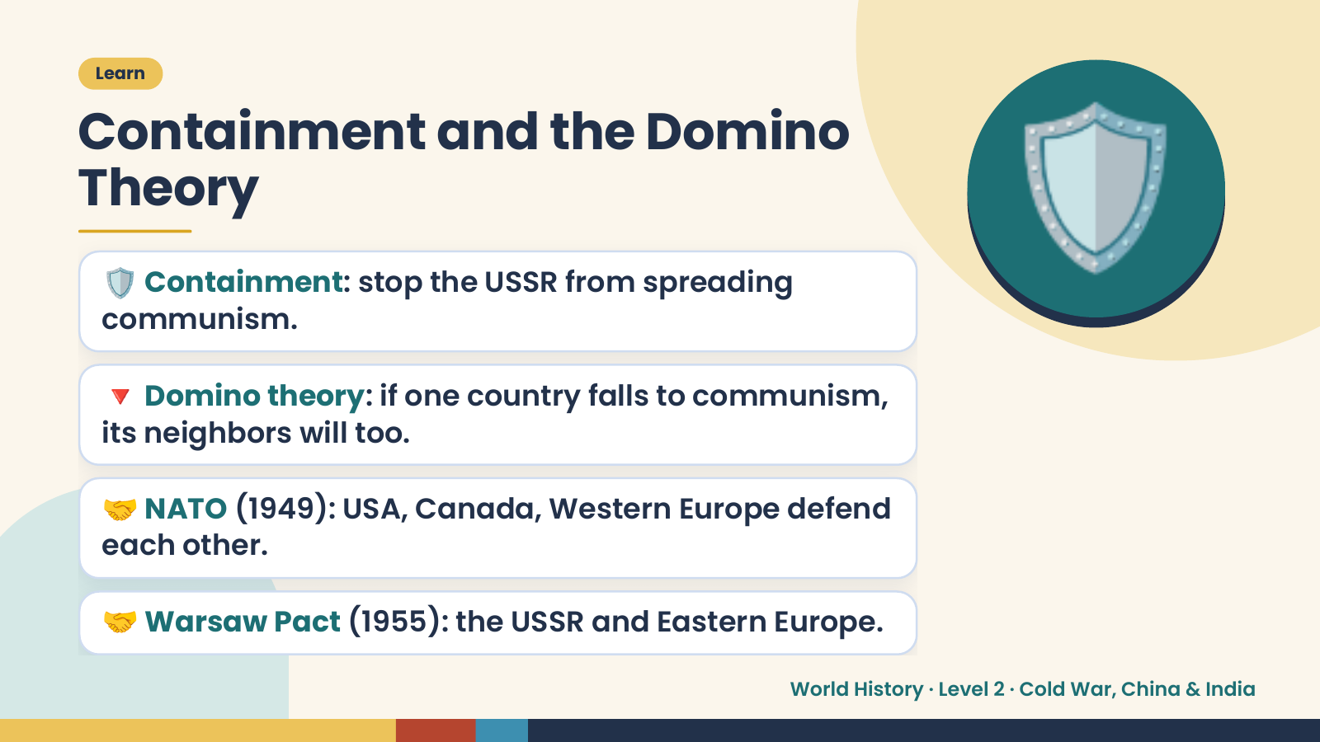
Notes:
Learn
Containment and the Domino
Theory
🛡️ Containment: stop the USSR from spreading
communism.
🔻 Domino theory: if one country falls to communism,
🛡️
its neighbors will too.
🤝 NATO (1949): USA, Canada, Western Europe defend
each other.
🤝 Warsaw Pact (1955): the USSR and Eastern Europe.
World History · Level 2 · Cold War, China & India

Slide 10
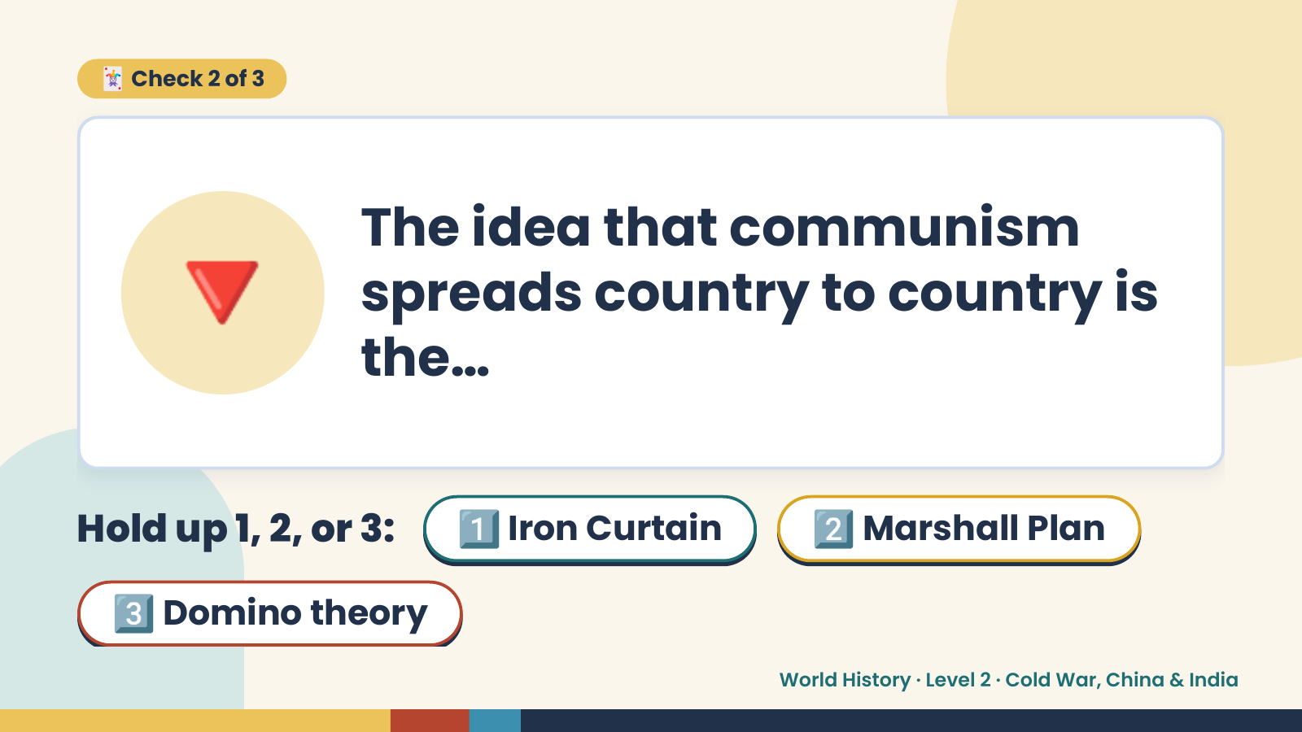
Notes:
🃏 Check 2 of 3
🔻 The idea that communism
spreads country to country is
the…
Hold up 1, 2, or 3: 1️⃣ Iron Curtain 2️⃣ Marshall Plan
3️⃣ Domino theory
World History · Level 2 · Cold War, China & India

Slide 11
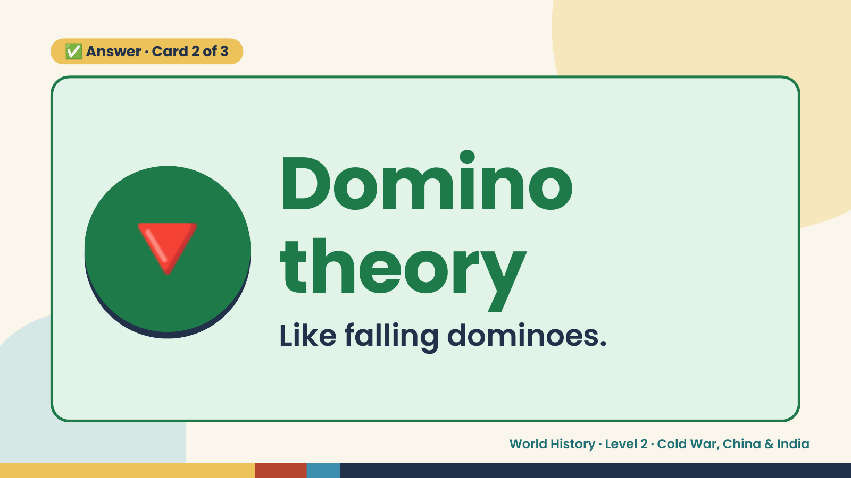
Notes:
✅ Answer · Card 2 of 3
🔻 Domino
theory
Like falling dominoes.
World History · Level 2 · Cold War, China & India

Slide 12
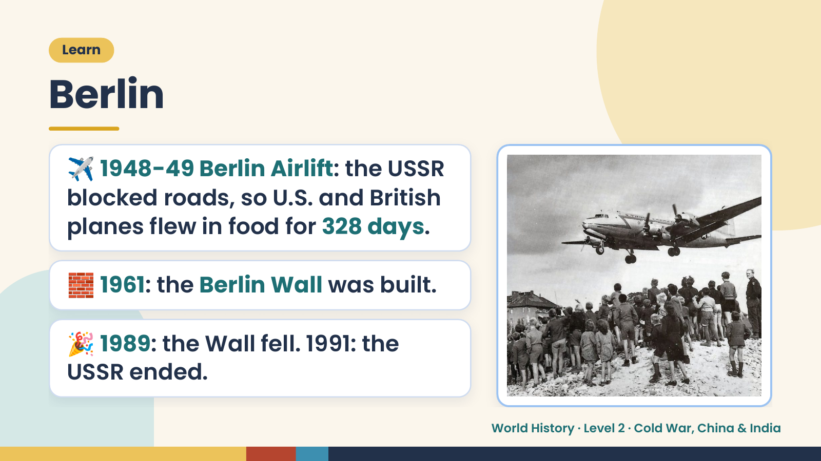
Notes:
Learn
Berlin
✈️ 1948-49 Berlin Airlift: the USSR
blocked roads, so U.S. and British
planes flew in food for 328 days.
🧱 1961: the Berlin Wall was built.
🎉 1989: the Wall fell. 1991: the
USSR ended.
World History · Level 2 · Cold War, China & India

Slide 13
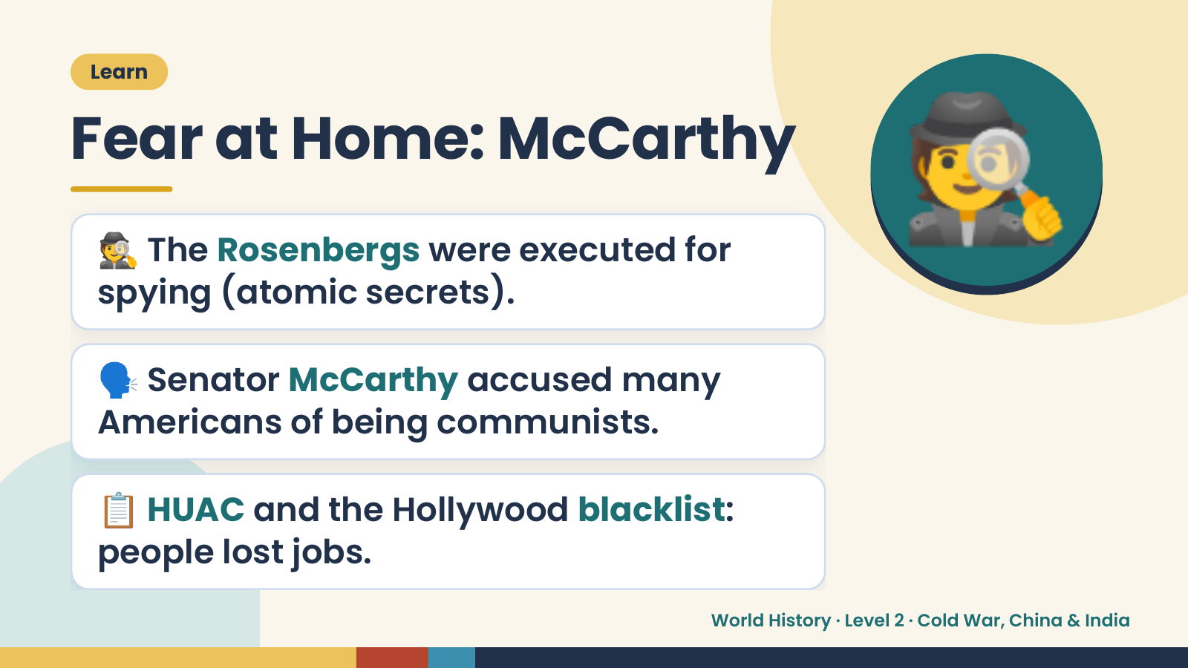
Notes:
Learn
Fear at Home: McCarthy
🕵️ The Rosenbergs were executed for
spying (atomic secrets).
🕵️
🗣️ Senator McCarthy accused many
Americans of being communists.
📋 HUAC and the Hollywood blacklist:
people lost jobs.
World History · Level 2 · Cold War, China & India

Slide 14
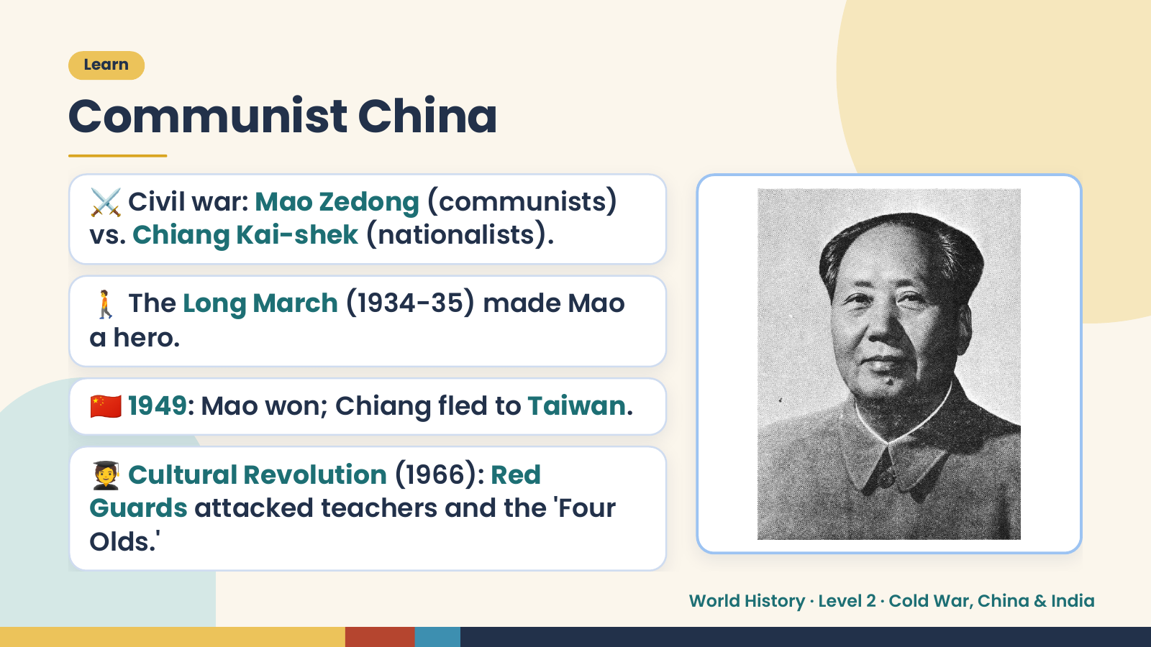
Notes:
Learn
Communist China
⚔️ Civil war: Mao Zedong (communists)
vs. Chiang Kai-shek (nationalists).
🚶 The Long March (1934-35) made Mao
a hero.
🇨🇳 1949: Mao won; Chiang fled to Taiwan.
🧑‍🎓 Cultural Revolution (1966): Red
Guards attacked teachers and the 'Four
Olds.'
World History · Level 2 · Cold War, China & India

Slide 15
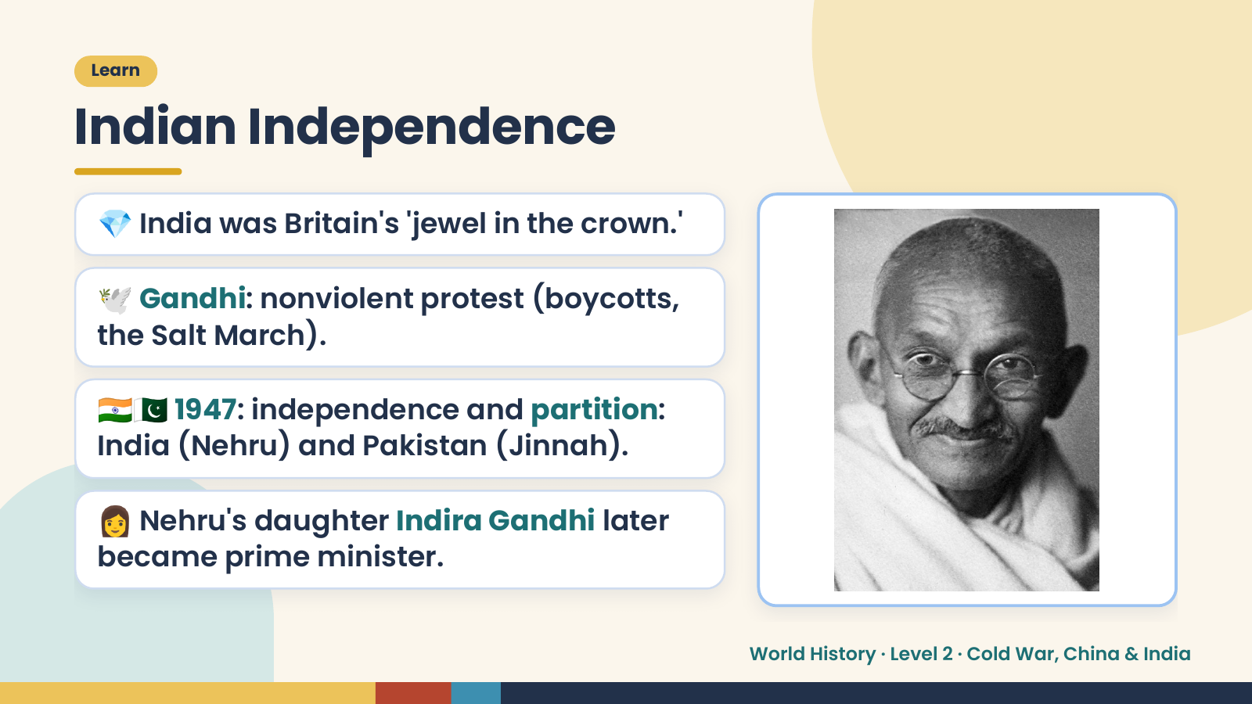
Notes:
Learn
Indian Independence
💎 India was Britain's 'jewel in the crown.'
🕊️ Gandhi: nonviolent protest (boycotts,
the Salt March).
🇮🇳🇵🇰 1947: independence and partition:
India (Nehru) and Pakistan (Jinnah).
👩 Nehru's daughter Indira Gandhi later
became prime minister.
World History · Level 2 · Cold War, China & India

Slide 16
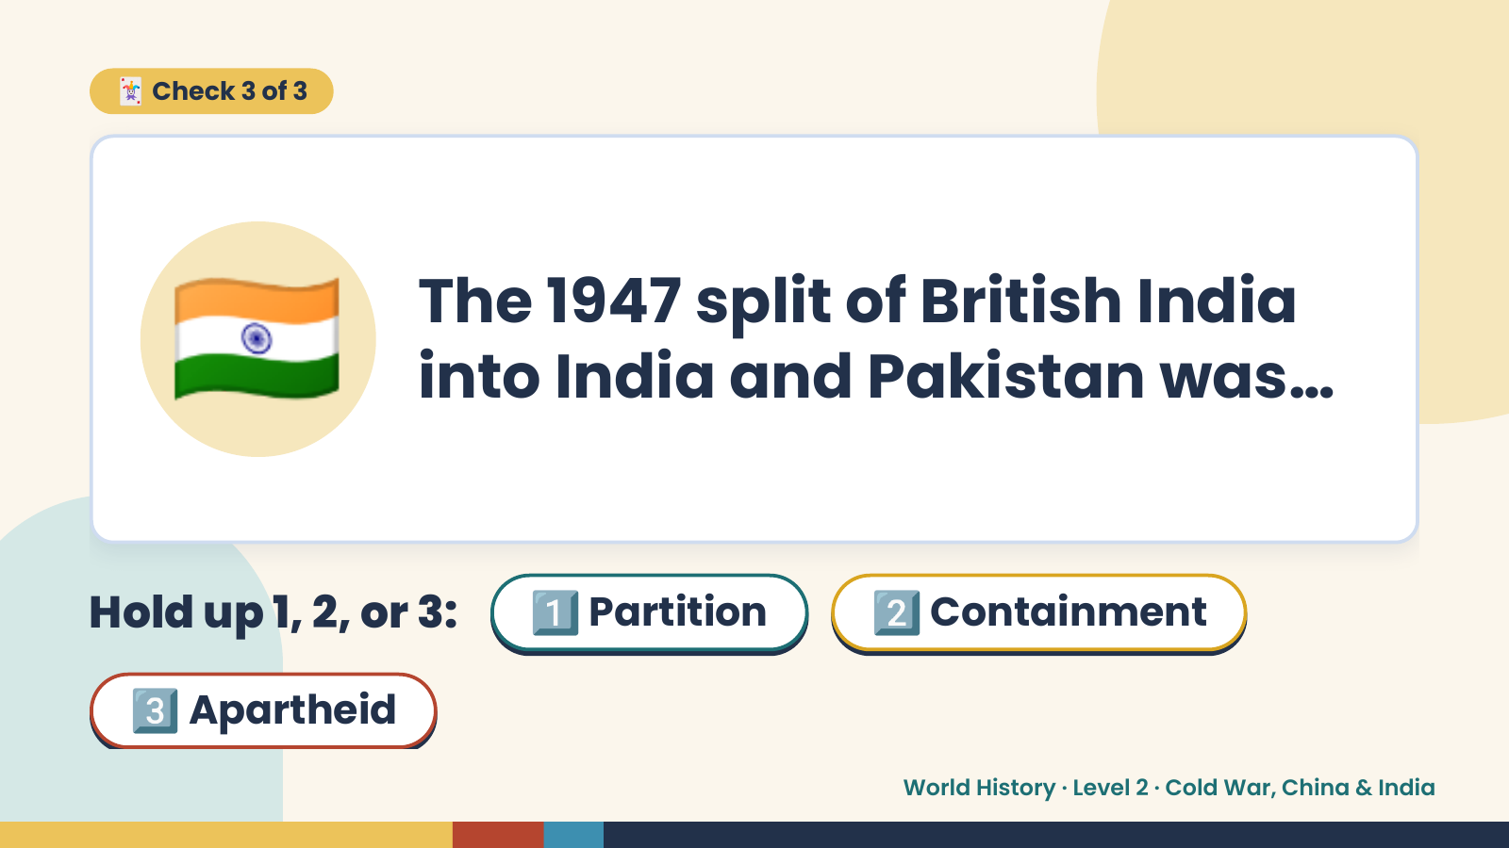
Notes:
🃏 Check 3 of 3
🇮🇳 The 1947 split of British India
into India and Pakistan was…
Hold up 1, 2, or 3: 1️⃣ Partition 2️⃣ Containment
3️⃣ Apartheid
World History · Level 2 · Cold War, China & India

Slide 17
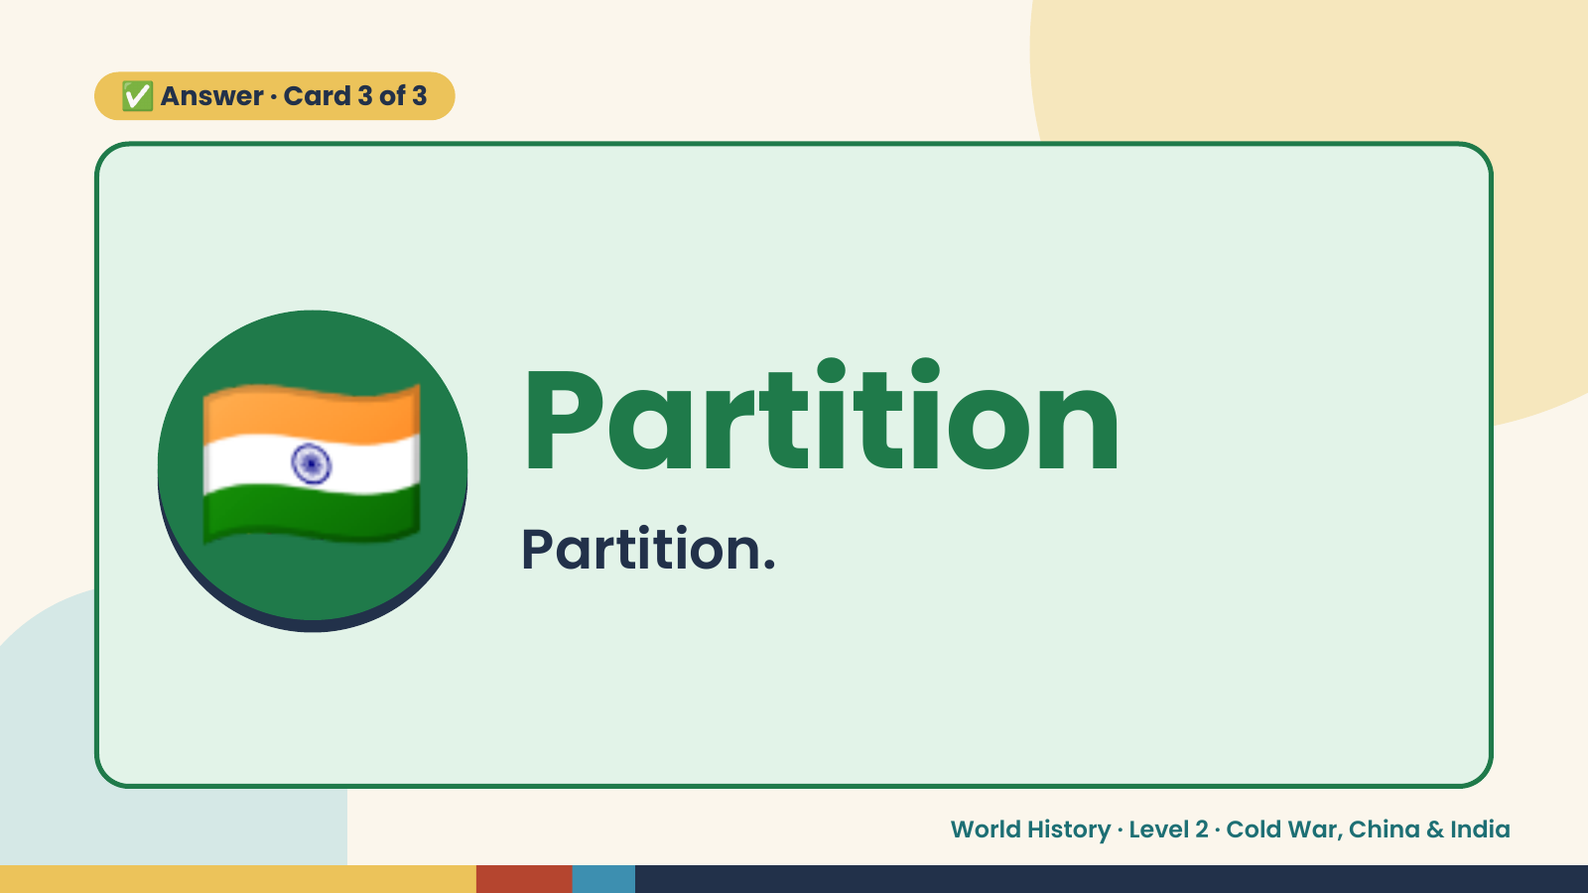
Notes:
✅ Answer · Card 3 of 3
🇮🇳 Partition
Partition.
World History · Level 2 · Cold War, China & India

Slide 18
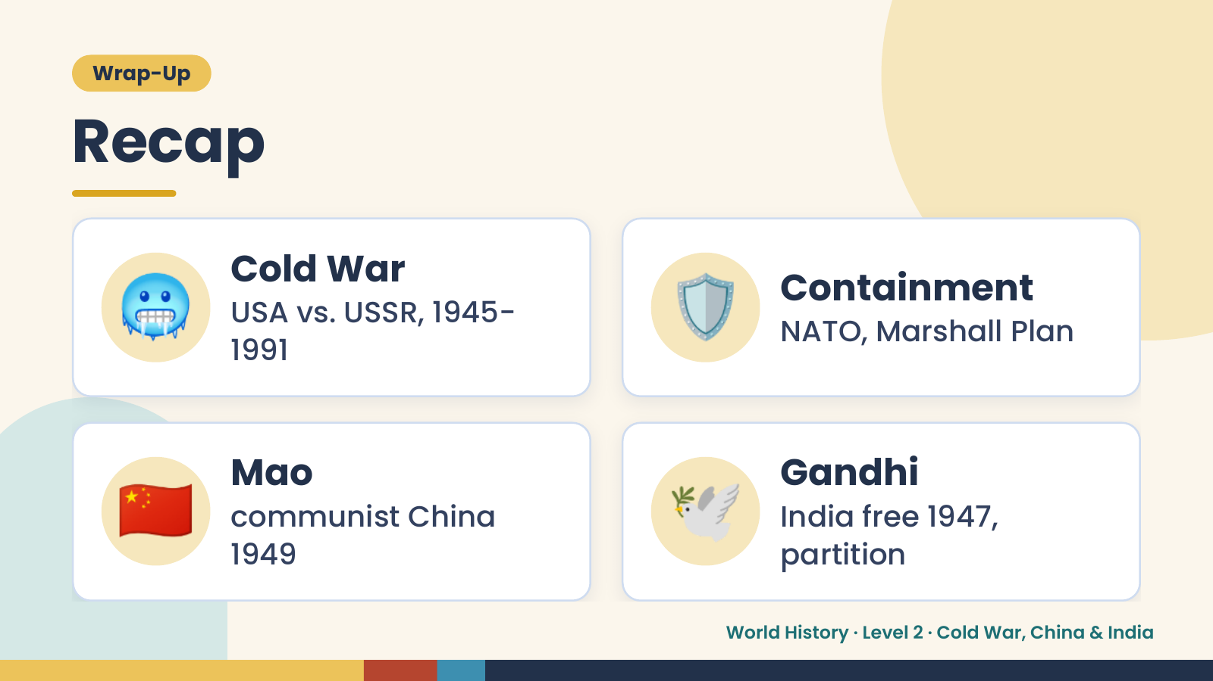
Notes:
Wrap-Up
Recap
🥶 Cold War
USA vs. USSR, 1945-
1991
🛡️ Containment
NATO, Marshall Plan
🇨🇳 Mao
communist China
1949
🕊️ Gandhi
India free 1947,
partition
World History · Level 2 · Cold War, China & India

Slide 19
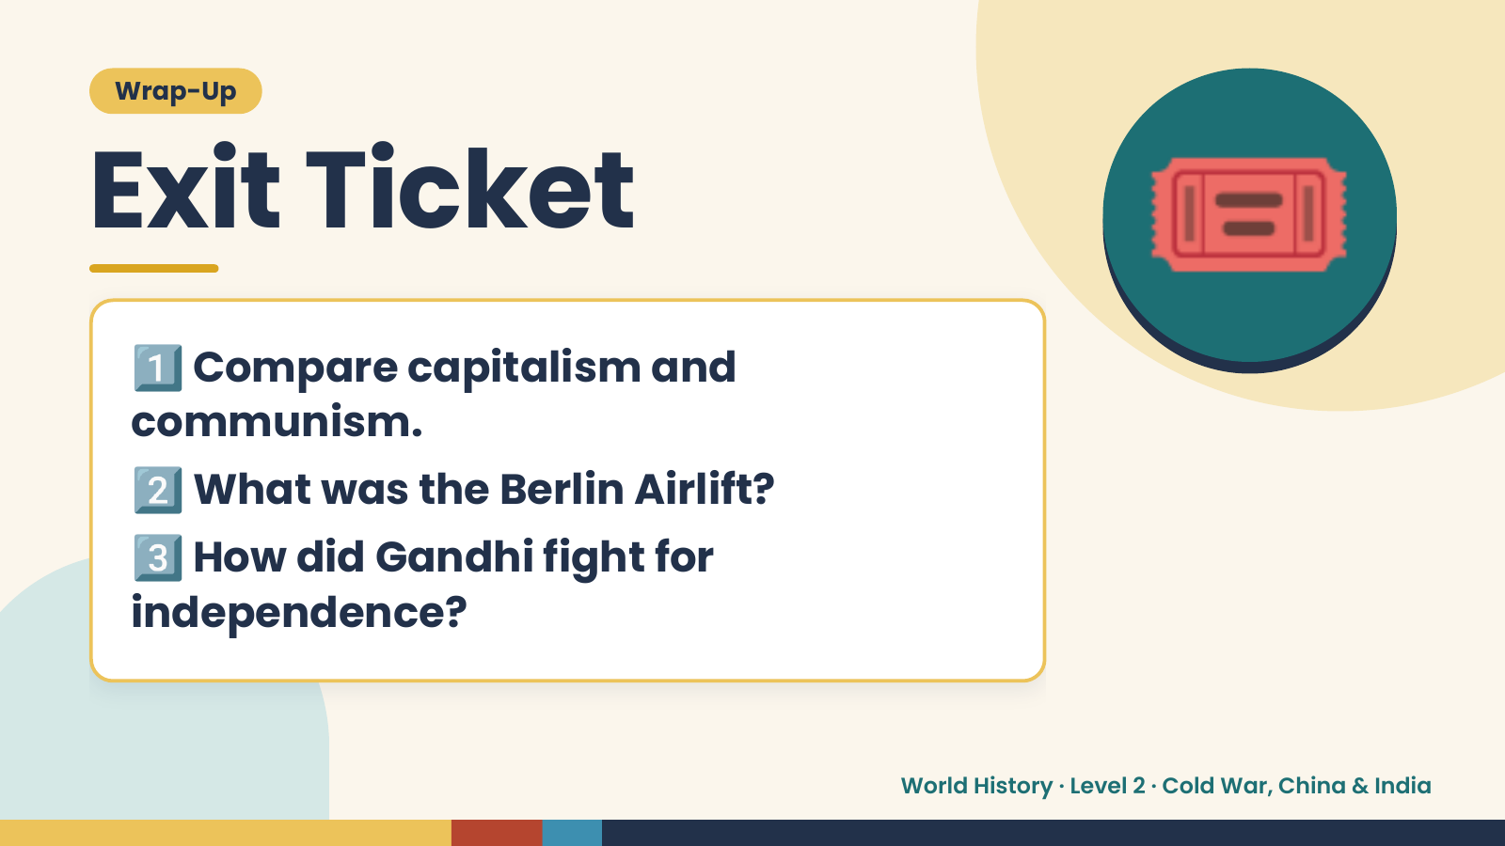
Notes:
Wrap-Up
Exit Ticket
1️⃣
Compare capitalism and
communism.
🎟️
2️⃣What was the Berlin Airlift?
3️⃣
How did Gandhi fight for
independence?
World History · Level 2 · Cold War, China & India

