Slide 1
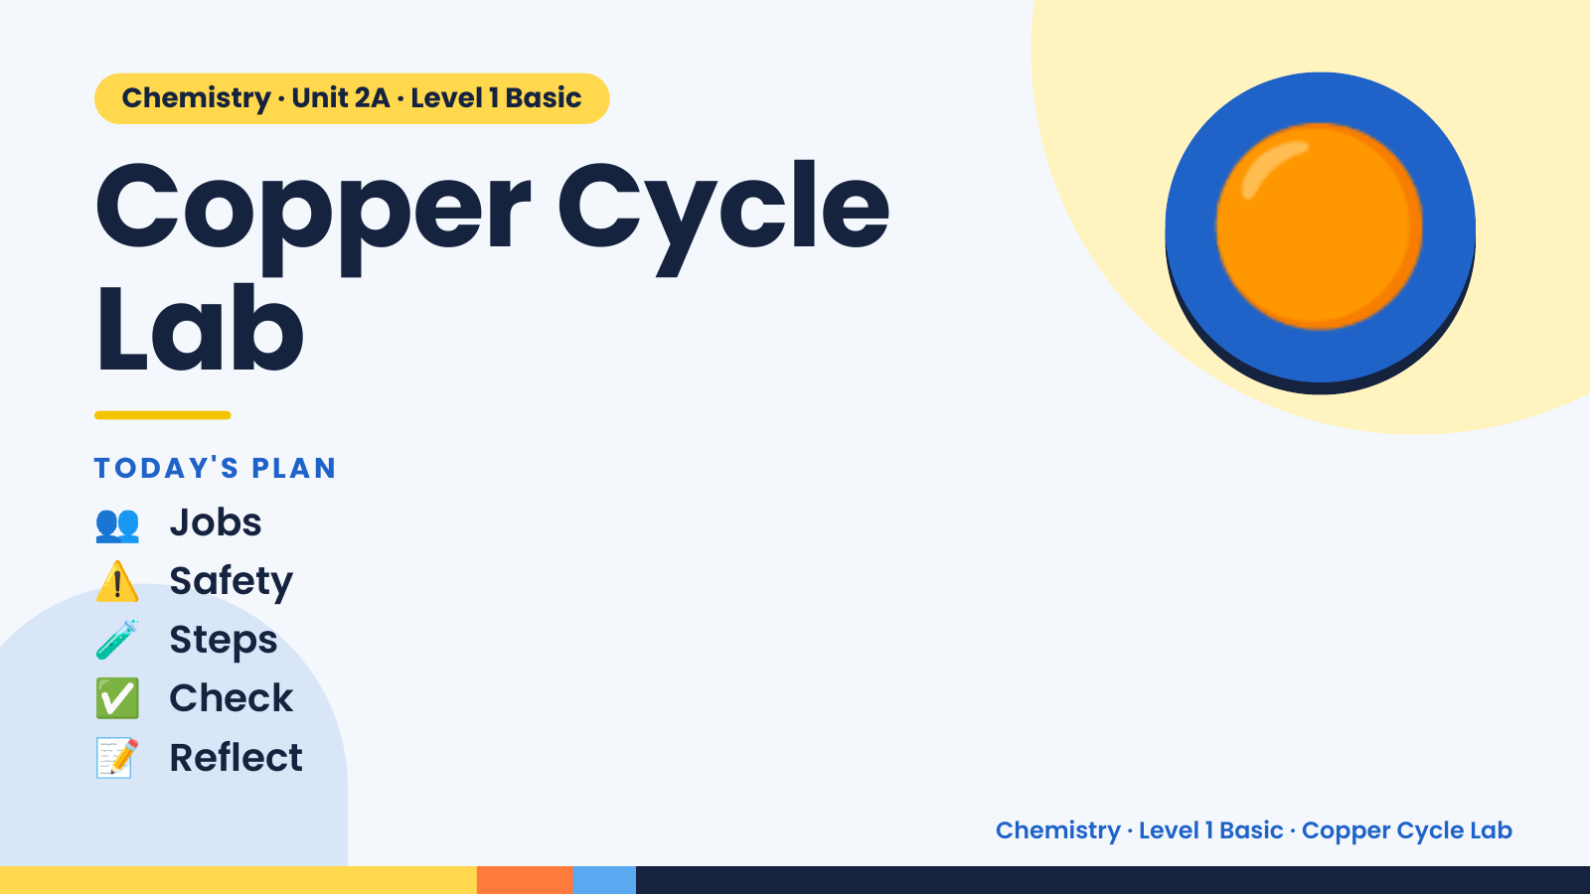
Notes:
Chemistry · Unit 2A · Level 1 Basic
Copper Cycle
Lab
TODAY'S PLAN
🟠
👥 Jobs
⚠️ Safety
🧪 Steps
✅ Check
📝 Reflect
Chemistry · Level 1 Basic · Copper Cycle Lab

Slide 2
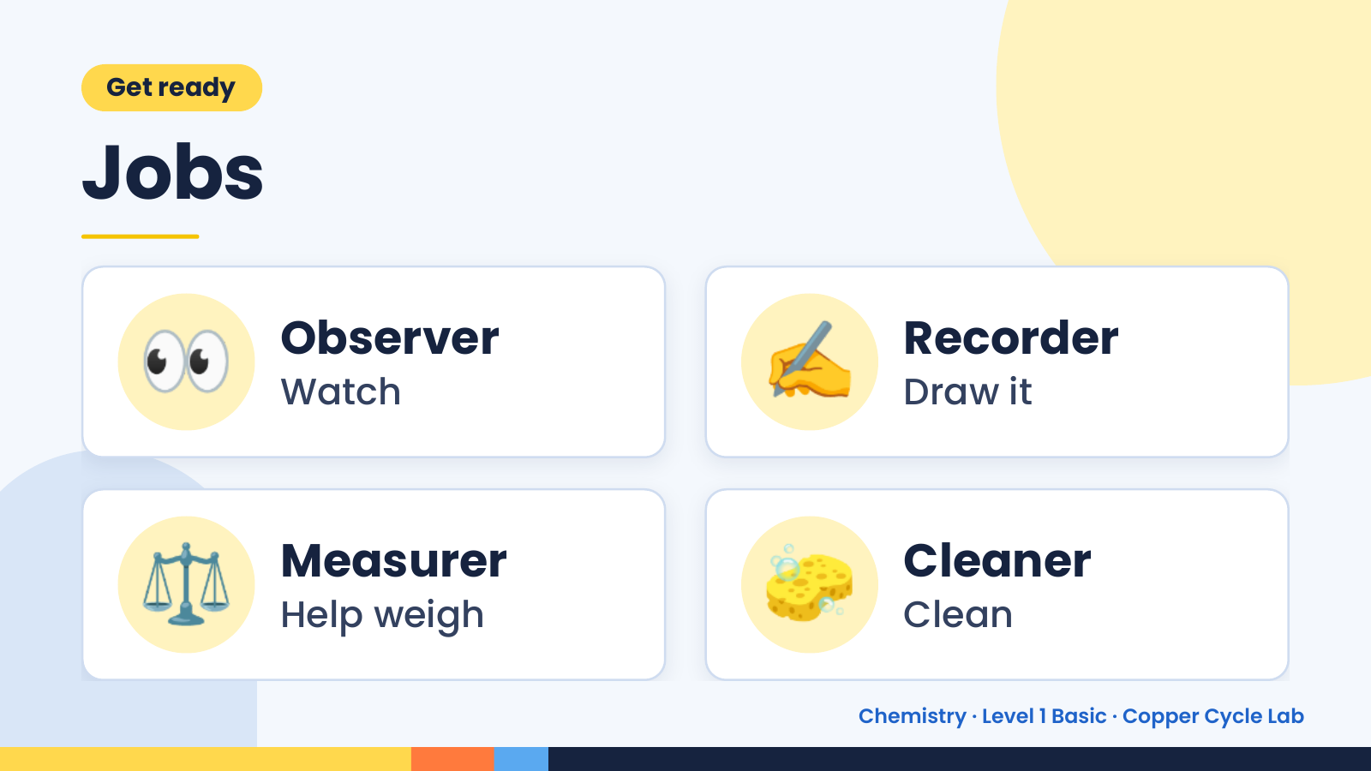
Notes:
Get ready
Jobs
👀 Observer
Watch ✍️ Recorder
Draw it
⚖️ Measurer
Help weigh 🧽 Cleaner
Clean
Chemistry · Level 1 Basic · Copper Cycle Lab

Slide 3
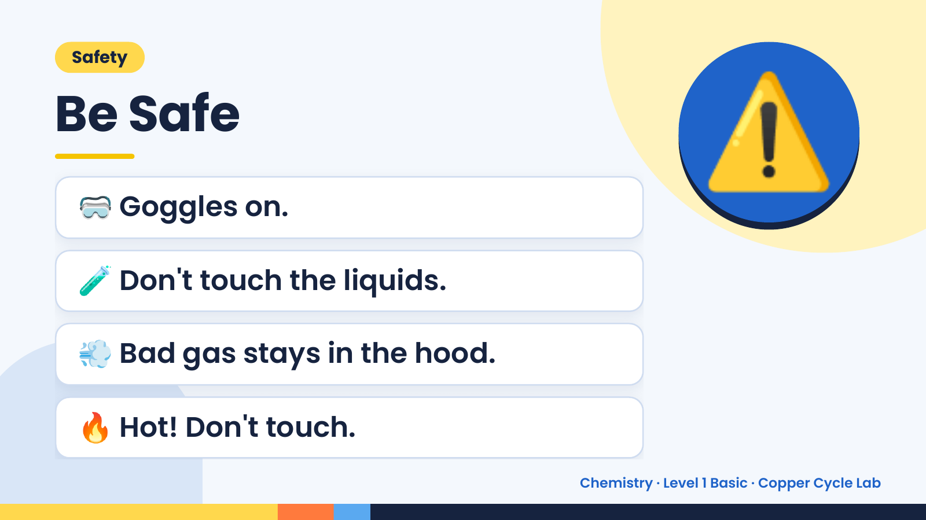
Notes:
Safety
Be Safe
🥽 Goggles on.
🧪 Don't touch the liquids.
⚠️
💨 Bad gas stays in the hood.
🔥 Hot! Don't touch.
Chemistry · Level 1 Basic · Copper Cycle Lab

Slide 4
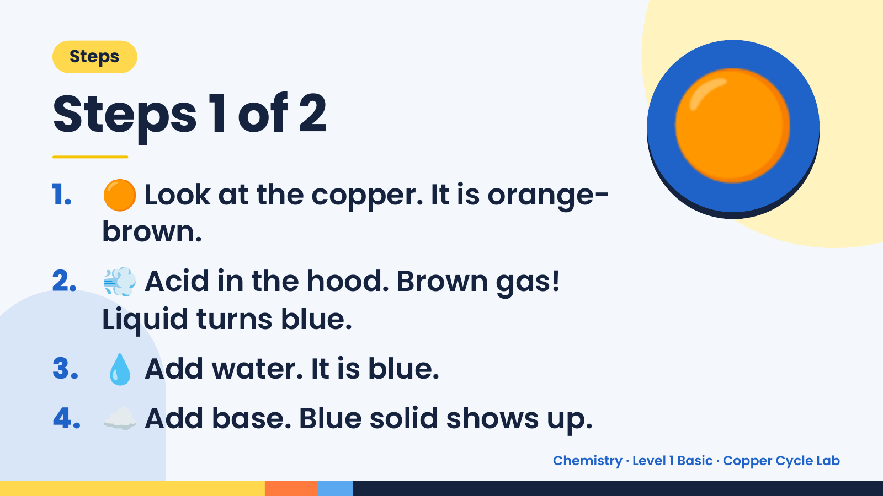
Notes:
Steps
Steps 1 of 2
1. 🟠 Look at the copper. It is orange-
brown.
🟠
2. 💨 Acid in the hood. Brown gas!
Liquid turns blue.
3. 💧 Add water. It is blue.
4. ☁️ Add base. Blue solid shows up.
Chemistry · Level 1 Basic · Copper Cycle Lab

Slide 5
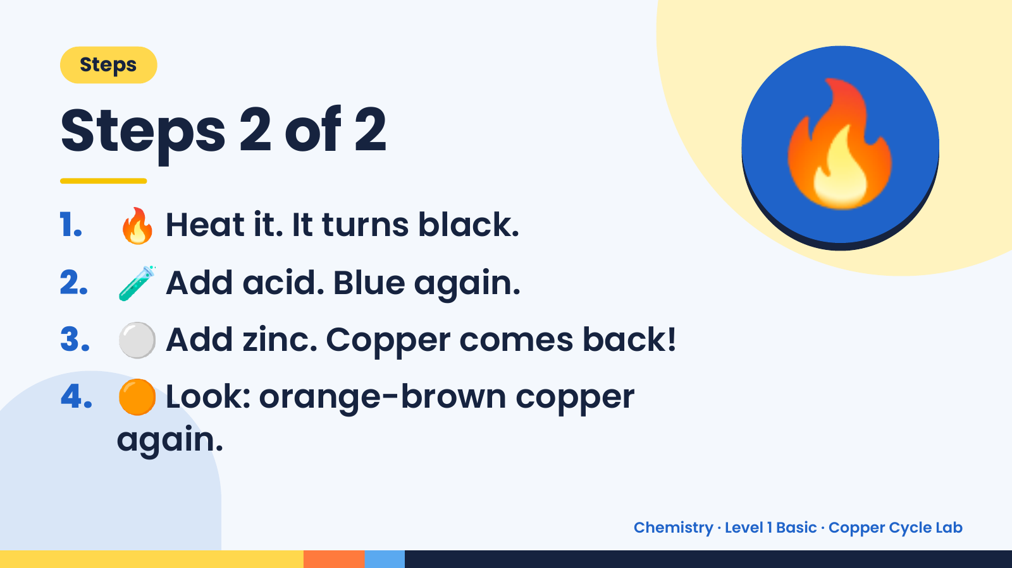
Notes:
Steps
Steps 2 of 2
1. 🔥 Heat it. It turns black.
2. 🧪 Add acid. Blue again.
🔥
3. ⚪ Add zinc. Copper comes back!
4. 🟠 Look: orange-brown copper
again.
Chemistry · Level 1 Basic · Copper Cycle Lab

Slide 6
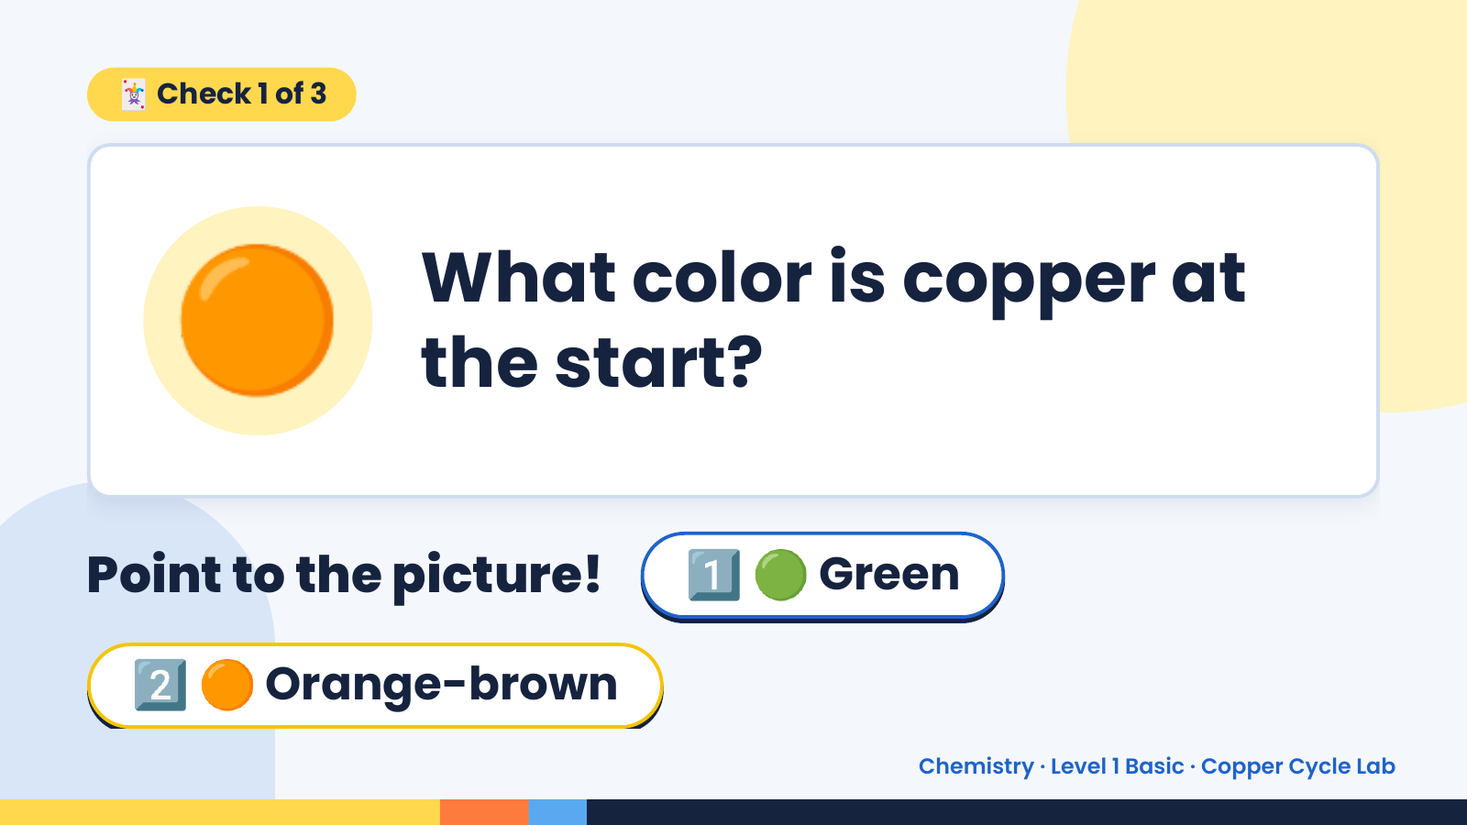
Notes:
🃏 Check 1 of 3
🟠 What color is copper at
the start?
Point to the picture! 1️⃣ 🟢 Green
2️⃣ 🟠 Orange-brown
Chemistry · Level 1 Basic · Copper Cycle Lab

Slide 7
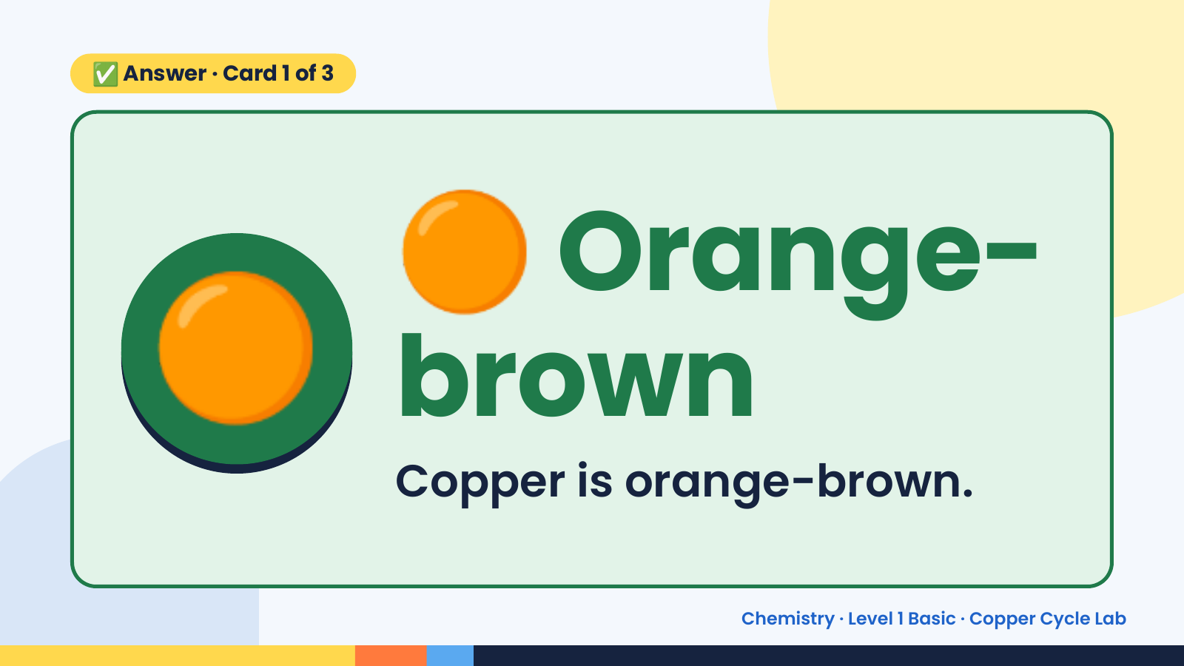
Notes:
🟠
✅ Answer · Card 1 of 3
🟠 brown
Orange-
Copper is orange-brown.
Chemistry · Level 1 Basic · Copper Cycle Lab

Slide 8
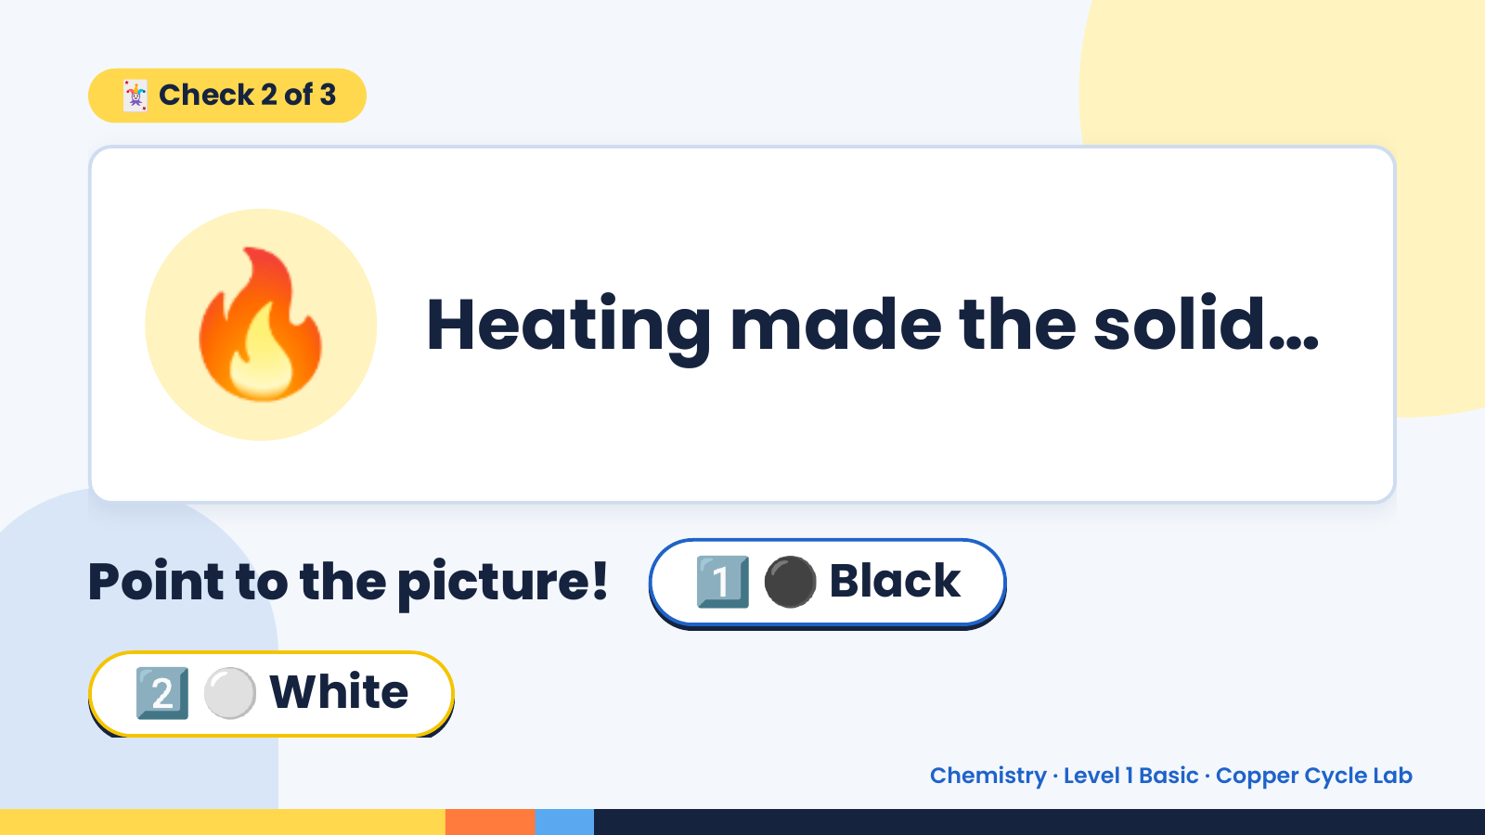
Notes:
🃏 Check 2 of 3
🔥 Heating made the solid…
Point to the picture! 1️⃣ ⚫ Black
2️⃣ ⚪ White
Chemistry · Level 1 Basic · Copper Cycle Lab

Slide 9
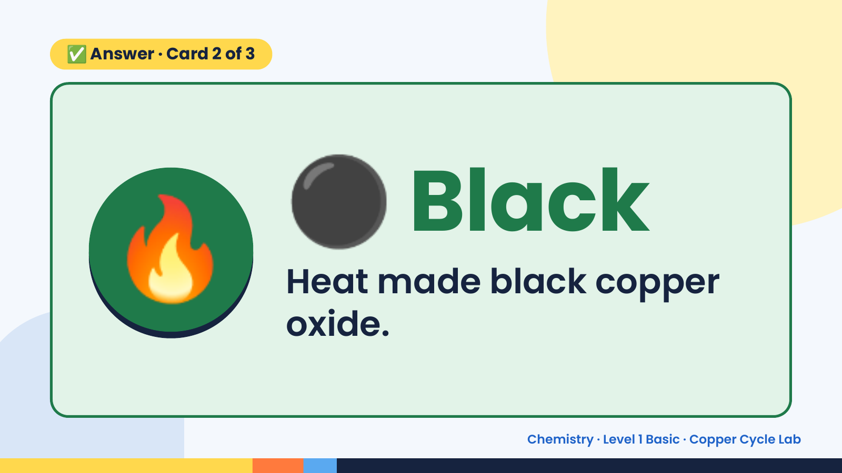
Notes:
✅ Answer · Card 2 of 3
🔥 ⚫ Black
Heat made black copper
oxide.
Chemistry · Level 1 Basic · Copper Cycle Lab

Slide 10
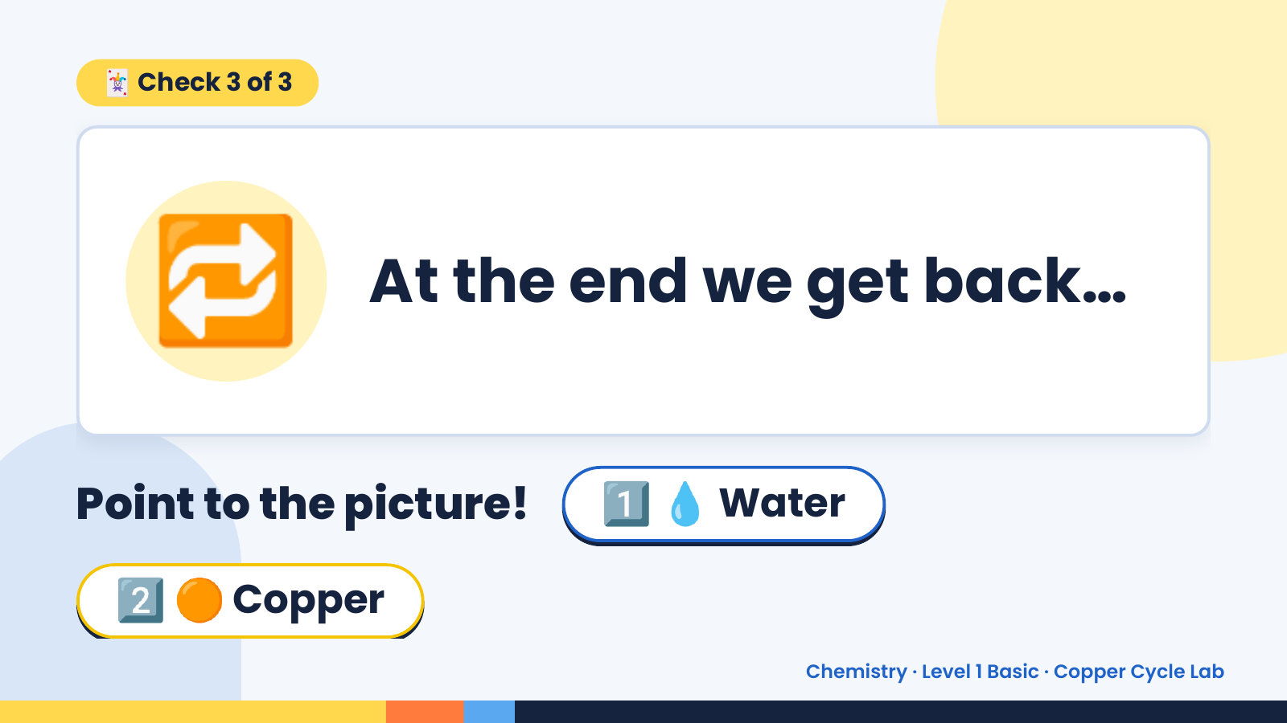
Notes:
🃏 Check 3 of 3
🔁 At the end we get back…
Point to the picture! 1️⃣ 💧 Water
2️⃣ 🟠 Copper
Chemistry · Level 1 Basic · Copper Cycle Lab

Slide 11
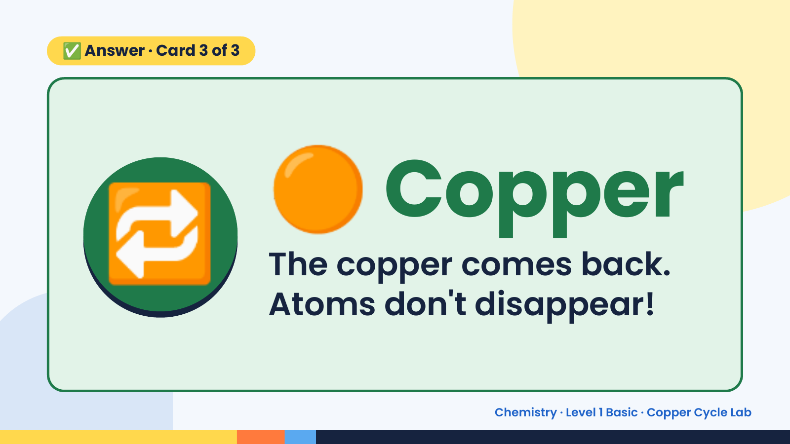
Notes:
✅ Answer · Card 3 of 3
🔁 🟠 Copper
The copper comes back.
Atoms don't disappear!
Chemistry · Level 1 Basic · Copper Cycle Lab

Slide 12
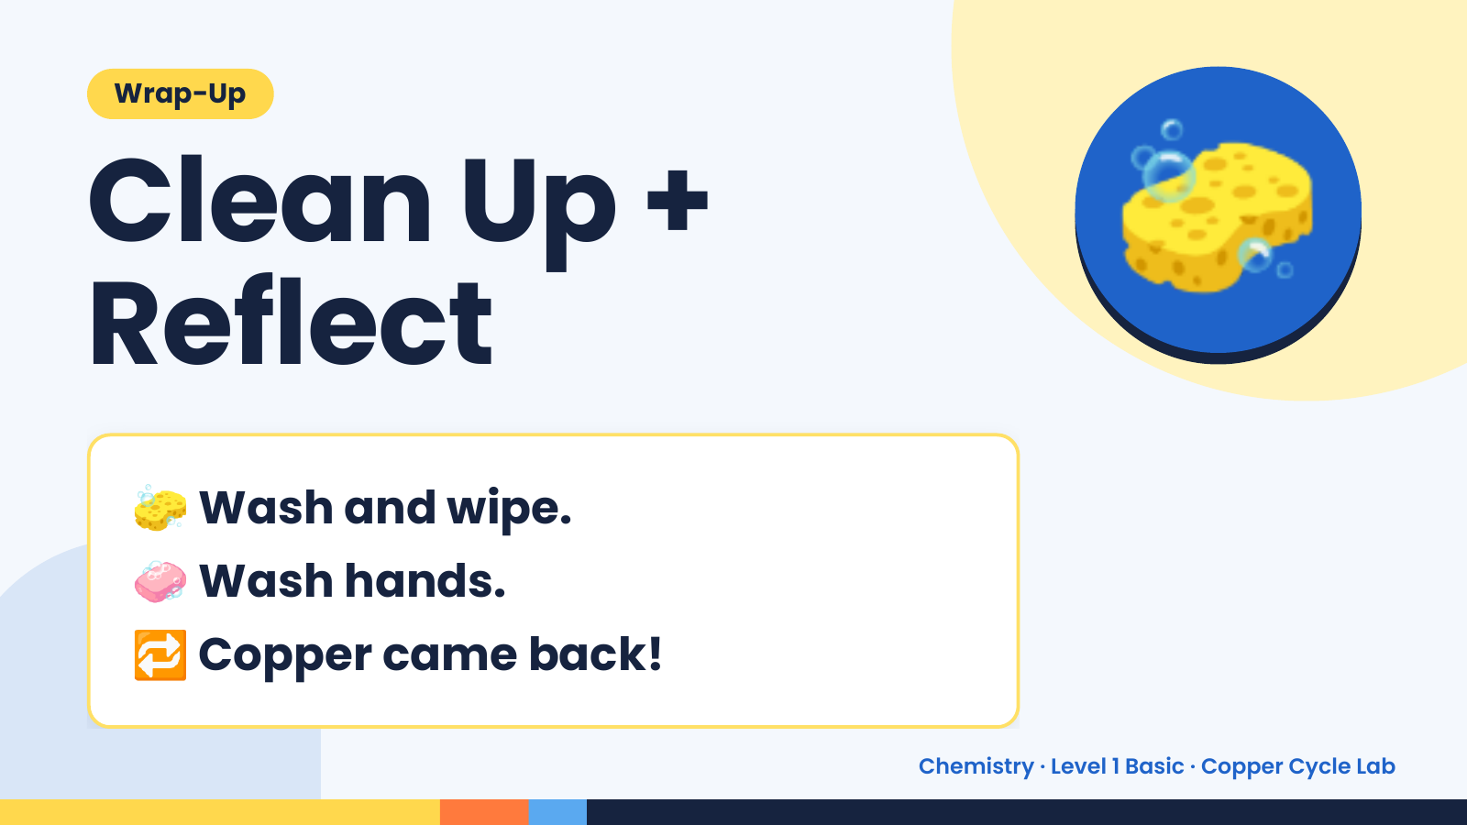
Notes:
Wrap-Up
Clean Up +
Reflect
🧽
🧽 Wash and wipe.
🧼 Wash hands.
🔁 Copper came back!
Chemistry · Level 1 Basic · Copper Cycle Lab

